Slide 1
The EVERSE Project
Ian Bird; LAPP

Slide 2
Background
Responding to HORIZON-INFRA-2023-EOSC-01-02
“Development of community-based approaches for ensuring and improving the quality of scientific software and code”
This is directly in line with what we (ESCAPE) and the other Science Clusters had recognised as a key issue
software quality, complexity, career development for scientists involved in software & computing, etc.
We had expressed in our white papers the need for a Virtual Institute (or competence centre) to address this need
➔ ”EVERSE” proposal

Slide 3
EVERSE: European Virtual Institute for Research Software Excellence
EVERSE aims to create a framework for research software and code excellence, collaboratively designed and championed by the research communities, in pursuit of building a European network of Research Software Quality and setting the foundations of a future Virtual Institute for Research Software Excellence:
Set up a Virtual Institute
Create a Knowledge Hub (Research Software Quality toolkit – RSQKit)
Drive recognition of software and support career development
Cross-fertilise and share expertise across the domains of the 5 science clusters
Act as a lobbying organisation to raise awareness of importance of software in research
Contribute to cultural change where research software is recognised as first-class citizen of science, and the people involved are appropriately credited for it
ESCAPE represented by: CERN, CNRS(LAPP + IJCLab), FAU, SKAO

Slide 4
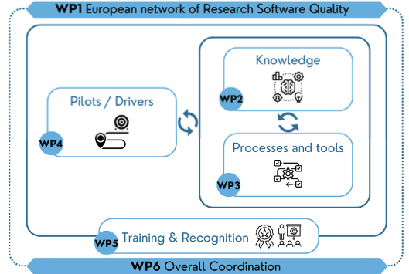
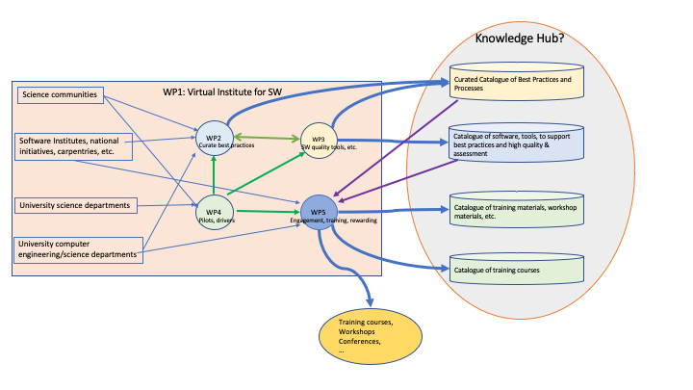

Slide 5
Work packages
WP1 Set up framework of a long term Virtual Institute
Lead CERN (Graeme Stewart-HSF) and ELIXIR; (IJCLab & SKAO partners)
WP2 Community-led best practices for developing high-quality software
Lead BSC and NLeSC; (LAPP (12PM), FAU, SKAO partners)
WP3 Tools and Services for software quality and FAIRness
Lead CNRS-LAPP (Thomas Vuillame) (21 PM) and UEDIN; (FAU, CERN, SKAO partners)
EOSC Science Cluster pilots and driver projects
Lead HZDR, co-lead UniMAN (Caterina Doglioni);
WP5 Capacity building and recognition
Lead CERN (Stefan Roiser) and UPM; (LAPP (9PM), IJCLab partners)
WP6 Project Management and coordination
Lead CERTH & BSC (All partners, LAPP 4PM)

Slide 6
