Slide 1
The ESCAPE Collaboration
Giovanni Lamanna

Slide 2

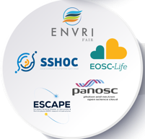

Rationale for ESCAPE
The H2020 cluster concept introduced by the European Commission, in 2018 was aimed at supporting:
“Open-science data-intensive research” in order to “rise productivity of researchers and to lead to new insights and innovation”
Commit in Open Science that means implement the FAIRness of scientific data
Connecting ESFRI and other world-class RIs to EOSC – European Open Science Cloud
ESCAPE is one of the five Science-Cluster projects that resulted from the H2020 topic call INFRAEOSC-04-2018
Other Science Clusters: ENVRI-FAIR (Environment and Earth Sciences), EOSC-LIFE (Biomedical Science),
PANOSC (Neutron and light sources facilities) and SSHOC (Social Science and Humanities).
Recognising synergies between HEP, Nuclear Physics, Astronomy, Cosmology, …:
Common Data Centres
Common Funding agencies
Overlapping community
Good experience with the precursor cluster ASTERICS
between Astroparticle physics and Astronomy (without HEP)
Giovanni Lamanna

Slide 4

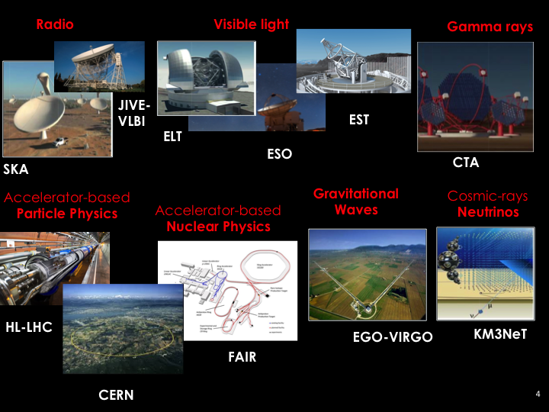
ESFRI and other large RIs in ESCAPE

Slide 5
ESCAPE: Astronomy and Particle Physics ESFRIs
Aligned expectations
  Large volume data generators (up to multi-Exabyte scale level).
  “Observatory” and “Facility” type of operation require global open access and long-term sustainability of research data.
  The astrophysics and the accelerator-based particle/nuclear physics ESFRI facilities join in a multi-probe approach towards the understanding of the Universe:
    addressing expectations of new generation of researchers for a “virtual space” - sharing workflows and interoperable data;
    acknowledging commitment of scientists (on transversal research).
  Engage with society and citizens.
Enhance coordination
  Leveraging two major complementary excellences in data stewardship:
    the astronomy Virtual Observatory infrastructure;
    long-standing expertise of the HEP community in large-scale distributed computing and big-data management.
  Operating a shared open innovation environment, adopting and enhancing FAIR/Open-Science principles.
Giovanni Lamanna

Slide 6
Common challenges
Management of Exabyte-scale science data (and associated tools, networks, infrastructure).
Move from “simple” x86-like clusters to very heterogenous resources:
  Use of HPC and Exascale computing resources.
Infrastructures & centres likely to be common between HEP & Astronomy, Astroparticle, GW, Cosmology, etc.
Software challenge (associated with the above):
  How to easily move code between various compute resources, validate correctness, adapt to new architectures, etc.
  HSF as a collaborative mechanism (also for cross-fertilization) –> lots of interest
Develop and retain skills in software and computing:
  In the scientific community – as well as with specialists.
  Issue of recognition in academic environments.
Giovanni Lamanna

Slide 7































ESCAPE H2020 consortium
31 partners including 2 SMEs
10 ESFRI projects & landmarks: CTA, EST, FAIR, HL-LHC, KM3NeT, SKA, LSST, VIRGO, ESO, JIVE
2 pan-European International Organizations: CERN, ESO with their world-class established infrastructures, experiments and observatories
2 European Research Infrastructures: EGO and JIV-ERIC
1 involved initiative/infrastructure: EURO-VO
4 supporting European consortia: APPEC, ASTRONET, ECFA and NuPECC
Budget: 15.98 M€
Started: 1/2/2019
Duration: 48 months (end date 31/1/2023)
Coordinator: CNRS-LAPP
Giovanni Lamanna

Slide 8
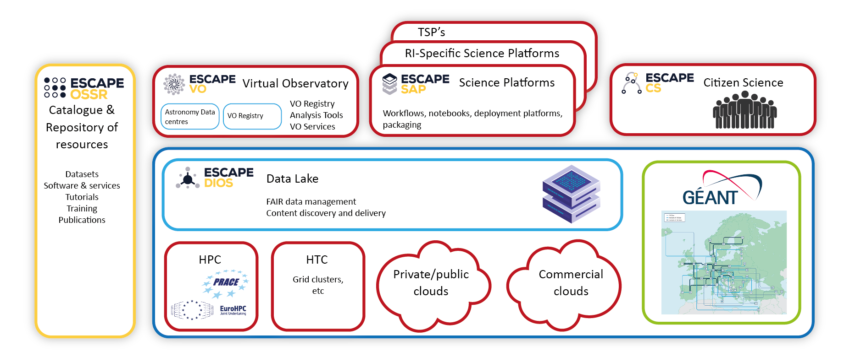
ESCAPE work programme aimed at building a
domain-based implemetation of EOSC
Science Platforms:
Flexible science platforms to enable the open data analysis tailored by and for each facility as well as a global one for transversal workflows.
Virtual Observatory:
Extend the VO FAIR standards, methods and to a broader scientific context; prepare the VO to interface the large data volumes of next facilities.
Citizen Science:
Open gateway for citizen science on ESCAPE data archives and ESFRI community
ESAP
Data Lake:
Build a scalable, federated, data infrastructure as the basis of open science for the ESFRI projects within ESCAPE.
Software Repository:
Repository of "scientific software" as a major component of the “data” to be curated in EOSC.
Giovanni Lamanna

Slide 9
High Level Key project results
Prototyped a full Exabyte-scale Data Management (Storage, Transfer and Access) Service with common AAI framework for distributed scientific computing;
  validated by ESFRIs through Data Challenges
Developed a catalogue to publish digital scientific products of ESCAPE communities;
  onboarded into EOSC portal
Developed interoperability standards for astronomical data services as well as tools and services based on IVOA standards
  VO services prepared to be integrated with EOSC
Produced a reusable analysis toolkit for integrating diverse service offerings, and a Virtual Research Environment prototype that integrates ESCAPE services
  A number of RI’s using tools in their analysis frameworks
Developed and produced training materials/schemes, and ran a number of highly successful schools and workshops
Several Citizen Science projects built upon ESCAPE developments, and attracted significant interest/involvement
Dark Matter and Extreme Universe Science Projects as demonstrations of Open Science in ESCAPE
  and integration with EOSC platform through EOSC-Future
Giovanni Lamanna

Slide 10
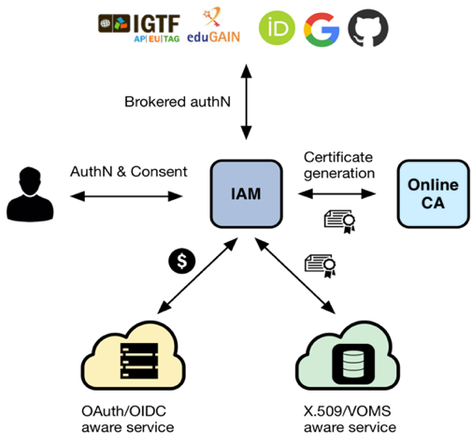
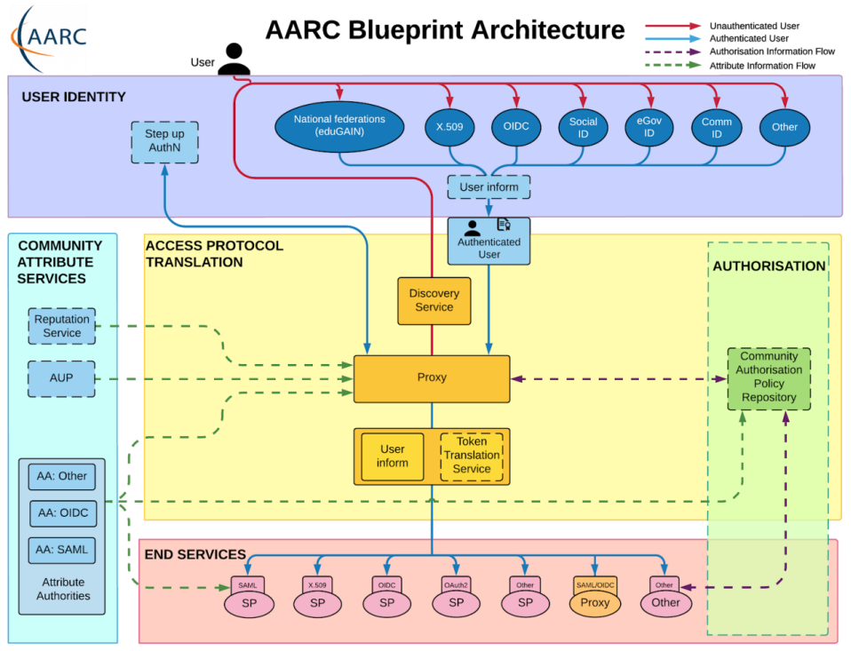
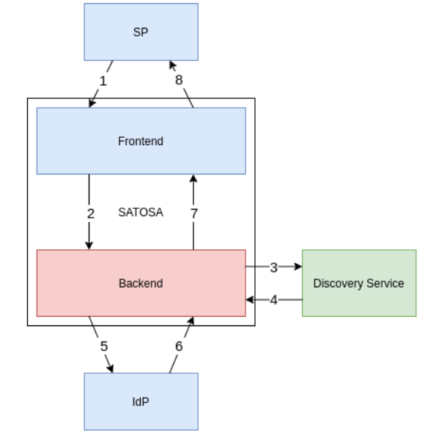
ESCAPE AAI – part of EOSC AAI Federation
ESCPE AAI
Hybrid – supports legacy infrastructure while migrating
ESCAPE AAI (IAM) is now part of the EOSC AAI federation
An additional proxy was required, now in place and tested – model for other communities that may need similar
ESCAPE has also demonstrated interoperation with FENIX HPC –
Step towards complex workflows using cloud, clusters, and HPC
Eventually should be part of the overall Federation
Building the AAI Federation is complex and takes time
Proxy to translate between OID/OAuth2/SAML
10
Giovanni Lamanna
Notes:
AAI follows the blueprint of the FIM4R/AARC working groups
being implemented across e-infrastructures globally
Migration to token-based AAI
Migration will take time; translation will be needed for some time
EOSC/EOSC-Future integrate the same model (as do other cyber- and e-infrastructures)
Important to maintain the existing trust networks

Slide 11
Next generation Data Infrastructure for Open Science (DIOS) - key concepts
➔ Help ensure FAIRness of scientific data
Idea is to localize bulk data in a cloud service:
  minimize replication, assure availability, minimize costs
  Hide complexity – transparent access to data – users see single entry point
Policy-driven data replication and distribution → Manage the data life-cycle
Distributed (federated) storage for reliability, accessibility, sustainability
  Think of a “RAID” configuration across storage sites, with QoS
  Allows to integrate private and commercial storage – if a storage goes away data is automatically (by policy) replicated
Federation through token-based AAI
Secure – AAI & policy allows embargoed or private data as well as public/open
Serving data, remote, cached, streaming, to heterogeneous compute facilities
  remote (or local) compute – grid, cloud, HPC, etc.
  Simple caching is all that is needed at compute site – data is local when it is needed
Works at national, regional, global scales
➔ Designed to support Exabyte scale, but model
applies to all volumes
➔ No special services needed at cloud or HPC sites
11
Giovanni Lamanna

Slide 12
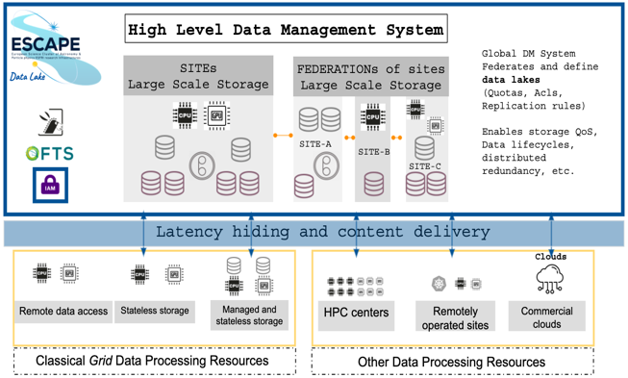








Federated data infrastructure: Data Lake concept
See talk 09/05, M. Lassnig - Extending Rucio with modern cloud storage support: Experiences from ATLAS, SKA and ESCAPE
See talk 11/05, M. Wadenstein - Nordic Data Lake Success Story
Storage Orchestration Services
Storage
Asynchronous
Data Transfer
Services
Storage
Minimize cost of storage (hw+ops)
Benefit from the network capabilities
Data (Lake)
Infrastructure
Distributed Storage
Storage
Storage
Volatile
Storage
Storage
Content Delivering and Caching Services
Data Center
Data Center
Grid Compute
Grid Compute
Cloud Compute
HPC
Compute
@HOME
Grid Compute
Compute
Infrastructure
Compute Provisioning
Followed by a full scale Data and Analysis Challenge performing production-like Data Management, Processing and Analysis workloads including interplay possibilities using large scale resources (batch systems and clouds) and user-analysis oriented platforms (online notebooks and analysis platforms).
Giovanni Lamanna

Slide 13
Open Science Software Repository (OSSR)
  Deployment of the Open-source ESCAPE catalogue of resources (data and software)
Shared domain-based open science software and services based on FAIR principles
Objectives:
  Facilitate and support continuous development, deployment, exposure and preservation of partners’ software/tools/services
  Foster interoperability, software re-use and cross-fertilisation between ESFRIs (e.g. simulation)
  Offer an open innovation environment for open standards (e.g. workflows, data-formats), common regulations and shared (novel) software for multi-messenger & multi-probe data
eOSSR library https://gitlab.in2p3.fr/escape2020/wp3/eossr
  incorporates all OSSR developments, based on the commonly defined practices and standards
  python-based
  OSSR API : send request to the OSSR, find and filter software and services, upload new entries, update existing entries
  CI : automated upload / update using gitlab CI
  Metadata : schema definition, crosswalk between CodeMeta and Zenodo, generator and validator available
Giovanni Lamanna

Slide 14
Work programme and key results: Science Platforms
Development of the ESFRI Science Analysis Platform: a toolkit for building platforms through which users can discover and interact with the data products, software tools, workflows, and services that are made available through ESCAPE.
Preparing ESFRI services, data products, and tools for integration with ESAP and their subsequent use within ESCAPE and EOSC.
Giovanni Lamanna

Slide 15
Work programme and key results: Science Platforms
Demo system
https://sdc-dev.astron.nl/esap-gui
Giovanni Lamanna

Slide 16
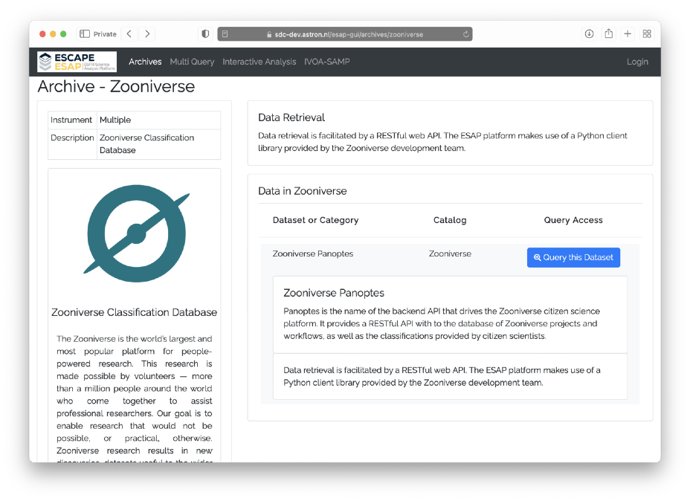
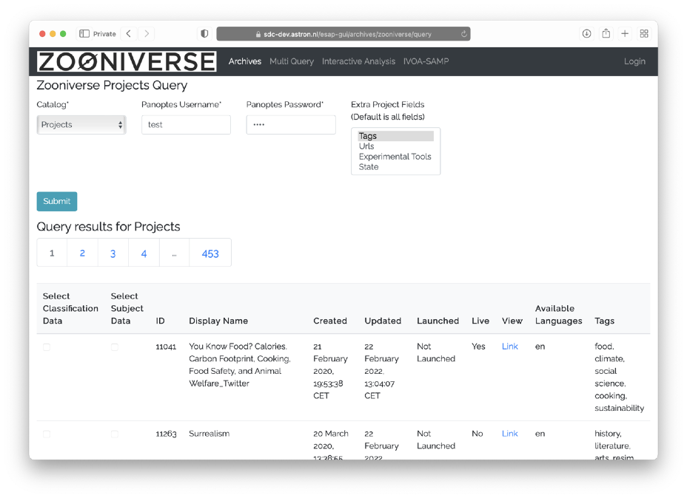
Work programme and key results: Citizen Science
Several Citizen Science projects built upon ESCAPE developments.
Full integration of ESAP with the ESCAPE Zooniverse “Panoptes” system.
Giovanni Lamanna
16

Slide 17
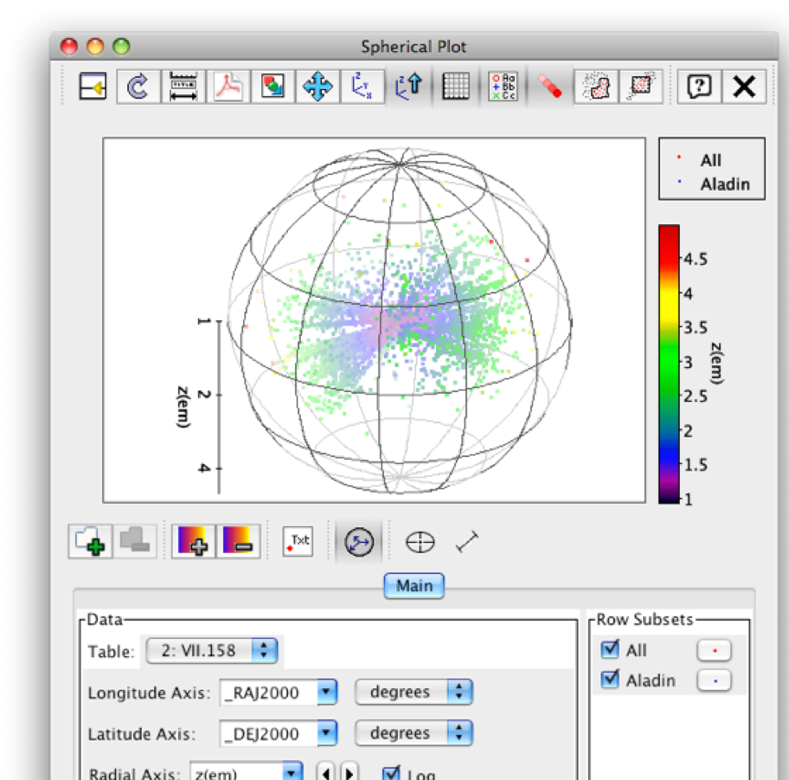
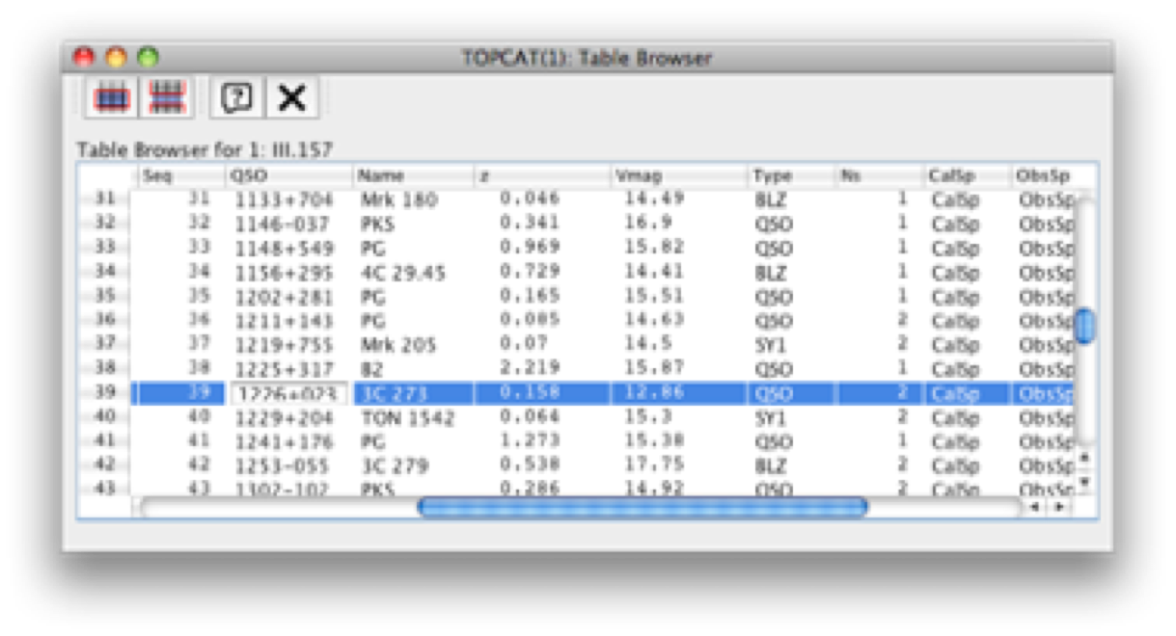
Work programme and key results: VO
Enables a Virtual Research Environment of interoperable tools and services based on IVOA standards, including ESO Science Archive and ESO Science Portal
Giovanni Lamanna

Slide 18

Broader synergies with other research clusters
Five thematic
Science Clusters
created under
INFRAEOSC-04-2018
(80% of ESFRI RIs)
https://www.projectescape.eu/sites/default/files/Escape_position_statement_web.pdf
https://zenodo.org/record/3675081 - .X2R2PJNLhTY
https://indico.in2p3.fr/event/24327/
https://zenodo.org/record/4889503
Giovanni Lamanna

Slide 19
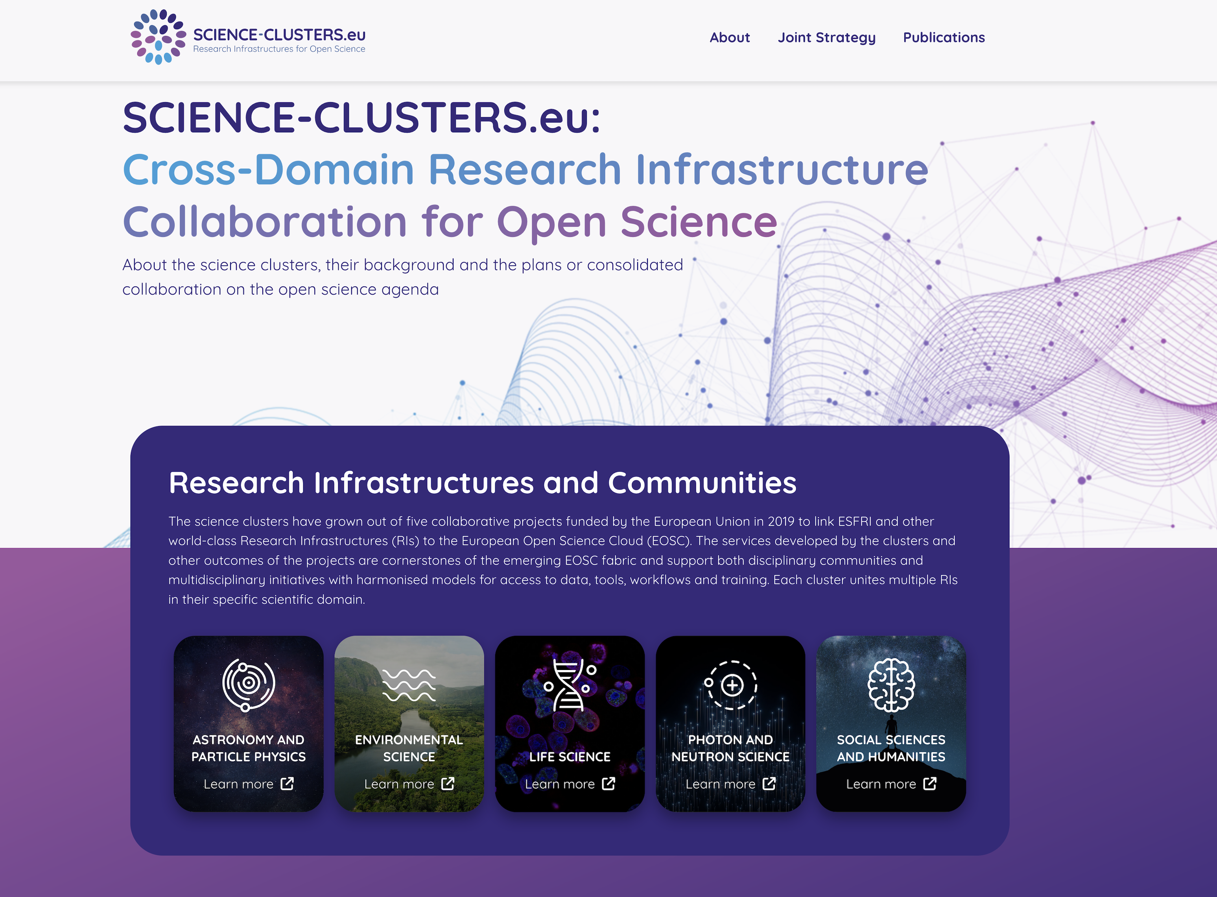
Science Clusters
https://www.science-clusters.eu/
Giovanni Lamanna

Slide 20


European Landscape
Giovanni Lamanna

Slide 21
ESCAPE, for Open Science Projects
Strengthening multidisciplinary collaborations
among young researchers on open-science projects
First set of Open Science Pilot Projects proposed to demonstrate multi-domain science integration across ESCAPE
  demonstrate new cutting edge open science capabilities, making use of the services implemented within ESCAPE
  benefit real science goals in exploring synergies between the ESFRIs and largely among three scientific communities Astrophysics/Astroparticle, accelerator-based Particle and Nuclear Physics (supported by consortia of EU member states research agencies and institutes within JENAA)
1. Dark Matter Science Project
2. Extreme Universe (& Gravitational waves) Science Project
ESCAPE part:
about 2 M€
250 PMs
10 institutes
Giovanni Lamanna

Slide 22
Implementing the ESCAPE disciplinary EOSC-cell
The ESCAPE “EOSC-cell” for a three-fold impact:
  a FAIR digital environment dedicated to scientists at large to interoperate data and workflows for fundamental science;
  data management solutions mutually adopted by a large fraction of RIs and potentially extendible to further disciplines;
  the “EOSC Web of FAIR Data and Services for Science” for our disciplines
A Virtual Research Environment (VRE): thematic collaborative digital environment used by scientists, which enables FAIR community-based scientific research, training, innovation, cross-fertilisation and open science.
Evolving practices on the assessment of research giving increasing value to open science contributions and outputs beyond publications. A wide range of digital objects beyond publications, including data, software, code, workflows, and processes, such as open peer-reviews (requiring an enhanced traceability, coherent and comprehensive metrics and FAIRness of a wide range of digital objects).
Digital content added in order to :
Perform, explore, repeat, modify data-analysis; upload analysis results; publish new results
Rewarding scientists
The ESCAPE Virtual Research Environment prototype
to host the Test Science Projects
(and part of the EOSC Future project […])
Giovanni Lamanna

Slide 23

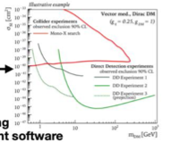
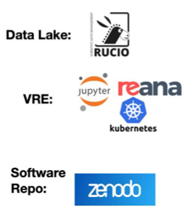

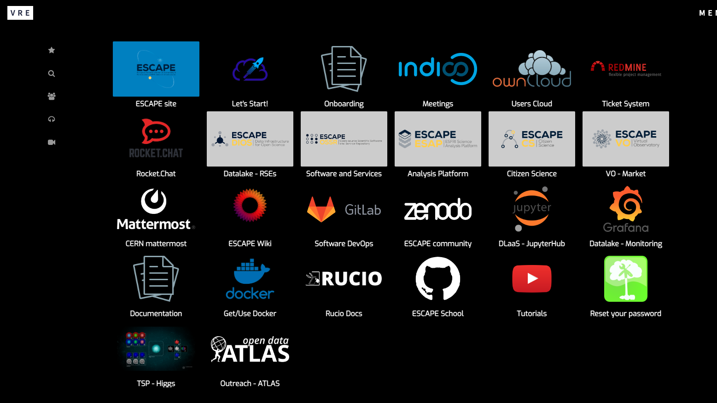
VRE: ESCAPE service composability and EOSC integration
See talk, 09/05, E. Gazzarrini - The Virtual Research Environment: towards a comprehensive analysis platform
ESCAPE AAI
AAI Federated with EOSC
Publish results to Zenodo
ESCAPE Data Lake (Federated storage)
Virtual Research Environment (VRE)
Hosts/ingests open data sources into a common store;
Includes EOSC Exchange provisioned storage
Virtual Research Environment
Cloud computing using EOSC Exchange provisioned compute, & HPC
Software Repository
Archive of reusable pipelines:
Onboarded to EOSC marketplace
EOSC Core:
+ Helpdesk as a service
(+monitoring)
(+accounting)
Giovanni Lamanna

Slide 24
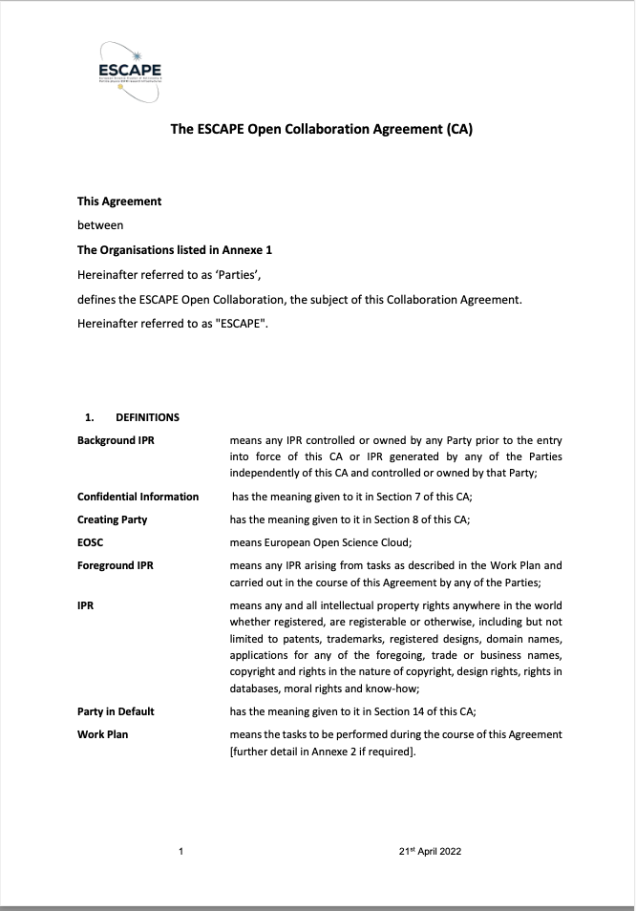
Outlook for Science Clusters
The 5 Science Cluster projects are ending
However, synergies between them have been significant, and collaborative activity is increasing
Recently, all of the 5 have put in place long-term structures – through MoU or Collaboration Agreement
  E.g. ESCAPE has Collaboration Agreement signed by
  Directors of all the partner RIs
    → ESCAPE Open Collaboration
The Clusters have a common position and agree: they want to have effective mechanisms to enable cross cluster/cross-domain collaborations
  but not an additional layer of governance
Giovanni Lamanna
07/07/2023

Slide 25
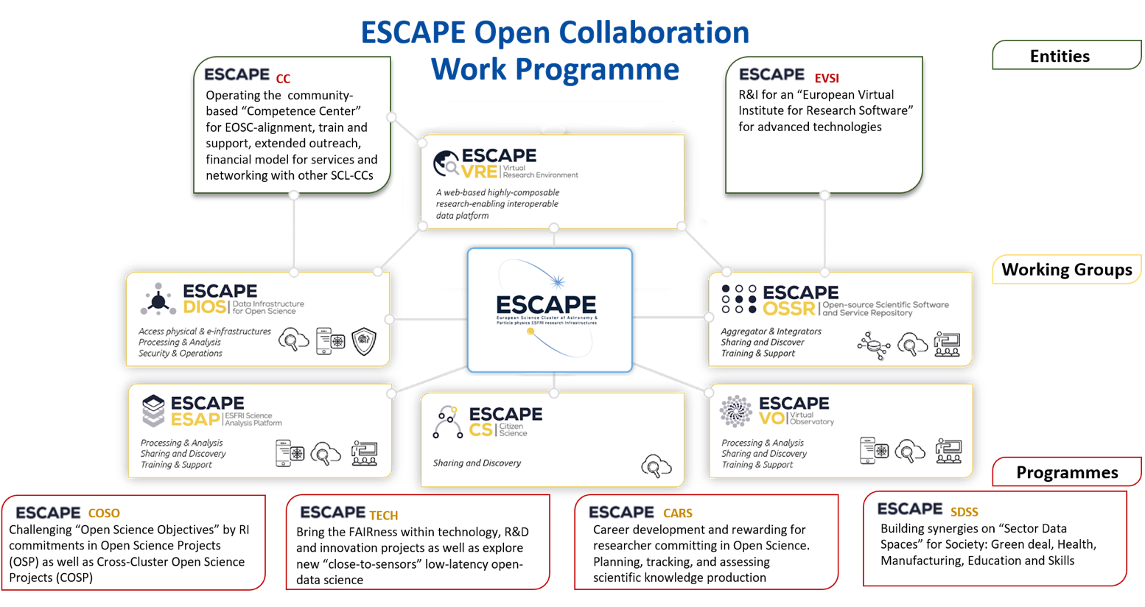

Slide 26
A work plan for the future of the Science Clusters
There is a prompt need and opportunity to support the Science Clusters further (in 2022-2025) within Horizon Europe framework
H2020 and potential Horizon Europe funded actions (aligned with the EOSC-SRIA Stage2 -to- Stage3)
General Objectives (GO):
- consolidation of thematic data infrastructures (cluster VREs, platforms and a “few core services”) as parts of a federation.
Specific Objectives (SO):
- relevant scientific results from clusters;
- increased number of RIs;
- enhance researchers uptake of OS and widening dimension.
Operational Objectives (OO):
- sustainable operation of the deployed cluster as a “platform infrastructure”;
- continuous promotion, extension and hosting of inter-domain FAIR Science Projects (new Open Science Objectives).
Science Cluster GO
H2020 Cluster projects
EOSC-Future
Science Cluster SO
Science Cluster OO
2021
2022
2023
2024
2025
2026
2027
EOSC-SRIA Stage2 Stage3

Slide 27

HORIZON EUROPE
The OSCARS – Open Science Clusters’ Action for Research & Society proposal was submitted in March in response to the call HORIZON-INFRA-2023-EOSC-01-01 for a budget of EUR 25.00 million.
Two activities:
Consolidation of the Science Cluster approaches between the RI communities
Demonstrate and pilot the use of EOSC resources by multiple research communities through cross-RI and/or cross-domain open science projects and services, by running 'open calls with cascading grants' with a budget of approximately EUR 16.00 million.
Giovanni Lamanna

Slide 28

Consolidating role of Science Clusters
Leverage successful training schemes developed by Science Clusters to target new cross-domain approaches.
Start complementary Community-based Competence Centres (CCC) focusing on pre-existing and established data-stewardship practices, as well as domain-based expertise.
The ESCAPE data-lake service will be extended to further RIs and other science clusters.
The “data management” will be one major “competence” to be leveraged in a dedicated community-based competence centre and will be made available in an interdisciplinary manner.
Giovanni Lamanna

Slide 29
Consolidating role of Science Clusters
Together with services for data analysis, the Science Clusters will foster the composability of services explored by ESCAPE with the deployed ESFRI RI-specific “analysis platforms”, as well as a prototype integrated Virtual Research Environment (VRE), currently under construction in EOSC Future and conceived to host dedicated Test Science Projects.
Giovanni Lamanna

Slide 30
Enhancing EOSC scientific content
The Science Clusters together would manage financial support (with cascading grants) to third parties with a primary aim of enabling cross-RI and/or cross-domain Open Science Projects and Services (OSPS).
All funded OSPS are expected to “build on the science cluster approach to ensure the uptake of EOSC”. Therefore, they are expected to participate in the consolidation of FAIR services of the five Science Clusters and, more broadly, to perform excellent science and pursue societal benefits by leveraging an Open Research approach.
Giovanni Lamanna

Slide 31
Consolidating role of Science Clusters
The catalogue of software will continue to be populated with new collaborative cross-border software, workflows and methods and for the benefit of the community at large.
Development of community-based approaches for ensuring and improving quality of scientific software and code highly relevant to all Science Clusters:
    Framework for community curation across disciplines
    Follow trends of technology including use of HPC
    Impacts all software layers from lowest and common packages to experiment-specific applications
    Make software heterogeneous, including GPUs needed by physics, need data reduction close to experiments to manage data rates, which requires being able to use different hardware
    Lots of opportunities for community-based initiatives (examples of previous work: HSF, SIDIS), for software carpentries, training materials and schools, career development of young scientists specialising in software and computing.
EVERSE
European Virtual Institute for Research Software Excellence
A proposal in response to the call HORIZON-INFRA-2023-EOSC-01-02
Giovanni Lamanna

