Slide 1
Robustness to Uncertainties in ML Applications for Particle Physics
AISSAI – Orsay Nov 28-Dec 1 2023
Tommaso Dorigo
INFN, Padova

Slide 2
Foreword
In a recent work a few of us (several participants to AISSAI among authors) published a thick book on AI for HEP.
Some of us reviewed the impact of nuisance parameters on HEP analyses and how to reduce it. Most of the focus there was on supervised learning.
→ See chapter 7.2 of the book “Artificial Intelligence for HEP”, published in 2022 by World Scientific (or preprint) [1]
- Credits to Pablo de Castro for part of the material
I will quickly review that survey, then discuss a few developments of the past two years

Slide 3
Contents
1. Problem statement
- Nuisance parameters in statistical inference
- What we want: sufficient statistic summaries
- A toy example to clarify what the problem is
2. A summary of topics covered elsewhere
- Nuisance-parametrized models
- Feature decorrelation, penalized methods, and adversary losses
- Mass taggers compared
- Inference-aware approaches: INFERNO et al.
3. Recent developments
- Application of INFERNO to a real CMS analysis
- Neos
- One recent application of Waldo
- Classification under prior shift in atmospheric shower classification
4. Bonus track: where this all leads
5. Instead of a summary

Slide 4
1. Problem statement
Supervised classifiers can be used to construct low-dimensional summary statistics
→ carry out statistical inference on parameters of interest
The compression is informed by simulated observations produced by a forward model (MC), whose fidelity is limited by known factors:
Known limitations in the model (e.g. “NLO accuracy”)
Imprecise simulation of the detector response (calibration constants, etc.)
Uncertainty in fundamental parameters (top mass, α, sin θ_{W} ...)
Finiteness of available data samples (e.g. due to CPU limitations)
The above are “known unknowns”: typical nuisance parameters relevant to our measurement goals
Note - our models can also be affected by other unknown factors
→ we have no way to assess their impact a priori (but see Gordon’s talk)
→ one further component outside our reach is the error of the third kind

Slide 5
Effects of Nuisances in Statistical Inference
To account for imperfections described by nuisance parameters α, we need to enlarge our model to p(x|θ,α). The latter may be used in the construction of a likelihood function or whatever other estimator we choose.
This allows us to account for the variability of the nuisances in our inference
The inclusion of nuisances is expected to widen resulting confidence intervals on θ
A similar effect occurs if we use the model in hypothesis testing → power reduction
→ The presence of nuisance parameters (and our struggling with properly accounting for their effect) limits measurement precision and discovery reach in fundamental science

Slide 6
What We Want: Sufficient Statistic Summaries
ML applications in the past focused almost exclusively on the goal of minimizing the statistical uncertainty on the estimates of parameters of interest θ.
The summary statistic they provide should enable the extraction of the highest amount of information on θ; but this is not granted – it is conditional to
validity of the underlying model used to generate the samples
assumptions made on the value of nuisance parameters α.
The conditionality is hard to get rid of!, as e.g.
Problems are complex and high-dimensional
Nuisance parameters have ill- or un-known PDF
Effect of nuisances on the default model is not easy to assess
→ The summary statistic is not usually sufficient: being oblivious of a part of feature space, it does not retain all the information relevant to the parameter estimation task

Slide 7
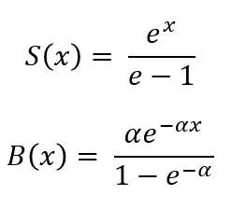
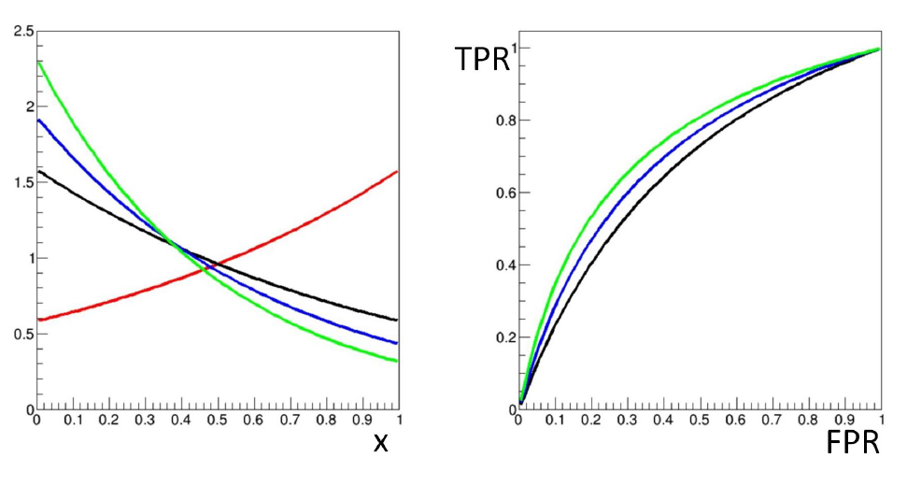
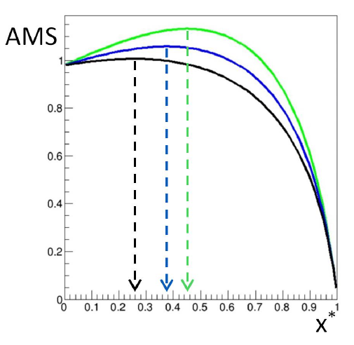
A Toy Example
B
S
x* grows
By writing B(x) as above, we assert we know the dependence on the nuisance α perfectly. Let our task be to estimate the signal fraction in a mixture model.
We must define a prescription to decide on the critical region, i.e. the value of x*. In order to claim we are optimizing a selection cut x>x*, we need a figure of merit. Let us use the “approximate median significance” (AMS):
$$AMS=\sqrt{2\left[\left(N_{s}+N_{b}+N_{r}\right)\ln\left(1+\frac{N_{s}}{N_{b}+N_{r}}\right)−N_{s}\right]}$$
AMS is a robust surrogate of the significance of an excess of events if a signal of mean N_{s} contributes to a dataset including background sampled from a Poisson of mean N_{b}. N_{r} regularization against divergences; N_{r}=10 is a sensible choice.
What happens to our toy problem? Let us consider N_{s}=20, N_{b}=400:

Slide 8
What We Get
B
S
x* grows
→ If we train a classifier with a given value of α, the performance is going to be under- or over-estimated if the true value of α is different; the choice of a critical region x>x* corresponding to a pre-defined FPR will similarly be affected, as will the value of TPR.
→If we do not know what α is, we cannot “optimize” our critical region, as the optimal choice of x* strongly depends on the unknown value of α
→ Nuisance parameters affect the optimal working point, as well as the performance of the classifier and in fact the relative merits of different classifiers (which produce different summaries x)
→ Standard supervised classification techniques may not reach optimality unless they address the mentioned conditionality issue.

Slide 9
2. A summary of topics covered in our review
In the past decade ML has provided tools and inspiration for a number of solutions to the problem of nuisances effect reduction in HEP:
Nuisance-parametrized models (e.g. n-subjettiness ratio) [2,3]
Adding the nuisance to training features (e.g. X→tt in ATLAS) [4,5]
Decorrelation (planing, Uboost, etc.) [6-10]
Penalization (DisCo, Gaussian smoothing, etc.) [11,12]
Adversarial setups (pivoting) [13-17], (autoencoders et al.) [18-22]
Semi-supervised methods (CWOLA et al.) [23-26]
Inference-aware methods (INFERNO et al.) [27-33]
A problem in making sense of all this wealth of results is that they target different problems... It is great when we can focus on specific benchmarks and compare

Slide 10
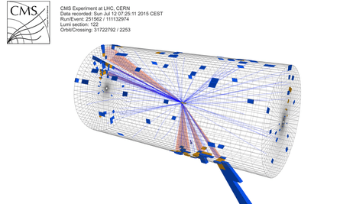
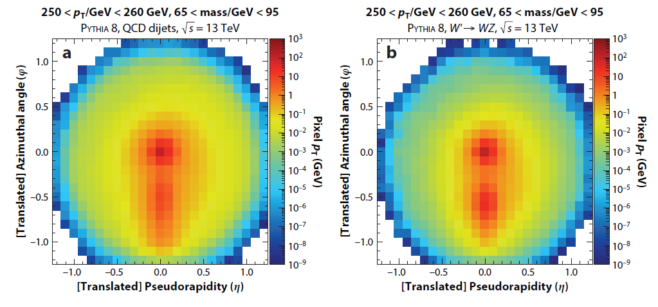
One Good Benchmark: Decorrelating the Mass
The W boson (1983) and the top quark (1995) were discovered using decays to electrons and muons, as the more frequent quark decays are difficult to distinguish from backgrounds
We later realized that if top quark, W, Z, H bosons have high energy, the jets of hadrons they produce in hadronic decays are distinguishable in highly granular calorimeters from backgrounds through their inner structure
Today the most sensitive searches for new massive particles benefit from CNN-powered imaging techniques
In this context, the mass of the heavy particle you are trying to reconstruct can be treated as a nuisance parameter which you want to decorrelate from classifiers that enhance signal purity
Above: a background jet image (left) and a W-quark jet image (right)

Slide 11
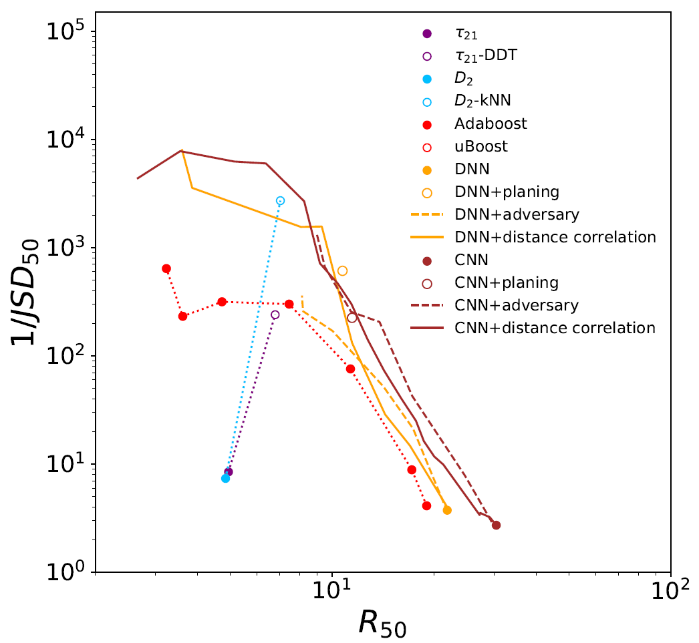
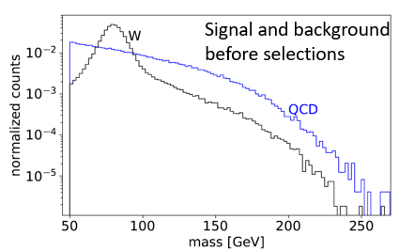
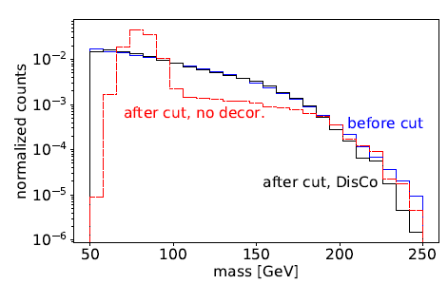
Comparisons
A comparison of the background rejection (x axis) of different W-boson taggers, retrofitted with decorrelation methods (planing, adversarial NN, and DisCo regularization) was provided by Gregor K. and D. Shih in their DisCo paper[11].
Above: a measure of decorrelation (inverse of Jensen-Shannon
divergence between QCD bgr before and after 50%TPR selection)
as a function of background rejection at 50%TPR.

Slide 12
Inference-aware neural optimization
Idea of P. de Castro and TD [27]: make the loss of a NN aware of what we really want to make of the NN output, and simultaneously inject in it a notion of the relevant nuisances, so that a loss minimization perfectly matches the (stat+syst) variance minimization of the final measurement.
If the NN constructs summaries that are differentiable WRT the nuisances, and this property is propagated to the inference step, a global minimization can be performed.
Problem 1: need to produce differentiable map of nuisance effect on features
→ calls for custom solutions in HEP problems of different complexity
Problem 2: how to estimate the final variance on the parameter of interest?
→ Use the inverse of the information matrix of a likelihood constructed with the summary statistic provided by the NN

Slide 13
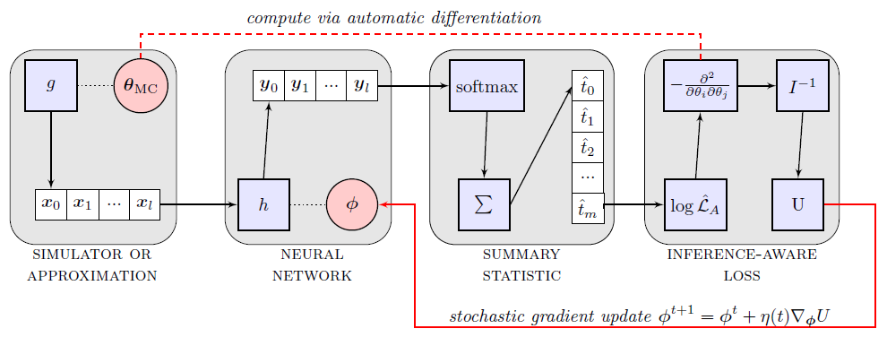
INFERNO
Βlock 1: A simulator or an approximation of it is used to sample observations given parameters θ
Block 2: NN with parameters φ produces outputs y
Block 3: A one-dimensional summary statistic, as a smoothed version of y, is produced by softmax
Block 4: A saturated likelihood is constructed with the summary (e.g. a histogram of Poisson counts), and used to get a Hessian matrix, yielding expected variance on parameter of interest
Autodiff allows to update the NN parameters given the value of the variance, to navigate with SGD to
the optimal solution

Slide 14
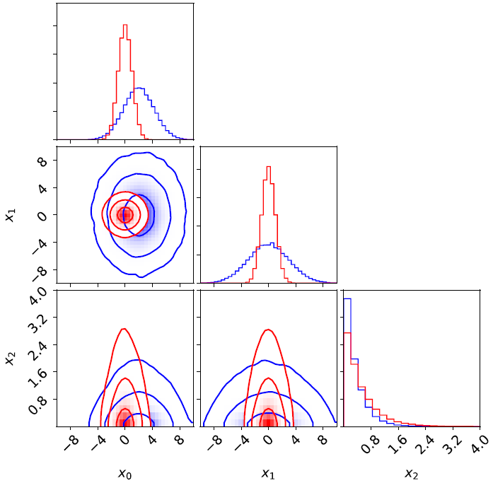
INFERNO Synthetic Example
In [27] a simple example with 3 nuisances affecting the background of a 2-component mixture problem is considered:
r shifts the background mean, λ changes the slope, and b is background normalization.
The model is then
and the optimization of the NN is tested with several benchmarks, releasing nuisances (see below)

Slide 15
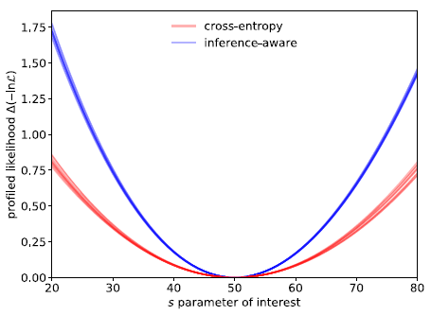
INFERNO Results
INFERNO consistently outperforms the bce-maximizing NN and has performance which approaches that of the analytical likelihood result.

Slide 16
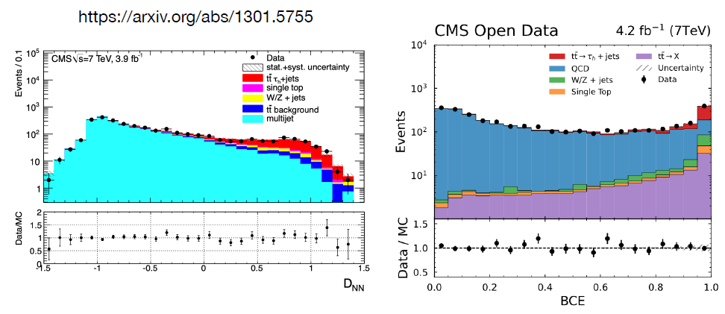
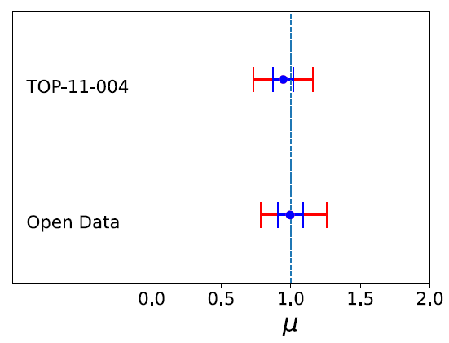
Test of INFERNO on a Real Physics Analysis
An issue in INFERNO is how to model HEP nuisances and effect on observations: must e.g. transform input features, interpolate simulated observation weights, or interpolate histogram counts.
To test the applicability of INFERNO on a real HEP analysis and benchmark it, we chose a result reproducible on open data, based on NN classification, and with large systematic uncertainties:
CMS cross section of tt → τh + jets (TOP-11-004)
An initial test with normal BCE loss produced consistent results on the cross section (and a lot of headache)

Slide 17
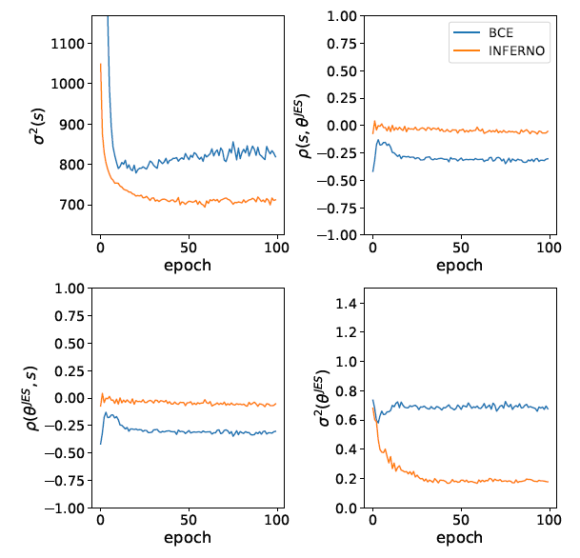
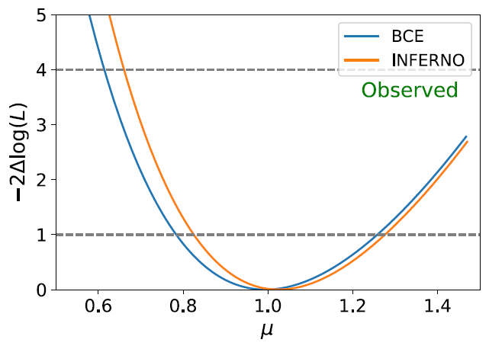
Results and Lessons Learned
On the σ(tt) measurement INFERNO produced a moderate improvement: it constrained the jet energy scale systematic, mainly through a decorrelation of the effect of that uncertainty from the summary statistic.
Since INFERNO cannot reduce systematic uncertainties affecting only the data normalization, the overall benefit in this particular analysis was small.

Slide 18
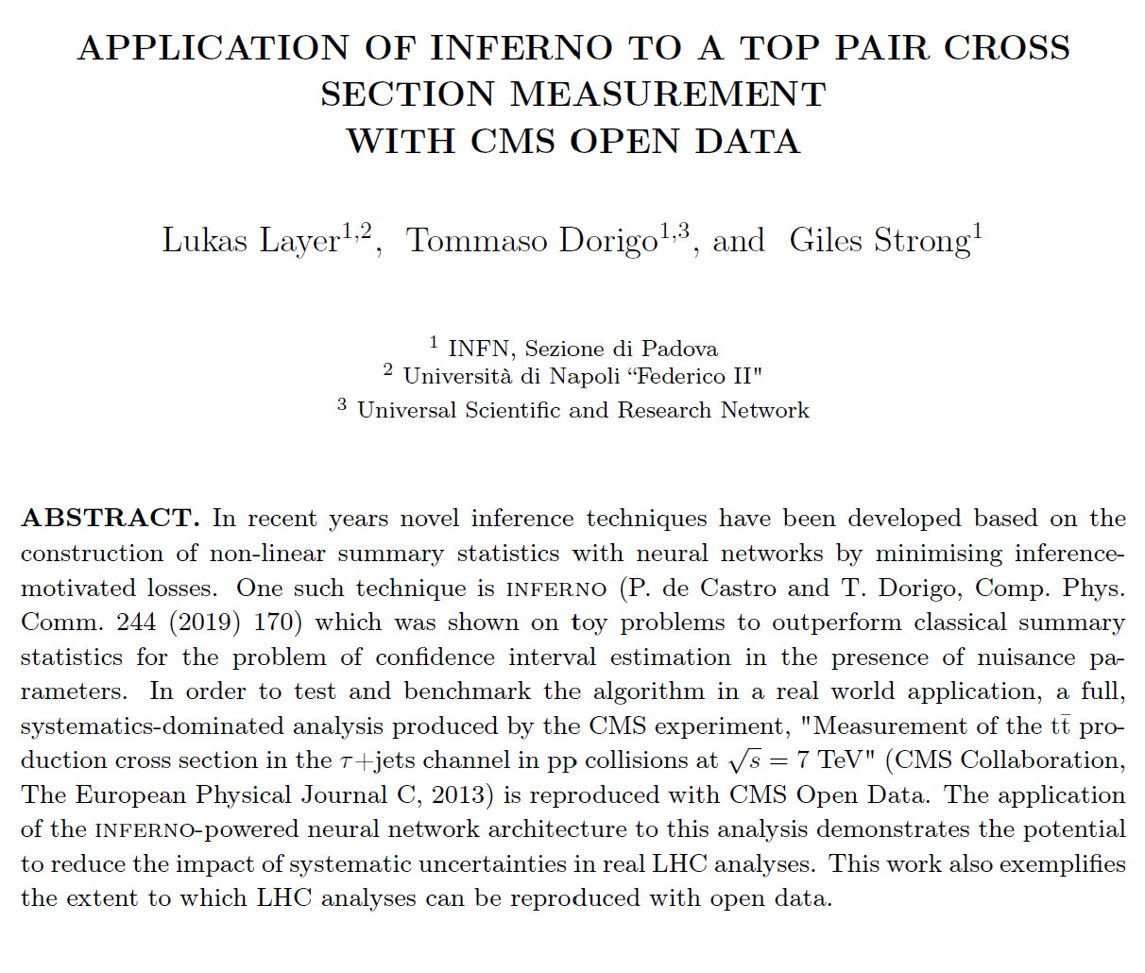
The study has been described in a preprint [34].
See L.Layer, T.Dorigo, and G.Strong, arXiv:2301.10358

Slide 19
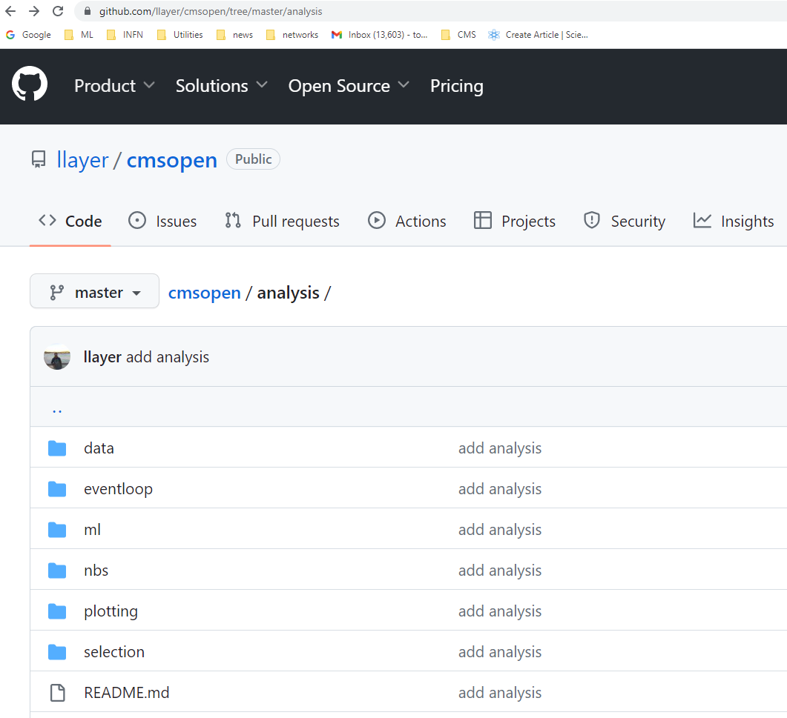
A valid benchmark for future studies!
Reproducing the original CMS analysis using open data was the hardest part of Lukas Layer’s work
Now there is a benchmark that can be used by all, with already processed data – ready to use!
Can use to compare different systematic mitigation techniques on a real-world analysis
See github.com/llayer/cmsopen
Other important take-away: reproducing analyses is damn hard, even when you have full access to data, code, documentation!

Slide 20
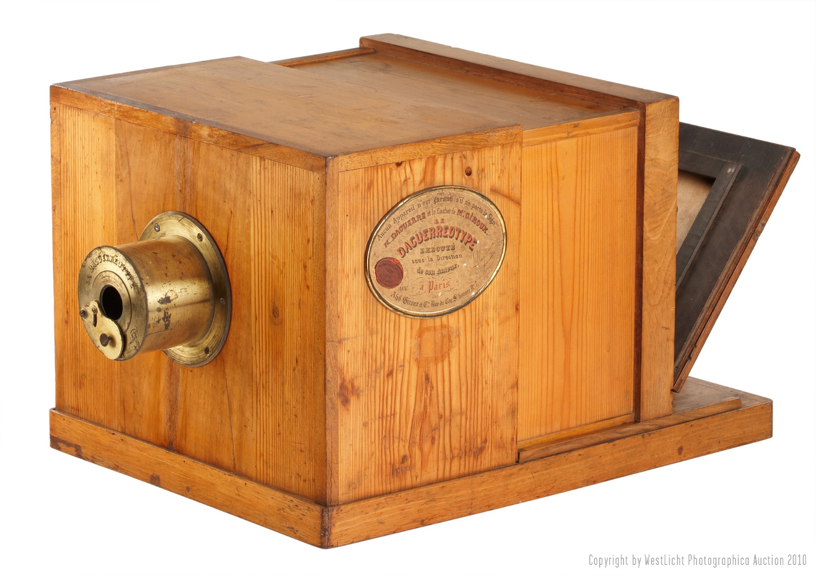
3. Recent developments

Slide 21
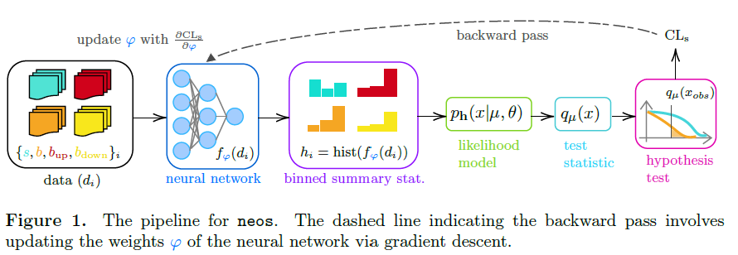
Neos
L. Heinrich and N. Simpson [35] took a similar approach to that of INFERNO, focusing on the p-value of a signal (or rather, its CLs value) resulting from a hypothesis test, to characterize the analysis sensitivity
They also used a differentiable pipeline, working their way to find differentiable solutions to each step

Slide 22
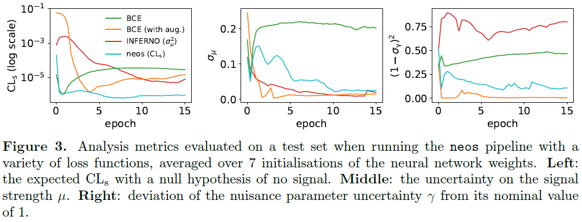
Neos comparisons
They study a 2D Gaussian S+B toy example, where B is affected by a systematic uncertainty affecting its mean. BCE, BCE with data augmentation, INFERNO, and Neos are compared on the metrics below.

Slide 23
After Neos: Neoteros, Neotatos, Neoterotatos
Neos is in course of being tried in a Atlas analysis but there is nothing public yet
In the meantime, Lukas H. continued along those lines with two recent preprints [36,37]:
2203.13079 (“Learning Optimal Test Statistics in the Presence of Nuisance Parameters”)
2306.12584 (“Hierarchical Neural Simulation-Based Inference over Event Ensembles”, with S.Mishra-Sharma, C. Pollard, P. Windischhofer)
No time to discuss these studies here, but the first in particular is quite relevant.

Slide 24
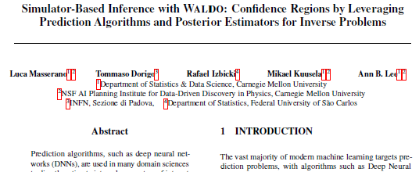
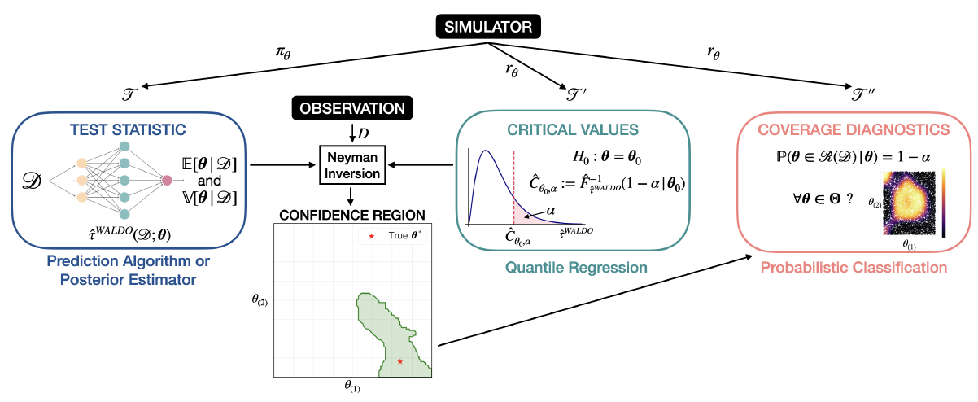
Waldo
Waldo [38] was discussed by Mikael Kuusela on Tuesday.
It produces correct coverage for the parameter of interest θ, given a trained algorithm that cooks up the conditional mean and covariance, E[θ|D] and V[θ|D] of the PoI

Slide 25
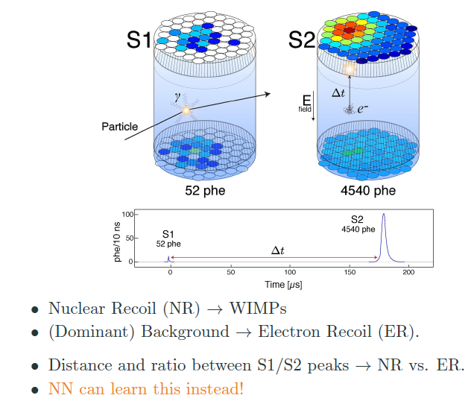
A recent application of Waldo
ML-powered DM searches with TPC
Primary objective: veto electron recoils backgrounds without sacrificing acceptance to nuclear recoils
Material by Andre Scaffidi and Roberto Trotta (unpublished yet)
See ALPACA workshop at ECT, Nov 20-24 2023
https://indico.ectstar.eu/event/184/

Slide 26
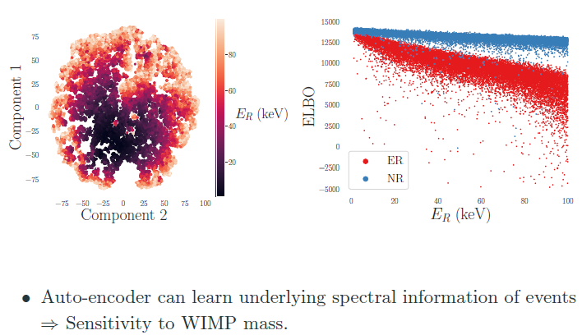
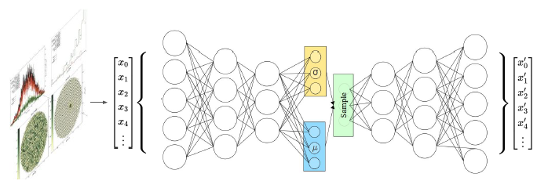
VAE learns recoil energy…
Using SBI NN classifier, may avoid cutting NR events to reject ER. They do that with a CNN on an ensemble of WIMP masses (bypassing M nuisance in classification step), but then they also need the recoil energy to have sensitivity to M
As WIMPS manifest through counting + spectral distribution, they try to learn the spectral distribution with a variational autoencoder trained on EB.

Slide 27
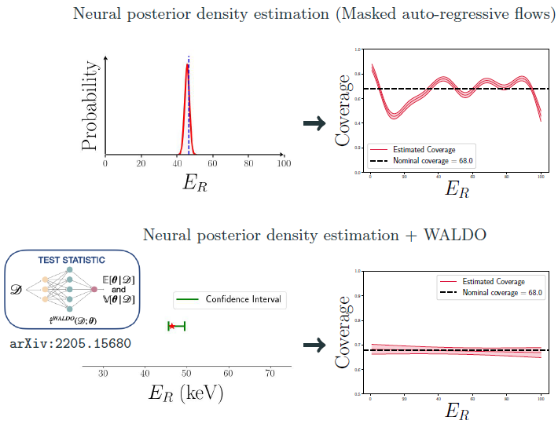
They finally use Waldo to obtain correct coverage for their estimated recoil energy distributions, obtained from masked auto-regressive flows:
1) estimate posterior with MAF
2) Extract Waldo test statistic using amortized posterior
3) Obtain CI with correct coverage
Works like a charm!

Slide 28
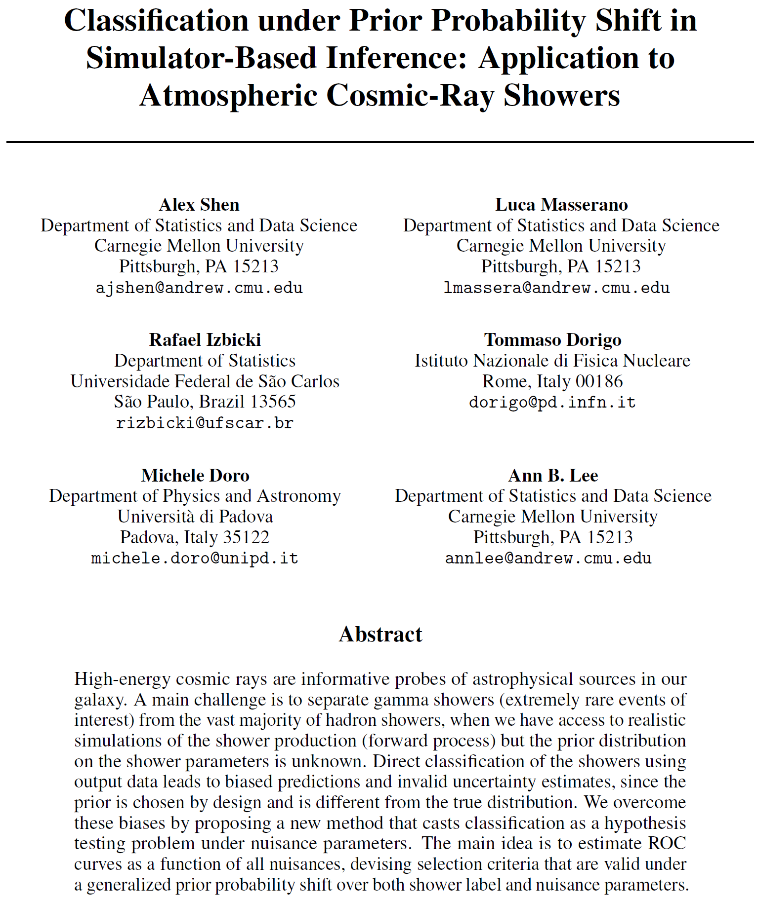
Ensuring correct confidence sets in classification under nuisances: the case of SWGO
In a paper just accepted by NeurIPS [39], with a subset of the authors of Waldo we discuss how to ensure correct confidence sets for gamma/hadron separation when
- the priors are not known
- a nuisance parameter (shower energy) affects the observed data

Slide 29
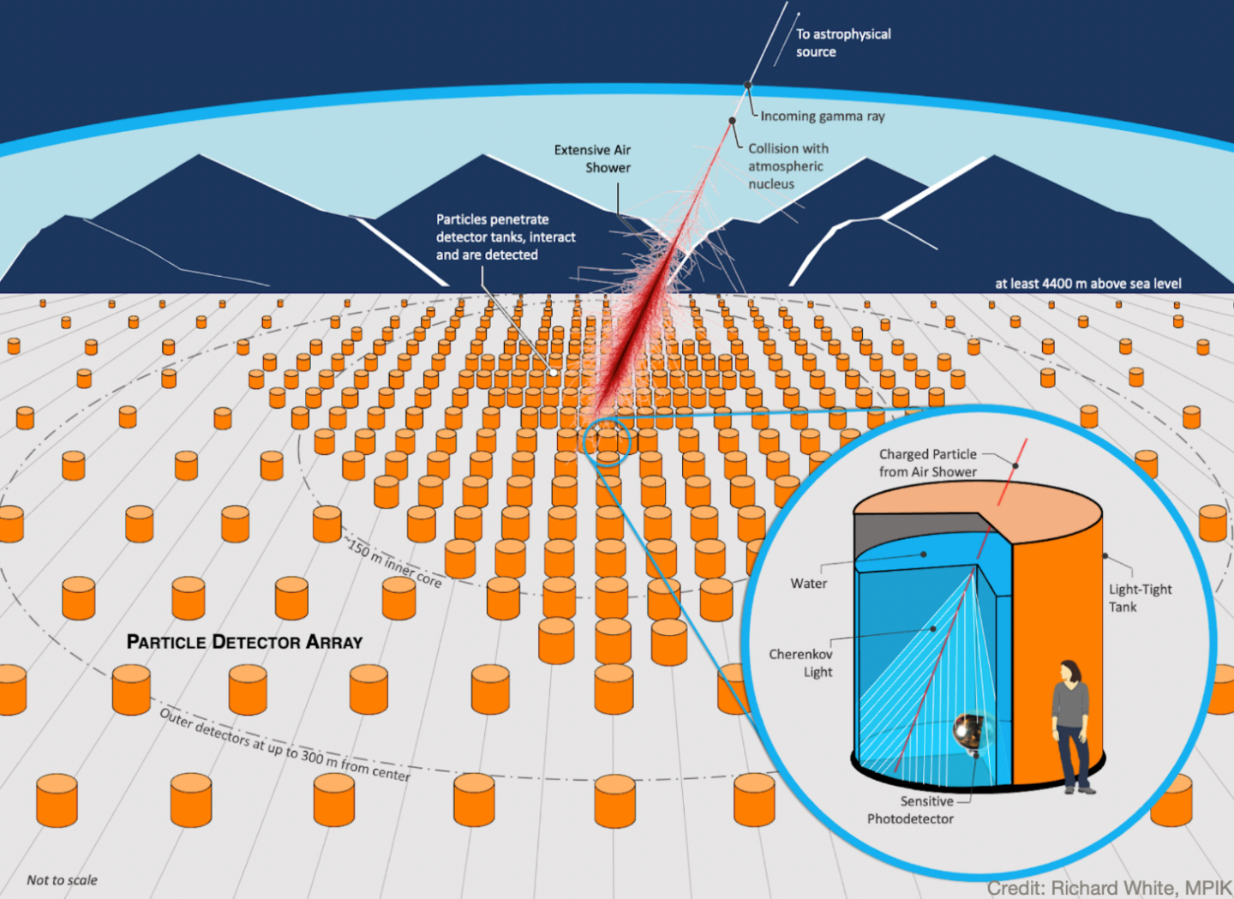
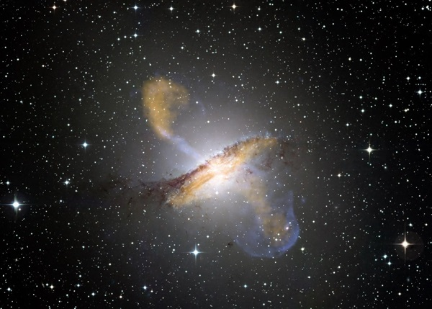
SWGO and high-energy gamma rays
SWGO (Southern Wide-field Gamma Observatory)
will detect ultra-high-energy gamma rays from
astrophysical sources

Slide 30
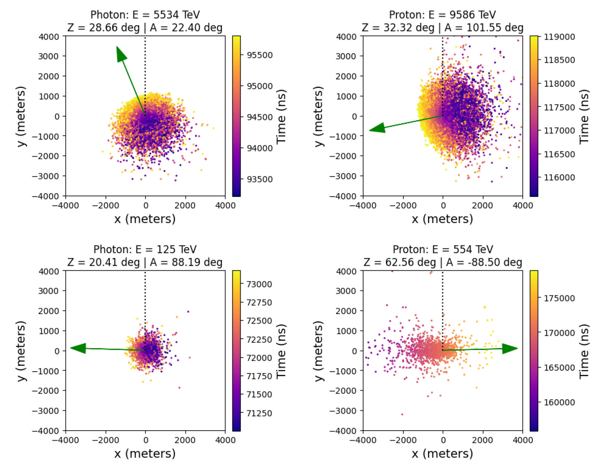
How showers look like
Showers from gamma and protons overall look quite similar on the ground
Muon content and distribution are among the few distinguishing features

Slide 31
Systematics in the SWGO photon discrimination
We have access to simulated data (with CORSIKA), so we can train a probabilistic classifier to predict
the class (photon or proton primary particle) given the collected hits:
However, we are in a situation when we do not know the true prior distributions, AND the prior
depends on the unknown nuisance (shower energy, in the considered setup).
Simulated data can only be generated from a “guessed” prior r(μ,ν) that may not be the true one
(prior probability shift, PPS)

Slide 32
Classification under systematic uncertainty
If we guess the prior and obtain a class probability with a classifier, we encounter two issues:
→ Even if perfectly estimated, P’ will give biased measures of uncertainty.

Slide 33
Solution
To obtain reliably
inference on the class,
robust to uncertainty
we follow this procedure:
This produces valid confidence sets for class prediction (μ given X) regardless of nuisance value
This method evaluates ROC curves across the whole parameter space

Slide 34
Test statistics for γ and p
Can estimate directly from a
pre-trained classifier – no need
to learn the LR of X given μ,ν

Slide 35
More detail
We can estimate the rejection probability for the TS using a monotonic Neural network. Noting that for class μ and nuisance ν the rejection probability for cutoff C is
we define FPR (μ₀=0), TPR (μ₀=1) as
and estimate them:

Slide 36
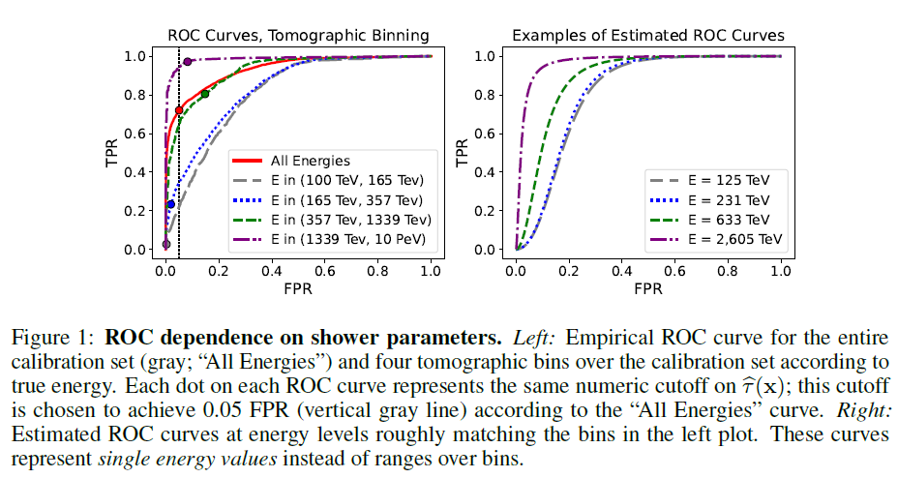
Tweaking the ROCs
red

Slide 37
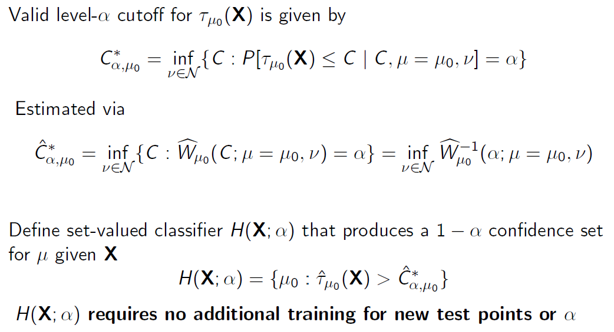
→ Uniform FPR control across nuisance space

Slide 38
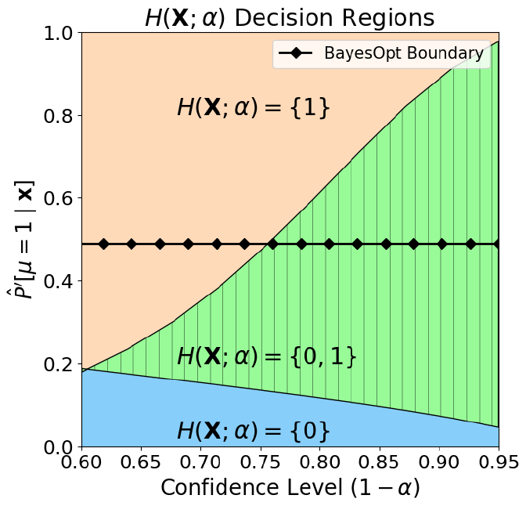
The set-based classifier partitions the space of the base classifier output based on CL

Slide 39
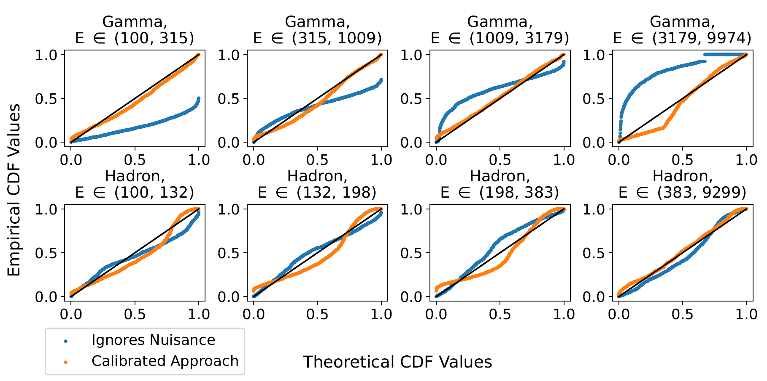
Check of calibration performance
The marginal power function (averaging over energy) fails to reproduce the CDF values.
The CDF produced by the calibrated approach matches much better the “theoretical” one (which assumes flat nuisance not affecting TPR,FPR)
We see that FPR, TPR do depend on nuisance, especially for gamma showers (top row)

Slide 40
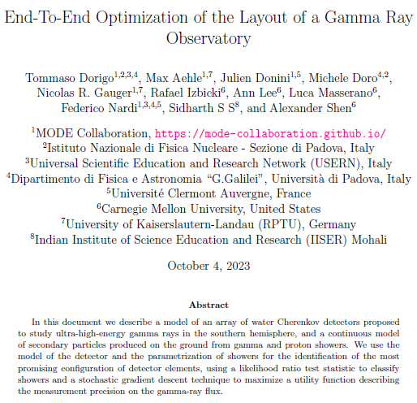
4. Bonus Track
Since we discussed SWGO, I could not help adding to this talk a short description of what kept me busy recently – an end-to-end model of that experiment[40].
Goal: optimize the layout of O(6000) Cherenkov tanks on the ground, for maximum sensitivity to gamma fluxes

Slide 41
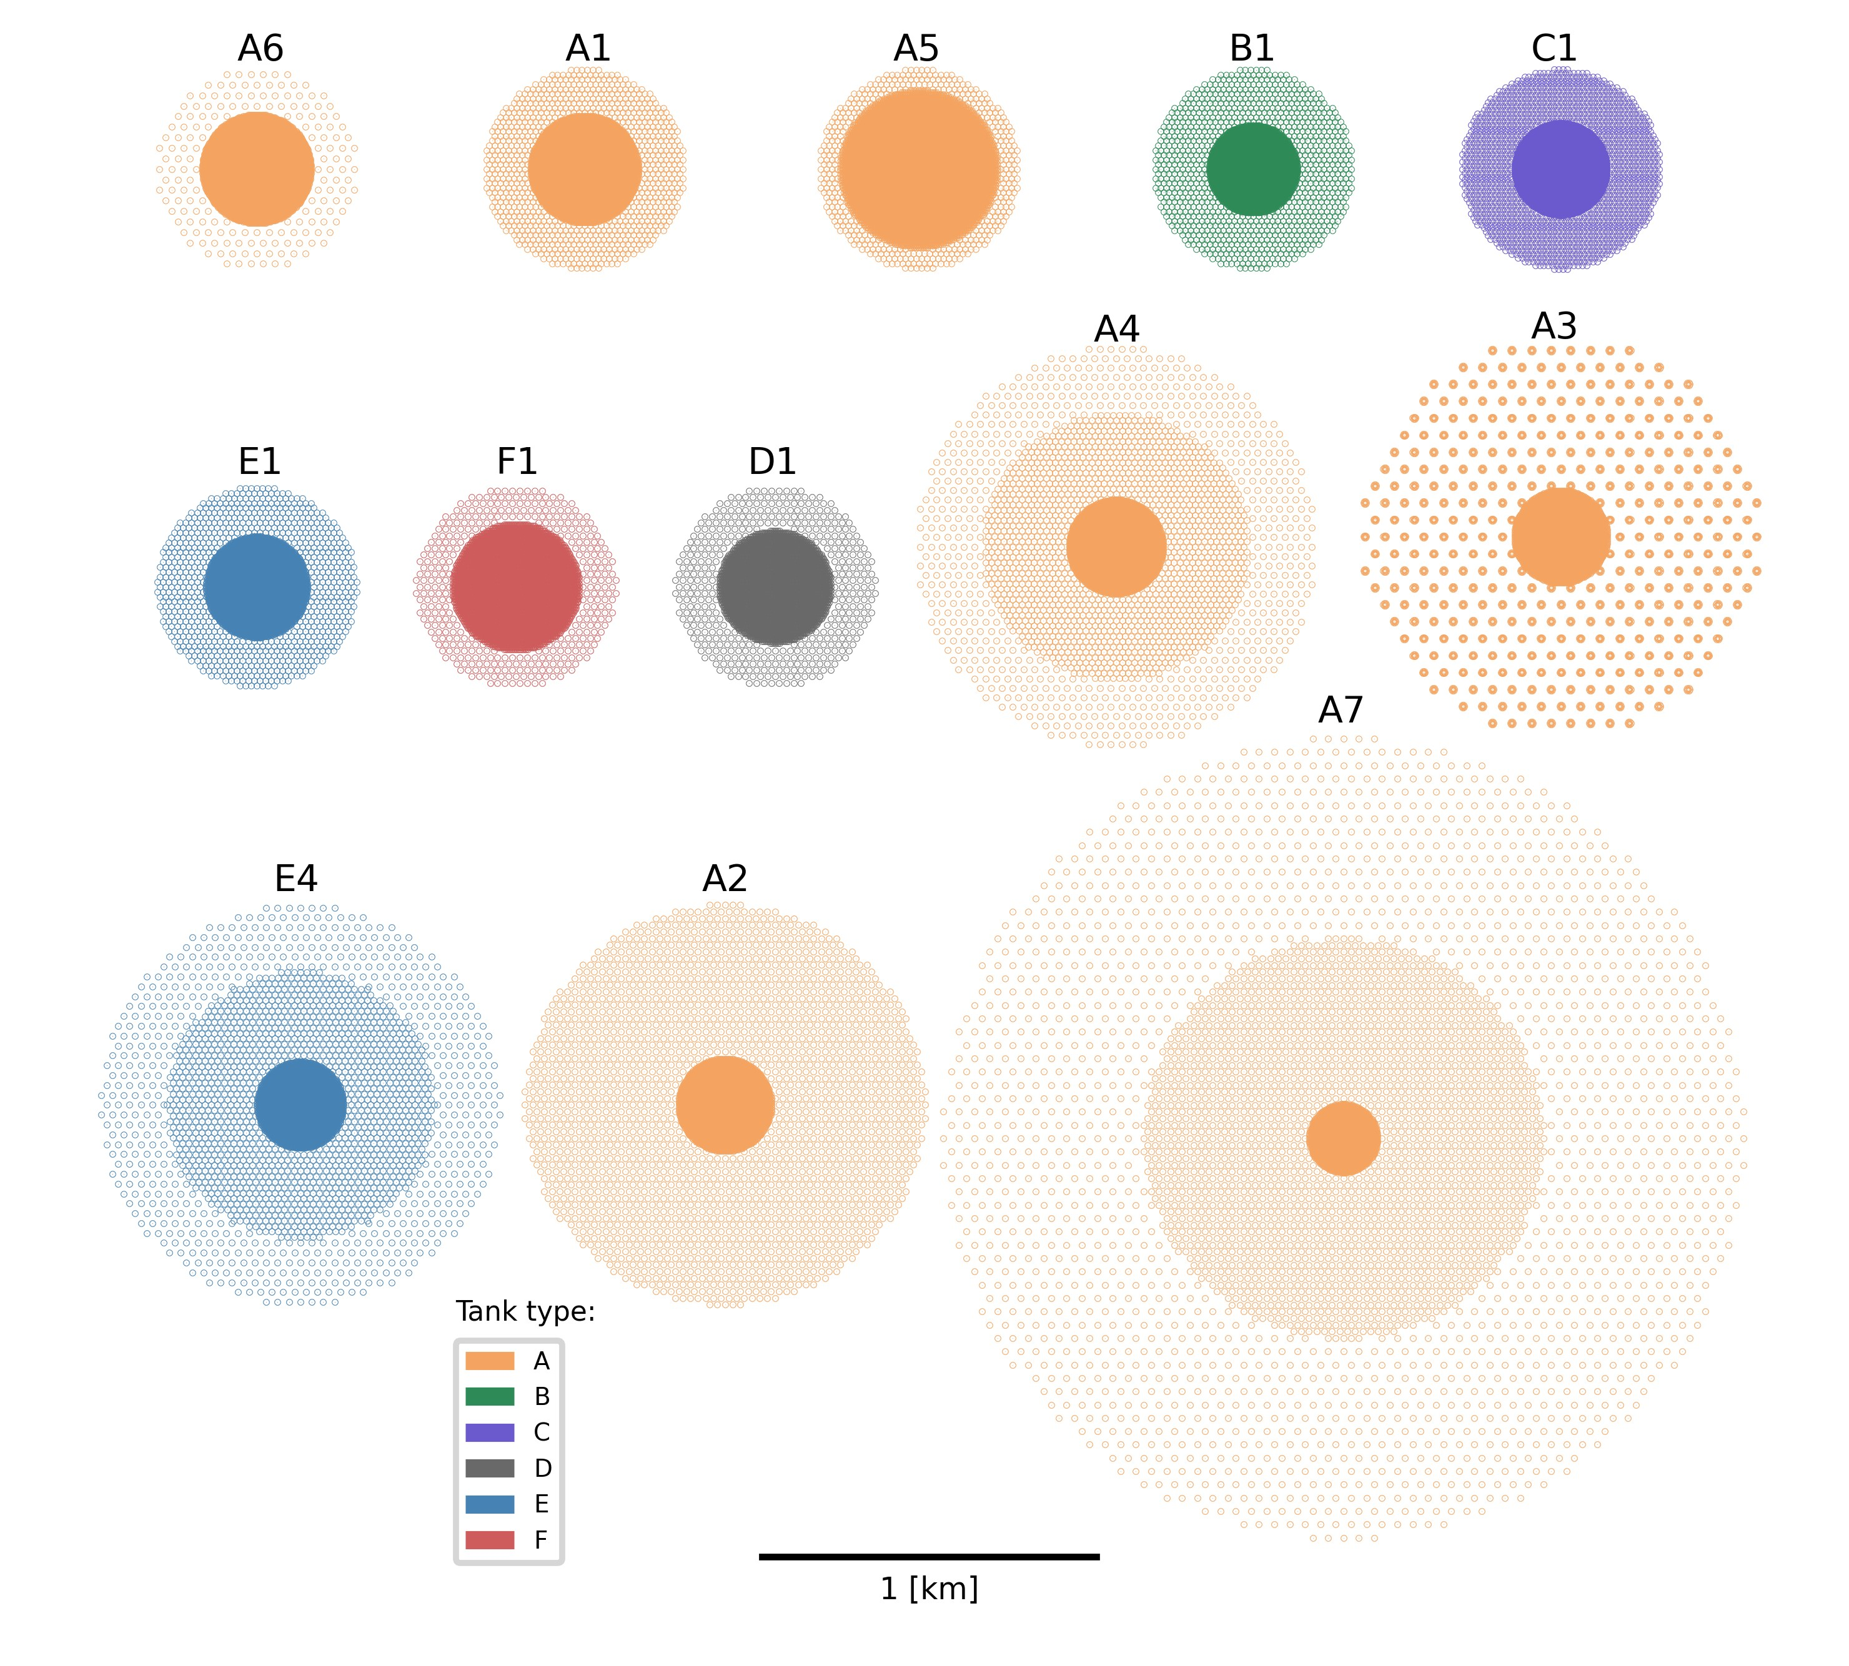
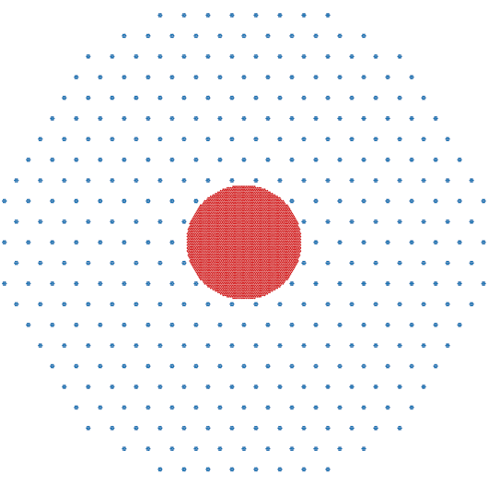
The Question
Several layouts have been proposed for SWGO.
→ Reasonable choices, sharing the idea of a dense core and sparse periphery
Which among these 13 is the best layout (in terms of science output per invested $) ?

Slide 42
The Question and a Possible Answer
Recipe:
Simulate showers in 13 given configurations
Endow ourselves with accurate model of best achievable inference extraction
Agree on a Utility function - e.g., weights w_{E} of
$U=\sum_{E=E_{1}}^{E_{n}}{w_{E_{i}}}\frac{Φ_{i}}{σ_{Φ_{i}}}$
Get 13 estimates of energy-integrated precision on $Φ_{γ}$, modulated by scientific value

Slide 43
The Principled Question
The most principled question is,
«WHAT is the best possible layout given X detectors?»
This is on another league – it demands the sorting out of R^{2X-3} choices, not 13!
The question can NOT be answered by the above discrete-sampling technique.
→ We need something better!

Slide 44
Layout of Optimization Pipeline
Simulate an initial layout for detector array

Slide 45
Layout of Optimization Pipeline
Simulate an initial layout for detector array
p
p
γ
Simulate a set of gamma and proton showers hitting array

Slide 46
Layout of Optimization Pipeline
Simulate an initial layout for detector array
p
p
γ
Simulate a set of gamma and proton showers hitting array
Reconstruct shower parameters ω in each hypothesis by likelihood maximization

Slide 47
Layout of Optimization Pipeline
Simulate an initial layout for detector array
Simulate a set of gamma and proton showers hitting array
T_{i} = log L_{γ}^{max,i} – log L_{p}^{max,i}
Reconstruct shower parameters ω in each hypothesis by likelihood maximization
Derive log-likelihood ratio of the two hypotheses for each event

Slide 48
Layout of Optimization Pipeline
Simulate an initial layout for detector array
pdf
p γ
Simulate a set of gamma and proton showers hitting array
T = log L_{γ} - log L_{p}
Reconstruct shower parameters ω in each hypothesis by likelihood maximization
Derive log-likelihood ratio of the two hypotheses
Obtain PDFs of LLR for the gamma and proton hypotheses given current layout

Slide 49
Layout of Optimization Pipeline
Simulate an initial layout for detector array
pdf
Use Gaussian kernels with sigma
equal to per-event resolution in T
to obtain continuous PDF model
p γ
Simulate a set of gamma and proton showers hitting array
T = log L_{γ} - log L_{p}
Reconstruct shower parameters ω in each hypothesis by likelihood maximization
Derive log-likelihood ratio of the two hypotheses
Obtain PDFs of LLR for the gamma and proton hypotheses given current layout

Slide 50
Layout of Optimization Pipeline
Simulate an initial layout for detector array
$$L\left(f_{γ}\right)=\prod_{1}^{N_{events}}{\left[f_{γ}p_{γ}+\left(1−f_{γ}\right)p_{p}\right]}$$
Compute the likelihood of the observed batch as a function of the fraction of gammas in the batch; compute the second derivative of the likelihood
Simulate a set of gamma and proton showers hitting array
$$σ_{f_{γ}}^{2}=−{\left(\frac{d^{2}L}{d{f_{γ}}^{2}}\right)}^{−1}$$
Reconstruct shower parameters ω in each hypothesis by likelihood maximization
Derive log-likelihood ratio of the two hypotheses
Obtain PDFs of LLR for the gamma and proton hypotheses given current layout
Simulate a batch of gammas and protons and reconstruct them; obtain the TS of each shower

Slide 51
Layout of Optimization Pipeline
Simulate an initial layout for detector array
Use RCF bound to estimate the expected variance of the signal flux measurement
Compute the likelihood of the observed batch as a function of the fraction of gammas in the batch; compute the second derivative of the likelihood
Simulate a set of gamma and proton showers hitting array
$$σ_{f_{γ}}^{2}=−{\left(\frac{d^{2}L}{d{f_{γ}}^{2}}\right)}^{−1}$$
Reconstruct shower parameters ω in each hypothesis by likelihood maximization
Derive log-likelihood ratio of the two hypotheses
Obtain PDFs of LLR for the gamma and proton hypotheses given current layout
Simulate a batch of gammas and protons and reconstruct them; obtain the TS of each shower

Slide 52
Layout of Optimization Pipeline
Simulate an initial layout for detector array
Update layout (x,y of each tank) following gradient of U
Obtain the utility and its gradient with respect to each detector x,y position
Use RCF bound to estimate the expected variance of the signal flux measurement
Compute the likelihood of the observed batch as a function of the fraction of gammas in the batch; compute the second derivative of the likelihood
Simulate a set of gamma and proton showers hitting array
Reconstruct shower parameters ω in each hypothesis by likelihood maximization
$$U=\sum_{E=E_{1}}^{E_{n}}{w_{E_{i}}}\frac{Φ_{i}}{σ_{Φ_{i}}}+f(∆E,∆θ,∆φ)$$
dU/dx
Derive log-likelihood ratio of the two hypotheses
Obtain PDFs of LLR for the gamma and proton hypotheses given current layout
Simulate a batch of gammas and protons and reconstruct them; obtain the TS of each shower

Slide 53
Layout of Optimization Pipeline
Simulate an initial layout for detector array
Stop when satisfied
Update layout (x,y of each tank) following gradient of U
Obtain the utility and its gradient with respect to each detector x,y position
Use RCF bound to estimate the expected variance of the signal flux measurement
Compute the likelihood of the observed batch as a function of the fraction of gammas in the batch; compute the second derivative of the likelihood
Simulate a set of gamma and proton showers hitting array
Reconstruct shower parameters ω in each hypothesis by likelihood maximization
Derive log-likelihood ratio of the two hypotheses
Obtain PDFs of LLR for the gamma and proton hypotheses given current layout
Simulate a batch of gammas and protons and reconstruct them; obtain the TS of each shower

Slide 54
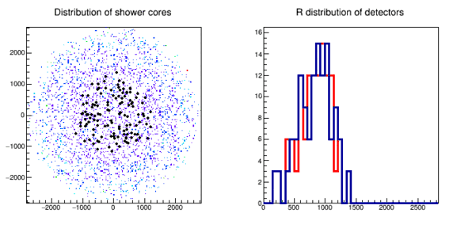
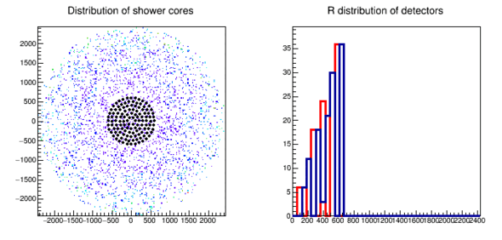
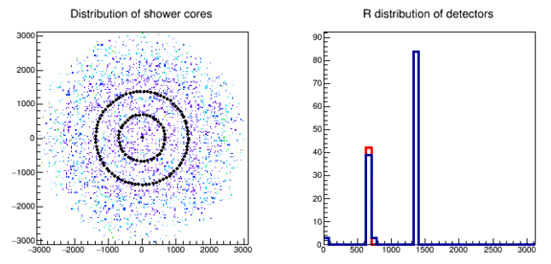
The utility derivatives progressively push
detectors out, to “catch more showers”
(note: scale of graphs changes with epoch)
Different layouts converge to the same optimized configuration - Not trivial feat in a O(100)-dimensional space!!!

Slide 55
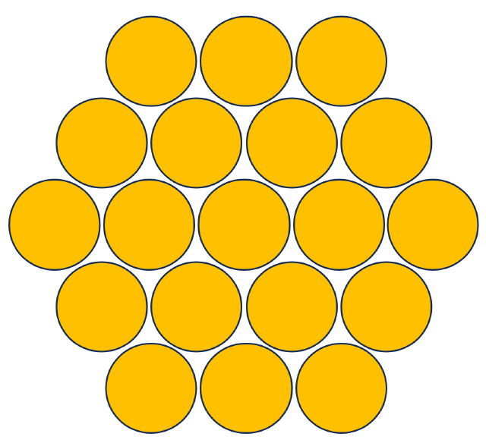
One run with full utility
We next performed a run with 300 macro-tanks aggregates, fixed to triangular symmetry → 5700 units equivalent, 197 parameters.
2000 epochs are run → 12 million showers generated, reconstructed, classified; 1.2M gradients (each a complex sum over all units) computed.
CPU load: 1 week on a 30-core cluster
It is interesting (but I would say mesmerizing) to observe how the layout evolves, changing configuration as it expands:

Slide 56
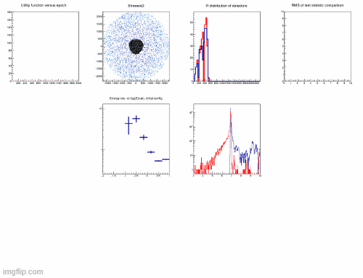
Epochs 1- 1000
Left: utility function as a function of number of epoch
Center: current detector layout (black points). Coloured points
indicate the core of the generated showers in each batch
Right: radial distribution of the detectors (blue)
compared to starting layout

Slide 57
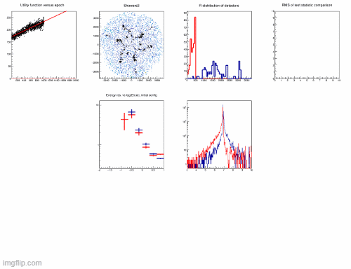
Epochs 1001-2000
Left: utility function as a function of number of epoch
Center: current detector layout (black points). Coloured points
indicate the core of the generated showers in each batch
Right: radial distribution of the detectors (blue)
compared to starting layout

Slide 58
Next MODE Workshop: September 23-25, Valencia – Save the date!

Slide 59
5. Instead of a summary, some considerations
A wide arsenal of techniques that try to remove or reduce the impact of systematic uncertainties in application of ML to fundamental physics problems has been developed in recent years
I do not think we can “solve” the problem – nor that it is the only concern in uncertainty quantification (see error of the third kind) – but we are considerably better off today than a few years ago
I suspect the (bold) way forward will be to take a more holistic approach, where we combine our desiderata (precision, robustness, coverage, transferability, etc.) into the loss of a smarter algorithm that may consider them together, and which can offer explicit tradeoffs on demand

Slide 60
References (1/4)
[1] T. Dorigo and P. de Castro, Dealing with Nuisance Parameters using Machine Learning in High Energy Physics: a Review, arXiv:2007.09121 (2020); P. Calafiura, D. Rousseau, K. Terao (eds.), Artificial Intelligence for High-Energy Physics, World Scientific 2022, https://doi.org/10.1142/12200 .
[2] J. Thaler and K. Van Tilburg, Maximizing Boosted Top Identication by Minimizing N-subjettiness, JHEP. 02, 093 (2012). doi: 10.1007/JHEP02(2012)093.
[3] J. Dolen, P. Harris, S. Marzani, S. Rappoccio, and N. Tran, Thinking outside the ROCs: Designing Decorrelated Taggers (DDT) for jet substructure, JHEP. 05, 156 (2016). https://doi.org/10.1007/JHEP05(2016)156.
[4] P. Baldi, K. Cranmer, T. Faucett, P. Sadowski, and D. Whiteson, Parameterized neural networks for high-energy physics, Eur. Phys. J. C. 76(5), 235 (2016). doi: 10.1140/epjc/s10052-016-4099-4.
[5] J. de Favereau, C. Delaere, P. Demin, A. Giammanco, V. Lemaitre,A. Mertens, and M. Selvaggi, DELPHES 3, A modular framework for fast simulation of a generic collider experiment, JHEP. 02, 057 (2014). doi: 10.1007/JHEP02(2014)057.
[6] J. Aguilar-Saavedra, J. H. Collins, and R. K. Mishra, A generic anti-QCD jet tagger, JHEP. 11, 163 (2017). doi: 10.1007/JHEP11(2017)163.
[7] S. Chang, T. Cohen, and B. Ostdiek, What is the Machine Learning?, Phys. Rev. D. 97(5), 056009 (2018). doi: 10.1103/PhysRevD.97.056009.
[8] J. Stevens and M. Williams, uBoost: A boosting method for producing uniform selection efficiencies from multivariate classifiers, JINST. 8, P12013 (2013). doi: 10.1088/1748-0221/8/12/P12013.
[9] Y. Freund and R. E. Schapire, A decision-theoretic generalization of on-line learning and an application to boosting, Journal of Computer and System Sciences. 55(1), 119{139 (Aug., 1997). doi: 10.1006/jcss.1997.1504.
[10] A. Rogozhnikov, A. Bukva, V. Gligorov, A. Ustyuzhanin, and M. Williams, New approaches for boosting to uniformity, JINST. 10(03), T03002 (2015). doi: 10.1088/1748-0221/10/03/T03002.

Slide 61
References (2/4)
[11] G. Kasieczka and D. Shih, DisCo Fever: Robust Networks Through Distance Correlation, arXiv:2001.05310 (Jan 2020).
[12] S. Wunsch, S. Jorger, R. Wolf, and G. Quast, Reducing the dependence of the neural network function to systematic uncertainties in the input space (July, 2019). URL http://arxiv.org/abs/1907.11674.
[13] S. Ben-David, J. Blitzer, K. Crammer, and F. Pereira. Analysis of representations for domain adaptation. In eds. B. Scholkopf, J. C. Platt, and T. Homan, Advances in Neural Information Processing Systems 19, pp. 137-144. MIT Press (2007). URL http://papers.nips.cc/paper/2983-analysis-of-representations-for-domain-adaptation.pdf.
[14] S. Ben-David, J. Blitzer, K. Crammer, A. Kulesza, F. Pereira, and J. W. Vaughan, A theory of learning from different domains, Machine Learning. 79 (1-2), 151{175 (Oct., 2009). URL https://doi.org/10.1007/s10994-009-5152-4.
[15] H. Ajakan, P. Germain, H. Larochelle, F. Laviolette, and M. Marchand, Domain-adversarial neural networks, arXiv:1412.4446 (2014).
[16] G. Louppe, M. Kagan, and K. Cranmer. Learning to pivot with adversarial networks. In eds. I. Guyon, U. V. Luxburg, S. Bengio, H. Wallach, R. Fergus, S. Vishwanathan, and R. Garnett, Advances in Neural Information Processing Systems 30, pp. 981{990. Curran Associates, Inc. (2017). URL http://papers.nips.cc/paper/6699-learning-to-pivot-with-adversarial-networks.pdf.
[17] M. H. Degroot and M. J. Schervish. Probability and statistics, Carnegie-Mellon Univ., 1977.
[18] C. Shimmin, P. Sadowski, P. Baldi, E. Weik, D. Whiteson, E. Goul, and A. Sgaard, Decorrelated Jet Substructure Tagging using Adversarial Neural Networks, Phys. Rev. D. 96(7), 074034 (2017). doi: 10.1103/PhysRevD.96. 074034.
[19] V. Estrade, C. Germain, I. Guyon, and D. Rousseau. Adversarial learning to eliminate systematic errors: a case study in high energy physics. In NIPS 2017 (2017).
[20] P. Simard, B. Victorri, Y. LeCun, and J. Denker. Tangent prop - a formalism for specifying selected invariances in an adaptive network. In eds. J. E. Moody, S. J. Hanson, and R. P. Lippmann, Advances in Neural Information Processing Systems 4, pp. 895{ 903. Morgan-Kaufmann (1992). URL http://papers.nips.cc/paper/536-tangent-prop-a-formalism-for-specifying-selected-invariances-in-an-adaptive-network.pdf.

Slide 62
References (3/4)
[21] A. Blance, M. Spannowsky, and P. Waite, Adversarially-trained autoencoders for robust unsupervised new physics searches, JHEP. 10, 047 (2019). doi: 10.1007/JHEP10(2019)047.
[22] C. Englert, P. Galler, P. Harris, and M. Spannowsky, Machine Learning Uncertainties with Adversarial Neural Networks, Eur. Phys. J. C. 79(1), 4 (2019). doi: 10.1140/epjc/s10052-018-6511-8.
[23] L. M. Dery, B. Nachman, F. Rubbo, and A. Schwartzman, Weakly supervised classification in high energy physics, J. High Energy Phys. 2017(5), 145 (May, 2017). URL https://doi.org/10.1007/JHEP05(2017)145.
[24] E. M. Metodiev, B. Nachman, and J. Thaler, Classication without labels: learning from mixed samples in high energy physics, J. High Energy Phys. 2017(10), 174 (Oct., 2017). URL https://doi.org/10.1007/JHEP10(2017) 174.
[25] ATLAS collaboration, Dijet resonance search with weak supervision using sqrt(s)=13 TeV pp collisions in the ATLAS detector, arXiv:2005.02983 (hep-ex), 2020.
[26] F. de Almeida Dias, talk at Anomaly detection mini-workshop, July 16th 2020. [27] P. de Castro and T. Dorigo, INFERNO: Inference-Aware neural optimisation, Comput. Phys. Commun. 244, 170-179 (Nov., 2019). URL http://www.sciencedirect.com/science/article/pii/S0010465519301948.
[27] P. de Castro and T. Dorigo, INFERNO: Inference-Aware neural optimisation, Comput. Phys. Commun. 244, 170-179 (Nov., 2019). URL http://www.sciencedirect.com/science/article/pii/S0010465519301948.
[28] T. Charnock, G. Lavaux, and B. D. Wandelt, Automatic physical inference with information-maximizing neural networks, Phys. Rev. D. 97(8), 083004 (Apr., 2018). URL https://link.aps.org/doi/10.1103/PhysRevD.97.083004.
[29] J. Alsing and B. Wandelt, Nuisance hardened data compression for fast likelihood-free inference, Mon. Not. R. Astron. Soc. 488(4), 5093{5103 (Oct., 2019). URL https://academic.oup.com/mnras/article-abstract/488/4/5093/5530778.
[30] S.Wunsch, S. Jorger, R.Wolf, and G. Quast, Optimal statistical inference in the presence of systematic uncertainties using neural network optimization based on binned poisson likelihoods with nuisance parameters, arXiv:2003.07186 (Mar., 2020). URL http://arxiv.org/abs/2003.07186.

Slide 63
References (4/4)
[31] L. Heinrich and N. Simpson. pyhf/neos: initial zenodo release, URL https://doi.org/10.5281/zenodo.3697981 (Mar 2020).
[32] A. Elwood and D. Krucker, Direct optimisation of the discovery significance when training neural networks to search for new physics in particle colliders, arXiv:1806.00322 (June, 2018). URL http://arxiv.org/abs/1806.00322.
[33] L.-G. Xia, QBDT, a new boosting decision tree method with systematic uncertainties into training for high energy physics, arXiv:1810.08387 (Oct., 2018). URL http://arxiv.org/abs/1810.08387.
[34] L. Layer, T. Dorigo, and G. Strong, Application of INFERNO to a Top Pair Cross Section Measurement with CMS Open Data (2023), arXiv:2301.10358.
[35] N. Simpson and L. Heinrich, neos: End-to-End-Optimised Summary Statistics for High Energy Physics (2022), arXiv:2203.05570.
[36] L. Heinrich, Learning Optimal Test Statistics in the Presence of Nuisance Parameters (2022), arXiv:2203.13079.
[37] L. Heinrich, S.Mishra-Sharma, C. Pollard, and P. Windischhofer, Hierarchical Neural Simulation-Based Inference over Event Ensembles (2023), arXiv: 2306.12584.
[38] L. Masserano, T. Dorigo, R. Izbicki, M. Kuusela, and A. Lee, Simulator-Based Inference with Waldo: Confidence Regions by Leveraging Prediction Algorithms and Posterior Estimators for Inverse Problems (2022), arXiv:2205.15680v4.
[39] A. Shen, T. Dorigo, M. Doro, R. Izbicki, L. Masserano, and A. Lee, Classification Under Prior Probability Shift in Simulation-Based Inference: Application to Atmospheric Cosmic-Ray Showers, NeurIPS 2023.
[40] T. Dorigo et al., End-to-End Optimization of the Layout of a Gamma Ray Observatory (2023), https://arxiv.org/abs/2310.01857.

Slide 64
BACKUP

Slide 65
