Slide 1
Controlling Systematic Errors with an Adversary
Artificial Intelligence and the Uncertainty challenge in Fundamental Physics
G. Watts
For the ATLAS Collaboration and the CalRatio Analysis Team
2023-11-30
Notes:
Needs UW logo
Needs Paris background picture

Slide 2
Systematic Errors
Reduce the precision and accuracy of your experimental measurement
Known Unknowns
Usually accounted for with some sort of calibration or characterization
Should affect only the precision
If done right, can be differentiated through and included in optimization
e.g. Known measurement errors in your experiment
Unknown Unknowns
e.g. An unknown bias in measurement technique
Discovered via closure tests failing
Difference is often added to a overall systematic error
Often discovered as a measurement nears completion.

Slide 3
Systematic Errors
Discovered via closure tests failing
Difference is often added to a overall systematic error
Often discovered as a measurement nears completion.
Can this closure test help us train the analysis to steer away from the discrepancy?

Slide 4
HEPDATA

Slide 5
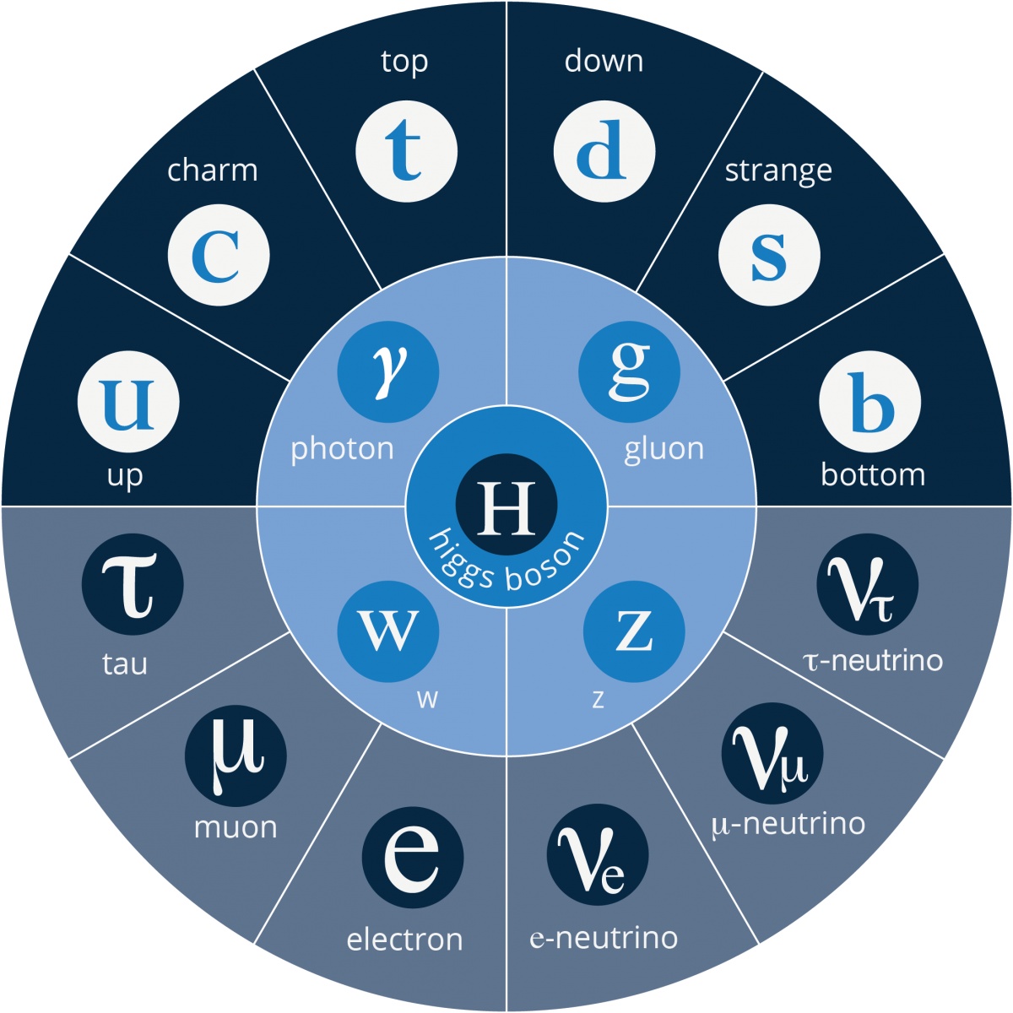
Searching For hidden sectors
(Hidden Sector)
Possible explanation for Dark Matter, Dark Energy, etc.
Notes:
The usual BSM and HS slide I have

Slide 6
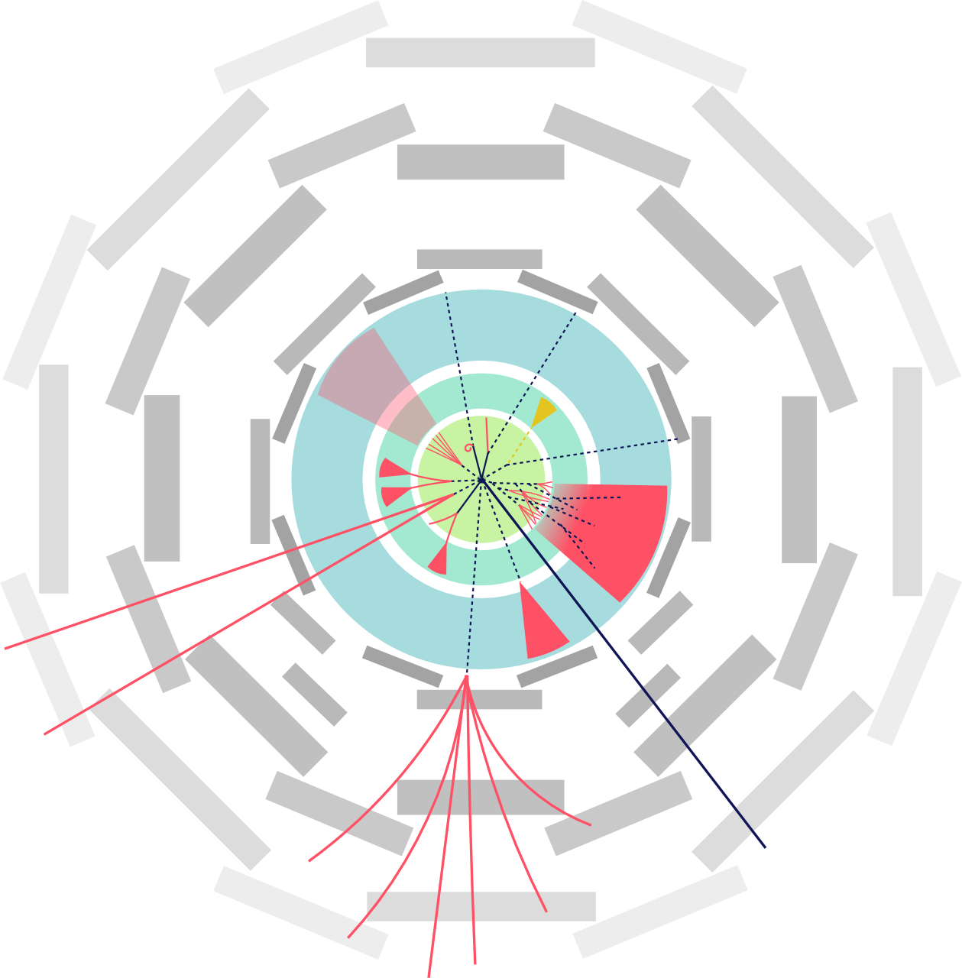
Searching For hidden sectors
(Hidden Sector)
But it does decay/mix back to SM particles!

Slide 7
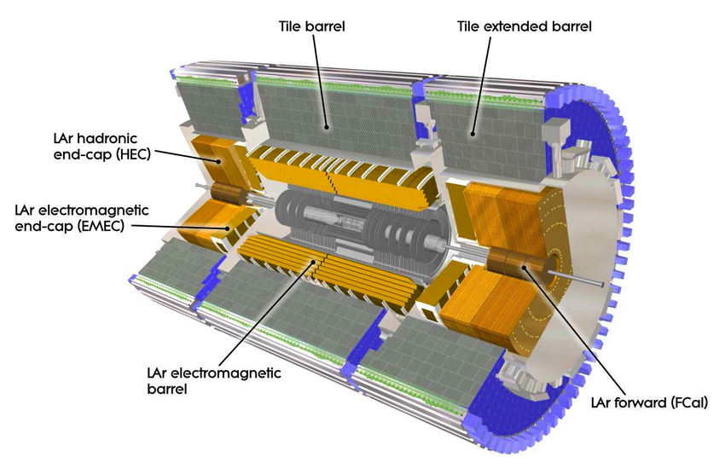
Signal
Standard Model
The ATLAS Calorimeter
Measures energy deposited from particle jets
Originates from Interaction Point
Leaves tracks, calorimeter energy, etc.
Notes:
Picture of the detector slice, with a regular SM jet and then a shifted SM jet

Slide 8
Signal
Long Lived Particle
The ATLAS Calorimeter
Measures energy deposited from particle jets
Displaced from Interaction Point
Little activity between IP and the displaced jet
Notes:
Picture of the detector slice, with a regular SM jet and then a shifted SM jet

Slide 9
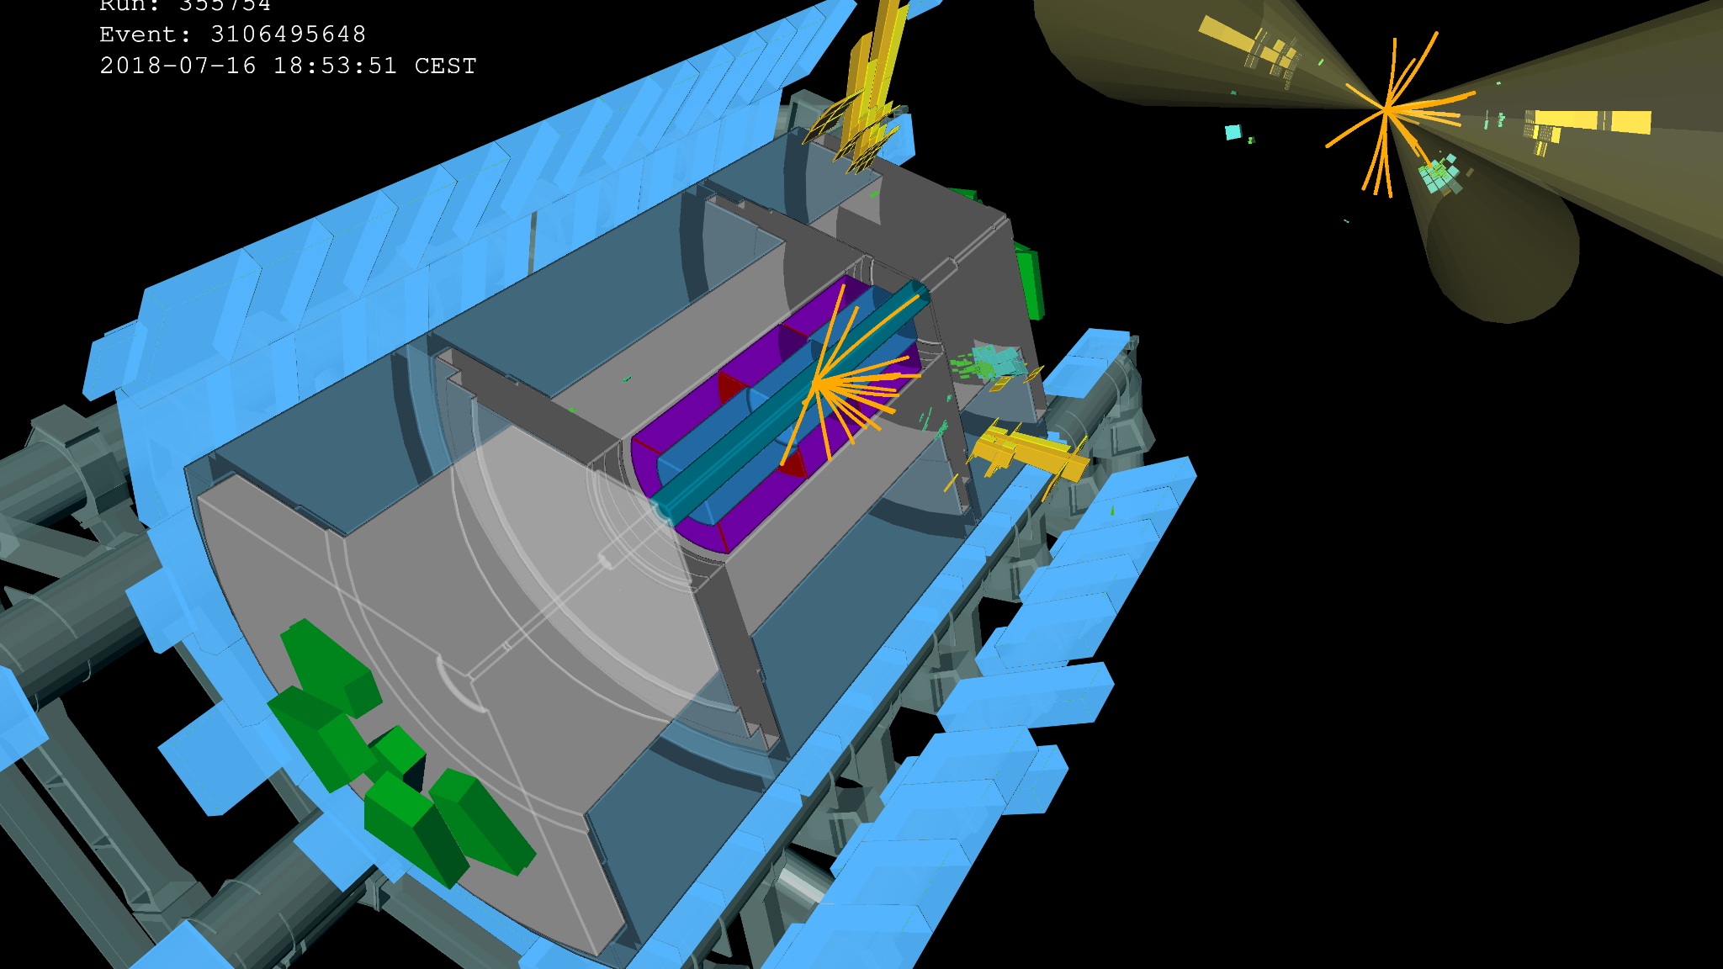
Displaced Jet with little activity in front…
A “Typical” Event
Notes:
Detector and Event Picture side-by-side

Slide 10
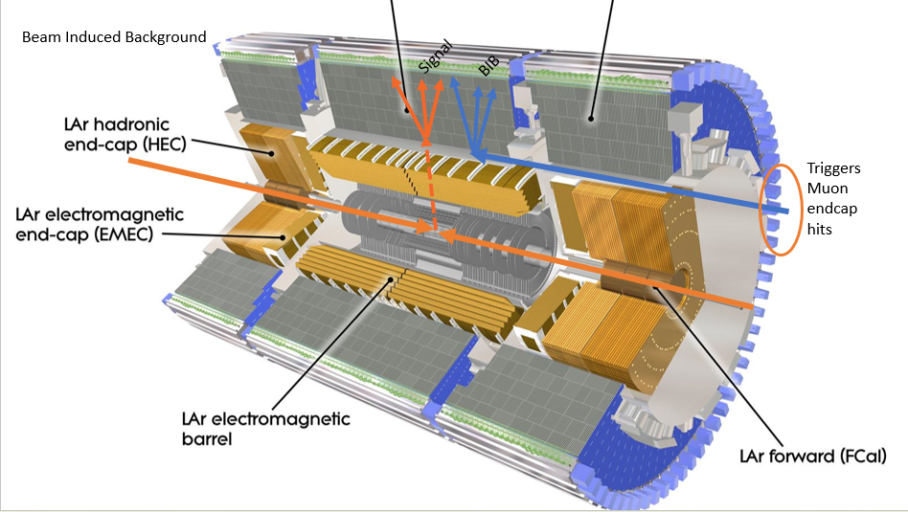
Irreducible Backgrounds
This caused all the trouble!
Standard Model MultiJet Background (Multijet)
Beam Induced Background (BIB)
Cross section of SM Jets is about ${10}^{10}$
Our signal is ~${10}^{−2}$
Regular fluctuations in jet evolution will make a signal-like jet every now and then!
(arrival time differences)

Slide 11
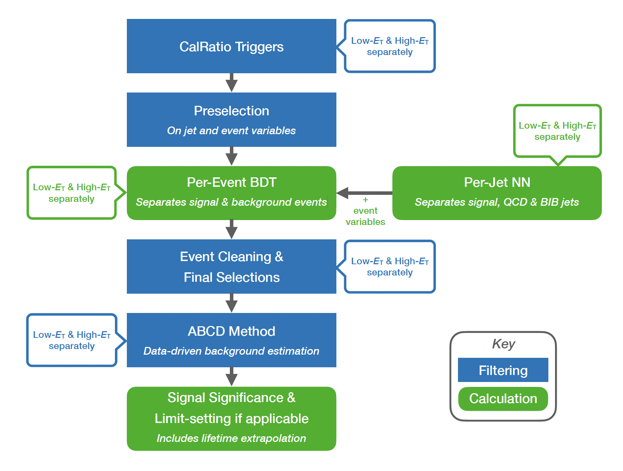
Analysis Workflow
Analysis Follows Standard HEP pattern
After triggers, Per-Jet NN classifies each jet
Beam Induced Background, Multi-jet Background, or Signal
The scoring from the jets is combined by a Per-Event BDT
And final selections are fed to standard limit setting algorithms
Notes:
Block diagram workflow of the analysis

Slide 12
The Per-Jet NN – Where The Problem Is
Per-Jet NN powers most of the signal/background discrimination.
Using a recurrent neural net as one part of the process
Uses recurrent connections to capture and utilize information from previous steps in the sequence. Each step is a physics object!
Data in the network has already gone through various processing steps
Eliminating and selecting most relevant data
Various pre-selection and processing

Slide 13
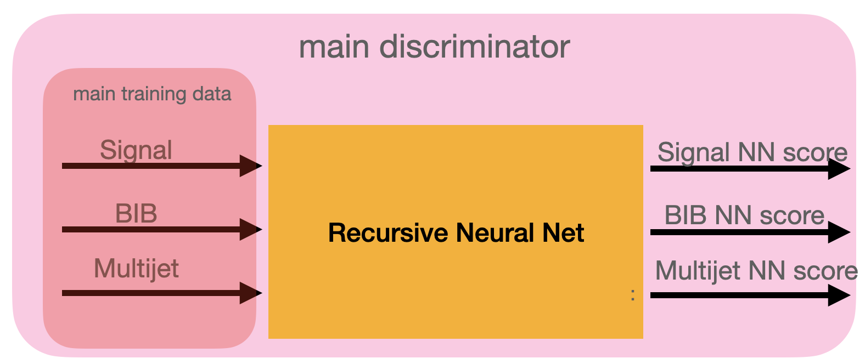
The Per-JET NN
Uses topo-clusters, muon segments, and track information in training, along with jet and LLP data
Neural net architecture is a set of convolutional layers feeding into an LSTM layer
Optimal hyperparameters achieved through grid search
Notes:
What the per-jet NN has to do, and, in general, how it will do it, use event picture to help?

Slide 14
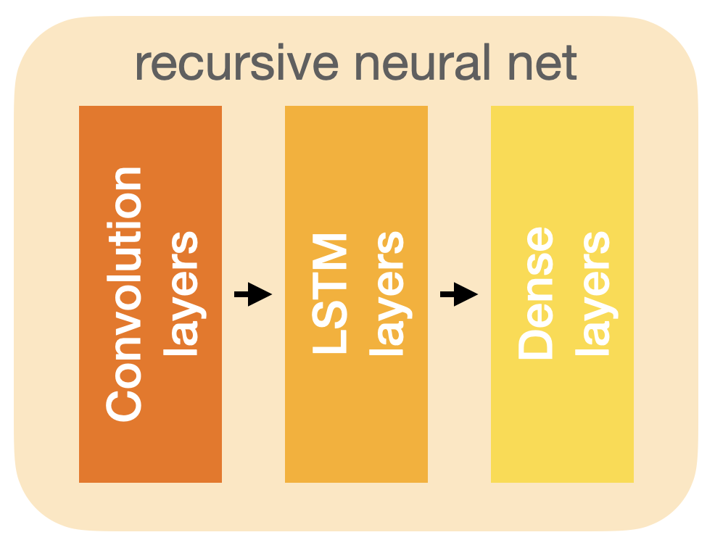
RNN Design
Convolutional neural network
Feature extractor
Exploits correlations between input variables
LSTM network
Memory remembers information between subsequent inputs
Exploits correlations between cluster/tracks/muon segments
Dense network
Information concatenated with jet inputs
Outputs predictions on classification
Notes:
Motivate the RNN, and the inputs, and mention why each segment/input is needed

Slide 16
OPS!
Our (internal) closure plots were not working!
Eventually we traced it to a MC/Data difference.
MC
Data
MC
Notes:
Show the discrepancy that we saw – can’t really show the actual problem that triggered it, I think. Or maybe we can motivate it?

Slide 17
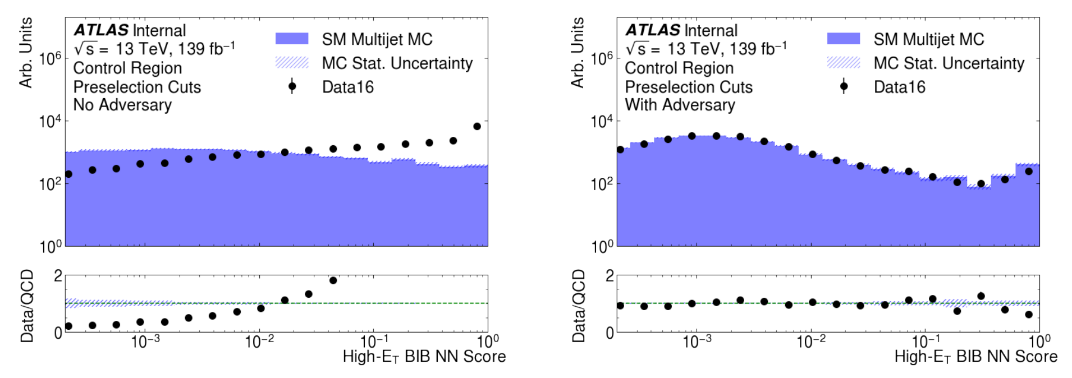
OPS!
Canonical HEP Data/MC Comparison
NN Output
Notes:
Show the discrepancy that we saw – can’t really show the actual problem that triggered it, I think. Or maybe we can motivate it?

Slide 18
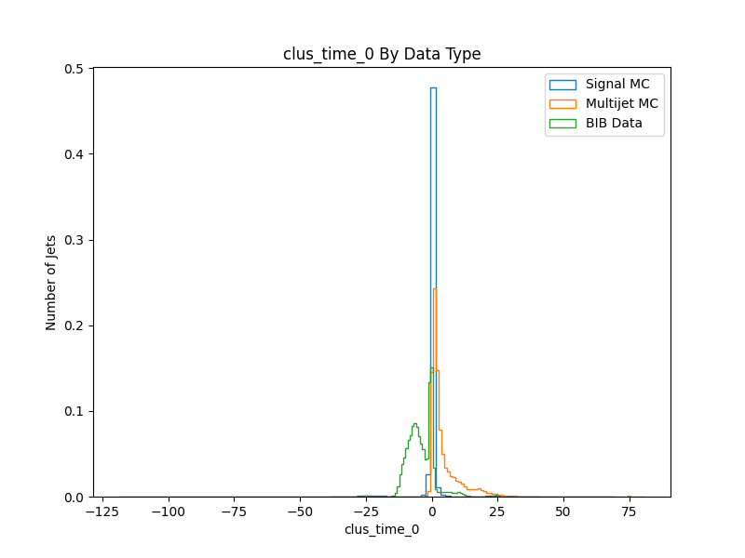
Ops!
The problem was in the simulation of the cluster timing for the calorimeter.
Remove this entirely from the training inputs
Correct it block-wise
Find a cleverer approach
Problem: Timing is a vital way to discriminate BIB from signal and background.
Problem: Even trained only on MC (if we could), it would make a mistake on the actual data!*
* Since the background calculate is data-driven, the error would have only been on the sensitivity calculation

Slide 19
A Way Forward
Prevent the RNN from learning Data/MC features
Build an adversary that tries to tell the difference between Data and MC solely from the 3 outputs of the RNN.
But we need to do this on a sample that should be otherwise identical!
Can’t use the signal and background!
Need a new Control Sample!

Slide 20
A Way Forward
Prevent the RNN from learning Data/MC features
But we need to do this on a sample that should be otherwise identical!
Can’t use the signal and background!
Need a new Control Sample!
Control sample should have no signal
Controls sample should have the same NN score!
Control sample must be well modeled otherwise in both MC and Data

Slide 21
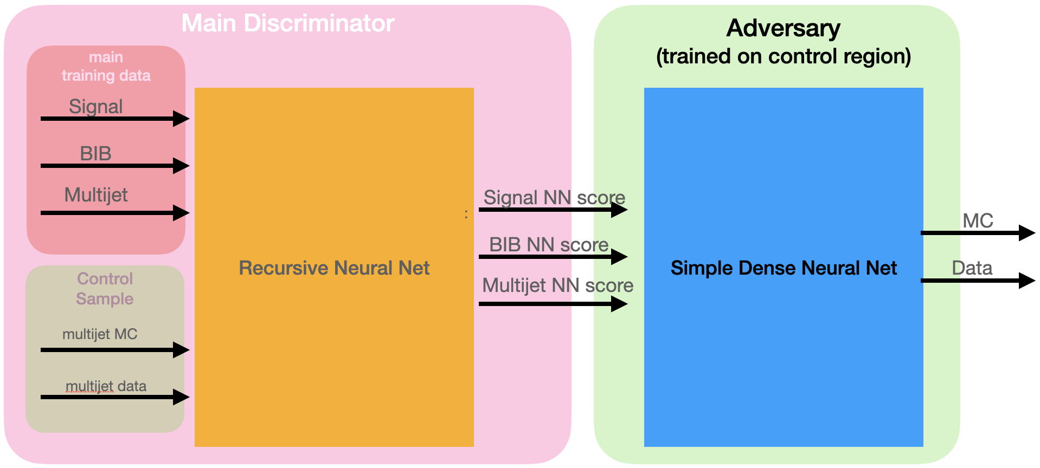
The Adversary
Anything other than 50-50 is fed back into the loss function for the main network training.
Notes:
The philosophy behind this idea

Slide 23
How Does The Training Work?
3 steps!

Slide 24
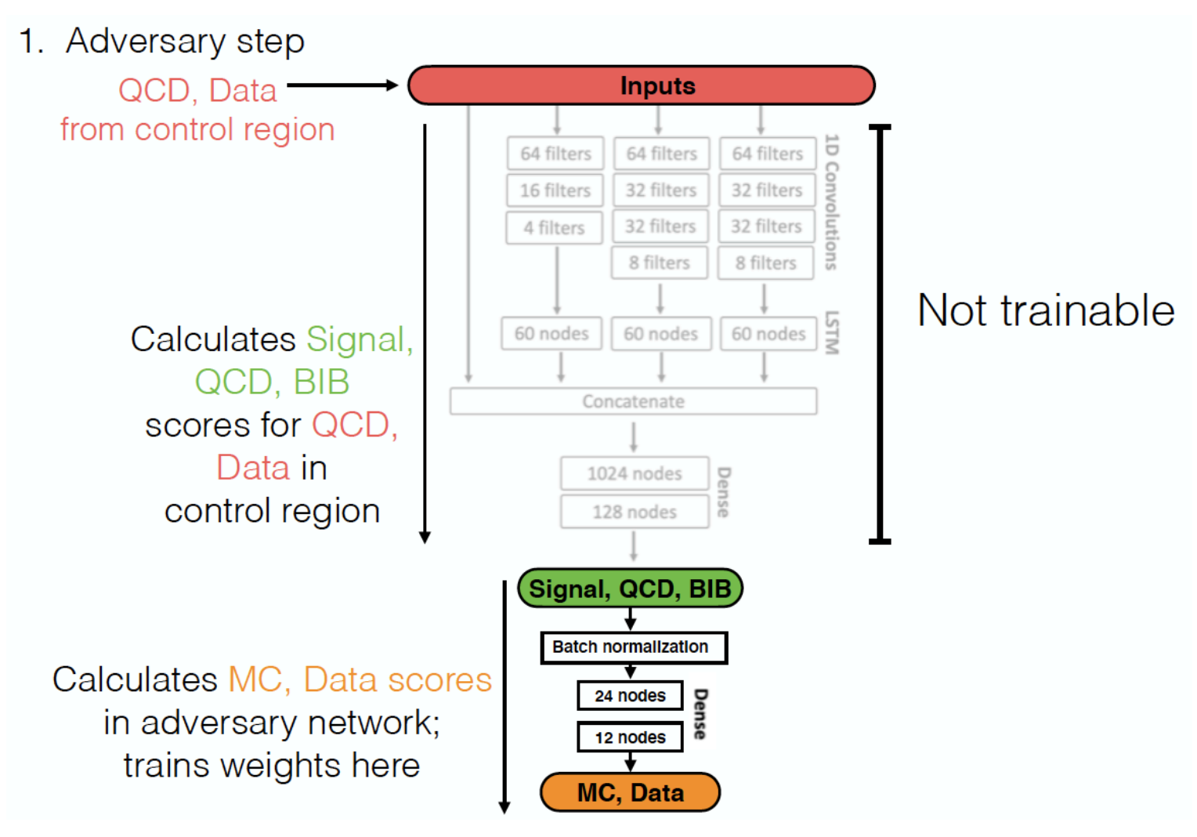

Slide 25
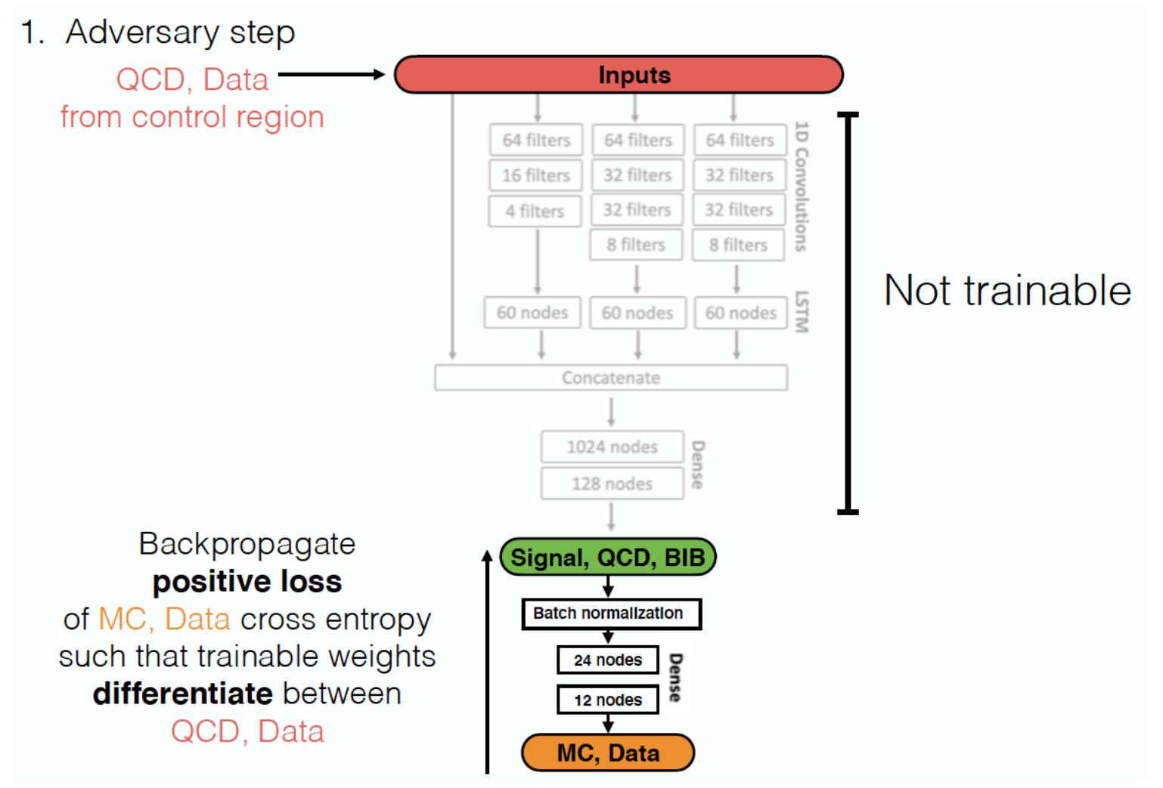

Slide 26
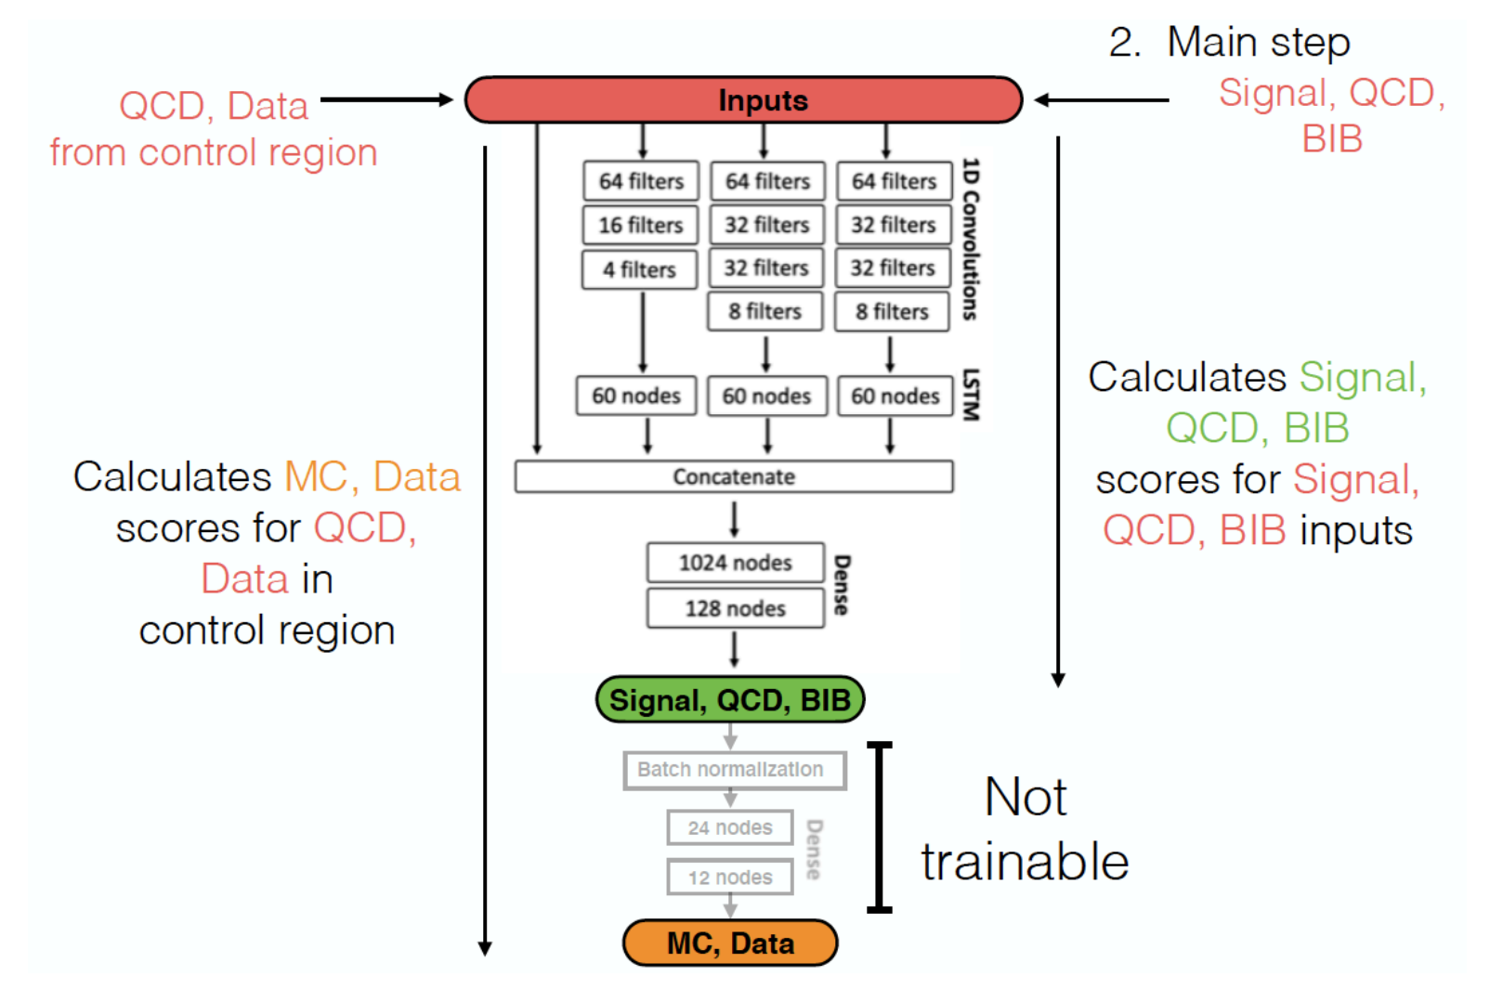

Slide 27
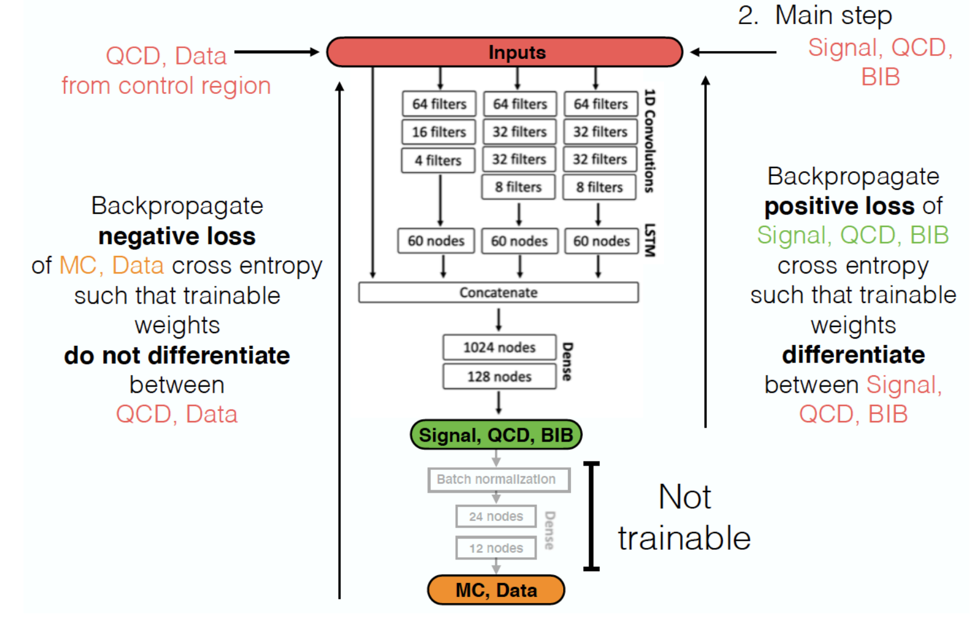

Slide 28
NN Output Is Much Better REpresented

Slide 29
Conclusions
There is evidence this reduced the systematics in other areas of modeling as well
Cluster distributions seem to be a little better
We started thinking about this like in-situ calibrations, or simultaneous fits in a profile-likelihood.
Overall, the analysis was some 35% more sensitive than the previous version
Previous version used a BDT for the per-jet NN
The timing was still an issue – but the BDT was not sensitive enough to really bring out the error!
The mechanics were complex
Training frameworks aren’t really built for this.
As a side plea
Moving this code from a graduate student’s experiment to production level took almost 6 months!

