Slide 1

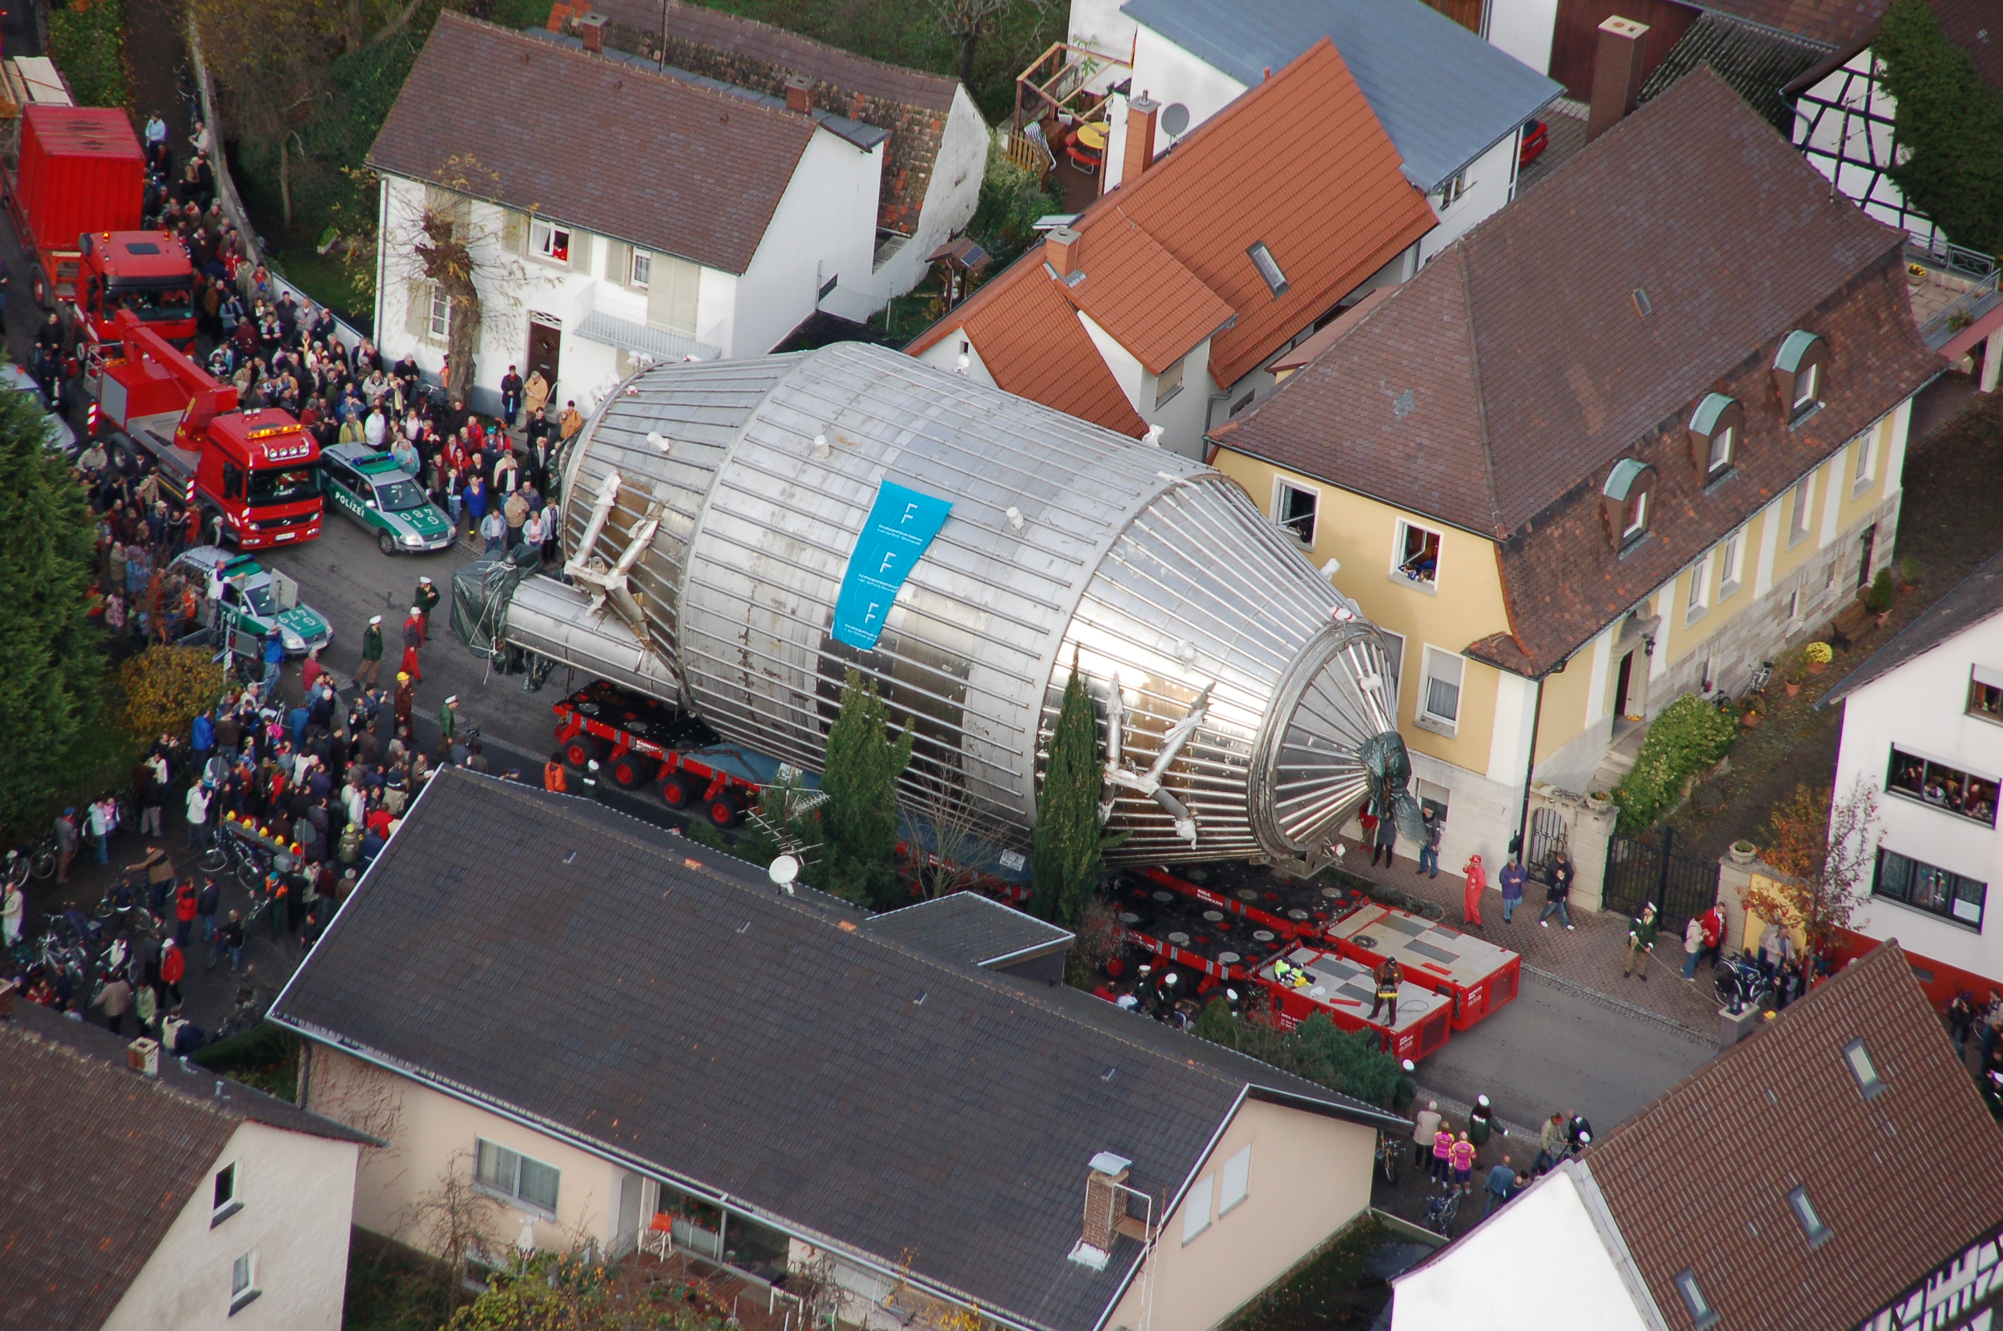
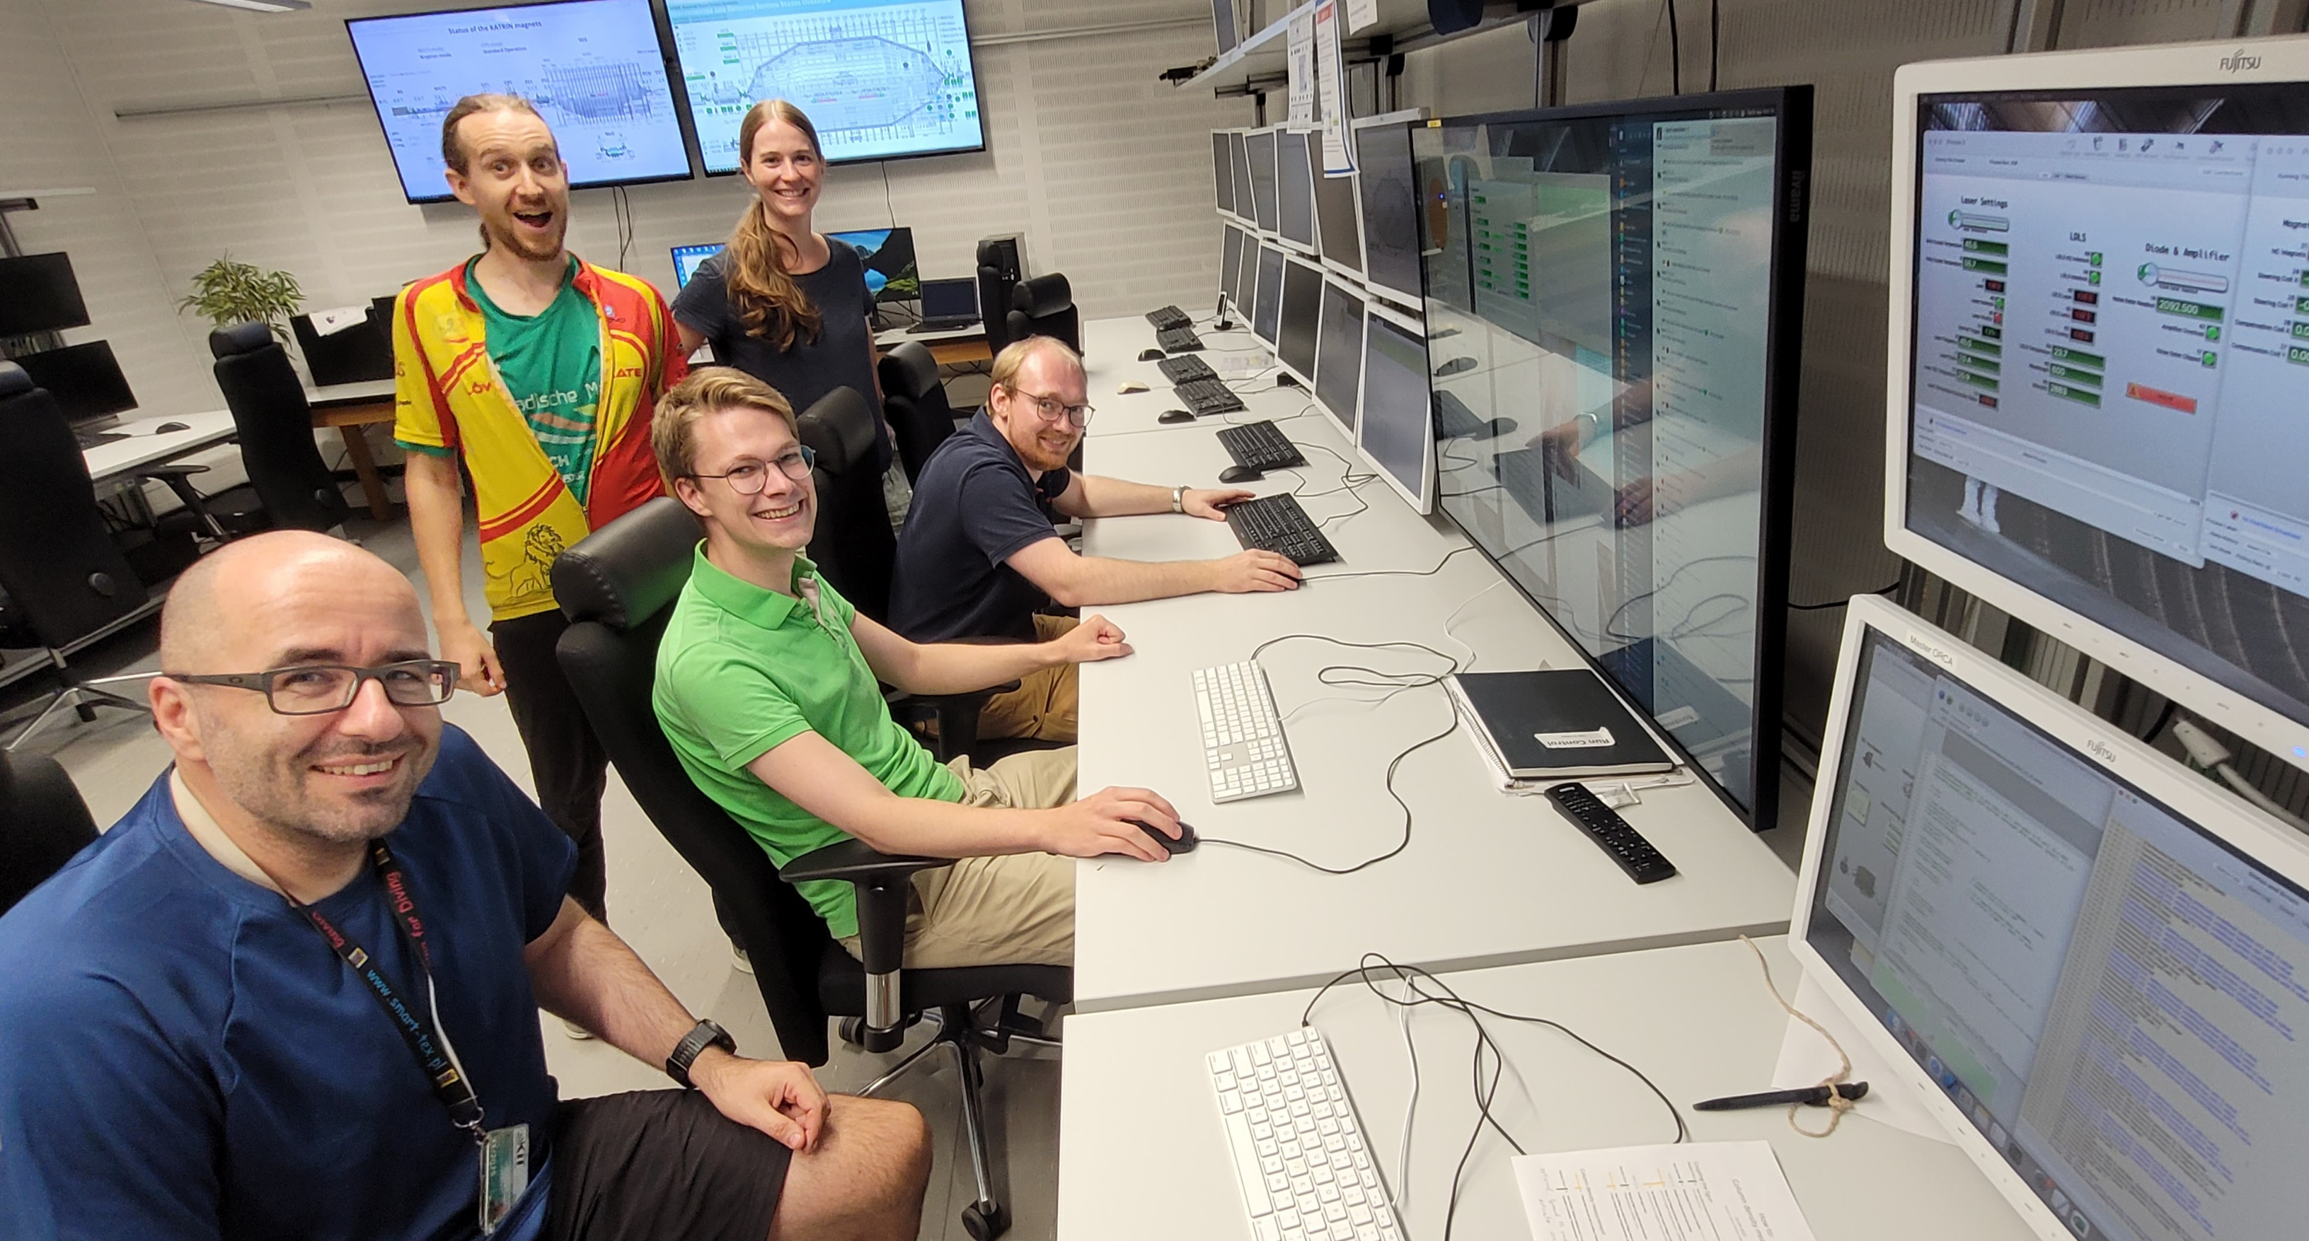
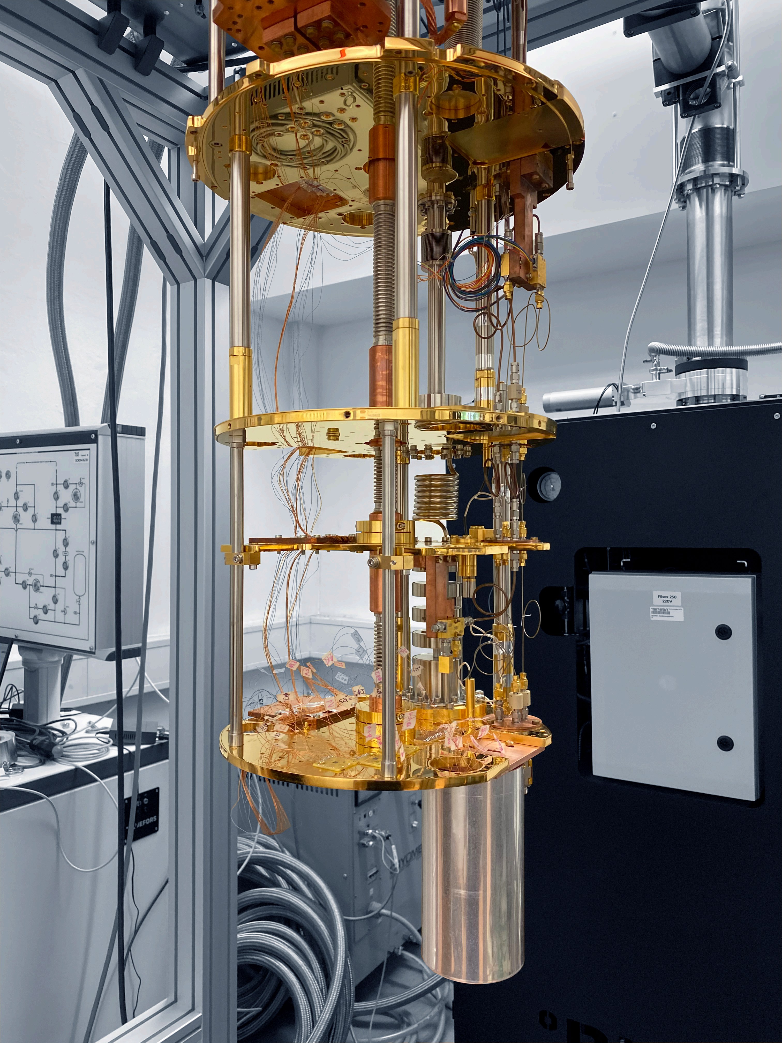
KATRIN: Current results from high-precision
beta-spectroscopy and plans for the future
Magnus Schlösser for the KATRIN Collaboration
IRN Neutrino meeting, November, 27th -28th 2023, KIT
2006
2023
2023
Future

Slide 2
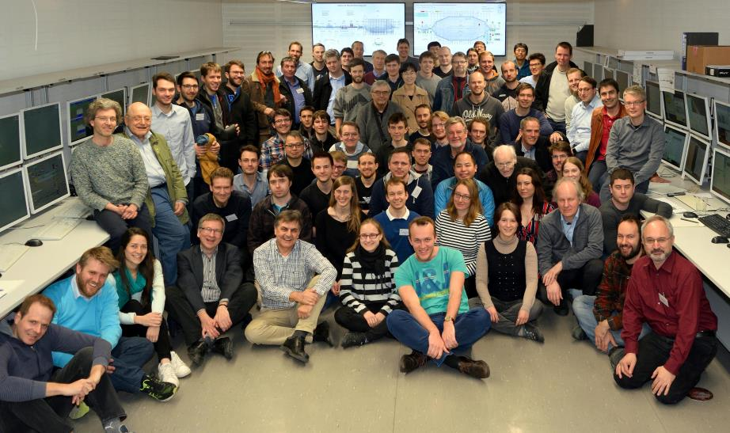



















Who is the KATRIN collaboration?
Thierry Lasserre,
CEA, Saclay
Funding and support from: Helmholtz Association (HGF), Ministry for Education and Research BMBF (05A17PM3, 05A17PX3, 05A17VK2, and 05A17WO3), Helmholtz Alliance for Astroparticle Physics (HAP), and Helmholtz Young Investigator Group (VH-NG-1055) in Germany; Ministry of Education, Youth and Sport (CANAM-LM2011019) in the Czech Republic; and the Department of Energy through grants DE-FG02-97ER41020, DE-FG02-94ER40818, DE-SC0004036, DE-FG02-97ER41033, DE-FG02-97ER41041, DE-AC02-05CH11231, and DE-SC0011091 in the US.

Slide 3
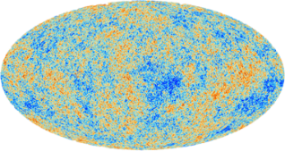

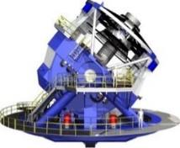
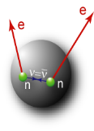
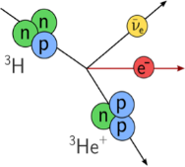
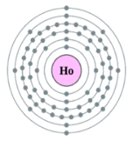




Ways to access the neutrino mass
 | Cosmology | Search for 0νββ | β-decay & electron capture
Observable
Present upper limit | 0.12 eV* | 0.18 eV* | 0.8 eV
Model dependence | Multi-parameter cosmological model | Majorana ν contributions other than m(ν)? nuclear matrix elements, g_{A} | Direct, only kinematics; no cancellations in incoherent sum
KATRIN → 0.2 eV

Slide 4
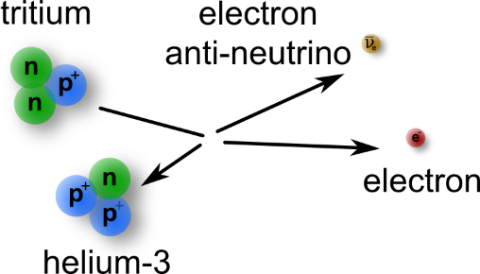
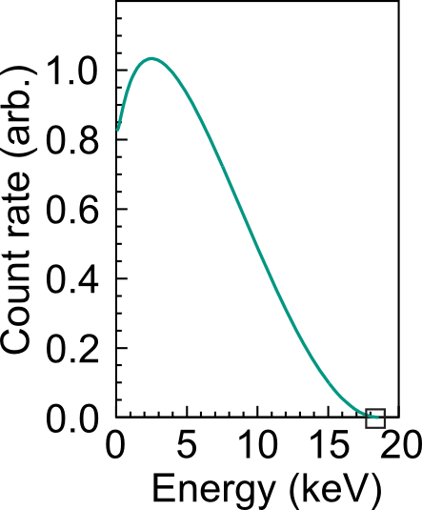
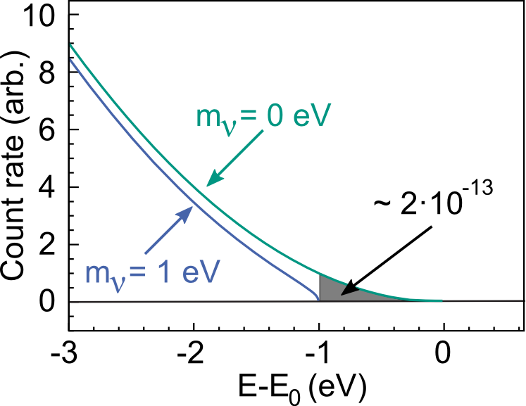
Tritium beta decay experiments
Direct, model-independent access to neutrino mass
E₀ = 18.6 keV
T_{1/2} = 12.3 y
KATRIN’s aim: Measurement of m_{ν} with a sensitivity of 0.2 eV/c²

Slide 5
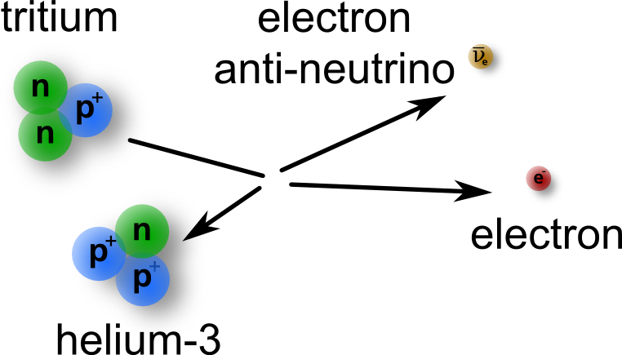
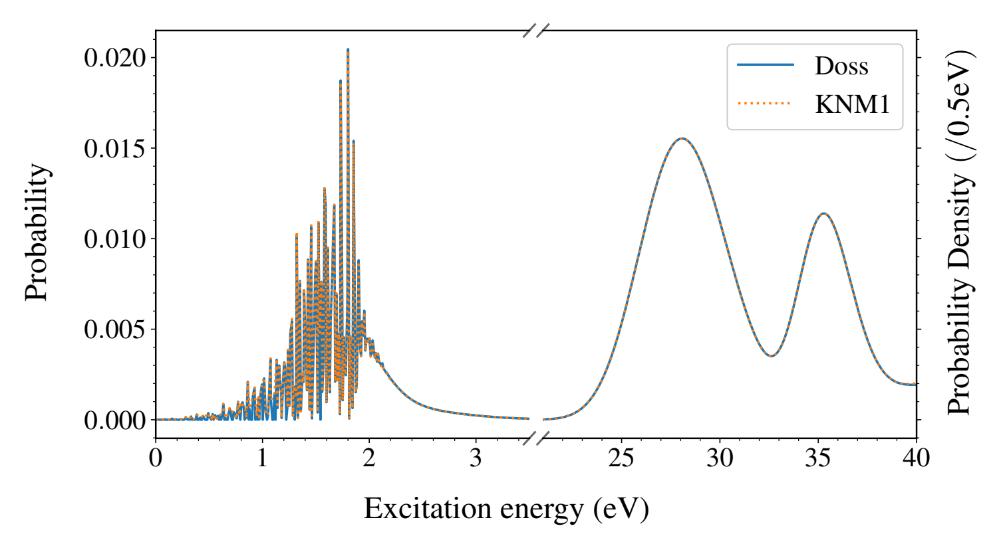
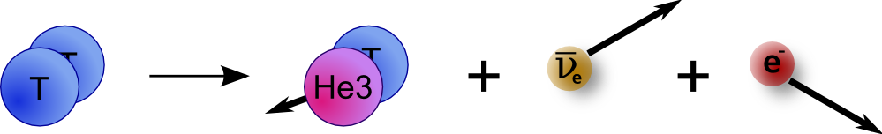
Molecular decay
Atomic decay
Final-state distribution
Decay from a molecule
Molecular effects need to be
taken into account in
neutrino mass analysis
+ further inner excitations (rotation / vibration)
„model-dependence“

Slide 6
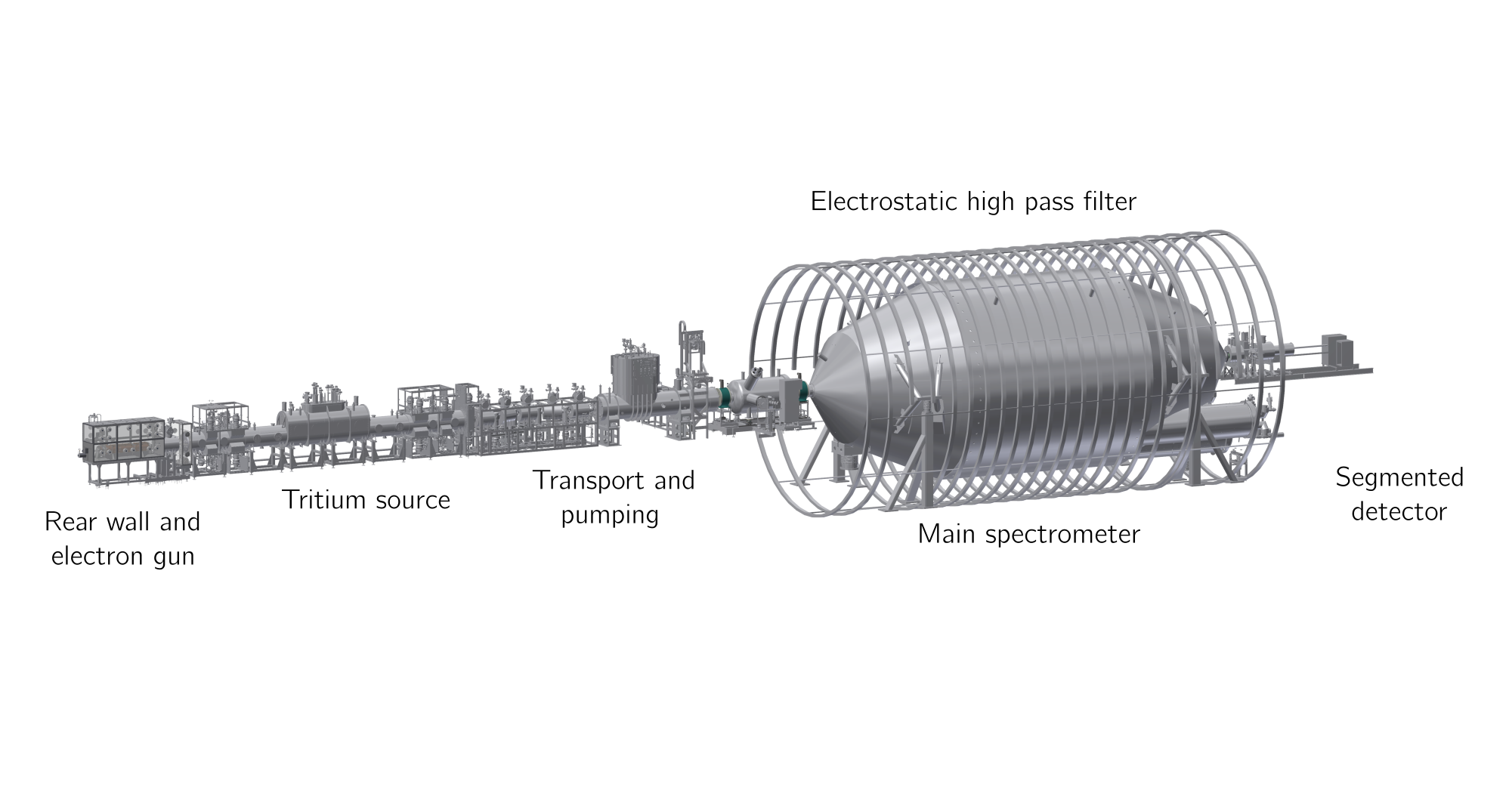
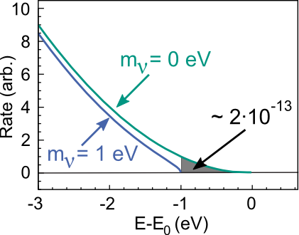
Karlsruhe Tritium Neutrino Experiment (KATRIN)
ultra-stable high-luminosity
windowless gaseous tritium
source (10¹¹ Bq)
high-resolution MAC-E filter
with < 1 eV energy resolution

Slide 7
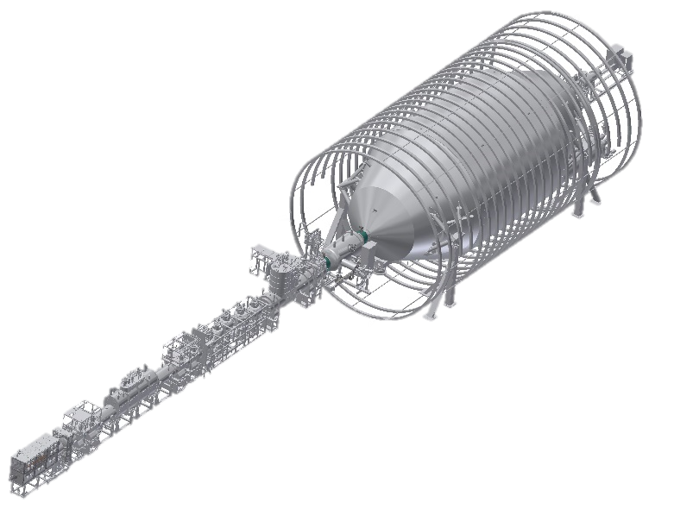
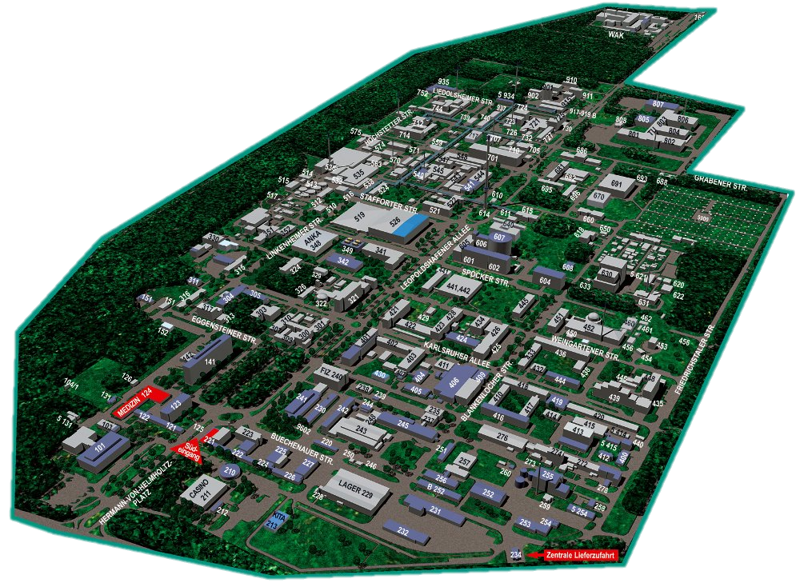
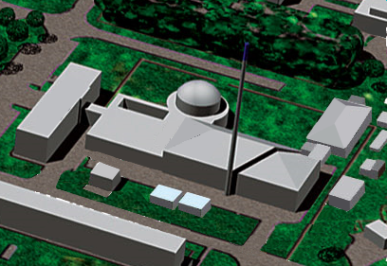
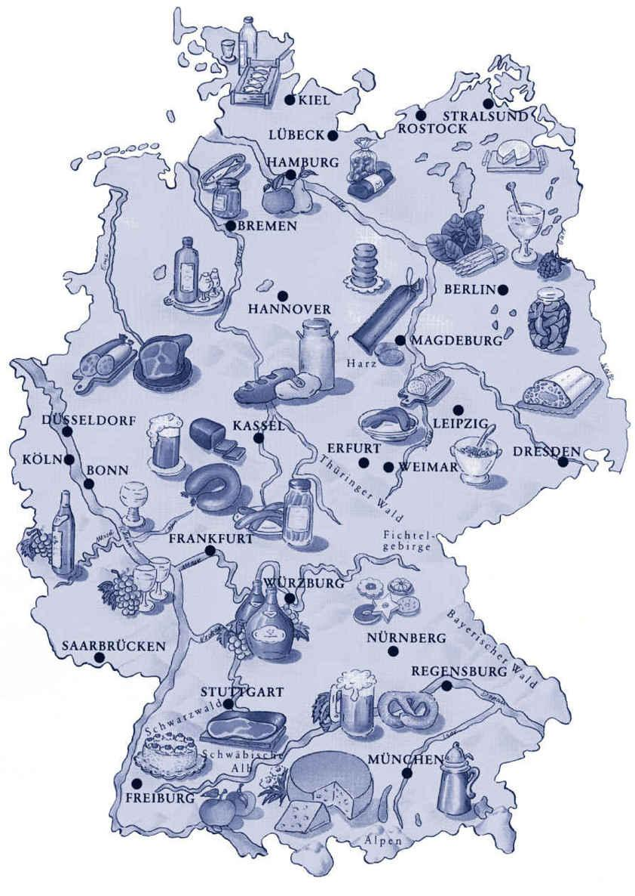
The Tritium Laboratory Karlsruhe
Tritium Laboratory Karlsruhe (TLK)
Commissioning 1993
Licensed for 40 g Tritium
Two missions:
  Fuel cycle for fusion reactors
  KATRIN Experiment
Karlsruhe Institute of Technology
Campus North

Slide 8
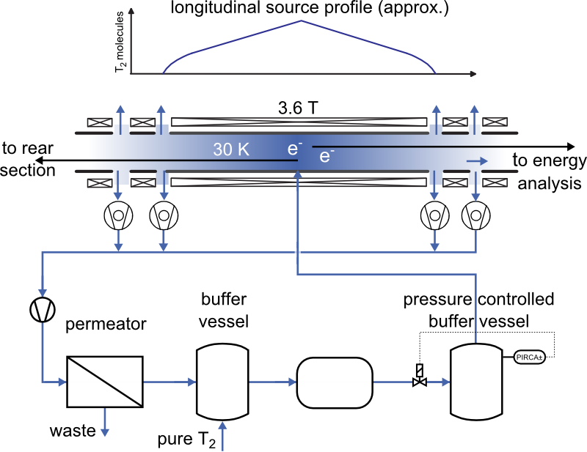
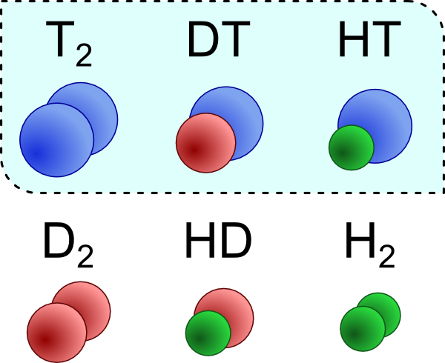
The stable tritium source
T₂ purity > 95%
Source activity 10¹¹ Bq
Source profile stable to 10⁻³ level
T
Hydrogen
isotopologues
p
p
T₂ throughput ~ 40 g/day
Operation 24/7, 60 days/run
Necessary inventory >15 g
isotopic composition
measurement

Slide 9
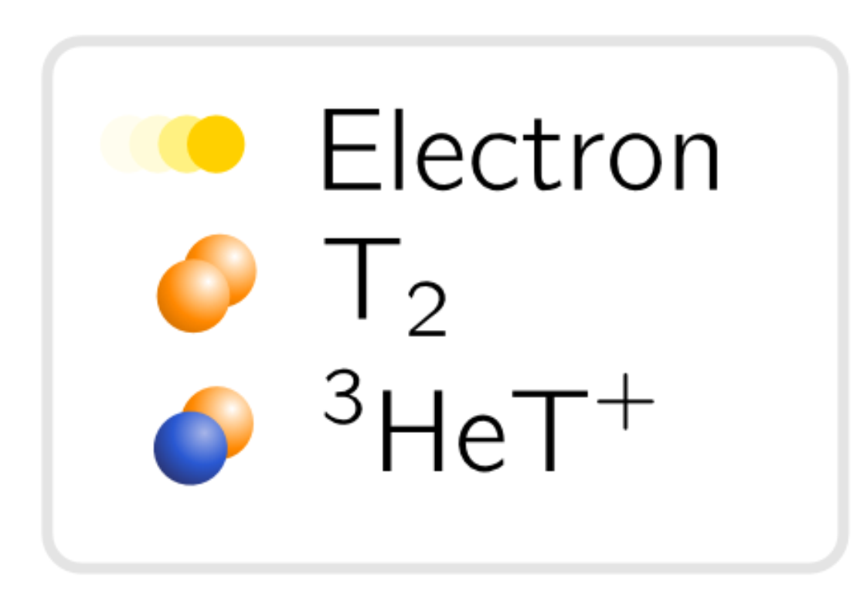
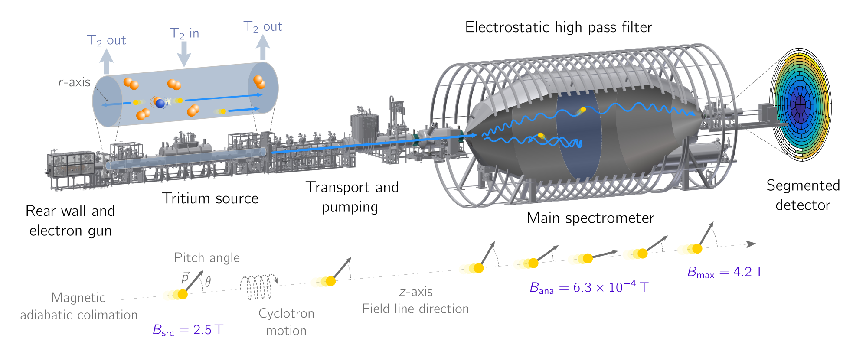
Working principle of KATRIN
Artwork L. Köllenberger

Slide 10
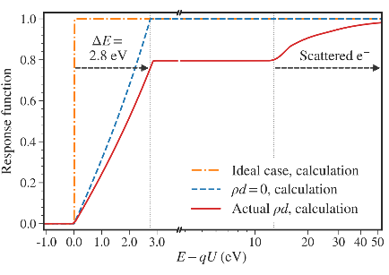
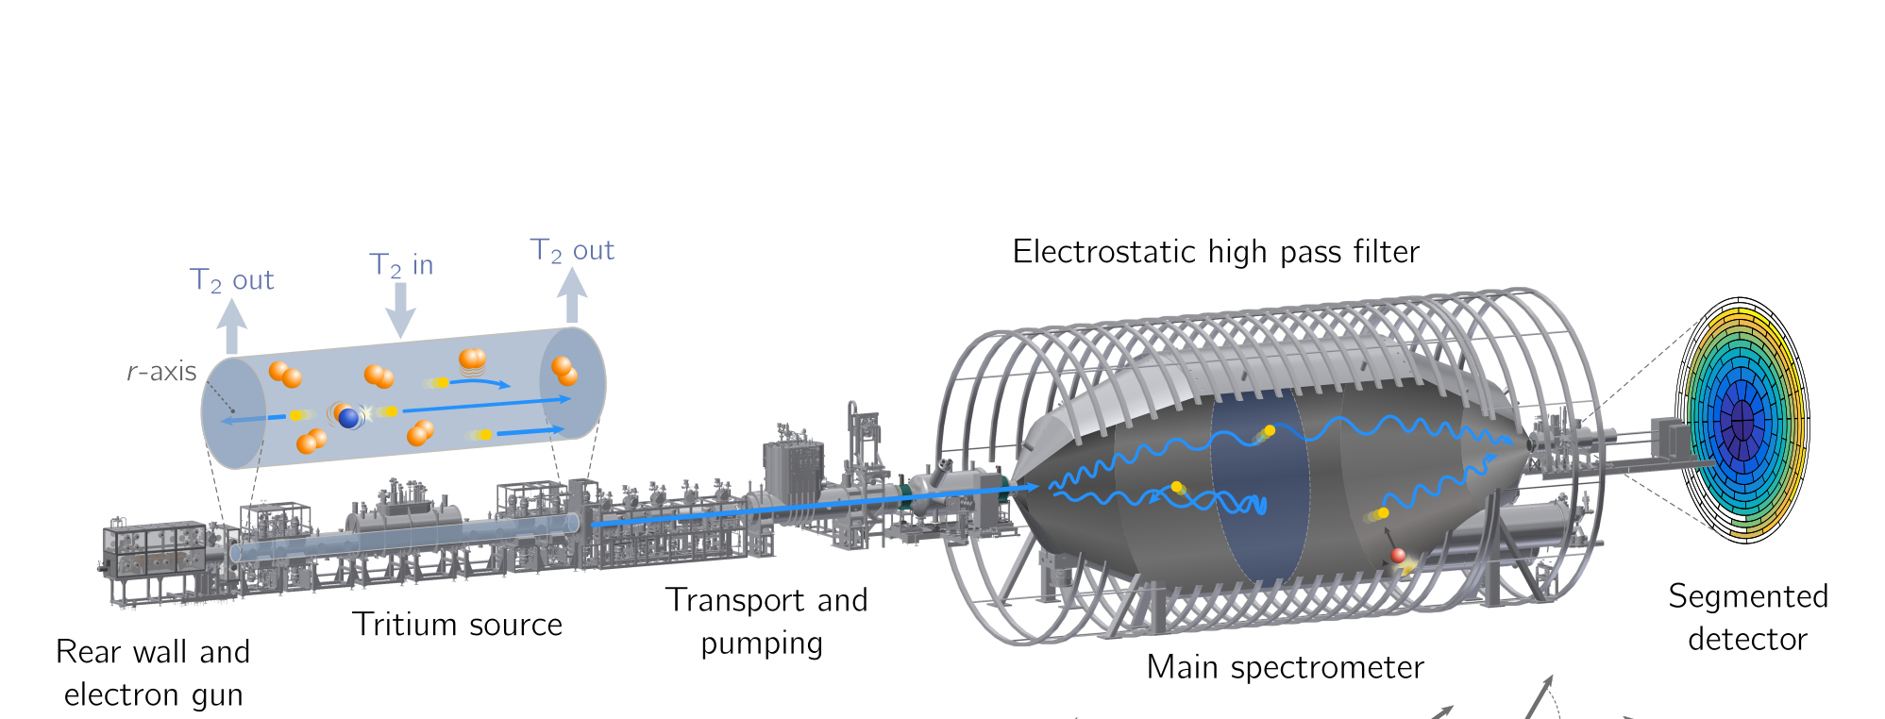
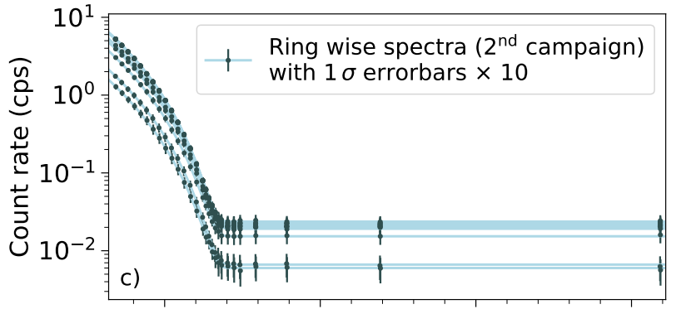
Systematic effects
Signal-related effects
- magnetic fields, inelastic scattering,
stability, molecular effects, source plasma,..
Background-related effects
- influence by background rate and shape
Artwork L. Köllenberger

Slide 11
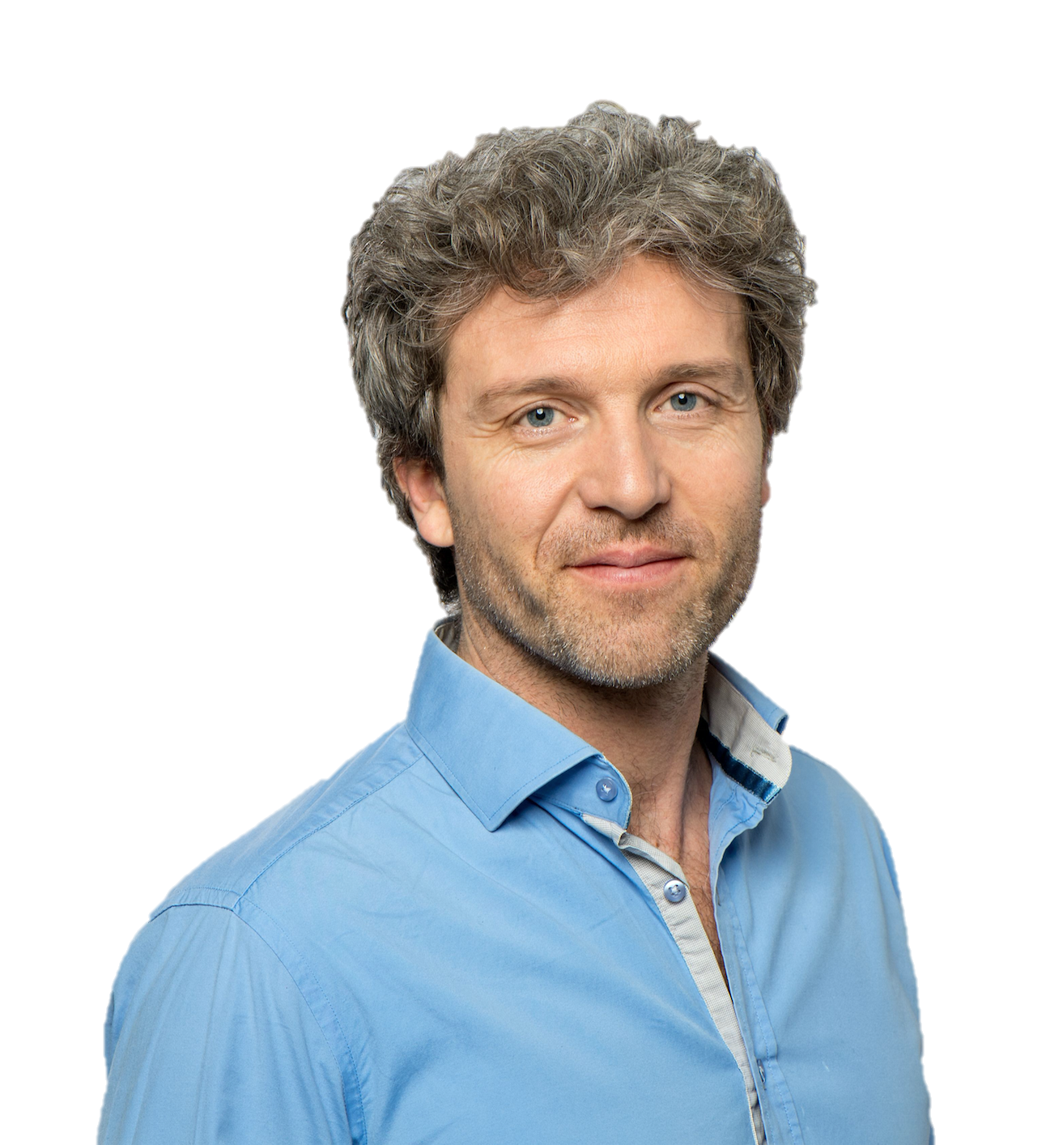

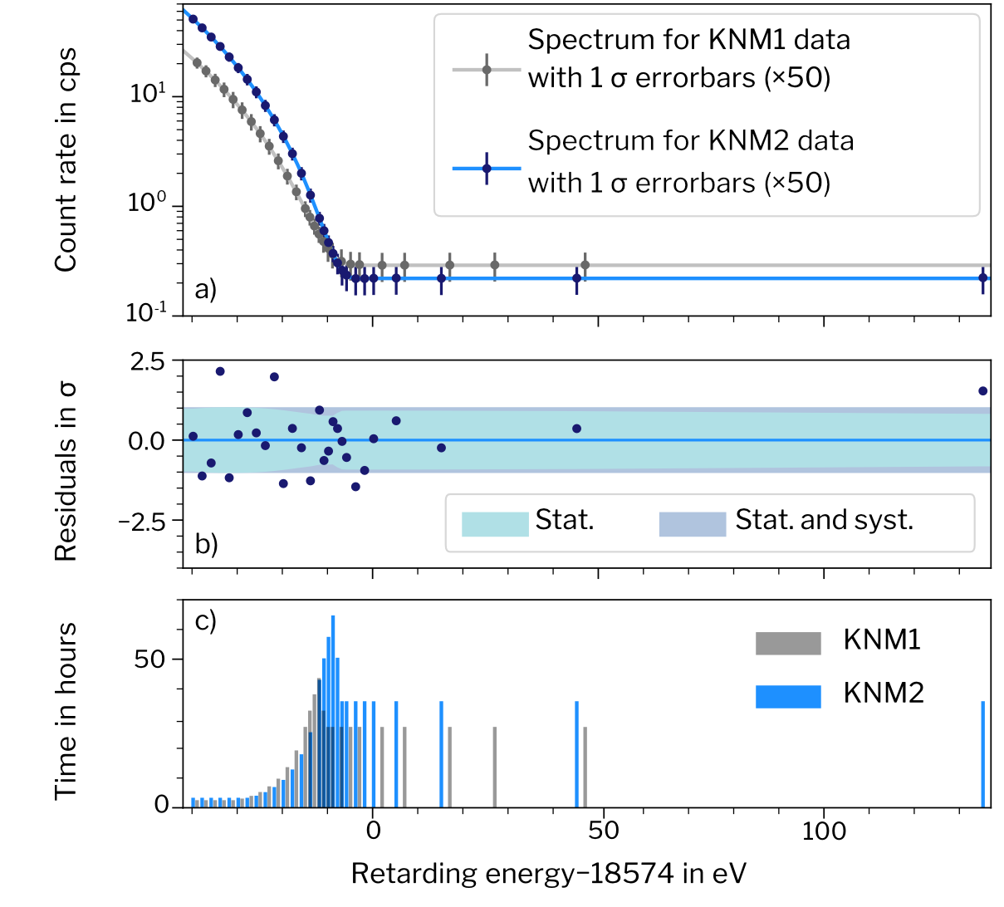
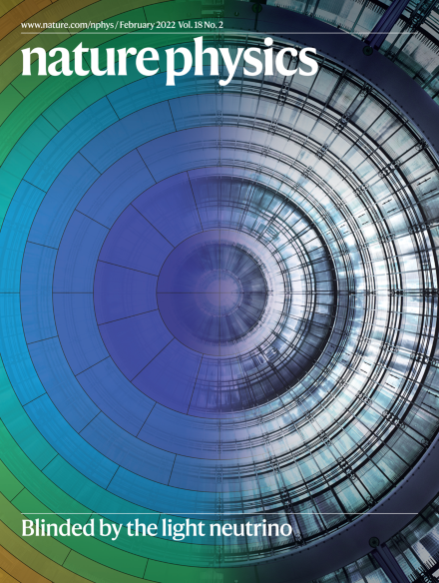

Recent results from KATRIN
Première analyse coordonnée par CEA
Phys. Rev. Lett. 123, 221802 (2019)
Phys. Rev. D. 104 (1), 012005 (2021)
$$E_{0}$$
First campaign
(“KNM1”, spring 2019)
  total stat.: 2 million events
  best fit: $$m^{2}\left(ν_{e}\right)={−1.0}_{−1.1}^{+0.9}{eV}^{2}$$
  limit: $$m(ν_{e})<1.1$$ eV (90% C.L.)
Second campaign
(“KNM2”, autumn 2019)
  total stat.: 4.3 million events
  best fit: $$m^{2}\left(ν_{e}\right)={0.26}_{−0.34}^{+0.34}{eV}^{2}$$
  limit: $$m(ν_{e})<0.9$$ eV (90% C.L.)
Combined result:
$$m(ν_{e})<0.$$8 eV (90% C.L.)
$$A_{s}$$
$$R_{bg}$$
$$m^{2}\left(ν_{e}\right)$$
Nat. Phys. 18, 160–166 (2022)
KNM: KATRIN Neutrino Mass measurement
Nat. Phys. 18, 160–166 (2022)

Slide 12
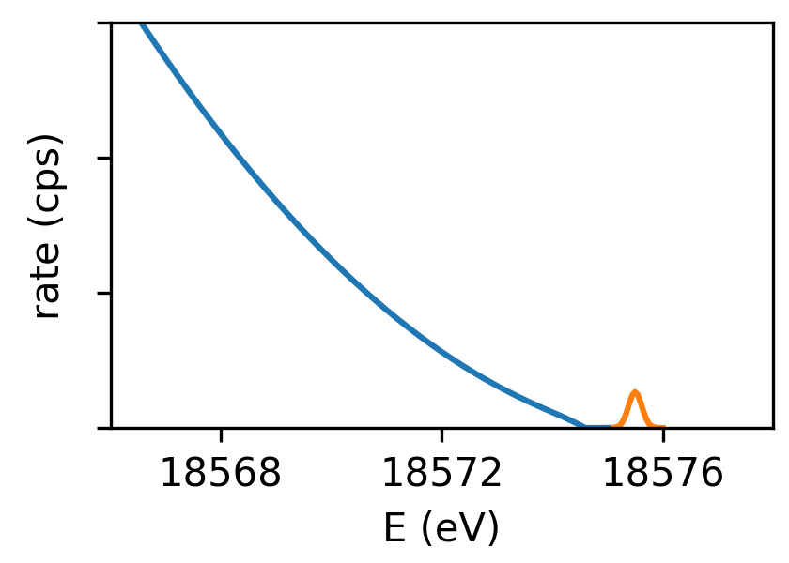
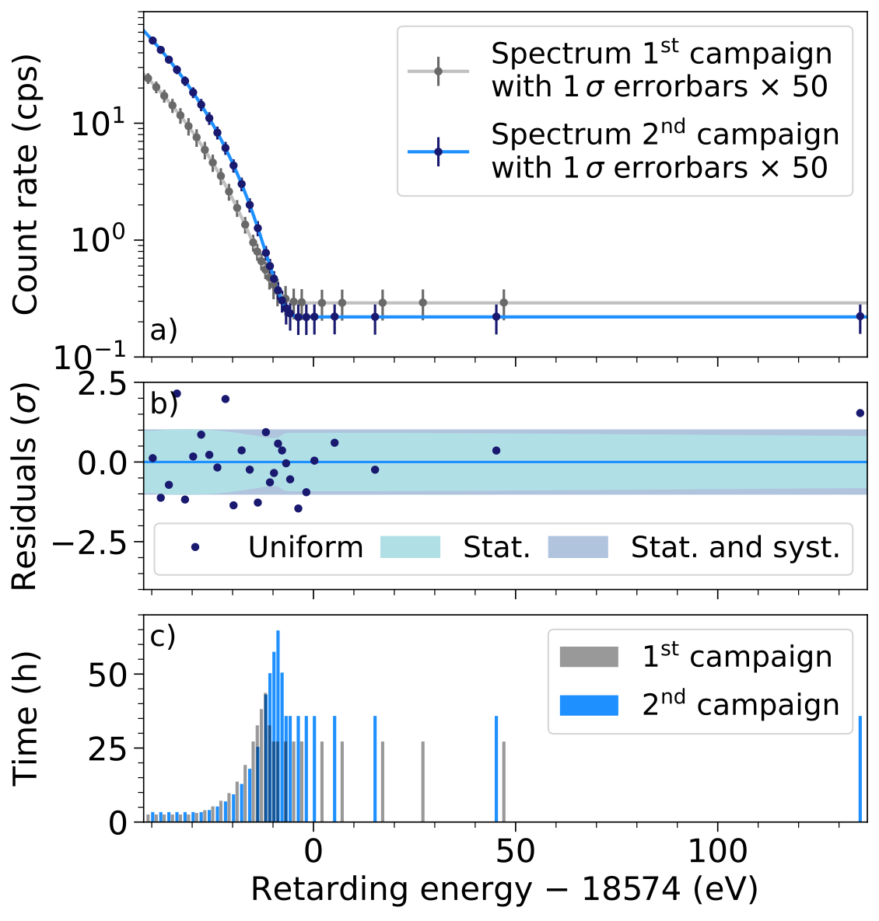
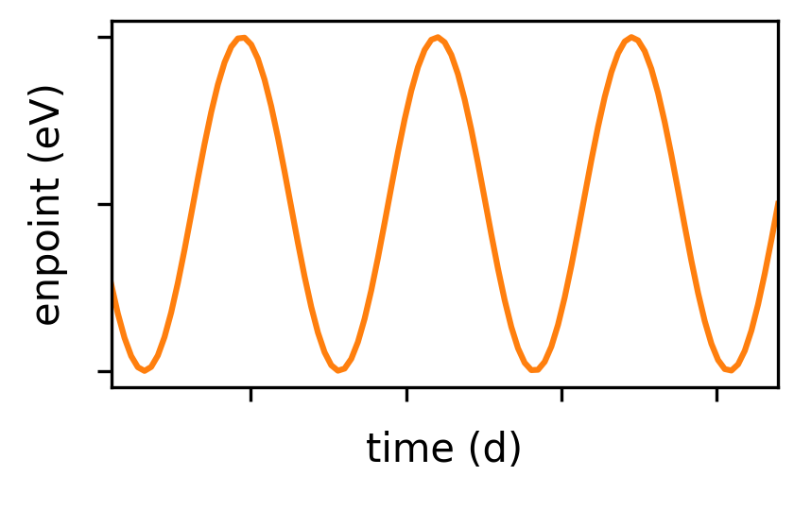
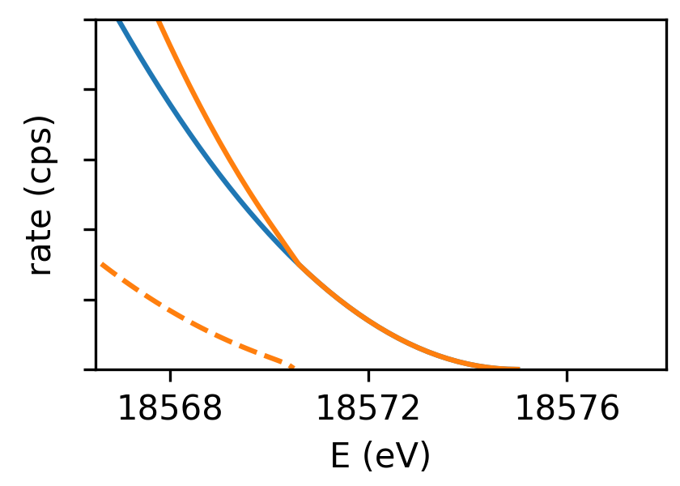
Science beyond neutrino mass from
1st and 2nd campaign
Search for relic big-bang neutrinos
Phys. Rev. Lett. 129, 011806 (2022)
Search for violation of Lorentz
invariance
Phys. Rev. D 107, 082005 (2023)
Search for light sterile neutrinos
Phys. Rev. Lett. 126, 091803 (2021)
Phys. Rev. D 105, 072004 (2022)
La * nouvelle physique, c'est moi!
* coordination de la
Notes:
Of course with such high-precision spectral data, one can also look for physics beyond the neutrino mass…

Slide 13
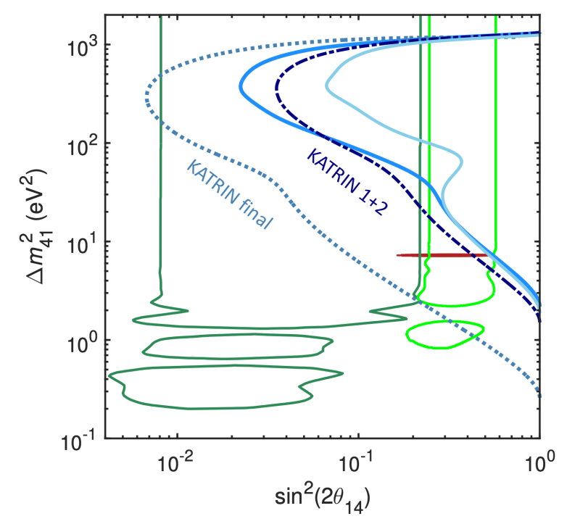
Direct search for eV-scale sterile neutrinos
Start probing interesting parameters space
KATRIN Collab., PRL 126, 091803 (2021)
KATRIN Collab., PRD 105, 072004 (2022)
Claimed observation by Neutrino-4 experiment
Phys. Rev. D 104, 032003

Slide 14
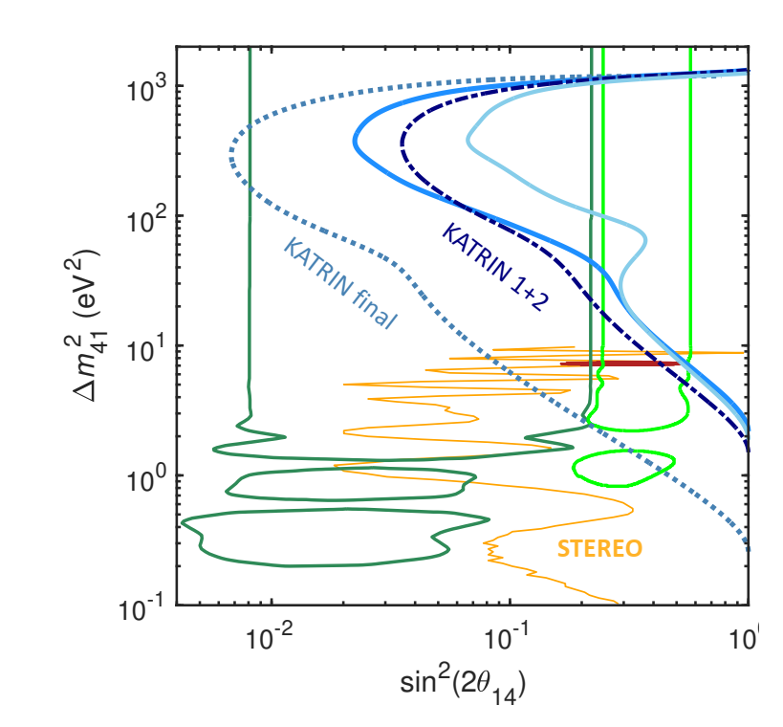
Complementary to other approaches
Start probing interesting parameters space
tackling short baseline oscillation anomalies
from a different perspective
complementary probe to oscillation-based
experiments
DANSS, arXiv:1911.10140 (2019)
STEREO, Phys. Rev. D 102, 052002 (2020)
PROSPECT, Phys. Rev. D 103, 032001 (2021)
Gallex, Phys. Lett. B 342, 440 (1995); 420, 114 (1998)
Sage, Phys. Rev. Lett. 77, 4708 (1996); Phys. Rev. C 59, 2246 (1999)
BEST, Phys. Rev. Lett. 128, 232501 (2022)
KATRIN Collab., PRL 126, 091803 (2021)
KATRIN Collab., PRD 105, 072004 (2022)

Slide 15
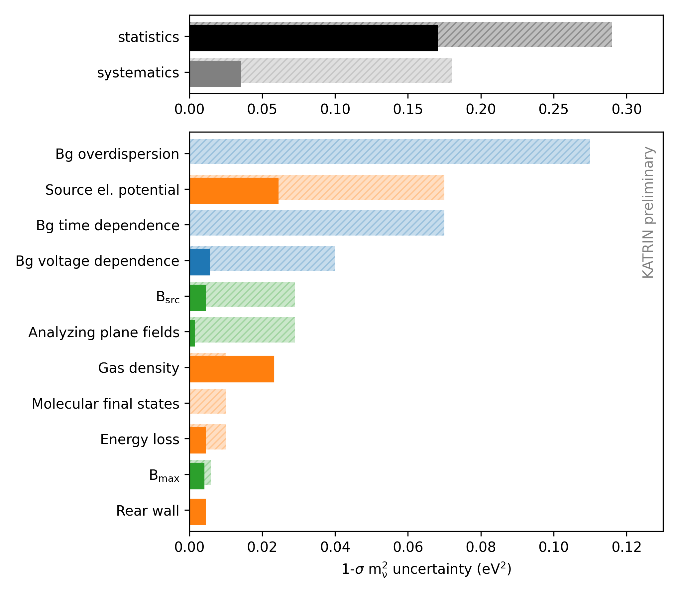
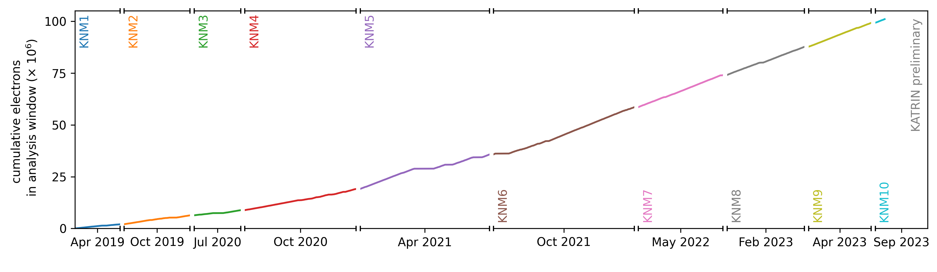
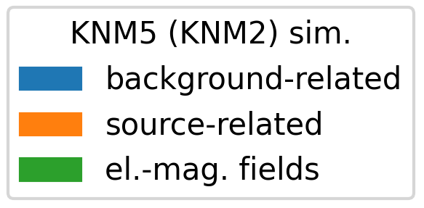
Improvements: 2nd vs 5th campaign
KNM2
KNM5
2019
2021
>10⁸ signal electrons in 2023
Notes:
So, you may wonder what happened since this second campaign. To illustrate this, I‘m showing here a comparison of the 2nd and 5th campaing, that took place 2 years later.
The big achievement was a significant reduction of the systematic uncertainties, which were dominated by background-related and source-related effects.
How did we achieve this improvement

Slide 16
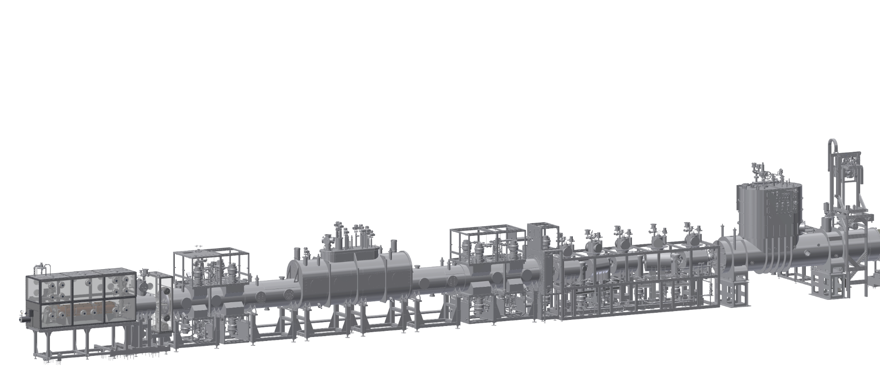
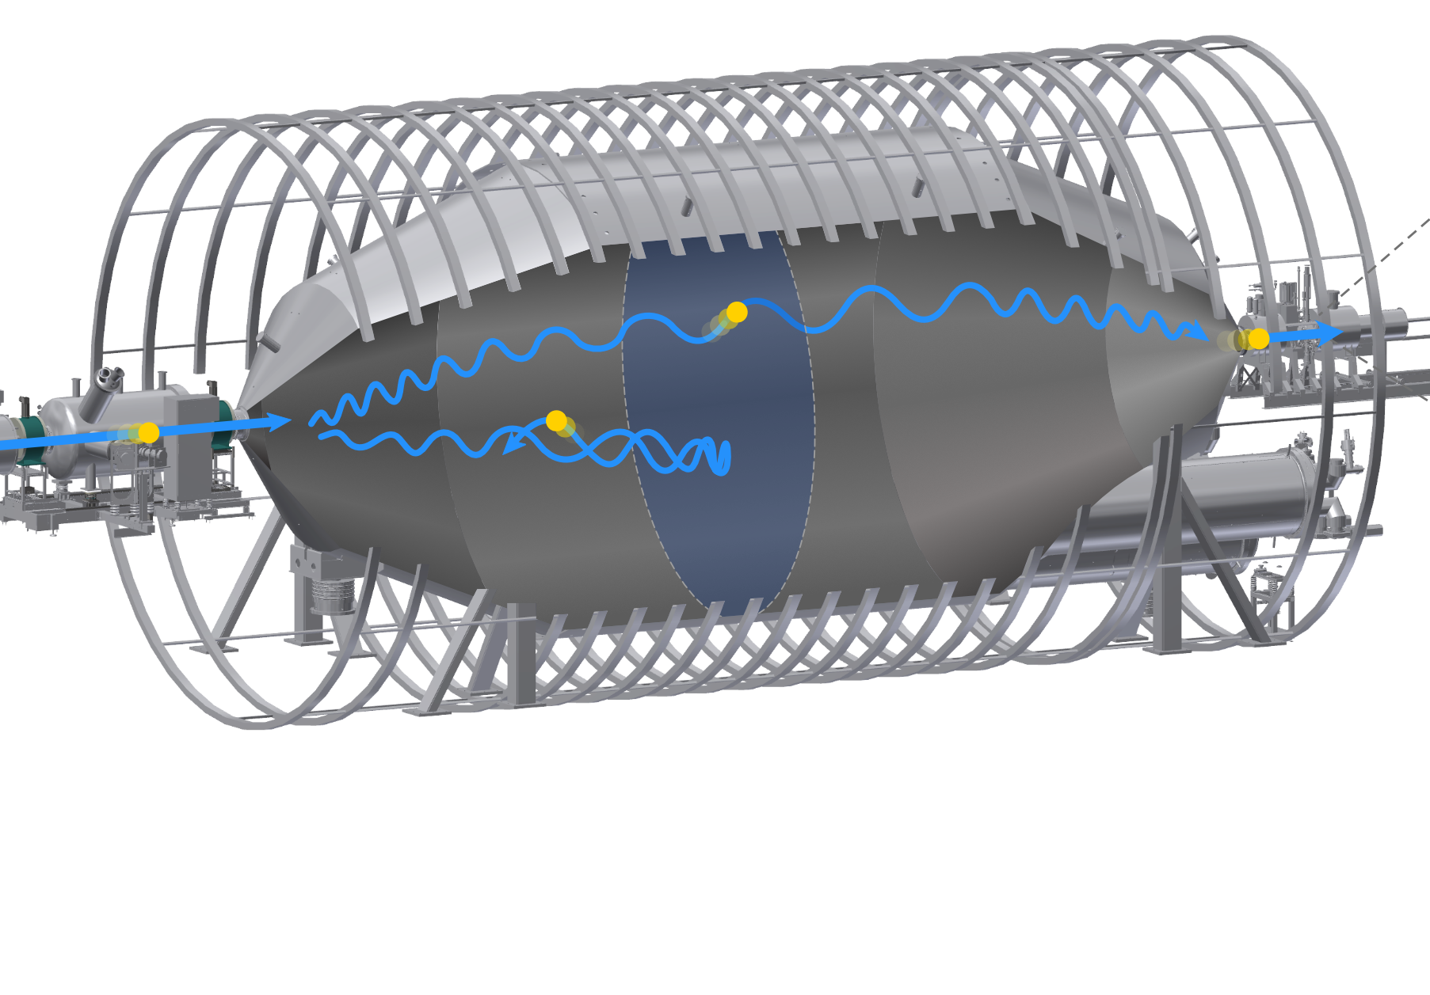
Improvements: 2nd vs 5th campaign
Shifted analyzing plane
A.Lokhov et al. Eur. Phys. J. C 82:258 (2022)
Removal of the penning trap
M. Aker et al. Eur. Phys. J. C 80: 821 (2020)
High-statistics krypton-83m calibration
A. Marsteller et al. JINST 17 P12010 (2022)
Improved evaluation of theoretical uncertainties
S. Schneidewind et al., arxiv:2310.12634 (2023)
Notes:
First, we….

Slide 17
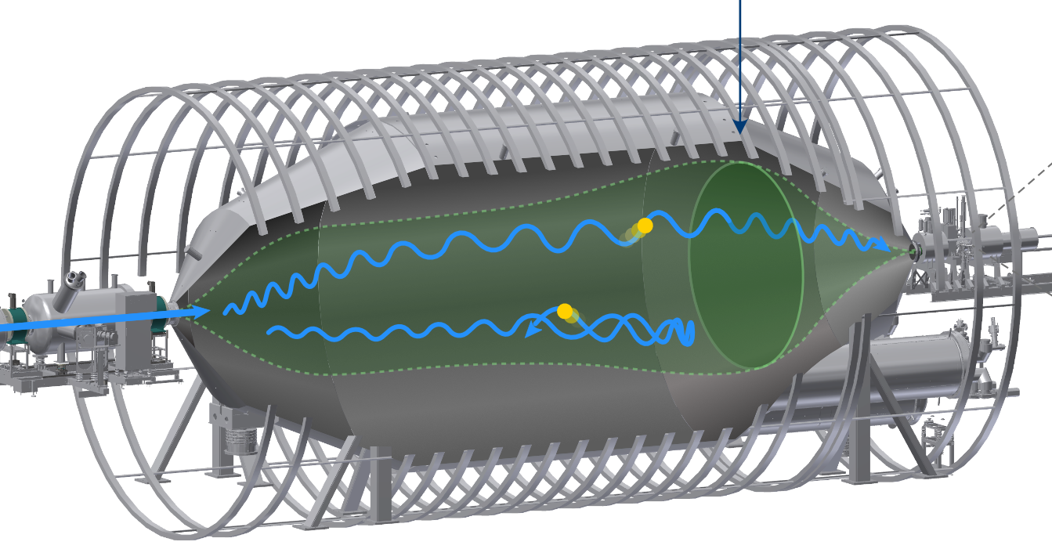
Improvements: 2nd vs 5th campaign
Shifted analyzing plane
A.Lokhov et al. Eur. Phys. J. C 82:258 (2022)
Removal of the penning trap
M. Aker et al. Eur. Phys. J. C 80: 821 (2020)
High-statistics krypton-83m calibration
A. Marsteller et al. JINST 17 P12010 (2022)
Improved evaluation of theoretical uncertainties
S. Schneidewind et al., arxiv:2310.12634 (2023)

Slide 18
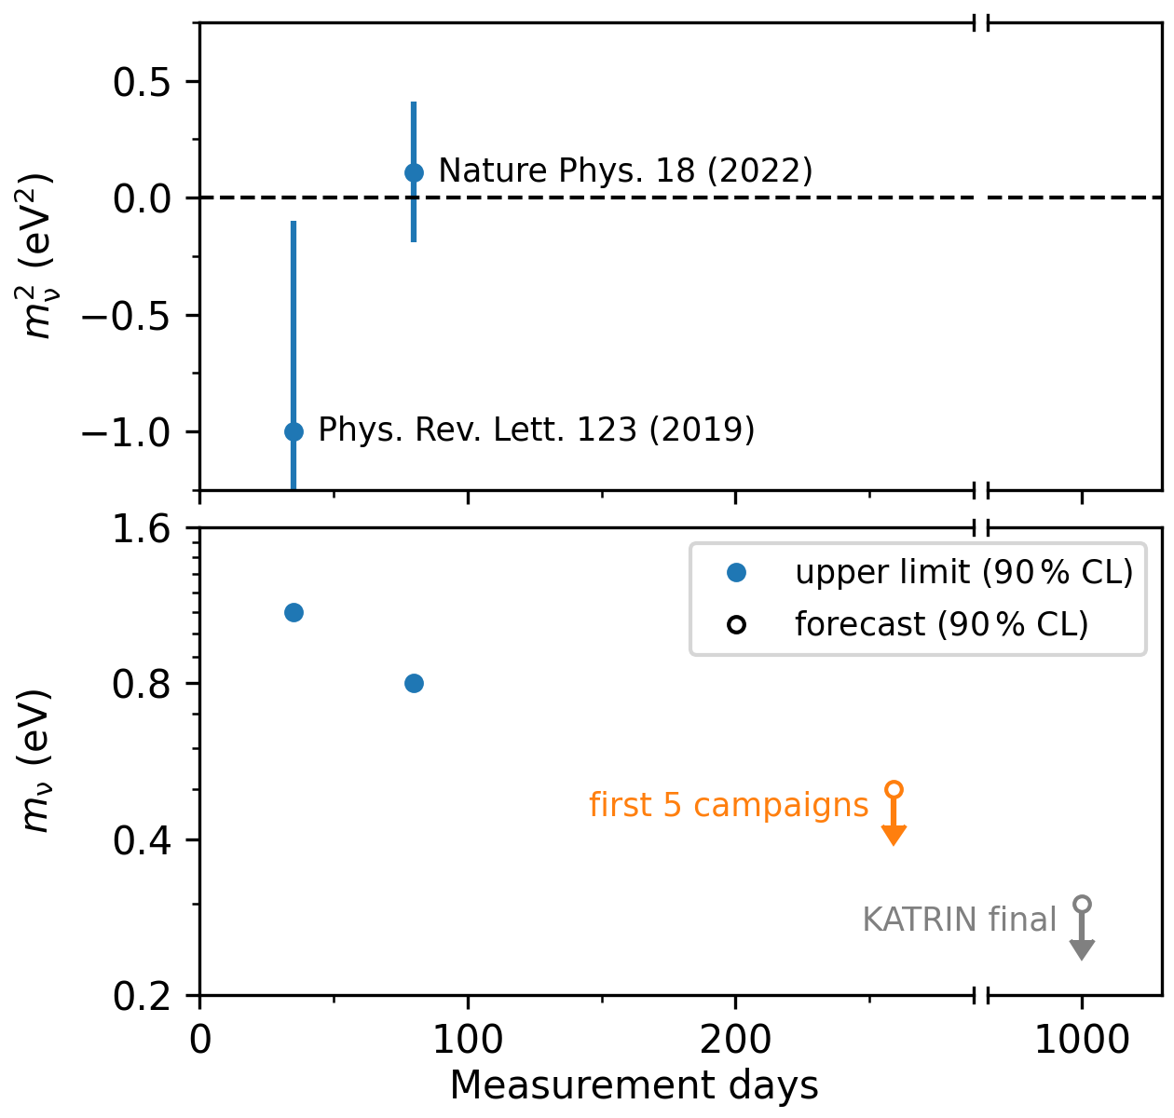
Upcoming results
Upcoming result (this year):
  Based on first five campaigns
  Statistics $$÷$$ 6, Systematics $$÷$$ 3
  Sensitivity better than m_{ν} < 0.5 eV
  Paper (almost) ready for submission
Final result:
  Based on 1000 days of data taking
  (completed end of 2025)
  Sensitivity better than m_{ν} < 0.3 eV
Upcoming result:
  Based on first five campaigns
  Statistics $$÷$$ 6, Systematics $$÷$$ 3
  Sensitivity better than m_{ν} < 0.5 eV
  Paper (almost) ready for submission
Final result:
  Based on 1000 days of data taking
  (completed end of 2025)
  Sensitivity better than m_{ν} < 0.3 eV
Notes:
What will be the next results?
The next data release will be based on the first five campaigns. With 6x more statistics and 3 times less systematics, we expect a sensitivity of better than 0.5 eV…

Slide 19
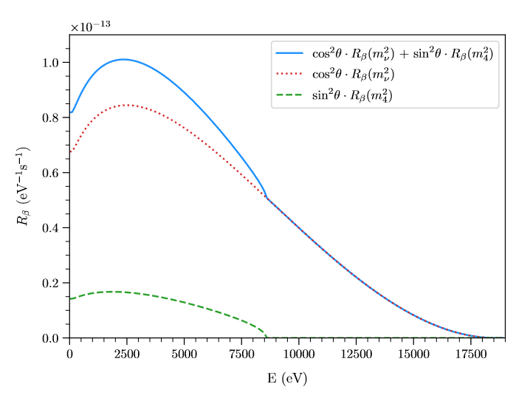
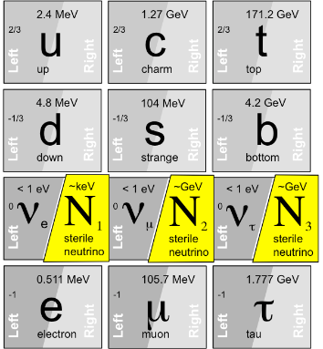
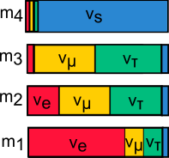
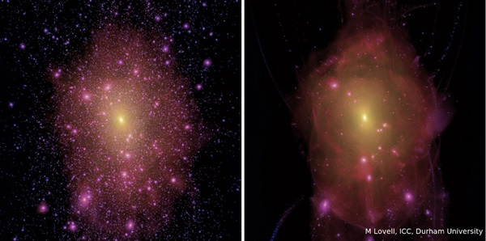
Standard Model (SM)
Identify a
kink-signature
Cold dark matter
Warm dark matter
2026-2027
Search for warm dark matter (keV sterile neutrinos)
Simulation of milky-way like
dark matter haloes (M Lovell/ICC Durham)
Notes:
Mission -> Phase 2 differentielle Measurement

Slide 20
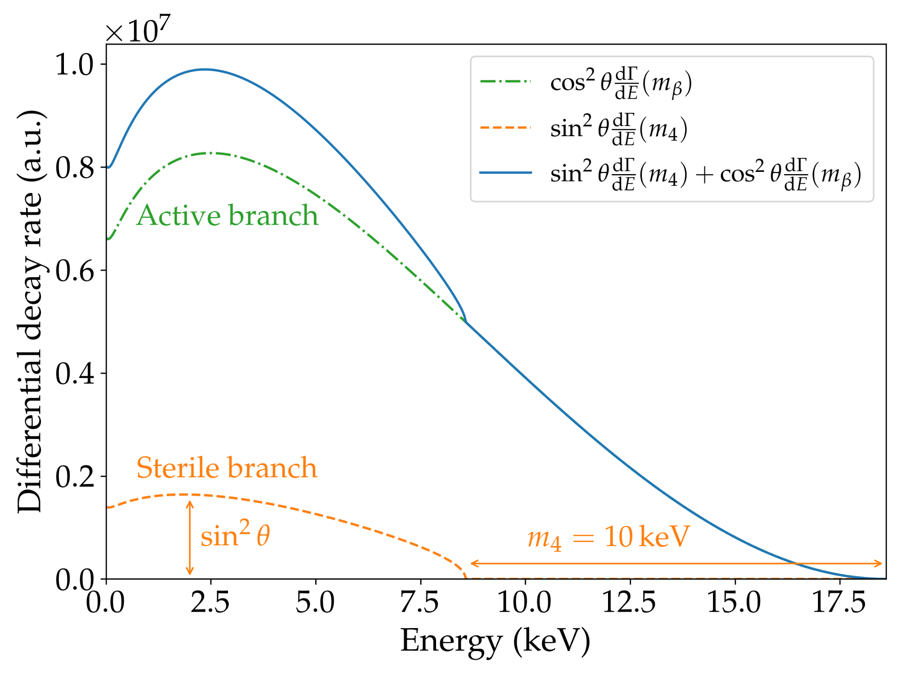
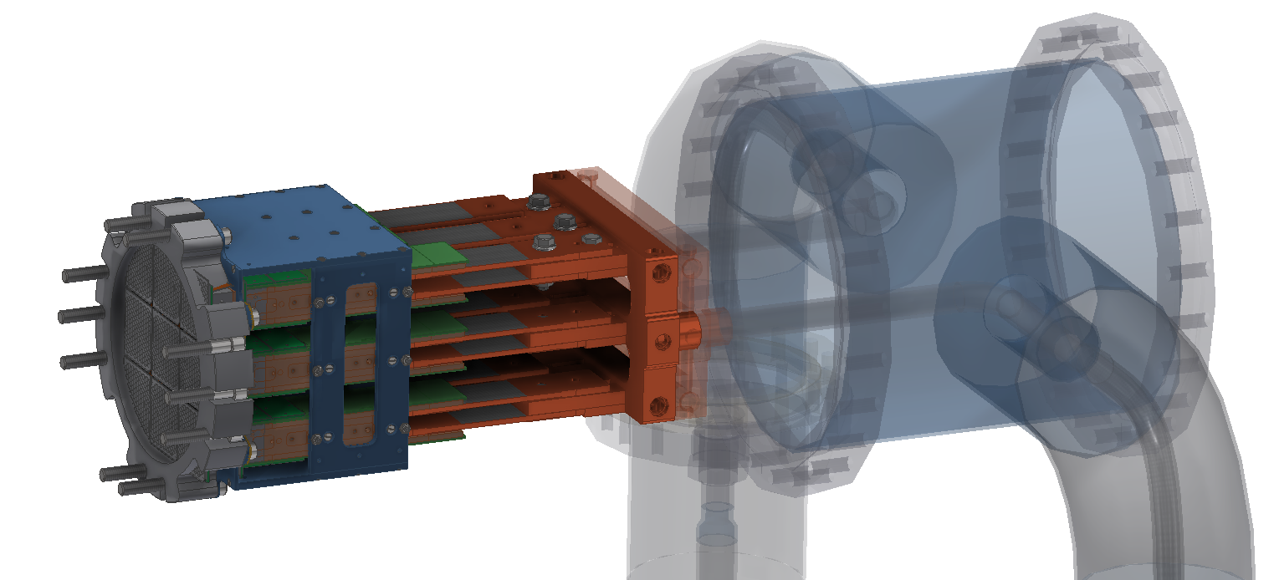

KATRIN with TRISTAN Detector (2026-2027)
  New 9 module detector
  1500 pixel, 100k counts s⁻¹ per pixel
$$→$$Full spectral coverage
with high statistics
10¹⁶ counts
Differential measurement
with ~300 eV resolution
  Source activity
  100 fold reduced
Notes:
Sehr voll.
Integral / Differentiell

Slide 21


Current status of TRISTAN detector
Module performance
Production overview
Measurements with photons (⁵⁵Fe)
– Energy resolution (Mn-Kα): 146.8 eV FWHM
Experiment on track for integration
in 2026

Slide 22

Outlook after 2027
R&D for future $$m_{ν}$$ experiments

Slide 23

Going beyond KATRIN
KATRIN
KATRIN final: < 0.3 eV (90% CL)
Distinguish between degenerate and hierarchical scenario
ν₁~ ν₂~ ν₃
IO
ν₃
ν₂
NO
ν₁

Slide 24
Going beyond KATRIN
KATRIN
KATRIN final: < 0.3 eV (90% CL)
Distinguish between degenerate and hierarchical scenario
New technologies: < 0.05 eV
Cover inverted ordering
ν₂
ν₁
New
technologies
ν₃
IO
ν₃
NO
ν₂
ν₁

Slide 25
Going beyond KATRIN
Differential measurement (FWHM < 1 eV)
  Better use of statistics
  Lower background
Atomic tritium
  Avoid broadening (~ 1 eV)
  Avoid limiting systematics of T₂
Preliminary
Stat only
10 eV region
1000 days
T₂, integral (ΔE = 1 eV, bg = 0.01 cps)
IO
T₂, differential (FWHM = 0.2 eV, bg = 10⁻⁵ cps/eV)
T-atom, differential (FWHM = 0.2 eV, bg = 10⁻⁵ cps/eV)
NO
KATRIN source
Notes:
So what does it take to really go beyond KATRIN?
If we would continue with a KATRIN-like integral measurement mode, we would need much more tritium
The first key to boost the sensitivity is…
The second key to boost the sensitivity is…

Slide 26




Improved measurement principle
Retarding voltage
(scanned!)
Integral measurement
(high pass filter)
Energy resolution
determined by filter
Detector „only“ counts
Reduced statistics
arXiv:1806.00369v2
All energies
at onces
Differential measurement
Energy resolution determined by detector or time of flight
threshold
More signal
Less background
Notes:
Integral spectrum
TRITIUM2019 Proceedings
Differential spectrum
arXiv:1806.00369v2 [physics.data-an] 28 Jun 2018

Slide 27




KATRIN and TLK as ideal R&D facilities
Molecular effects → spectral broadening
Quantum detector
technology
eV resolution
for differential
detection
immune to
Rydberg-like
backgrounds
Atomic source
technology
µm-size
calorimeters
Notes:
Grüner Kasten weg → andere Frage
Ggf. 20 + 21 kombinieren

Slide 28
KATRIN and TLK as ideal R&D facilities
Molecular effects → spectral broadening
Quantum detector
technology
eV resolution
for differential
detection
immune to
Rydberg-like
backgrounds
Atomic source
technology
µm-size
calorimeters
Notes:
Grüner Kasten weg → andere Frage
Ggf. 20 + 21 kombinieren

Slide 29



Quantum sensors as high resolution differential detectors
Advantages
Energy resolution O(eV) compared to conventional detectors O(100 eV)
Nearly 100% quantum efficiency
Broad spectrum of possible applications
Electron
Thermometer
incoming
particle
Absorber
Thermal bath
Weak thermal link
absorber
  e.g. Metallic Magnetic Calorimeters (MMC)
  Temperature-dependence in
  sensor magnetization
  Read-out by SQUID
  Energy resolution:
  - Current: $$ΔE ≲ 2 eV$$
  - Midterm: $$ΔE ≲1 eV$$
  - Future: $$ΔE ∼100 meV$$
sensor
$$τ=\frac{C_{tot}}{G}$$
Temperature
$$δT=\frac{E}{C_{tot}}$$
$$T_{bath}$$
$$1 ms$$
SQUID
Time
Not yet tested with external electrons

Slide 30
Next R&D goal:
Demonstrate KATRIN with a quantum sensor array
+
10⁶ x
Preliminary
Stat only
10 eV region
1000 days
T₂, integral
Challenges of coupling quantum sensor detector array
to KATRIN infrastructure
  Type of quantum sensor
  Operation in magnetic field
  Coupling of mK cryo-platform with RT spectrometer
  Large area detector and multiplexing of ~1e6 channels
  Limits to energy resolution
IO
T₂, differential
NO
KATRIN source

Slide 31
KATRIN and TLK as ideal R&D facilities
Molecular effects → spectral broadening
Quantum detector
technology
eV resolution
for differential
detection
immune to
Rydberg-like
backgrounds
Atomic source
technology
µm-size
calorimeters
Notes:
Grüner Kasten weg → andere Frage
Ggf. 20 + 21 kombinieren

Slide 32




Atomic vs molecular tritium
Atomic FSD
~70% of decays to electronic GS
~ 8 eV shift of endpoint
Molecular FSD
Intrinsic broadening
to about 1 eV FWHM
~57% of decays to electronic GS

Slide 33

Atomic tritium demonstrator at TLK
2022-2025
TLK
2025-2028
TLK+Mainz
2028…
TLK+P8/…
Molecular
tritium
Atomic
tritium
(hot, 2500 K)
Atomic
tritium
(cold)
Atomic
tritium
(trapped, injected)
15x3x3 m³
Loss
Inline
reprocessing
Offering room for extended
atomic tritium experiments
return T₂ + impurities
Impurity
processing
Essential for next generation neutrino mass experiment (e.g. KATRIN++) : Demonstrate the large scale generation and cooling (~10 mK) of atomic tritium

Slide 34
Final R&D goal
Atomic tritium with Quantum sensor array
Warm/cold
interfacing
Conceptual idea
Electron
filtering
Atomic T trap
Atomic T
flow in
Sensor array
Work started
- concept
- sensitivities
- R&D
Flow out

Slide 35



Ongoing R&D progress
MMC array with ^{83m}Kr source
next: T-graphene source
Decontaminated
glove box
KIT-IMS cyrostat
Measure external electrons with
quantum sensors
First krypton electron
spectra since summer 2023
Installation of first ever atomic tritium source
at TLK ongoing
First results expected after summer 2024

Slide 36

KATRIN++ and Project8 – future competitors?
Currently, no technology proven to reach ultimate sensitivity
Neutrino mass detection must be confirmed by independent technologies
Atomic tritium trap is key for
both detection techniques
B-field
Atomic
tritium
trap

Slide 37

KATRIN++ and Project8 – future competitors?
Currently, no technology proven to reach ultimate sensitivity
Neutrino mass detection must be confirmed by independent technologies
Atomic tritium trap is key for
both detection techniques
B-field
CRES
antenna
CRES
Atomic
tritium
trap
Acceptance
wrt B-field

Slide 38

KATRIN++ and Project8 – future competitors?
Currently, no technology proven to reach ultimate sensitivity
Neutrino mass detection must be confirmed by independent technologies
Atomic tritium trap is key for
both detection techniques
CRES and bolometer complementary
B-field
CRES
antenna
Bolometer
array
CRES
Atomic
tritium
trap
Acceptance
wrt B-field
Bolometer array

Slide 39

KATRIN++ and Project8 – future competitors?
Currently, no technology proven to reach ultimate sensitivity
Neutrino mass detection must be confirmed by independent technologies
Atomic tritium trap is key for
both detection techniques
CRES, bolometer and ToF complementary
B-field
CRES
antenna
Bolometer
array
CRES
Tagger
and ToF
measurement
Acceptance
wrt B-field
Bolometer array

Slide 40

Summary
2019-2025
2026-2027
2028-2034 (PoF-V)
Final goal
Phase 1 (integral)
neutrino mass
Phase 2 (differential)
keV sterile $$ν$$
R&D for KATRIN ++
neutrino mass
Atomic T demonstrator
Quant. detector demonstrator
KATRIN is running on track towards 1000 days. Next $$m_{β}$$ result upcoming: ~ 0.5 eV sensitivity
We are ready for TRISTAN operation for keV neutrino search
Ultimate neutrino mass detection (normal ordering; m<40 meV) requires differential detector and atomic tritium source → R&D needed
KATRIN is inviting research groups to tackle related challenges

Slide 41
The KATRIN collaboration
Funding and support from: Helmholtz Association (HGF), Ministry for Education and Research BMBF (05A17PM3, 05A17PX3, 05A17VK2, and 05A17WO3), Helmholtz Alliance for Astroparticle Physics (HAP), and Helmholtz Young Investigator Group (VH-NG-1055) in Germany; Ministry of Education, Youth and Sport (CANAM-LM2011019) in the Czech Republic; and the Department of Energy through grants DE-FG02-97ER41020, DE-FG02-94ER40818, DE-SC0004036, DE-FG02-97ER41033, DE-FG02-97ER41041, DE-AC02-05CH11231, and DE-SC0011091 in the US.

