Slide 1
Marcella Grasso
Scientific Director
Nuclear and Hadronic Physics
CNRS Nucléaire & Particules
IN2P3
France

Slide 2

Welcome to EuNPC 2025 in Caen
on behalf of IN2P3, CNRS Nucléaire & Particules

Slide 3
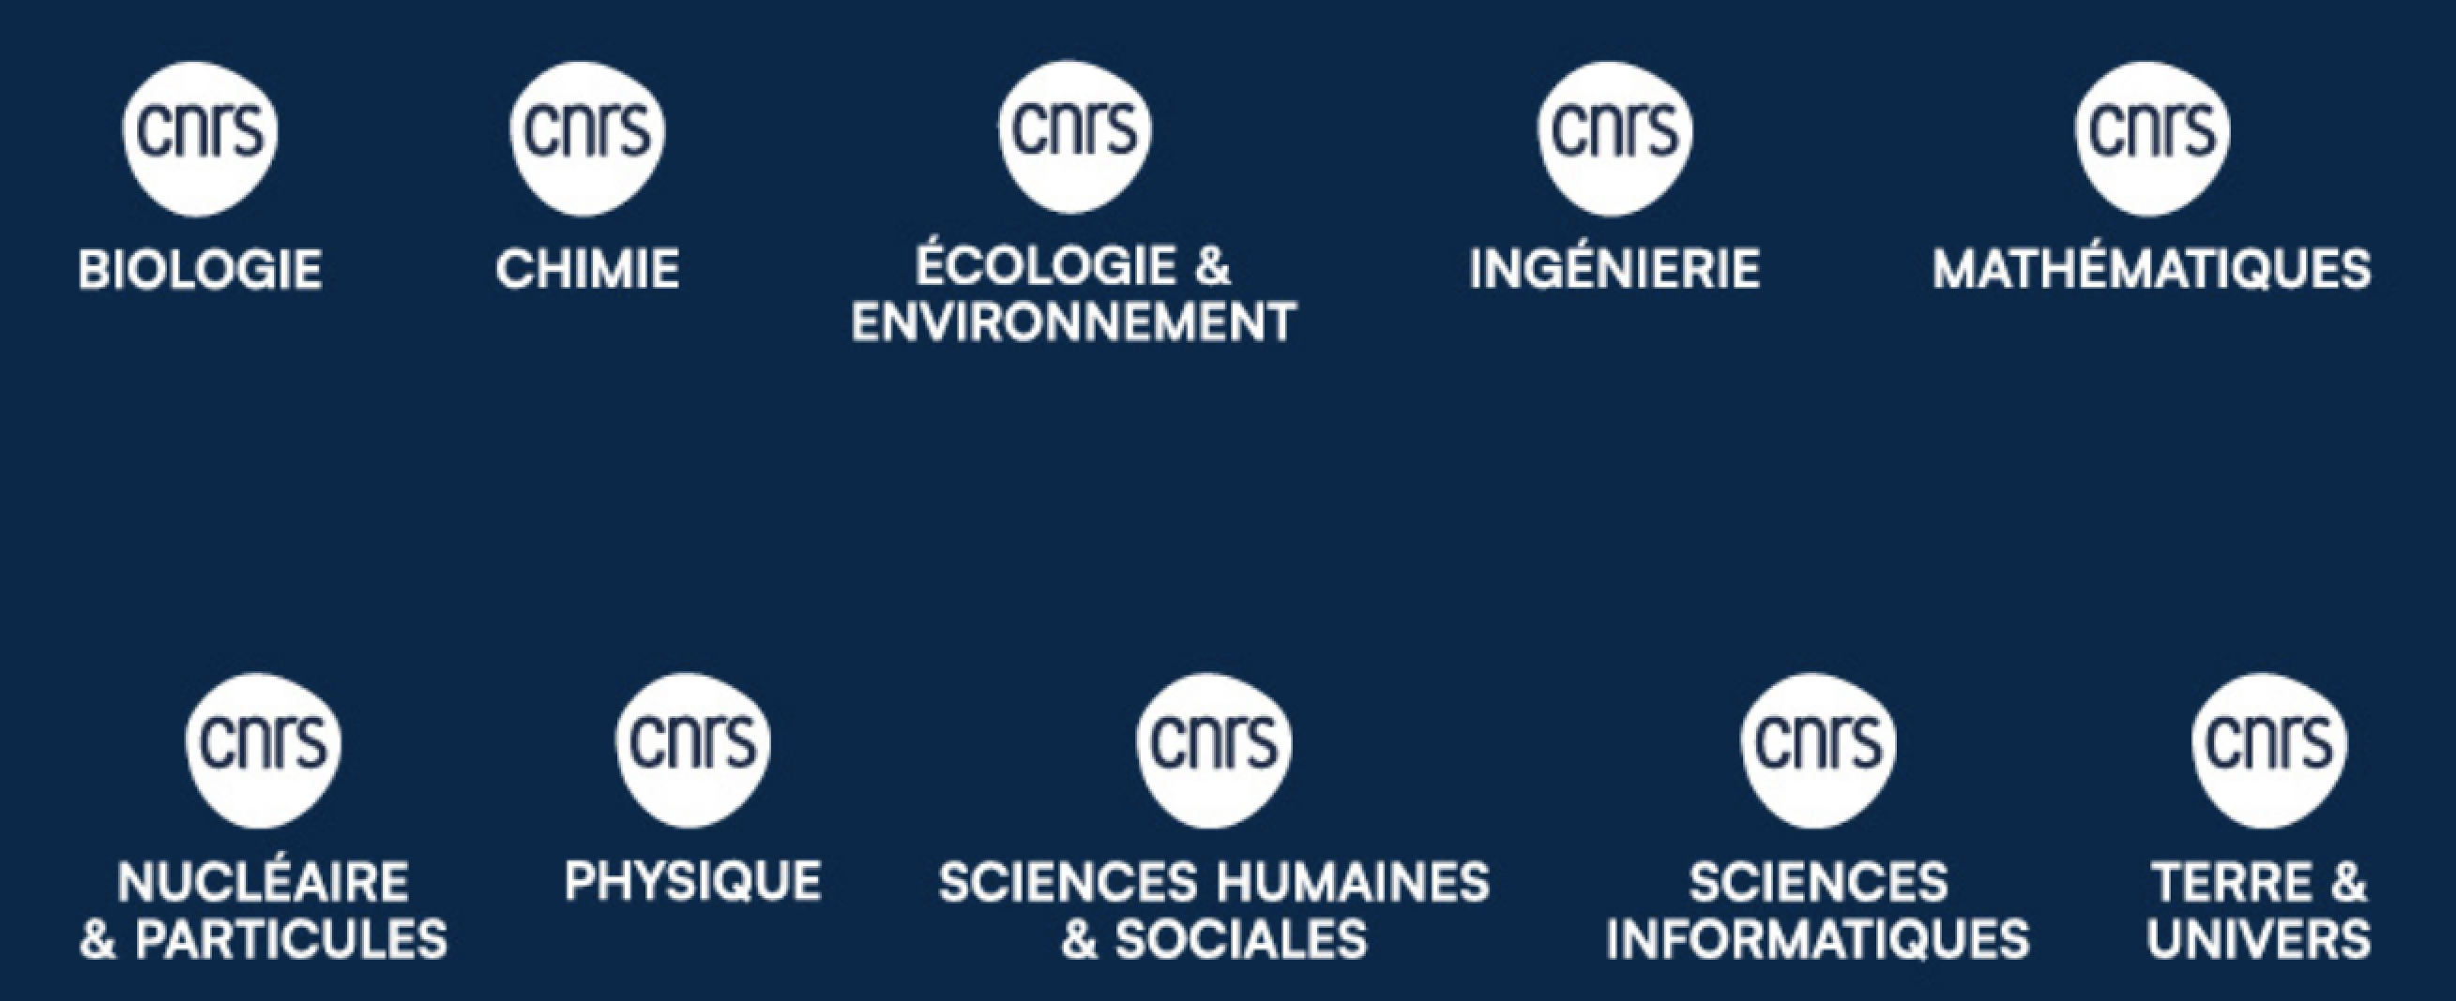
IN2P3 Institut National de Physique Nucléaire et de Physique des Particules One of the 10 institutes of CNRS, with a national mission -> Decree published in 2016, decision of the French Minister of National Education, Higher Education and Research
CNRS in 2024
More than 34000 employees -> more than 29000 scientists
10 institutes and more than 1000 laboratories
About 80 international laboratories, real CNRS laboratories abroad to strengthen international links

Slide 4
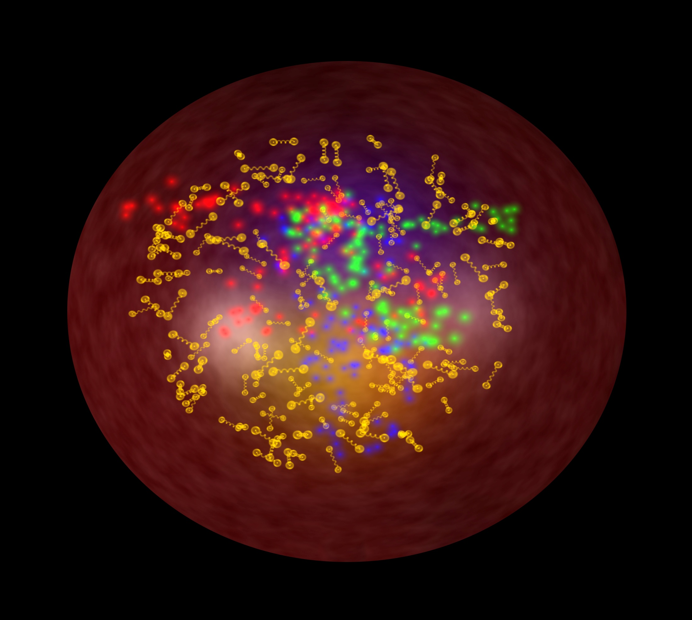
IN2P3: a national institute, with a national mission
COORDINATING RESEARCH IN THE FIELDS OF NUCLEAR, PARTICLE, AND ASTROPARTICLE PHYSICS, RELATED APPLICATIONS AND TECHNOLOGICAL DEVELOPMENTS
Strong links with Universities and CEA
EXPLORES
the physics of the two infinities: from elementary particles to cosmology
RUNS and OVERSEES
COORDINATES
research laboratories in connection with universities and
other finding agencies
research programs,
French involvement in facilities, projects and
international
collaborations
LINKS WITH SOCIETY
DEVELOPS
technologies, applications
of societal interest
expertise,
teaching, training
PROVIDES
Many projects are carried out within international collaborations and in large infrastructures (in coherence with the national Road Map for Research Infrastructures)

Slide 5
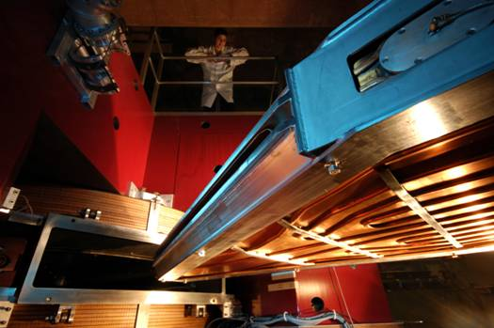
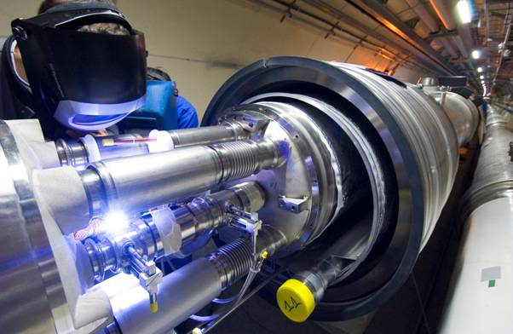
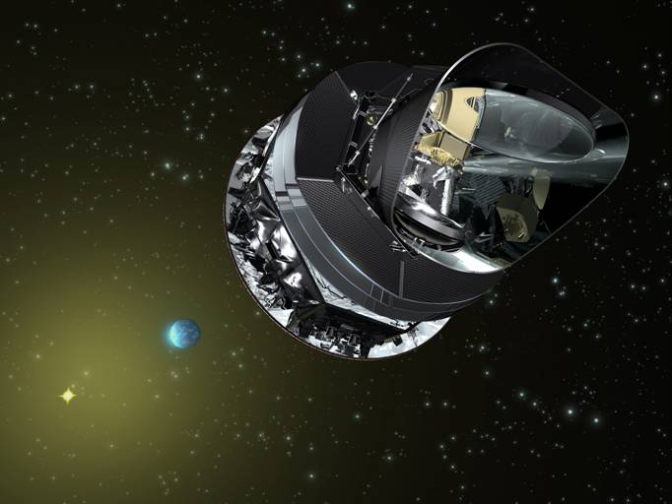
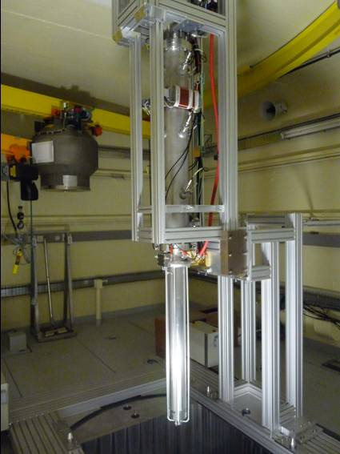
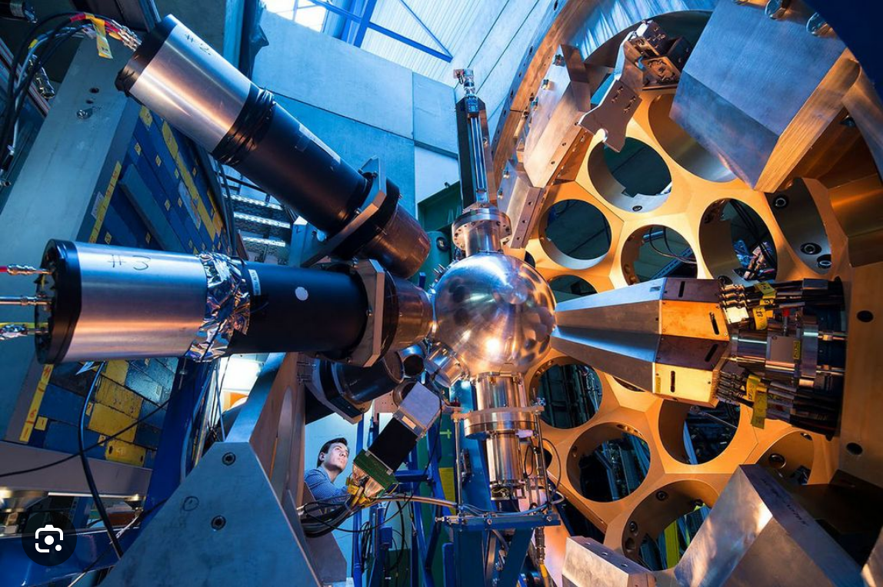
IN2P3 Organization Chart
Institute Director: C Roy
Deputy: J-L Biarrotte
Administrative Director :
S Pannetier
Technical Director:
R Cornat
Scientific Directors
Accelerators and
Technologies
A Lucotte
Astroparticle Physics and Cosmology
N Leroy
Nuclear and Hadronic Physics
M Grasso
Particle Physics
L Vacavant
Societal-impact activities (energy, health, environment)
J Marteau
15 laboratories (partnerships with local universities), GANIL (CNRS and CEA), 8 national science&technology platforms
About: 1000 physicists (half of them CNRS staff), 1400 engineers, technicians and administration staff (1200 CNRS staff)
About 300 post-doc, 500 PhD students, and 200 engineers, technicians and administration staff with fixed-term contracts
Advisory Committees:
IN2P3 Scientific Council (3 sessions per year)
Laboratory Directors Committee (meetings every month)

Slide 6
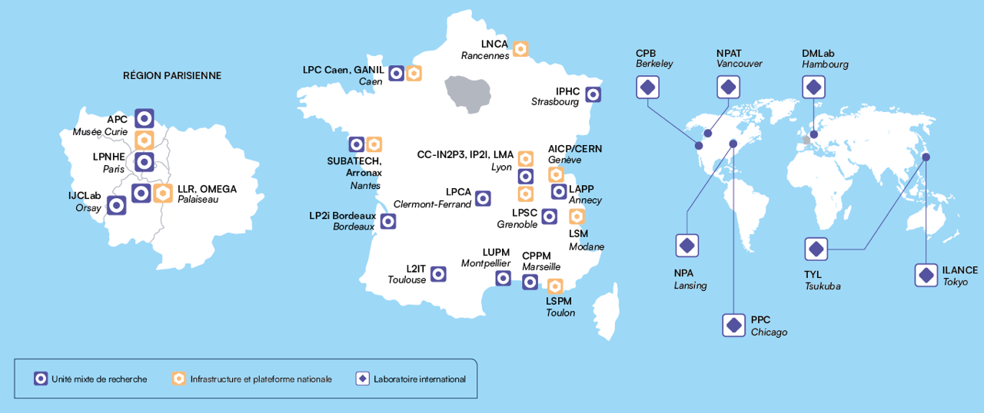
IN2P3 today, a distributed laboratory in France
Partnerships with Universities
GANIL is a CNRS-CEA laboratory

Slide 7
International links and actions at IN2P3
About 40 ongoing Memorandum of Understanding with international partners
9 International Research Networks (IRNs), to favor exchanges and links with other countries (scientific animation and common projects
7 International Research Laboratories (IRLs), where our scientists may spend periods of a few years (CNRS secondments), and students and post-doc may be co-trained
Canada:
-NPAT (Nuclear Physics, Nuclear Astrophysics and Accelerator Technologies), TRIUMF
Germany:
-DMLab (Dark Matter Laboratory), DESY
Japan:
-ILANCE (International Laboratory for Astrophysics, Neutrino and Cosmology Experiments),Tokyo Univ.
- TYL (Toshiko Yuasa Laboratory, particle physics), KEK
US
-CPB (Centre Pierre Binétruy, astroparticle physics), University of California, Berkeley
-NPA (Nuclear Physics and Nuclear Astrophysics), Michigan State University, FRIB
-PPC (Particle Physics and Cosmology), University of Chicago, Fermilab

Slide 8

IN2P3 contributes to the overall French strategy for research infrastructures driven by the ministry : national road map. An update is ongoing -> the new road map is expected in 2026

Slide 9
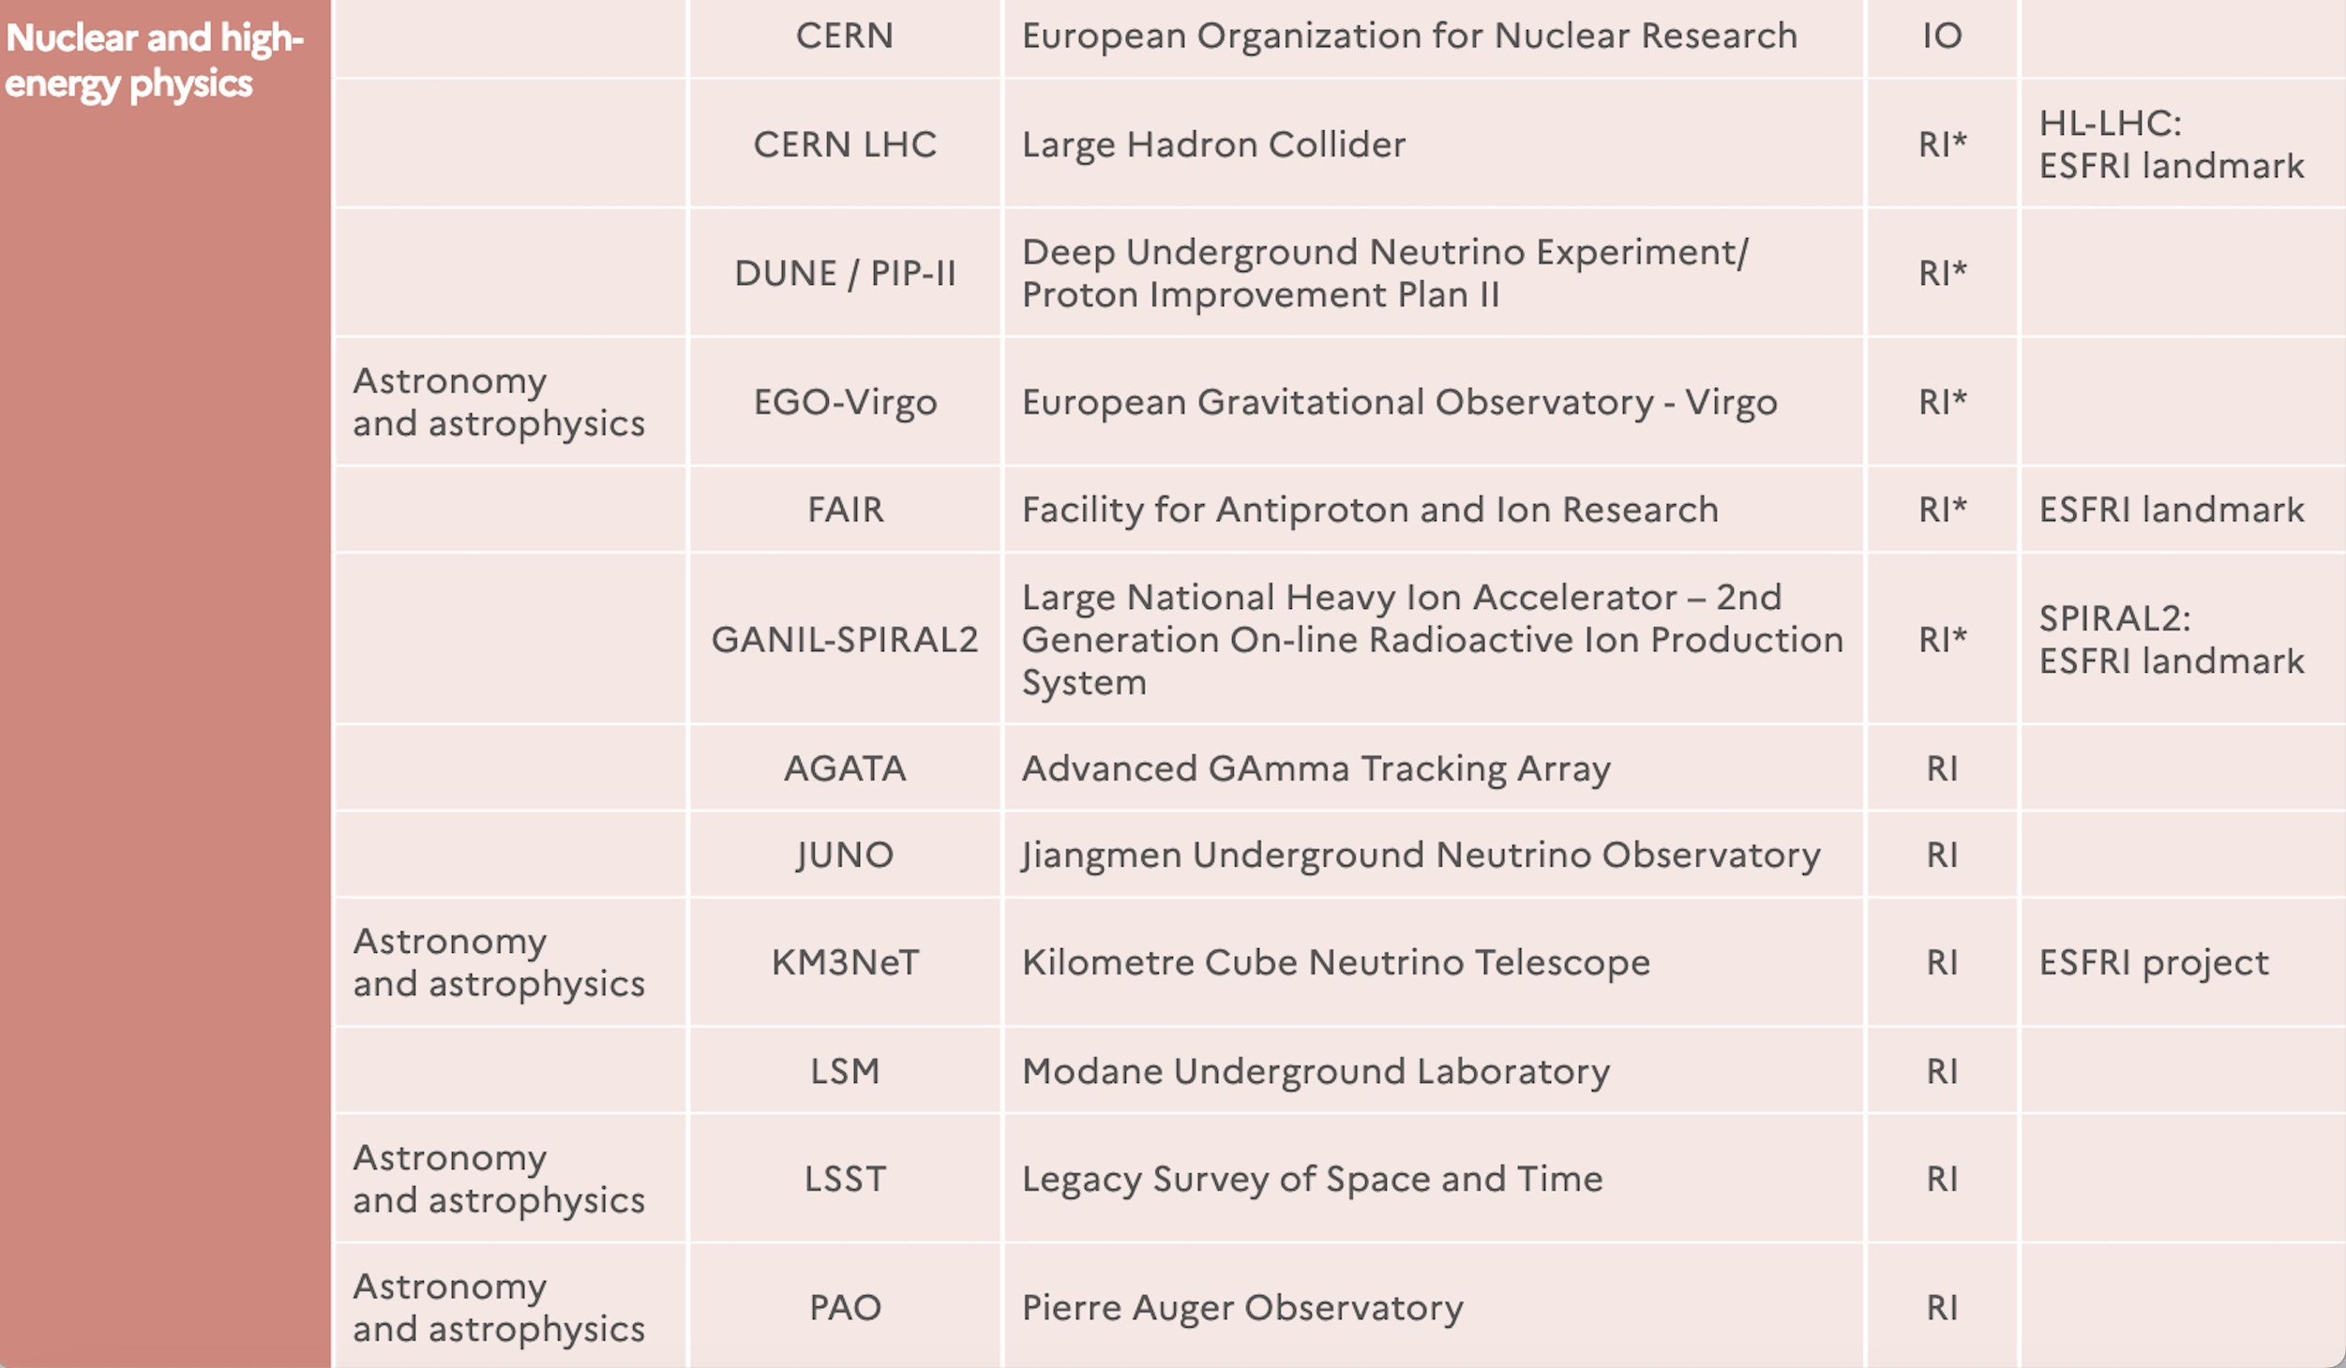
2021 Research Infrastructure French Road Map (Minister of Higher Education, Research and Innovation).
Dedicated funding from the Ministry for RI*
IO: International Organizations,
legally based on an intergovernmental
convention
RI*: (large) Research
Infrastructures, under
the scientific responsibility of research operators, subject to specific budgetary allocation by the Ministry
RI: Research infrastructures
whose scientific strategy and budgetary
monitoring are the responsibility
of research operators

Slide 10
Nuclear and Hadronic Physics

Slide 11
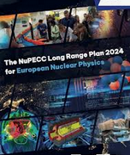

IN2P3 scientists strongly contribute to NuPECC and have strongly contributed to its recent Long Range Plan

Slide 12
General view of scientific communities in nuclear and hadronic physics at IN2P3
(plus engineers and technicians)
Nuclear physics
GANIL is the French national large facility for nuclear physics (IR*). Activities also at ALTO in France and, abroad, at: ISOLDE, FAIR (NUSTAR), LNL, LNS, JYFL, RIKEN, FRIB, TRIUMF, ARGONNE, …
180 scientists (including 30 theorists)
80 PhD, 60 post-doc
Recent change : Double beta decay in the nuclear physics portfolio: 12 experimentalists and a few theorists (for the calculation of nuclear matrix elements)
Hadronic physics :
heavy ions and nucleon structure (CERN, Jefferson Lab, GSI, R&D EIC)
60 physicists (including 15 theorists)
25 PhD, 10 post-doc

Slide 13
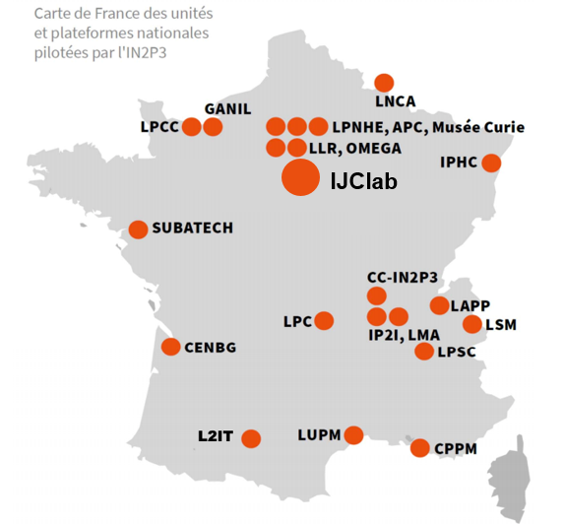
Physique nucléaire et applications associées dans les laboratoires
Nuclear and Hadronic Physics at IN2P3
Nuclear physics (including double beta decay) and nuclear astrophysics
Hadronic physics (heavy-ion physics and nucleon structure)
LP2I

Slide 14
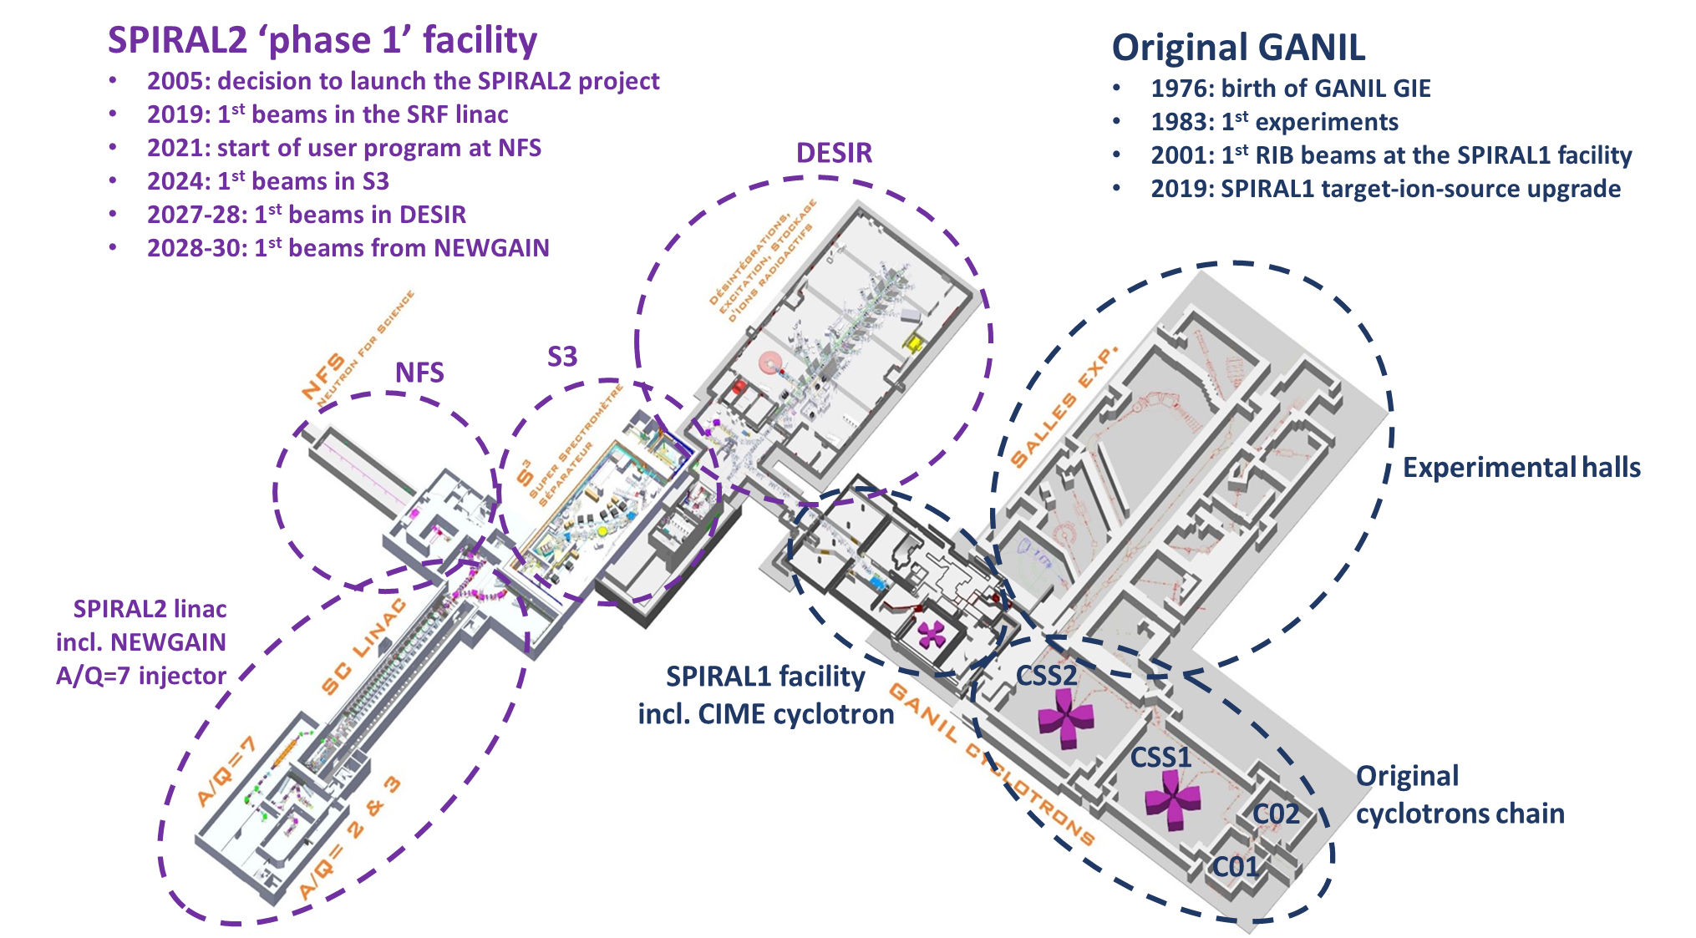
GANIL in the present decade
Neutrons for Science (NFS) started to work in 2021 (first exp).
Neutrons produced from the interaction of protons or deuterons accelerated from the LINAC with a converter
Mainly fission, but also low-energy excitations with a PARIS experiment, …
Commissioning of the Super
Separator Spectrometer (S3) starting soon: nuclei with very low cross sections, such as
superheavy elements
neutron deficient nuclei close to the limit of stability
DESIR (Decay, excitation and storage of radioactive ions) in 2027-2028
unique opportunities in terms of selection of exotic nuclei and/or beam purity.
masses, laser spectroscopy, beta-decay spectroscopy, high-precision measurements… building construction started in 2023.
First stone ceremony on November 10, 2023
AGATA installed during 2028, for campaigns starting in 2029
NEWGAIN, Injector 2: A/Q =3-7
Increasing beam intensities of heavy (A > 40) and very heavy (Xe, Pb, U) nuclei
Refurbishment of the cyclotrons
A project is also starting: increase and implement beam time for industry

Slide 15
Enjoy the conference!

