Slide 1
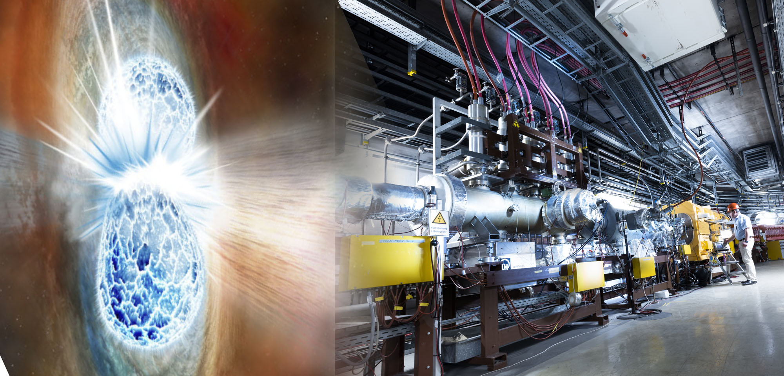






Propagation of Cosmic Rays
and Nuclear Cross Sections
Karl-Heinz Kampert
Bergische Universität Wuppertal
Euopean Nuclear Physics Conference 2025

Slide 2
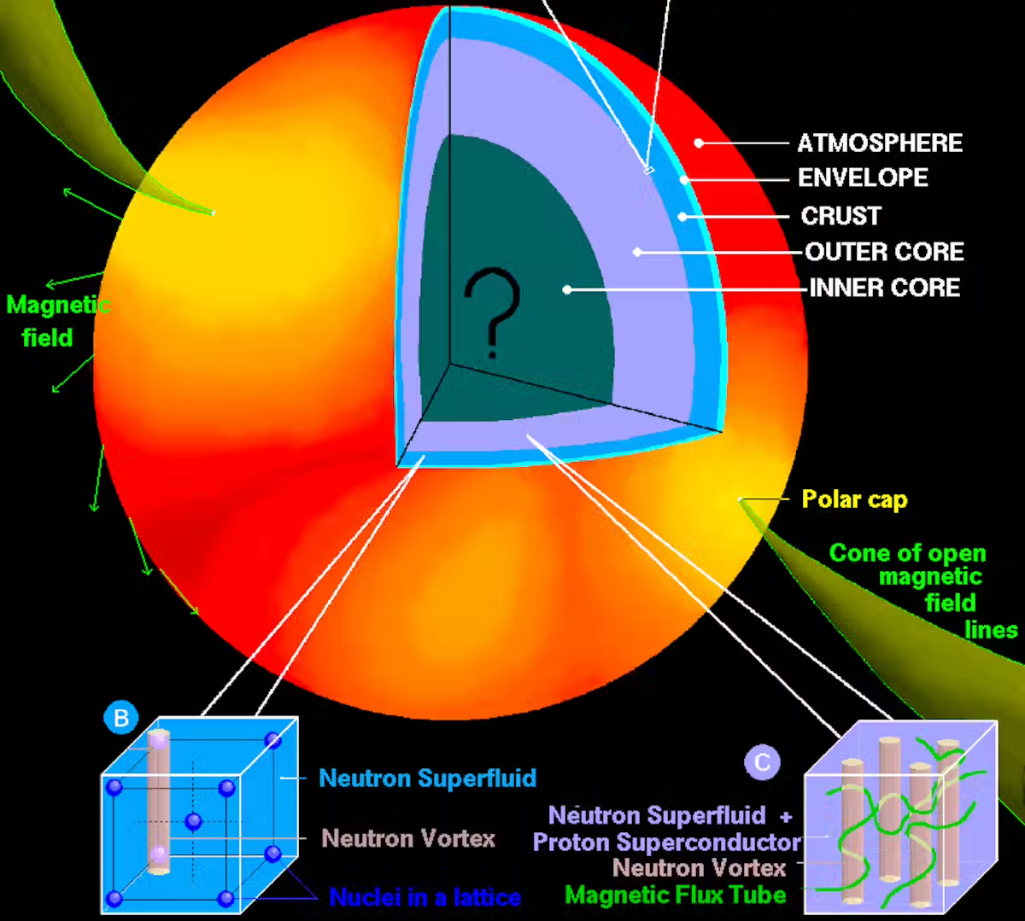
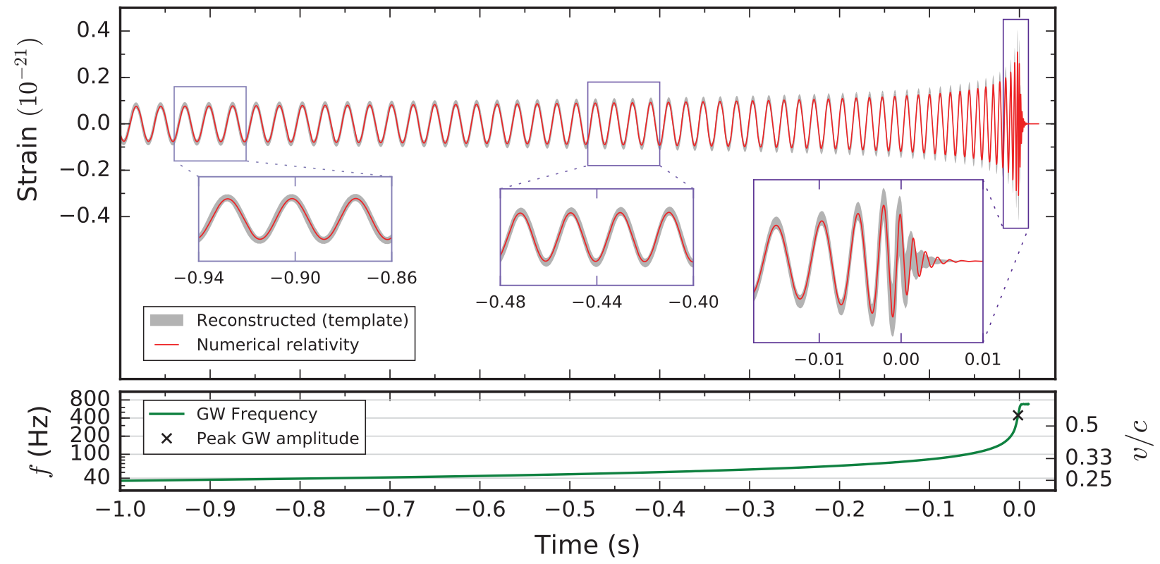
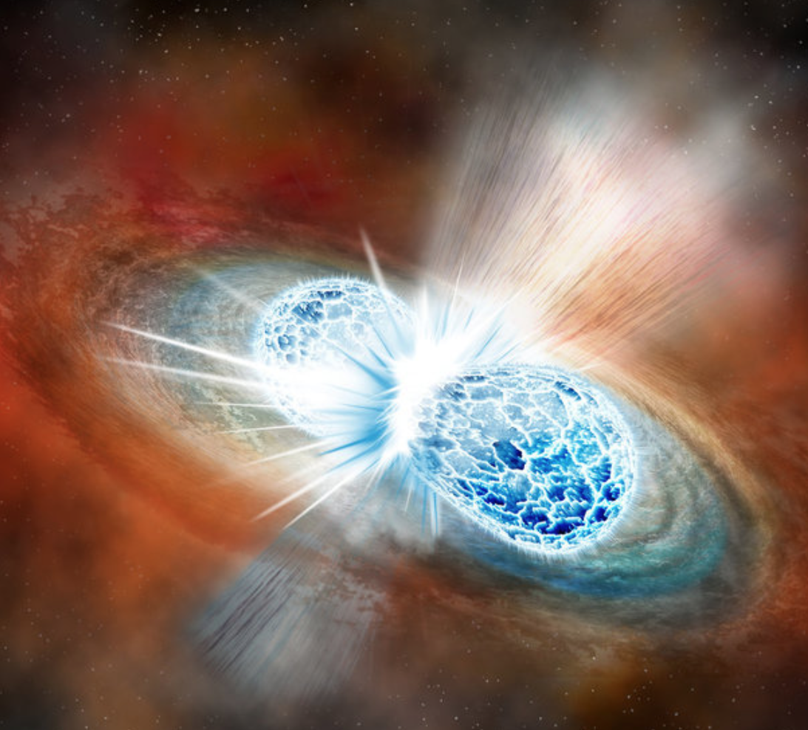
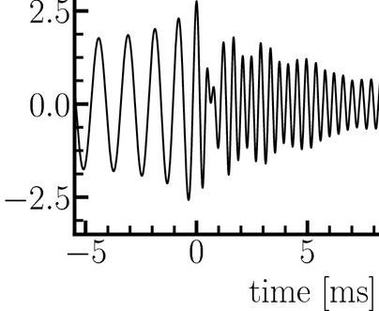
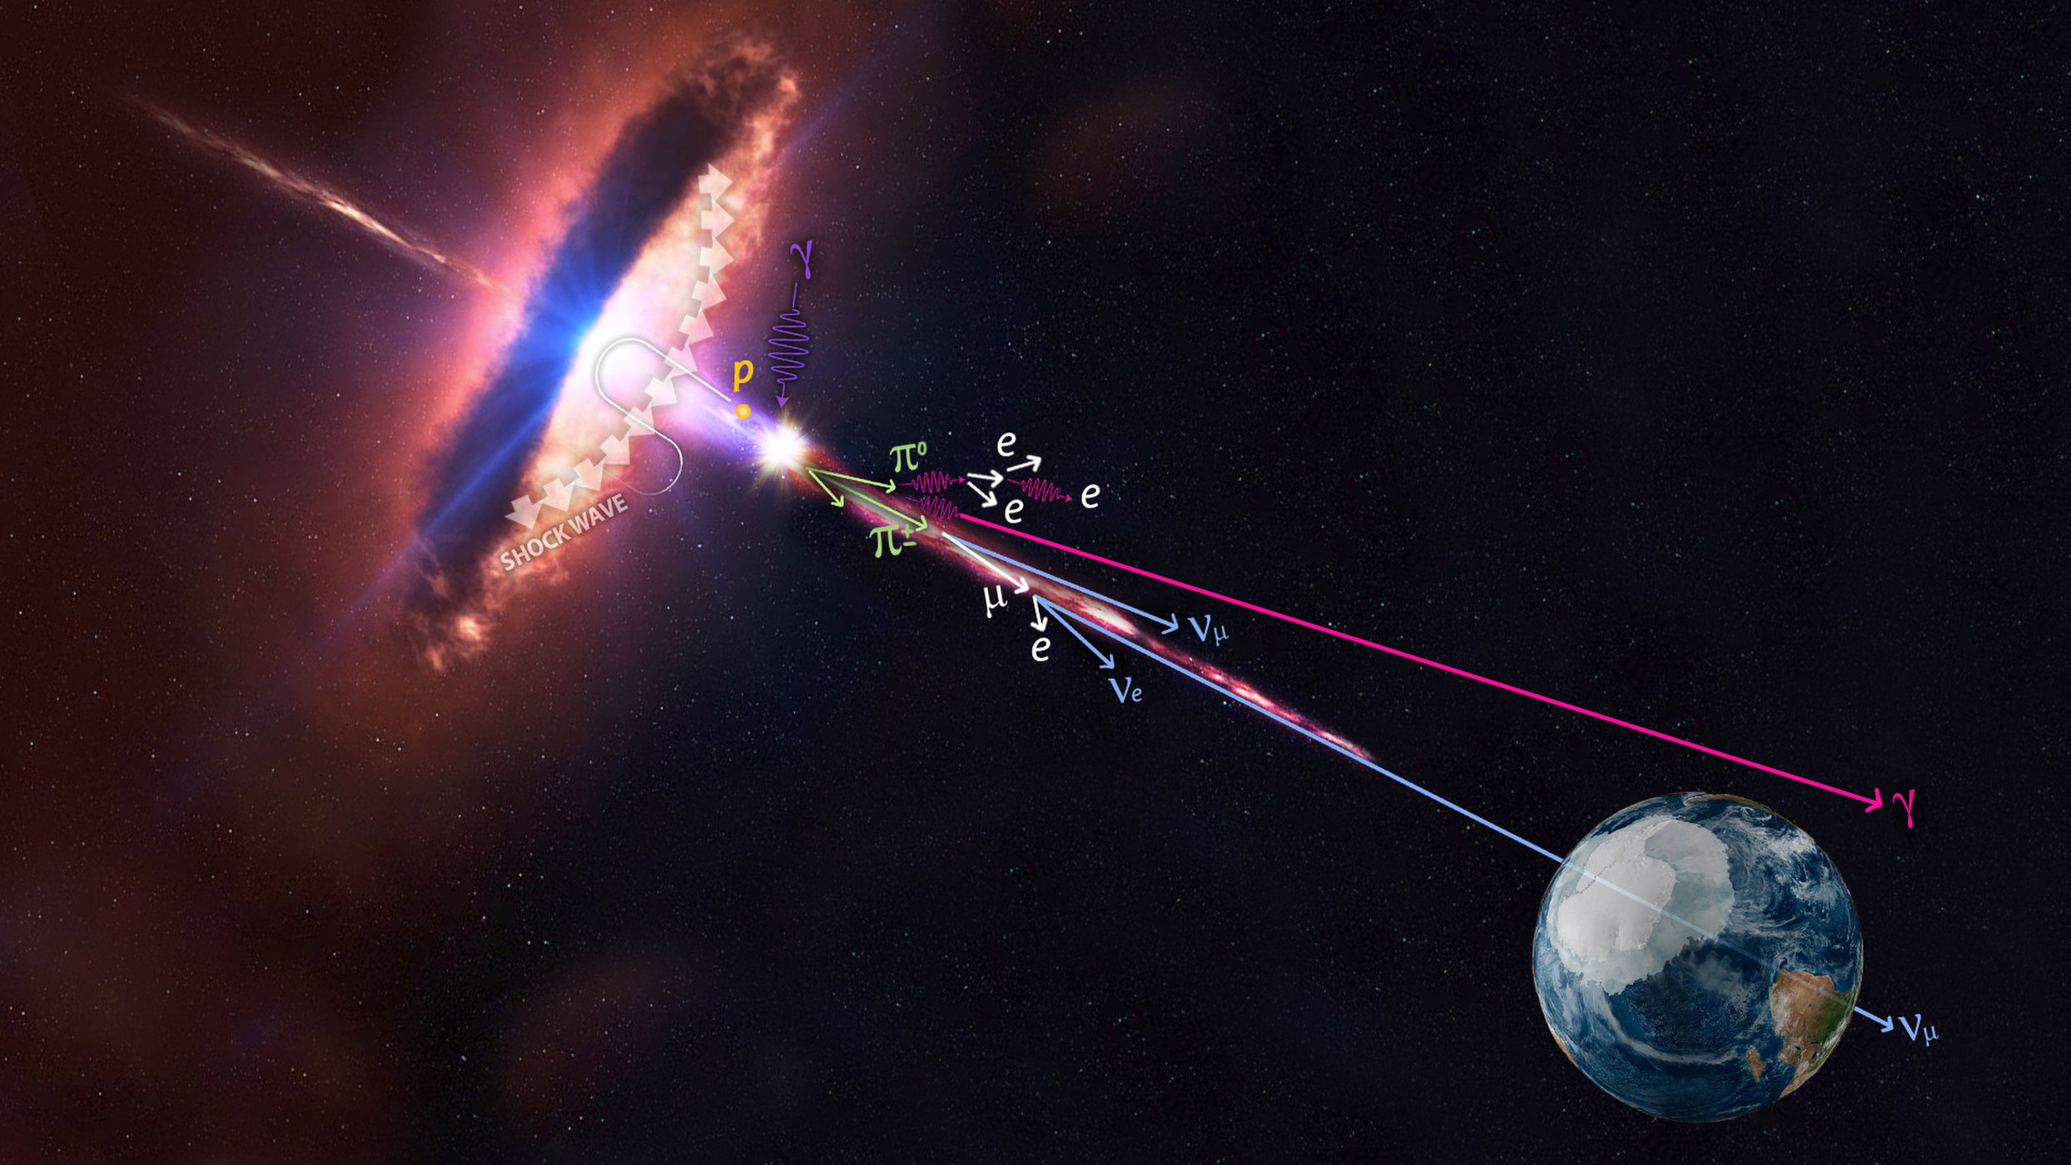
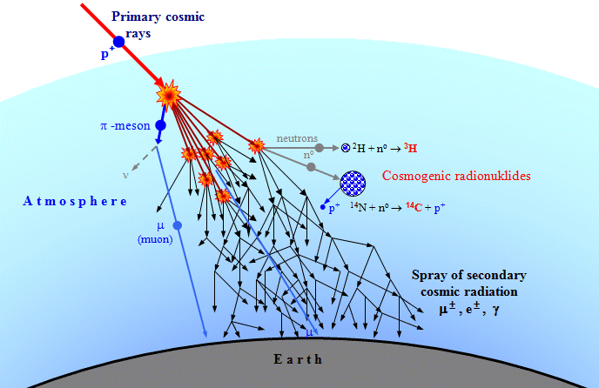
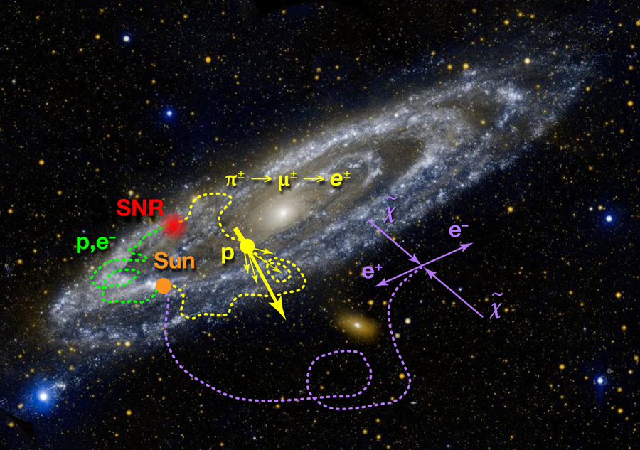
Cross Roads between Nuclear and Astro(particle) physics
Physics of neutron stars
Gravitational waves from BNSM and EoS
High-Energy Multi Messenger Astroph.
Dany P. Page
Nucleosynthesis from BB to SN and NSM
Physics of Extensive Air Showers
and „muon puzzle“
Disintegration of nuclei in matter and radiation fields
Felix Riehn, tomorrow at 17:00 hrs
Vojtech Ullman
P. Senger, Phys.Scripta 96 (2021) 5, 054002

Slide 3
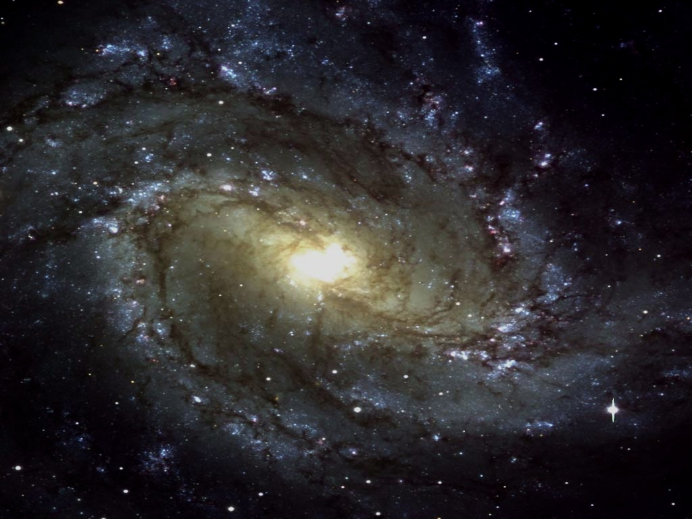


The simple world of galactic CRs
Source:
Stellar atmosphere, Nucleosynthesis…
Accelerator:
Supernovae?,
Pulsars? ...
Propagation:
Hadronic interactions: e.g. Spallation, anti-particles, … radioactive decays, …
?
?
?
$$D=\frac{⟨x^{2}⟩}{2t}$$
solar
modulation
Detection:
Ballon & Space born
and EAS experiments
Karl-Heinz Kampert - University of Wuppertal
EuNPC2025, Caen (France), Sept. 22-26, 2025

Slide 4
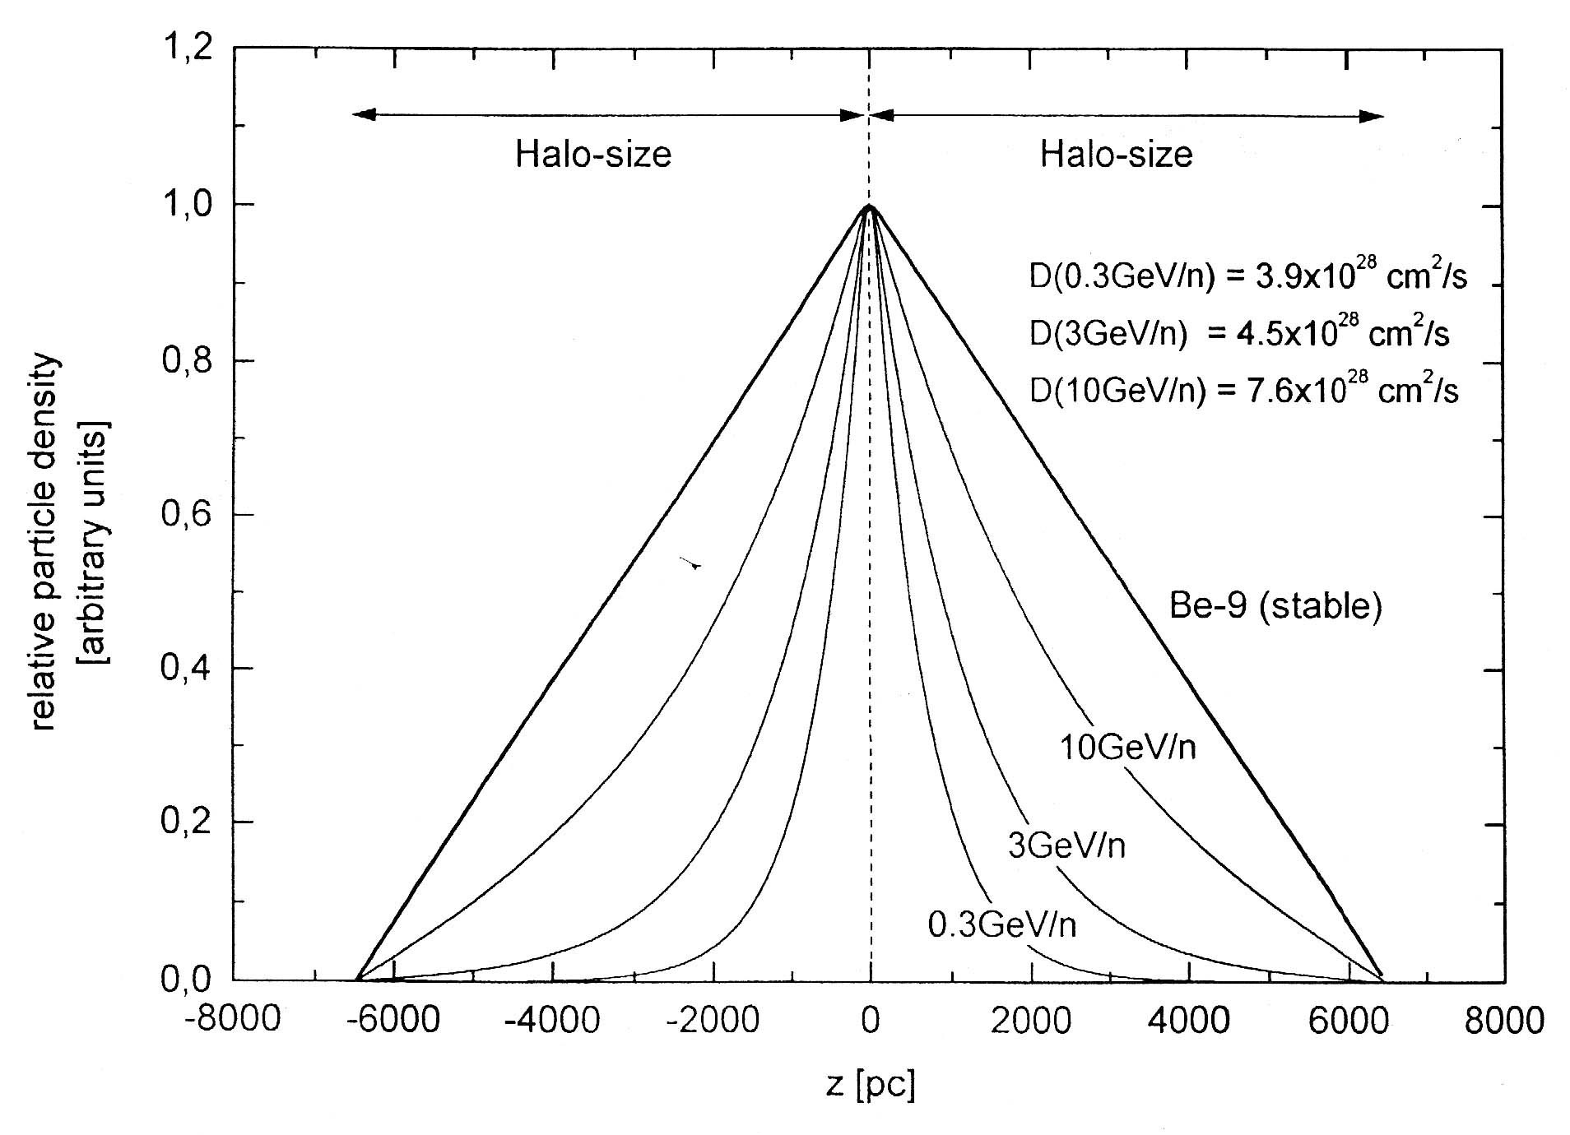
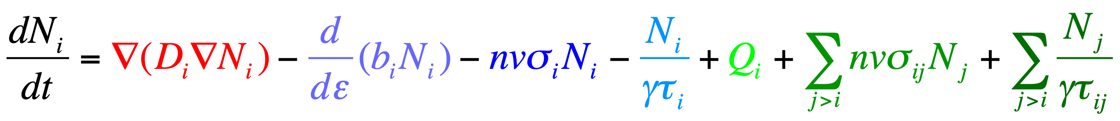



Leaky Box (LBM) and Diffusion Halo Model (DHM)
Basic Idea: Sources (mostly) in galactic disk, particles diffuse into halo
z
2h
Galactic disk
2H
Galactic halo
Equilibrium between gains and losses in LBM is substituted by diffusion equation.
D=D(z, …)
diffusion
energy losses
losses by radio-
active decays
gains by radio-
active decays
losses by coll. in ISM
source term
gains by coll. in ISM

Slide 5

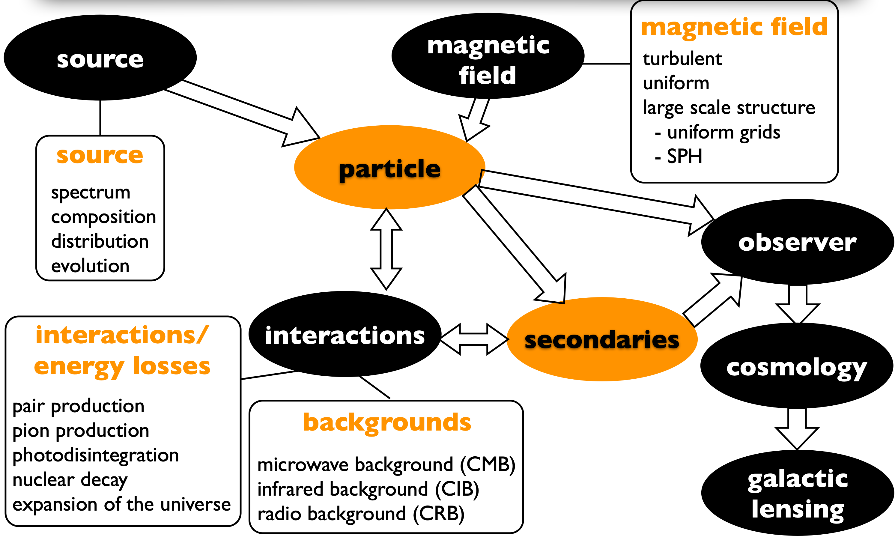
Monte Carlo Approach
open source https://crpropa.github.io/
Latest public release:
R. Alves Basista, … KHK, …
JCAP 09 (2022) 035
First release with nuclear interactions
K.-H. Kampert et al,
Astropart. Physics 42 (2013) 41
Other codes specific for galactic CR propagation: GALPROP, DRAGON, ….
Karl-Heinz Kampert - University of Wuppertal
EuNPC2025, Caen (France), Sept. 22-26, 2025

Slide 6

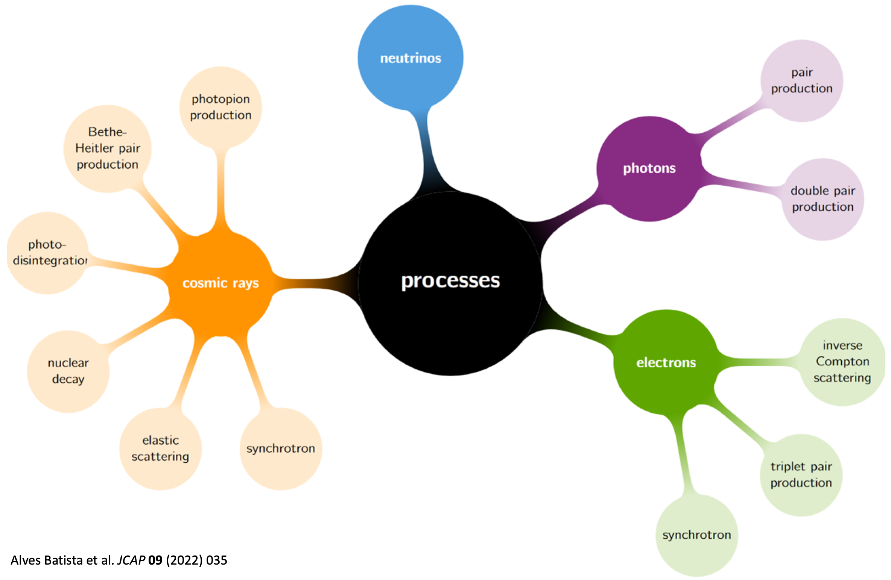



Monte Carlo Approach
mostly relevant for galactic propagation
nuclear
interaction
mostly relevant for in-source photon fields and extra- galactic CMB
Karl-Heinz Kampert - University of Wuppertal
EuNPC2025, Caen (France), Sept. 22-26, 2025

Slide 7
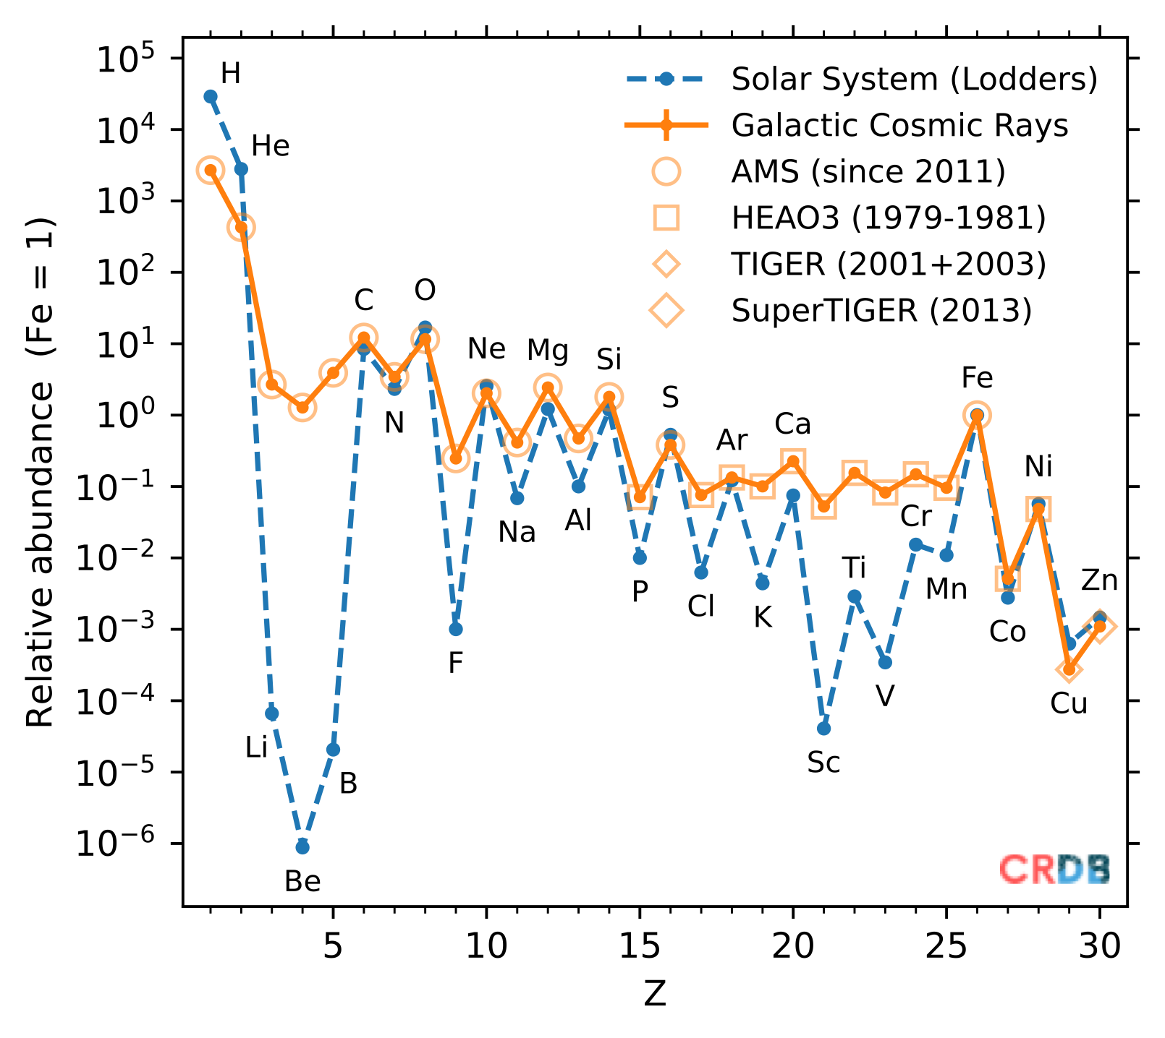

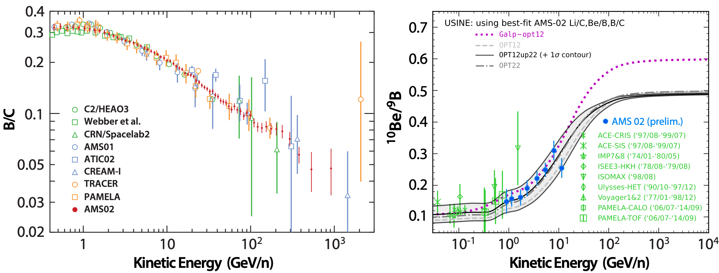


Propagation of Galactic CRs
Spallation Reactions
Li,Be,B
C,O
C
O
O
high-energy
CR nucleus
p of
ISM
+ → spallation prod.
Secondary/Primary ⇒ traversed matter
Unstable/stable ⇒ age of CRs
Li
B
Be
https://lpsc.in2p3.fr/crdb/
Most of the models reply on simple scalings due to lack of data !
B/C, ¹⁰Be/⁹Be, etc. measure the amount of matter CRs traverse
Cross section uncertainties larger than CR uncertainties from AMS → physics reach limited by that !
Karl-Heinz Kampert - University of Wuppertal
EuNPC2025, Caen (France), Sept. 22-26, 2025

Slide 8
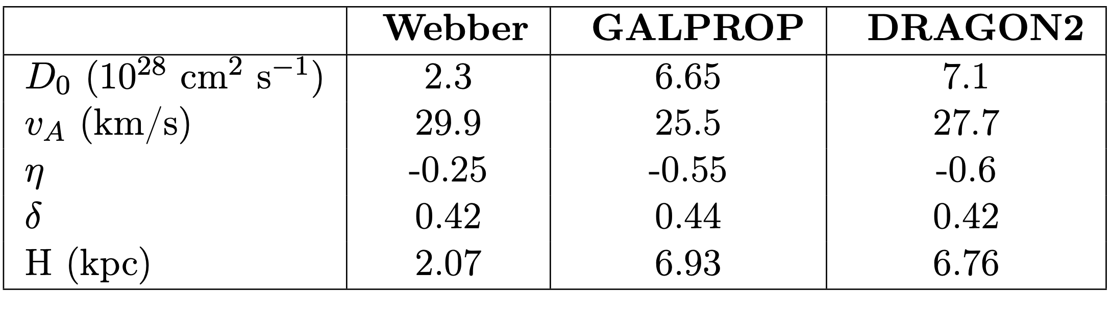
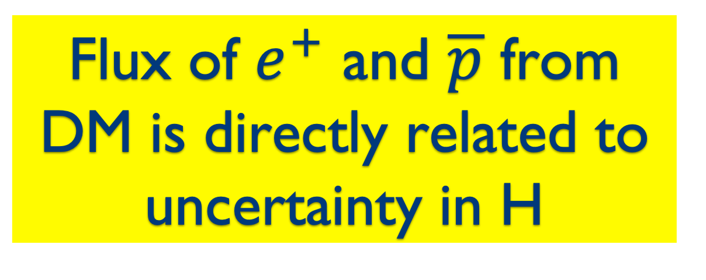
Leaky Box (LBM) and Diffusion Halo Model (DHM)
z
Factor of 3
uncertainty on size of Halo !
2h
2H
Flux of $e^{+}$ and $\overline{p}$ from DM is directly related to uncertainty in H
Pedro De La Torre Luque, et al., JCAP, 03:099, 2021
B/C, ¹⁰Be/⁹Be, etc. measure the amount of matter CRs traverse
Cross section uncertainties larger than CR uncertainties from AMS → physics reach limited by that !
Karl-Heinz Kampert - University of Wuppertal
EuNPC2025, Caen (France), Sept. 22-26, 2025

Slide 9
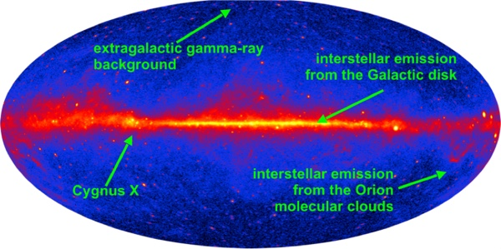
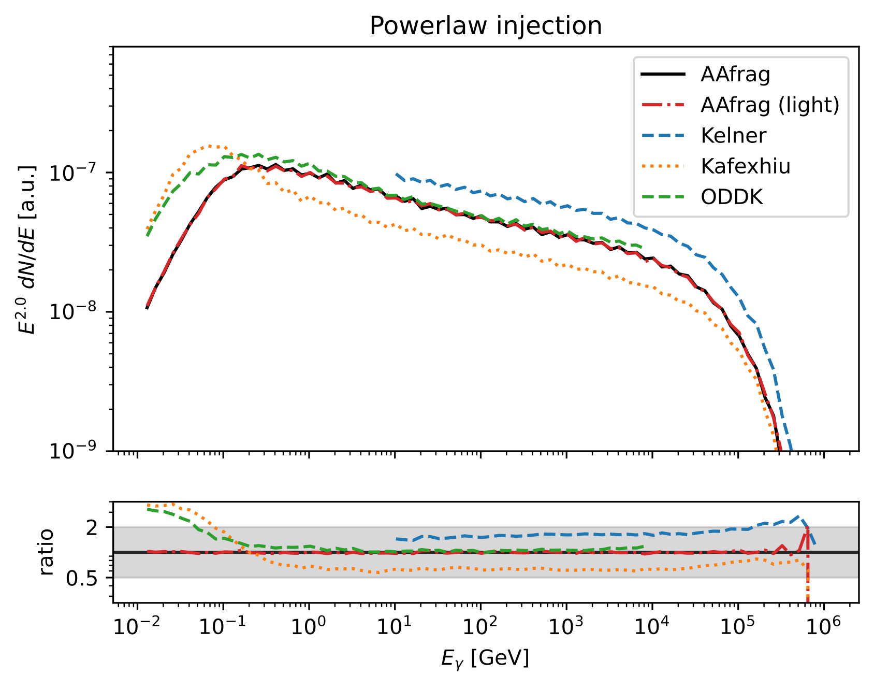
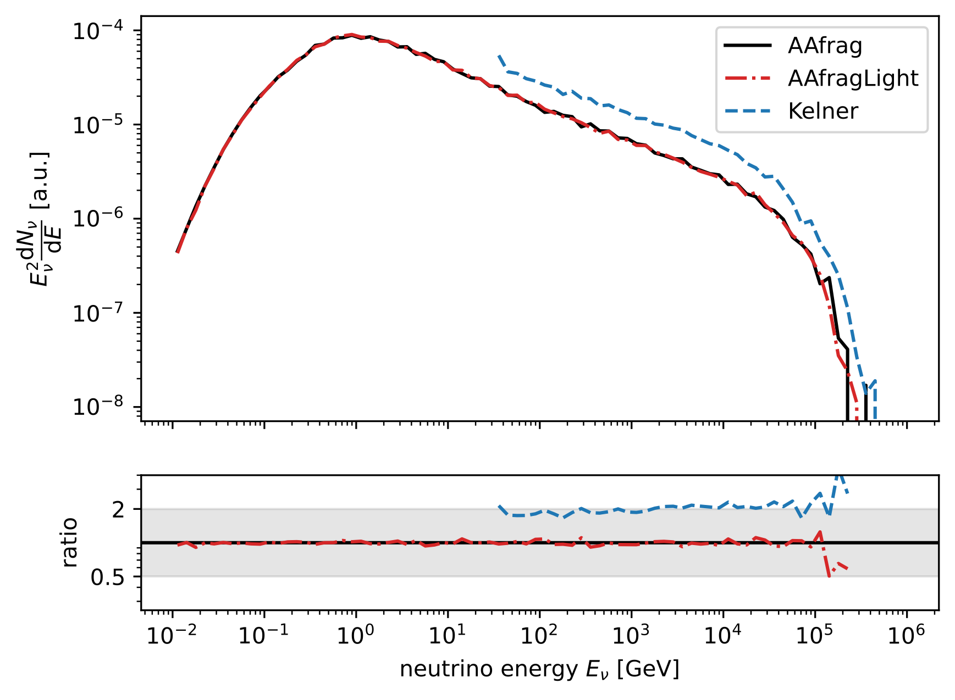
Diffuse Gamma-Ray & Neutrino Flux from Galactic Plane
Gamma-Ray
All-Flavor Neutrino
factor 3
factor 2
factor 3
Factor of two in galactic diffuse emission from different cross section models
Critical for understanding DM models, hadronic vs leptonic origin of GeV/TeV gamma rays, etc
LHAASO 2025 and IceCube 2025 in tension with calculations
J. Dörner, KHK, ... JCAP 04 (2025) 043
Karl-Heinz Kampert - University of Wuppertal
EuNPC2025, Caen (France), Sept. 22-26, 2025

Slide 10
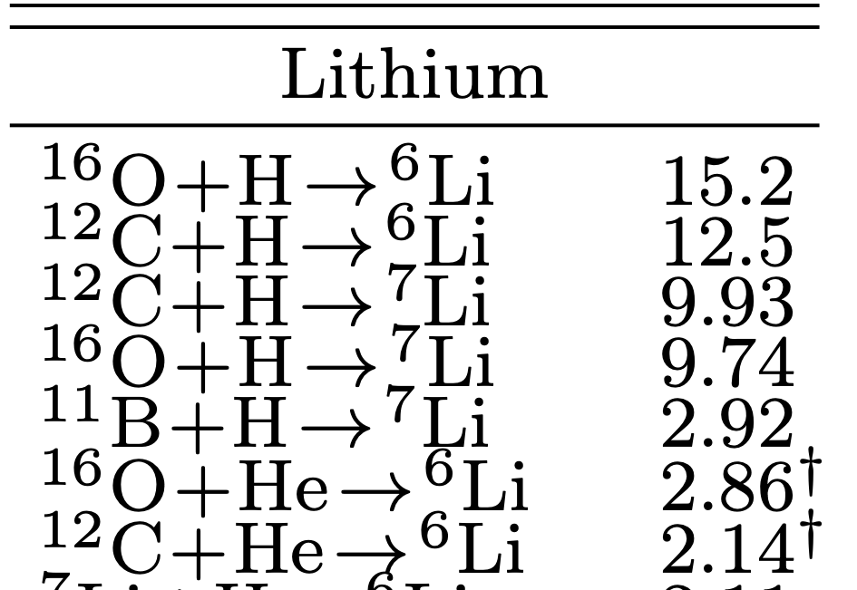
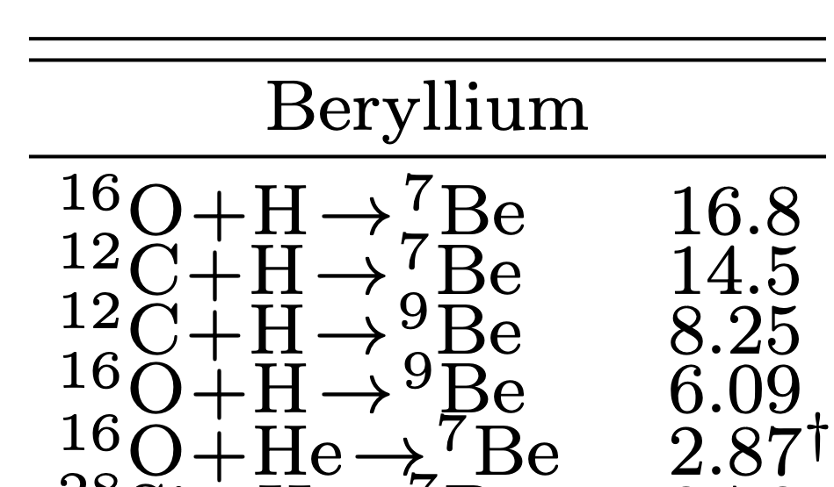
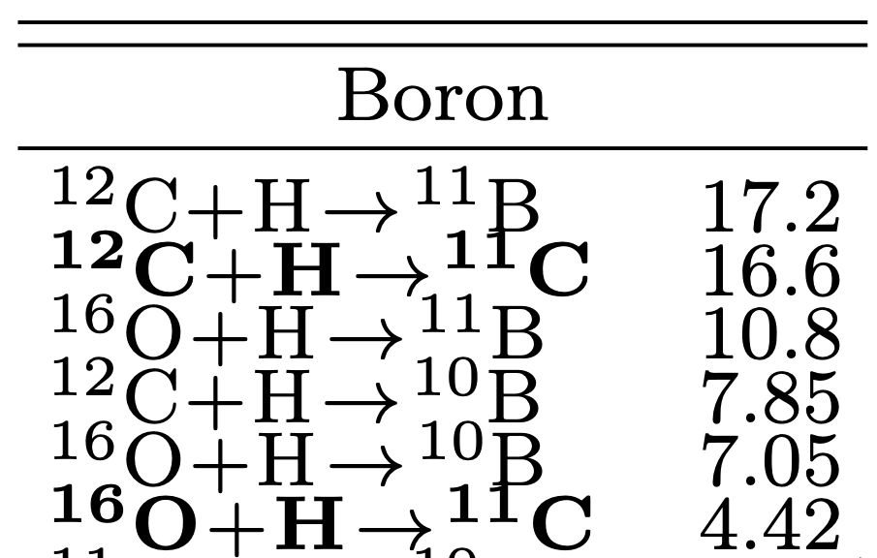
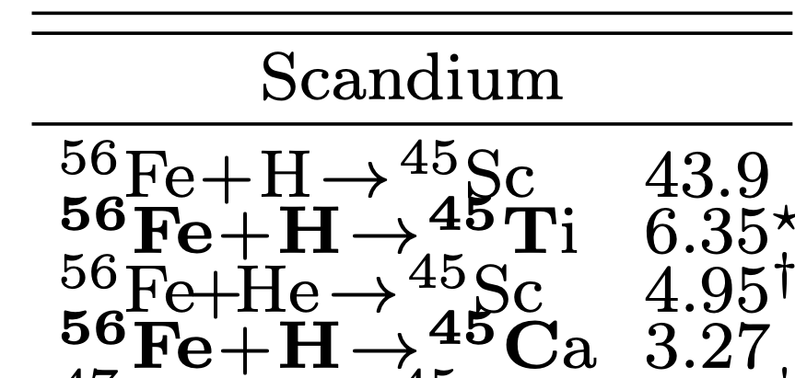
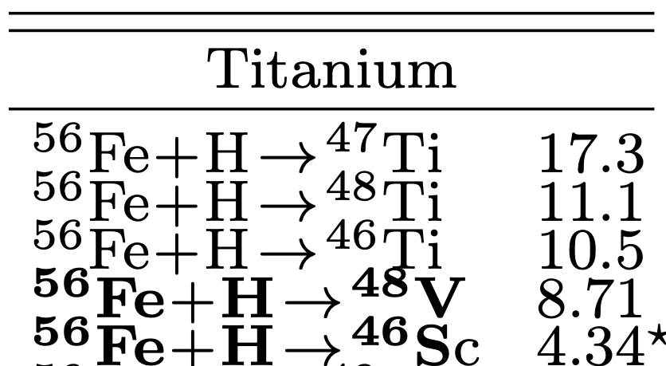
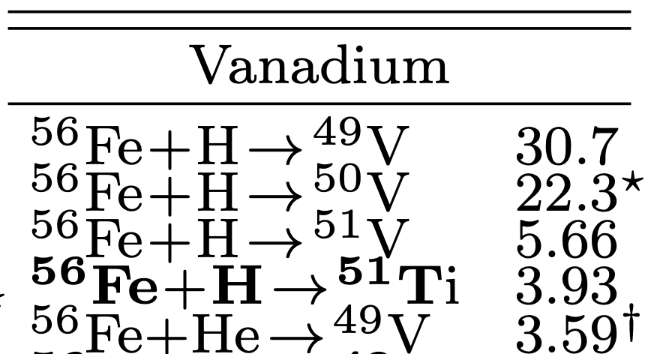

Examples of what’s needed…
%-contr
%-contr
%-contr
Note, 90% of ISM is
made of p and He
%-contr
%-contr
%-contr
bold: short lived
†: no exp. data
*: cumulative > 50%
XSCRC working group, series of workshops, see e.g arXiv:2503.16173

Slide 11
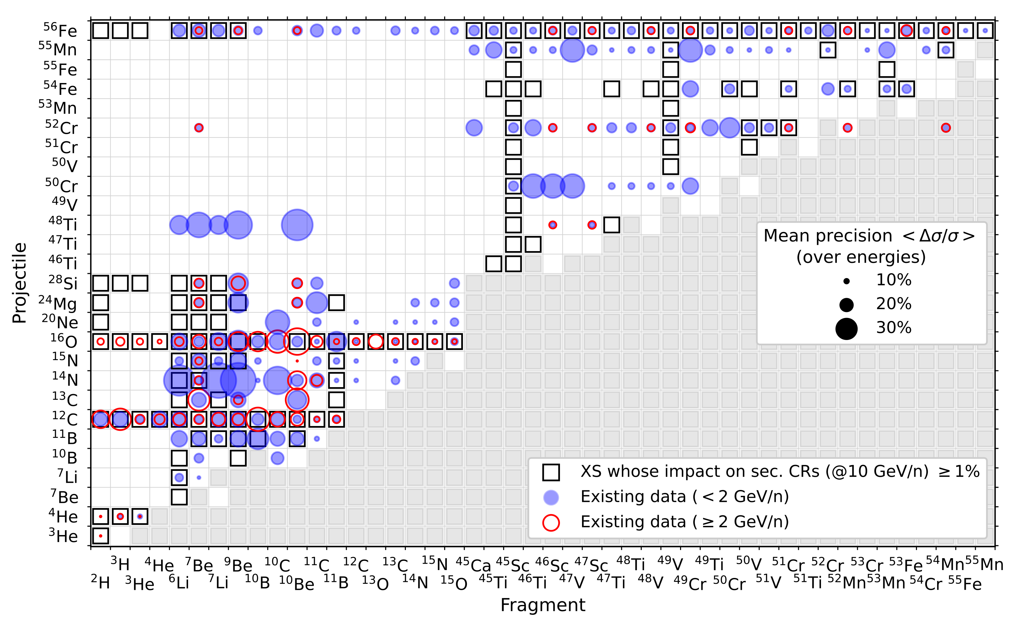
Existing data and their precision
XSCRC working group, arXiv:2503.22783

Slide 12
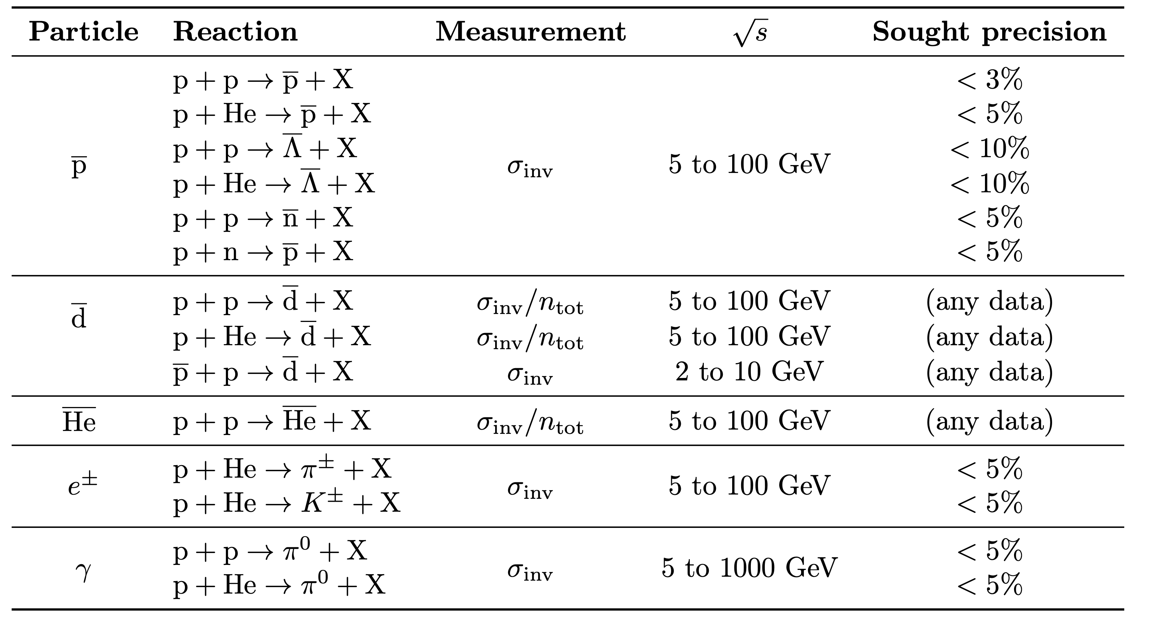

Antiparticle Production & DM
Note, 90% of ISM is
made of p and He
particularly relevant for understanding DM contributions of CR-flux
leptonic vs hadronic & DM
Multi-Messenger
XSCRC working group, series of workshops, see e.g arXiv:2503.16173

Slide 13

Monte Carlo Approach
nuclear
interaction
mostly relevant for in-source photon fields and extra- galactic CMB
Karl-Heinz Kampert - University of Wuppertal
EuNPC2025, Caen (France), Sept. 22-26, 2025

Slide 14
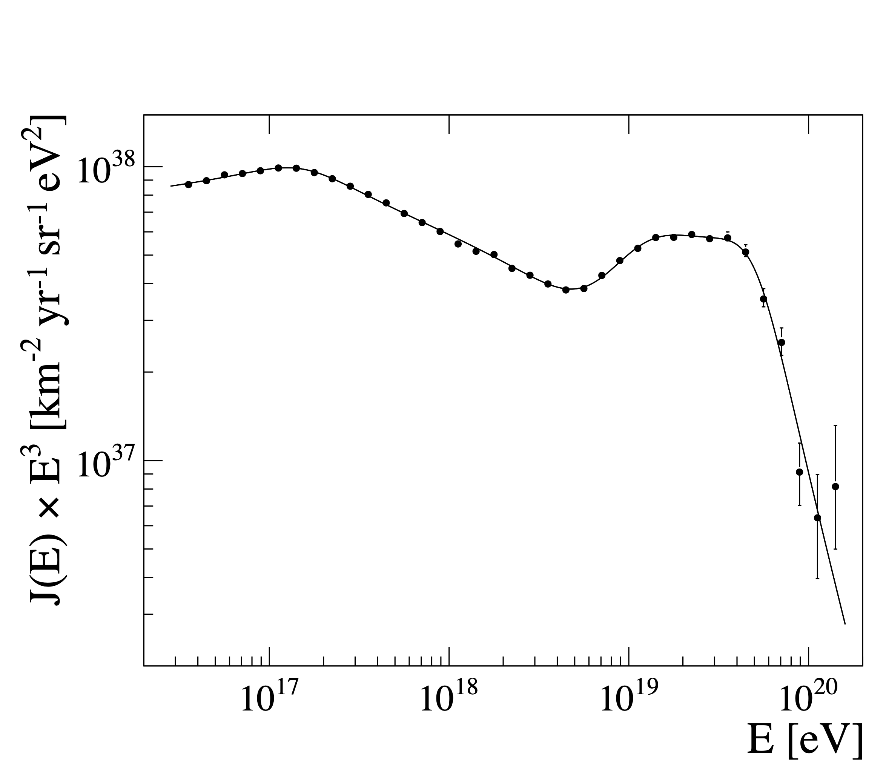
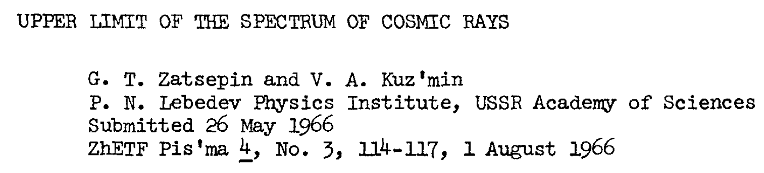

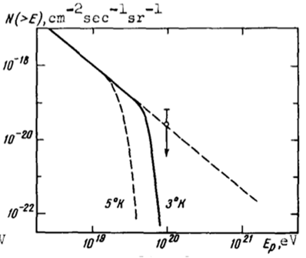


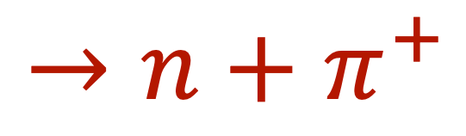
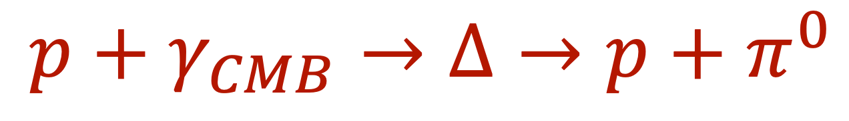
The End of the CR Energy Spectrum
1.7∙10¹⁷
ankle
2nd knee
4.6∙10¹⁹
5∙10¹⁸
⬆︎
in-step
cut-off
1.3∙10¹⁹
galactic origin
??
9 events
6 events
GZK-Effect:
UHECR above 6∙10¹⁹ eV suffer energy losses by photo-pion production
891 972 events
~80 000 km² sr yr exposure
$$p+γ_{CMB}→Δ→p+π^{0}$$
Auger Collaboration
Phys. Rev. Lett. 125, 121106 (2020); Phys. Rev. D 102, 062005 (2020), Eur. Phys. J. C 81 (2021) 966; A. Brichetto, PoS(ICRC2023) 398
$$→n+π^{+}$$
Karl-Heinz Kampert - University of Wuppertal
EuNPC2025, Caen (France), Sept. 22-26, 2025

Slide 15
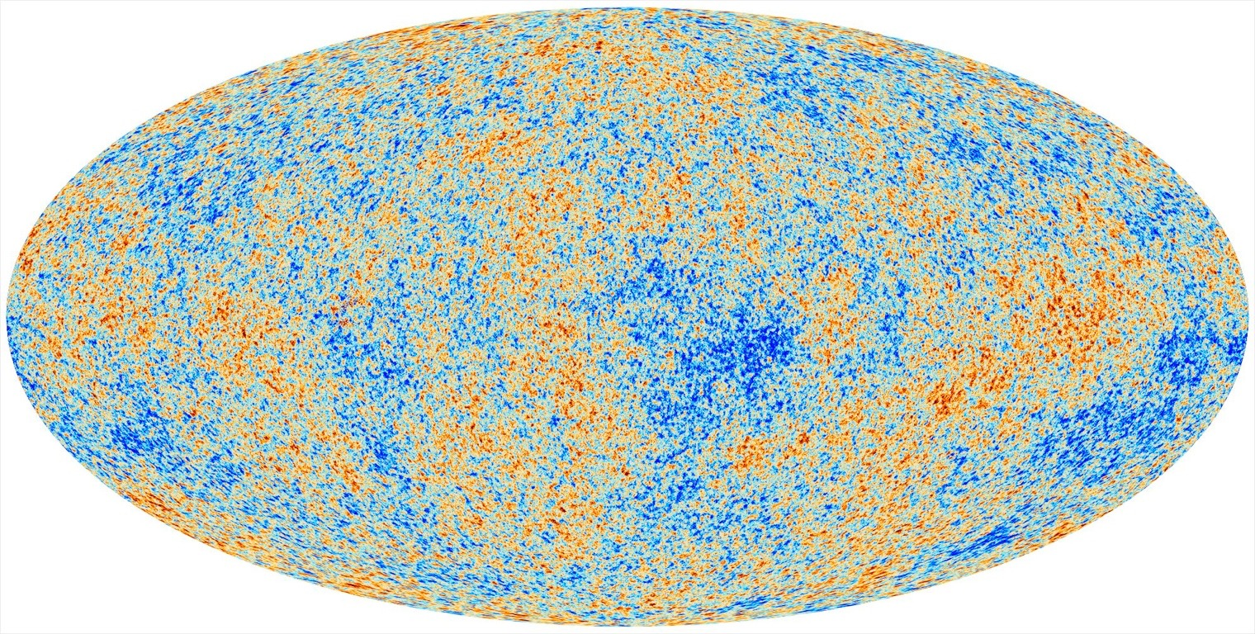


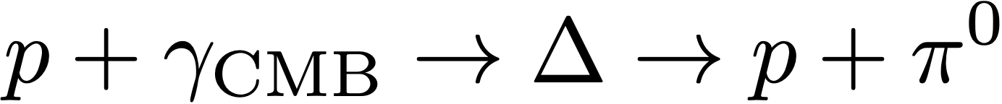
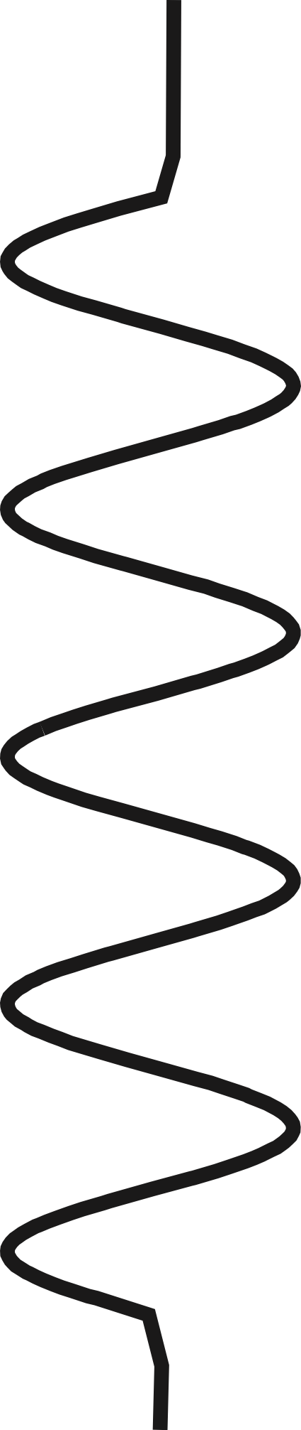

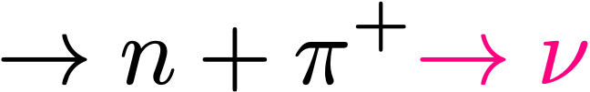
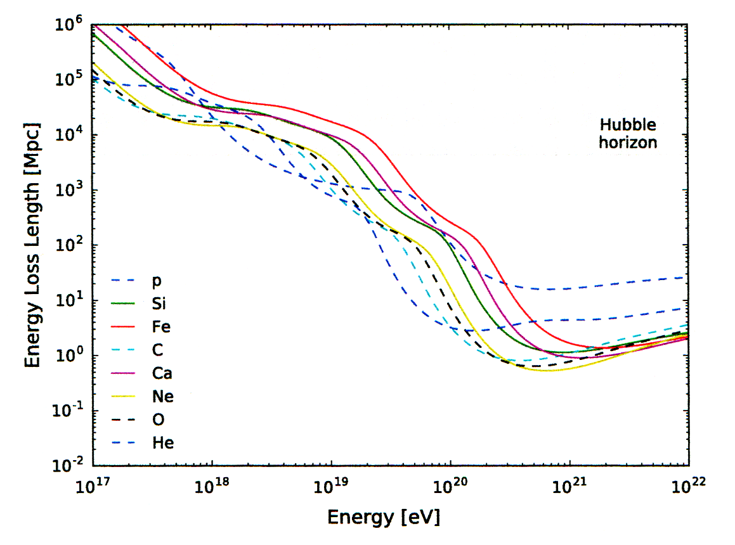

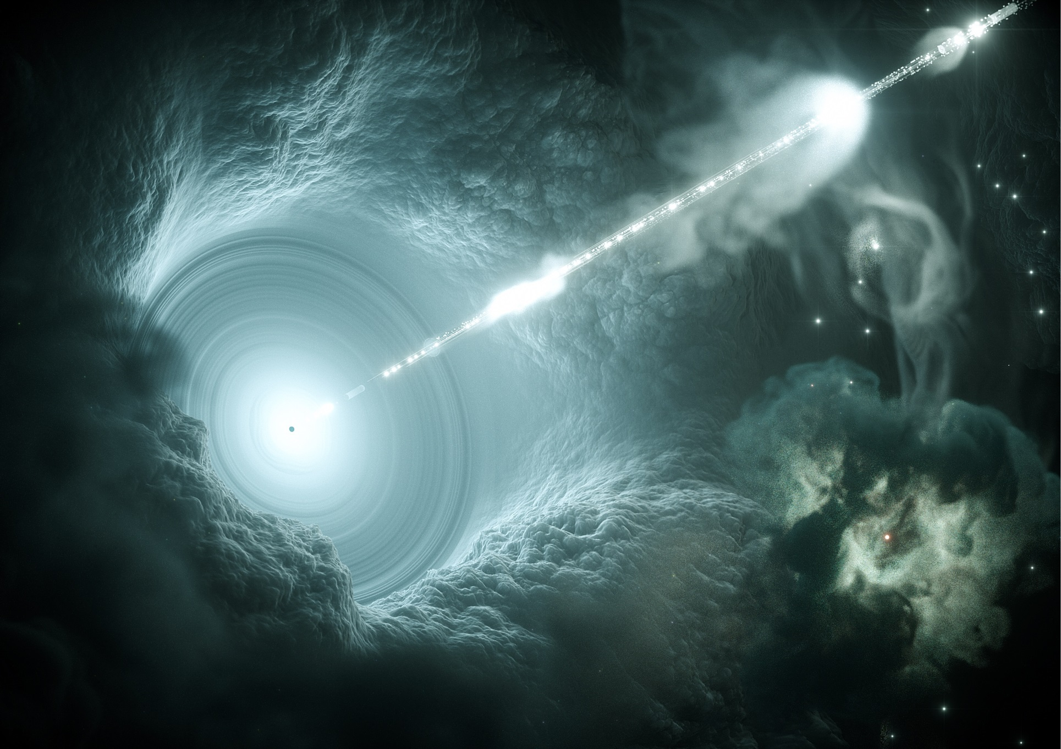
GZK-effect: Rapid Energy Loss of p & Nuclei in CMB
photo-pion production
p
p
π
CMB
CMB
A
Same processes expected
in Active Galactic Nuclei
E-loss in CMB
photo disintegration
E-loss in IRB
Fe
p
He
Greisen-Zatsepin-Kuz‘min (1966)
threshold: E_{p}E_{γ} > (m_{Δ}² - m_{p}²)
⇒ E_{GZK} ≈ 6·10¹⁹ eV
➙ GZK-Horizon ~ 60 Mpc
KHK et al., Astropart. Phys. 42 (2013) 41
Notes:
p+\gamma_{CMB} \to \Delta & \to & p+\pi^{0} \\
& \to & n+\pi^{+}
\lambda_{free} = \frac{1}{n_\gamma \cdot \sigma_{p\gamma}} \approx 8 {\rm ~Mpc}

Slide 16
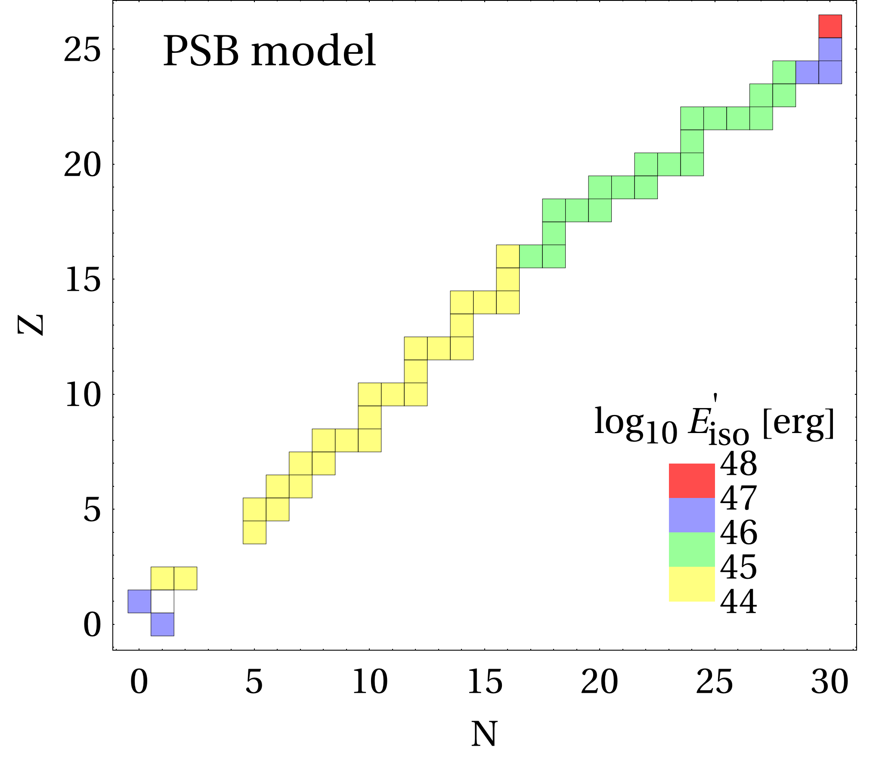
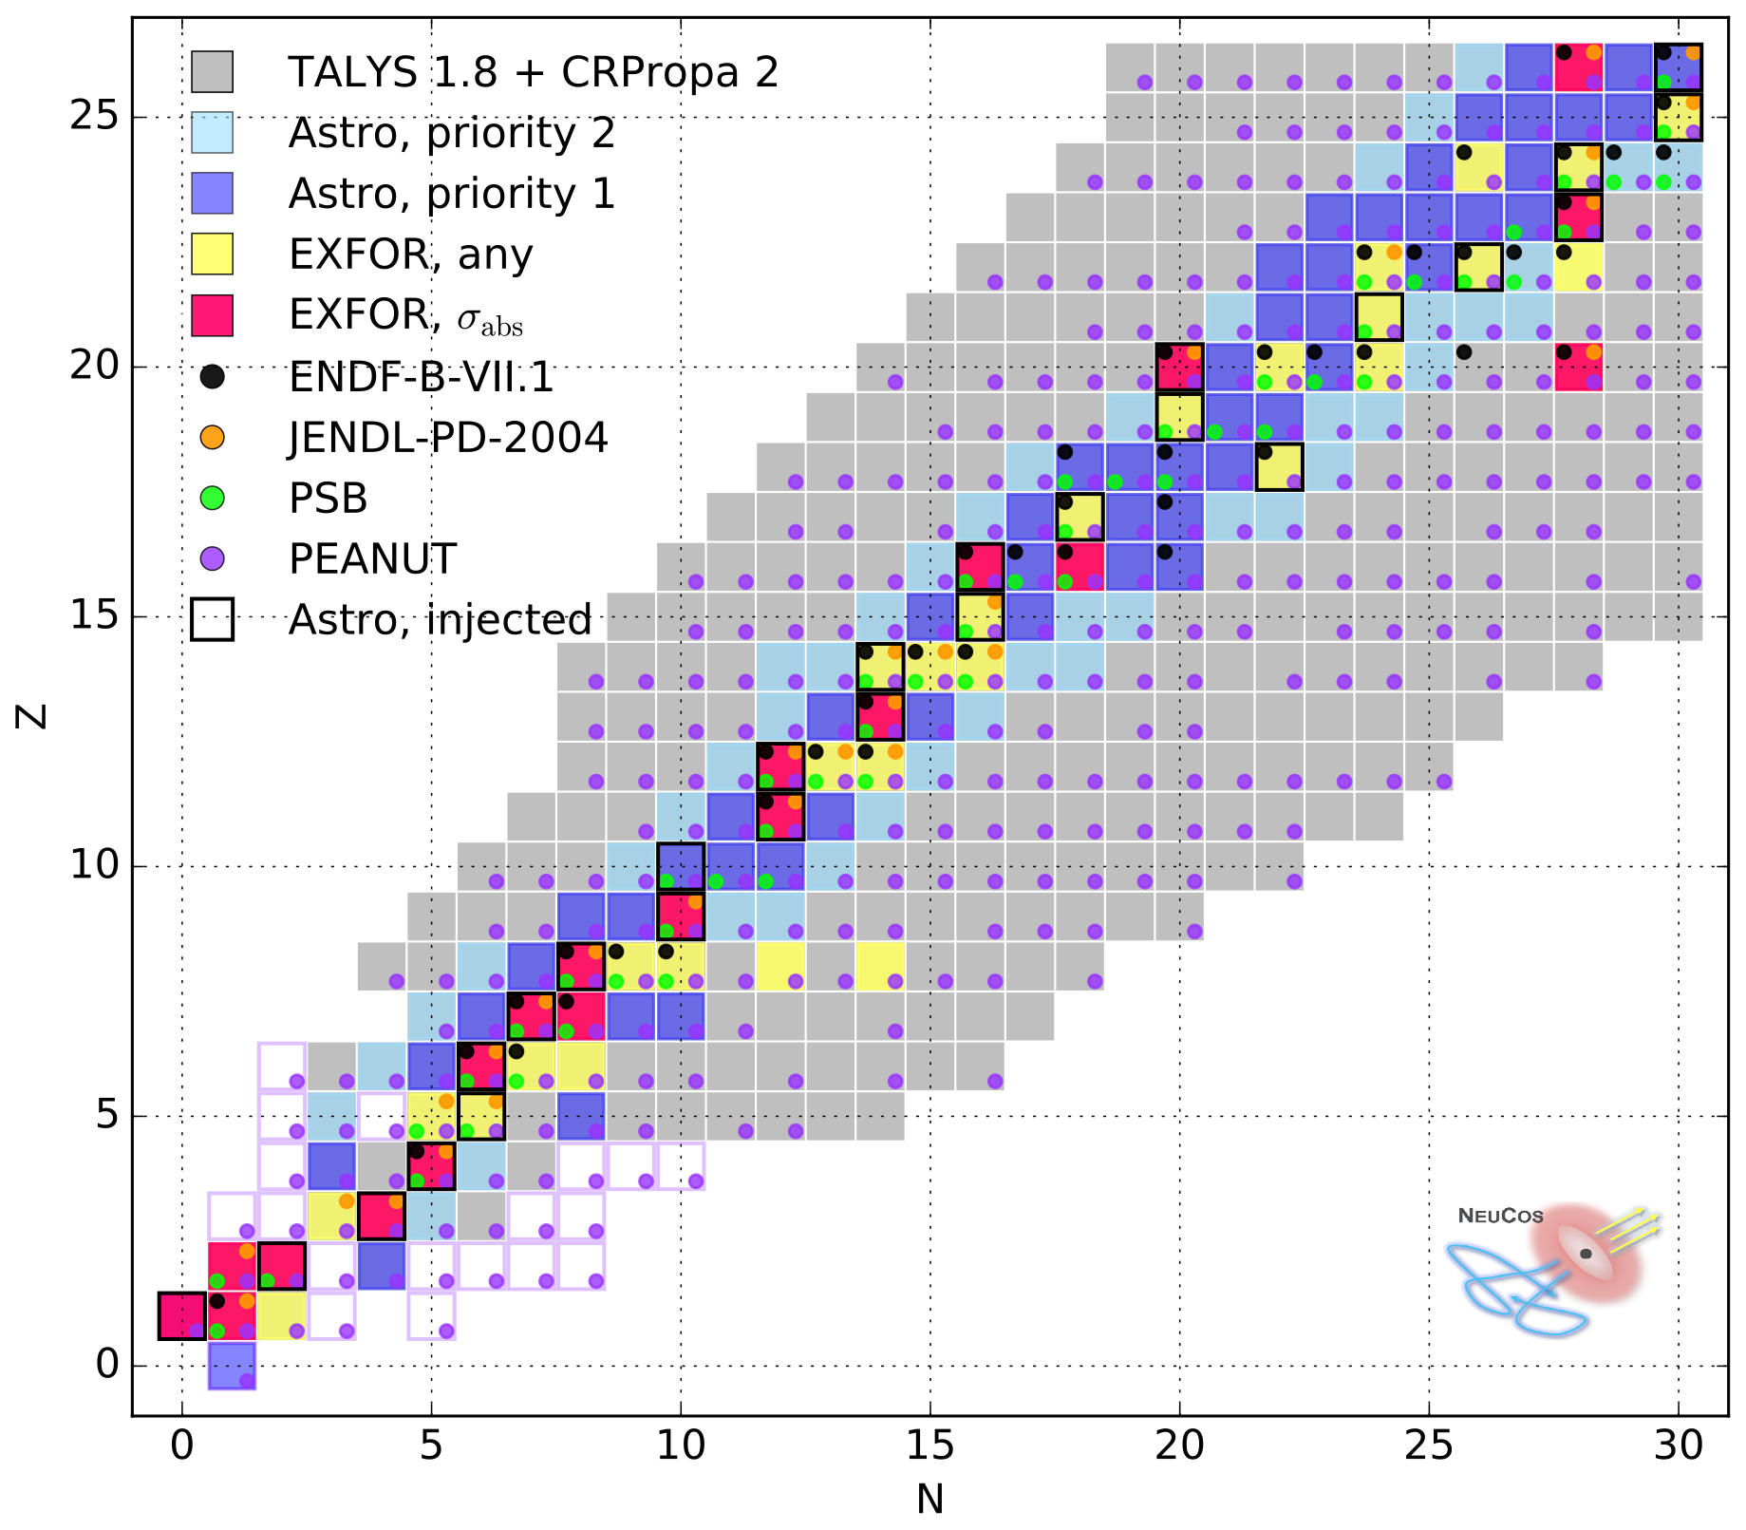
Photodisintegration in CRPropa (using TALYS)
Fe
Pudget, Stecker, Bredekamp ApJ205 (1976) 638
p
Classical PSB-Model for comparison:
• only main isotope considered • simple scaling of cross sections
• one nucleon loss assumption
Boncioli, Fedynitch Winter, Scientific Reports 7:4882 (2017)
Karl-Heinz Kampert - University of Wuppertal
EuNPC2025, Caen (France), Sept. 22-26, 2025

Slide 17
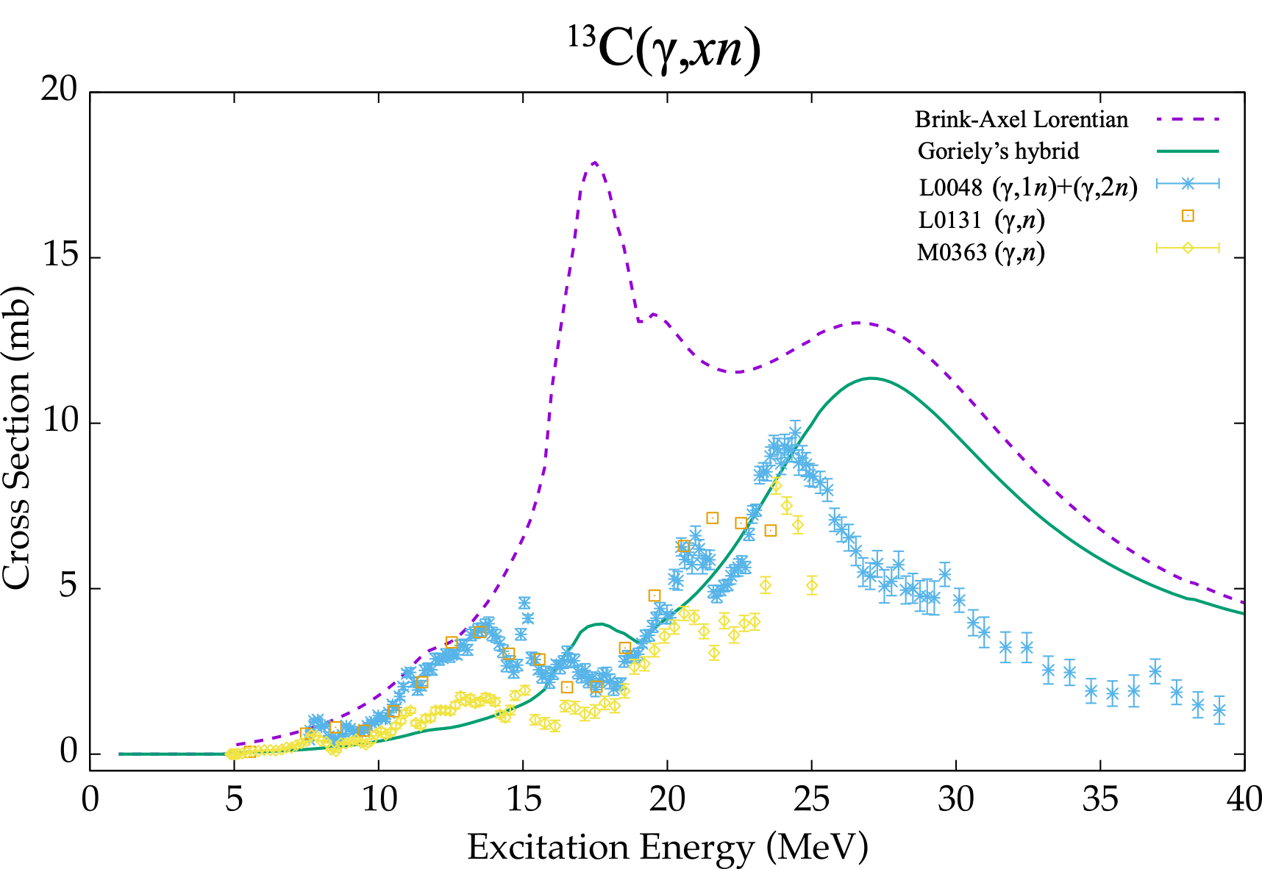
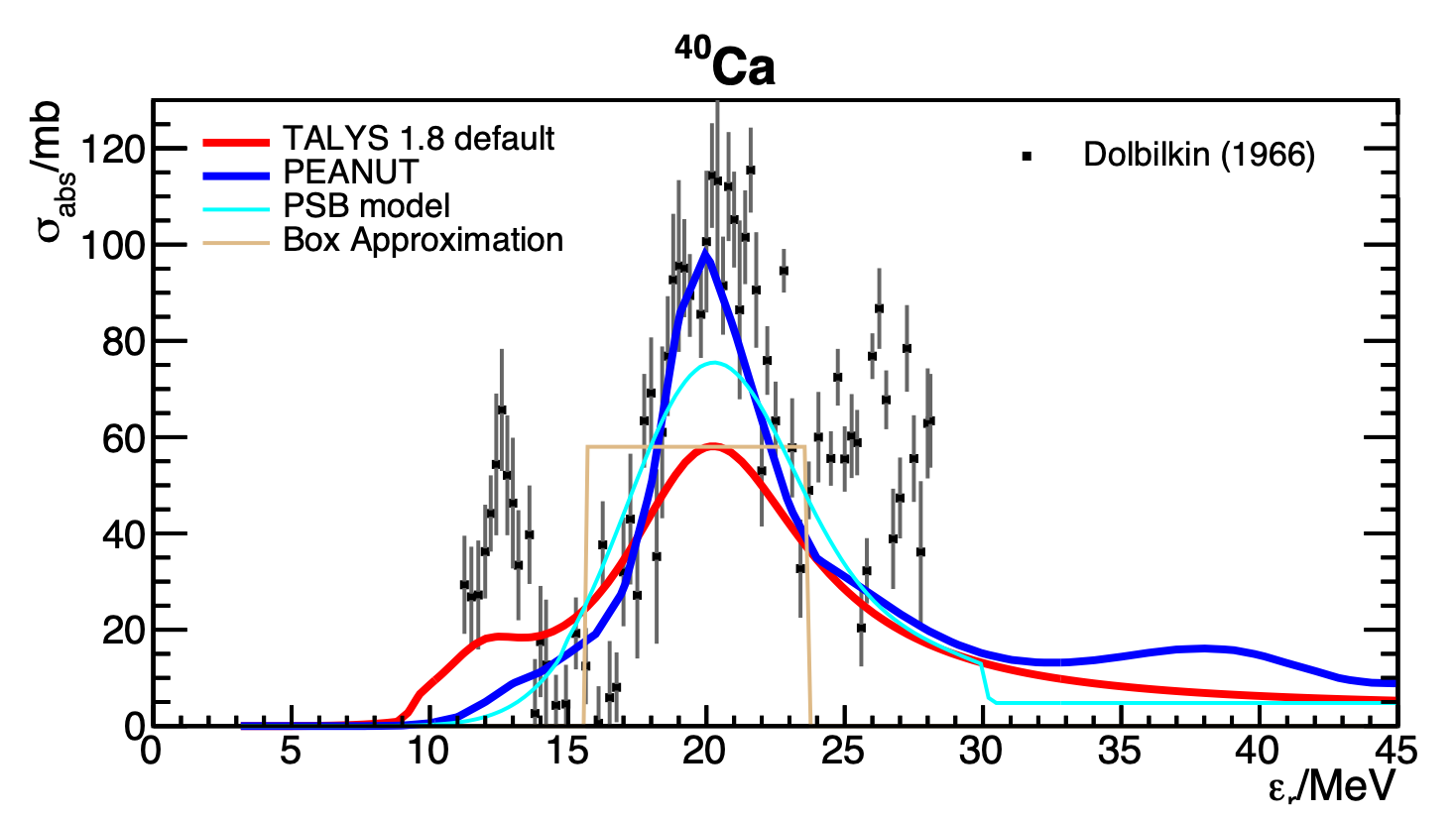
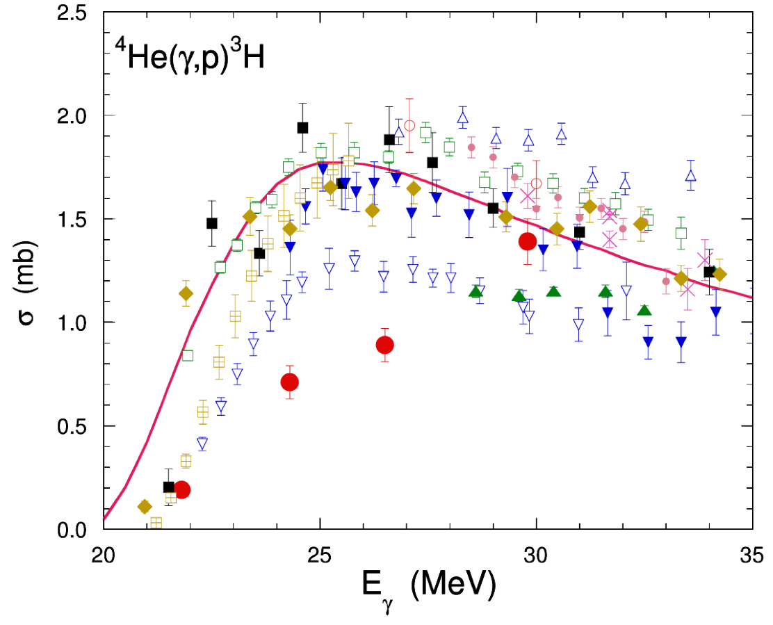
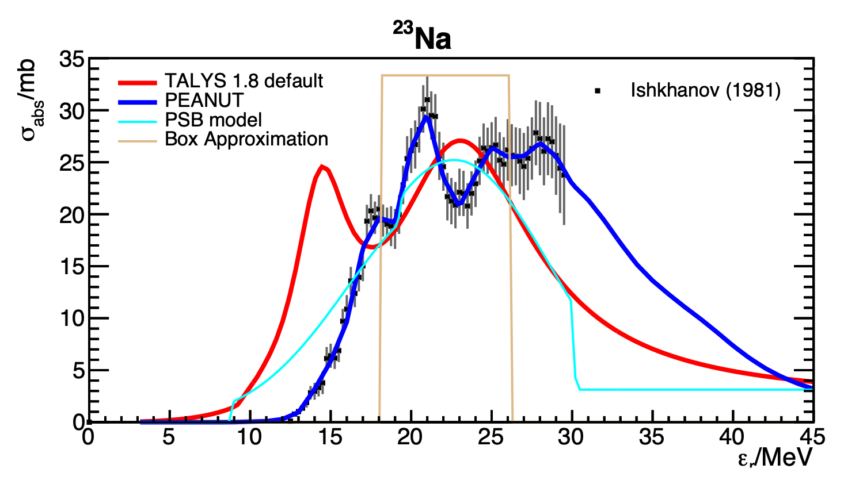
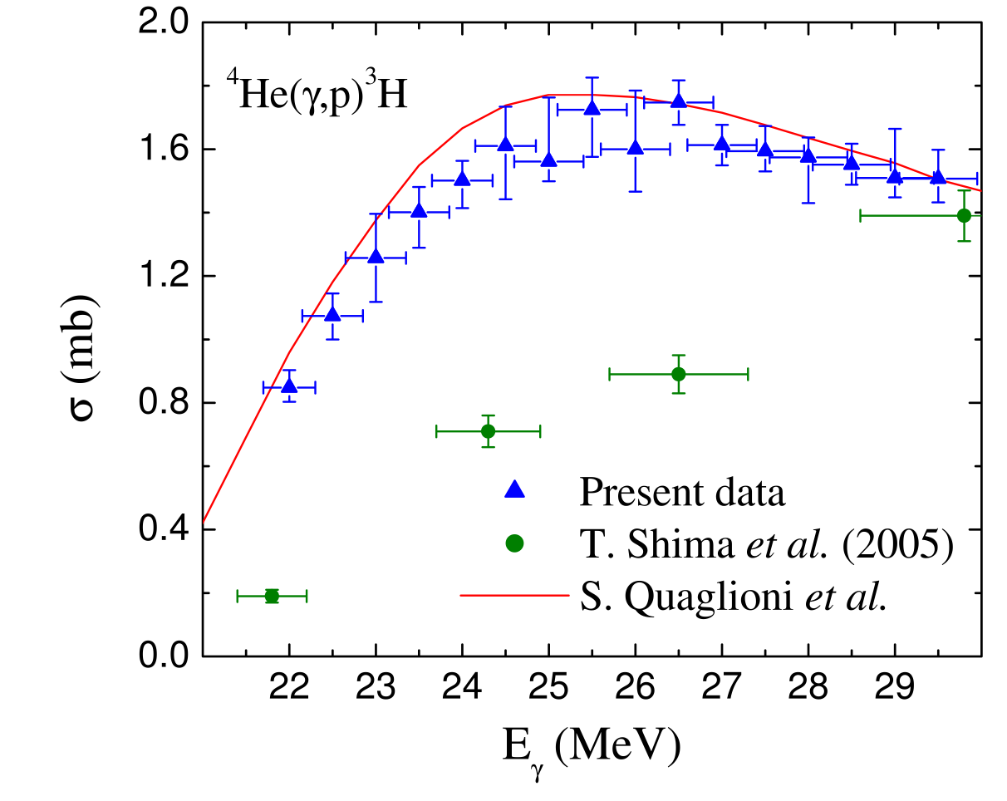
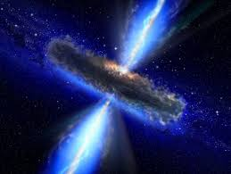
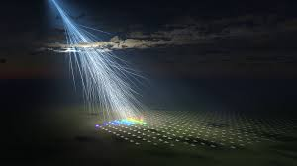
Examples of Missing X-sections and Uncertainties
Tamii, et al., Eur. Phys. J. A (2023) 59:208
R. Raut et al., PRL 108 (2012) 042502
UHECR transfer function Source → Earth significantly affected by unknown and poorly known cross sections
Boncioli, Fedynitch Winter, Scientific Reports 7:4882 (2017)
Karl-Heinz Kampert - University of Wuppertal
EuNPC2025, Caen (France), Sept. 22-26, 2025

Slide 18
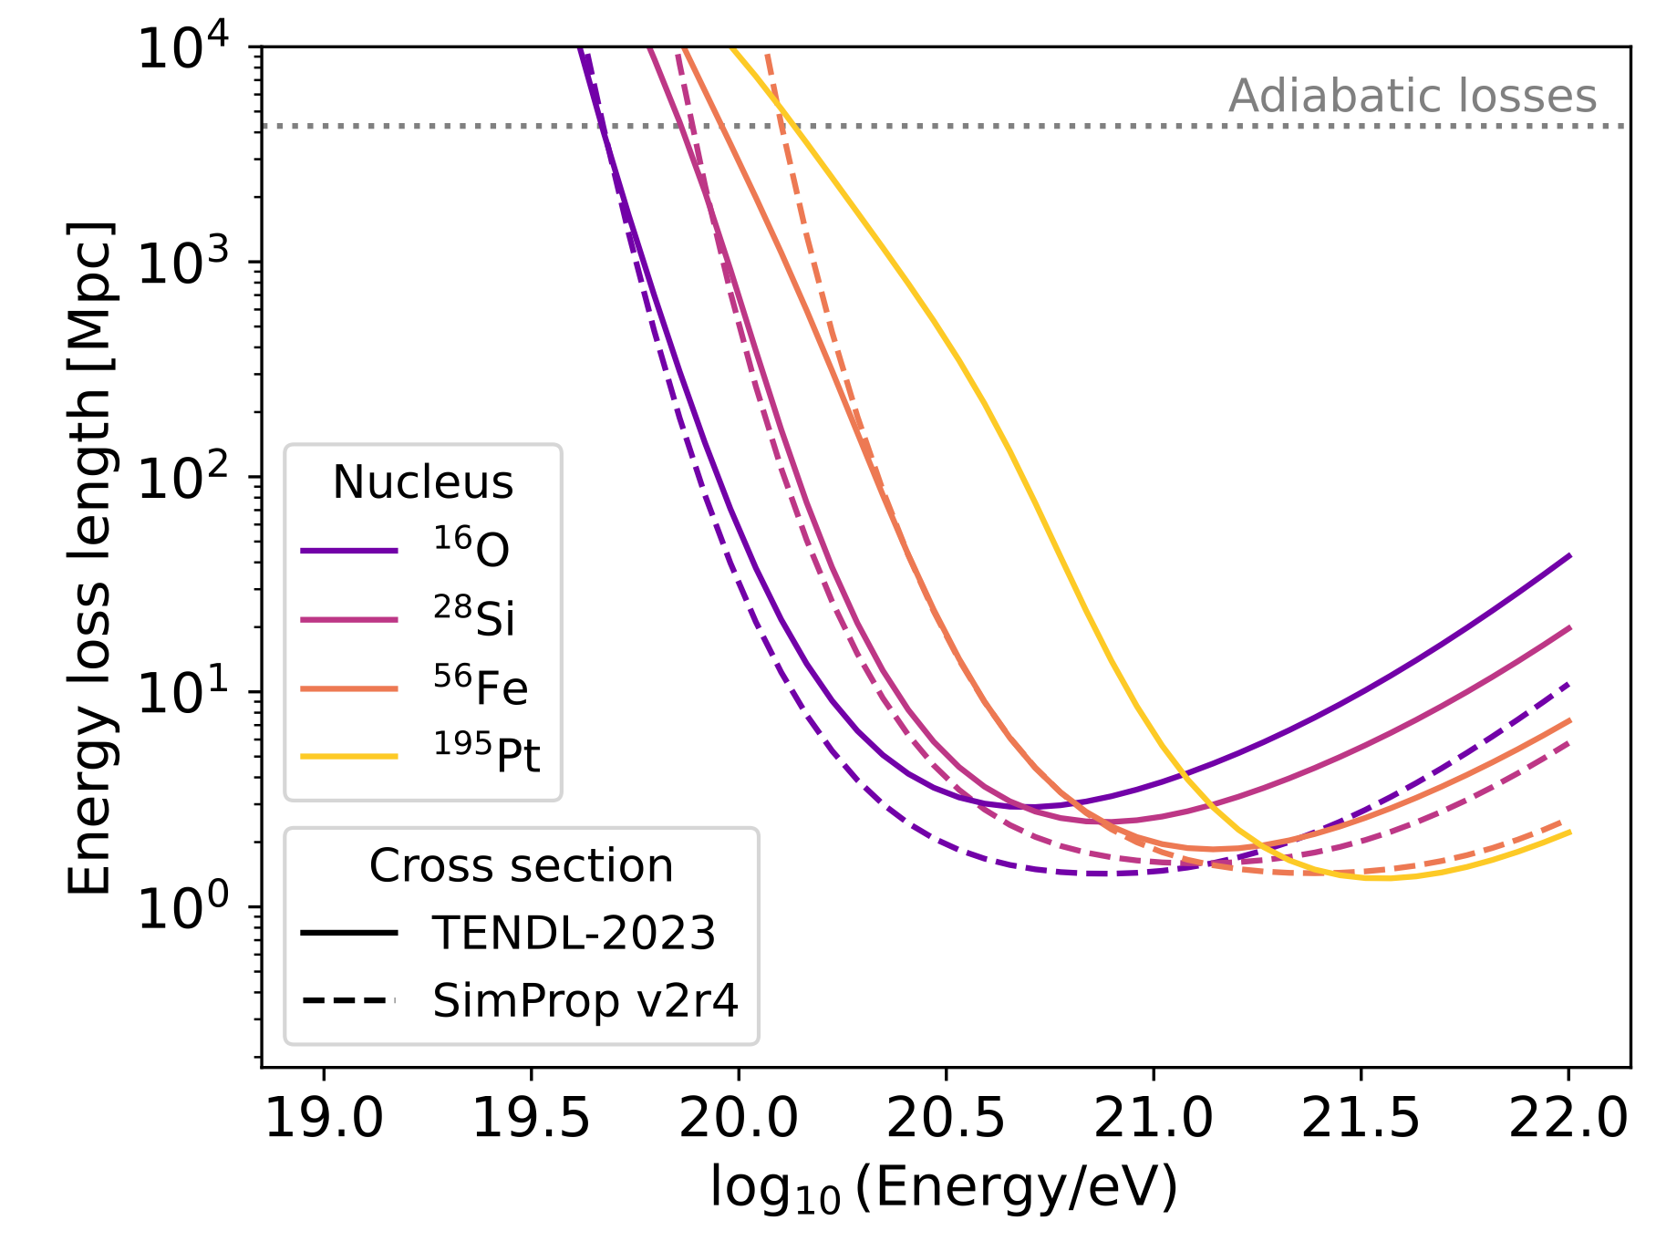
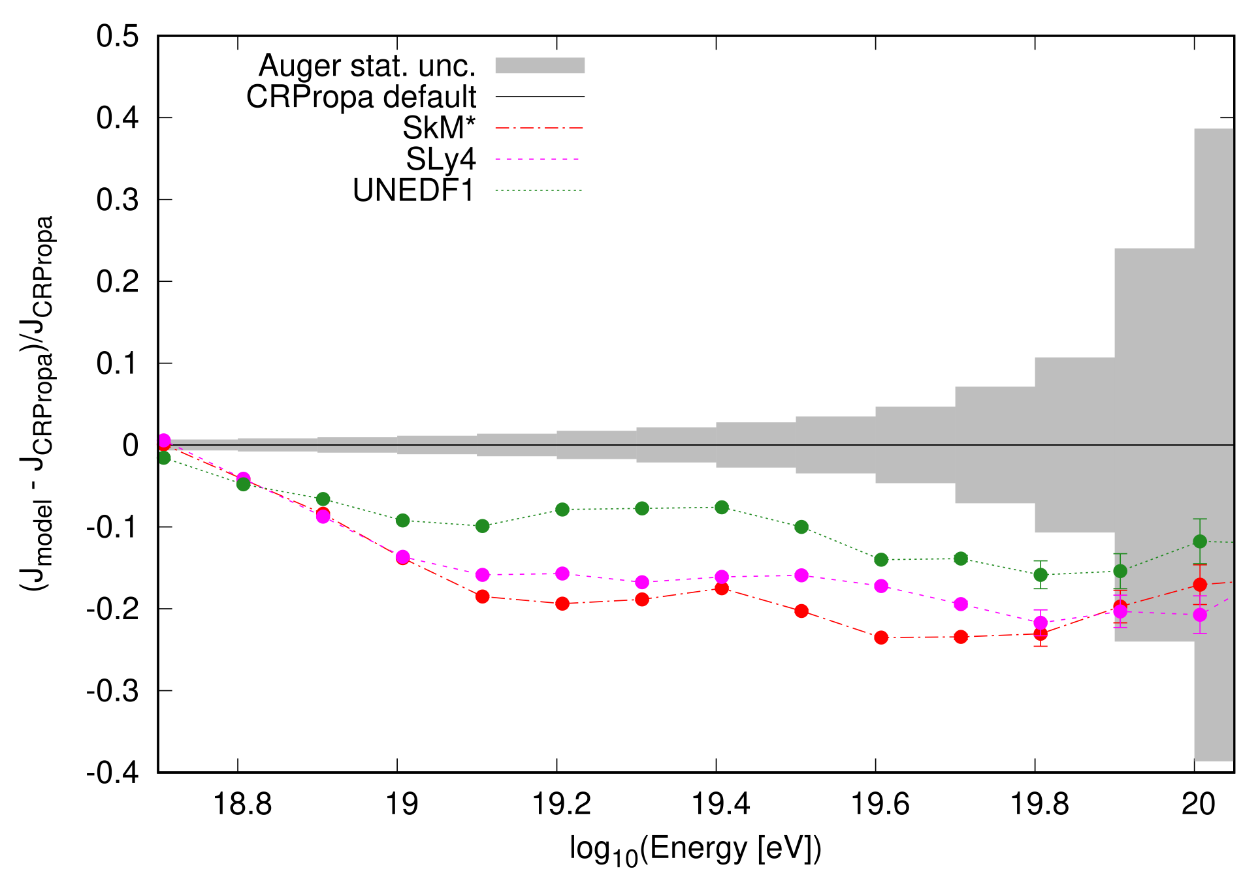
Effects of photo-disintegration uncertainties to UHECR observations
Differences in Energy Loss-Lentgh
Differences in UHECR flux at Earth
CrPropa
different parameter sets of Skyrme energy-density functionals
L.A. Dourado et al, PoS(UHECR2024)067
E. Kido, et al., Astropart. Phys. 153 (2023) 102866
Karl-Heinz Kampert - University of Wuppertal
EuNPC2025, Caen (France), Sept. 22-26, 2025

Slide 19
Summary
Advanced in Cosmic ray physics – and Astroparticle physics in general – are slowed down due to lack of precision in nuclear physics cross section data
e.g. extracting galactic diffusion coefficients and possible DM signals from AMS02 and other Exp’ts suffers from modelling CR interactions rather than from observational data
Propagation of UHE-Nuclei in CMB suffers from lack of precise photo-disintegration data → source properties cannot be constrained well
Similarly, modelling of air-shower data cannot describe experimental data due to limitations of event generators → F. Riehn, tomorrow
Several joint projects have been started, but many more are required

