Slide 1
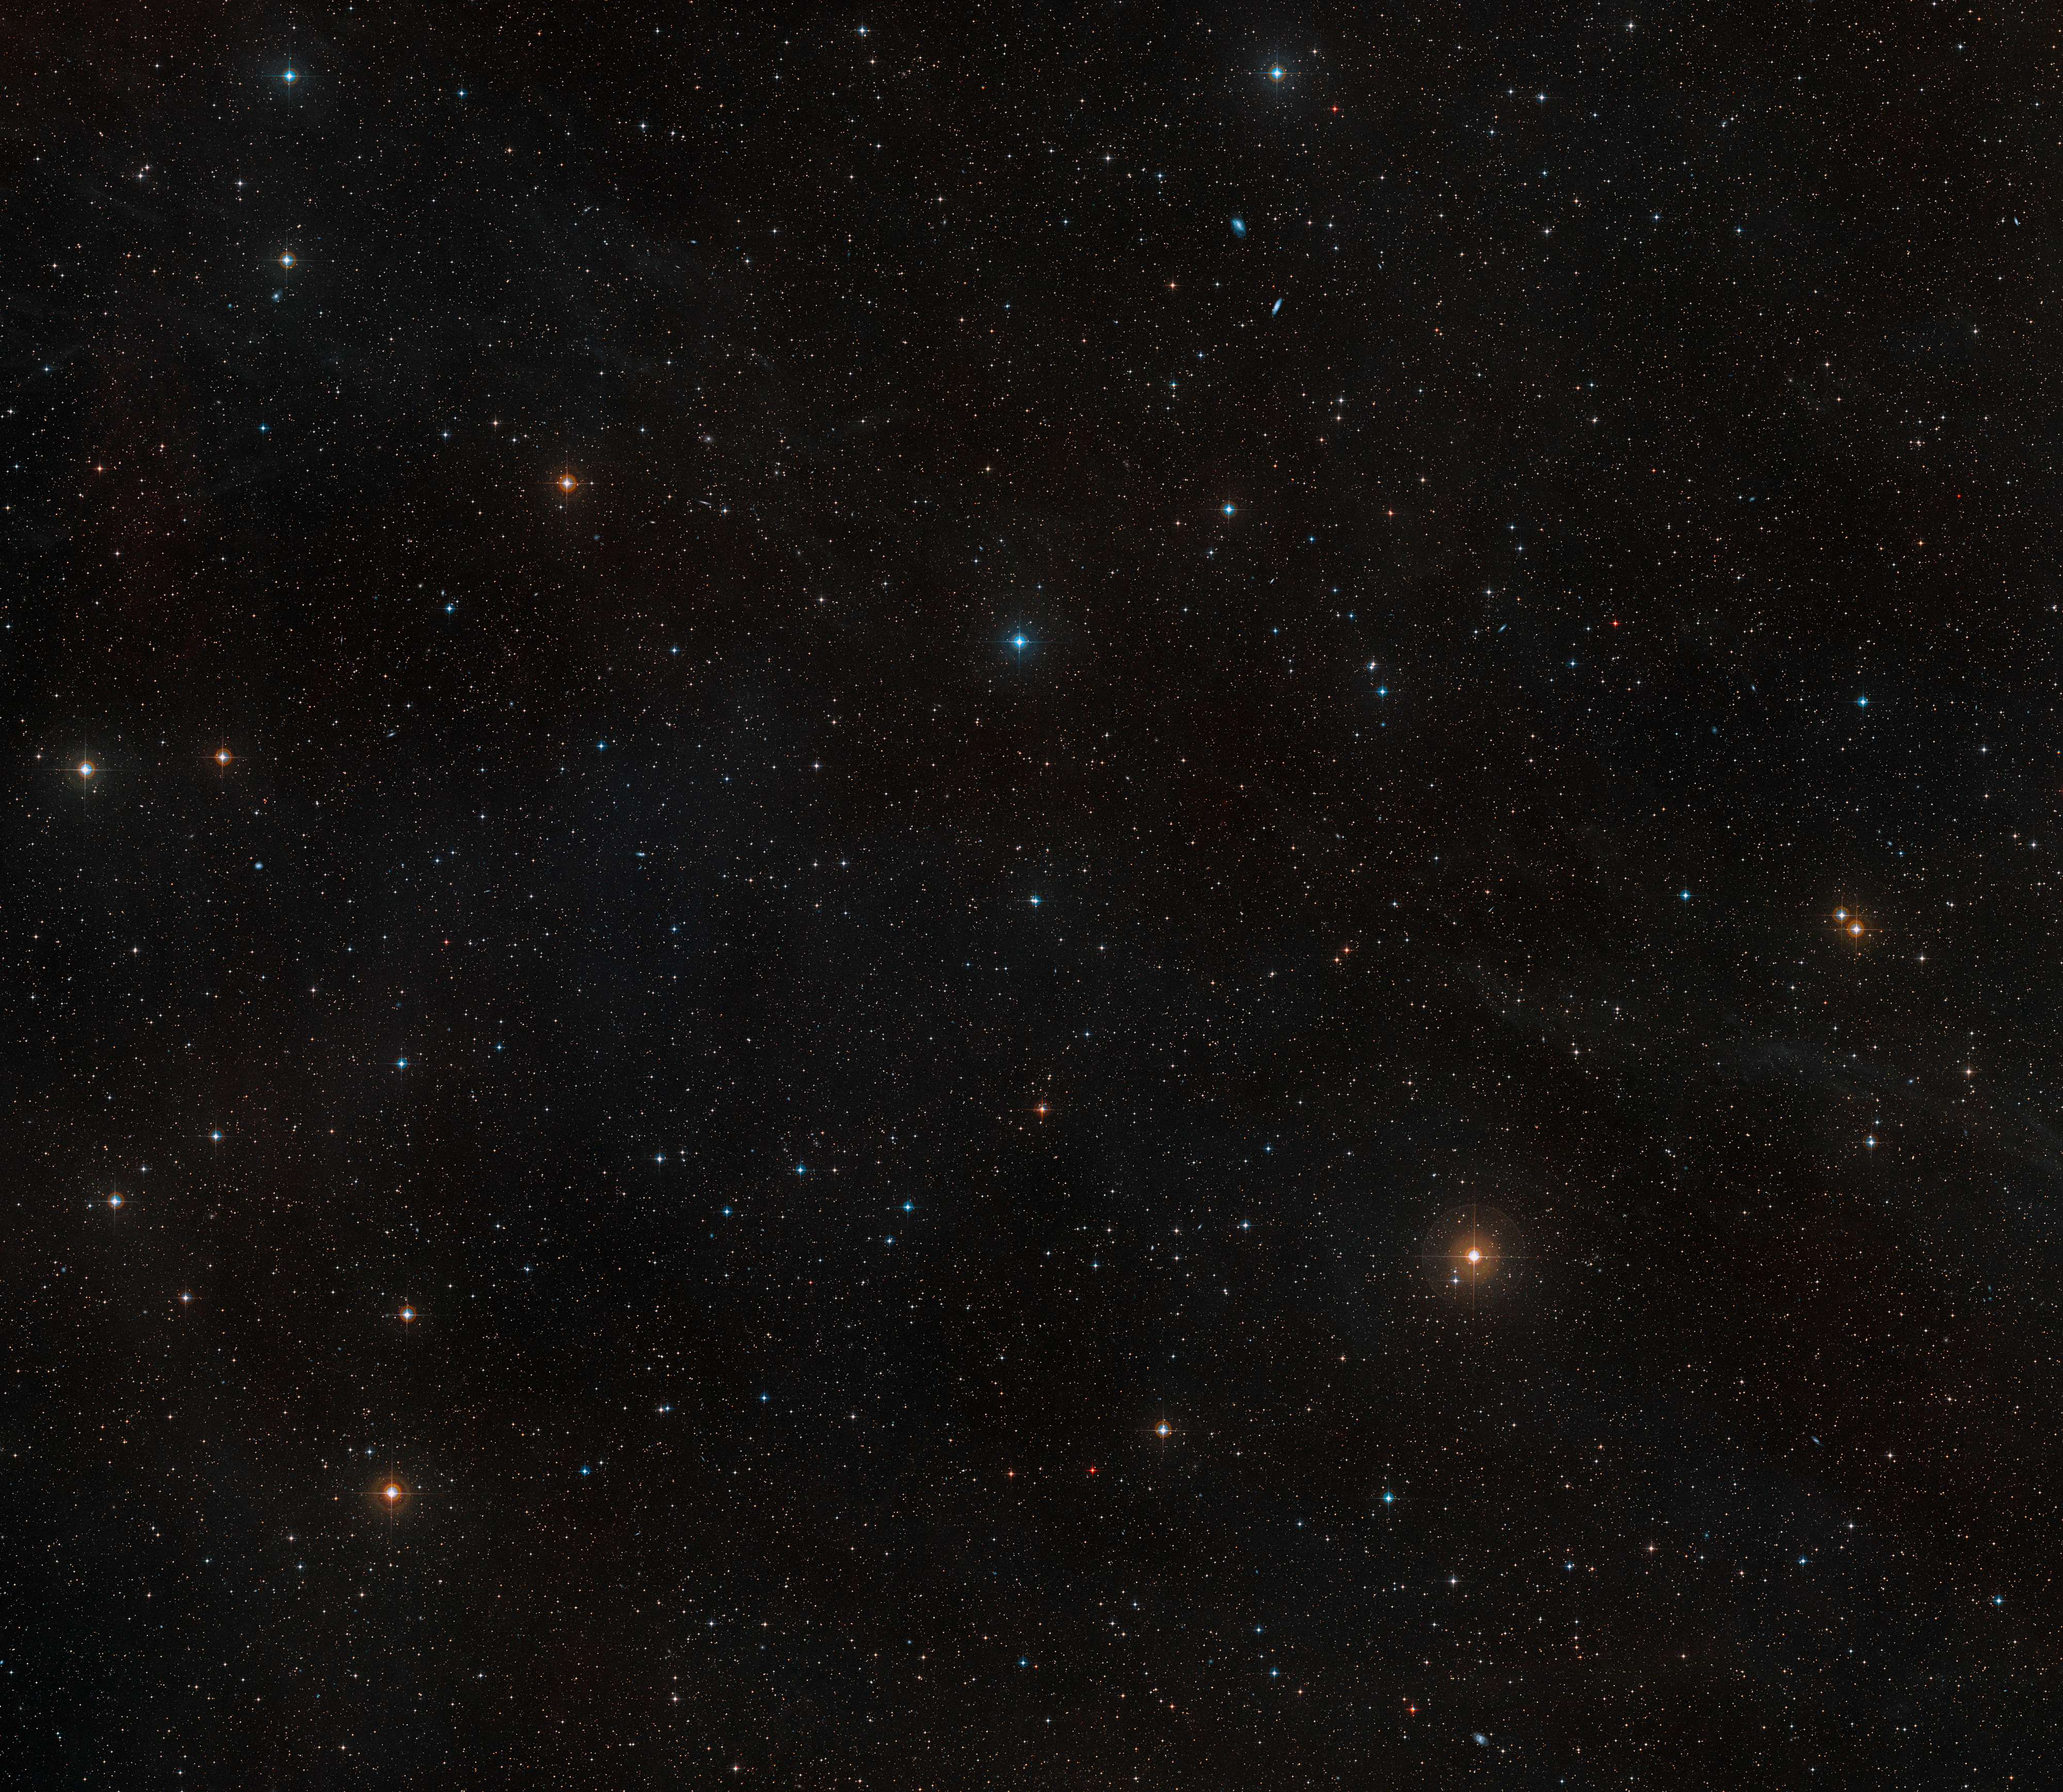
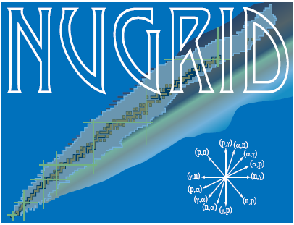




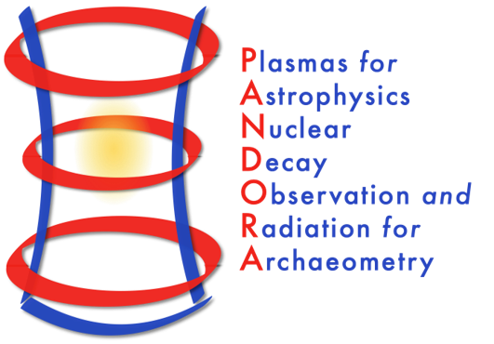
Nucleosynthesis in zero and extremely low metallicity rotating massive stars
European Nuclear Physics Conference 2025
Caen, Sep 22, 2025
Lorenzo Roberti, INFN – Laboratori Nazionali del Sud, Catania, Italy
Main collaborations:
Pandora + AsFiN
Budapest group: M. Pignatari, M. Lugaro
Rome + Berkeley group: M. Limongi, A. Chieffi, A. Falla, L. Boccioli
NuGriD collaboration

Slide 2

Zero and extremely low metallicity massive stars
Lack of CNO nuclei: early activation of 3$α$ reaction during H burning→ H and He burning zones operate at similar temperature;
Activation of 3$α$ reaction up to Z$\sim {10}^{−6}$ (second generation stars);
Hot CNO cycle activation and possible H ingestion in He burning regions→¹⁴N production, i-process?
Lack of neutron sources and Fe-seeds for s-process nucleosynthesis.

Slide 3

The s-process during central He burning
¹⁴N($α$, $γ$)¹⁸F($β$⁺)¹⁸O($α$, $γ$)²²Ne at Tc$\sim$200 MK, followed by ²²Ne($α$,n)²⁵Mg at Tc$\sim$300 MK (in competition with ²²Ne($α$, $γ$)²⁶Mg);
Efficiency scales with the initial metallicity → depends on ¹⁴N left by CNO cycle;
Limited by the metallicity and low neutron-to-seed ratio: only able to produce weak s-process component (Sr, Y, Zr) at $\sim$solar metallicity;
The bulk of the s-process yields ejected after the CCSN is produced in central He burning; marginal contribution from the He and C burning shells.

Slide 4
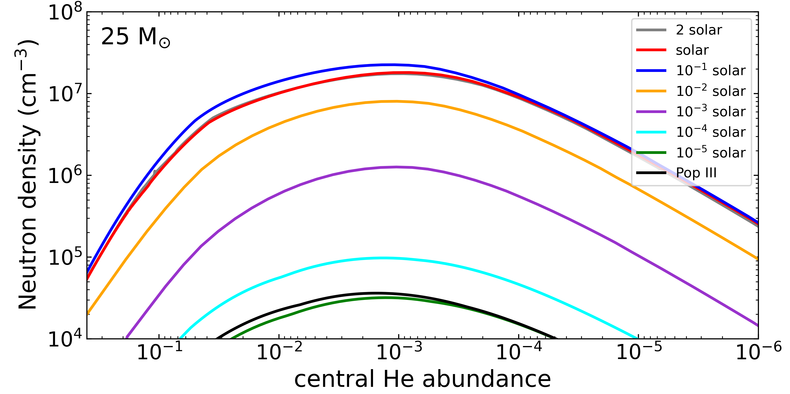
The s-process during central He burning

Slide 5
Rotation in massive stars
Rotational instabilities → Mixing between convective zones;
Important in H and He central burning phases: advanced phases (C, Ne, O, Si burning) too fast compared to secular instabilities;
Impact on ¹⁴N, ¹⁹F and s-process elements: higher neutron-to-seed ratio → beyond the weak s-process peak.

Slide 6
Rotation induced mixing
He convective core
He radiative core
H-rich zone
p
⁴He → ¹²C
p
p
Non rotating star

Slide 7
Rotation induced mixing
¹²C
He convective core
He radiative core
H-rich zone
¹²C
p
⁴He → ¹²C
¹²C
p
¹²C
p
Rotating star

Slide 8
Rotation induced mixing
¹²C
He convective core
He radiative core
H-rich zone
¹²C
p
⁴He → ¹²C
¹²C
p
¹²C
p
Rotating star
¹²C+p → CNO (¹⁴N, ¹³C, ¹⁵N, ¹⁷O)

Slide 9
Rotation induced mixing
¹²C
He convective core
He radiative core
H-rich zone
¹²C
p
⁴He → ¹²C
¹²C
p
¹⁴N
¹²C
p
CNO + ⁴He
Rotating star
¹²C+p → CNO (¹⁴N, ¹³C, ¹⁵N, ¹⁷O)

Slide 10
Rotation induced mixing
¹²C
He convective core
He radiative core
H-rich zone
¹²C
p
⁴He → ¹²C
CNO pocket
¹²C
p
(¹⁴N, ¹³C, ¹⁵N, ¹⁷O)
¹⁴N → ²²Ne → neutrons
¹²C
p
CNO + ⁴He
Rotating star
¹²C+p → CNO (¹⁴N, ¹³C, ¹⁵N, ¹⁷O)

Slide 11
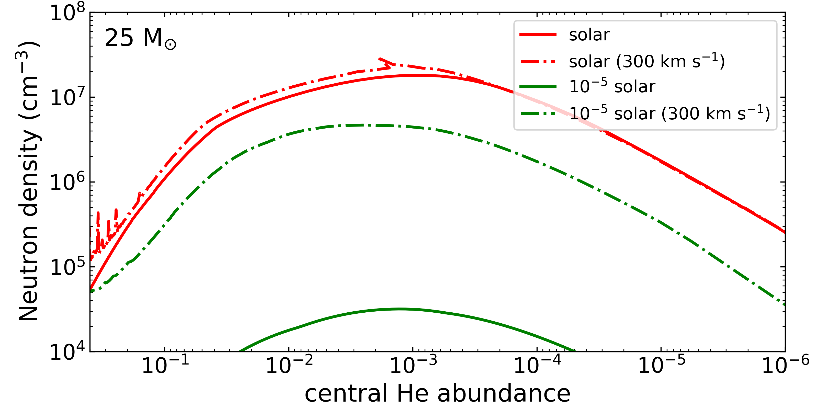
The s-process in rotating massive stars

Slide 12
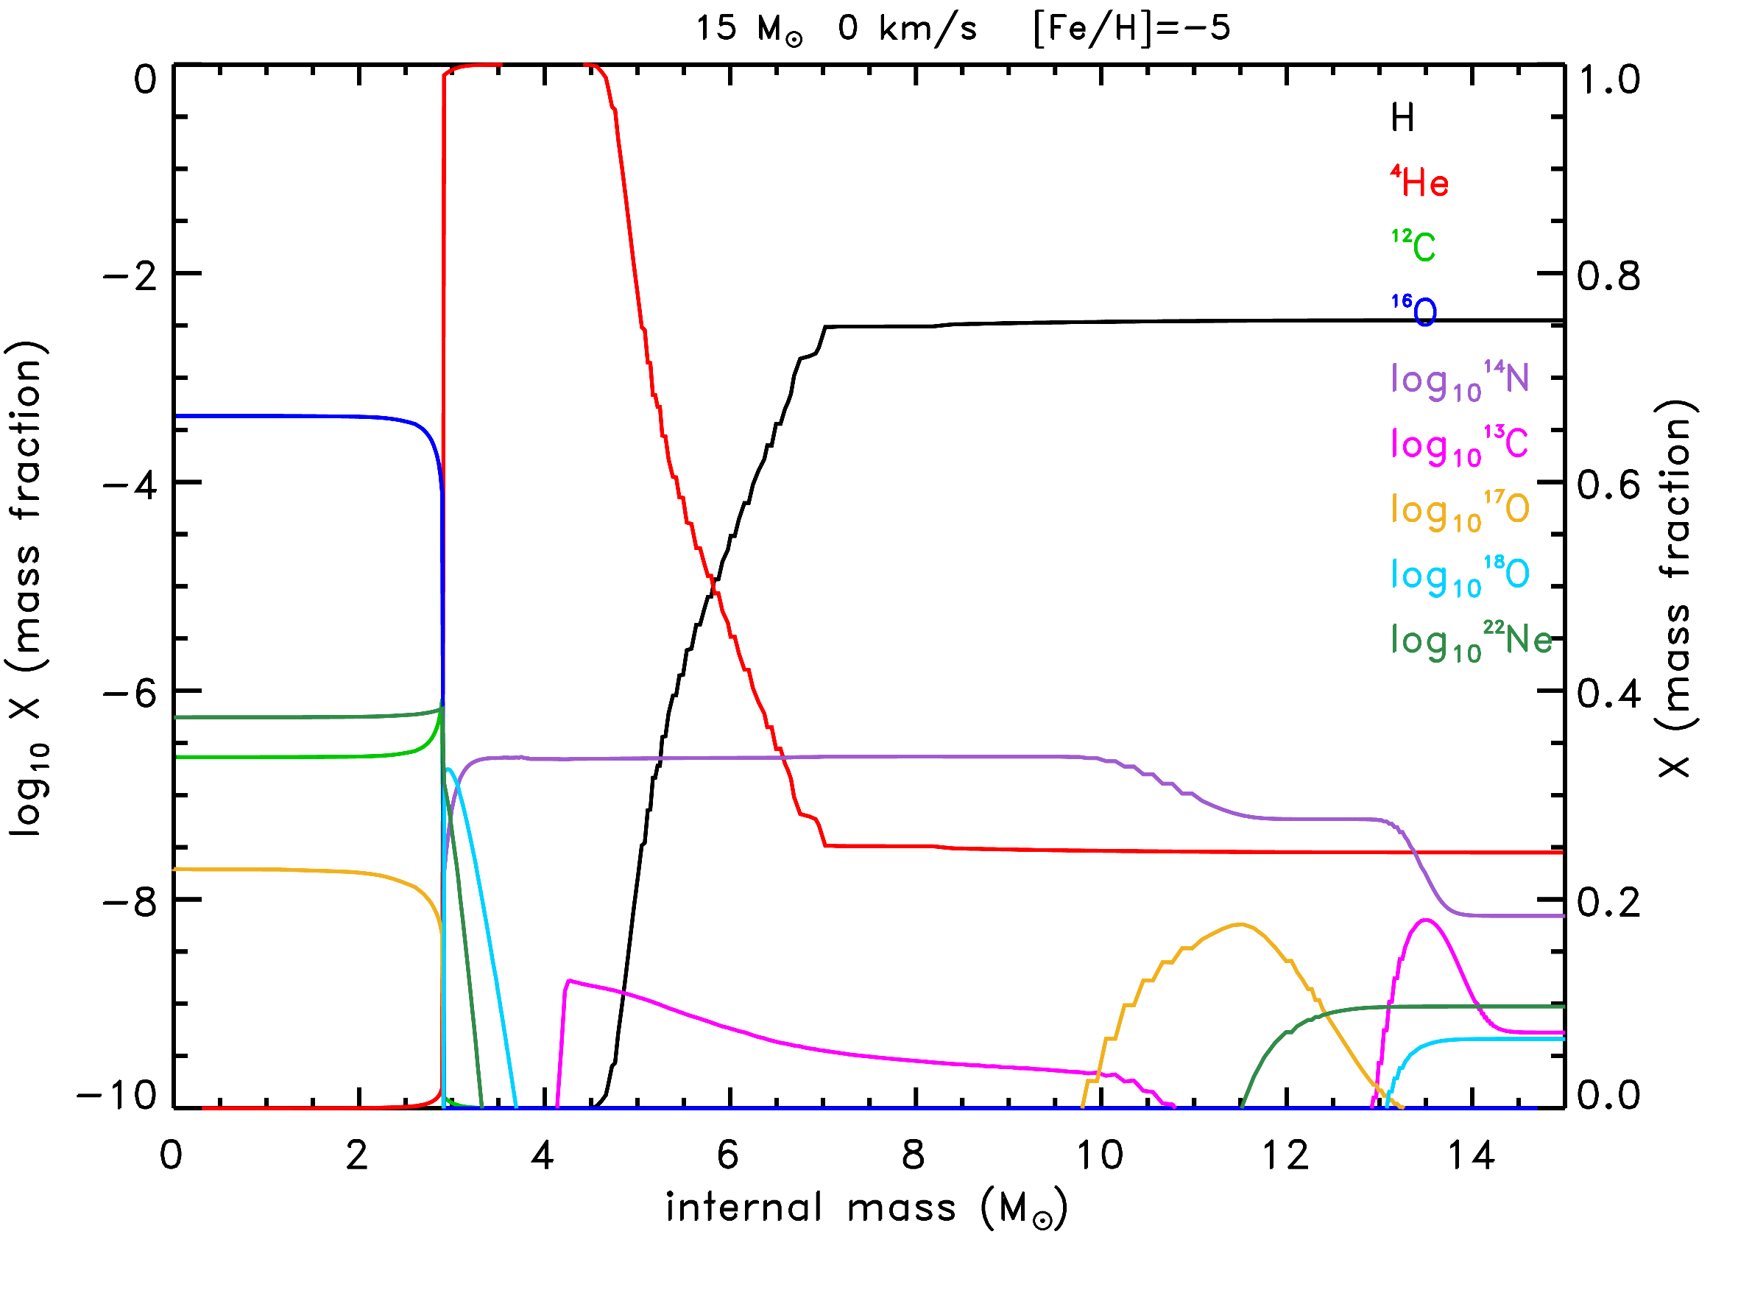
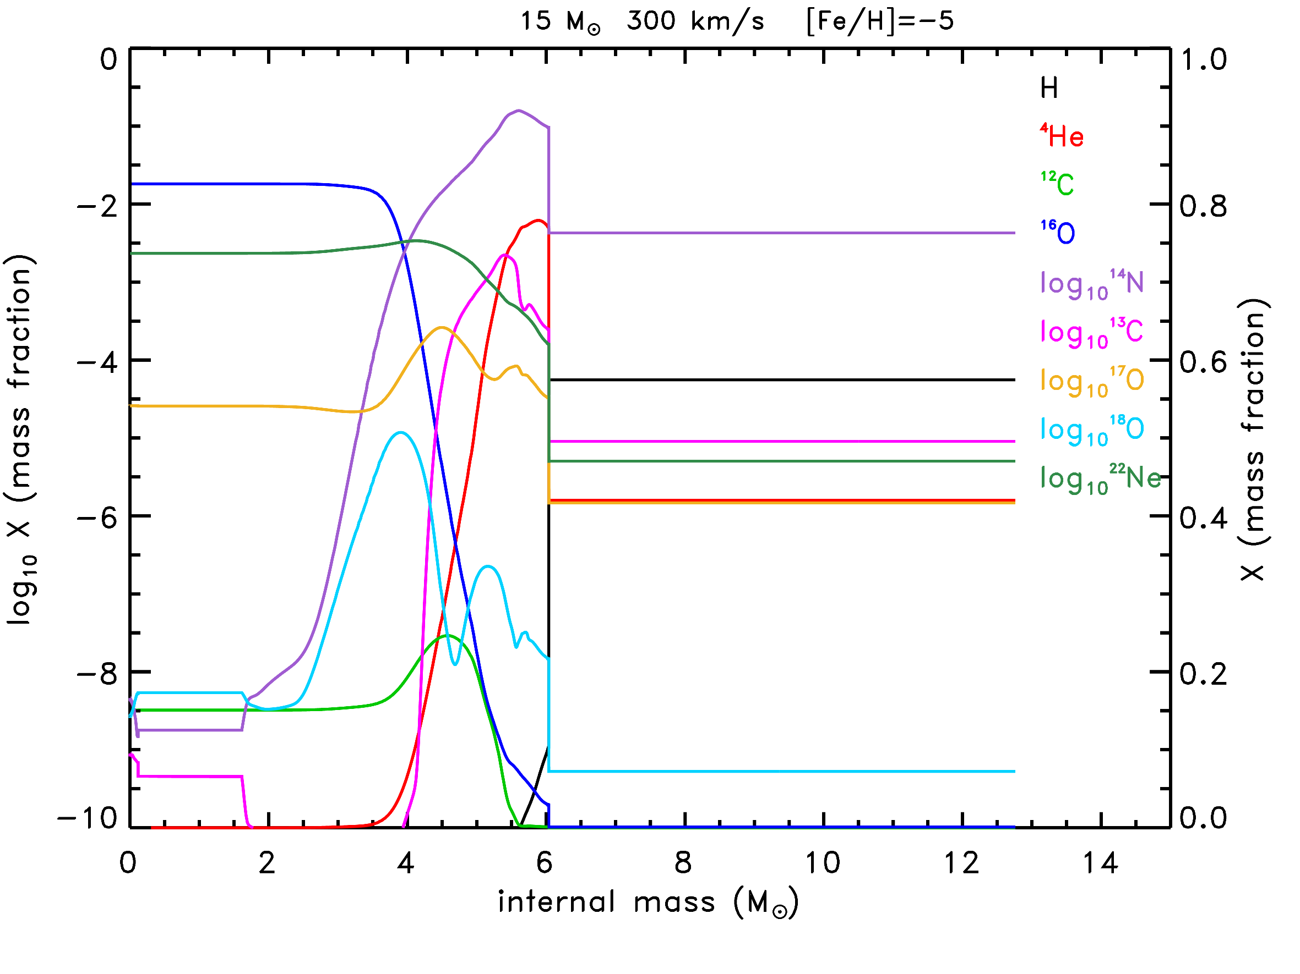
The s-process in rotating massive stars

Slide 13
The s-process in rotating massive stars
²²Ne

Slide 14
The s-process in rotating massive stars
CNO pocket

Slide 15

¹⁹F production in rotating massive stars
¹⁹F is produced through the chain of reactions:
¹⁴N($α$, $γ$)¹⁸F($β$⁺)¹⁸O(p,$α$)¹⁵N($α$, $γ$)¹⁹F
It requires CNO, p, n, and $α$ in the same environment (protons are provided by ¹⁴N(n,p)¹⁴C);
AGB stars or He burning in shell in rotating massive stars;
Formation of the convective He shell in the CNO pocket.

Slide 16
¹⁹F production in rotating massive stars

Slide 17
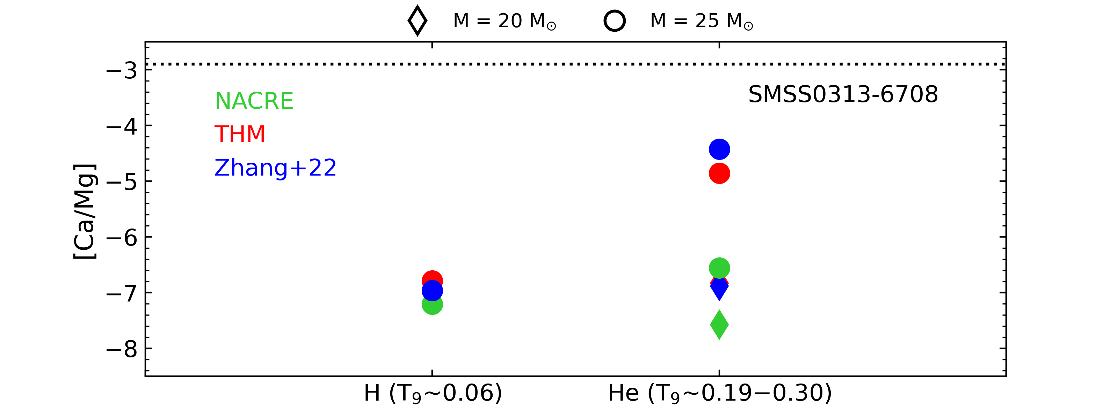
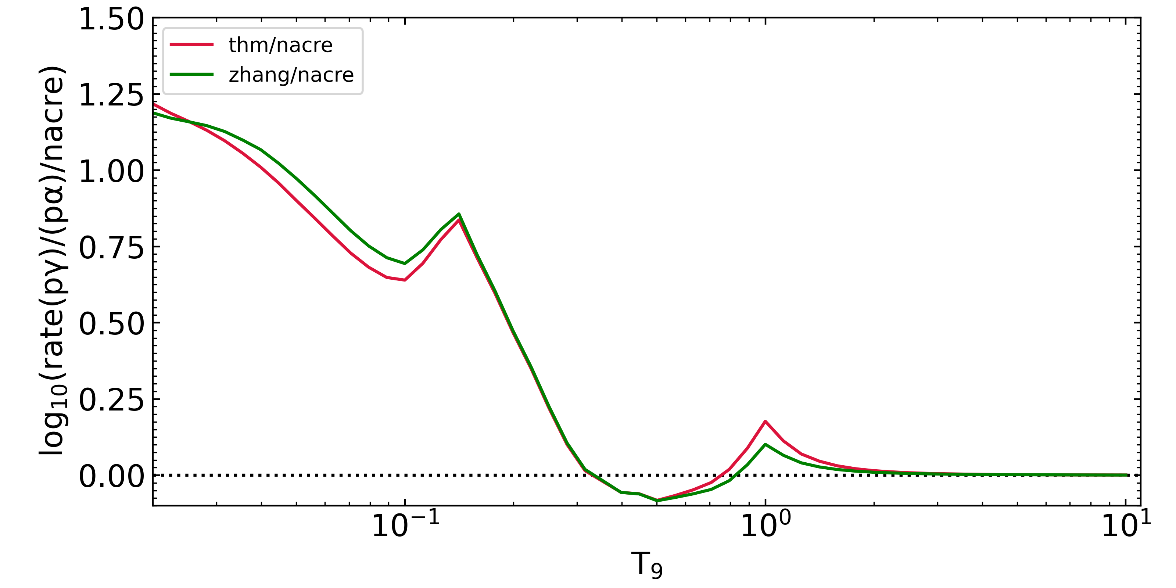

¹⁹F and CNO breakout in primordial stars?
¹⁹F destruction channels (p-captures): ¹⁹F(p,$α$)¹⁶O, ¹⁹F(p, $γ$)²⁰Ne ;
(p, $γ$) reaction proposed as mechanism of Ca production through (hot) CNO breakout (Wiescher+99, Keller+14, Zhang+22);
New measures (Su+25, PRL in press, DOI:10.1103/cq71-jy7s) exclude this scenario;
⁴⁰Ca (most abundant Ca isotope) naturally produced in CCSNe (explosive Si- and O-burning)→independent from initial metallicity;
Impact of these reactions on ¹⁹F nucleosynthesis needs to be tested in AGB stars.

Slide 18
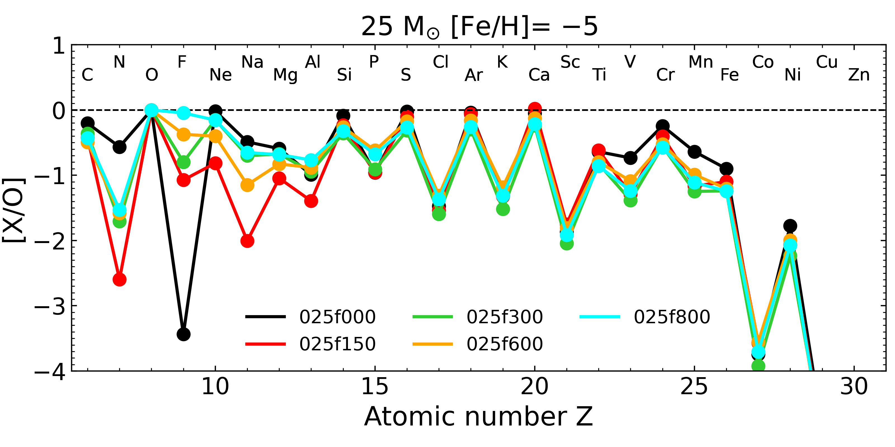
Production factors at low metallicity

Slide 19

Production factors at low metallicity
$$\left[X/O\right]=log10 (X/O)⋆−log10 (X/O)⨀$$

Slide 20
Production factors at low metallicity
$$\left[X/O\right]=log10 (X/O)⋆−log10 (X/O)⨀$$
¹⁹F increases with rotation

Slide 21
Production factors at low metallicity
$$\left[X/O\right]=log10 (X/O)⋆−log10 (X/O)⨀$$
H ingestion
¹⁴N increases with rotation

Slide 22
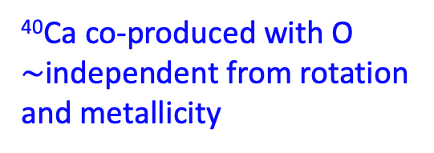
Production factors at low metallicity
$$\left[X/O\right]=log10 (X/O)⋆−log10 (X/O)⨀$$
⁴⁰Ca co-produced with O
$\sim$independent from rotation
and metallicity

Slide 23
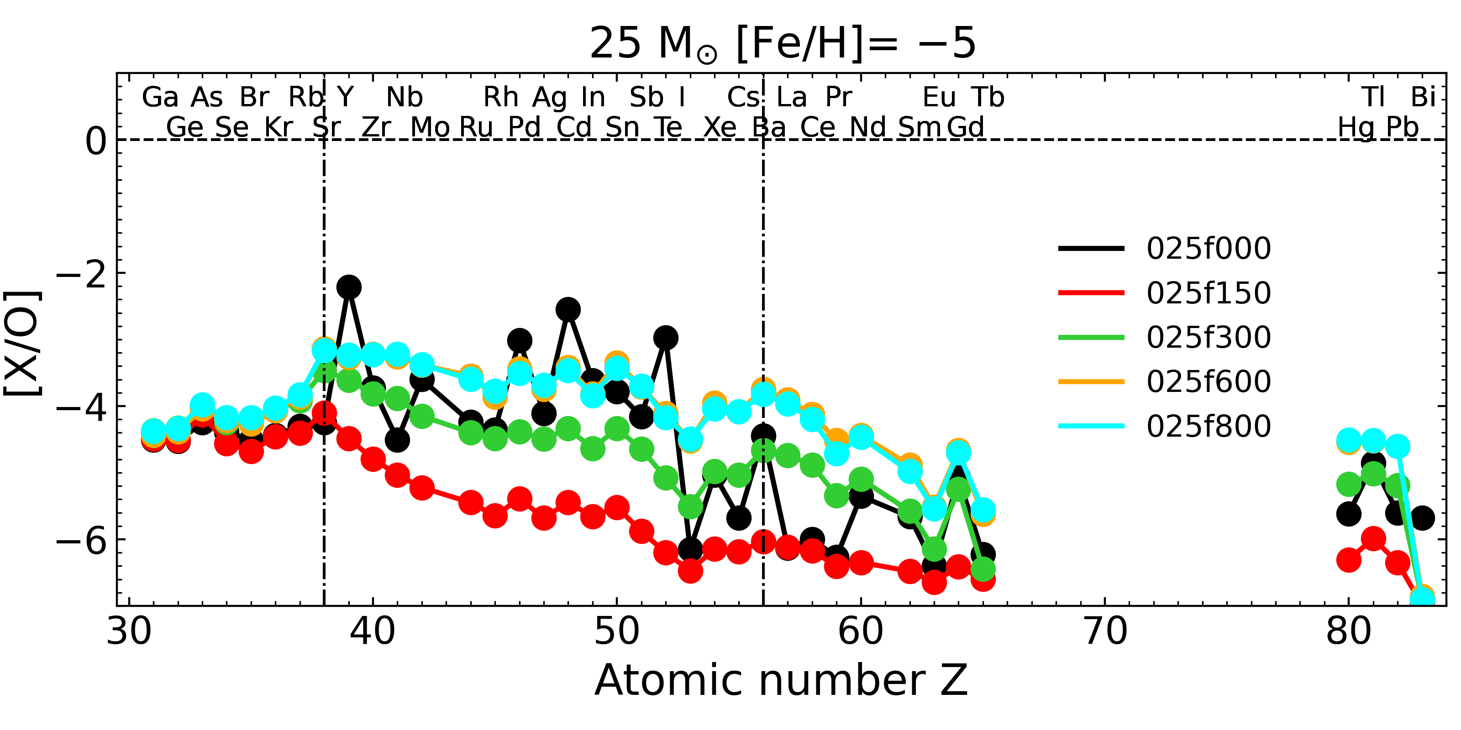
Production factors at low metallicity
$$\left[X/O\right]=log10 (X/O)⋆−log10 (X/O)⨀$$

Slide 24
Production factors at low metallicity
$$\left[X/O\right]=log10 (X/O)⋆−log10 (X/O)⨀$$
i-process at low metallicity?

Slide 25
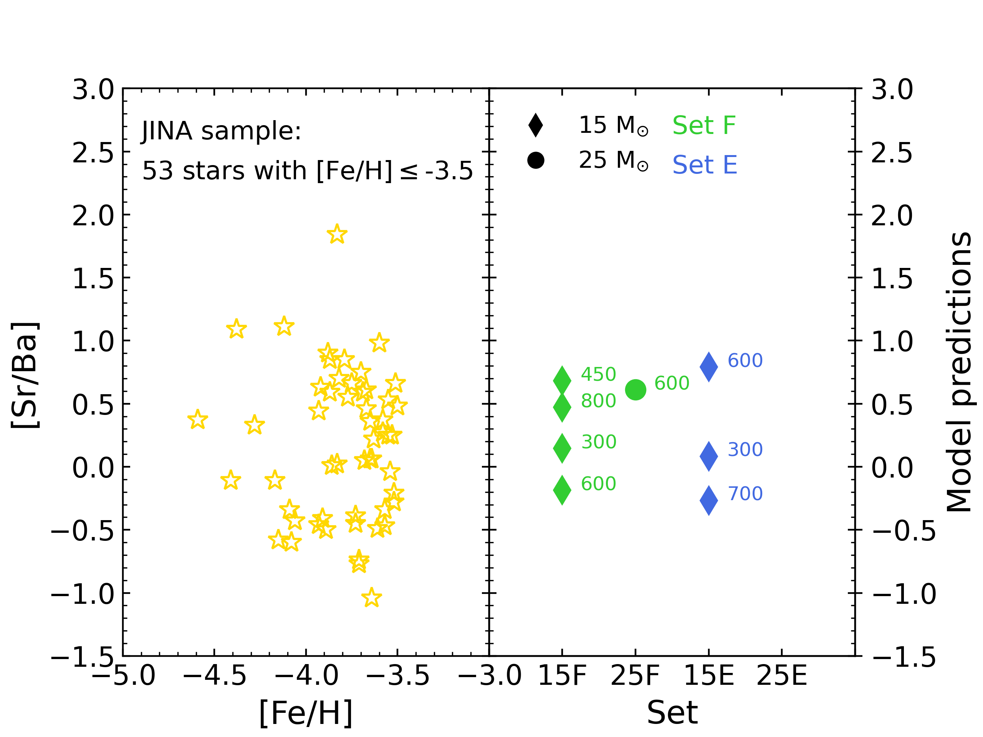
Comparison with observations

Slide 26
Summary and conclusions
He burning phase is the main site for s-process in massive stars;
Rotation increases the efficiency of the s-process, ¹⁴N, and ¹⁹F nucleosynthesis (CNO pocket) in He burning;
Very low metallicity rotating massive stars can produce elements beyond the weak s-process component and match the abundance ratios of the most metal poor stars observed today;
Indirect proof that these stars existed and exploded in the early universe!

