Slide 1





?
Neutron-rich systems and
neutron correlations
R. Lazauskas (IPHC)

Slide 2
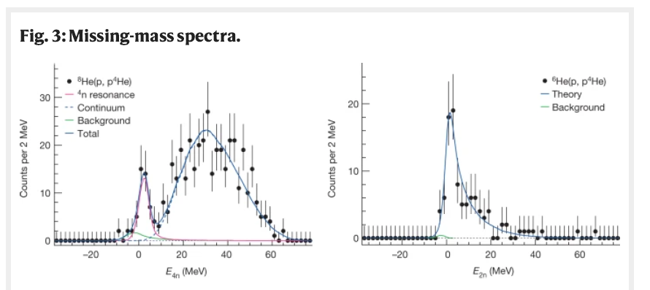

Introduction
RL, J. Carbonell et al., Prog. Theor. Phys. 7, 073D03 (2017)
2
2
Notes:
2

Slide 3
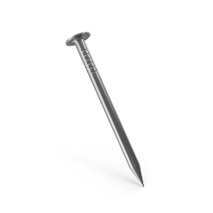




Introduction
0
R.L et al., Phys.Rev.Lett. 130 (2023) 10
$${}_{}^{3}H$$
$${}_{}^{4}{He}$$
$${}_{}^{6}{He}$$
$${}_{}^{8}{He}$$
3
3
Notes:
Being mimited to 4-body problem. We came up with a model/
3

Slide 4
Introduction
0
R.L et al., Phys.Rev.Lett. 130 (2023) 10
$${}_{}^{3}H$$
$${}_{}^{4}{He}$$
Questions remain
If this feature remains within more complete model
What about other 4n-halo systems, like ¹⁴Be
F.M. Marqués et al., Phys. Rev. C 65, 044006 (2002).
$${}_{}^{6}{He}$$
$${}_{}^{8}{He}$$
Notes:
Being mimited to 4-body problem. We came up with a model/
4

Slide 5
Introduction
Non-relativistic Collisions
How to take care of the boundary condition?
  Conceptual difficulties to uncouple different particle channel, to constrain assymptotes of the solutions in all directions and thus get unique (physical) solution to the Schrödinger eq.
  It is ok, as long as there is single particle channel (elastic plus target/projectile excitations)
  Mathematically Ill-conditioned problem when several particle channels are open
Faddeev-Yakubovsky equations efficiently separates asymptotes of the binary channels
In configuration space wave functions extend to infinity!
Increasingly complex asymptotic behaviour for A>2 systems!!
…
L. D. Faddeev, Zh. Eksp. Teor. Fiz. 39, 1459 (1960). [Sov. Phys. JETP 12, 1014(1961)].
O. A. Yakubovsky, Sov. J. Nucl. Phys. 5, 937 (1967).
5
5
Notes:
5

Slide 6


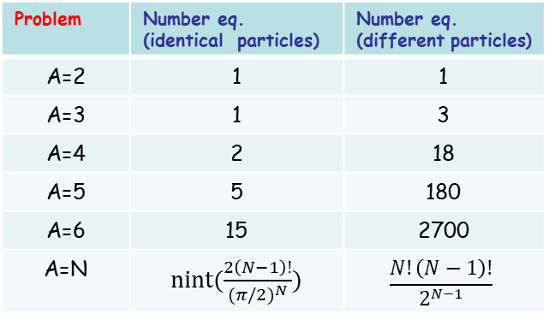
Faddeev-Yakubovski eq. (5-body example)
2
1
2
1
2
1
2
1
3
4
3
2
1
3
4
3
4
4
4
3
5
5
5
5
5
Merits:
Handling of symmetries
Boundary conditions for binary channels
Easy reduction to subsystems
Multipile ways to handle problem of
resonant states (scattering, CS, ACCC..)
Price
Overcomplexity with N
Problem | Number eq. (identical particles) | Number eq. (different particles)
A=2 | 1 | 1
A=3 | 1 | 3
A=4 | 2 | 18
A=5 | 5 | 180
A=6 | 15 | 2700
A=N | nint($\frac{2\left(N−1\right)!}{{(π/2)}^{N}})$ | $$\frac{N!\left(N−1\right)!}{2^{N−1}}$$

Slide 7




Complicate structure of He isotopes
Many studies, mostly structure & using simplistic interactions:
M. V. Zhukov et al., Phys. Rev. C 50, R1(R) (1994)
Y. Kanada-En’yo, Phys. Rev. C 76, 044323 (2007)
N. Itagaki et al. , Phys. Rev. C 78, 017306 (2008)
Y. Yamaguchi et al. Phys. Rev. C 108, L011304 (2023)
T. Myo et al. Phys. Rev. C 107, 034305 (2023); Phys. Rev. C 104, 044306 (2021)
but also ab-initio
S. Baroni et al., Phys. Rev. Lett. 110, 022505 (2013)
M. A. Caprio et al, Phys. Rev. C 90, 034305 (2014)
F. Bonaiti et al., Phys. Rev. C 105, 034313 (2022)
0
$${}_{}^{3}H$$
-28.3
$${}_{}^{4}{He}$$
-29.3
$${}_{}^{6}{He}$$
-31.4
$${}_{}^{8}{He}$$
E (MeV)
M. Vorrabi et al., Phys. Rev. C 97, 034314 (2018),
//indico.ectstar.eu/event/1/contributions/48/attachments/36/42/Vorabbi.pdf

Slide 8

Complicate structure of He isotopes
Many studies, mostly structure & using simplistic interactions:
M. V. Zhukov et al., Phys. Rev. C 50, R1(R) (1994)
Y. Kanada-En’yo, Phys. Rev. C 76, 044323 (2007)
N. Itagaki et al. , Phys. Rev. C 78, 017306 (2008)
Y. Yamaguchi et al. Phys. Rev. C 108, L011304 (2023)
T. Myo et al. Phys. Rev. C 107, 034305 (2023); Phys. Rev. C 104, 044306 (2021)
but also ab-initio
S. Baroni et al., Phys. Rev. Lett. 110, 022505 (2013)
M. A. Caprio et al, Phys. Rev. C 90, 034305 (2014)
F. Bonaiti et al., Phys. Rev. C 105, 034313 (2022)
M. Vorrabi et al., Phys. Rev. C 97, 034314 (2018),
//indico.ectstar.eu/event/1/contributions/48/attachments/36/42/Vorabbi.pdf

Slide 9
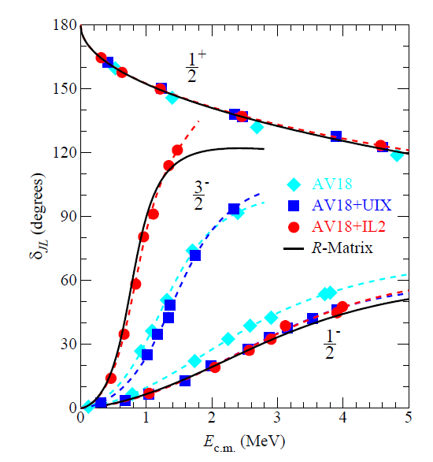
Complicate structure of He isotopes
0
⁴He-n atypical case
$${}_{}^{4}{He^{∗}}$$
$${}_{}^{3}H$$
-28.3
$${}_{}^{4}{He}$$
-29.3
$${}_{}^{6}{He}$$
-31.4
$${}_{}^{8}{He}$$
R. Lazauskas, Phys. Rev. C 79, 054007 (2009).
P. Navratil et al., Physica Scripta 91 (2016) 053002
K.M. Nollett et. al., Phys.Rev.Lett.99:022502,2007
E (MeV)

Slide 10


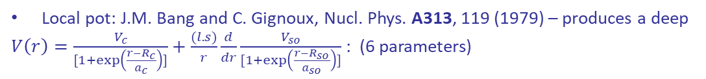




Struggles with a model
There exist several 2-body models for α-n interaction
  Major difference how to account for repulsion produced by Pauli
  principle, leading to repulsive S-wave
$${}_{}^{4}{He(0^{+})}$$
0
Local pot: J.M. Bang and C. Gignoux, Nucl. Phys. A313, 119 (1979) – produces a deep
$V\left(r\right)=\frac{V_{c}}{[1+\exp\left(\frac{r−R_{c}}{a_{c}}\right)]}+\frac{(l.s)}{r}\frac{d}{dr}\frac{V_{so}}{[1+\exp\left(\frac{r−R_{so}}{a_{so}}\right)]}$ : (6 parameters)
-0.973
$${}_{}^{6}{He\left(0^{+}\right)}$$
Spurious S-wave state: -9.84 MeV
→ +$∞$
-3.11
$${}_{}^{8}{He\left(0^{+}\right)}$$
n
p
E (MeV)
$${1P}_{1/2}$$
$${1P}_{3/2}$$
$${1S}_{1/2}$$

Slide 11

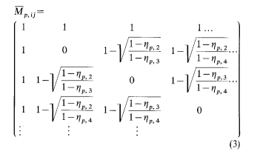
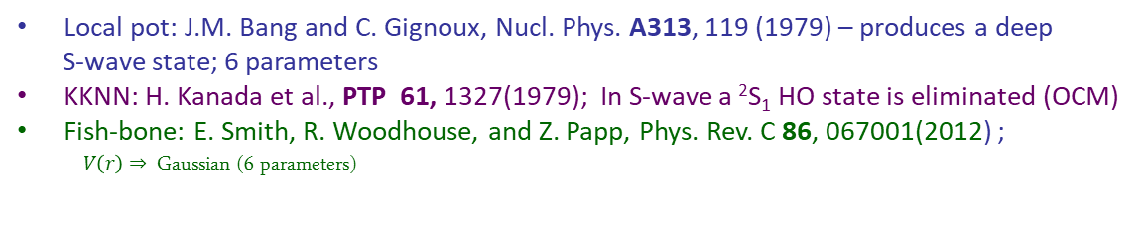

Struggles with a model
There exist several 2-body models for α-n interaction
  Major difference how to account for repulsion produced by Pauli
  principle, leading to repulsive S-wave
$${}_{}^{4}{He(0^{+})}$$
Local pot: J.M. Bang and C. Gignoux, Nucl. Phys. A313, 119 (1979) – produces a deep
S-wave state; 6 parameters
KKNN: H. Kanada et al., PTP 61, 1327(1979); In S-wave a ²S₁ HO state is eliminated (OCM)
Fish-bone: E. Smith, R. Woodhouse, and Z. Papp, Phys. Rev. C 86, 067001(2012) ;
$V\left(r\right)⇒$ Gaussian (6 parameters)
-0.973
$${}_{}^{6}{He\left(0^{+}\right)}$$
-3.11
$${}_{}^{8}{He\left(0^{+}\right)}$$
E (MeV)
$${1P}_{1/2}$$
$${1P}_{1/2}$$
$${1P}_{3/2}$$
D.A. Zaikin, Nucl. Phys. A170, 584 (1971)
$${1S}_{1/2}$$
Notes:
It is more complex to exclude possible existence of a resonant state, as it is much less constrained... And first how we define it and what we are really looking for… In experiment some complex reaction are involved with a potential end product of multi-neutron. Then resonance is associated with a presence of rapid variation..
But it appears that fast variation is not sufficient evidence of presence of a resonance.. Complex reaction mechanism maybe involved, or complex phasespace,…
BUT EVEN REPRODUCING A MINIMAL REQUIREMENT -- GETTING FAST VARIATION TURNS TO BE HEAVY CHALLENGE….

Slide 12
Struggles with a model
There exist several 2-body models for a-n interaction
  Major difference how to account for repulsion produced by Pauli
  principle, leading to repulsive S-wave
$${}_{}^{4}{He(0^{+})}$$
 | Model | E(6He)-E(4He),MeV
Bang/Gignoux | Repulsive S wave | Not bound
 | Excluding S wave | -0.199
KKNN | OCM | -0.755*
Papp | Fish-bone | -0.171
Exp. |  | -0.973
-0.973
$${}_{}^{6}{He\left(0^{+}\right)}$$
-3.11
Av18 for nn interaction
J.M. Bang and C. Gignoux, Nucl. Phys. A313, 119 (1979)
H. Kanada et al., PTP 61, 1327(1979); *less accurate description of Nα data
E. Smith, R. Woodhouse, and Z. Papp, Phys. Rev. C 86, 067001(2012)
$${}_{}^{8}{He\left(0^{+}\right)}$$
E (MeV)
$${1P}_{1/2}$$
$${1P}_{3/2}$$
$${1S}_{1/2}$$

Slide 13
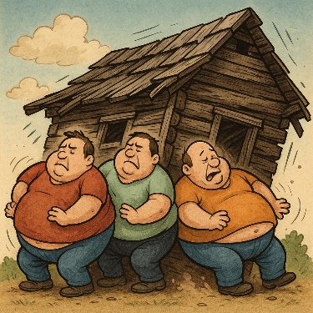
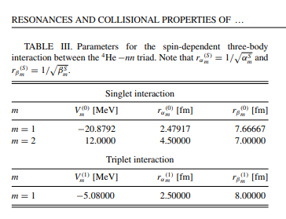
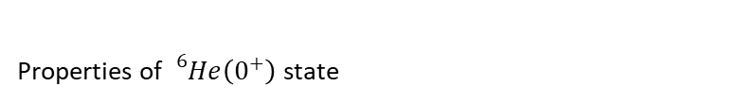
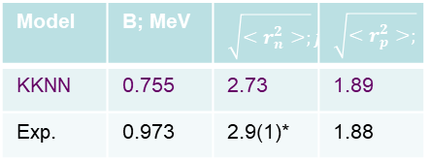
Struggles with a model
There exist several 2-body models for α-n interaction
  Major difference how to account for repulsion produced by Pauli
  principle, leading to repulsive S-wave
Conventional way to improve description of He-isotopes introduce
(α-n-n) 3-body force, but…
              E. Garrido, D.V. Fedorov , and A.S. Jensen, Eur. Phys. J. A 25, 365–378 (2005)
              M.D. Higgins, C. H. Greene, Phys. Rev. C 111, 014001 (2025)
$${}_{}^{4}{He(0^{+})}$$
-0.973
$${}_{}^{6}{He\left(0^{+}\right)}$$
Properties of${}_{}^{6}{He}\left(0^{+}\right)$state
-3.11
$${}_{}^{8}{He\left(0^{+}\right)}$$
Model | B; MeV | $$\sqrt{<r_{n}^{2}>;}fm$$ | $$\sqrt{<r_{p}^{2}>;} fm$$
KKNN | 0.755 | 2.73 | 1.89
Exp. | 0.973 | 2.9(1)* | 1.88
E (MeV)
$${1P}_{1/2}$$
S.C. Pieper et al., Phys. Rev. C 64, 014001(2001)
$${1P}_{3/2}$$
$${1S}_{1/2}$$

Slide 14

Struggles with a model
There exist several 2-body models for α-n interaction
  Major difference hox to account for repulsion produced by Pauli
  principle, leading to repulsive S-wave
  Nevertheless, when combined with realistic nn interactions,
all these models fail to describe ${}_{}^{6}{He\left(0^{+}\right)}$ binding
  Conventional way to improve description of He-isotopes introduce
(α-n-n) 3-body force, but…
              E. Garrido, D.V. Fedorov , and A.S. Jensen, Eur. Phys. J. A 25, 365–378 (2005)
              M.D. Higgins, C. H. Greene, Phys. Rev. C 111, 014001 (2025)
  α-n phaseshifts favors presence of deep bound states, simple Yukawa
  Potential:
  $$V_{lj}\left(r\right)=V_{lj}\frac{exp\left(−r\right)}{r}$$
$${}_{}^{4}{He(0^{+})}$$
-0.973
$${}_{}^{6}{He\left(0^{+}\right)}$$
-3.11
$${}_{}^{8}{He\left(0^{+}\right)}$$
E (MeV)

Slide 15



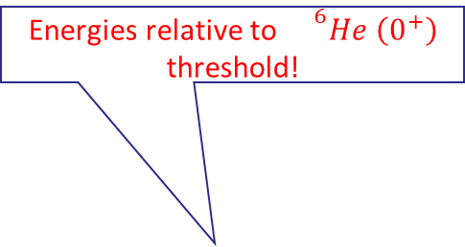
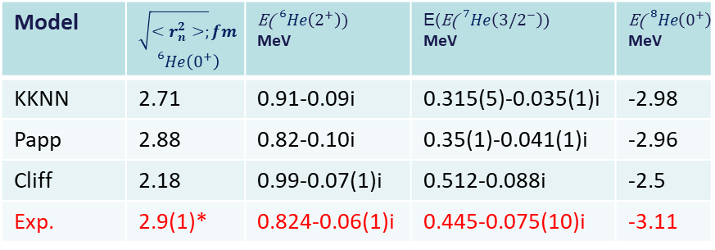

Struggles with a model
How to resolve underbinding problem in α-n-n models?
Ease projection of the deep (α-n) spurious states
In OCM deep states are projected to E(α-n)=+$∞$
0
$${}_{}^{4}{He^{∗}}$$
$${}_{}^{3}H$$
-8.5
OCM
Energies relative to ${}^{6}He \left(0^{+}\right)$
threshold!
-10.7
$${}_{}^{3}{H+^{2}H}$$
vs
Model | $$\sqrt{<r_{n}^{2}>;}fm$$ $${}_{}^{6}{He}\left(0^{+}\right)$$ | E(${}_{}^{6}{He}\left(2^{+}\right))$ MeV | E(E(${}_{}^{7}{He}\left({3/2}^{−}\right))$ MeV | $$\text{E}\text{(}{}_{}^{8}{He}\left(0^{+}\right))$$ MeV
KKNN | 2.71 | 0.91-0.09i | 0.315(5)-0.035(1)i | -2.98
Papp | 2.88 | 0.82-0.10i | 0.35(1)-0.041(1)i | -2.96
Cliff | 2.18 | 0.99-0.07(1)i | 0.512-0.088i | -2.5
Exp. | 2.9(1)* | 0.824-0.06(1)i | 0.445-0.075(10)i | -3.11
-28.3
$${}_{}^{4}{He}$$
-29.3
$${}_{}^{6}{He}$$
-31.4
$${}_{}^{8}{He}$$
1 parameter is adjusted to reproduce ${}_{}^{6}{He}\left(0^{+}\right)$ binding energy
E (MeV)

Slide 16
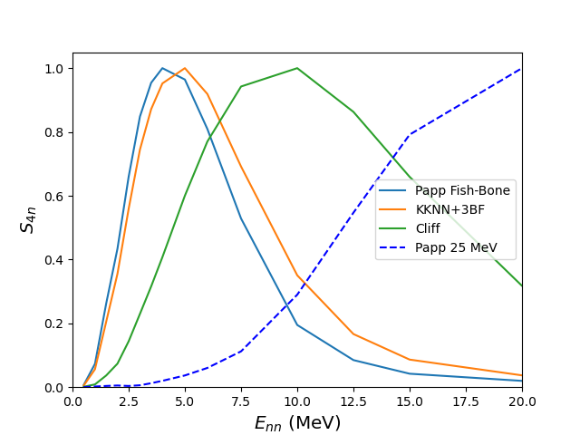
Calculation of 4n energy distribution
16
16
Preliminary

Slide 17
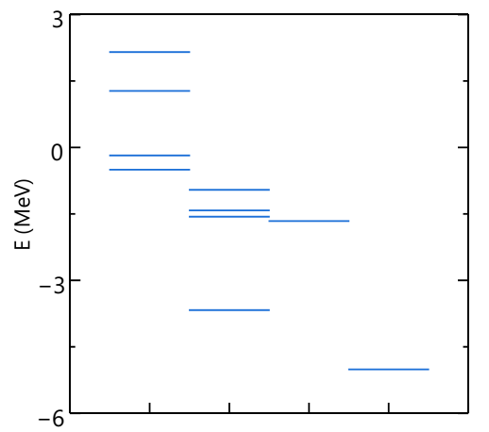

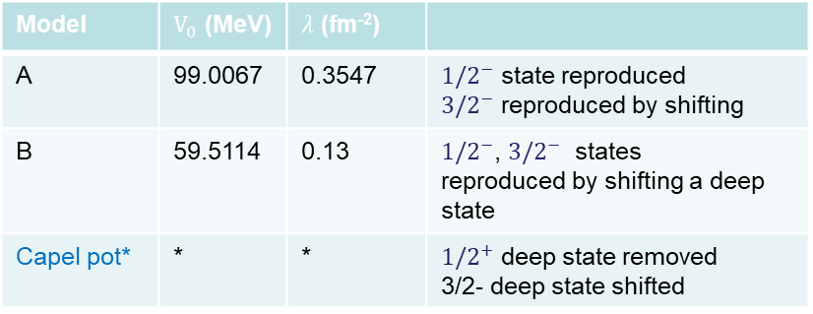












¹¹⁻¹⁴Be case
Models
¹⁰Be-n interaction is a single Gaussian potential with OCM, parameters adjusted to reproduce ¹¹Be states
$\hat{Vα}\left(r,r′\right)=−V_{0}exp\left(−λr^{2} \right)δ\left(r,r′\right)+∞|ψ_{1s}^{OH}(r^{′})><ψ_{1s}^{OH}(r)|$
*Wood-Saxon potential from P.Capel et al., Phys. Rev C 70, 064605 (2004)
¹⁰Be-n-n Hyperradial interaction adjusted to reproduce ¹²Be states
$${3/2}^{−}$$
$${5/2}^{+}$$
$${}_{}^{10}{Be(0+)}$$
$${1/2}^{−}$$
$${1/2}^{+}$$
$$1^{−}$$
Model | $V_{0}$ (MeV) | $λ$ (fm⁻²)
A | 99.0067 | 0.3547 | ${1/2}^{−}$ state reproduced ${3/2}^{−}$ reproduced by shifting
B | 59.5114 | 0.13 | ${1/2}^{−}$, ${3/2}^{−}$ states reproduced by shifting a deep state
Capel pot* | * | * | ${1/2}^{+}$ deep state removed 3/2- deep state shifted
$$2^{+}$$
$${5/2}^{+}$$
$$0^{+}$$
$$0^{+}$$
$$0^{+}$$
$${}_{}^{11}{Be}$$
$${}_{}^{12}{Be}$$
$${}_{}^{13}{Be}$$
$${}_{}^{14}{Be}$$
$${1P}_{1/2}$$
$${1P}_{3/2}$$
$${1S}_{1/2}$$

Slide 18
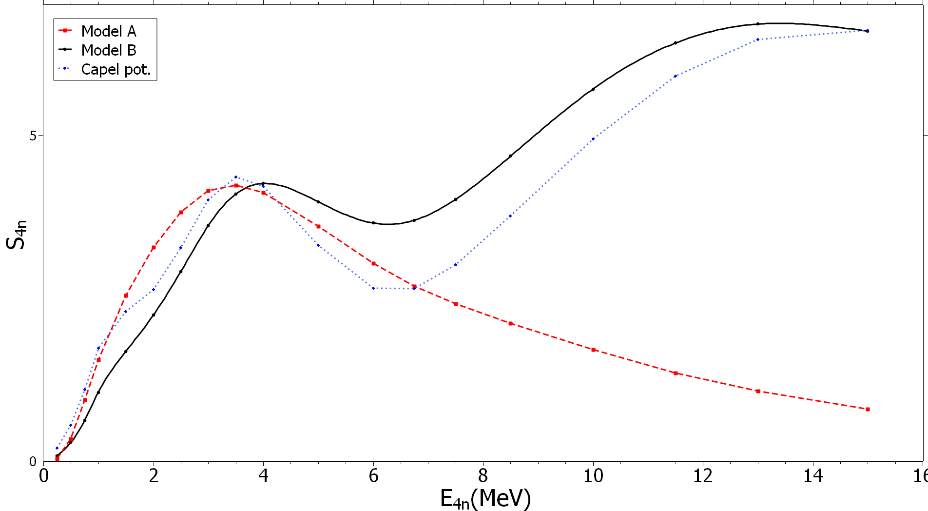
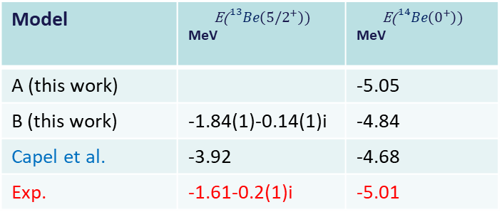
¹¹⁻¹⁴Be case
Model | $$\text{E}\text{(}{}_{}^{13}{Be}\left({5/2}^{+}\right))$$ MeV | $$\text{E}\text{(}{}_{}^{14}{Be}\left(0^{+}\right))$$ MeV
A (this work) |  | -5.05
B (this work) | -1.84(1)-0.14(1)i | -4.84
Capel et al. | -3.92 | -4.68
Exp. | -1.61-0.2(1)i | -5.01
$${3/2}^{−}$$
$${5/2}^{+}$$
$${}_{}^{10}{Be(0+)}$$
$${1/2}^{−}$$
$${1/2}^{+}$$
$$1^{−}$$
$$2^{+}$$
$${5/2}^{+}$$
$$0^{+}$$
*Wood-Saxon potential from P.Capel et al., Phys. Rev C 70, 064605 (2004)
$$0^{+}$$
$$0^{+}$$
Preliminary
$${}_{}^{11}{Be}$$
$${}_{}^{12}{Be}$$
$${}_{}^{13}{Be}$$
$${}_{}^{14}{Be}$$
n
p

Slide 19
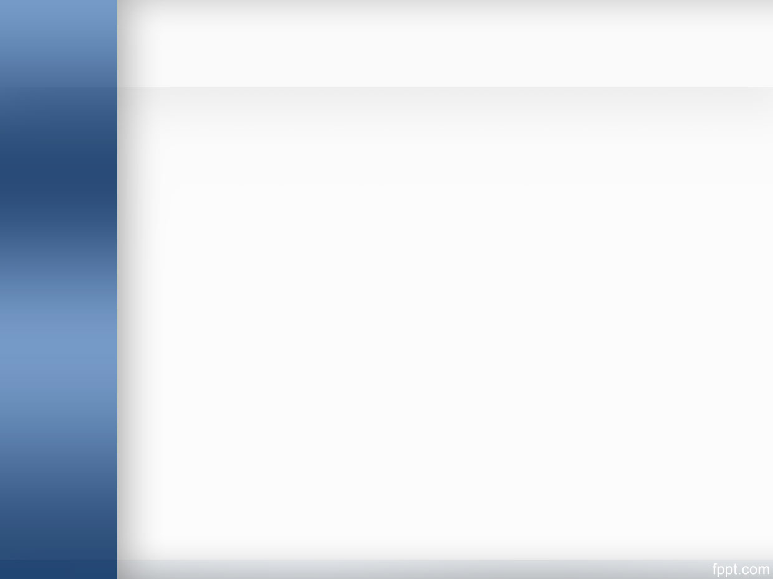
Conclusions
Neutron-halo states are ideal testground for cluster methods and phenomena related with Pauli exclusion principle
Very striking dynamical phenomena was observed by Duer et al., where sharp low-energy peak appears naturally without any underlying ⁴n resonant state
The key in explaining this phenomena lies in understanding structure of ⁸He nucleus
I am trying to construct Α+4n model able to sucessfuly describe 4n halos and their eventual decay emitting 4n
It appears that if initial state contains weakly bound and peripheral 4n halo – presence of nn corelations leads to sharp low energy peak structures in total 4n energy distribution, without presence of underlying ⁴n resonant state.

Slide 20
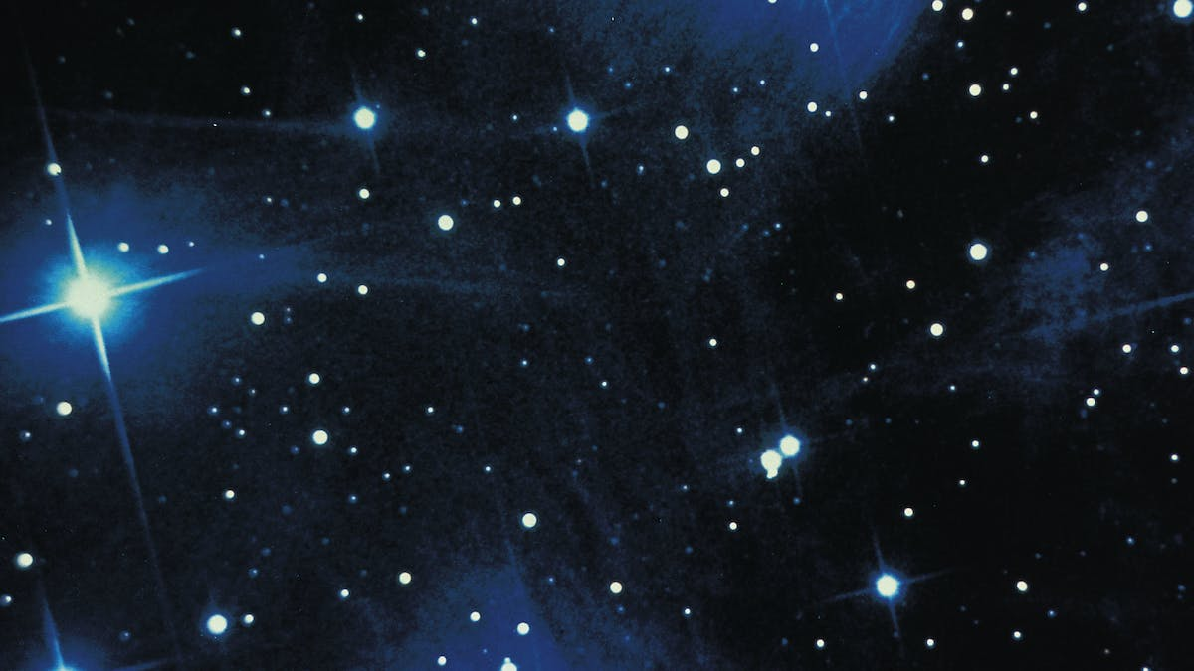
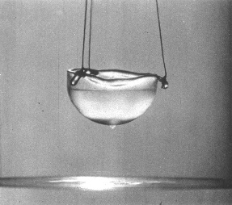
Bound multineutron: no way?
²n is allready resonant in ¹S₀ state
³He-³He | Aziz
a(Å) | -7.61
r₀ (Å) | 13.5
r(V_{min}) | 2.97
γ_{s} | 1.299
n-n | AV18 | INOY | Reid93 | Exp
a_{nn} (fm) | -18.49 | -18.60 | -17.54 | -18.5(4)
r₀ (fm) | 2.84 | 2.82 | 2.84 | 2.80(11)
r(V_{min}) | 0.874 |  | 0.930 | -
γ_{s} | 1.080 | 1.102 | 1.087 | -
*Enhancement factor γ_{s}∼1.09 (V_{γ}=γV_{nn}) is enough to bind ²n in ¹S₀ state
…
Needs gravity to be bound in n-stars..
(³He)_{A} is bound for A>34
R. Guardiola, J. Navarro, Phys. Rev. Lett. 84 (2001) 1144
at 1mK

Slide 21
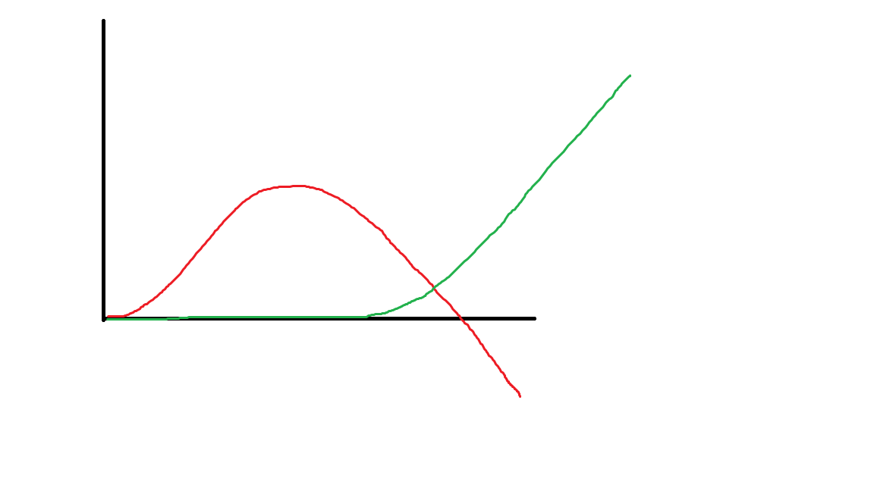


Theory is ruthless for ³n & ⁴n
Moderate attraction a<0
$$u\left(r_{bc}\right)=r_{bc}ψ(r_{bc})$$
Repulsion a>0
Bound state exists a>0
Presence of ³n & ⁴n resonant states is not compatible with QM!
Notes:
First if interaction is repulsive: particles can not approach each other, thus wave function is zero close to the origin. Then it starts evolving to reach linear asymptotic behaviour. Scattering length is a position where tangent to asymptote crosses the axis and thus it is positive. If one adds some attraction to the interaction then paricles may approach more and wave function starts bending – scattering length becomes negative…

Slide 22
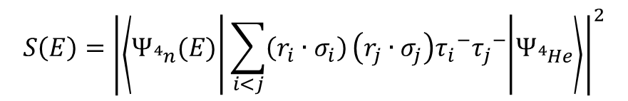
Selected results: external probes
Mimicing experimental reaction using simplistic model:
⁴He(⁸He, ⁸Be)⁴ n:
⁴He
⁴n
$$S\left(E\right)={\left|\left\langle Ψ_{{}_{}^{4}n}(E) | \sum_{i<j}{\left(r_{i}∙σ_{i}\right)}\left(r_{j}∙σ_{j}\right){τ_{i}}^{−}{τ_{j}}^{−} | Ψ_{{}_{}^{4}{He}}\right\rangle \right|}^{2}$$
⁸He
⁸Be
We do not observe any narrow structures in the cross section, without generating S-matrix poles in ⁴n
RL, J. Carbonell et al., Prog. Theor. Phys. 7, 073D03 (2017)
Results obtained by solving CS FY equation in config space Schrödinger employing Lagrange-Laguerre mesh method
R. Lazauskas, HDR defence

