Slide 1


Results from nuclear structure studies at FRIB
Alexandra Gade
University Distinguished Professor
FRIB and Department of Physics and Astronomy
Michigan State University
A.G. is supported by the U.S. Department of Energy (DOE), Office of Science, Office of Nuclear Physics, under Award No. DESC0023633

Slide 2
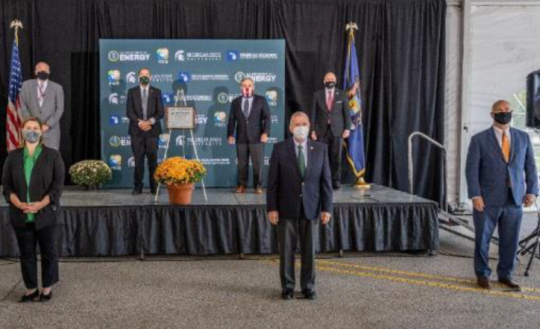
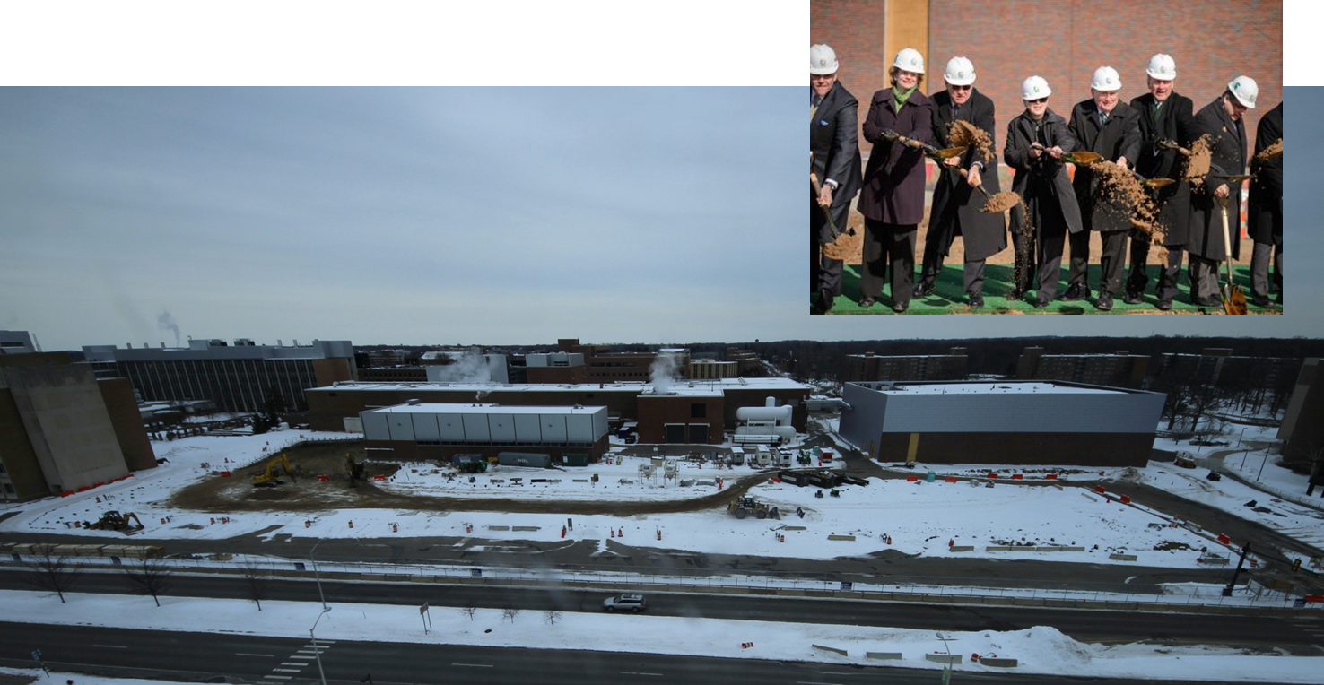
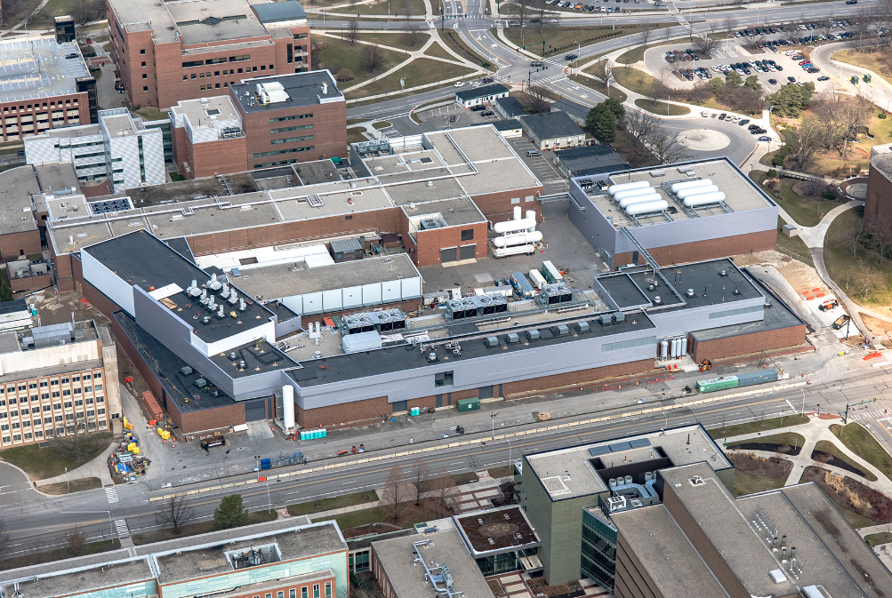
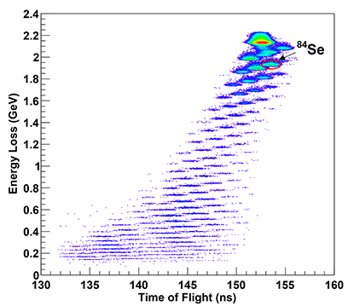
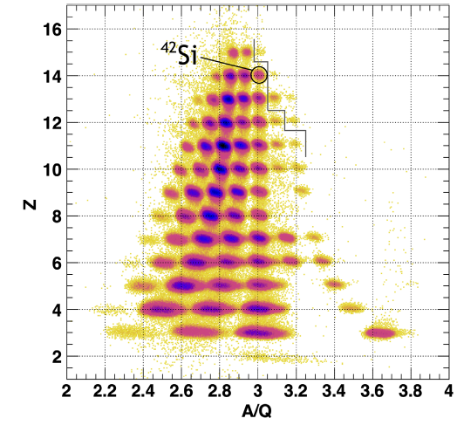
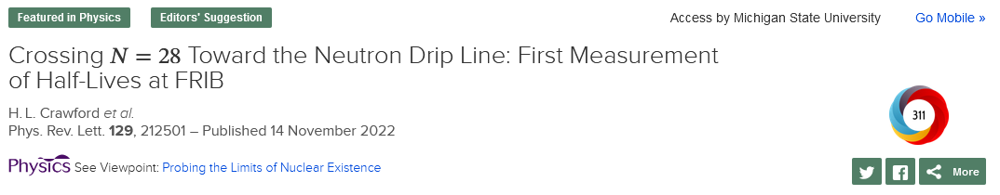
Who we are – Facility for Rare Isotope Beams ~800 employees, incl. >45 faculty, >140 graduate and ~90 undergraduate students as of Fall 2025
For decades, NSCL was funded by the U.S. National Science Foundation to operate a user facility for rare isotope research and education in nuclear science, nuclear astrophysics, accelerator physics, and societal applications
Since the FRIB Project was completed - is a national user facility for the U.S. Department of Energy Office of Science with first beam to an experiment in May 2022
Groundbreaking 03/2014
Beneficial occupancy 03/2017
Designated as DOE-SC User Facility 09/2020
First rare isotopes produced and identified 12/2021
First science results published 11/2022

Slide 3

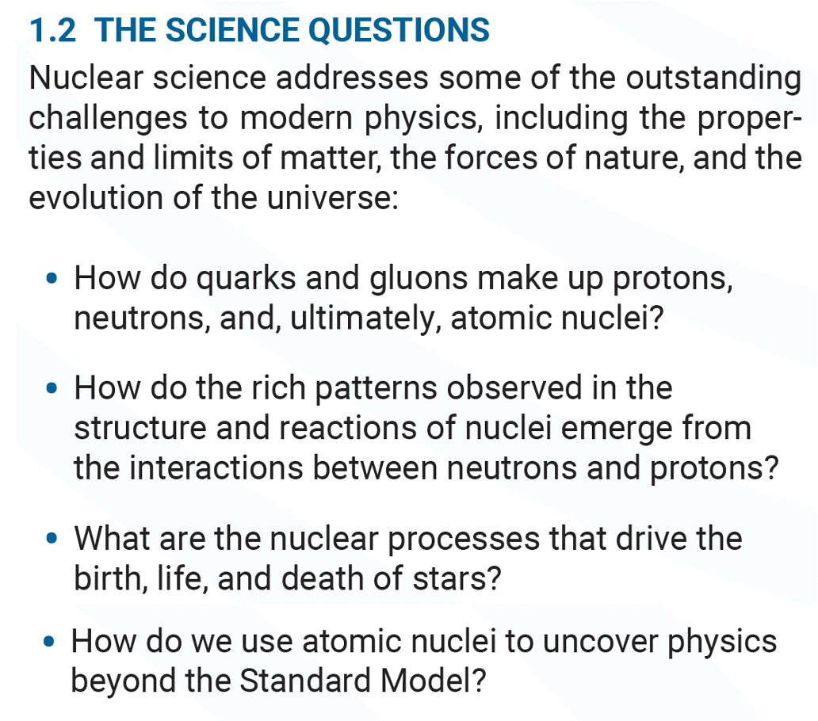

Outline
FRIB in a nutshell
Selection of nuclear structure results
Limits of existence – discovery of new isotopes
The nucleus as open quantum system – precision masses and outlook on exploring the anatomy of decays
Not your 60ies textbook nuclear physics and the magic of probing the nucleus with complementary methods
What we learn from β decay – a story of increasing complexity (FDSi)
Not so magic: Probing nuclear shape and deformation at neutron number N=40 and N=28 (GRETINA)
At the shore of the N=20 with one-neutron transfer (SOLARIS)
Summary and outlook
All over the chart …

Slide 4
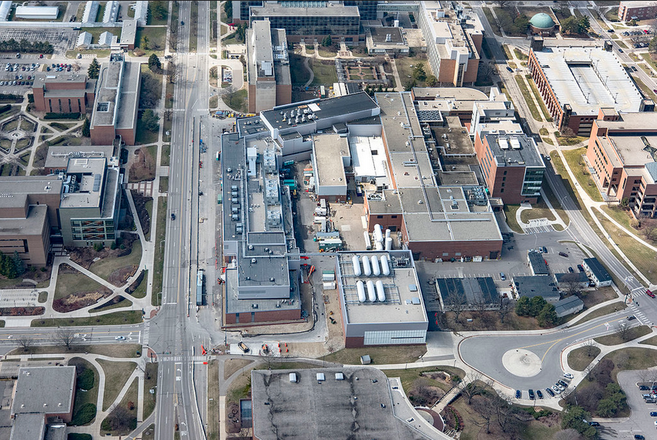
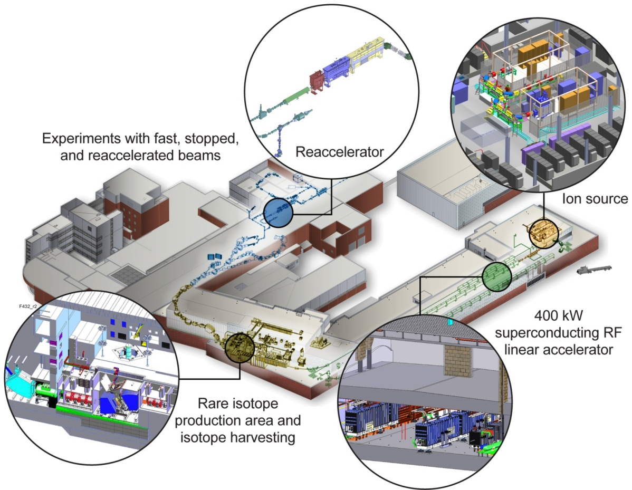
… located in the middle of the MSU Campus
Physics
Bio Chem
Chemistry
Plant Sciences
MSU Law
Vet School
Performing Arts

Slide 5
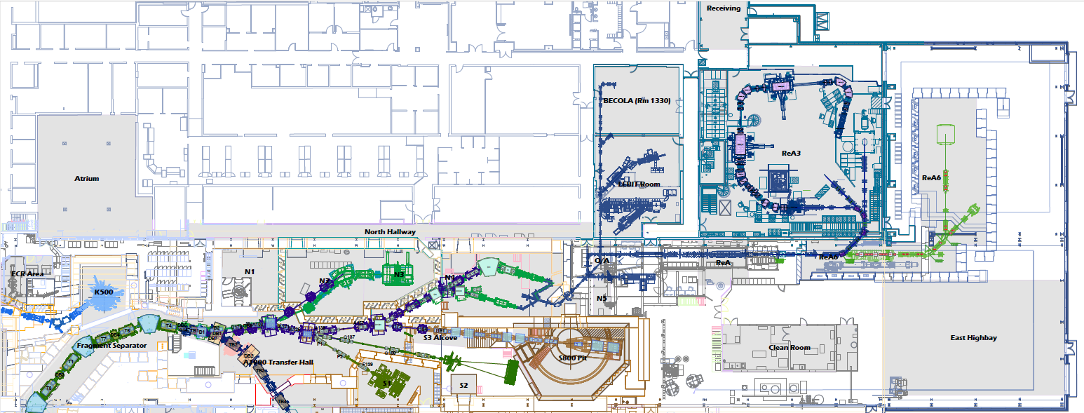
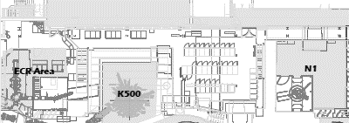
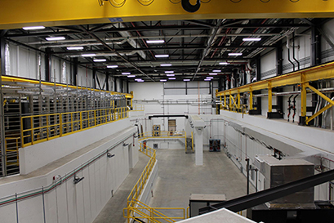


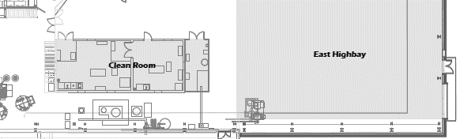

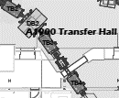
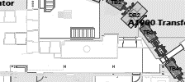

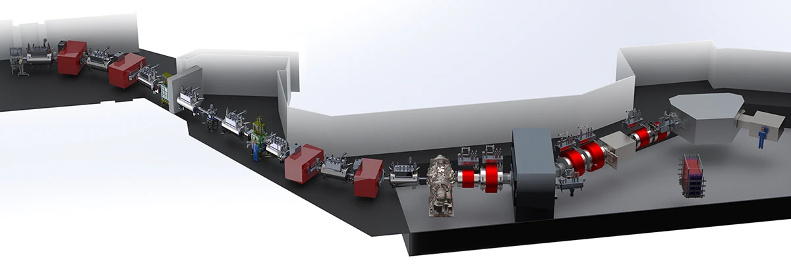
All experimental areas for user experiments ready
FRIB offers fast, stopped, and reaccelerated experiments with rare isotopes
All vaults have been re-commissioned and have received beam for experiments
FRIB Decay Station initiator has moved to its permanent home
High Rigidity Spectrometer is on track (as two sub-projects)
SECAR
Stopped Beams
ReA3
ReA6
SOLARIS
BECOLA/RiSE
LEBIT
ACGS
RTGC
BMIS
Identification and beam transport
S1
S1: FDSi
S2: Sweeper Magnet MoNA/LISA
S3: S800

Slide 6
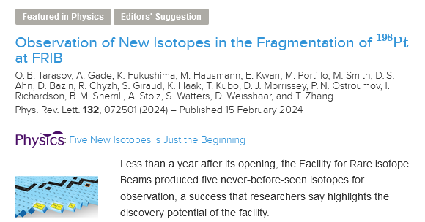
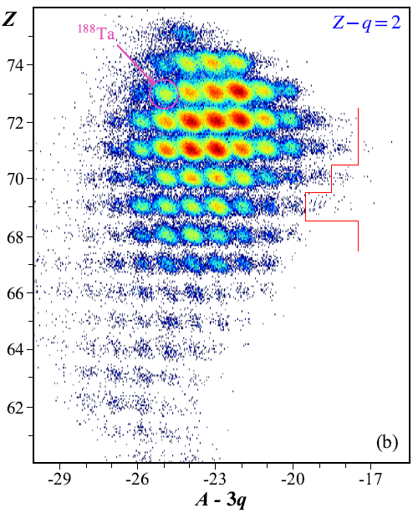
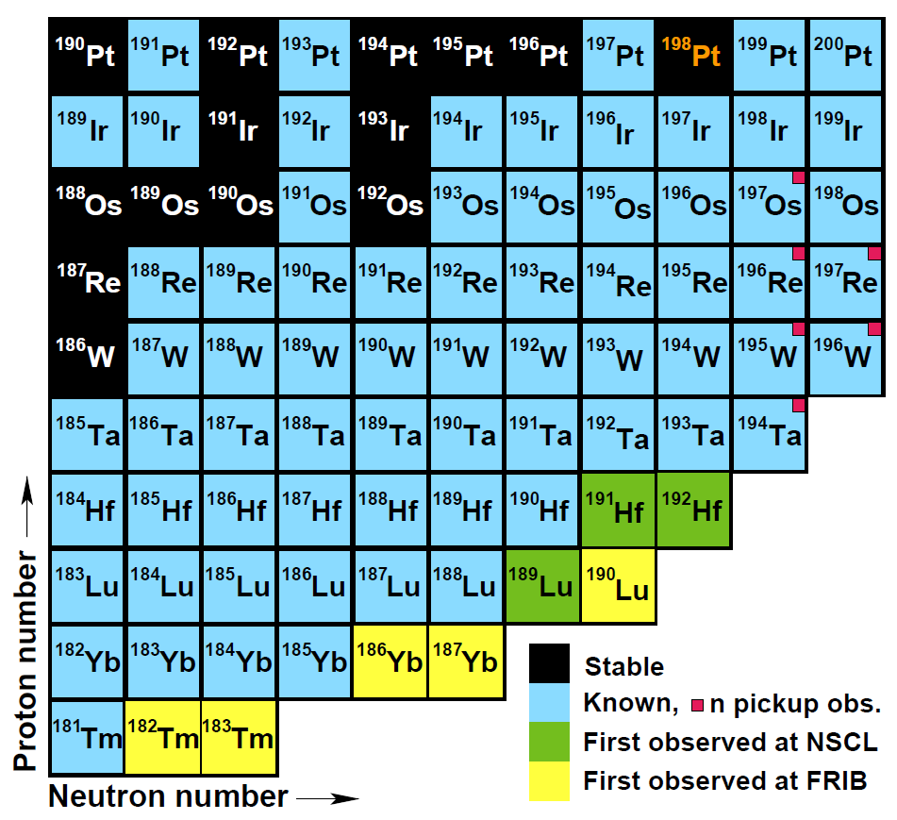
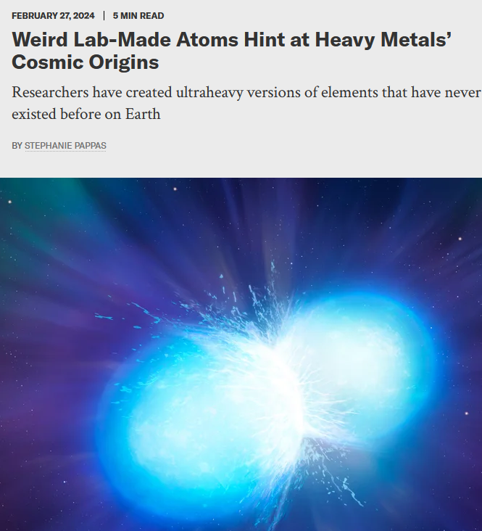

New isotopes discovered at FRIB
Phys. Rev. Lett. 132, 072501 (2024)
FRIB made 5 never-before-seen isotopes of the elements thulium, ytterbium, lutetium
The new isotopes were formed in the fragmentation of ¹⁹⁸Pt on C at 1.5 kW → discovery potential!

Slide 7
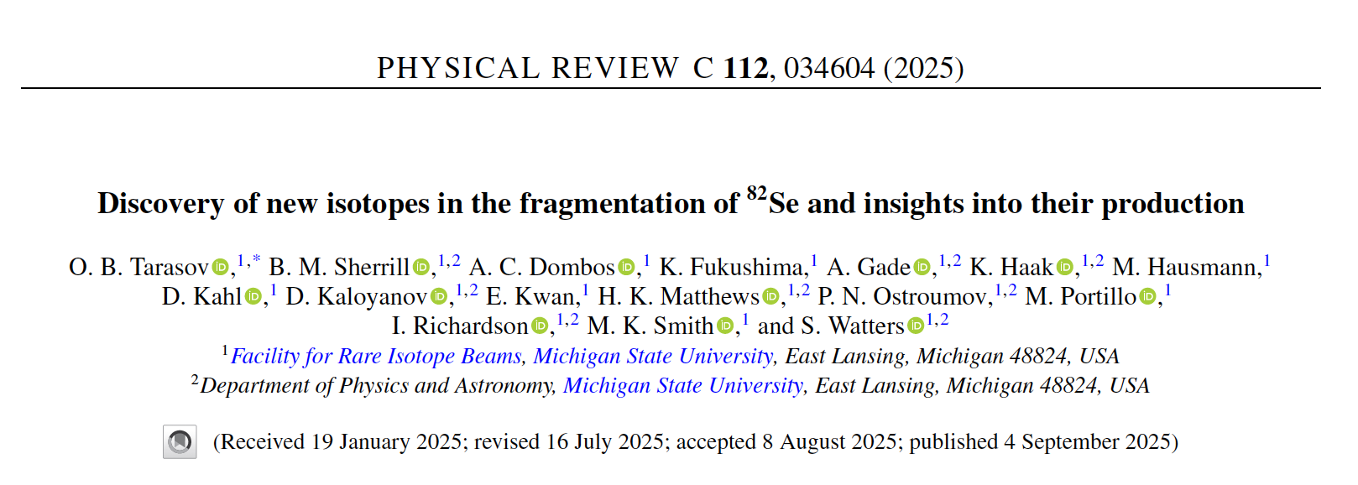
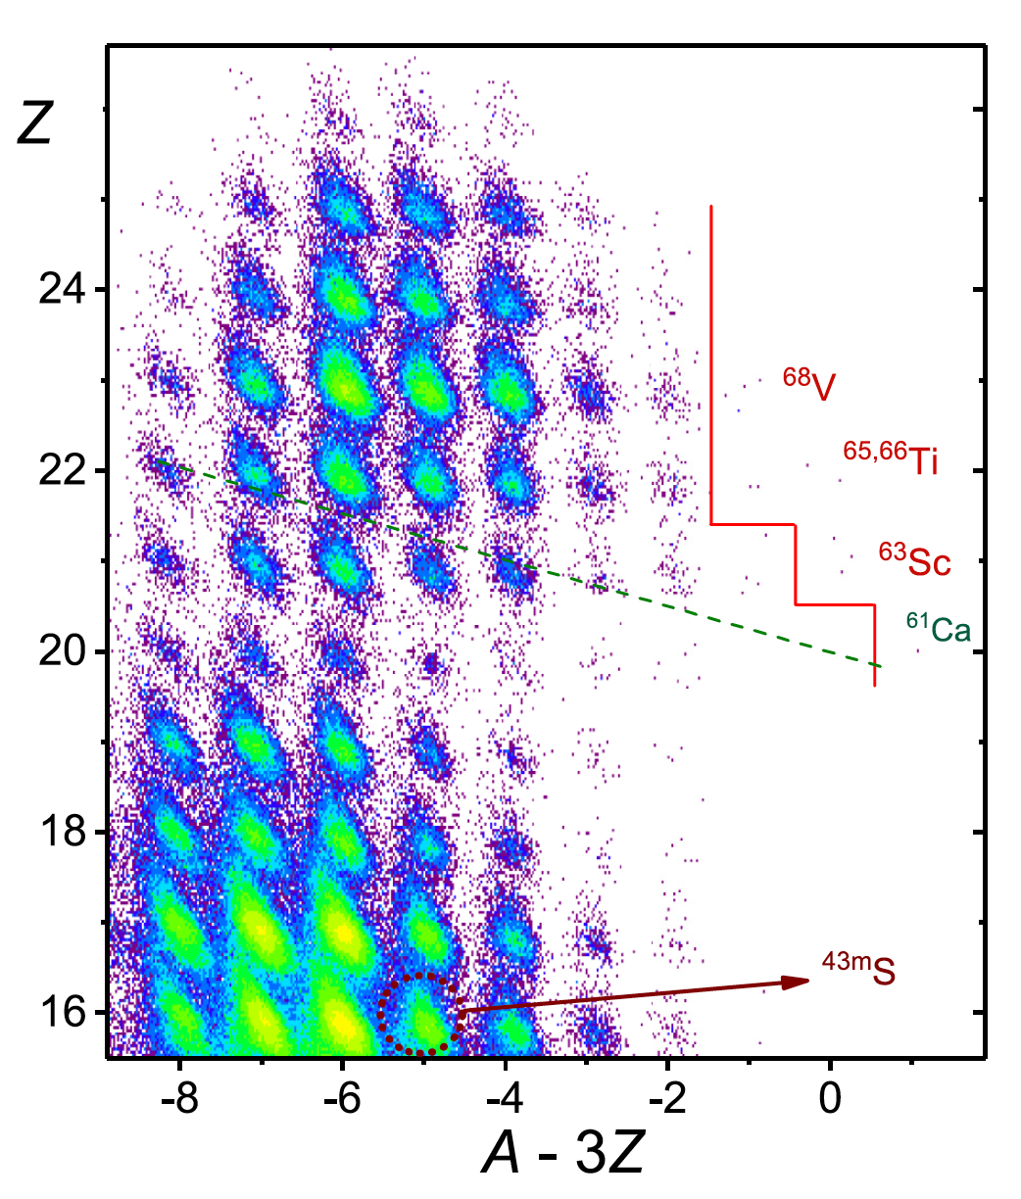
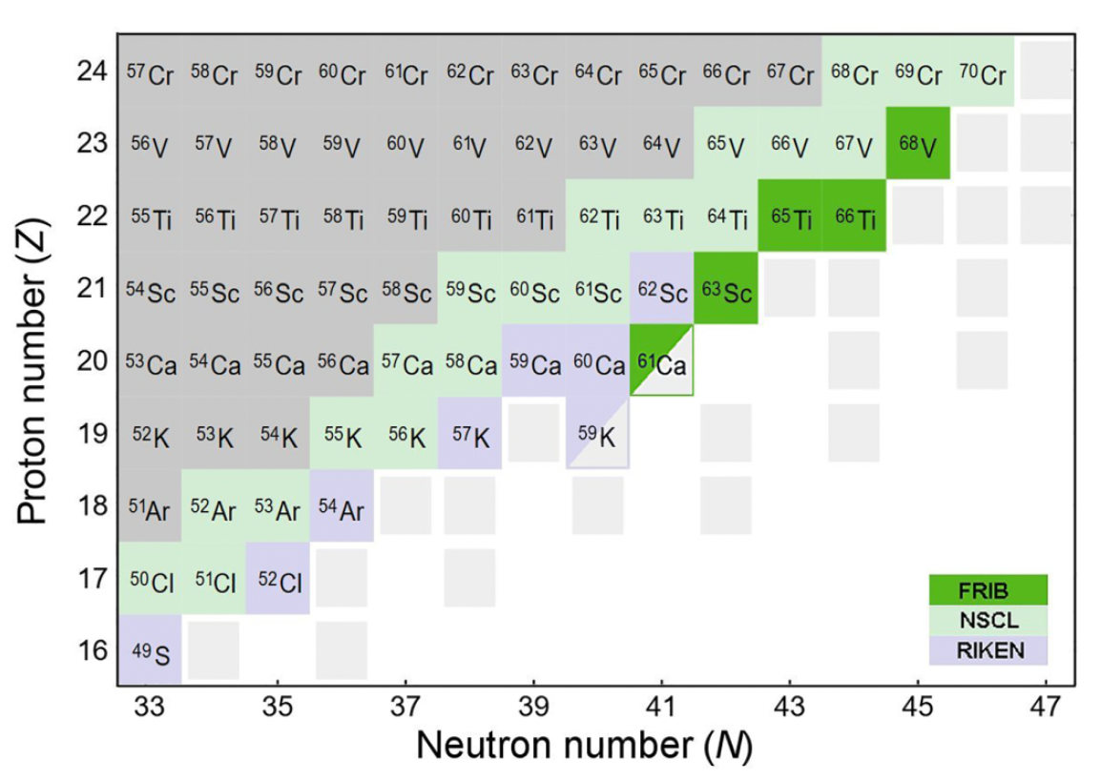
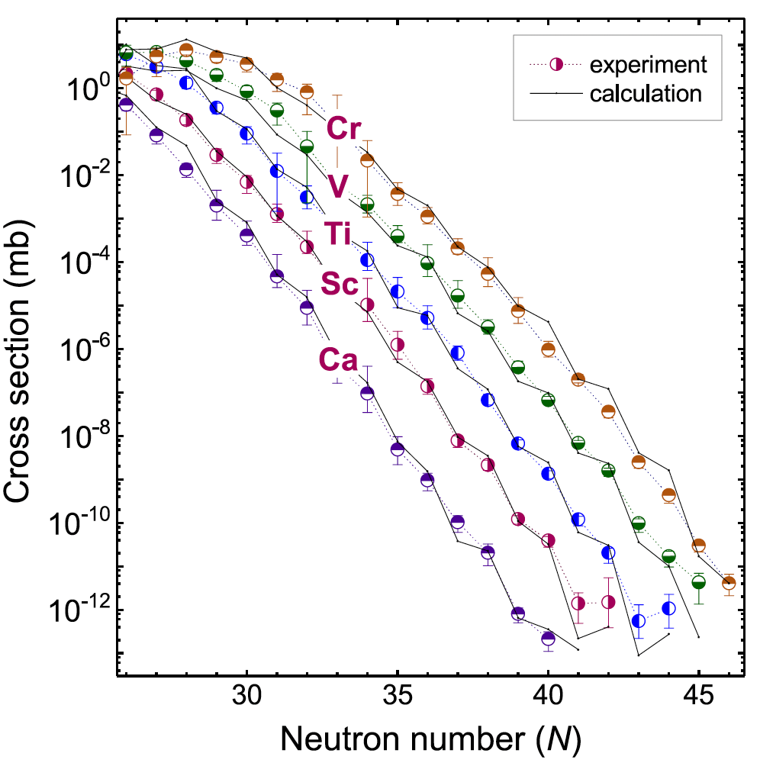
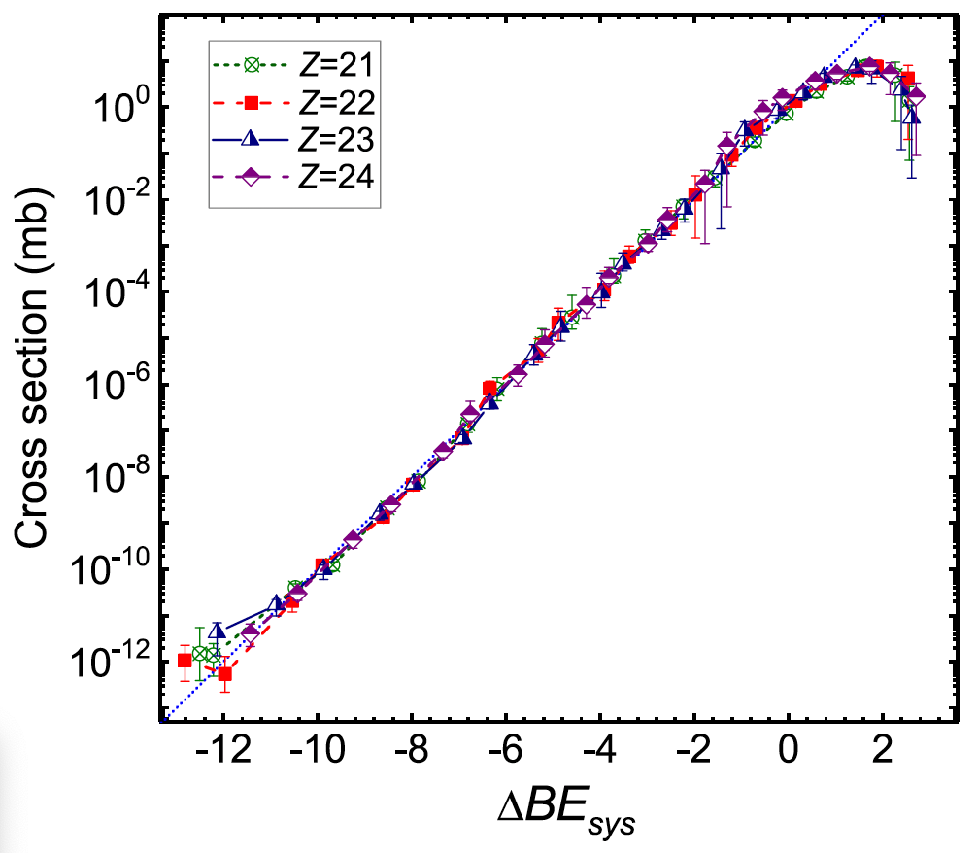
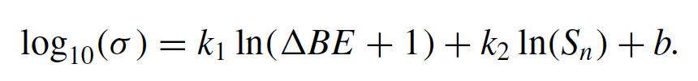
New isotopes discovered at FRIB – We did it again

Slide 8
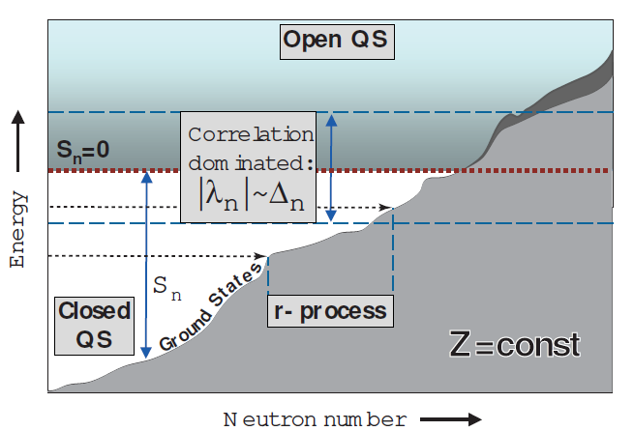
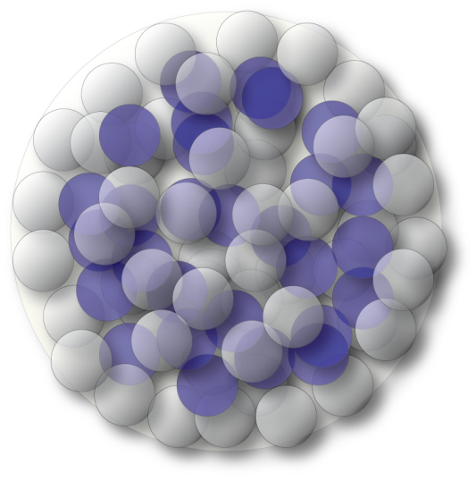
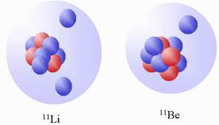
The nucleus as open quantum system
Nuclei are open quantum systems that connect to the environment through decays and reactions
RIB facilities can produce nuclei with desired N/Z and nucleon separation energies to amplify weak binding effects of interest
Access to nuclei with extreme skins (>0.5 fm) – crucial for understanding neutron stars
Access to nuclei with exotic decay modes, e.g. 2-proton or 2-neutron radioactivity – sensitive to pairing and spatial correlations
J. Dobaczewski et al., PPNP 59, 432 (2007)
Variations of nuclear mean field with neutron excess due to details of the nuclear force
Influence of open channels on properties of weakly bound and unbound nuclear
Nuclei with large neutron skins or halo structures

Slide 9
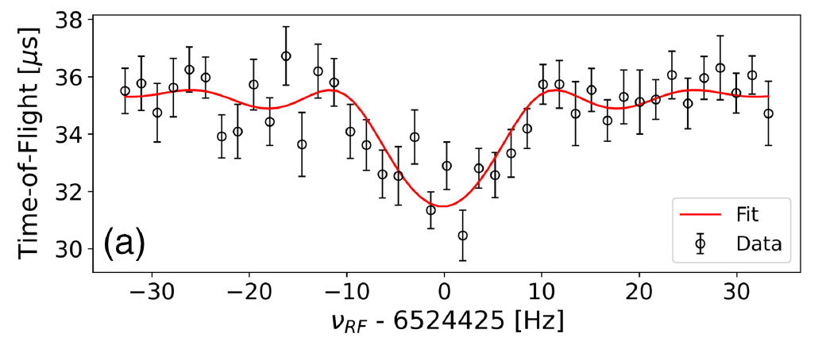

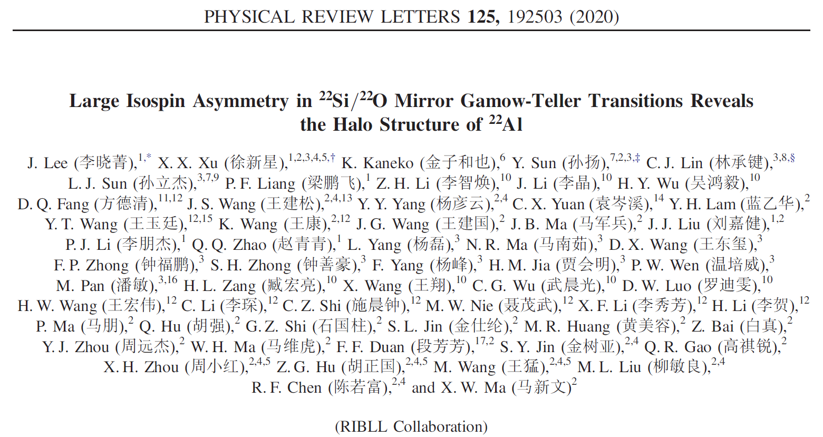
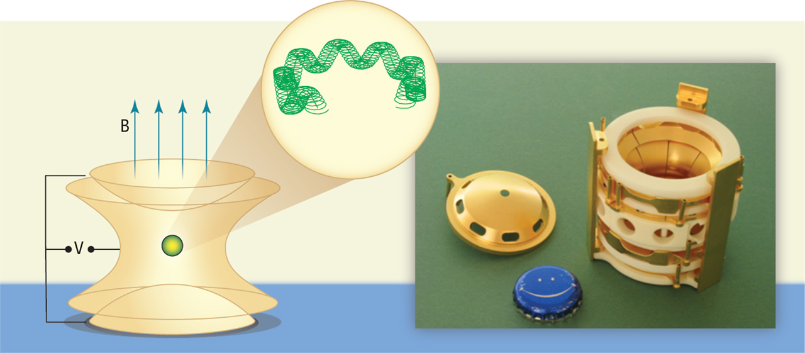
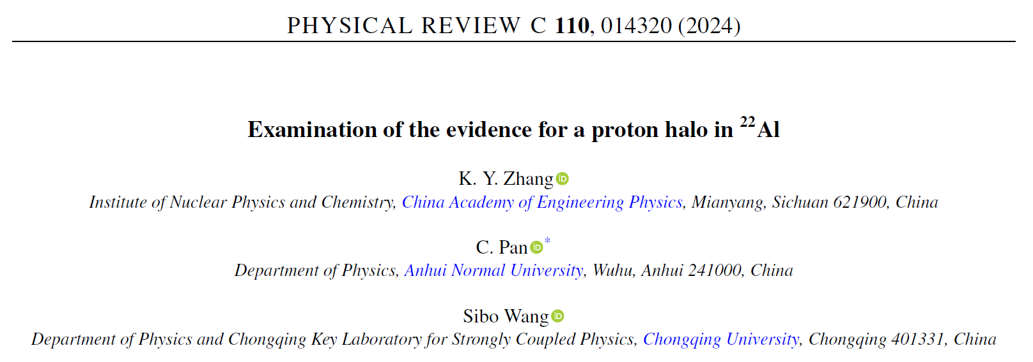

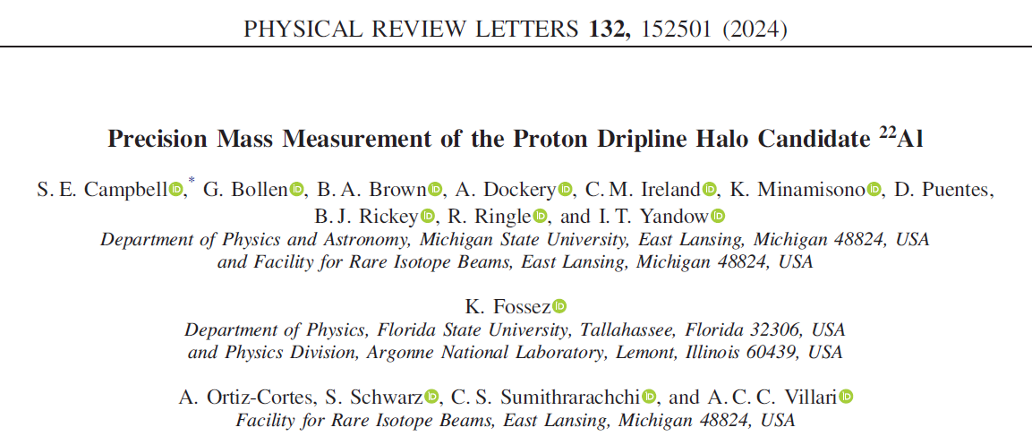
FRIB: First results on weak binding from precision program
Halo nature controversially discussed in recent literature: Halo vs. not likely a halo
The necessary, not sufficient condition is that the proton separation energy is low:
Highest-precision mass of ²²Al
It only takes 100.4(8) keV to remove the last proton
The final precision answer will be given following a charge radius measurement – stay tuned for that.
Charge radius was measured at FRIB, stay tuned (MIT, MSU collaboration)
“Future measurements of reaction or interaction cross sections and momentum distributions of breakup fragments for ²²Al are highly desirable”

Slide 10
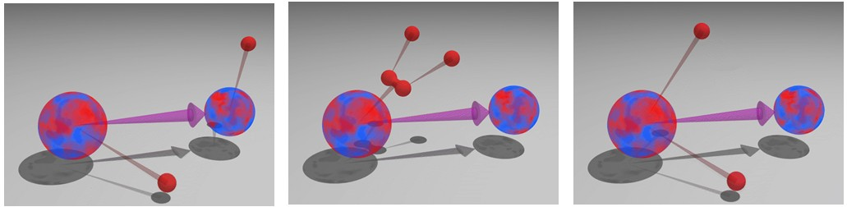
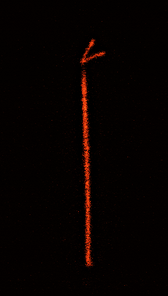
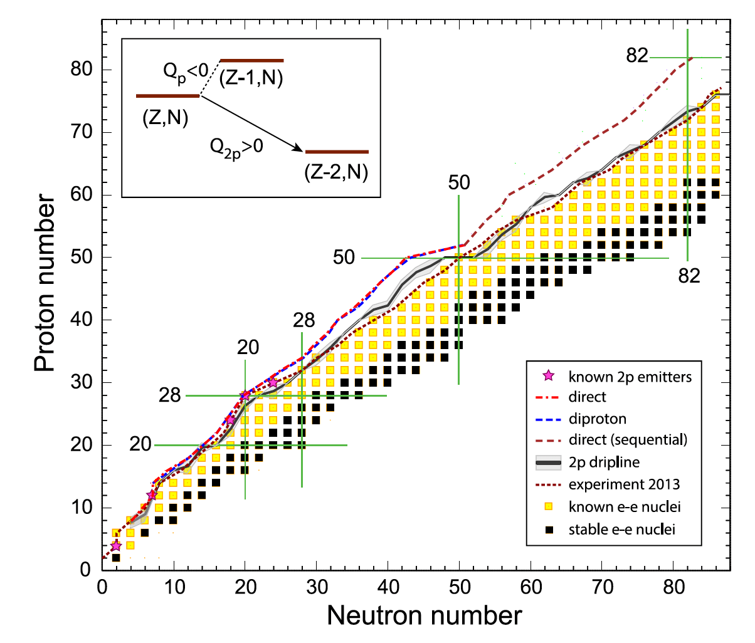
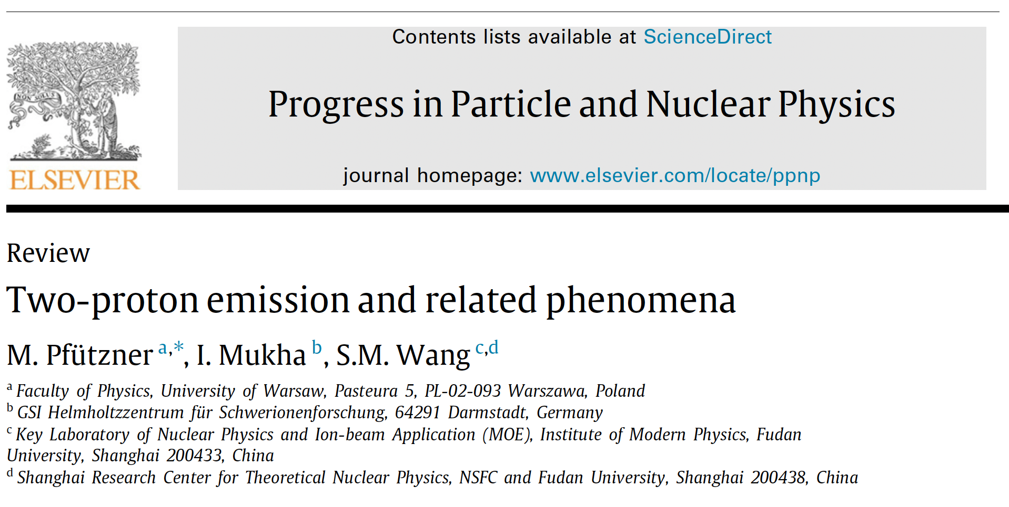
The nucleus as open quantum system – decay modes
https://heberge.lp2ib.in2p3.fr/desir/Beta-delayed-charged-particle
Outlook: M. Pfuetzner, C. Mazzocchi et al. have high-statistics FRIB data on 2p emitters from 2025

Slide 11
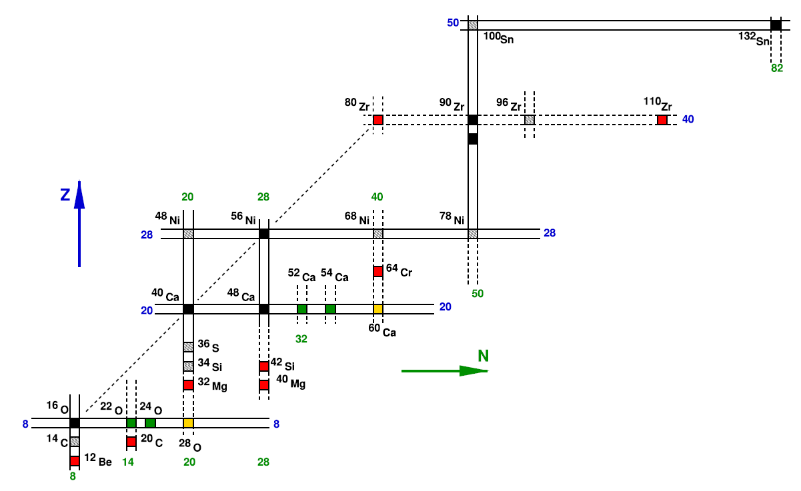
Changing nuclear structure across the nuclear chart
Frédéric Nowacki, Alexandre Obertelli, Alfredo Poves, PPNP 120, 103866 (2021)
Not all nuclei are equally important to constrain nuclear models
Nuclear theory, computational physics and experiment work in concert to identify key nuclei and properties
The nuclear chart offers a rich playground to amplify the drivers of structural evolution
Access key nuclei and compare to theory to identify missing physics in models
Explore the chart and find surprises that lead to revisions of models
Variations of nuclear mean field with neutron excess due to details of the nuclear force
Influence of open channels on properties of weakly bound and unbound nuclear

Slide 12
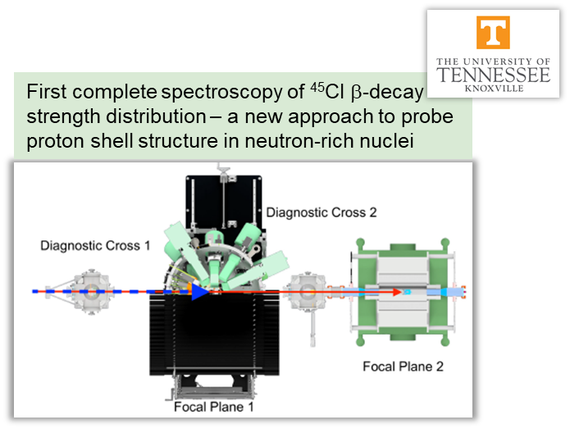
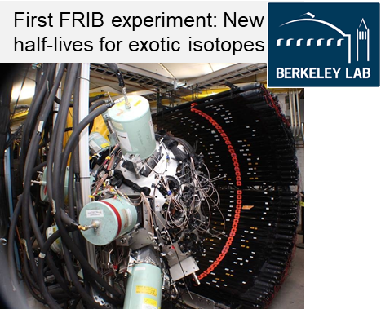
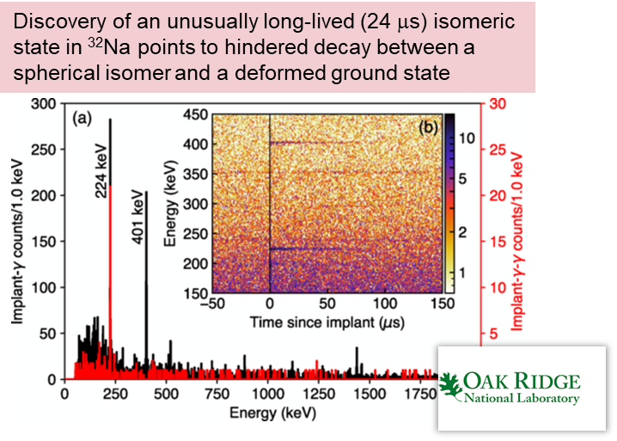
Not your 60ies textbook nuclear structure physics Experimental challenge increases in complexity
Phys. Rev. Lett. 129, 212501 (2022)
Phys. Rev. Lett. 132, 152503 (2024)
Phys. Rev. Lett. 130, 242501 (2023)

Slide 13
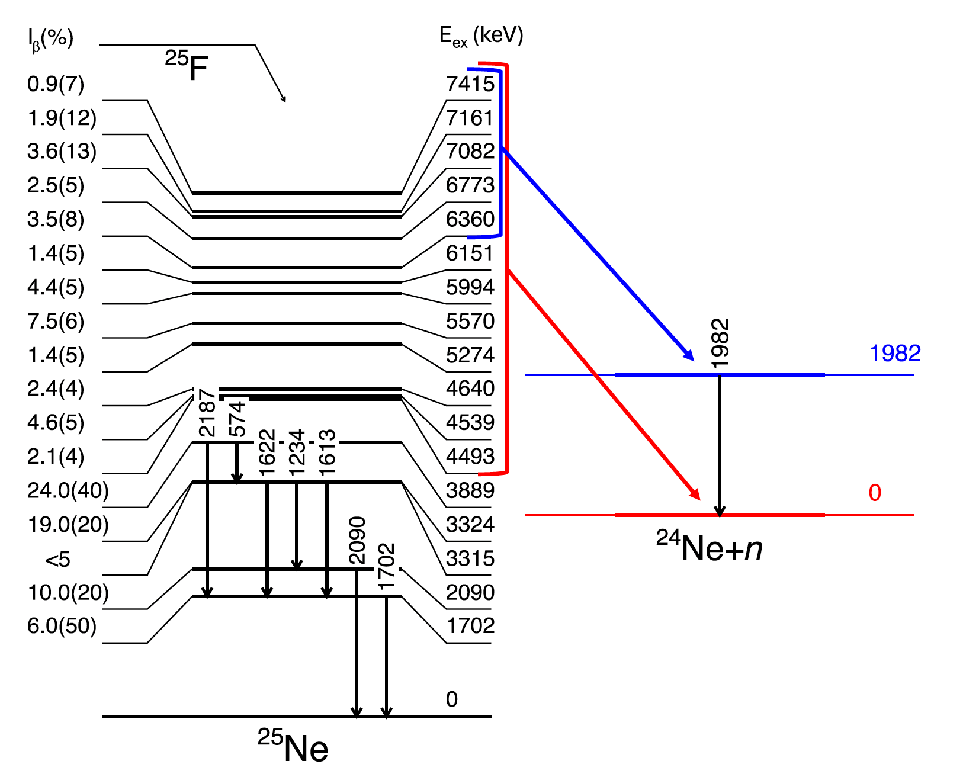
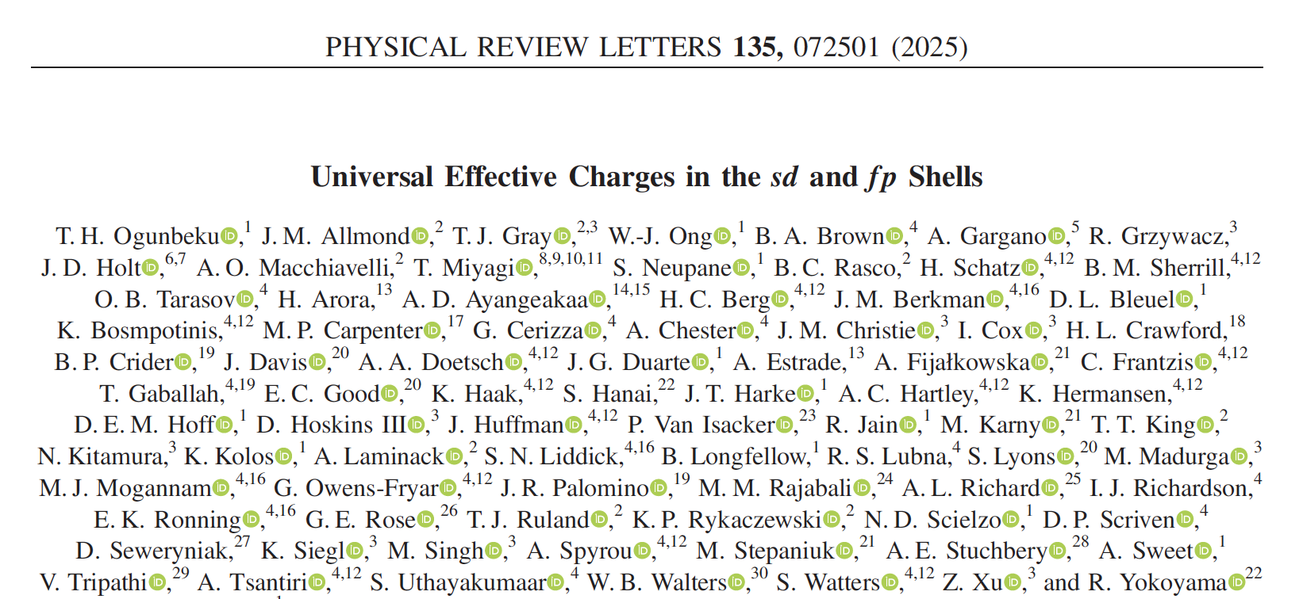
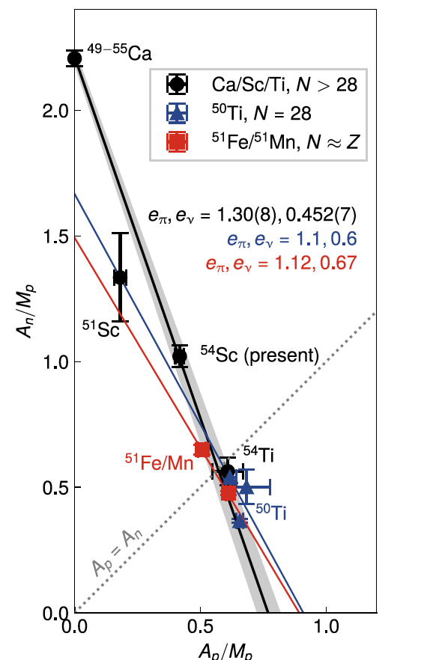

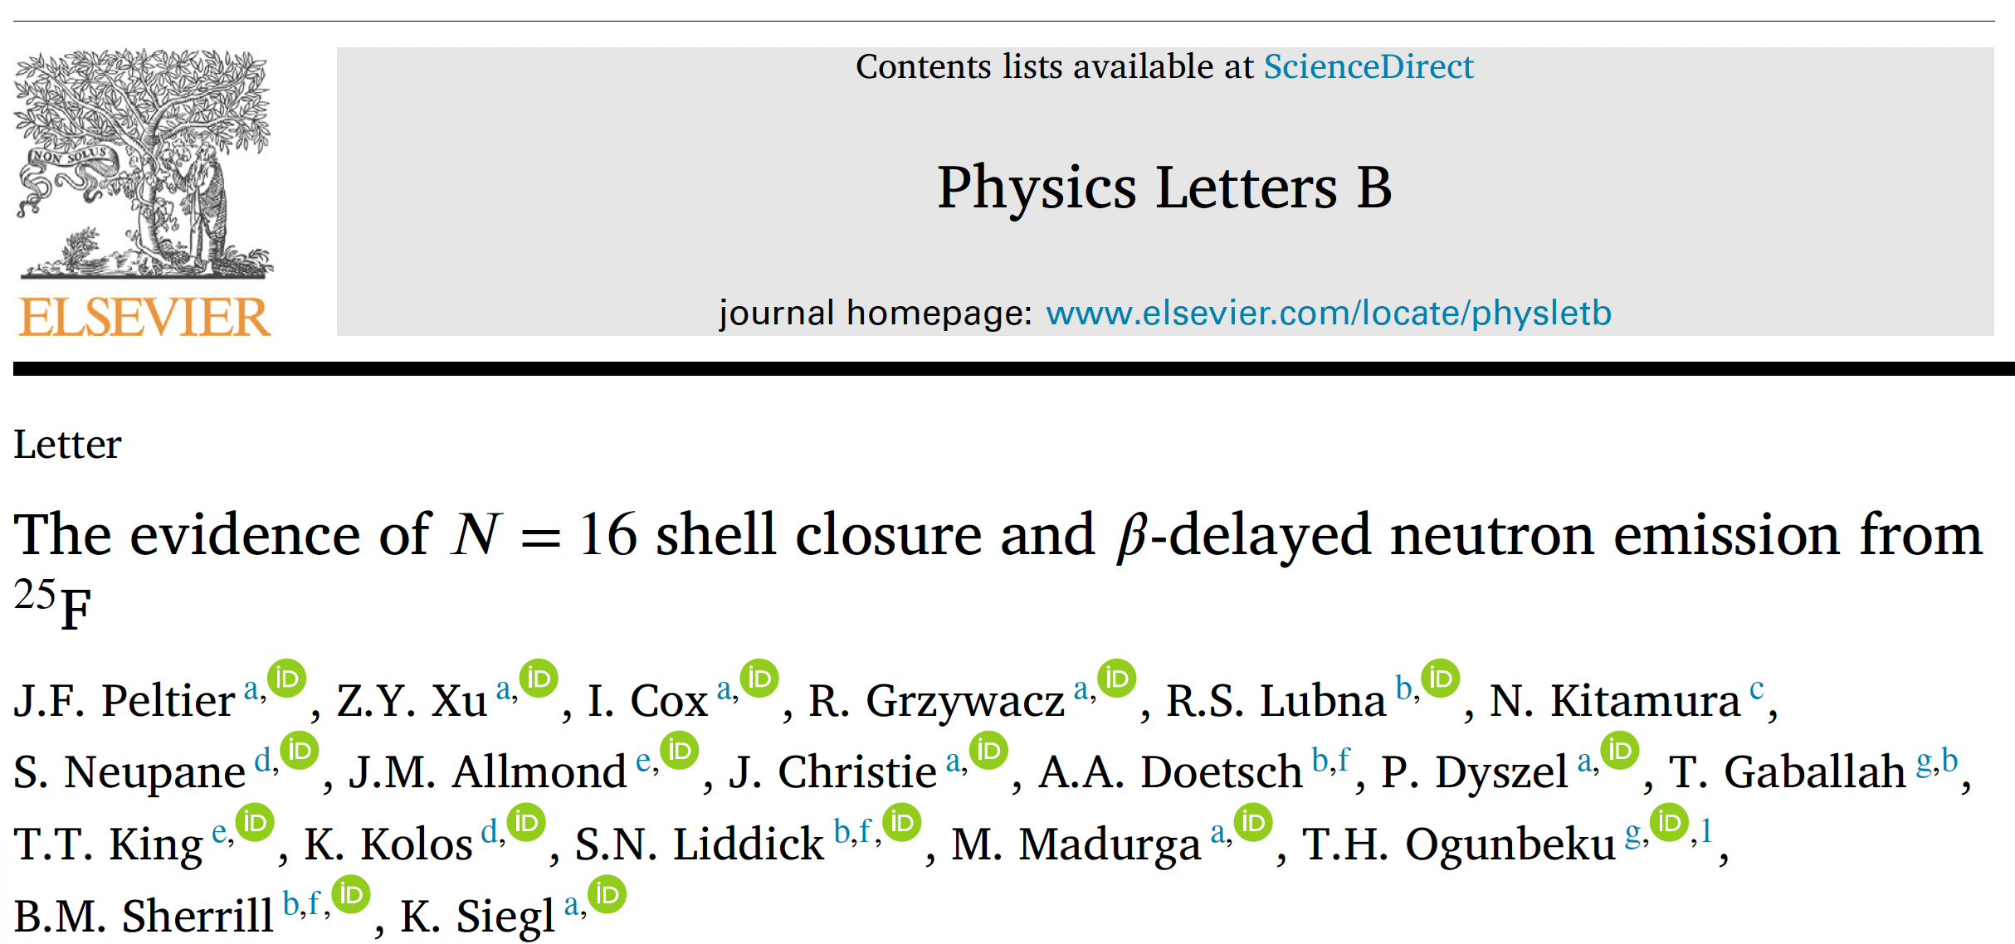

Not your 60ies textbook nuclear structure physics Brand new FDSi results from 2025

Slide 14
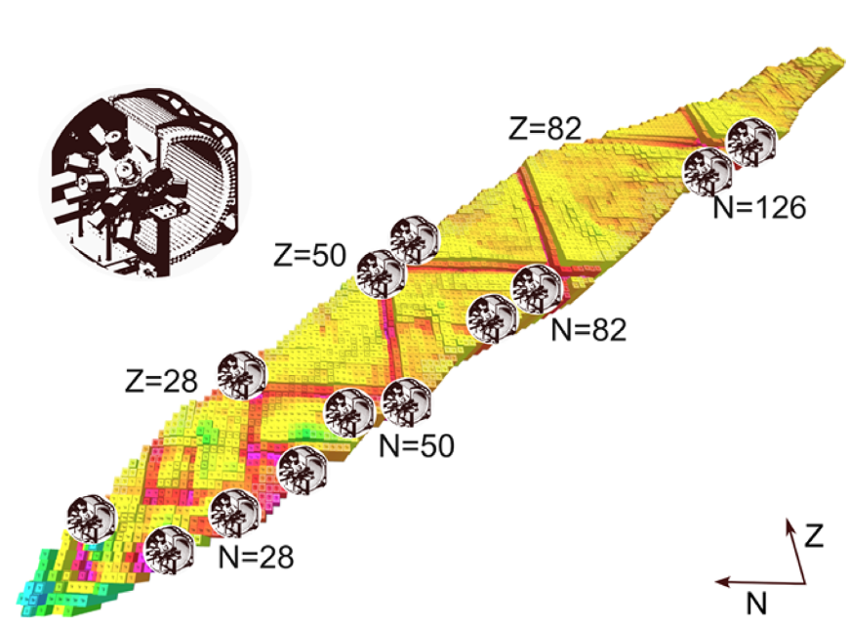
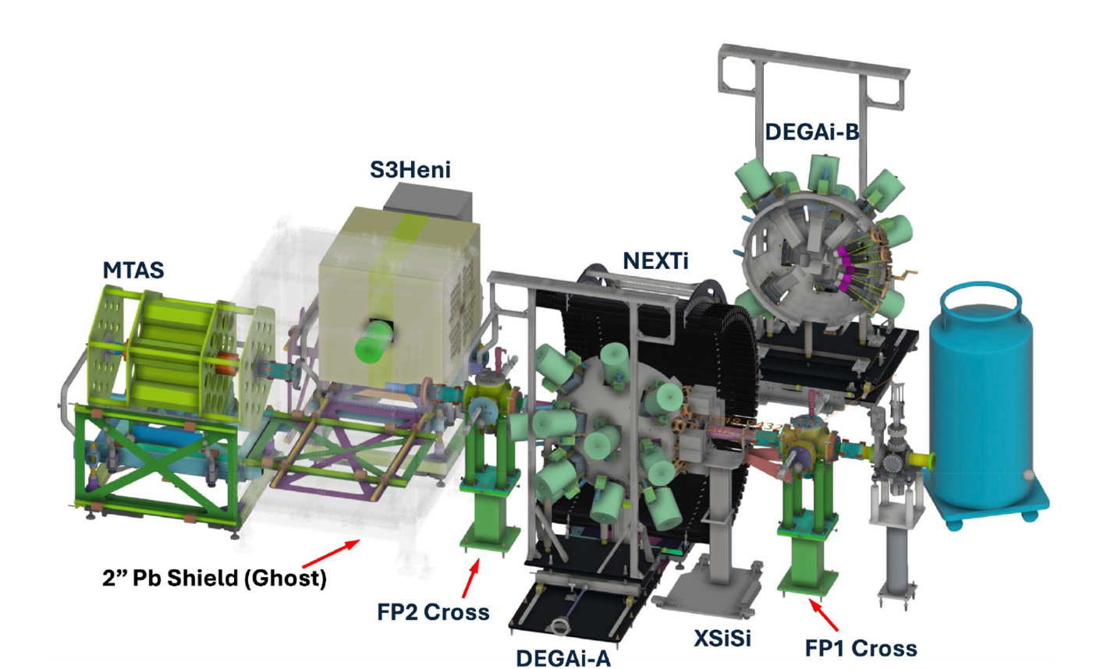
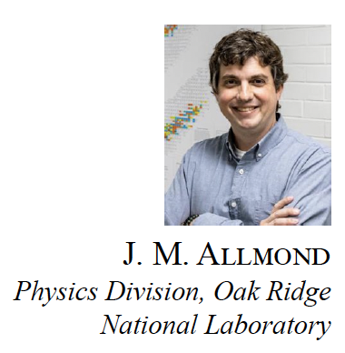
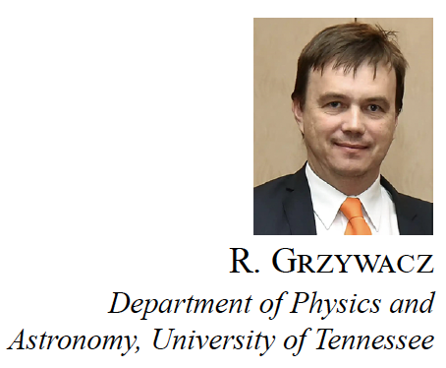

More to come – all regions with accepted FDSi experiments, many of them ran
FDSi in 2025

Slide 15




Knocking into yet another region of structural change
GRETINA
First GRETINA experiment at FRIB
S800 spectrograph

Slide 16



Motivation: Interesting collective structures predicted in the N=40 Island of Inversion
Already proposed in the spectroscopy paper
Goal: Find the predicted 0⁺ band head and maybe the other collective structure

Slide 17




⁶⁴Fe-2p at at FRIB

Slide 18


Understanding ⁶²Cr via two-nucleon knockout
For the states where the transitions are free-standing, have ok peak-to-background ratios, and feeding is manageable, the momentum distributions extracted confirm total angular momentum assignments
4⁺₁ and 6⁺₁ assignments confirmed
0⁺₂ assignment convincing, but 2⁺₂ cannot be excluded
Deformation in βγ according to Kumar-Cline invariants extracted from the conventional shell model (LNPS effective interaction)
Interesting case of shape coexistence

Slide 19

Analyzing the shapes of ⁶²Cr … Or the magic of experiment theory collaboration
Duc D. Dao, Frederic Nowacki, Silvia Lenzi, Alfredo Poves
Duc D. Dao, Frederic Nowacki
Deformation in βγ according to Kumar-Cline invariants extracted from the conventional shell model (LNPS effective interaction)
βγ planes according to the discrete non-orthogonal shell model

Slide 20


Outlook: First nuclear structure experiment with ReA beam
Alan Wuosmaa, Ben Kay et al.,
SOLARIS solenoidal spectrometer built by ANL for NSCL/FRIB experiments
Preliminary

Slide 21







2025 nuclear structure results I did not mention

Slide 22
Summary and Outlook
FRIB is up and running, providing beam to all areas, and ramping up capabilities
Nuclear structure results have come out from work all over the chart and have exploited fast, stopped, and reaccelerated beams
FRIB’s program is broad, including nuclear astrophysics, fundamental symmetries, applications … and I only showed you nuclear structure results
Thank you for your attention!
This material is based upon work supported by the U.S. Department of Energy, Office of Science, Office of Nuclear Physics and used resources of the Facility for Rare Isotope Beams (FRIB) Operations, which is a DOE Office of Science User Facility under Award Number DE-SC0023633.
A.G. is supported by the U.S. Department of Energy (DOE), Office of Science, Office of Nuclear Physics, under Award No. DE-SC0023633

Slide 23





Excursion: Shape of longitudinal momentum distribution encodes final-state total angular momentum
B. Longfellow et al., PRC 101, 031303(R) (2020)
D. Santiago-Gonzalez et al., PRC 83, 061305(R) (2011)

Slide 24




Momentum distributions in two-nucleon knockout

Slide 25




γ rays emitted in flight are Doppler shifted – needed for reconstruction: Velocity and emission angle
Segmented HP Ge detectors
Signal decomposition from digitizer traces
Determine precise location and sequence of γ-ray interaction points
Doppler-reconstruction of γ rays emitted in flight

Slide 26













First in-beam spectroscopy at the FRIB reveals competing nuclear shapes in the rare isotope ⁶²Cr
Motivation: Calculations allowing excitations across N=40 pointed to potentially interesting collective structures
Goal: Find and characterize the 0⁺ band head in ⁶²Cr.
How: Longitudinal momentum distributions of ⁶²Cr in ⁹Be(⁶⁴Fe,⁶²Cr+γ) are sensitive to the final-state total angular momenta
Discovery of shape-coexisting 0⁺ state in ⁶²Cr and stunning agreement with theory promises exciting nuclear structure at ⁶⁰Ca by extrapolation
Model calculations predict different shapes for the ground state and excited band on top of the newly found excited 0⁺ state
A. Gade, B. Longfellow, R. V. F. Janssens et al., Nature Physics 21, 37 (2024)
DOI: 10.1038/s41567-024-02680-0

