Slide 1
New decay studies along the proton drip line between Mg and P at FRIB
Hans O. U. Fynbo, Aarhus University, Denmark
Direct and stepwise 2p-emission
β-delayed particle emission
Status of the subject
New results from FRIB on ²²Al and ²⁶P
Outlook

Slide 2
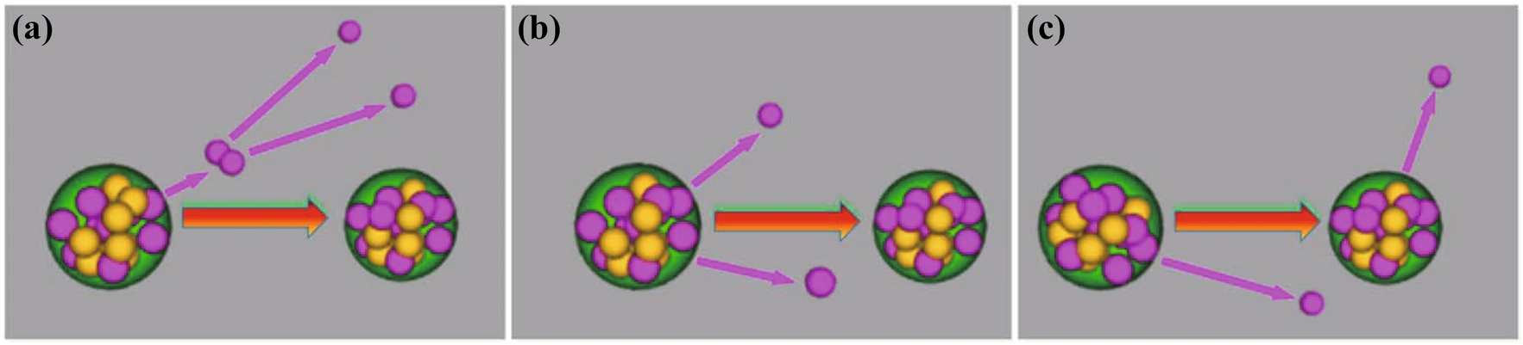
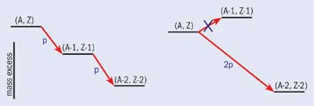
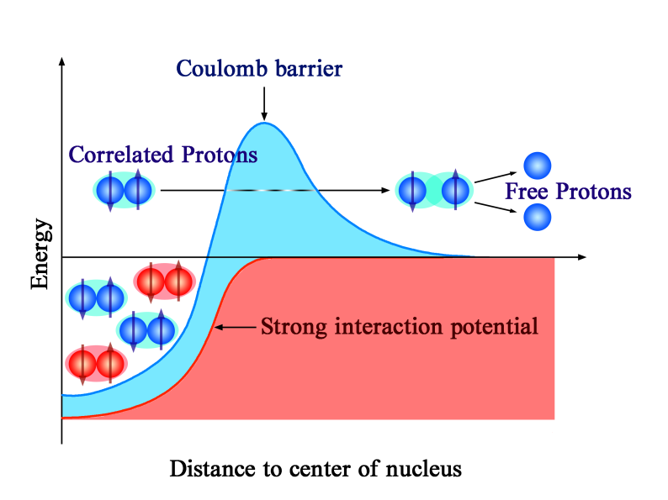
Direct 2p-emission
Image by Sun Lijie
Final state not determined by kinematic conservation laws
⁴⁵Fe, ⁵⁴Zn, ⁴⁸Ni, and ⁶⁷Kr

Slide 3
Stepwise 2p-emission
?
Image by Sun Lijie
Final state not determined by kinematic conservation laws

Slide 4
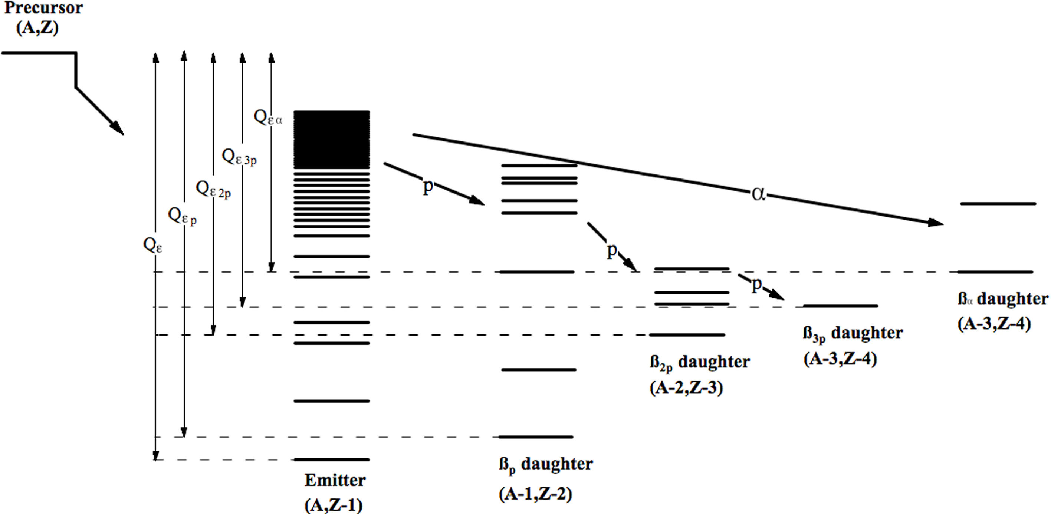
^{β-delayed particle emission}
Z > N
IAS can be populated
direct 2p ?
direct 2p
J.C. Batchelder, Atomic Data and Nuclear Data tables 132 (2020), 101323

Slide 5
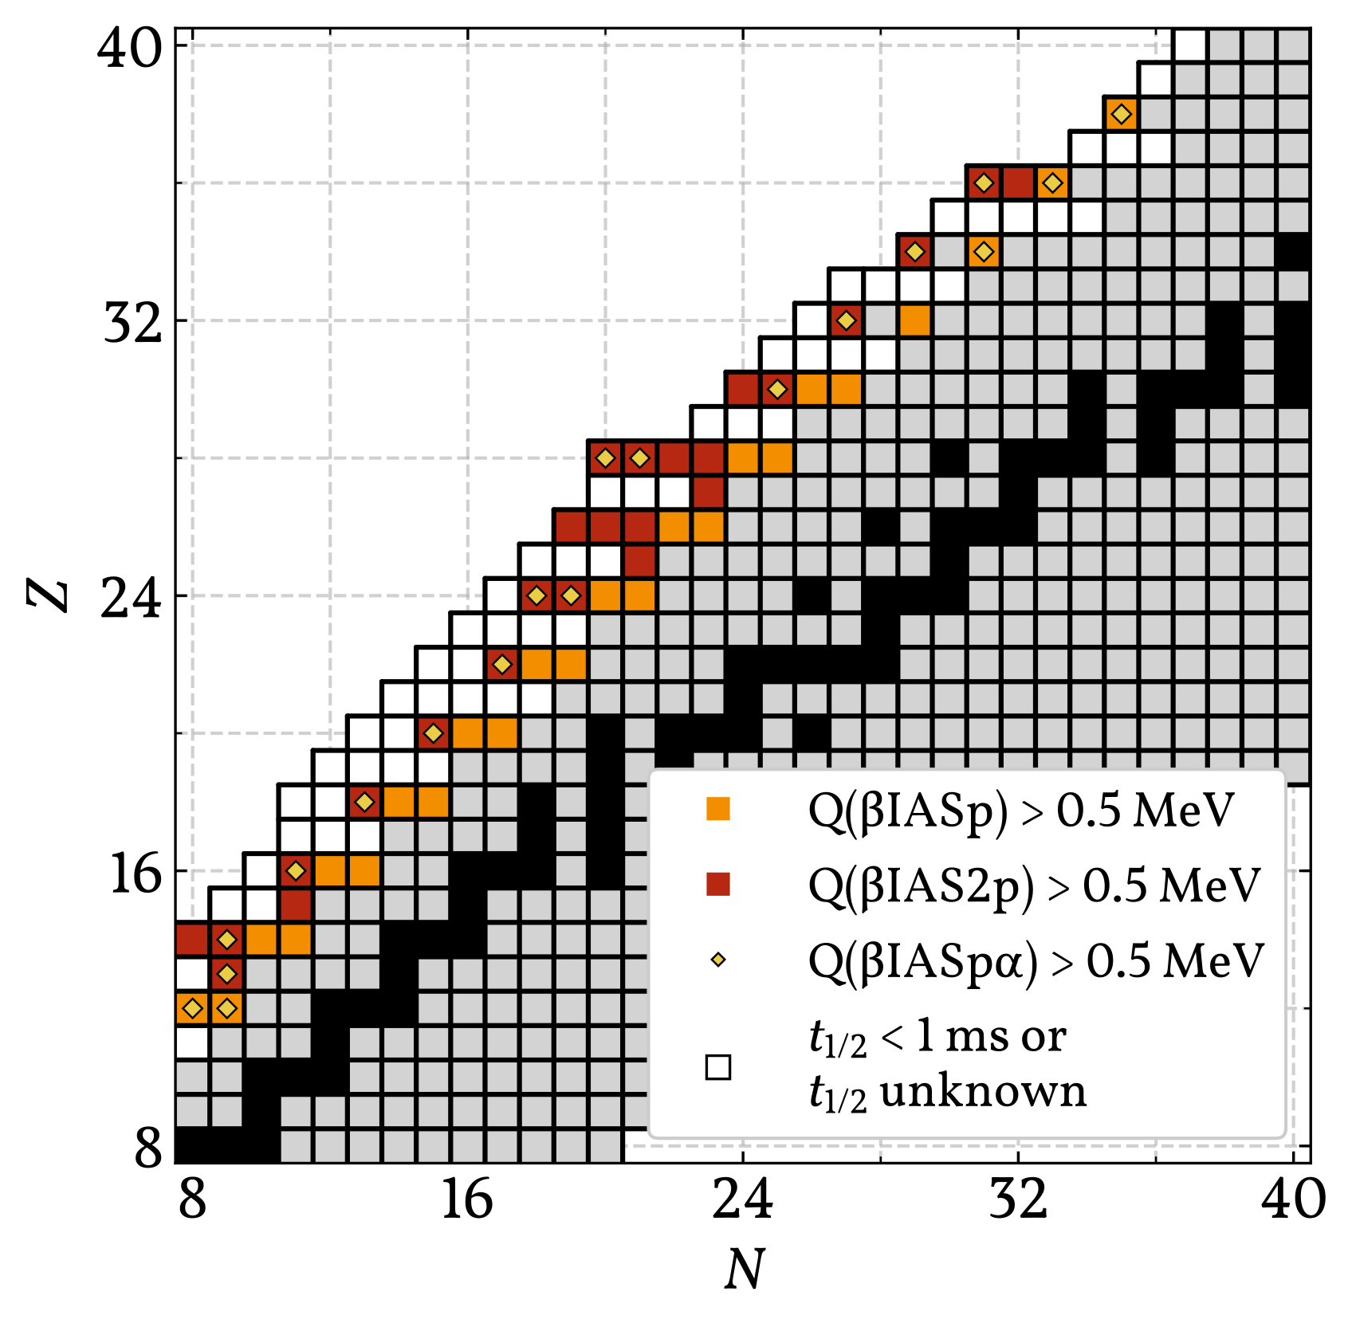
^{β-delayed particle emission}

Slide 7
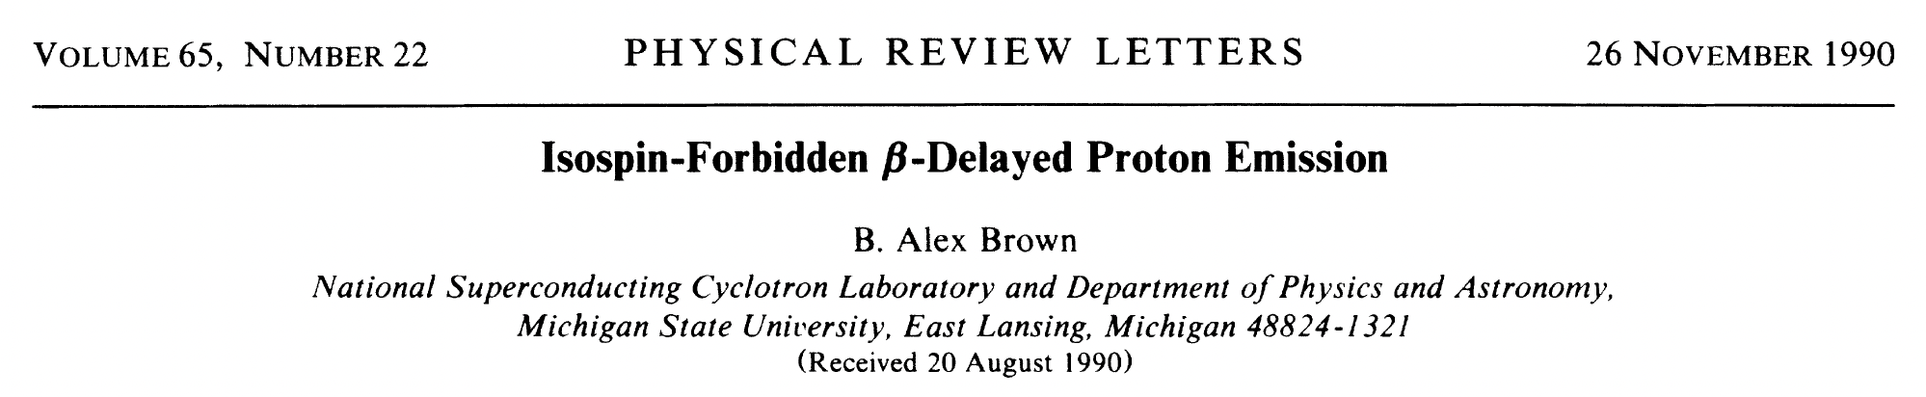
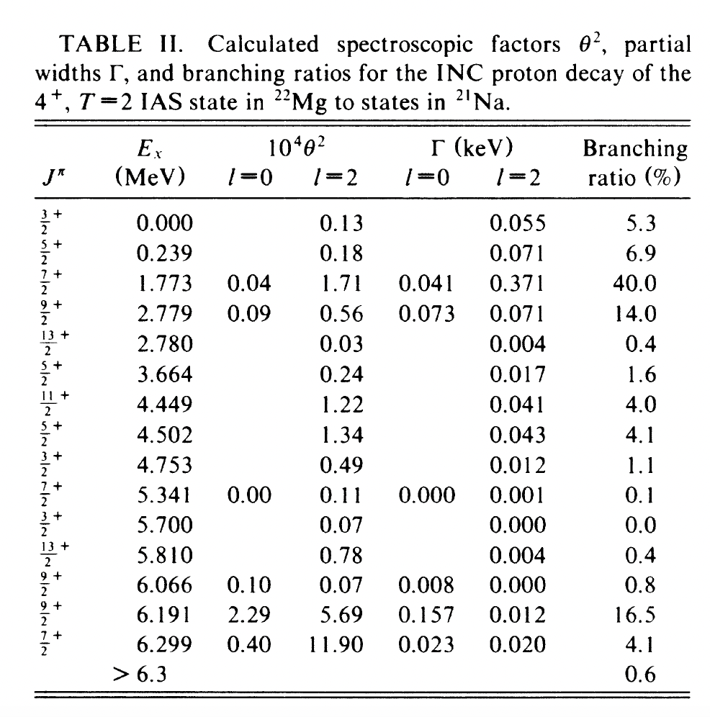
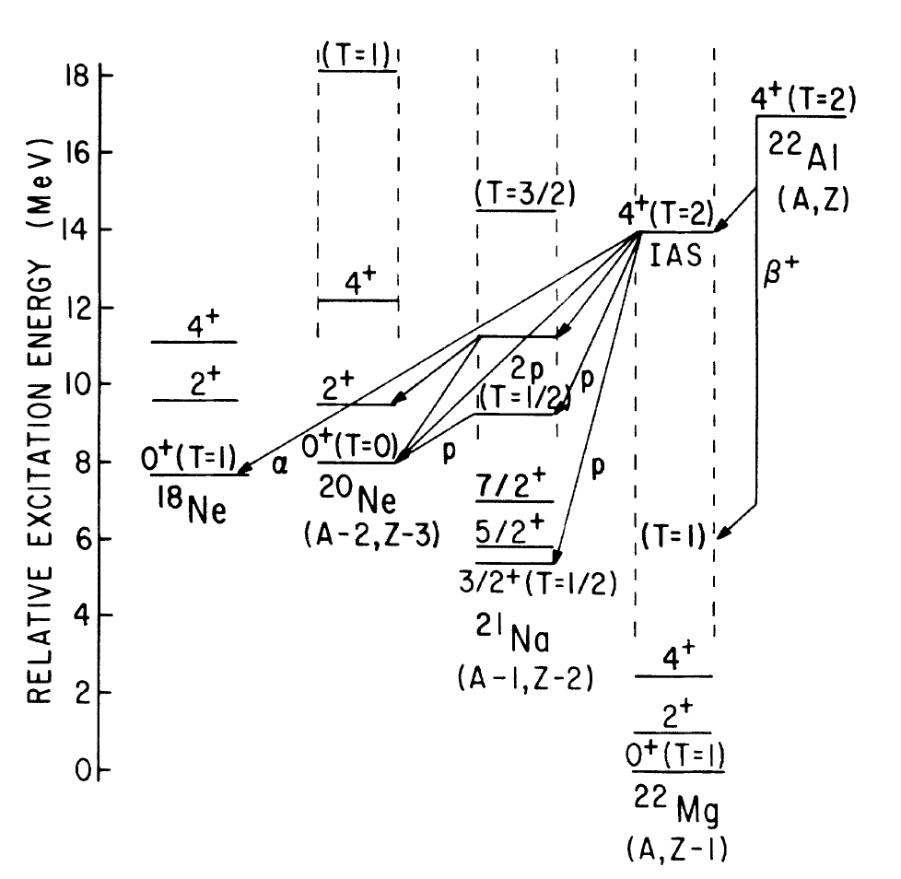
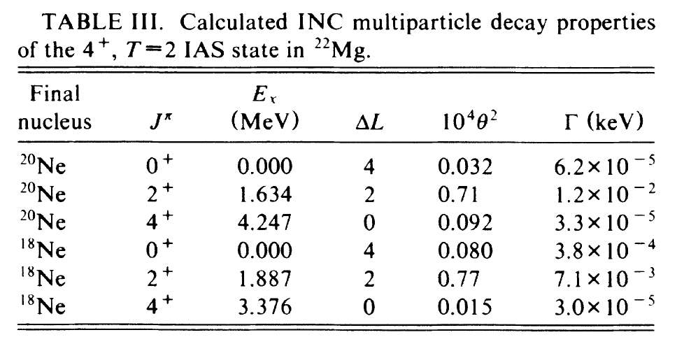
1p
~50%
2p
~50%
~1% “²He”
~1% α

Slide 8
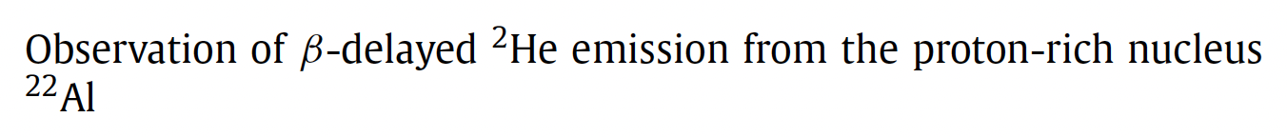
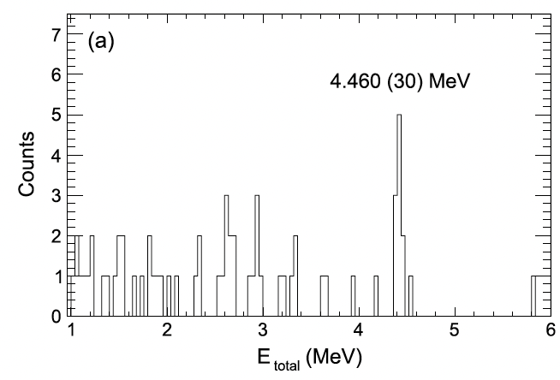
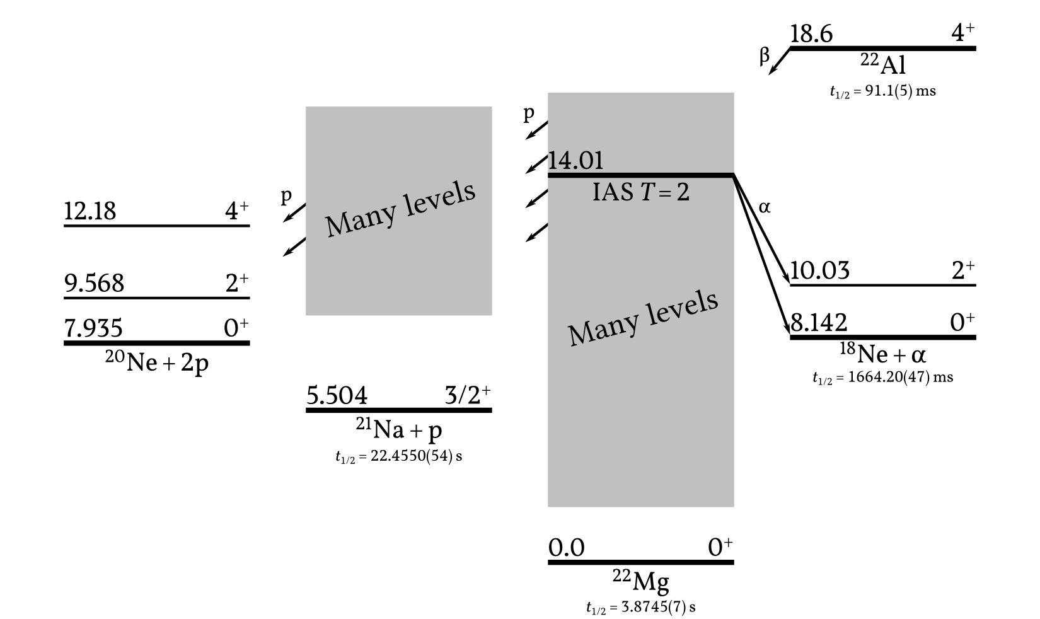
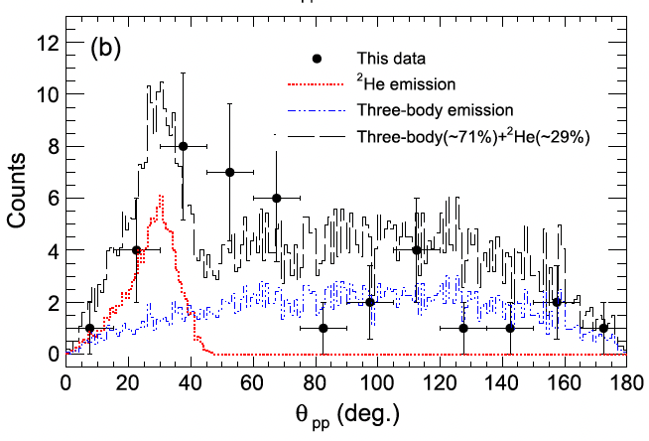
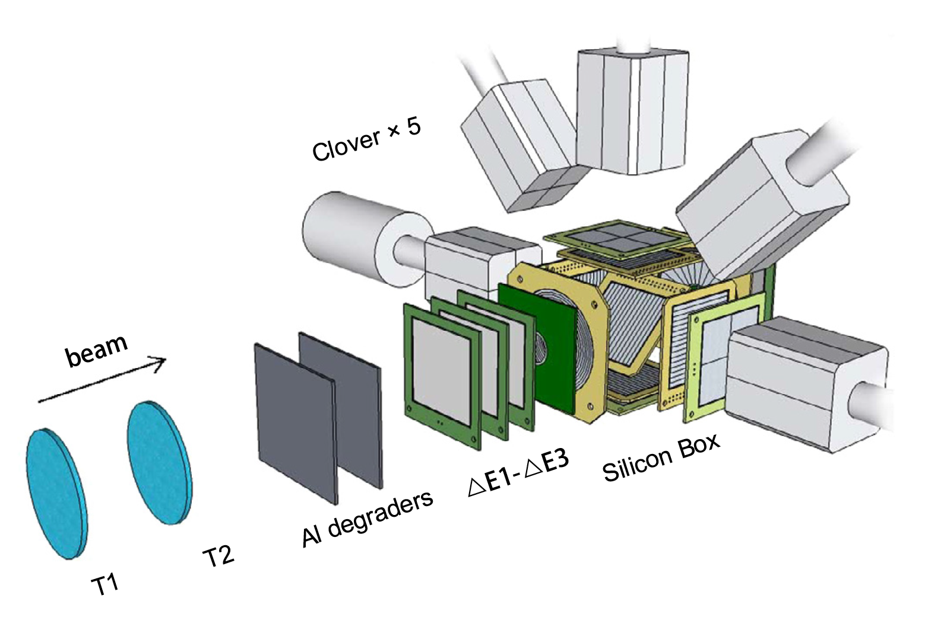
Y.T. Wang et al. Phys. Lett. B784 (2018) 12
29(13)%
“²He”

Slide 9
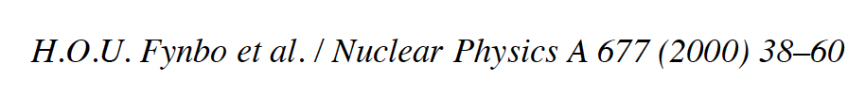
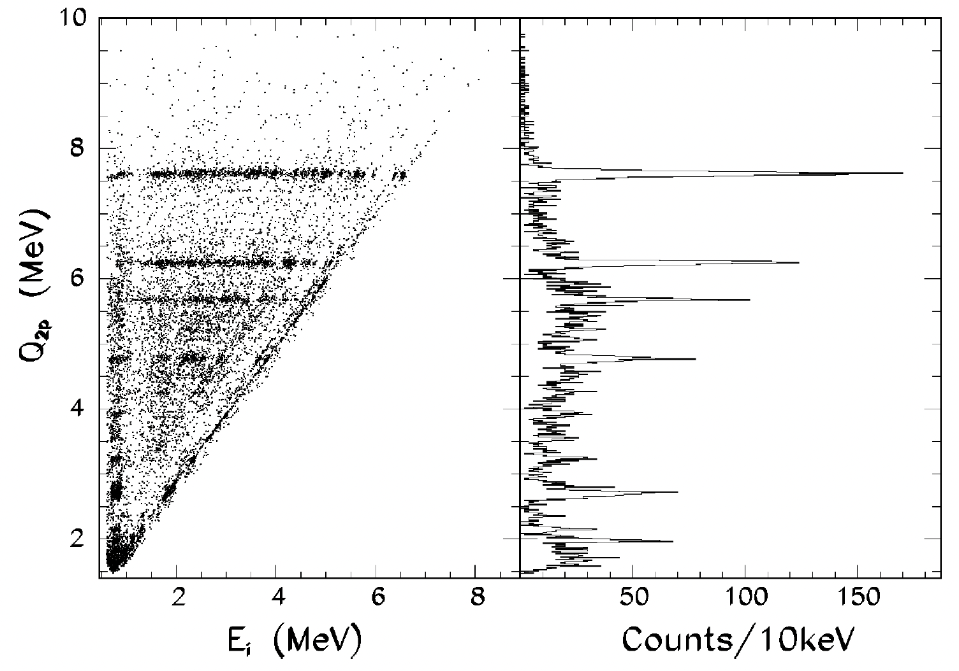
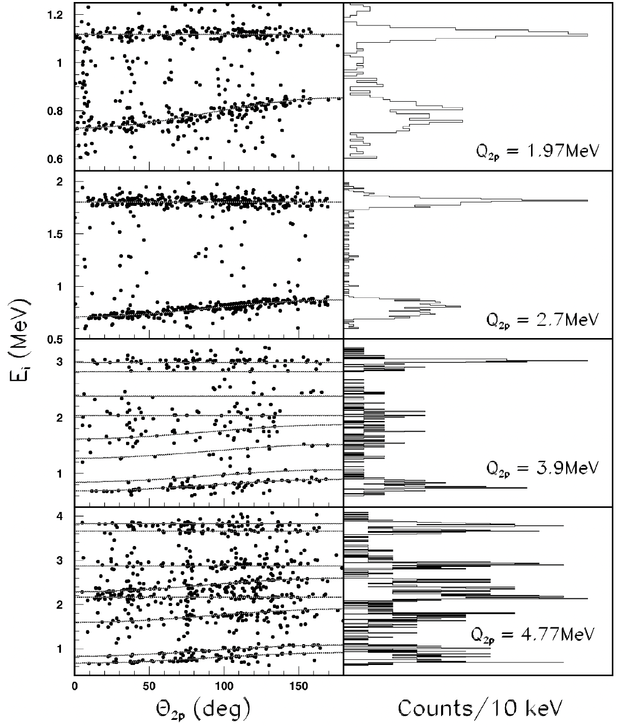
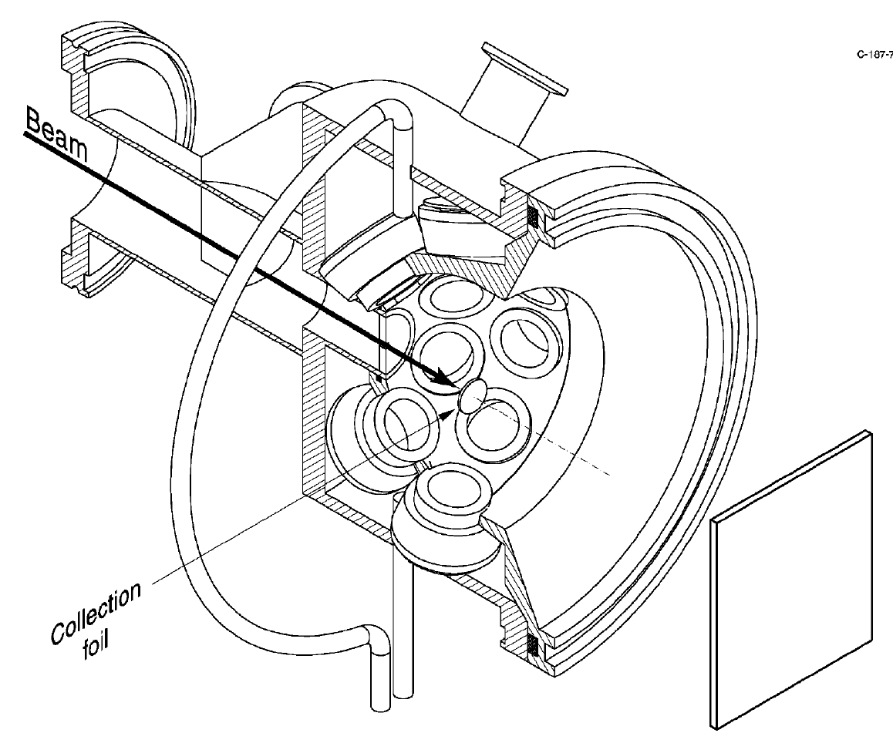
IAS to g.s.
IAS to 1st ex.
IAS to 2nd ex.
³¹Ar

Slide 10
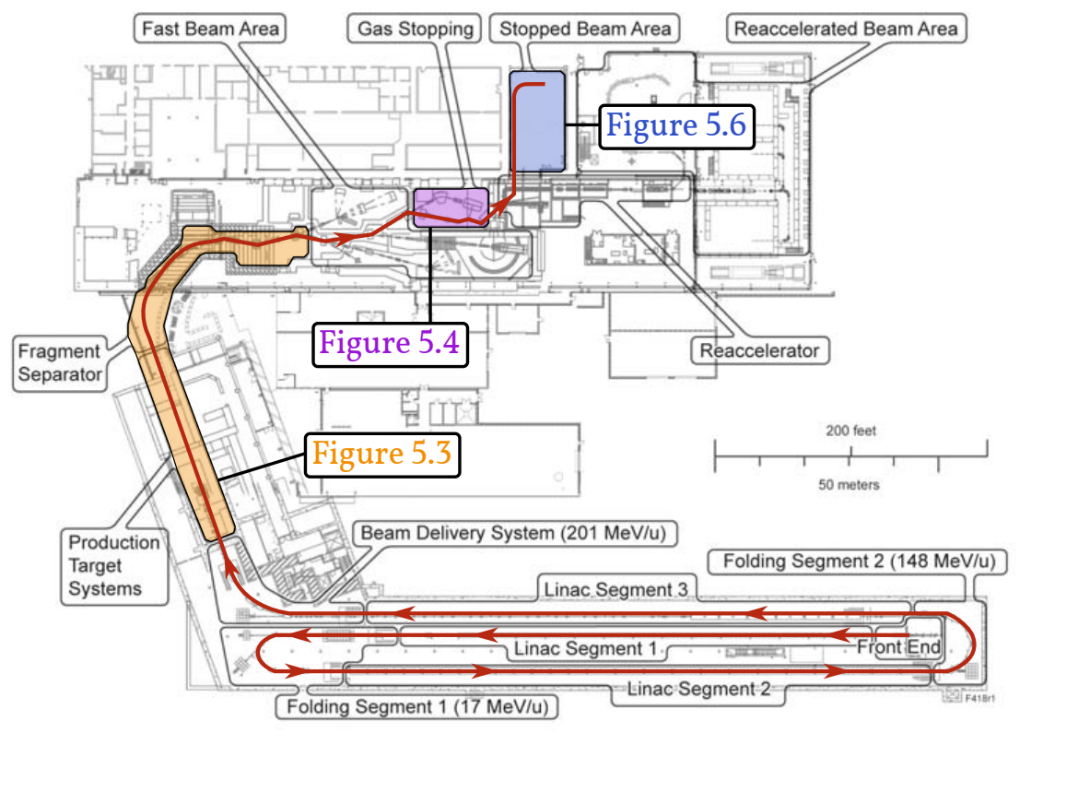
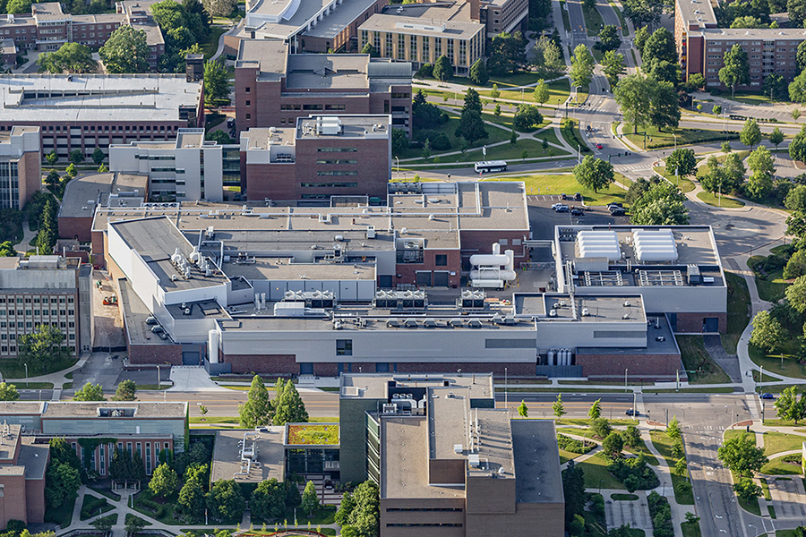
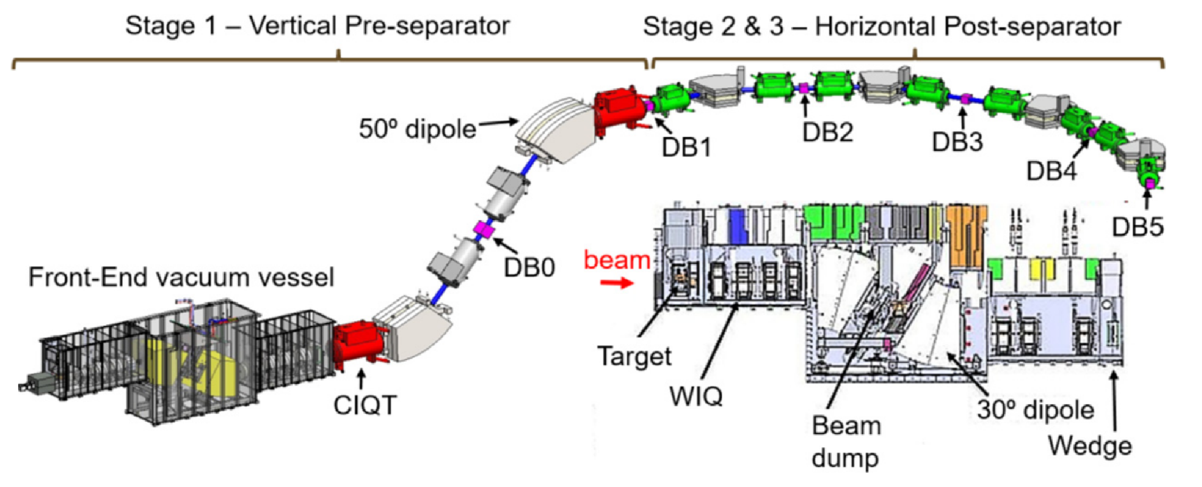
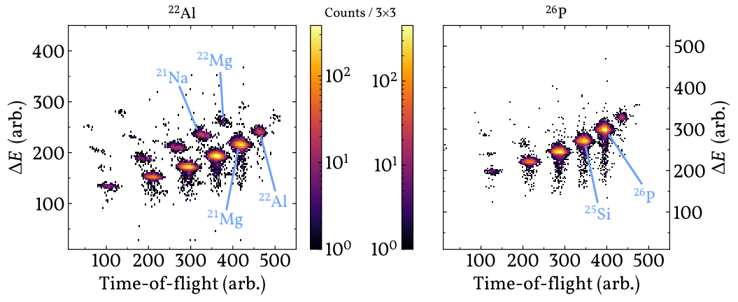
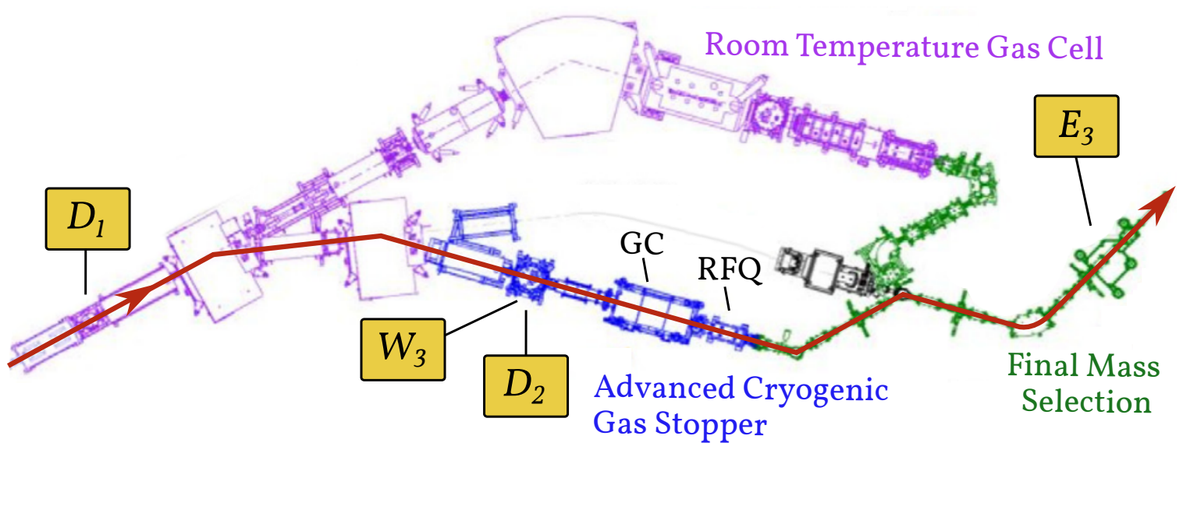
²²Al and ²⁶P at FRIB
Experiment in June-July 2023 was the 1st Stopped Beam Experiment at FRIB
- Primary beam ³⁶Ar
- Production target ¹²C
- Cooling of high-energy beam in Gas Stopper

Slide 11
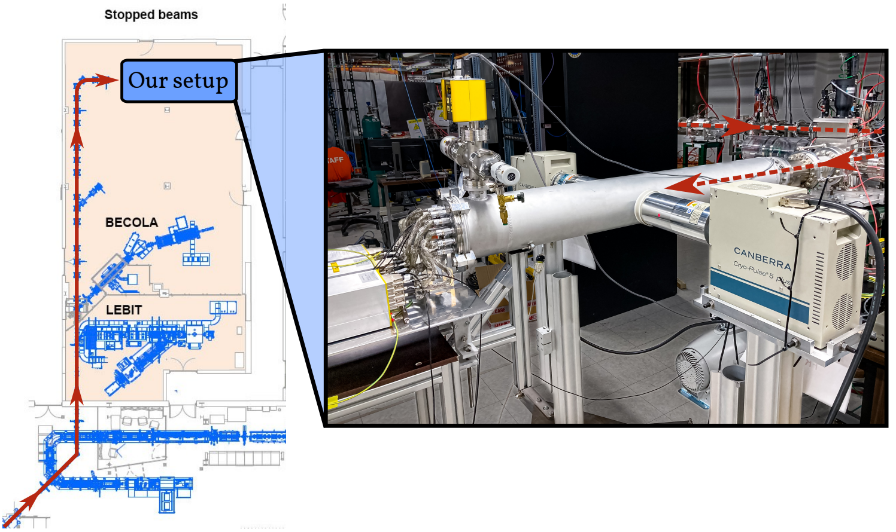
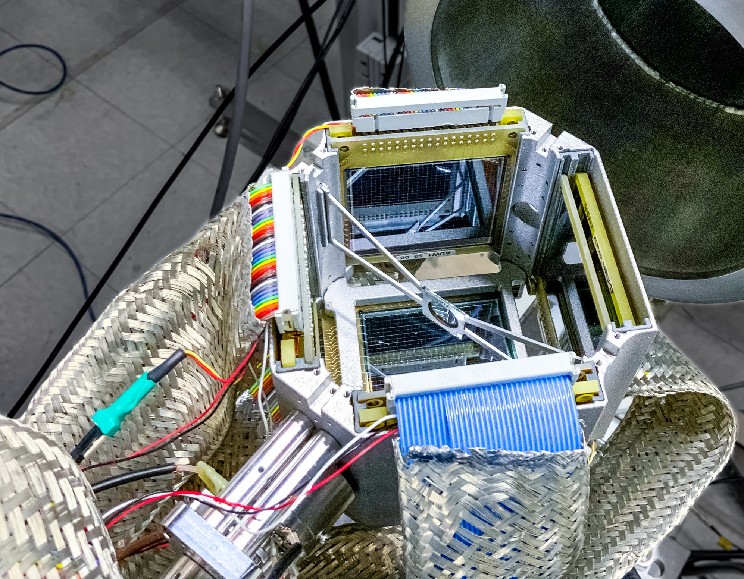
²²Al and ²⁶P at FRIB
Germanium detectors
5.6
Beam
Silicon cube :
-6 ΔE-E silicon detectors
-ΔE 16x16 DSSSDs
-42 % of 4π for p/α; 18% of 4π for 2p

Slide 12
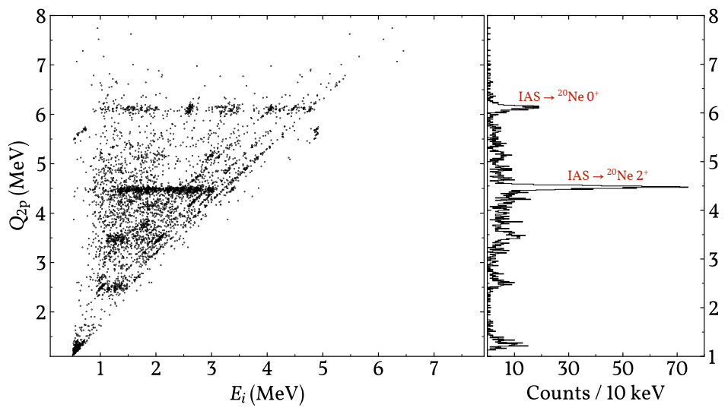
²²Al: β2p
33h beam time
9 10³ pps expected
7 pps delivered
1.2 10⁵ 1p events
2.4 10³ 2p events
IAS ²⁰Ne 4⁺

Slide 13
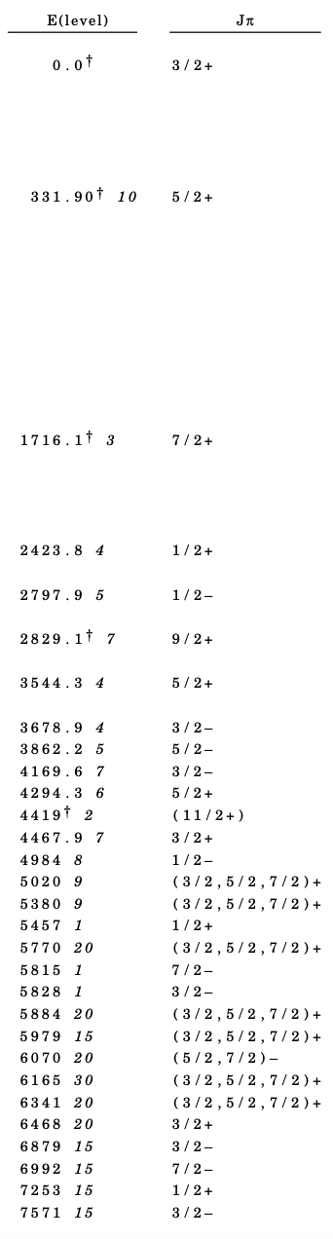
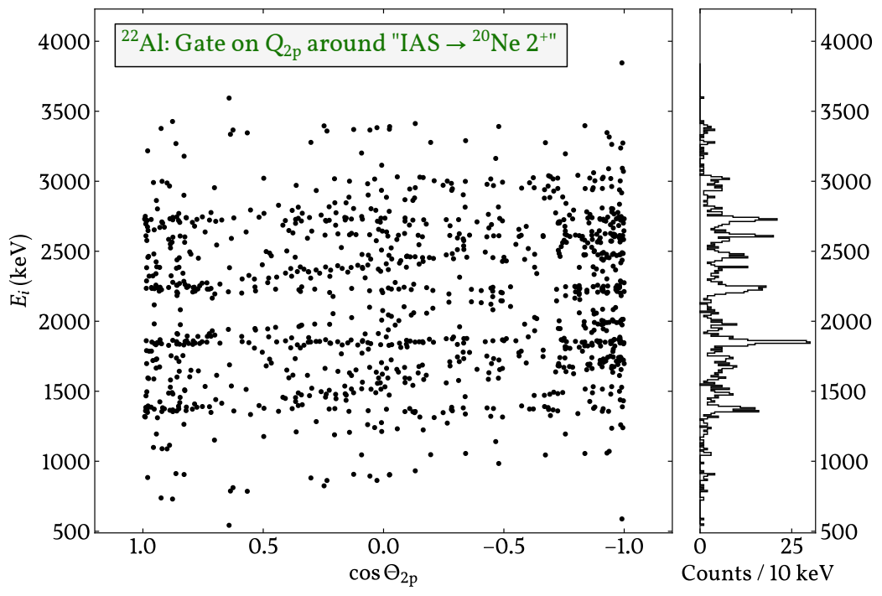
²²Al: β2p
Nuclear data sheet

Slide 14
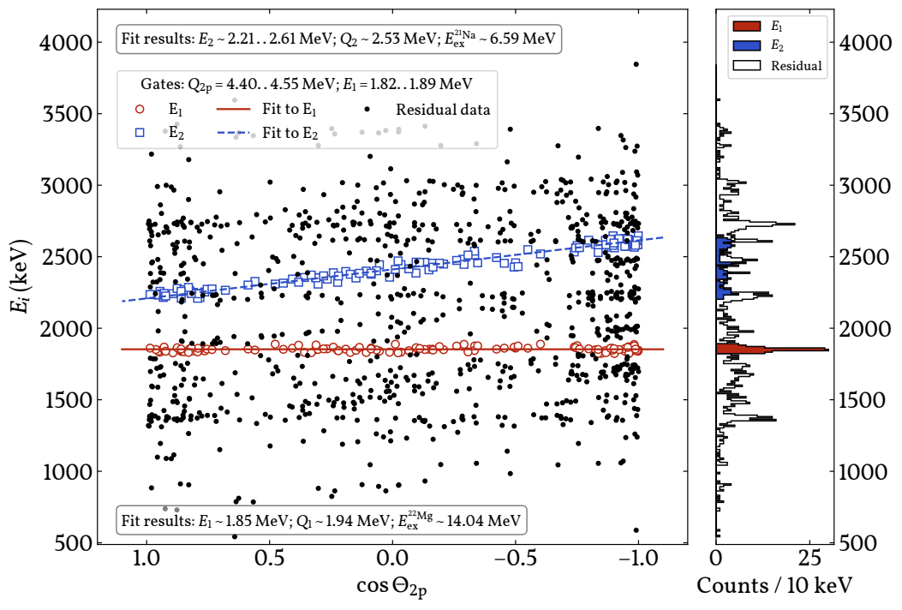
²²Al: β2p
6.5MeV
Nuclear data sheet

Slide 15
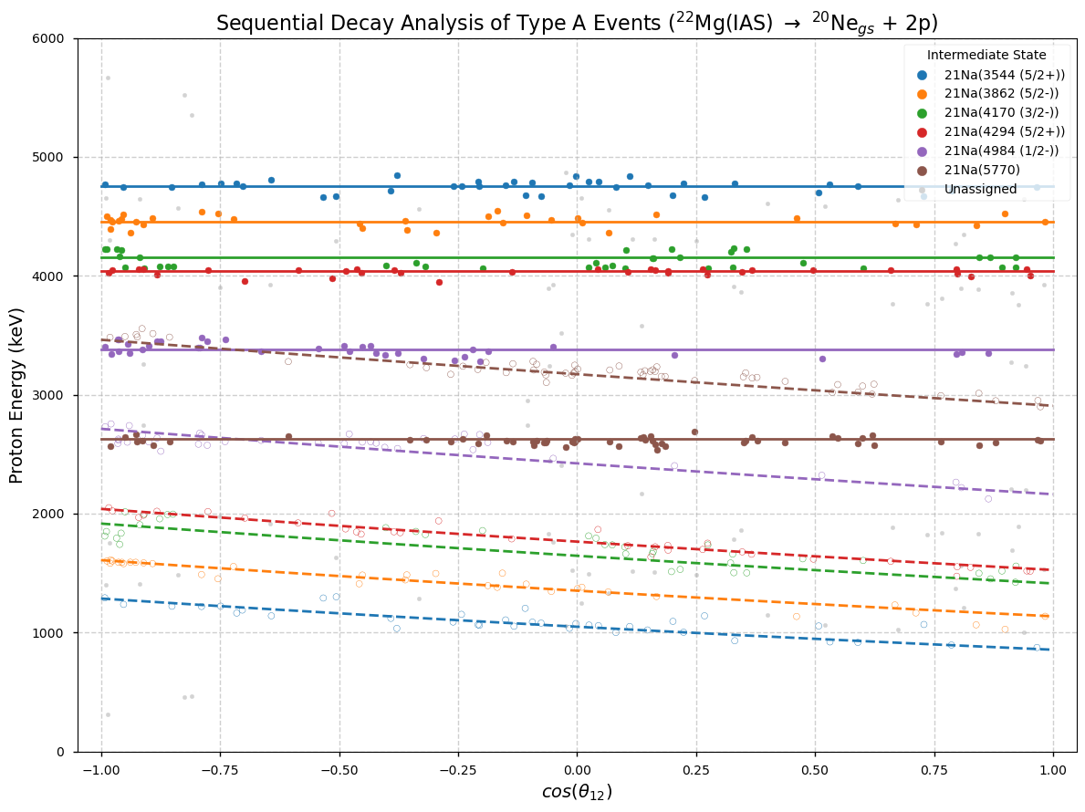
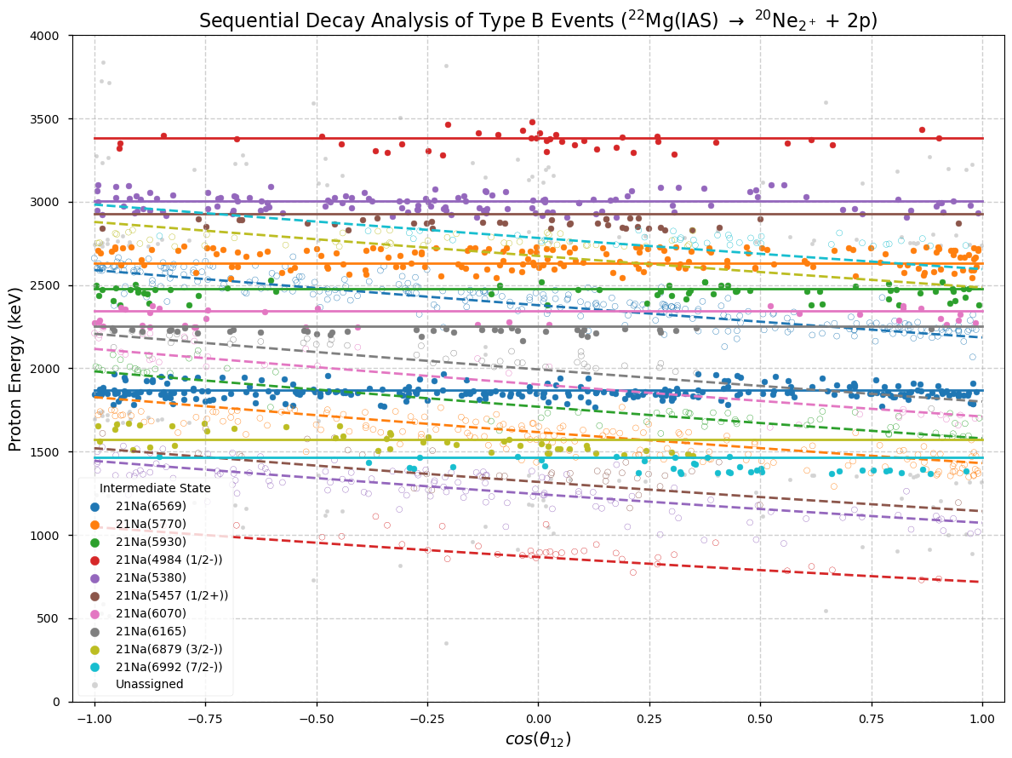
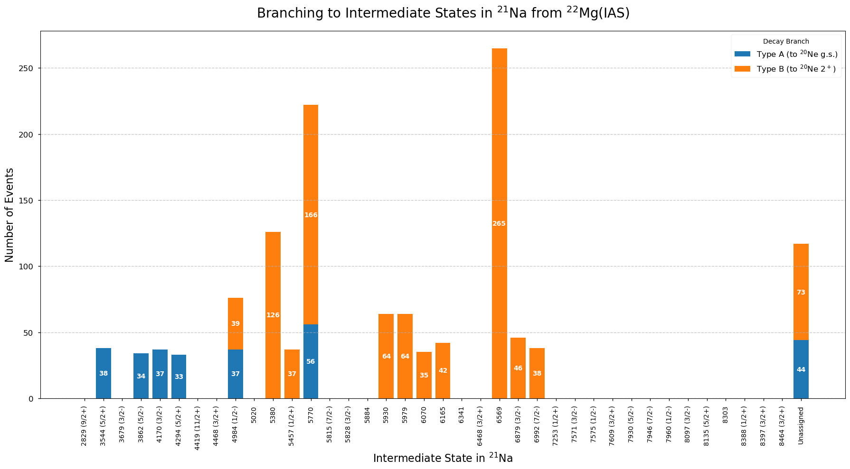

Slide 16
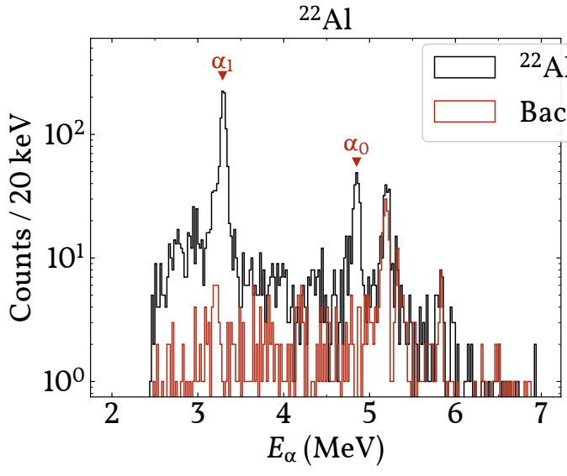
²²Al: βα
Observation of βα from IAS to g.s. in alpha daughter settles spin-parity assignment of 4⁺. The alternative 3⁺ is ruled out
Proposed potential halo structure of ²²Al g.s. unfeasible...

Slide 17
²²Al: β1p β2p βα
Exp SM1990
β1p 42(10)% ~50%
β2p 35(2)% ~50%
βα 23(2)% ~1%
β“²He” <2% ~1%

Slide 18
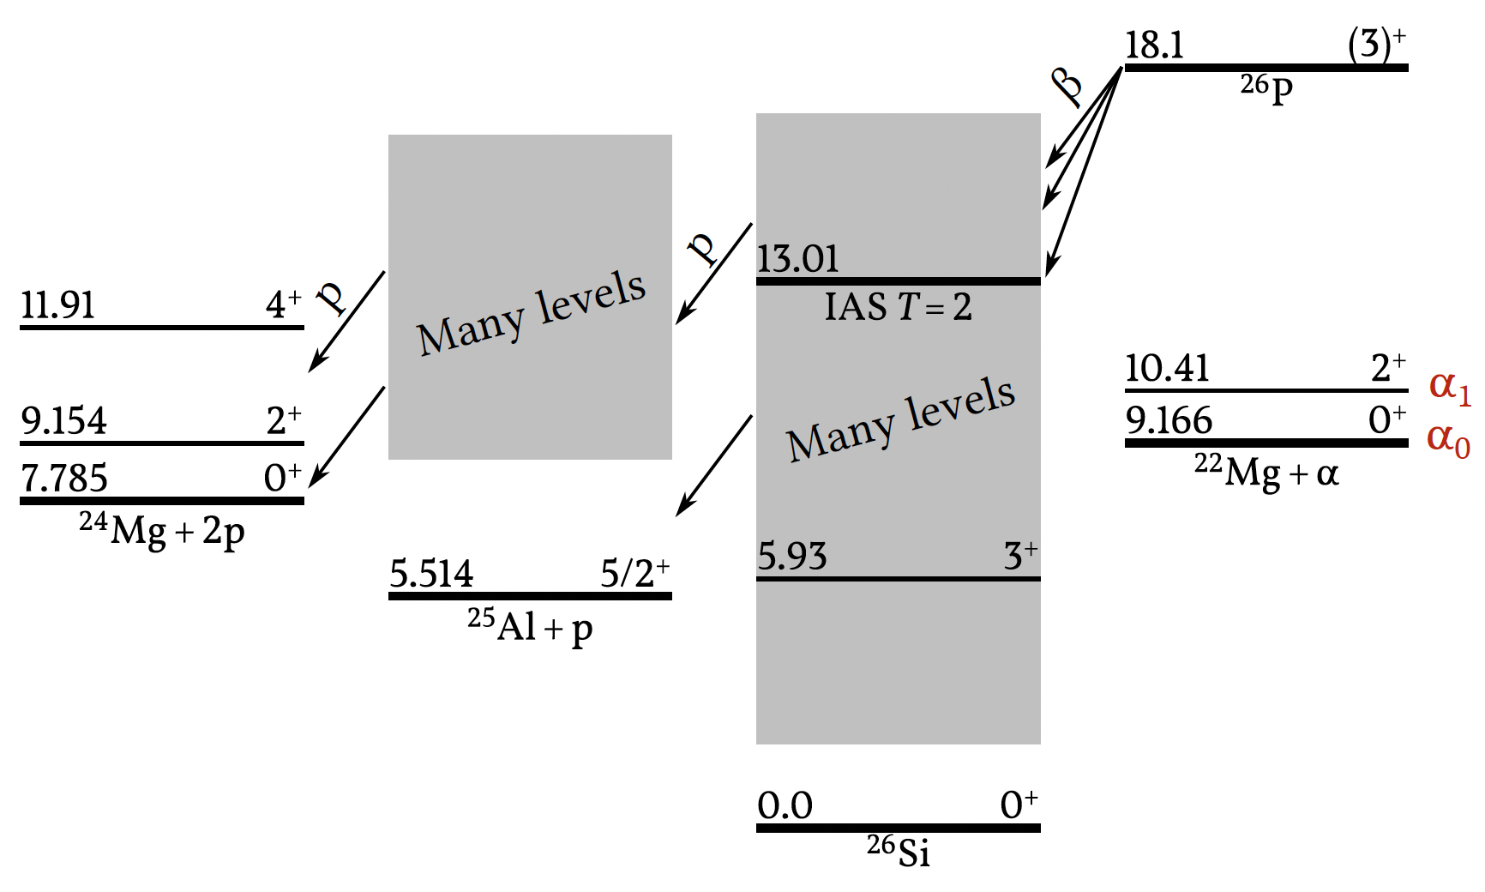
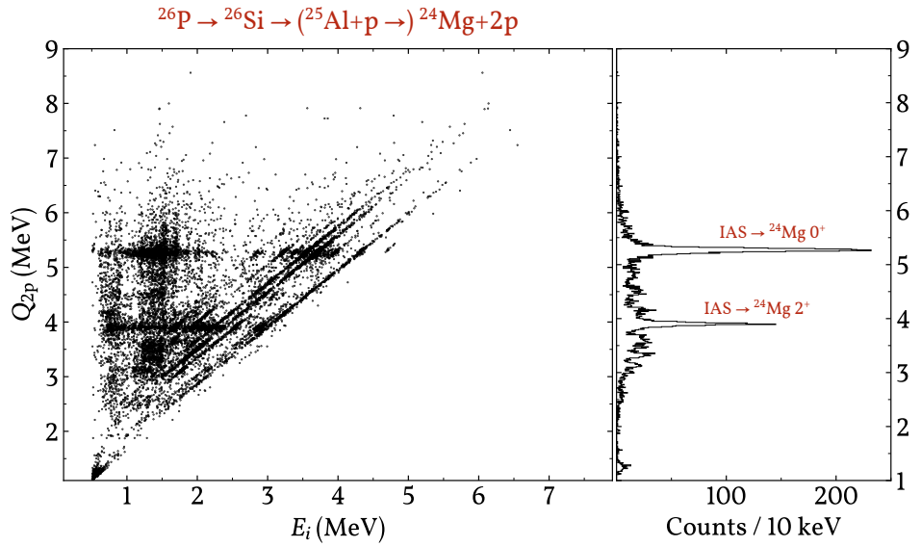
²⁶P: β2p
31h beam time
5 10³ pps expected
30 pps delivered
2.3 10⁵ 1p events
8.0 10³ 2p events

Slide 19
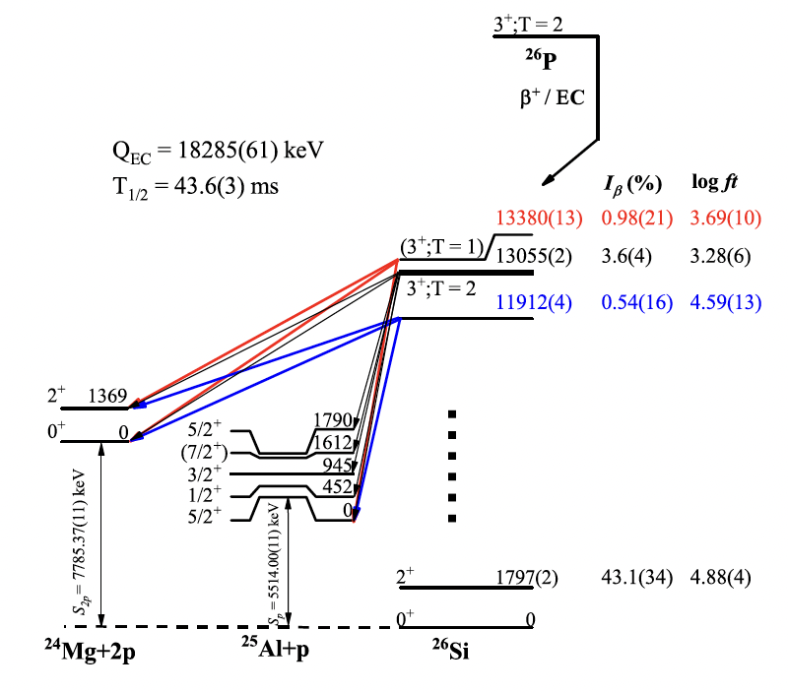
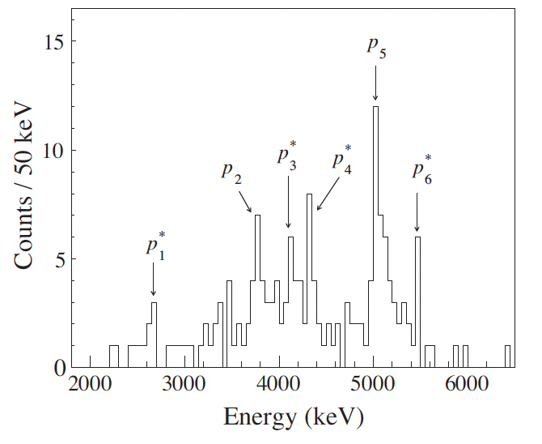
²⁶P: β2p
J.J. Liu et al. Phys.Rev.Lett. 129 (2022) 242502
FRIB data: ²⁶P
30 h beam time
~8,000 2p events
No
No, No
No

Slide 20
β-delayed multi-particle emission
Now three cases of β2p studied with ~10 pps and ~10³ 2p events and complete kinematics
No indication of direct β2p channel in ²²Al in disagreement with recent report
No strong isospin mixing in ²⁶P in disagreement with recent report
4⁺ spin of ²²Al
New theoretical evaluations are welcome!
³¹Ar β2p
²²Al β2p
²⁶P β2p

Slide 21
Outlook
Present yields at FRIB:
²²Al 2.4 10³
²²Si 10-20
²³Si 4 10²
²⁶P 1-2 10³
²⁷S 80
Measured
Estimated
The door is now open for a statistically significant search for direct β2p
³¹Ar
²⁷S
²⁶P
^{22,23}S
²²Al

Slide 22









Thanks to all collaborators
Erik Asbjørn Jensen, Phd
And thank you!

