Slide 1
Recent Advances in
Hadron Therapy
Dr Charlot Vandevoorde
Biophysics Department
EuNPC 2025 – Caen, FR
21-26 September 2026

Slide 2
Content
Introduction
  Proton therapy
  Carbon-ion therapy
  Boron-neutron capture therapy
  New kids on the block
Technological Innovations
  Particle ARC therapy (PAT)
  Upright hadron therapy
Preclinical Breakthroughs
  Heavy ion FLASH
  Heavy ion spatially fractionated radiotherapy (SFRT)
  Radioactive ion beams (RIB) for hadron therapy

Slide 3
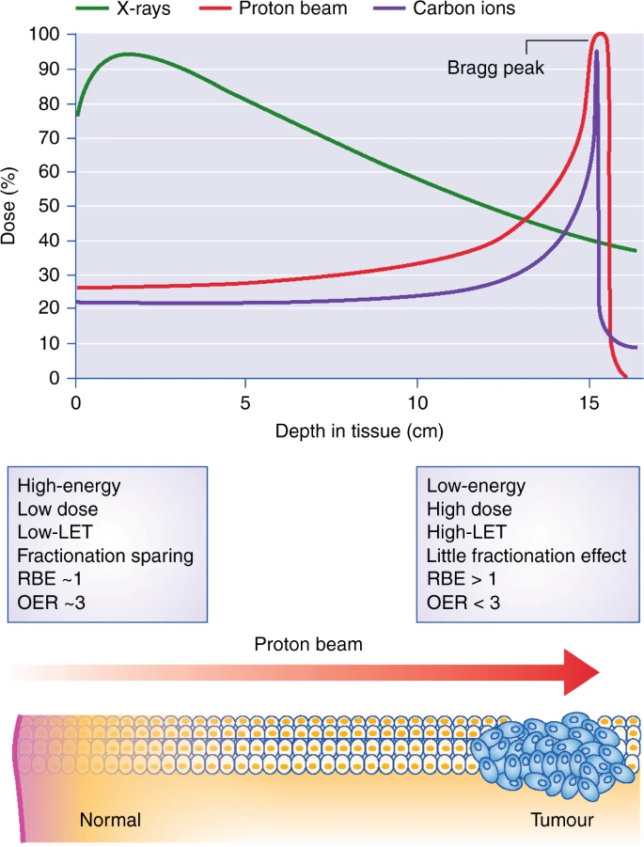
Introduction: Proton Therapy
Clinical advantages of proton therapy:
  Maximum dose at tumour location
  Sparing of surrounding normal tissue
  Integral dose is a factor of 2-3 times lower in proton therapy compared to photons
Beneficial for the following treatments:
  Tumours located close to critical structures (e.g., spinal cord, brain…)
  Paediatric patients, with a longer life span to develop therapy related side effects and more radiosensitive tissues
Disadvantage: RBE is similar to X-rays
Durante et al. – Br J Cancer 2019

Slide 4
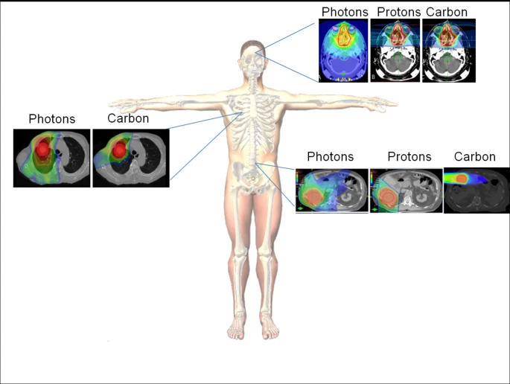
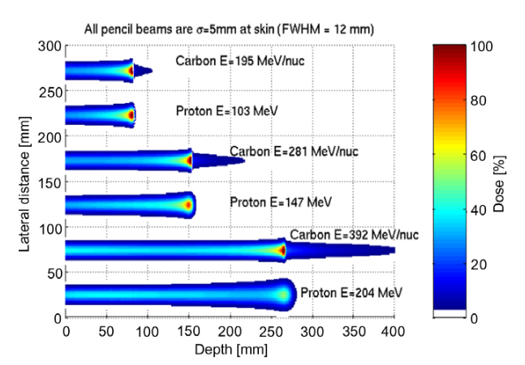
Introduction: Carbon Ion Therapy
Clinical advantages of carbon ion therapy:
  Maximum dose deposition at tumour location
  High LET: dense and complex DNA breaks
  Relative biological effectiveness (RBE) of 2-3, compared to an RBE of 1.1 for protons and 1 for X-rays
Beneficial for the following treatments:
  Radioresistant tumours, due to the higher RBE and cell killing potential
  Recurrent tumours that are not responding to the standard treatment
Disadvantage: dose beyond the Bragg peak is not zero -> the fragmentation tail
Top: Schlaff et al. – Rad Oncol 2014 Bottom: Suit et al. – Rad Oncol 2010

Slide 5
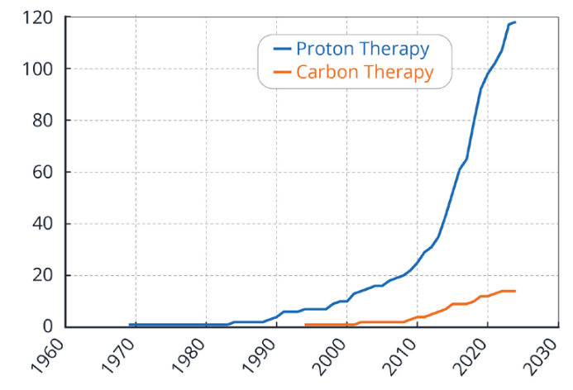
Introduction: Global Status Hadron Therapy
Number of particle therapy facilities today: 113 proton and 13 C-ion facilities
Source: https://www.ptcog.site/

Slide 6
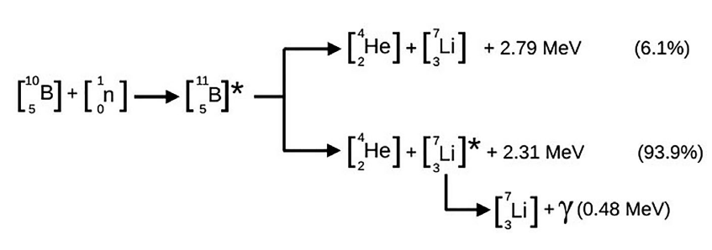
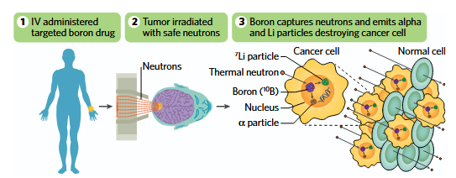
Introduction: BNCT
Principle of Boron Neutron Capture Therapy:
  Selective delivery of boron-10 to tumour cells
  Expose the tumour to low energy thermal neutrons
  Neutron capture reaction creates high-LET alpha particles (150 keV/µm) and lithium-7 nuclei (175 keV/µm) with a very short range in tissue
  Beneficial for precise, cellular-level tumour destruction and effective against hypoxic radioresistant tumours
  Disadvantage: achieving sufficient boron concentration and selective uptake in tumour cells
Source: TEA Life Sciences

Slide 7
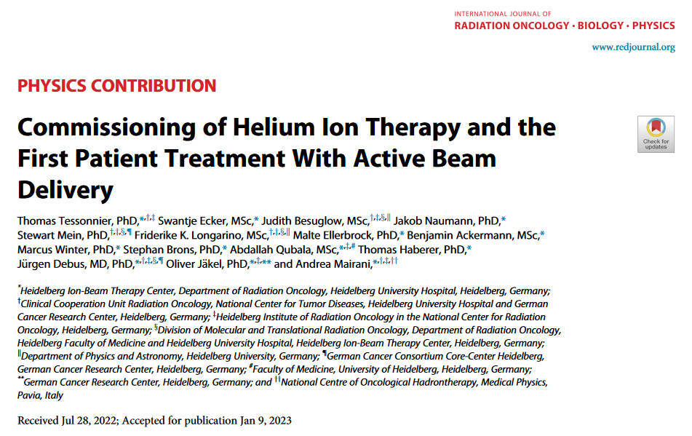
Introduction: New kids on the block
Come-back of helium ion therapy to the clinic:
Advantages compared to protons:
Reduced lateral scattering and sharper distal fall-off
Higher RBE in the Bragg peak
Advantages compared to carbon ions:
Reduced fragmentation tail
Lower LET variations
Reduced RBE uncertainty

Slide 8
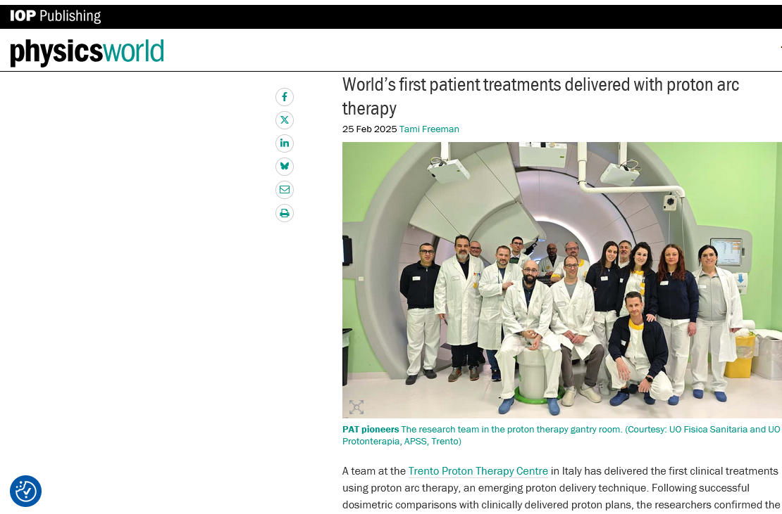
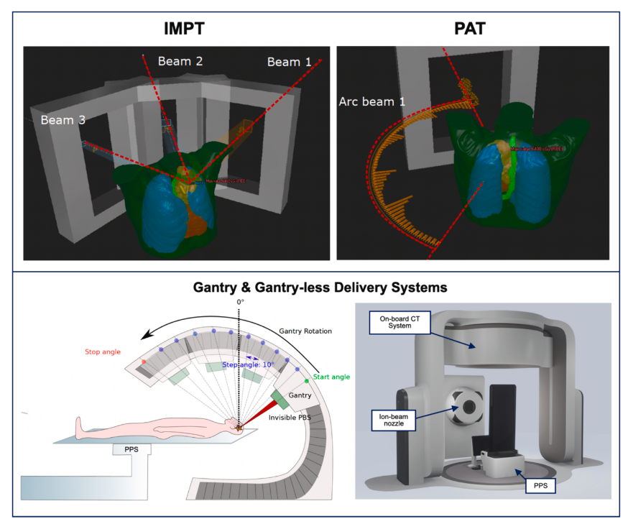
Technological Innovations
Technological innovations have significantly enhanced dose conformality while minimizing exposure to surrounding healthy tissue:
  Improved beam delivery systems
  Adaptive treatment planning
  Real-time imaging
  Particle arc therapy (PAT)
  Upright particle therapy
Notes:
an emerging radiotherapy technique that aims to improve dose conformity and the biological effects of treatment by delivering beams from multiple directions in an arc, rather than fixed angles. While offering benefits like enhanced tumor-killing effectiveness due to the high linear energy transfer (LET) of heavy ions and improved normal tissue sparing, this approach faces challenges including the need for expensive rotating gantries, the time-consuming process of changing beam energies with synchrotron-based heavy-ion accelerators, and the development of specialized treatment planning and delivery

Slide 9
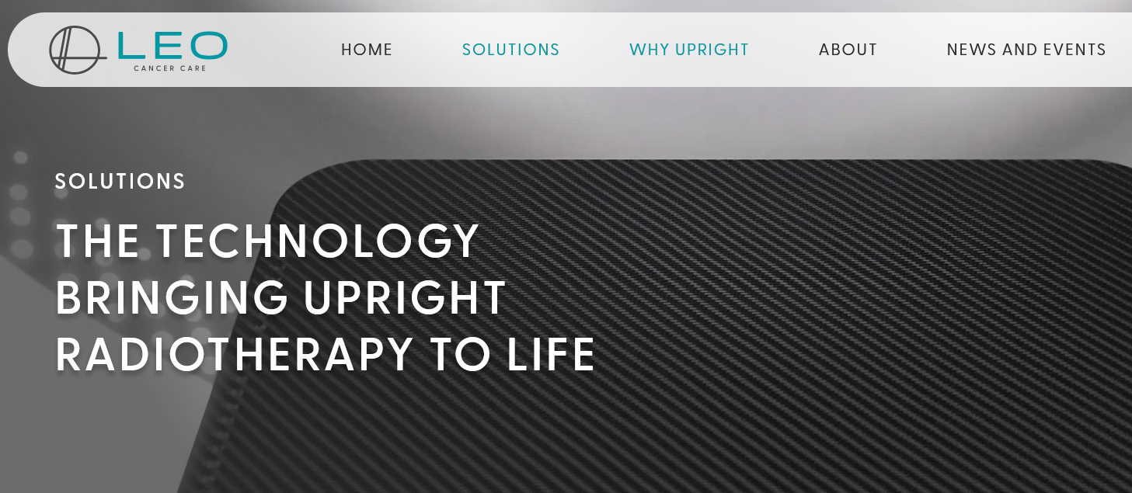
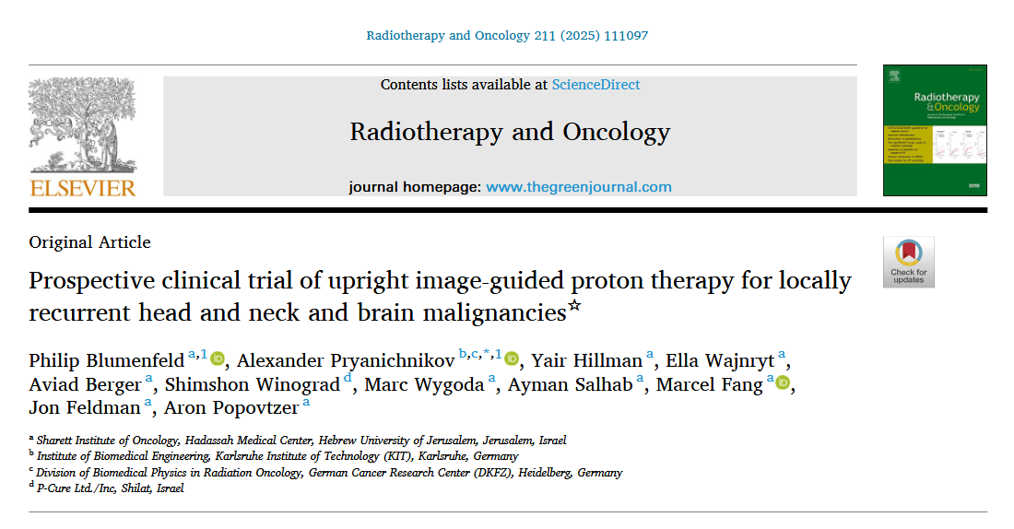
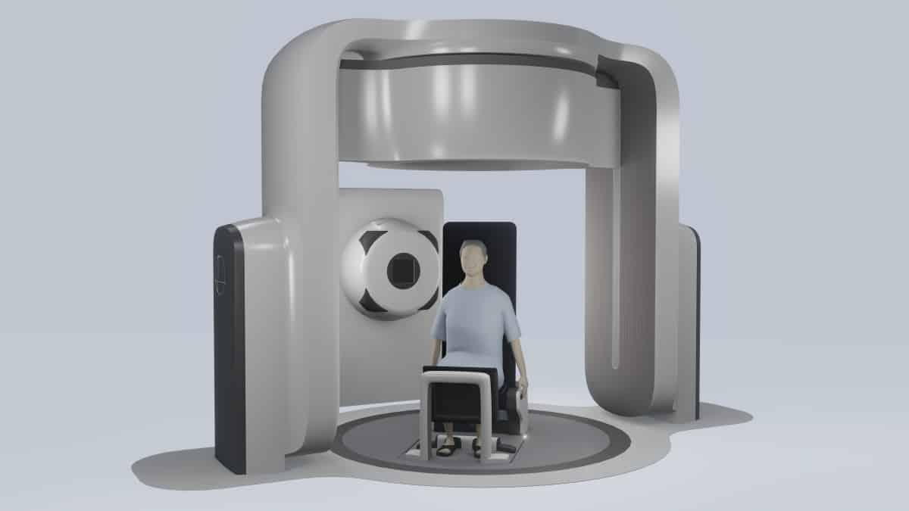
Technological Innovations
Upright hadron therapy: commercially available vertical CT systems has renewed interest in gantry-less proton therapy, in which patients are treated in an upright position using a fixed beamline and robotic positioning

Slide 10
Preclinical Breakthroughs
Despite the technological advances and remarkable improvements in dose conformation achieved in recent decades, normal tissue toxicity remains the primary factor limiting the efficient treatment of radioresistant tumours, lesions near radiosensitive structures (e.g., spinal cord) as well as some paediatric cancers
Therefore, the exploration of new therapeutic modalities allowing a further reduction of toxicities is of paramount importance. Two such novel strategies are and FLASH radiotherapy (FLASH-RT) and spatially fractionated radiation therapy (SFRT)

Slide 11
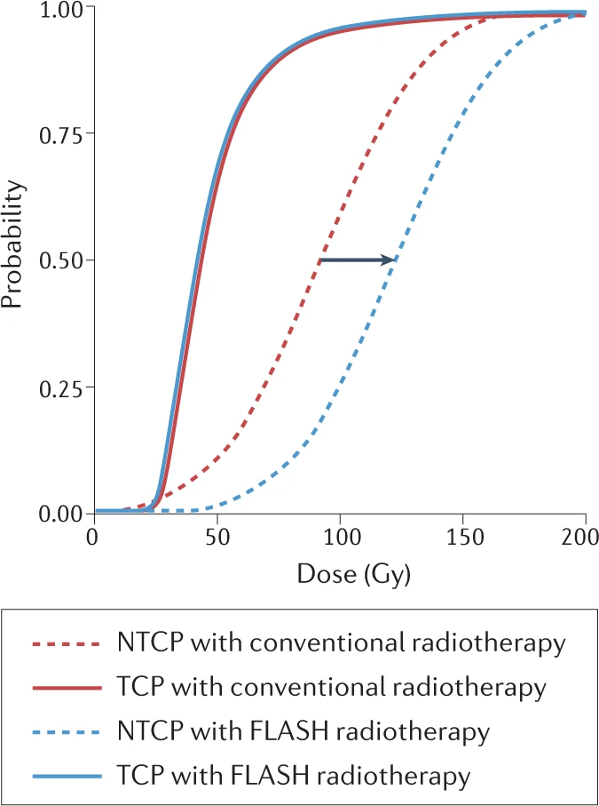
Preclinical Breakthroughs: Heavy Ion FLASH
What is FLASH-RT?
  Temporal aspects of the dose delivery
  Ultimate goal of radiation oncology = eradicate tumours without toxicity to non-malignant tissues
  Therapeutic window = dose region between the normal tissue complication probability (NTCP) and the tumour control probability (TCP) curves
  Delivery of ultra-high dose rates of radiation (>40 Gy/s)
  Radiation dose threshold > 8 Gy
  Very short delivery times < 200 ms
  Reduced normal tissue toxicity through unknown mechanism
Dose escalation to enhance anti-tumour efficacy
Reduction of treatment time and organ motion issues
Increase the number of treated patients
Vozenin et al. – Nature Reviews Clinical Oncology 2023

Slide 12
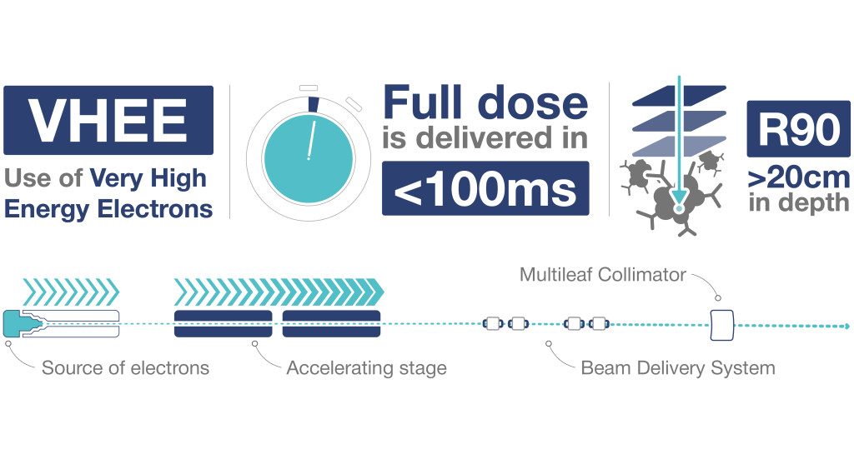
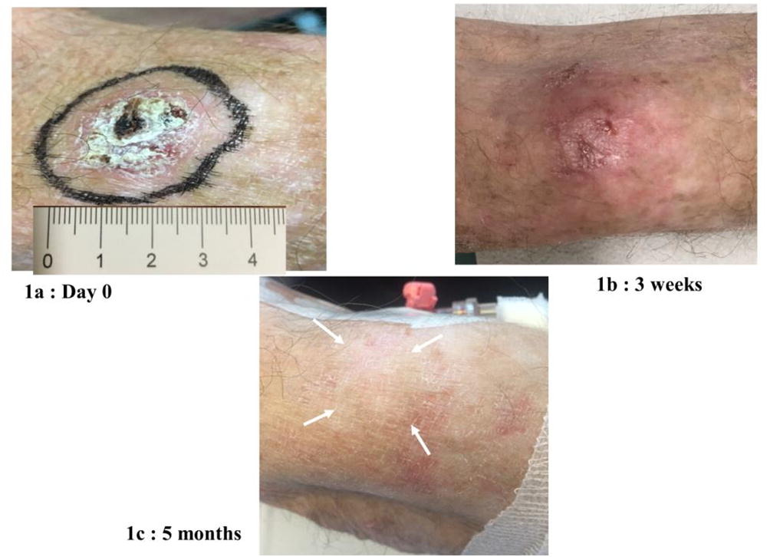
Preclinical Breakthroughs: Heavy Ion FLASH
FLASH is recognized as one of the most promising breakthroughs in radiation oncology today
First patient was treated with FLASH-RT (electrons):
A 3.5-cm diameter skin tumor with a 5.6-MeV linac specifically designed for FLASH-RT. The prescribed dose to the PTV was 15 Gy, in 90 ms.
Left: Bourhis et al. – Radiother & Oncol 2019 – Right: THERYQ

Slide 13
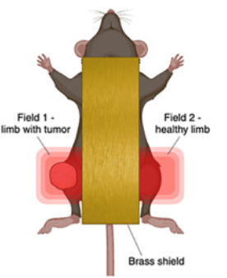
Preclinical Breakthroughs: Heavy Ion FLASH
Interestingly, all models predict that the FLASH effect should be LET-dependent, with a tendency to disappear at high-LET
First in vivo carbon ion FLASH experiment at GSI:
  Test the current mechanistic models at high-LET
  Clinical implementation in C-ion therapy
  If the sparing effect survives at high-LET, possibility of using very heavy ions (such as ²⁰Ne or ⁴⁰Ar) in therapy, and idea originally pursued by Cornelius Tobias at the Lawrence Berkeley Laboratory
SIS18: ¹²C-ions: 240 MeV/n
Irradiation: 20 Gy SOBP
FLASH local dose rate:
> 100 Gy/s ~ 5x10⁹ ions per spill
Conventional dose rate 18 Gy/min
LET= 65 – 85 keV/µm
Content: Dr W Tinganelli (GSI)
Tinganelli et al. – Int J Rad Oncol Biol Phys 2025

Slide 14
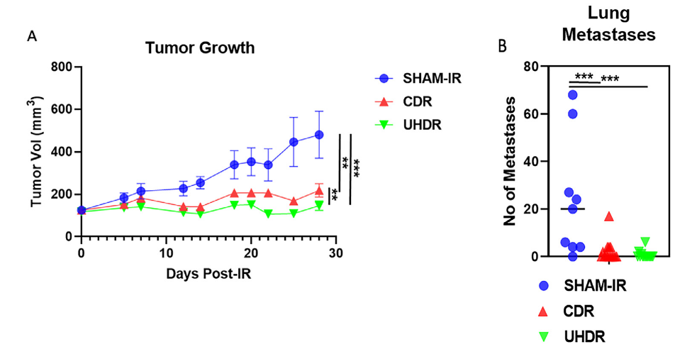
Preclinical Breakthroughs: Heavy Ion FLASH
Results on tumour control:
Content: Dr W Tinganelli (GSI)
Tinganelli et al. – Int J Rad Oncol Biol Phys 2025

Slide 15
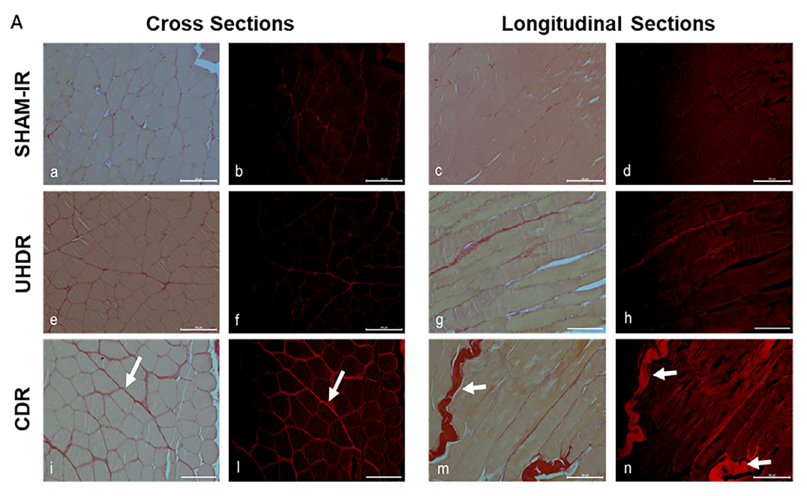
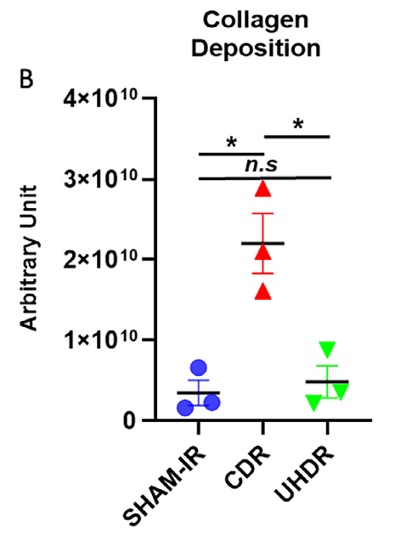
Preclinical Breakthroughs: Heavy Ion FLASH
Normal tissue toxicity:
Content: Dr W Tinganelli (GSI)
Tinganelli et al. – Int J Rad Oncol Biol Phys 2025

Slide 16
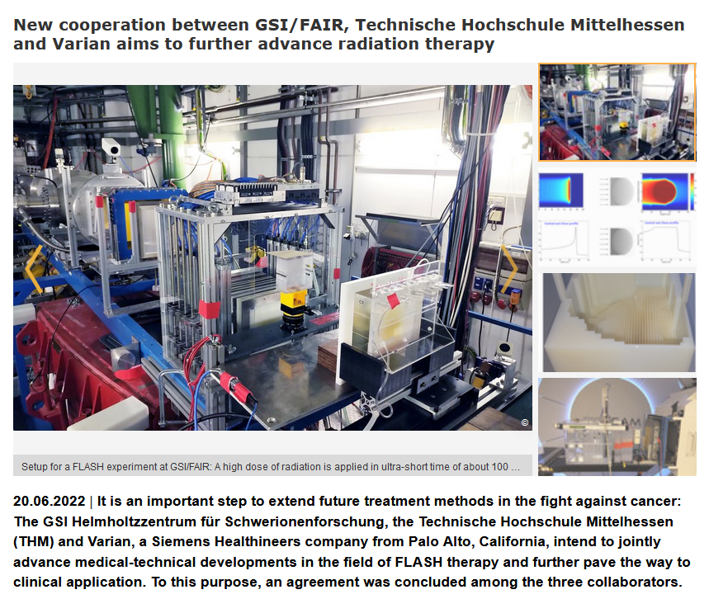
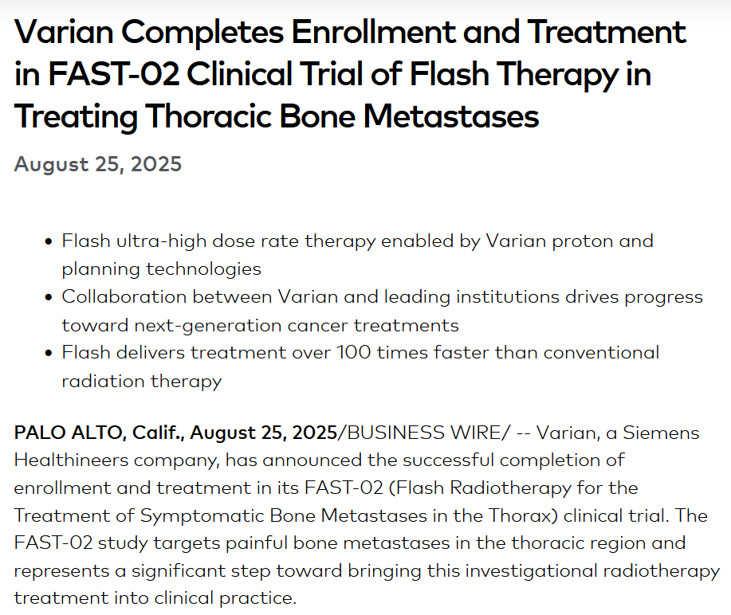
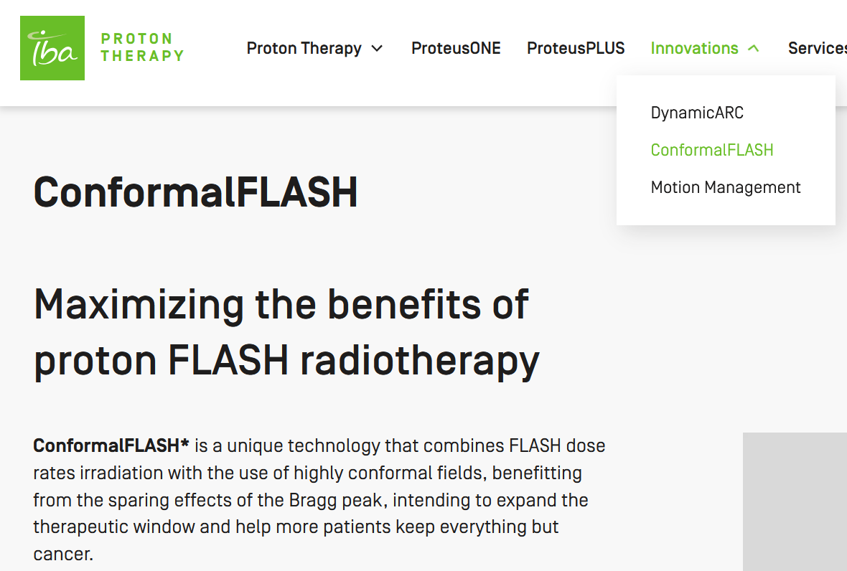
Preclinical Breakthroughs: Heavy Ion FLASH

Slide 17
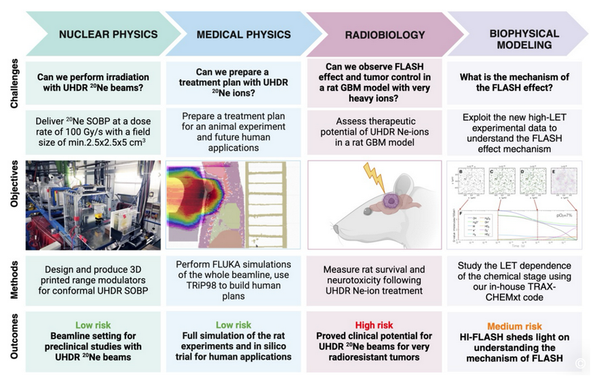
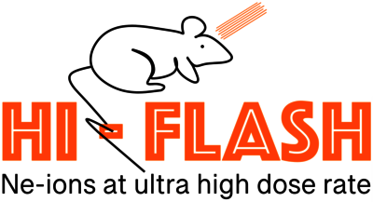
Preclinical Breakthroughs: Heavy Ion FLASH
Advanced ERC grant: Prof Dr Marco Durante

Slide 18
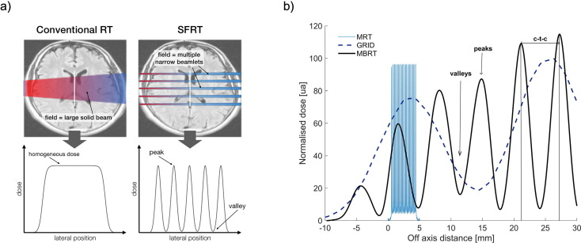
Preclinical Breakthroughs: Heavy Ion SFRT
What is SFRT = spatially fractionated radiotherapy?
  Spatial modulation of the dose
  Dose is spatially modulated to create alternating regions of high dose, called peaks, and low dose, called valleys.
  Contrasting the flat dose profiles used in conventional radiotherapy
  Different types of SFRT:
    GRID-RT and Lattice-RT (cm-scale)
    Mini- and Microbeam RT (µm-scale)
Remarkable reduction of normal tissue toxicities while simultaneously offering high tumour control rate
Schneider et al. Radiotherapy & Oncology 2022

Slide 19
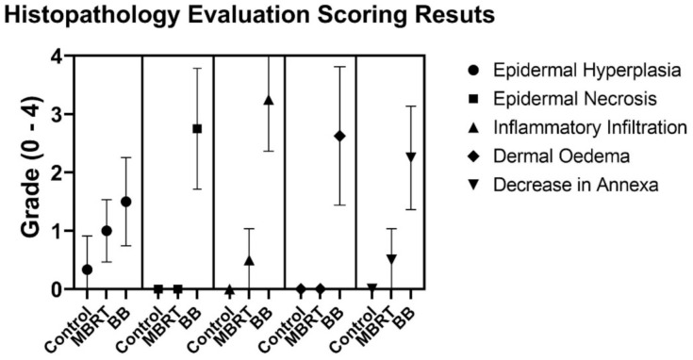
Preclinical Breakthroughs: Heavy Ion SFRT
Very heavy ions, such as Neon (Ne) or Argon (Ar), are the optimum candidates for hypoxic tumour treatments due to their reduced oxygen enhancement effect
Pioneering clinical use in the 1970s was halted due to severe side effects
SFRT could open the door for a renewed use of heavy ions for therapy
Prezado et al. Cancers 2015

Slide 20
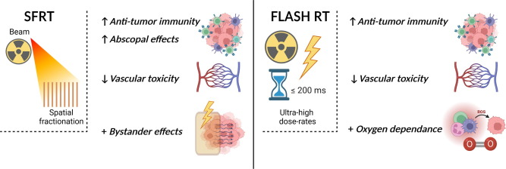
Preclinical Breakthroughs: Heavy Ion SFRT
Although FLASH and SFRT are likely based on different mechanisms, both have shown to elicit radiobiological effects that significantly differ from those induced by conventional X-ray based radiotherapy
Schneider et al. Radiotherapy & Oncology 2022

Slide 21
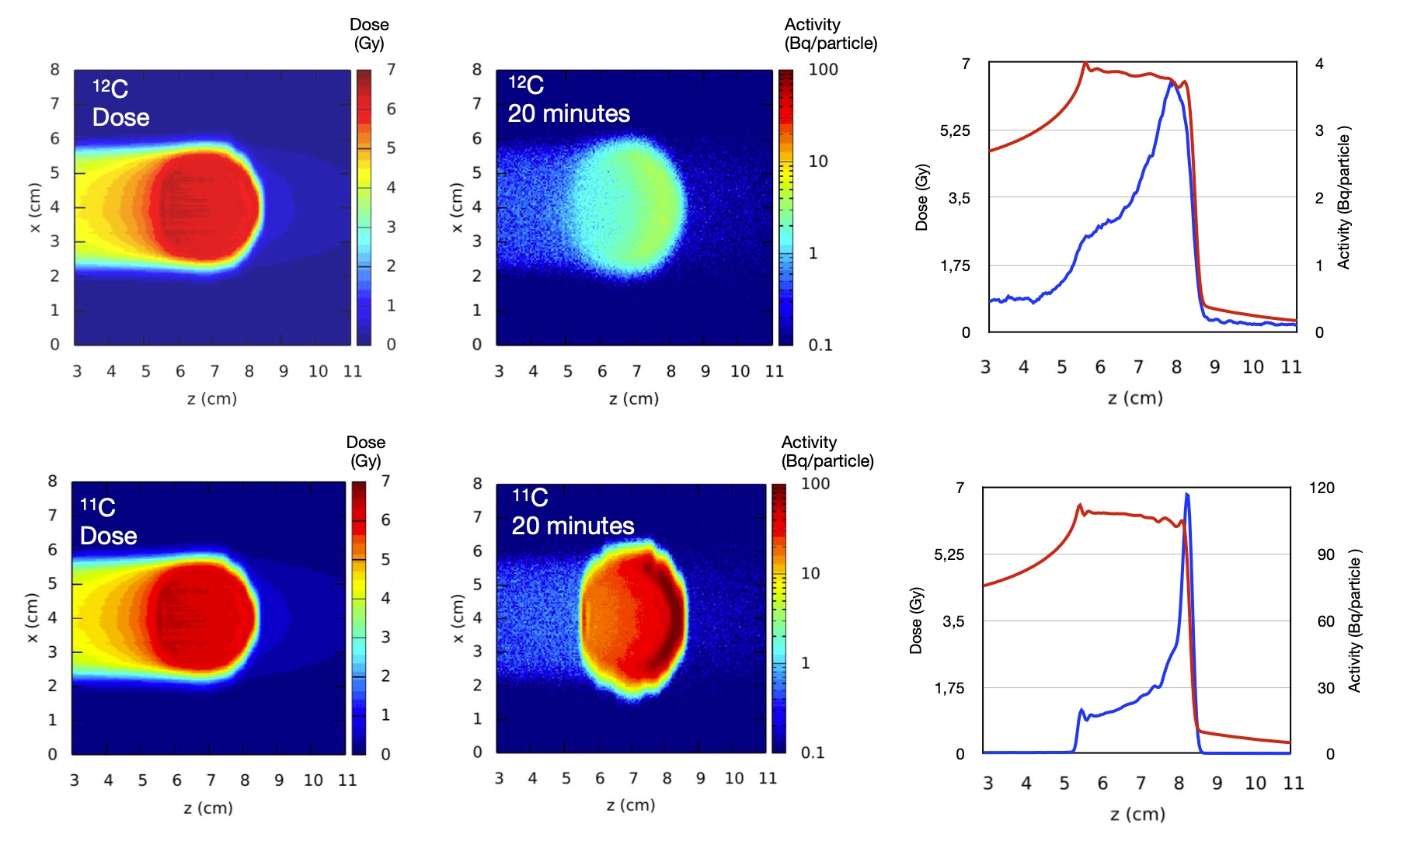
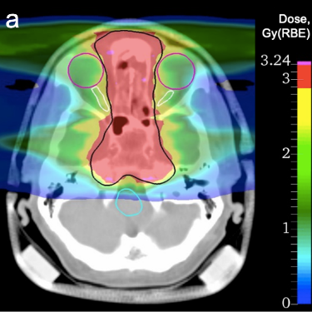
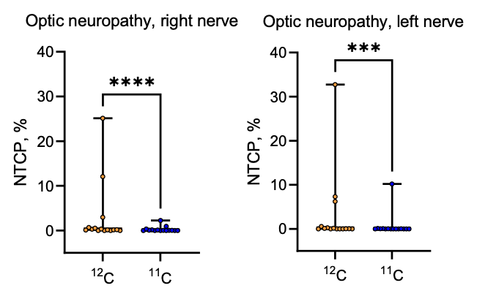
Preclinical Breakthroughs: radioactive ion beams
Motivation: improved PET count rate for precise beam range monitoring in particle therapy
Dose (Gy)
Activity (Bq/particle)
Radioactive ion beams for therapy and imaging:
Significantly improved count rate compared to stable beams
PET signal better correlated with Bragg peak
Reduced washout blur thanks to short lived isotopes
Precise range monitoring -> reduced tumor margins -> less toxicities!
Dose (Gy)
Activity (Bq/particle)
¹²C: range and setup uncertainties
¹¹C: setup uncertainties only
Requirements (and current limitations) for RIB treatments: Sufficient production rate >10⁷ pps
Boscolo et al. Frontiers in Oncology 2021
https://www.gsi.de/barb
Sokol et. al. Scientific Reports 2022

Slide 22

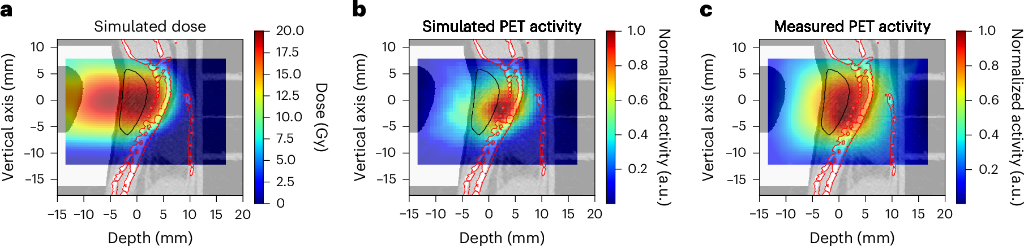
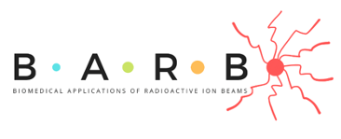
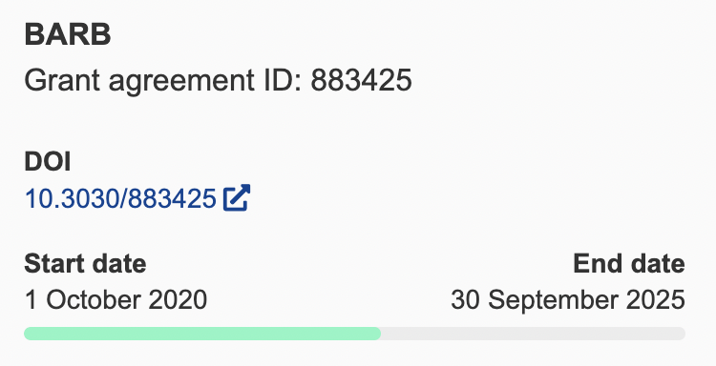

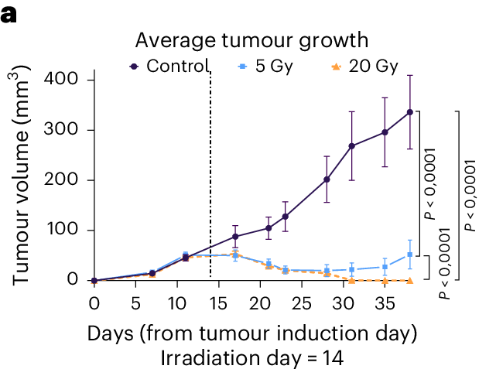
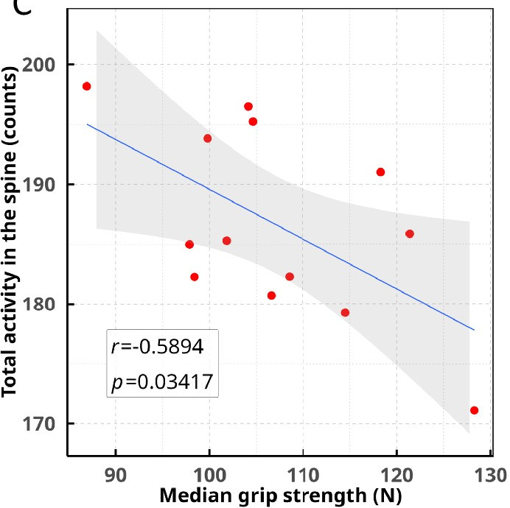
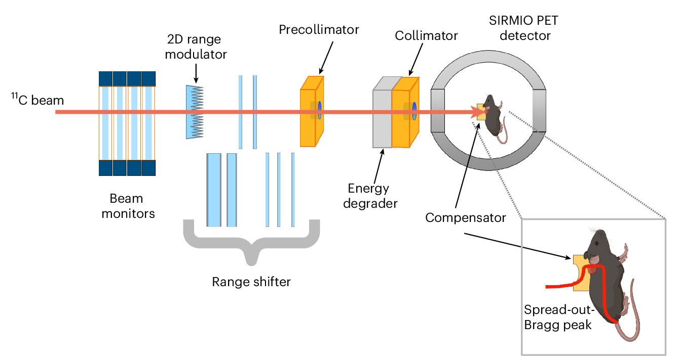
Biomedical Applications of
Radioactive ion Beams
ERC Advanced Grant to Prof. Marco Durante
¹¹C successfully applied to treat an osteosarcoma neck tumor in a mouse
PET activity measured in the spine was predictive of the beam range and thus of the observed late toxicity (loss of forelimb strength)
Boscolo, D., Lovatti, G., Sokol, O. et al. Nat. Phys. (2025)

Slide 23
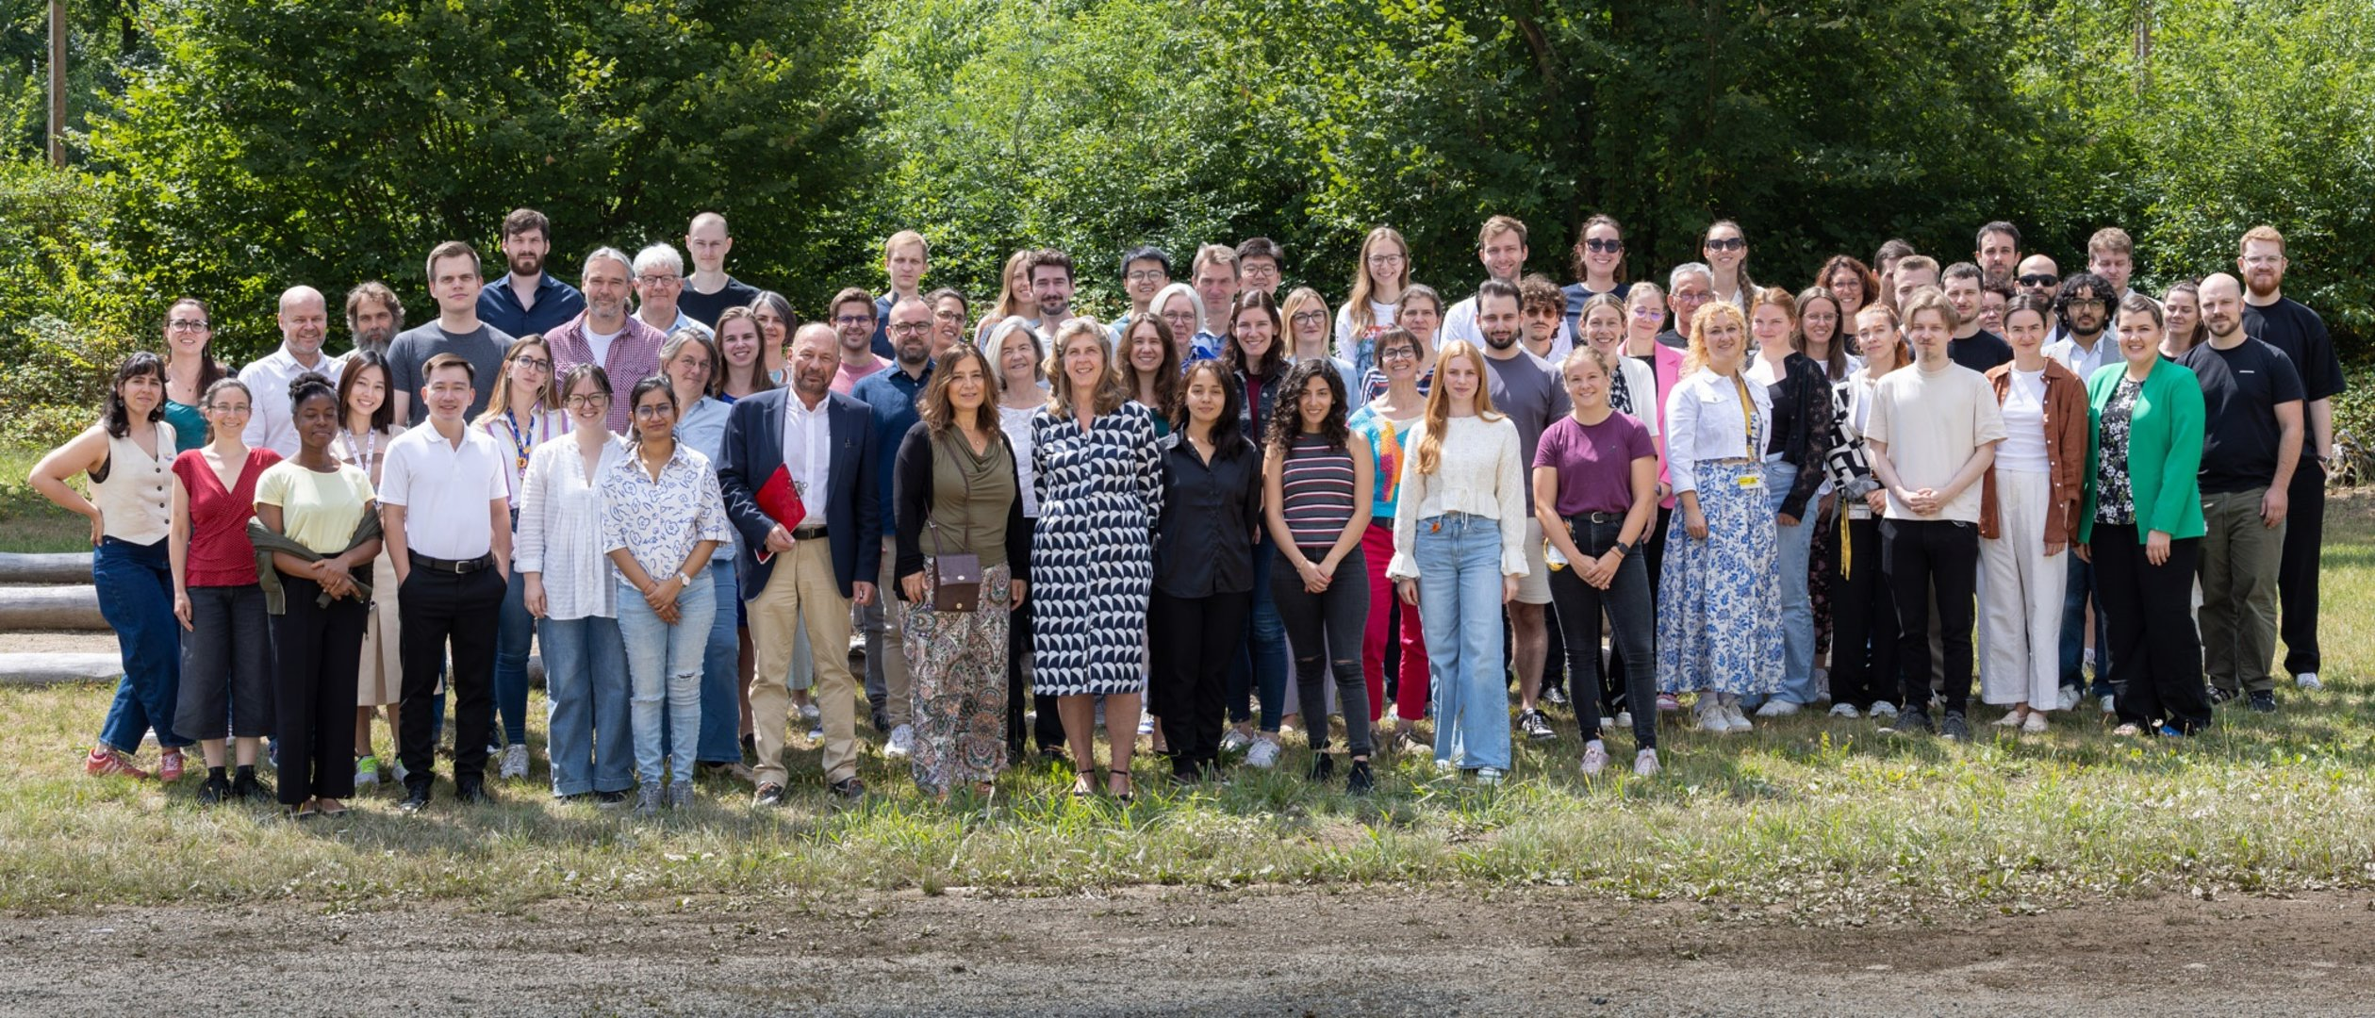
Acknowledgement:
Biophysics Department at GSI/FAIR

Slide 24
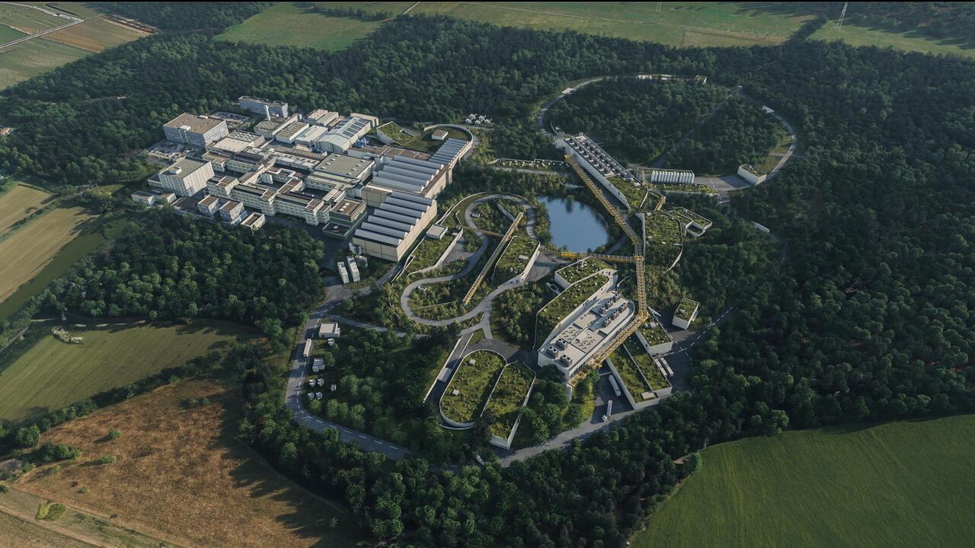
Thank you for your attention!
Visualisation FAIR Campus
© GSI/FAIR, Zeitrausch

