Slide 1




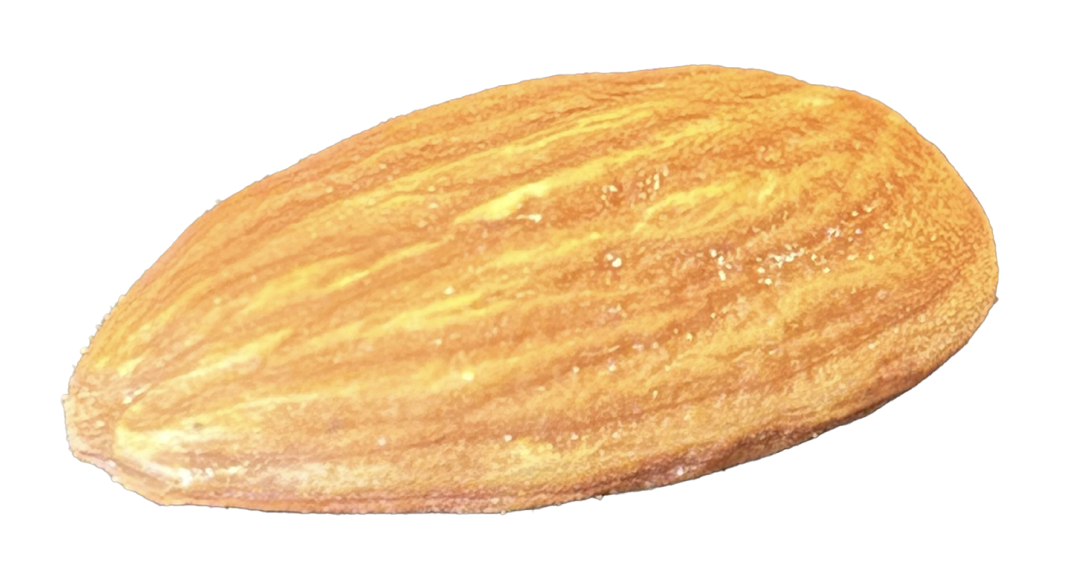

A novel overall view of nuclear shapes, rotations and vibrations
The 6th European Nuclear Physics Conference
(EuNPC2025)
Caen
September 26 (20-26), 2025
Takaharu Otsuka
Are atomic nuclei like
rugby ball or almond ?
Collaboration with
Yusuke Tsunoda (CNS/Tsukuba)
Noritaka Shimizu (Tsukuba)
Yutaka Utsuno (JAERI)
Tokashi Abe (Keio U.)
Hideki Ueno (RIKEN)
Thomas Duguet (Saclay)
Tsunoda
Supported by “Program for promoting research
on the supercomputer Fugaku”, MEXT, Japan
(JPMXP1020230411)

Slide 2
Outline
1. Historical background and “rotational energy”
2. Prevailing triaxial shapes
3. Vibrational excitations – deformed case -
(4. Vibrational excitations – spherical case -)
If time permits, ……
Sections 1 & 2 have been made in collaboration with Y. Tsunoda (CNS, Tokyo), N. Shimizu (Tsukuba), Y. Utsuno (JAEA), T. Abe (Keio U.), H. Ueno (Riken), while
T. Duguet (Saclay) joined for Sections 3 & 4.

Slide 3
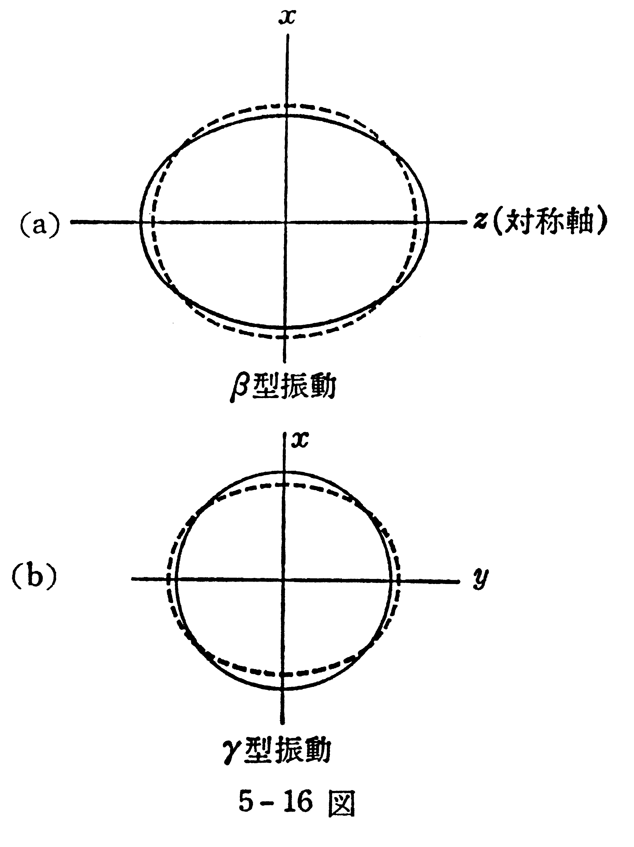
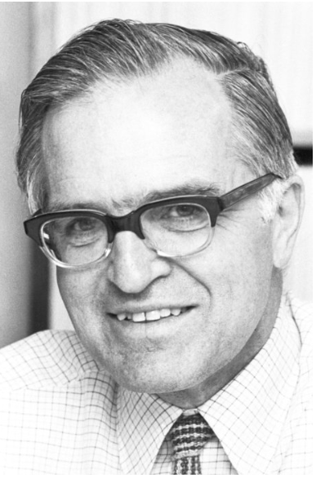
A case of the textbook example:
原子核 by M. Nogami
Aage Bohr
Novel Prize Lecture
(1975)
¹⁶⁶Er
γ – vibration
phonon
excitation
Aage N. Bohr, 1922-2009
Nobel Foundation archive
Axially symmetric
prolate ellipsoid
(equilibrium)
also emphasized in
A. Bohr and B. R. Mottelson,
Nuclear Structure II
(1975, Benjamin, New York)

Slide 4
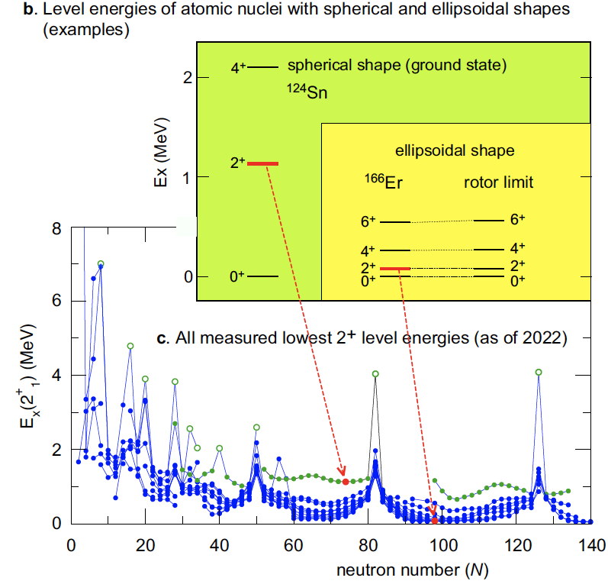
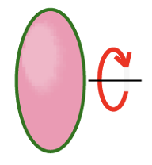

Conventional picture of nuclear
shape and rotation
side
view
like
J
rotor limit
Ex J(J+1)
top
view
circle
a la Aage Bohr (1952)
Textbooks kept teaching us for 70 years:
For strongly deformed nuclei,
1. axially symmetric ellipsoid emerges,
and rotates, like a rugby ball
2. J(J+1) rule of excitation energy
is due to rotational kinetic energy
3. γ band is due to γ vibration
4. if axial symmetry is broken,
no good K quantum numbers remain

Slide 5




Origin of the J(J+1) rule of rotational excitation energy
conventional description
Ring & Schuck,
The Nuclear Many-Body Problem
classical mechanics
time t, angle Ω(t)
rotation of rigid body
Bohr Hamiltonian
time t₀, angle Ω₀
quantization of free rotation of this rigid body
→ eigenstate with angular momentum h J
- superposition of states
at varying angles
- for axially symmetric shape,
J(J+1) rule is suggested
Thus, for axially symmetric shapes (I₃=0), the rotational kinetic energy is given by
T _{rot}
J ( J+1 )
- just kinetic energy of free
rotation

Slide 6
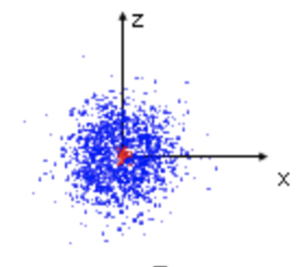
However, rotational states can be formulated in a quantum mechanical way
without having such a rigid-body picture.
Wave functions of members of a rotational band are produced by superposing a common intrinsic state rotated to various directions, so that the superposed state has a good angular momentum (J, M), by using Wigner’s D function.
the same underlying ideas
Electron-cloud picture
for atoms
Cranking of an object pointing
to a fixed orientation
An electron in an s-orbital
This concept can be materialized, by following the well-defined recipe
of the angular momentum projection of a given intrinsic state.

Slide 7
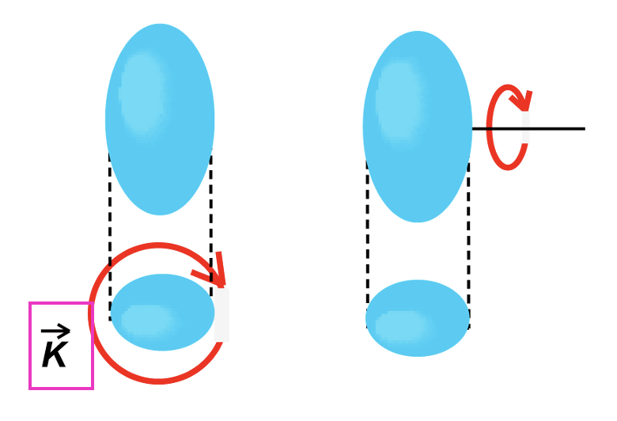



H
The Hamiltonian H then couples those rotated states,
which are superposed with amplitudes determined
for designated (J, M) values.
Here, H stands for a nucleon Hamiltonian which comprises SPE and NN, 3N etc. interactions, which have shell-model, ab initio or DFT origins.
Based on mathematical arguments using the finite expansion of polynomials (cos β -1) ^{k}, (with β being one of Euler angles), of Legendre or hypergeometric functions, the formula for a general triaxial ellipsoid with a finite K value is derived up to the next-to-leading order (i.e.,k = 0 and 1).
J
For instance,
with
K
K

Slide 8
The excitation energy thus depicts the J(J+1) – K²
dependence in the cases of strong deformation :
J
The excitation energies in the rotational band represent a loss of the binding
energy as a function of J.
binding
energy
J=4
excitation
energy
J(J+1)
Almost no (even opposite in some cases)
contribution from rotational kinetic energy,
in contrast to the conventional picture.
J=2
J=0
Note: Despite rather substantial differences from the present work, the underlaying picture can be partly shared with earlier works, Peierles & Yoccoz (1957), Verhaar (1963), Kamlah (1968), Siemens & Jensen (book, 1987).
The infinite Taylar expansion of Wigner d function with β ^{k} was used in Verhaar and Siemens & Jensen, but the d function is simply polynomials like (cos β -1) ^{k}, which leads to a finite expansion converging differently.

Slide 9
Outline
1. Historical background and “rotational energy”
2. Prevailing triaxial shapes
3. Vibrational excitations – deformed case -
(4. Vibrational excitations – spherical case -)
If time permits, ……

Slide 10
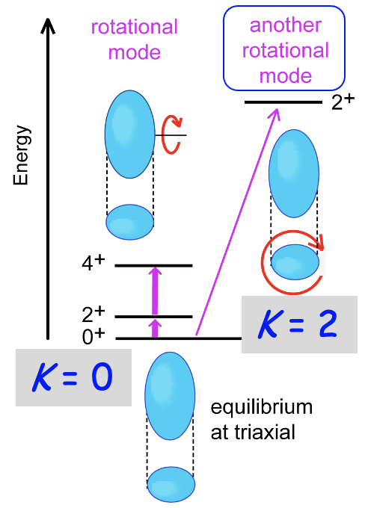
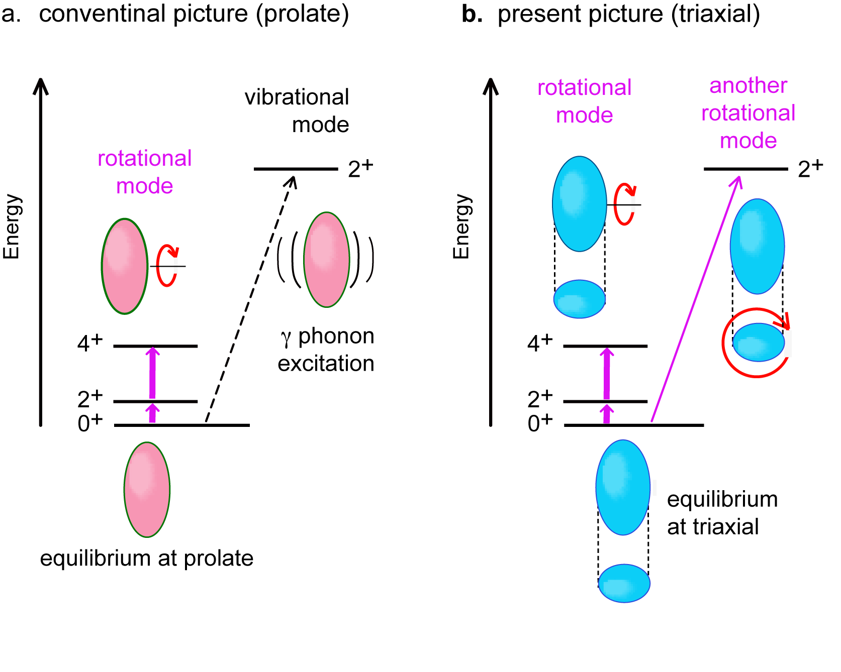

Theoretical studies include
Axially symmetric
shape -a la A. Bohr-
Triaxial shape
Davydov model for ¹⁶⁶Er (1959)
2⁺₂/2⁺₁ energy ratio → γ ~ 13 deg.
B(E2) 2⁺₂/2⁺₁ ratio → γ ~ 9 deg.
DFT approaches
Tajima et al. (1996)
dominance of prolate (γ =0) shape by Skyrme HF
Scamps, Goriely et al. (2021)
γ =1.6 (1.2) deg for ¹⁶⁶Er (¹⁵⁴Sm) by Skyrme HFB
K = 2
Li et al., (2010); Yang et al. (2021)
Relativistic HB for ¹⁶⁶Er etc. γ ~ 6 deg.,
γ smaller, mostly 0 for other nuclei of interest
K = 0
side view
top view
Robledo et al. (2008),
PES by HFB with Gogny D1S for many
circle
ellipse
(cannot rotate)
Li et al. (2009),
Rel. EDF -> 5-dim coll. Hamiltonian,
γ = 0 deg.
γ > 0 deg.
Delaroche et al., (2010)
Gogny -> 5-dim coll. Hamiltonian
triaxiality parameter γ (deg.)
From experimental side
Sharpey-Schafer et al.(2019)

Slide 11
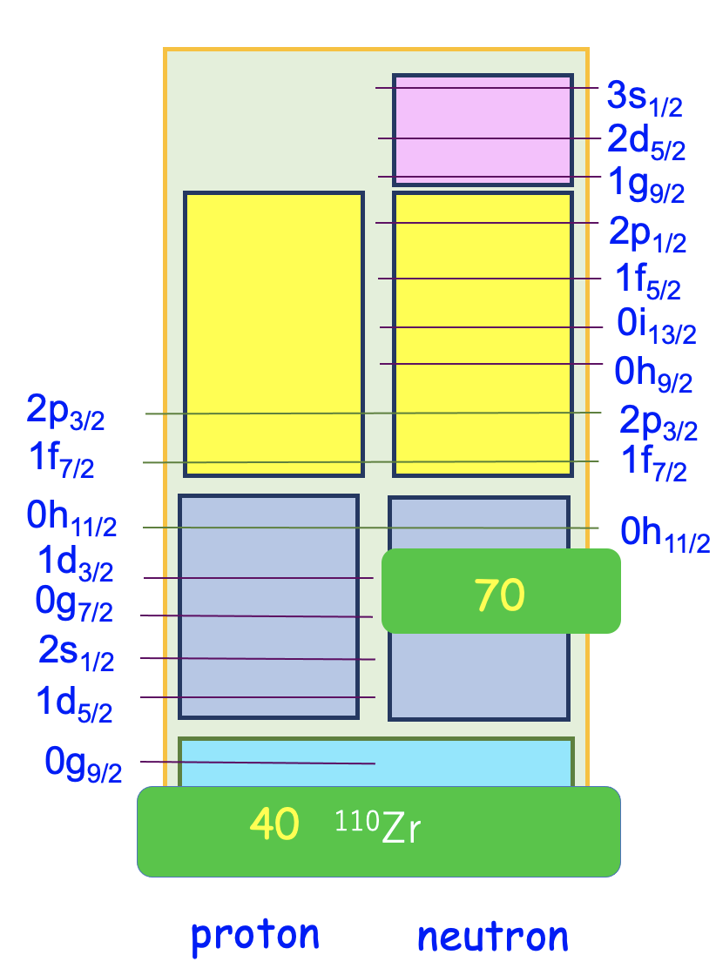

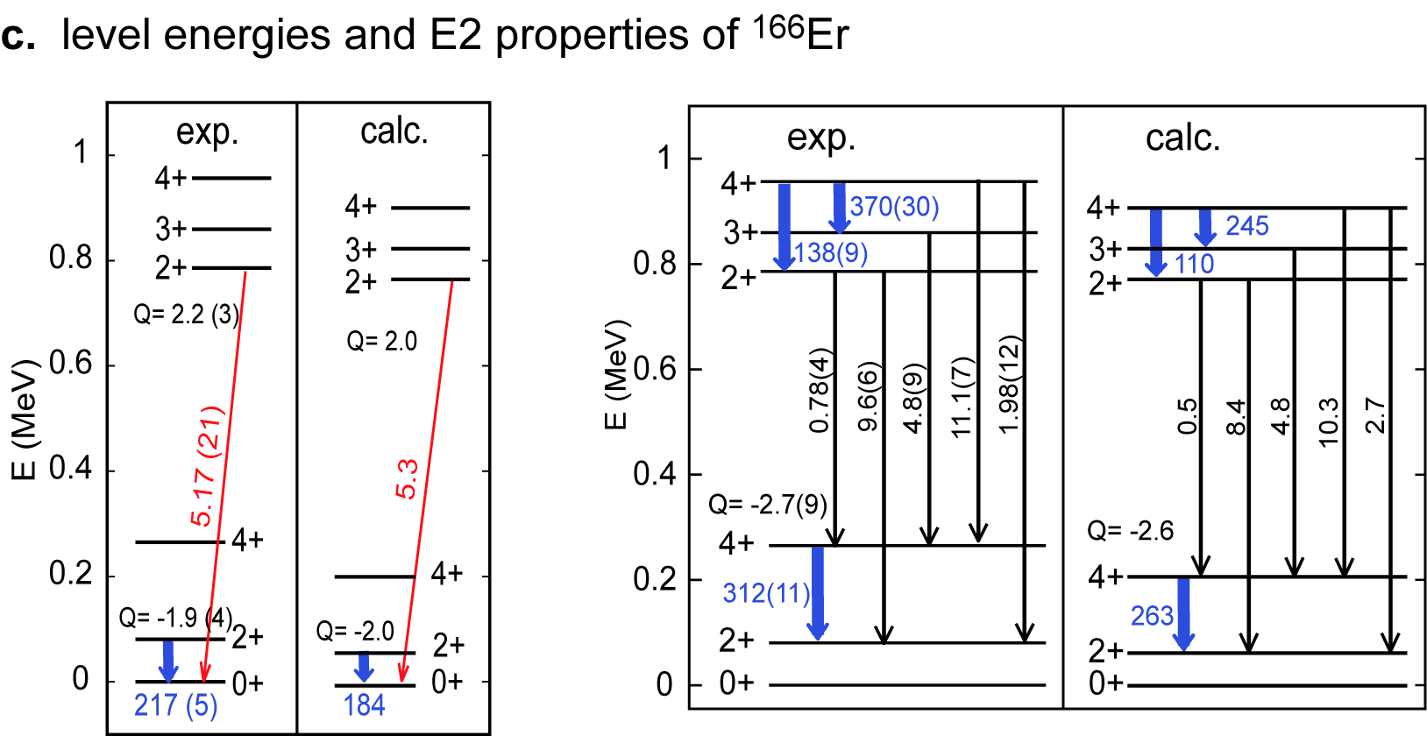
Revisit with Monte Carlo Shell Model (CI calculation)
We performed Monte Carlo Shell Model (MCSM) calculations, where the largest case corresponds to the diagonalization of 3.9 x 10³¹ dim. matrix. The advanced version of MCSM, Quasiparticle Vacua Shell Model (QVSM)*, was used, in order to incorporate both pairing and deformation effects on an equal footing, with N-projected Bogoliubov basis vectors. Supercomputer Fugaku of RIKEN was utilized.
*Shimizu et al, PRC 103, 014312 (2021)
The model space
Effective interaction: G-matrix* + V_{MU}
* Brown, PRL (2000)
V_{MU} : same interaction for the description of shell evolution in exotic nuclei

Slide 12

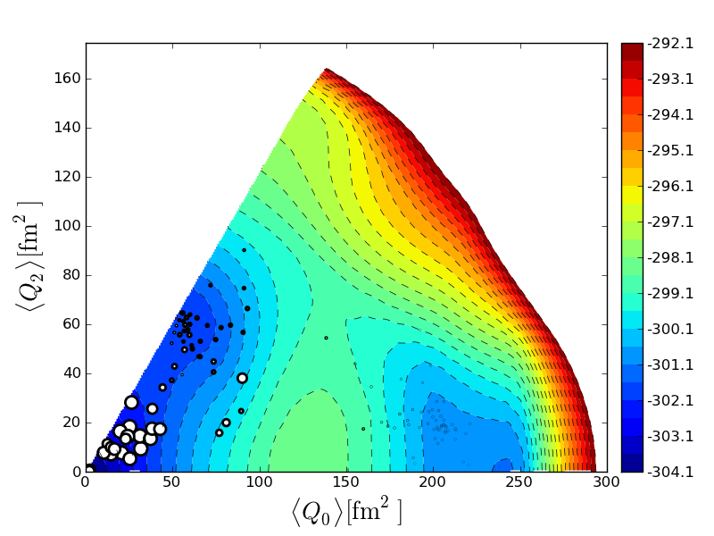
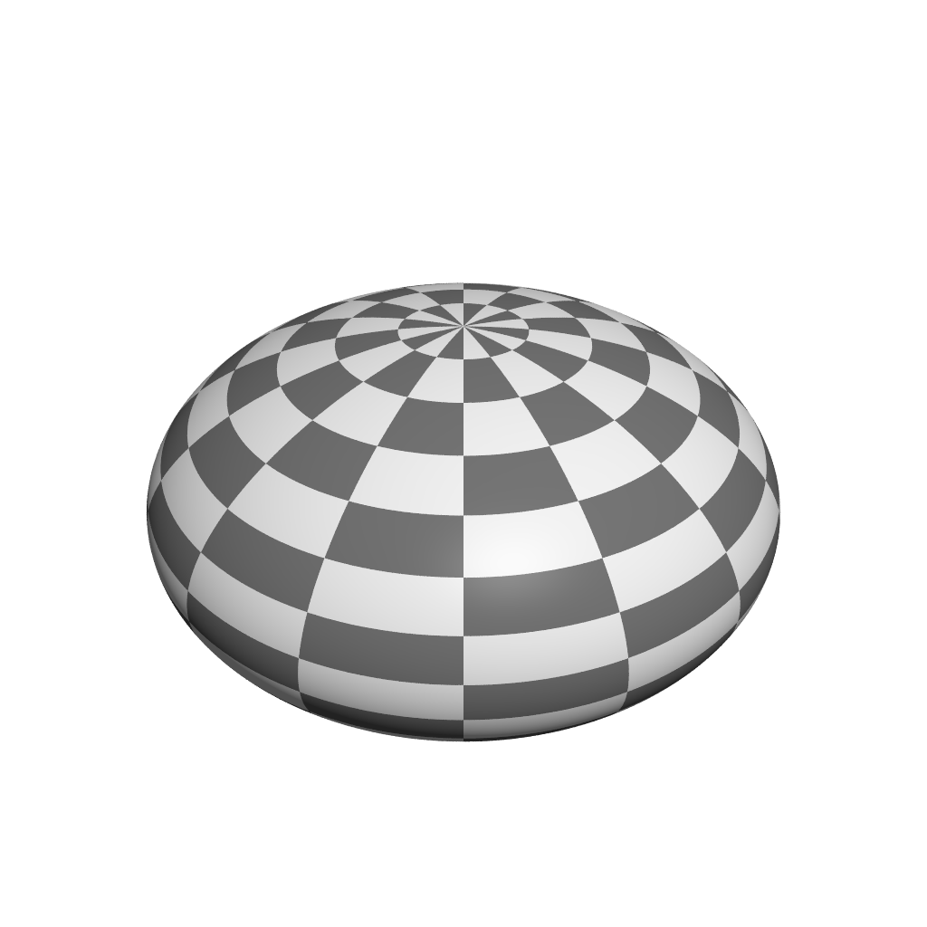
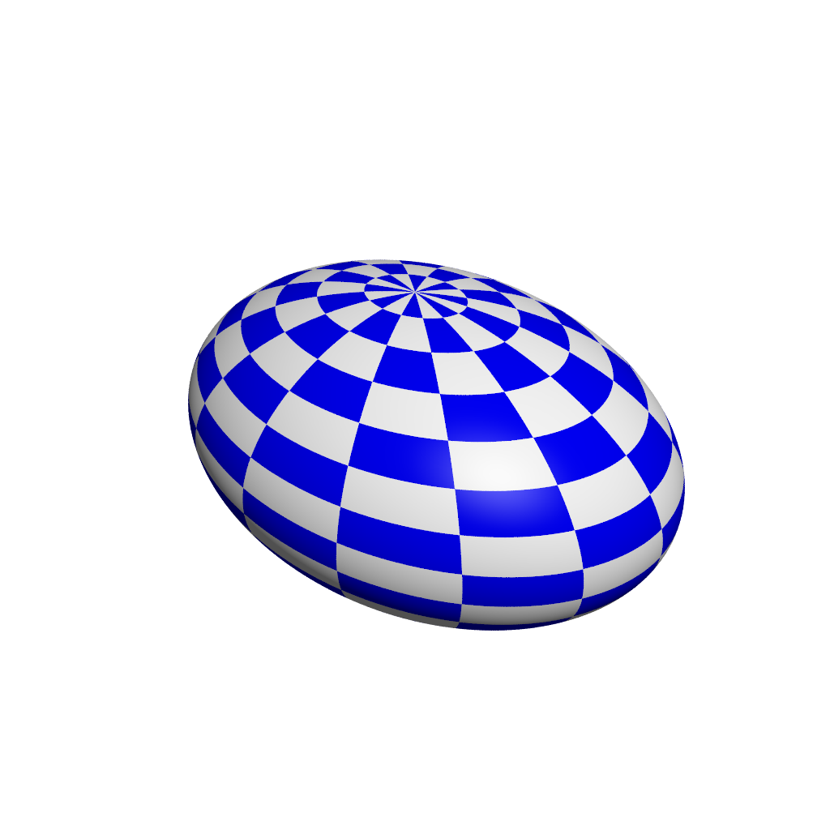
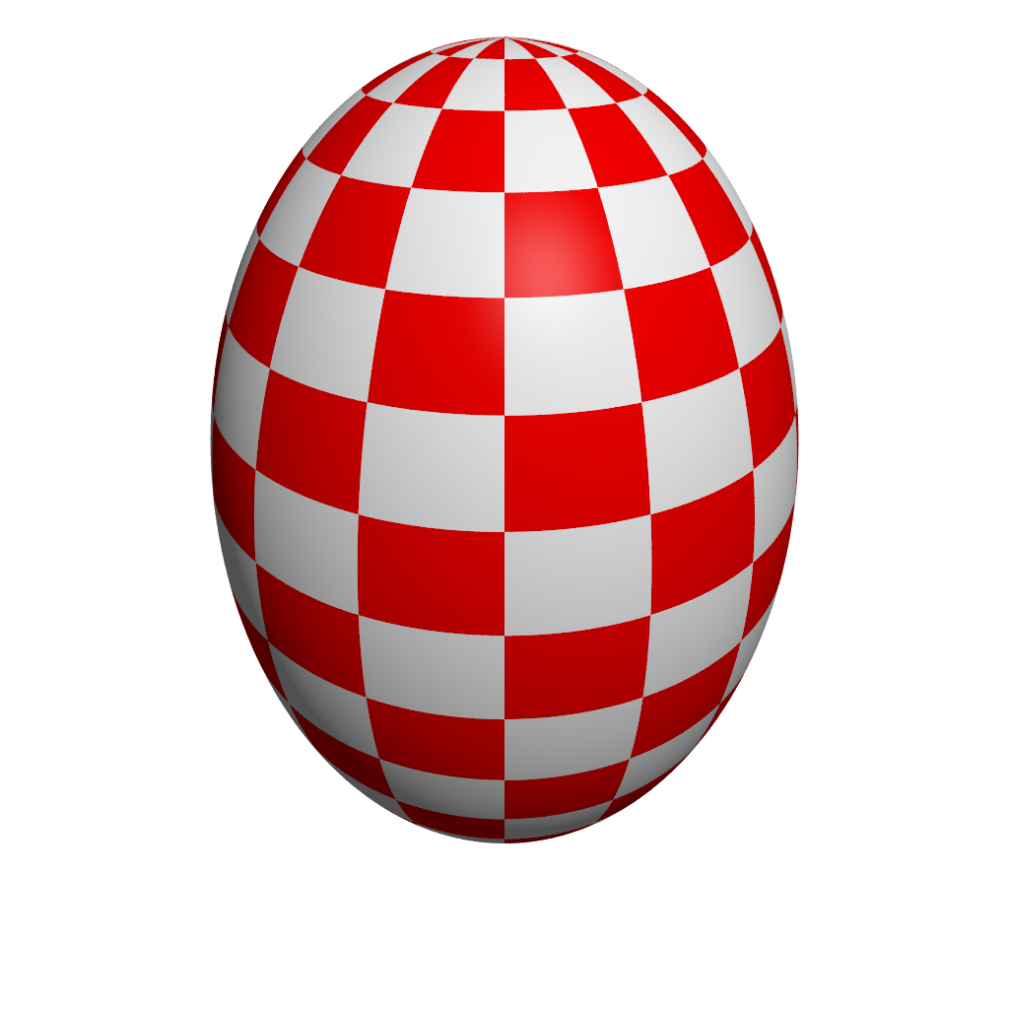

T-plot : visualization of MCSM eigenvector on Potential Energy Surface
eigenstate
optimum deformed Slater determinant or Bogoliubov state
→ intrinsic shape
amplitude
projection onto J^{π}
PES is calculated by CHF for the shell-model Hamiltonian
Location of circle : quadrupole deformation of unprojected MCSM basis vectors
Area of circle :
overlap probability
between each
projected basis and
eigen wave function
0⁺₁ state of ⁶⁸Ni
Rx = Rz
γ
β ₂ and γ are
used as partial
labelling of
basis vectors
oblate
triaxial
spherical
β ₂
prolate
Rx = Ry
Y. Tsunoda, et al. PRC 89, 031301 (R) (2014)

Slide 13
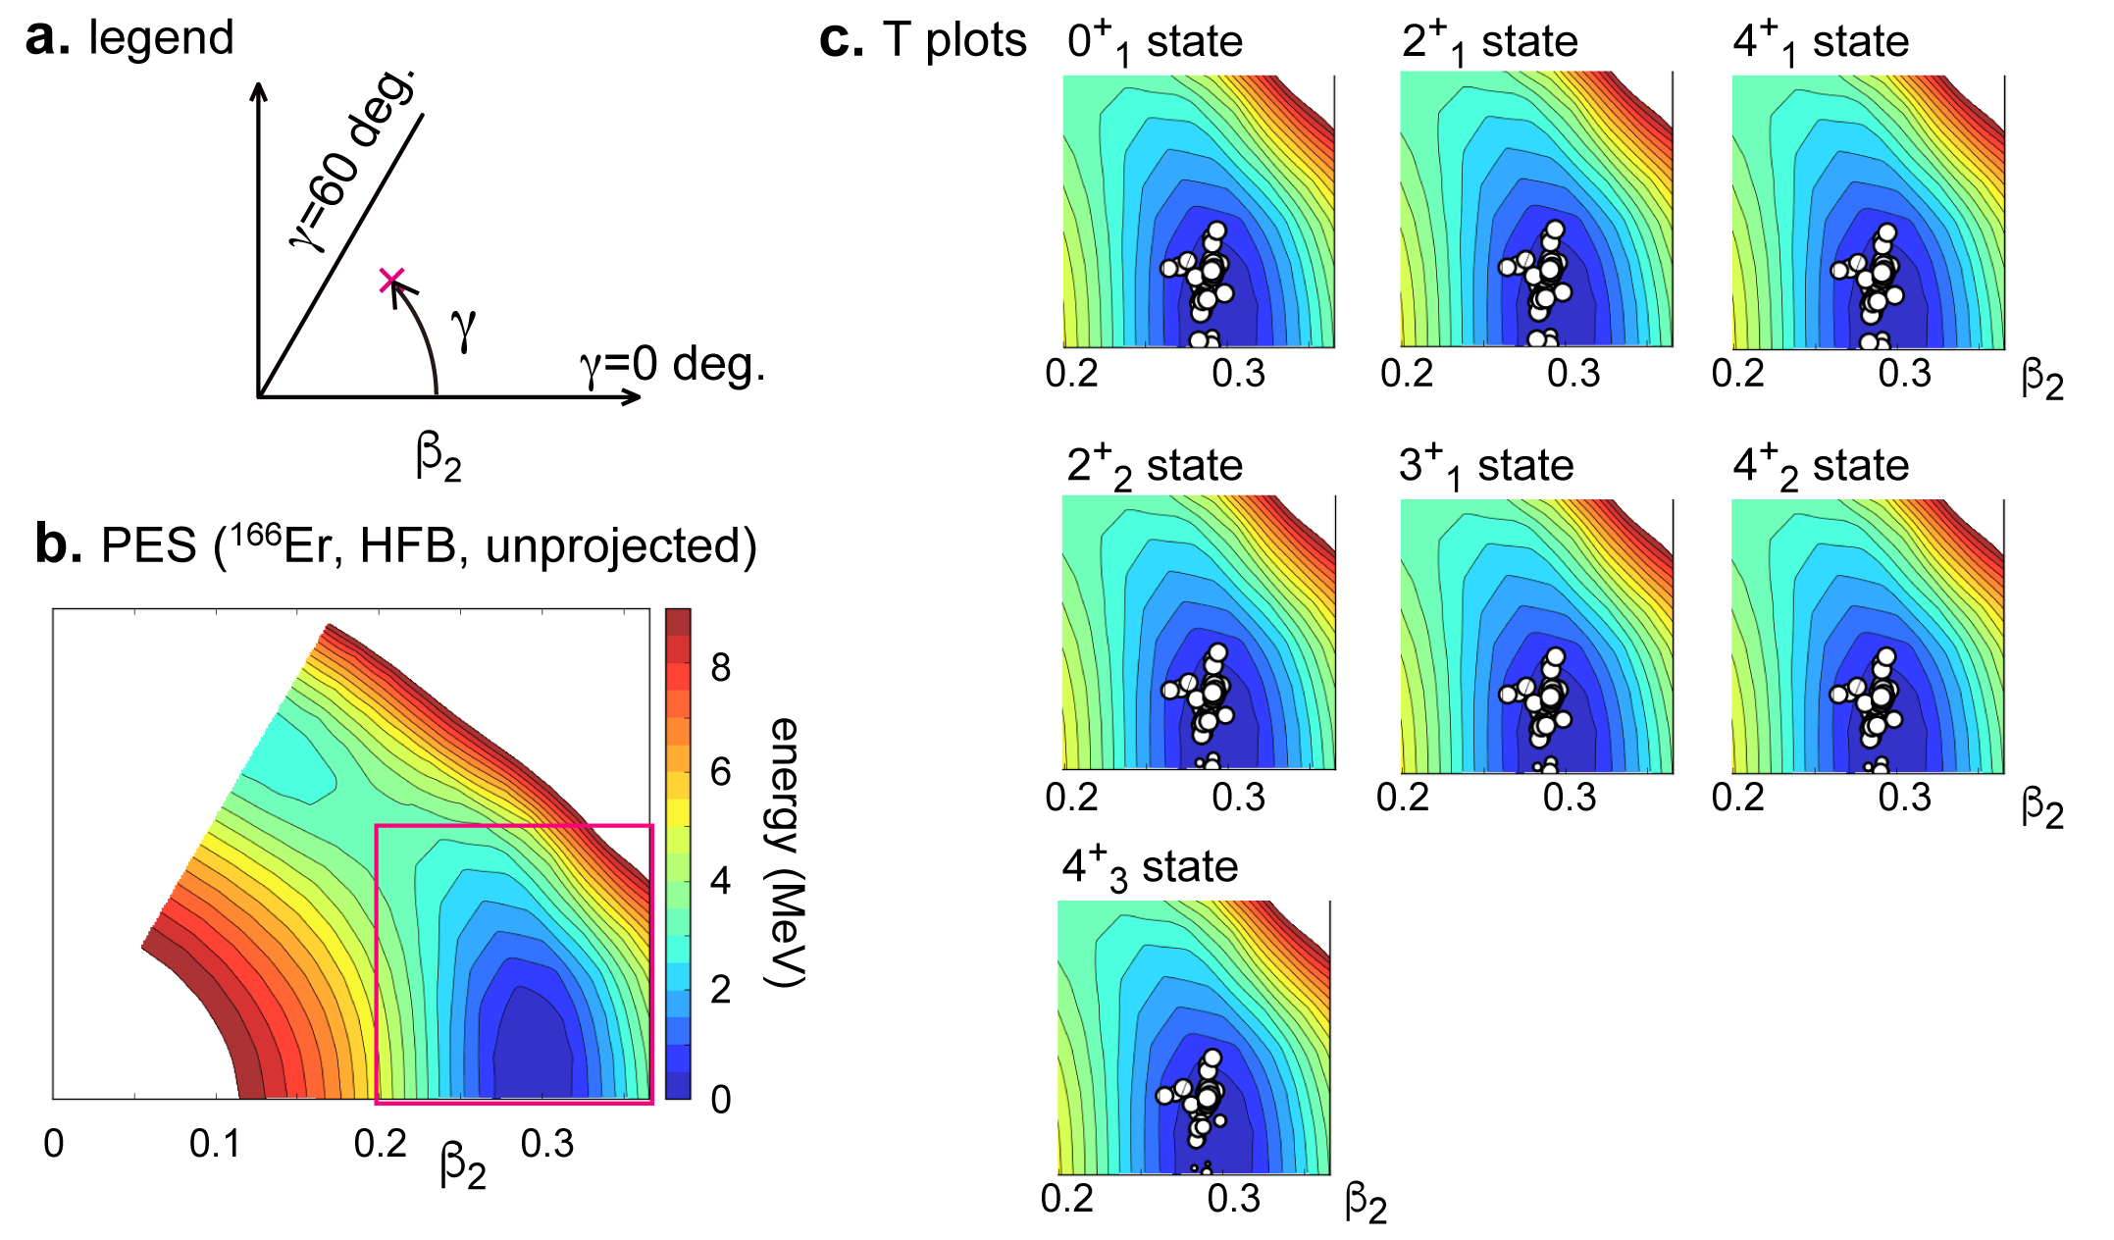
T-plots for the ground and lowest states of ¹⁶⁶Er
oblate
triaxial
triaxial with
<γ> = 8.4 deg
K = 0
prolate
triaxial with
<γ> = 9.1 deg
K = 2
<γ> = 9.5 deg
cut
K = 4
Similar result from Kumar invariant
<γ> ~ 9.2 deg, <β₂> ~ 0.30

Slide 14
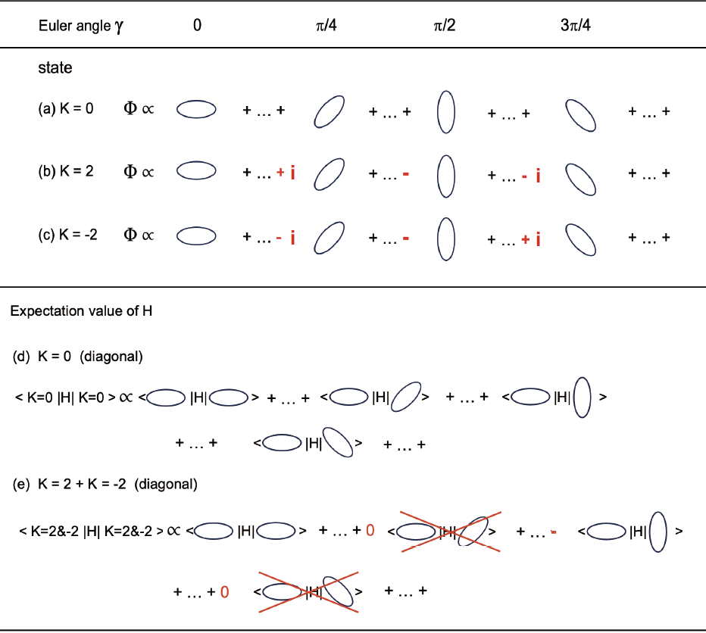
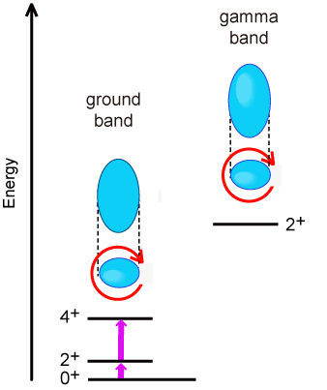
Triaxiality provides nuclei with additional binding energy !
(different representations of the 2-dim. rotational group)
K=2
ellipse in
the xy plane
finite triaxial deformation
→ more binding energy
K=0
The rotational symmetry in the
xy plane is broken because of this ellipse, but it is restored
by projecting onto a good K value.
opposite
less binding energy than K=0
K conservation is discussed later.

Slide 15
Two origins and two appearances of triaxiality in deformed heavy nuclei
1. Small triaxiality due to symmetry restoration with K (ex. ¹⁵⁴Sm in next pages)
This mechanism alone generates γ up to 5 degrees.
This occurs in most (virtually all) strongly deformed nuclei.
2. Medium triaxiality mainly due to
monopole part of pn tensor force (through self-organization)
and/or
hexadecupole part of pn central force.
This mechanism enlarges γ to a range of 6 - 14 degrees (or more),
in selected heavy deformed nuclei (~half ?).
Both cases involve high-j orbitals, like g_{9/2,7/2} , h_{11/2,9/2} , i_{13/2,11/2} , etc.
This enlargement has been verified by constrained HFB calculation.

Slide 16
small triaxiality
¹⁵⁴Sm : small triaxiality (gamma~3.7 deg.) in the ground band
medium triaxiality (gamma~13 deg.) in the beta+gamma bands
shape coexistence in γ direction
(traditionally β and γ phonon excitations)
shape coexistence

Slide 17
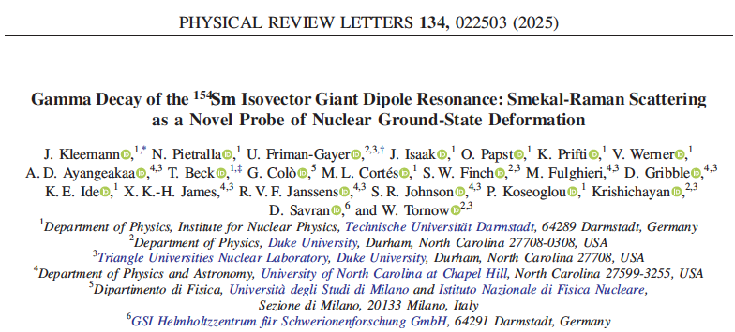
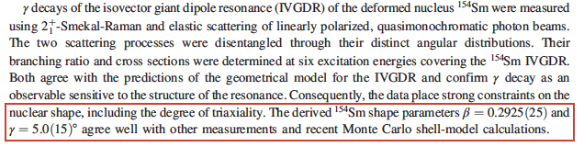
The triaxiality of ¹⁵⁴Sm
has been confirmed
experimentally !
GDR experiment
@ High-Intensity
γ-ray Source (HIγS)
by TU Darmstadt+ group

Slide 18
Two origins of triaxiality in deformed heavy nuclei
1. Small triaxiality due to symmetry restoration with K
This mechanism alone generates γ up to 5 degrees.
This occurs in most (virtually all) strongly deformed nuclei.
2. Medium triaxiality mainly due to
monopole part of pn tensor force (through self-organization)
and/or
hexadecupole part of pn central force.
This mechanism enlarges γ to a range of 6 - 14 degrees (or more),
in selected heavy deformed nuclei (~half ?).
Both cases involve high-j orbitals, like g_{9/2,7/2} , h_{11/2,9/2} , i_{13/2,11/2} , etc.
This enlargement has been verified by constrained HFB calculation.

Slide 19
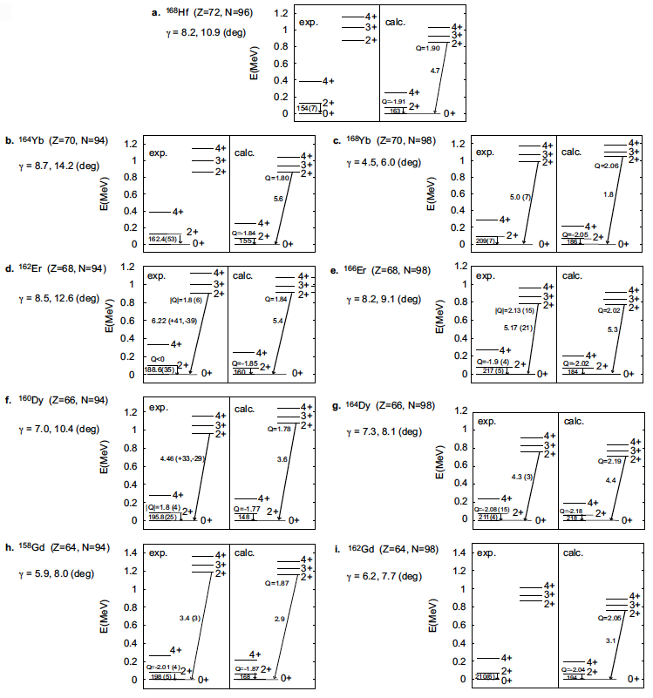
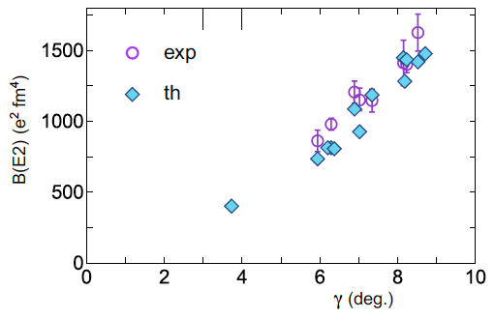
Medium triaxiality
systematically produced
by the same Hamiltonian
Levels, B(E2)’s and
Q-moments reproduced
: γ values by MCSM (QVSM)
~ Multiple CoulEx values
a la D. Cline (1986~)
An experimental evidence :
clear correlation between γ
and B(E2; 0⁺₁ -> 2⁺_{gamma} )
¹⁶⁶Er
¹⁶⁴Dy
¹⁵⁸Gd
Predicted B(E2) to 2⁺ at Ex~2.7 MeV of ¹⁵⁴Sm
an example of small triaxiality

Slide 20
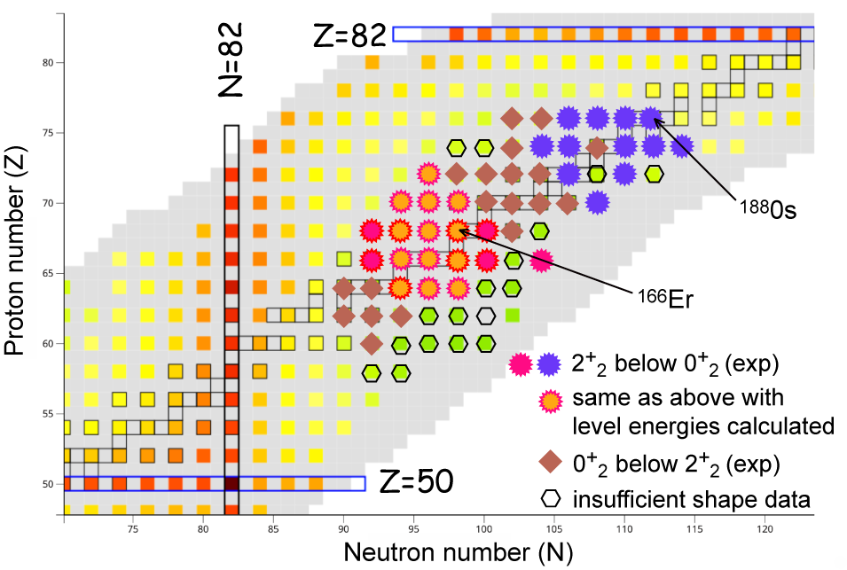
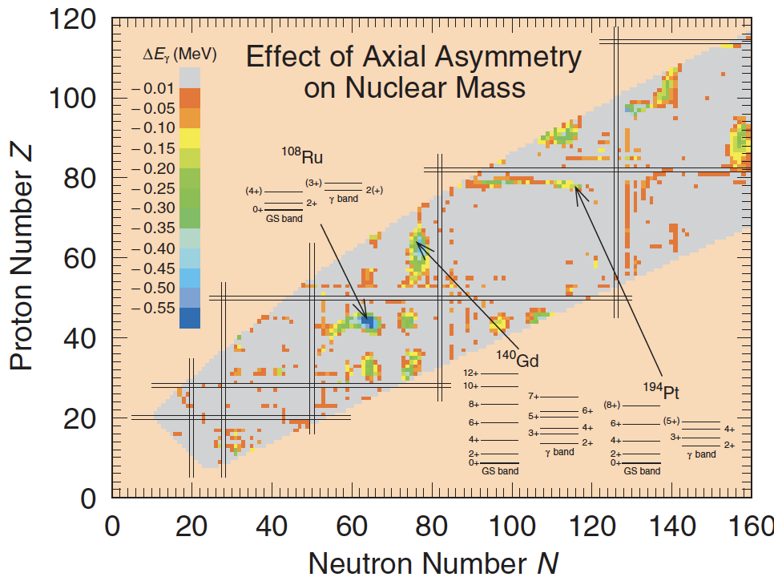
Appearance of triaxial shapes in the nuclear chart
Conventionally
axially symmetric
Moller et al. (2006)
medium
triaxiality
~ small triaxiality

Slide 21
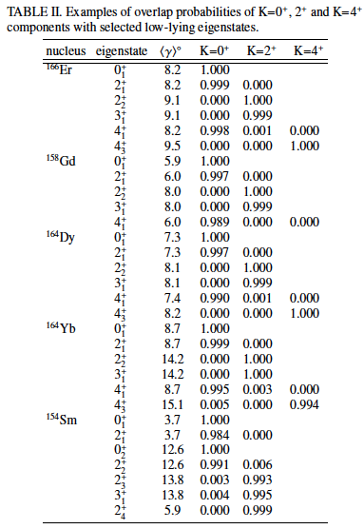
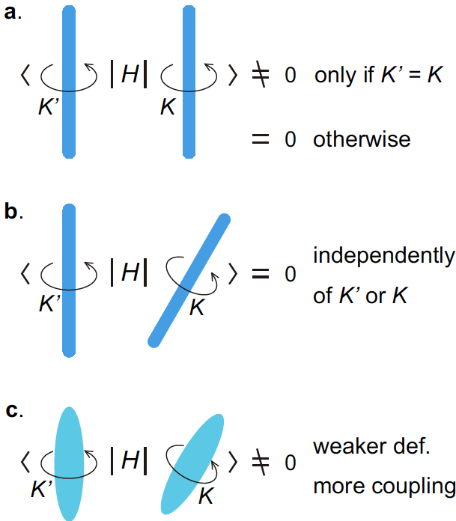
K quantum number is (practically) conserved, even with medium triaxiality
Robust mechanism for
good K with triaxiality
Rather strong K mixing may have been expected
in traditional picture for triaxial shapes.
K is now shown to be a practically good quantum number.
Dynamical symmetry as a many-body
effect (<−>Partial Dynamical Symmetry)

Slide 22
Outline
1. Historical background and “rotational energy”
2. Prevailing triaxial shapes
3. Vibrational excitations – deformed case -
(4. Vibrational excitations – spherical case -)
If time permits, ……

Slide 23
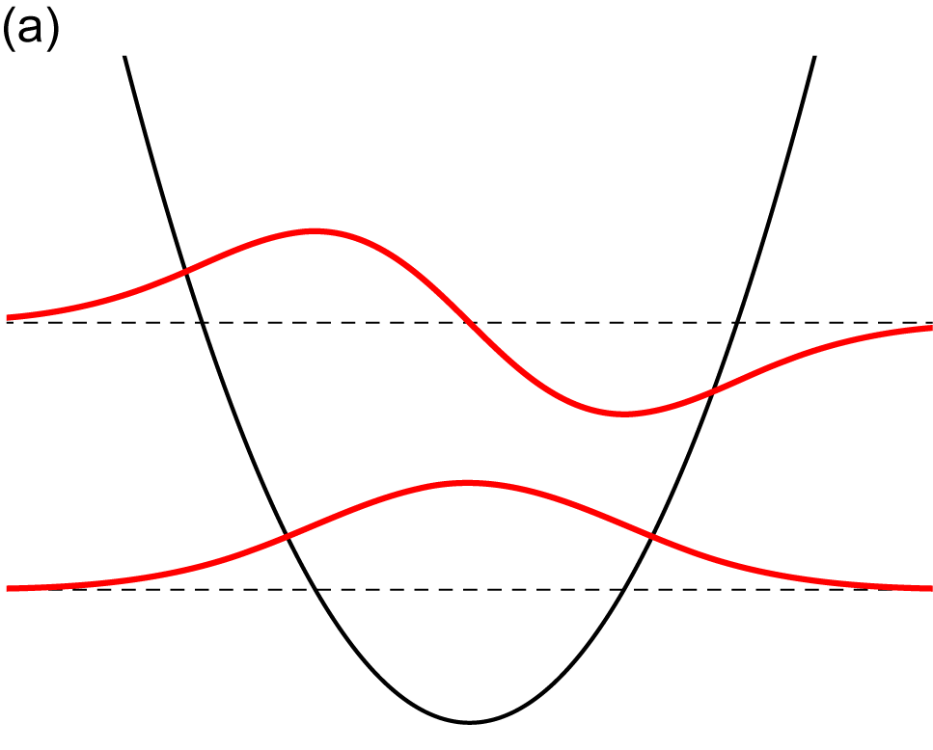
Energies and wave functions
of a particle confined in a
one-dimensional harmonic
oscillator potential
(= quantum model of vibration)
“Vibrational” excitation of collective states
with respect to collective coordinates
(like β ₂ and γ )
Our eigenstates are written as
/N_{i}
oscillation
amplitude
basis vector (many-body
state) with shape parameters
N_{i} : relevant norm
peak
E₁
node
Expected basic pattern of the amplitudes
peak
peak
E₀
at rest
reference (ex, ground) state
vibrational mode
peak
peak
“node”
amplitude
γ
γ
No classical image of
surface vibration is used.
shape parameter
peak
chosen to be real positive

Slide 24
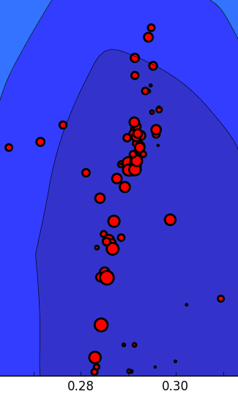
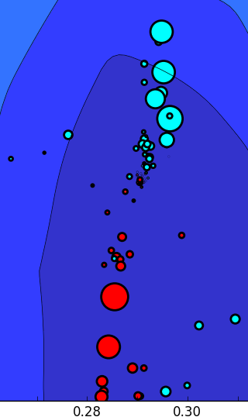
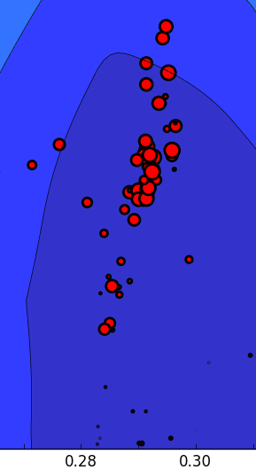
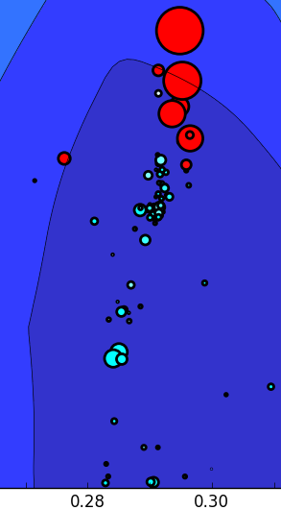
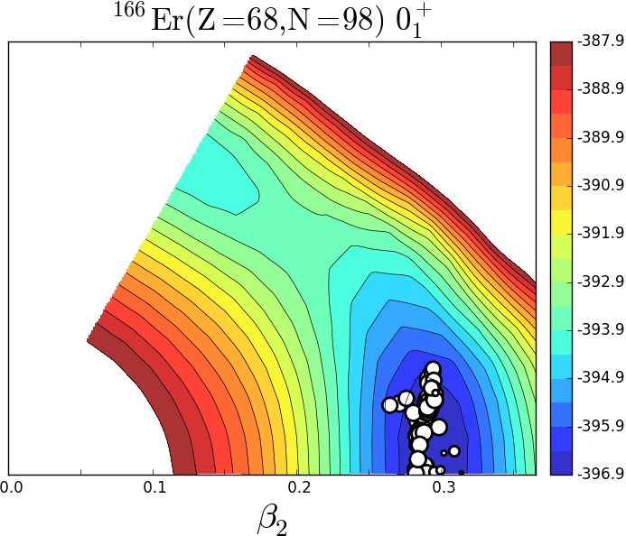
MCSM eigenstates
Advanced T-plot exhibiting also phases of amplitudes
(Phase-specified T-plot (PT-plot)) by Tsunoda (2025)
/N_{i}
red (blue) circles : amplitudes are positive (negative)
phase convention:
all real positive for reference state
(ex. 0⁺₁ and 2⁺₂ states)
¹⁶⁶Er
0⁺₃
2⁺₂
2⁺₅
0⁺₁
K=0
K=0 vib
K=2
K=2 vib
Usual T plot for the probability.
Expected basic pattern of the amplitudes
reference (ex. ground) state
vibrational mode
amplitude
γ
γ

Slide 25
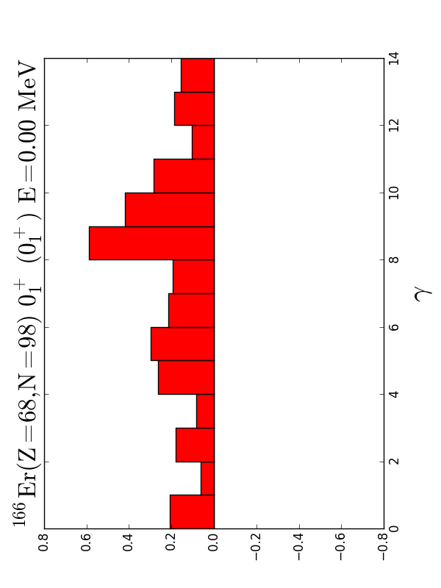
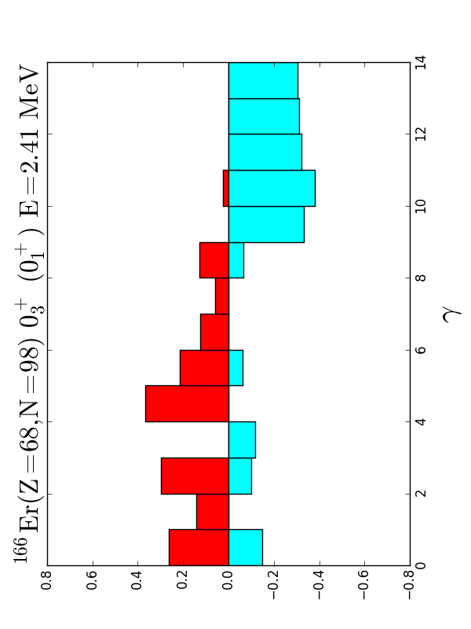
We can take superpositions within a given bin of γ, e.g., γ = 9 - 10 degrees,
separately for positive and negative amplitudes.
amplitudes are positive for 0⁺₁ state
as it is also the reference state
positive
amplitude
negative
amplitude
0⁺₃ state
0⁺₁
0⁺₃
K=0
K=0 vib
γ
γ
red (blue) circles : amplitudes are positive (negative)
This is a clear and important signature of the vibration in quantum
many-body language. No (semi) classical arguments used.

Slide 26
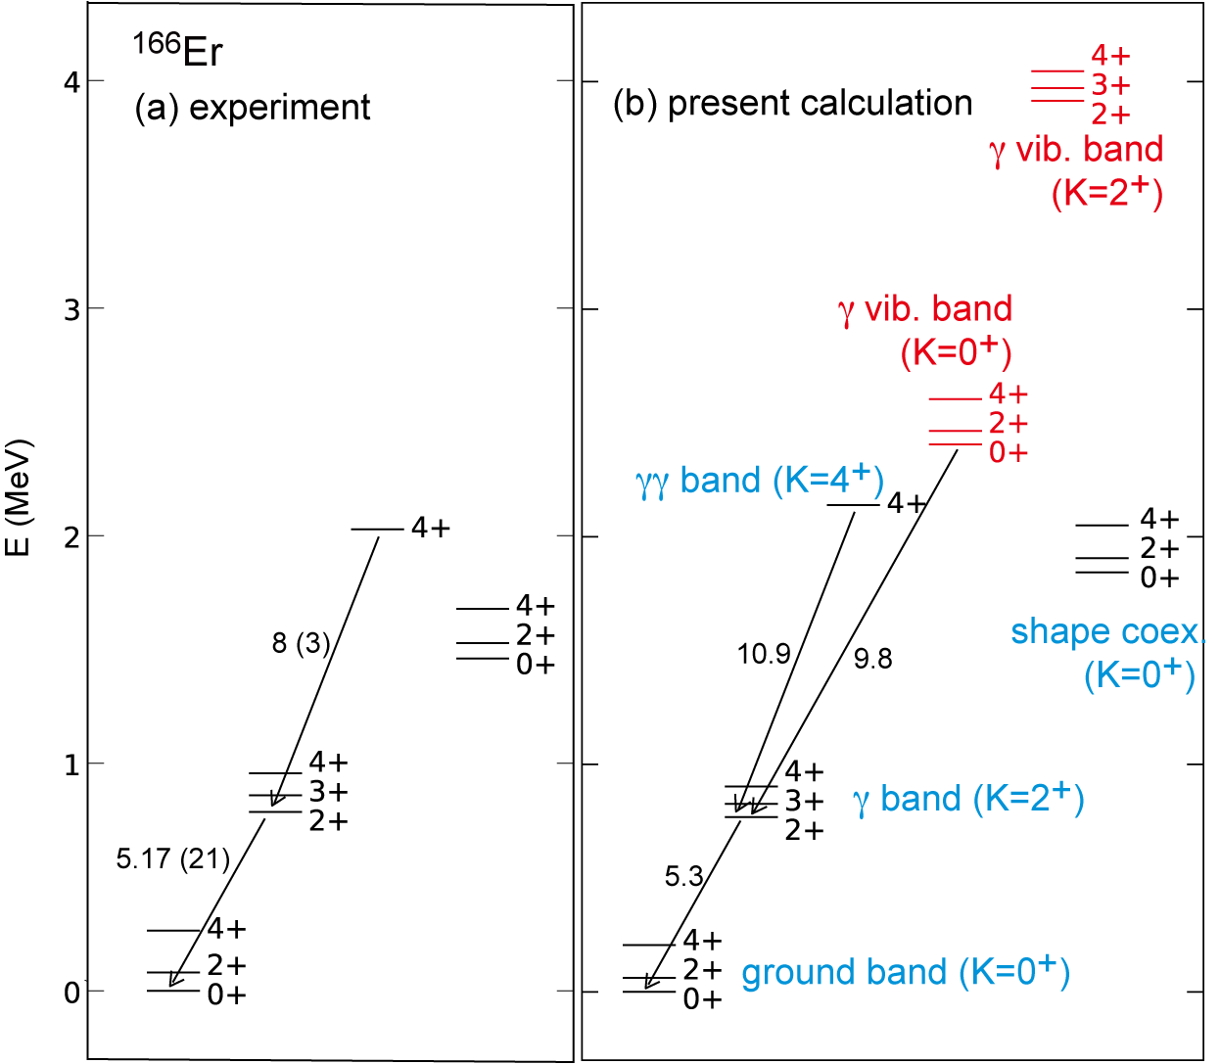
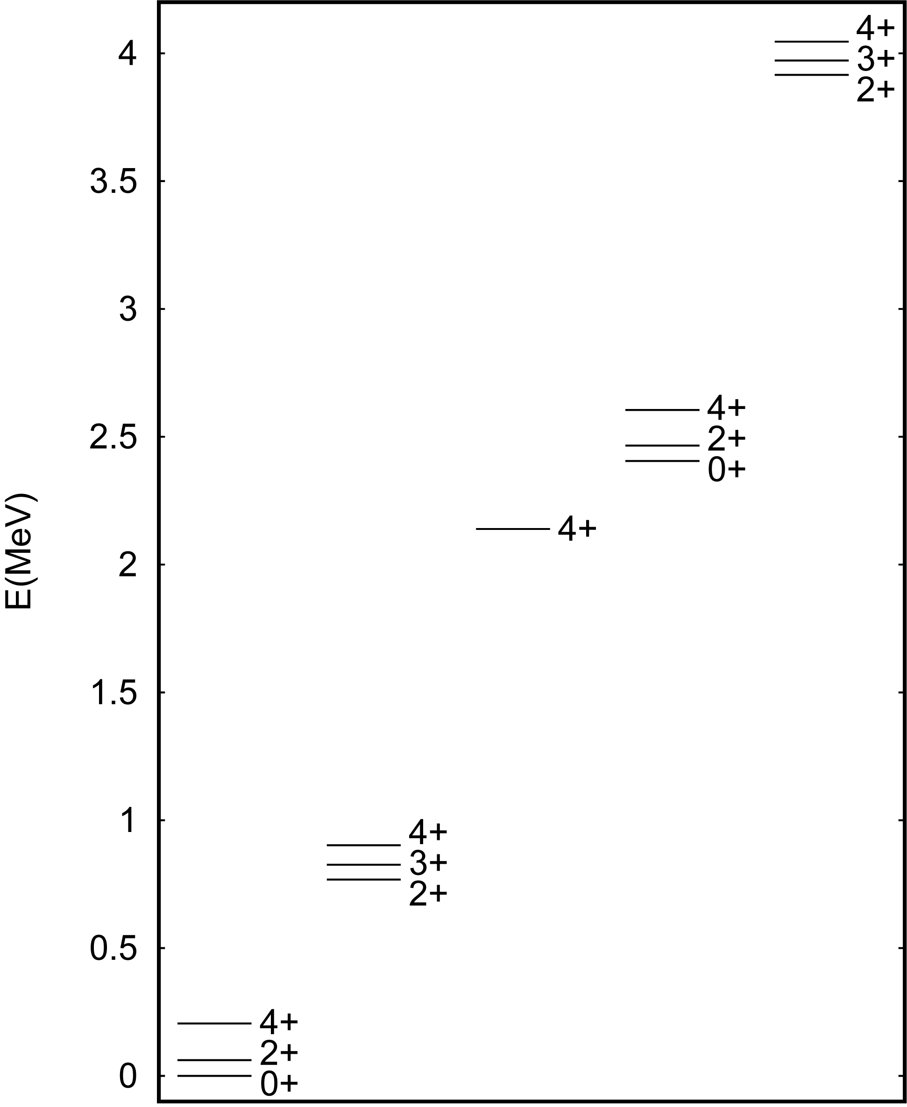
¹⁶⁶Er
B(E2) in W.u.
Level energies of ¹⁶⁶Er
including vibrational states
¹⁶⁶Er calc.
(basis vectors
in and around the
PES minimum as
seen in T-plot)
γ vibrational
K=2
xy plane cross section of low-lying triaxial states
higher states
not shown
decay paths
xy plane cross section of
γ vibrational states built on
lower triaxial states
11 W.u.
γ vibrational
K=0
"γγ" (K=4)
-
12 W.u.
→ both K=0 and K=2 arise
γ band (K=2)
K=2 ex. energy is higher than
K=0 one by the same reason as
that for the 2⁺γ band
ground band (K=0)

Slide 27
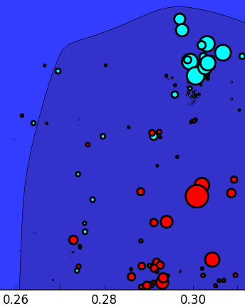
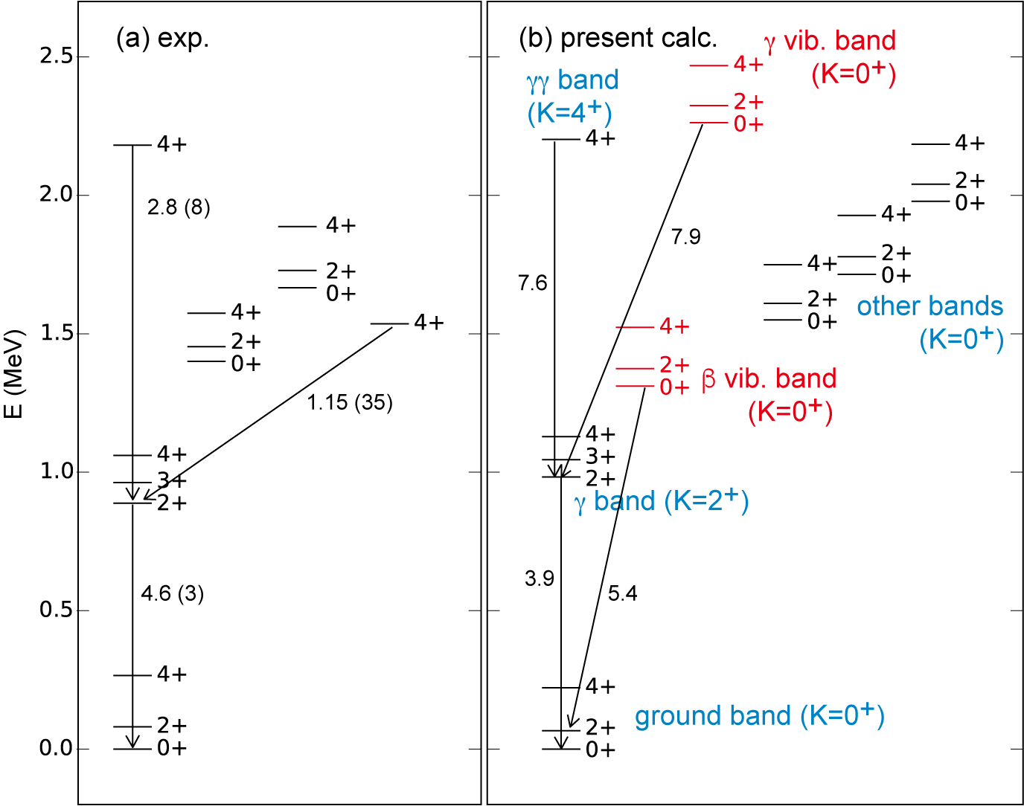
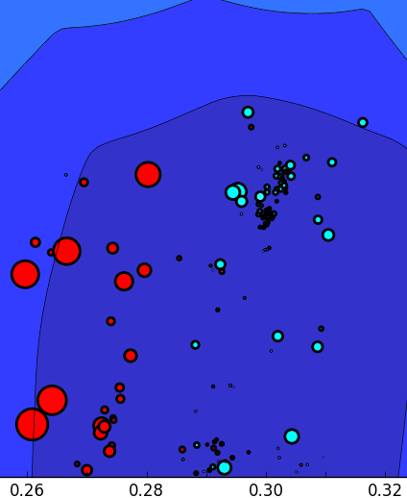
¹⁶²Dy
exp: ensdf2 +
*Aprahamian et al.
EPJA (2024)
8.4 (+5.8, -4.3)*
arrow :
major decay path
ground (γ=6.9 deg)

Slide 28
Outline
1. Historical background and “rotational energy”
2. Prevailing triaxial shapes
3. Vibrational excitations – deformed case -
(4. Vibrational excitations – spherical case -)
If time permits, ……

Slide 29
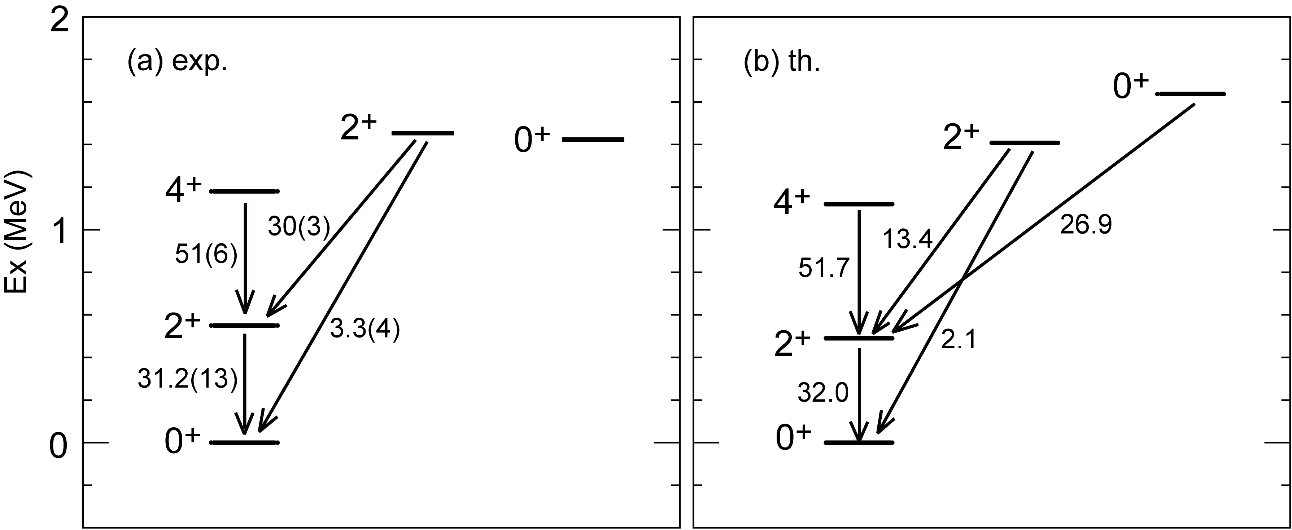
¹⁴⁸Sm : a typical vibrational nucleus with a (near-)spherical ground state
2-phonon (triplet)
1-phonon
0-phonon
from ensdf
by QVSM calc.

Slide 30
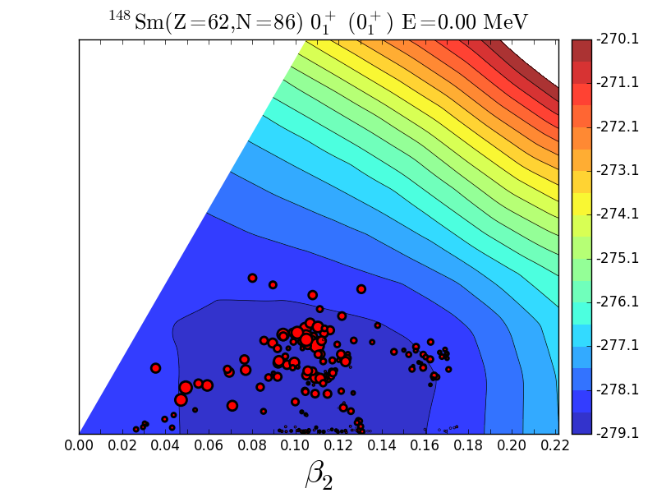

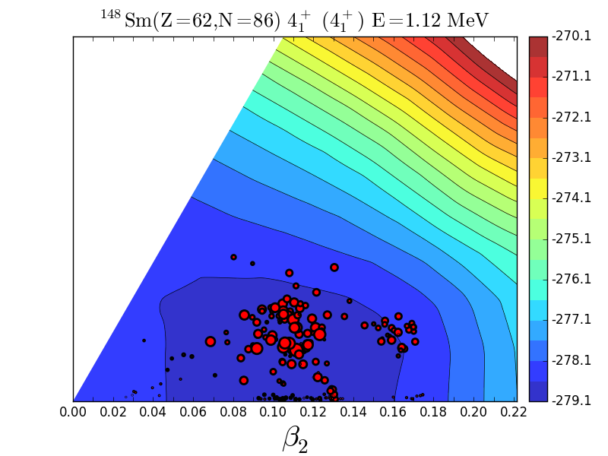


¹⁴⁸Sm PT-plots
Traditional phonon assignment
0⁺₁
2⁺₁
1-phonon
4⁺₁
0-phonon
2-phonon
shifts to larger β ₂ (quadrupole phonon excitations)
K ~ 0
Modest shifts of the distribution towards larger β ₂ in the sequence 0⁺₁ → 2⁺₁ → 4⁺₁
0⁺₂
2-phonon
2⁺₂
2-phonon
one-phonon vibration
in the present sense
shifts to K=2
The structure of 2⁺₂ looks like quadrupole phonon towards K=2.

Slide 31
A summary (for rotational modes)
Conventional picture of strongly
deformed nuclei in textbooks for 70 years
Presently …
side
view
J
circle
a la Aage Bohr (1952)
Novel overall view
1. axially symmetric ellipsoid emerges,
and rotates, like a rugby ball
1. Prevailing triaxial shape
like an almond (ΔΕ ~ 3MeV)
2. J(J+1) rule of excitation energy
is due to rotational kinetic energy
2. J(J+1) rule represents the whole
Hamiltonian, primarily interactions
3. γ band is due to γ vibration
3. γ band is a K=2 rotation
4. if axial symmetry is broken,
no good K quantum numbers remain
4. K quantum number is practically
conserved even with triaxiality
Prevailing triaxiality → Davydov et al. (1958-9)

Slide 32
Prospects may include
- Observation of shapes (CoulEx; RHC (see Bur for STAR on ¹⁵⁴Sm and ¹⁶⁶Er))
- Conventional empirical picture of band structure with good K quantum number
is shown to be valid even with substantial triaxiality in deformed nuclei.
- 2⁺_{γ} and 4⁺_{γγ} are K=2 and 4 rotations
- No K=0 γγ band, but γ vibrational K=0 band appears and decays to 2⁺_{γ} level
- so-called β band appears at low excitation energy in certain nuclei (e.g. ¹⁶²Dy)
- Shape coexistence emerges everywhere in many different ways
- Prolate(-like) band is found as high as 4 MeV
- K=0 dominance of core→ “Nilsson model” works with triaxialities ➔ e.g. ²²⁹Th
Refs.:
A shorter introductory article: T. Otsuka, arXiv: 2509.08552 [nucl-th],
to appear in the Proceedings of the Ischia conference 2025
TO et al., EPJ-A, 61, 126 (2025); Tsunoda et al., arXiv:2507.20275

Slide 33
E N D
Thank you

Slide 34
B a c k u p s

Slide 35
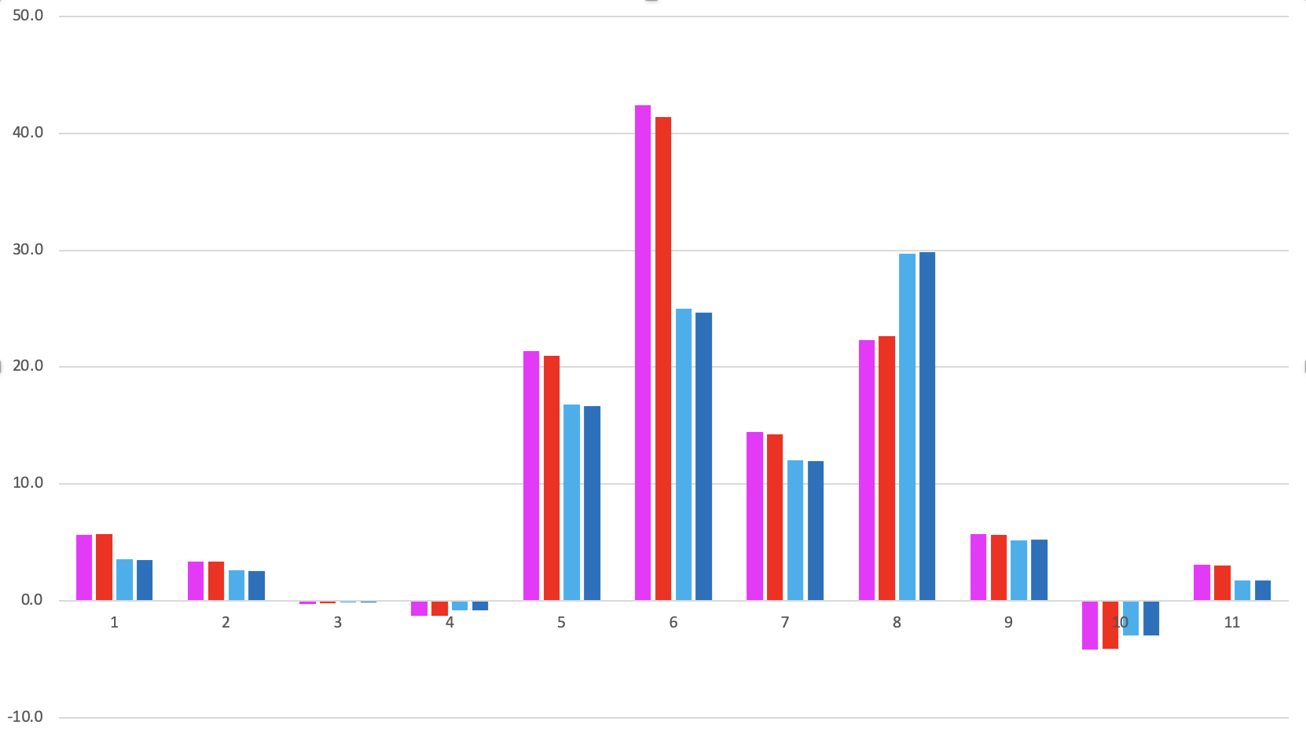
Decomposition of rotational excitation energies for two bands in ¹⁶⁶Er
dominated by NN interactions
40
kinetic term ~ 5% lowering
30
ground band
gamma band
20
Fraction (%)
2⁺₁ - 0⁺₁
10
4⁺₁ - 0⁺₁
3⁺₁ - 2⁺₂
4⁺₂ - 2⁺₂
0
p spe
n spe
pp mono
nn mono
pn cent qq
pp 0⁺ pairing
nn 0⁺ pairing
pn cent mono
pn cent higher
pn tens mono
pn tens multi

Slide 36



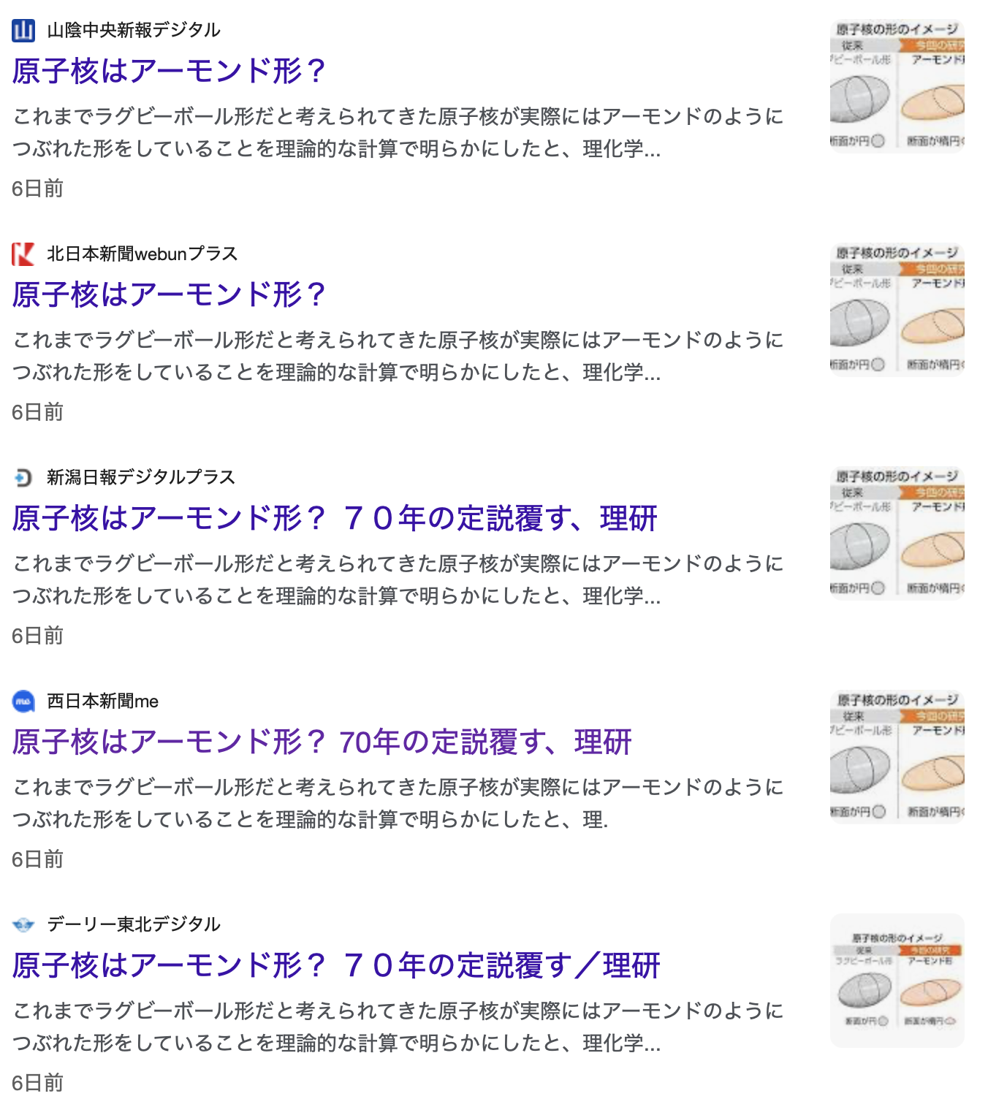
Public
Relations
in Japan
雑誌ニュートン
８月号
まず結果から
７月号
Googleで検索
アーモンド＋原子核
一部スポーツ紙
にも出ました

Slide 37
Summary
1. Rotational excitation energy proportional to J(J+1) can be derived in quantum many-body
framework, without resorting to the quantization of the free rotation of rigid body.
2. Triaxial deformation occurs in virtually all deformed nuclei, because the symmetry
restoration gives more binding energy to triaxial K=0⁺ states. → “small triaxiality”
- no separation between intrinsic and extrinsic degrees of freedom -
3. Triaxiality is enlarged by tensor and central (hexadecupole) forces in some nuclei,
at least in 13 rare-earth nuclei, such as ¹⁶⁶Er, ¹⁶⁴Dy, ¹⁵⁸Gd as confirmed by the QVSM calc.
Combined with the above process → “medium triaxiality” - almond instead of rugby ball -
4. Band structure appears with practically conserved K quantum number with triaxiality (as
expected from empirical observations). Shape coexistence emerges in many ways everywhere.
5. β - and γ -vibrational excitations emerge, above the γ band, that is nothing but K=2⁺ rotation.
6. A lot of novel stuff are anticipated; a new era of the spectroscopy of heavy nuclei has arrived.
Easily accessible article: “A comprehensive view of nuclear shapes, rotations and vibrations
from fully quantum mechanical perspectives”, T. Otsuka,
to appear in the Proceedings of the Ischia conference 2025, arXiv: 2509.08552 [nucl-th]

Slide 38
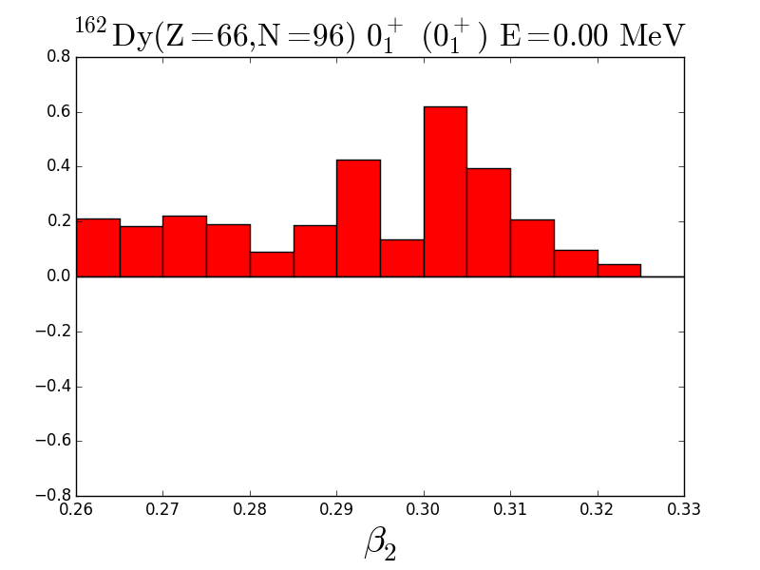
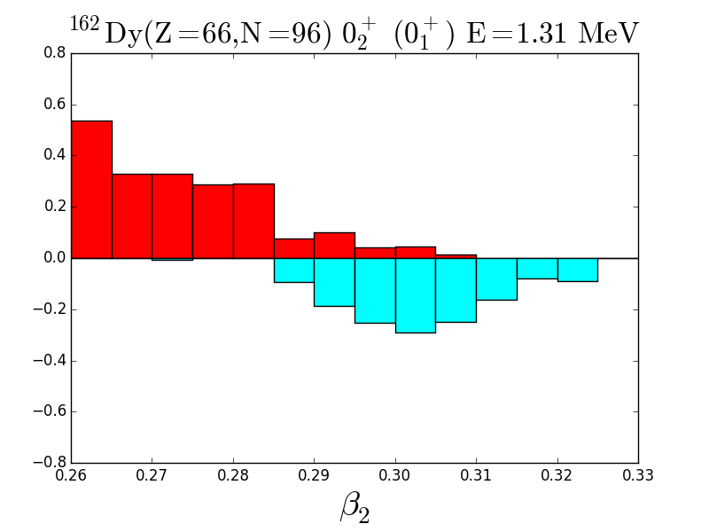
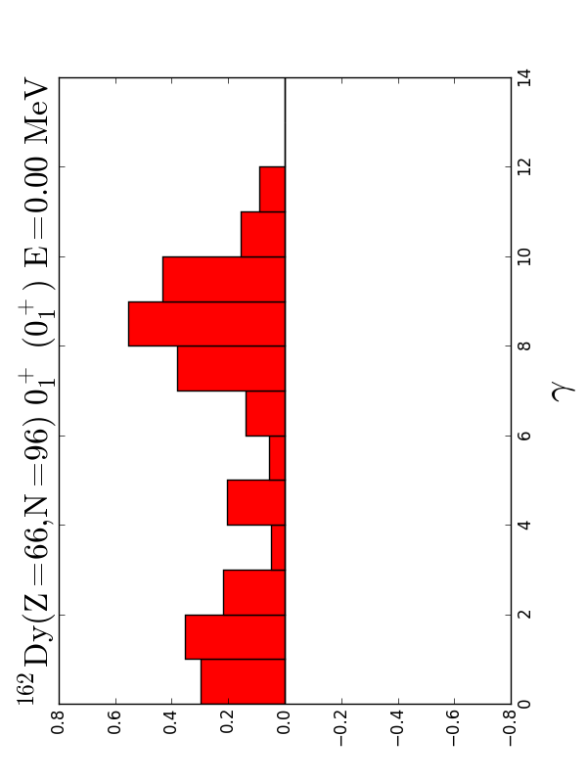
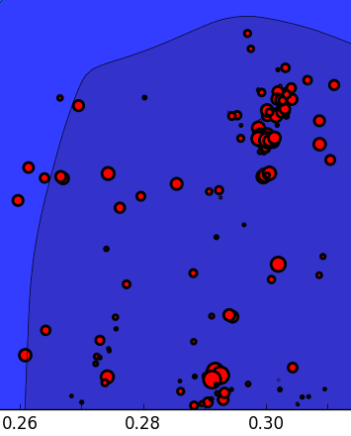
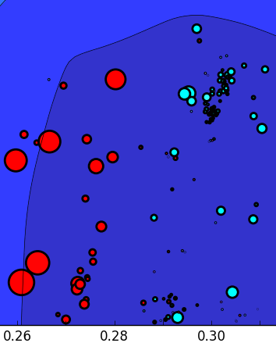
¹⁶²Dy
0⁺₂
PES bottom
wider than ¹⁶⁶Er
ground state
β – vibrational mode
β ₂
β ₂
0⁺₁
0⁺₂
K=0
K=0 vib
γ

Slide 39
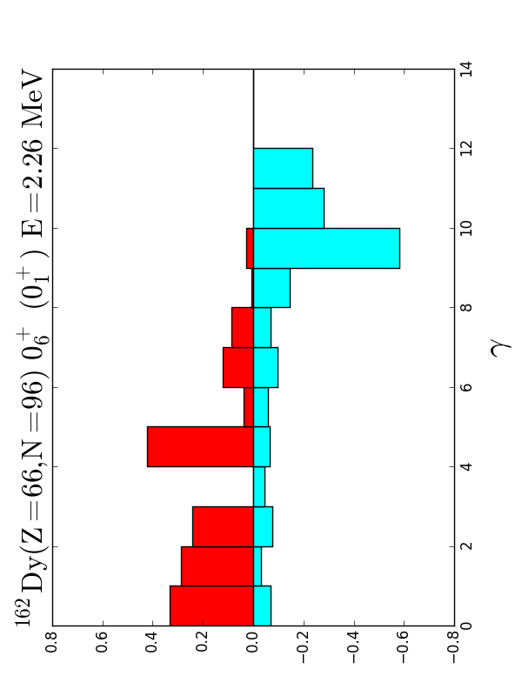
¹⁶²Dy
0⁺₆
ground state
β ₂
γ – vibrational mode
0⁺₁
0⁺₆
K=0
K=0 vib.
γ
γ

Slide 40






¹⁵⁴Sm
Level scheme
and T-plot
2nd vibrational (γ direction)
1st vibrational (β direction)
dual β shape coex
γ~13 deg
β & γ (triaxial;
shape coex;
K=0 & 2)
ground
(γ=3.7 deg)

Slide 41

Unprojected and projected energies relative to γ=0 value as a function of γ
Along the cut (β = 0.3) in the PES
HFB with good particle number
for the same Hamiltonian
lowering of K=0⁺ projected state
the triaxiality gives
more binding energy to K=0⁺
triaxiality is not
a fluctuation but a mean effect
A non-trivial feature:
The flat bottom of the unprojected
PES is one of the crucial factors for
yielding the distinct triaxial minimum
after the projections onto K=0⁺ (or 2⁺).
QVSM 1st
QVSM

Slide 42







Quantum many-body derivation of rotational excitation energy
: intrinsic state (i.e., state in the body-fixed frame) with K=0
The member of angular momentum J of a rotational band
y axis
is given by the projected state
rotation about y axis
→ the energy is given by
H
y axis
β
energy kernel
y axis
polynomial expansion:
+ …
(stops at finite power)

