Slide 1


CYCLHAD and the C400 accelerator for ion therapy and research
Gabriel Gaubert / CEO / EUNPC2025 – CAEN – 23/09/2025

Slide 2
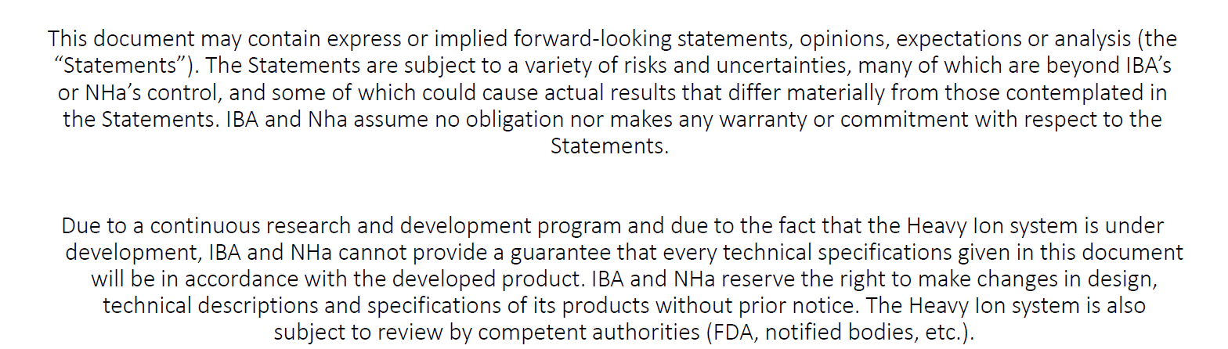
Disclaimer
PROPRIETARY INFORMATION
THE INFORMATION CONTAINED IN THIS DOCUMENT IS CONFIDENTIAL AND IS PROPERTY OF CYCLHAD SAS, IBA S.A. AND NHA. THIS IS SHARED FOR INFORMATION ONLY. THE REPRODUCTION, TRANSMISSION OR USE OF THIS INFORMATION IS FORBIDEN, UNLESS PRIOR WRITTEN PERMISSION OF CYCLHAD, IBA AND NHA IS PROVIDED.
Additional IBA / NHA disclaimer

Slide 3
Content
Talking about cancer & treatments
  Numbers & Treatments
  Radiotherapy / hadrontherapy
  Hadrontherapy worldwide
  Clinical advantages / evidence
Cyclhad Centre
  The hadrontherapy R&D ecosystem in Caen
  Facility & Staff
  Some facts
Proton therapy with the ProteusOne
  ProteusONE design
  Patient workflow and indications
  Clinical activity since 2018
Hadrontherapy with the C400 system
  SRTH : General overview
  Main features of the C400 cycloton
  The fixed beam treatment room
  Installation and timeline
  R&D facilities
Take home message

Slide 4
1. Talking about cancer and treatments

Slide 5
NUMBERS
1. Cancer and treatments
Monde*
Europe*
France**
Number of new cases /year
^{è}
483 568 including
+ 2200 children
20 millions
4.47 millions
Number of deaths /year
1st cause of death in
France
^{è}
9.74 millions
1.98 millions
190 612
* IARC – OMS 2022 **INCA 2025

Slide 6
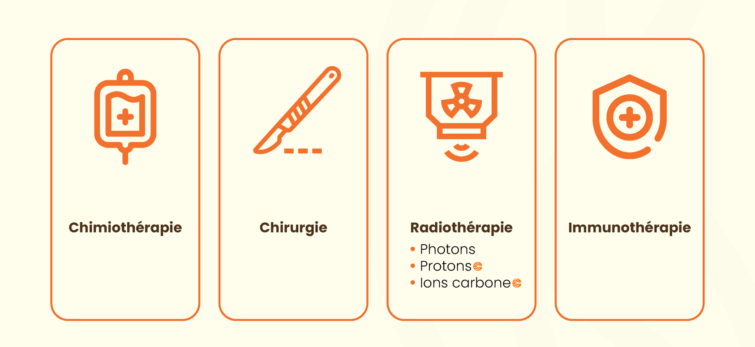
TREATMENTS
1. Cancer and treatments
Chemotherapy
Surgery
Radiotherapy
Immunotherapy
Carbon ions
40-50%
50-60%
60%
<10%

Slide 7
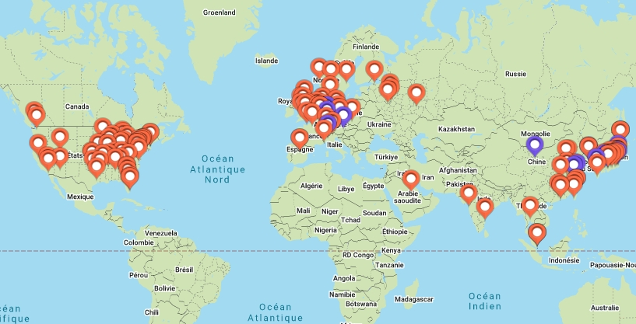
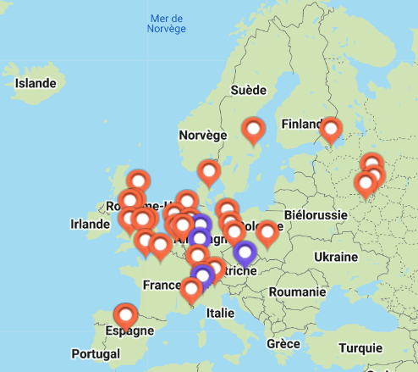
HADRONTHERAPY WORLDWIDE
1. Cancer and treatments
CONVENTIONAL RADIOTHERAPY CENTERS (Xrays)
~20,000 treatment rooms
PROTON THERAPY CENTERS
182 centres in operation or under installation ~ 400 treatment & research rooms
CARBON THERAPY CENTERS
14 multi-ions operational centres with carbon therapy + 6 under installation

Slide 8
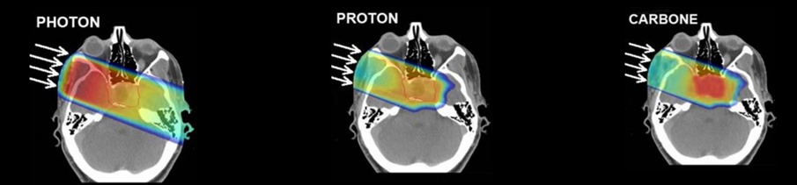
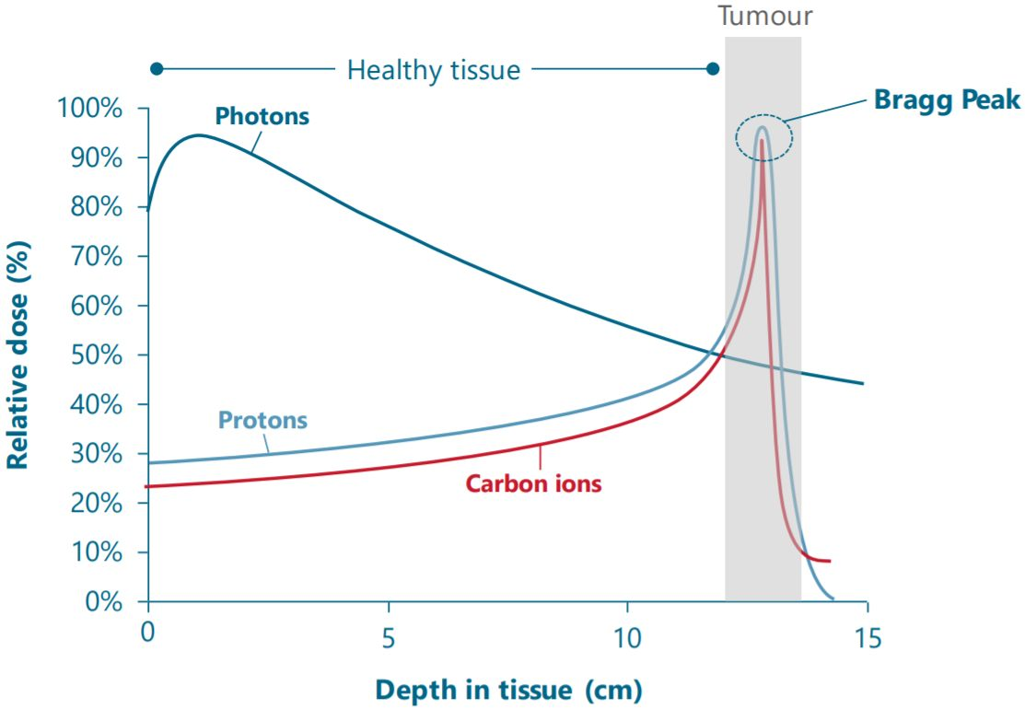
CLINICAL ADVANTAGES
1. Cancer and treatments
Proton & carbon ions:
  Dose conformity at tumour location
  Sparing of the healthy tissues and organs at risk (OAR)
  Relative Biological efficiency (RBE): x1,1 for proton - RBE x 2 to 3 for carbon
Carbon ions
  Less treatment fractions
  Hight LET for more complex DNA breaks
  Effectiveness on radioresistant and hypoxic tumours

Slide 9
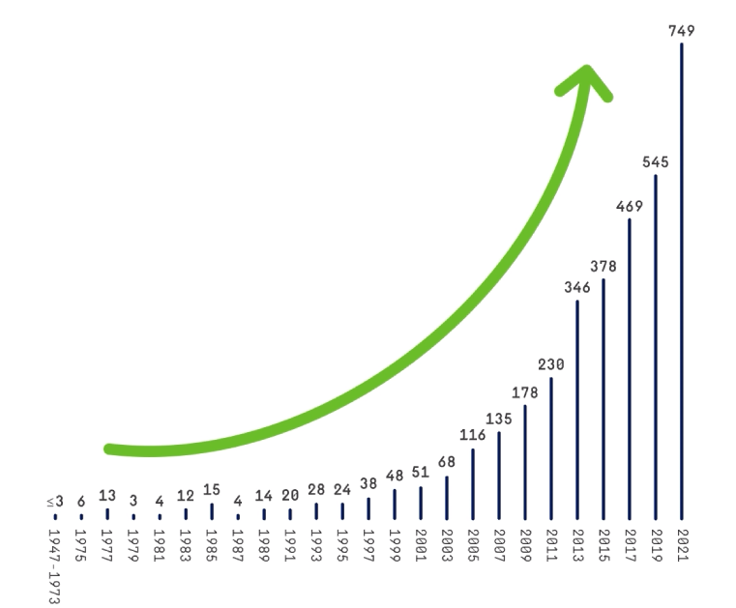
CLINICAL EVIDENCE
1. Cancer and treatments
But …
  Only 1,2% and 0,6% of all radiotherapy patients received proton therapy in US and EU respectively
  Less than 15% of paediatric patients receive proton therapy for the ASTRO- recommended indications
Number of proton therapy scientific publications worldwide

Slide 10
2. CYCLHAD Centre

Slide 11
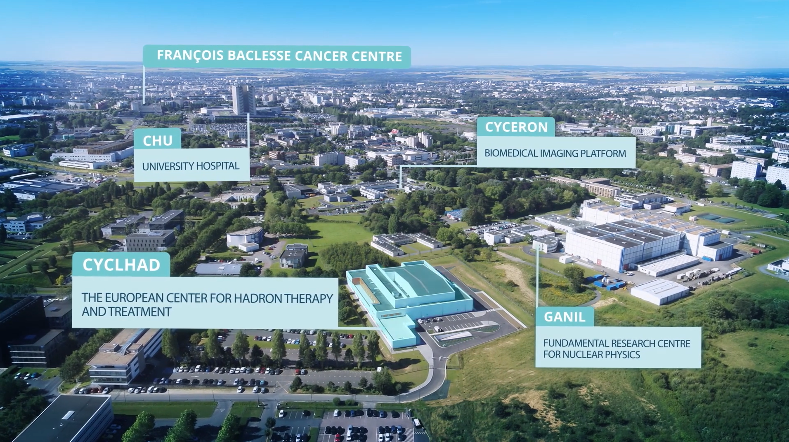











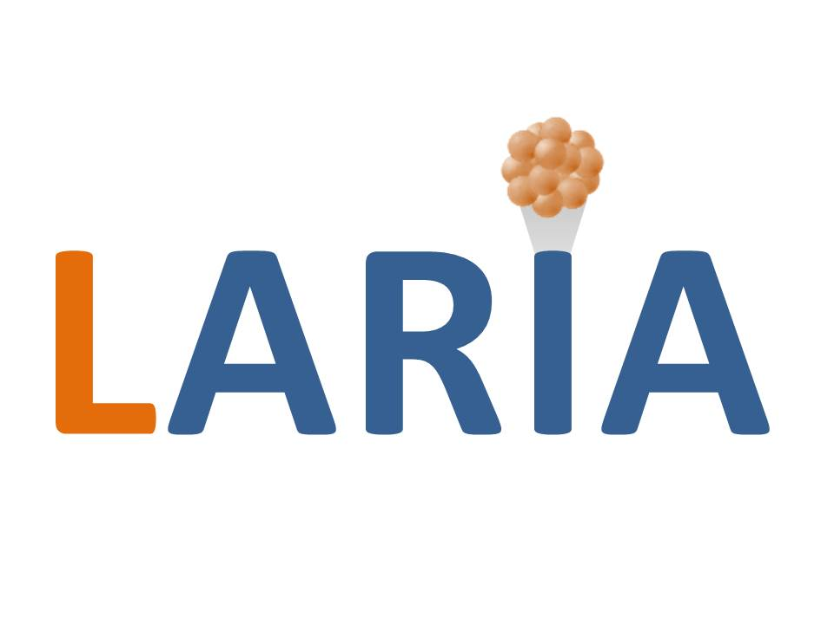


THE HADRONTHERAPY ECOSYSTEM IN CAEN
2. CYCLHAD CENTRE
CLINICAL
RESEARCH
ENSICAEN
IST₂
UNIVERSITE
RADIO-
BIOLOGY
GREYC
LPC
PHYSICS &
CHEMISTRY
LARiA
IMAGING
CIMAP

Slide 12
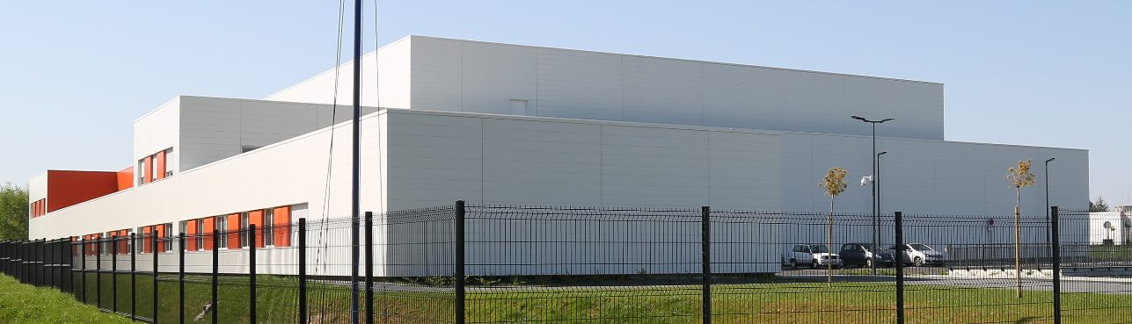
FACILITY AND STAFF
2. CYCLHAD CENTRE
EQUIPMENTS
  Protons: ProteusONE
    1 treatment room
  Multi-ions: C400 – under installation:
      1 treatment room
      1 mix room for treatment and research
      1 research and industrial application room
LABORATORIES & OFFICES
ECOSYSTEM & ENVIRONNEMENT
STAFF
CYCLHAD employees
Technical staff
      ProteuONE: IBA engineers
      C400: NHa engineers
      Building : Vinci Facilities technicians
Clinical staff
      ProteusONE: Centre François Baclesse
    Radiation oncologists, medical physicists and dosimetrist, radiotherapists, medical secretary
      C400: clinical French national model under definition

Slide 13


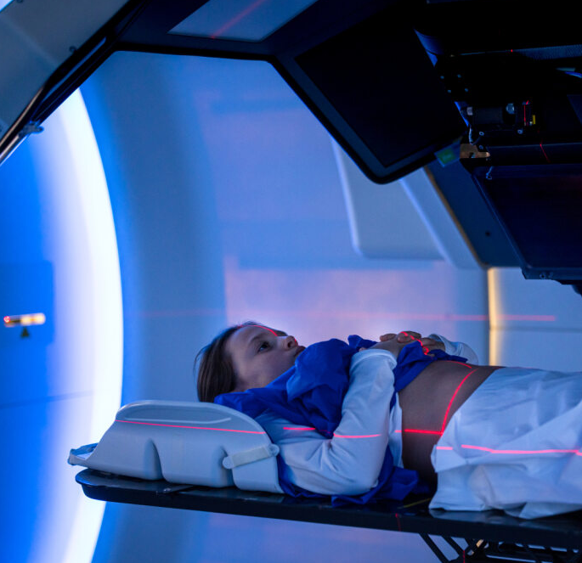
SOME FACTS…
3. CYCLHAD CENTRE
✅ 1 of 3 French protontherapie centres
✅ 1 of 20 multi-ion centers worldwide
✅ Patient workflow: TOP 1 Europe & TOP 3 World with a ProteusONE single room
✅ The unique French multi-ion hadrontherapy center
✅ Patient feedback from Google: 4.9/5 which reflect an excellent patient care at the CFB/Cyclhad partnership
✅ First multi-ion hadron therapy center equipped with a cyclotron
✅ Expertise in distraction techniques for pediatric patients and skin cancers

Slide 14
3. Proton therapy with the ProteusOne

Slide 15
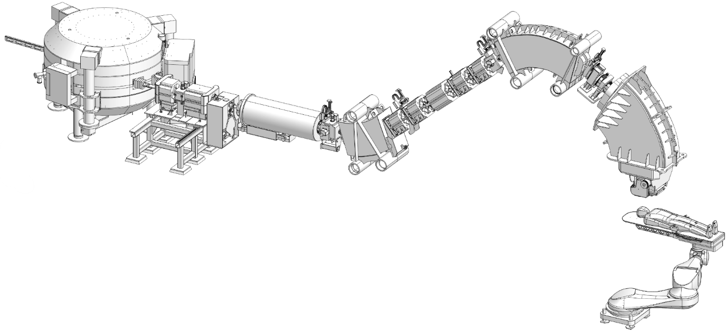
ProteusONE DESIGN
3. PROTON THERAPY WITH THE ProteusONE
S2C2 accelerator:
Super conducting Synchro-cyclotron
Energy: 230 Mev/u
Beam line tranfer
Scanning magnets (x-y)
x
y
z
Centre openning
Patient couch
52 weeks / year from Monday to Friday
2 hours / day for Quality controls
6 am – 10 pm
6 axes positioning robot
14 hours / day of clinical treat. room operation
Evening & Week-end for maintenance

Slide 16
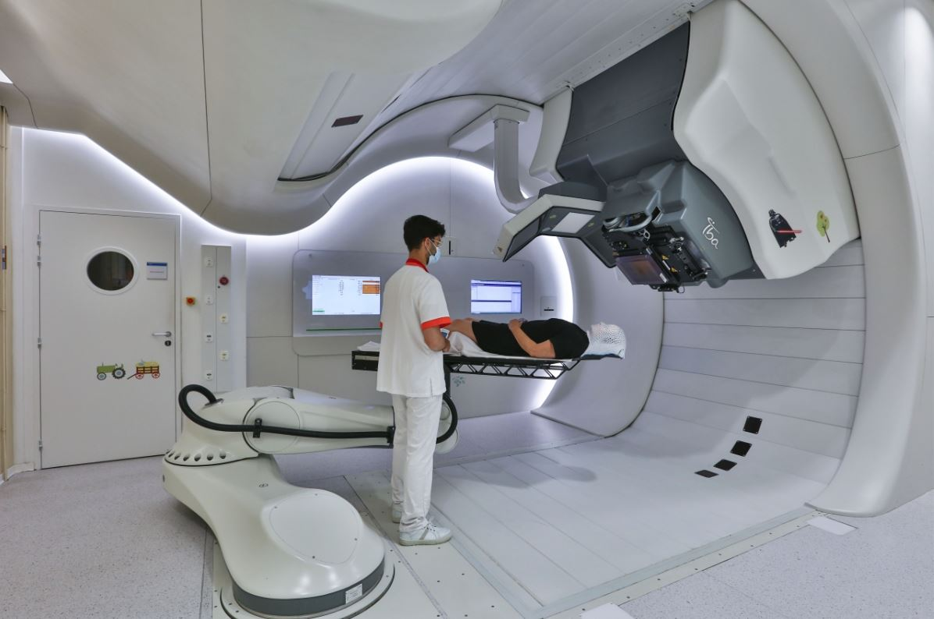
ProteusONE DESIGN
3. PROTON THERAPY WITH THE ProteusONE
270° isocentric gantry
Gantry & S2C2 access
Flat Panels
Nozzle with IC and range shifter
6D robotic couch
Stereoscopic
X-ray sources

Slide 17
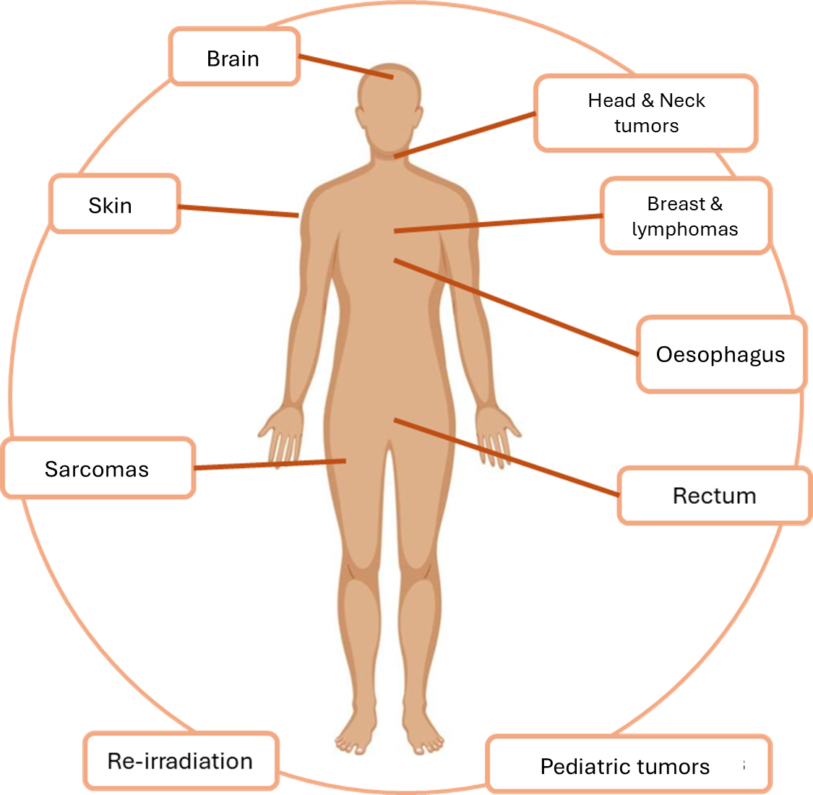
PATIENT WORKFLOW & INDICATIONS
The patient's journey and treatment indications: from the François Baclesse Center to Cyclhad
3. PROTON THERAPY WITH THE ProteusONE
Average proton therapy treatment
30 beam delivery fractions at 2 Gy within 5 weeks
25 minutes mean time per fraction
3 fractions per week for skin cancer: hypofractionation @6Gy
No anaesthesia even for children

Slide 18
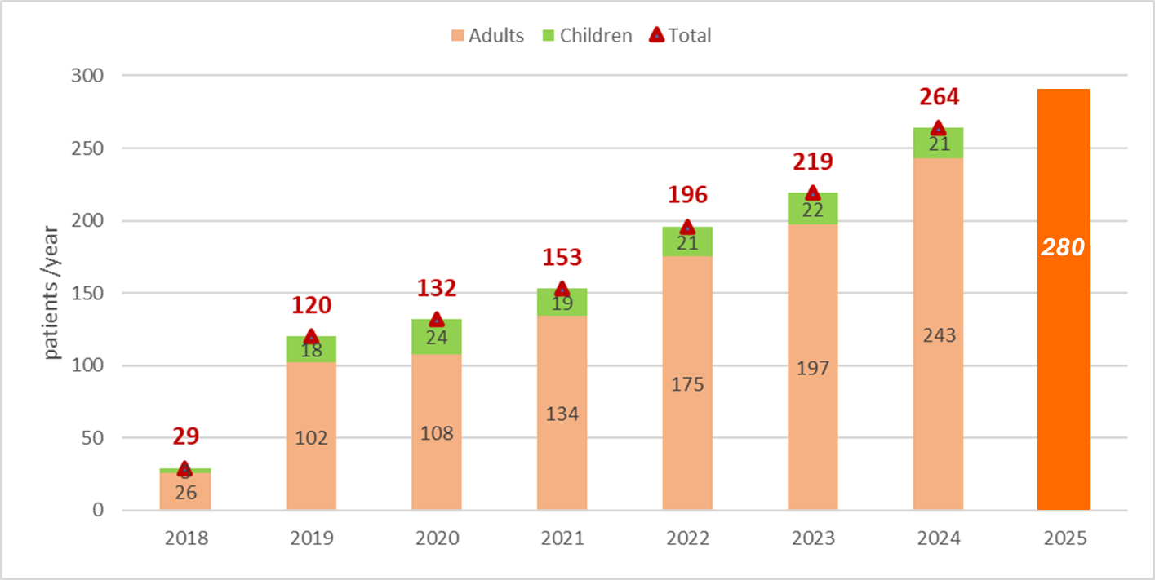
CLINICAL ACTIVITY SINCE 2018
3. PROTON THERAPY WITH THE ProteusONE
New achievements
30,000 proton fractions delivered
1,300 patient treated including
150 paediatric patients
Number of patients treated per year with proton therapy at Cyclhad
Capacity to treat up to 300+ patients per year

Slide 19
4. Multi-ion hadrontherapy with the C400 system

Slide 20
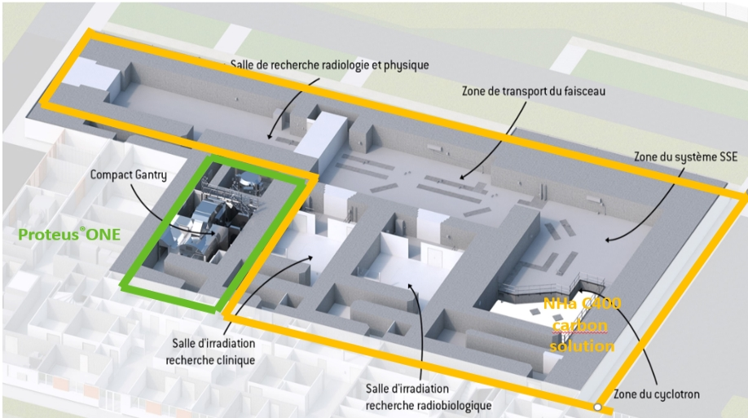

GENERAL OVERVIEW
4. HADRONTHERAPY WITH THE C400 SYSTEM
SRTH: Système de Recherche et de Traitement en Hadronthérapie
Research room
Beam line
Energy Selection
PROTEUS®ONE
Fixed beam room
Clinical research
Fixed beam room
Radiobiology research
C400

Slide 21
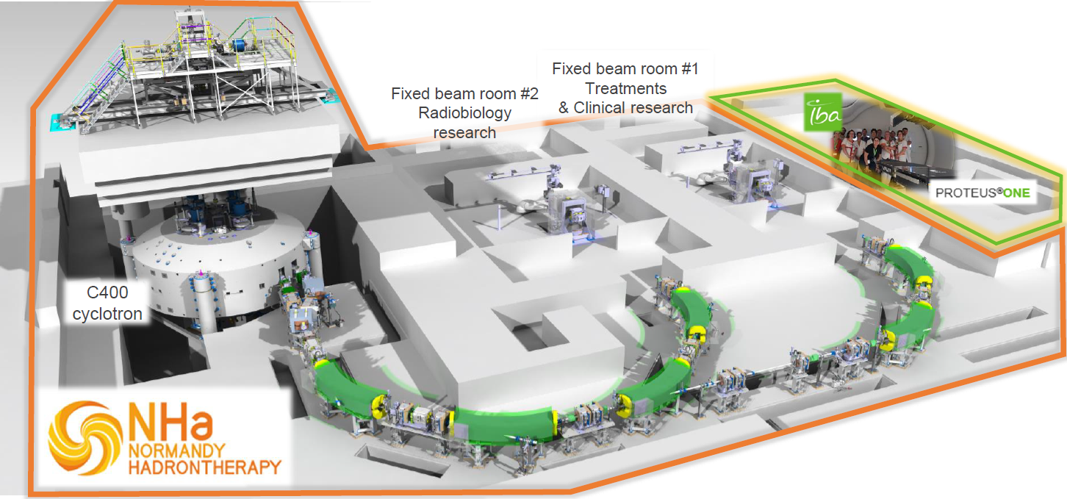
GENERAL OVERVIEW
4. HADRONTHERAPY WITH THE C400 SYSTEM
Ion sources
room
Fixed beam
room #3
Physics

Slide 22
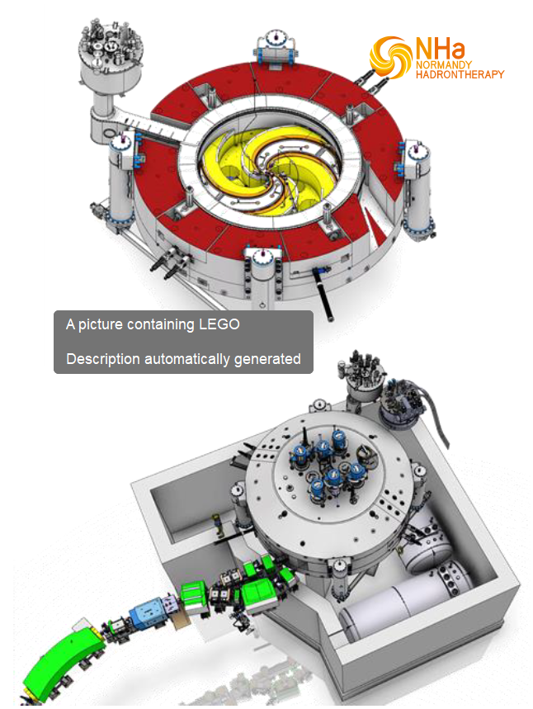
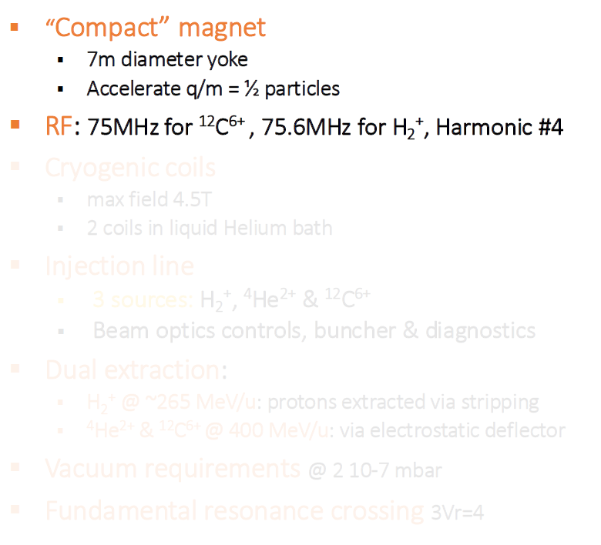
MAIN FEATURES OF THE C400 CYCLOTRON
4. HADRONTHERAPY WITH THE C400 SYSTEM
Superconducting cyclotron

Slide 23
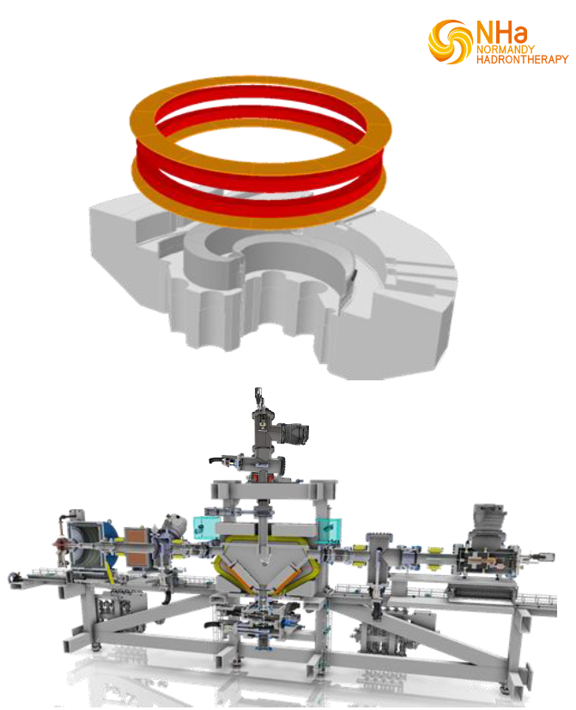
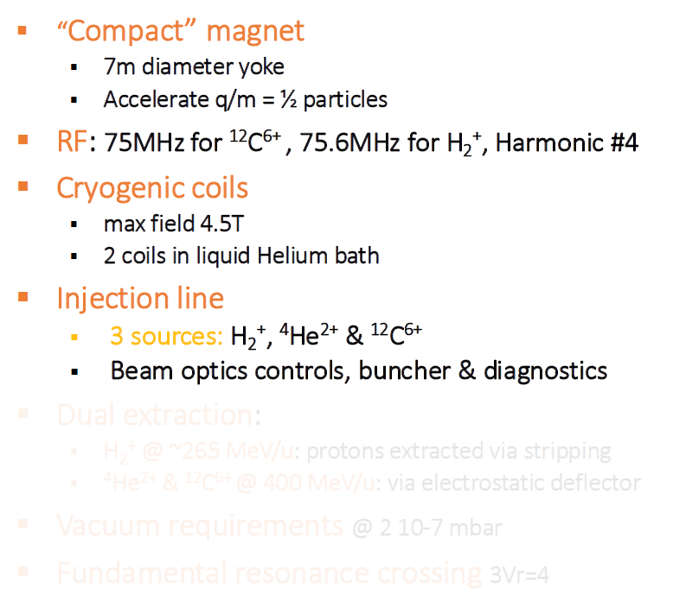
MAIN FEATURES OF THE C400 CYCLOTRON
4. HADRONTHERAPY WITH THE C400 SYSTEM
Superconducting cyclotron

Slide 24
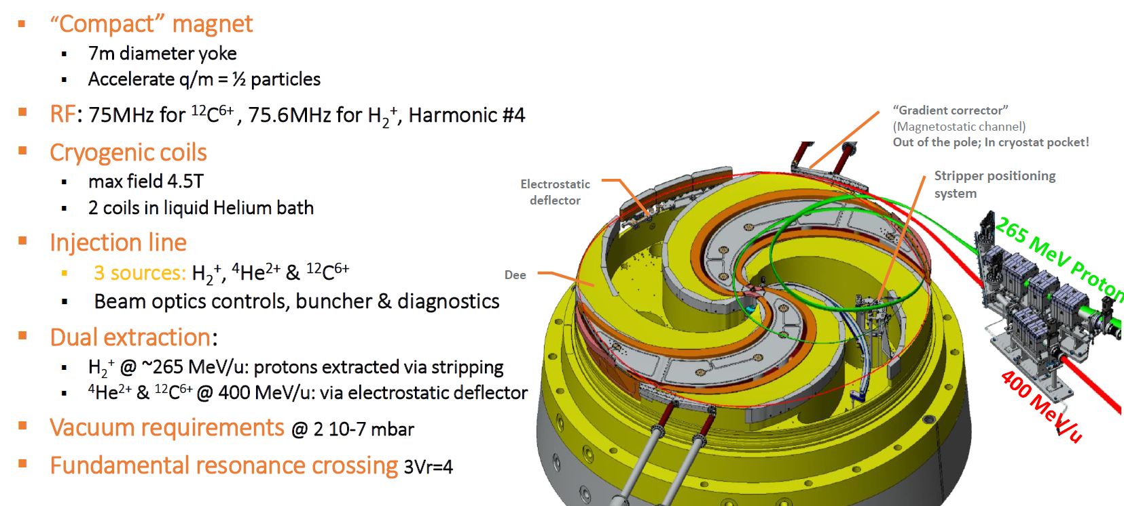
MAIN FEATURES OF THE C400 CYCLOTRON
4. HADRONTHERAPY WITH THE C400 SYSTEM
Superconducting cyclotron

Slide 25
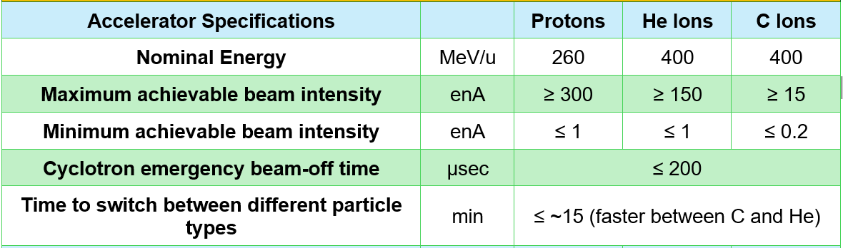
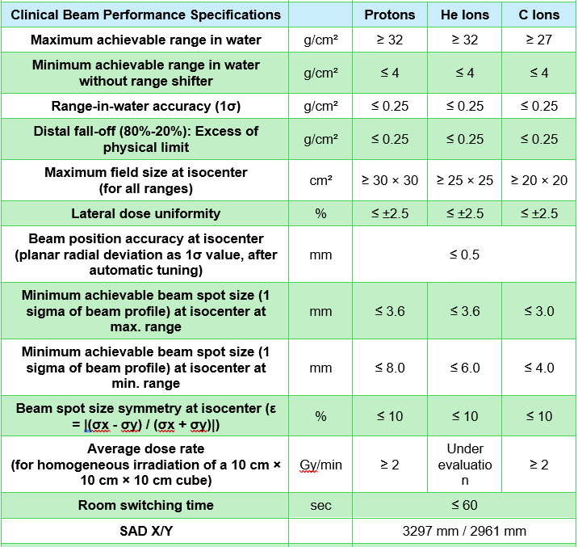
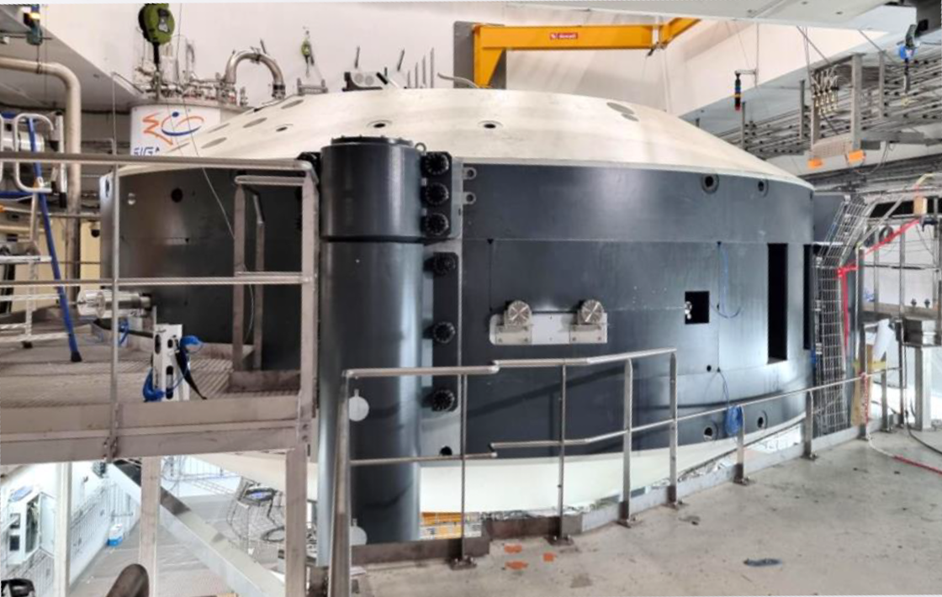
MAIN FEATURES OF THE C400 CYCLOTRON
4. HADRONTHERAPY WITH THE C400 SYSTEM

Slide 26
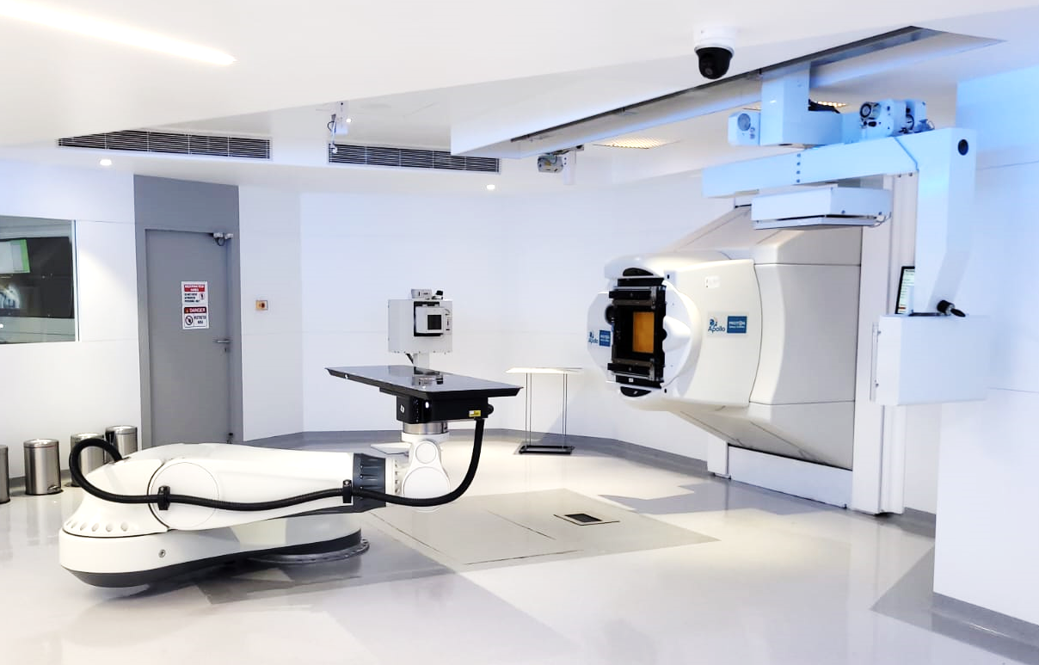
FIXED BEAM TREATMENT ROOM
4. HADRONTHERAPY WITH THE C400 SYSTEM
Horizontal fixed beamline with PBS – larger SAD
6D PPS robotic system
Couch and Chair patient positioning system
2D PPVS flat panel with 3 X-ray tubes
Alignment lasers
Nozzle bottom clearance improved for a chair
Fixed Ripple filter to reduce the number of layers
Movable accessory - Range shifter for ranges < 4cm

Slide 27
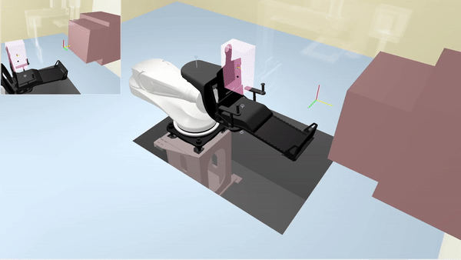
FIXED BEAM TREATMENT ROOM
Mix patient positioning system: a unique design
4. HADRONTHERAPY WITH THE C400 SYSTEM

Slide 28
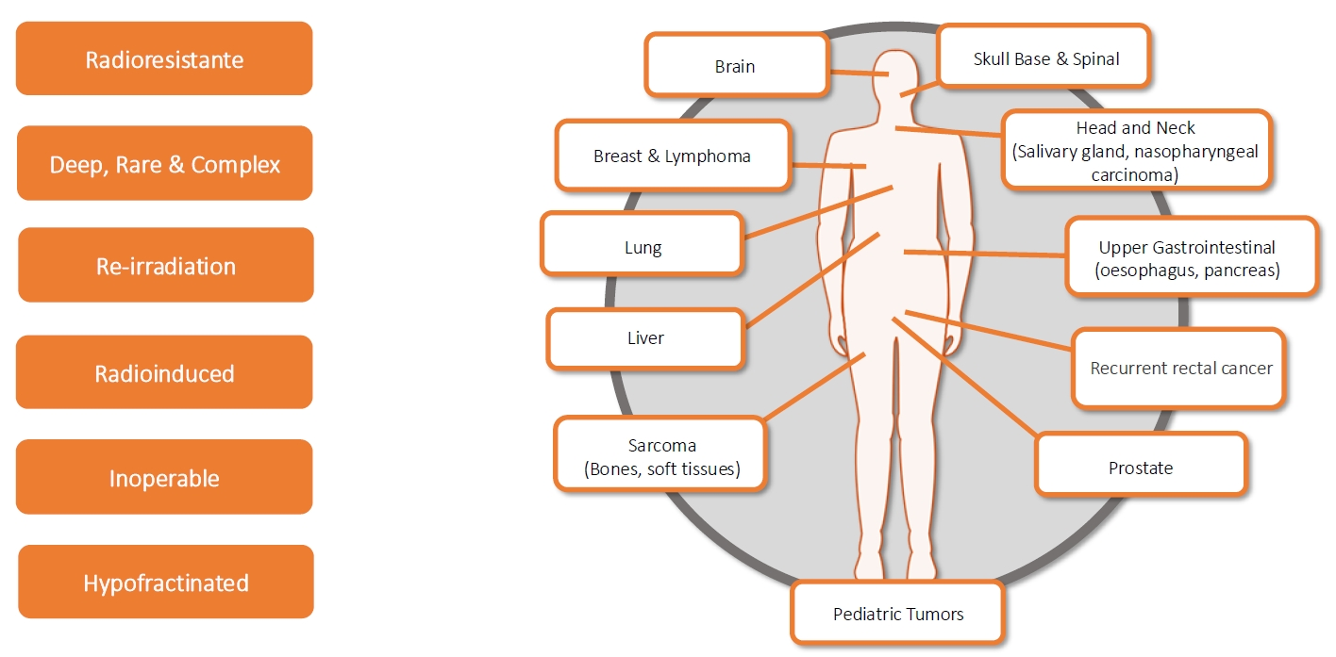
FIXED BEAM TREATMENT ROOM
Therapeutic indications with carbon ions
4. HADRONTHERAPY WITH THE C400 SYSTEM

Slide 29
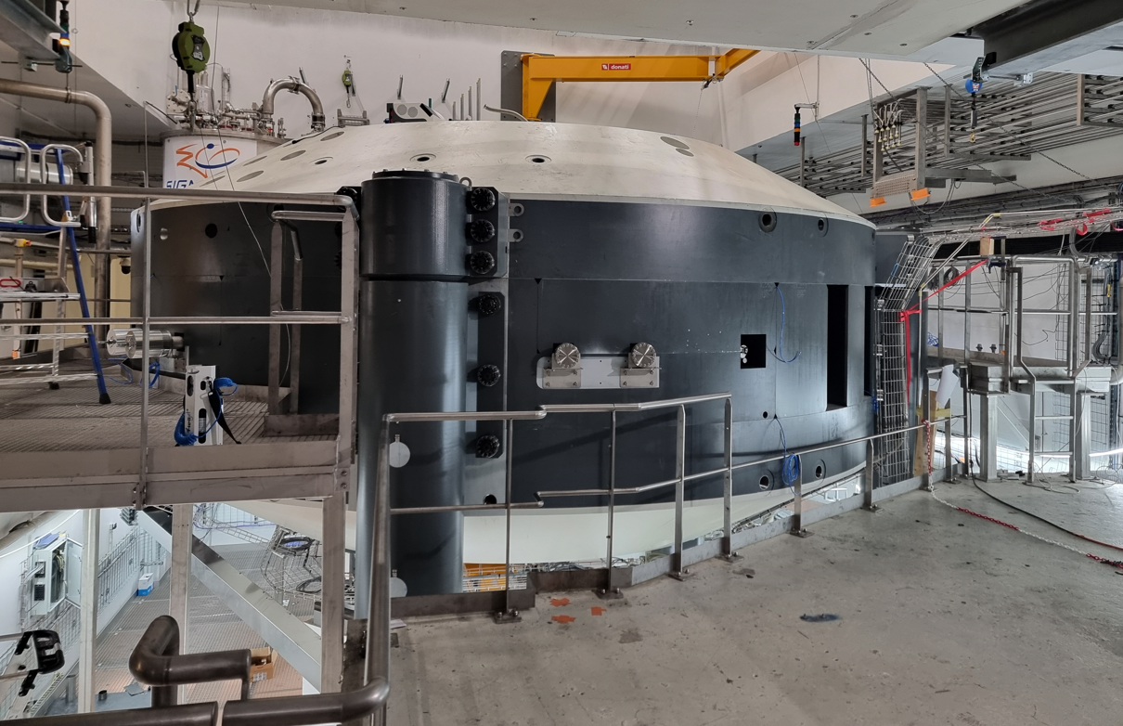
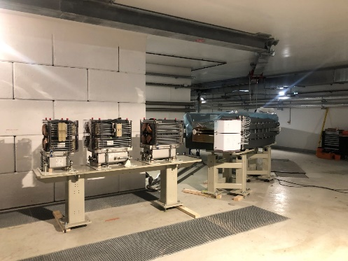
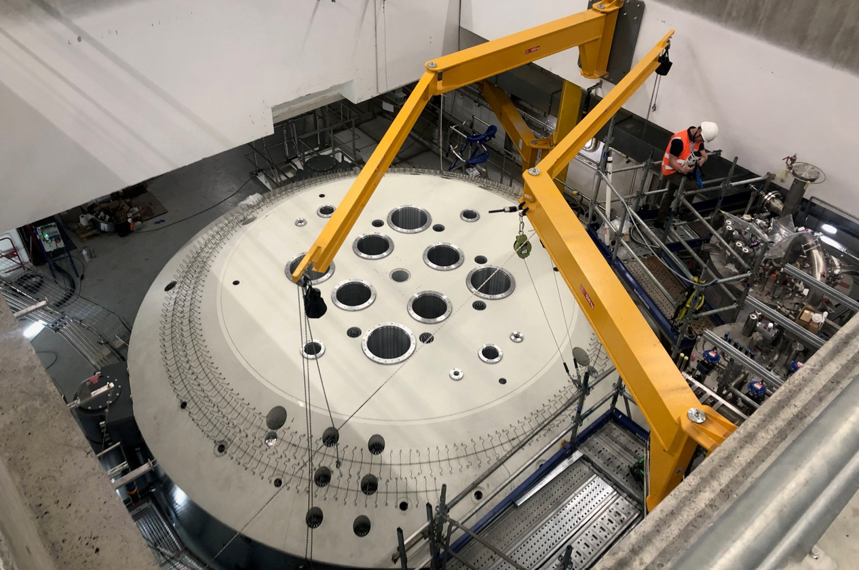
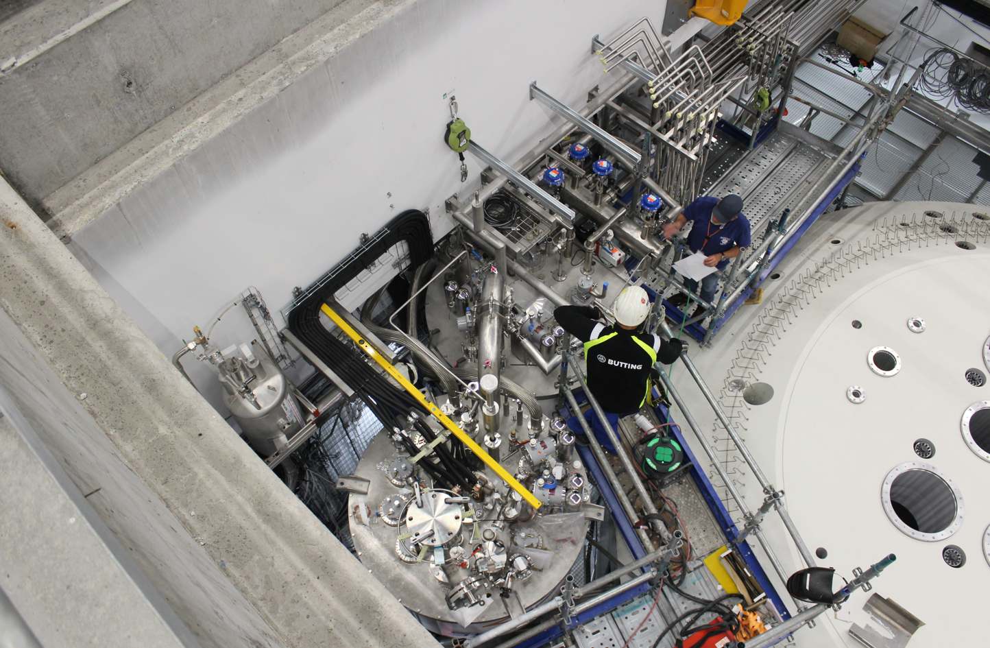
INSTALLATION AND TIMELINE
4. HADRONTHERAPY WITH THE C400 SYSTEM

Slide 30
INSTALLATION AND TIMELINE
4. HADRONTHERAPY WITH THE C400 SYSTEM
C400 Acceptance
Beam @ isocenter
C400 1st beam extraction
Design Review, Manufacturing, QRS, Team setup, …
C400 IONS Equipment installation
2022
2023
2024
2025
2026
2027
2028
Coming soon:
Cryocooling system & superconductive coil testing
Magnetic mapping
RF system commissioning

Slide 31
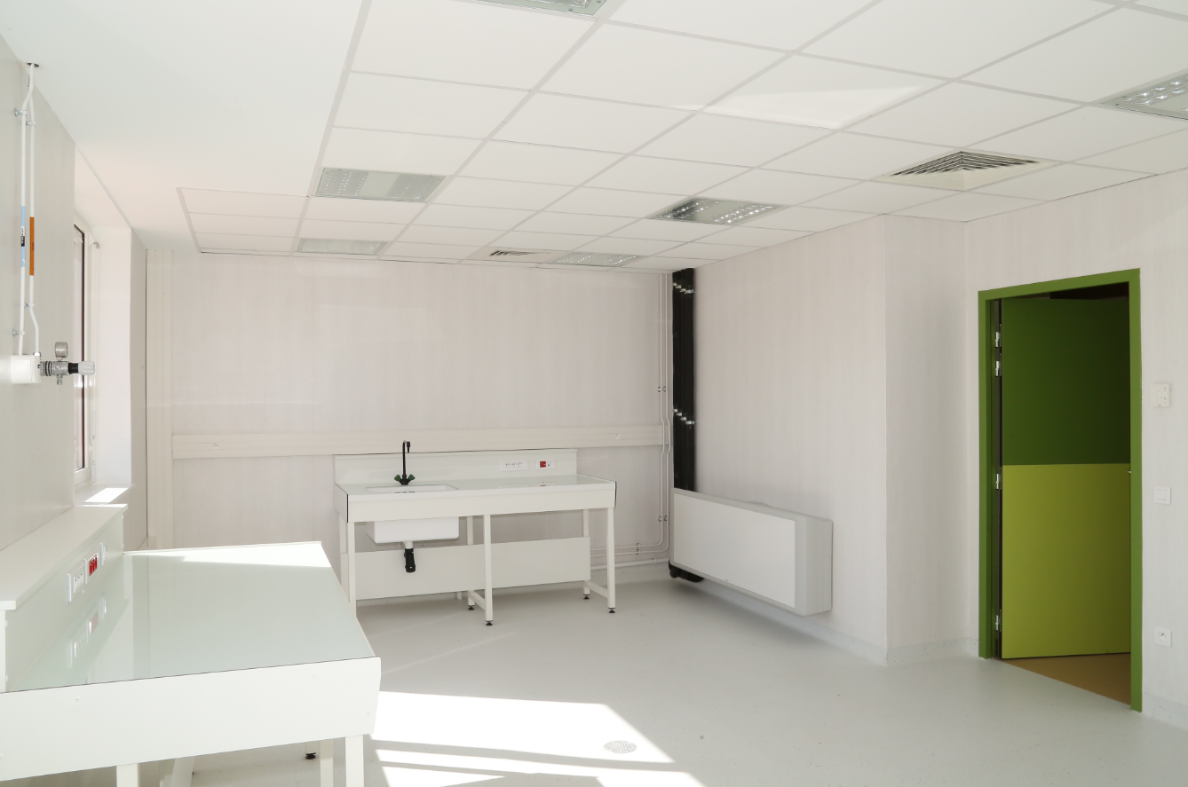
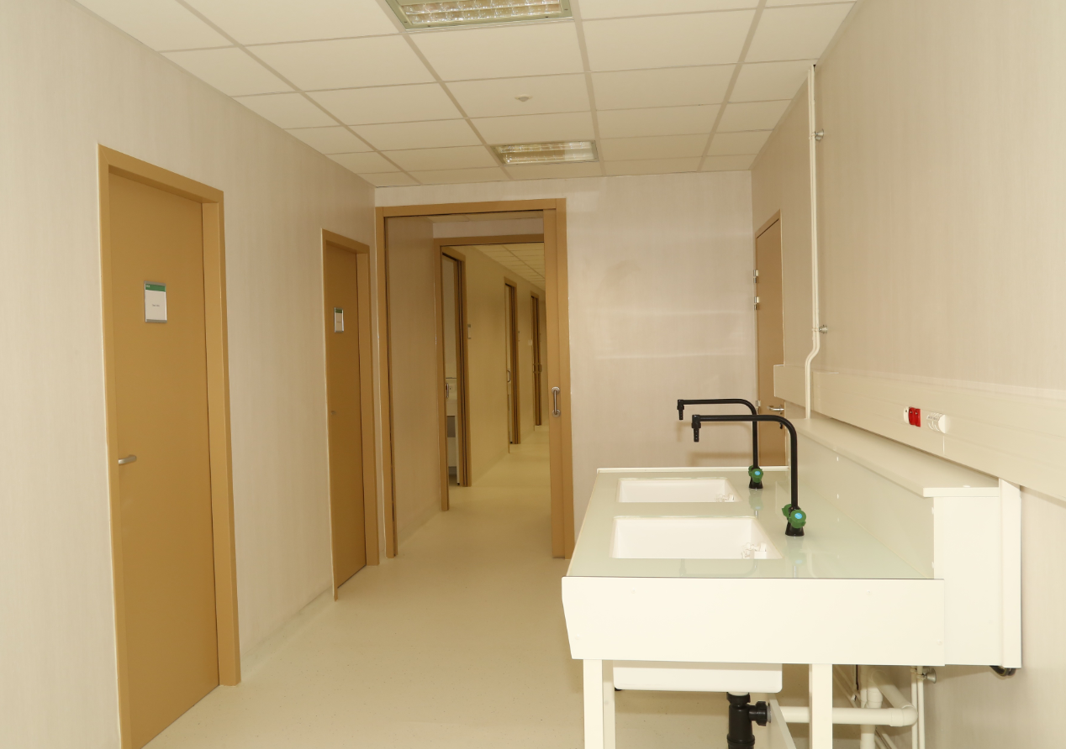
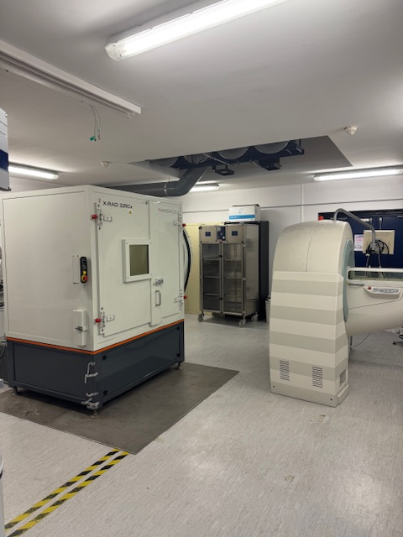
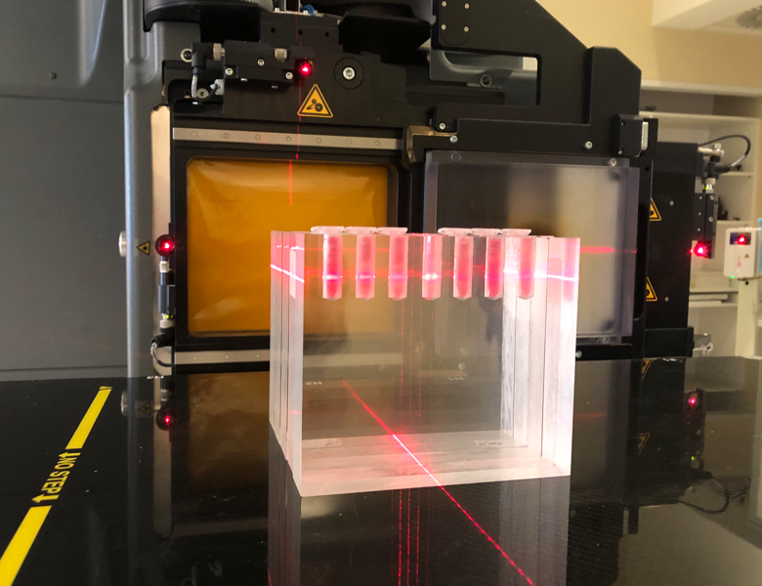
R&D FACILITIES
500 m² dedicated for radiobiology laboratories
4. HADRONTHERAPY WITH THE C400 SYSTEM
Direct access to the irradiation rooms delivering different ion species
Access to a cells & small animals Xray on site irradiator
Bio molecular and cellular labs connected to a temporary small animal room facility
Major strength: combine multi-irradiation modalities in the same centre facility avoiding external bias

Slide 32
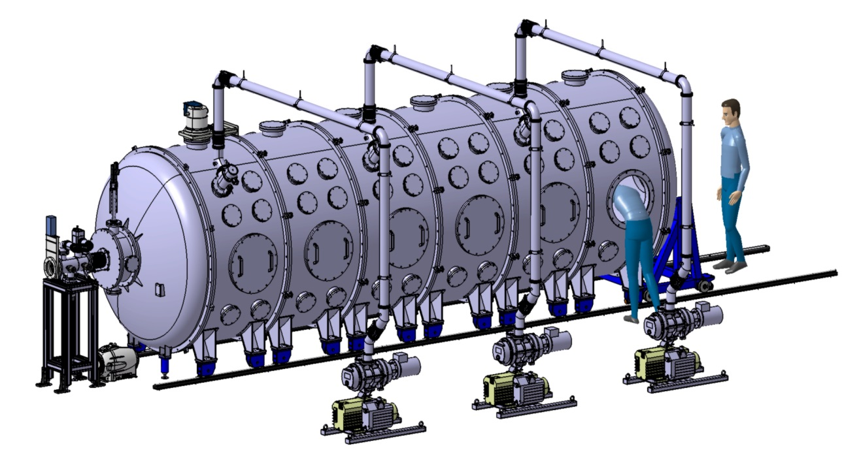
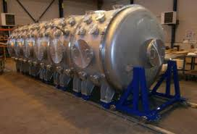
R&D FACILITIES
300 m² experimental hall for physics and industrial applications
4. HADRONTHERAPY WITH THE C400 SYSTEM
A FIXED BEAM LINE ROOM OPERATED BY A DEDICATED ENGINEERS & PHYSICISTS TEAM
Physics experiments, measurements and studies with heavy ions
Instrumentation and detectors developments
Material development and characterization
Radio pharma experiments
Radioprotection testing
Microelectronic radiation hardness testing and qualification
Major strenght: Modular research room with easy switching ion species and irradiation experimental stands

Slide 33


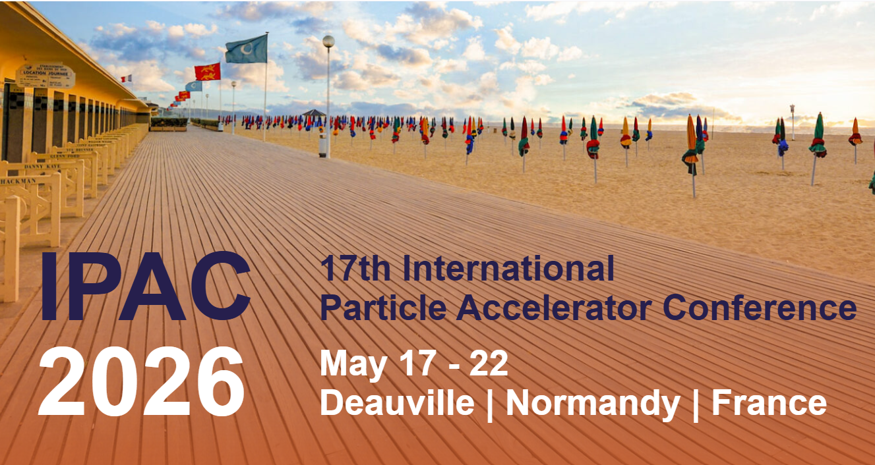
TAKE HOME MESSAGE
5. TAKE HOME MESSAGE
CYCLHAD is a multi-ion facility running since 2018 for research & treatments
The new compact C400 IONS system will be fully commissioned early 2028
Great perspectives for Clinical & Physics research

Slide 34

THANK YOU
CYCLHAD.COM

