Slide 1
Few-body structure of hypernuclei
Emiko Hiyama (Tohoku Univ./RIKEN)

Slide 2
Major goals of hypernuclear physics
To understand baryon-baryon interactions
Fundamental and important for the study
of nuclear physics
Total number of
Nucleon (N) -Nucleon (N) data: 4,000
YN and YY potential models so far proposed
(ex. Chiral, Nijmegen,
Kyoto-Niigata) have large ambiguity.
・ Total number of differential cross section
Hyperon (Y) -Nucleon (N) data: 40
・ NO YY scattering data

Slide 3
Therefore, for the study of YN and YY interactions,
the systematic investigation of the
structure of light hypernuclei is one of the important
way.
(Some YN scattering experiments have been done
and further experiment is planned at J-PARC.)
Once YN and YY interactions are determined, we can
predict interesting phenomena which cannot be imagined so far.
In addition, we could study inner part of neutron stars which
have been observed.

Slide 4
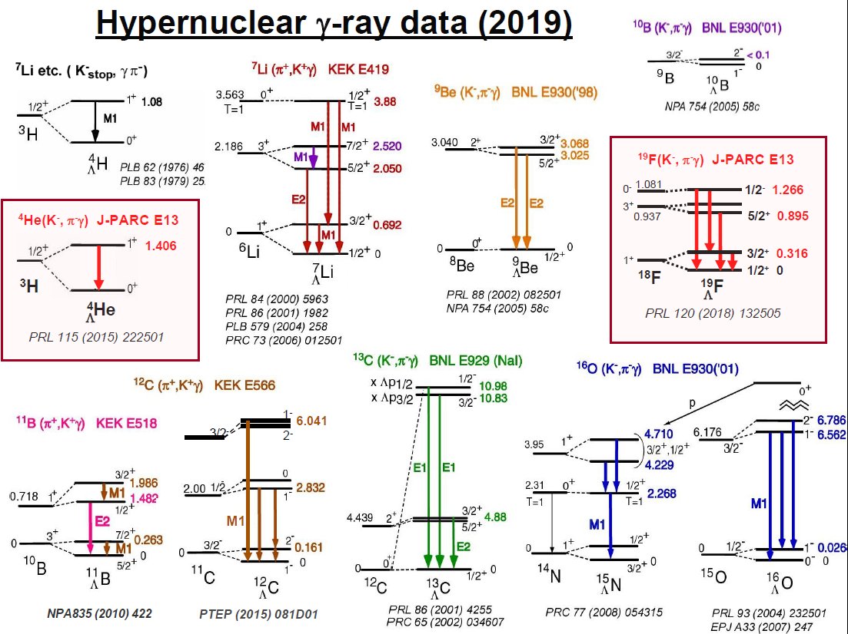
Since 1998
n
n
p
n
p
Λ
Ab-initio calculation
Shell model calculation
+
High-resolution experiments
N
Λ
We have been obtaining
information on ΛN
two-body interaction.

Slide 5
2021
Mass-Radius Relation of Neutron Stars
ΛN interaction updated by
structure study of Λ hypernuclei
+ EoS by cluster variational
calculation done by Togashi
Still, the maximum mass of
neutron star is less than twice
of solar mass.
J1614-2230: Nature 467 (2010) 1081, APJ 832 (2016) 167
J0348+0432: Science 340 (2013) 1233232
J0740+6620: Nat. Astron. (2019)
GW170817: PRL 121 (2018) 161101
Hyperon puzzle
missing part of YN interaction: ΛN-ΣN coupling
Notes:
Observationaly Suggested region

Slide 6
ΛN－ΣN coupling
S=-1
Mass is smaller.
It is expected that
Λ-Σ conversion
might affect
in structure of
Λ hypernuclei.
Σ
Non-strangeness sector
N
Δ
80 MeV
Λ
ΛN-ΣN coupling is key issue to
construct YN two-body interaction
completely.
N
N
Δ
300MeV
N
Probability of Δ in nuclei is
not large.

Slide 7
Role of the ΛN-ΣN interaction
・ Three-body effect
N₁
Λ
N₂
N₃
N₁
Λ
N₂
N₃
①
②
Σ
Σ
N₁
Λ
N₂
N₃
N₁
Λ
N₂
N₃
Effective two-body force
Three-body force
In the neutron matter or neutron star, three-body force
might play important role.
・Charge symmetry breaking effect

Slide 8
Charge Symmetry breaking
In S=0 sector
Energy difference comes from
dominantly Coulomb force
between 2 protons.
Charge symmetry breaking
(n-n,p-p) effect is small.
Exp.
N+N+N
0 MeV
- 7.72 MeV
0.76 MeV
1/2⁺
- 8.48 MeV
³He
1/2⁺
³H
n
p
p
n
n
p

Slide 9
In S= -1 sector
Exp.
0 MeV
³He+Λ
0 MeV
³H+Λ
-1.00
-1.24
1⁺
1⁺
0.24 MeV
-2.04
-2.39
0⁺
0⁺
0.35 MeV
p
n
n
n
p
Λ
p
Λ
⁴H
⁴He
Λ
Λ

Slide 10
n
p
n
n
p
Λ
p
Λ
⁴He
⁴H
Λ
Λ
However, Λ particle has no charge.
⁴He
⁴H
Λ
Λ
p
n
n
p
p
n
p
p
+
+
p
Λ
Σ-
p
Λ
Σ-
p
n
+
+
+
+
p
n
n
n
p
n
n
n
+
+
p
Σ0
Σ+
n
Σ0
n
Σ+
p
Notes:
So, charge symmetry breaking effect is considered to come from interaction between Sigma and nucleon.Then, in order to CSB effect, these Σ coupling effect should be taken into account.

Slide 11
In order to explain the energy difference, 0.35 MeV,
N
N
N
N
+
N
Λ
N
Σ
(3N+Λ）
(3N+Σ）
・E. Hiyama, M. Kamimura, T. Motoba, T. Yamada and Y. Yamamoto,
Phys. Rev. C65, 011301(R) (2001).
・A. Nogga, H. Kamada and W. Gloeckle,
Phys. Rev. Lett. 88, 172501 (2002)
・H. Nemura. Y. Akaishi and Y. Suzuki,
Phys. Rev. Lett.89, 142504 (2002).
Coulomb potentials between charged particles (p, Σ±) are included.

Slide 12
0 MeV
³He+Λ
0 MeV
³H+Λ
-1.00
-1.24
1⁺
1⁺
(Exp: 0.24 MeV)
(cal: -0.01 MeV(NSC97e))
-2.04
-2.39
0⁺
0⁺
(Exp: 0.35 MeV)
(cal. 0.07 MeV(NSC97e))
n
n
n
p
p
Λ
p
Λ
・A. Nogga, H. Kamada and W. Gloeckle,
Phys. Rev. Lett. 88, 172501 (2002)
⁴H
⁴He
Λ
Λ
・E. Hiyama, M. Kamimura, T. Motoba, T. Yamada and Y. Yamamoto,
Phys. Rev. C65, 011301(R) (2001).
・H. Nemura. Y. Akaishi and Y. Suzuki,
Phys. Rev. Lett.89, 142504 (2002).
N
N
N
N
+
N
Λ
N
Σ
Notes:
Among these calculation, Nogga and his collaborators investigated the charge symmetry breaking effect by sophisticated 4-body calculation using modern realistic YN and NN interactions. These are results using Nijmegen soft core ’97e model. The calculated energy difference in the ground state is 0.07 MeV. And this value in the excited state is -0.01 MeV. Both of energy difference in the ground state and the excited state are inconsistent with the data. At the present, there exist no YN interaction to reproduce the charge symmetry breaking effect.

Slide 13
0 MeV
³He+Λ
0 MeV
³H+Λ
-1.00
-1.24
1⁺
1⁺
(Exp: 0.24 MeV)
(cal: -0.01 MeV(NSC97e))
-2.04
-2.39
0⁺
0⁺
(Exp: 0.35 MeV)
(cal. 0.07 MeV(NSC97e))
n
n
n
p
p
Λ
p
Λ
⁴H
⁴He
Λ
Λ
There has been exist NO YN interaction to reproduce the data.

Slide 14
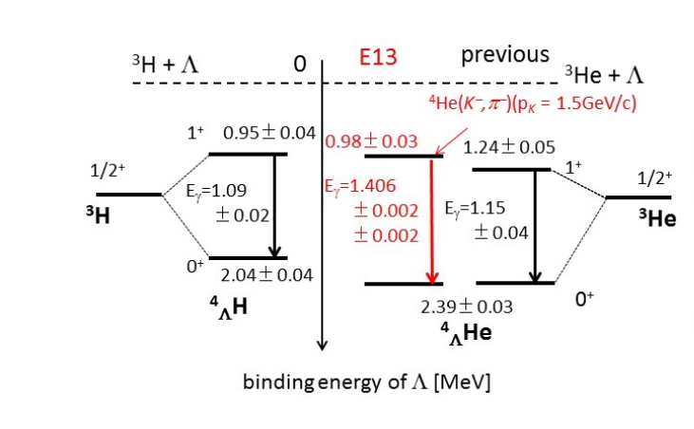
T. O. Yamamoto,
Phys. Rev. Lett.115, 2225 (2015).
Old data
New data
M. Schafer et al., PRC106, L031001(2022)
Very recent calculation by R. Lazauskas
Still difficult to reproduce the data
Still it is difficult to reproduce the data for the study
of CSB which is related to ΛN-ΣN coupling. We need more data
related to ΛN-ΣN coupling.

Slide 15
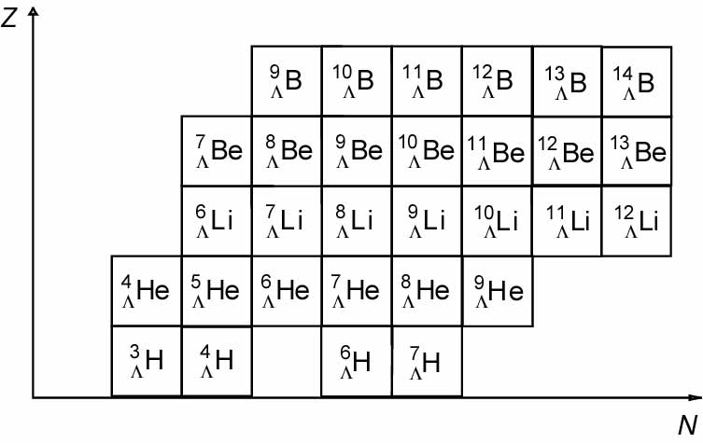
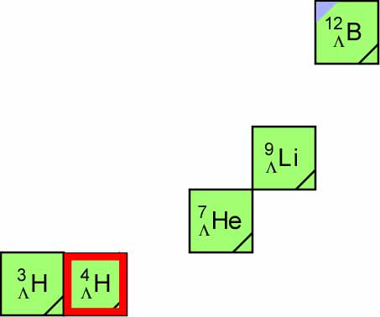
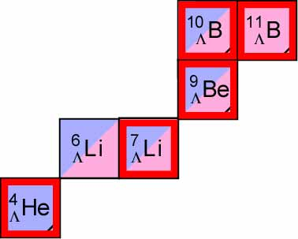
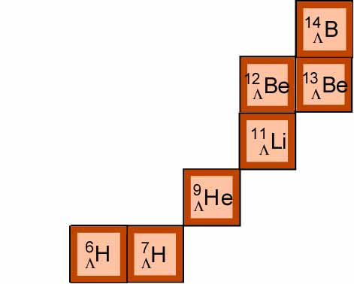
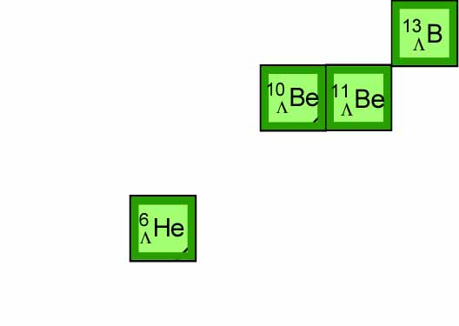

How do we obtain information on ΛN-ΣN coupling?
(1)YN scattering experiment at J-PARC
(2) To study neutron-rich Λ hypernuclei at J-PARC
difficult to obtain information on
ΛN-ΣN coupling
Total isosopin of core nuclei is small.
Z=N line
(K⁻, π⁻)
(π⁺ ,K⁺)
Total isospin is larger.
ΛN-ΣN coupling give a great contribution
to binding energies of neutron-rich Λ
hypernuclei.
⁸ B
^{Λ}
¹⁵B
⁶Be
^{Λ}
^{Λ}
⁵ Li
^{Λ}
(π⁻,K⁺)
Especially, He isotope is
important to obtain information
on ΛN-ΣN coupling, Because He
isotope Λ hypernuclei have been
observed. Among these Λ
hypernuclei, _{Λ}⁹He is planned to
produce in the future.
¹³Li
¹⁰He
¹¹He
^{Λ}
^{Λ}
^{Λ}
⁵H
⁸ H
^{Λ}
^{Λ}
These neutron-rich Λ hypernuclei are important.
Notes:
So, charge symmetry breaking effect is considered to come from interaction between Sigma and nucleon.

Slide 16
For ⁹_{Λ}He, there have been
no observed data.
To predict binding energy of
this hypernucleus, it is
necessary to reproduce the
energy spectra of core nucleus,
⁸He.
T. Myo and E. Hiyama,
Phys. Rev. C107, 054302(2023)
α+xn+Λ model
n
n
・・・
n
X=1～4
α
Λ
⁶_{Λ}He,⁷_{Λ}He,⁸_{Λ}He,⁹_{Λ}He
Cf. R. Wirth and R. Roth, Phys. Lett. B779, 336 (2019).: Non-core shell model+NN+NNN+YN
Since they did not focus on reproducing observed binding energies of hypernuclei and core nuclei,
it was difficult to predict the energy spectra of ⁹_{Λ}He.

Slide 17
Energy spectra of He Isotope core nuclei:
Λ
n
n
・・・
n
α
The theoretical results are in good agreement with data.
Let’s add a Λ particle into He isotope nuclei.

Slide 18
B_{Λ}=2.49MeV
+Λ
B_{Λ}=7.09MeV
In ⁹_{Λ}He, three bound states are predicted.
By (π⁻,K⁺) reaction at J-PARC using ⁹Be target, it is possible
to produce thise hyperucleus.
This would be observation of the
most heavy He isotope Λ hypernucleus .

Slide 19
・YN scattering experiment
proposal:J-PARC-E90
Improvement of potentials
Chiral potential etc.
・YN interaction from view point of Ab-initio calculation such as
Lattice QCD
YN interaction by HAL QCD
It will be possible to employ
the interaction.
slide by T. Doi

Slide 20
Ξ hypernuclei

Slide 21
Ξ⁻
core
nucleus
For the study of ΞN interaction, it is important to study
the structure of Ξ hypernuclei.
However, so far there was no observed Ξ hypernucleus.
Therefore, we do not know that ΞN interaction is attractive or repulsive.
If we observe Ξ hypernuclei as bound states, we understand ΞN interaction should be attractive. Thus, we have been searching bound Ξ hypernclei experimentally.

Slide 22
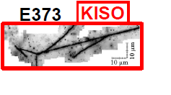
The first measurement of bound Ξ hypernucleus,
¹⁴N-Ξ.
¹⁴N-Ξ-
0 MeV
-1.03 ± 0.18 MeV
or
-3.87 ± 0.21 MeV
Ξ⁻
¹⁴N
We understood Ξ-nuclear
potential should be attractive.

Slide 23
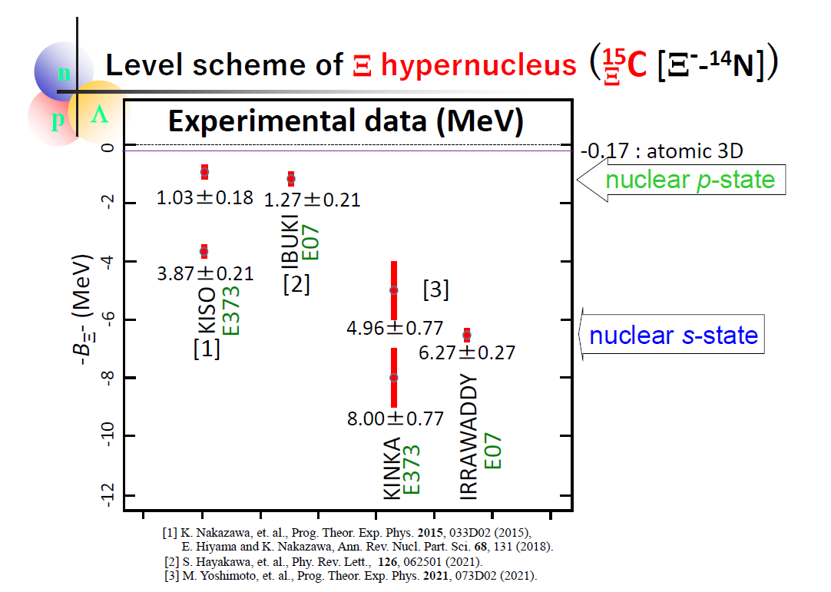
Slide by Nakazawa
After observation of Kiso event, they observed several
events of ¹⁴N-Ξ hypernucleus.
Some are observed as excited state and
some are observed as ground state.

Slide 24
Important subject in Ξ hypernuclei
ΞN interaction: T=0, S=0
T=0, S=1
T=1, S=0
T=1, S=1
Ξ
N
t=1/2
S=1/2
t=1/2
S=1/2
Four components should be attractive? Or repulsive?
To investigate it, what is best suited Ξ hypernuclei?
How do we produce Ξ hypernuclei？
Cf. NN interaction
N
N
T=0, S=0,l=odd
T=0, S=1
T=1, S=0
T=1,S=1,l=odd
strong attraction to have a bound state
as a deuteron

Slide 25
N
N
N
N
No data
Ξ
N
Ξ
These s-shell Ξ hypernuclei is suited for obtaining (T,S)=(0,0), (0,1),
(1,0) and (1,1).
To obtain (predict) the binding energies of these Ξ hypernuclei,
We should employ ‘reliable’ ΞN interaction.
We have ΞN potential models by Nijmegen group. However,
The models have a lot of ambiguity due to no ΞN scattering data and
a few data on Ξ hypernuclei.

Slide 26
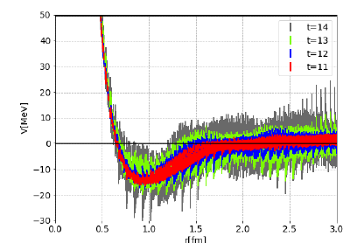
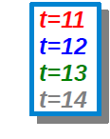
ΞN interaction by HAL QCD collaboration
ΞN potential has been proposed by K. Sasaki and T. Doi et al.

Slide 27
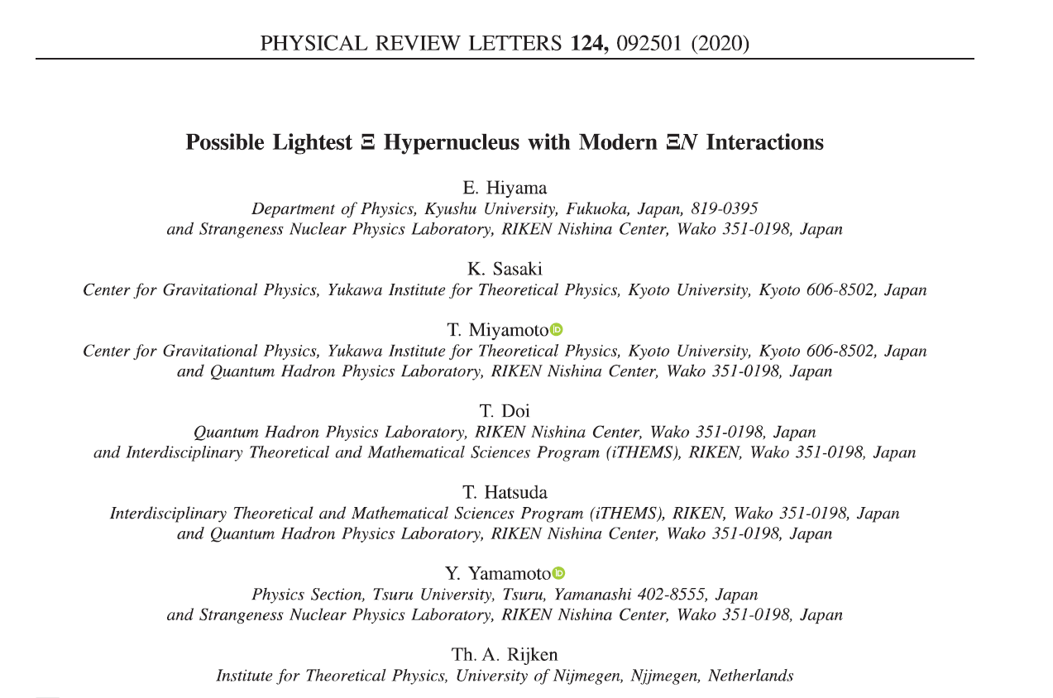
N
N
N
N
Ξ
N
Ξ
NN interaction: AV8 potential
ΞN interaction :
Nijimegen extended soft core potential (ESC08c)
ΞN interaction by HAL collaboration (Lattice QCD calculation)
The potential was made by K. Sasaki and Miyamoto.

Slide 28
Property of the spin- and isospin-components of ESC08 and HAL
V(T,S)
ESC08c
HAL
T=0, S=1 strongly attractive
T=0, S=0
T=1, S=1
T=1, S=0
Weakly attractive
weakly repulsive
Strongly attractive
strong attractive
Weakly attractive
weakly repulsive
Weakly repulsive
Although the spin- and isospin-components of these two models are very different between them.
It is interesting to see the difference in the energy spectra in s-shell Ξ hypernuclei.

Slide 29
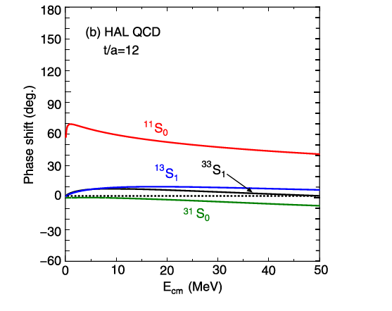
Property of the spin- and isospin-components of HAL
V(T,S)
HAL
T=0, S=1(¹³S₁)
T=0, S=0 (¹¹S₀)
T=1, S=1 (³³S₁)
T=1, S=0(³¹S₀)
Weakly attractive
Strongly attractive
Weakly attractive
Weakly repulsive

Slide 30
To investigate bound state of ΞN system, it might be
possible to perform the following experiment:
n
n
T=1, S=0 or S=1
K⁻
K⁺
p
Ξ⁻
It would be difficult to obtain information on ΞN interaction (T=1,S=0 or 1).
Because, there might be no bound state for this system.

Slide 31
To obtain ΞN two-body interaction,
the suited systems to study are s-shell Ξ hypernuclei such as
NNΞ and NNNΞ systems.
E. Hiyama et al., PRL124, 092501 (2020)
N
N
N
N
Ξ
Ξ
N
I show my results of these light systems.
NN interaction: AV8 potential
ΞN interaction :
Nijimegen extended soft core potential (ESC08c)
Realistic potential (only ΞN channel)
ΞN interaction by HAL collaboration (Lattice QCD calculation)
The potential was made by K. Sasaki, Miyamoto, Hatsuda
and Aoki.

Slide 32
N
N
T=1/2, J=1/2⁺ and J=3/2⁺
Ξ
ESC08c
Unbound
0 MeV
d+ Ξ
d+ Ξ
0 MeV
-2.57 MeV
J=3/2⁺
However, I also have two bound states in three-body system.

Slide 33
N
T=1/2, J=1/2⁺ and J=3/2⁺
N
Ξ
HAL potential
0 MeV
d+ Ξ
0 MeV
d+ Ξ
No bound state
J=3/2⁺
J=1/2+

Slide 34
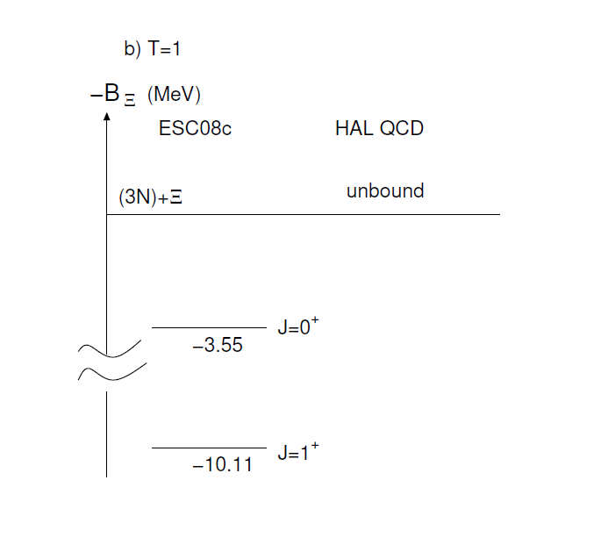
N
N
N
Ξ

Slide 35
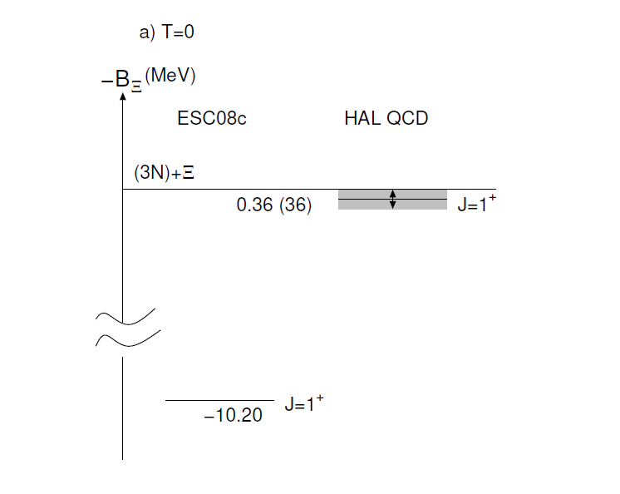
N
N
N
Ξ
H.Le et al., EPJA57, 339 (2021).
NNNΞ

Slide 36
K ⁺
T=1/2
^{K-}
Using ³He and ⁴He target,
It might be possible
to produce NNΞ and NNNΞ
systems by (K⁻,K⁺) reaction.
Another tool is to use
Heavy ion collision.
n
p
n
p
p
Ξ-
³He
K ⁺
K ⁻
In the future,
we hope to observe
these light Ξ hypernuclei.
n
n
p
p
n
Ξ
n
p
⁴He
T=1

Slide 37
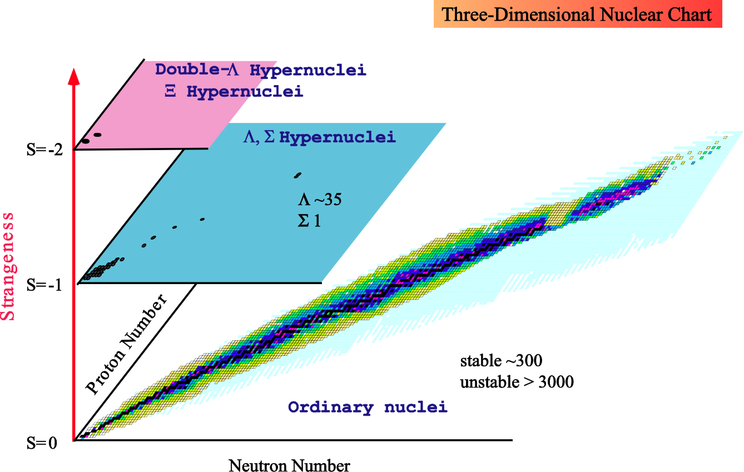
Concluding remark
Multi-strangeness system
such as Neutron star
J-PARC
ALLICE
GSI
JLab
J-PARC

Slide 38
Thank you

Slide 39
S=-2 hypernuclei
and
YY interaction

Slide 40
What is the structure when one or more Λs are
added to a nucleus?
Λ
+
Λ
+
Λ
+
Λ
+ ・・・・
Λ
nucleus
It is conjectured that extreme limit, which includes
many Λs in nuclear matter, is the core of a neutron star.
In this meaning, the sector of S=-2 nuclei ,
double Λ hypernuclei and Ξ hypernuclei is
just the entrance to the multi-strangeness world.
However, we have hardly any knowledge of the YY interaction
because there exist no YY scattering data.
Then, in order to understand the YY interaction, it is crucial to
study the structure of double Λ hypernuclei and Ξ hypernuclei.

Slide 41
Before 2000
Only three double Λ hypernuclei
Λ
Λ
Λ
Λ
Λ
Λ
⁸Be
¹¹B
α
¹³B
¹⁰Be
ΛΛ
ΛΛ
⁶He
ΛΛ
ΛΛ
Ambiguity for identifying these double Λ hypernuclei
There was NO observed double Λ hypernuclei
without ambiguity.

Slide 42
In 2001, the epoch-making data has been reported by the
KEK-E373 experiment.
Observation of ⁶He
ΛΛ
Uniquely identified without ambiguity
for the first time
α+Λ+Λ
Λ
Λ
６．９1±0.16 MeV
α
0⁺

Slide 43
Strategy of how to determine YY interaction from the study of light hypernuclear structure
YY interaction
Nijmegen model D
①
use
③
Suggest reducing the strength of
spin-independent force by half
⁶He
ΛΛ
Accurate structure calculation
Λ
Λ
α
②
compare between the theoretical result
and the experimental data of the biding
energy of ⁶He
prediction of new
double Λ hypernuclei
④
ΛΛ
Spectroscopic experiments
Emulsion experiment (KEK-E373)
by Nakazawa and his collaborators

Slide 44
Approved proposal at J-PARC
・E07
“Systematic Study of double strangness systems at J-PARC”
by Nakazawa and his collaborators(done in 2018)
It is difficult to determine
(1) spin-parity
(2) whether the observed state is
the ground state or an excited state
My theoretical contribution
using few-body calculation
comparison
Emulsion experiment
Theoretical calculation
input: ΛΛ interaction to reproduce
the observed binding energy of ⁶He
ΛΛ
the identification of the state

Slide 45
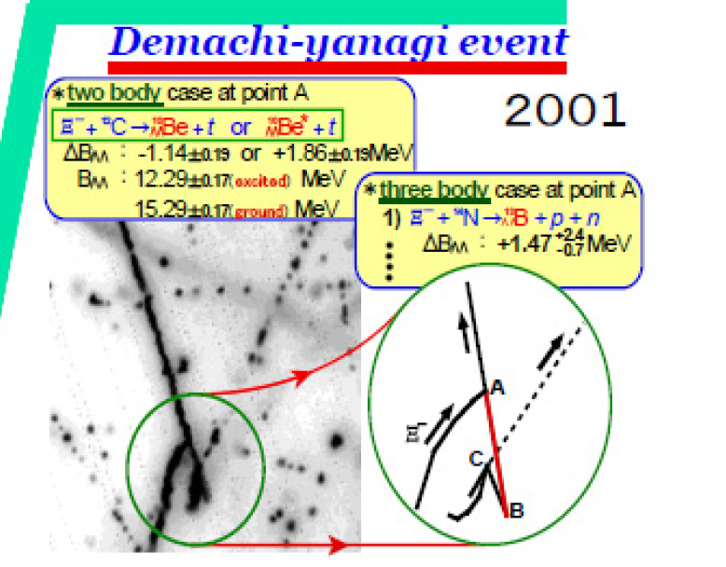
Successful example to determine spin-parity of
double Λ hypernucleus --- Demachi-Yanagi event for ¹⁰Be
ΛΛ
Observation of ¹⁰Be
--- KEK-E373 experiment
ΛΛ
Λ
Λ
⁸Be+Λ+Λ
α
α
11.90±0.13 MeV
¹⁰Be
ground state ?
excited state ?
ΛΛ
¹⁰Be
ΛΛ
Demachi-Yanagi event

Slide 46
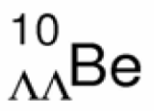
Successful interpretation of spin-parity of
Λ
Λ
α
α
E. Hiyama, M. Kamimura,T.Motoba, T. Yamada and Y. Yamamoto
Phys. Rev. 66 (2002) , 024007
11.83
11.90
α+Λ+Λ
6.91 ±0.16 MeV
Λ
Λ
Demachi-Yanagi
event
-14.70
α

Slide 47
Spectroscopy of ΛΛ-hypernuclei
E. Hiyama, M. Kamimura,T.Motoba, T. Yamada and Y. Yamamoto
Phys. Rev. 66 (2002) , 024007
New data:
-20.64 MeV
I have been looking forward to having
new data in this mass-number region.
H. Ekawa et al.
PTEP 2019, 021D02
(2019)

