Slide 1




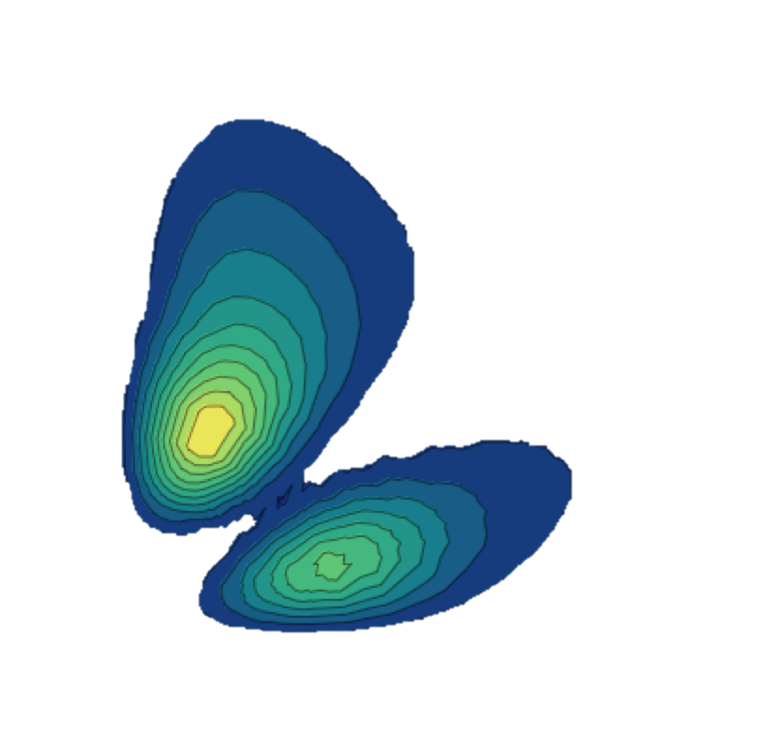





Ab initio framework for nuclear fusion reactions
Guillaume Hupin, CNRS IJClab
Collaborators
S. Quaglioni (LLNL)
K. Kravvaris (LLNL)
P. Navratil (TRIUMF)
M. Aliotta (UoE)
and many other distinguished colleagues!
Notes:
Good morning, my name is Guillaume Hupin. I am both a nuclear structure and reaction theoretician. Those two facets are necessary to describe exotic nuclei which lie close in energy to the reaction threshold. I seek to come to an understanding of nuclei starting from first principle that is starting from the underlying theory of QCD.

Slide 2
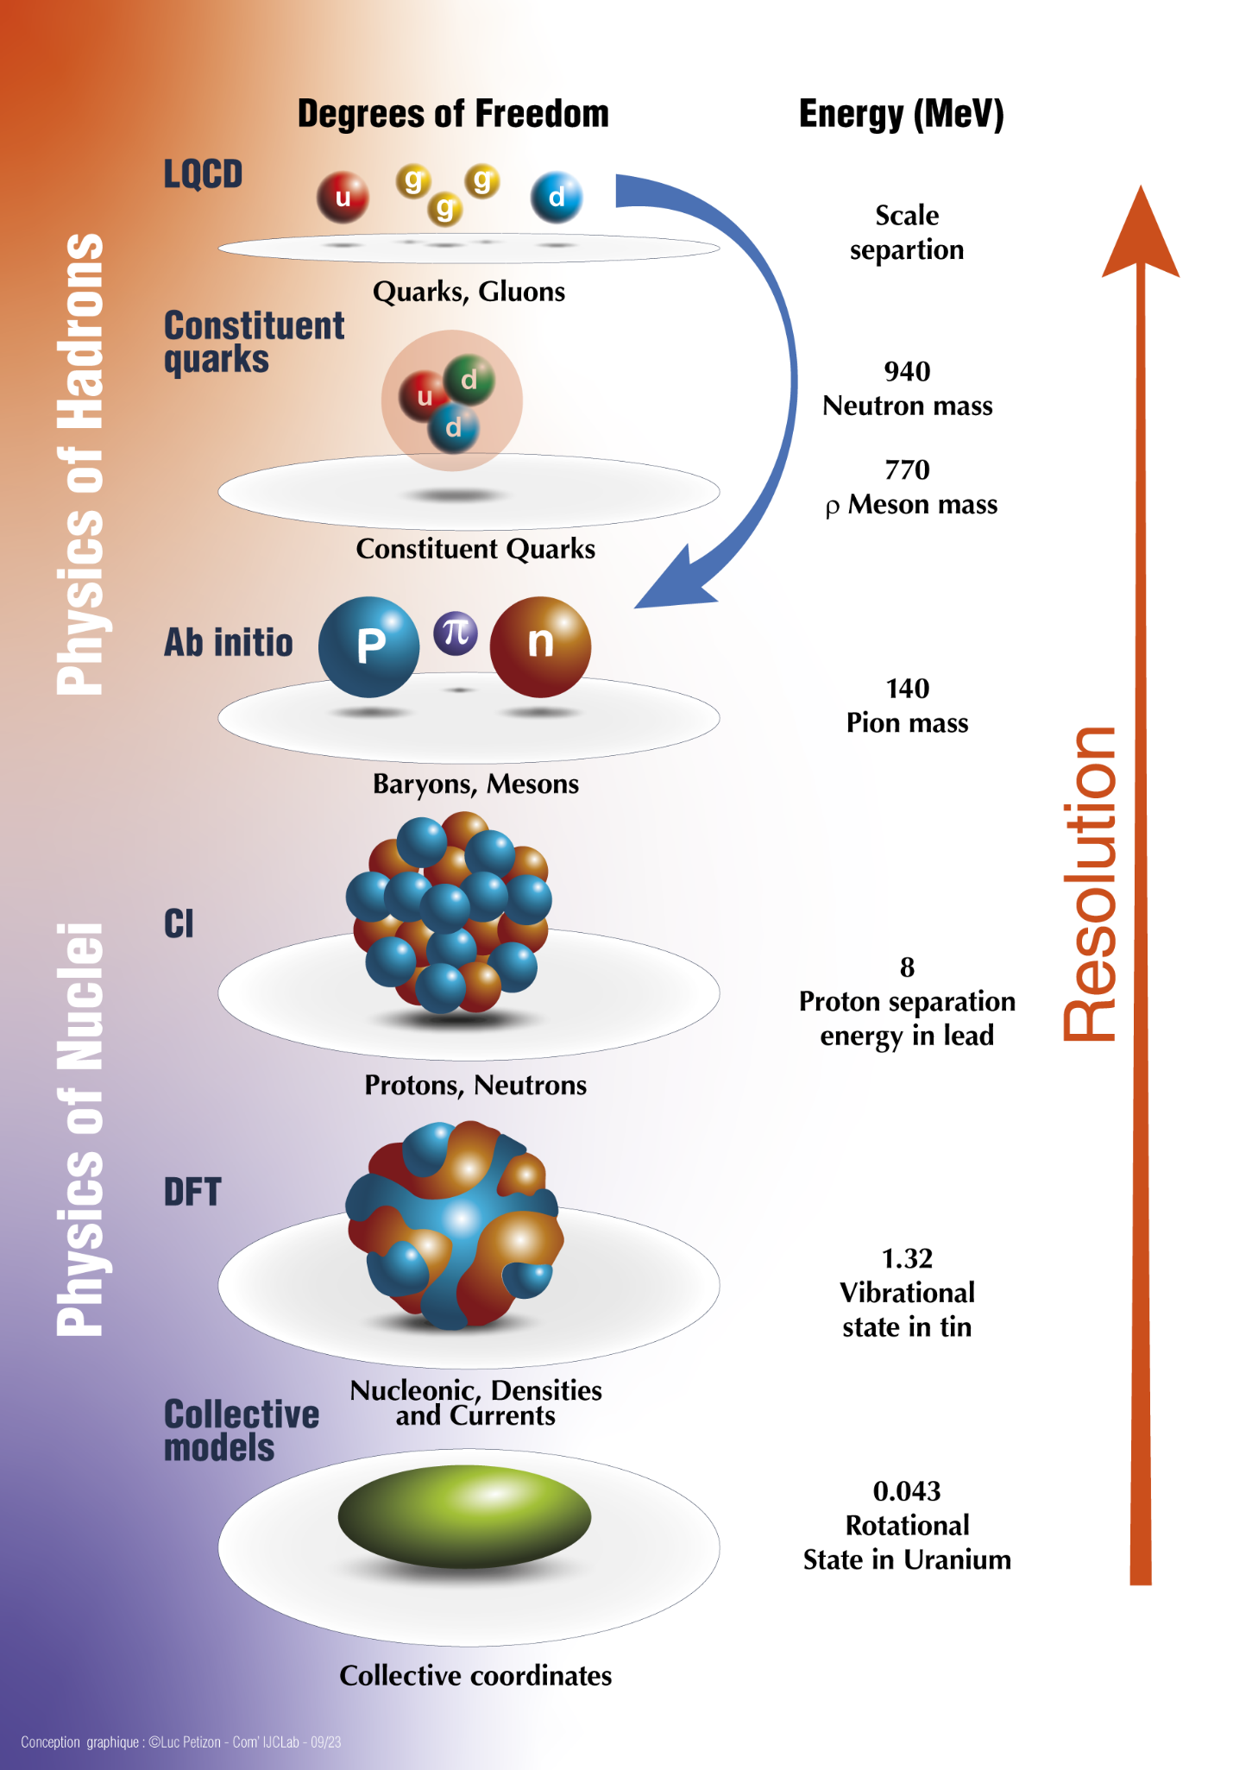
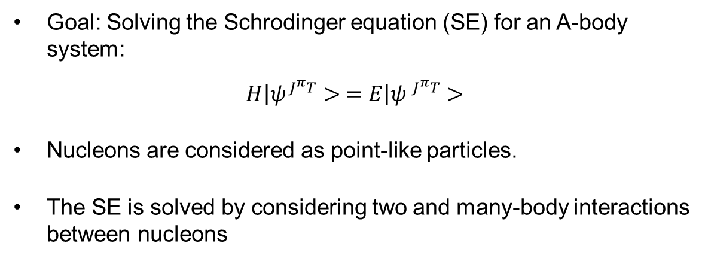




A story of multiple scale
Goal: Solving the Schrodinger equation (SE) for an A-body system:
$$\left.H\right|ψ^{J^{π}T}> =\left.E\right|ψ^{{ J}^{π}T}>$$
Nucleons are considered as point-like particles.
The SE is solved by considering two and many-body interactions between nucleons
$$V_{13}$$
$$V_{123}$$
$$V_{12}$$
$$V_{23}$$

Slide 3
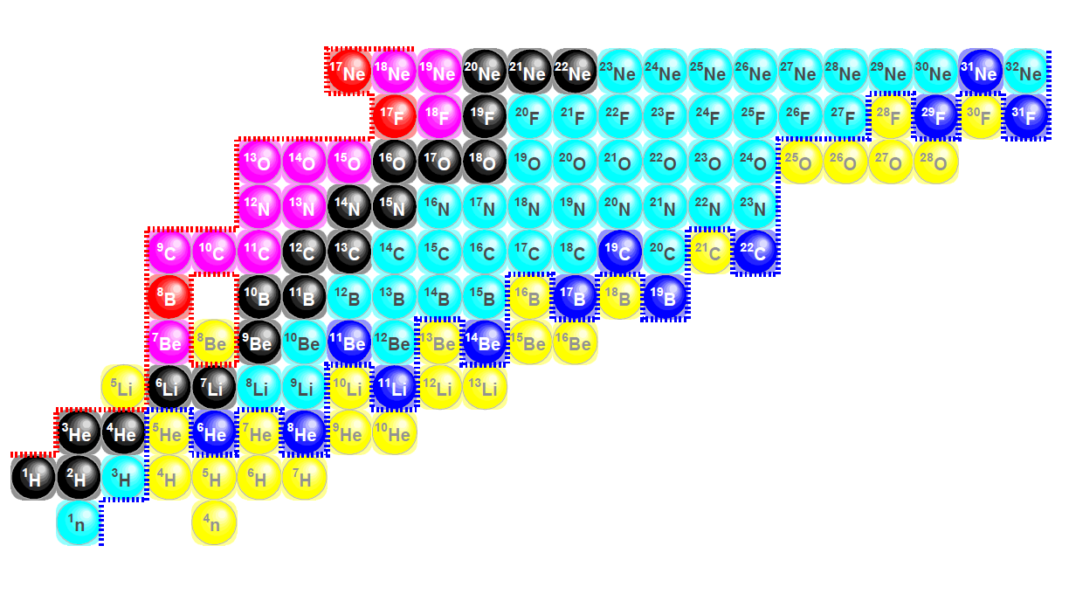

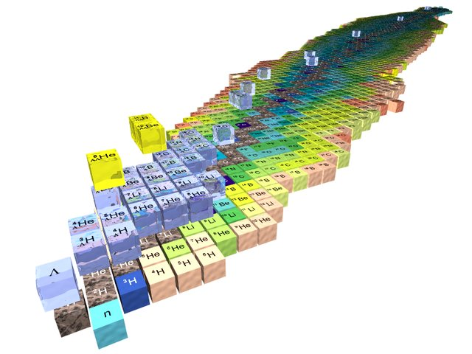
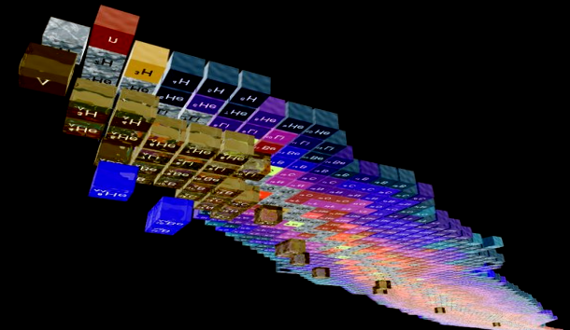

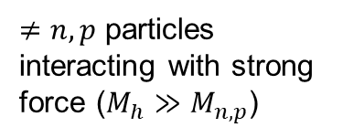
(ii) Research directions
Complexity of scattering problem
Complexity of many-body solution
Both
$≠n,p$ particles interacting with strong force ($M_{h}≫M_{n,p}$)
Nuclear theory is data driven.
Few-body techniques scale very bad with the number of constituents in the continuum.
$$M_{h}≤M_{n,p}$$
Credits H. Lenske
Notes:
The research axis is basically two-fold:
1- More complex reactions
2- Towards heavier mass systems
In higher resolution:
We want to study halo nuclei with full glory NN+3N interaction
Study break up and FSI
Etc…

Slide 4




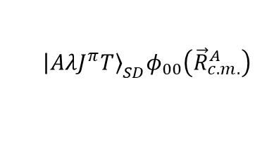
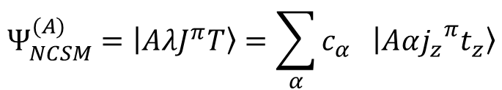
No-core shell model: best for well bound states B.R. Barrett, P. Navrátil, J.P. Vary, J.P. Progr. Part. Nucl. Phys. 69 (2013).
One way to solve the many-body problem
$$Ψ_{NCSM}^{(A)}=\left|\left.AλJ^{π}T\right\rangle \right.=\sum_{α}{c_{α} \left|\left.Aα{j_{z}}^{π}t_{z}\right\rangle \right.}$$
Can address bound and low-lying resonances (short range correlations)
Mixing coefficients(unknown)
A-body harmonic oscillator states
$${\left|\left.AλJ^{π}T\right\rangle \right.}_{SD}φ_{00}\left({\vec{R}}_{c.m.}^{A}\right)$$
Second quantization
$$N_{max}$$
Advantage of HO CI methods:
Center of mass is factorized.
Mathematically possible to derived s.p. to Jacobi coordinates transformation.
Fourier transform is trivial: NCSM, RGM with HO CI is equivalent in momentum or position space.
$$ℏΩ$$
No-Core Shell Model

Slide 5
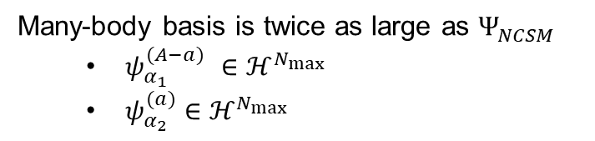



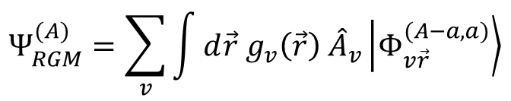



Resonating group method for NCSM: long-range dynamics and scattering S. Quaglioni, P. Navrátil PRL101 (2008).
One way to solve the many-body problem when two scales appear
$$Ψ_{NCSM}^{(A)}=\left|\left.AλJ^{π}T\right\rangle \right.=\sum_{α}{c_{α} \left|\left.Aα{j_{z}}^{π}t_{z}\right\rangle \right.}$$
Can address bound and low-lying resonances (short range correlations)
Mixing coefficients(unknown)
A-body harmonic oscillator states
$${\left|\left.AλJ^{π}T\right\rangle \right.}_{SD}φ_{00}\left({\vec{R}}_{c.m.}^{A}\right)$$
Second quantization
$${\vec{r}}_{A−a,a}$$
$$Ψ_{RGM}^{(A)}=\sum_{v}{\int{d\vec{r} g_{v}\left(\vec{r}\right) {\hat{A}}_{v}\left|\left.Φ_{v\vec{r}}^{(A−a,a)}\right\rangle \right.}}$$
$$a$$
$$(A−a)$$
$$ψ_{α_{1}}^{(A−a)}ψ_{α_{2}}^{(a)} δ(\vec{r}−{\vec{r}}_{A−a,a})$$
Relative wave function (unknown)
Channel basis
Cluster expansion technique
Antisymmetrizer
Many-body basis is twice as large as $Ψ_{NCSM}^{ }$
$ψ_{α_{1}}^{(A−a)}$ $∈ℋ^{N_{max}}$
$ψ_{α_{2}}^{(a)}$ $∈ℋ^{N_{max}}$
NCSM/RGM
Cluster formalism for elastic/inelastic

Slide 6

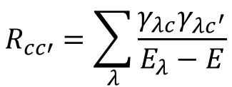


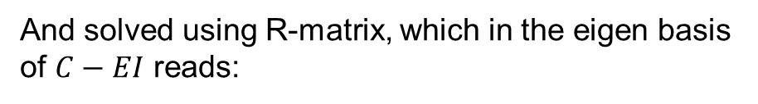

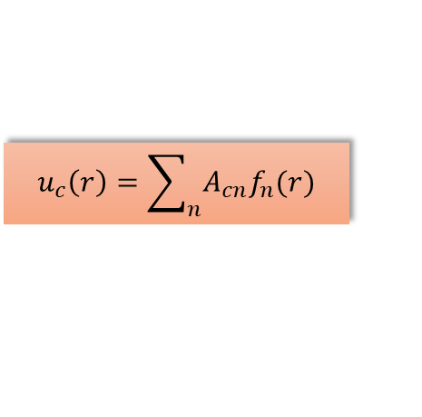

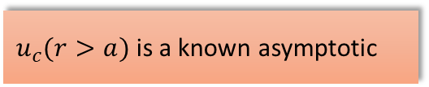

Calculable R-matrix with inert space from spectral decomposition of $H_{RGM}$
Internal region
External region
$$V=V_{N}+V_{\text{Coul}}$$
$$V=V_{\text{Coul}}$$
$$u_{c}\left(r\right)=\sum_{n}{A_{cn}f_{n}(r)}$$
$u_{c}(r>a)$ is a known asymptotic
$$0$$
$$a$$
$$r$$
Decomposition on a Lagrange mesh.
NCSMC can be cast as Bloch-Schrödinger equation:
$$\left(C−EI\right)\vec{X}=Q(B)$$
And solved using R-matrix, which in the eigen basis of $C−EI$ reads:
$$R_{cc′}=\sum_{λ}{\frac{γ_{λc}γ_{λc^{′}}}{E_{λ}−E}}$$
Simple for binary reacting system, more involved for neutral ternary system and extremely challenging for charged breakup.

Slide 7
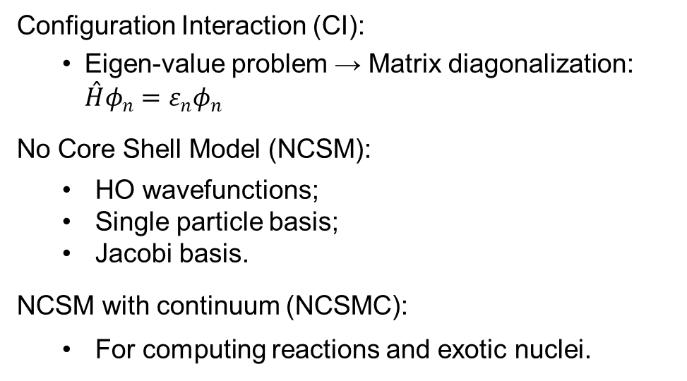
Resonating group method for NCSM: long-range dynamics and scattering
Configuration Interaction (CI):
Eigen-value problem → Matrix diagonalization: $\overset{ˆ}{H}φ_{n}^{ }=ε_{n}φ_{n}^{ }$
No Core Shell Model (NCSM):
HO wavefunctions;
Single particle basis;
Jacobi basis.
NCSM with continuum (NCSMC):
For computing reactions and exotic nuclei.
$$Ψ_{NCSM}^{(A)}=\left|\left.AλJ^{π}T\right\rangle \right.=\sum_{α}{c_{α} \left|\left.Aα{j_{z}}^{π}t_{z}\right\rangle \right.}$$
Mixing coefficients(unknown)
A-body harmonic oscillator states
$$Ψ_{RGM}^{(A)}=\sum_{v}{\int{d\vec{r} g_{v}\left(\vec{r}\right) {\hat{A}}_{v}\left|\left.Φ_{v\vec{r}}^{(A−a,a)}\right\rangle \right.}}$$
Relative wave function (unknown)
Channel basis
Antisymmetrizer
Limitations:
Resonance properties cannot be accessed directly.
Reaction channels must be introduced manually.

Slide 8
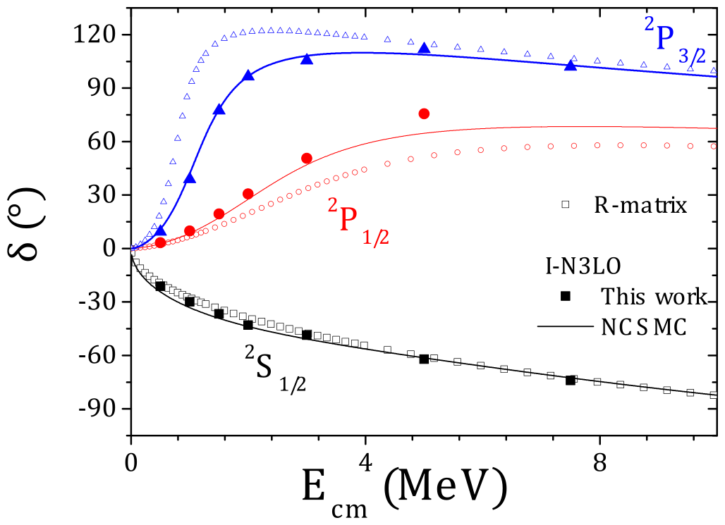







n-⁴He scattering: NCSMC vs Faddeev-Yakubovsky
Benchmark: scattering phase shifts NCSMC/FY
Good agreement between the two methods.
Faddeev-Yakubovsky
R. Lazauskas, PRC 97 (2018).*
*there is a more recent paper with 3N force.
Notes:
Let us now get back to our benchmark case namely the n-alpha collision. Again the phase-shift are well determined from experiment. We can there play with the different scenario of interaction: NN-only, NN+3N-ind ie the initial NN-only corresponding to lee-suzuky here we see that clearly the NN-only agreement was just accidental and the real picture with a NN force online is much worse. The 3N force helps a lot to improve the agreement in particular the spin-orbit splitting.

Slide 9
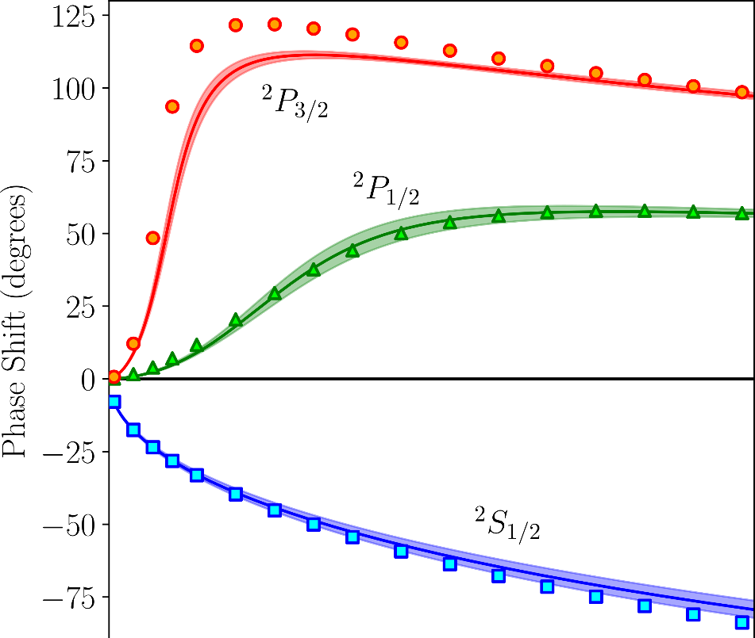
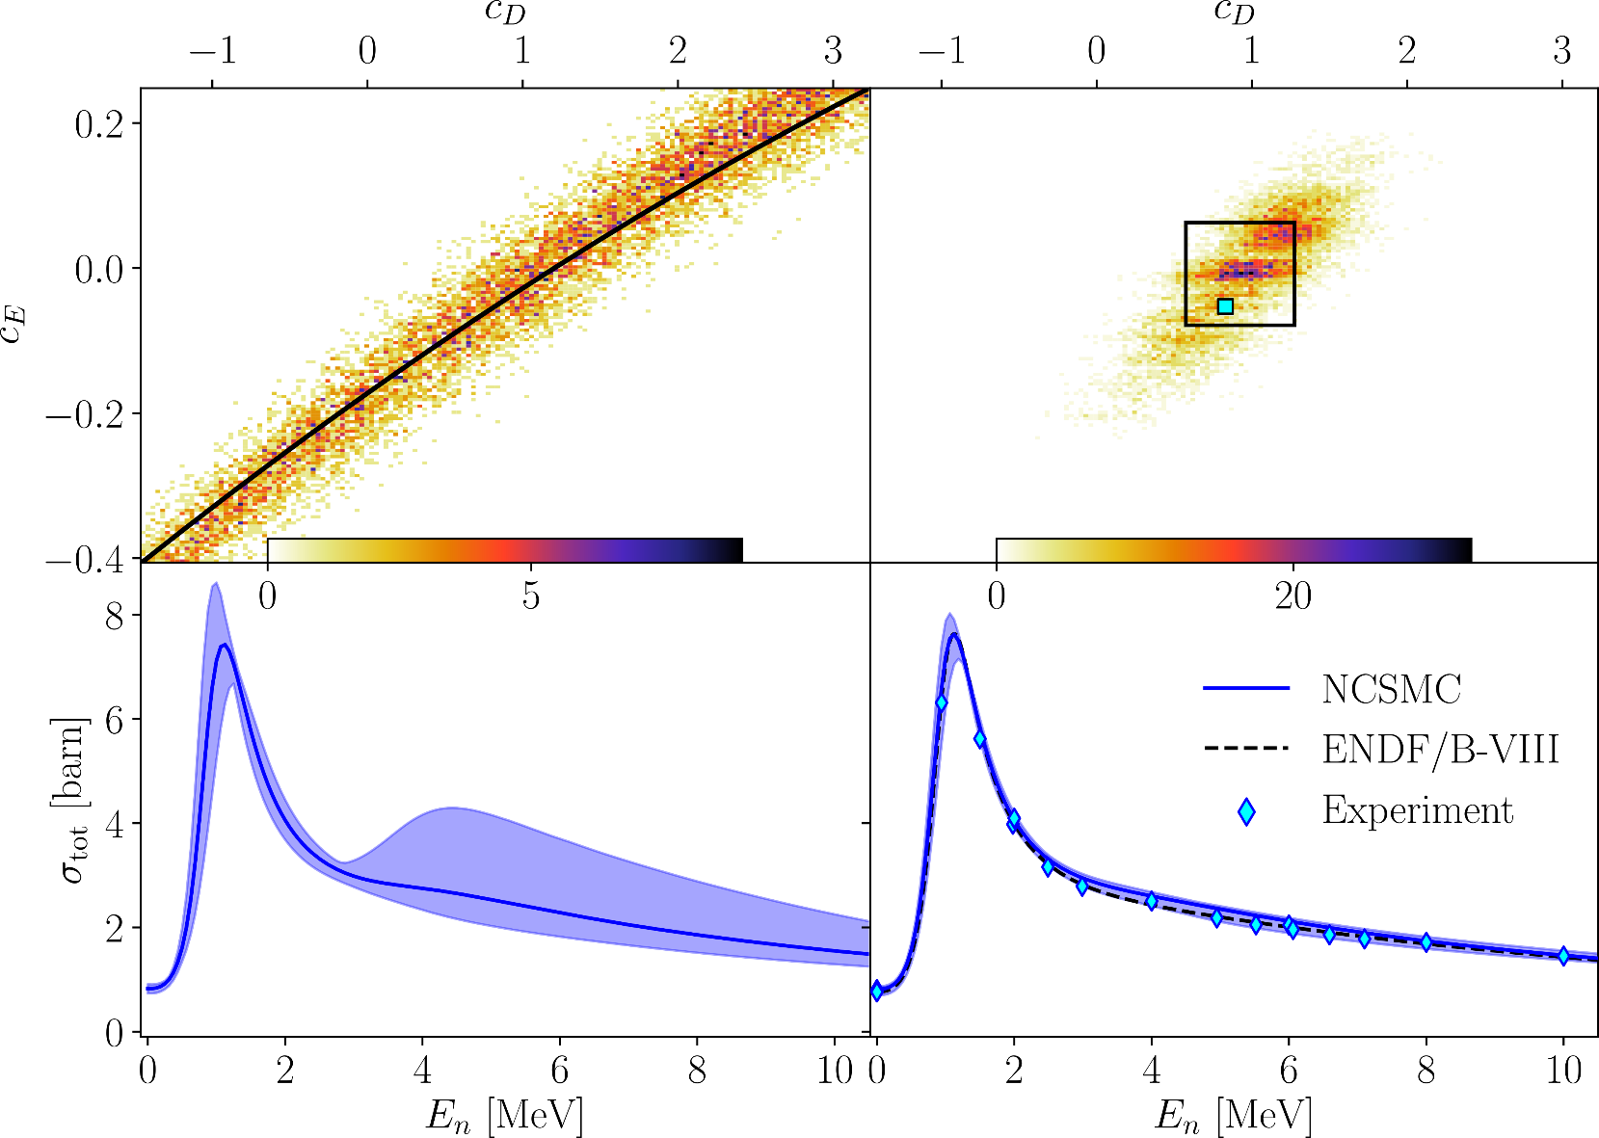
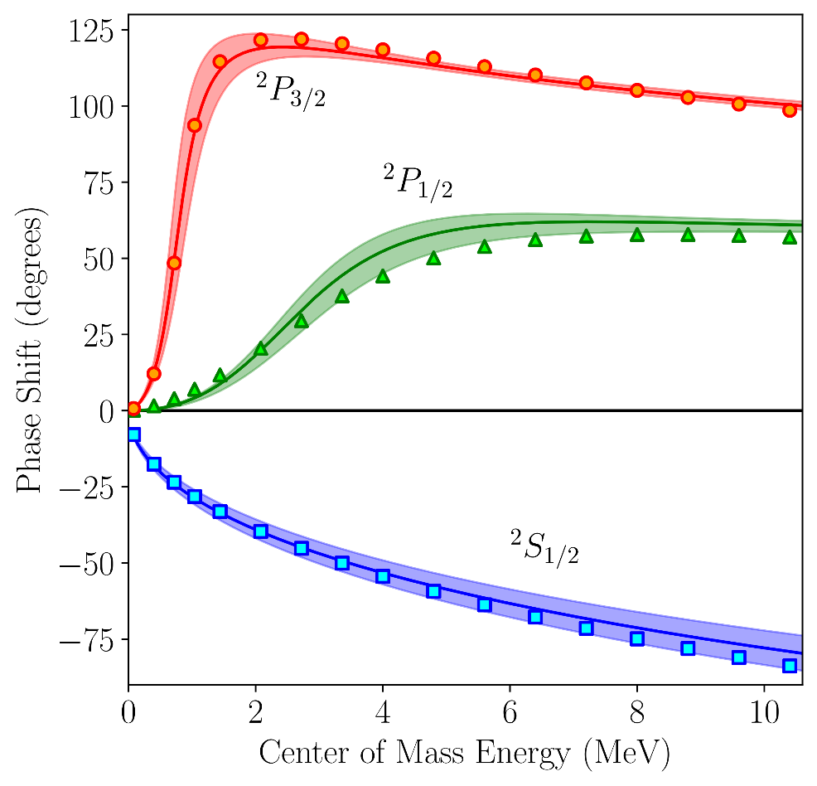

Uncertainty quantifications using Gaussian Process Model as emulator K. Kravvaris et al. PRC102, 024616 (2020)
Sensitivity to $c_{D}$ and $c_{E}$
NN-N4LO + 3N-N2LO cannot reproduce the p-wave splitting.
Tighter posterior distribution if the properties of the ⁵He are included in the fit of 3N LEC.
N⁴LO+N²LO-loc.
³H,⁴He
⁵He
N³LO+N²LO-lnl
Notes:
Let us now get back to our benchmark case namely the n-alpha collision. Again the phase-shift are well determined from experiment. We can there play with the different scenario of interaction: NN-only, NN+3N-ind ie the initial NN-only corresponding to lee-suzuky here we see that clearly the NN-only agreement was just accidental and the real picture with a NN force online is much worse. The 3N force helps a lot to improve the agreement in particular the spin-orbit splitting.

Slide 10
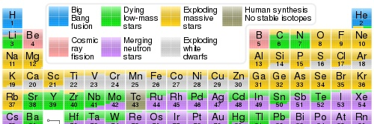
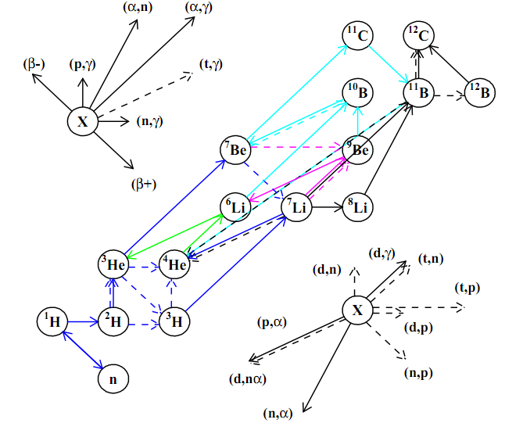
Low-energy Transfer reactions (d,N)
Primordial Nucleosynthesis (blue)
Notes:
In some cases we can discriminate between different sets of experiments where discrepancies still exist. Having a lot of data is also revealing the missing feature of the present knowledge of the interaction and motivating the community to expand their knowledge of nuclear interaction.

Slide 11
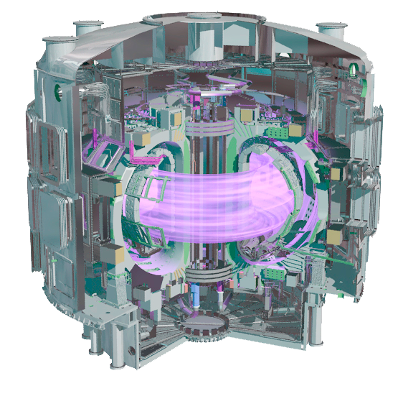
Low-energy Transfer reactions (d,N)
Primordial Nucleosynthesis (blue)
ITER design (Cadarache, France)
(d,n)
Structure of the ⁵He ${3/2}^{+}$ resonance
$${}_{ }^{0}{p_{1/2}}$$
p-shell
$${}_{ }^{0}{p_{3/2}}$$
1p1h excitation
Major shell spacing
s-shell
Notes:
In some cases we can discriminate between different sets of experiments where discrepancies still exist. Having a lot of data is also revealing the missing feature of the present knowledge of the interaction and motivating the community to expand their knowledge of nuclear interaction.

Slide 12
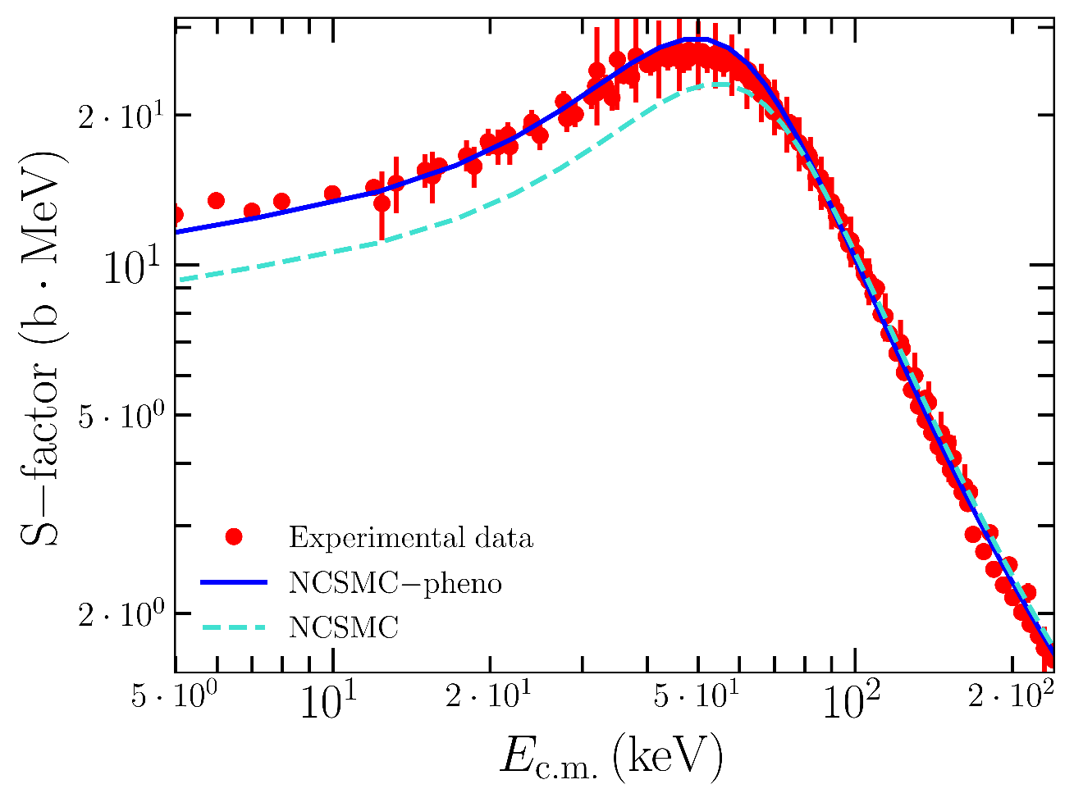
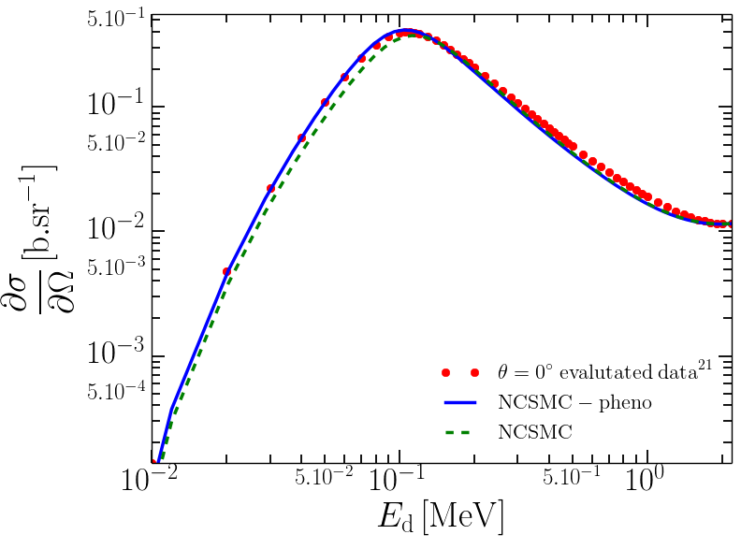
³H(d,n)⁴He fusion reaction: benchmark to data and evaluation
S-factor: computed and data
Angular distribution at $θ=0^{°}$
Adjusted to ${3/2}^{+}$ resonance centroid
Ab initio
$<10$ keV
M. Drosg and N. Otuka, INDC(AUS)-0019 (2015).
The S-factor is globally well reproduced.
The accurate reproduction (of the order of keV) of the resonance position/width is essential.
Shape of the angular distribution agrees with recent evaluation.

Slide 13
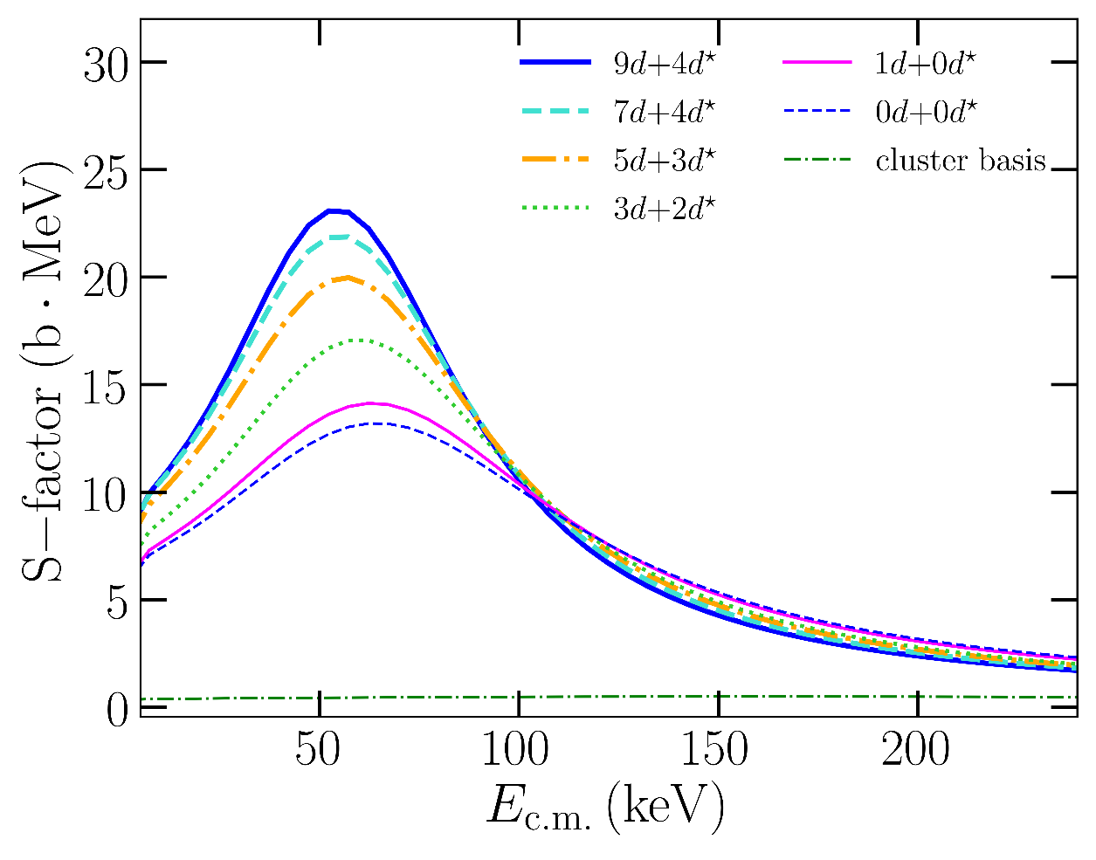
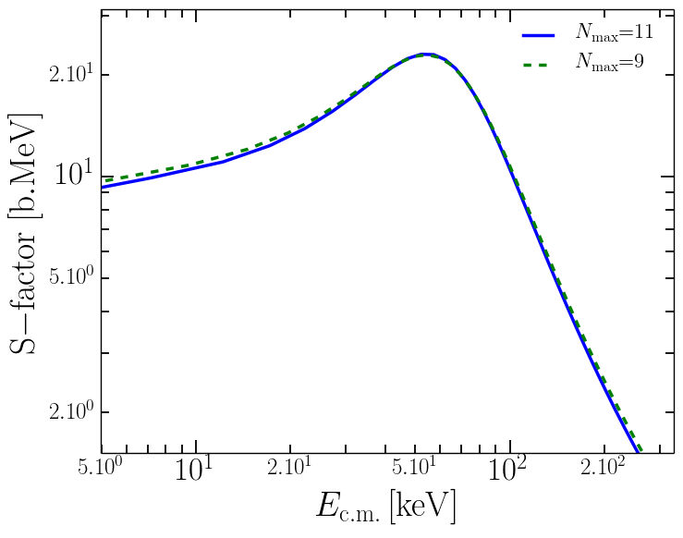
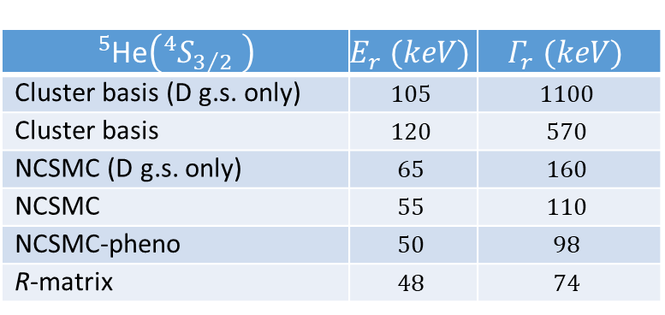
³H(d,n)⁴He fusion reaction: Model convergence
Convergence wrt ²H continuum
Convergence with $Nmax$
Continuum discretization ~ virtual ²H breakup
$$N_{max}$$
$${}_{ }^{5}{\text{He}}\left({{}_{ }^{4}S}_{3/2} \right)$$ | $$E_{r} (keV)$$ | $$Γ_{r} (keV)$$
Cluster basis (D g.s. only) | $$105$$ | $$1100$$
Cluster basis | $$120$$ | $$570$$
NCSMC (D g.s. only) | $$65$$ | $$160$$
NCSMC | $$55$$ | $$110$$
NCSMC-pheno | $$50$$ | $$98$$
R-matrix | $$48$$ | $$74$$
Discretization of ²H is essential for the reproduction of the S-factor.
Stable behavior with respect to the number of ²H pseudo states.
Converged with $N_{max}$.
correlated
G.M. Hale, et al. PRL 59 (1987).

Slide 14
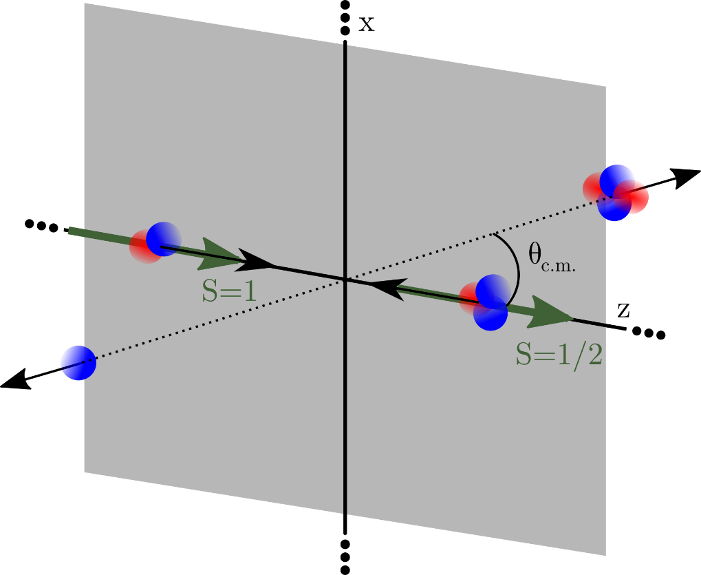
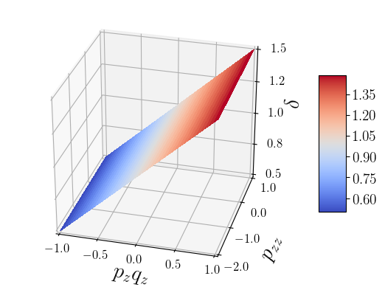
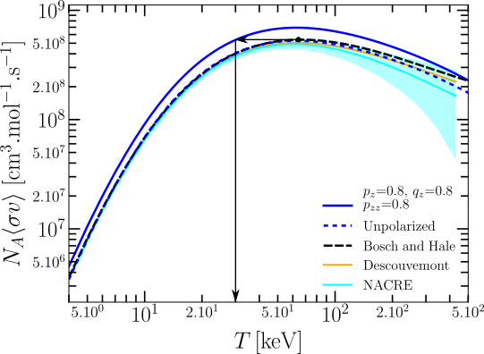
DT polarized thermonuclear fusion G. Hupin, S. Quaglioni and P. Navrátil, Nat. Commun. 10, 351 (2019)
Enhancement factor and reaction rate
$$E_{D}=100 \text{keV}$$
Reactant spins are prepared in a configuration
$$\frac{{∂σ}^{\text{polar}}}{∂Ω}\left(θ\right)=\frac{{∂σ}^{ }}{∂Ω}\left(θ\right)\left(1+\frac{1}{2}p_{zz}A_{zz}\left(θ\right)+\frac{3}{2}p_{z}q_{z}C_{z,z }\left(θ\right)\right)$$
Predictions for polarized ${}_{ }^{3}{\vec{H}}\left(\vec{d},n\right){}_{ }^{4}{He}$ enhancement factor and reaction rate.
Confirmation of maximum enhancement ($δ=1.5)$ scenario.
Ab initio calculation shows that $δ=1.38$ can be achieved in lab.

Slide 15
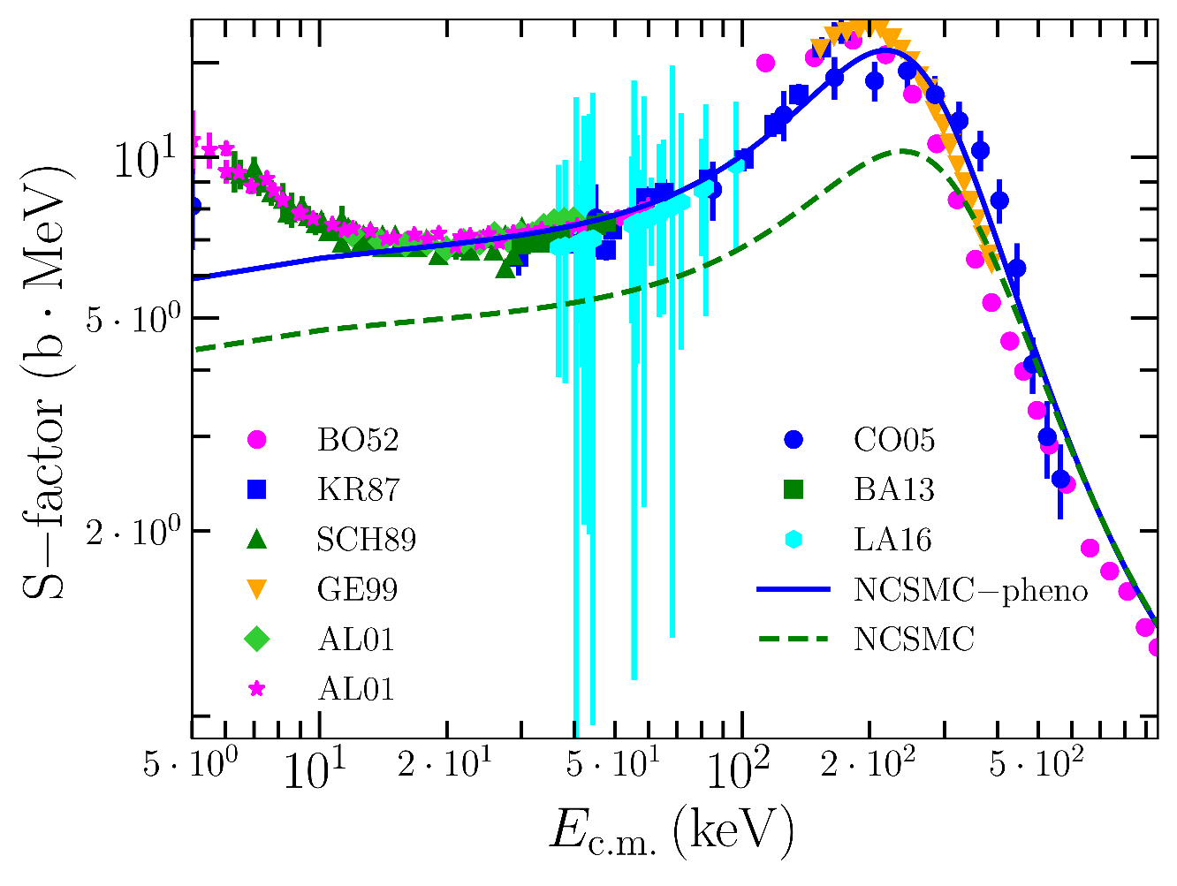
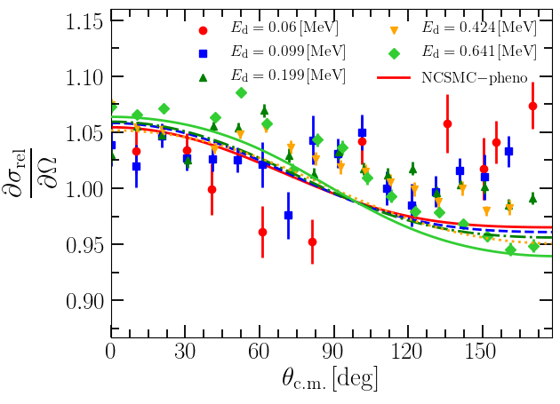
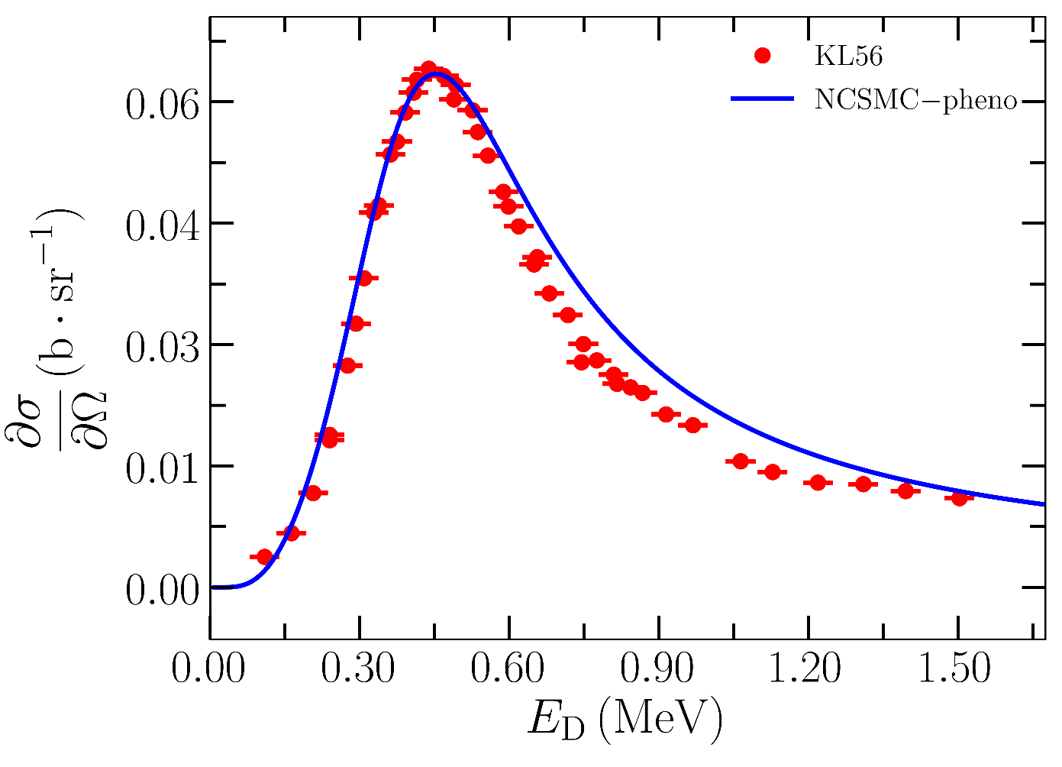
³He(d,p)⁴He fusion reaction: mirror reaction, globally similar to DT
The S-factor is globally well reproduced.
However, there are discrepancies between data sets around the peak of the S-factor.
Influence of p- and d-waves in agreement with data.

Slide 16
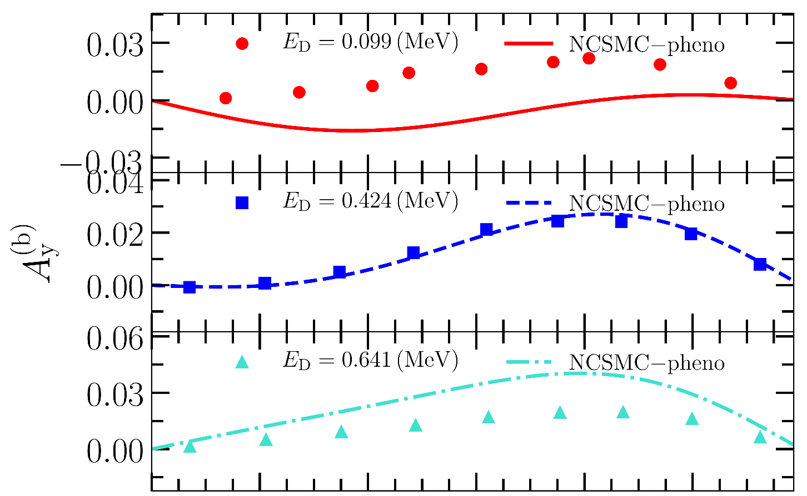
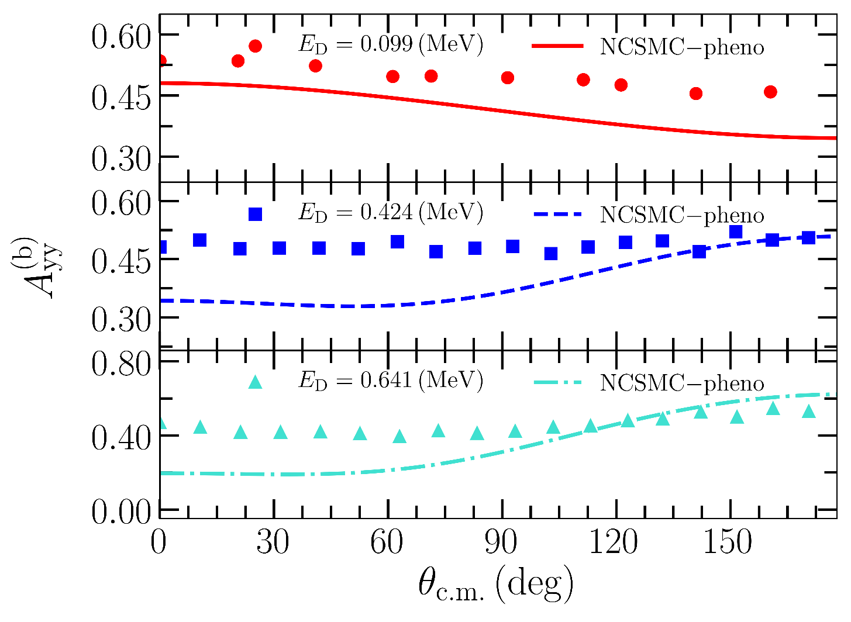
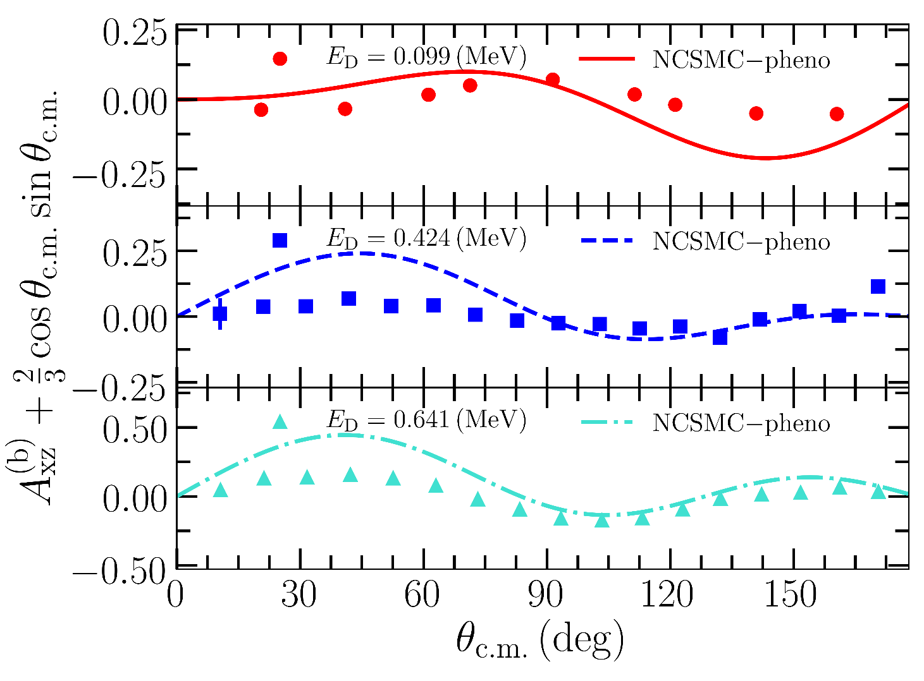
³He($\vec{d}$,p)⁴He: analyzing tensors
W.H. Geist, et al. PRC60 (1999).
Deviations from a pure s-wave of the analyzing tensors are globally reproduced in shape but their amplitude is not.

Slide 17
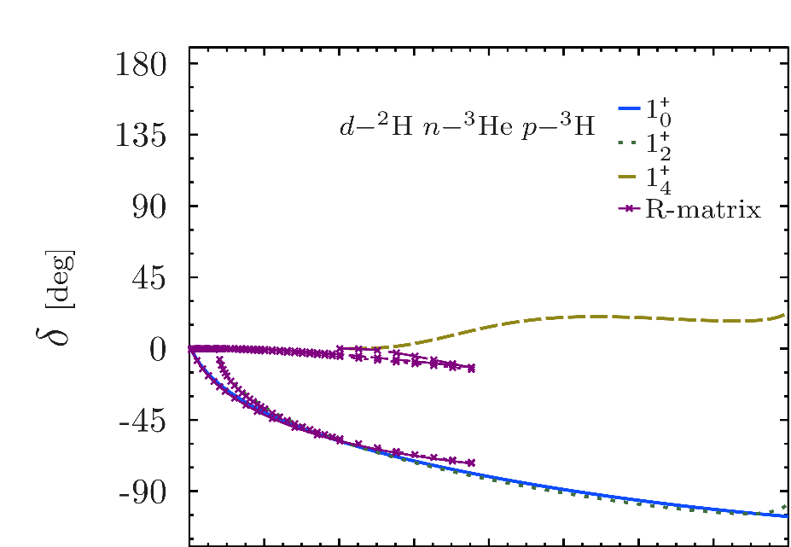
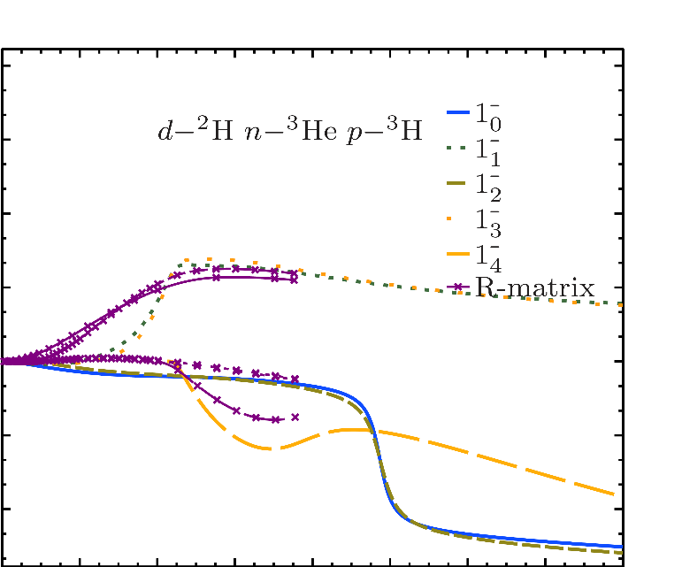
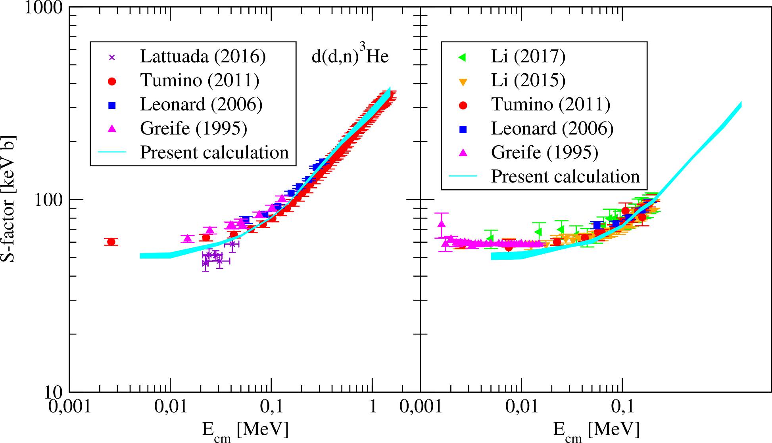
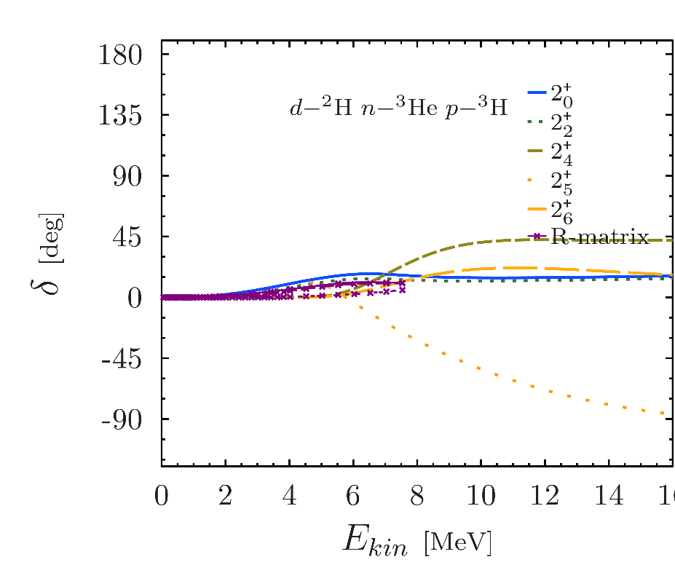
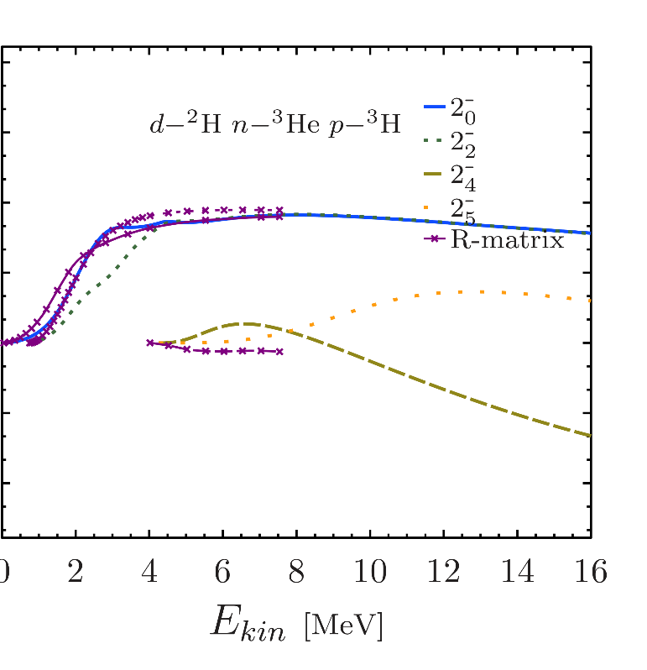
DD fusion
HH and Kohn variational principle for DD fusion
NCSMC phase shifts NN+3N-LNL
M. Viviani, L. Girlanda et al. PRL130 122501 (2023).
Excellent agreement with data for the low-energy fusion.
Reasonable agreement with R-matrix analysis of data over large energy range.
Notes:
So basically we merge the two approach
The one for the nuclear structure that will get a good shot at the low-lying resonance
The one that will deal with the scattering degree of freedom !
The NCSMC is born cf those paper.

Slide 18
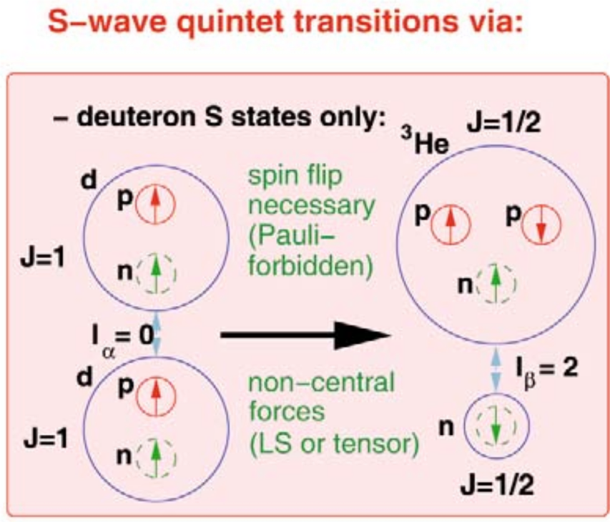
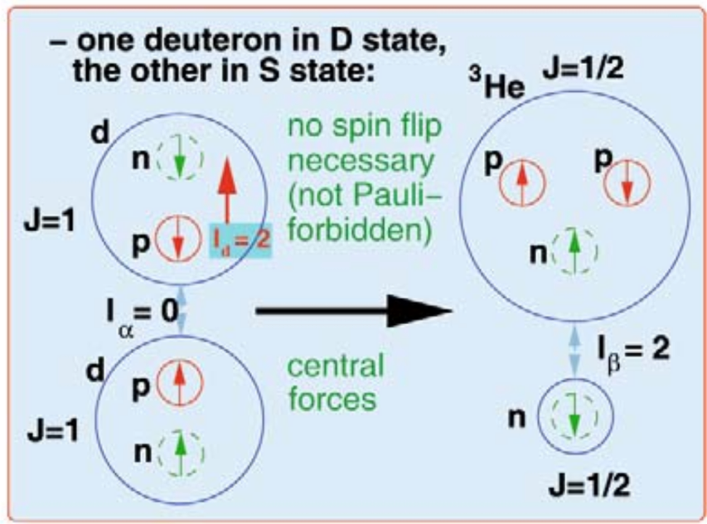
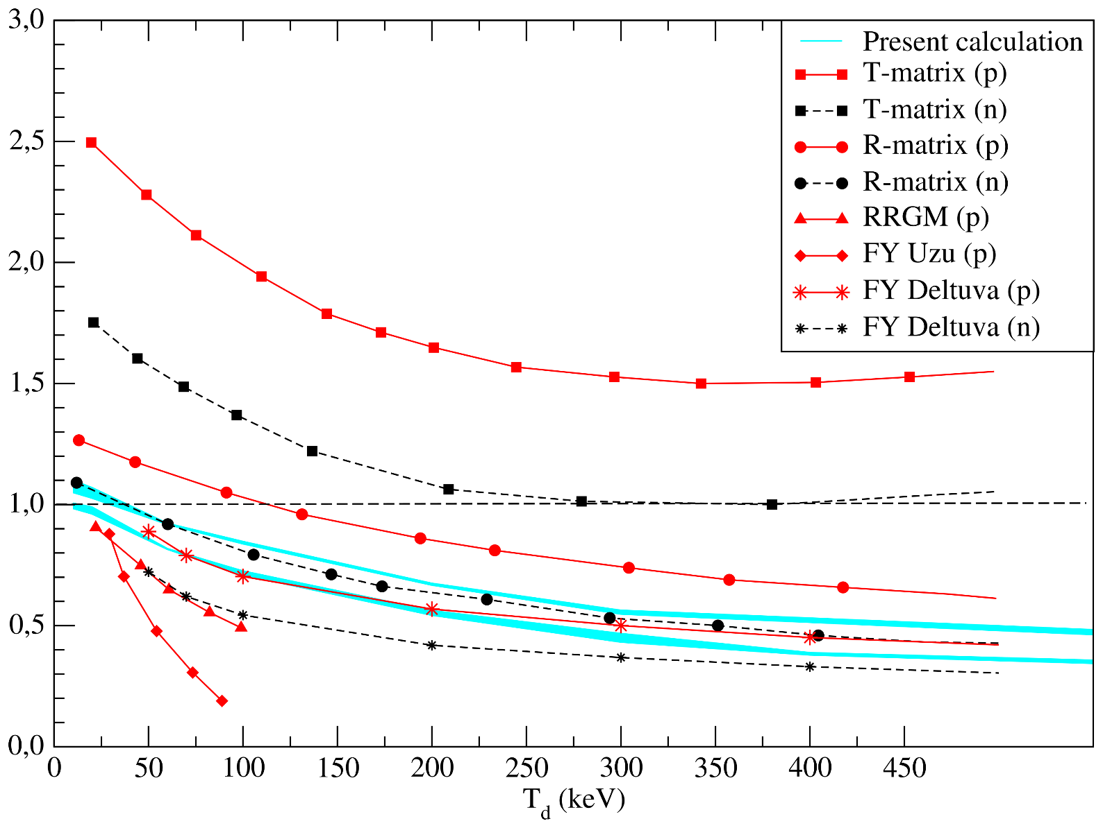
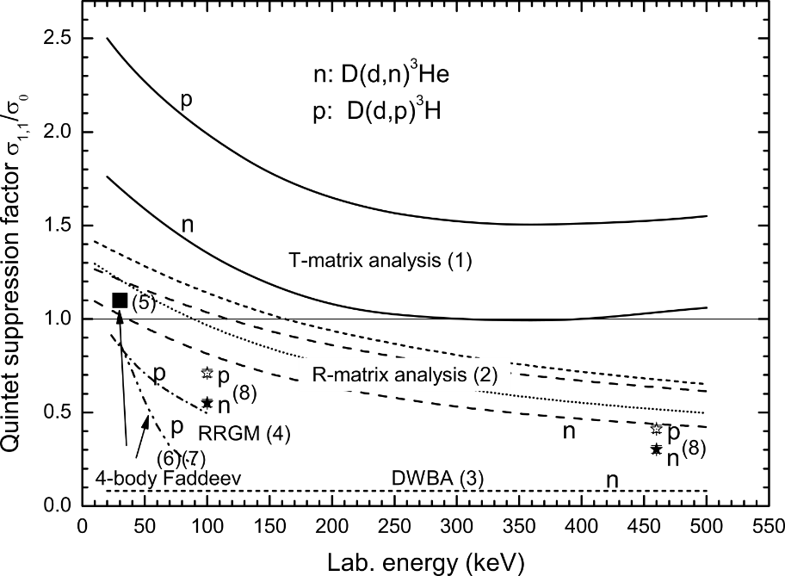

DD fusion: quintet suppression for fusion
Advanced design for an aneutronic reactor..
$$σ_{tot}\text{=}\frac{1}{9}(2σ_{1,1}+4σ_{1,0}+σ_{0,0}+σ_{1,−1})$$
quintet
triplet
singlets
Quintet suppression factor
H.P. gen. Schieck EPJA44 (2010).
No experimental data
No clear cut evidence from calculations:
Low-energy
Coulomb.
Lack of complete nuclear interaction.
M. Viviani, L. Girlanda et al. PRL130 122501 (2023).
Notes:
So basically we merge the two approach
The one for the nuclear structure that will get a good shot at the low-lying resonance
The one that will deal with the scattering degree of freedom !
The NCSMC is born cf those paper.

Slide 19
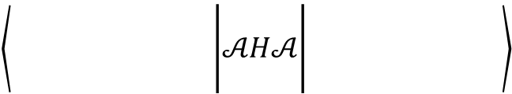
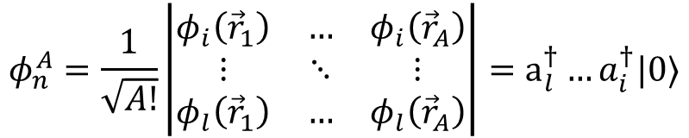
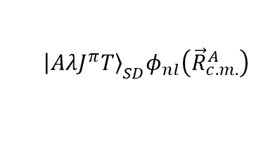
NCSM/RGM with boosted NCSM wave functions K. Kravvaris, S. Quaglioni et al. PLB856, 138930 (2024)
One way to solve the many-body problem
$$Ψ_{NCSM}^{(A)}=\left|\left.AλJ^{π}T\right\rangle \right.=\sum_{α}{c_{α} \left|\left.Aα{j_{z}}^{π}t_{z}\right\rangle \right.}$$
“Trivial” to create a basis of boosted NCSM wave functions
Mixing coefficients(unknown)
A-body harmonic oscillator states
$${\left|\left.AλJ^{π}T\right\rangle \right.}_{SD}φ_{00}\left({\vec{R}}_{c.m.}^{A}\right)$$
Second quantization
Advantage of HO CI methods:
Center of mass is factorized.
$${\left|\left.AλJ^{π}T\right\rangle \right.}_{SD}φ_{nl}\left({\vec{R}}_{c.m.}^{A}\right)$$
Second quantization
Span the same basis as
$$(A−1)$$
$$(A−1)$$
$$\left\langle \begin{matrix} & & \\ & & \\ & & \end{matrix}\begin{matrix} & & \\ & & \\ & & \end{matrix}\begin{matrix} & \\ & \\ & \end{matrix} | 𝒜H𝒜 | \begin{matrix} & & \\ \begin{matrix} & & \\ & & \\ & & \end{matrix} & & \\ & & \end{matrix}\begin{matrix} & \\ & \\ & \end{matrix}\right\rangle$$
$${\vec{r}}_{A−a,a}$$
$$φ_{n}^{A}=\frac{1}{\sqrt{A!}}\left|\begin{matrix}φ_{i}\left({\vec{r}}_{1}\right) & … & φ_{i}\left({\vec{r}}_{A}\right) \\ ⋮ & ⋱ & ⋮ \\ φ_{l}\left({\vec{r}}_{1}\right) & … & φ_{l}\left({\vec{r}}_{A}\right)\end{matrix}\right|=a_{l}^{†}…a_{i}^{†}|0⟩$$
$${\vec{r}}^{′}$$
$$(a^{′}=1)$$
$$(a=1)$$
$$\vec{r}$$
$$(A−a)$$
$$a$$
$$ψ_{α_{1}}^{(A−a)}ψ_{α_{2}}^{(a)} δ(\vec{r}−{\vec{r}}_{A−a,a})$$

Slide 20
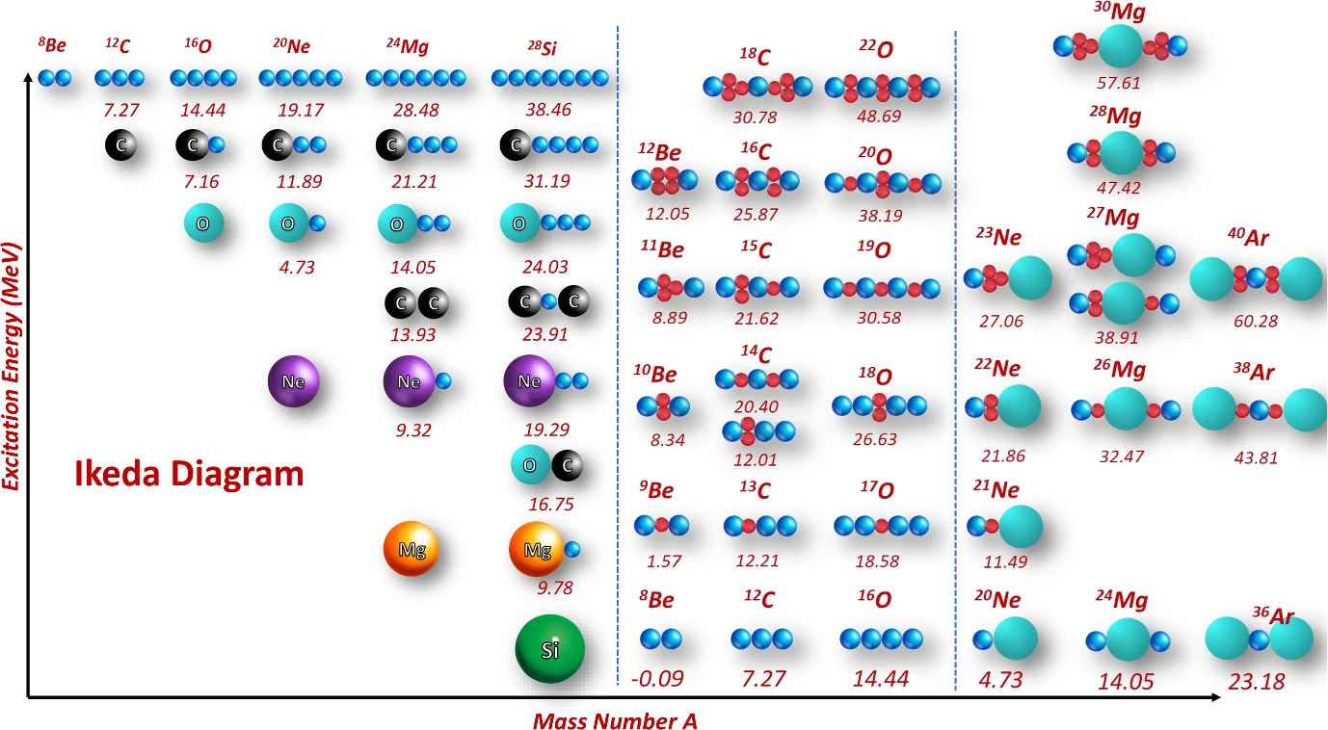

From α+α scattering to α clustering in ¹²Be and channel sensitivity in ⁶He(⁶He,α)⁸He K.Kravvaris, S. Quaglioni et al. PLB856, 138930 (2024)
α+α scattering phase-shift
I. Lombardo et al. Riv. Nuovo Cim. 46 (2023)
Ab initio NCSM/RGM calculation of α−α scattering using chiral NN+3N;
3N regulator choice strongly affected resonance positions;
NN+3Nlnl give best agreement with experimental data.

Slide 21





From α+α scattering to α clustering in ¹²Be and channel sensitivity in ⁶He(⁶He,α)⁸He K.Kravvaris, S. Quaglioni et al. PLB856, 138930 (2024)
Evolution of ¹²Be with cluster structure
Evidence of channels selectivity
Coupling to ¹¹Be+n channel reshapes ¹²Be spectrum.
Neutron decay strongly influences ⁶He(⁶He,α)⁸He cross section.
Helium clustering survives high above decay thresholds.
$$⋯$$

Slide 22




Asymptotically vanishing equivalent problem
Complex scaling
“A” definition of a resonance is that it corresponds to a pole in the S-matrix at the complex energy associated with the resonance location.
Kruppa et al. PRC89 (2014)
$$\hat{H}\left(θ\right)=e^{−2iθ}\hat{T}+\hat{V}\left(re^{iθ}\right)$$
$$\hat{H}\left(r\right)=\hat{U}\left(θ\right)\hat{H}\left(r\right){\hat{U}}^{⊺}\left(θ\right)$$
$$\hat{H}\left(r\right)=\hat{T}+\hat{V}\left(r\right)$$
$$U\left(θ\right)H(r){U\left(θ\right)}^{⊺}$$
Spatially extended but exponential fall off
Boundary limit problem
Known asymptotic
Bound state problem
$$ψ\left(r,θ\right)\underset{∞}{\sim}e^{−kr\sin{θ}}$$

Slide 23


Hidden truth
A=2 Hamiltonian matrix elements with complex values*
Maximum model space achievable $N_{max}\sim 200$ (100 nodes a box in excess of 20 fm)
The contour deformation from complex scaling induces a large off-diagonal couplings;
The latter is a no-go theorem for many-body practitioner as it implies slow UV convergence.
Large off-diagonal coupling m.e.s
* The absolute value of the elements are shown

Slide 24




Similarity Renormalization Group (SRG) technique and non-Hermitian matrices E. D. Jurgenson, P. Navrátil, R. J. Furnstahl PRL103 (2009); PRC83 (2011)…
In configuration interaction methods we need to soften interaction to address the hard core. We use the Similarity-Renormalization-Group (SRG) method
$$H_{λ}\left(θ\right)=U_{λ}H\left(θ\right)U_{λ}^{T}$$
$$\left\{\begin{aligned}\frac{dH_{λ}\left(θ\right)}{dλ}=−\frac{4}{λ^{5}}\left[η\left(λ\right),H_{λ}\left(θ\right)\right] \\ η\left(λ\right)=\frac{dU_{λ}}{dλ}U_{λ}^{T}\end{aligned}\right.$$
Similarity
Transformation
Evolution with flow parameter λ
Consistent evolution of the imaginary part
Notes:
Before we get to the actual calculation we have to deal with the so call hard-core problem. That is the fact that the potential will connect states included in the many body calculation to state that are not. For instance in this plot of the two-nucleon force in momentum space …. In this work, we use the SRG method to soften the interaction. It consists in a set of unitary transformation that will drive the Hamiltonian to a prediagonal form suitable for the NCSM.
Important things are that the unitary transformation by design preserve the physics while decoupling low and high momentum however this will induce extra many-body forces.
Once the interaction is evolved we can cut it to the scale of the many-body theory.

Slide 25




Quality of the rotated Hamiltonian evaluated in A=3
Triton g.s. convergence with CS-Hamiltonian ($θ=0.3$ rad)
SRG leads to faster convergence;
Induced 3N-interaction needs to be accounted for (as expected from literature).
Maximum model space achievable $N_{max}\sim 60$ (30 nodes a box in excess of 15 fm)

Slide 26




Quality of the rotated Hamiltonian evaluated in A=4
α g.s. convergence with CS+SRG NN+3N Hamiltonian ($θ=0.3$ rad)
Induced $A=4$ interaction is not significant;
The flow parameter is limited to at best $1.8 fm^{−1}$ due to the A=3 CI space needed for the evolution.
$A=3$evolution is made in the maximum model space achievable $N_{max}\sim 60$

Slide 27


How to extract the thresholds ?
This analysis is made without the induced 3bdy force because of the numerical cost.
$$ℏΩ$$
The expected threshold are somewhat recovered w.r.t. experiments;
Threshold energies do not converge at the same pace as the g.s.

Slide 28



Wrap-up on the spectrum after analysis of the results
⁴Li, ⁴He, ⁴H and 4n
$$J^{π};T$$ | $$Er$$ $$[MeV]$$ | $$ε_{N_{max}}$$ | $$ε_{θ}$$ | $$Γ_{r}$$ | $$ε_{N_{max}}$$ | $$ε_{θ}$$ | R-matrix |  | $$Δ$$
 |  |  |  |  |  |  | $$E_{r}$$ | $$Γ_{r}$$
$$0⁺;0$$ | $$0.40$$ | $$−0.04$$ | $$−0.43$$ | $$2.00$$ | $$−0.79$$ | $$−0.80$$ | $$0.391$$ | $$0.50$$ | $$0.75$$
$$0⁻;0$$ | $$1.31$$ | $$+0.03$$ | $$−0.52$$ | $$1.20$$ | $$−0.38$$ | $$+0.02$$ | $$1.199$$ | $$0.84$$ | $$0.85$$
$$2⁻;0$$ | $$1.98$$ | $$+0.02$$ | $$−0.28$$ | $$1.60$$ | $$−0.45$$ | $$+0.04$$ | $$2.09$$ | $$2.01$$ | $$2.25$$
$$1⁻;1$$ | $$2.93$$ | $$−0.16$$ | $$≳ −1$$ | $$3.36$$ | $$−0.80$$ | $$+0.52$$ | $$3.829$$ | $$6.20$$ | $$3.66$$
$$1⁻;0$$ | $$3.21$$ | $$−0.11$$ | $$≳ −1$$ | $$3.94$$ | $$−0.56$$ | $$+0.21$$ | $$4.439$$ | $$6.10$$ | $$3.42$$
$$2⁻;1$$ | $$3.02$$ | $$−0.31$$ | $$≳ −1$$ | $$3.00$$ | $$+0.16$$ | $$−0.24$$ | $$3.519$$ | $$5.01$$ | $$0.00$$
$$0⁻;1$$ | $$3.37$$ | $$−0.15$$ | $$≳ −1$$ | $$4.20$$ | $$−0.48$$ | $$+1.03$$ | $$5.469$$ | $$7.97$$ | $$3.73$$
$$1⁻;1$$ | $$3.45$$ | $$−0.48$$ | $$≳ −1$$ | $$4.89$$ | $$−0.95$$ | $$+0.74$$ | $$6.139$$ | $$12.66$$ | $$4.23$$
Careful extrapolation techniques need to be designed;
Proof of principle that the CS-Hamiltonian is accurate and can be used in NCSM calculation up to $A\sim 16$;
Discrepancies with experiments too large to be corrected by 3N forces;

Slide 29



⁴H system: a benchmark with Faddeev calculation
We compare with a calculation based on solving the Faddeev equations.
Deltuva & Lazauskas, 2019, PRC
We perform a naïve extrapolation wrt to the CS rotation angle $θ$.
We find an overall agreement of the calculating with the exact solution (up to 500 keV bias due to the extrapolation).
Notes:
I show here the states for 4Li and 4Hi which are isospin analogues and have similar excited states.
Also here we see two well reproduced resonances and two significantly shifted ones.

Slide 30


4-neutron: a resonance ?
or
Claimed by experiment
CS shows no indication of such a resonance in $1^{+},$ $1^{−}$, $0^{+}$ or $0^{−}$.
Lower bound of :
$$Γ_{r}=1.9 E_{r}$$
or :
$$Γ_{r}=4.5 MeV$$

Slide 31
Thank you !

