Slide 1


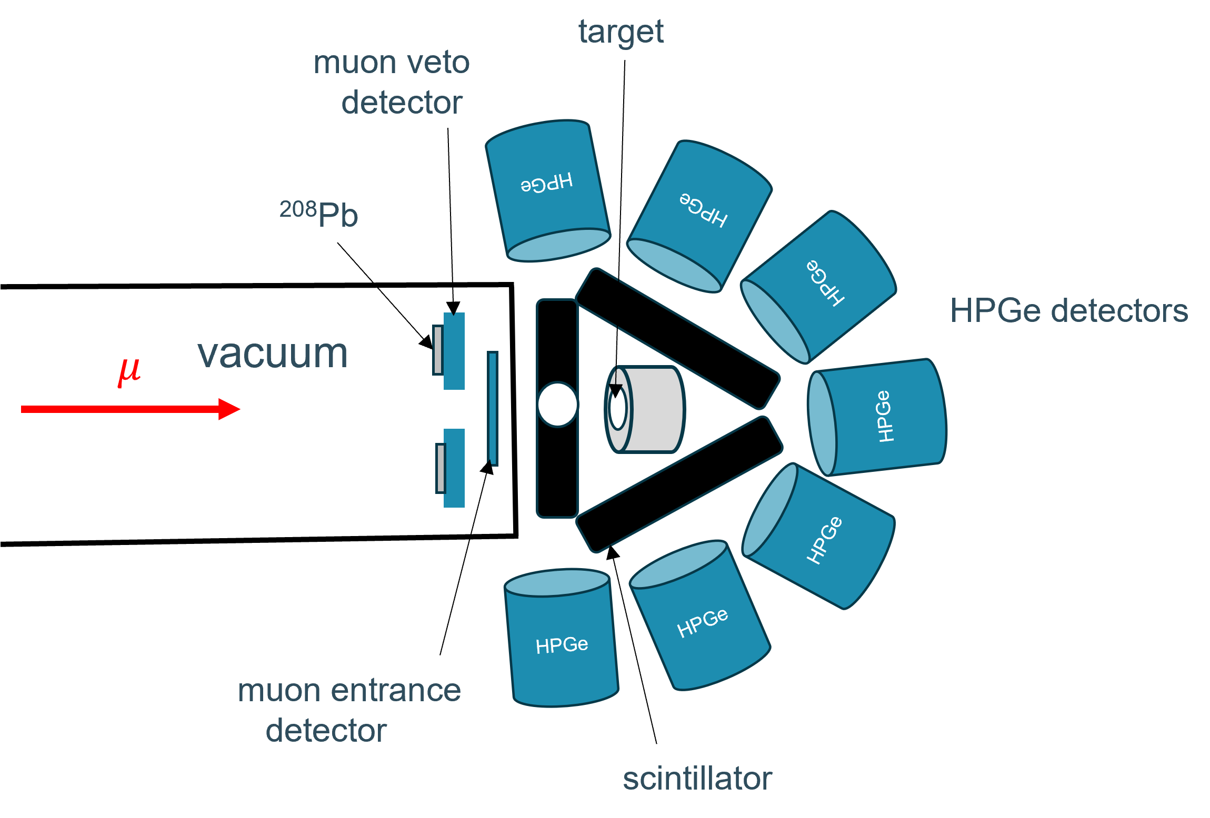
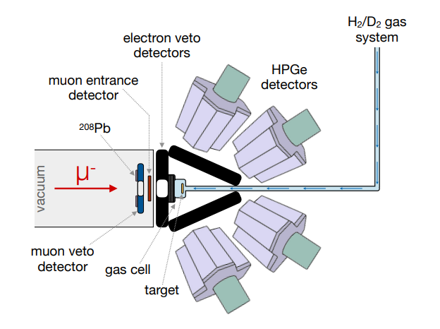
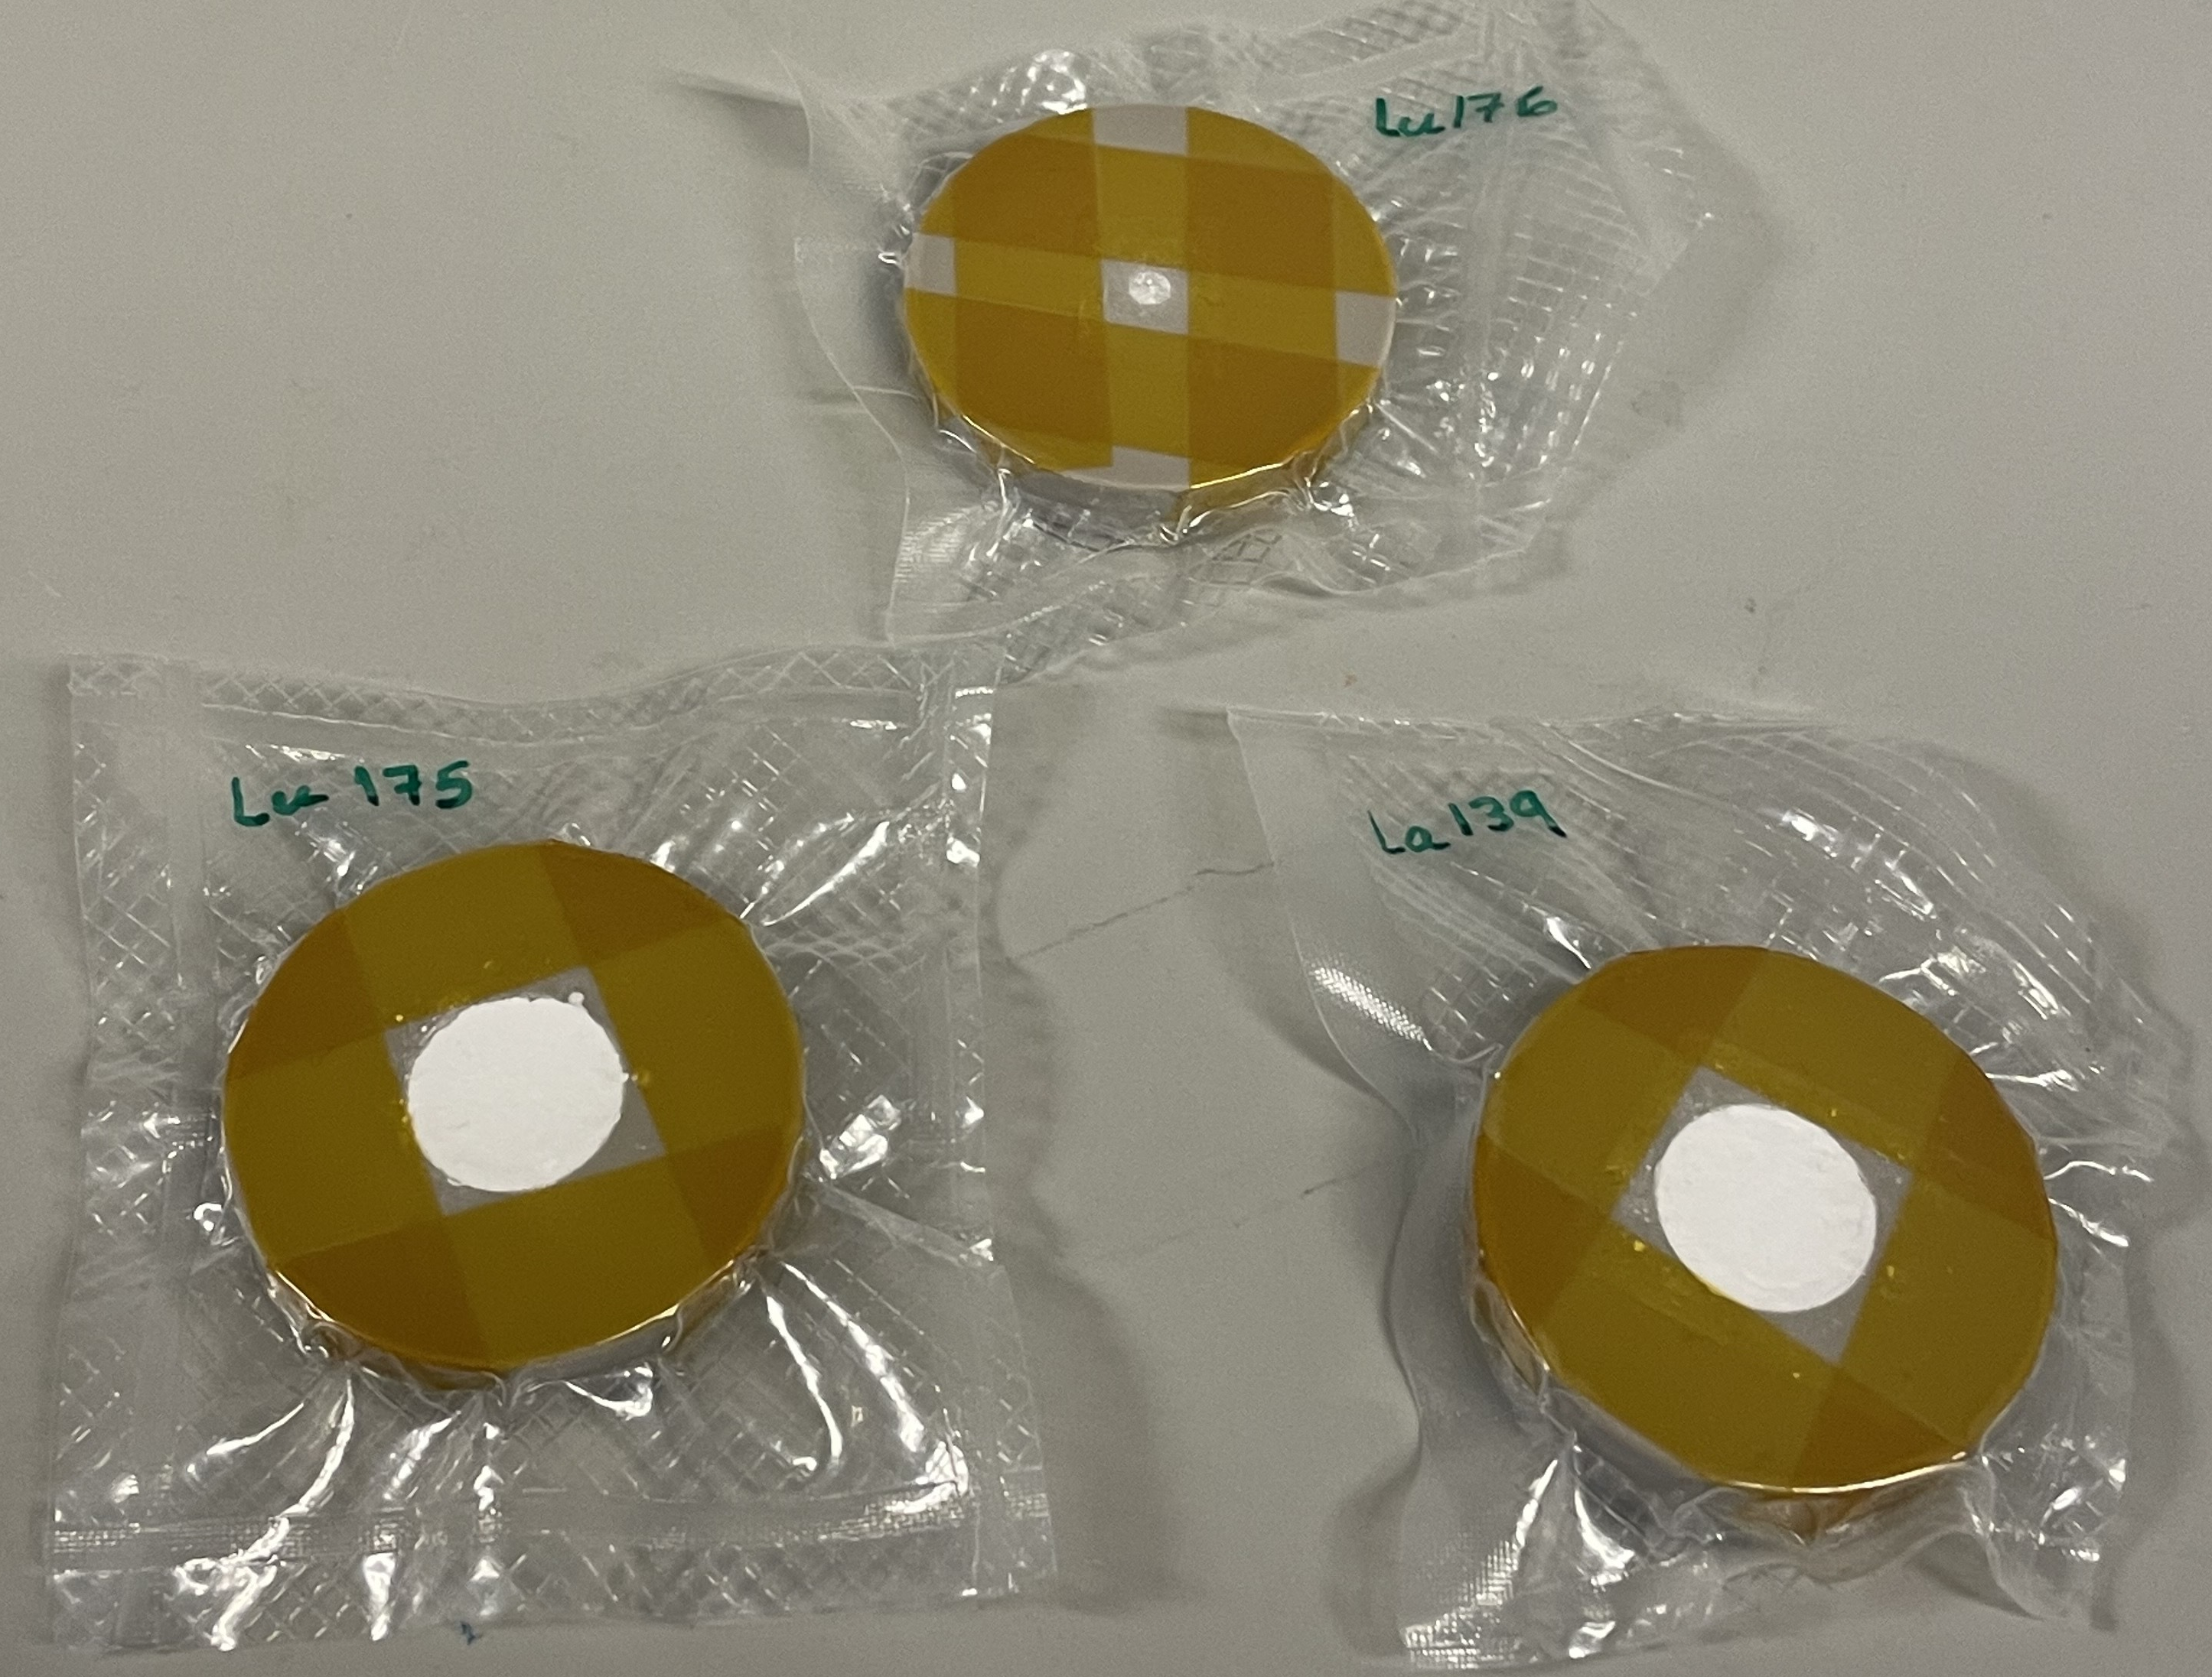
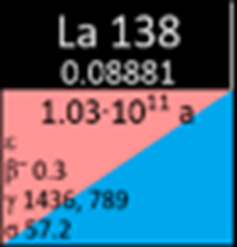

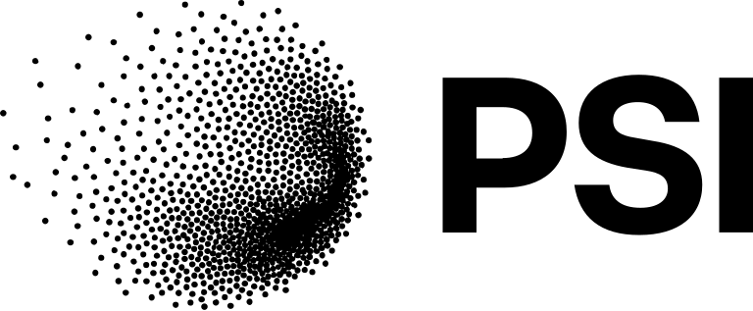


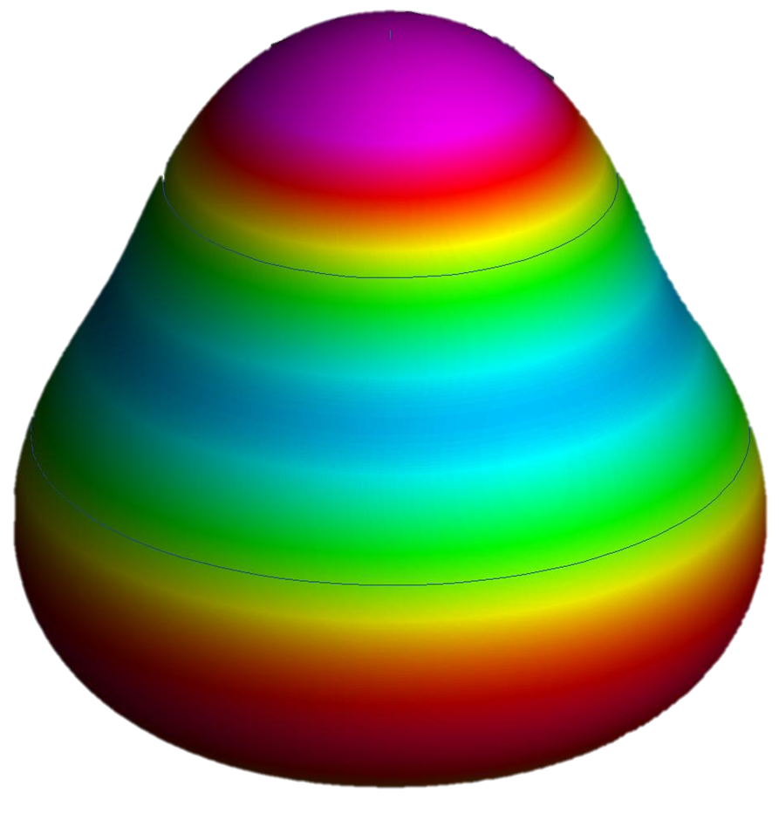



Muonic x-ray spectroscopy of La and Lu: measurement techniques and target productions
Muonic atom
War War Myint Myat Phyo
Supervisor: Prof. Thomas Elias Cocolios
muX and Reference Radii collaborations
Why La and Lu?
n= 1
n= 14
$$μ$$
$$e$$
Measurement Techniques
Large targets
Microgram targets
Project number: 101088504

Slide 2
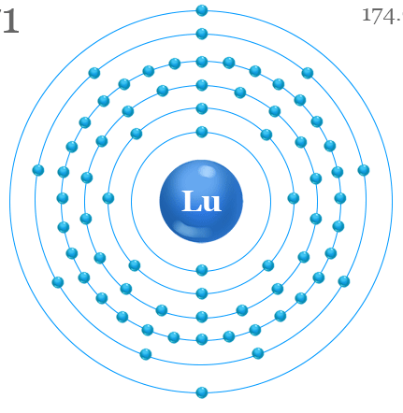
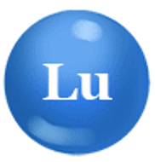

Muonic x-ray spectroscopy
Muonic atom forms
n= 1
n= 14
$$μ$$
*orbital distances not to scale

Slide 3
Muonic x-ray spectroscopy
Muonic atom forms
n= 1
n= 14
$$μ$$
*orbital distances not to scale

Slide 4
Muonic x-ray spectroscopy
HPGe
Muonic atom forms
n= 1
n= 14
$$μ$$
HPGe
once the muon reaches the ground state, there are two possible fates:
free muon decay, emitting an electron and two neutrinos
captured by the nucleus
*orbital distances not to scale

Slide 5


Muonic x-ray spectroscopy
Bohr Model:
$r_{n}∝\frac{n^{2}}{mZ}$
Muonic orbitals are much closer than electronic orbital to the nucleus. Therefore, more sensitive to nuclear properties.
$$μ$$
$$e$$
m$μ \sim 207 me$
*orbital distances not to scale

Slide 6
Why La and Lu?

Slide 7
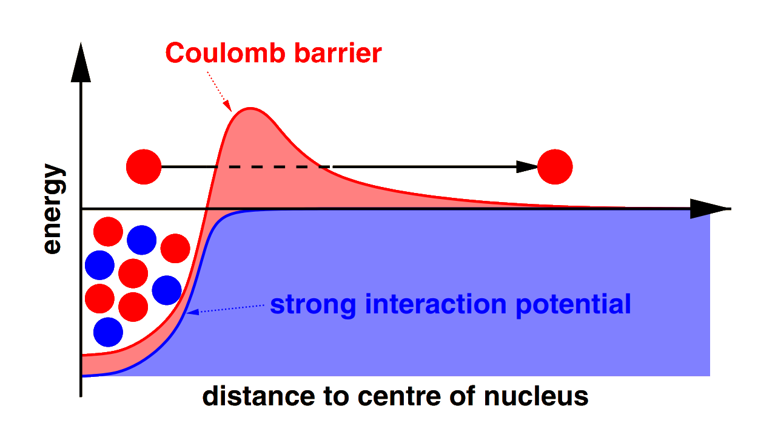
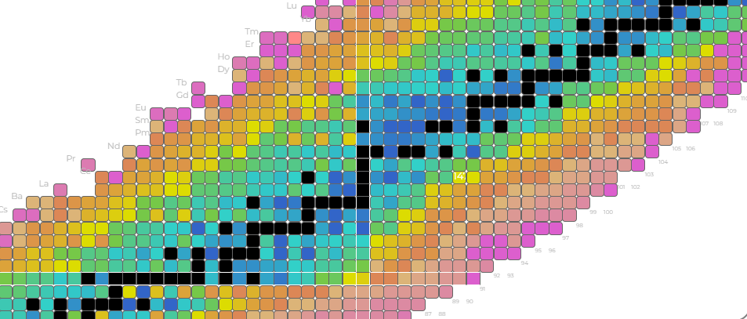
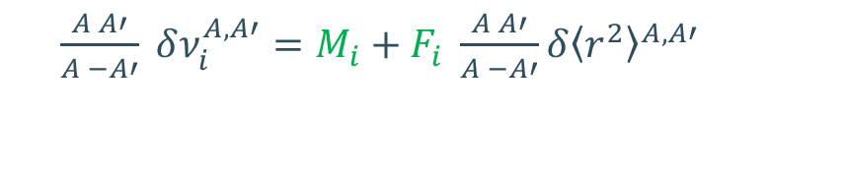
Laser spectroscopy:
$\frac{A A′}{A −A′} δν_{i}^{A, A′}=M_{i}+F_{i} \frac{A A′}{A −A′}δ{\left\langle r^{2}\right\rangle }^{A,A′}$
proton emitter
slightly oblate deformed
close to N=82
¹⁵⁰Lu,¹⁵¹Lu
¹⁵⁶Lu, ¹⁷⁵Lu
proton emitter
largely prolate deformed
far from any shell closure
¹³⁷La, ¹³⁸La, ¹³⁹La
absolute charge radii measurement
using muonic x-ray spectroscopy
¹¹⁷La

Slide 8



Measuring the absolute charge radii of ^{137, 138, 139}La and ^{175, 176}Lu
¹¹⁷La
¹⁵⁰Lu
¹⁵¹Lu
Laser spectroscopy:
$\frac{A A′}{A −A′} δν_{i}^{A, A′}=M_{i}+F_{i} \frac{A A′}{A −A′}δ{\left\langle r^{2}\right\rangle }^{A,A′}$
slope and intercept
Modified $δν_{i}^{A, A′}$
$$Modified δ{\left\langle r^{2}\right\rangle }^{A,A′}$$

Slide 9
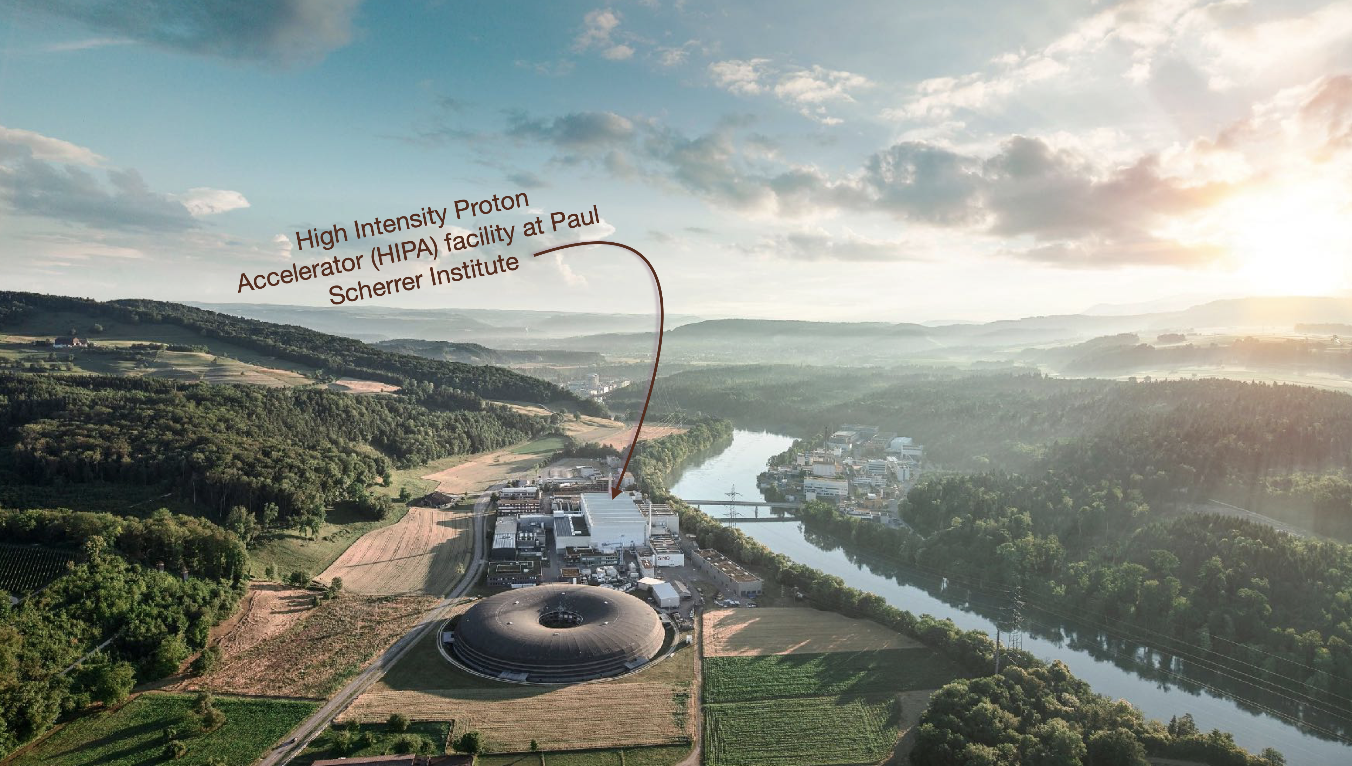

Slide 10
Measurement techniques
1. Direct muon capture method
2. Indirect muon capture method

Slide 11
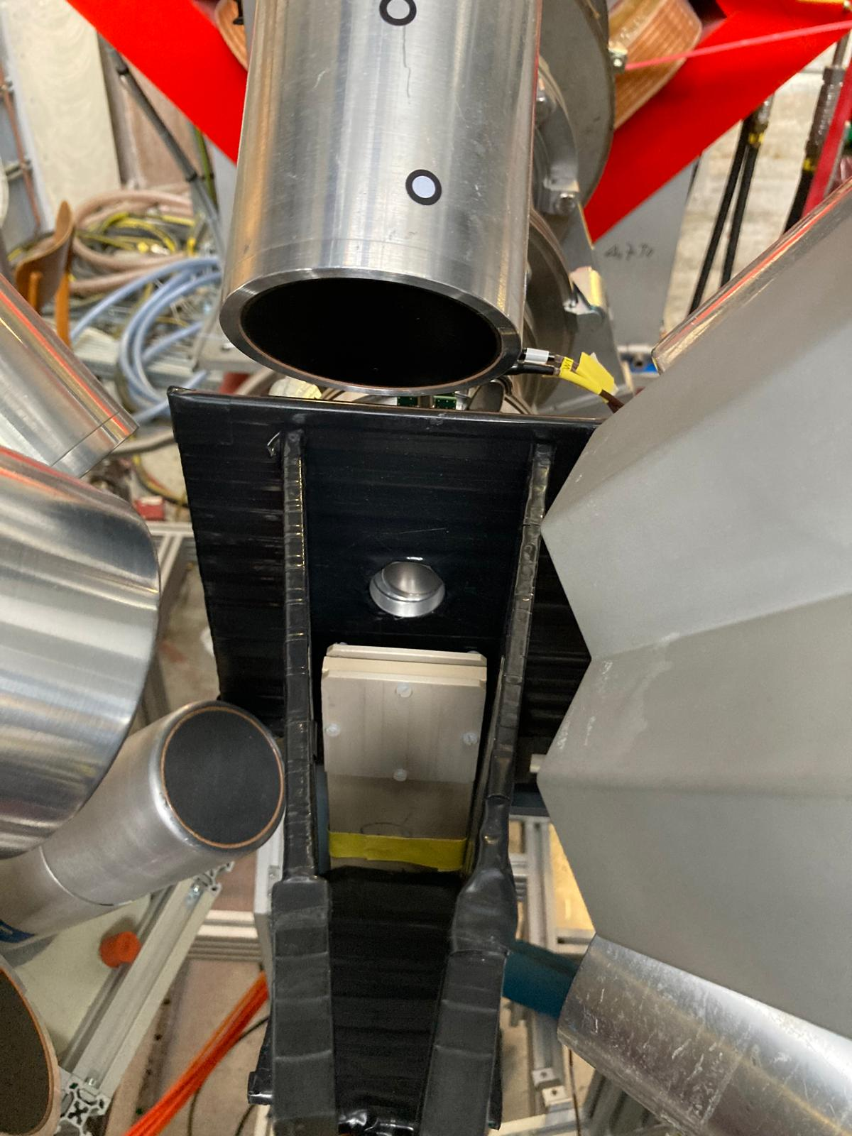
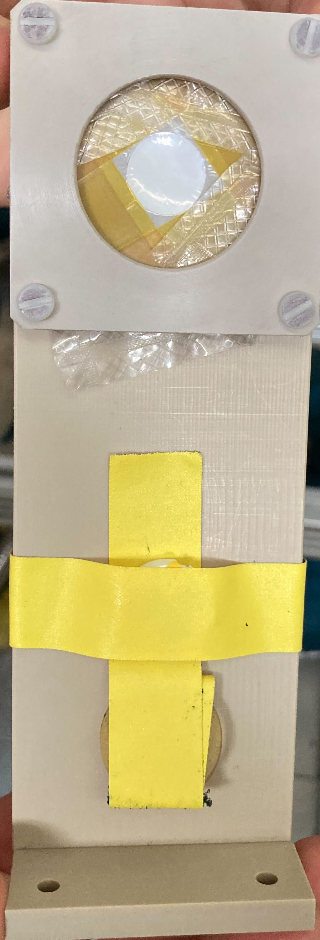

Direct muon capture method
For sufficiently large targets (10-100mg)
Shot muons directly on target
target
$$μ$$

Slide 12
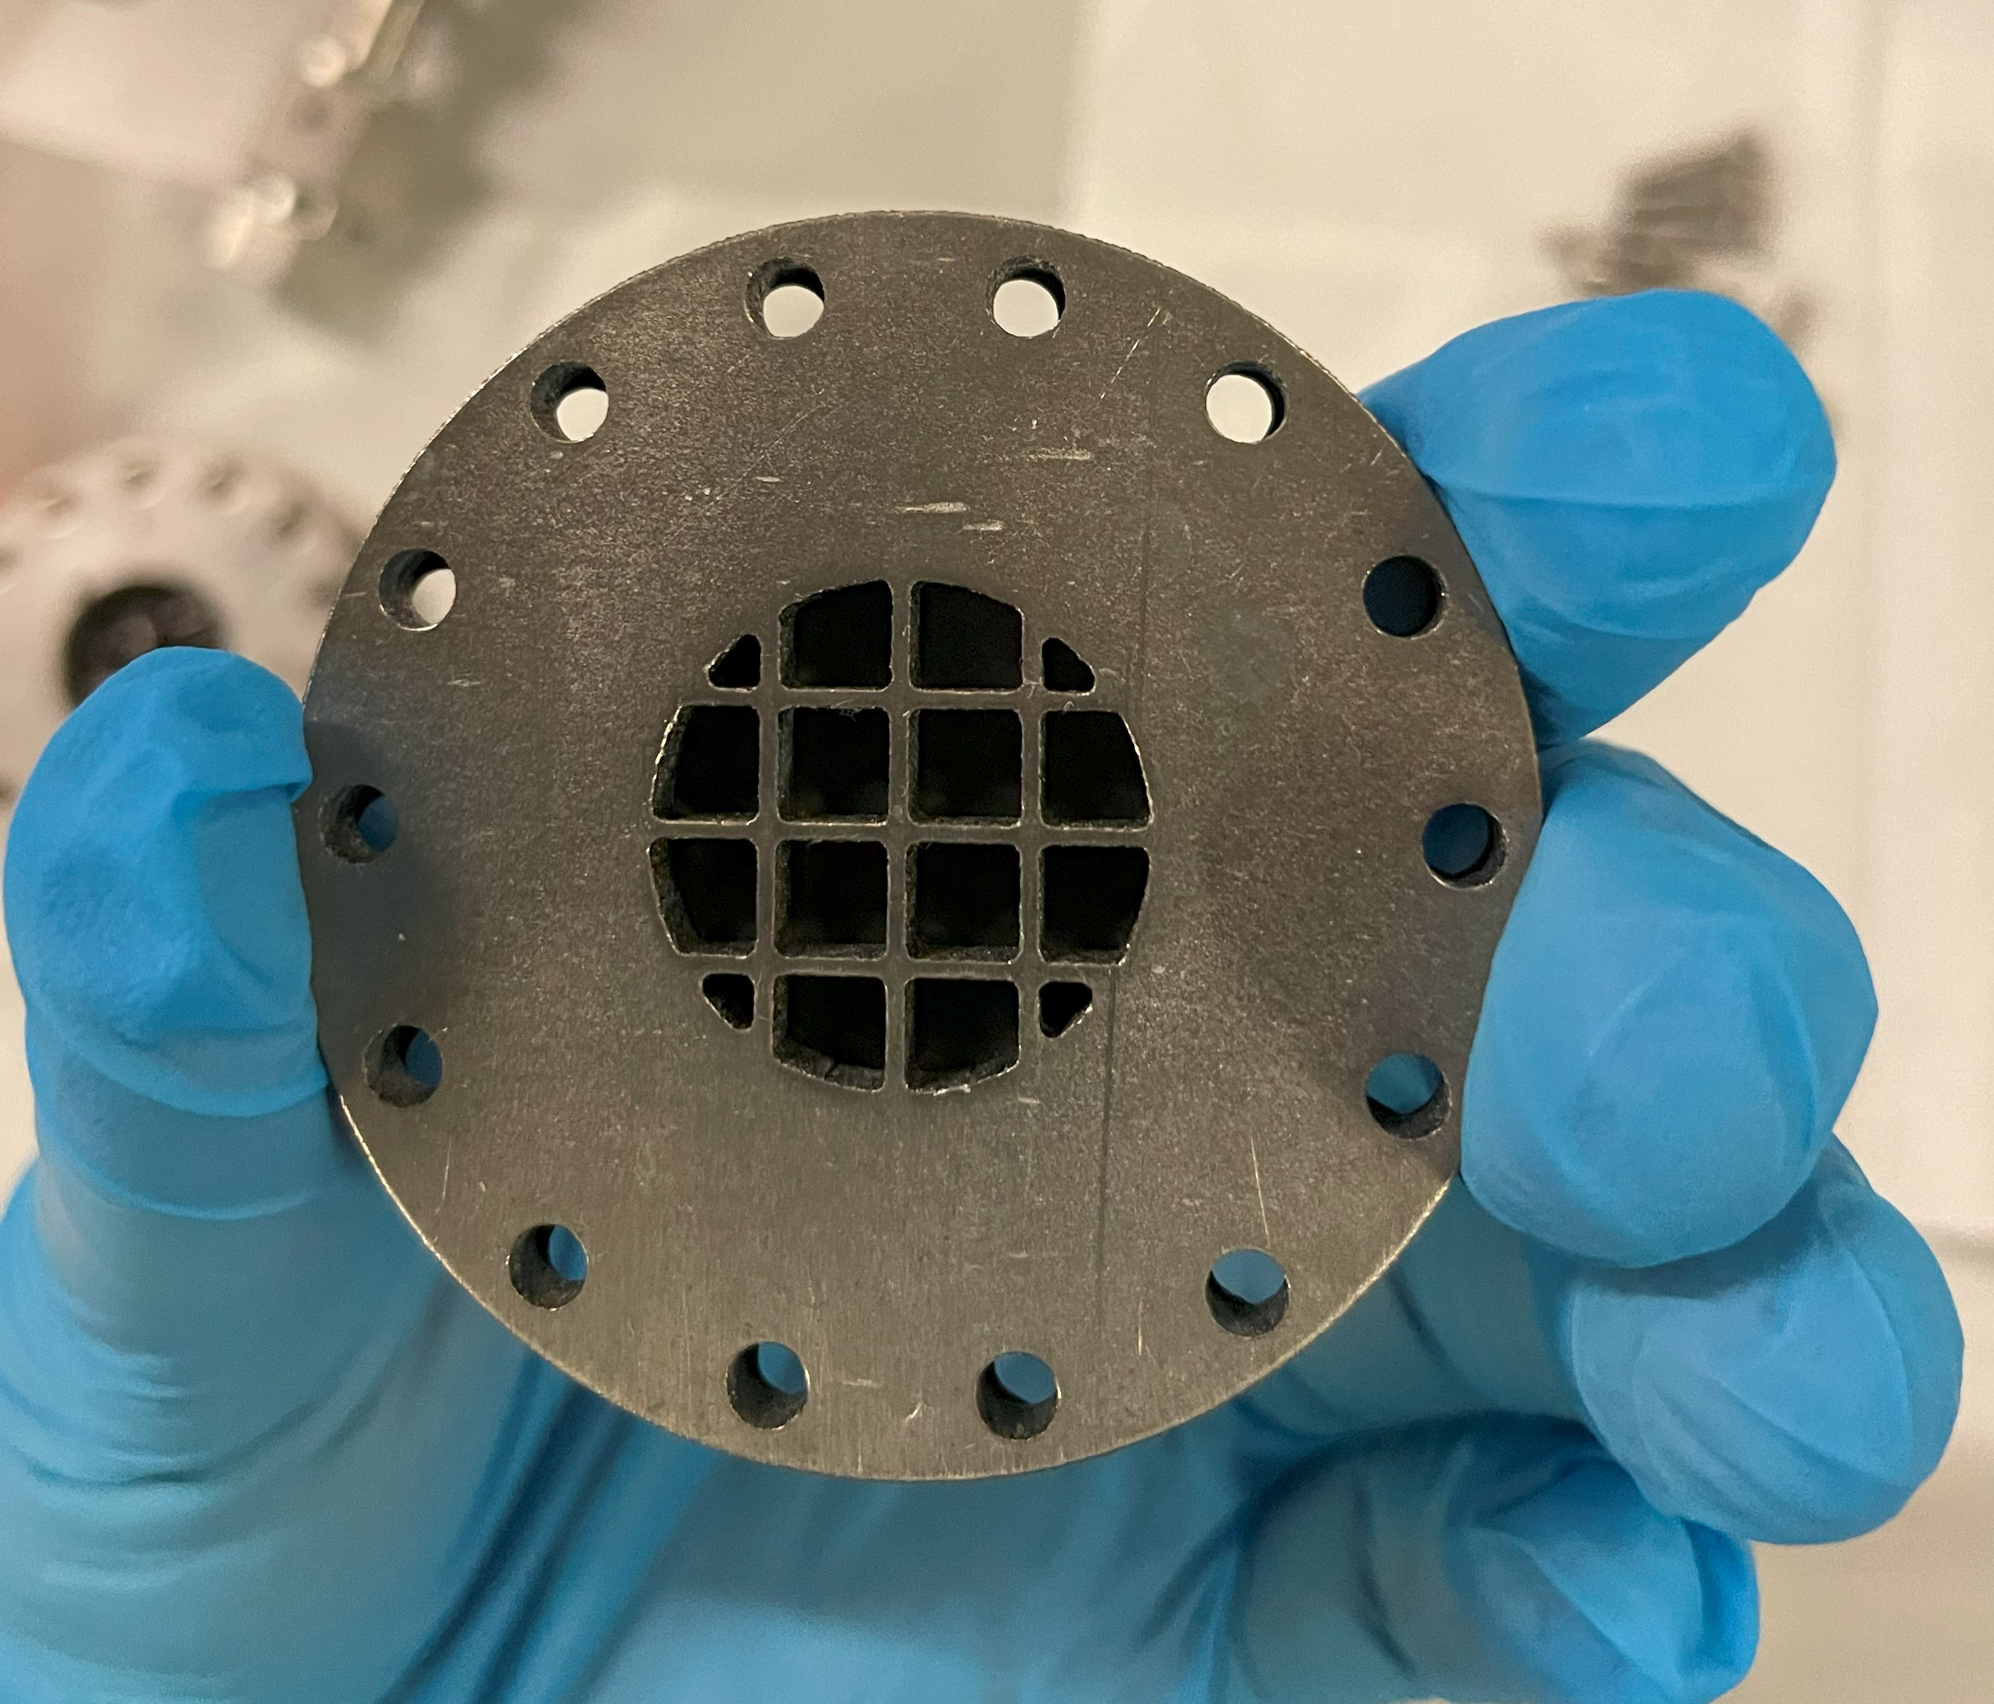
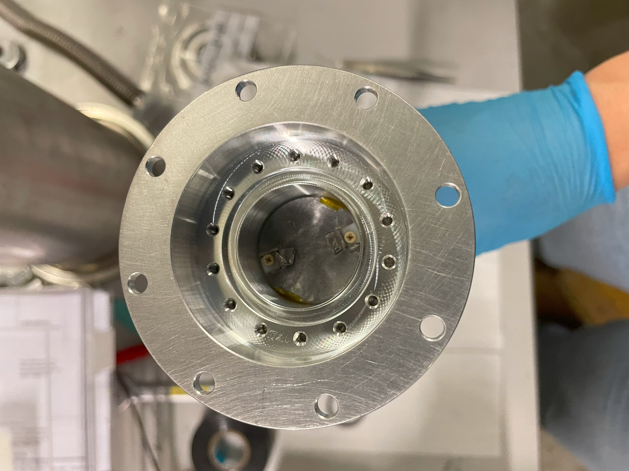
Indirect muon capture method
For small targets (≳ 5 ug)
Gas cell filled with H₂ with 0.25% of D₂ is used
Muon is transferred to the target through the diffusion processes inside the gas cell
target will be placed here
Stergiani Marina Vogiatzi. Studies of muonic 185,187Re, 226Ra, and 248Cm for the extraction of nuclear charge radii. PhD thesis, Doctor of Sciences of ETH Zurich

Slide 13
Diffusion processes inside the gas cell
Muon veto
Muon entrance
Target
@100 bar
H₂
H₂
D₂
D₂
H₂
H₂
H₂
H₂
H₂
H₂
H₂
H₂
H₂
D₂
H₂
D₂
H₂
- Adamczak, Andrzej, et al. "Muonic atom spectroscopy with microgram target material." The European Physical Journal A 59.2 (2023): 15.
Animation @ M.Heines

Slide 14
Diffusion processes inside the gas cell
@100 bar
H₂
H₂
D₂
D₂
µ⁻
H₂
H₂
H₂
H₂
H₂
H₂
H₂
H₂
H₂
D₂
H₂
D₂
H₂
- Adamczak, Andrzej, et al. "Muonic atom spectroscopy with microgram target material." The European Physical Journal A 59.2 (2023): 15.
Animation @ M.Heines

Slide 15
Diffusion processes inside the gas cell
@100 bar
H₂
H₂
D₂
D₂
H₂
H₂
H₂
µH
H₂
H₂
H₂
H₂
H₂
D₂
H₂
D₂
H₂
- Adamczak, Andrzej, et al. "Muonic atom spectroscopy with microgram target material." The European Physical Journal A 59.2 (2023): 15.
Animation @ M.Heines

Slide 16
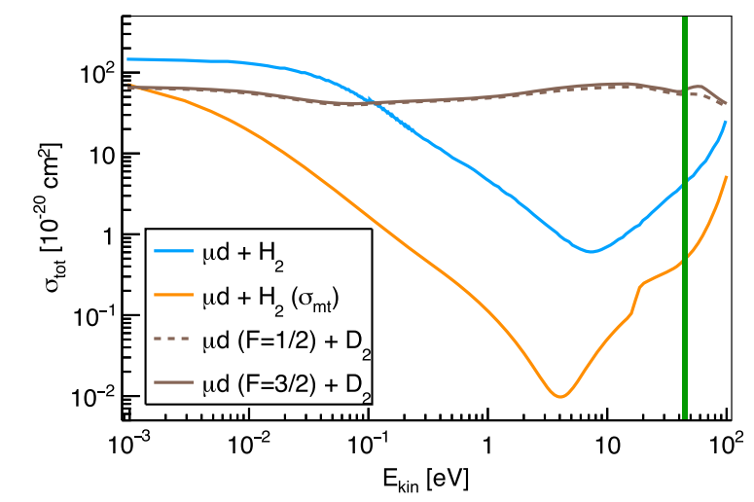
Diffusion processes inside the gas cell
@100 bar
H₂
H₂
D₂
D₂
H₂
H₂
H₂
H₂
H₂
H₂
H₂
H₂
H₂
D₂
H₂
µD
H₂
- Adamczak, Andrzej, et al. "Muonic atom spectroscopy with microgram target material." The European Physical Journal A 59.2 (2023): 15.
Animation @ M.Heines

Slide 17
Diffusion processes inside the gas cell
@100 bar
H₂
H₂
D₂
D₂
H₂
H₂
H₂
H₂
H₂
H₂
H₂
µD
H₂
H₂
D₂
H₂
H₂
- Adamczak, Andrzej, et al. "Muonic atom spectroscopy with microgram target material." The European Physical Journal A 59.2 (2023): 15.
Animation @ M.Heines

Slide 18
Diffusion processes inside the gas cell
@100 bar
H₂
H₂
D₂
D₂
H₂
H₂
H₂
H₂
H₂
µZ
H₂
H₂
H₂
H₂
D₂
H₂
D₂
H₂
- Adamczak, Andrzej, et al. "Muonic atom spectroscopy with microgram target material." The European Physical Journal A 59.2 (2023): 15.
Animation @ M.Heines

Slide 19
Target preparations

Slide 20
Targets
microgram targets
¹⁷⁶Lu
¹⁷⁵Lu
¹³⁹La
¹³⁸La
¹³⁷La
enriched sample
10mg of La₂O₃
5.9% purity
needs to be mass separated to enhance the purity
200ug of La₂O₃
ongoing characterization to know the purity
Large targets
enriched sample
20mg of Lu₂O₃
74.5% purity
natural sample
1g of Lu₂O₃
97.4% purity
natural sample
1g of La₂O₃
99.9% purity

Slide 21


Targets
¹³⁸La
¹³⁷La
enriched sample
10mg of La₂O₃
5.9% purity
needs to be mass separated to enhance the purity
200ug of La₂O₃
sample is being characterized
¹⁷⁶Lu
¹⁷⁵Lu
¹³⁹La
enriched sample
20mg of Lu₂O₃
74.5% purity
natural sample
1g of Lu₂O₃
97.4% purity
natural sample
1g of La₂O₃
99.9% purity

Slide 22
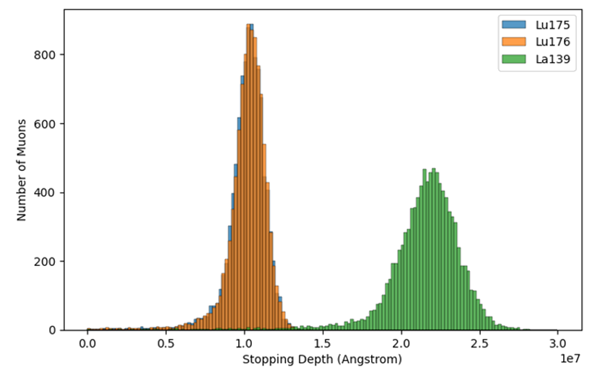
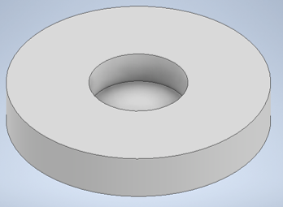
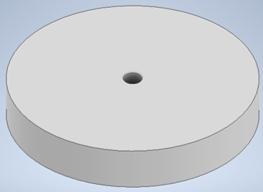
Large targets preparation
Dimension optimization
Number of muons
stopping depth (Angstrom)

Slide 23
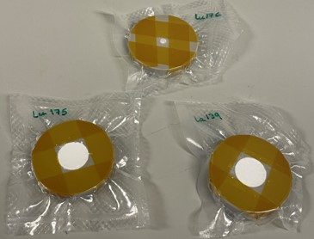
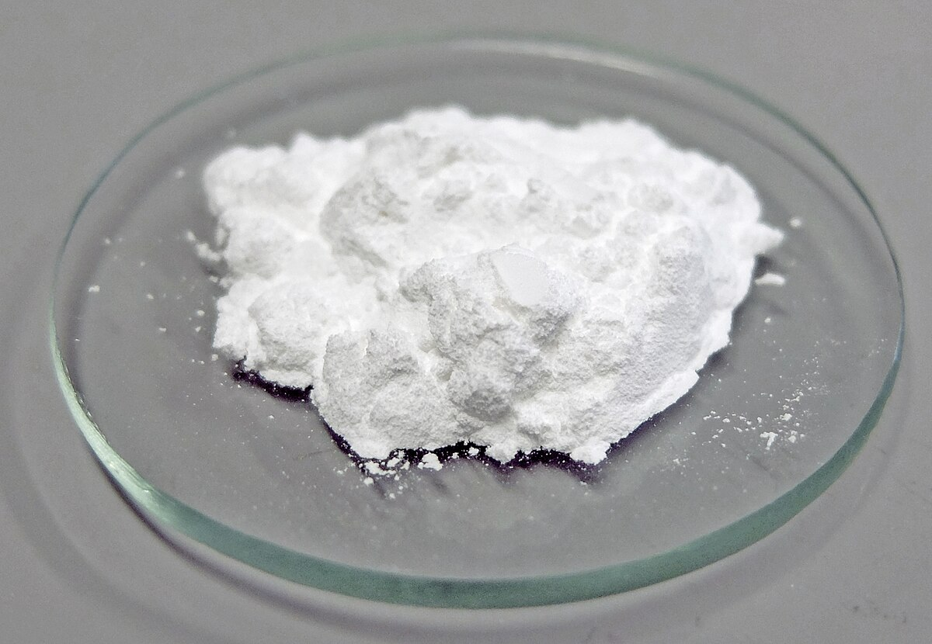
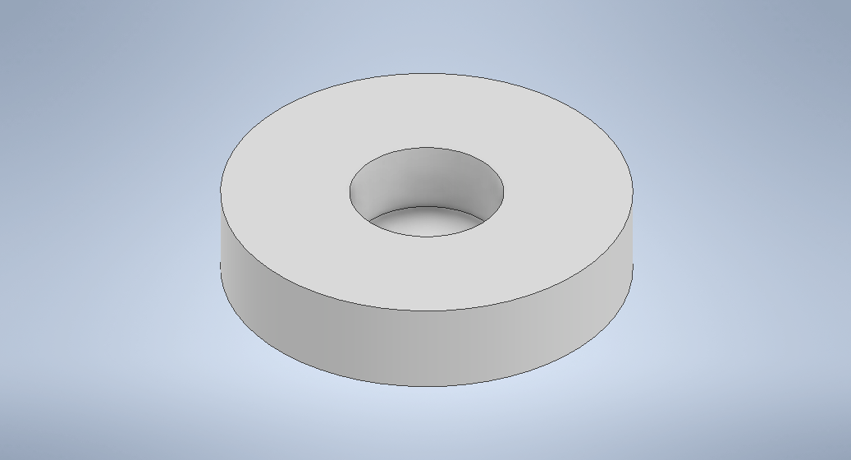
Large targets preparation
powder
La₂O₃ / Lu₂O₃
powder
PEEK holder
placed in a PEEK target holder
and sealed in plastic pouch

Slide 24
Microgram target preparation
mass separation and implantation
¹³⁸La
glassy carbon disc
¹³⁹La
¹³⁸La
at least 75% purity
10 ug
5.9% purity
10 mg

Slide 25
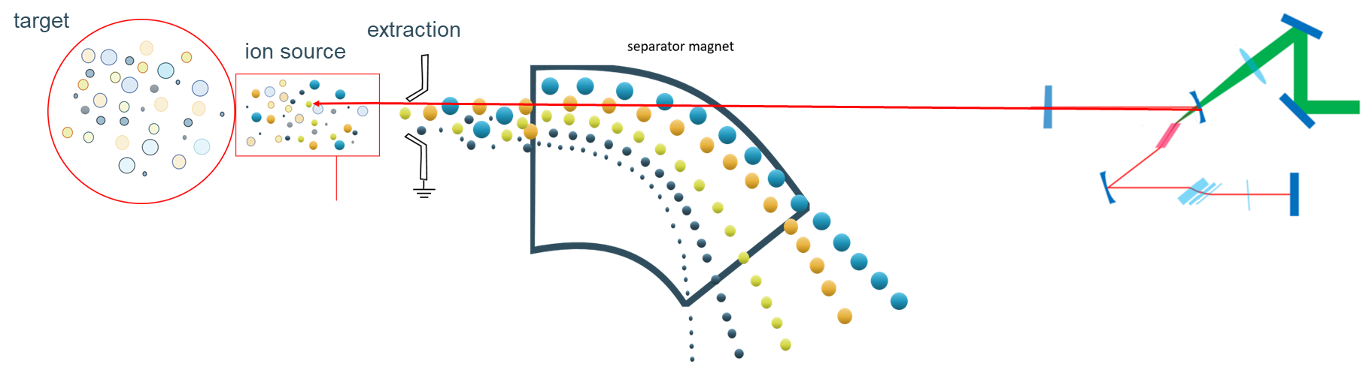
Mass separation technique
laser
HV
In separator magnet, the trajectories depend on A / q ratio
Heavier ions bend less, lighter ions bend more
¹³⁸La can be separated from ¹³⁹La using this technique

Slide 26
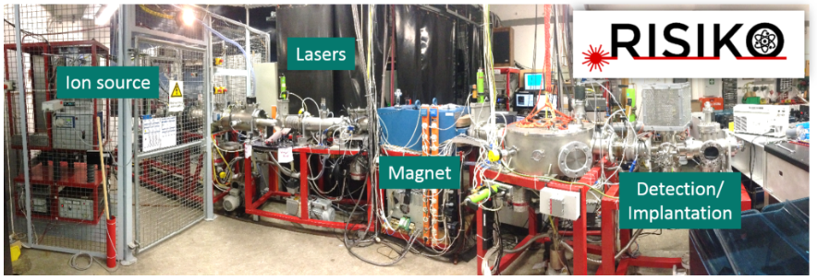
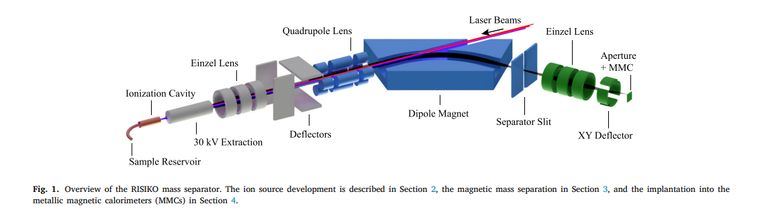
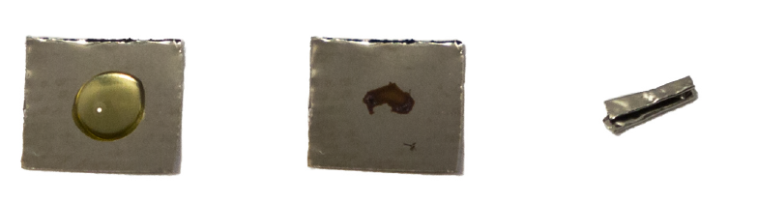
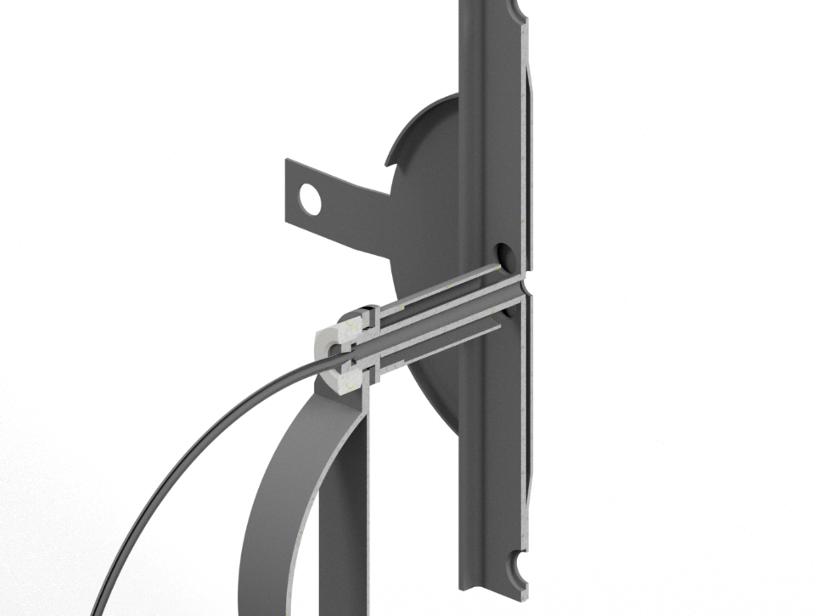


Test separation at RISIKO
RISIKO – an offline ion beam separator in Mainz, Germany
Lanthanum nitrate solution droplet was deposited on a foil. After drying, it was folded and inserted into the sample reservoir
Sample was heated till it vaporizes, then La was ionized using the resonance laser ionization (Ionization scheme of La was developed by the group in Mainz)
Extracted the ions and measured the signal on the FC
3 mm
Ions
Laser beams
Sample
$$I_{1}$$
$$I_{2}$$
D. Studer, Joint ARIEL SANDA meeting

Slide 27
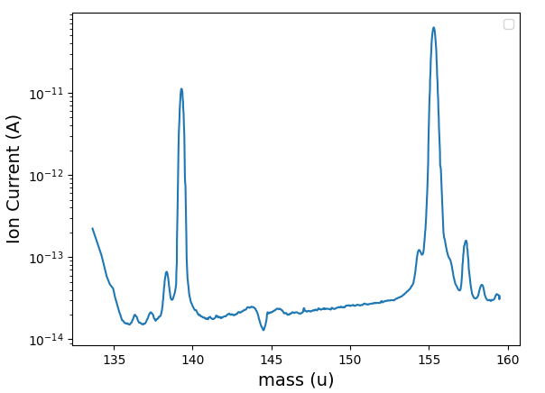
Test separation at RISIKO
laser ionized ¹³⁹La ion peak
surface ionized LaO peak
Very low separation efficiency of La ions
< 0.1%

Slide 28
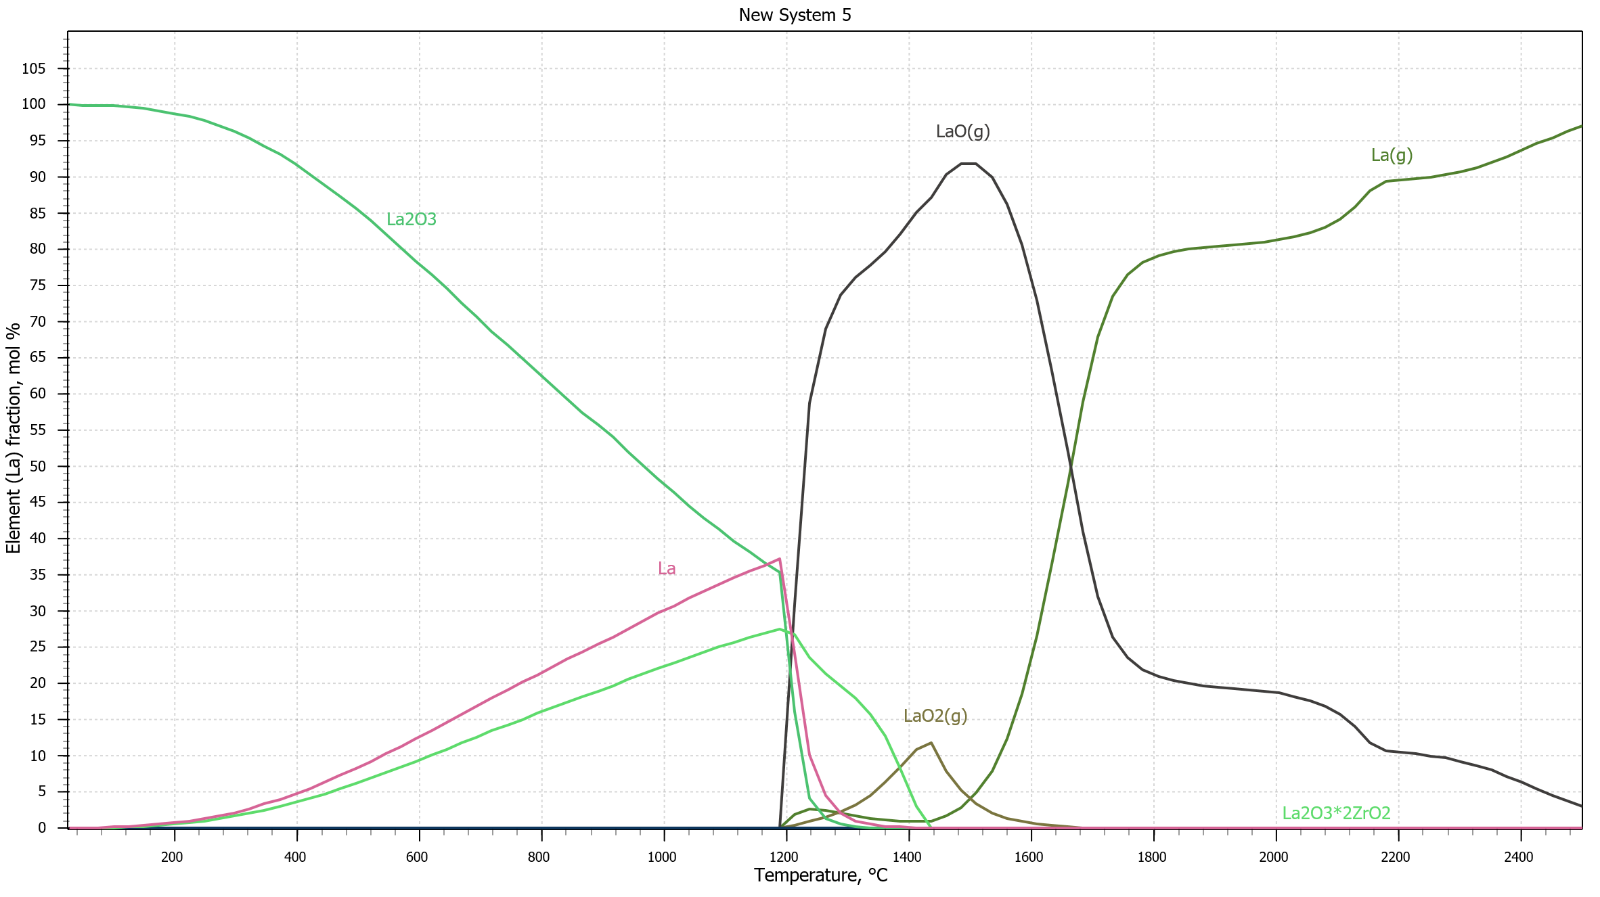
Test separation at RISIKO
LaO(g)
La(g)
La₂O₃
Attempted to reduce the LaO formation
using Y as a reducing agent
Tried different configurations of the samples
Couldn’t reach above 0.5% efficiency
Plot provided by W.Wojtaczka / R.J. Hasse

Slide 29
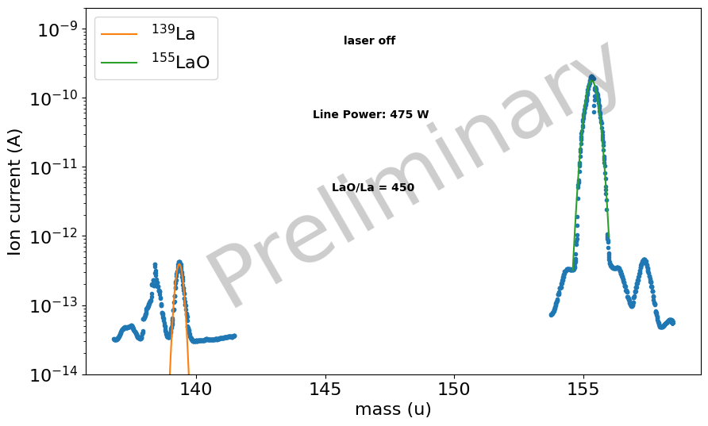
Test separation at RISIKO
surface ionized LaO peak
Achieved 1.5% efficiency during the test
1.5% efficiency → 8.8 μg of ¹³⁸La
Lower limit of target for the gas cell method is 5 μg.
0.08% of ¹³⁸La¹⁶O
in natural sample
Plot produced by R.J.Hasse

Slide 30

Targets
microgram targets
¹³⁸La
¹³⁷La
enriched sample
10mg of La₂O₃
5.9% purity
needs to be mass separated to enhance the purity
200ug of La₂O₃
sample is being characterized
Large targets
¹⁷⁶Lu
¹⁷⁵Lu
¹³⁹La
enriched sample
20mg of Lu₂O₃
74.5% purity
natural sample
1g of Lu₂O₃
97.4% purity
natural sample
1g of La₂O₃
99.9% purity

Slide 31
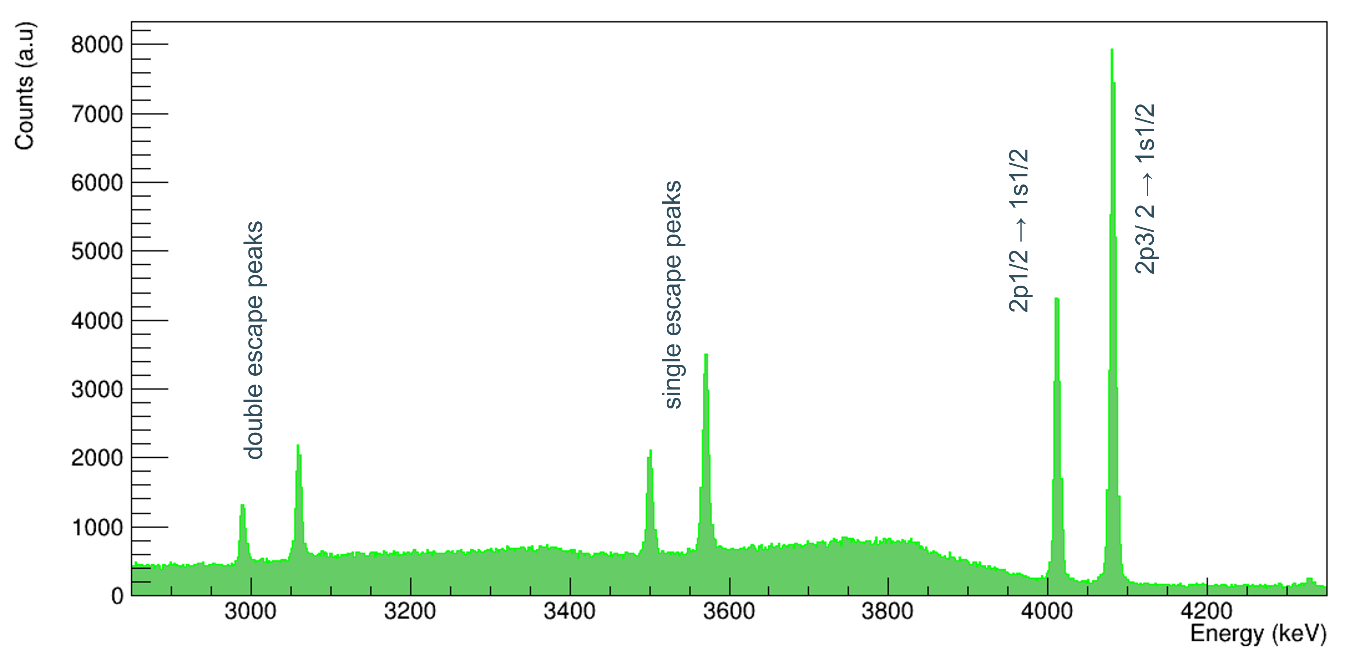
Preliminary data from 2024 beamtime
Muonic x-ray energy spectrum of 139La
Shows the readiness for next measurement

Slide 32
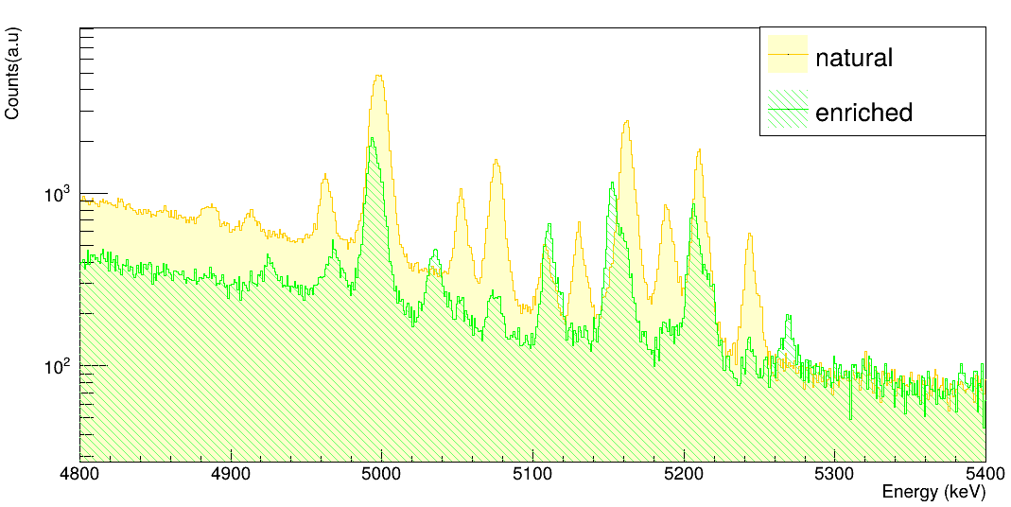
Preliminary data from 2024 beamtime
Enriched : 74.5% of ¹⁷⁶Lu
Natural : 97.4% of ¹⁷⁵Lu
Muonic x-ray energy spectrum of Lu
Several peaks for 2p-1s transition because of the hyperfine structure
Dynamic hyperfine structure is present. Complex analysis ongoing

Slide 33
Conclusion & Outlook
Presented:
Muonic x-ray spectroscopy measurement techniques
Target productions
Preliminary results
Outlook:
Ongoing analysis to extract the muonic transition energies of Lu from experiment
Initiate the theoretical calculations and charge radius extraction
Prepare microgram targets for next beamtime

Slide 34
Thank you very much!
Project number: 101088504

Slide 35
Back Up slides

Slide 36
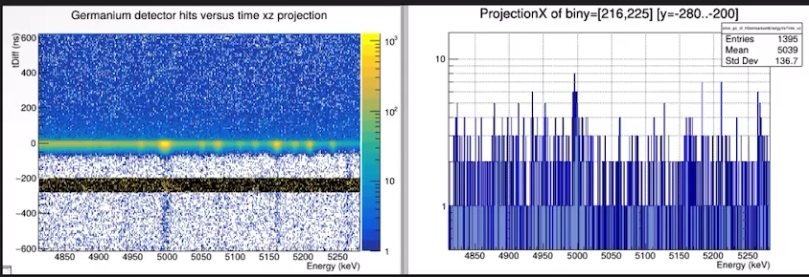
Energy Vs Time

Slide 37
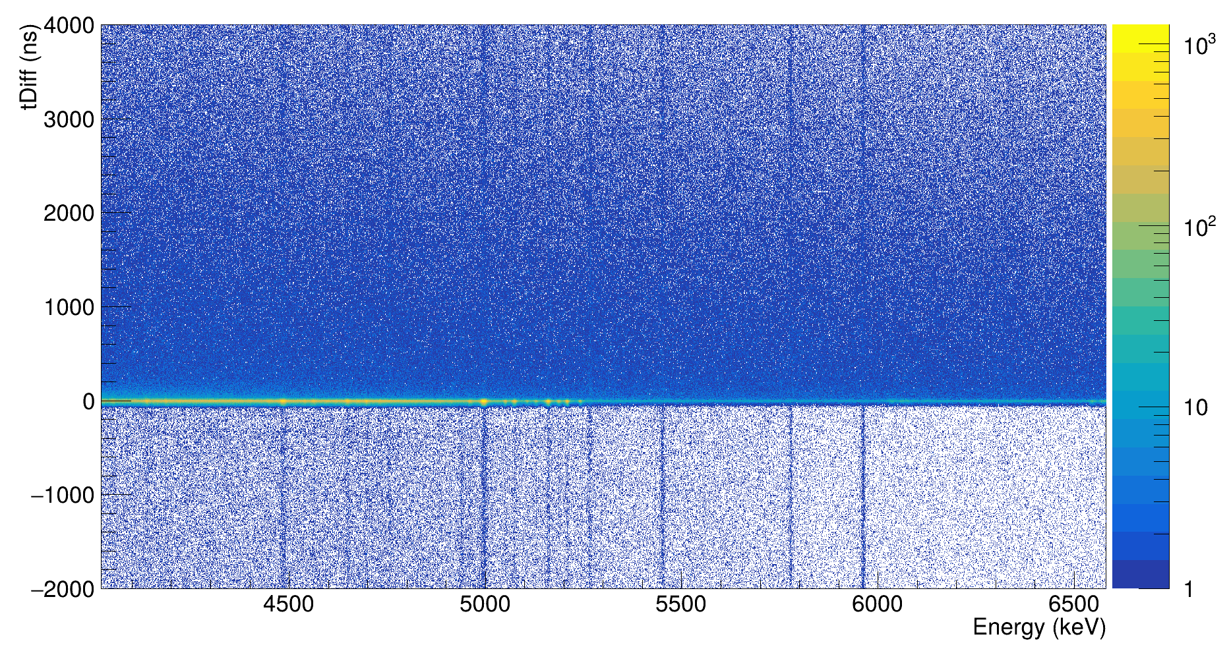
Analysis pipeline
tDiff = t _{HPGe} – t _{muon entrance}
Timing optimization
Energy calibration
Gain drift correction
3) Energy extraction
muonic x rays
calibration lines

Slide 38
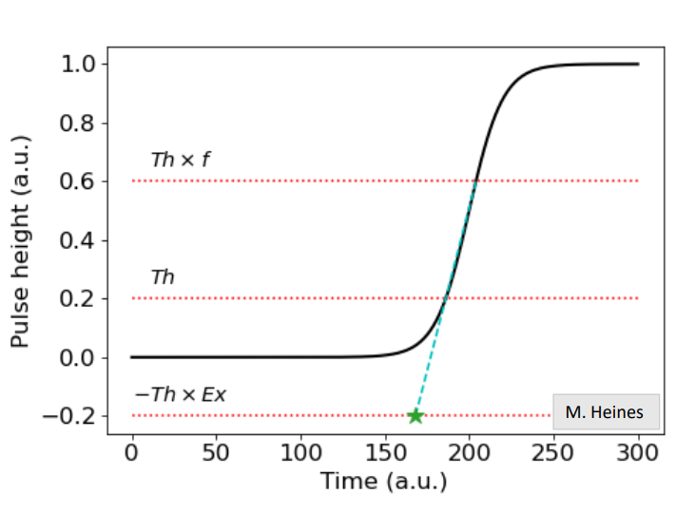
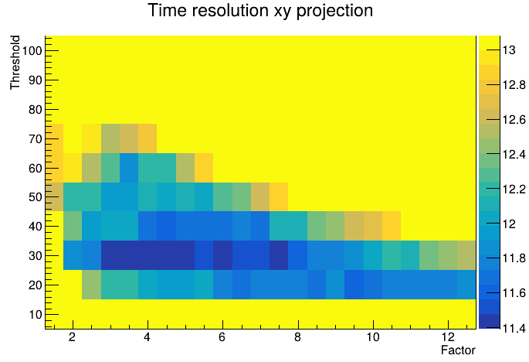
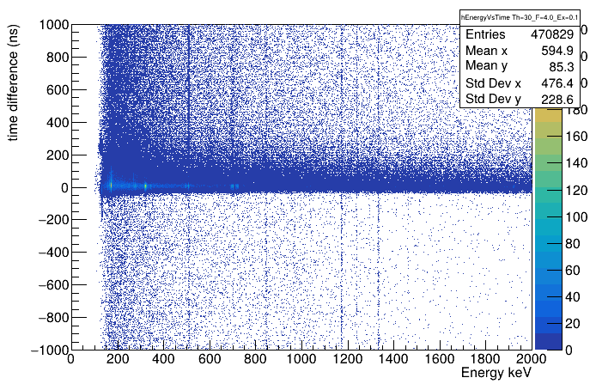
Timing analysis
ELET optimization : optimize Th, f and Ex in each detector
Ex= 0.1,
Th= 30,
f = 4
Example of good ELET
Time resolution per detector : 8.9 – 20.5 ns sigma

Slide 39
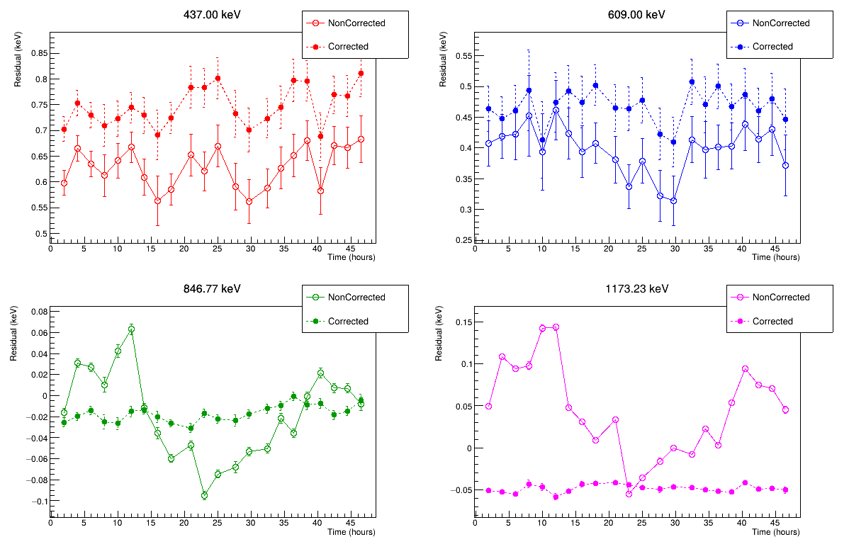
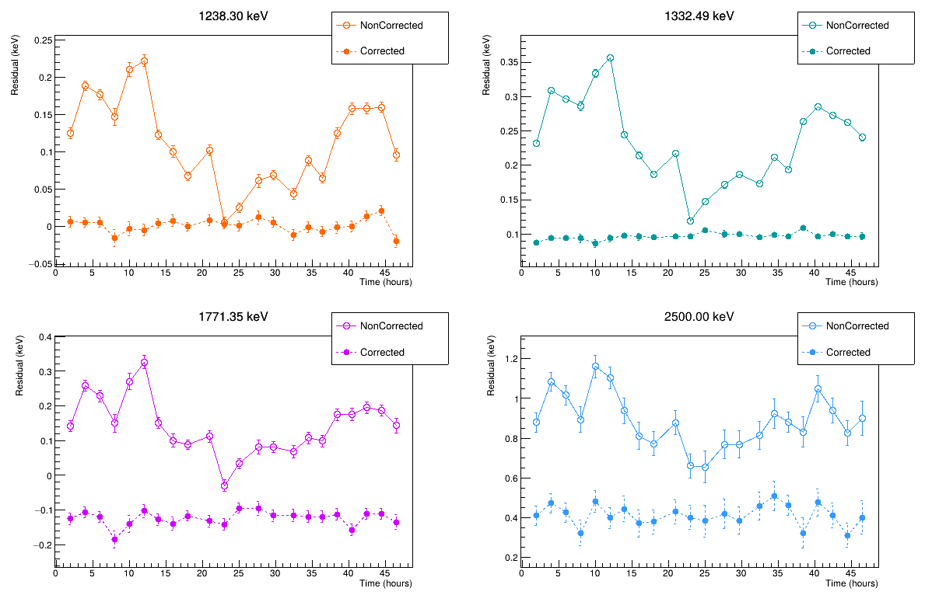
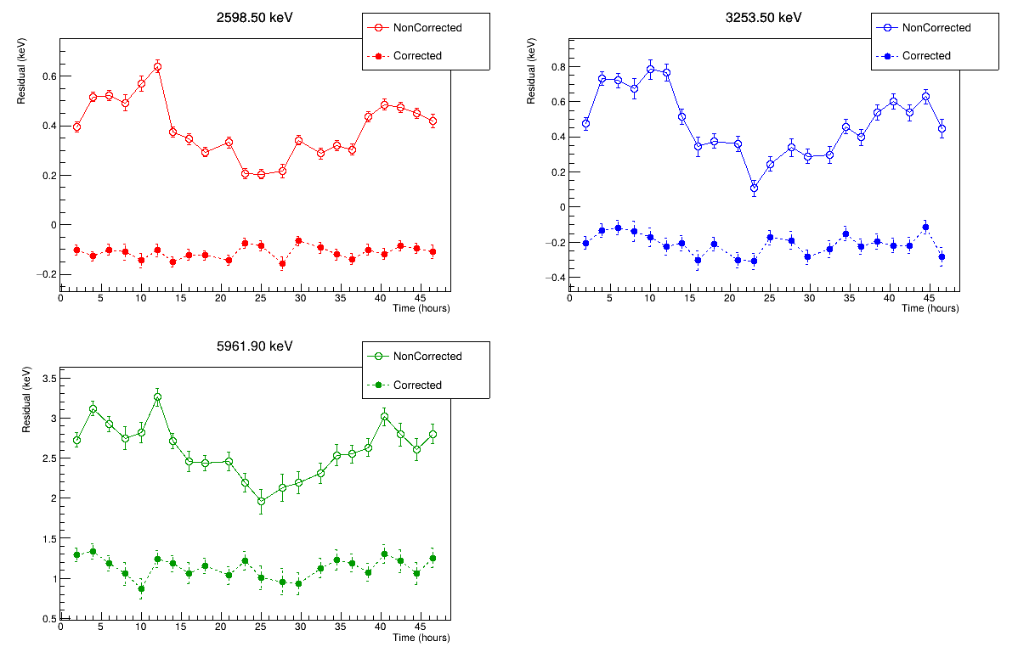
Example of
Gain Drift
Correction

Slide 40
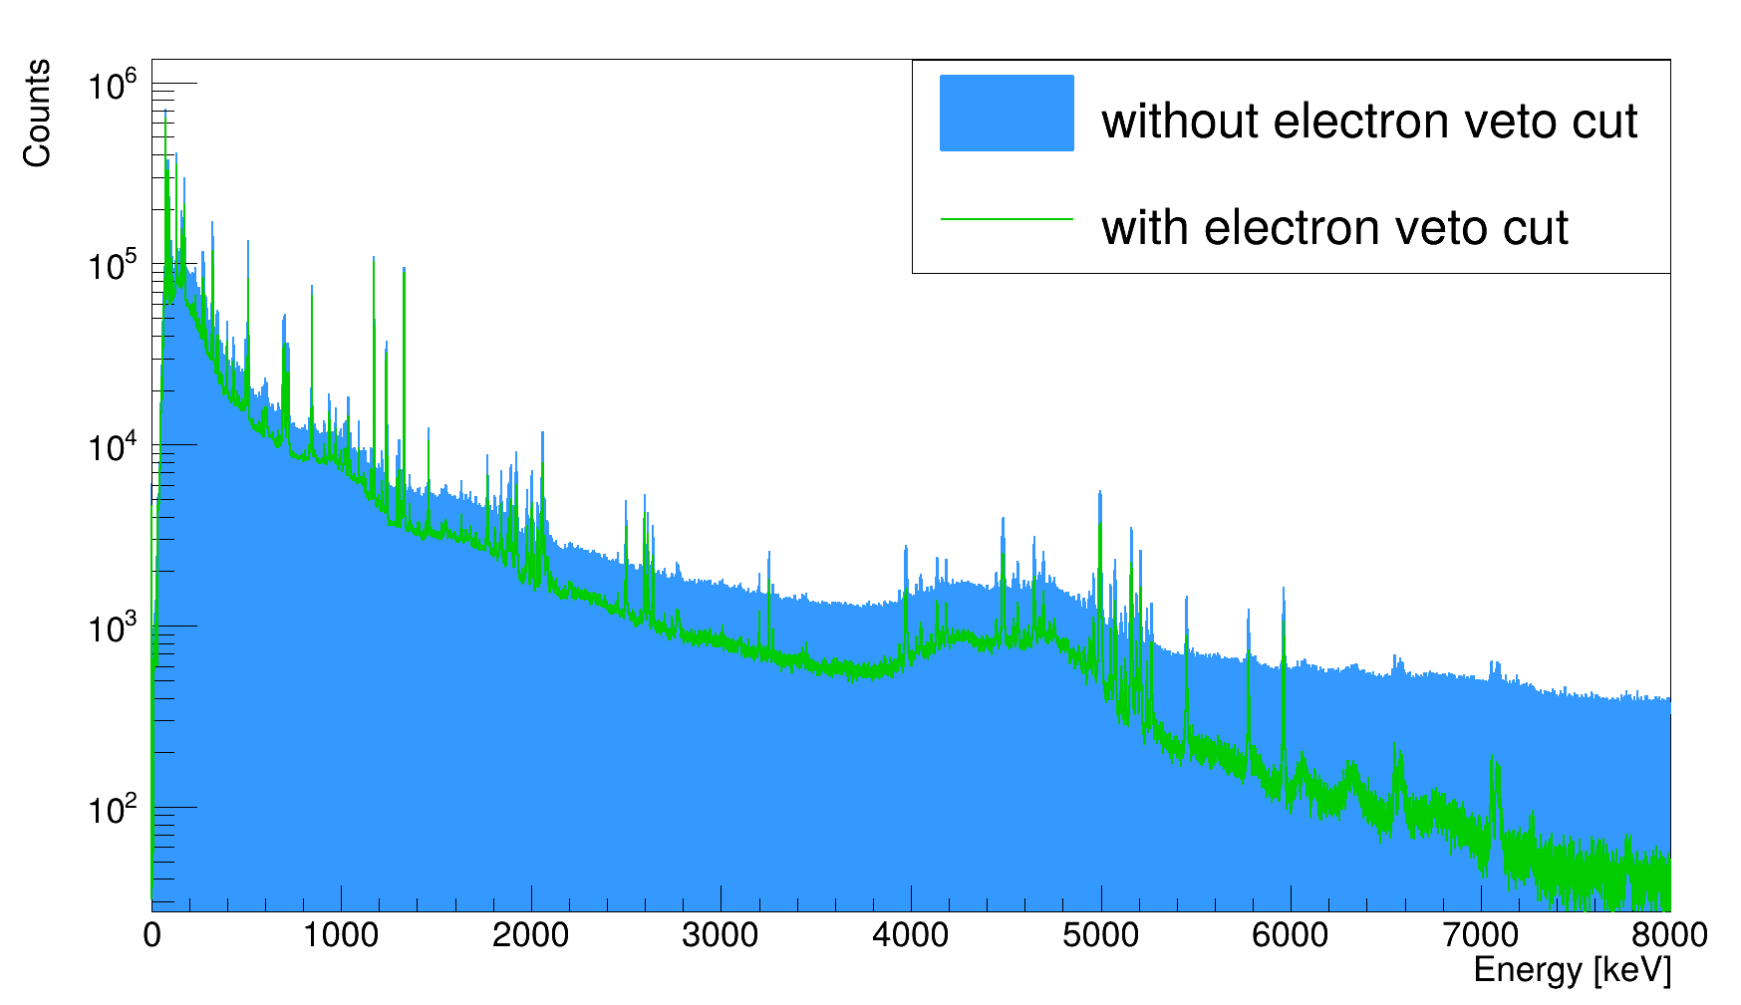
Effect of electron veto cut

Slide 41
Analysis pipeline
energies
charge distribution parameters
Theoretical calculations of
the Dirac equation
(α ⋅ p_{μ} + β m_{μ}) ψ = (E − V(r)) ψ
Correction of the muonic energy levels

Slide 42
Analysis pipeline
Experimental measured energies
Extract the charge distribution parameters
Theoretical calculations of
the Dirac equation
(α ⋅ p_{μ} + β m_{μ}) ψ = (E − V(r)) ψ
Correction of the muonic energy levels

Slide 43
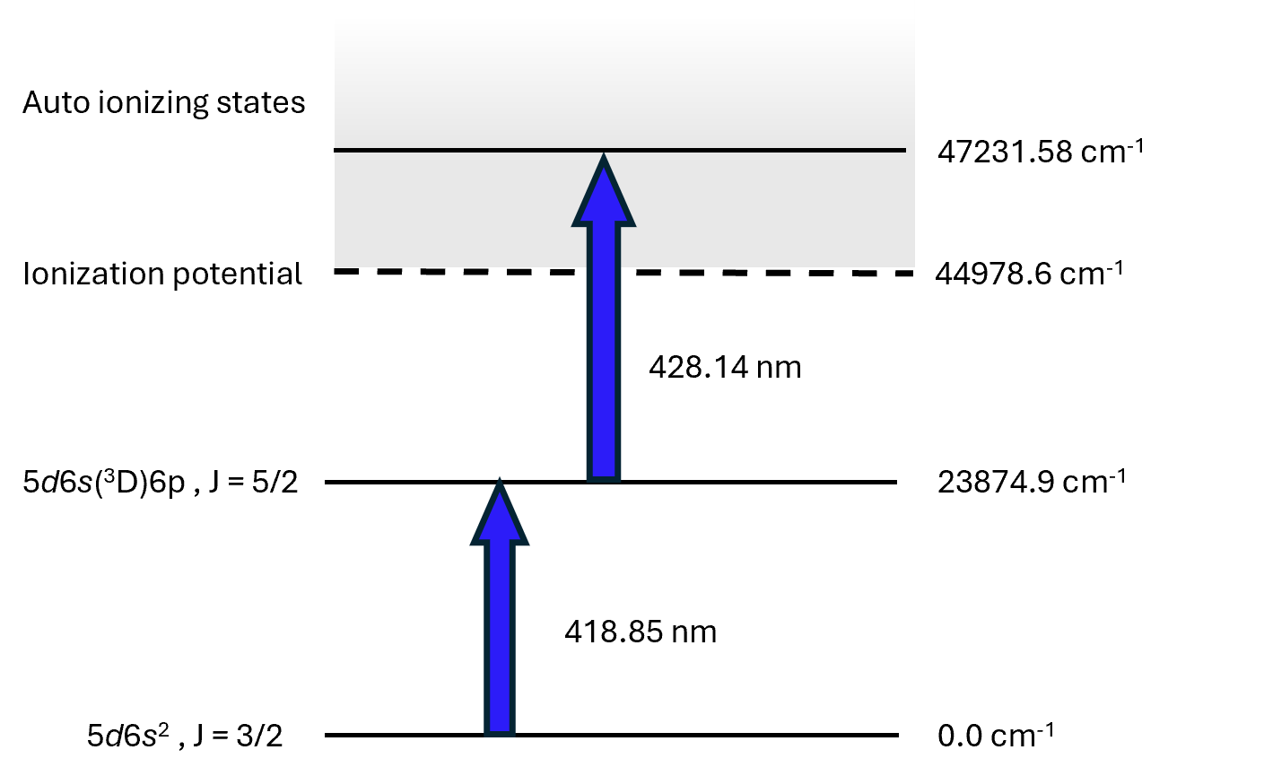
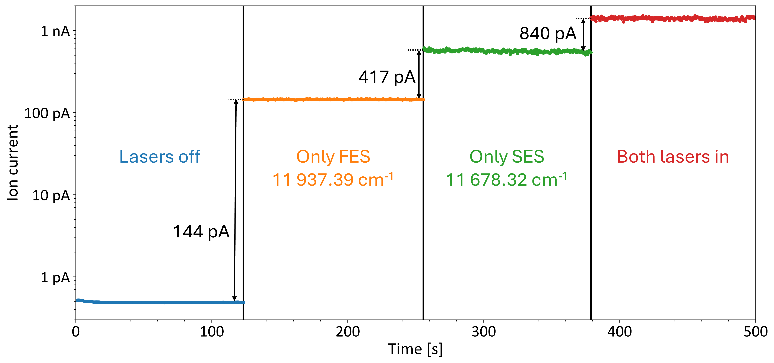
Laser effect for the excitation scheme
[1]
ionization scheme for La developed by Raphael from Mainz
[1] Photo from Raphael, Mainz

