Slide 1



Search for a neutron dark decay in ⁶He
d
u
d
Φ
H. Savajols (GANIL), M. Le Joubioux (GANIL), W. Mittig (FRIB/NSCL), X. Fléchard (LPC), L. Hayen (LPC) et al.
Physical Review Letter 132, 132501 (2024)

Slide 2
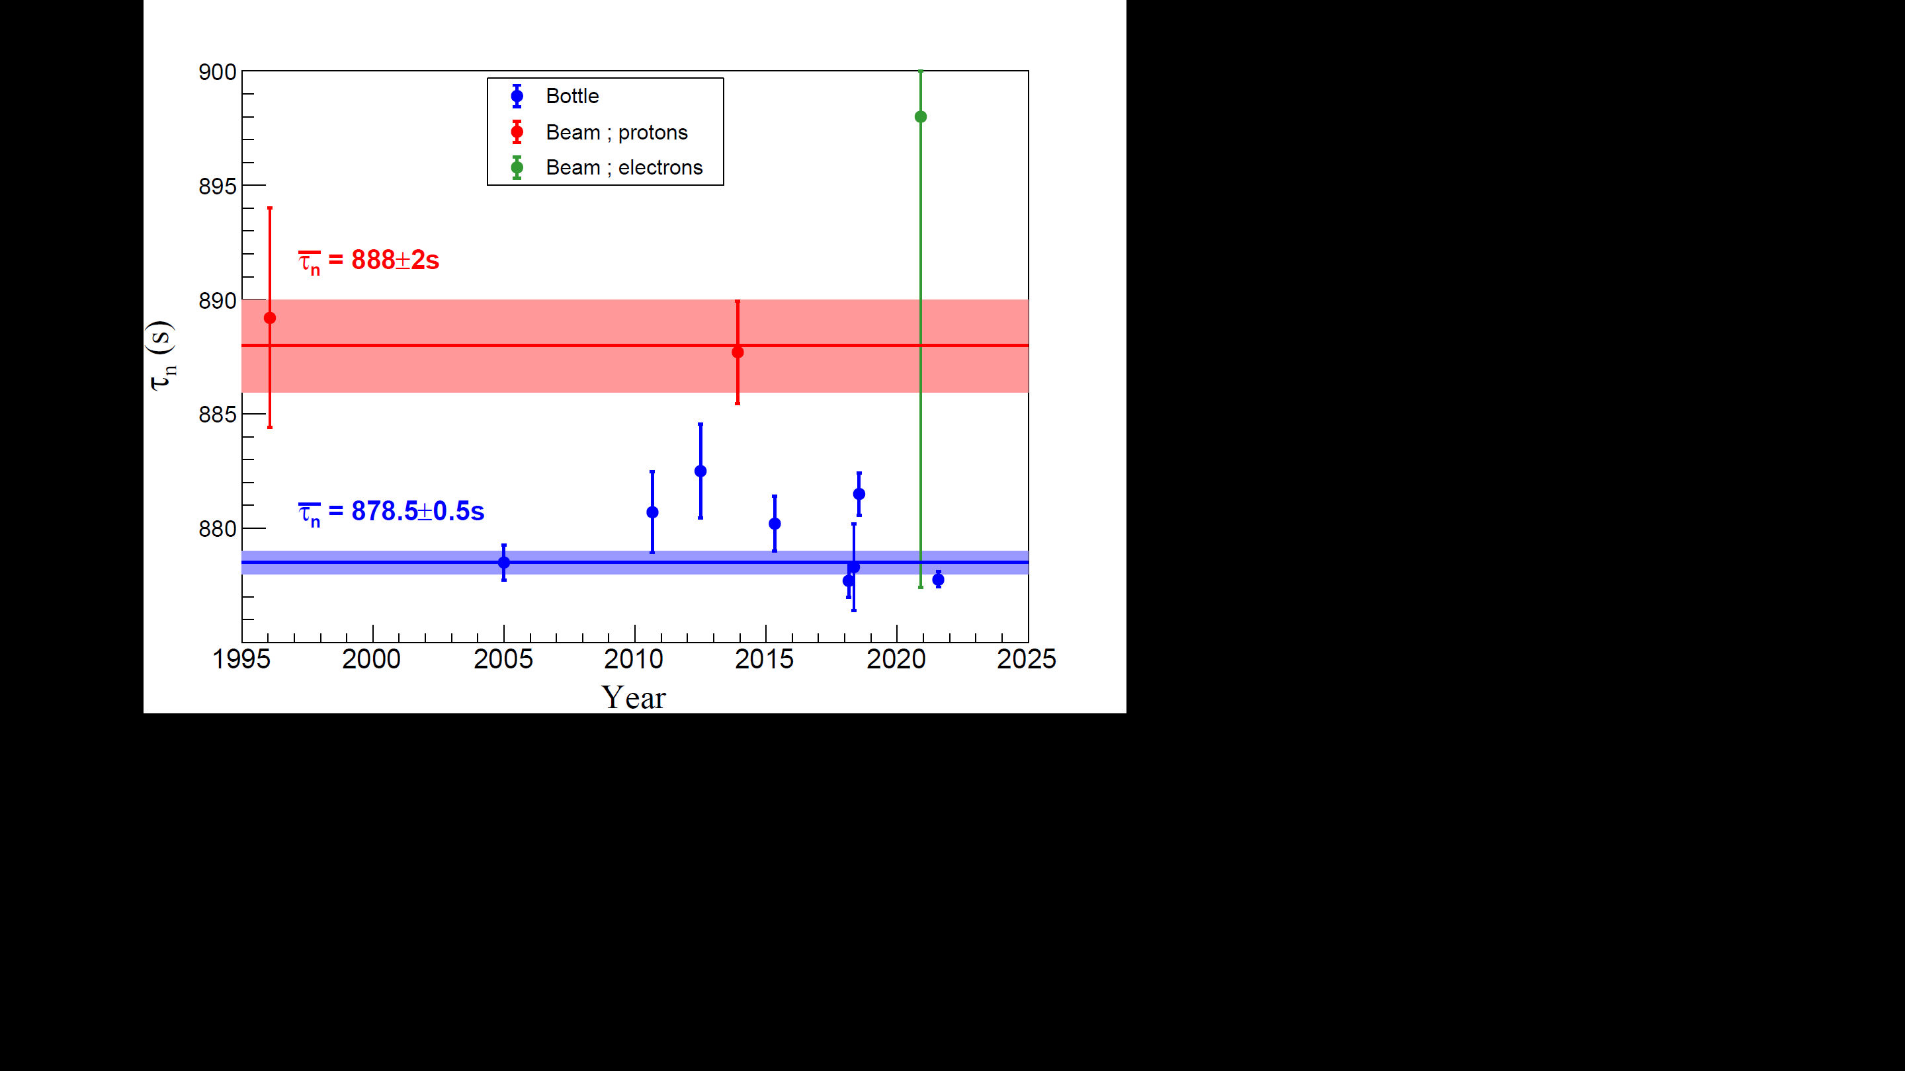
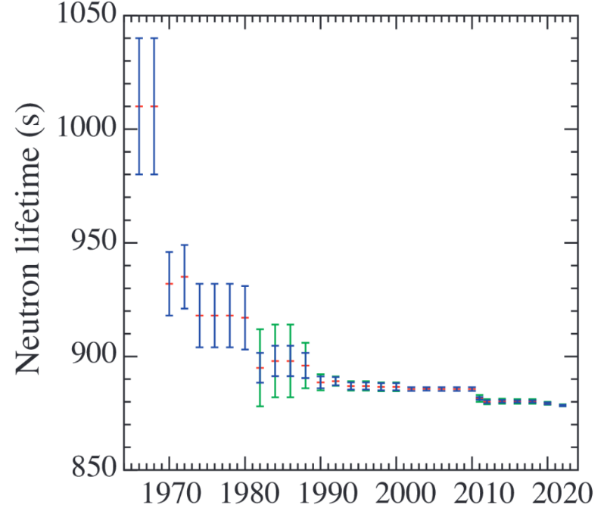

Motivation : the neutron lifetime anomaly
Between beam and bottle experiments
τ^{beam} = 888.0 ± 2.0 s
JPARC preliminary result
τ_{n}
τ^{bottle} = 878.4 ± 0.5 s
Updated NIST result
Ref : PDG 2024 review
UCNτ result
Actual lifetime discrepancy : Δτ_{n} = (9.6 ± 2.1) seconds
or ≈ 1% with a strong tension at the level of ≈ 4.5σ
2018 : Last PDG average including a beam result
2019-2024 : Only bottle results
What is the cause of this difference ?
Notes:
systematic uncertainties : protons from neutron decay undergoing charge exchange with residual gas

Slide 3
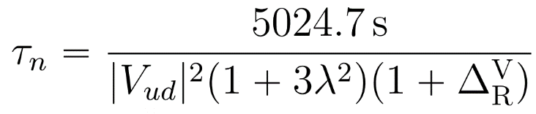
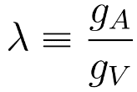
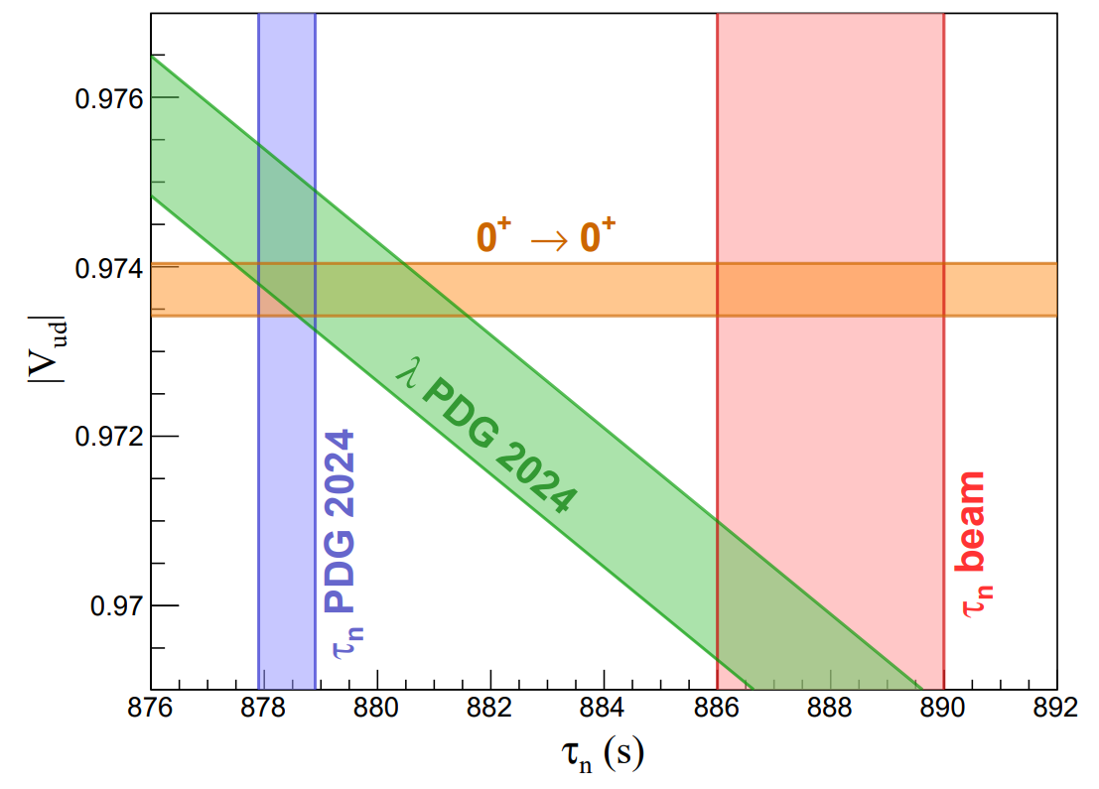
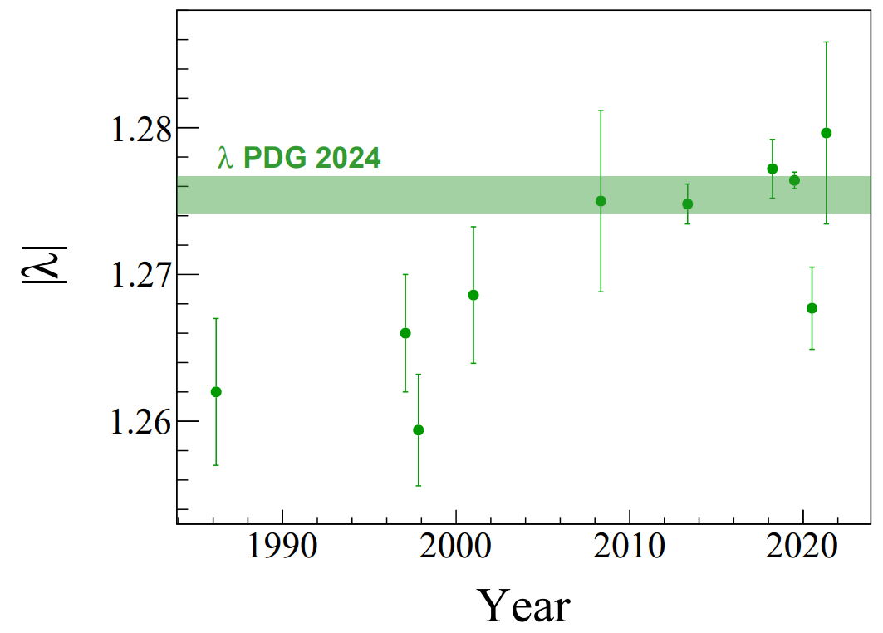
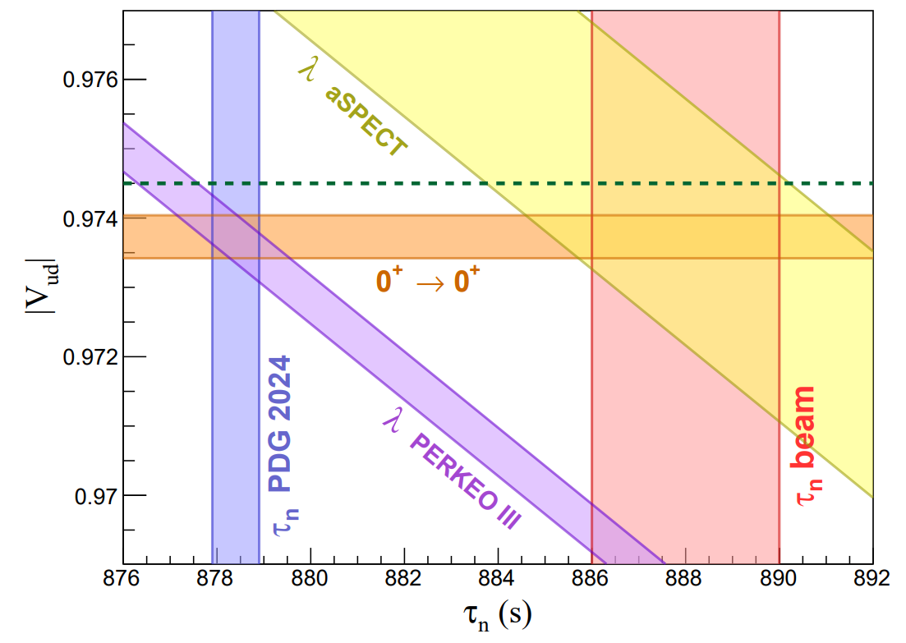
The neutron lifetime anomaly
In the Standard Model (SM)
|V_{ud}| = 0.97373(31) from 0⁺ to 0⁺ superallowed β decays
Inner radiative correction
λ_{PDG} = -1.2754(13) : PDG mean value of 10 measurements
First element of the CKM matrix
Good agreement with the actual bottle mean value…
... but the different λ values offer a constrasting picture…
… which can favor the neutron lifetime from beam experiments
PERKEO III
CKM unitarity through |V_{ud}|
aSPECT
Notes:
is a crucial parameter that determines the neutron-to-proton ratio at the onset of Big Bang nucleosynthesis (BBN)
Axial vector to vector ratio
Beta Asymmetry in polarized neutron decay A
Electron-antineutrino angular correlation (𝑎 coefficient)
CKM unitarity violation exceeding 2σ
Aspect : shape of the recoiling proton
PerkeoIII : electron

Slide 4
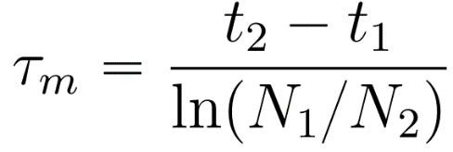
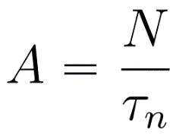

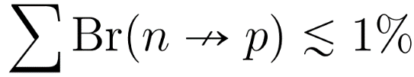
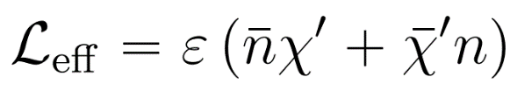
The neutron lifetime anomaly
Interpreting the lifetime discrepancy
Bottle
Beam
What does this mean for the beam-bottle discrepancy ?
Counting the survivors
over time
Measuring the 𝛽⁻ decay
products
τ_{β}
τ^{beam} = 888.0 ± 2.0 s
τ_{n}
τ^{bottle} = 878.4 ± 0.5 s
The experimental discrepancy is compatible with the
existence of another decay channel λ_{n} = λ_{β} + λ?
τ_{χ}
Δτ ≈ 81250 s
2018 : Fornal and Grinstein propose new decay modes for the neutron
PhysRevLett.120.191801
n
χγ
n
χe⁺e⁻
n
χϕ
χ : neutral dark fermion
ϕ : neutral dark scalar
Effective picture : mass mixing mechanism between n and χ
Notes:
hydrogen atom formation
mirror neutron transitions
The effective Lagrangian behind this process can be written

Slide 5





The neutron dark decay
937.993 MeV
938.783 MeV
Energy conditions
Open mass range
⁹Be stability :
f = χγ ; χe⁺e⁻ ; χϕ
Dark matter stability :
Available energy for the SM particles : Derived from the two previous conditions
n
χγ
Energy range for the γ-ray :
n
χe⁺e⁻
Energy range for the e⁺e⁻ pair :
m_{n} – 938.783
m_{n} - 937.993
2m_{e}
m_{n} - 937.993
Notes:
Stable nuclei with the lowest binding energy

Slide 6
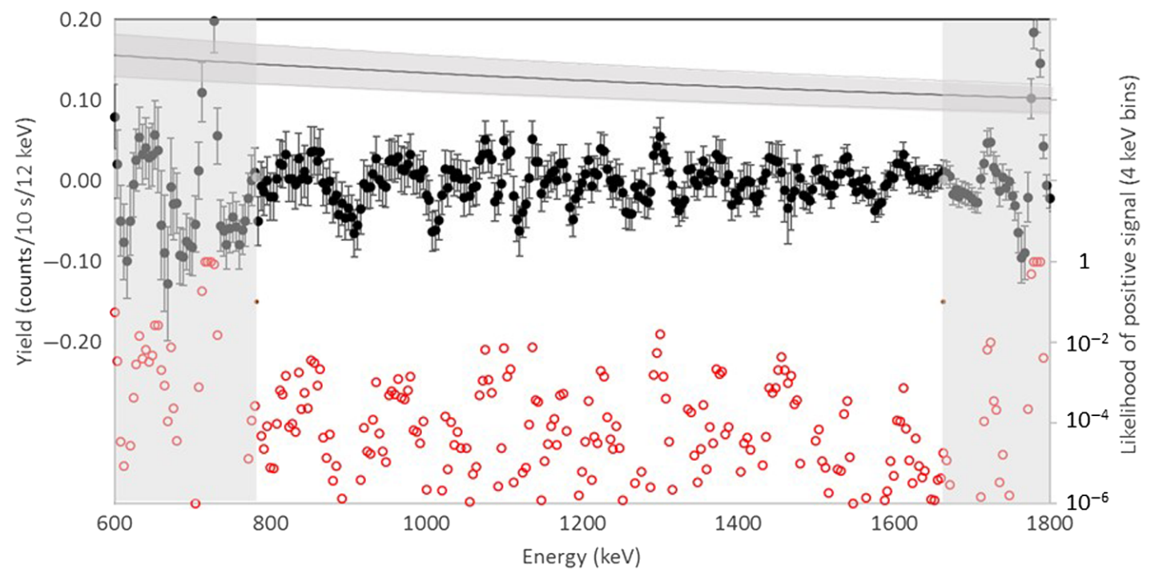
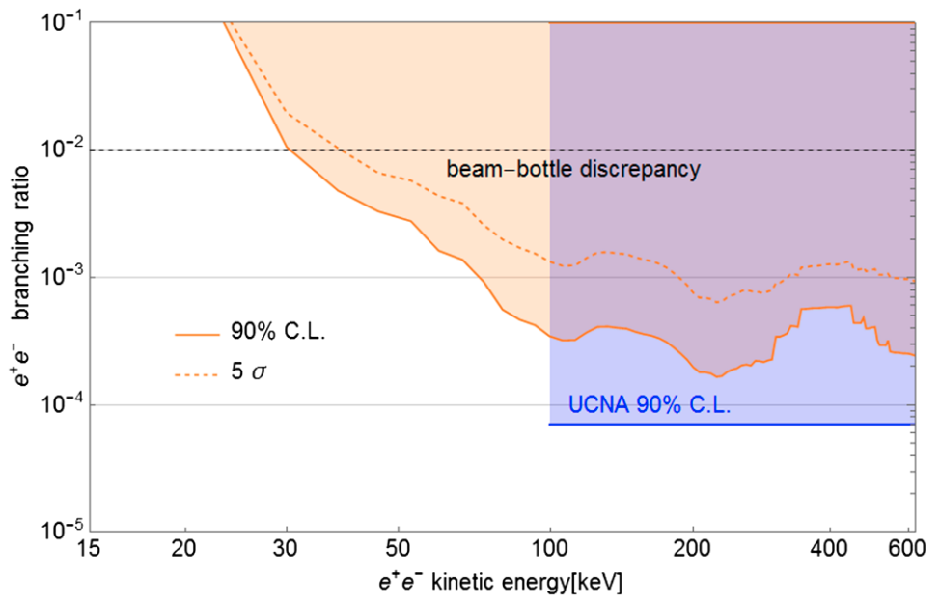
Dark decay investigations
Dark decays with SM particles in the final state
n
χγ
n
χe⁺e⁻
Bottle filled with UCNs at Los Alamos parasitically during the UCNτ experiment with HPGe detector
UCNA and PERKEO II : β spectrometer used for angular
correlations measurements in free neutron decay experiments
Beam-bottle discrepancy
E_{γ} ROI
PhysRevLett.122.222503
PhysRevLett.121.022505
n➔
χϕ : cannot be tested in free neutron experiments

Slide 7

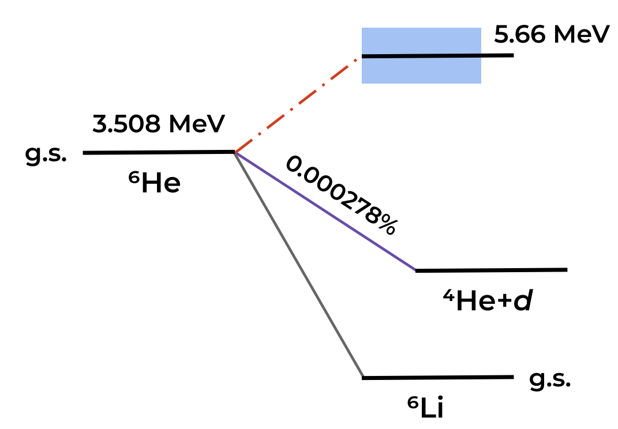
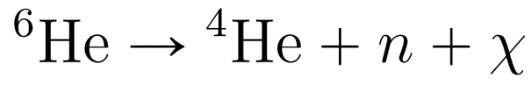
Nuclear dark decay
937.993 MeV
938.783 MeV
Energy conditions
Open mass range
m_{n} - S_{2n} (⁶He)
Neutron dark decay in nuclei :
S_{n} < 1.572 MeV
Fornal and Grinstein : ¹¹Li
Requires complementary measurements to isolate the dark decay channel
PhysRevLett.120.191801
Pfützner and Riisager : ⁶He , ¹¹Be , ¹⁵C , ¹⁷C
Good candidate but beam intensity too low
PhysRevC,042501(R) 2018
Probe ~45% of the open mass range only
The ⁶He case :
S_{n} (⁶He) = 1.7 MeV
S_{2n} (⁶He) = 0.975 MeV
𝛽d
𝛽
Neutron emission : unique signature of DM creation in ⁶He
Maximum branching ratio estimated at Br_{χ} ≤ 1.2 x 10⁻⁵
Can probe ∼75% of the open mass range
Standard ⁶He decay scheme
Notes:
Unfortunately, other decay channels could lead to the same decay products

Slide 8
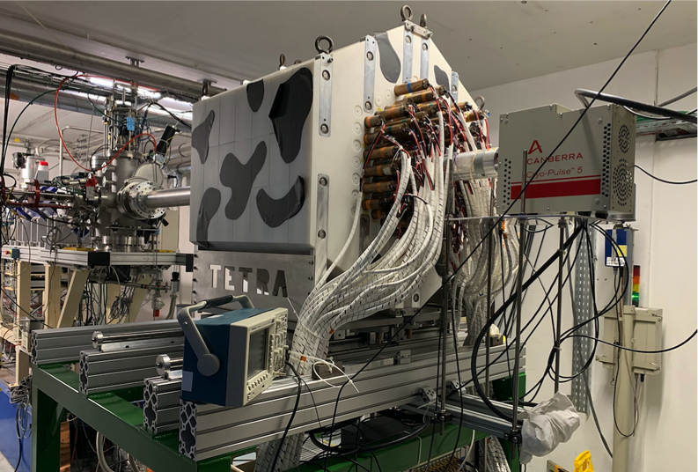
E819S experiment at GANIL
Beam : ⁶He¹⁺ SPIRAL1 at low energy (LIRAT) and at the maximum intensity > 10⁸ pps (World record !)
Experimental technique : detection of an excess of neutrons with the apparent lifetime of ⁶He (T_{1/2} = 0.8s)
Particles are implanted in a thin aluminium catcher at the center of TETRA (Beam on / Beam Off)
4π neutron detector TETRA : ³He counters
β-particle detector : Small solid angle plastic scintillator for beam intensity monitoring
Silicon detector in the LIRAT line to asses the rate of ions
γ-ray detector : Germanium semiconductor
Additional beam : ⁸He to benchmark the experimental setup (β-decay & βn-decay) with intensity ≈ 4.10⁵ pps

Slide 9
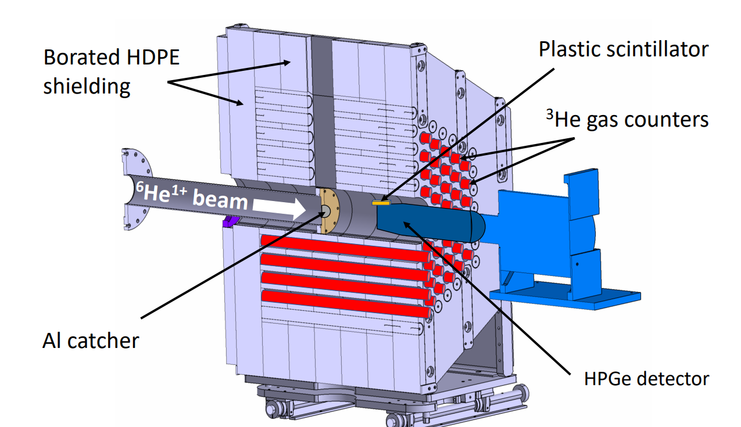
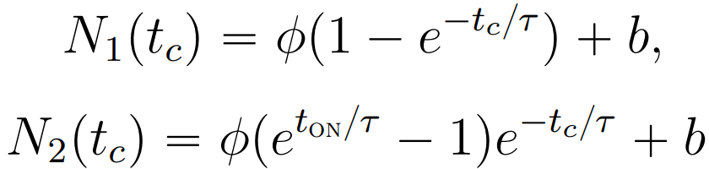
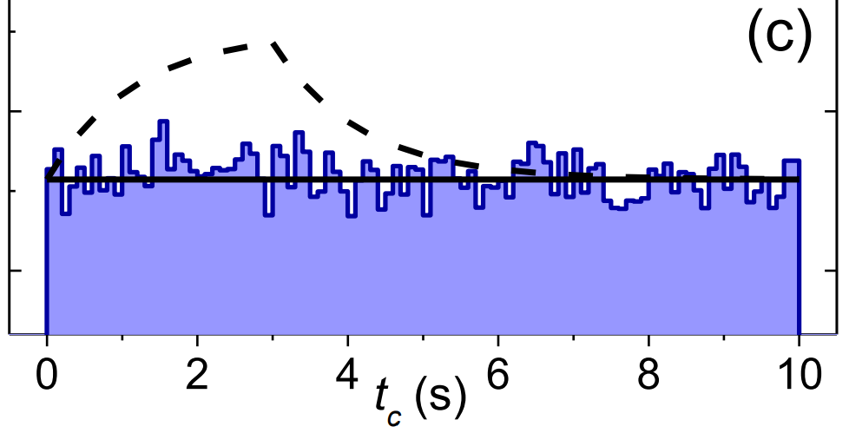
E819S experiment at GANIL
Experimental technique and associated model
Experimental technique : Implantation and decay cycles of 10 s
t_{ON} = 3 seconds of implantation
t_{OFF} = 7 seconds of observation
➜ Detect an excess of neutrons with a lifetime compatible with ⁶He decay
Detection rate model :
Expected behavior with :
r₀ = 2x10⁸ pps and Br_{χ} = 10⁻⁹
b : constant background parameter ; free
τ : known ⁶He lifetime at 1.164 s ; fixed
𝛟 : scaled beam intensity ; free
Phys.Rev.C 106, 045502
ε_{n} : detection efficiency
r₀ : ⁶He beam intensity
Br_{χ} : dark branching ratio
ϕ = ε_{n} r₀ Br_{χ}
Average implanted rate r₀ : (1.08 ± 0.06) x 10⁸ pps from the plastic scintillator
Total number of implanted ⁶He over 37374 cycles : (1.21 ± 0.06) x 10¹³

Slide 10
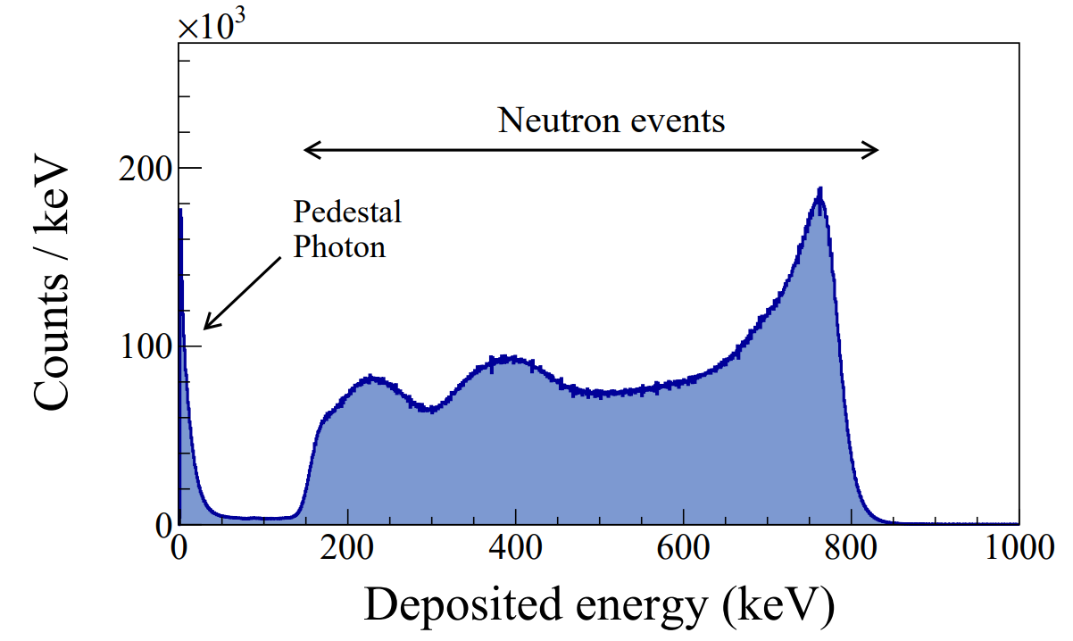
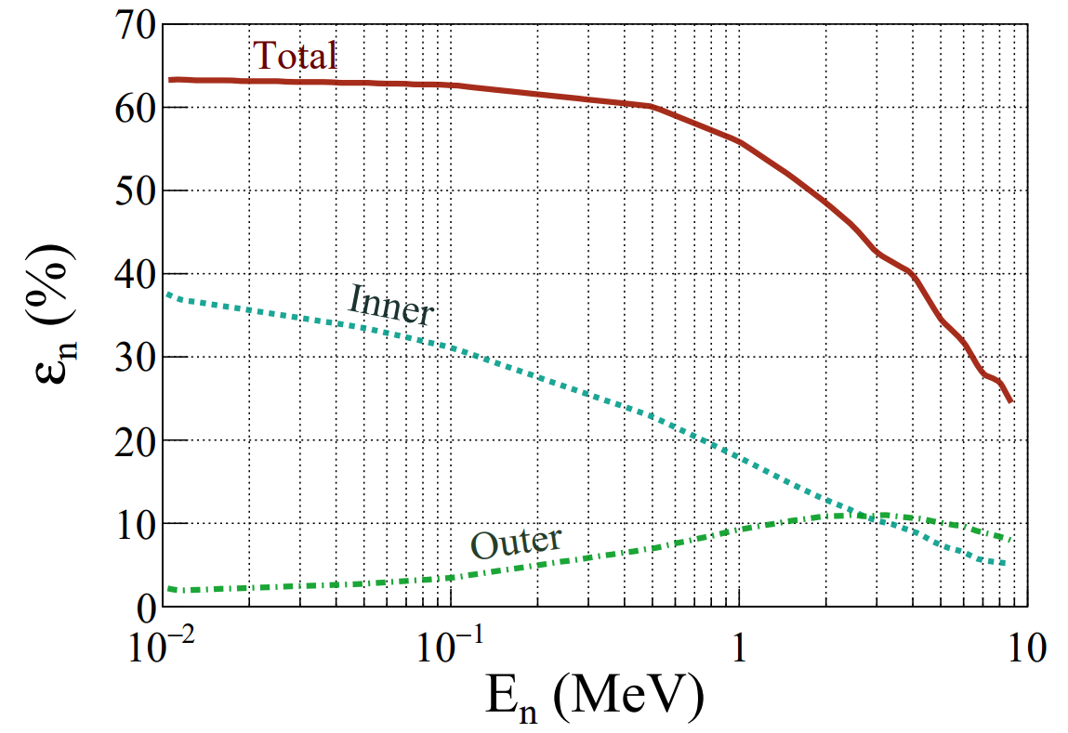
E819S experiment at GANIL
Calibration of TETRA and measurement of ε_{n} with a ²⁵²Cf source
Neutron capture reaction :
Neutron detection efficiency ε_{n} = (46.89 ± 5.09) %
with 72 counters and 150 ≤ E_{dep} ≤ 820 keV
Ref : D. Testov 2016
⁶He
²⁵²Cf
Each counters of TETRA were calibrated linearly in deposited energy
with the 765 keV peak
ϕ = ε_{n} r₀ Br_{χ}
TETRA offers a good discrimination between neutron
and gamma detection
No correction = conservative estimate of ε_{n}

Slide 11
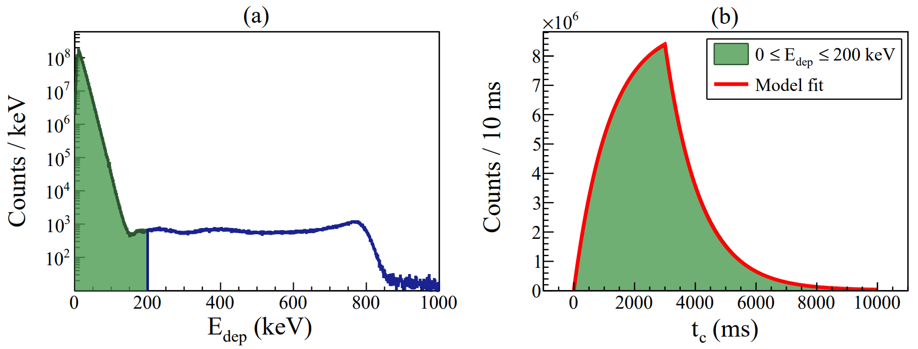
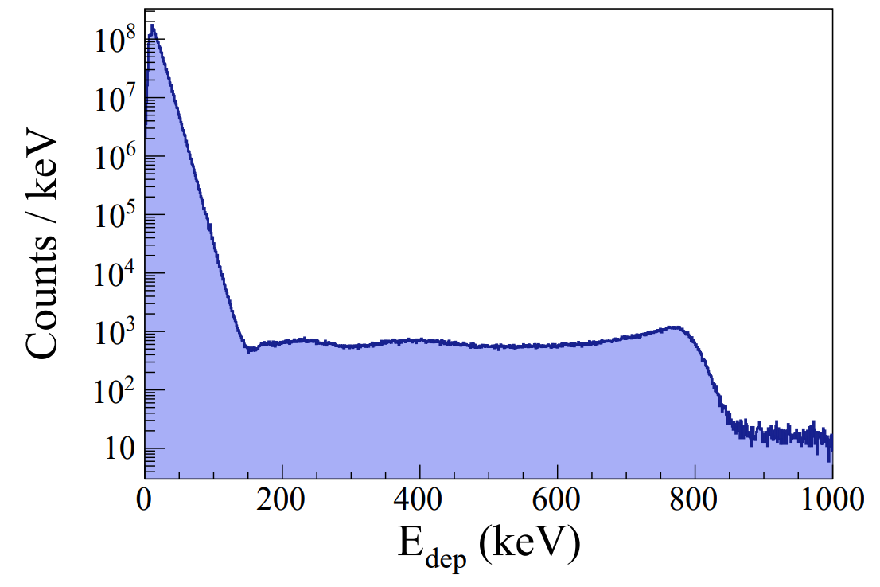
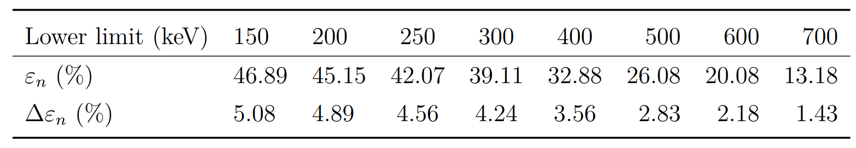
⁶He data analysis
Systematic effects in TETRA – Anomalous counters, event sources & Bremsstrahlung
Detection of bremsstrahlung photons with TETRA :
Common upper limit at 820 keV
… can also mimic the ⁶He dark decay
²⁵²Cf neutron source

Slide 12
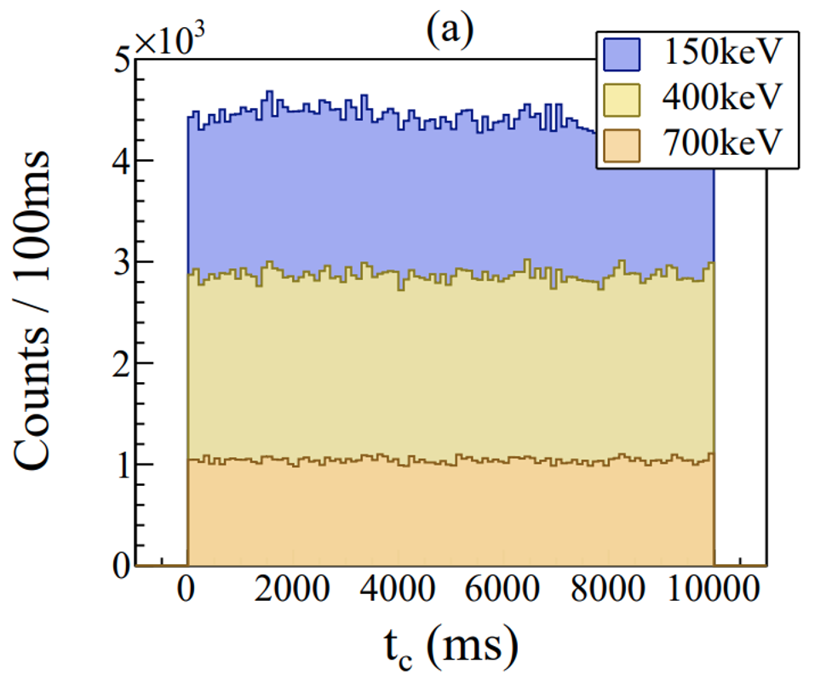
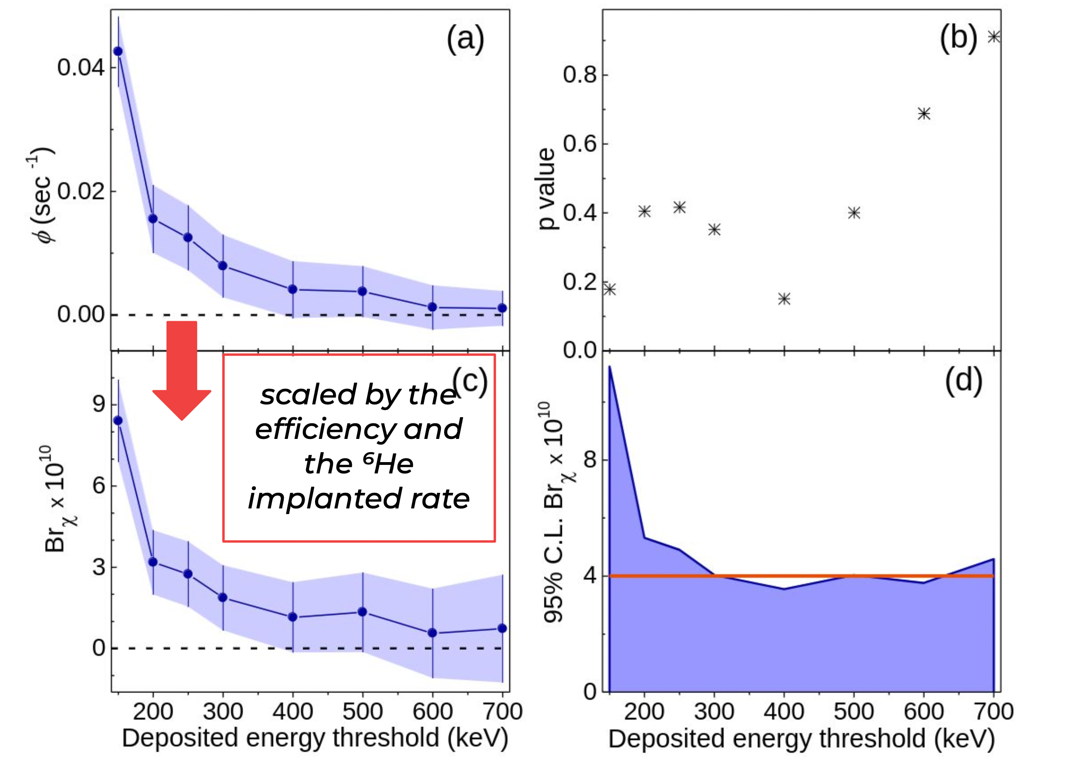
⁶He data analysis
Stringent upper limit on the ⁶He dark decay
𝜙 = ε_{n} r₀ B_{r}
Conservative upper limit at 4 x 10⁻¹⁰
with a 95% confidence level

Slide 13
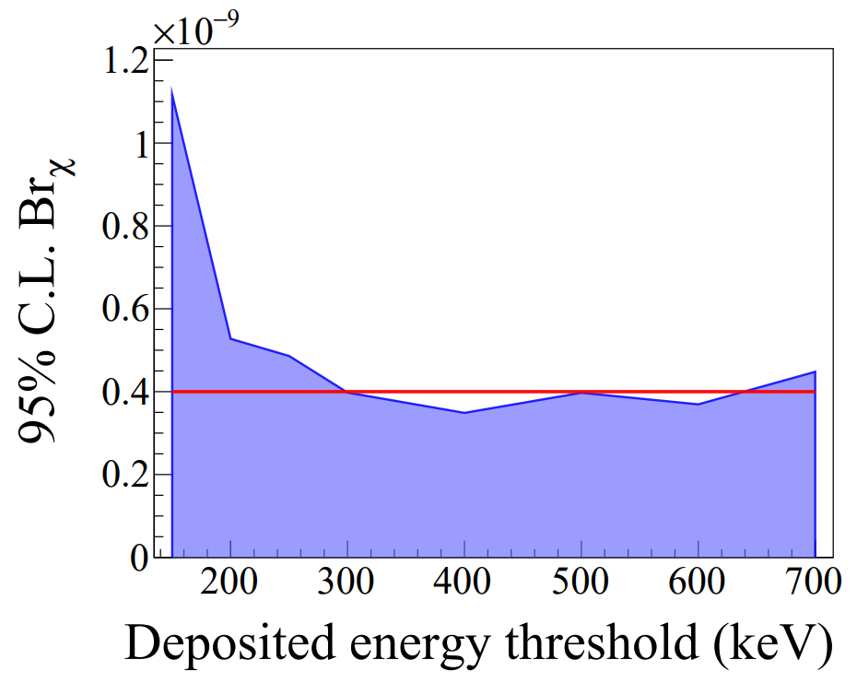
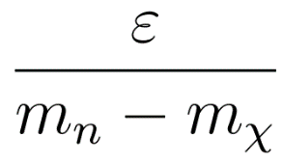
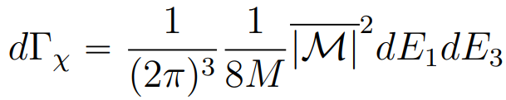

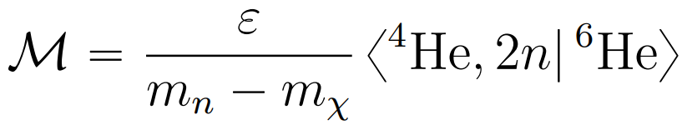
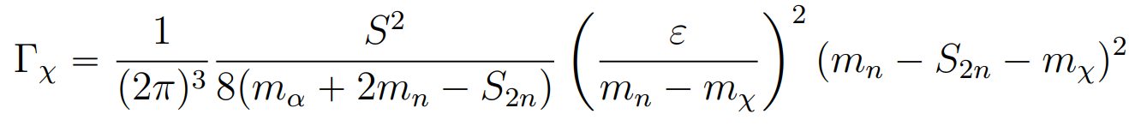
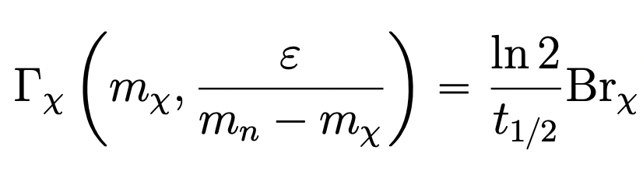
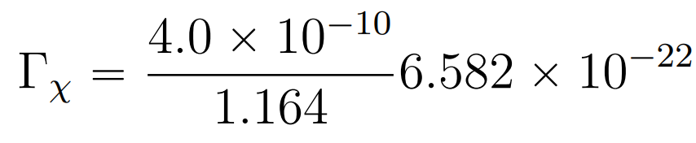

Mass mixing constraint
Mass mixing mechanism :
⁶He dark decay rate
Mass mixing parameter :
3-body decay rate :
Writing the ⁶He mass as :
Decay amplitude :
Theoretical decay rate in natural units :
Wavefunction overlap in halo nuclei :
¹¹Be : S = 0.85 Ref : J. S. Winfield 2001
¹⁵C : S = 0.75 Ref : J. D. Goss 1975
⁶He : S = 1 and S = 0.5
Experimental decay rate :

Slide 14

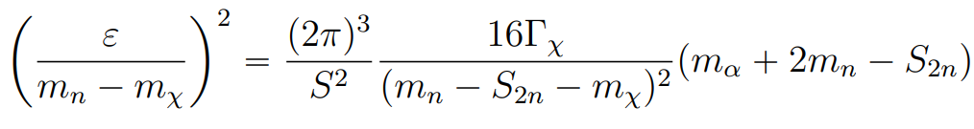
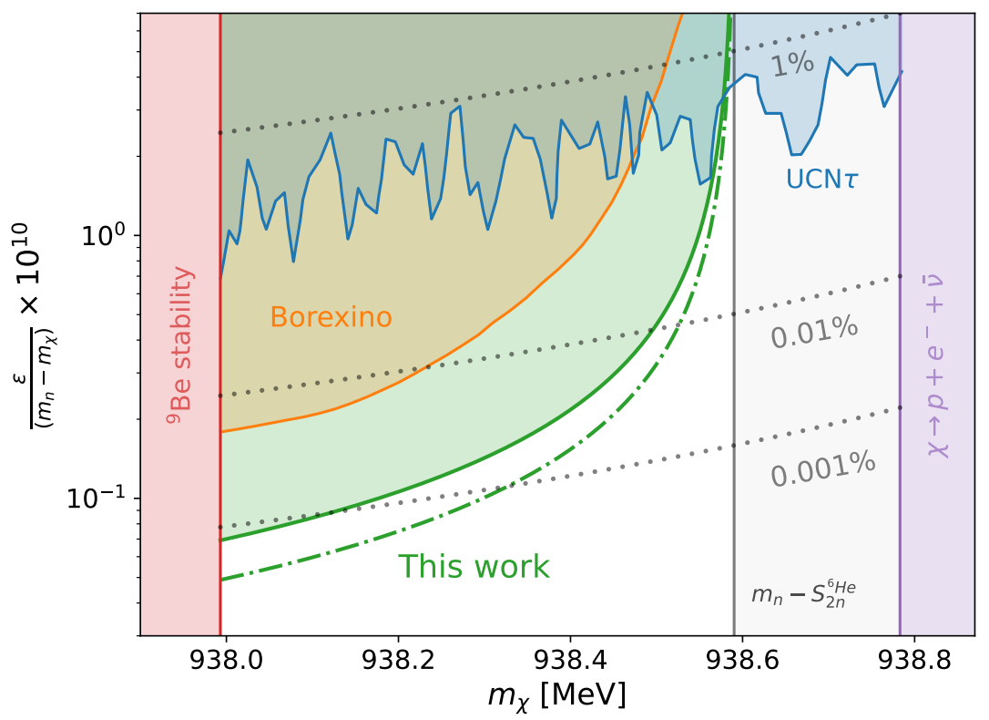

Mass mixing constraint
937.993 MeV
938.783 MeV
Exclusion diagram
Open mass range
938.590 MeV
GANIL : Looking for
n
χγ
UCNτ : Looking for
Already discussed previously
Borexino : Looking for H stability
In the case m_{χ} < m_{p} + m_{e} = 938.783 MeV
Atomic hydrogen can decay through electron capture
e⁻ + p → 𝜈 + 𝜒
S=1
S=0.5
The apparatus contains large amount of H atoms :
Date used to constraint hydrogen radiative decay through
e⁻ capture and mass mixing with the dark fermion
Mass mixing constraints from UCNτ and Borexino
data were first derived by D. McKeen and M. Pospelov (2023)

Slide 15
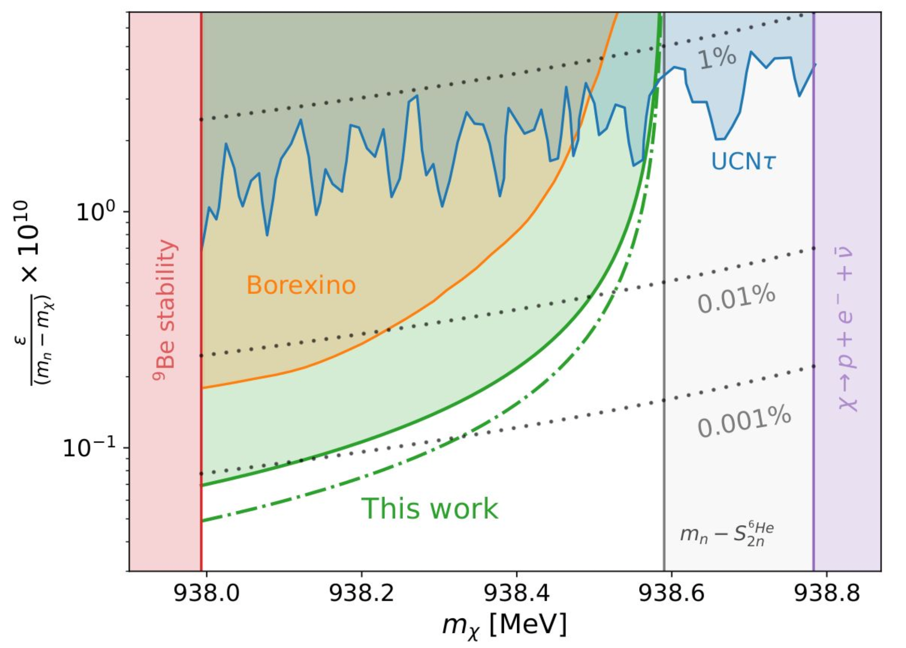
Conclusion
Search for neutron dark decay
Halo nucleus (⁶He) ➔ Clean decay signature
Conservative upper limit at 4 x 10⁻¹⁰ : five orders of magnitude lower than the upper limit to explain the neutron lifetime anomaly
Highly competitive (UCN𝛕, Borexino, …)
This result completely excludes the dark decay as a solution to the neutron lifetime anomaly in the 75% of the mass range probed with ⁶He.
The remaining 25% seems to be fully covered by the UCNτ but one must be reminded that this experiment (and the data from Borexino as well) only probed the decay n ➔ χ 𝛄.
¹⁷C nucleus can probe the whole mass range, but intensity is still too low
Physical Review Letter 132, 132501 (2024)

Slide 16
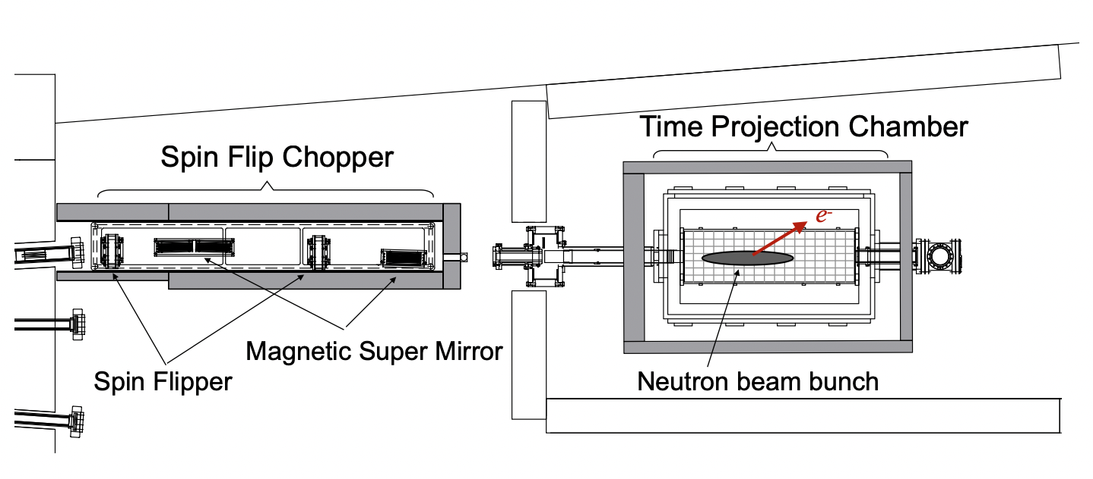
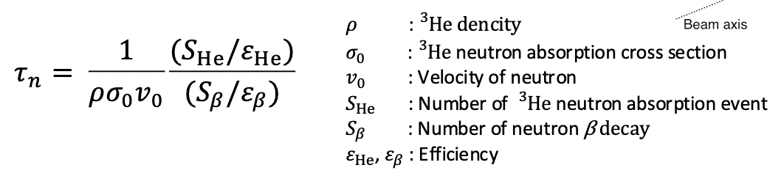
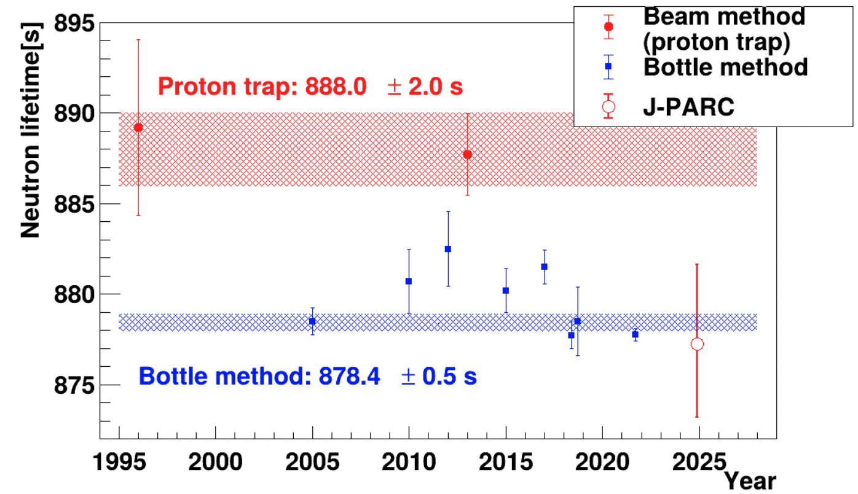
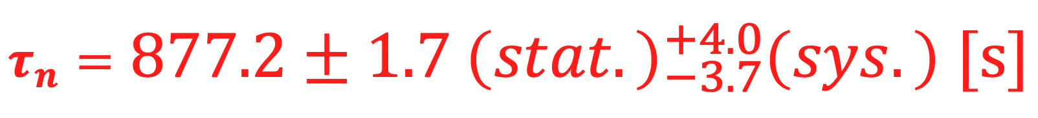
A new “beam” experiment is ongoing at JPARC
Method
Pulse neutron beam (polarised)
The neutron lifetime is determined from the ratio of neutron decay counts (electrons instead of protons) to ³He(n,p)³H reactions in a gas detector (TPC : ⁴He, CO₂, ³He)
Results
The improved results using data from 2014 to 2023 :
[Y. Fuwa et al., arXiv:2412.19519v1]
The χ²/NDF of the fitting is large (pressure dependence ?)
There is a still room for discussion in those results
Additional data will be taken with less background conditions

Slide 17
Thank you !

Slide 18
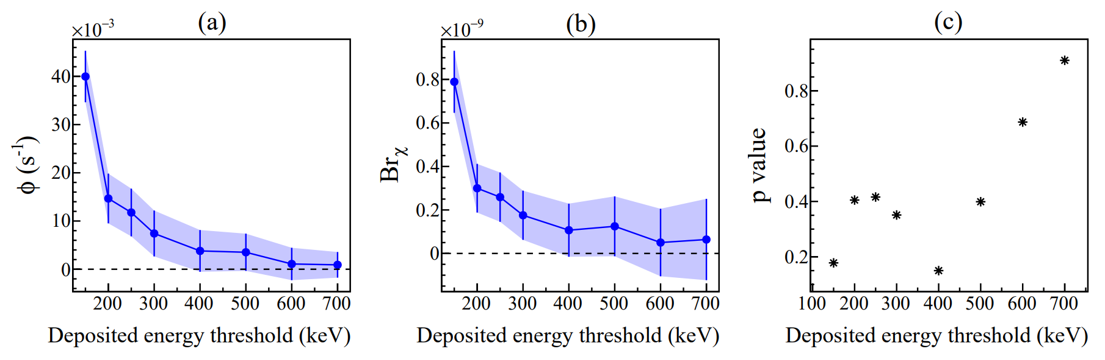
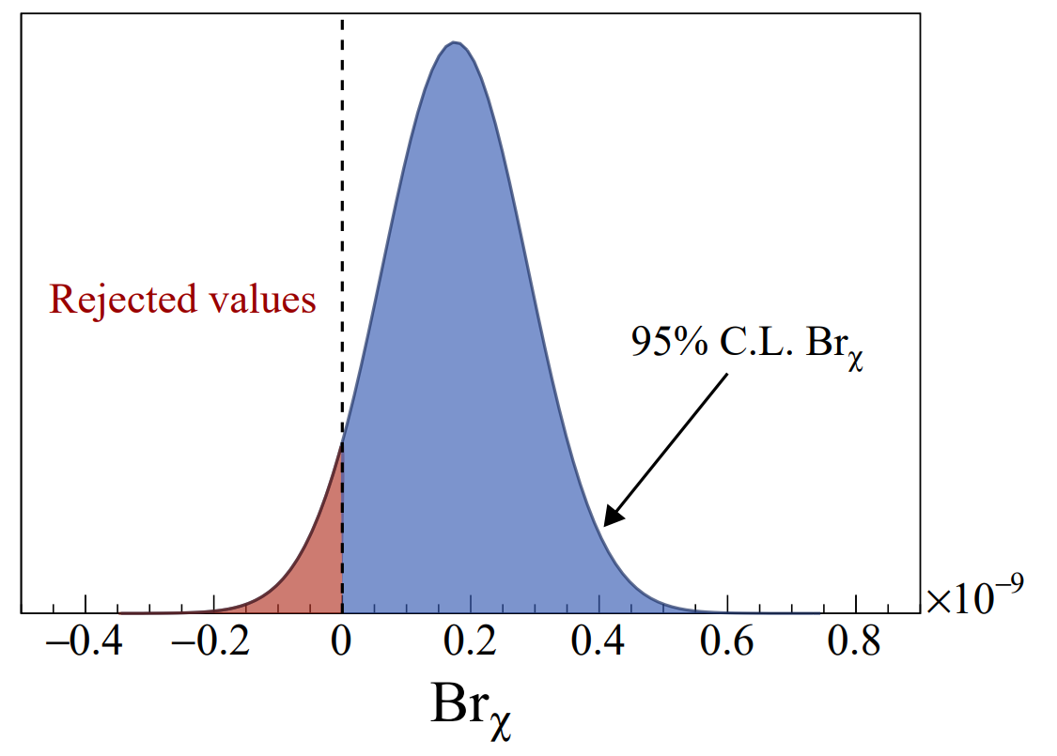

⁶He data analysis
Stringent upper limit on the ⁶He dark decay
Maximizing the branching ratio values :
E_{dep} = 300 keV
Renormalization with meaningful Br values
Final experimental result : Br_{χ} ≤ 4.0 x 10⁻¹⁰

Slide 19

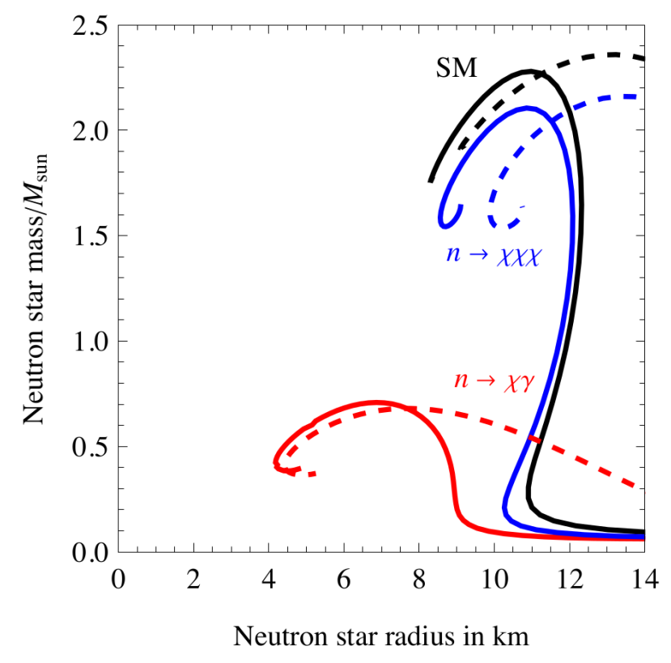
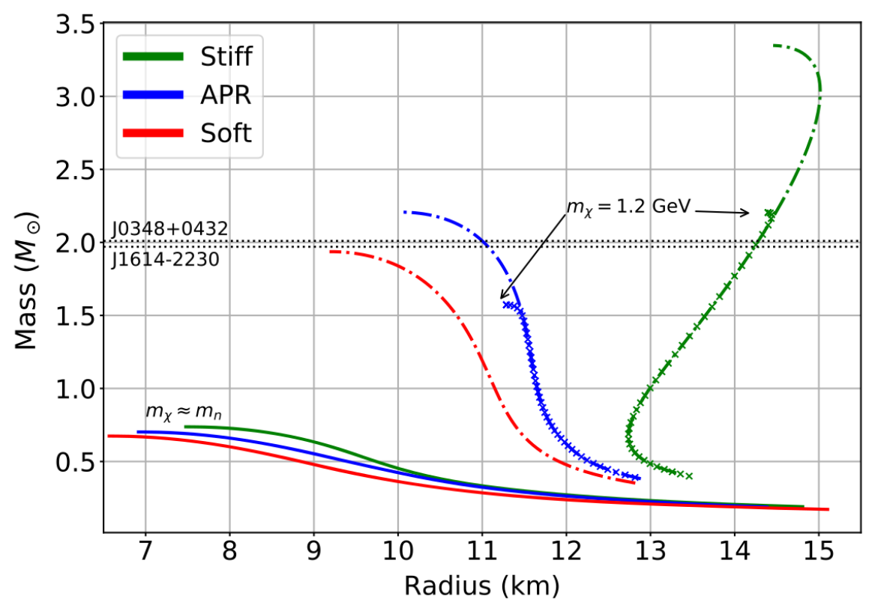
Dark decay investigations
Heaviest neutron stars :
Impact on neutron stars
Neutron stars (NS) : remnants of massive supergiant stars that have undergone supernova explosions
Equation of State (EoS) : relationship between the pressure and the energy density
Ref : A. Strumia 2022
Solve the Tolman-Oppenheimer-Volkoff equations to obtain a Mass-Radius distribution
Nuclear matter
Ref : D. McKeen 2018
Hybrid matter
Disagreement between NS and the neutron dark decay
Reconciliation by changing/adding ingredients to the model
The study of NS do not provide conclusive evidence against the neutron dark decay

Slide 20
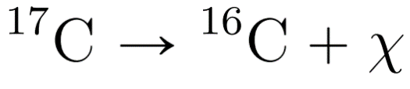
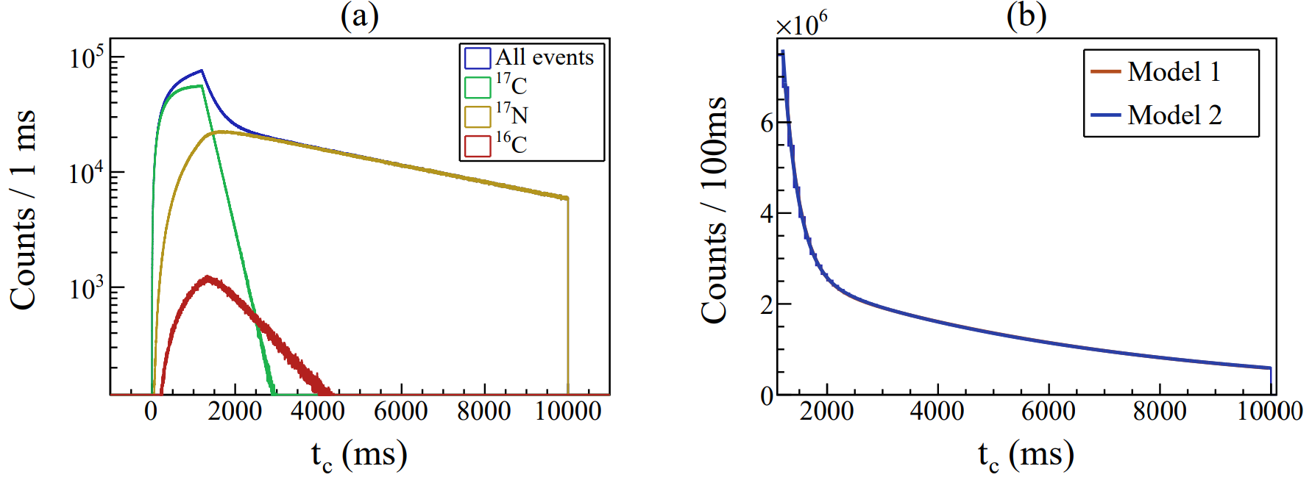
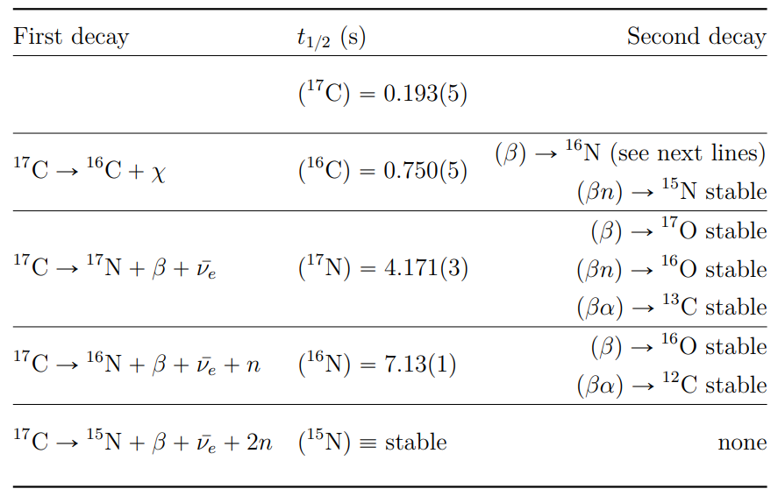
Perspective on nuclear dark decays
The ¹⁷C nucleus to probe the whole mass range
S_{n}(¹⁷C) = 0.734 MeV
Estimated upper limit at Br_{χ} ≤ 3 x 10⁻⁶
Looking for
MC simulations with Br _{χ} = 1% ; r₀ = 10⁵ pps ; ~5h30 of beamtime :
937.993 MeV
938.783 MeV
Open mass range
Br _{χ} = 1%
Br _{χ} = 1%
Model 1 :
¹⁷C
¹⁷N
Model 2 :
Isolating the dark decay from neutron detection
in an implantation and decay experiment
¹⁶C

