Slide 1


Deep Learning–Driven Differentiable
Autoplanning for Proton Therapy:
A Proof-of-Concept
European Nuclear Physics Conference 2025 - Caen, France
L. Arsini^{1,2}, B. Caccia³, A. Ciardiello³, S. Giagu^{1,2}, A. Sarti⁴, C. Mancini Terracciano^{1,2}
¹Department of Physics, Sapienza University of Rome, Rome, Italy. ²INFN, Section of Rome, Rome, Italy.
³Istituto Superiore di Sanità, Rome, Italy, ⁴Department of Basic and Applied Sciences for Engineering, Sapienza University of Rome, Rome, Italy
22/09/2025

Slide 2
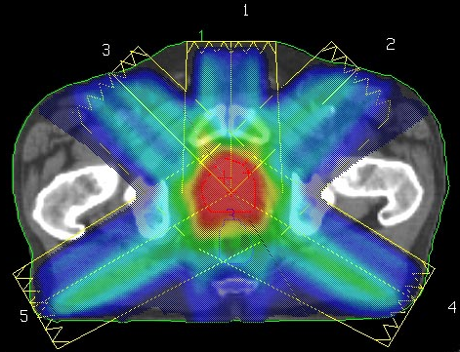
Treatment Planning Optimization
Choice of directions, energies and intensities of the beamlets
to
Fit dose medical prescription
Dose estimation
2 steps
Plan Optimisation
Heavily depends on operator performance
Deep Learning–Driven Differentiable Autoplanning for
Proton Therapy: A Proof-of-Concept
Lorenzo Arsini - 22/09/2025
EuNPC 2025 - Caen, France

Slide 3
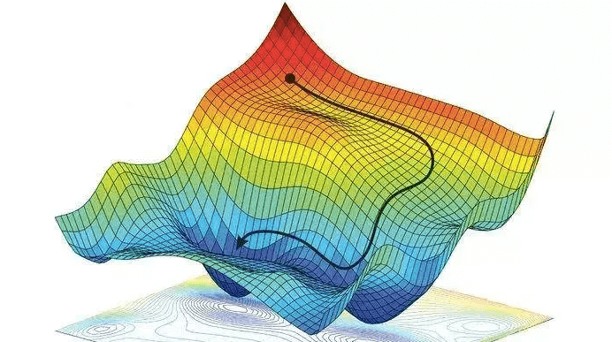
Differentiable approach
Deep Learning driven
NOT a Knowledge-based DL model
Reproduce sub-optimal plans
Established RT only
Explainability?
Build a differentiable surrogate model for dose computation
Use powerful gradient-based optimizers
Treat all parameters jointly & automatically
GPU native
Deep Learning–Driven Differentiable Autoplanning for
Proton Therapy: A Proof-of-Concept
Lorenzo Arsini - 22/09/2025
EuNPC 2025 - Caen, France

Slide 4
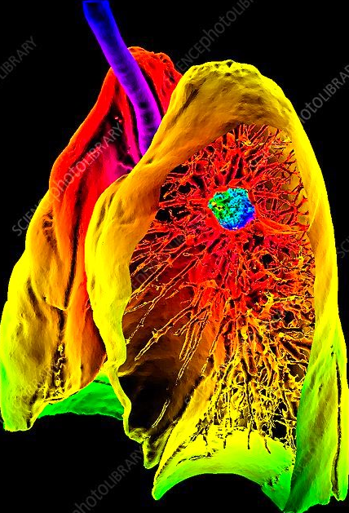
Cylindrical approach
Dose data collected in a cylinder in the beam-eye view
Three main advantages:
Reduce complexity without loss of generalisation: the cylinder follows the beam
Overcome problems related to the size of CT images
More resolution near the beamline
Deep Learning–Driven Differentiable Autoplanning for
Proton Therapy: A Proof-of-Concept
Lorenzo Arsini - 22/09/2025
EuNPC 2025 - Caen, France

Slide 5
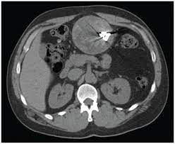
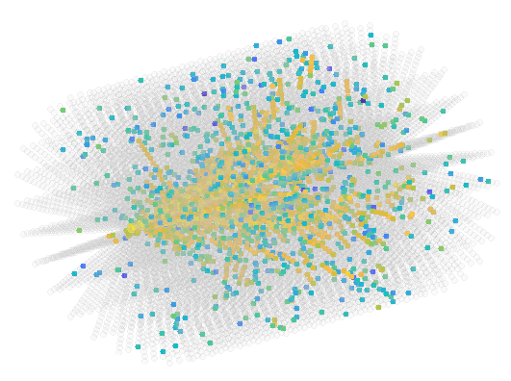
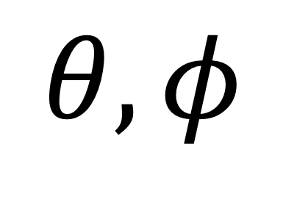
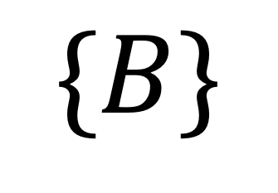
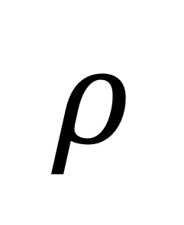
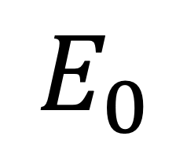
Dose deposition in CT scans
Monte Carlo
simulated dose
$$\{B\}$$
$$θ,φ$$
$$E_{0}$$
$$ρ$$
Deep Learning model
Density map in the cylinder
Deep Learning–Driven Differentiable Autoplanning for
Proton Therapy: A Proof-of-Concept
Lorenzo Arsini - 22/09/2025
EuNPC 2025 - Caen, France

Slide 6
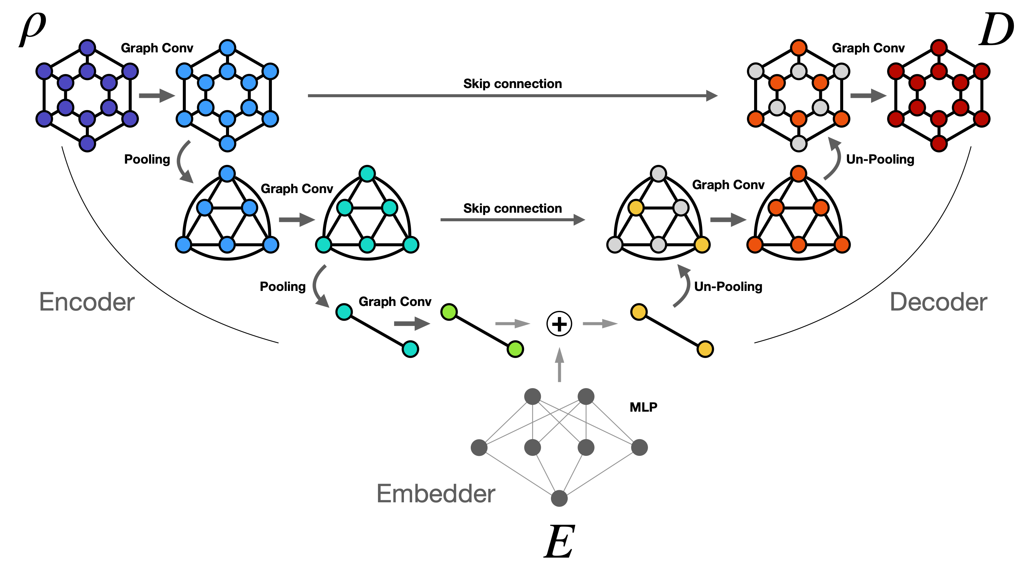
Architecture
L. Arsini et al. Fast and precise dose estimation for very high energy electron radiotherapy with graph neural networks. Frontiers in Physics, 2024, 12, 1443306
L. Arsini et al. Nearest Neighbours Graph Variational AutoEncoder. Algorithms, 2023, 16(3), 143
Graph NN and
an original pooling
Deep Learning–Driven Differentiable Autoplanning for
Proton Therapy: A Proof-of-Concept
Lorenzo Arsini - 22/09/2025
EuNPC 2025 - Caen, France

Slide 7
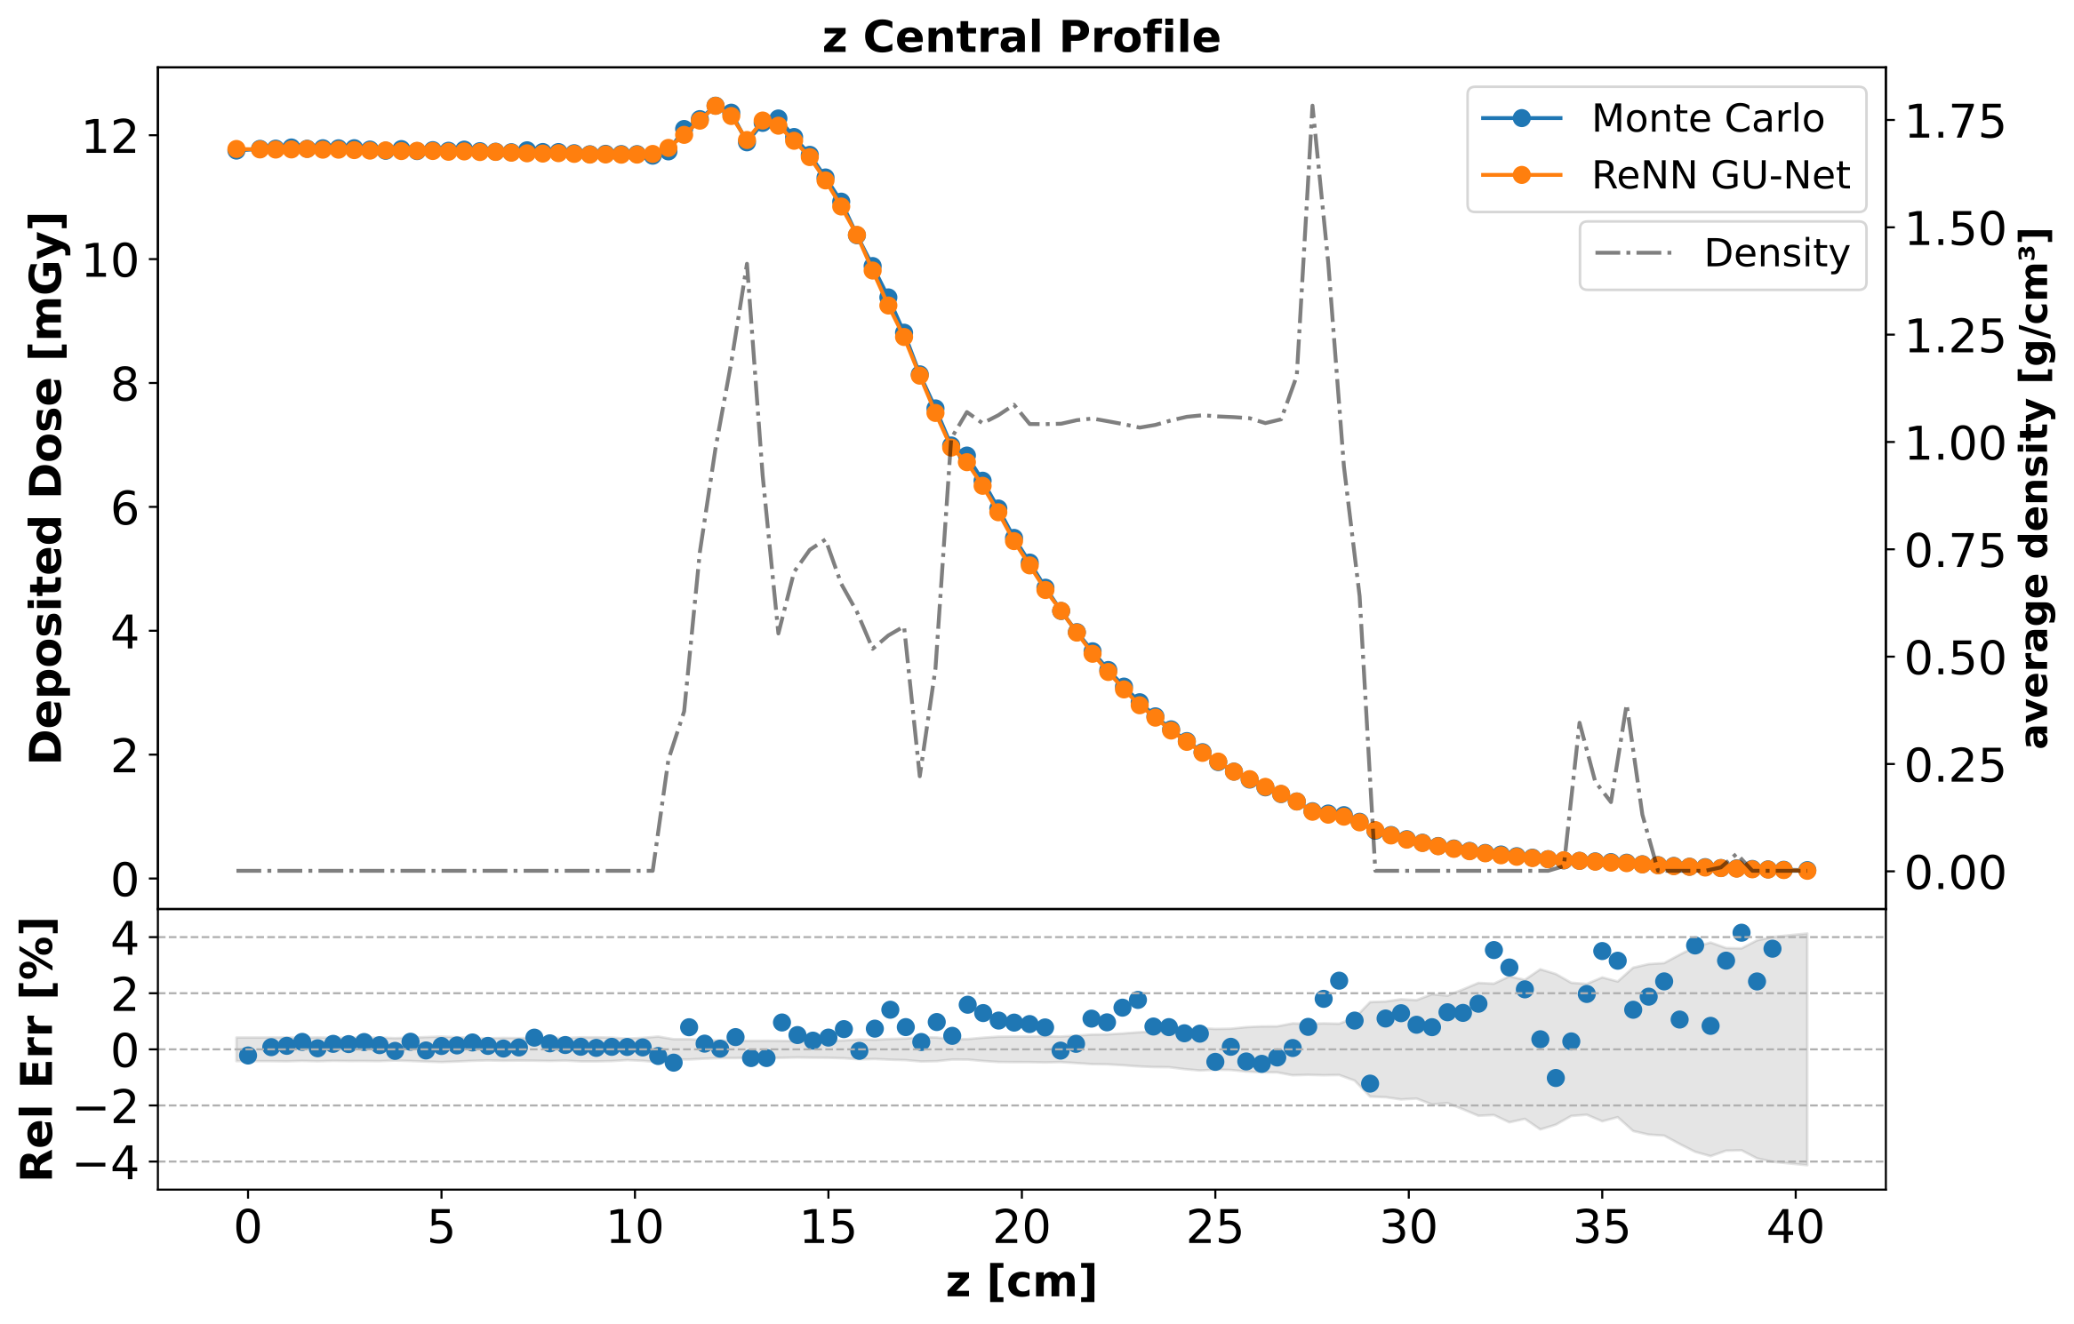
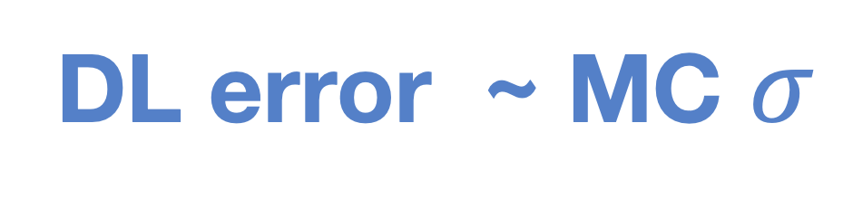
DL prediction vs MC simulation
Dose depth curve
In a 4 mm radius cylinder around the beam
(75% of the dose)
Test set example
DL error ~ MC $σ$
L. Arsini et al. Frontiers in Physics 2024
Deep Learning–Driven Differentiable Autoplanning for
Proton Therapy: A Proof-of-Concept
Lorenzo Arsini - 22/09/2025
EuNPC 2025 - Caen, France

Slide 8
Computation speed-up
Monte Carlo simulation
Deep Learning emulation
~ 18 min
~ 5 ms
Can be reduced even more in batch mode
1M primaries
48 core CPU on HPC Cluster
1 NVIDIA V100 GPU
Deep Learning emulation of Physical Processes
in Radiation Therapy
Lorenzo Arsini - 08/01/2025

Slide 9
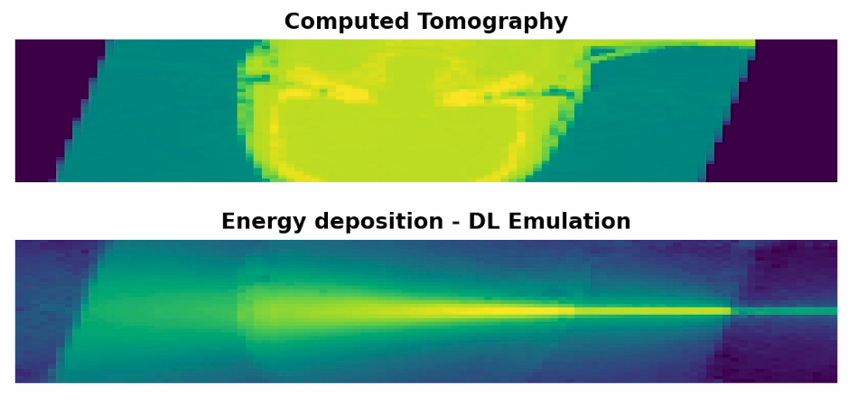
Deep Learning–Driven Differentiable Autoplanning for
Proton Therapy: A Proof-of-Concept
Lorenzo Arsini - 22/09/2025
EuNPC 2025 - Caen, France

Slide 10
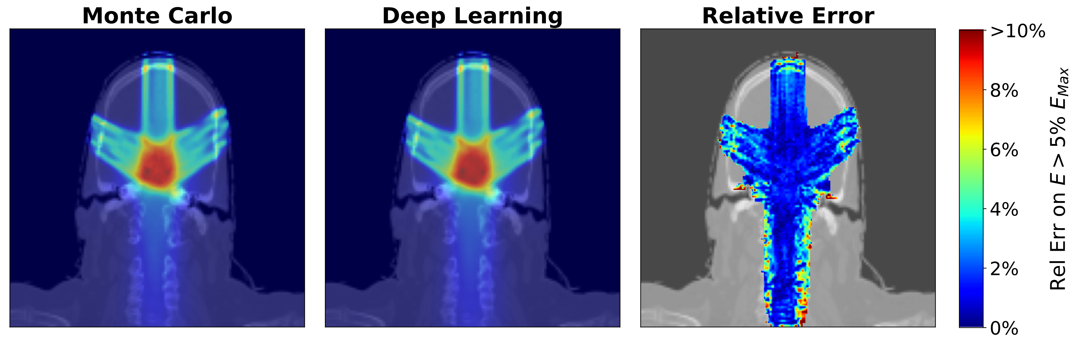
Full Treatment Plan (Energy)
2 mm grid
Deep Learning–Driven Differentiable Autoplanning for
Proton Therapy: A Proof-of-Concept
Lorenzo Arsini - 22/09/2025
EuNPC 2025 - Caen, France

Slide 11
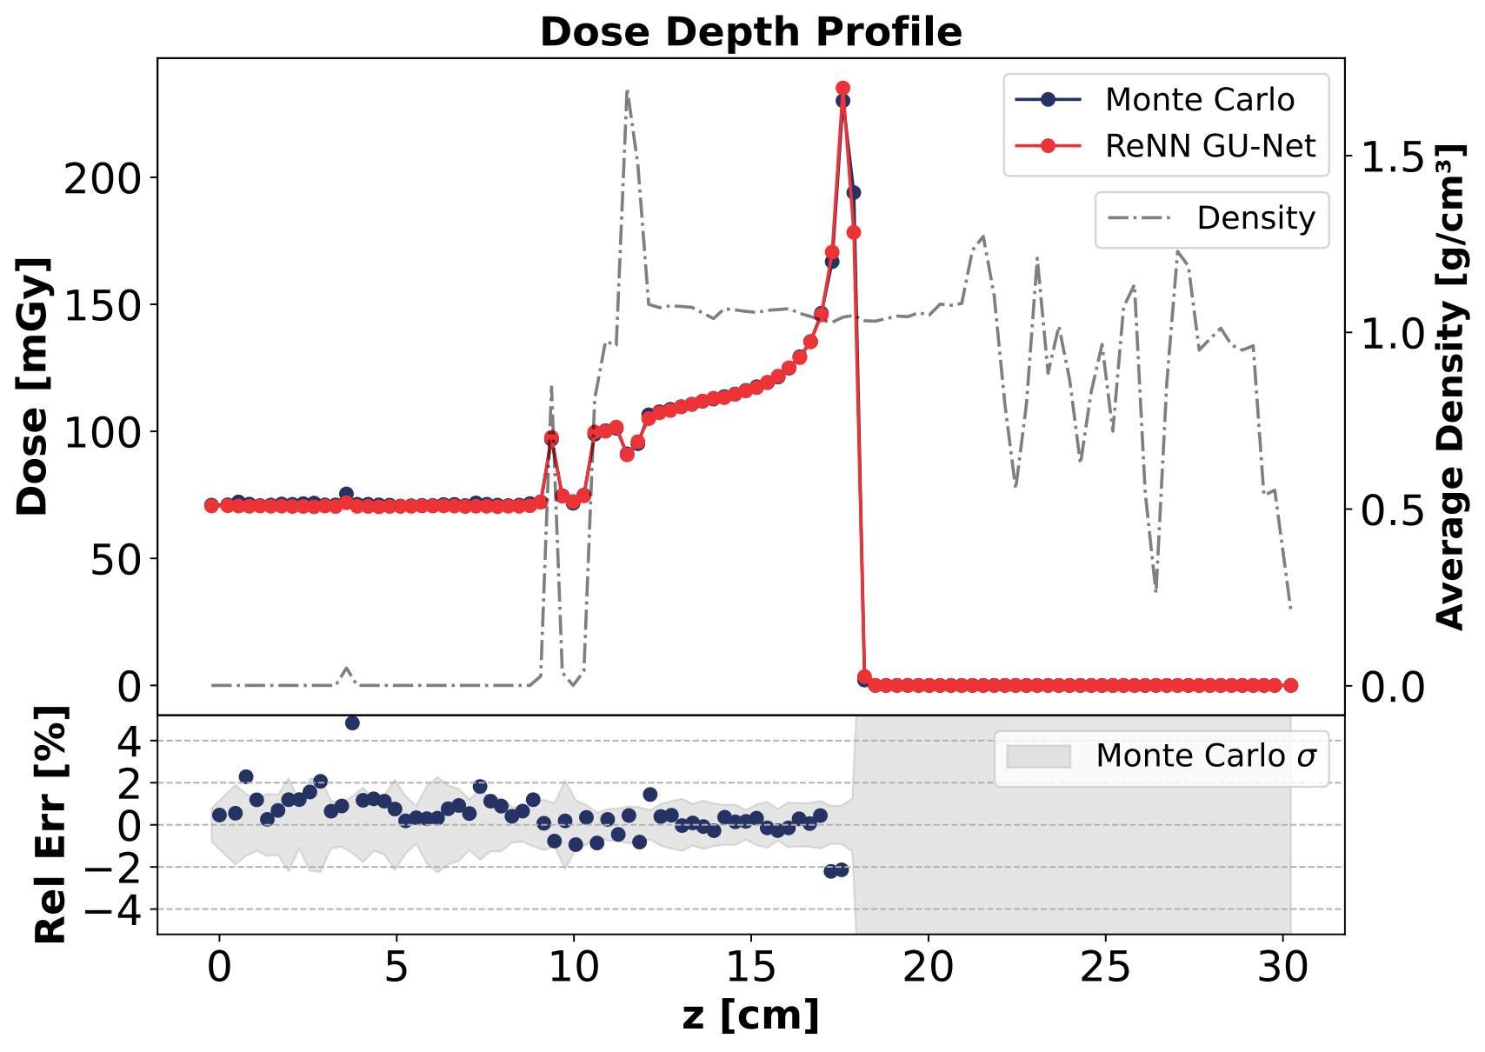
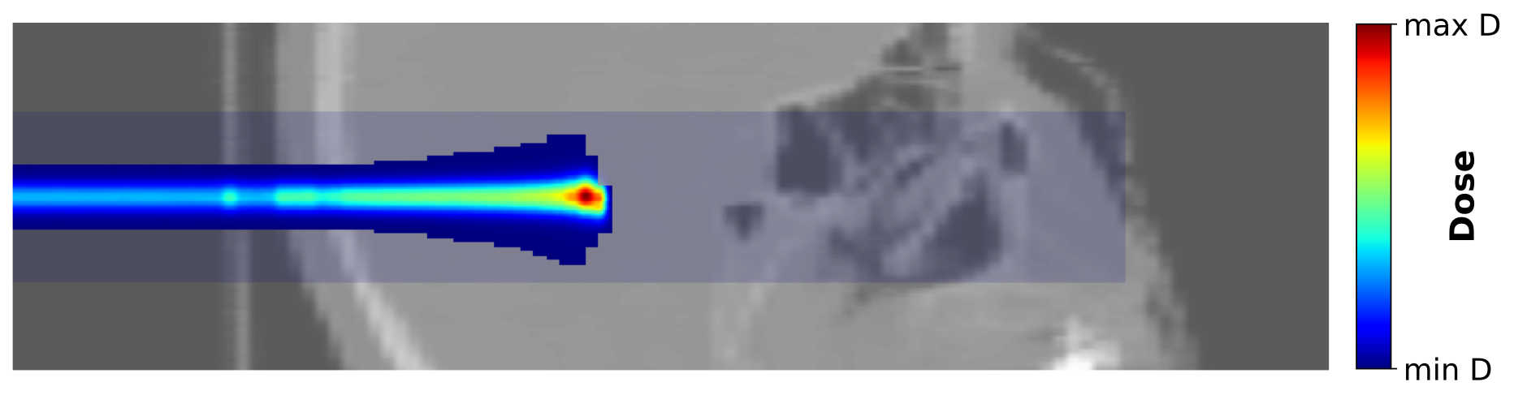
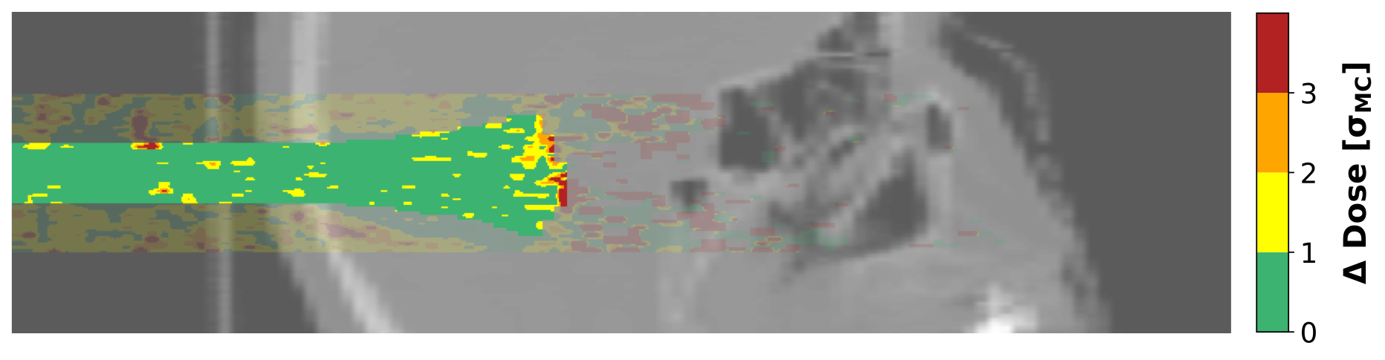
Proton dose engine
Dose
Prediction Error
Deep Learning–Driven Differentiable Autoplanning for
Proton Therapy: A Proof-of-Concept
Lorenzo Arsini - 22/09/2025
EuNPC 2025 - Caen, France

Slide 12
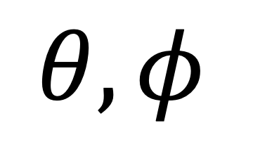
Optimizing Spread Out Bragg Peak
$$θ,φ$$
SOBP Optimization
Field
Fluence
5 variables
x
pencil beam
Energy
Pencil beam
Fluence
PTV
Objective function:
Clinical volumetric + voxel constraints (L2)
OAR
10 pencilbeams
Deep Learning–Driven Differentiable Autoplanning for
Proton Therapy: A Proof-of-Concept
Lorenzo Arsini - 22/09/2025
EuNPC 2025 - Caen, France

Slide 13
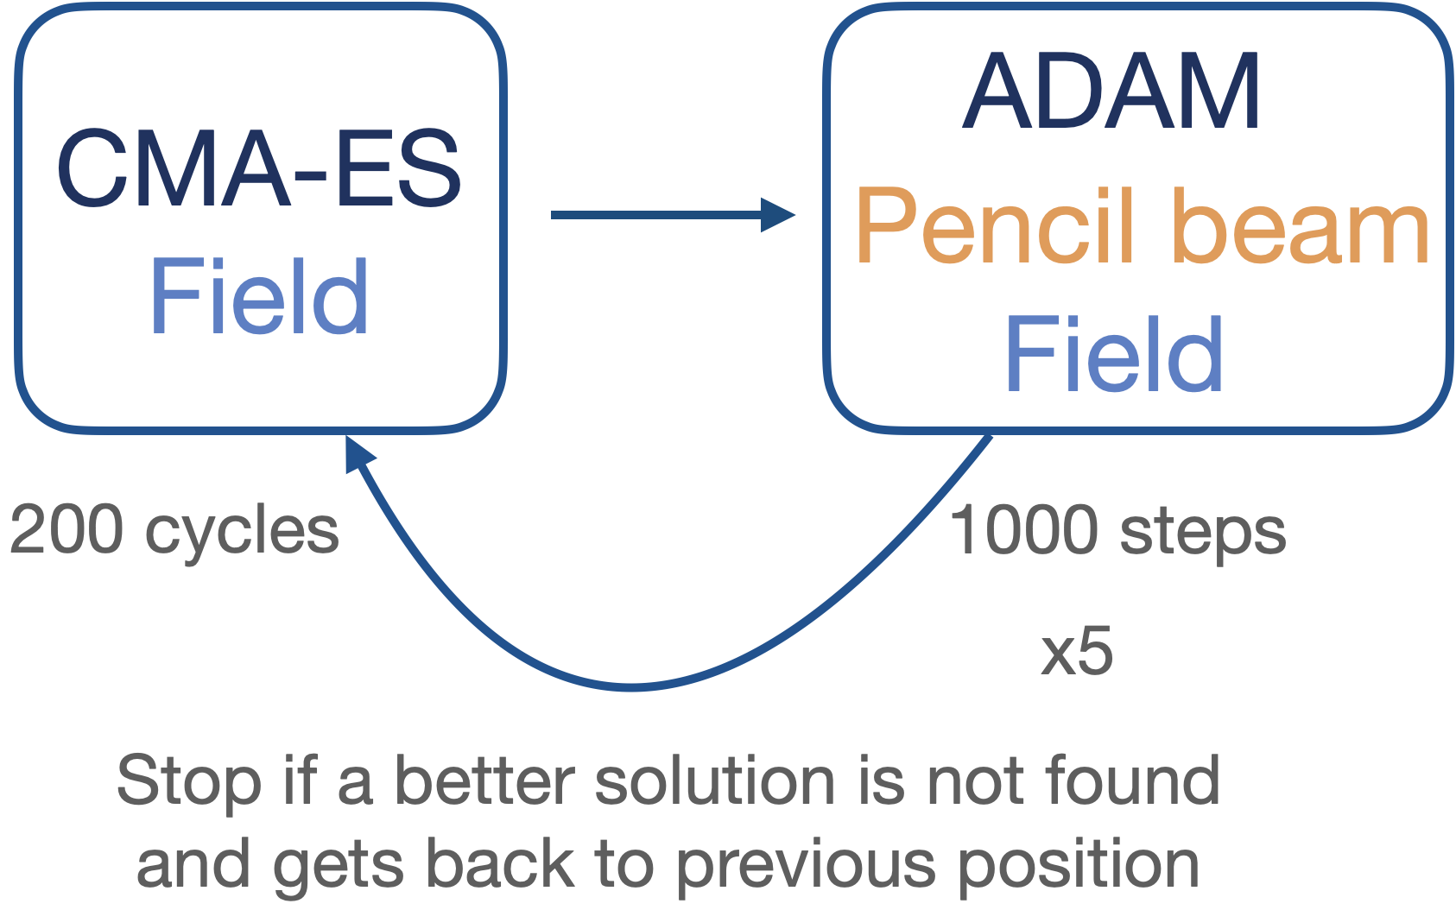
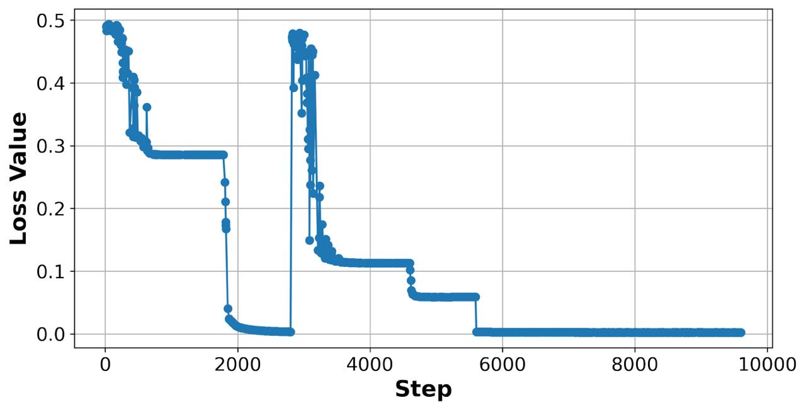
Optimisation strategy
ADAM
Deep Learning–Driven Differentiable Autoplanning for
Proton Therapy: A Proof-of-Concept
Lorenzo Arsini - 22/09/2025
EuNPC 2025 - Caen, France

Slide 14
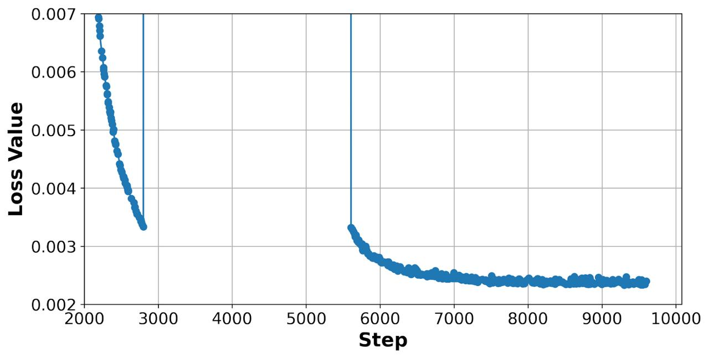
Optimisation strategy
ADAM
Deep Learning–Driven Differentiable Autoplanning for
Proton Therapy: A Proof-of-Concept
Lorenzo Arsini - 22/09/2025
EuNPC 2025 - Caen, France

Slide 15
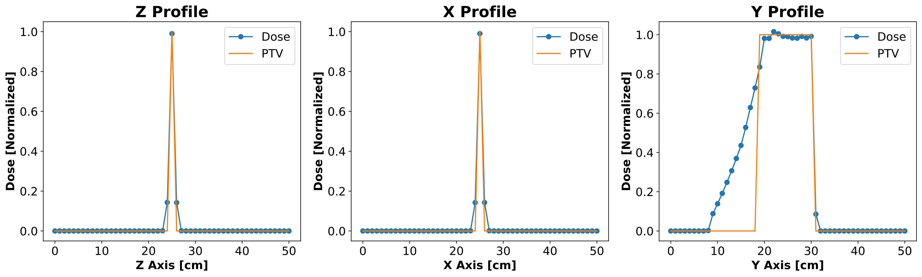
Results with one field
The algorithm manages to find the parameters for the optimal solution
Producing a Spread Out Bragg Peak
Deep Learning–Driven Differentiable Autoplanning for
Proton Therapy: A Proof-of-Concept
Lorenzo Arsini - 22/09/2025
EuNPC 2025 - Caen, France

Slide 16
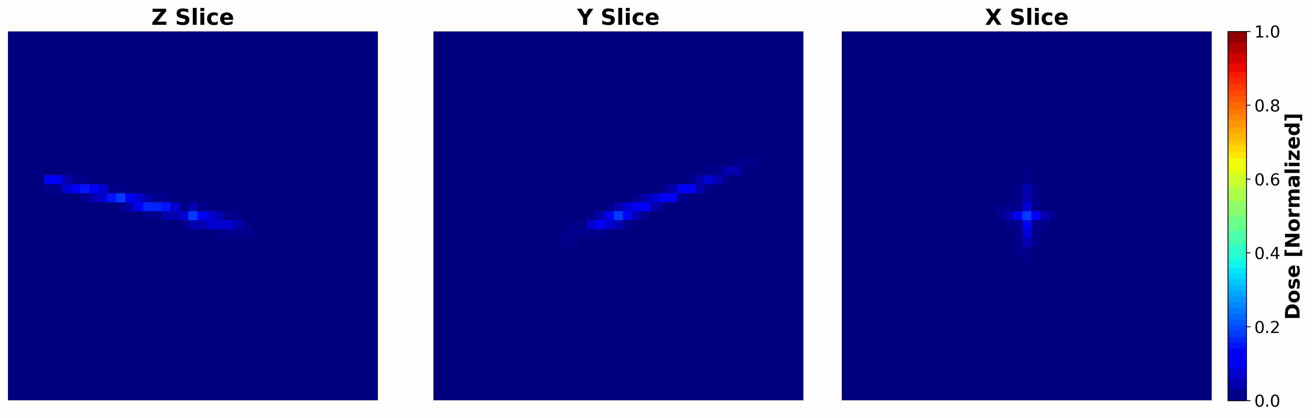
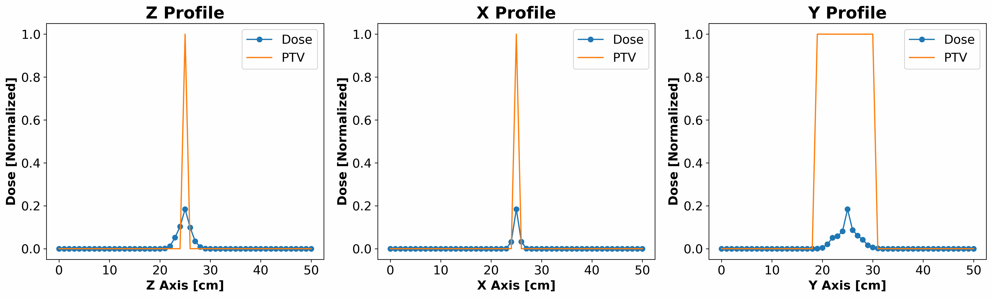
Two fields optimisation
Deep Learning–Driven Differentiable Autoplanning for
Proton Therapy: A Proof-of-Concept
Lorenzo Arsini - 22/09/2025
EuNPC 2025 - Caen, France

Slide 17
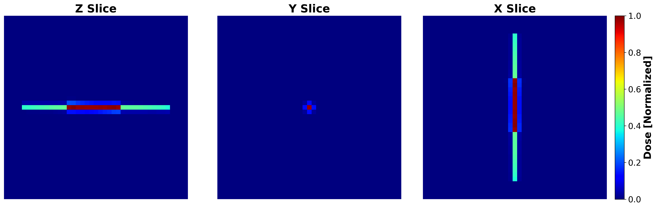
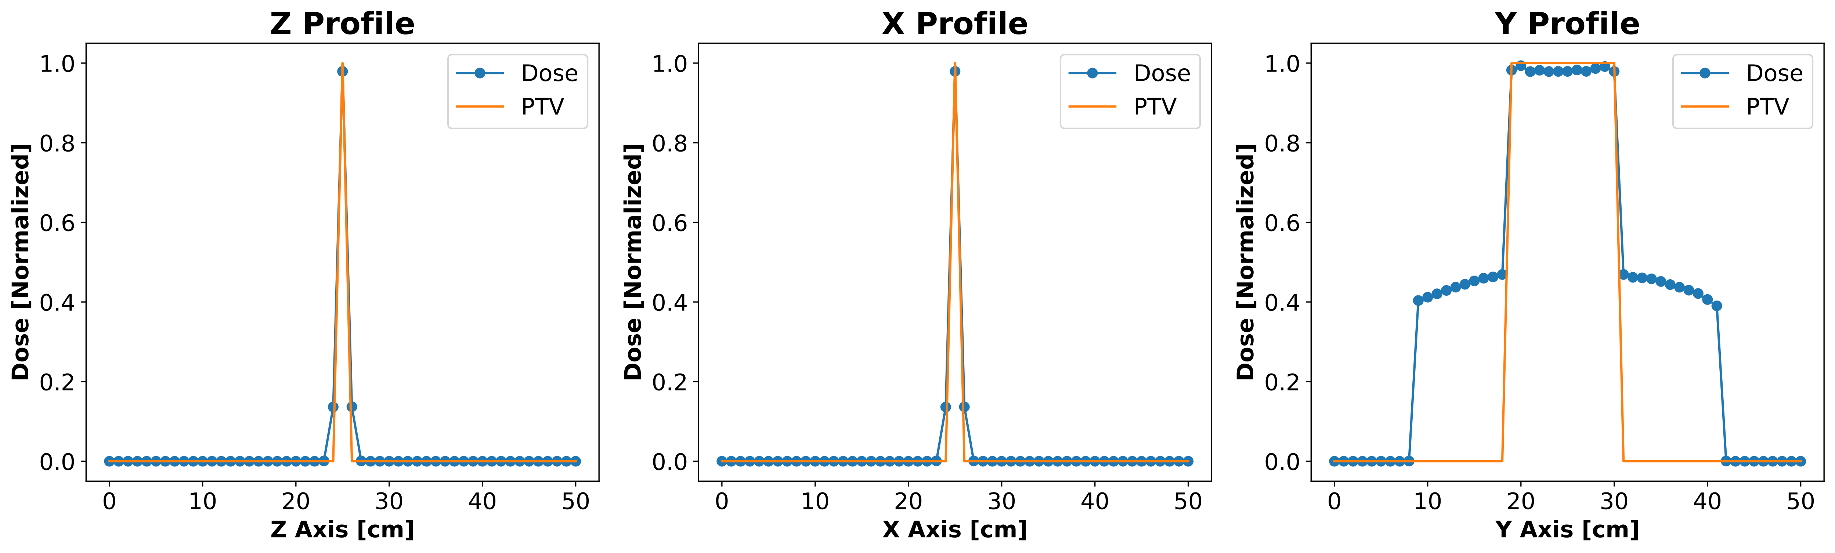
Two fields optimisation
Final solution
Deep Learning–Driven Differentiable Autoplanning for
Proton Therapy: A Proof-of-Concept
Lorenzo Arsini - 22/09/2025
EuNPC 2025 - Caen, France

Slide 18
Benefits
Autoplanning algorithm
Optimize all beams parameters as continuous degrees of freedom
Field and pencil-beam orientation, energy, fluence, shape, …
Possibility to explore more the parameter space
Speed and precision
Explainability
Possibly
Better Treatments
Entire pipeline on GPU
Deep Learning not as a black-box
Deep Learning–Driven Differentiable Autoplanning for
Proton Therapy: A Proof-of-Concept
Lorenzo Arsini - 22/09/2025
EuNPC 2025 - Caen, France

Slide 19
Opportunities
Robust optimisation
  It is possible to estimate the uncertainties voxel-wise
  Also the uncertainties are differentiable
Biological effectiveness
it is possible to compute LET with no computational overhead
Could be included in the objective function
Deep Learning–Driven Differentiable Autoplanning for
Proton Therapy: A Proof-of-Concept
Lorenzo Arsini - 22/09/2025
EuNPC 2025 - Caen, France

Slide 20
Next steps
Optimise the algorithm
Define stop strategies
Dose engine per field
Test on a clinical case
  Increase number of fields
  Use multiple GPUs
Deep Learning–Driven Differentiable Autoplanning for
Proton Therapy: A Proof-of-Concept
Lorenzo Arsini - 22/09/2025
EuNPC 2025 - Caen, France

Slide 21
Thank you for your attention!
Deep Learning–Driven Differentiable Autoplanning for
Proton Therapy: A Proof-of-Concept
Dose engine for fast and accurate dose calculation
Cylindrical Graph Neural Network model:
From CT scan to dose deposition
Gradient based plan optimization on GPUs
Lorenzo Arsini 22-09-2025
lorenzo.arsini@uniroma1.it

