Slide 1
Performance Evaluation and Simulation of Segmented SiC-Based Particle Detectors for Dosimetry and Real-Time Monitoring
Giuseppe Ferdinando D’Agata
Università degli Studi di Catania & INFN – Sezione di Catania
EuNPC, September 21st-27th 2025

Slide 2
The SAMOTHRACE ecosystem aims to realize the vision of a global collaboration environment among major actors in microelectronics, microsystems, materials and micro technologies that have been operating with base in Sicily but with a global perspective.
SAMOTHRACE focuses on the European Commission global challenge “Digital, Industry & Space”, but it also addresses other challenges as “Health”, “Energy & Mobility”, “Agriculture & Environment”.
A collaboration between UniCT, INFN – LNS and INFN – Sez. Catania has recently started with the aim to develop and characterize new innovative SiC detector.

Slide 3
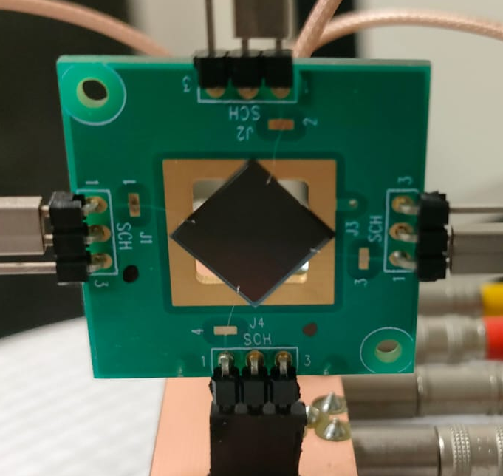
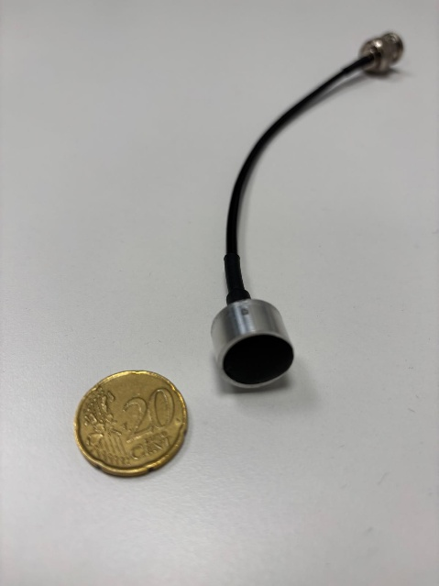
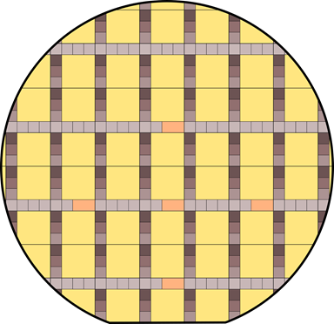
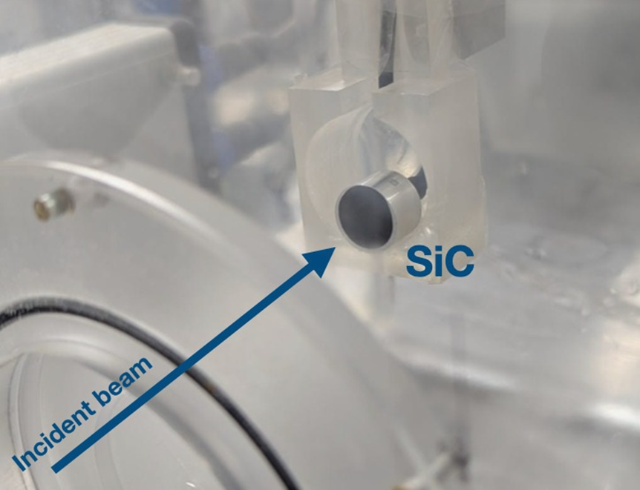
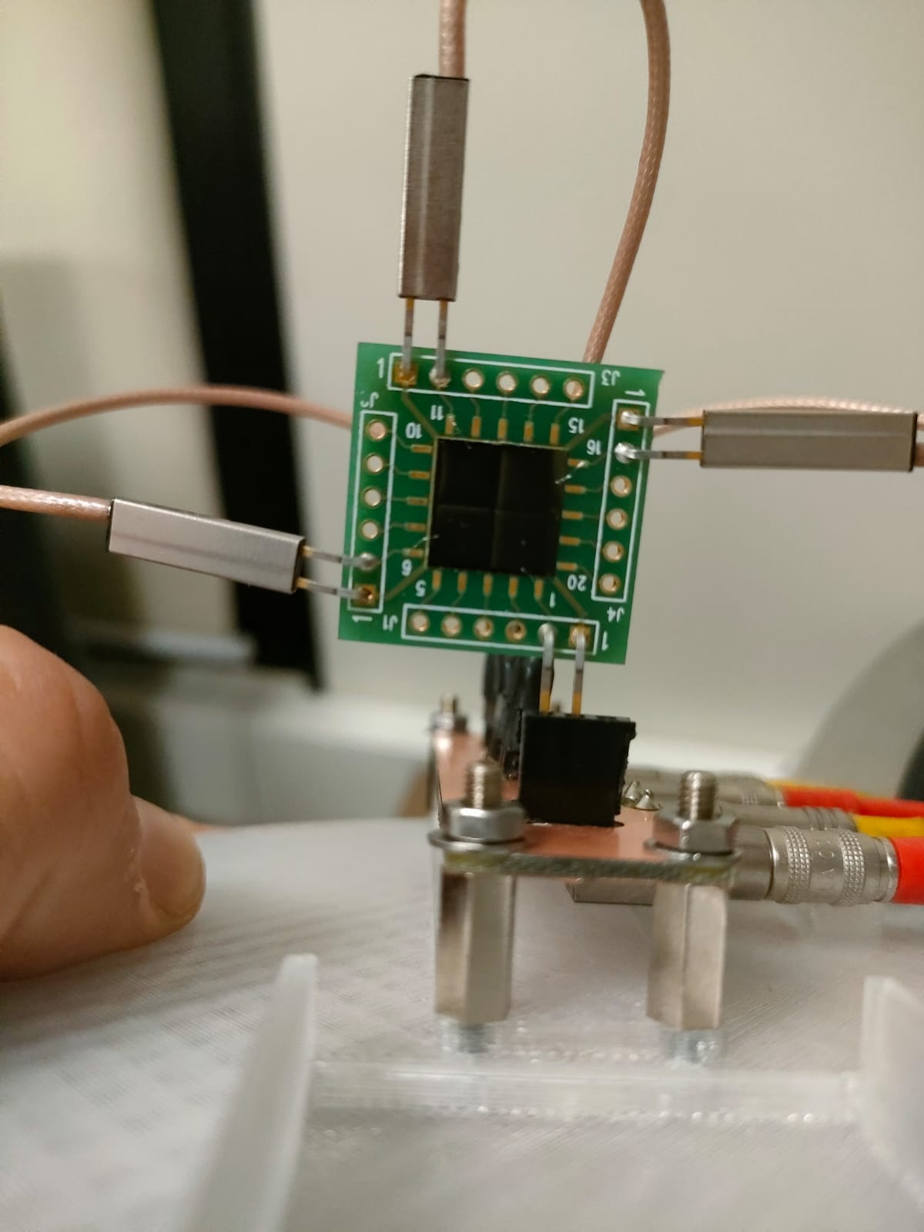
In the last decade, SiC-based tecnology has been appointed as a possible and viable alternative for detectors and dosimeters in both nuclear and medical physics.
Our aim is double folded:
Build an array of SiC detectors for on-line beam monitoring
Provide a SiC dosimiter, able to real-time dose measurements.

Slide 4
To develop such a device, the first step is to simulate the detector (GEANT4) keeping in mind:
The detector response
  Expected energies detected
  Necessary thickness for the various purposes
  Solid angle covered
The effects coming from the interaction between the different parts of the detector
  Cross-talk
  Interaction between electric fields
  edge effects

Slide 5
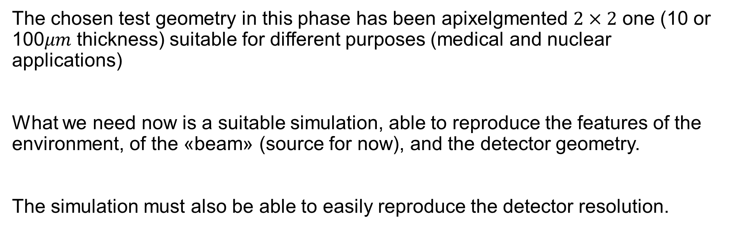
The chosen test geometry in this phase has been apixelgmented $2×2$ one (10 or 100$μm$ thickness) suitable for different purposes (medical and nuclear applications)
What we need now is a suitable simulation, able to reproduce the features of the environment, of the «beam» (source for now), and the detector geometry.
The simulation must also be able to easily reproduce the detector resolution.

Slide 6
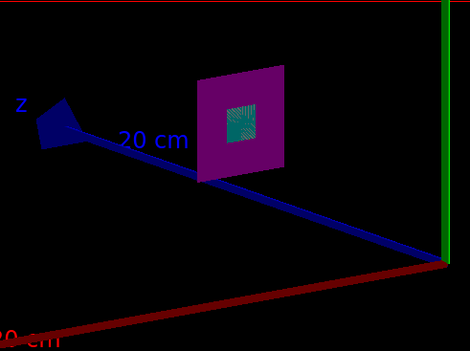
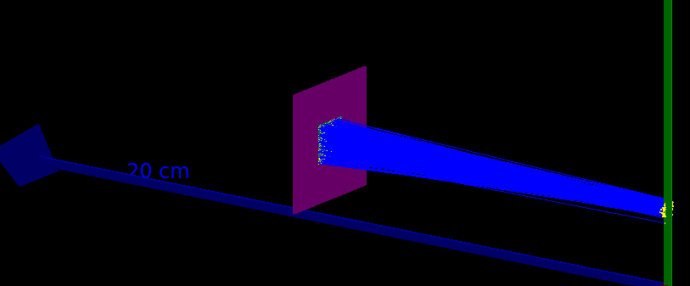
Given the various purposes and geometries of the segmented detector, the simulation must be versatile enough to easily modify
The matrix structure of the detector (how many pixels and in which configuration).
The relative position between the beam and the detector.
The characteristics of the beam itself (rate, spatial/energetic distribution)
It is also necessary to implement some feature able to provide information on lost events (almost simple), edge events (harder) and electric field effects (very hard).
1
3
2
4

Slide 7
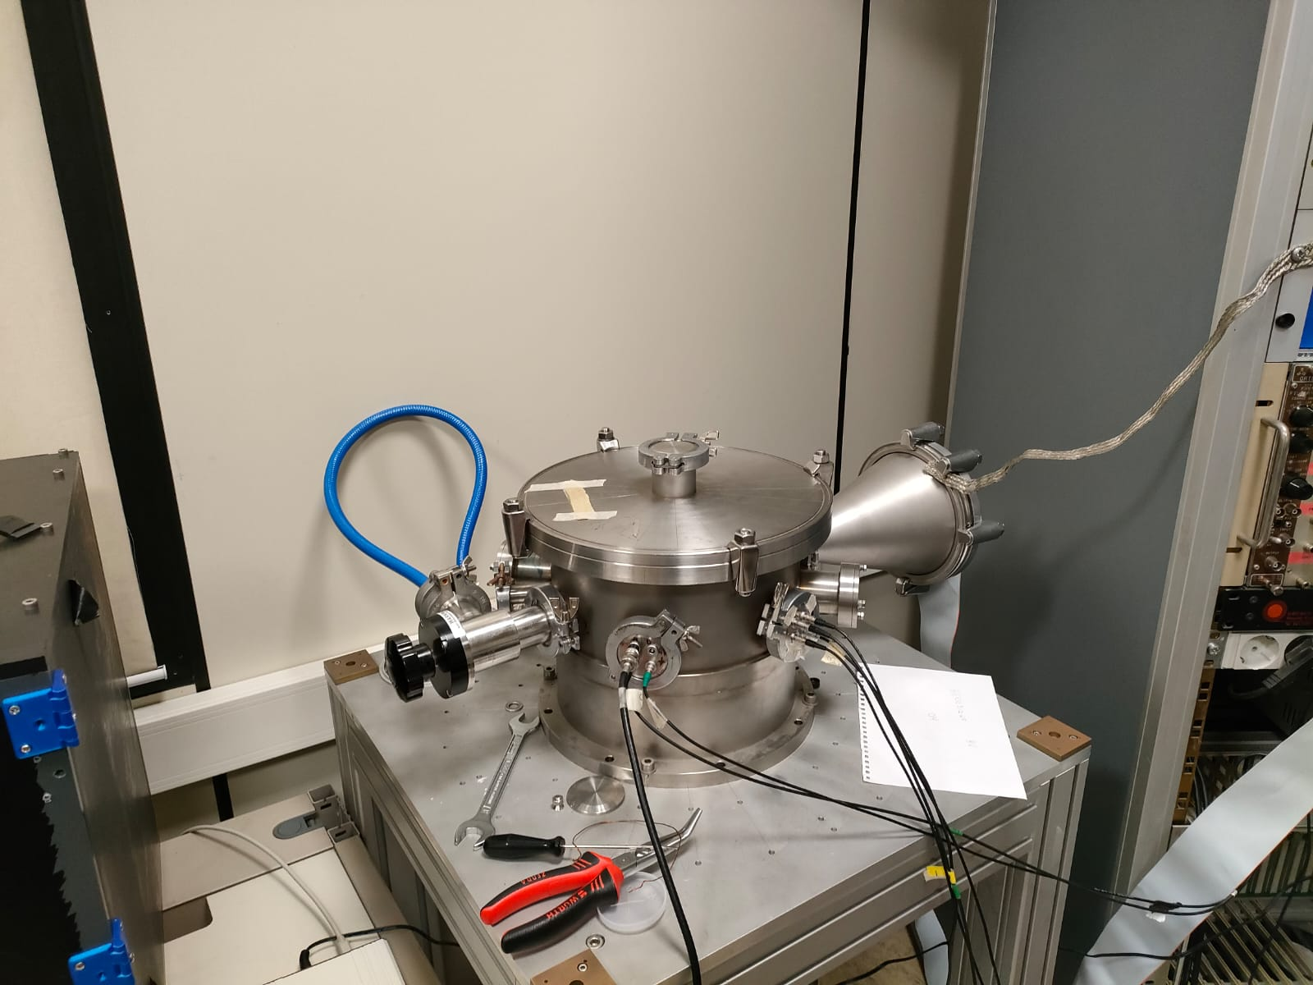
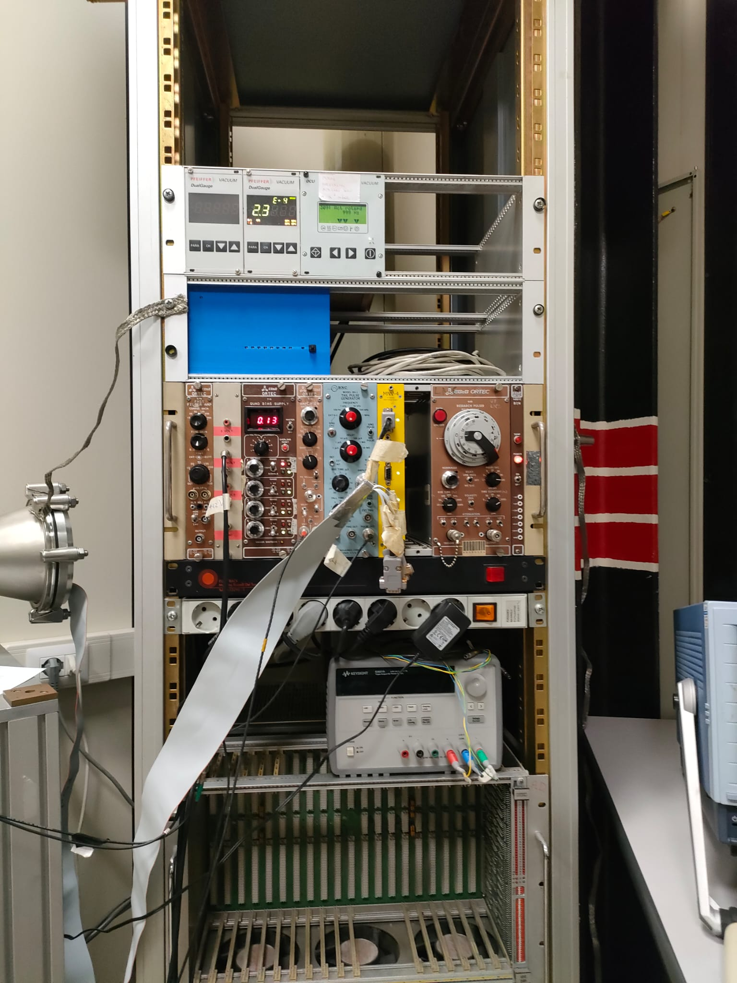
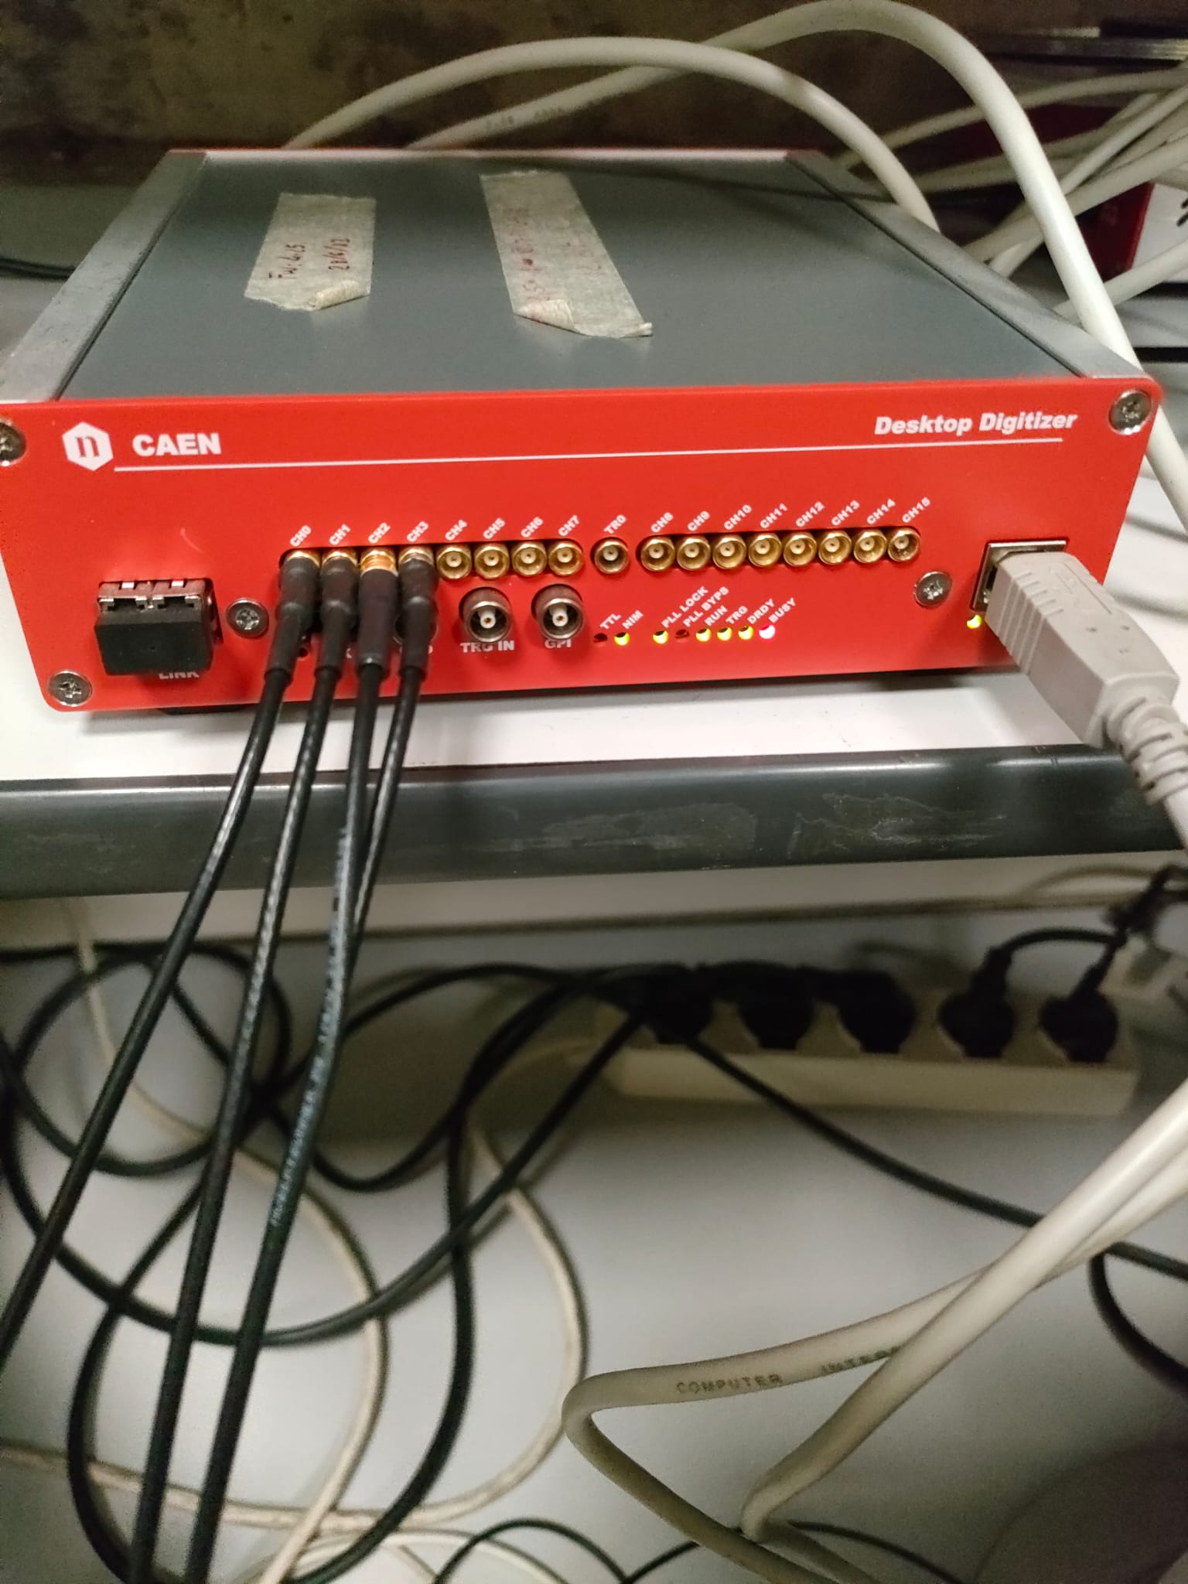
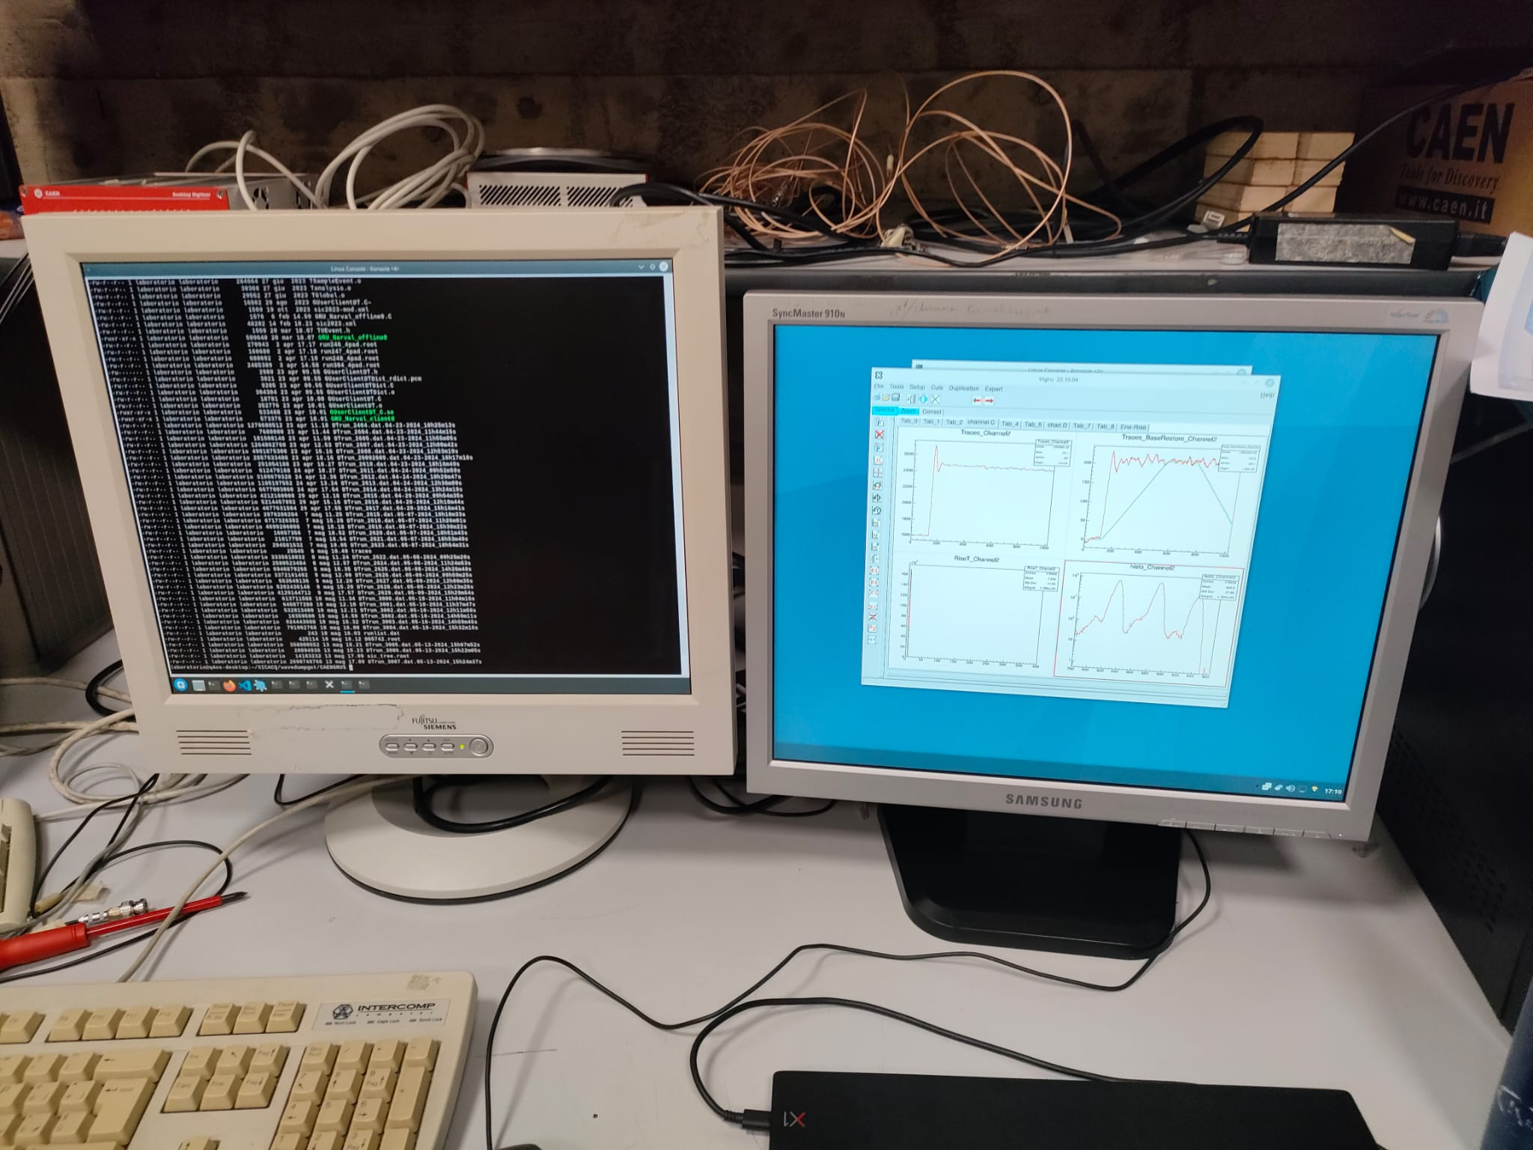
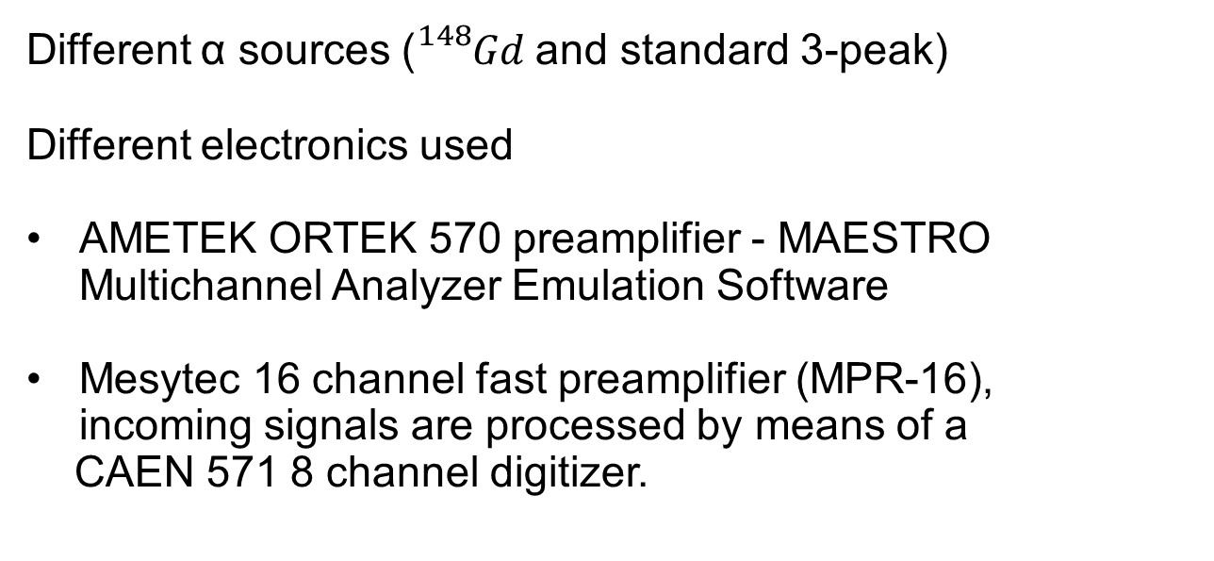
Different α sources (${}_{}^{148}{Gd}$and standard 3-peak)
Different electronics used
AMETEK ORTEK 570 preamplifier - MAESTRO Multichannel Analyzer Emulation Software
Mesytec 16 channel fast preamplifier (MPR-16), incoming signals are processed by means of a
CAEN 571 8 channel digitizer.

Slide 8
Given the structure and purpose of the detectors, it is crucial to understand how and why impinging particles can also lead to improper, incomplete or totally missing signal reconstruction.
For example, if a particle does not end up in the active zone of the SiC detector, hitting the detector in the inter-pixel sections
In such cases either the particle is lost, or the incoming can be detected at the same time. The signal will then be recorded by both pixels.
The possibility of missing particles cannot be ruled out a priori

Slide 9
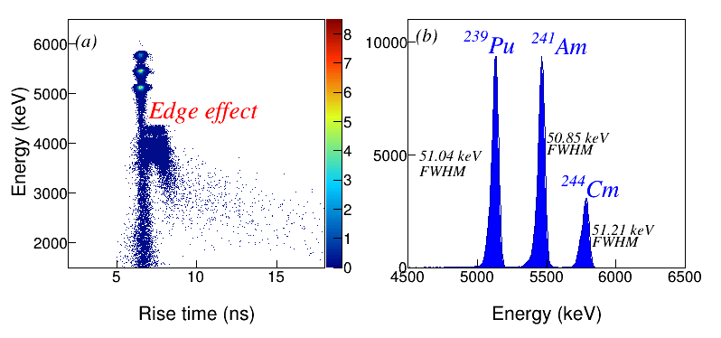
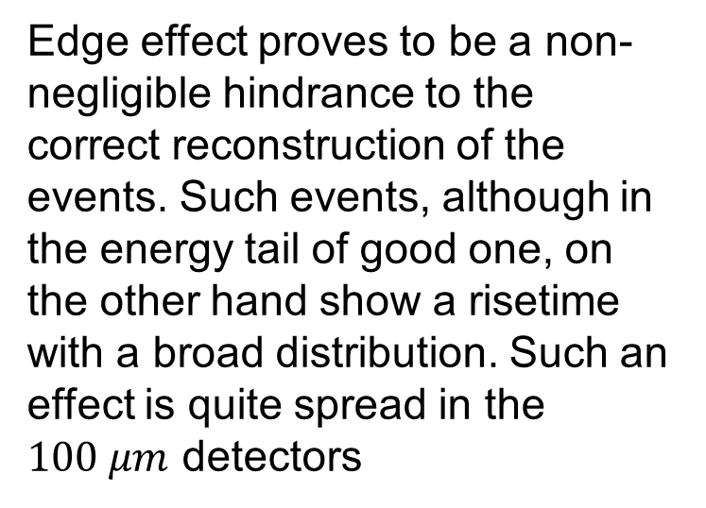
Edge effect proves to be a non- negligible hindrance to the correct reconstruction of the events. Such events, although in the energy tail of good one, on the other hand show a risetime with a broad distribution. Such an effect is quite spread in the $100 μm$ detectors

Slide 10
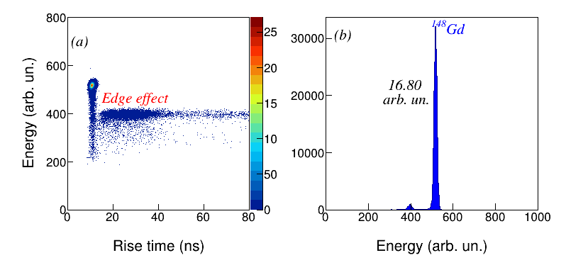
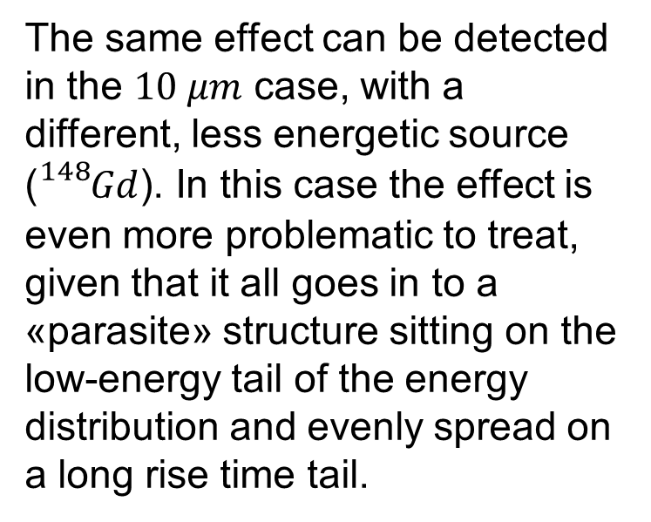
The same effect can be detected in the $10 μm$ case, with a different, less energetic source (${}_{}^{148}{Gd}$). In this case the effect is even more problematic to treat, given that it all goes in to a «parasite» structure sitting on the low-energy tail of the energy distribution and evenly spread on a long rise time tail.

Slide 11
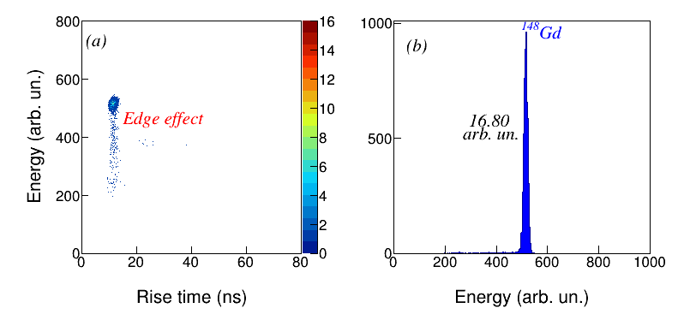
The first idea to thoroughly investigate the effect, can be to strongly collimate the source of one of the four pixels.
As it is clear, the effect is due to the construction of the detector, given that the «edge» events are taken out if the source is collimated directly on the center of the detector.

Slide 12
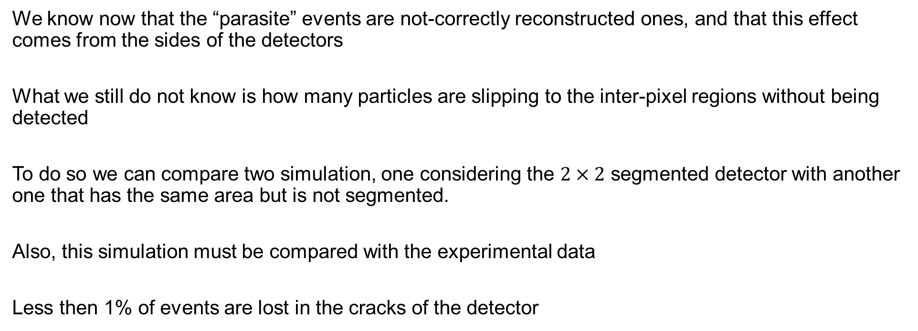
We know now that the “parasite” events are not-correctly reconstructed ones, and that this effect comes from the sides of the detectors
What we still do not know is how many particles are slipping to the inter-pixel regions without being detected
To do so we can compare two simulation, one considering the $2×2$ segmented detector with another one that has the same area but is not segmented.
Also, this simulation must be compared with the experimental data
Less then 1% of events are lost in the cracks of the detector

Slide 13
From the inter-pixel zone most the events are not lost, but poorly reconstructed. This could be mainly due to electric field effects in the detector.
Thoroughly simulate this occurrence can be very tricky, due to the difficulties to properly mimic the electric field produced by the different regions of the detectors,
In first approximation we assume that the charge collection in the two adjacent pixels generated by an impinging particle is directly proportional to the distance from the hit point and the centre of the pixel. In this way we can obtain a first (rough) approximation of the number and energy of the charged particles detected in the inter-pixel.

Slide 14
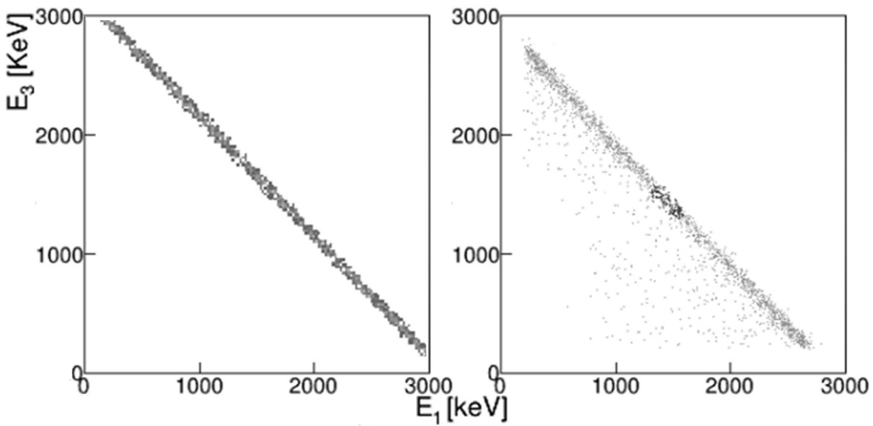
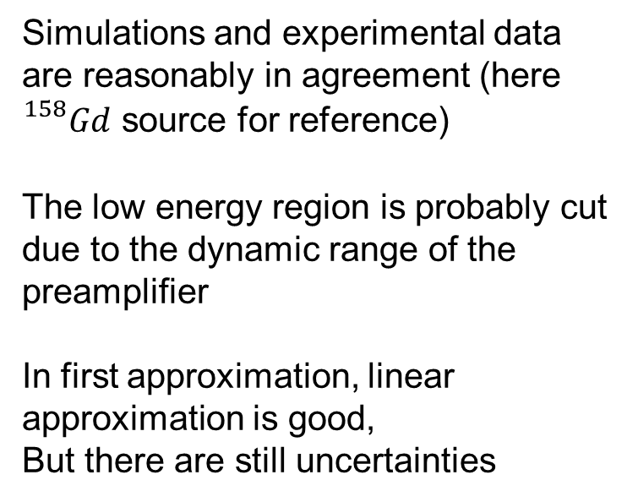
Simulations and experimental data are reasonably in agreement (here ${}_{}^{158}{Gd}$ source for reference)
The low energy region is probably cut due to the dynamic range of the preamplifier
In first approximation, linear approximation is good,
But there are still uncertainties

Slide 15
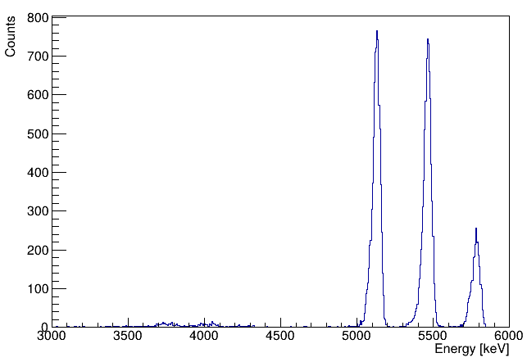
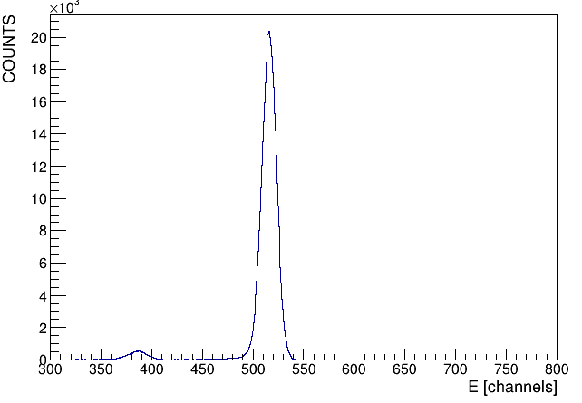
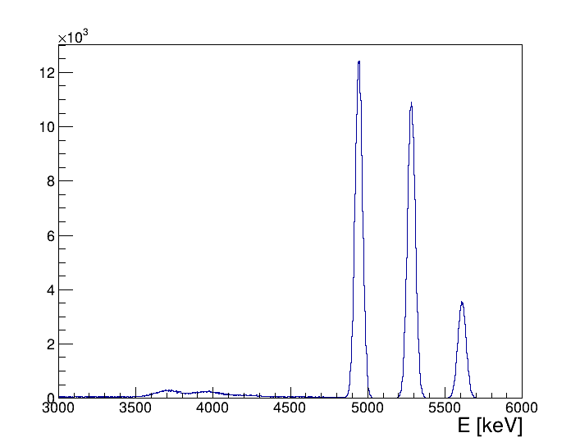
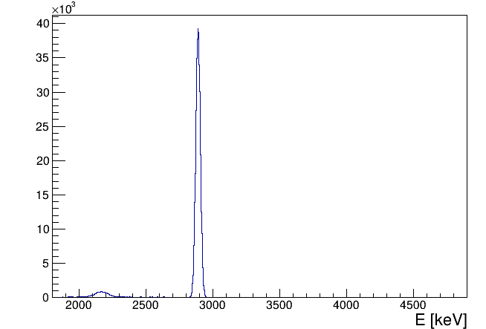
A more refined version of the detector simulation consists in an approximation of the signal generated by an impinging particle as the one discussed before + a gaussian function centred at about 70% of the real energy of the particle.
This is most probably due to electric field effects in the inter-pixel region!
Simulations and experimental data are reasonably in agreement

Slide 16
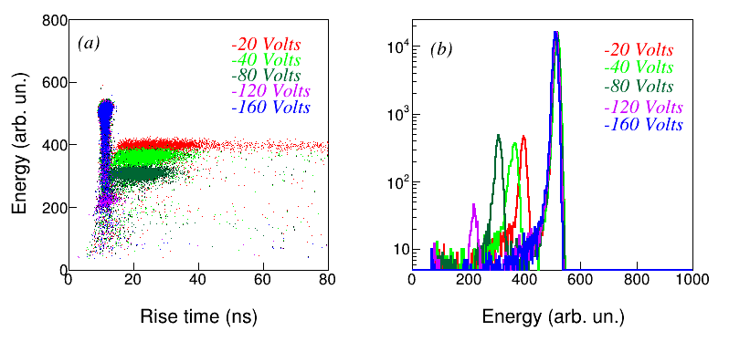
Given the sturdiness of the detector, we decided to increase the recommended voltage
The result is that the main peak does not move much in both position and charge collected, while the «parasite» one (that now we know comes form the sides of the detector)
What moves, on the other hand, is the unwanted contribution from the sides of the detectors

Slide 17
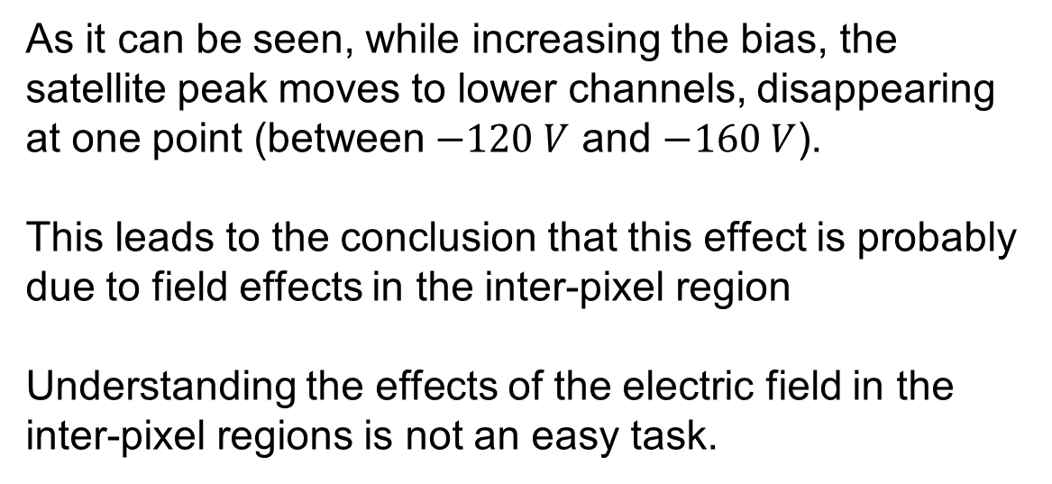
As it can be seen, while increasing the bias, the satellite peak moves to lower channels, disappearing at one point (between $−120 V$ and $−160 V$).
This leads to the conclusion that this effect is probably due to field effects in the inter-pixel region
Understanding the effects of the electric field in the inter-pixel regions is not an easy task.

Slide 18
CONCLUSIONS:
Inter- pixel effects have been studied from simulations
The events from the inter-pixel have been simulated, and experimental data are reasonably in agreement with simulations
Uncertainties rose up from the edge effects (inter-pixel dimensions non consistent between simulations and experimental data)
Probably this last point can not be further treated via GEANT4 simulations, and different simulation codes must be used (Synopsys,…)

