Slide 1
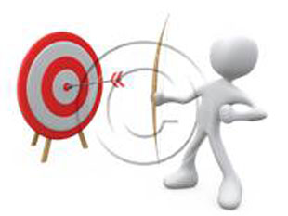




Enhancing Target development at GANIL for nuclear research: Optimization of the deposition technique for lanthanide targets
Radia Rahali, Christelle Stodel, Georges Frémont, Marius Bourges, Franck Perocheau.
Grand Accélérateur National d’Ions Lourds (GANIL), CEA/DRF-CNRS/IN2P3

Slide 2
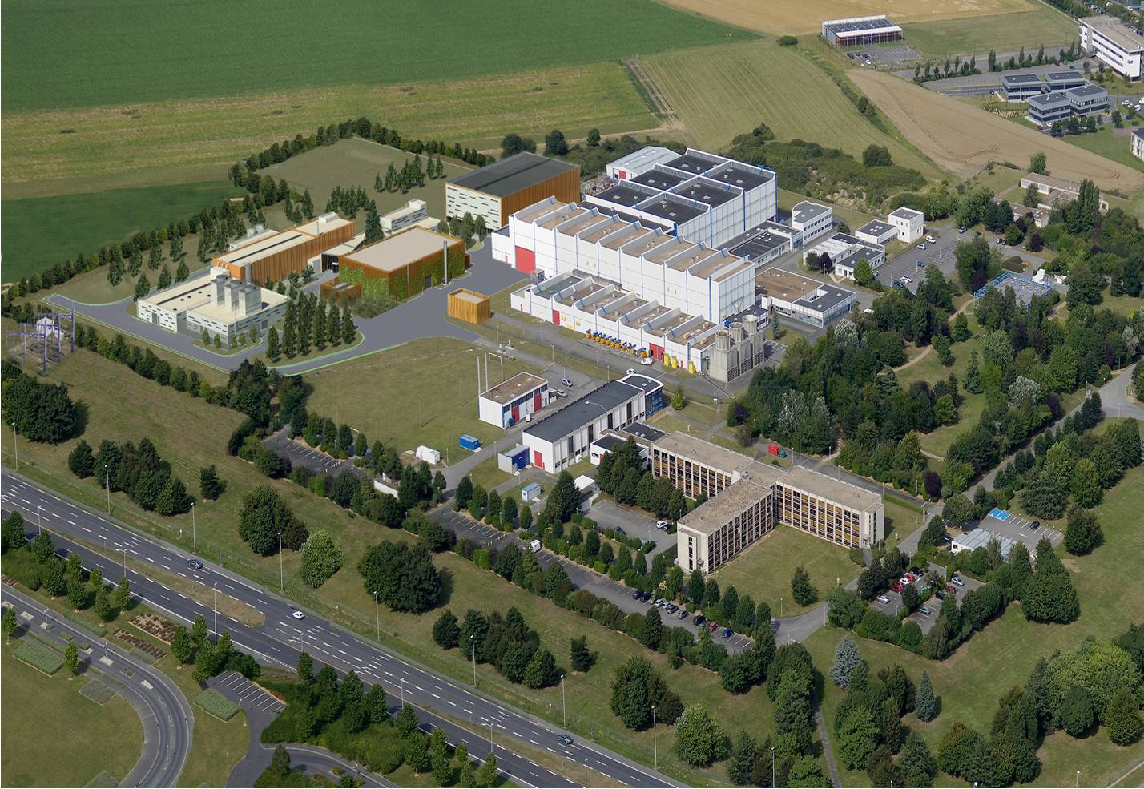
Outline
GANIL/SPIRAL2 Facility
- Accelerators and targets.
2. GANIL target laboratory
3. Examples of target fabrication
4. Conclusion

Slide 3
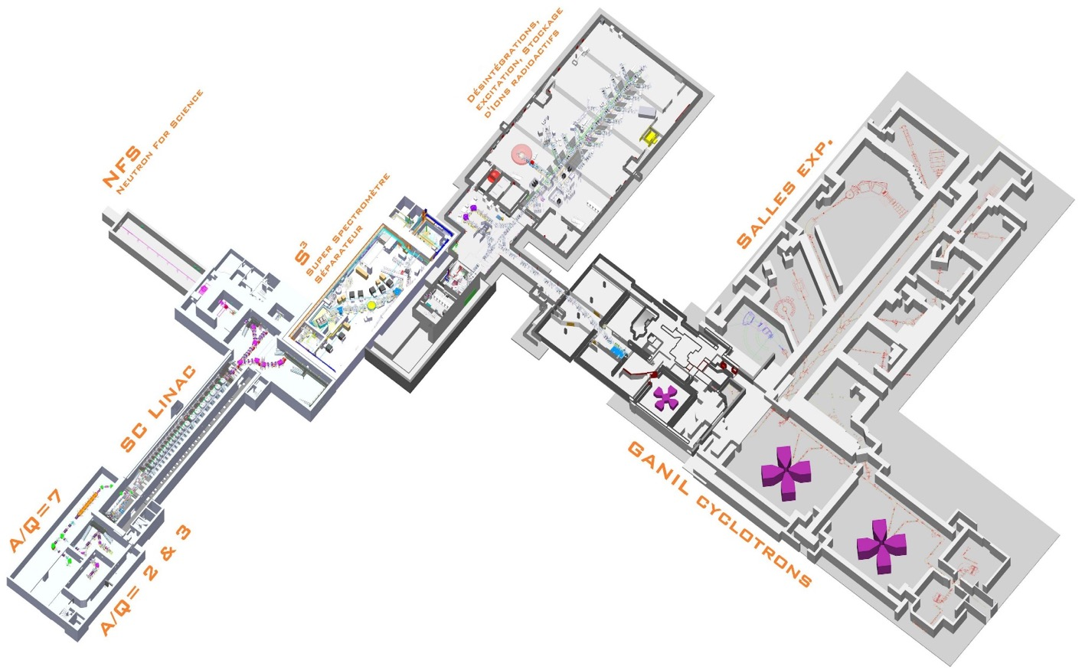
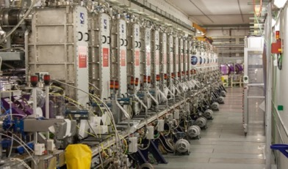
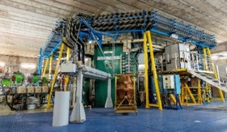
GANIL/SPIRAL2 Facility
Beams : ¹²C à U
Energy : from <1 MeV/nucleon up to 95MeV/nucleon
Up to 4 parallel experiments
nuclear physics
Astrophysics,
materials under irradiation and nanostructuring,
molecular collisions and the interstellar medium…
Radiobilogy
Beams :
33 MeV protons
40 MeV deutons
He to U <14,5 MeV/nucleon ions lourds

Slide 4
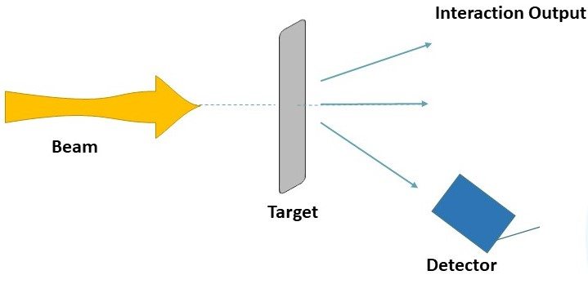
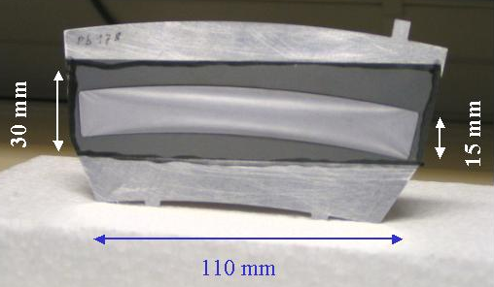
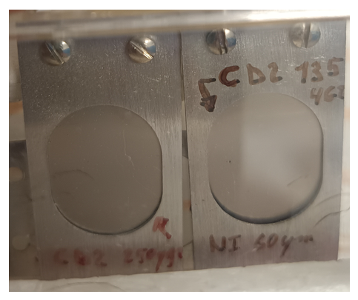
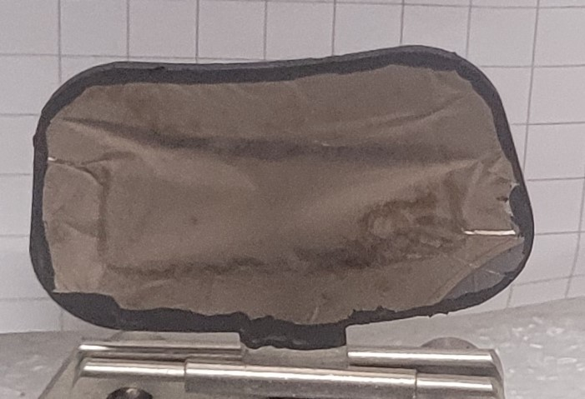
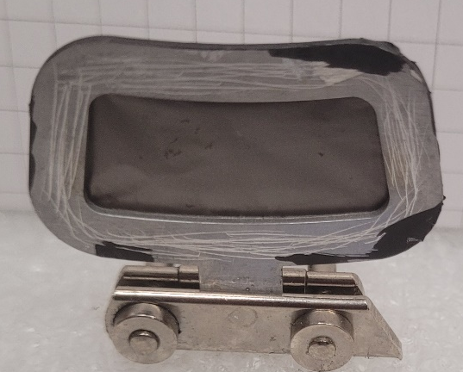
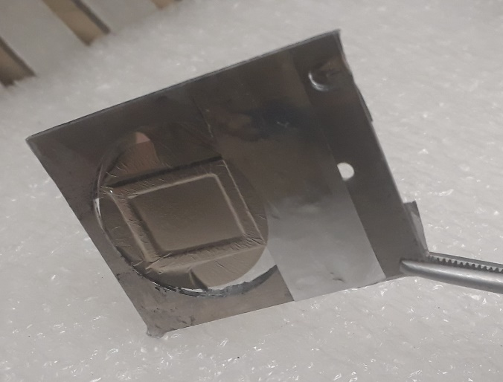
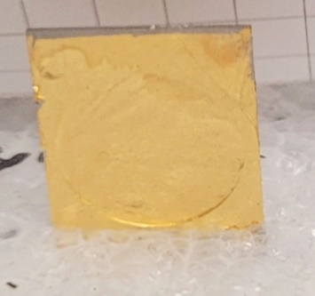
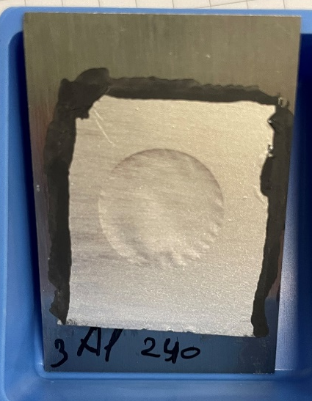
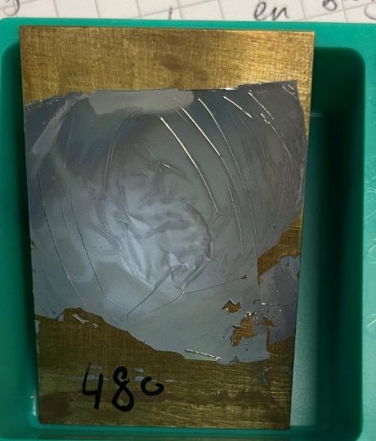
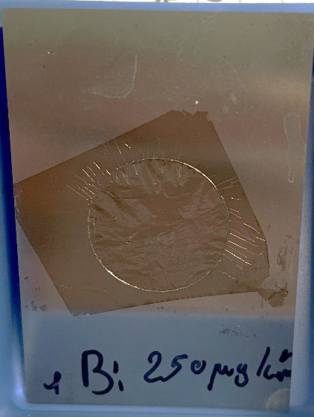
No matter the type of experiment one wishes to perform, a good target is needed!
But… What the target looks like ?!
Gaseous, liquid or solid state
209 Bi ~ 150 µg/cm²
On carbone backing of 35 µg/cm²
Resistive heating
Sn ~ 150 µg/cm²
On carbone backing of 35 µg/cm²
Resistive heating
CD2 ~ 135 µg/cm²
Ni backing
polymerisation
Enriched ²⁰⁸Pb target of 350 µg/cm² sandwiched between C 35 µg/cm² and C 5 µg/cm².
PVD
⁶⁰Ni
150 et 250 µg/cm²
Self supported
Electrodeposition
Au ~ 70 µg/cm²
Self supported
Bi ~ 250 µg/cm²
Self supported
PVD (resistive heating)
Al ~ 240 µg/cm²
Self supported
PVD (resistive heating)
⁷⁰Zn ~ 480 µg/cm²
Self supported
PVD (resistive heating)
Notes:
Zn 70 isotope
480 μg/cm²
Evaporation effet joule, dépôt sur du vinyl
Al naturel
240 μg/cm²
Effet joule, dépôt sur betaine
Bi naturel
250 μg/cm²
Effet joule, dépôt sur betaine

Slide 5

GANIL Target Laboratory
How can we manufacture a target ?

Slide 6
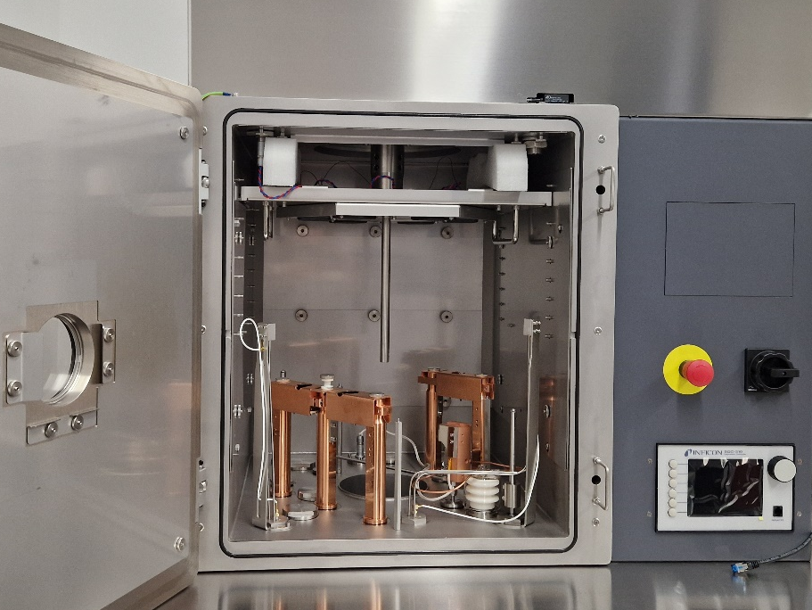
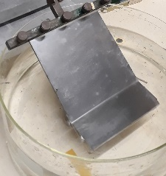

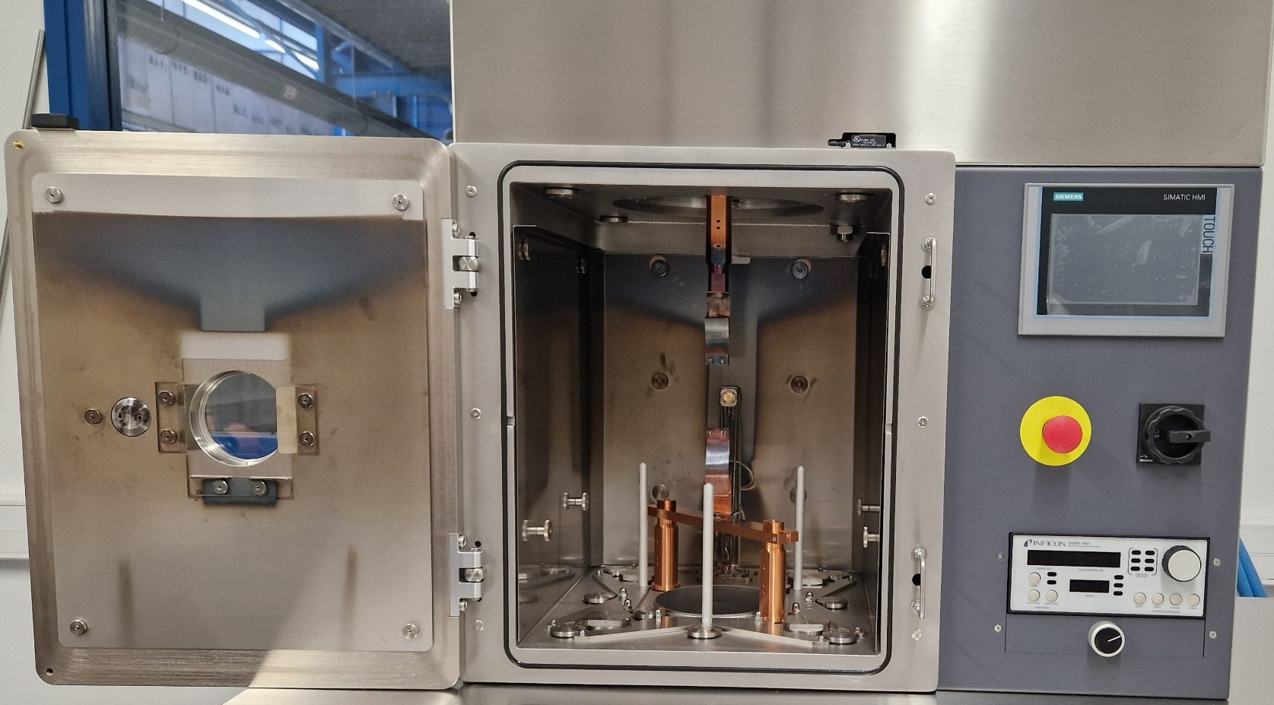
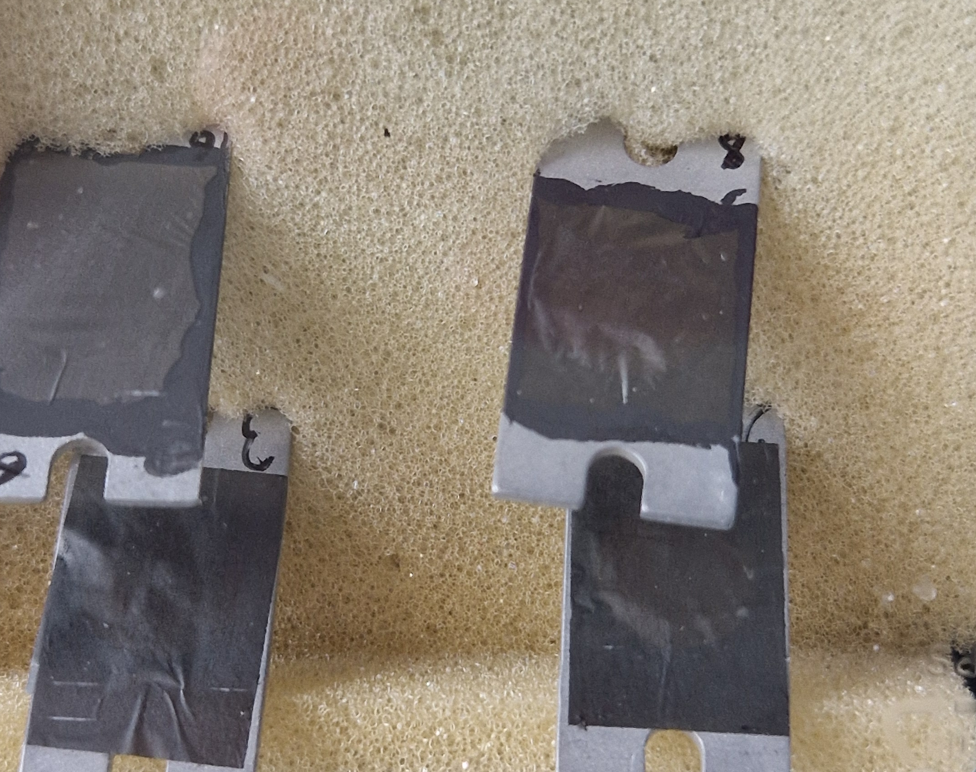
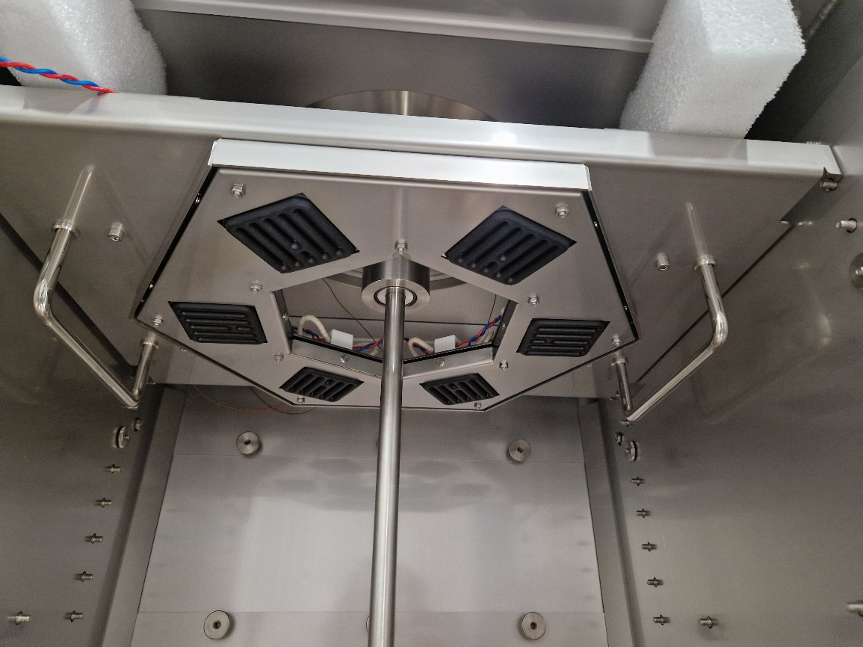
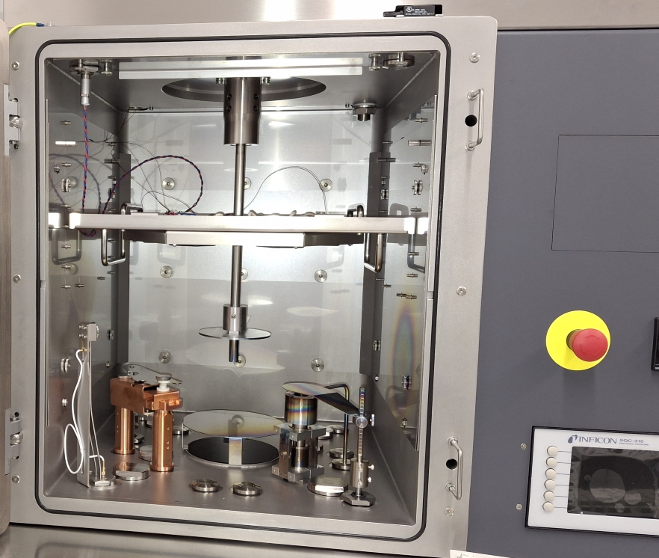
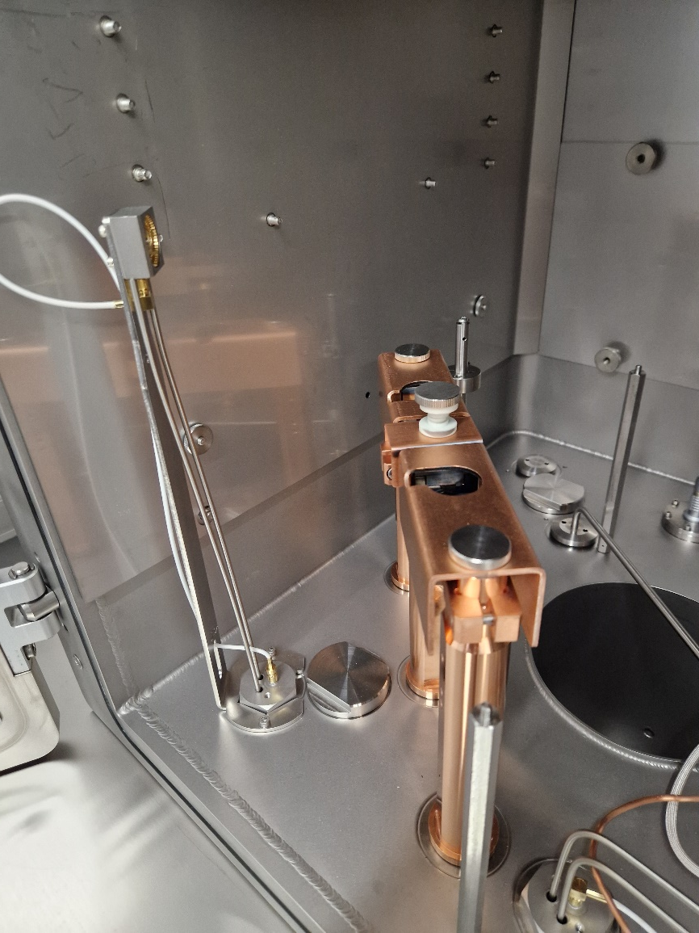
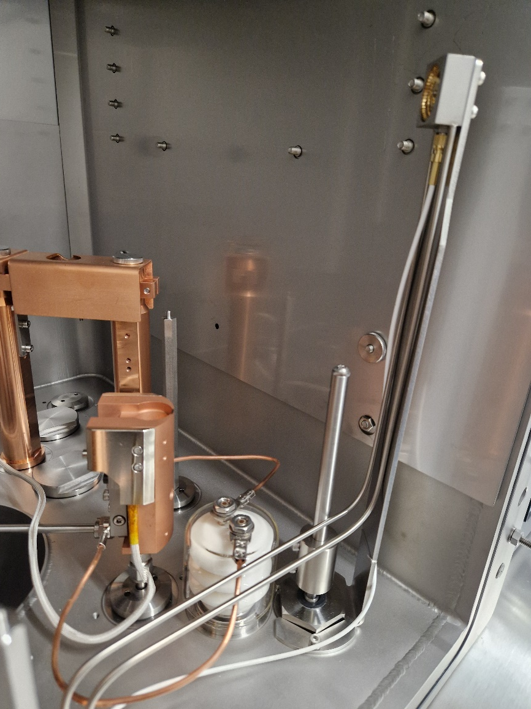
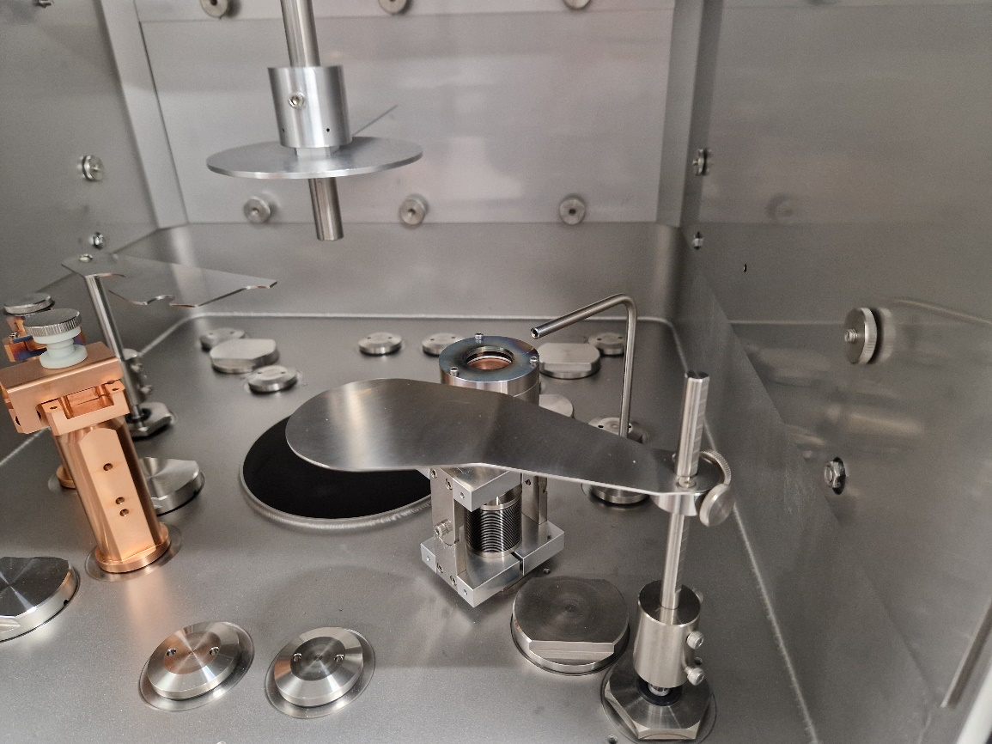
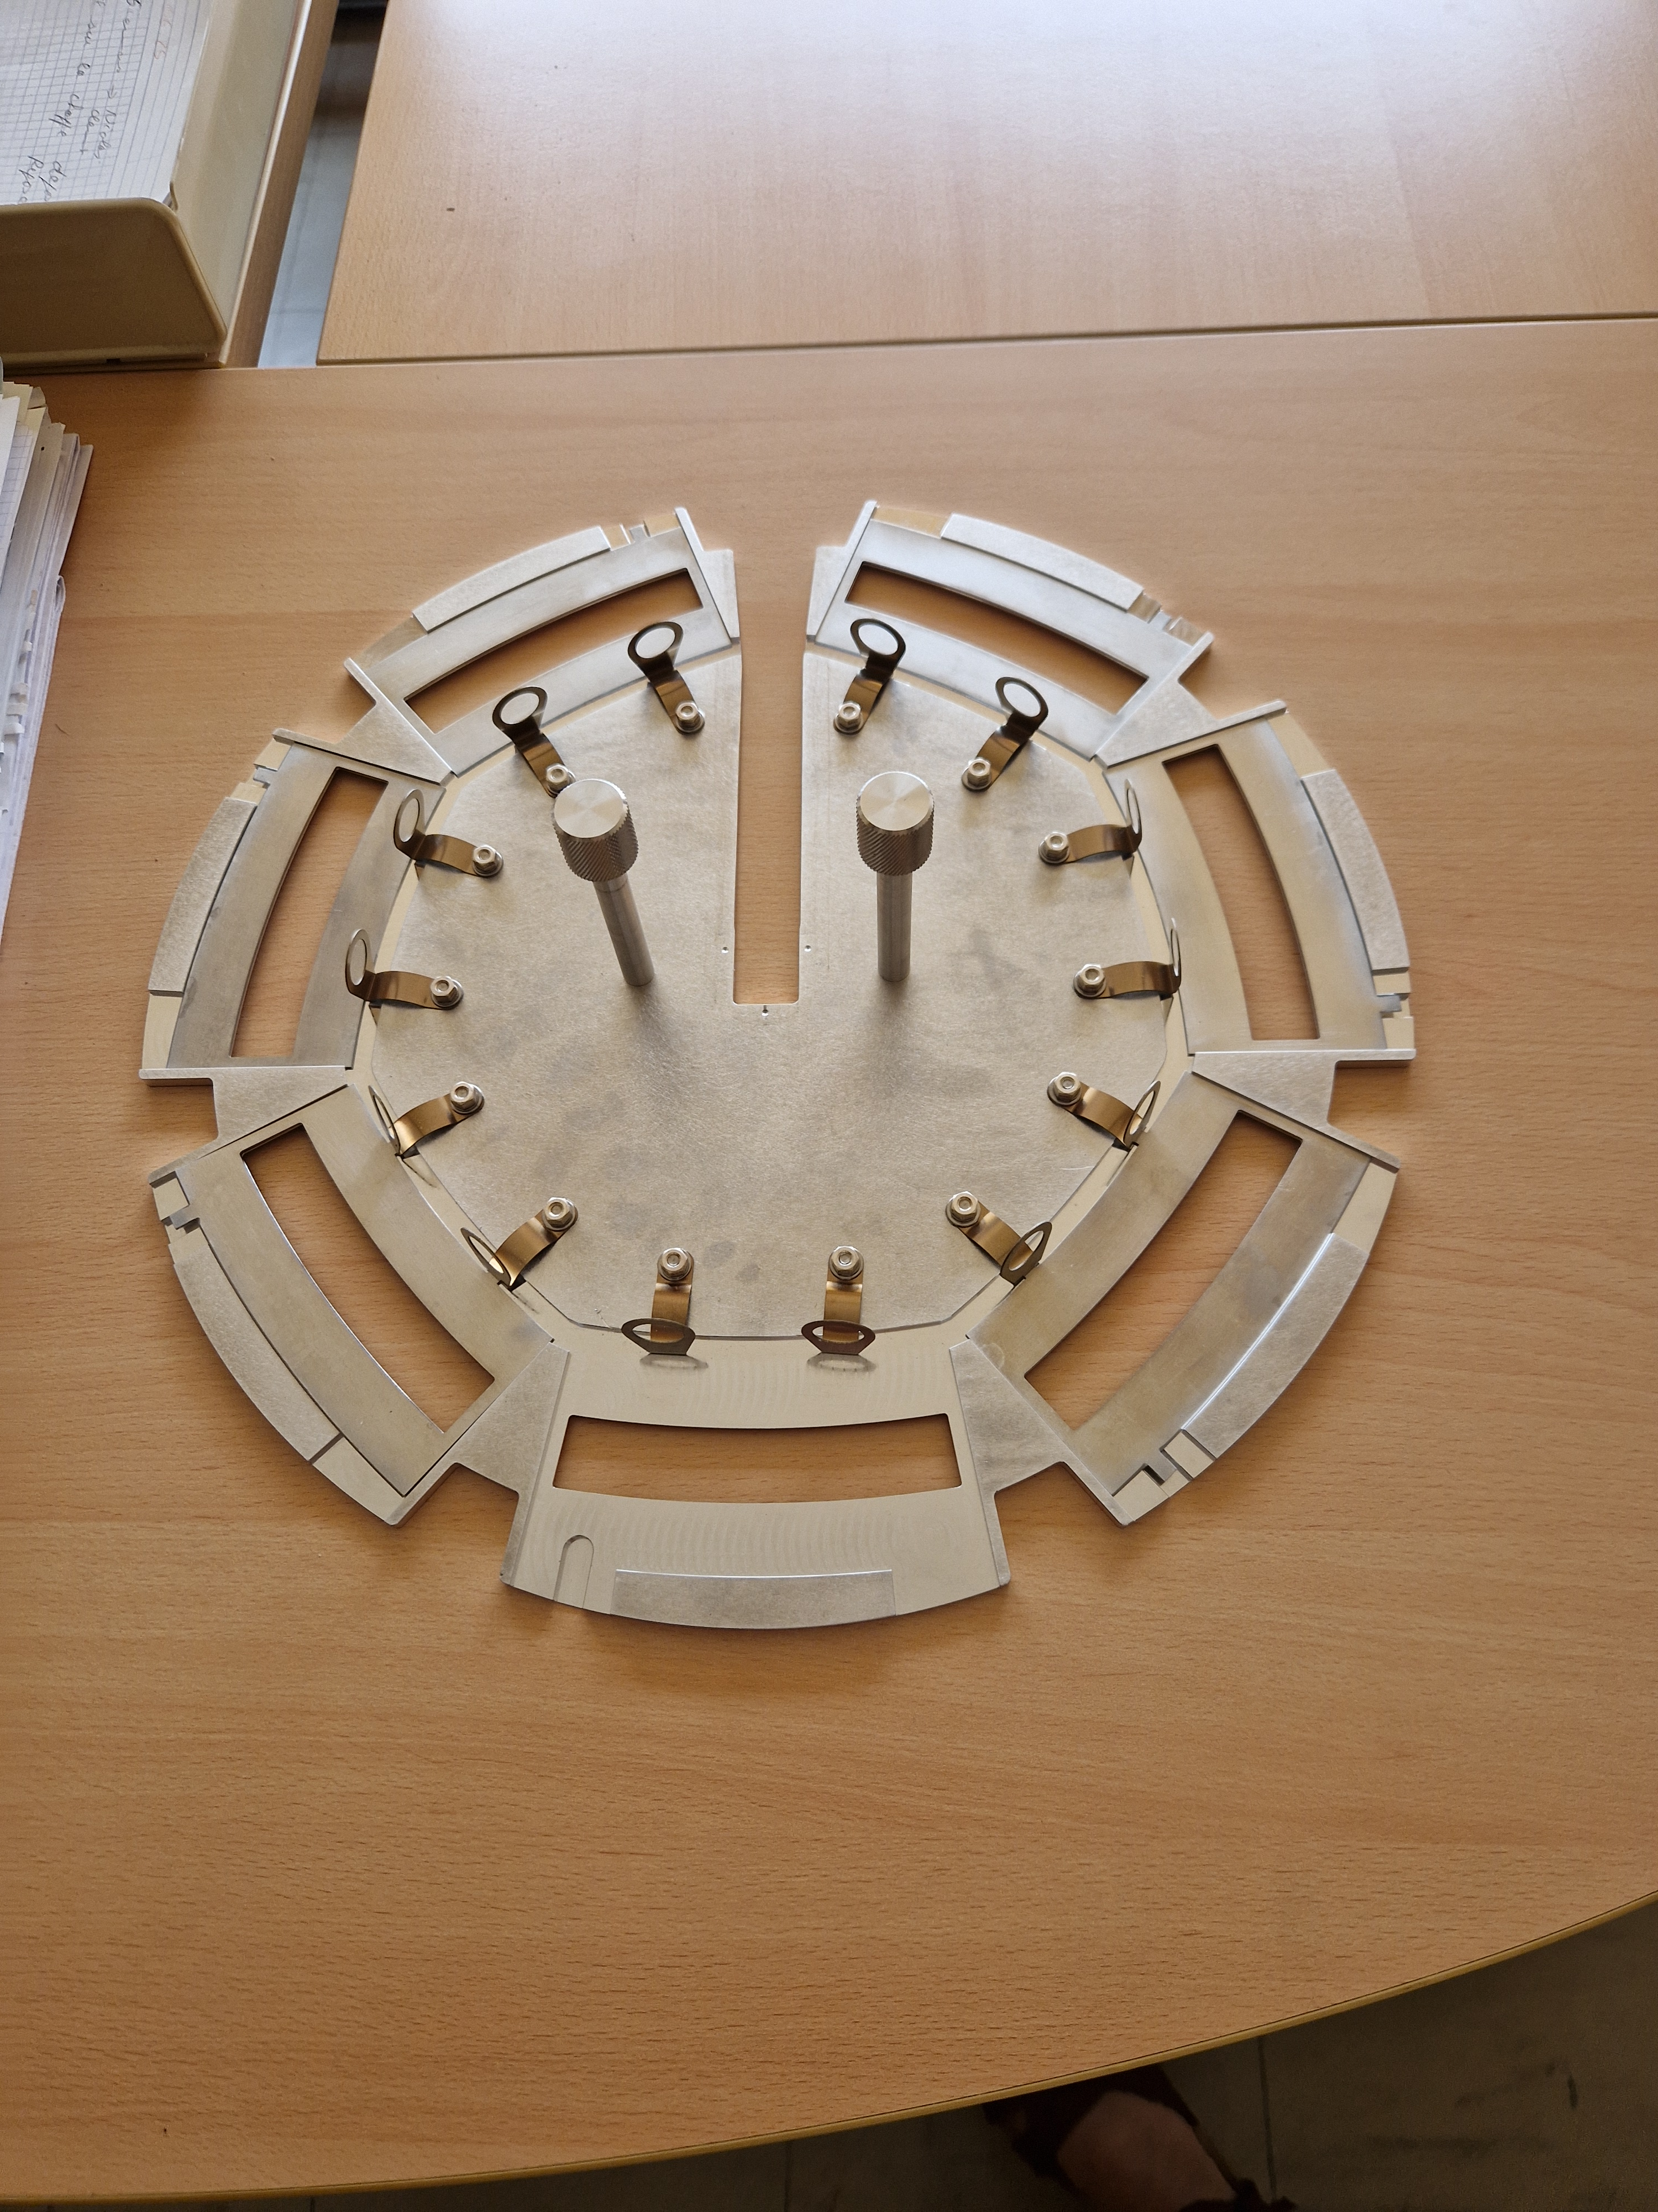
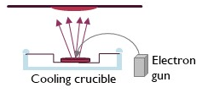
The target laboratory
PALAIS Project Plateforme Cibles pour GANIL/SPIRAL2 A renew at our laboratory !
Multi-material Evaporator
Carbon Evaporator
Sublimation
Φ = 3mm, length 75mm
10-100 µg/cm²
i
evaporator with sputtering method for ²³⁸U and monoisotopic materials.
Crucible/resistive heating
e-gun
Heating system for backings
Crucible/resistive heating
low melting point
high melting point
Evaporator with resistive heating & Electron gun method
Rotating tray for 7 targets

Slide 7
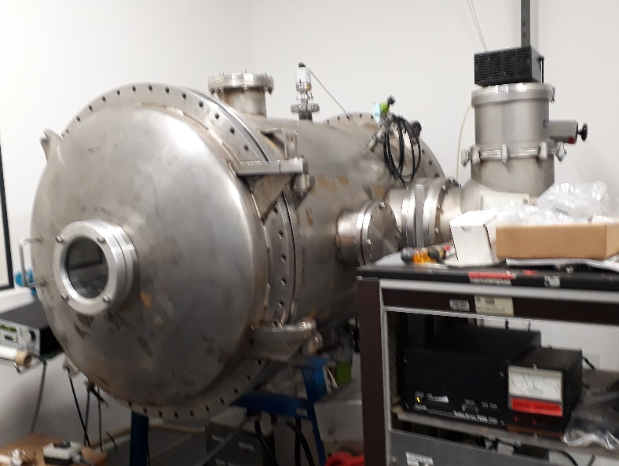
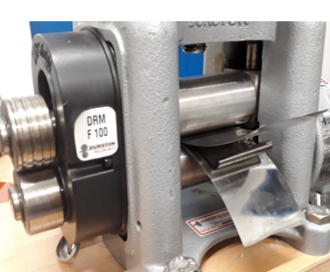
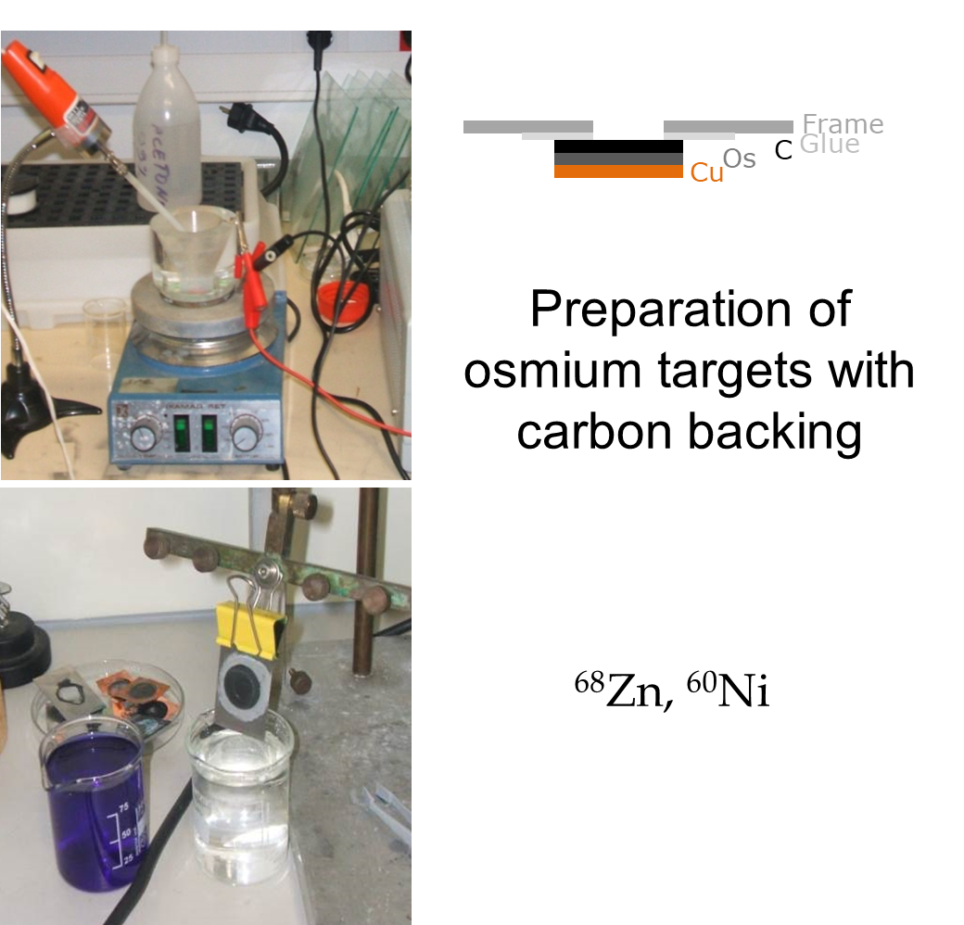
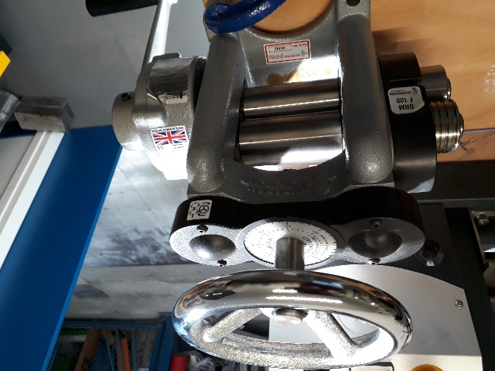
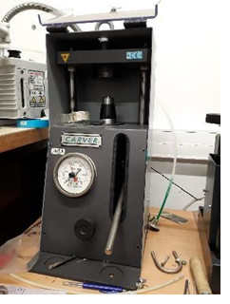
The target laboratory
Mechanical Shaping: Tablet pressing, rolling
Chemical Techniques: Electrodeposition/Molecular Plating, Polymerization
Electro-deposition
Rolling machines
Evaporator large dimension (diamètre 700 x1500)
Metallisation of thin foils for detectors
0.5 mg/cm² → g/cm²
Tablet pressing
Georges Fremont, et al, AIP Conf. Proc. 1962, 030002-1–030002-4; doi: 10.1063/1.5035519
~20 mg/cm² → g/cm²
Characterization system: X-ray fluorescence spectrometer for the chemical composition analysis of thin films
Weighing (balance)

Slide 8
Overview of the targets fabricated and the techniques used

Slide 9
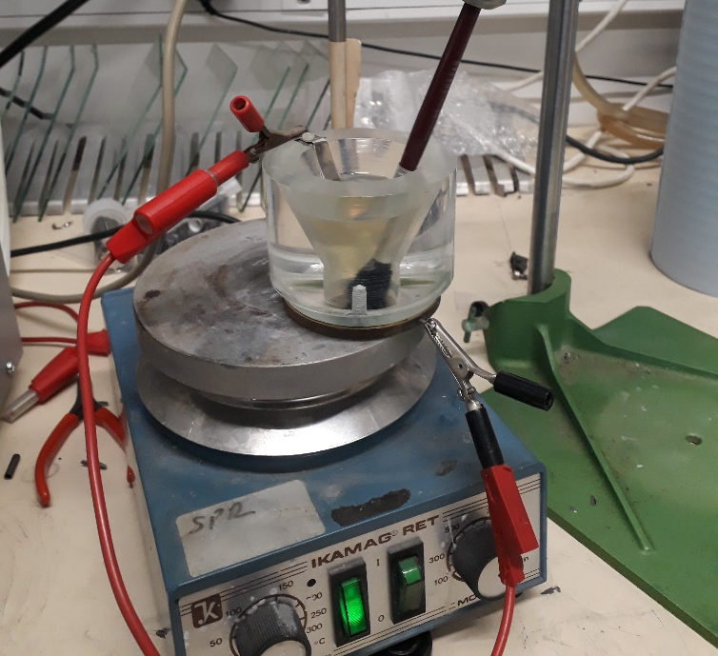
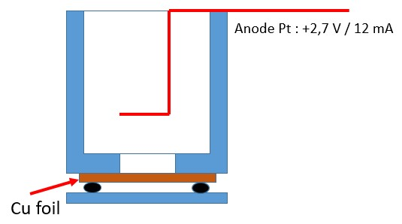
Target fabrication procedure
Chemical Technique → Electrodeposition
→ thin self-supported Nickel targets
dissolution
Ph ~ 6
Preparation of the nickel solution : Ni (Metal) + H₂SO₄ + H₂O + NH₄OH
180°C
Cathode : Cu foil
12 mA for 6 minutes
Several test shows:
The current Electrodeposition rate ( µg/cm²/min)
the deposition time the thickness (surface density ( µg/cm²))
Cathode
Notes:
bain au sulfate de nickel : nickel métallique dissous dans de l’acide sulfurique
Ammonium hydroxide

Slide 10
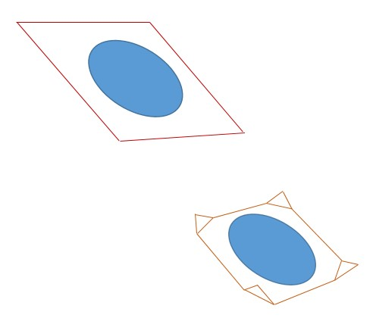
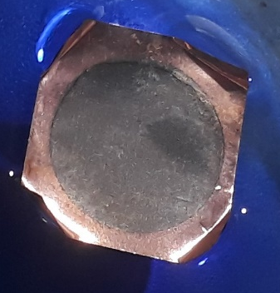
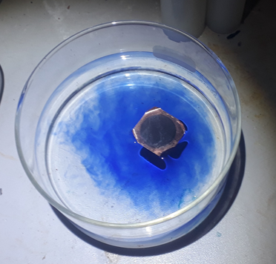
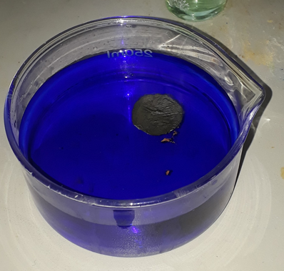
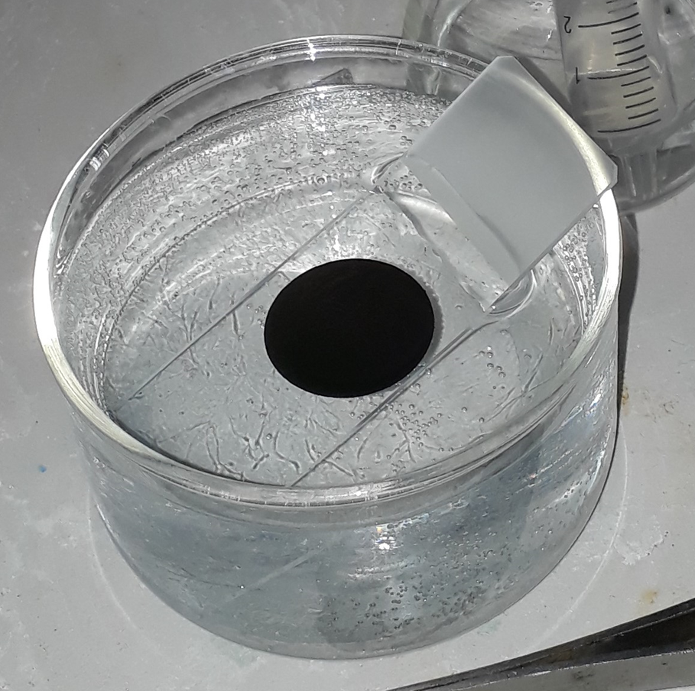
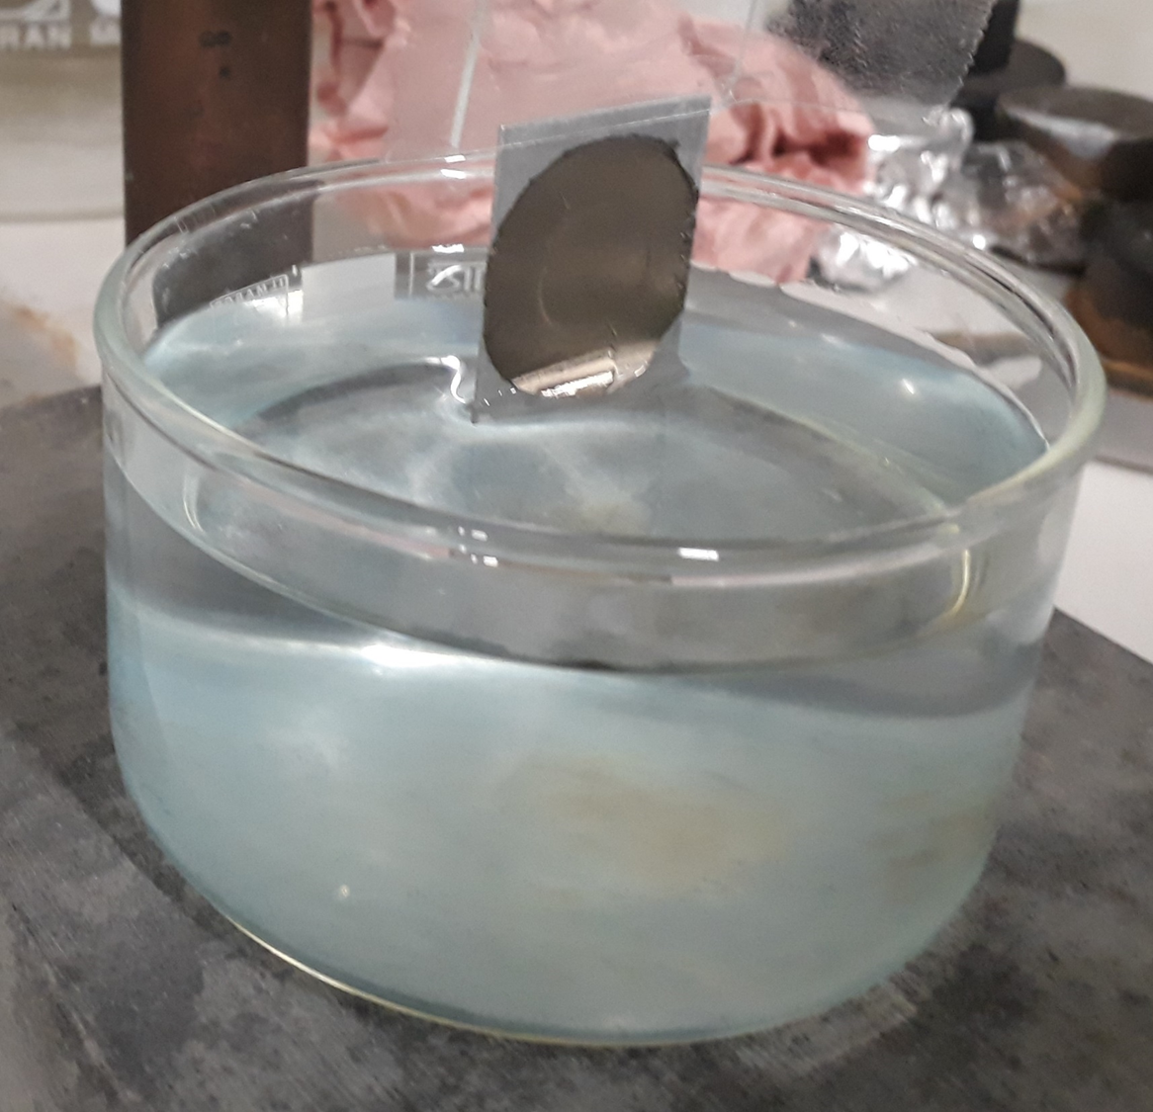
Target fabrication procedure
Chemical Technique → Electrodeposition → thin self-supported Nickel targets
→ Deposition on Cu substrate (cathode)
Dissolution of Cu (trichloroacetic acid C₂HCl₃O₂ + NH₄OH ammonia + distilled water)
Transfer onto glass plate
→ Transfer to a bath (water) to rinse it from the Cu dissolution bath.
→ Recovery of the Ni foil with the selected target frame
Notes:
faire flotter à la surface de la solution de dissolution ( acide trichloroacetic) 15mn

Slide 11
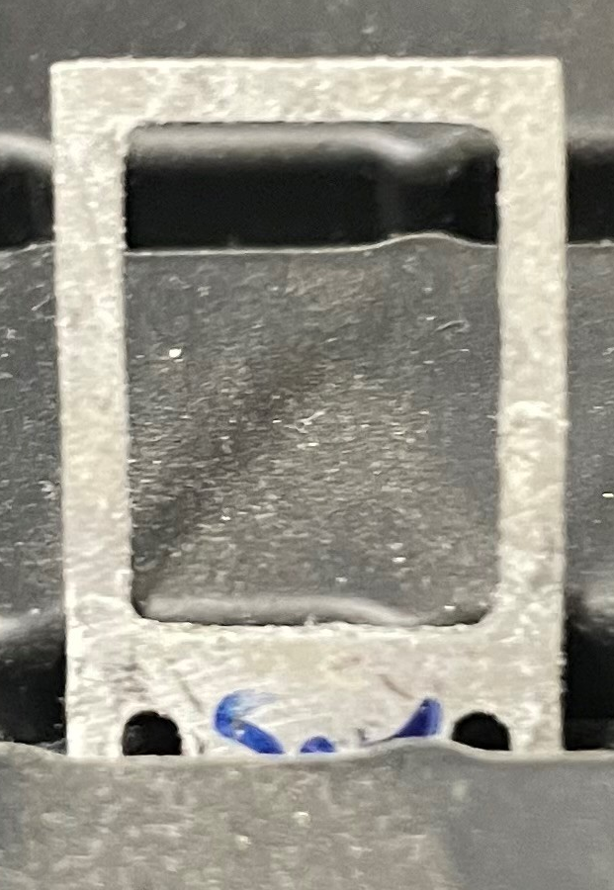
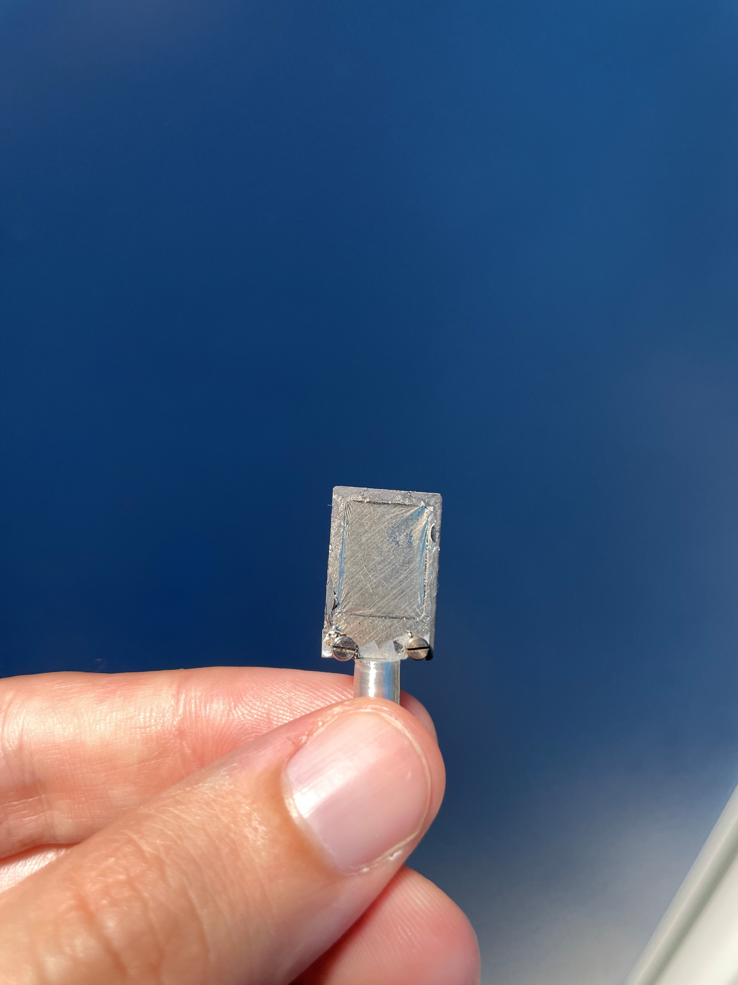
Target fabrication procedure
Chemical Technique → Electrodeposition → thin self-supported Nickel targets
The Ni foil is fished out and dried before being removed from the support frame.
L = 1.5 cm, l = 1.2 cm
⁶⁰Ni 150 µg/cm²
Up to 4 target ( foils) with one solution of 7 mg Ni
Self supported natural and isotopic ⁶⁰Ni → 130-250 µg/cm²
→ Homogenous and without comtaminatiton

Slide 12
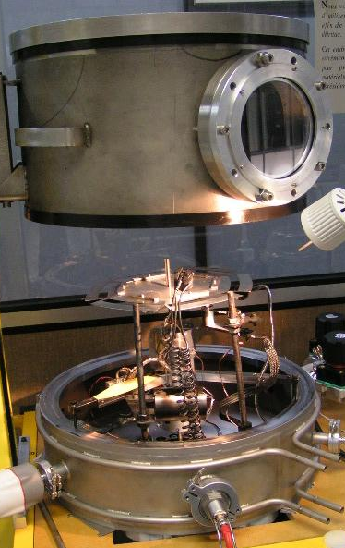

Target fabrication procedure
Physical vapor deposition (PVD) → Resistive Heating (crucible)
→ Thin self-supported Zinc targets
First step
Cyclohexanone + vinyl powder
Second step
Preparation of the pellet: Zinc + tantalum
Evaporator for metals, isotopes low melting point (not higher then 1600 -1800 °C)
Glass plate
Third step
5.10⁻⁴ mbar
The current is gradually increased
~ 40A
+ 100°C heating plate + vacuum heating 10⁻³ mbar

Slide 13
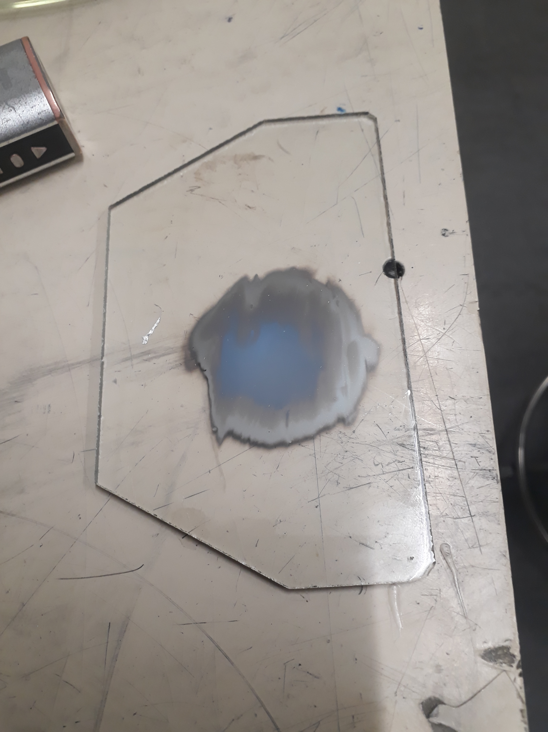
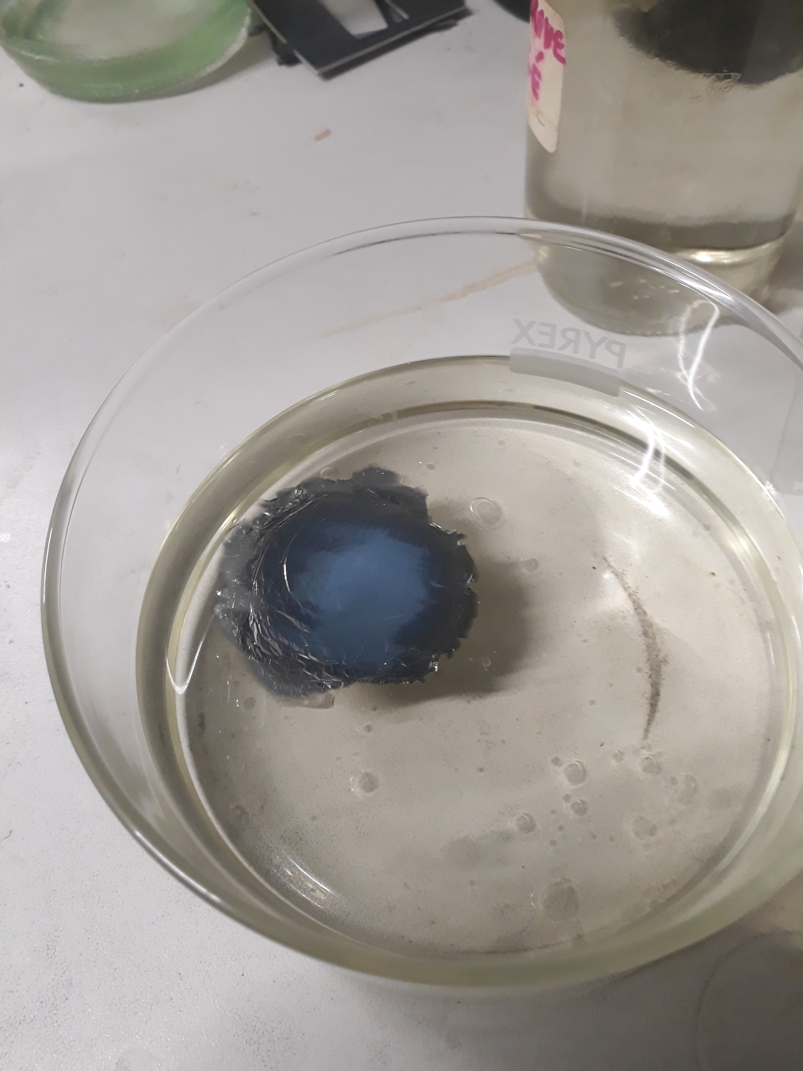
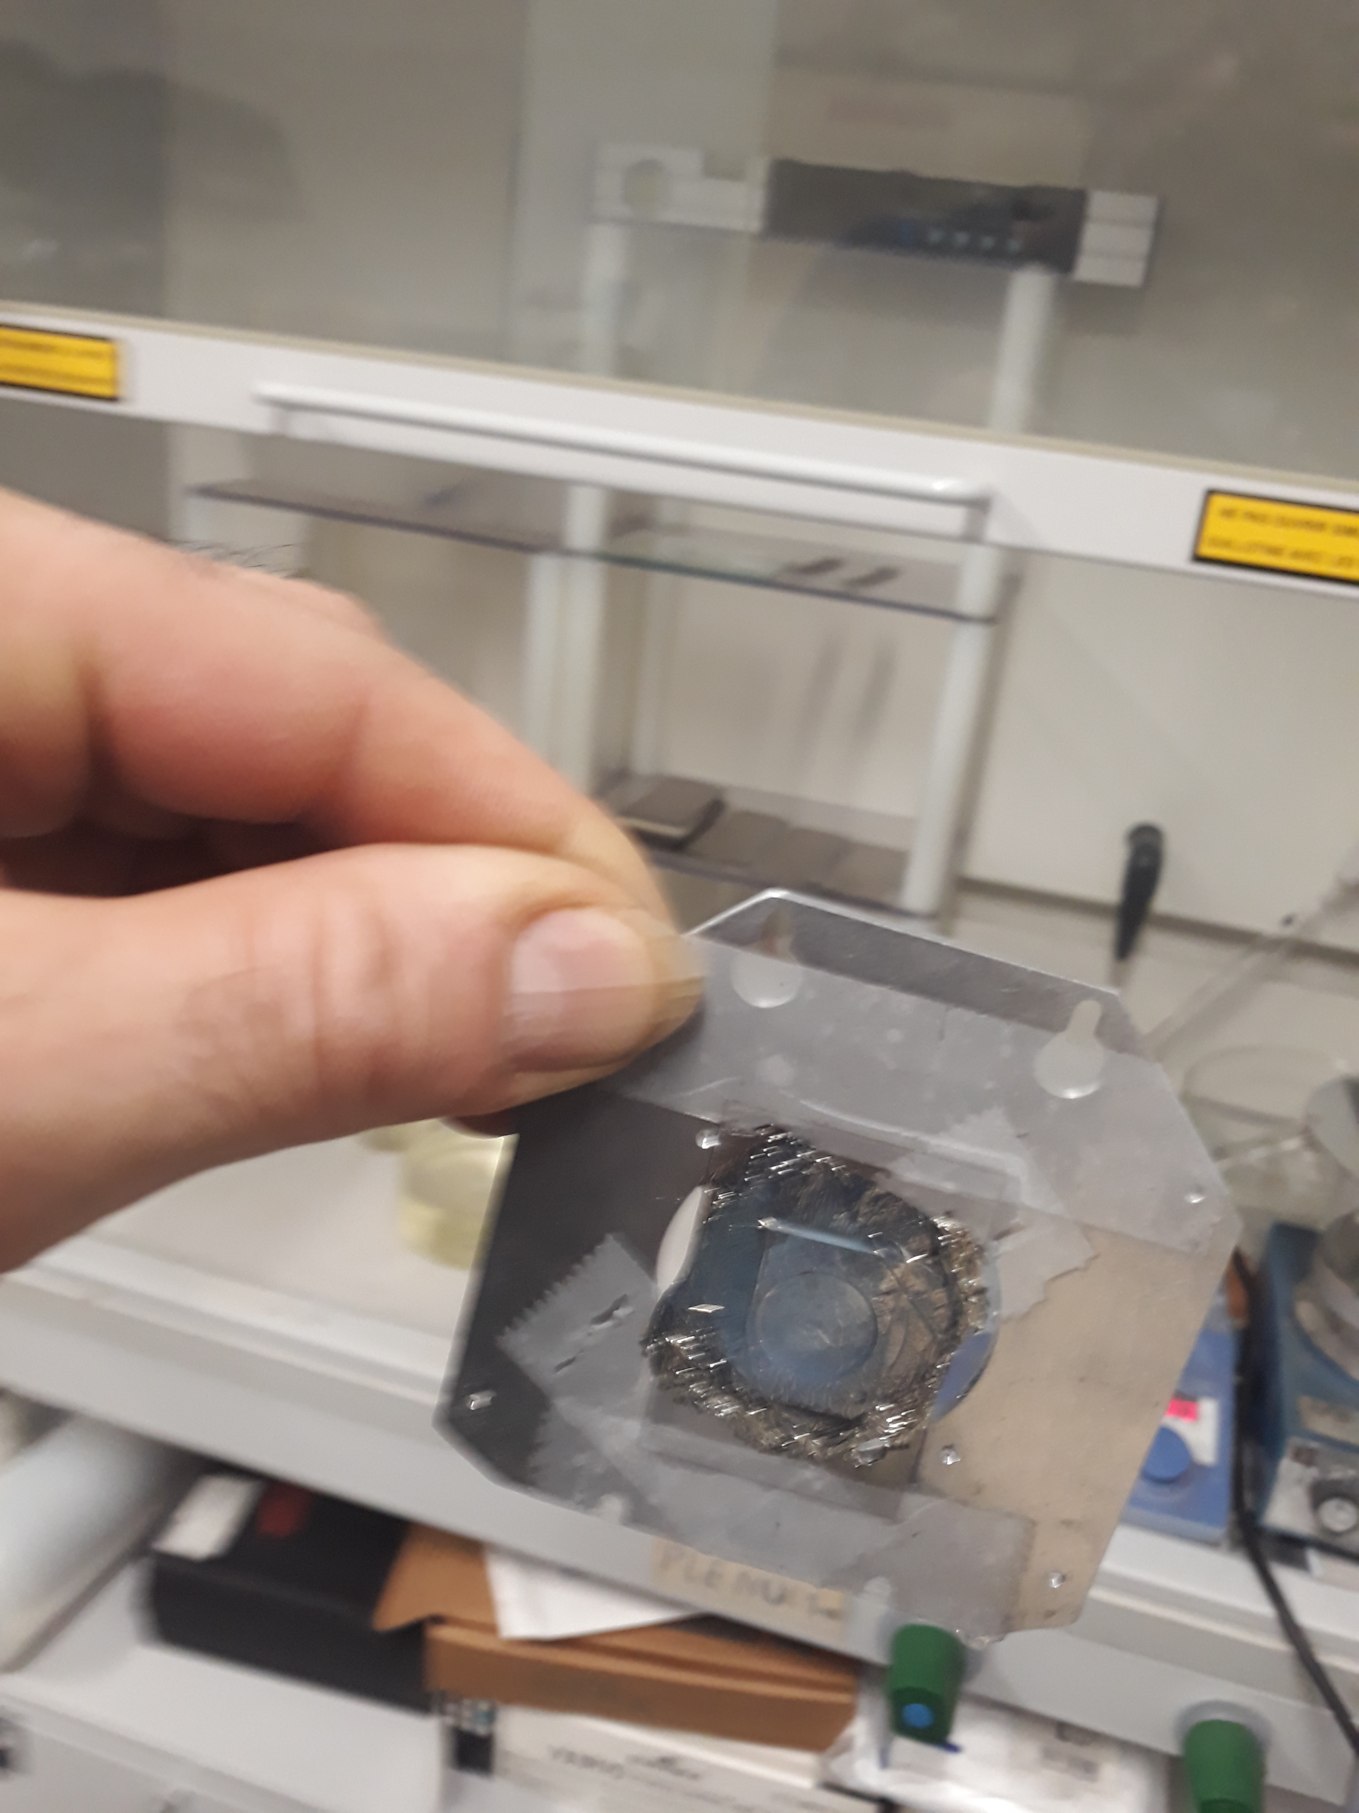
Target fabrication procedure
Physical vapor deposition (PVD) → Resistive Heating (crucible) → Thin self-supported Zinc targets
Final step
The deposit is circular and centred, the central area is cut out, the plate is immersed in distilled water to remove the foil.
Recover the foil on another plate and immerse it in cyclohexanone.
Recover the foil (target) on the frame.
Self supported ⁷⁰Zn → 250 to 500 µg/cm²

Slide 14
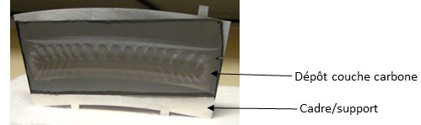
Target fabrication procedure
Physical vapor deposition (PVD) → Resistive Heating (crucible)
→ thin Ytterbium/Carbon targets
Frame with carbon foils of ~ 35 µg/cm² rotating at 50 rpm
Yb₂O₃+ Hf or La (reductant agent)
Crucible : Tantalum
Distance = 7 - 9 cm
Control with quartz
Current ~ 60 – 85 A
High vacuum condition: 6.10⁻⁵ mbar
Carbon foil pre-mounted on the frame
Rotating wheel
Crucible
Quartz
^{T < 1600° C}
Notes:
Oxide form to metalic one ( Hf,La)
Dilemma : size ( surface area = 16 to 20)

Slide 15
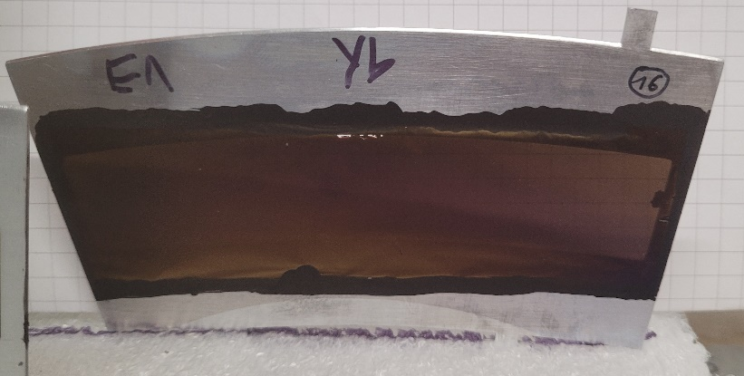
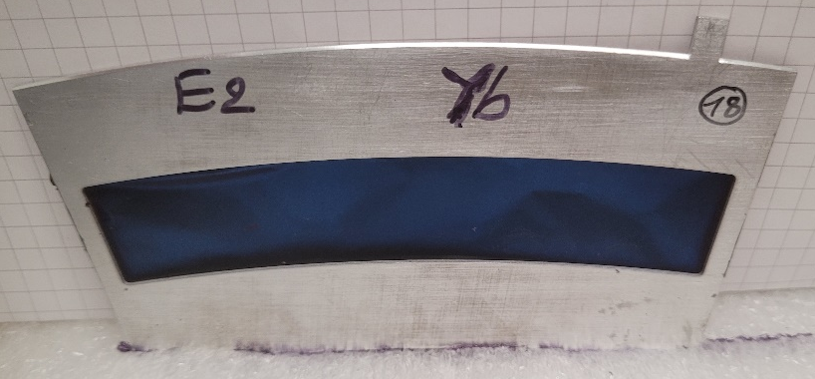
Target fabrication procedure
substrat
i
i
Yb/C → from 50 µg/cm² to 4 mg/cm²
creuset
Target material
1 Frame with carbon foils of ~ 35 µg/cm² and a mask rotating at 50 rpm
Yb₂O₃+ Hf or La (reductant agent)
Crucible : Tantalum
Distance = 7 - 9 cm
Current ~ 60 – 85 A
High vacuum condition: 10⁻⁵ mbar
^{T < 1600° C}
^{Nat} Yb ~ 115 µg/cm²
^{Nat} Yb ~ 4 mg/cm²
Rotating wheel → Homogeneous distribution over a large surface

Slide 16
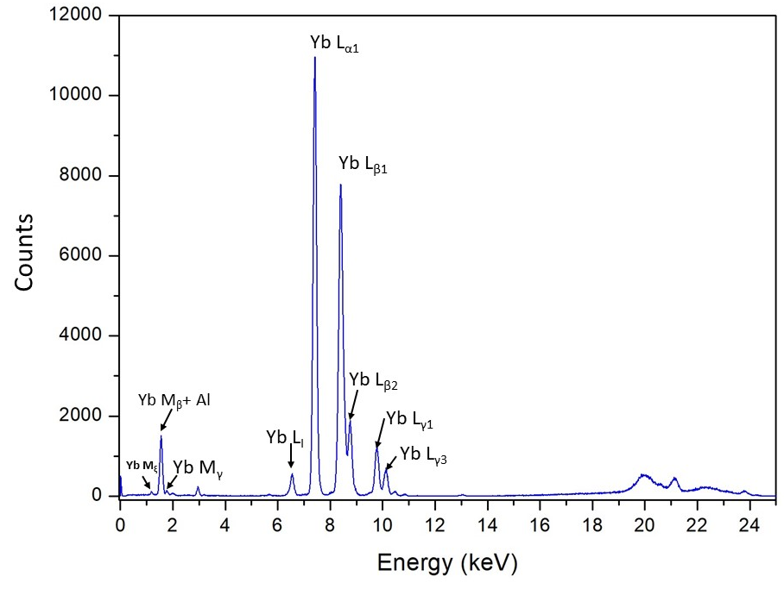
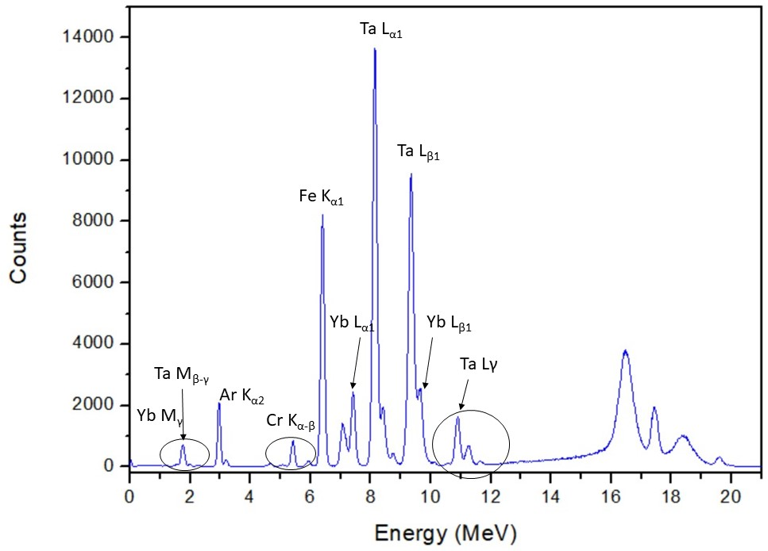

Target fabrication procedure
substrat
i
i
Yb/C → from 50 µg/cm² to 4 mg/cm²
creuset
Target material
1 Frame with carbon foils of ~ 35 µg/cm² and a mask rotating at 50 rpm
Yb₂O₃+ Hf or La (reductant agent)
Crucible : Tantalum
Distance = 7 - 9 cm
Current ~ 60 – 85 A
High vacuum condition: 10⁻⁵ mbar
^{T < 1600° C}
^{Nat} Yb ~ 115 µg/cm²
^{Nat} Yb ~ 4 mg/cm²
Rotating wheel → Homogeneous distribution over a large surface
Different results :
Variable deposition time
different distances (crucible- substrate)
Different type of crucible
XRF device (courtesy of PLATIN)
Long deposition time → Possible contamination of the crucible

Slide 17
Conclusion
Target lab renovation almost completed - PALAIS project : stable + ²³⁸U
Wide range of fabrication techniques: PVD, electro-deposition, rolling, sputtering
Enriched target production ongoing: Zn, Ni, Yb, Gd on carbon, Al backing, self-supported foils…
Without rotation: uneven circular patterns, suitable for small target
With rotation: improved homogeneity and preserved crucible integrity ( both small and large target)
New characterization tools in place: ED-XRF acquired, alpha energy loss, advanced analysis via SEM, XPS, etc. performed through collaborations.
Process optimization across the full production chain: from material to quality control
Expand R&D to other lanthanides and actinides.
Continuous efforts to improve target quality and production reliability through monitoring at each stage: fabrication, beam behavior, and post-irradiation analysis.
Future actinide target lab under discussion – GRAND PALAIS (ATLAS) project → Open postdoctoral position in radiochemistry.
Talk: Christelle Stodel on Thursday, 25 Sept, Session P2: Accelerators and Instrumentation (6)
🎯 Goal : support cutting-edge experiments with high-quality, reliable targets

Slide 18

ACKNOWLEDGMENTS
G. Fremont
M. Bourges
Ch. Stodel
F. Perocheau
F. Leroy (from the PLATIN platform)
Spectro-AMETEK staff
Thank for your attention

Slide 19

Target fabrication procedure
Physical vapor deposition (PVD) → Resistive Heating of crucible
For thin Ytterbium/Carbon targets
1 glass plate with carbon foils of ~ 35 µg/cm²
Yb₂O₃+ Hf or La (reductant agent)
Crucible : Tantalum
Distance = ~ 5 cm
Control with quartz
Current ~ 60 – 85 A
High vacuum condition: 10⁻⁵ mbar
Glass plate
Crucible
Quartz

Slide 20



Target fabrication procedure
Blue ~ 90 µg/cm²
Purple ~ 75 µg/cm²
Yellow ~ 52 µg/cm²

Slide 21

Optimization of the procedure
3mm
Variable parameters :
Substrate (backing) : Carbon, Aluminium, Ta
Different currents ( step by step or not)
Different Evaporation boat (Crucibles) (Ta, Zr, Al₂O₃) – different forms/shapes, different diameters, different depths.
Amount of material used ( 20mg, to 200 mg )
Reducing agent (Zr, Hf, La)
Different distance crucible- substrat
With and without rotating the frame
The deposition time ( PVD, electrodeposition)
The type/amount of solution ( electrodeposition)
6

Slide 22

Target fabrication procedure
cadre Exogam
Chemical Technique → Electrodeposition
La feuille de Ni est ensuite pêchée et séchée avant d’être démontée du cadre support
⁶⁰Ni 150 µg/cm²
L = 1.5 cm, l = 1.2 cm
Up to 4 target ( foils) with one solution of 7 mg Ni
Self supported natural and isotopic ⁶⁰Ni → 130-250 µg/cm²
→ Homogenous and without comptaminatiton

Slide 23

Target fabrication procedure
Physical vapor deposition (PVD) → Resistive Heating of crucible
For thin Ytterbium/Carbon targets
Preparation du cadre avec le backing en carbone

Slide 24




Fabrication Procedure
Sublimation
Step 1: High purity graphite from 3mm diameter rods are sublimed, and the C vapour is collected on betaine-sucrose-treated glass plates.
Φ = 3mm, length 75mm
Step 2: The layers are carefully separated with cold distilled water, allowing them to float to the surface
i
Step 3: The C thin film is picked up with target frames and used as strippers or backings for material deposition.
With one evaporation we can have
8 glass plates : (100*140) mm², 35 µg/cm² (150-200 nm)
16 C strippers or 24 C backing.
Thickness: 10 - 70 µg/cm²
Surface : 20 X 20 cm
30 mm
15 mm
110 mm
P. Maier-Komor, NIM 102 (1972) 485-486
W. Thalheimer et al, Cryst. Res. Technol. 34 (1999) 175-179.
Notes:
Carbon evaporator,
Resistance heating, sublimed, collected on betain-saccharose treated glass plate
Floated off and recover using the target framework

Slide 25


Fabrication Procedure
Resistive Heating of crucible
15 mm
110 mm
Frame
30 mm
Deposit
substrat
i
Bcking
i
Crucible
Target material
Fixed deposition
Rotating weel
For metals, isotopes low melting point
Rotating multi-target plate: homogeneous deposition and several targets at times
H.A.F. Muggleton, Vacuum 37 (1987) 785-817.
Evaporator for metals, isotopes low melting point (not higher then 1600 -1800 °C)
Notes:
Depending low or high meltingpoint
Either fixed position or by rotating the wheel
Cooled cooper plate
5 at once

Slide 26


Fabrication Procedure
15 mm
Frame
Deposit
110 mm
Bcking
30 mm
Electrostatic focused electrons (EFe-)
Electron heating of crucible
electron gun
Electron heating of material
Thickness ~100s nm
High melting point materials,
oxides → reduction for metallic deposit (with Zr, La..)
i
Electron
gun
Creuset refroidi
Evaporator with electron gun (3 kW or 6 kW)
Thickness > 1 µm
High melting point materials
Advantage : Prevent chemistry reaction with crucible according to temperature
Electronic bombardment of the crucible
L. Westgaard et al, Nucl. Inst. Meth. 42 (1966) 77-81
A. Stolarz, Journal of Radioanalytical and Nuclear Chemistry vol. 299, pages 913–931 (2014)
G.E. Thomas et al., Nucl. Instr. and Meth. A 303 (1991) 162-164.
Notes:
Electron gun

Slide 27




Lanthanides targets
Crucible : Zirconium of 0.7 x 0.7 mm diameter
Deposition without rotation.
Deposition on aluminum foil attached to a copper plate cooled throughout the deposition.
Current 104 A
100 mg Gd₂O₃
100 Zr
Yield ~ 1%
100 mg Gd₂O₃
200 Zr
120 mg Gd₂O₃
Zr 50mg
Non-homogeneous distribution over the surface → Different thickness
Notes:
Circular : thickness gradient

Slide 28


Lanthanides targets
2
1
100 mg Gd₂O₃
100 Zr
Different thickness distribution over the surface
Crucible (Zr) destroyed but no comtamination!
Notes:
Crucible destroyed
Fe : Device

Slide 29

First results of lanthanides targets
Technique used :
Evaporator with electrostatic focused electrons (EFe-)
oxides → reduction for metallic deposit (Zr)
i
Electronic bombardment/heating of the crucible
quartz (control of the start and end of the reaction)
Tantalum plate fixed 3 cm from the crucible
Tantalum crucible
-Inner diameter: 3 mm
-Depth: 6 mm
A current of 25 A passes through the W filament
The crucible is brought to 2.5 kV
Gadolinium target

Slide 30
First results of lanthanides targets
Distance foil-crucible: 5 cm Deposition of 2.7 mg over 10 cm² (= 270 μg/cm²)
Distance foil - crucible: 3 cm Deposition of 260 μg over 4 cm² (= 65 μg/cm²)
Probable explanations:
Challenges in controlling the crucible temperature (dependent on I fil and U), which impacts the Gd/Zr mixture:
At T > 1700 °C: Gd reacts with Ta
At T < 1600 °C: incomplete reduction may occur.
Zr powder: issues with purity and particle size?
Initial test used irregular particles.
Subsequent test involved an aqueous solution, followed by vacuum drying and heating.
Gd₂O₃ powder: prone to moisture absorption and impurities?
Heated to temperatures ranging from 300 to 900 °C.
Mixing of Gd and Zr: uniformity concerns?

Slide 31

Fabrication Activities

