Slide 1




ENHANCING CHARGE COLLECTION EFFICIENCY IN RADIATION-DAMAGED UNMETALLIZED 4H-SiC DETECTOR VIA LED ILLUMINATION
M. Rodríguez-Ramos, J. García-López, C. Torres-Muñoz, G. Pellegrini, P. Godignon, J.M. Rafi, G. Rius and M.C. Jiménez-Ramos
Centro Nacional de Aceleradores. Universidad de Sevilla

Slide 2
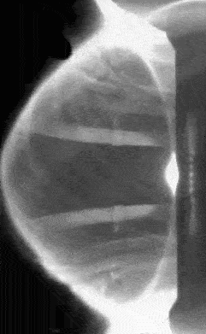
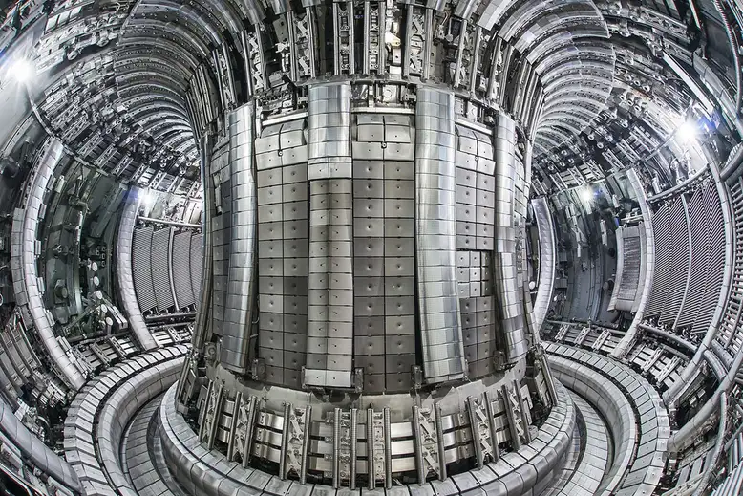
SiC: AN EXCELLENT CANDIDATE FOR HOSTILE RADIATION ENVIRONMENTS
Emerging technologies require reliable devices for high radiation environments (fusion reactors, high-energy physics, outer space).
4H-SiC offers unique properties, making it a promising semiconductor for high-temperature and radiation-hard applications.
MAST Tokamak
https://ccfe.ukaea.uk/wp-content/uploads/2019/09/MAST-plasma.gif
ID-90
Slide 1/14
EuNPC2025

Slide 3
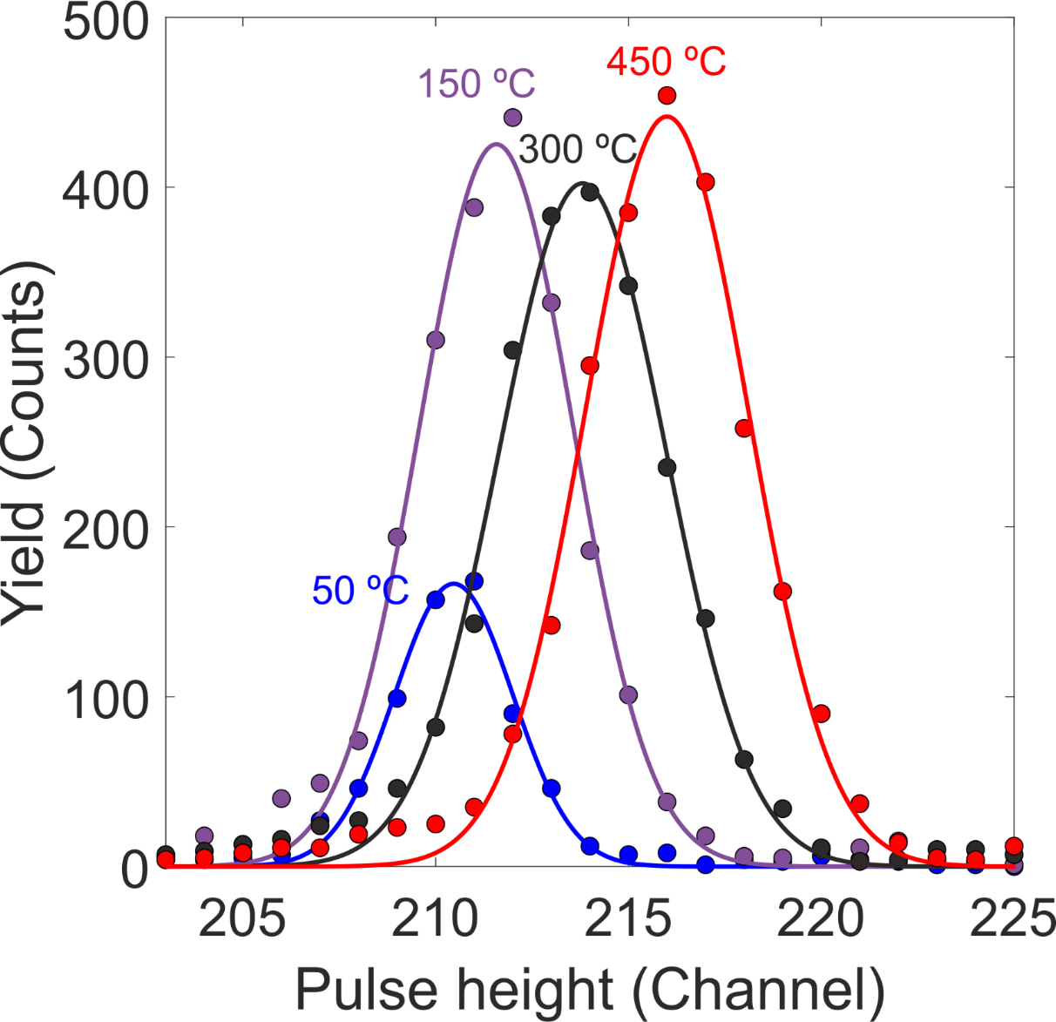
SiC: AN EXCELLENT CANDIDATE FOR HOSTILE RADIATION ENVIRONMENTS
Emerging technologies require reliable devices for high radiation environments (fusion reactors, high-energy physics, outer space).
4H-SiC offers unique properties, making it a promising semiconductor for high-temperature and radiation-hard applications.
MAST Tokamak
https://ccfe.ukaea.uk/wp-content/uploads/2019/09/MAST-plasma.gif
3.5 MeV He²⁺
4H-SiC detectors operate up to 450 ℃ with excellent energy resolution (≲2%) (J. Radiat. Phys. Chem. 2024, 214, 111283).
ID-90
Slide 1/14
EuNPC2025

Slide 4
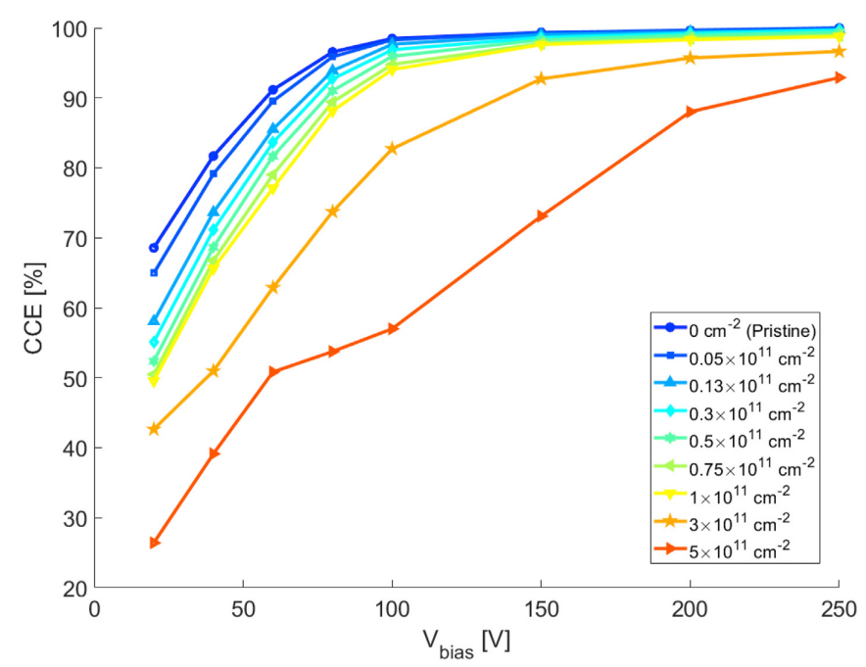
SiC: AN EXCELLENT CANDIDATE FOR HOSTILE RADIATION ENVIRONMENTS
Emerging technologies require reliable devices for high radiation environments (fusion reactors, high-energy physics, outer space).
4H-SiC offers unique properties, making it a promising semiconductor for high-temperature and radiation-hard applications.
MAST Tokamak
https://ccfe.ukaea.uk/wp-content/uploads/2019/09/MAST-plasma.gif
4H-SiC detectors operate up to 450 ℃ with excellent energy resolution (≲2%) (J. Radiat. Phys. Chem. 2024, 214, 111283).
Detector radiation hardness was studied at room temperature up to fluences of 5×10¹¹ ions/cm², showing a significant decrease in charge collection with increasing fluence (J. Radiat. Phys. Chem 2020, 177, 190100)
3.5 MeV He²⁺
ID-90
Slide 1/14
EuNPC2025

Slide 5
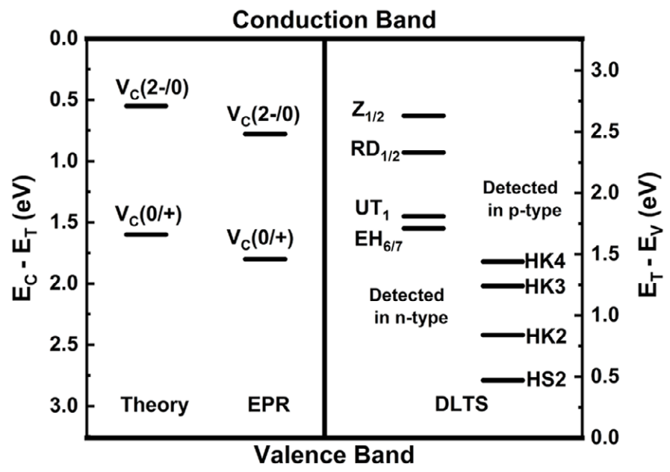
IMPROVING DETECTOR PERFORMANCE THROUGH DIFFERENT MECHANISMS
Intrinsic or radiation-induced trapping centers (defects, impurities, …) in the lattice structure can capture free charge carriers, leading to signal degradation.
Lan Luo et al,. Phys. Status Solidi A,2025, 222: 2400840.
ID-90
Slide 2/14
EuNPC2025

Slide 6
IMPROVING DETECTOR PERFORMANCE THROUGH DIFFERENT MECHANISMS
Intrinsic or radiation-induced trapping centers (defects, impurities, …) in the lattice structure can capture free charge carriers, leading to signal degradation.
Dynamic annealing: defect recombination during irradiation at high temperature that mitigates damage accumulation.
Lan Luo et al,. Phys. Status Solidi A,2025, 222: 2400840.
ID-90
Slide 2/14
EuNPC2025

Slide 7
IMPROVING DETECTOR PERFORMANCE THROUGH DIFFERENT MECHANISMS
Intrinsic or radiation-induced trapping centers (defects, impurities, …) in the lattice structure can capture free charge carriers, leading to signal degradation.
Dynamic annealing: defect recombination during irradiation at high temperature that mitigates damage accumulation.
Trap filling: Illumination fills active traps, reducing carrier trapping and improving charge collection.
Lan Luo et al,. Phys. Status Solidi A,2025, 222: 2400840.
ID-90
Slide 2/14
EuNPC2025

Slide 8
IMPROVING DETECTOR PERFORMANCE THROUGH DIFFERENT MECHANISMS
Intrinsic or radiation-induced trapping centers (defects, impurities, …) in the lattice structure can capture free charge carriers, leading to signal degradation.
Dynamic annealing: defect recombination during irradiation at high temperature that mitigates damage accumulation.
Trap filling: Illumination fills active traps, reducing carrier trapping and improving charge collection.
Photo-detrapping: Illumination with a light source can release trapped carriers by exciting them with photons.
Lan Luo et al,. Phys. Status Solidi A,2025, 222: 2400840.
ID-90
Slide 2/14
EuNPC2025

Slide 9
IMPROVING DETECTOR PERFORMANCE THROUGH DIFFERENT MECHANISMS
Intrinsic or radiation-induced trapping centers (defects, impurities, …) in the lattice structure can capture free charge carriers, leading to signal degradation.
Dynamic annealing: defect recombination during irradiation at high temperature that mitigates damage accumulation.
Trap filling: Illumination fills active traps, reducing carrier trapping and improving charge collection.
Photo-detrapping: Illumination with a light source can release trapped carriers by exciting them with photons.
Goal: Investigate the use of optical excitation to partially restore CCE
ID-90
Slide 2/14
EuNPC2025

Slide 10
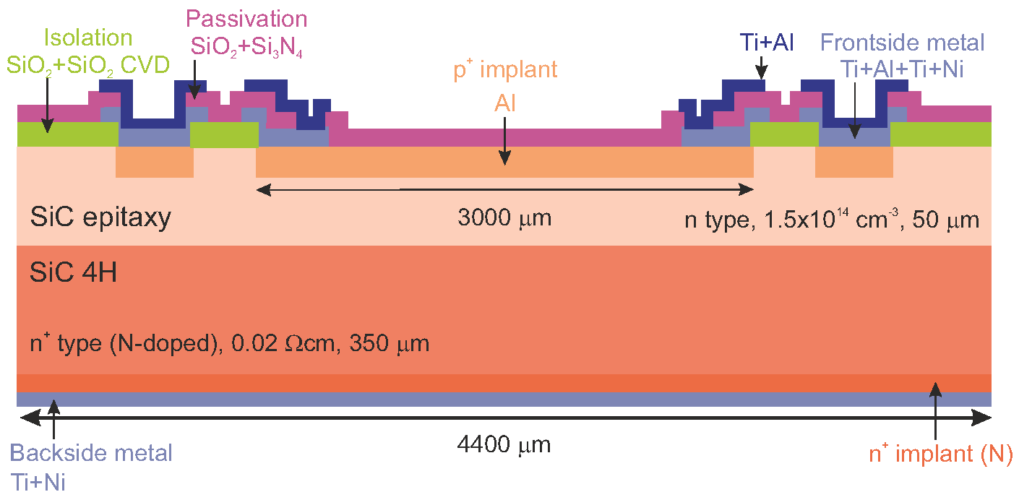
NEW TYPE OF UNMETALLIZED 4H-SiC SENSOR
n⁺ type 4H-SiC pn junction sensor manufactured at IMB-CNM and encapsulated in a commercial TO-257 package for high temperature applications.
Active area of 3x3 mm² with ~50 μm active region.
Non-metalized surface, with only a guard ring structure.
Passivation:SiO₂ (100 nm) + Si₃N₄ (500 nm).
Provided by the IMB-CNM-CSIC group
ID-90
Slide 3/14
EuNPC2025

Slide 11
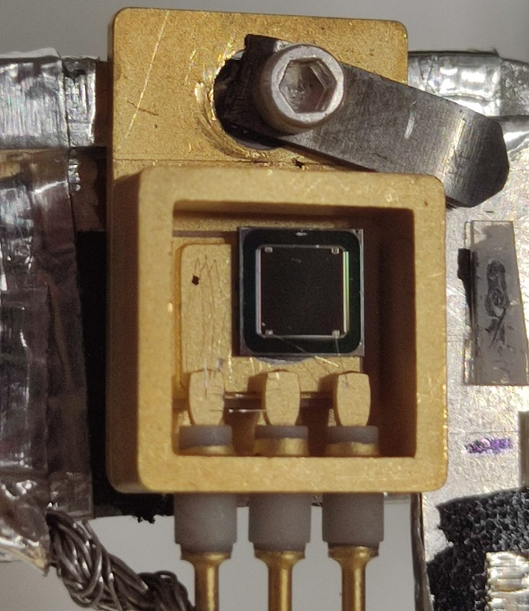
NEW TYPE OF UNMETALLIZED 4H-SiC SENSOR
SiC
Provided by the IMB-CNM-CSIC group
ID-90
Slide 3/14
EuNPC2025

Slide 12
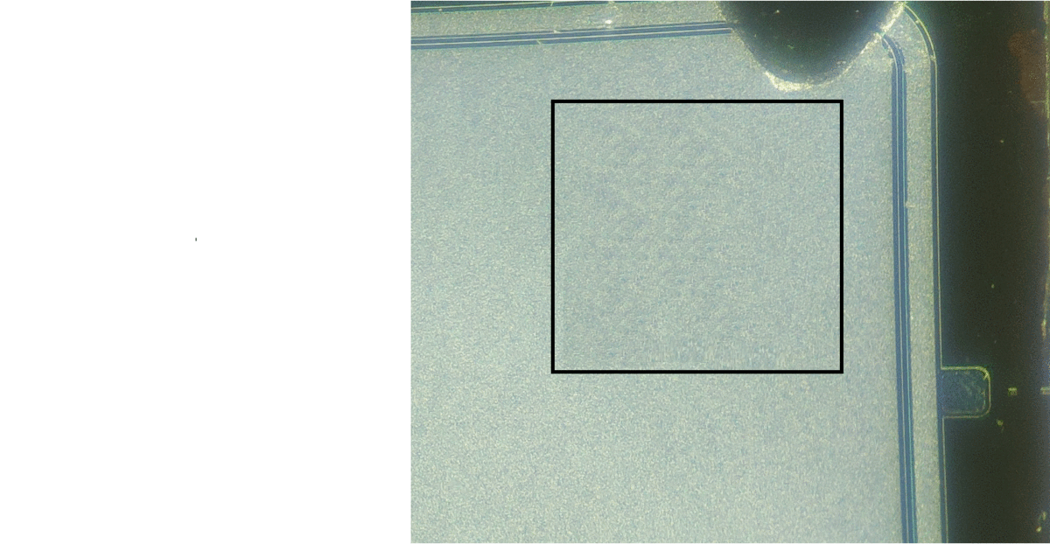
CNA µ-PROBE: DAMAGE EXPERIMENTS AT VARIOUS TEMPERATURES
Damaging ion beams: 3.5 MeV He²⁺ (relevant for fusion applications)
Nine different regions (100x100 μm²) were damaged at different doses (ranging from 1x10¹¹ to 1x10¹³ ions/cm²) for each temperature.
400ºC
ID-90
Slide 4/14
EuNPC2025

Slide 13
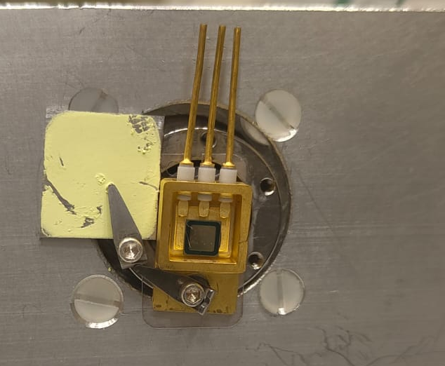
CNA µ-PROBE: DAMAGE EXPERIMENTS AT VARIOUS TEMPERATURES
Damaging ion beams: 3.5 MeV He²⁺ (relevant for fusion applications)
Nine different regions (100x100 μm²) were damaged at different doses (ranging from 1x10¹¹ to 1x10¹³ ions/cm²) for each temperature.
ID | Fluence (ions/cm²) | ID | Fluence (ions/cm²)
A | 1x10¹¹ | F | 3x10¹²
B | 3x10¹¹ | G | 5x10¹²
C | 5x10¹¹ | H | 8x10¹²
D | 8x10¹¹ | I | 1x10¹³
E | 1x10¹² | J | Pristine
400ºC
Ceramic heater
The irradition temperatures were settled at 30ºC, and 400ºC.
ID-90
Slide 4/14
EuNPC2025

Slide 14


ION BEAM INDUCED CHARGE (IBIC)
IBIC technique is an analytical tool based on the creation of electrons/holes by ionizing radiation using single ions.
Ions lose their energy dE/dx.
Creation of charge pairs e/h.
$$W$$
$$E_{0}$$
Direction of electric field
V_{bias}
Charge sensitive
preamplifier
Amplifier
ADC
+
MCA
ID-90
Slide 5/14
EuNPC2025

Slide 15
ION BEAM INDUCED CHARGE (IBIC)
IBIC technique is an analytical tool based on the creation of electrons/holes by ionizing radiation using single ions.
Ions lose their energy dE/dx.
Creation of charge pairs e/h.
Charge transport.
Induced current at the electrodes (Shockley - Ramo theorem).
$$W$$
Direction of electric field
Signal
V_{bias}
V_{out}
Charge sensitive
preamplifier
Amplifier
ADC
+
MCA
ID-90
Slide 5/14
EuNPC2025

Slide 16



ION BEAM INDUCED CHARGE (IBIC)
IBIC technique is an analytical tool based on the creation of electrons/holes by ionizing radiation using single ions.
Ions lose their energy dE/dx.
Creation of charge pairs e/h.
Charge transport.
Induced current at the electrodes (Shockley - Ramo theorem).
IBIC signal.
$$W$$
Direction of electric field
Signal
V_{bias}
V_{out}
N
100%
Charge sensitive
preamplifier
Amplifier
ADC
+
MCA
$CCE=\frac{\text{Charge} \text{collected}}{\text{Charge} \text{generated}}=$100%
$$E_{0}$$
ID-90
Slide 5/14
EuNPC2025

Slide 17

ION BEAM INDUCED CHARGE (IBIC)
Presence of defects, impurities or recombination centers affect the collection of carriers and hence the current.
Ions lose their energy dE/dx.
Creation of charge pairs e/h.
Charge transport.
Induced current at the electrodes (Shockley - Ramo theorem).
IBIC signal.
$$W$$
Traps induced by radiation damage
Direction of electric field
Signal
V_{bias}
V_{out}
N
<100%
100%
Charge sensitive
preamplifier
Amplifier
ADC
+
MCA
$CCE=\frac{\text{Charge} \text{collected}}{\text{Charge} \text{generated}}<$100%
$$E_{}$$
$$E_{0}$$
ID-90
Slide 5/14
EuNPC2025

Slide 18
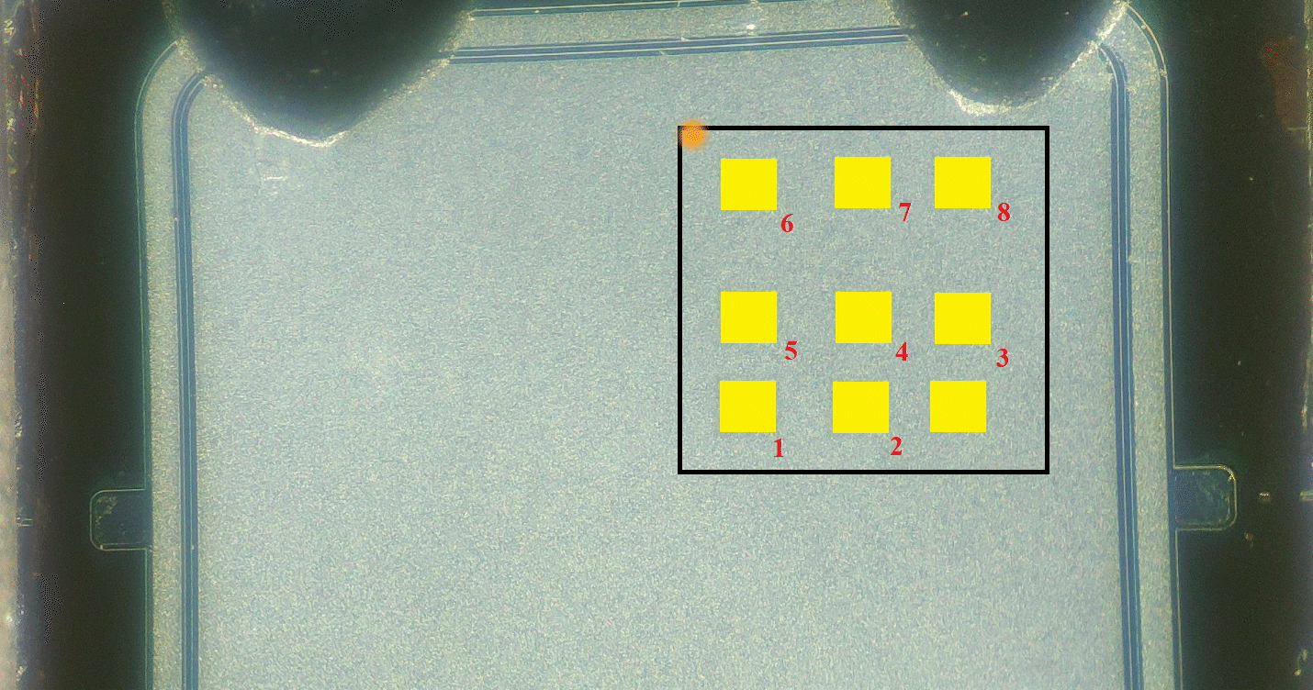

ION BEAM INDUCED CHARGE (IBIC)
Presence of defects, impurities or recombination centers affect the collection of carriers and hence the current.
$$W$$
Traps induced by radiation damage
Combining IBIC with a nuclear microprobe: Synchronous signal acquisition system with scanning (mappings).
Direction of electric field
Signal
V_{bias}
V_{out}
Charge sensitive
preamplifier
Amplifier
ADC
+
MCA
ID-90
Slide 5/14
EuNPC2025

Slide 19
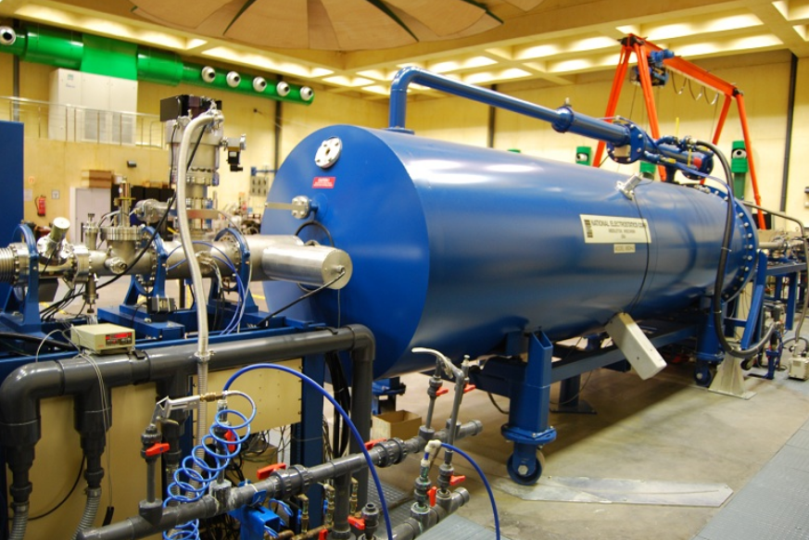
ACCELERATORS FOR STUDYING RADIATION INDUCED DEFECTS IN DETECTORS
The ion beam microprobe linked to a particle accelerator constitutes an powerful tool to characterize radiation detectors:
Small samples (3×3 mm²)
Controlled rate with micrometric slits to avoid additional damage during characterization
CNA 3 MV tandem accelerator
ID-90
Slide 6/14
EuNPC2025

Slide 20
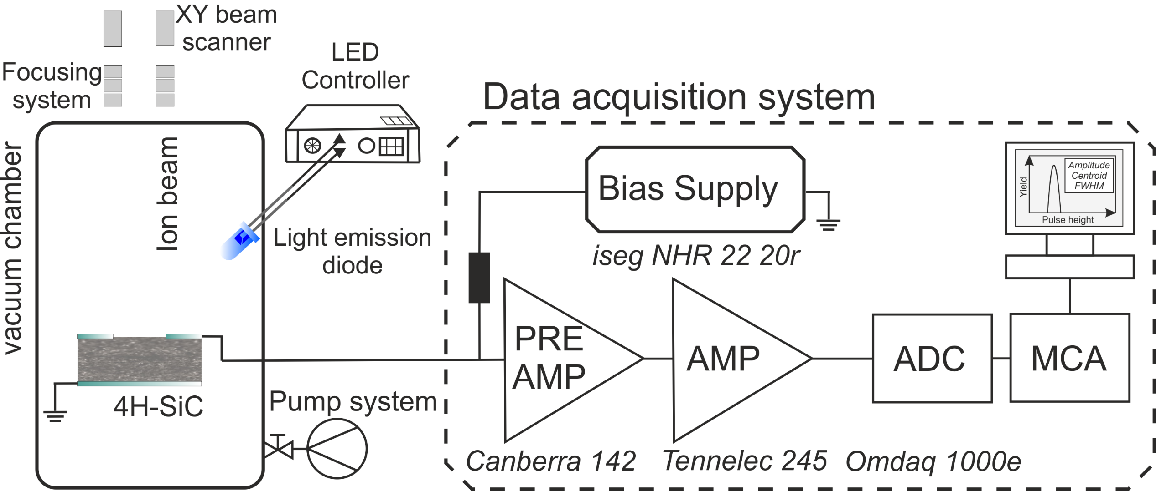
ACCELERATORS FOR STUDYING RADIATION INDUCED DEFECTS IN DETECTORS
The ion beam microprobe linked to a particle accelerator constitutes an powerful tool to characterize radiation detectors:
Small samples (3×3 mm²)
Controlled rate with micrometric slits to avoid additional damage during characterization
CNA 3 MV tandem accelerator
The detector is exposed to the focused ion beam.
LED installed inside the ion beam nuclear microprobe.
ID-90
Slide 6/14
EuNPC2025

Slide 21
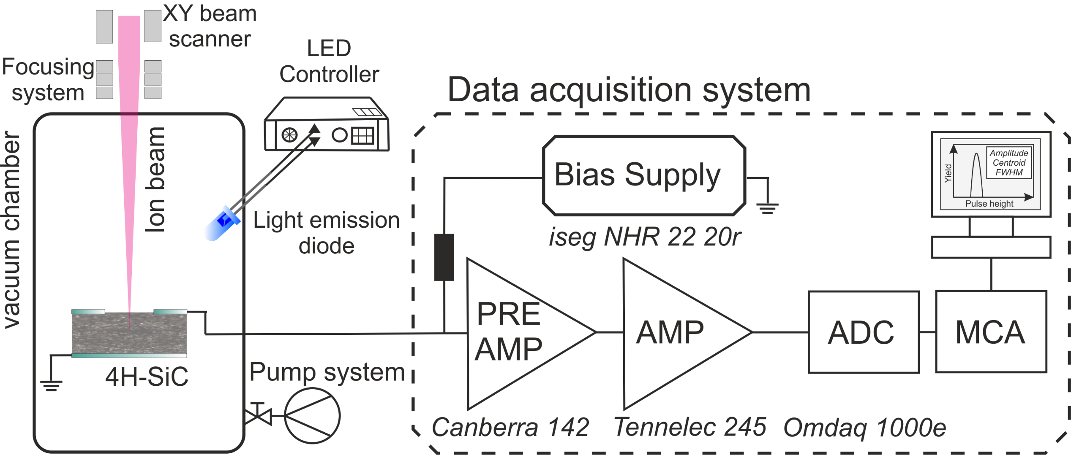
ACCELERATORS FOR STUDYING RADIATION INDUCED DEFECTS IN DETECTORS
The ion beam microprobe linked to a particle accelerator constitutes an powerful tool to characterize radiation detectors:
Small samples (3×3 mm²)
Controlled rate with micrometric slits to avoid additional damage during characterization
CNA 3 MV tandem accelerator
The detector is exposed to the focused ion beam.
LED installed inside the ion beam nuclear microprobe.
ID-90
Slide 6/14
EuNPC2025

Slide 22
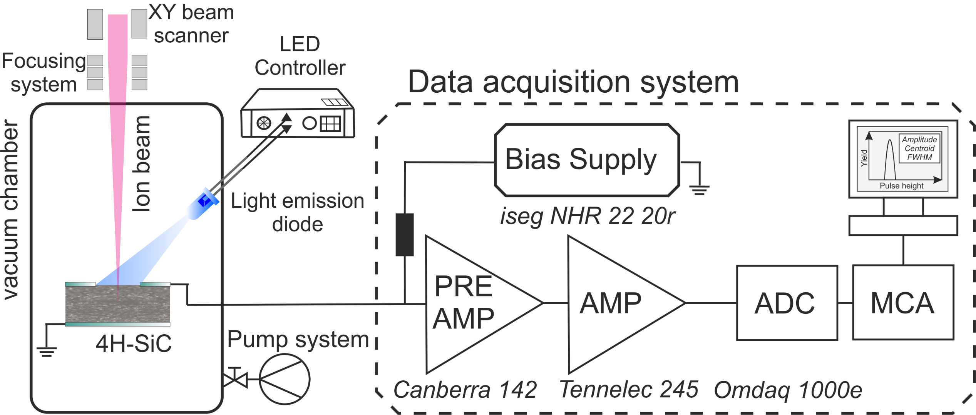
ACCELERATORS FOR STUDYING RADIATION INDUCED DEFECTS IN DETECTORS
The ion beam microprobe linked to a particle accelerator constitutes an powerful tool to characterize radiation detectors:
Small samples (3×3 mm²)
Controlled rate with micrometric slits to avoid additional damage during characterization
CNA 3 MV tandem accelerator
The detector is exposed to the focused ion beam.
LED installed inside the ion beam nuclear microprobe.
ID-90
Slide 6/14
EuNPC2025

Slide 23
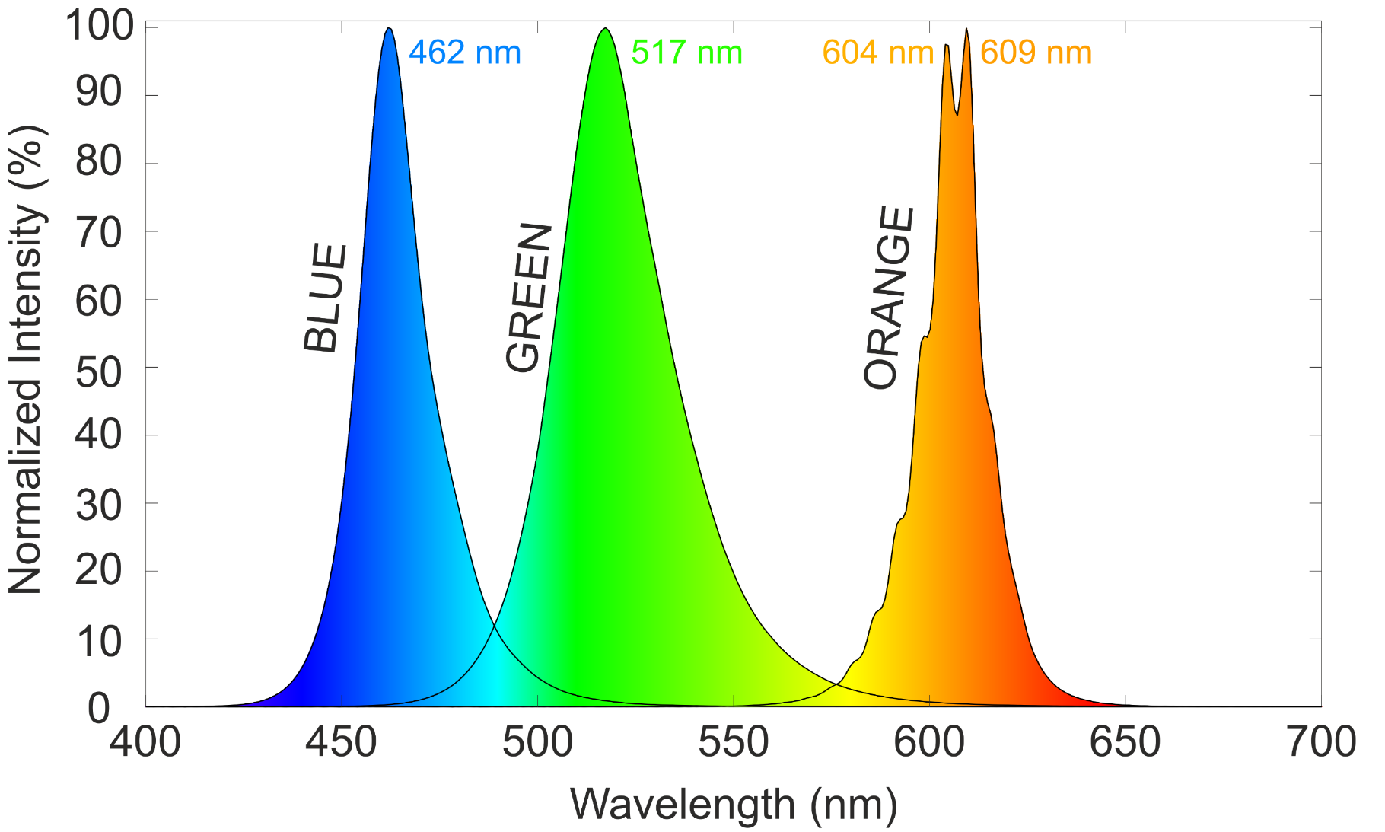
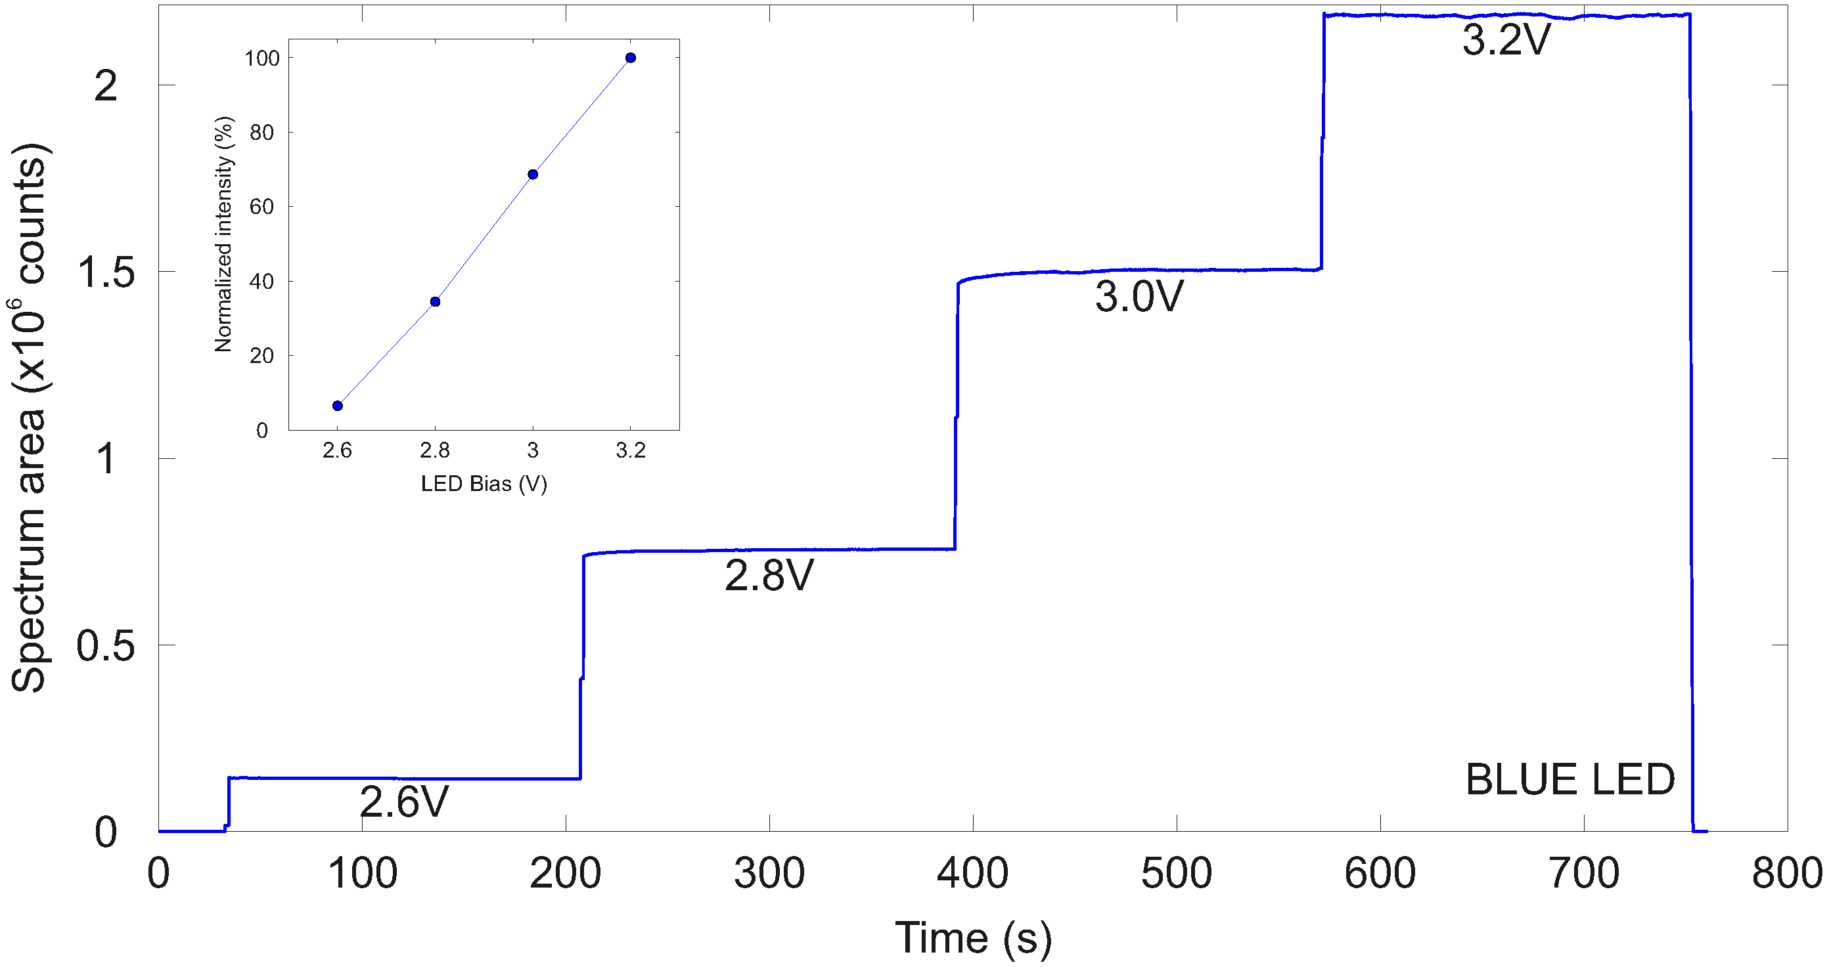
LEDS PRESENT GOOD PERFORMANCE AS OPTICAL EXCITATION SOURCE
Three commercial LEDs installed under identical conditions to illuminate the detector.
Spectral response measured offline using an optical spectrometer.
Illumination of the sensor did not result in photogeneration of electron-hole pairs.
• For the blue LED, the relative light output was measured with respect to the maximum operational voltage.
Absolute photon rate not available yet:
Work in progress…
ID-90
Slide 7/14
EuNPC2025

Slide 24
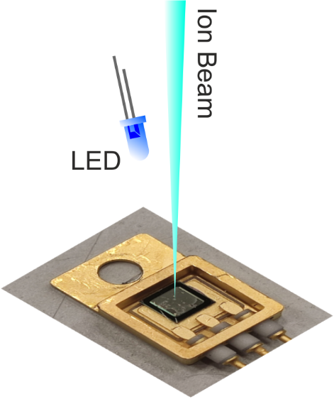
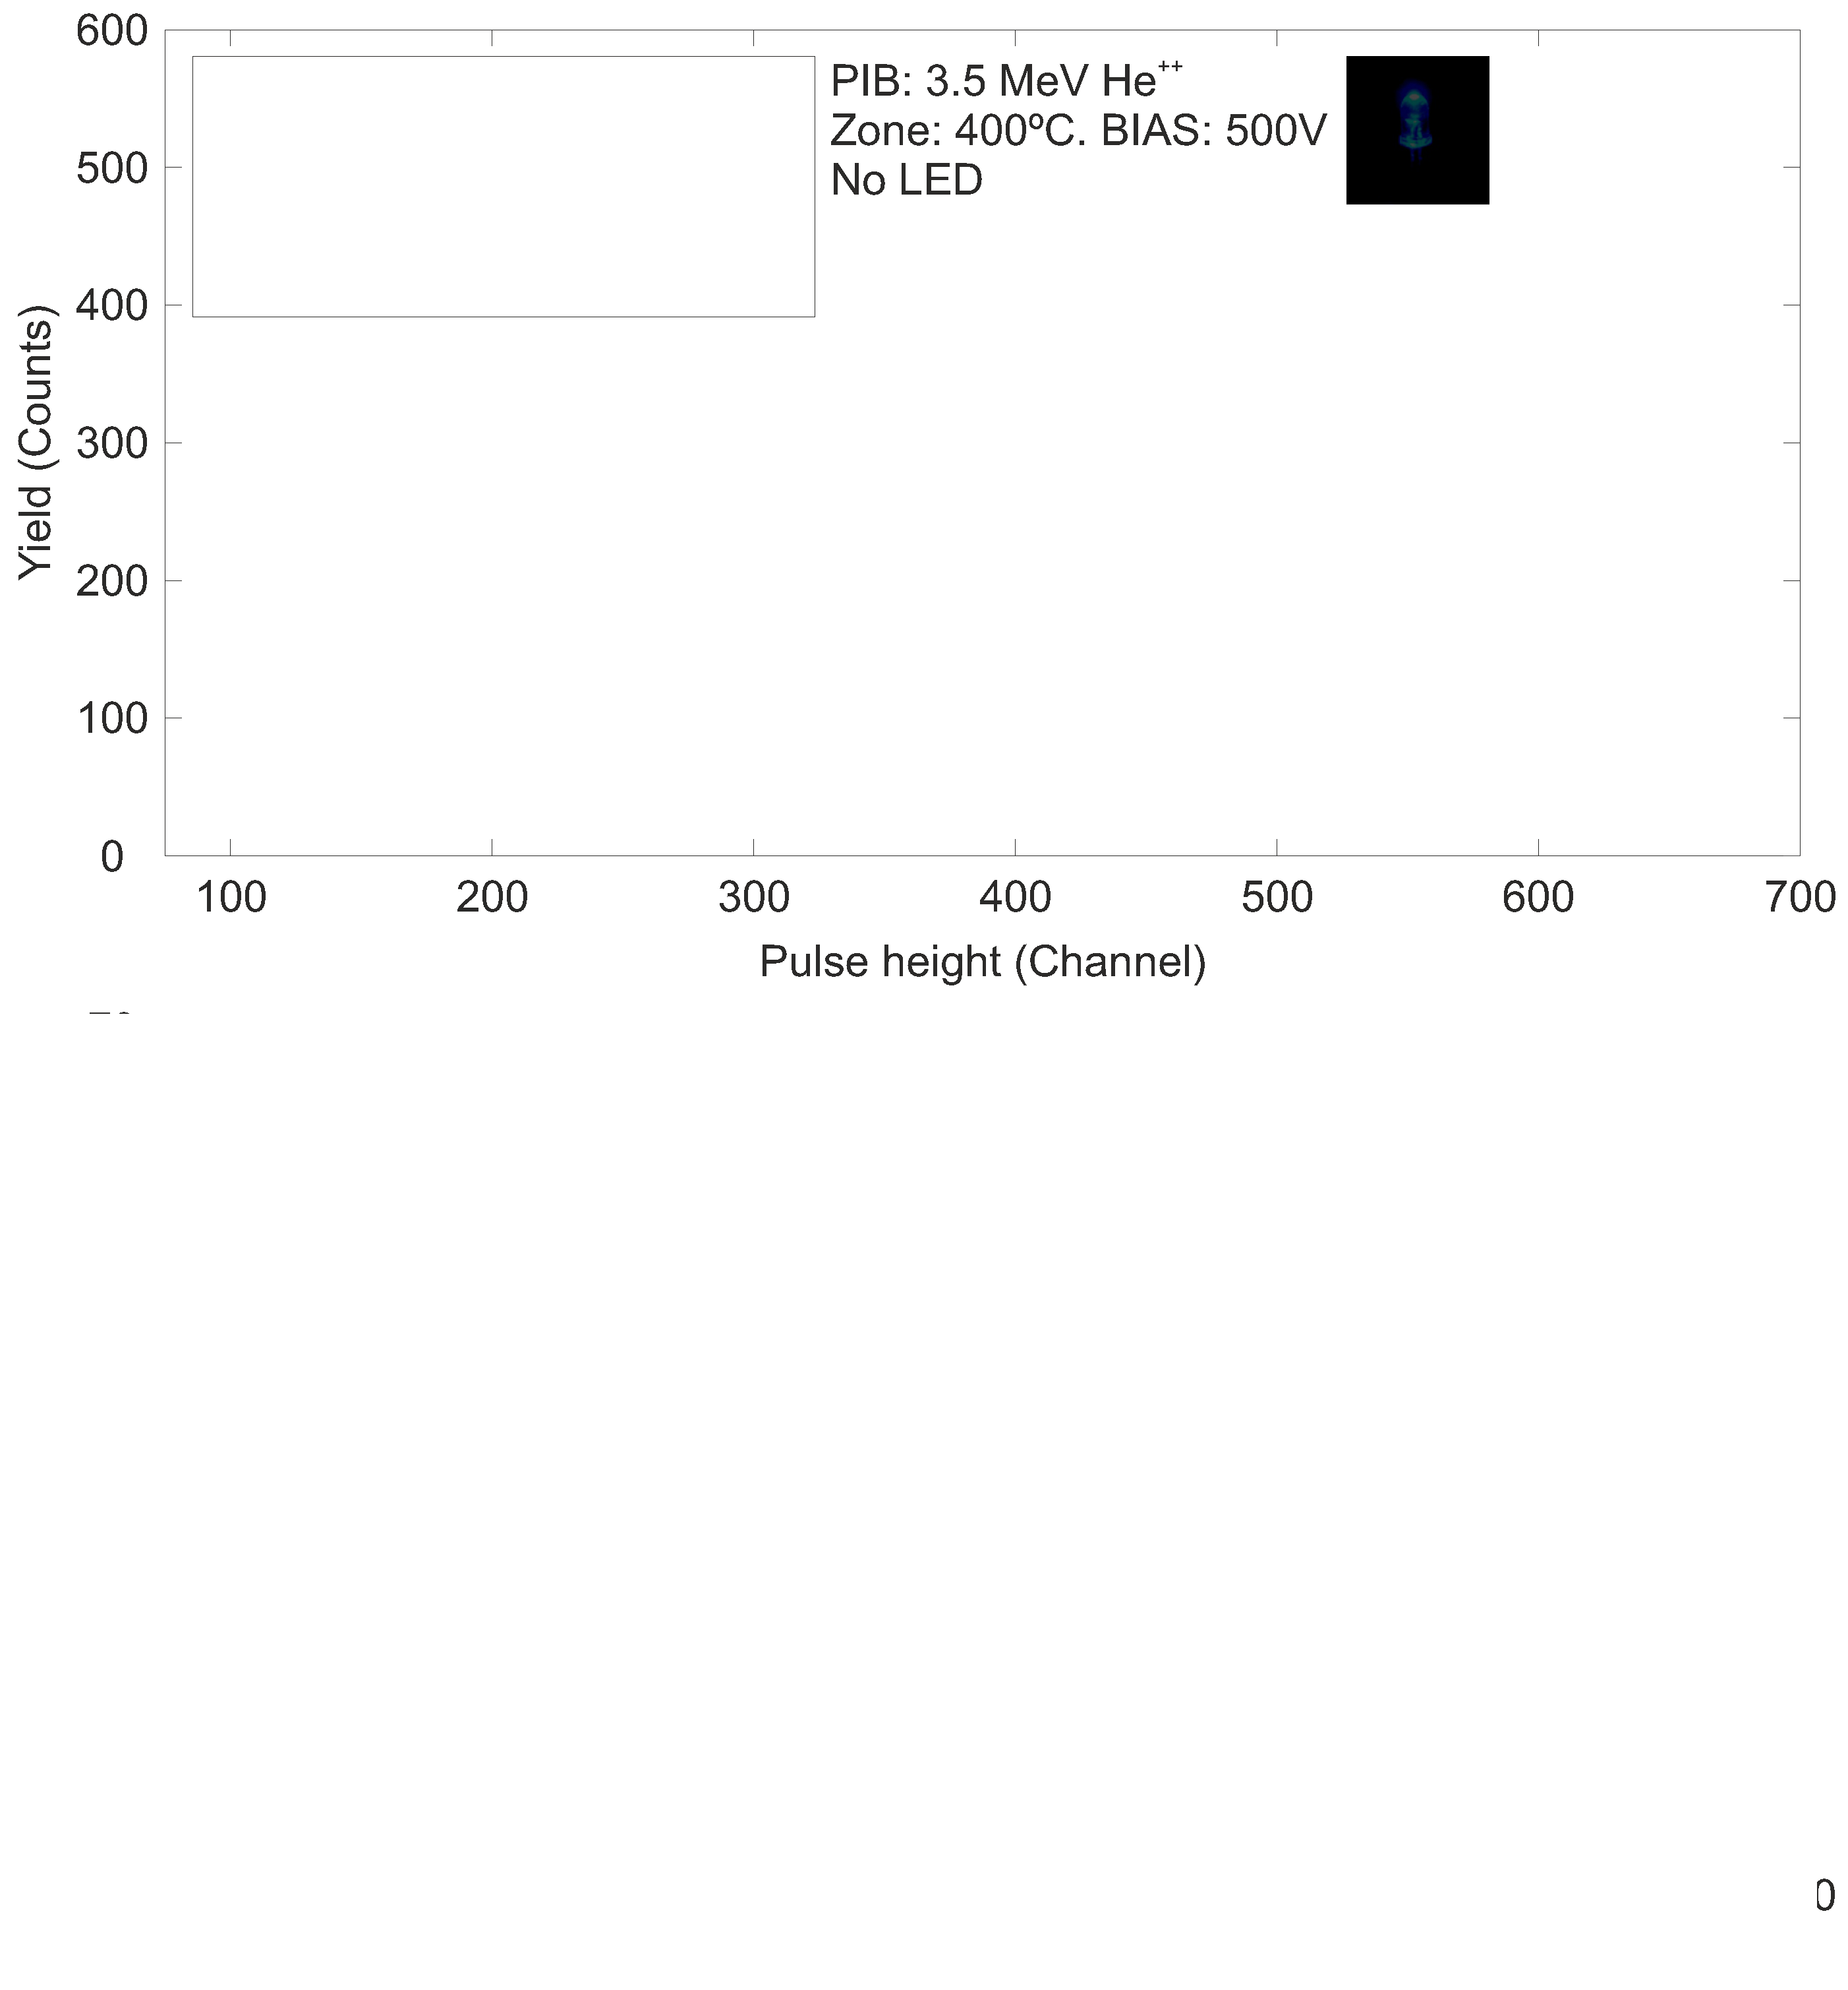
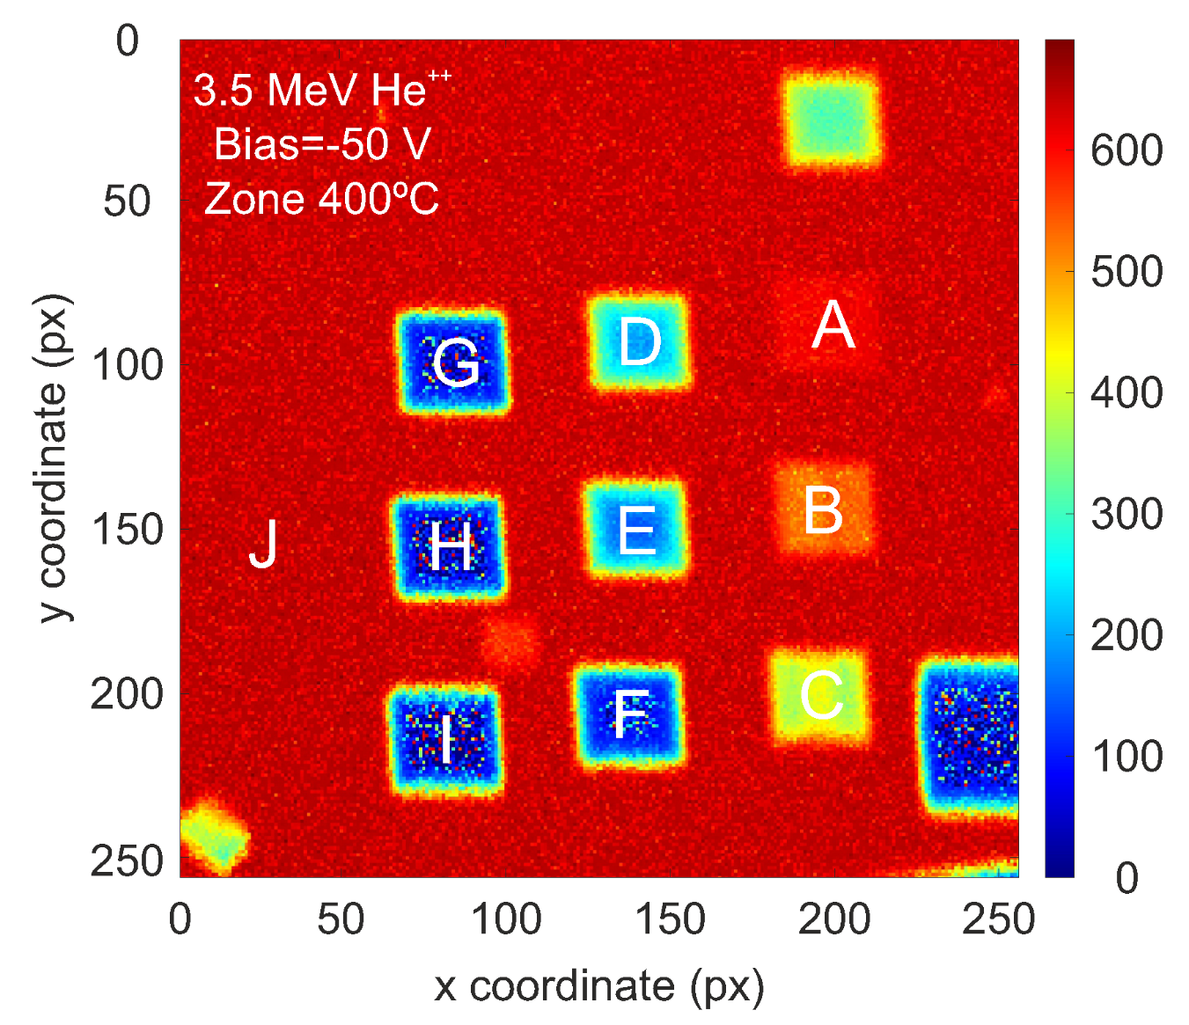
IBIC USED TO ASSESS POST-IRRADIATION RESPONSE AT ROOM TEMPERATURE
LED OFF
ID-90
Slide 8/14
EuNPC2025

Slide 25

IBIC USED TO ASSESS POST-IRRADIATION RESPONSE AT ROOM TEMPERATURE
LED OFF
ID-90
Slide 8/14
EuNPC2025

Slide 26
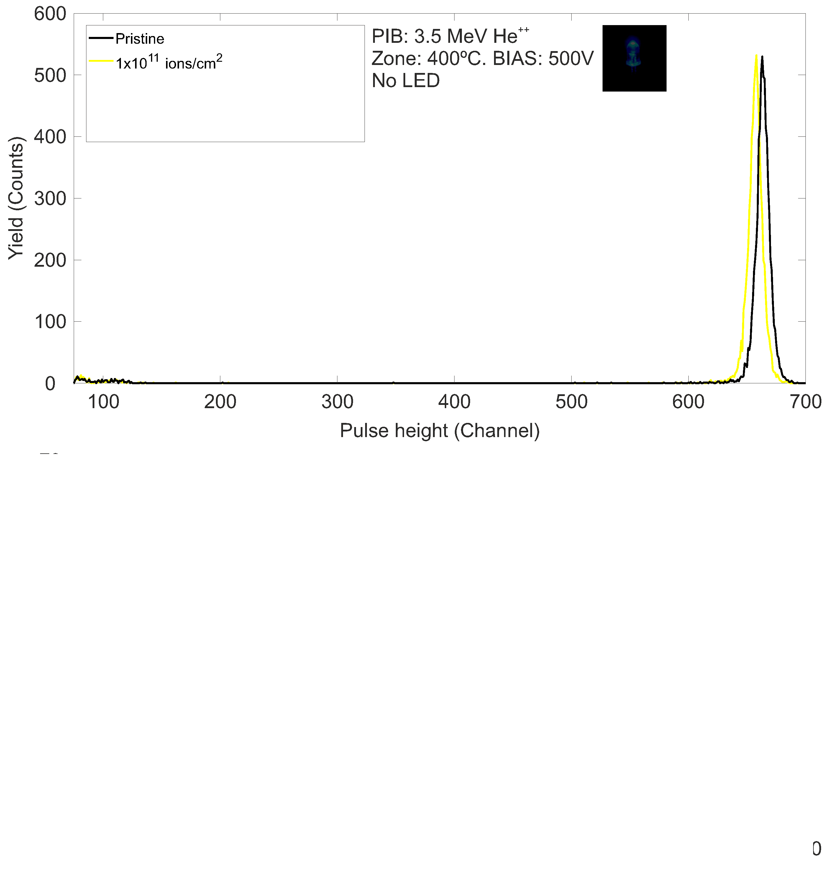
IBIC USED TO ASSESS POST-IRRADIATION RESPONSE AT ROOM TEMPERATURE
LED OFF
ID-90
Slide 8/14
EuNPC2025

Slide 27
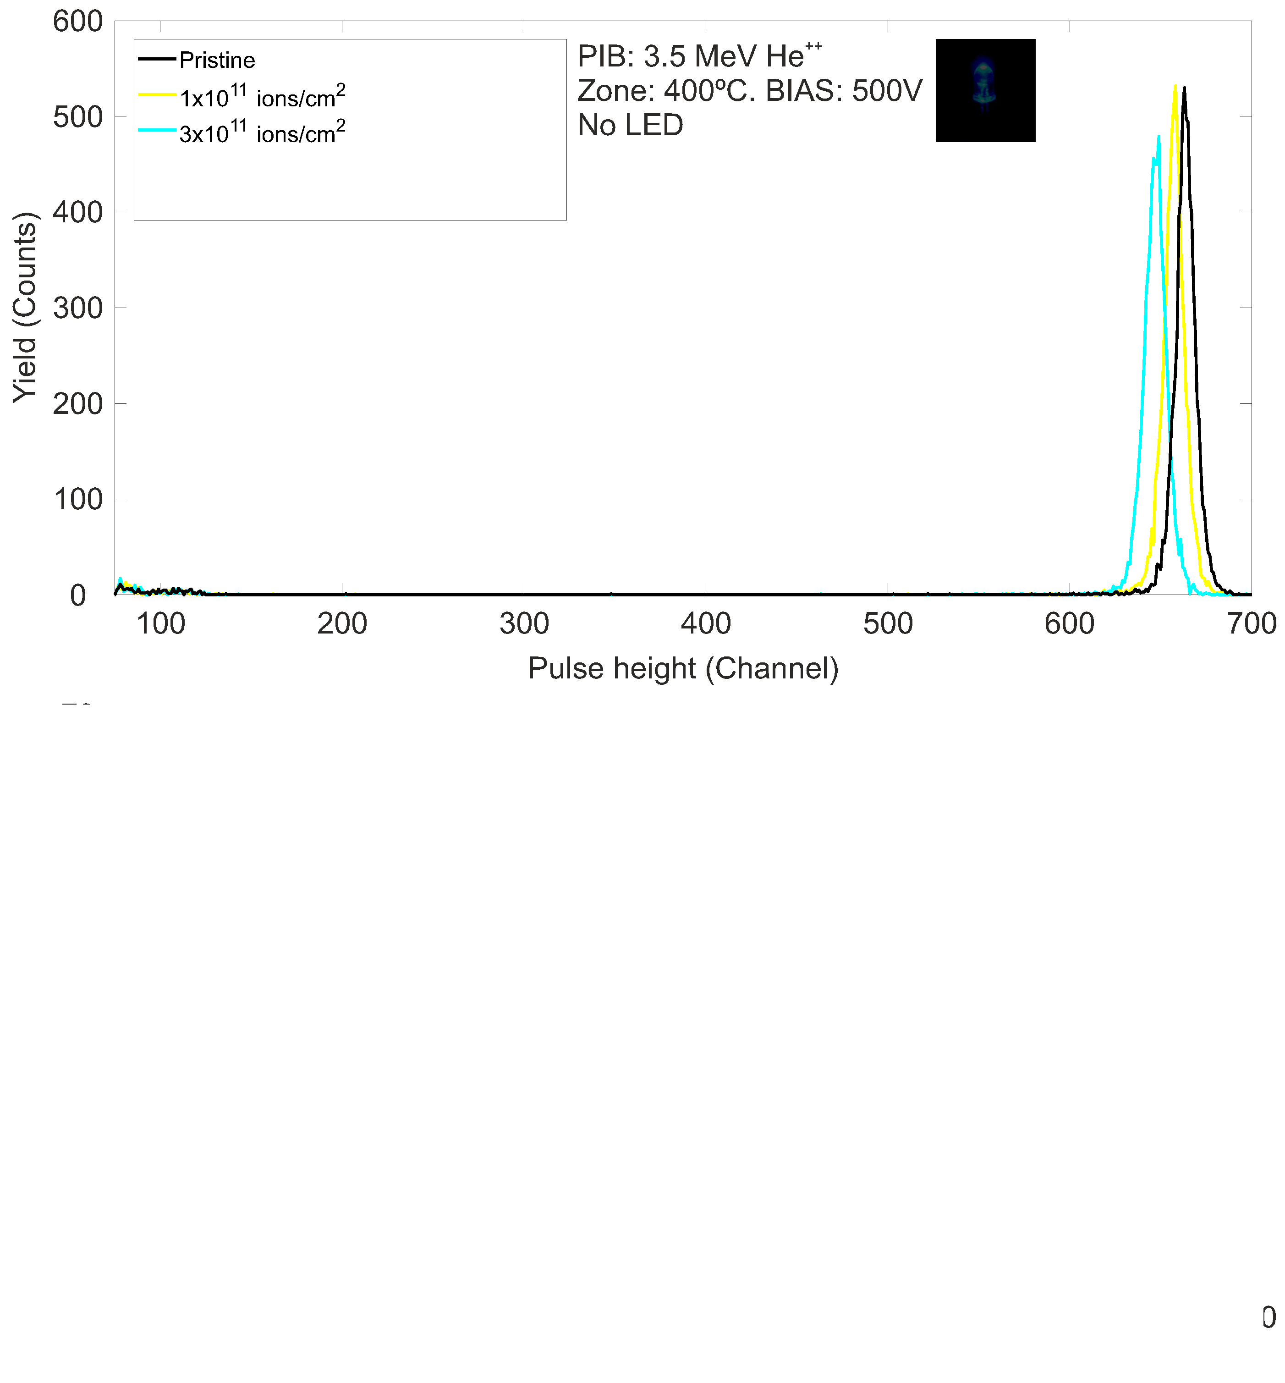
IBIC USED TO ASSESS POST-IRRADIATION RESPONSE AT ROOM TEMPERATURE
LED OFF
ID-90
Slide 8/14
EuNPC2025

Slide 28

IBIC USED TO ASSESS POST-IRRADIATION RESPONSE AT ROOM TEMPERATURE
LED OFF
Slight reduction in absolute CCE observed in regions with low damage levels.
ID-90
Slide 8/14
EuNPC2025

Slide 29
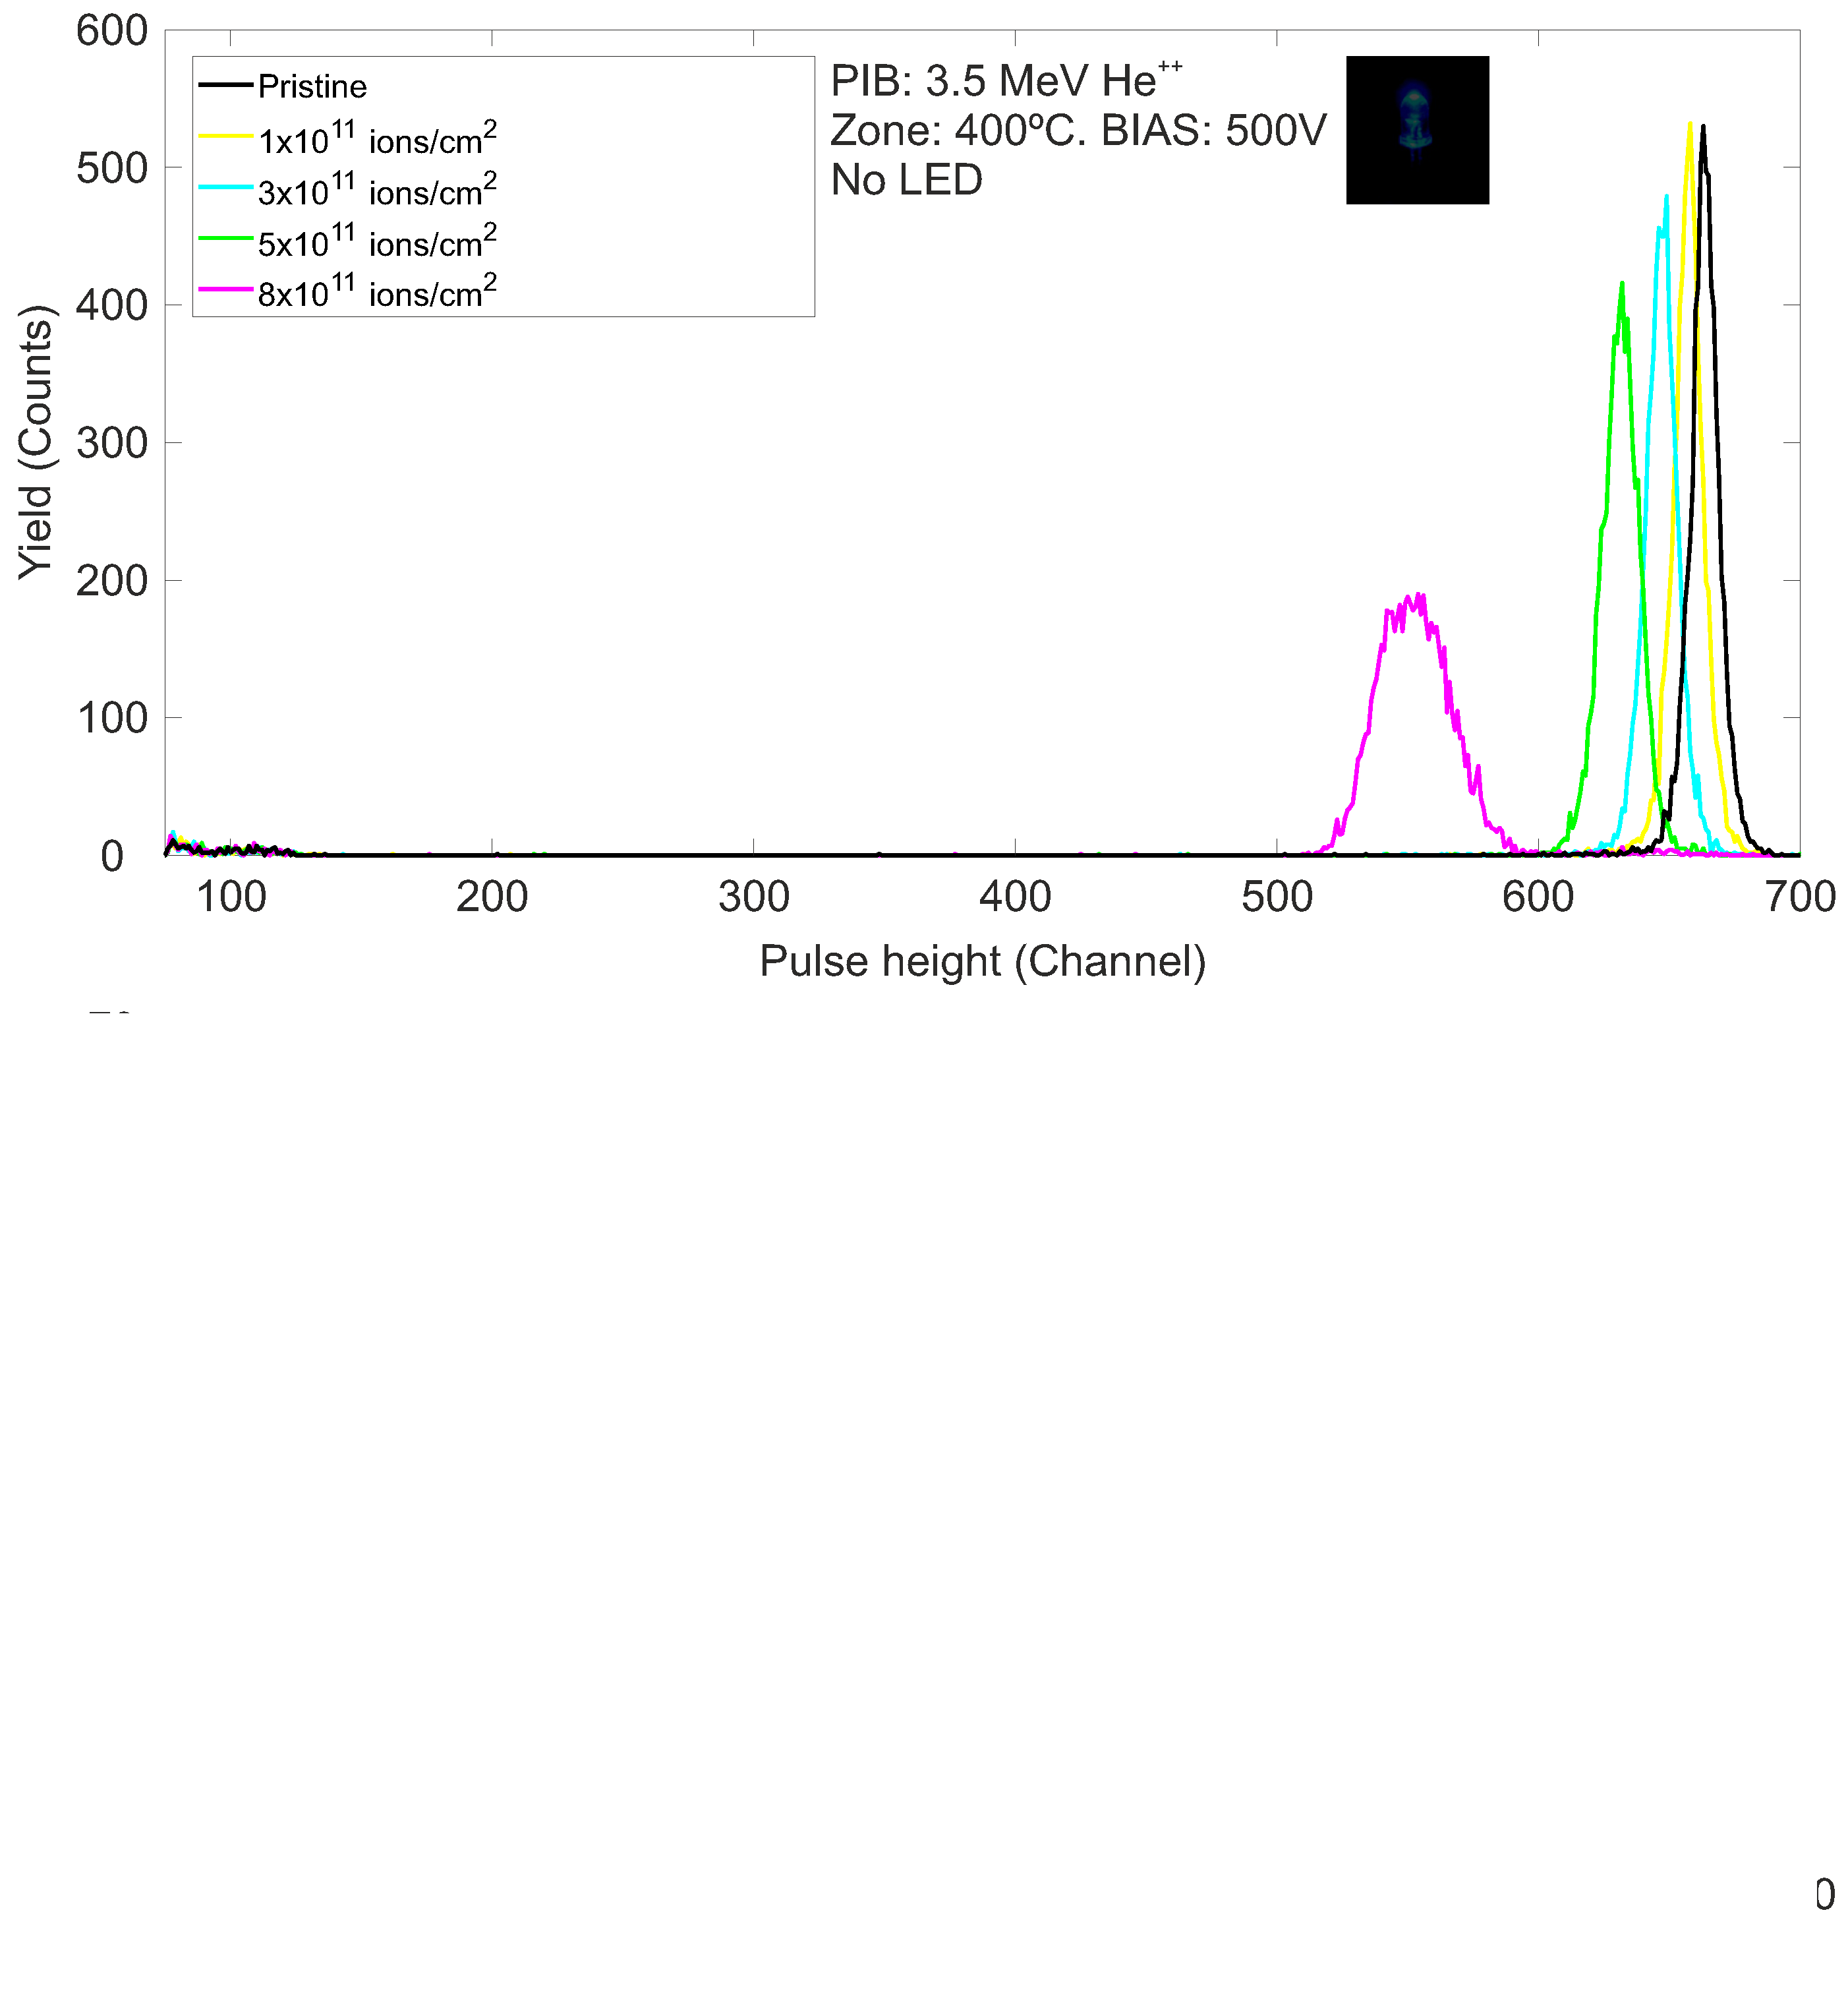
IBIC USED TO ASSESS POST-IRRADIATION RESPONSE AT ROOM TEMPERATURE
LED OFF
ID-90
Slide 8/14
EuNPC2025

Slide 30
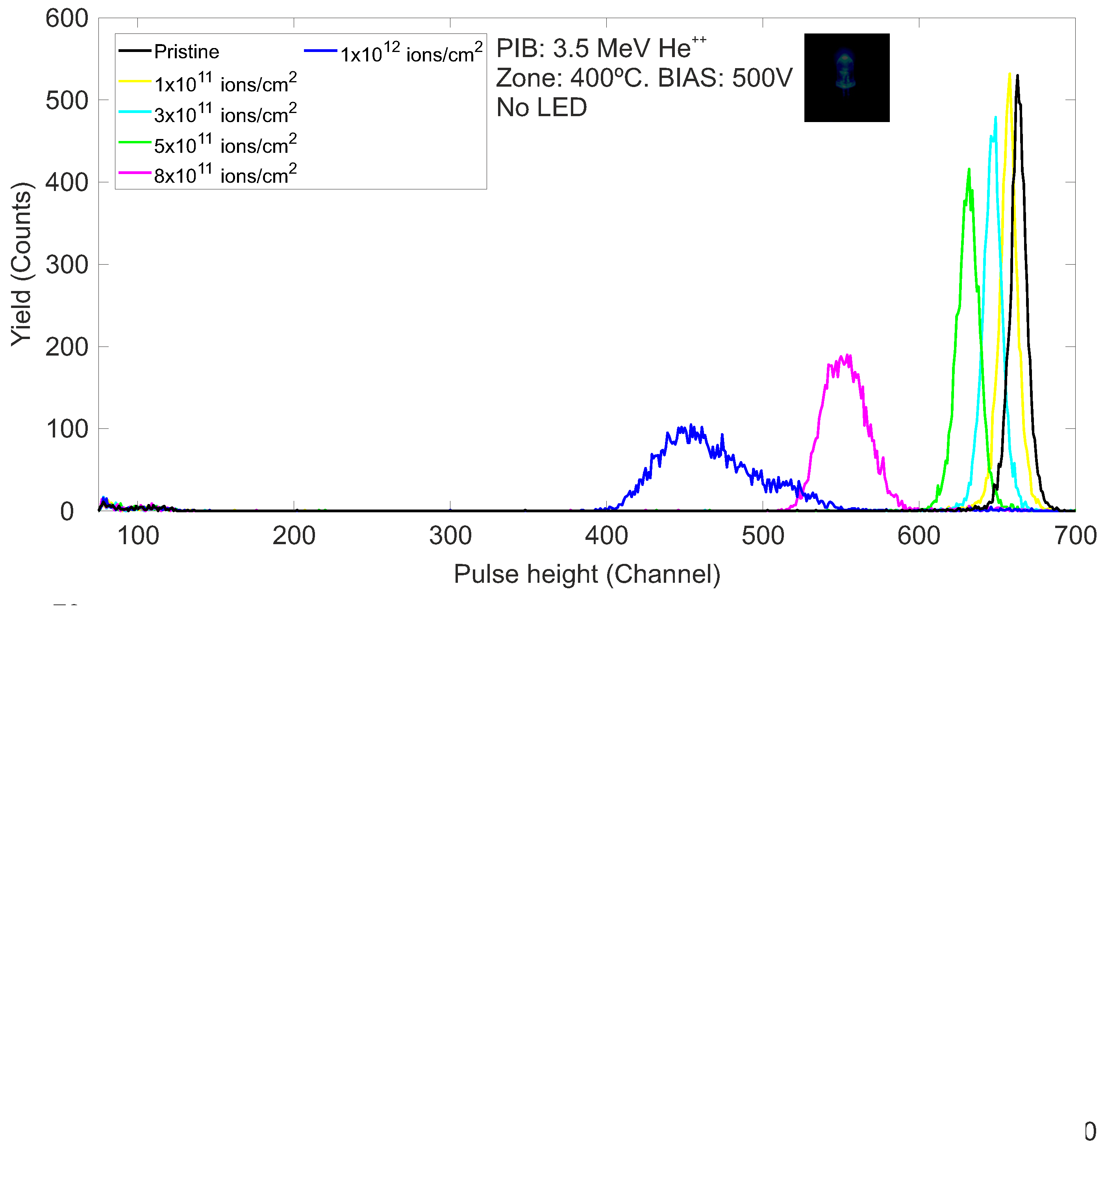
IBIC USED TO ASSESS POST-IRRADIATION RESPONSE AT ROOM TEMPERATURE
LED OFF
ID-90
Slide 8/14
EuNPC2025

Slide 31
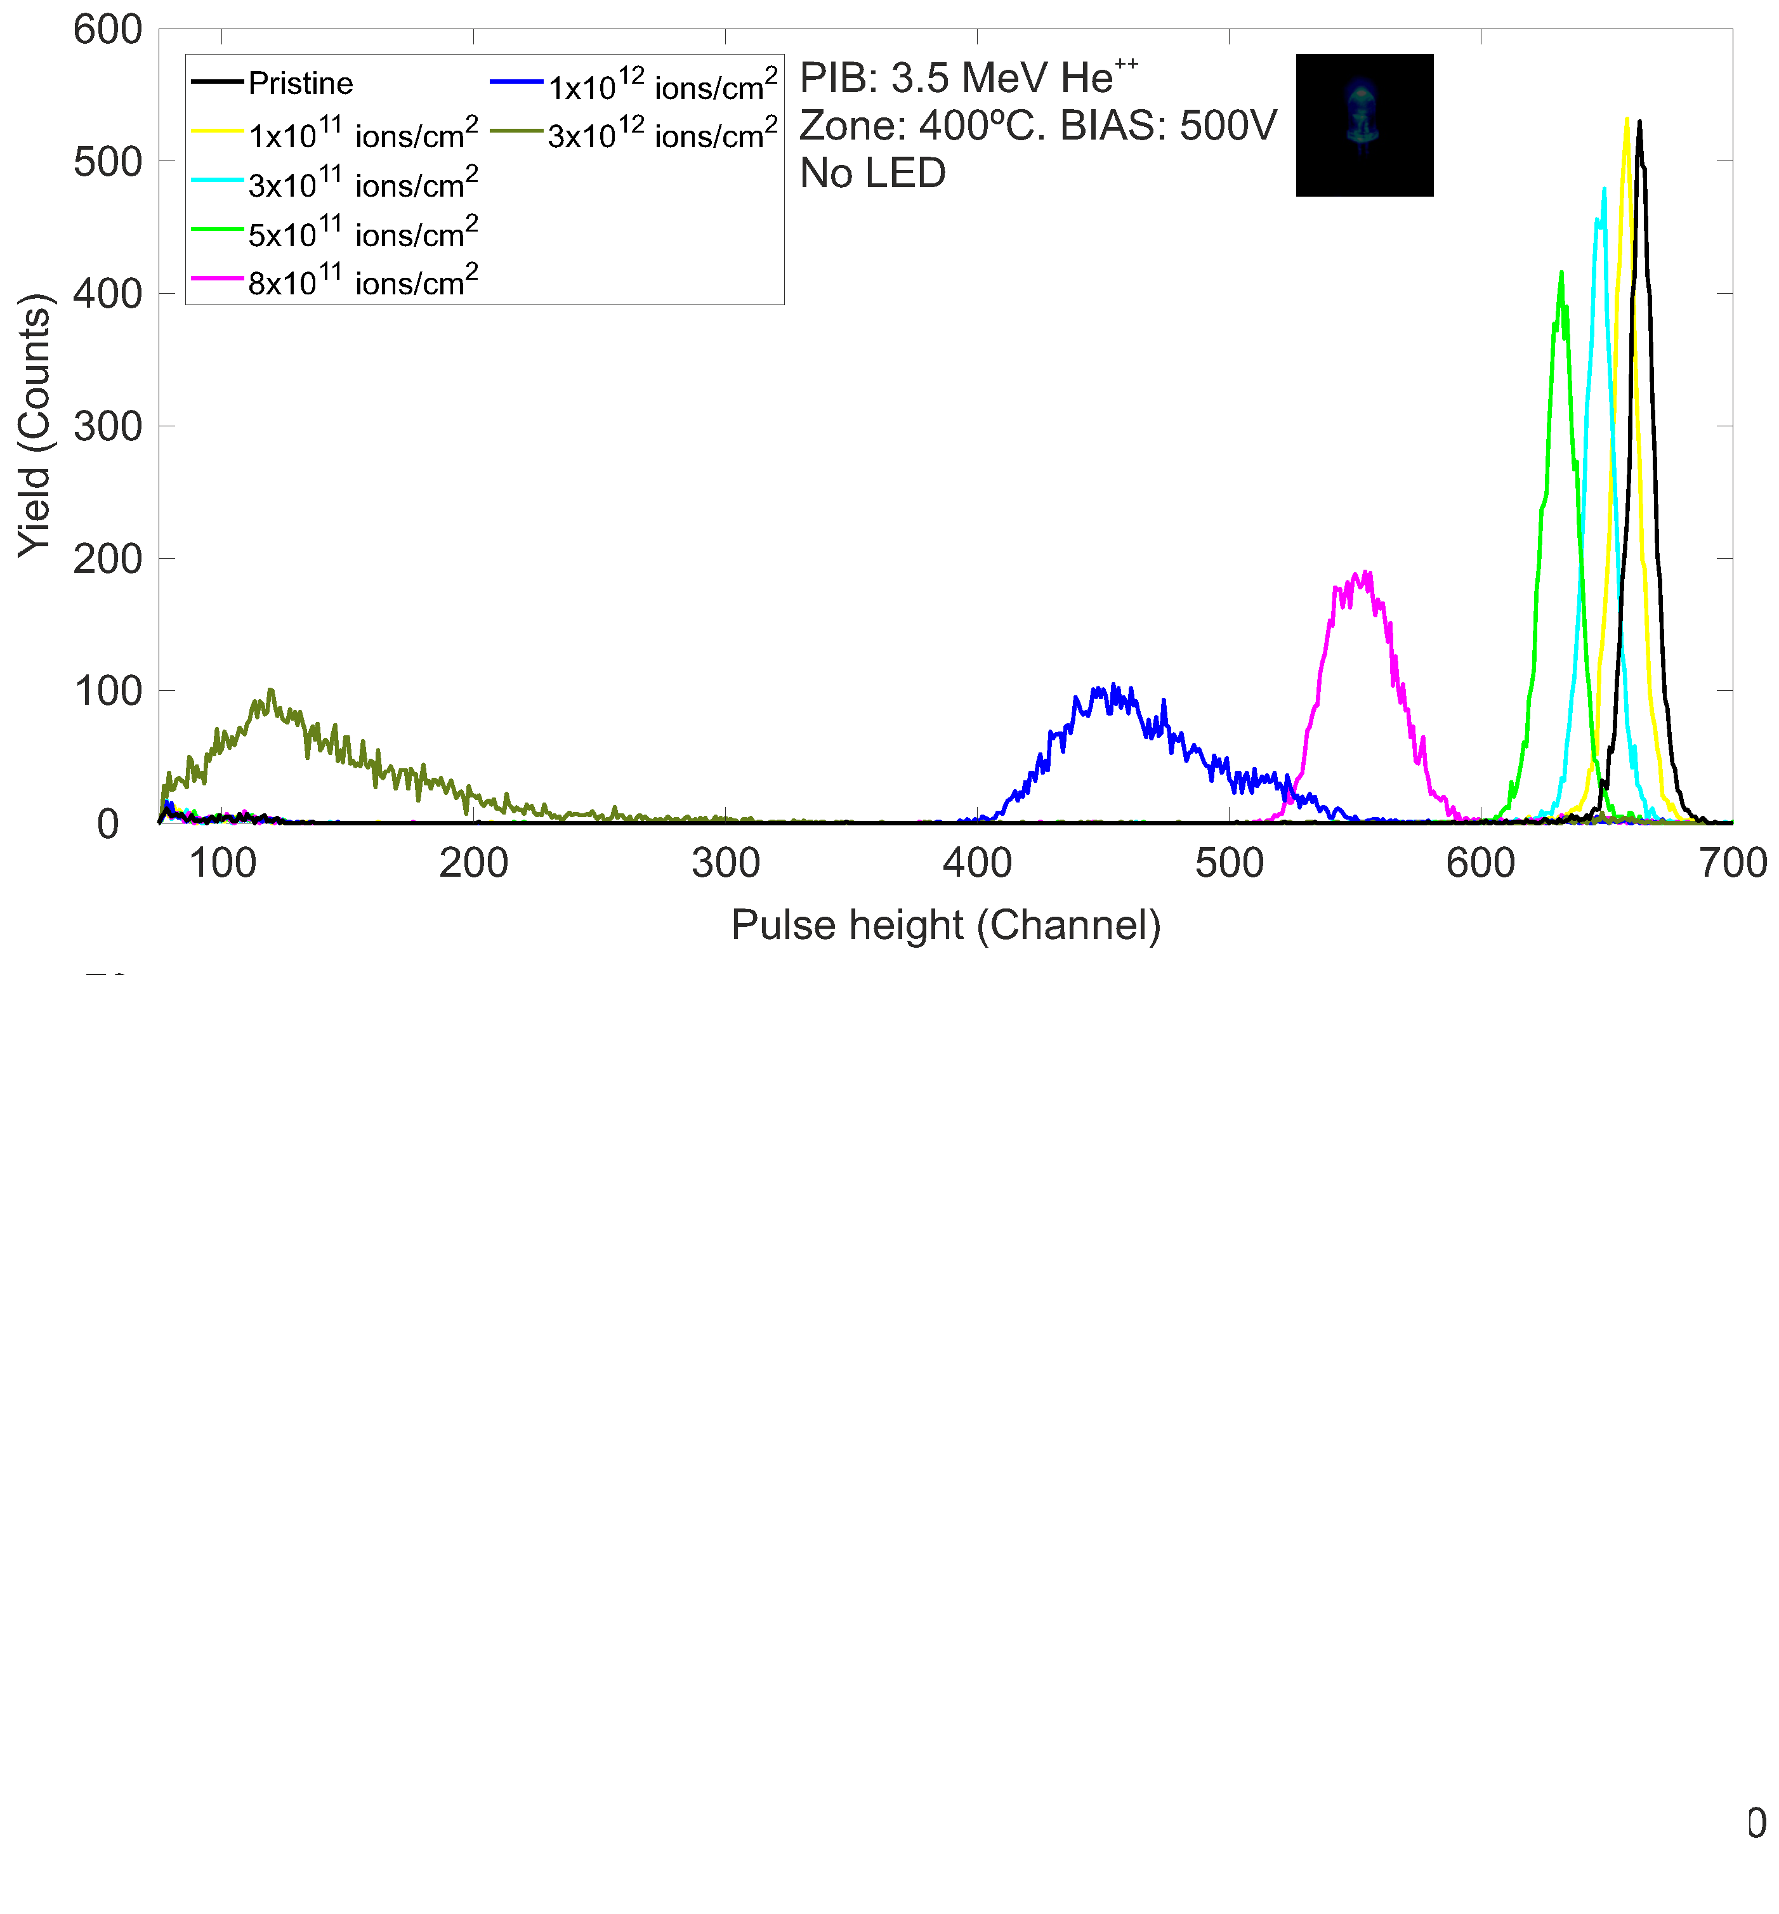
IBIC USED TO ASSESS POST-IRRADIATION RESPONSE AT ROOM TEMPERATURE
LED OFF
As fluence increases, a strong reduction in absolute CCE and peak broadening are observed.
ID-90
Slide 8/14
EuNPC2025

Slide 32
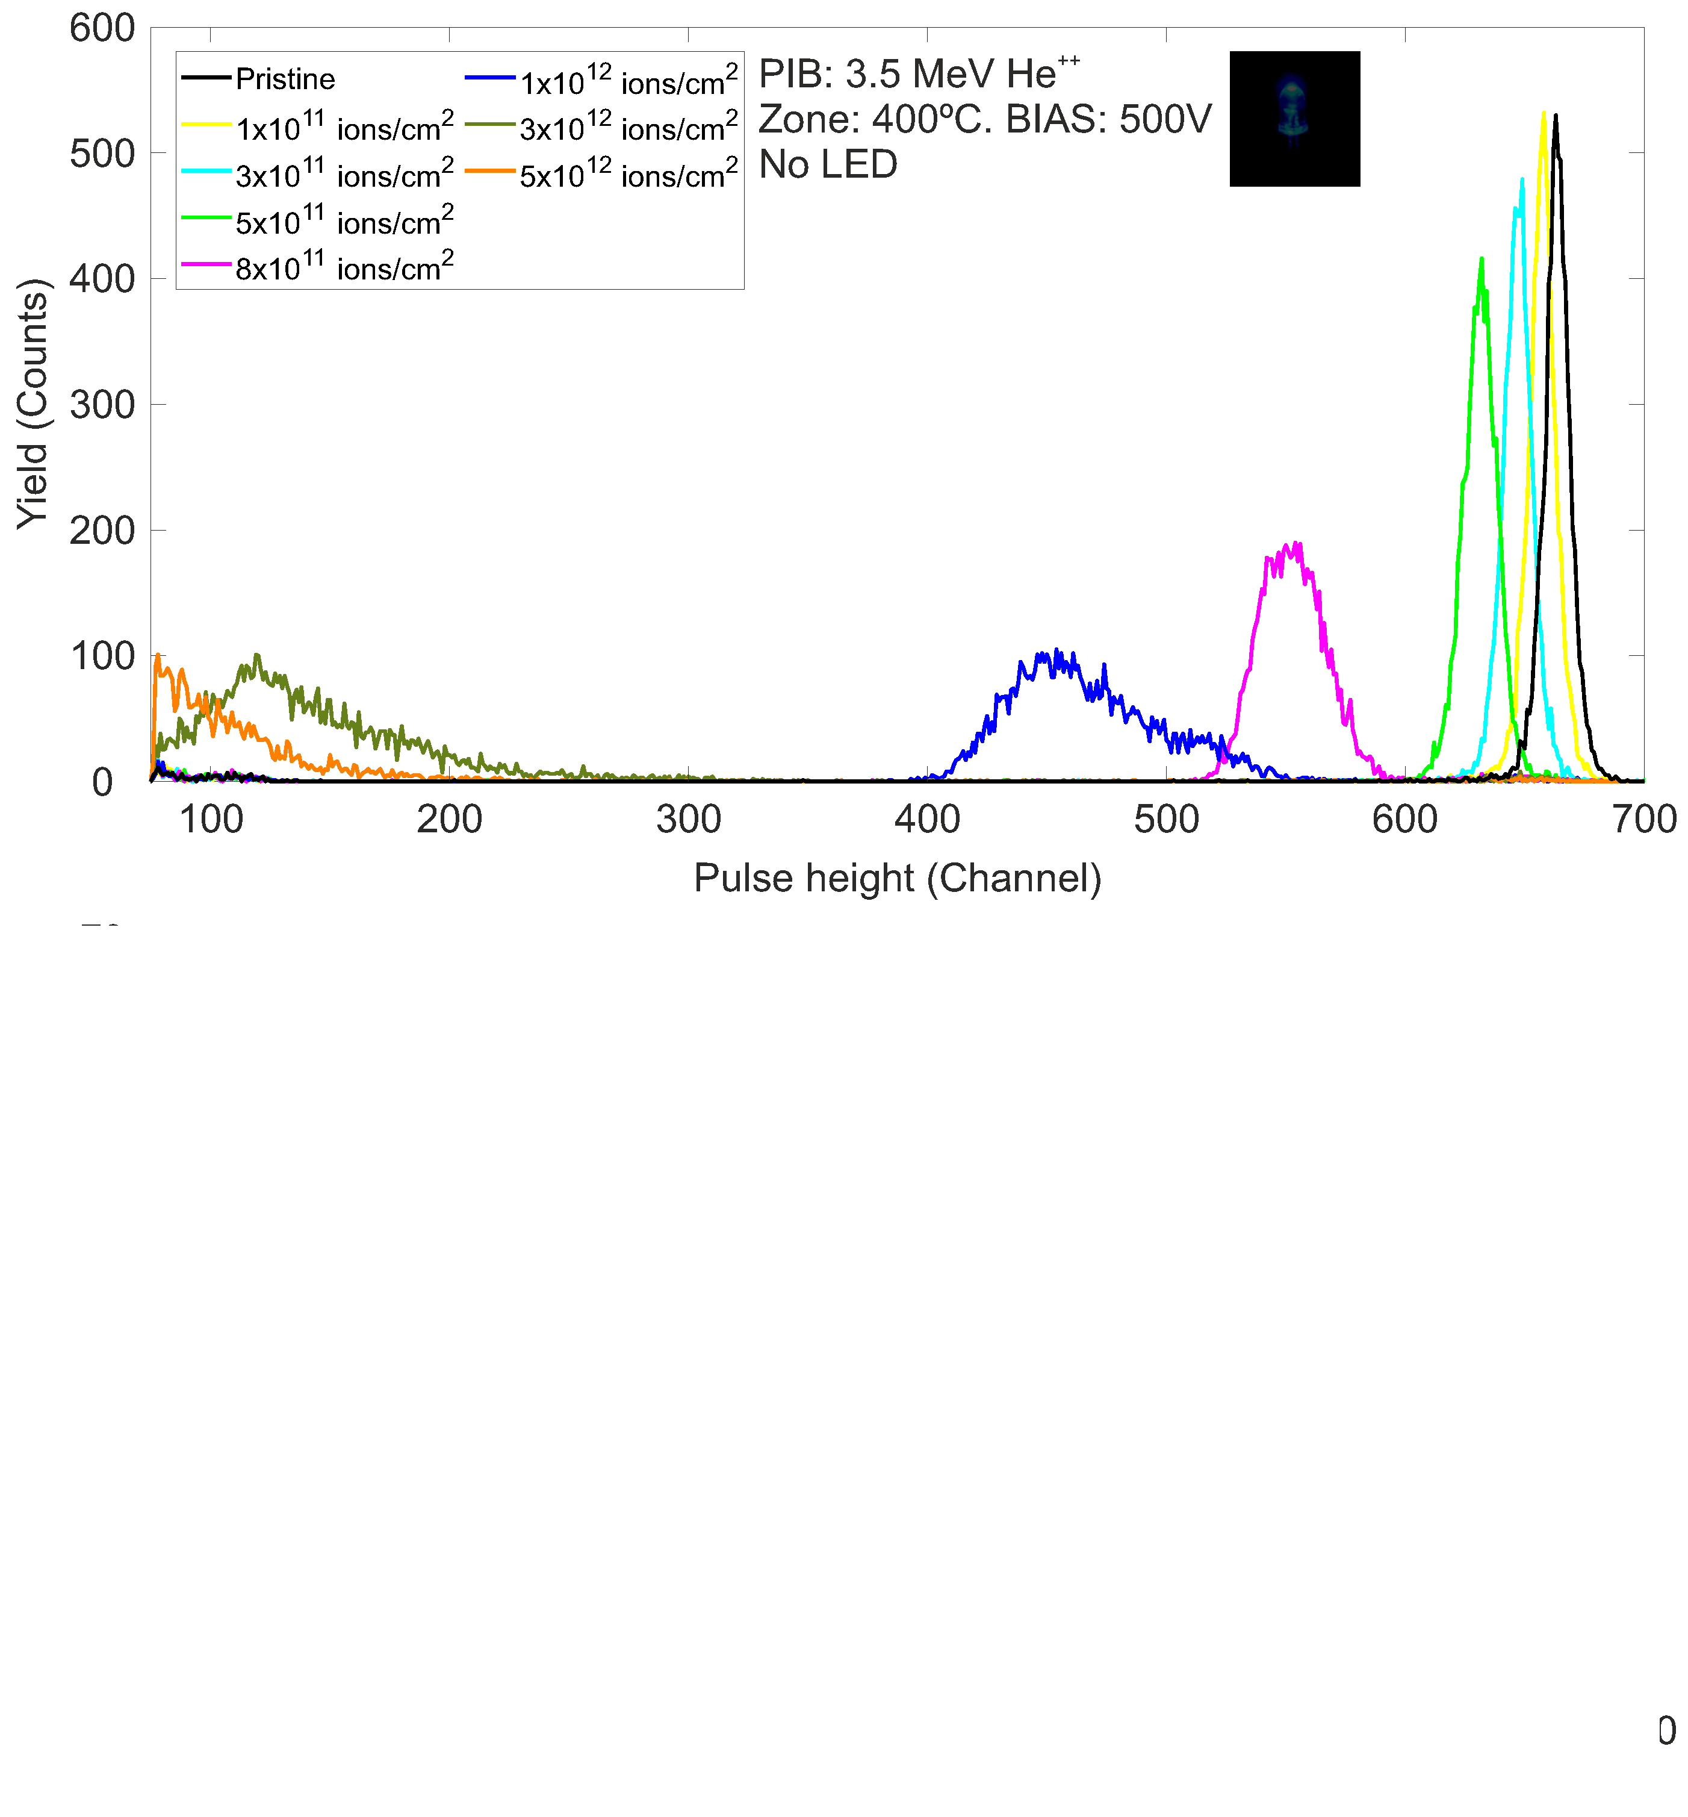
IBIC USED TO ASSESS POST-IRRADIATION RESPONSE AT ROOM TEMPERATURE
LED OFF
In our experimental setup, the detection limit is reached at 5×10¹² ions/cm², making higher fluences inaccessible for measurement.
ID-90
Slide 8/14
EuNPC2025

Slide 33
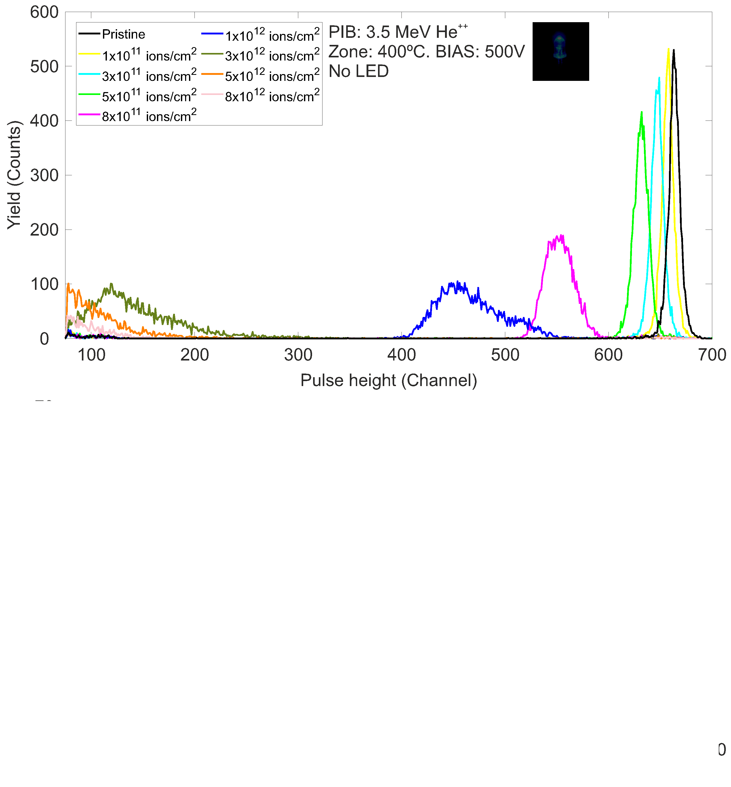
IBIC USED TO ASSESS POST-IRRADIATION RESPONSE AT ROOM TEMPERATURE
LED OFF
In our experimental setup, the detection limit is reached at 5×10¹² ions/cm², making higher fluences inaccessible for measurement.
ID-90
Slide 8/14
EuNPC2025

Slide 34
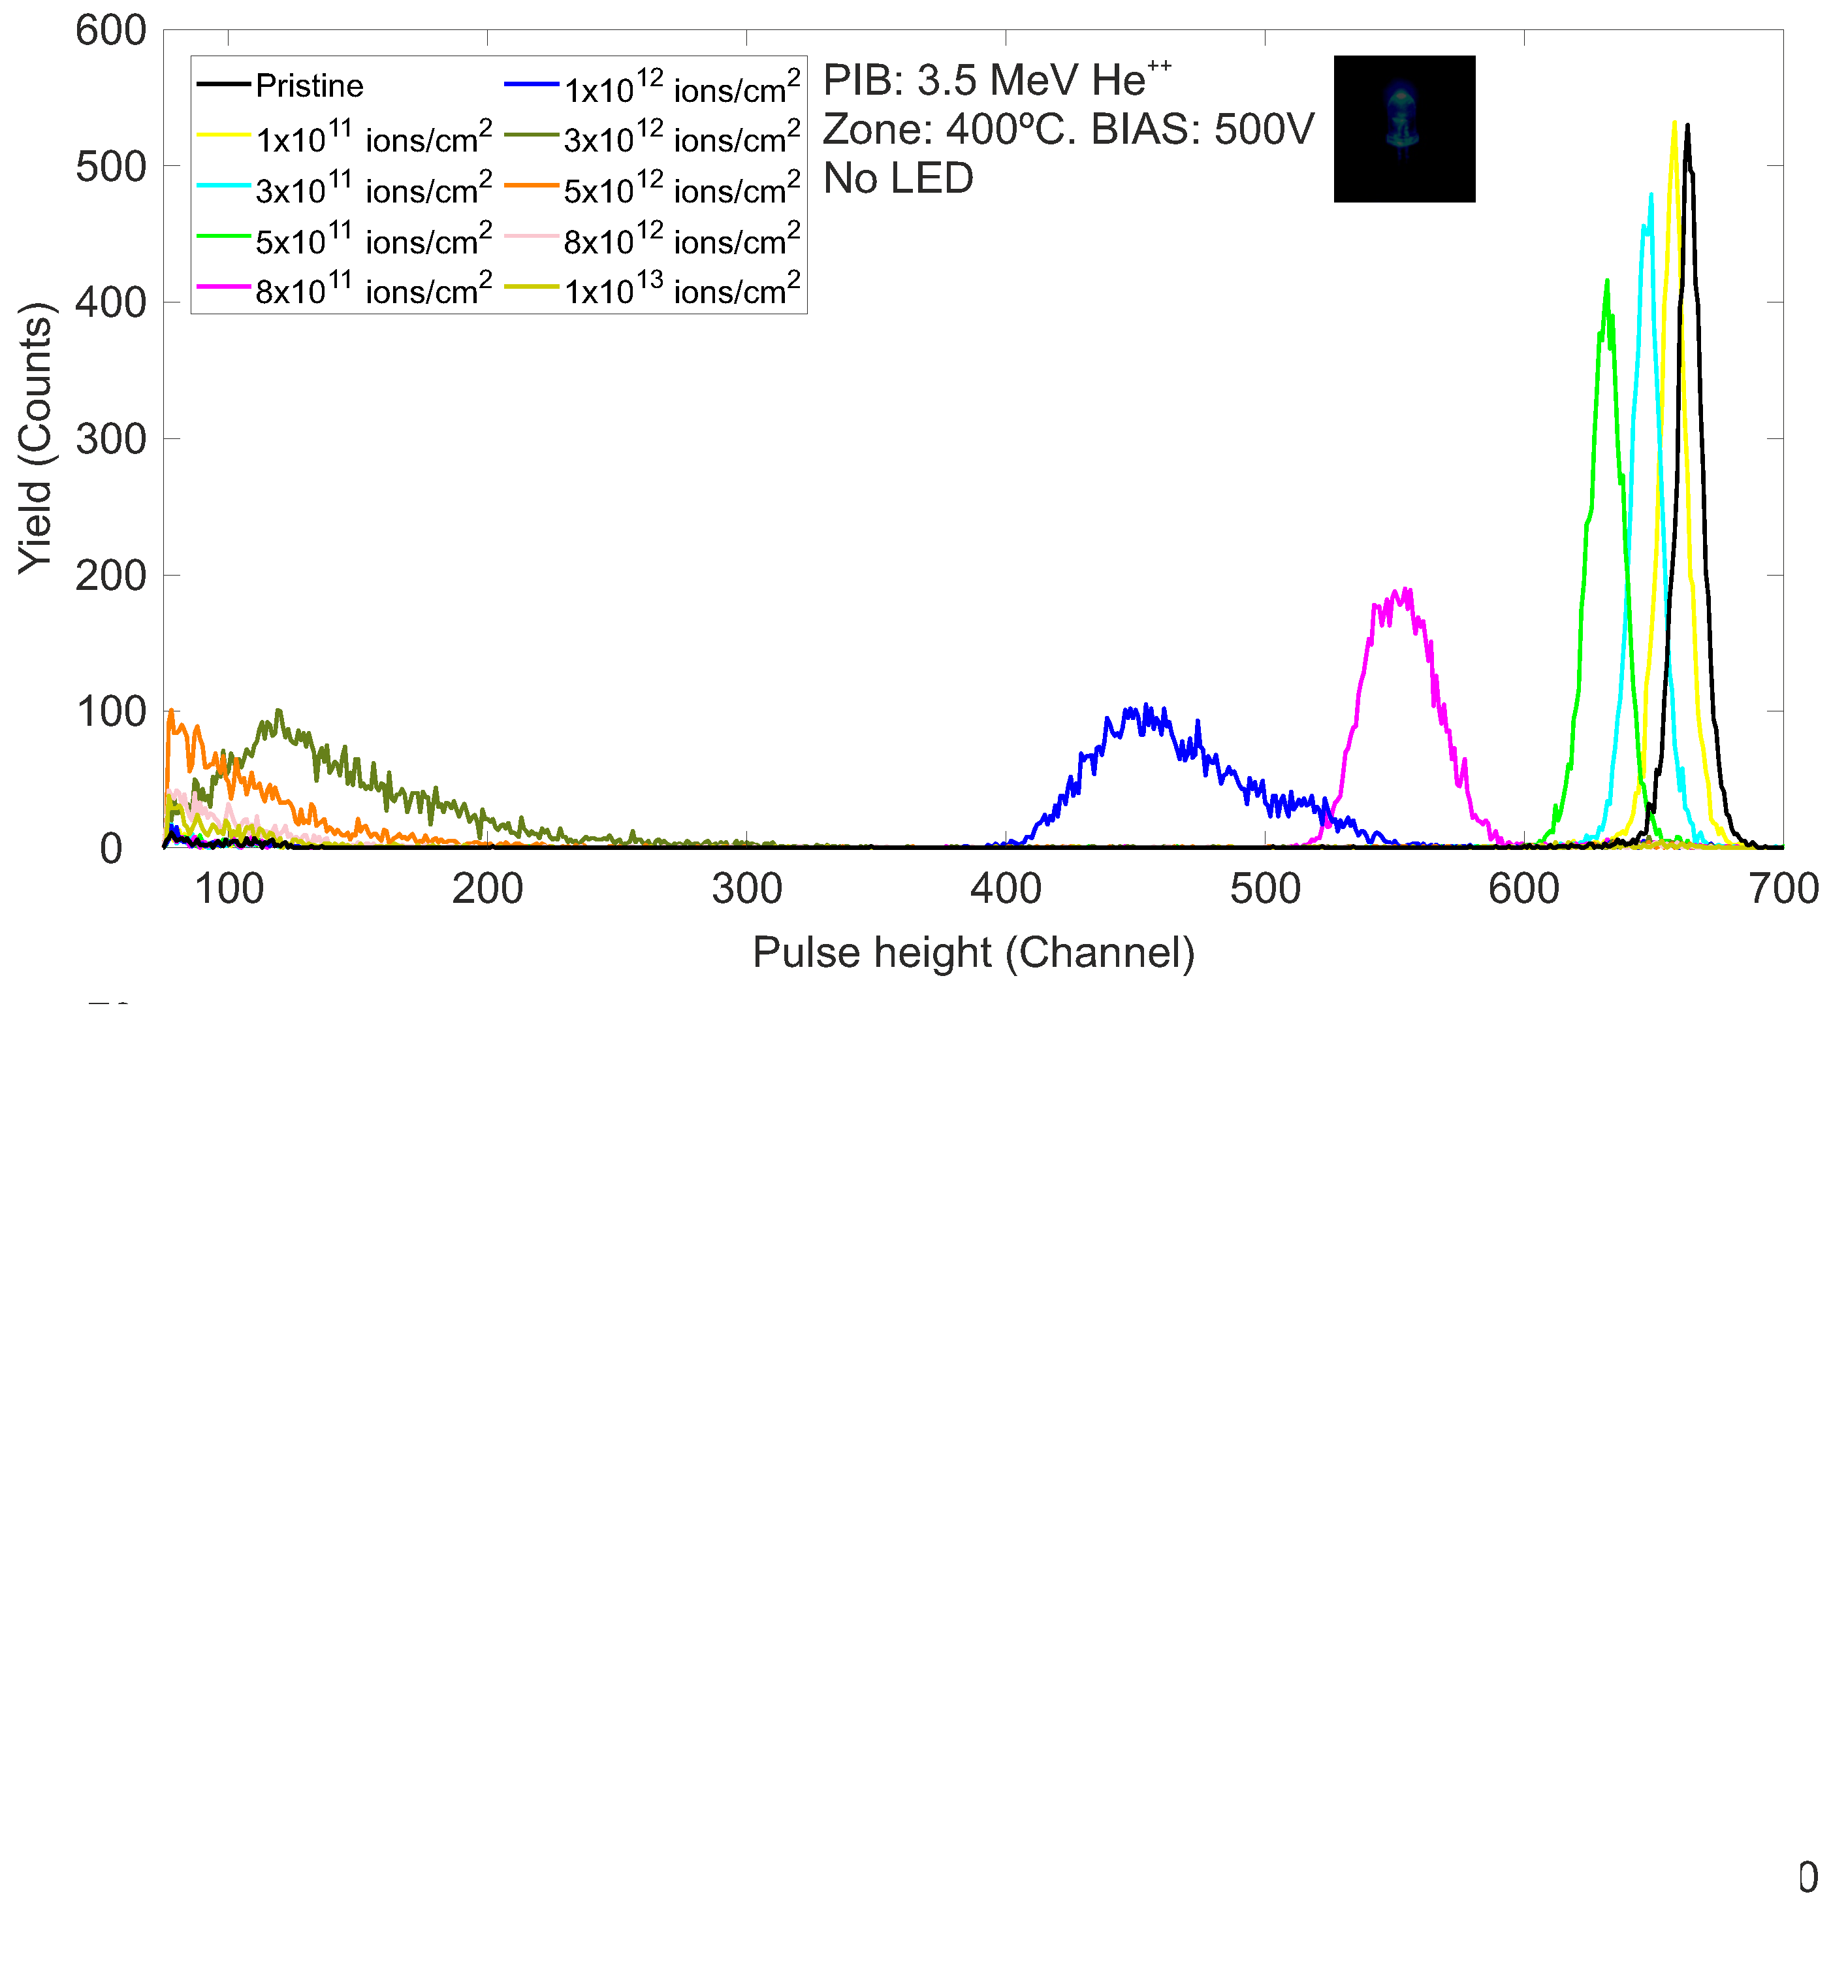
IBIC USED TO ASSESS POST-IRRADIATION RESPONSE AT ROOM TEMPERATURE
LED OFF
In our experimental setup, the detection limit is reached at 5×10¹² ions/cm², making higher fluences inaccessible for measurement.
ID-90
Slide 8/14
EuNPC2025

Slide 35
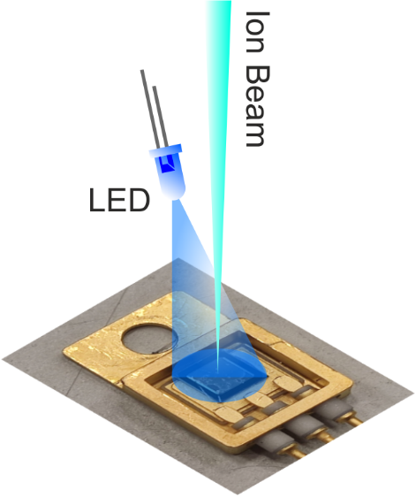
IBIC USED TO ASSESS POST-IRRADIATION RESPONSE AT ROOM TEMPERATURE
ID-90
Slide 8/14
EuNPC2025

Slide 36
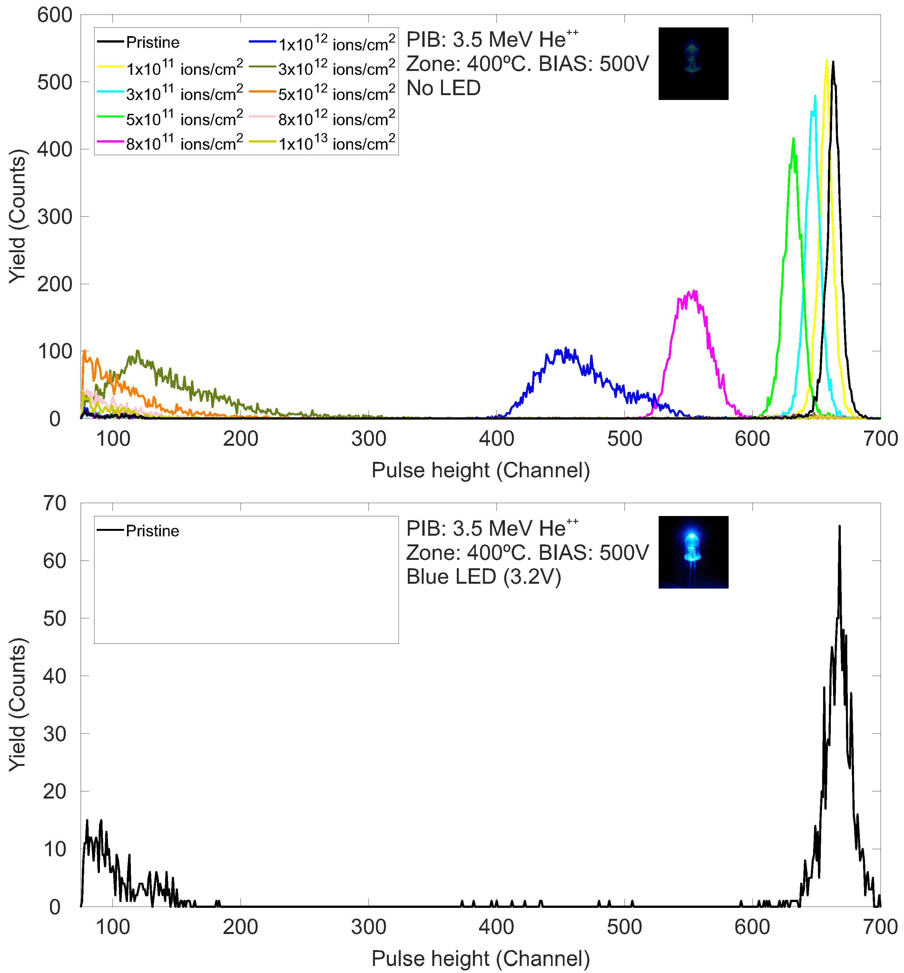
IBIC USED TO ASSESS POST-IRRADIATION RESPONSE AT ROOM TEMPERATURE
LED ON
ID-90
Slide 8/14
EuNPC2025

Slide 37
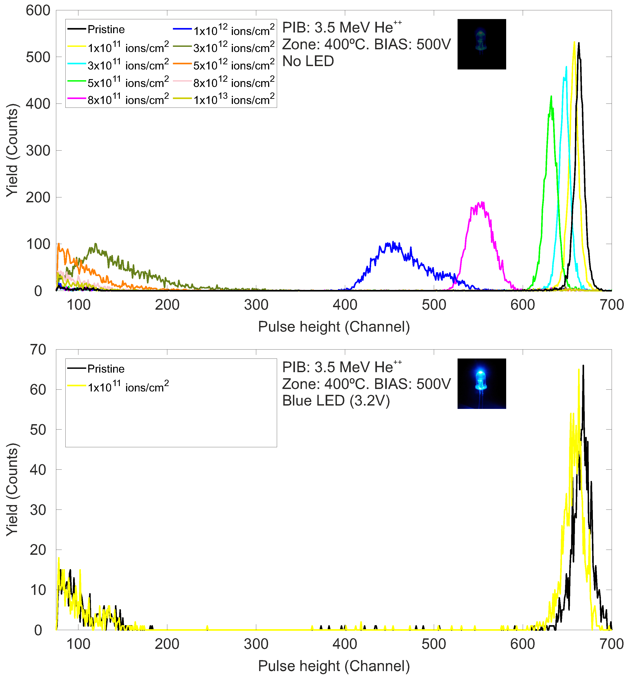
IBIC USED TO ASSESS POST-IRRADIATION RESPONSE AT ROOM TEMPERATURE
LED ON
ID-90
Slide 8/14
EuNPC2025

Slide 38
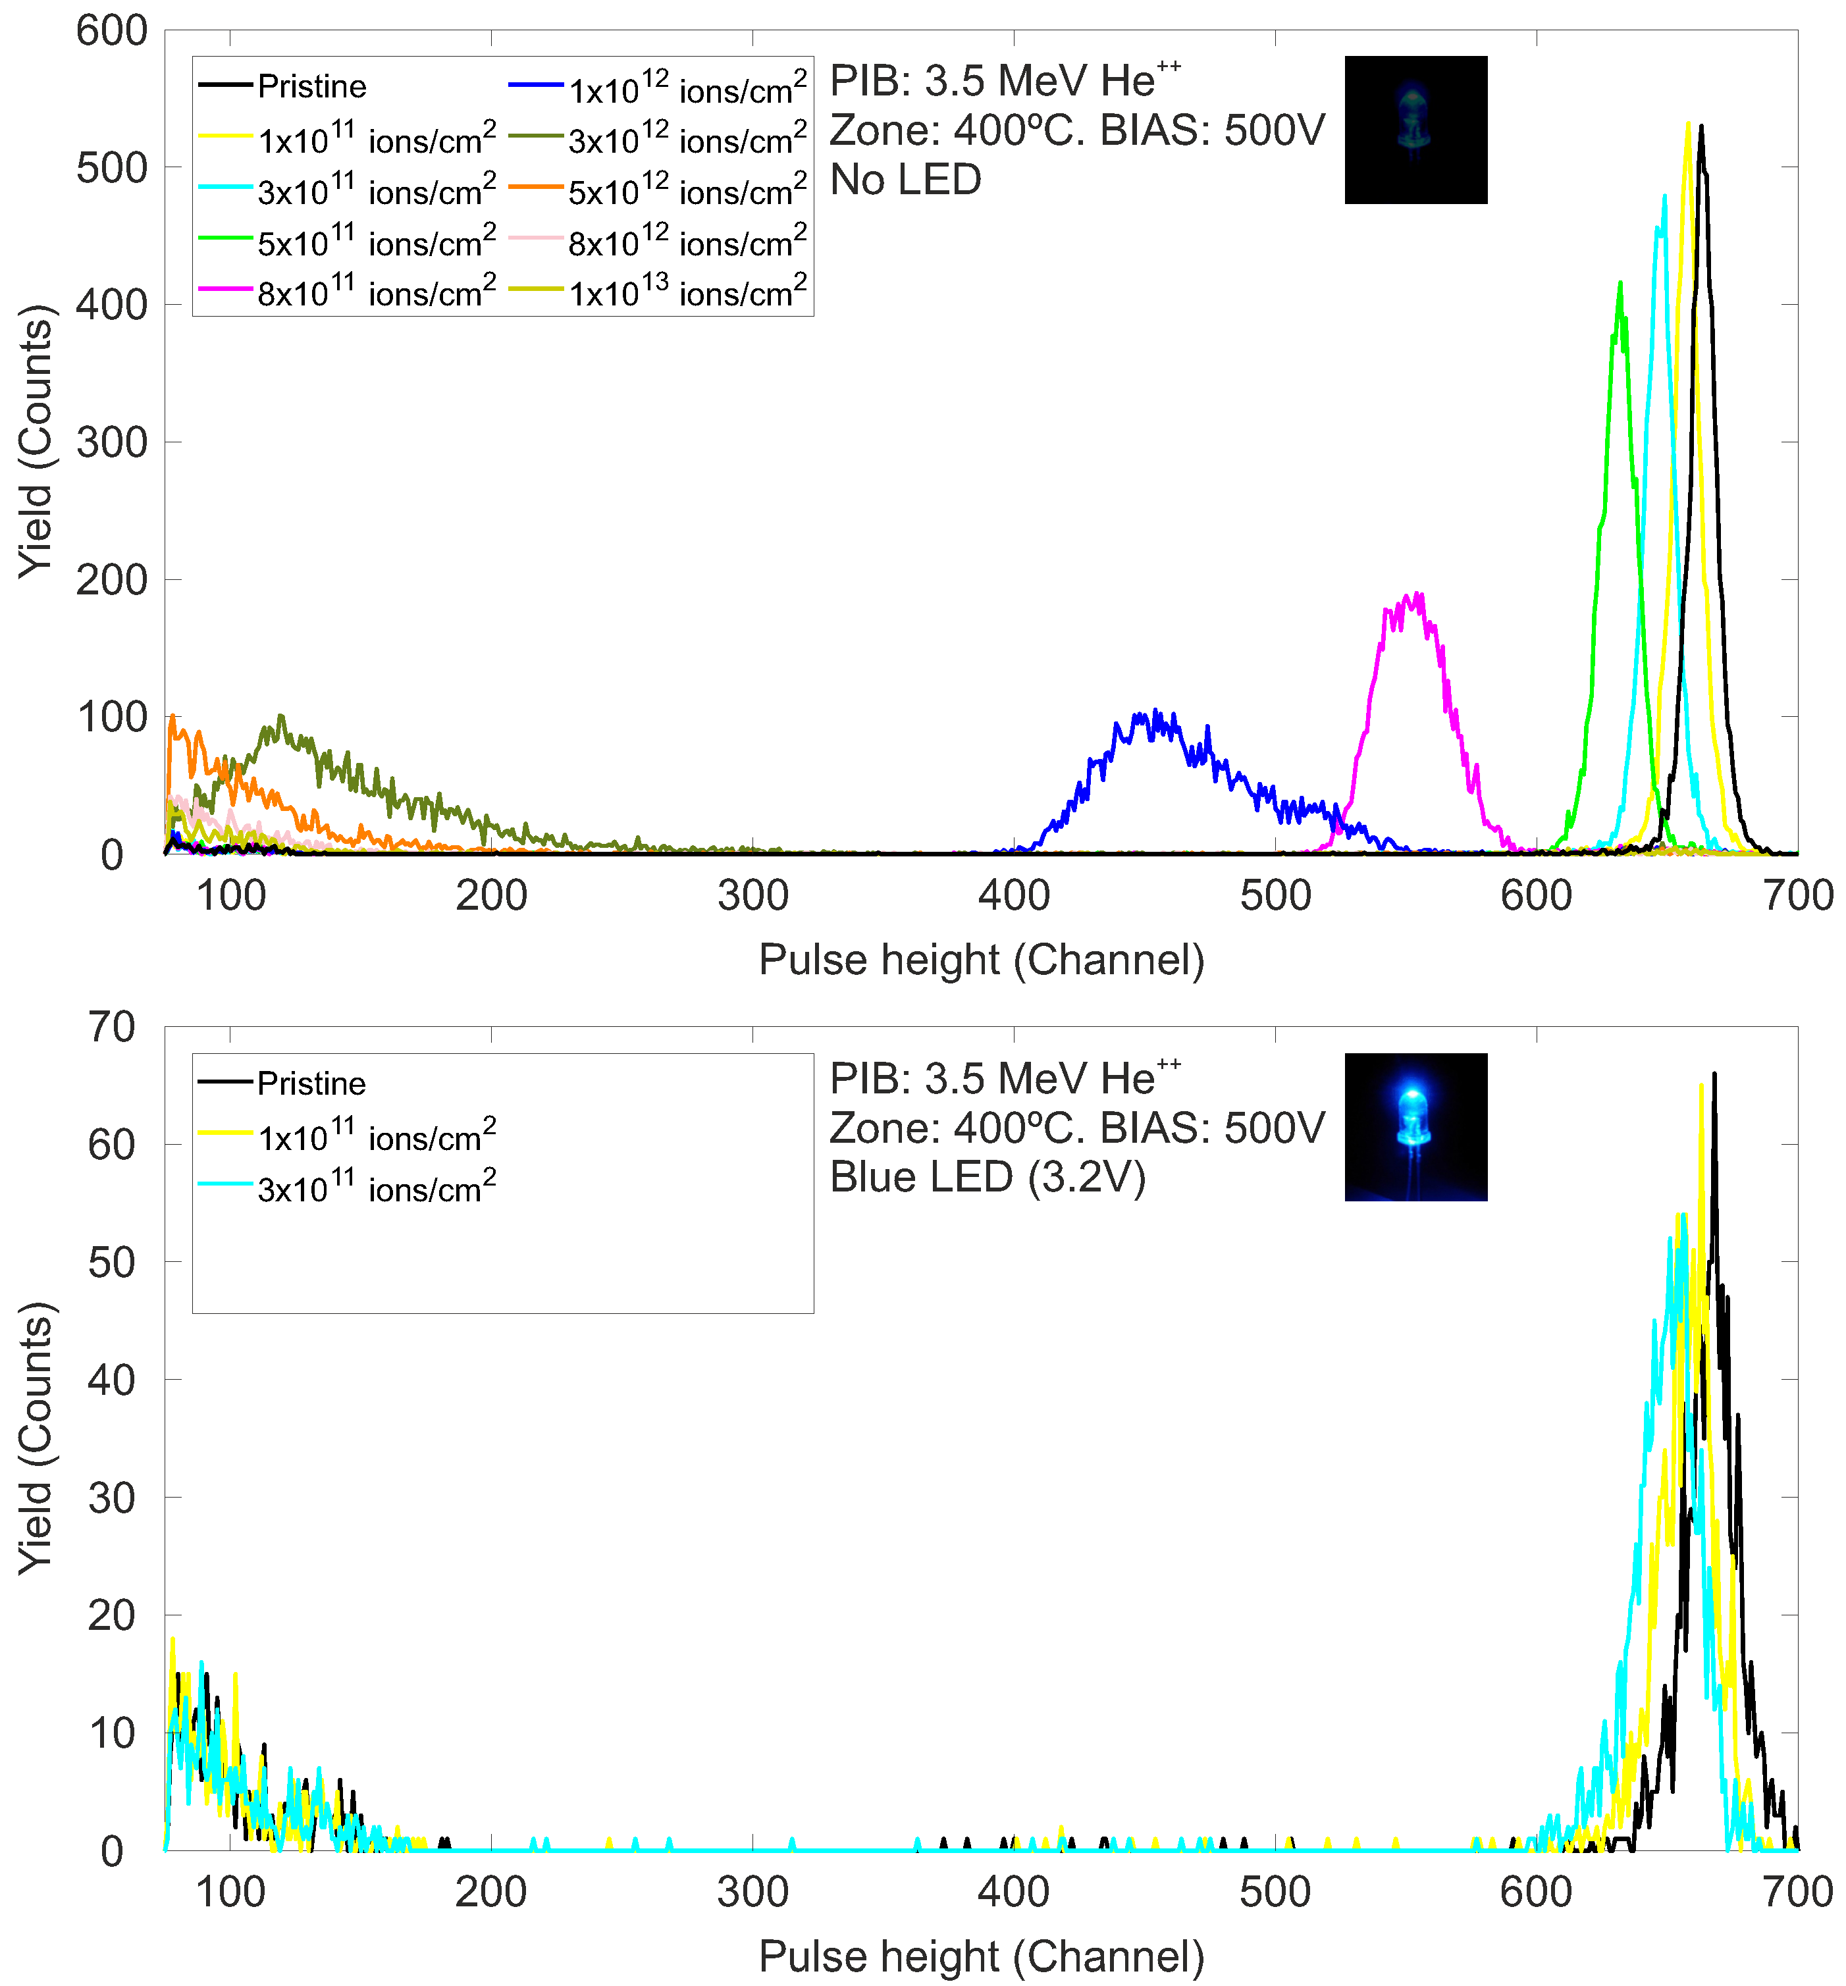
IBIC USED TO ASSESS POST-IRRADIATION RESPONSE AT ROOM TEMPERATURE
LED ON
No significant effect of light on CCE observed in regions with low damage levels...
ID-90
Slide 8/14
EuNPC2025

Slide 39
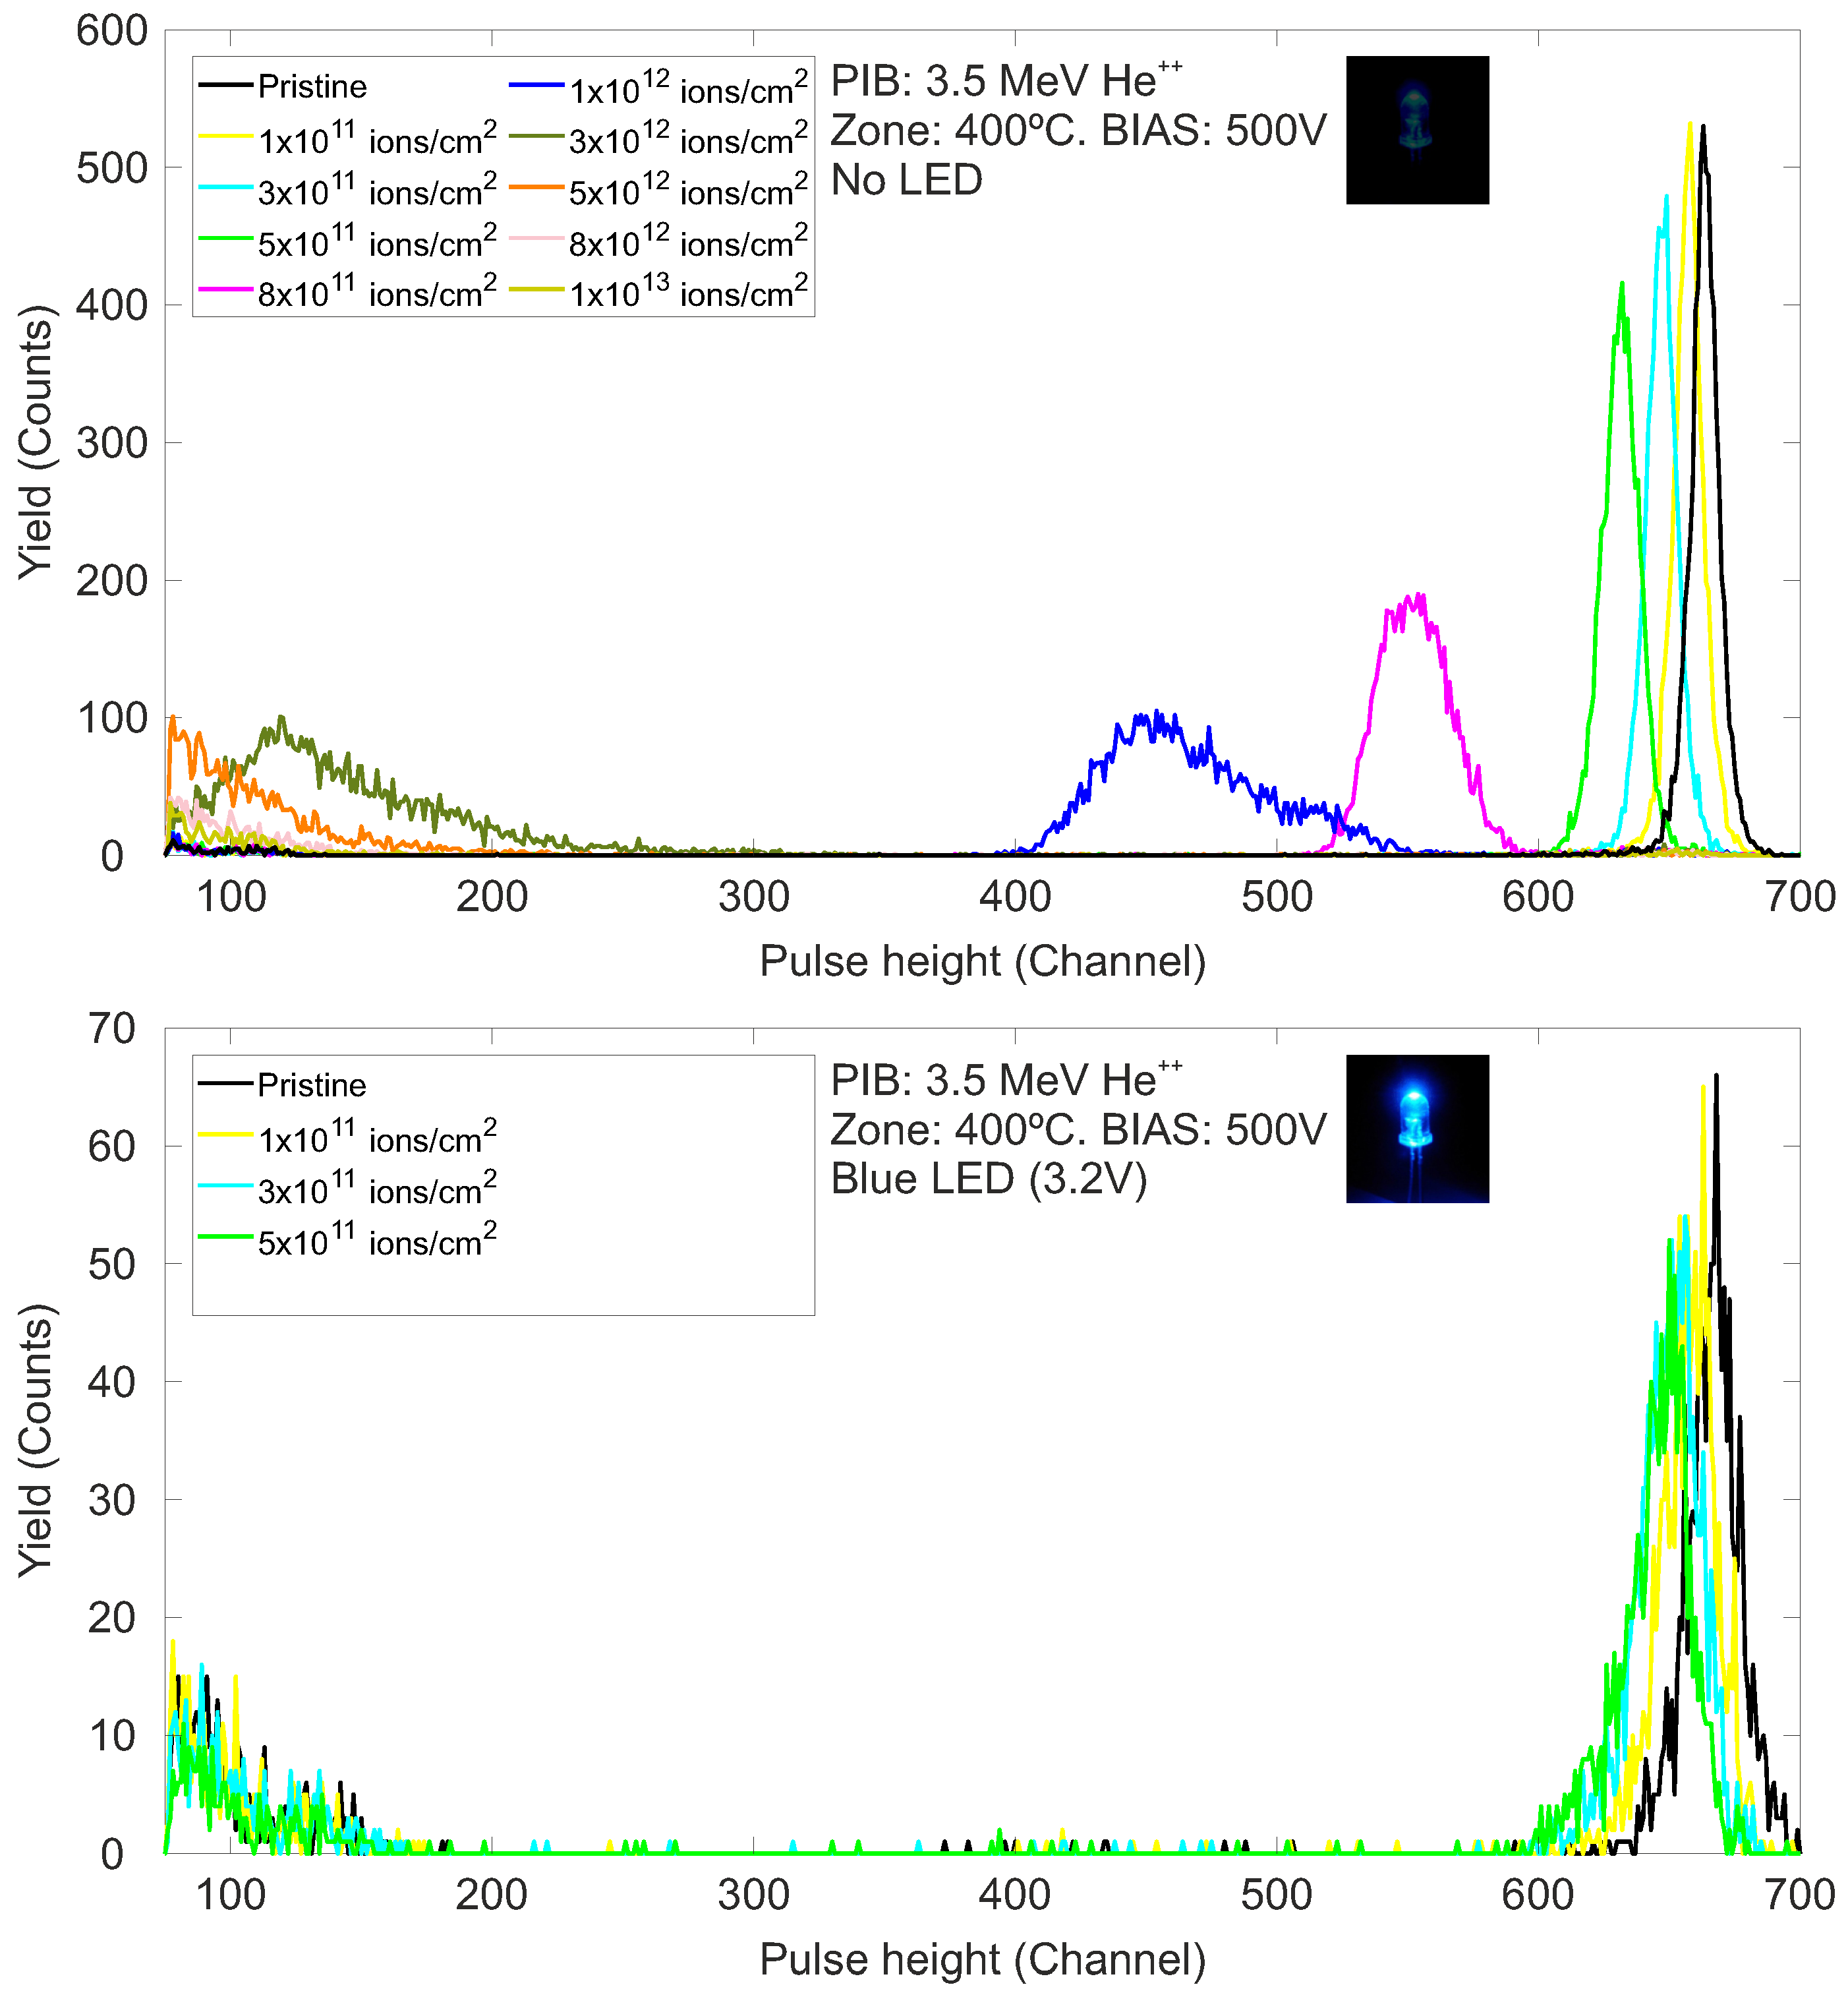
IBIC USED TO ASSESS POST-IRRADIATION RESPONSE AT ROOM TEMPERATURE
LED ON
... But small CCE enhancements start to appear.
ID-90
Slide 8/14
EuNPC2025

Slide 40
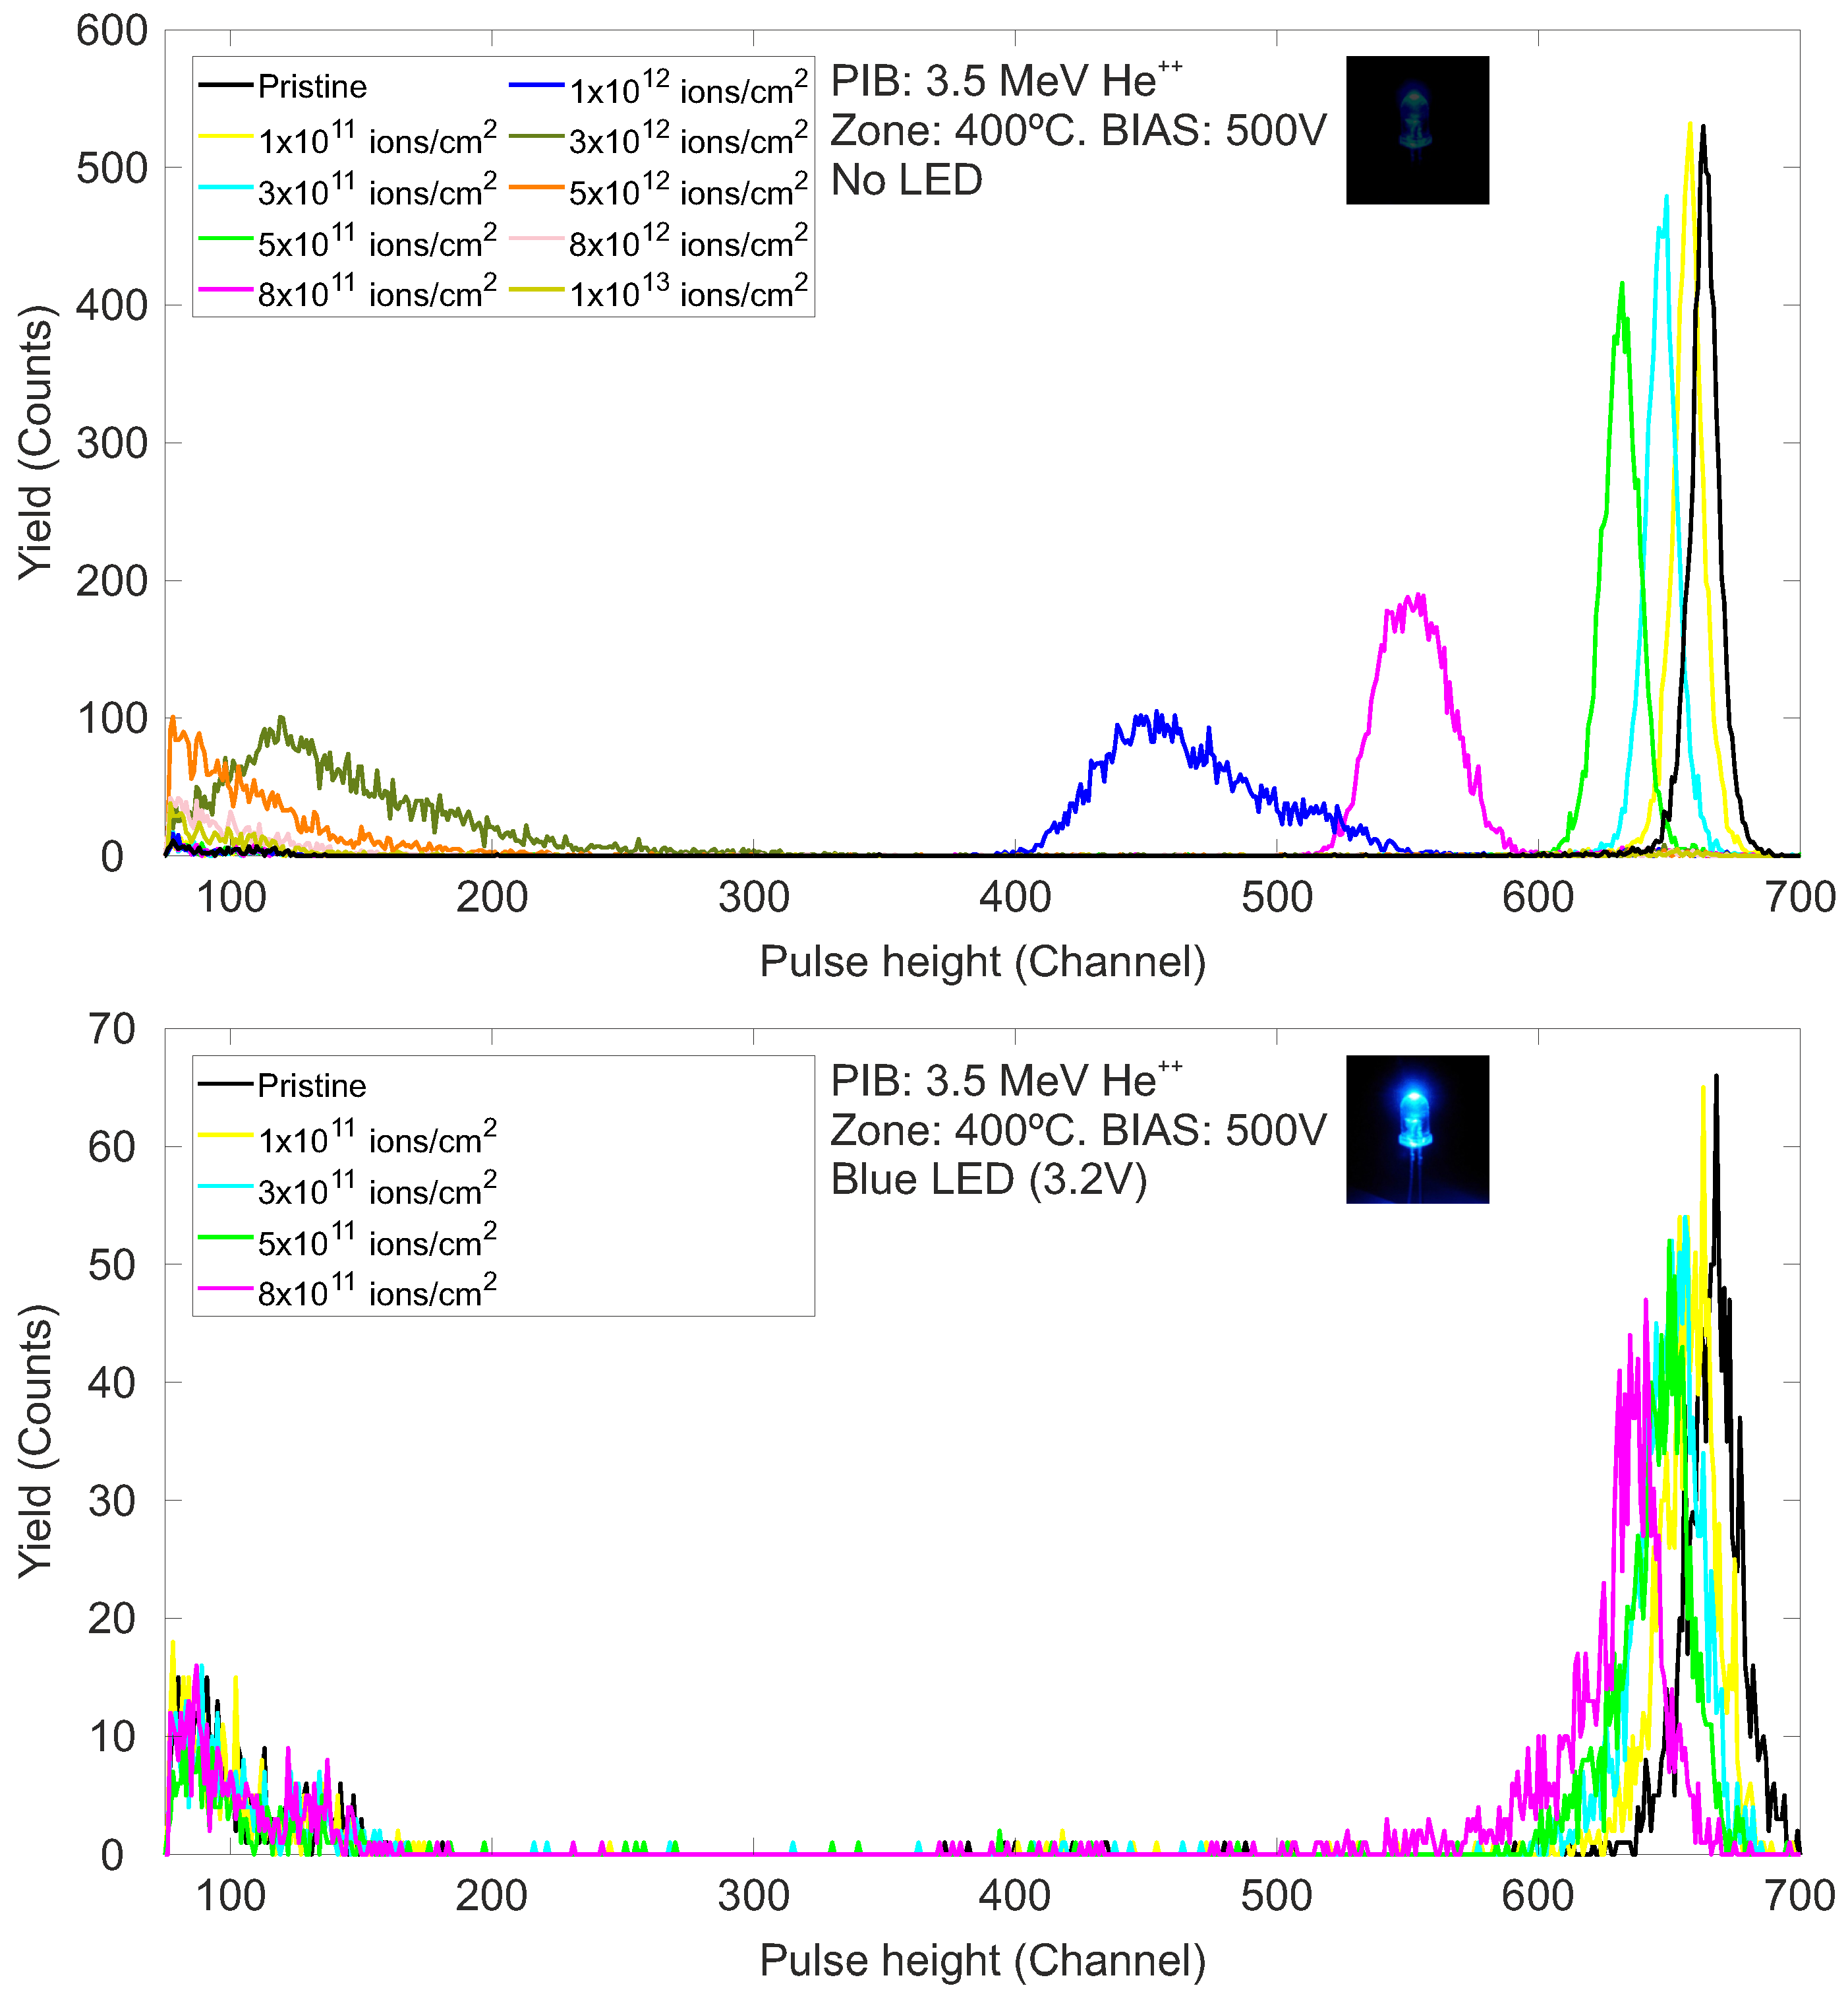
IBIC USED TO ASSESS POST-IRRADIATION RESPONSE AT ROOM TEMPERATURE
LED ON
ID-90
Slide 8/14
EuNPC2025

Slide 41
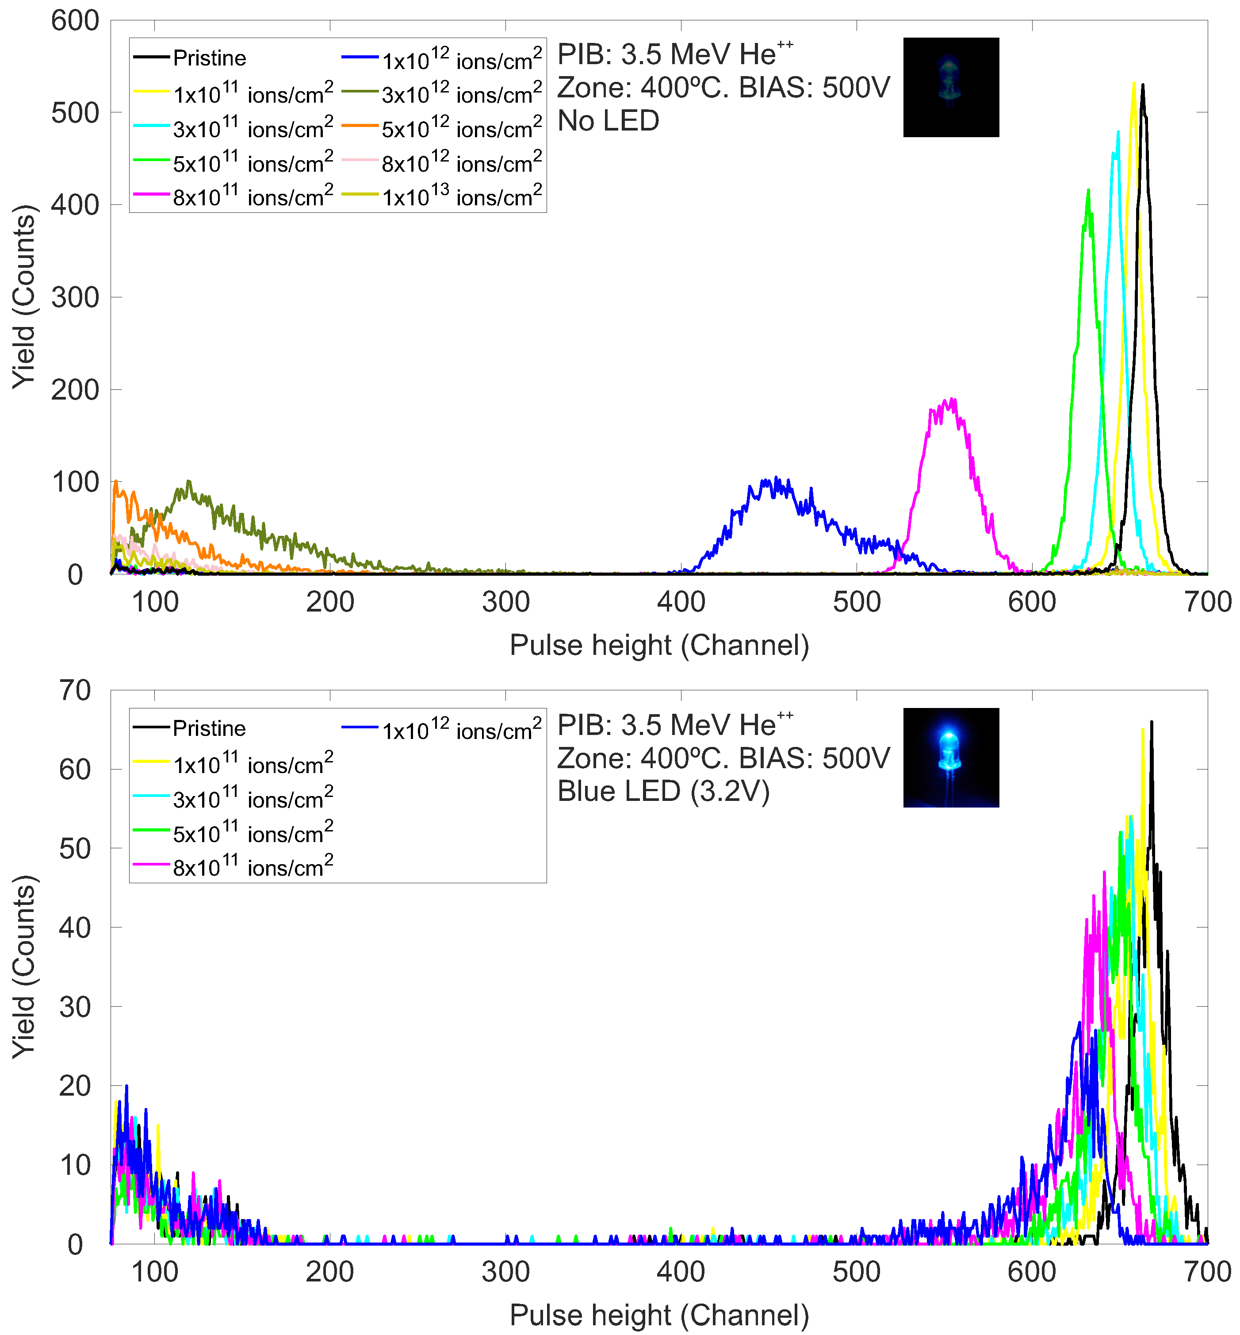
IBIC USED TO ASSESS POST-IRRADIATION RESPONSE AT ROOM TEMPERATURE
LED ON
ID-90
Slide 8/14
EuNPC2025

Slide 42
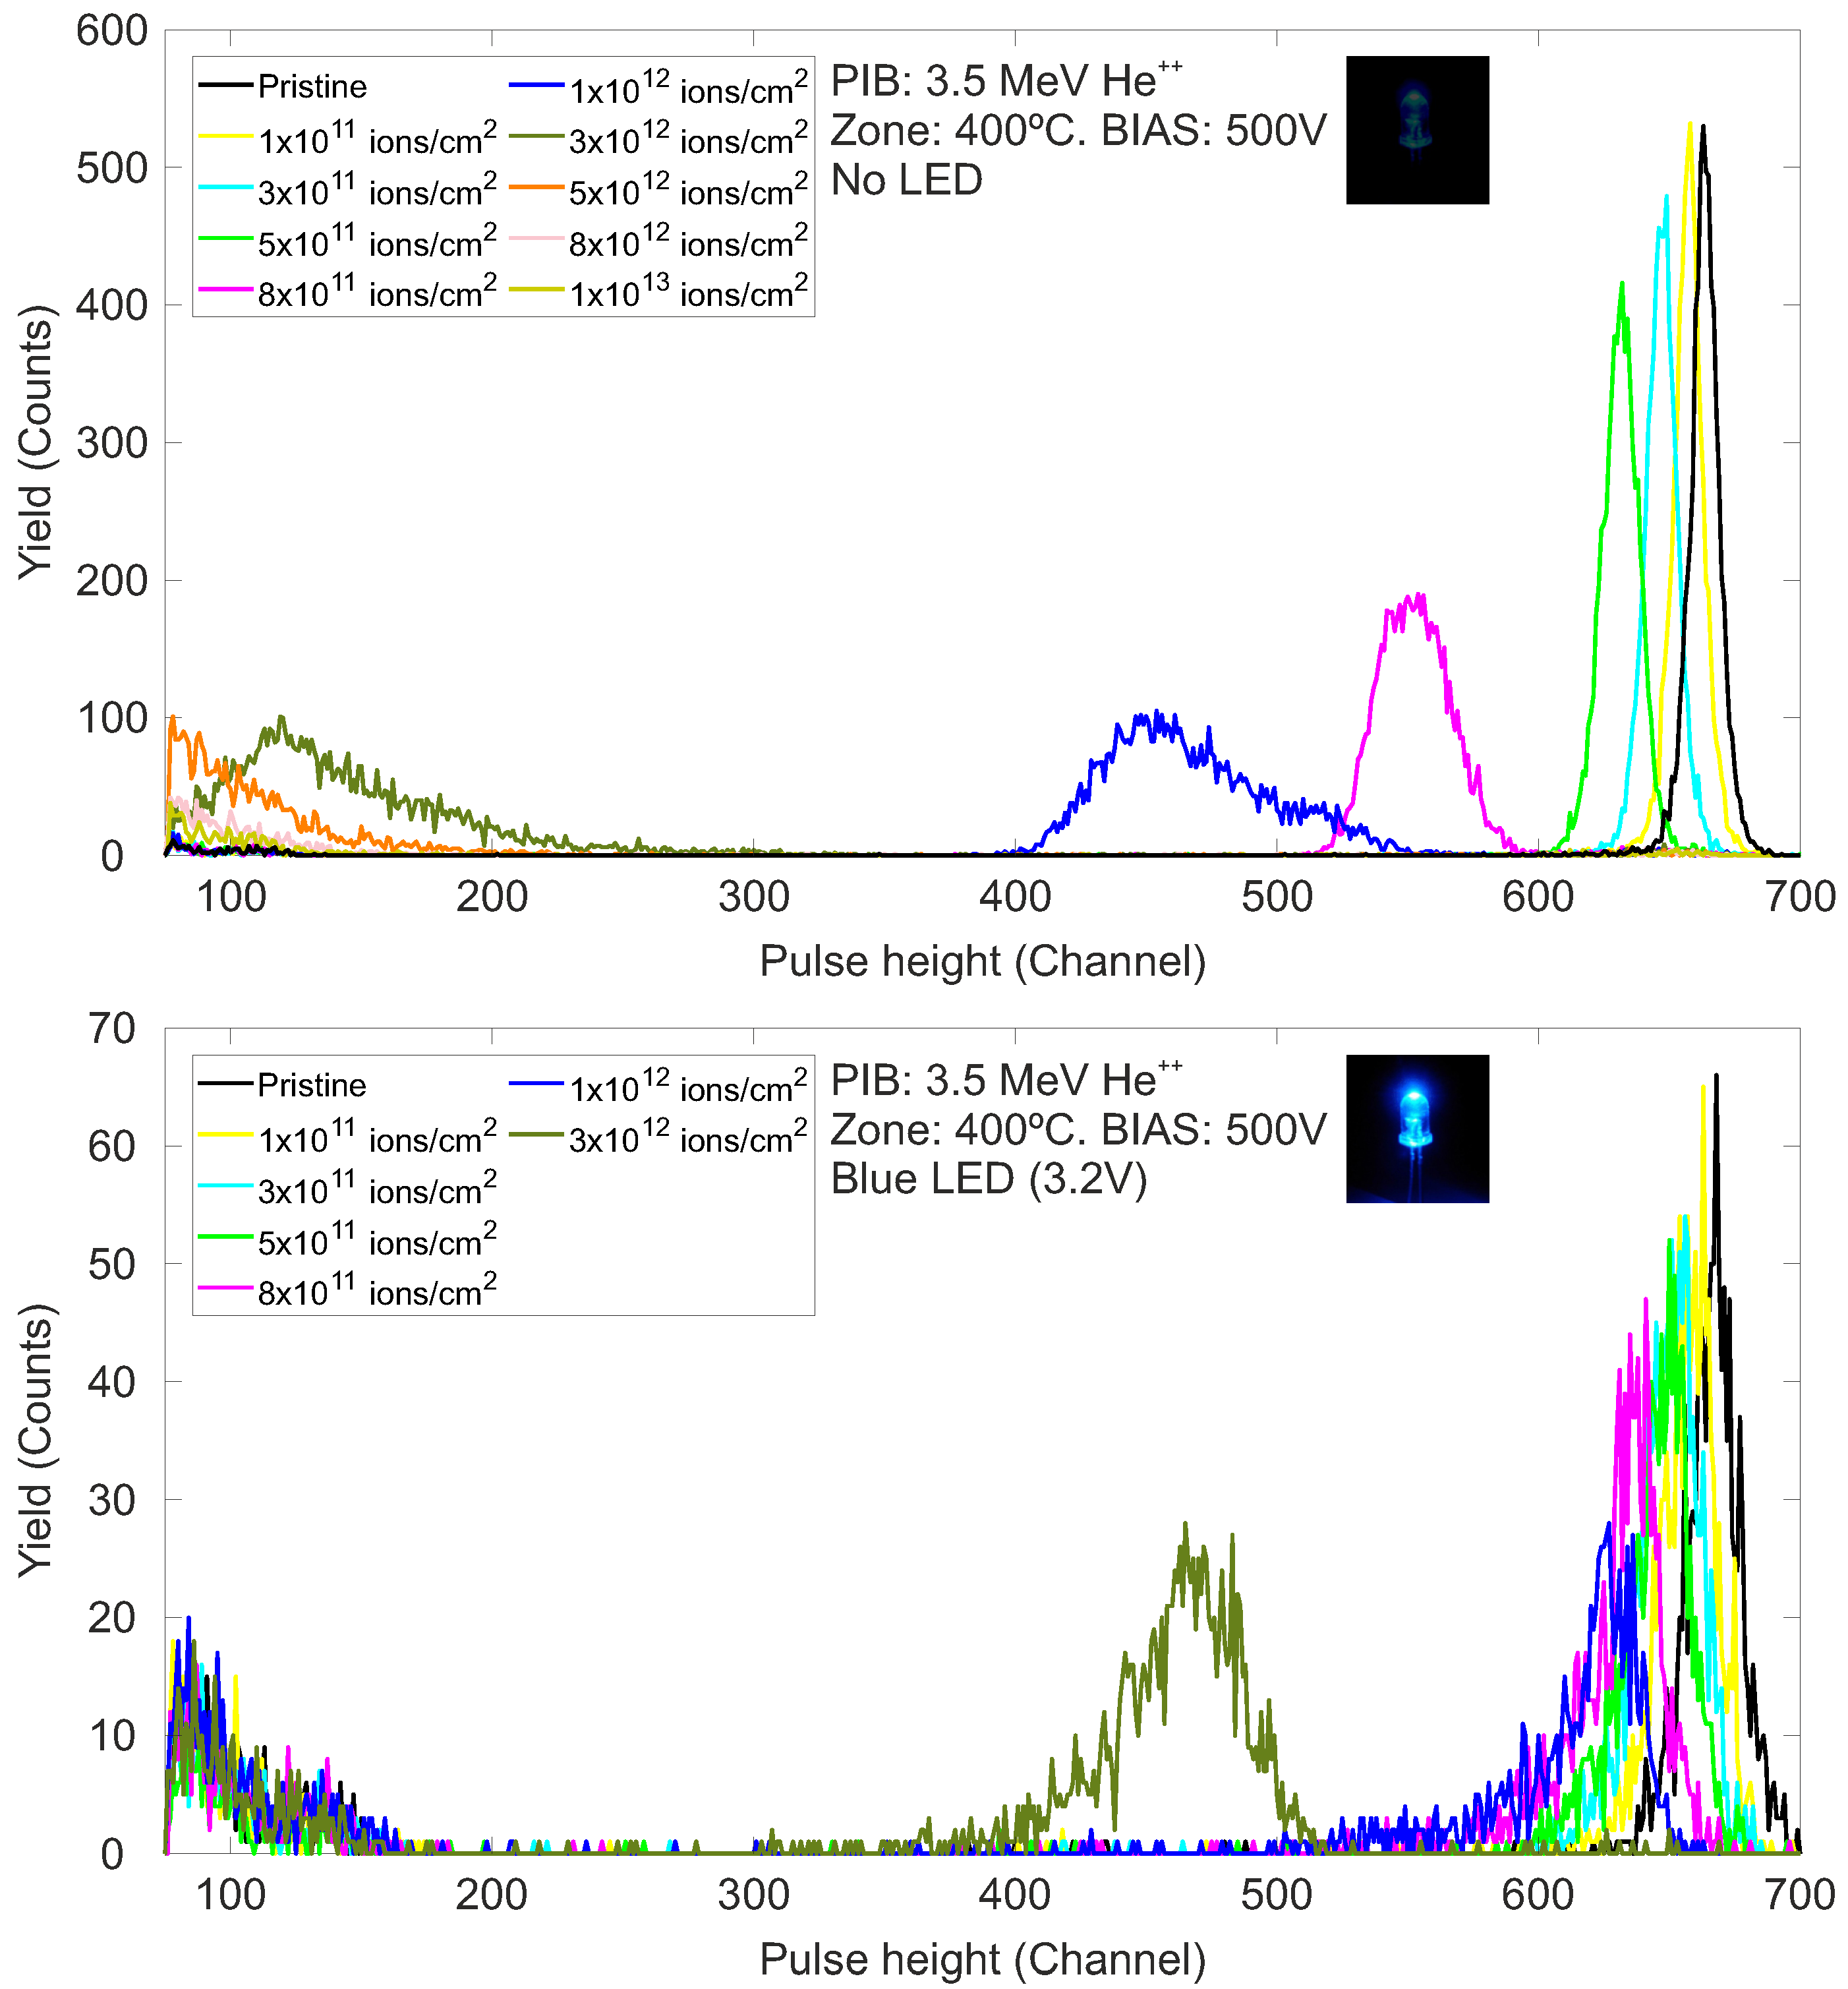
IBIC USED TO ASSESS POST-IRRADIATION RESPONSE AT ROOM TEMPERATURE
LED ON
Significant recovery of the signal respect to the measurement without light.
ID-90
Slide 8/14
EuNPC2025

Slide 43
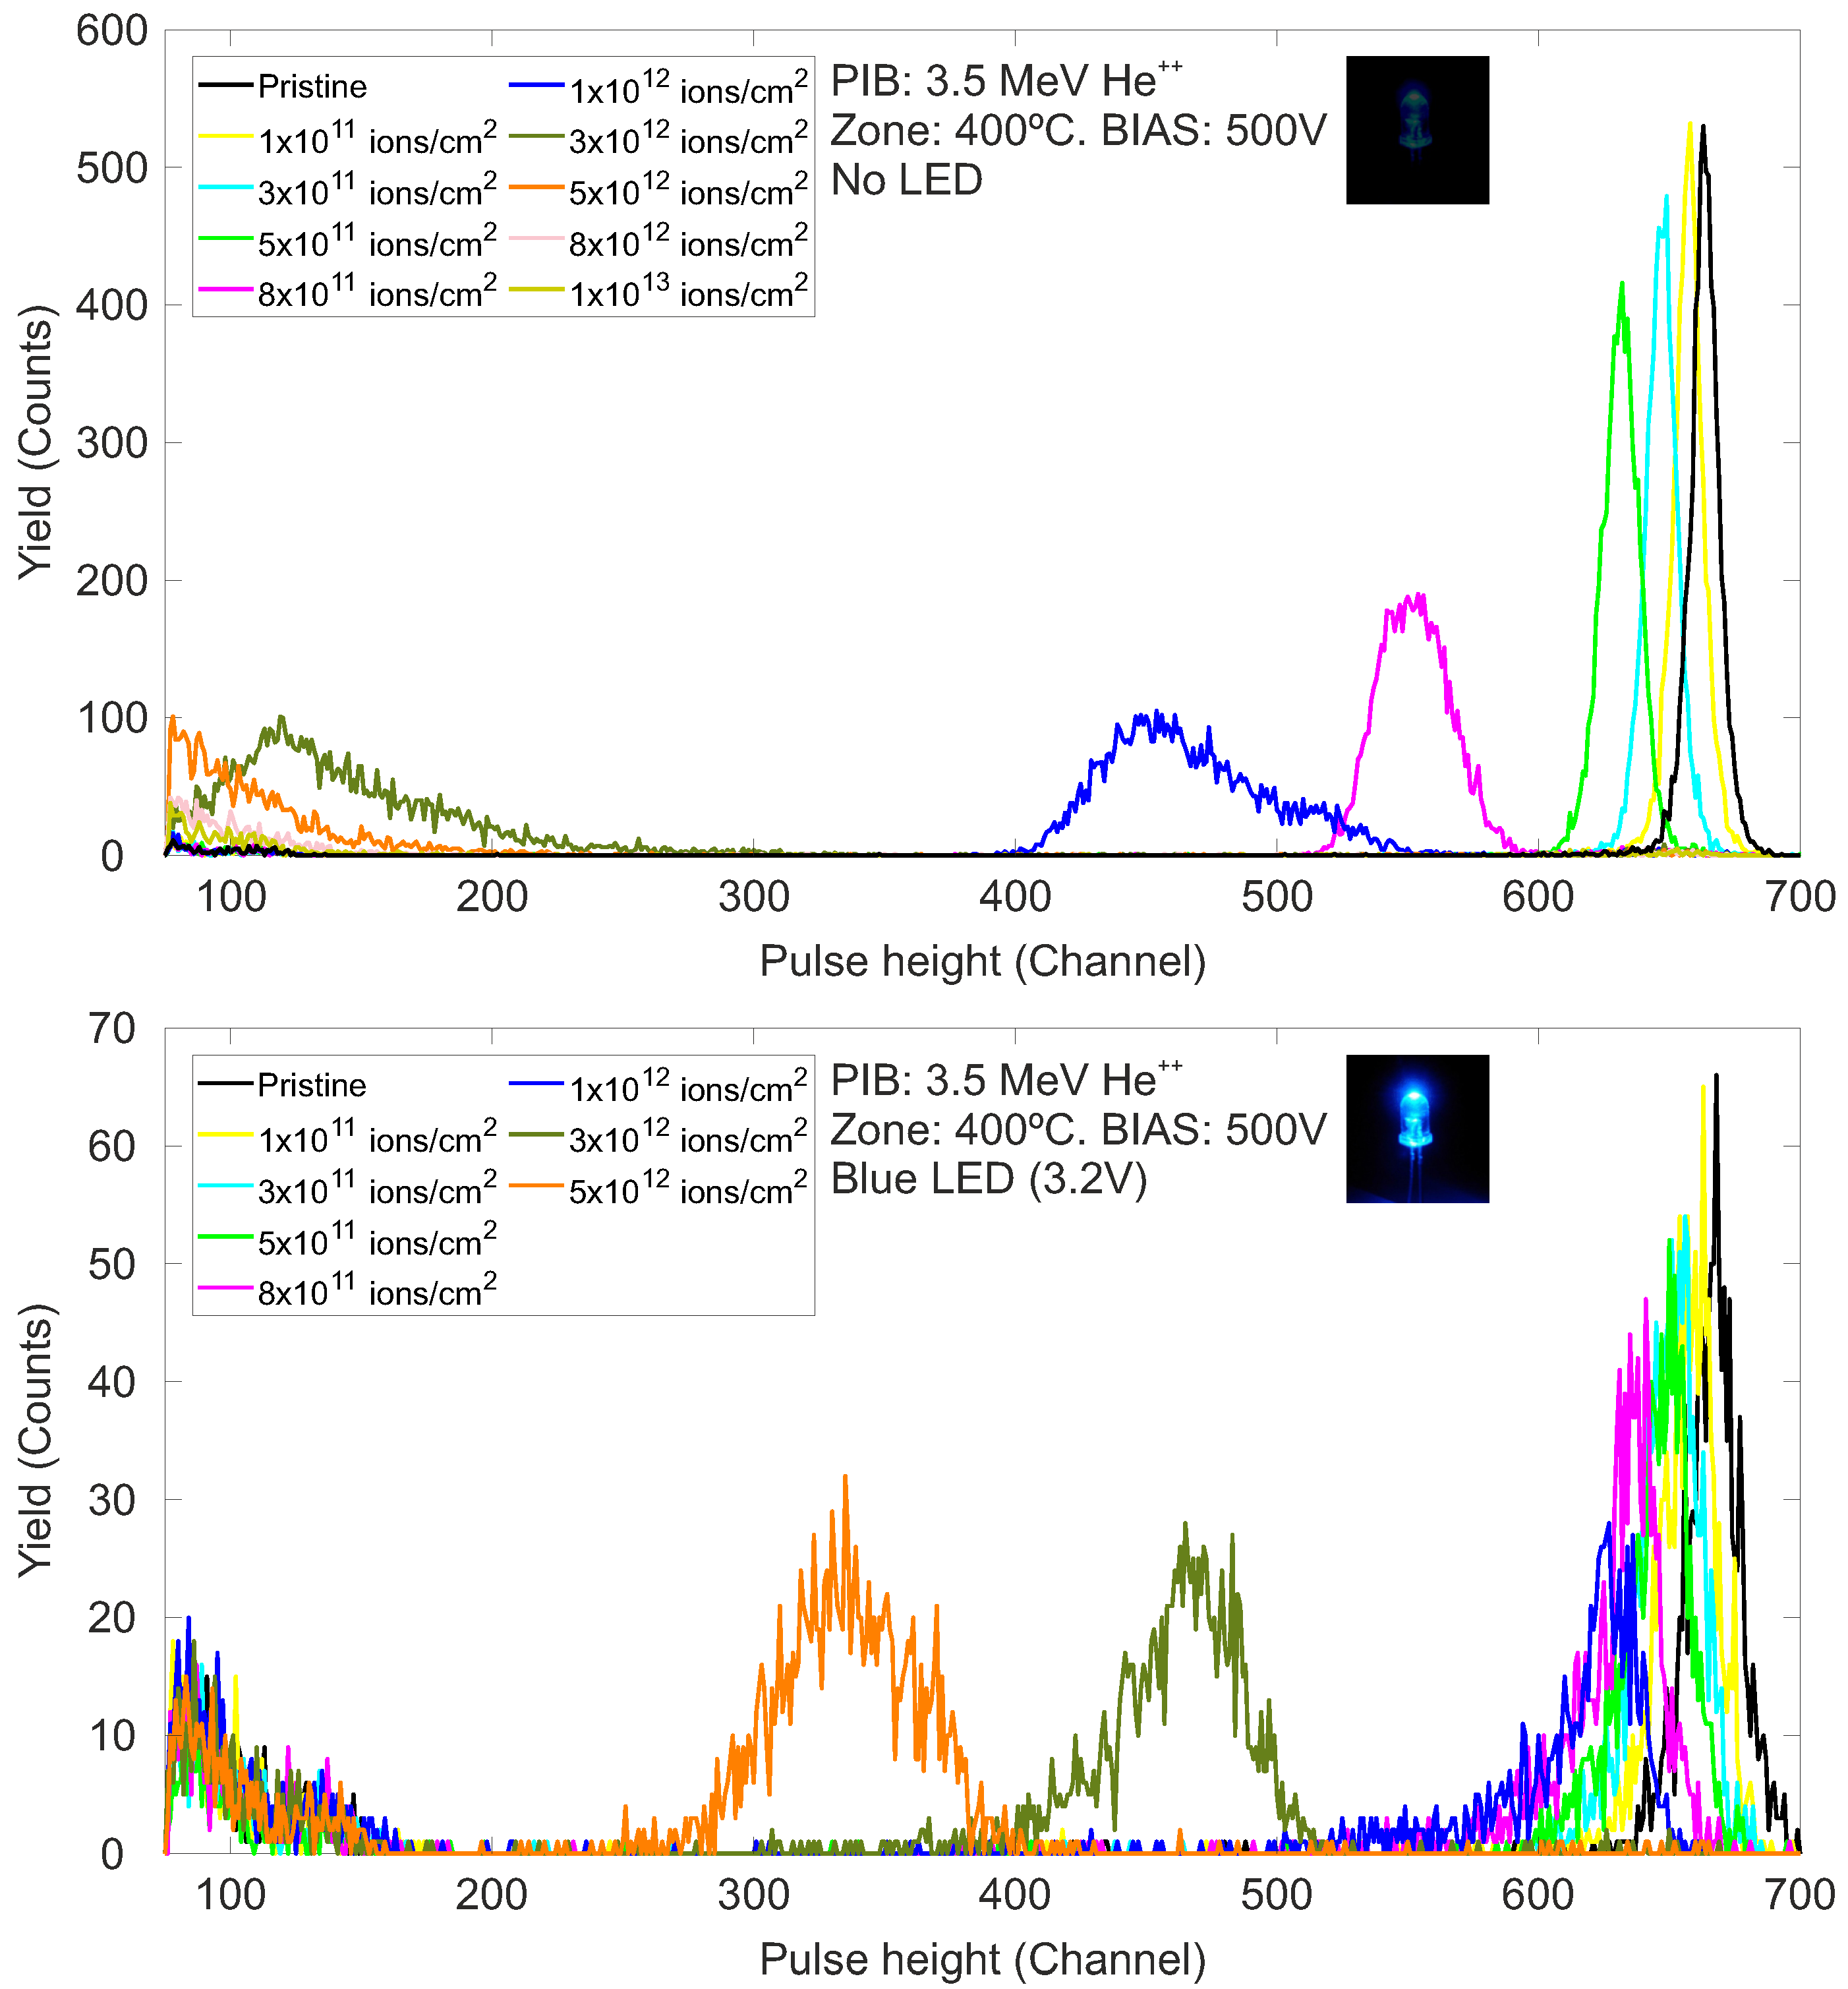
IBIC USED TO ASSESS POST-IRRADIATION RESPONSE AT ROOM TEMPERATURE
LED ON
The three previously inaccessible regions are now accessible due to strong CCE enhancements.
ID-90
Slide 8/14
EuNPC2025

Slide 44

IBIC USED TO ASSESS POST-IRRADIATION RESPONSE AT ROOM TEMPERATURE
LED ON
The three previously inaccessible regions are now accessible due to strong CCE enhancements.
ID-90
Slide 8/14
EuNPC2025

Slide 45
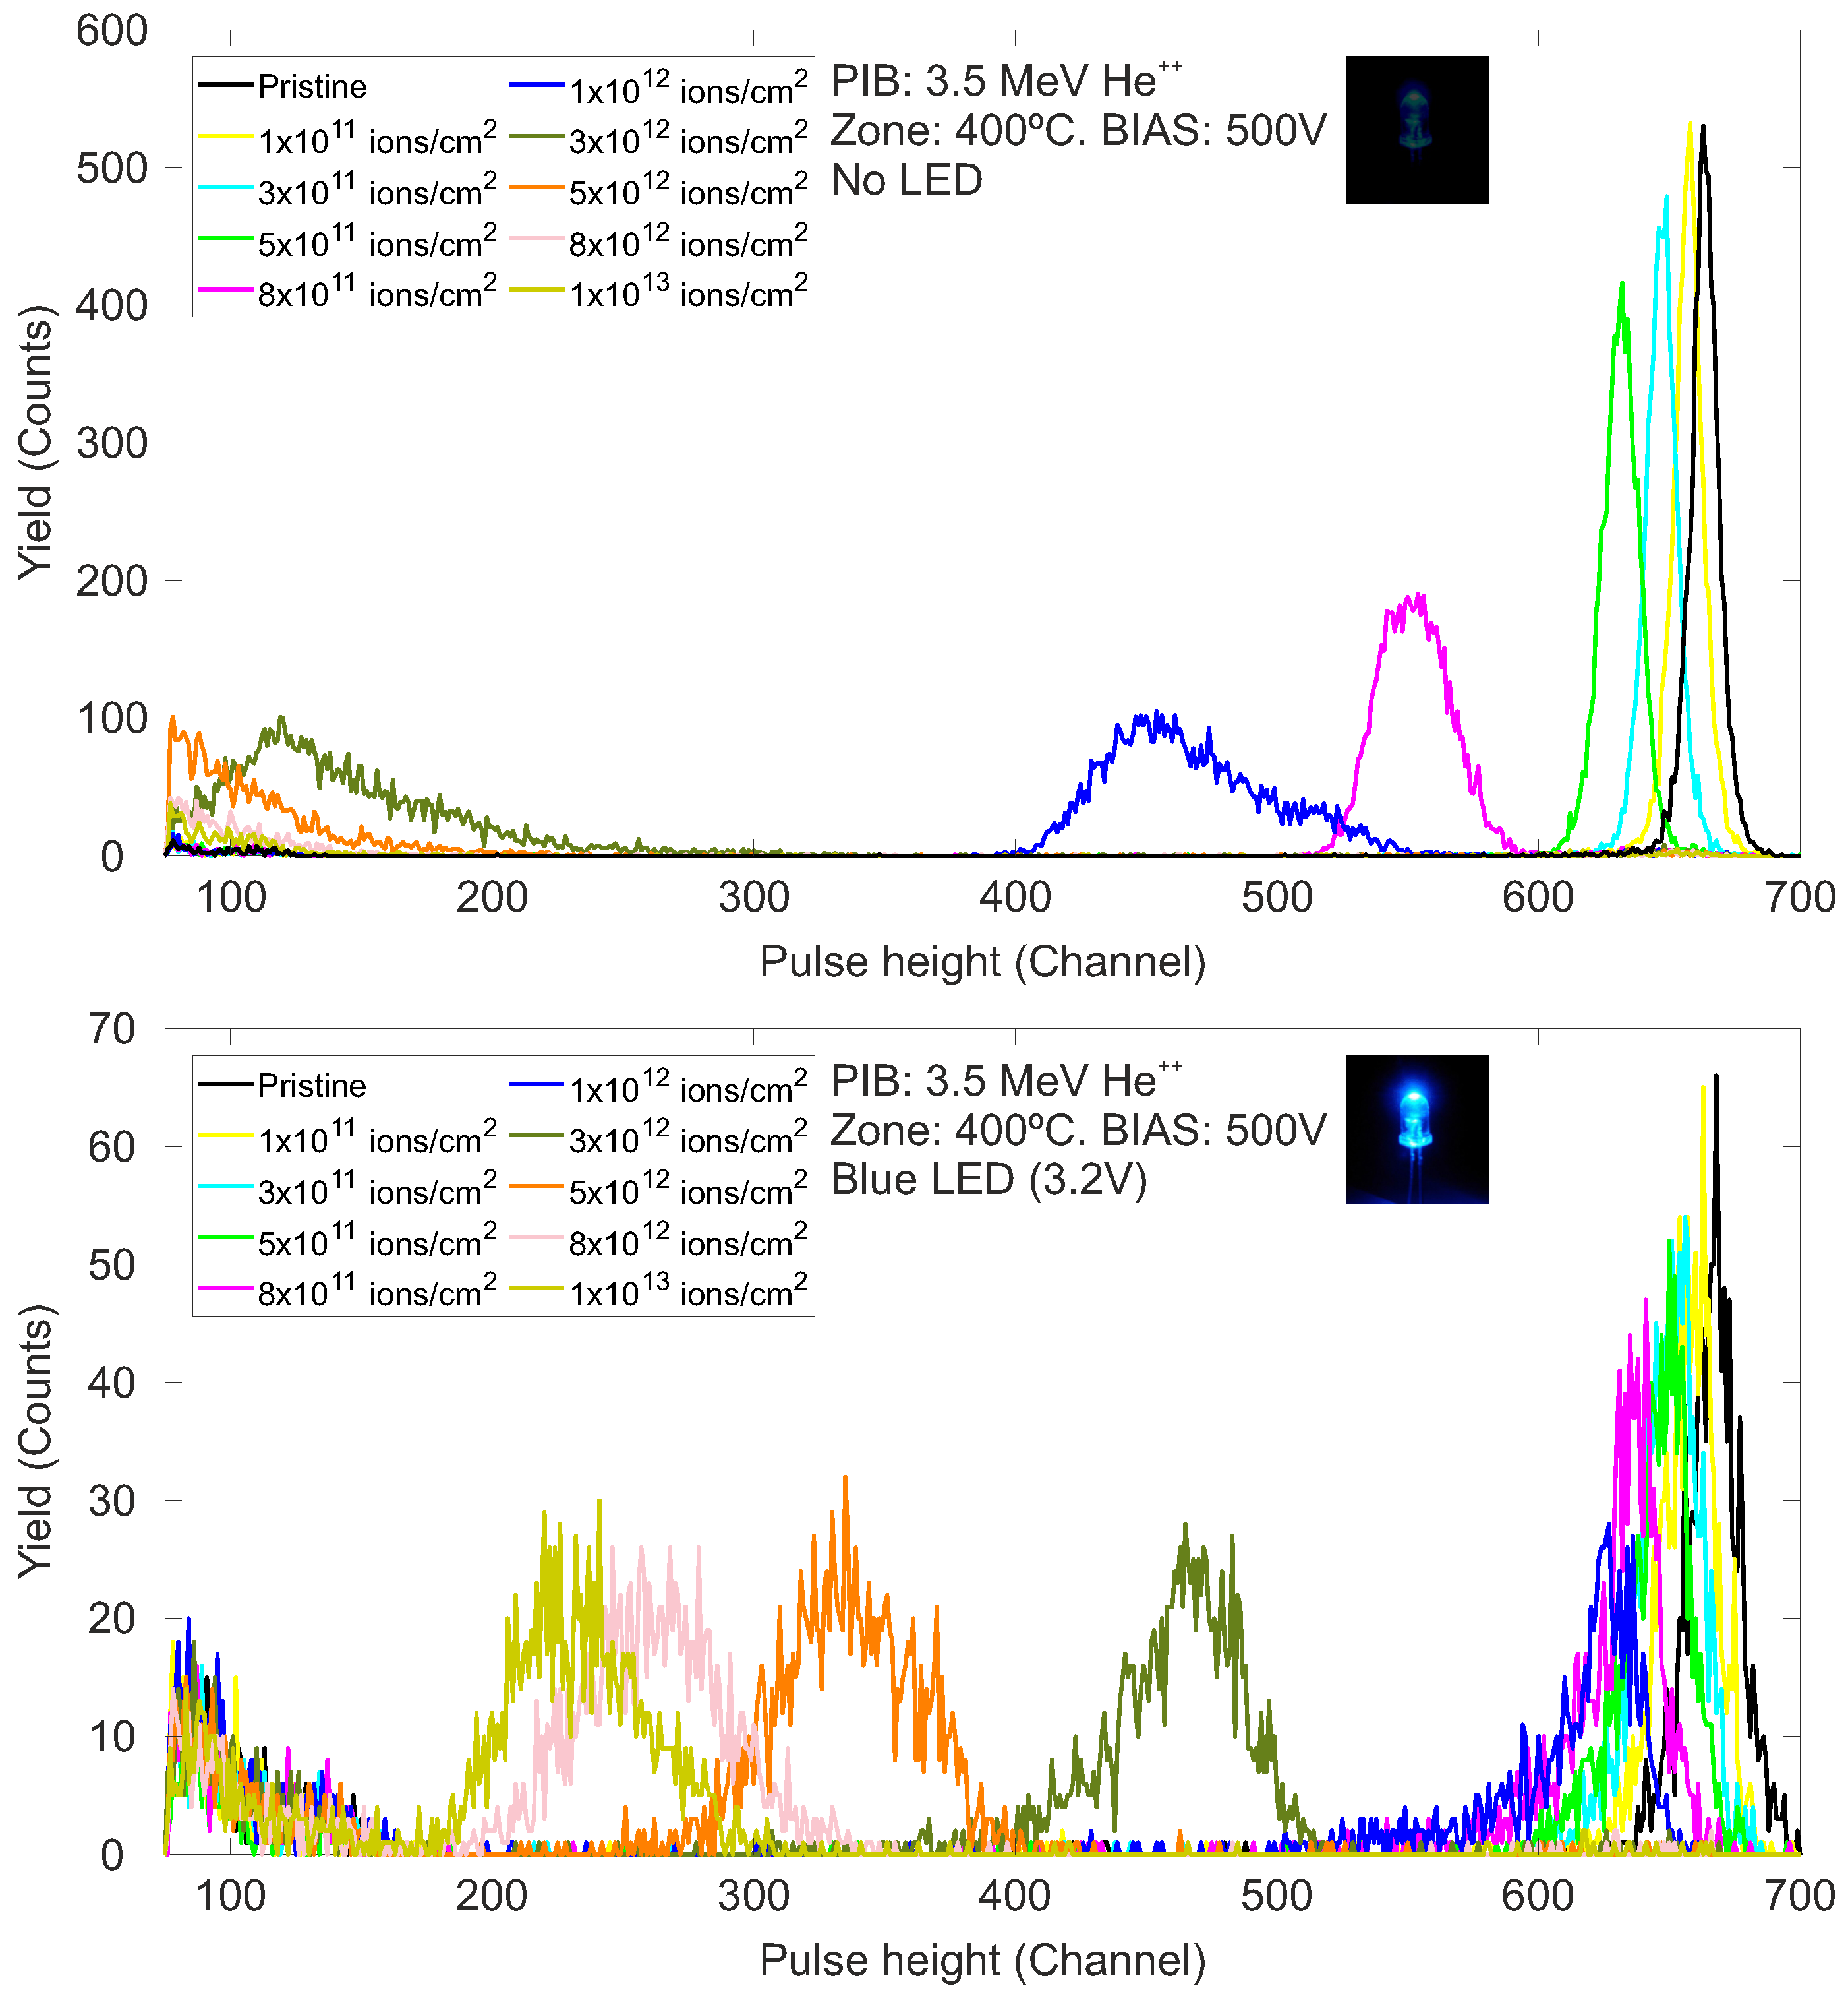
IBIC USED TO ASSESS POST-IRRADIATION RESPONSE AT ROOM TEMPERATURE
LED ON
The three previously inaccessible regions are now accessible due to strong CCE enhancements.
ID-90
Slide 8/14
EuNPC2025

Slide 46
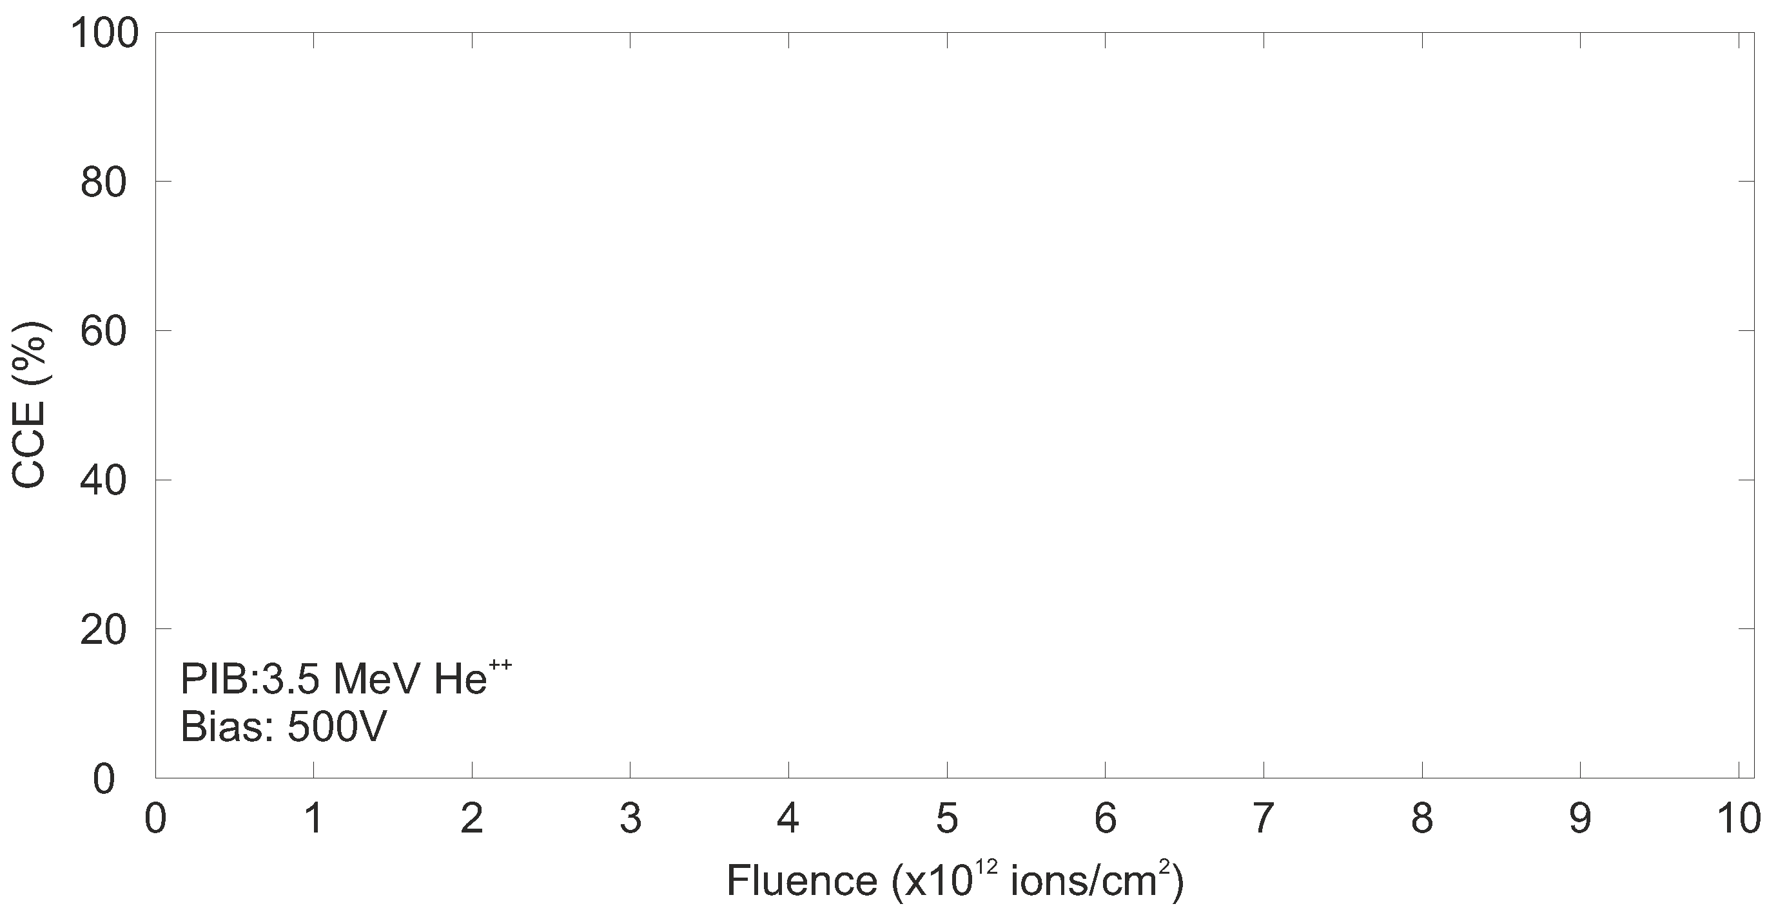
ILLUMINATION HAS A SIGNIFICANT EFFECT IN THE MOST DAMAGED REGIONS
ID-90
Slide 9/14
EuNPC2025

Slide 47
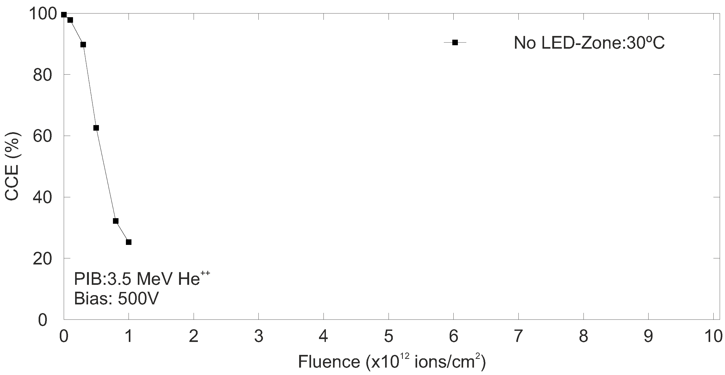
ILLUMINATION HAS A SIGNIFICANT EFFECT IN THE MOST DAMAGED REGIONS
• CCE drops as fluence increases, making some damaged regions inaccessible.
ID-90
Slide 9/14
EuNPC2025

Slide 48
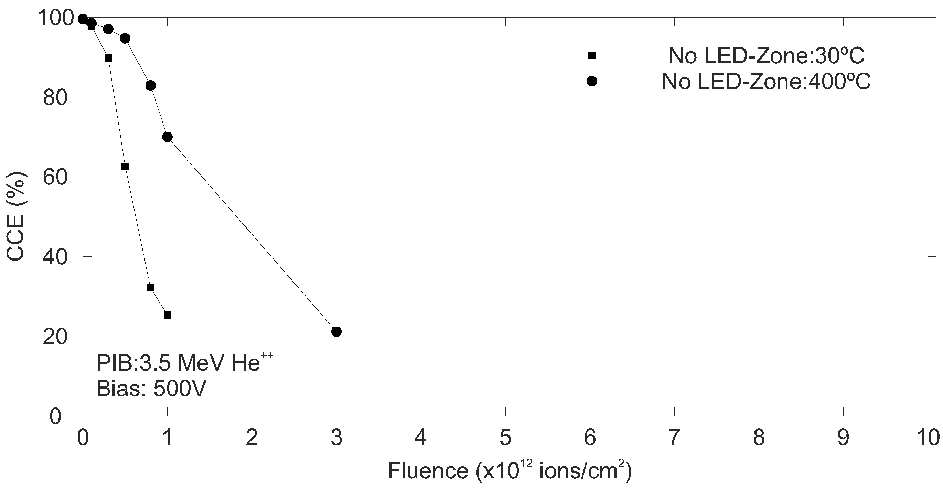
ILLUMINATION HAS A SIGNIFICANT EFFECT IN THE MOST DAMAGED REGIONS
• CCE drops as fluence increases, making some damaged regions inaccessible.
• CCE is significantly better preserved at higher irradiation temperatures due to dynamic annealing.
ID-90
Slide 9/14
EuNPC2025

Slide 49
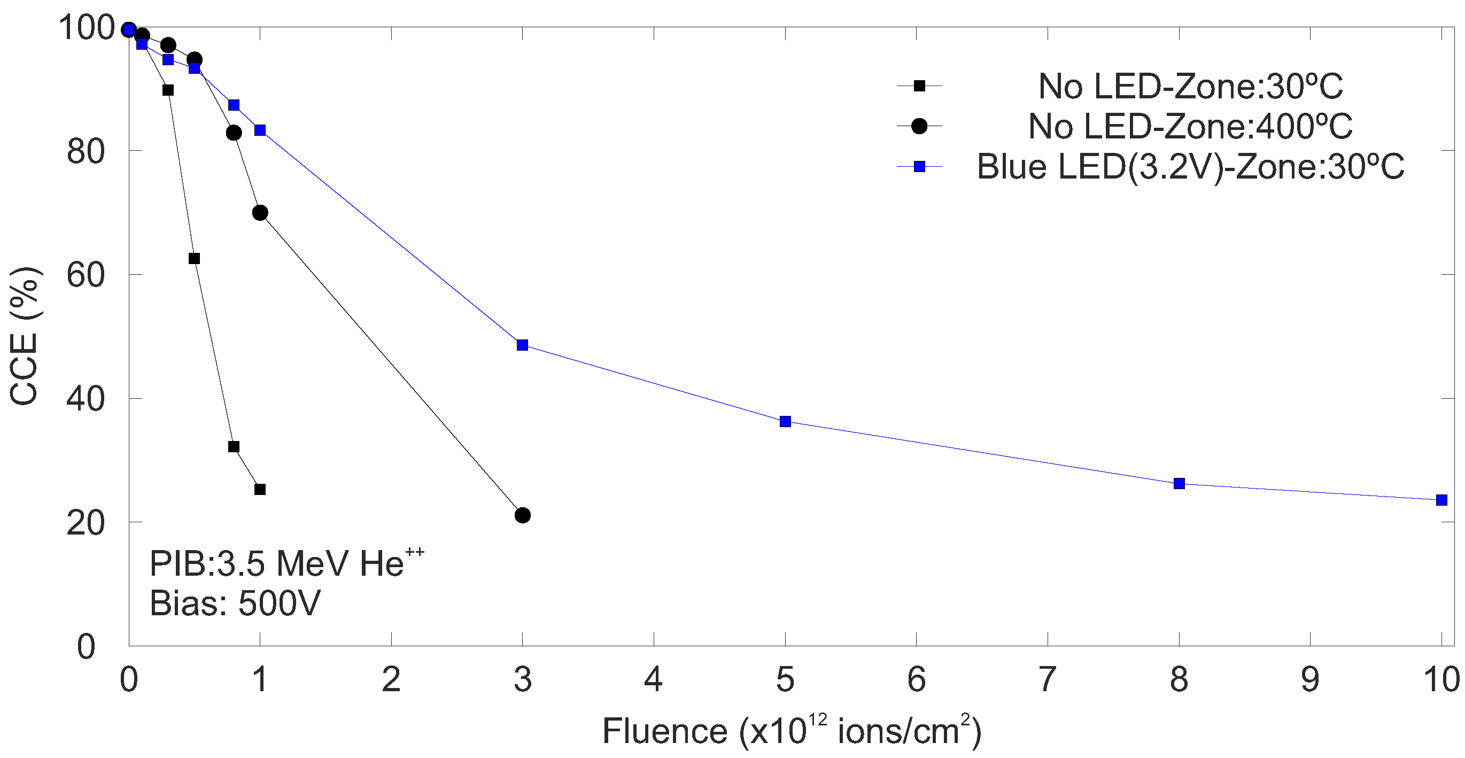
ILLUMINATION HAS A SIGNIFICANT EFFECT IN THE MOST DAMAGED REGIONS
Light significantly affects CCE in the most damaged regions, enabling measurement of regions otherwise inaccessible.
ID-90
Slide 9/14
EuNPC2025

Slide 50
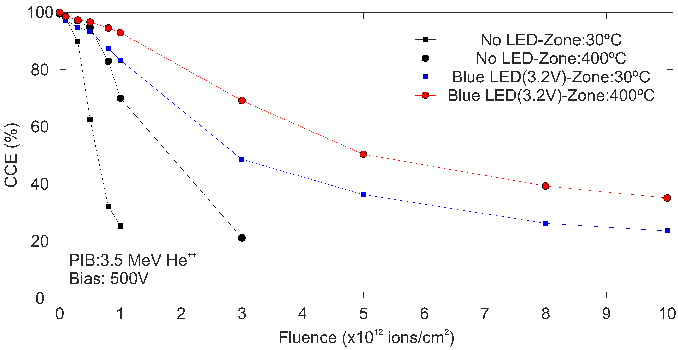
ILLUMINATION HAS A SIGNIFICANT EFFECT IN THE MOST DAMAGED REGIONS
This effect is more pronounced in regions damaged at high temperature.
ID-90
Slide 9/14
EuNPC2025

Slide 51
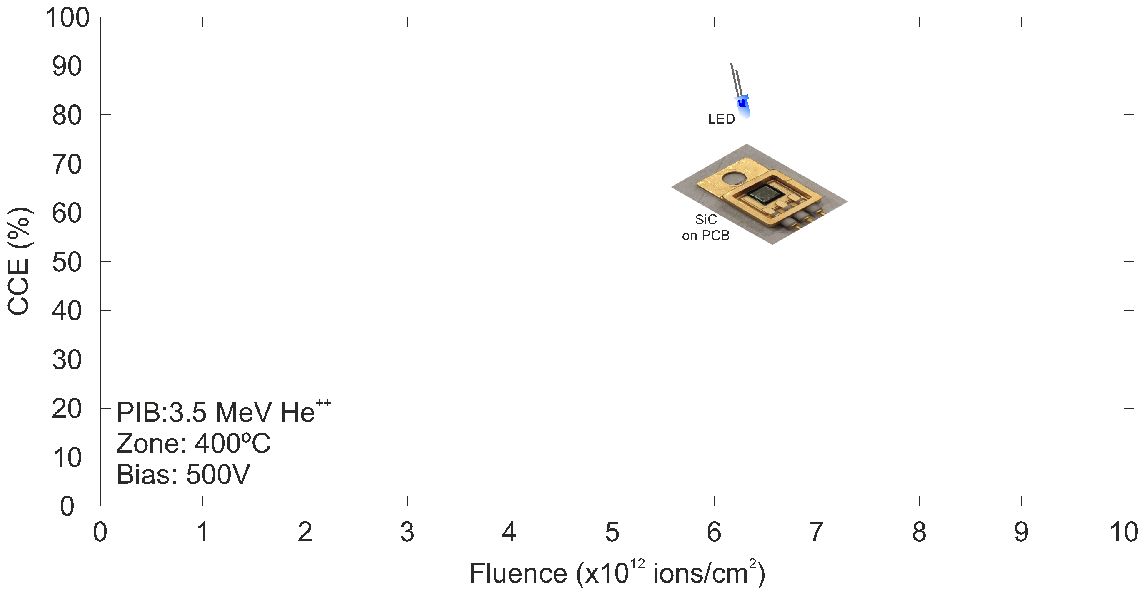
STUDY OF THE EFFECT OF PHOTON RATE ON CCE
ID-90
Slide 10/14
EuNPC2025

Slide 52
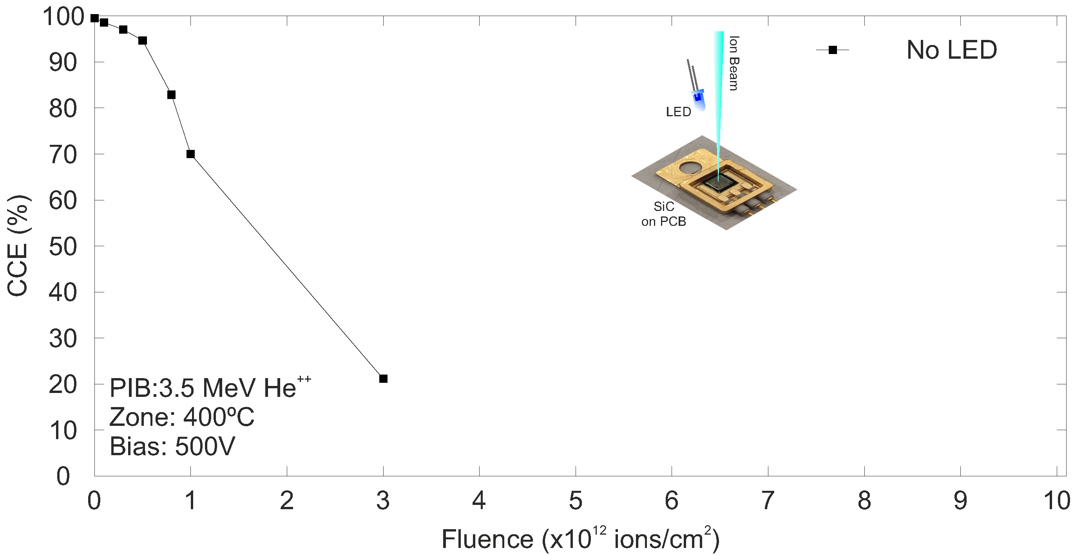
STUDY OF THE EFFECT OF PHOTON RATE ON CCE
• CCE drops as fluence increases, making some damaged regions inaccessible.
ID-90
Slide 10/14
EuNPC2025

Slide 53
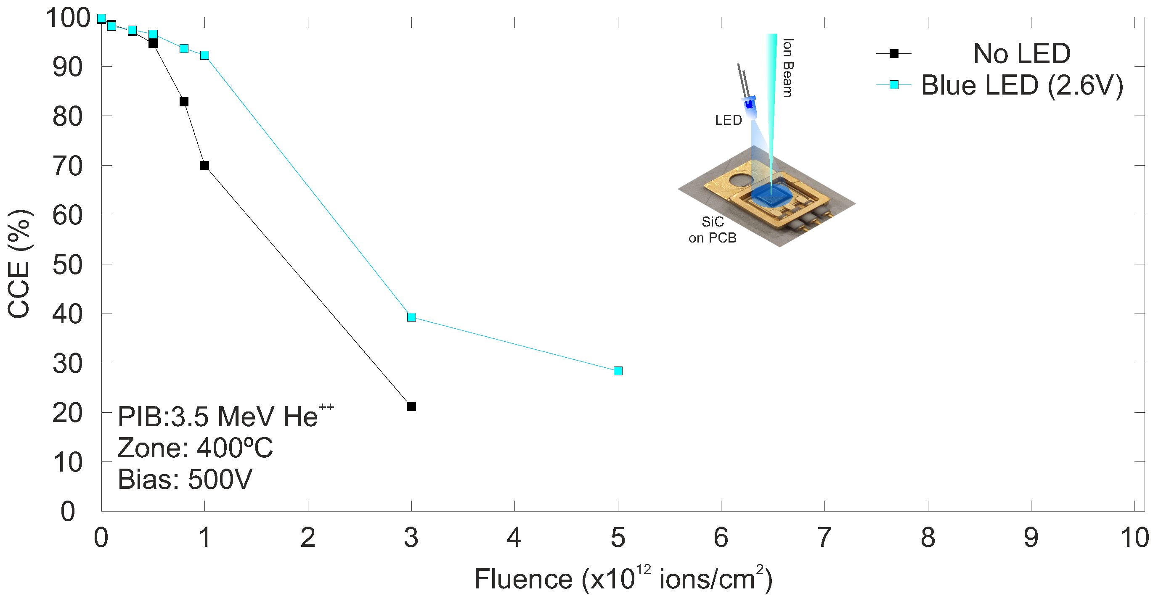
STUDY OF THE EFFECT OF PHOTON RATE ON CCE
• CCE improves with illumination, but at low photon rates not all damaged regions are accessible.
ID-90
Slide 10/14
EuNPC2025

Slide 54
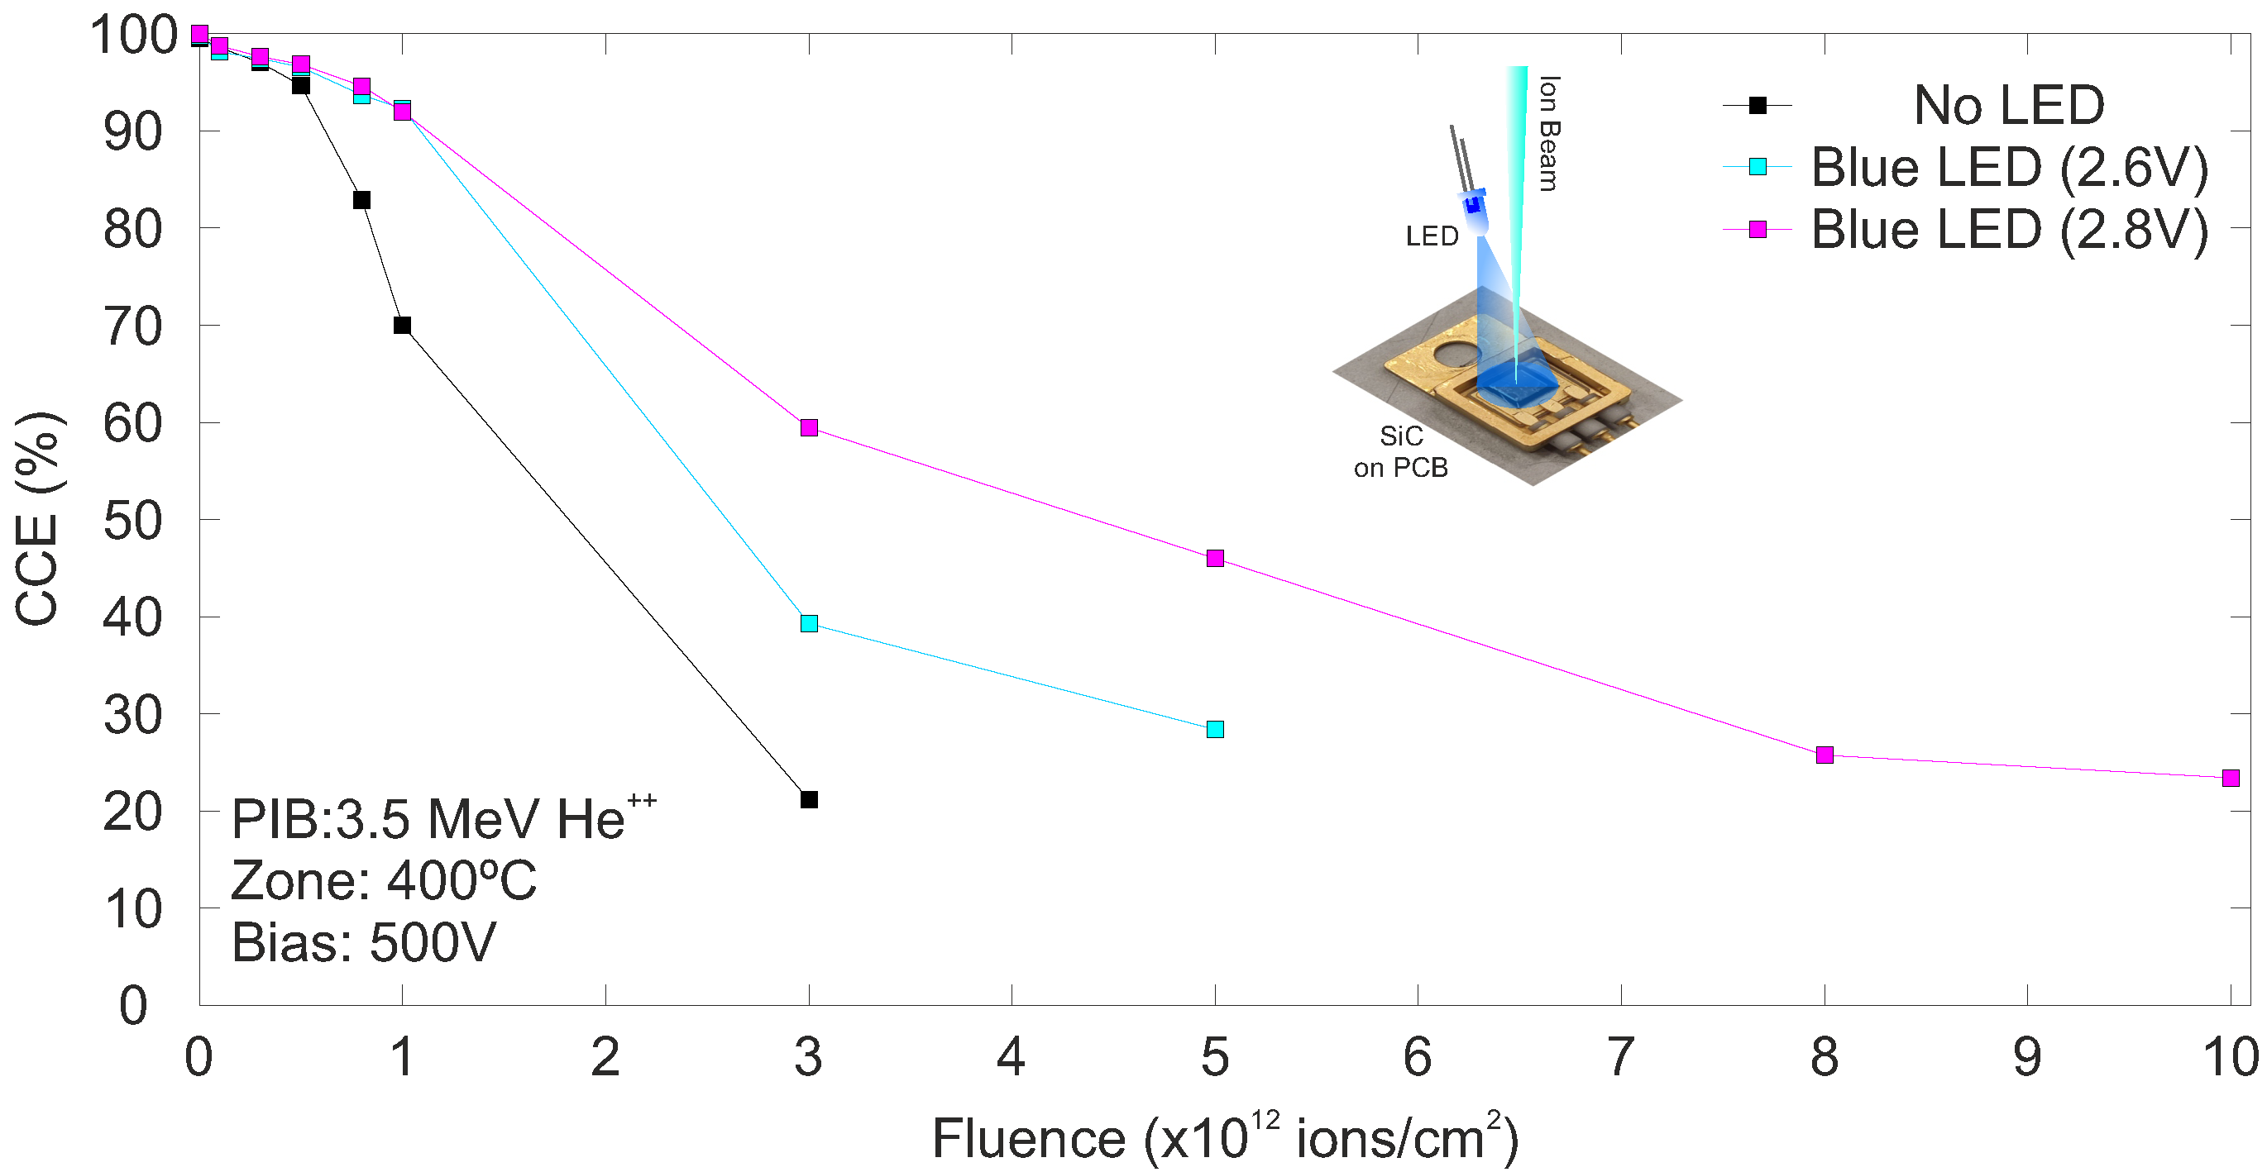
STUDY OF THE EFFECT OF PHOTON RATE ON CCE
CCE recovery improves further with increasing photon rate, but only in the most damaged regions.
ID-90
Slide 10/14
EuNPC2025

Slide 55
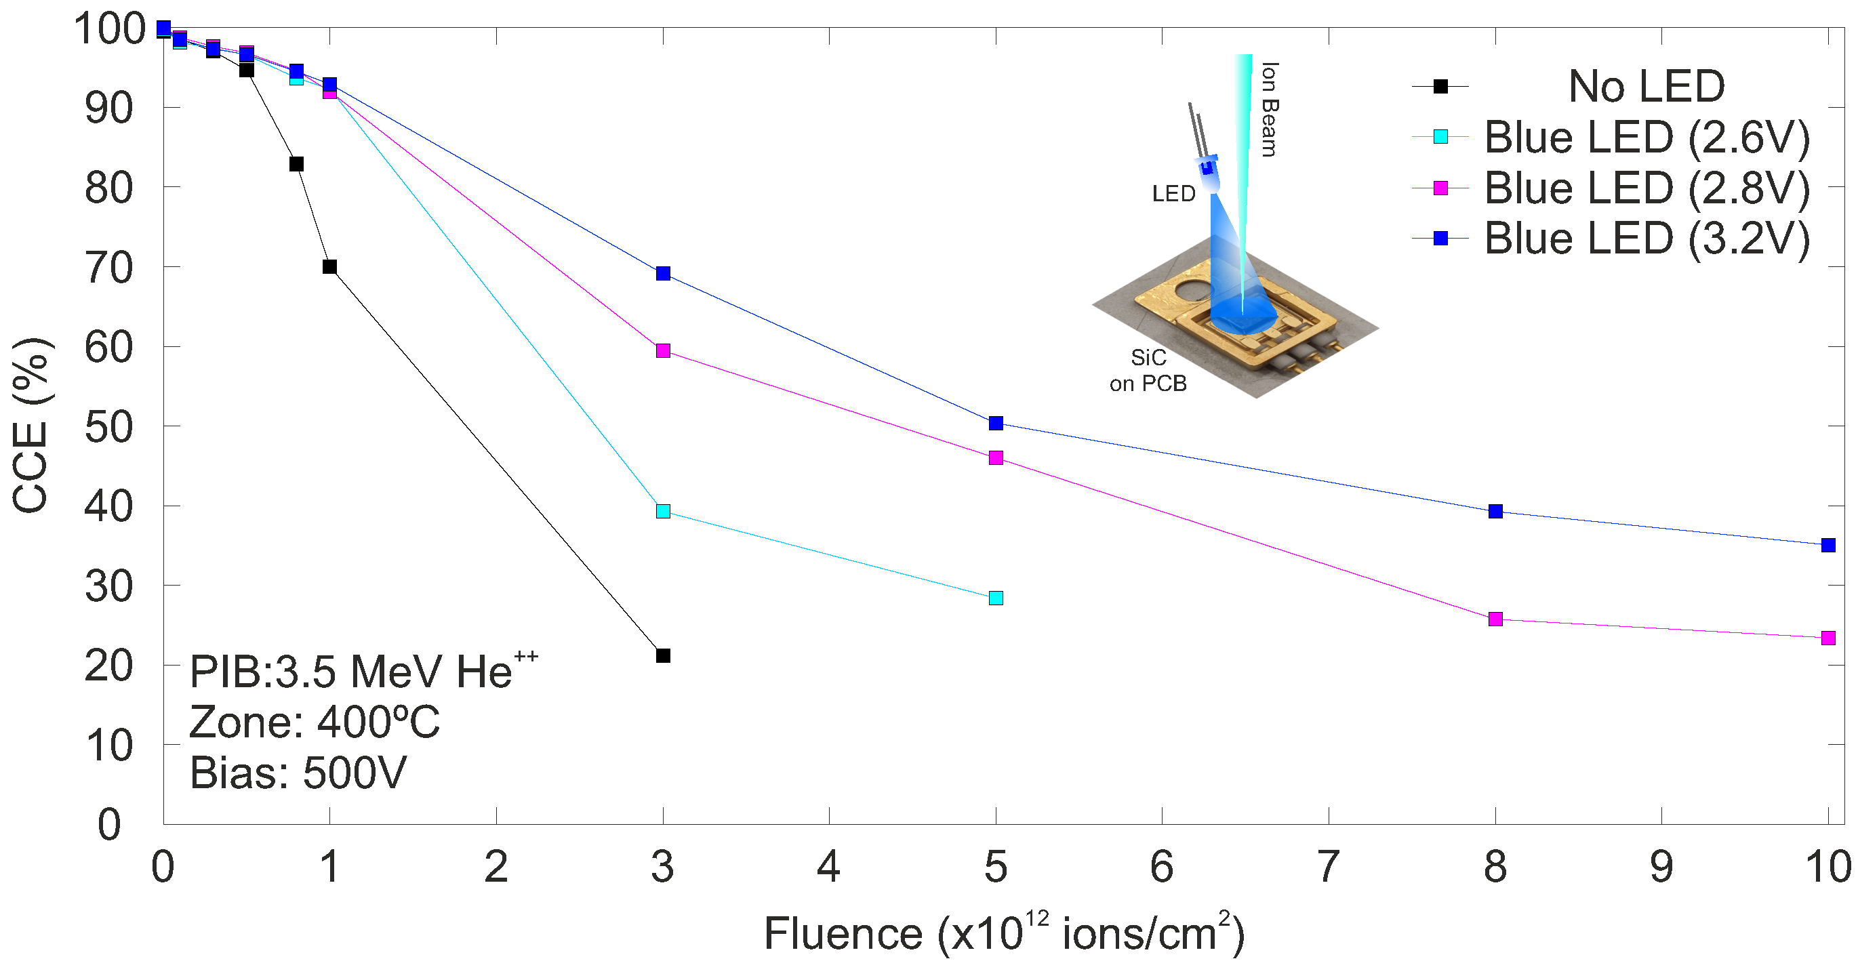
STUDY OF THE EFFECT OF PHOTON RATE ON CCE
• CCE is enhanced and new regions become accessible, while light has no significant effect in low-damage regions.
ID-90
Slide 10/14
EuNPC2025

Slide 56
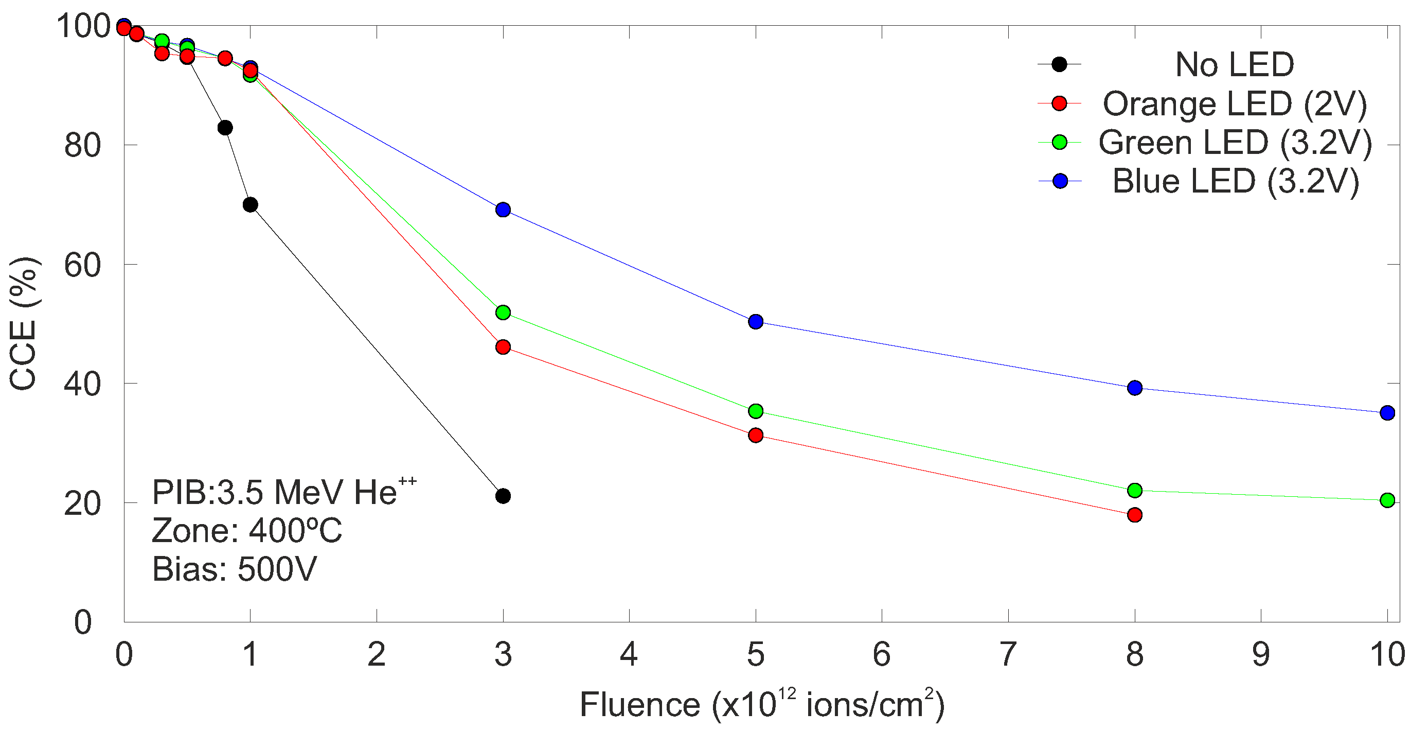
STUDY OF THE LED WAVELENGTH ON CCE
• All three LEDs help recover CCE in the most damaged regions, with the blue LED apparently providing the largest improvement in detector performance.
ID-90
Slide 11/14
EuNPC2025

Slide 57
STUDY OF THE LED WAVELENGTH ON CCE
However, comparison is tricky because the photon rates illuminating the detector differ; measurements should be done under the same illumination conditions.
ID-90
Slide 11/14
EuNPC2025

Slide 58
THE UNDERLYING PROCESS IS NOT FULLY UNDERSTOOD…
ID-90
Slide 12/14
EuNPC2025

Slide 59
THE UNDERLYING PROCESS IS NOT FULLY UNDERSTOOD…
Effect in low-damage zones
Few traps exist, slightly more that the undamaged zone.
Most electrons and holes are already collected. Light releases only a small fraction of trapped electrons → negligible effect on CCE.
CCE is roughly the same with or without light, though slightly lower than the undamaged zone.
ID-90
Slide 12/14
EuNPC2025

Slide 60
THE UNDERLYING PROCESS IS NOT FULLY UNDERSTOOD…
Effect in low-damage zones
Few traps exist, slightly more that the undamaged zone.
Most electrons and holes are already collected. Light releases only a small fraction of trapped electrons → negligible effect on CCE.
CCE is roughly the same with or without light, though slightly lower than the undamaged zone.
Effect in high-damage zones
Many active traps → many trapped electrons.
Light excites trapped electrons into conduction band → increases collected charge.
Time of detrapping is not instantaneous, but enough electrons reach contacts before recombination.
CCE increases with sub-gap light.
ID-90
Slide 12/14
EuNPC2025

Slide 61
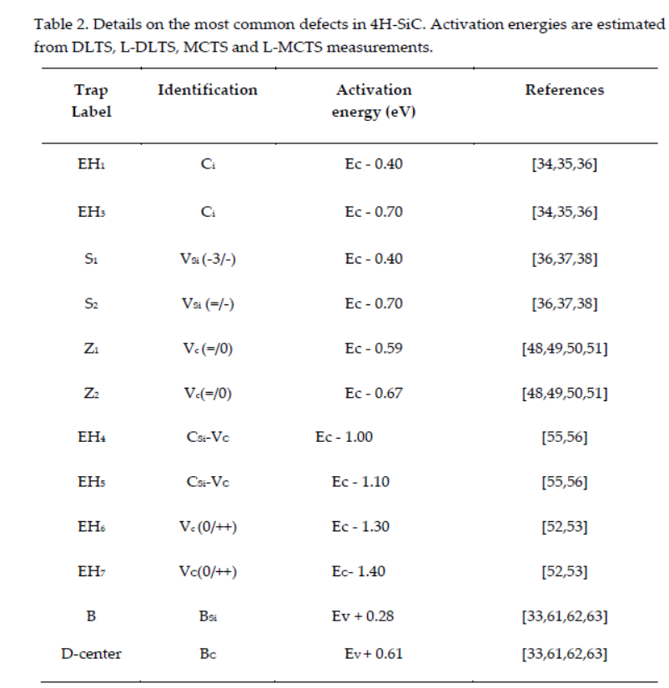
THE UNDERLYING PROCESS IS NOT FULLY UNDERSTOOD…
Common defects in 4H-SiC
Other possible explanation is the presence of different types of electrically active traps, which depend on the damage regime.
Only one type of trap is light-sensitive, explaining why CCE improves mainly where this trap dominates.
Ivana Capan,. Phys. Crytals, 2025, 15(3), 255. https://doi.org/10.3390/cryst15030255
ID-90
Slide 13/14
EuNPC2025

Slide 62
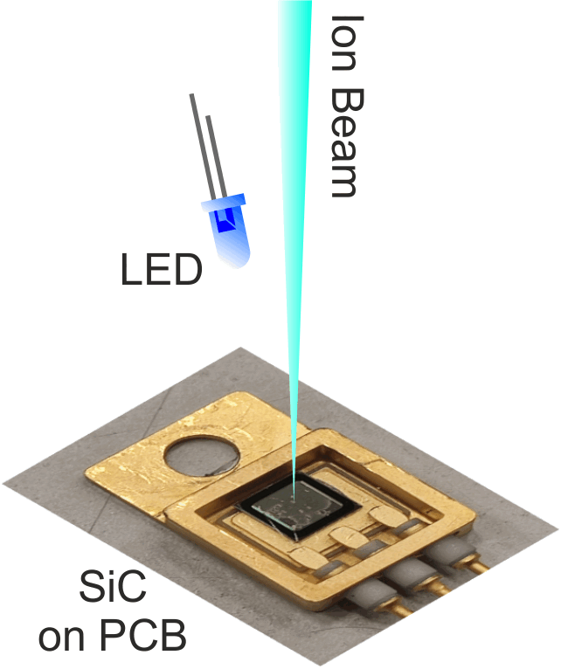
CONCLUSIONS
The potential use of commercial LEDs to improve the performance of a controlled-damaged 4H-SiC detector has been studied.
Illumination with LEDs can enhance the CCE of damaged regions.
The effect is most pronounced in regions with higher accumulated doses and depends of the photon rate.
Although the physical mechanism is not fully understood, these findings suggest a simple and effective way to mitigate radiation damage.
Future work: Study this phenomenon at high temperatures, potentially optimizing SiC-based detectors for harsh fusion environments.
ID-90
Slide 14/14
EuNPC2025

Slide 63


CLEAR: CLUSTER OF LOW ENERGY ACCELERATORS FOR RESEARCH
CLEAR is a consortium of three installations: ATOMKI in Debrecen, CNA in Seville and IST in Lisbon, offering access to stable-ion and neutron beams in the framework of the EURO-LABS project.
Accelerator Complexes:
ATOMKI: 2 MV Tandem, 18 MeV Cyclotron, ECRIS.
CNA: 3 MV Tandem, 18 MeV Cyclotron, 1 MV Tandetron for Accelerator Mass Spectrometry (AMS).
IST: 2.5 MV Van de Graaff.
Transnational Access https://institucional.us.es/clear/
ID-90
EuNPC2025

Slide 64








ACKNOWLEDGMENTS
M.C. Jiménez-Ramos acknowledges the support to this work through a VI PPIT-US contract.
Grant Award for EuNPC2025 Participation
Actividades del CNA para los "upgrades" de alta luminosidad de CMS y DRDs del ECFA (PID2023-148418NB-C44).
Actuación 1.1 Irradiación de detectores con aceleradores. (ASTRO21/1.1/1).
ID-90
EuNPC2025

Slide 65


Thank you for
your attention

Slide 66

BACKUP
ID-90
EuNPC2025

Slide 67


CCE OF SEMICONDUCTORS ANALYZED WITH FOCUSED MeV ION BEAMS
Tunable penetration depth (0.1-6 MeV).
Good selection of ion species and ionization profiles.
Beam current: nA to few pps (micrometric slits).
Scanning system: few mm².
Synchronous signal acquisition system with scanning: mappings.
Energy Loss
Detector
CNA μ-probe
ID-90
EuNPC2025

Slide 68


ELECTRICAL CHARACTERIZATION OF THE DEVICE
Pristine detector exhibits diode-like behavior, with a typical C-V response characteristic of a p-n junction.
A 3.5 MeV He²⁺ beam losses ≈306 keV in the passivation layers.
SRIM simulations confirm that all ions stop within the detector’s active volume for bias above 50V.
During real operation, the detector will be biased at 500 V.
ID-90
EuNPC2025

Slide 69

PIXE AS AN EFFECTIVE METHOD TO MEASURE ACCUMULATED ION DOSE
The ceramic heater generates electronic noise, making direct measurement impossible.
An indirect system is used to determine the accumulated fluence during controlled high-temperature damage.
PIXE detects X-rays generated in the SiC detector during alpha particle exposure.
X-ray yield is proportional to ion fluence.
Enables real-time monitoring of delivered fluence.
ID-90
EuNPC2025

Slide 70


ELECTRON TRAPPING DOMINATES CCE BEHAVIOR
Ionization profile: Energy loss is dominated by electronic stopping, peaking at the Bragg maximum near the end of the particle’s range.
Vacancy profile: As the particle slows down, nuclear stopping becomes dominant, producing a vacancy peak located to the right of the Bragg peak.
Damaging ion beam: 3.5 MeV He⁺⁺
Carriers traveling the farthest to the electrode experience the most trapping at the region of highest trap density.
ID-90
EuNPC2025

Slide 71


ION BEAM MICROPROBE UPGRADE ENABLES SAMPLE HEATING
ID-90
EuNPC2025

Slide 72

HOMOGENEITY ENSURES NOT DEPENDENCE WITH THE IMPACT POINT
3.5 MeV He²⁺ focused beam with spatial resolution ~2 mm.
IBIC map revealed high homogeneity in detector's CCE Values (red indicates 100% CCE).
CCE greater than 100%, identifies windows for potential electrical bondings.
CCE MAP
ID-90
EuNPC2025

