Slide 1

Bayesian optimization on FIFRELIN Monte-Carlo code to fit neutron and gamma multiplicities
G. BAZELAIRE¹, A. CHEBBOUBI¹, D. BERNARD¹, G. DANIEL², J.-B. BLANCHARD²
¹CEA, DES, IRESNE, DER, SPRC, Cadarache, Physics Studies Laboratory, Saint-Paul-lès-Durance, 13108, France
²Université Paris-Saclay, CEA, Service Génie Logciel pour la simulation, 91191, Gif-sur-Yvette, France

Slide 2

Context : nuclear data
Nuclear data
A. CHEBBOUBI, HDR (2023)

Slide 3
Contents
FIFRELIN : simulation of the de-excitation process of fission fragments
Gaussian Process Regressor & Bayesian Optimization : usefool tool
Adjustement of experimental data
Comparaison with the code CGMF

Slide 4
FIFRELIN
1

Slide 5
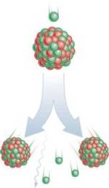
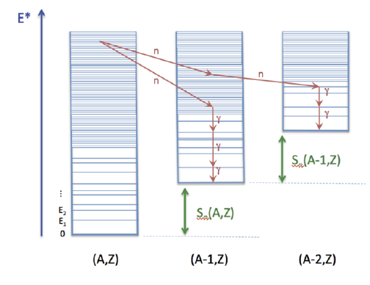
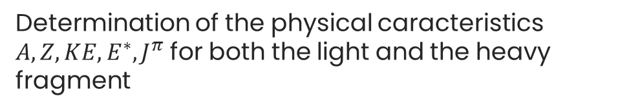
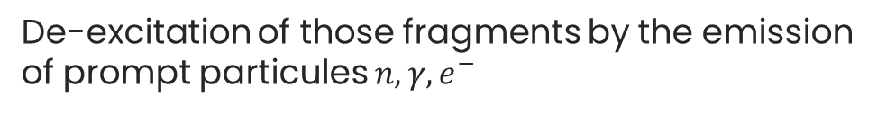
FIFRELIN : simulation of the de-excitation process of fission fragments
A FIFRELIN calculation is done in two steps :
STEP 1
Determination of the physical caracteristics $A, Z, KE, E^{∗}, J^{π}$ for both the light and the heavy fragment
STEP 2
De-excitation of those fragments by the emission of prompt particules $n, γ, e^{−}$
O. Litaize, O. Serot, and L. Berge, Eur. Phys. J. A 51, 177 (2015)

Slide 6
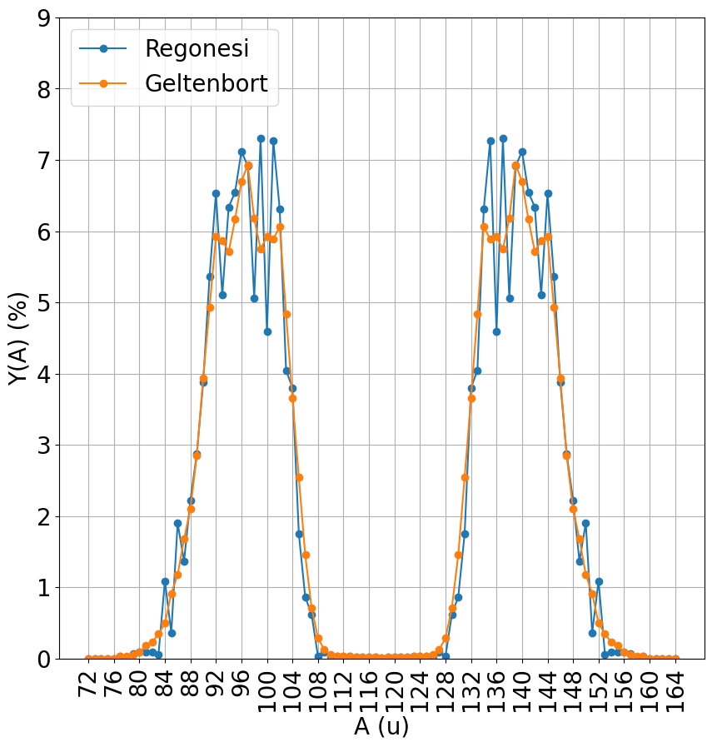
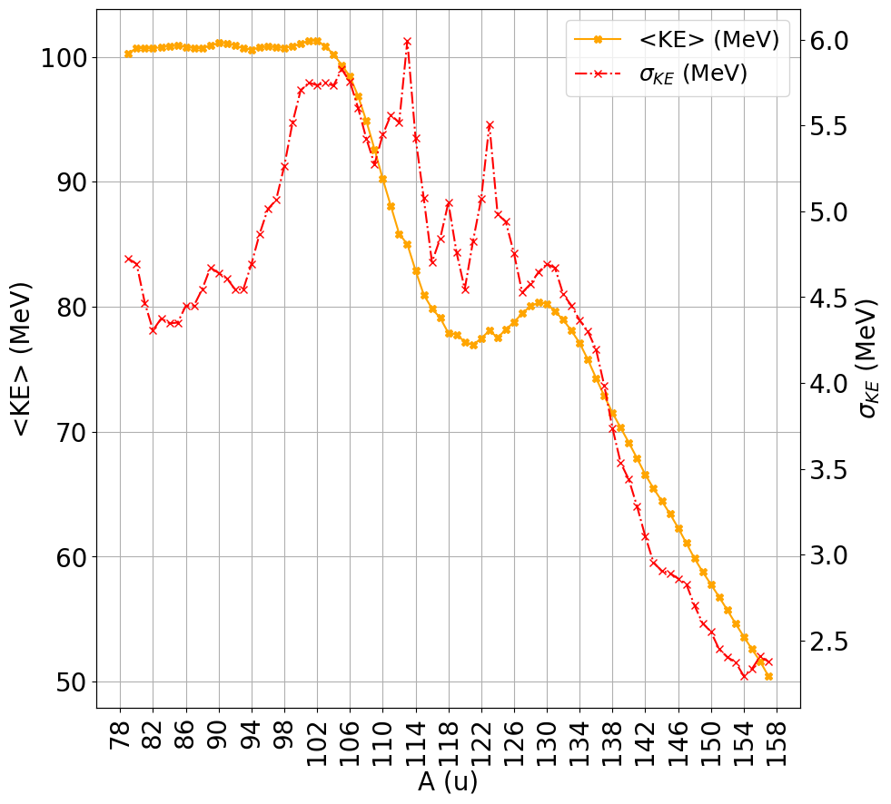


FIFRELIN step 1 : generation of fission fragments
Caracteristics are defined through a sampling over experimental data and phenomenological models
$$Y\left(A,Z,E^{∗},KE,J,π\right)=Y\left(A\right)×P\left(Z | A\right)×P_{θ_{1}}\left(E^{∗} | A,Z\right)×P\left(KE | A\right)×P_{θ_{2}}\left(J | A,Z,E\right)×P(π)$$
Experimental data
Phenemenological models
Wahl model
$${}^{235}U(n_{th},f)$$
$${}^{235}U(n_{th},f)$$

Slide 7
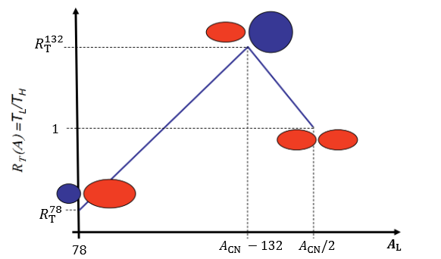
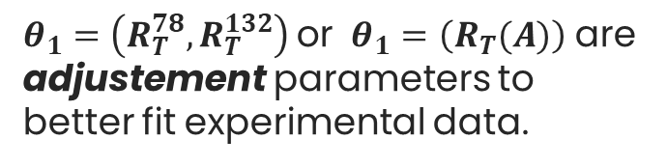
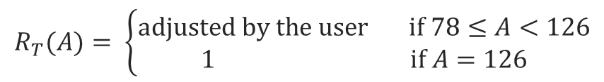
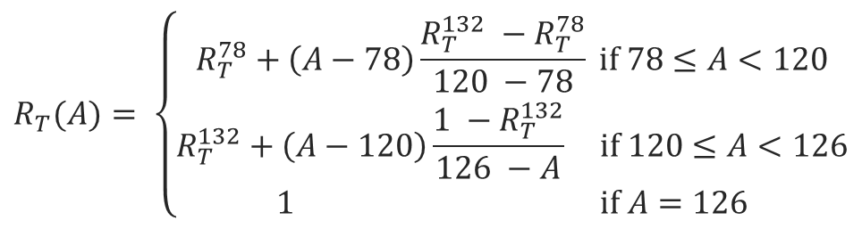
FIFRELIN step 1 : generation of fission fragments
$$Y\left(A,Z,E^{∗},KE,J,π\right)=Y\left(A\right)×P\left(Z | A\right)×P_{θ_{1}}\left(E^{∗} | A,Z\right)×P\left(KE | A\right)×P_{θ_{2}}\left(J | A,Z,E\right)×P(π)$$
Phenemenological models
Excitation energy sharing based on mass-dependant temperature ratio law
$$R_{T}(A)= \left\{\begin{aligned}R_{T}^{78}+\left(A−78\right)\frac{R_{T}^{132} −R_{T}^{78}}{120 −78} if 78≤A<120 \\ R_{T}^{132}+\left(A−120\right)\frac{1 −R_{T}^{132}}{126 −A} if 120≤A<126 \\ 1 if A=126\end{aligned}\right.$$
Default model
$θ_{1}=\left(R_{T}^{78}, R_{T}^{132}\right)$ or $θ_{1}=\left(R_{T}(A)\right)$ are adjustement parameters to
better fit experimental data.
$$R_{T}(A)= \left\{\begin{aligned}adjusted by the user if 78≤A<126 \\ 1 if A=126\end{aligned}\right.$$
Second model

Slide 8
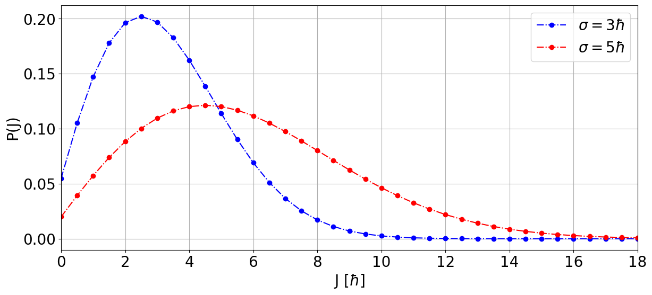
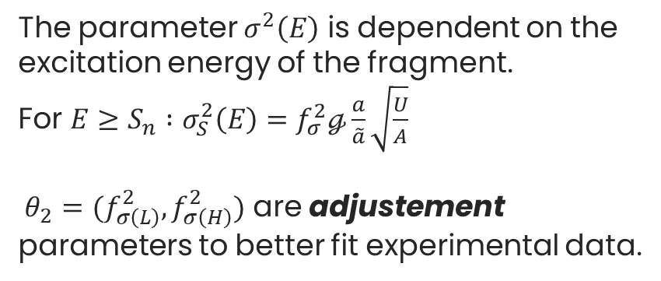
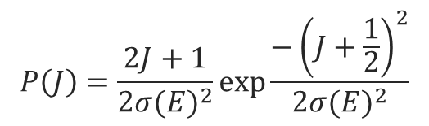
FIFRELIN step 1 : generation of fission fragments
$$Y\left(A,Z,E^{∗},KE,J,π\right)=Y\left(A\right)×P\left(Z | A\right)×P_{θ_{1}}\left(E^{∗} | A,Z\right)×P\left(KE | A\right)×P_{θ_{2}}\left(J | A,Z,E\right)×P(π)$$
$$P\left(J\right)=\frac{2J+1}{2{σ(E)}^{2}}\exp{\frac{−{\left(J+\frac{1}{2}\right)}^{2}}{2{σ(E)}^{2}}}$$
Phenemenological models
Total angular momentum definition
The parameter $σ^{2}\left(E\right)$ is dependent on the excitation energy of the fragment.
For $E≥S_{n} :σ_{S}^{2}\left(E\right)=f_{σ}^{2}ℊ\frac{a}{\tilde{a}}\sqrt{\frac{U}{A}}$
$θ_{2}=(f_{σ\left(L\right)}^{2}, f_{σ\left(H\right)}^{2})$ are adjustement parameters to better fit experimental data.

Slide 9
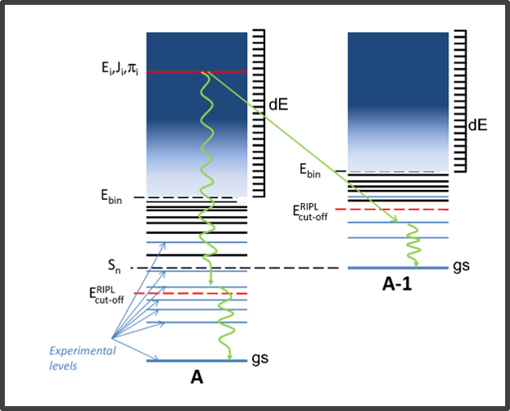
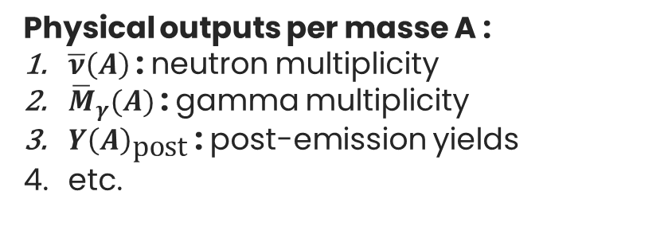
FIFRELIN step 2 : de-excitation process
De-excitation process based on Hauser-Feshbach formalism and nuclear realization.
No more interference from the selected free parameters.
Physical outputs per masse A :
$\overline{ν}\left(A\right)$ : neutron multiplicity
${\overline{M}}_{γ}(A)$ : gamma multiplicity
$Y{\left(A\right)}_{\text{post}}$ : post-emission yields
etc.
W. Hauser, H. Feshbach, Phys Rev 87.2, 366-373 (1952)
D. Regnier, Thesis (2013)

Slide 10
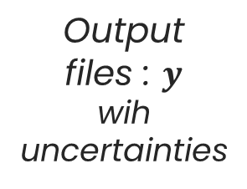




FIFRELIN : black-box
Experimental data
FIFRELIN
Fissile nucleus
Output
files : $y$
wih uncertainties
Experimental data with uncertainties
Models
$$≈$$
Free parameters : $x$
$$y=FIF\left(x\right)$$
Usually $\overline{ν}$ and ${\overline{M}}_{γ}$
Goal : optimization. Knowing $Y_{data}$, find $x$ such that $\left|FIF\left(x\right) −Y_{data}\right|≤ε$
This operation can take several hours done manually.
How about bayesian optimization ?

Slide 11
Gaussian Process regressor & Bayesian Optimization
2

Slide 12
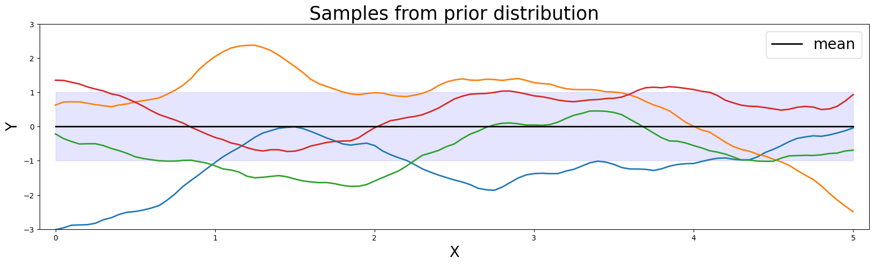
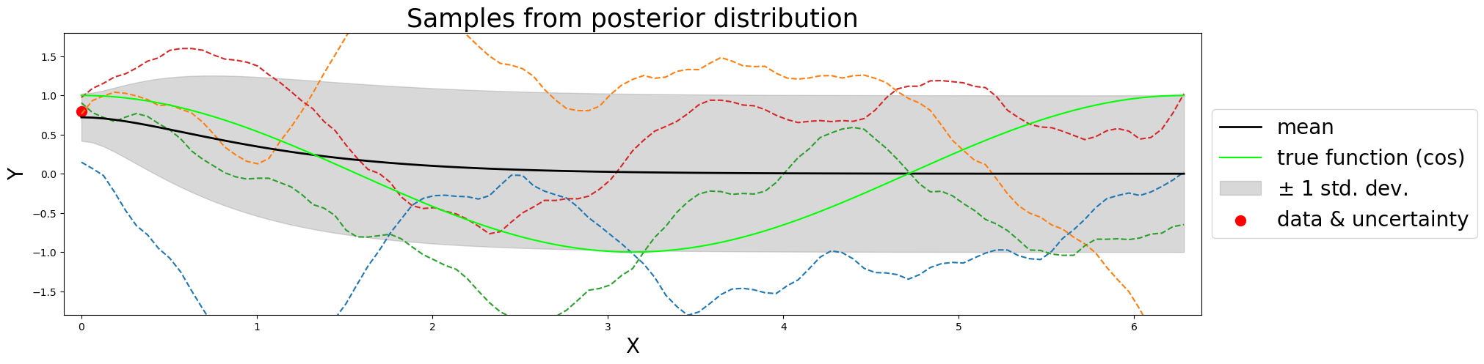
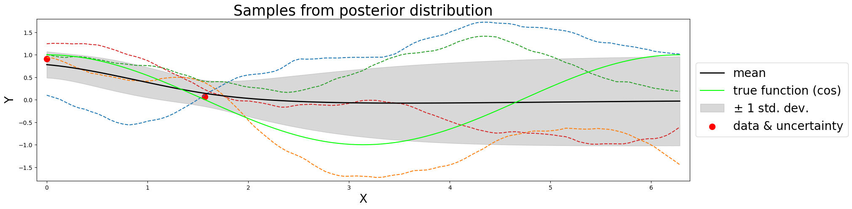
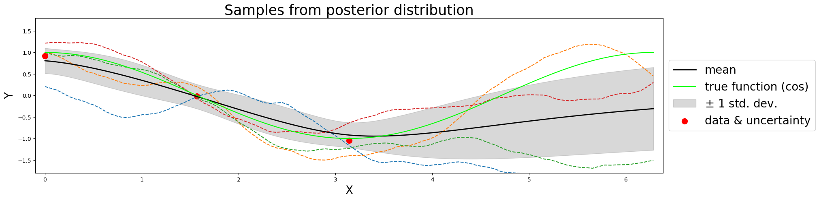
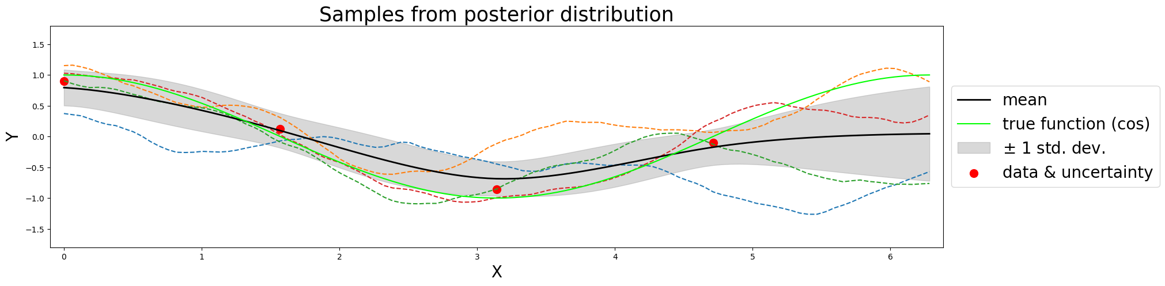
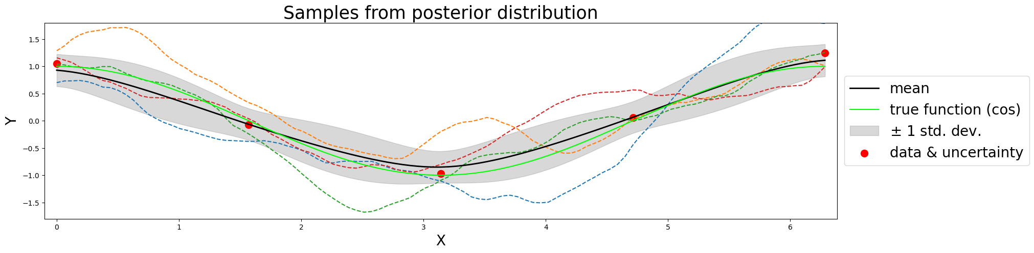
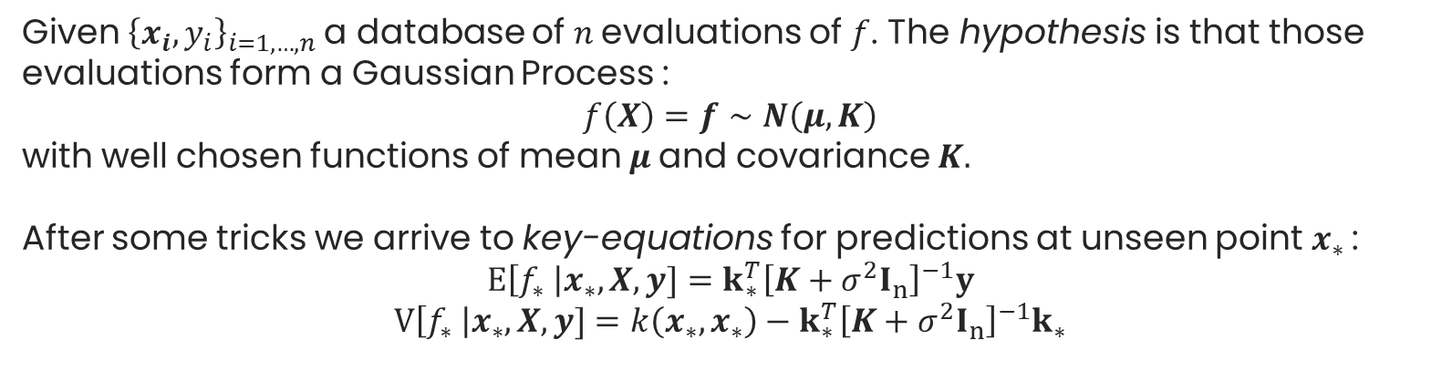
Gaussian Process regressor (GPR)
GPR : used mainly when the function $f$ is costly to evaluate, based on conditionning.
Given ${\left\{x_{i},y_{i}\right\}}_{i=1,…,n}$ a database of $n$ evaluations of $f$. The hypothesis is that those evaluations form a Gaussian Process :
$$f\left(X\right)=f∼N\left(μ, K\right)$$
with well chosen functions of mean $μ$ and covariance $K.$
After some tricks we arrive to key-equations for predictions at unseen point $x_{∗}$ :
$$E\left[f_{∗} \right|x_{∗},X,y]=k_{∗}^{T}{\left[K+σ^{2}I_{n}\right]}^{−1}y$$
$$V\left[f_{∗} \right|x_{∗},X,y]=k\left(x_{∗},x_{∗}\right)−k_{∗}^{T}{\left[K+σ^{2}I_{n}\right]}^{−1}k_{∗}$$
C. E. Rasmussen, C. K. I. Williams, Gaussian Process for Machine Learning (2006)

Slide 13
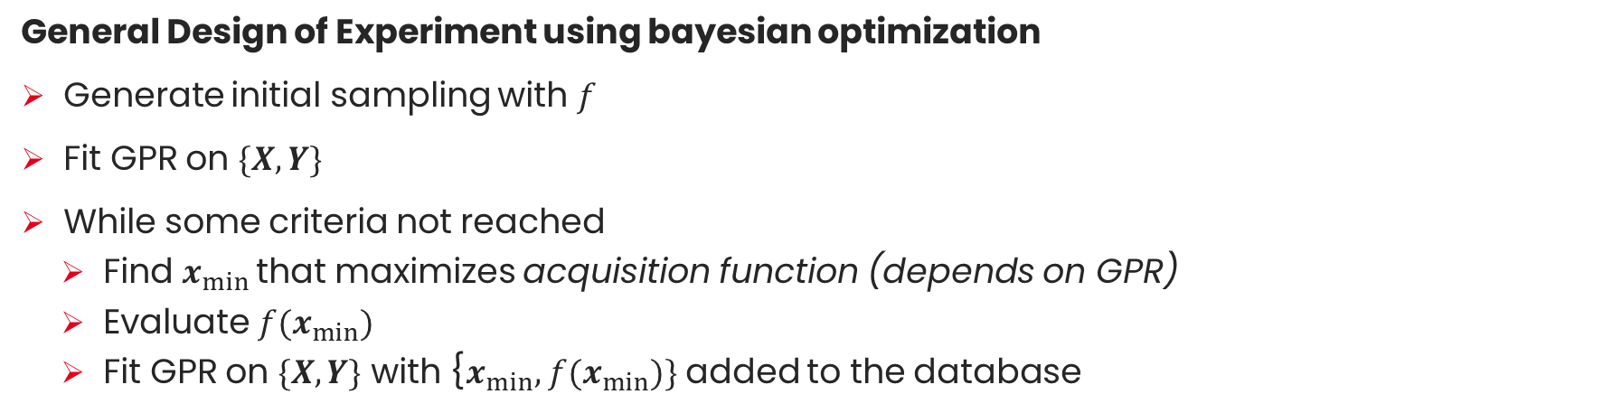
Bayesian Optimization (BO)
BO : generally used for minimizing stochastic, costly to evaluate functions.
General Design of Experiment using bayesian optimization
Generate initial sampling with $f$
Fit GPR on $\{X,Y\}$
While some criteria not reached
Find $x_{min}$ that maximizes acquisition function (depends on GPR)
Evaluate $f(x_{min})$
Fit GPR on $\{X,Y\}$ with {$x_{min},$ $f(x_{min})\}$ added to the database
J.-H Snoek et al., IEEE Transactions of Information Theory 58.5 (2012)

Slide 14
Adjustement of experimental data
3

Slide 15
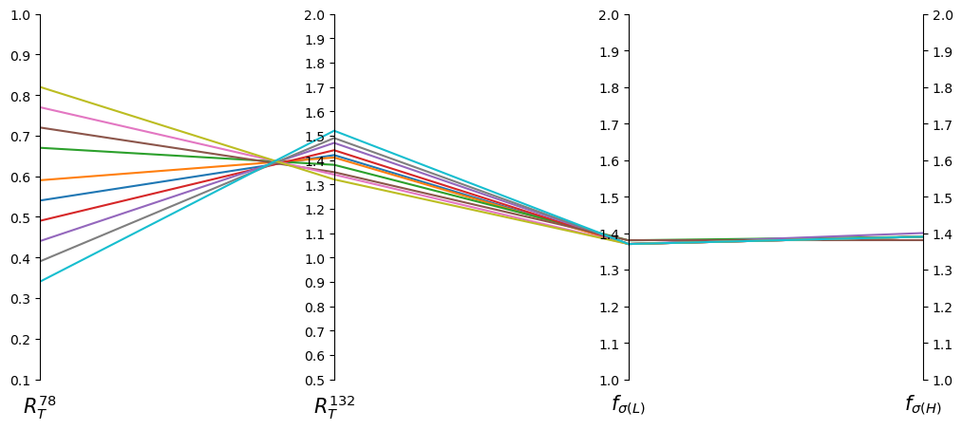
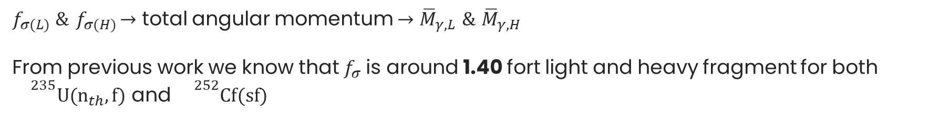
Fitting the saw-tooth
Goal : create an algorithm to adjust $R_{T}(A)$ and $f_{σ(L)} \&{ f}_{σ(H)}$in order to fit $\overline{ν}\left(A\right)$ (experimental saw-tooth) and gamma multiplicities.
$R_{T\left(A\right)}→$ excitation energy for fragments of the corresponding fragmentation $→$ neutron multiplicities $\overline{ν}\left(A_{L}\right) \& \overline{ν}\left(A_{H}\right)$
$f_{σ(L)} \&{ f}_{σ(H)}→$ total angular momentum $→{\overline{M}}_{γ,L} \text{\&} {\overline{M}}_{γ,H}$
From previous work we know that $f_{σ}$is around 1.40 fort light and heavy fragment for both ${}^{235}U(n_{th},f)$ and ${}^{252}Cf(sf)$

Slide 16
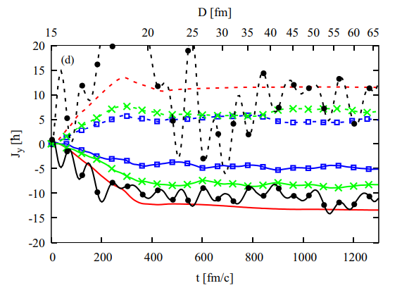
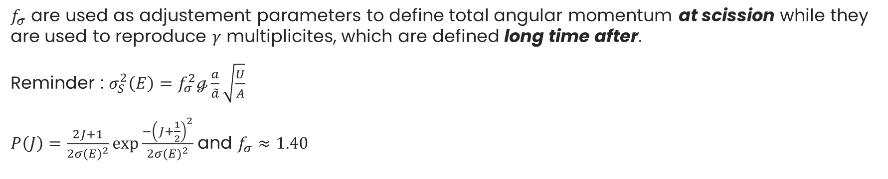
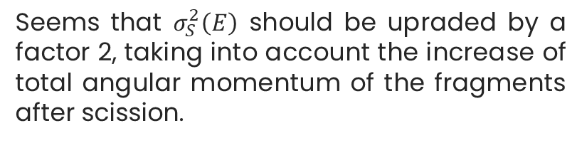
Adjustement parameters $f_{σ(L)}$and $f_{σ(H)}$
$f_{σ}$ are used as adjustement parameters to define total angular momentum at scission while they are used to reproduce $γ$ multiplicites, which are defined long time after.
Reminder : $σ_{S}^{2}\left(E\right)=f_{σ}^{2}ℊ\frac{a}{\tilde{a}}\sqrt{\frac{U}{A}}$
$P\left(J\right)=\frac{2J+1}{2{σ(E)}^{2}}\exp{\frac{−{\left(J+\frac{1}{2}\right)}^{2}}{2{σ(E)}^{2}}}$ and $f_{σ}≈1.40$
Seems that $σ_{S}^{2}\left(E\right)$ should be upraded by a factor 2, taking into account the increase of total angular momentum of the fragments after scission.
G. Scamps, Physical Review C 106.5 (2022)
: total angular momentum for light fragment
: total angular momentum for heavy fragment

Slide 17
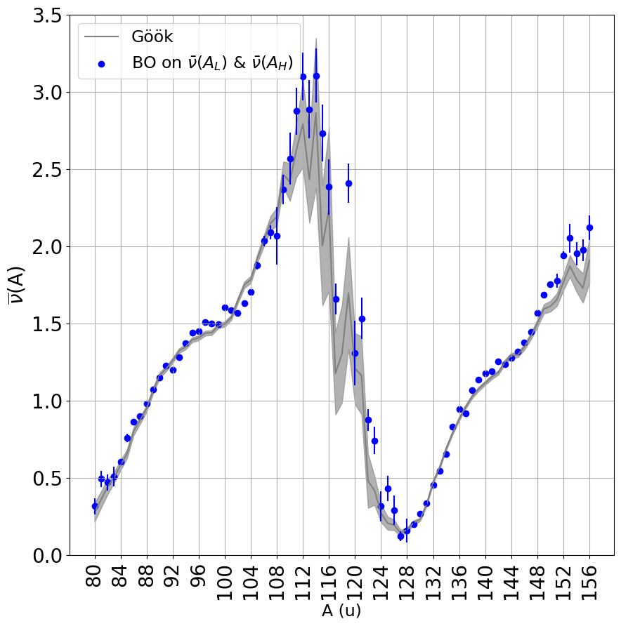
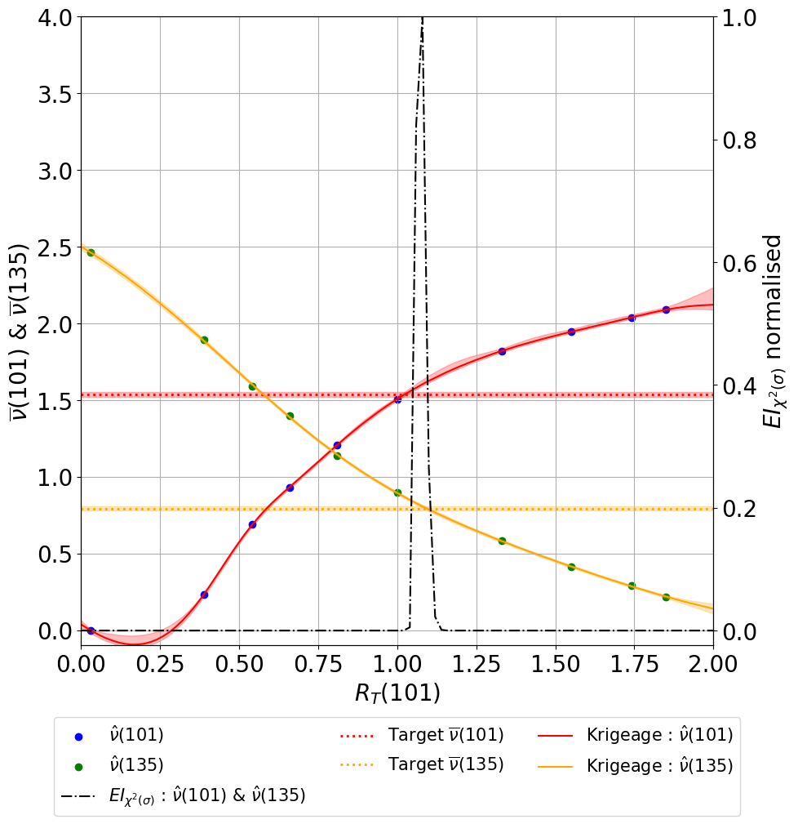

Fitting the saw-tooth
Reaction : ${}^{235}U(n_{th},f)$
 | Number of points | Computation time (min)
Initial sampling | 10 | 110
DoE | 5 | 55
For each mass $A$ : find $R_{T\left(A\right)}^{∗}=\min_{R_{T\left(A\right)}∈[0,2]}\frac{{\left(\hat{ν}\left(A_{L}\right) − \overline{ν}\left(A_{L}\right)\right)}^{2}}{σ_{\overline{ν}\left(A_{L}\right)}^{2}}+\frac{{\left(\hat{ν}\left(A_{H}\right) − \overline{ν}\left(A_{H}\right)\right)}^{2}}{σ_{\overline{ν}\left(A_{H}\right)}^{2}}$

Slide 18
Comparaison / results
4

Slide 19
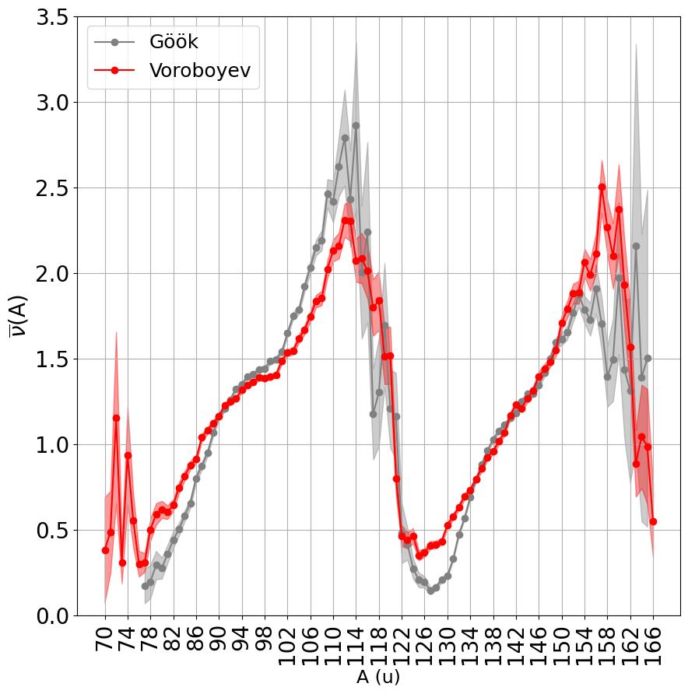
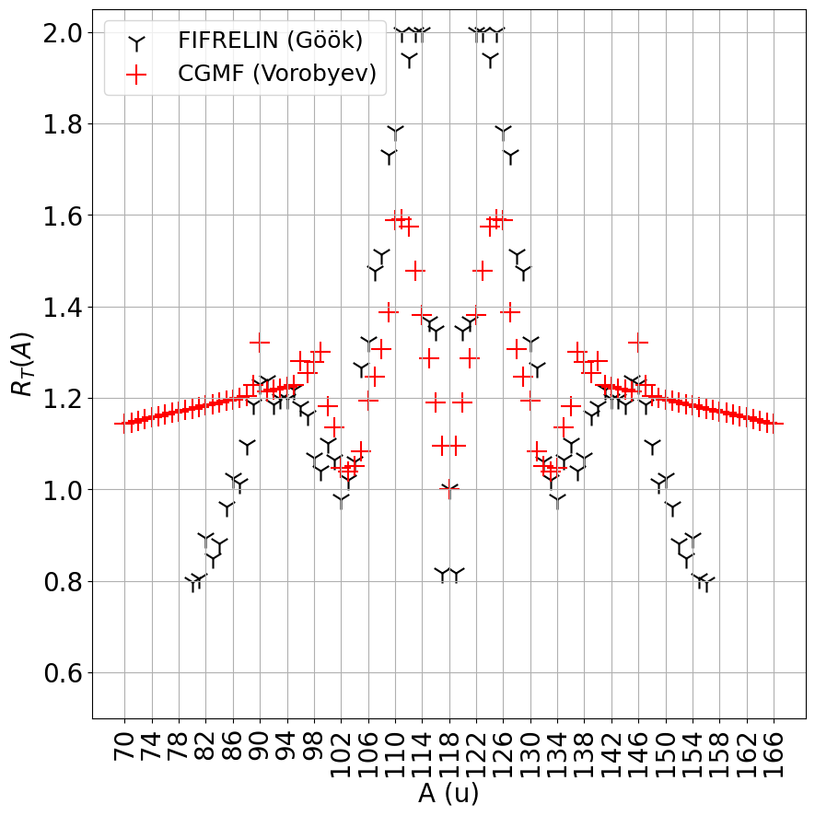
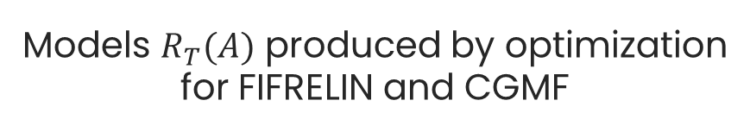
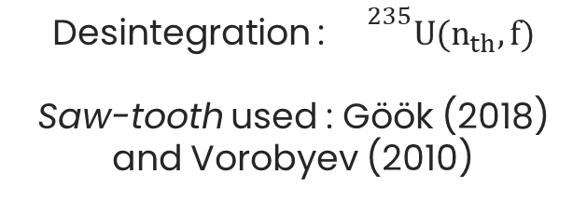
Comparaison with CGMF
Desintegration : ${}^{235}U(n_{th},f)$
Saw-tooth used : Göök (2018) and Vorobyev (2010)
Models $R_{T}(A)$ produced by optimization for FIFRELIN and CGMF

Slide 20

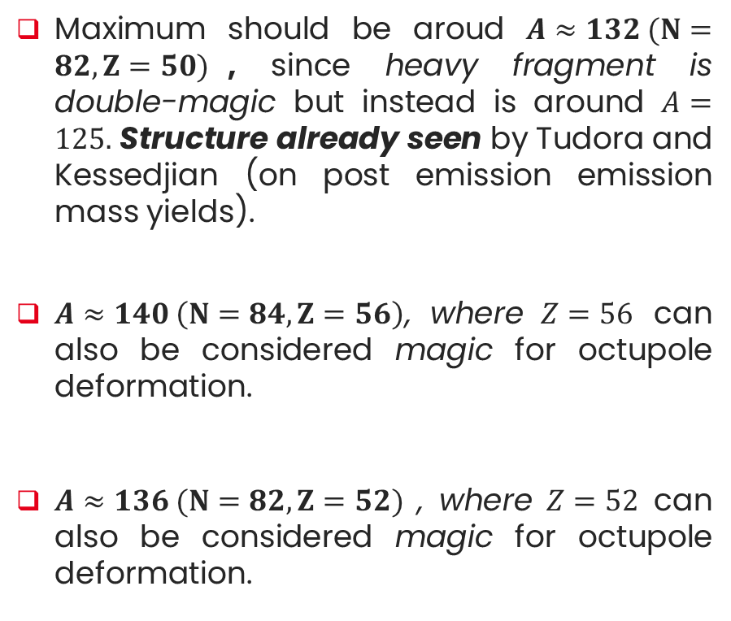
Comparaison with CGMF
Structures show-up around :
Maximum should be aroud $A≈132 (N=82, Z=50)$, since heavy fragment is double-magic but instead is around $A=125.$ Structure already seen by Tudora and Kessedjian (on post emission emission mass yields).
$A≈140 \left(N=84, Z=56\right)$, where $Z=56$ can also be considered magic for octupole deformation.
$A≈136 (N=82, Z=52)$ , where $Z=52$ can also be considered magic for octupole deformation.
Desintegration : ${}^{235}U(n_{th},f)$
A. Tudora, P. Gogita, Eur. Phys. J. A 60,9, 190 (2024)

Slide 21
Conclusion
Bayesian Optimization is well-suited applied on stochastic codes such as FIFRELIN.
Automation of the adjustement procedure of the free parameters that correctly reproduce experimental data.
Gives us interesting physical insights to investigate.
Perspectives
Differents targets to reproduce
Different reactions (only two reactions studied now)

Slide 22
Thank you

Slide 23
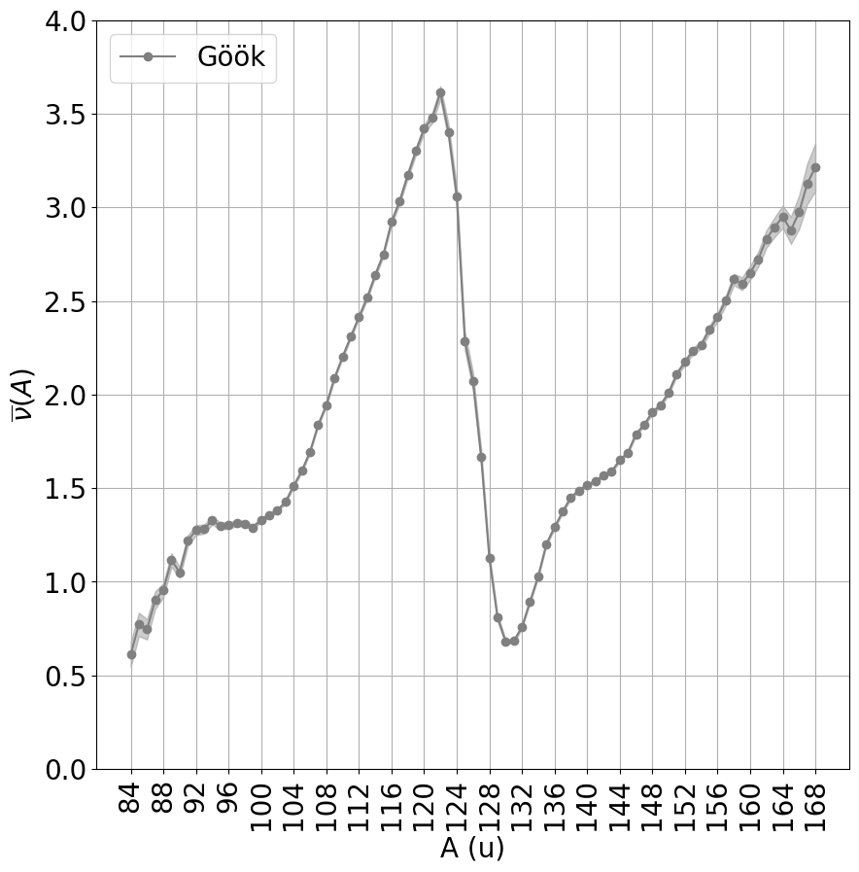
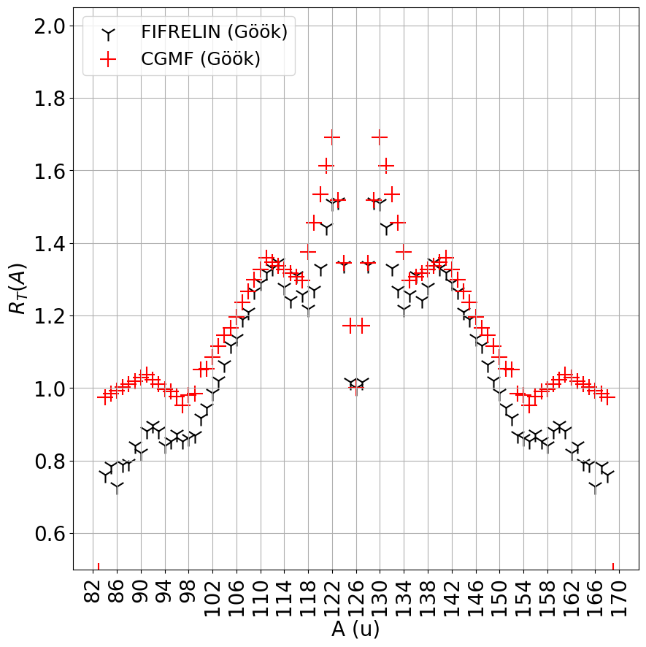
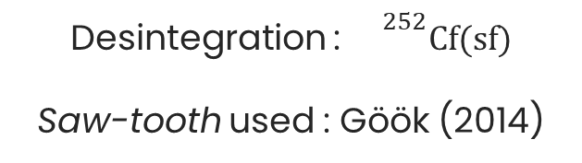
Comparaison with CGMF
Desintegration : ${}^{252}Cf(sf)$
Saw-tooth used : Göök (2014)
Models $R_{T}(A)$ produced by optimization for FIFRELIN and CGMF

Slide 24

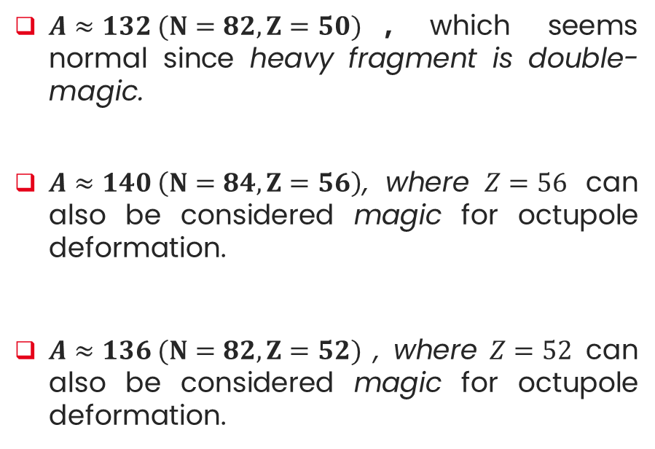
Comparaison with CGMF
Desintegration : ${}^{252}Cf(sf)$
Structures show-up around :
$A≈132 (N=82, Z=50)$, which seems normal since heavy fragment is double-magic.
$A≈140 \left(N=84, Z=56\right)$, where $Z=56$ can also be considered magic for octupole deformation.
$A≈136 (N=82, Z=52)$ , where $Z=52$ can also be considered magic for octupole deformation.

