Slide 1
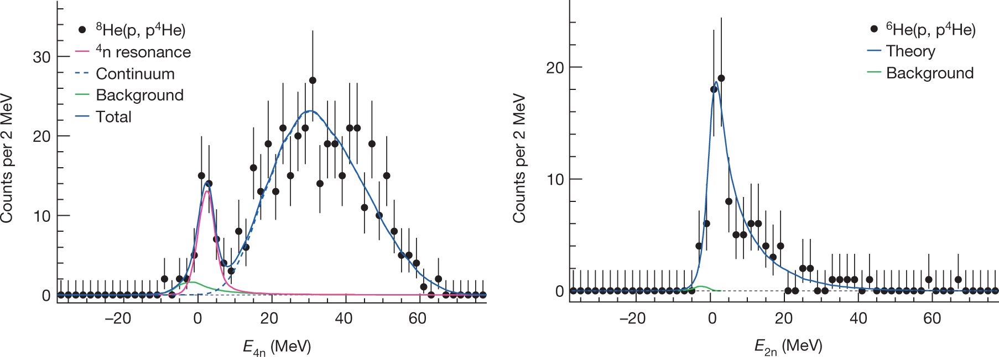
Four-neutron point-production within pionless EFT
resonance-like structure ?
Duer et al.
Nature 606.7915 (2022): 678-682
Timothy George Backert
- Technische Universität Darmstadt -

Slide 2
Introduction – Why multi-neutron systems?
Very light and isospin asymmetrical systems → investigate nucleon-nucleon interaction
Multi-neutron systems → uncharged nucleons
Since 1960s search for bound/resonant neutral nuclei; @GANIL and RIKEN
- di-neutron: → close to unitarity/near threshold
- tri-neutron: neither resonances nor virtual states
Marqués et al.
PRC 65.044006 (2001)
Marqués et al.
EPJA 57.3 (2021)
Sebatian Dietz
TU Prints (TU Darmstadt) – Dissertation (2023)

Slide 3
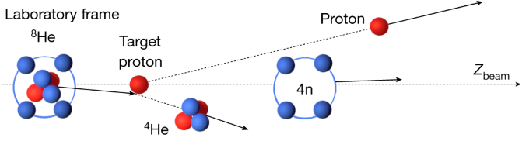

Introduction – Why multi-neutron systems?
Tetra-neutron: Experiment Theory
Possible explanations:
- physical resonance
- dineutron-dineutron correlations
- artifacts of -structure
Task for us: investigate the tetra-neutron continuum independent of a model:
→ start with leading-order pionless EFT
Lazauskas et al.
PRL 130 102501 (2023)
Duer et al.
Nature 606.7915 (2022): 678-682

Slide 4
Contents
0 Introduction – Why Multi-Neutron Systems?
1 Pionless EFT and Point-Production
2 Faddeev Formalism & Three-Neutron System
3 Faddeev-Yakubovsky Formalism
4 Four-Neutron System
5 Summary & Outlook

Slide 5
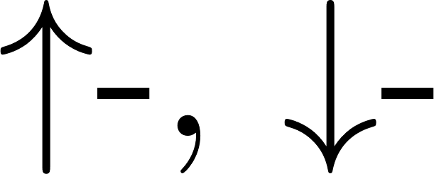
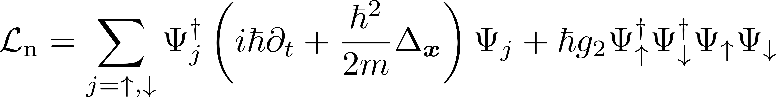

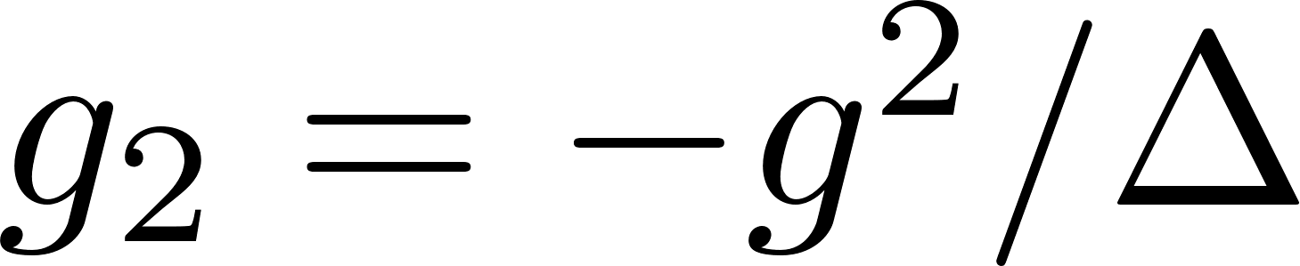
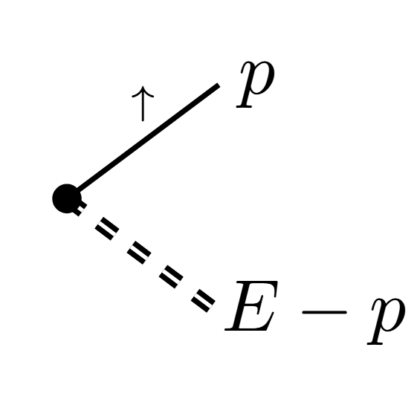
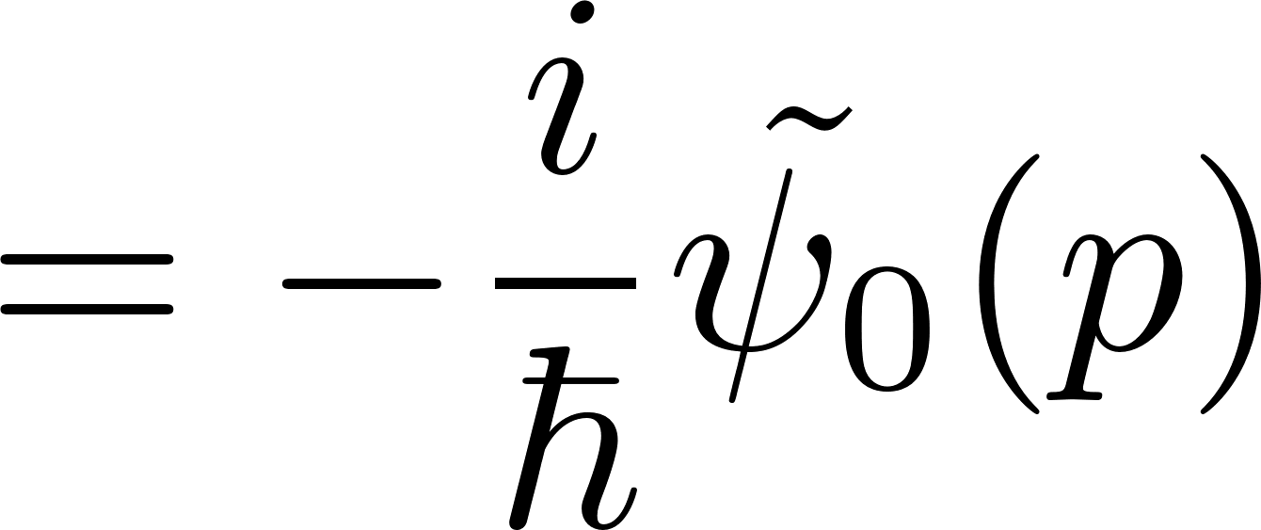
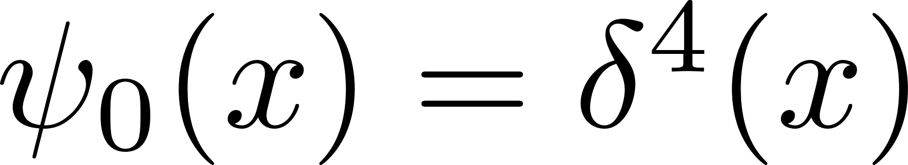
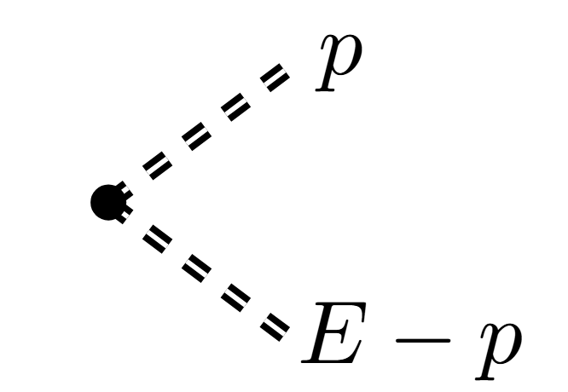
1. Pionless EFT & Point-production
Leading-order pionless EFT for distinguishable neutrons
Diatomic field trick with static dimer field
Point-production
Braaten et Hammer
Phys. Rep. 428,259 (2006)
equivalent theories
point-like

Slide 6
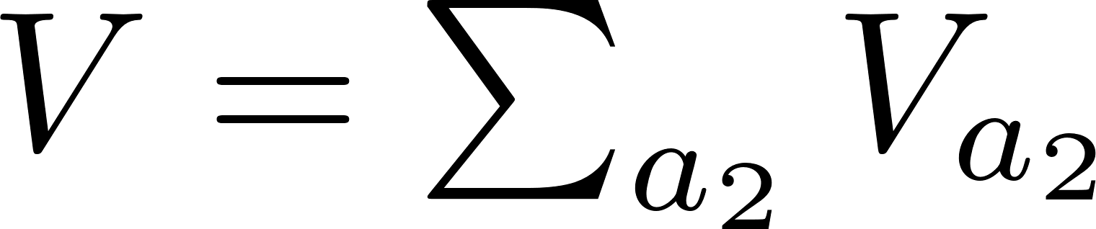
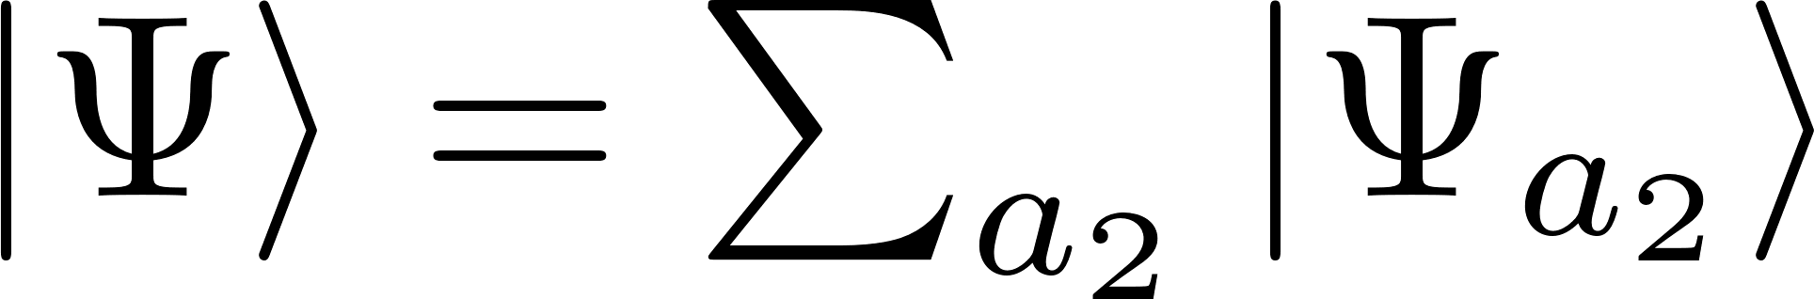
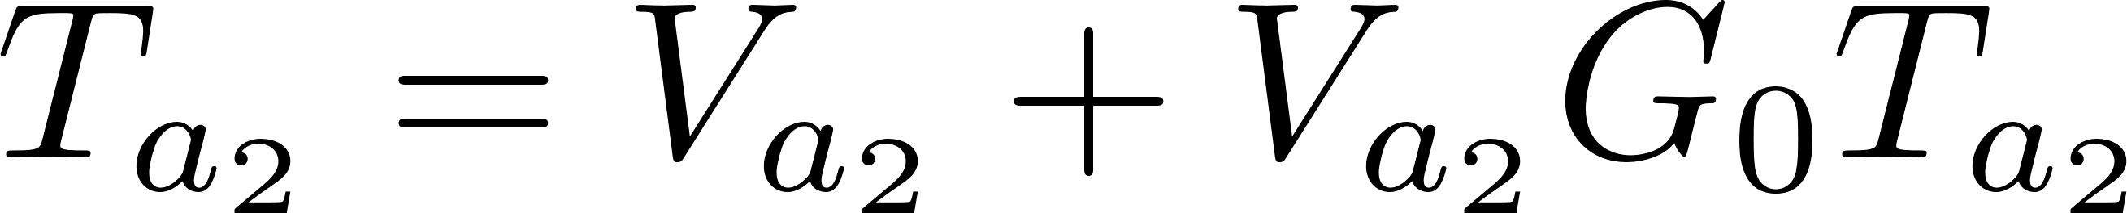
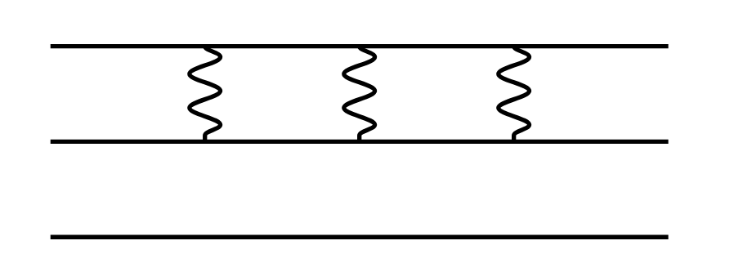
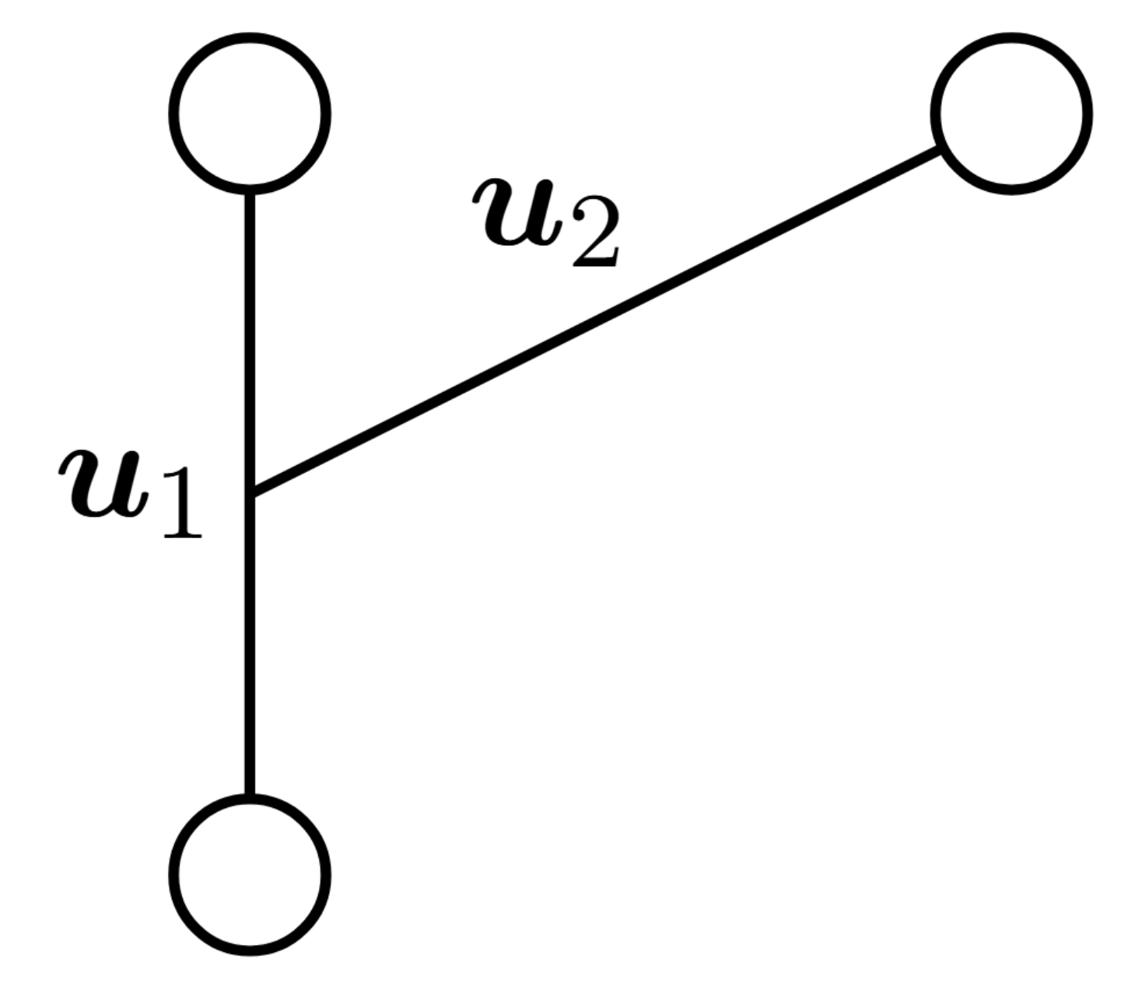
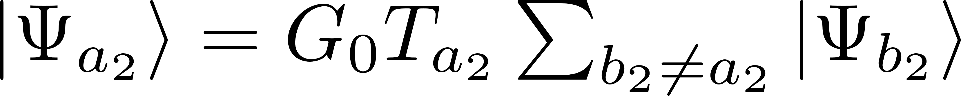
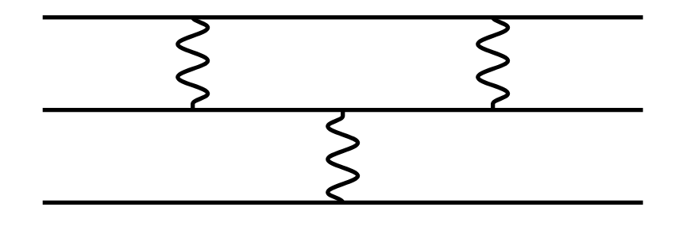
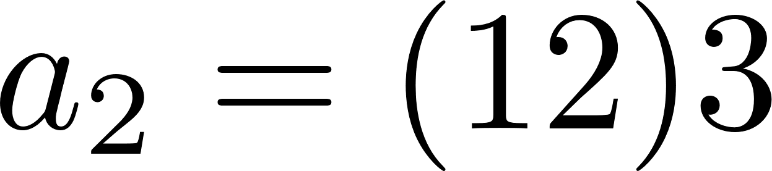
2. Faddeev Formalism
Lippmann-Schwinger eqn. with
Faddeev fragmentation
Use
Faddeev eqn.
Glöckle, The quantum mechanical few body problem
Springer Sc. & Business Media (2012)
fragmentation, e.g.
2+1
disconnected piece
1
3
Fredholm-eqn.
2

Slide 7
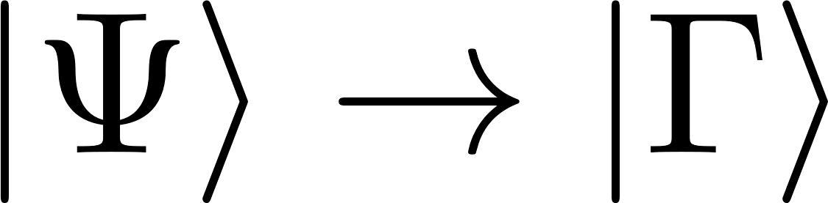
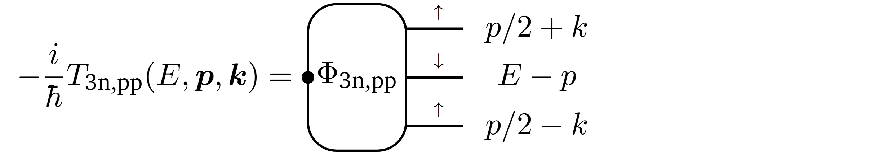
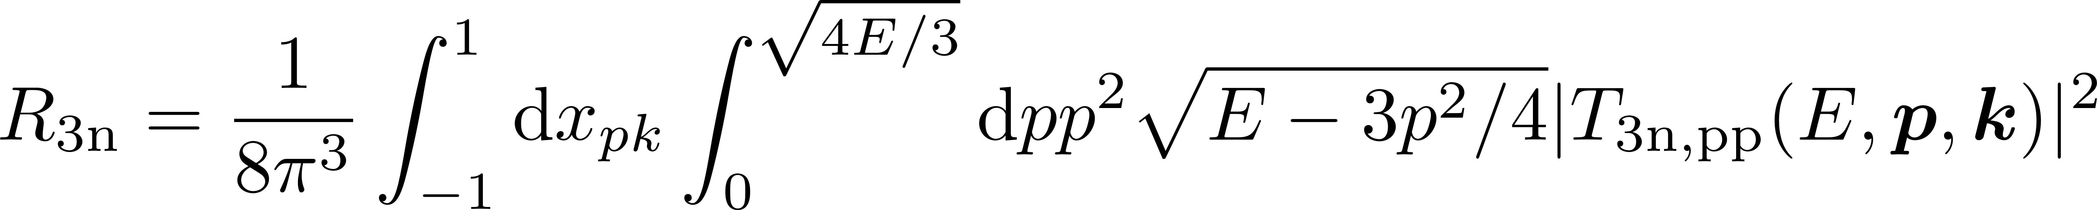
2. Faddeev Formalism
Faddeev eqn. for point-production
For diagrammatic point-production amplitude holds
By comparison of inh. integral eqn. →
homogeneous → point-production
Connection of Faddeev and diagrammatic formalism

Slide 8
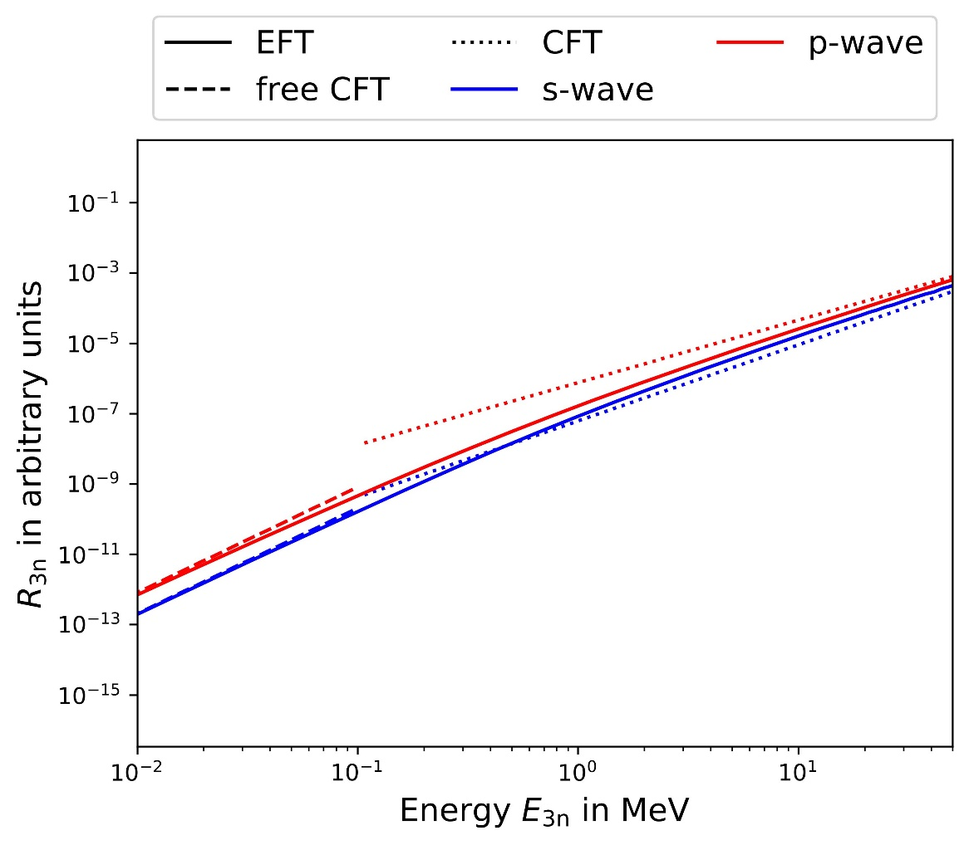
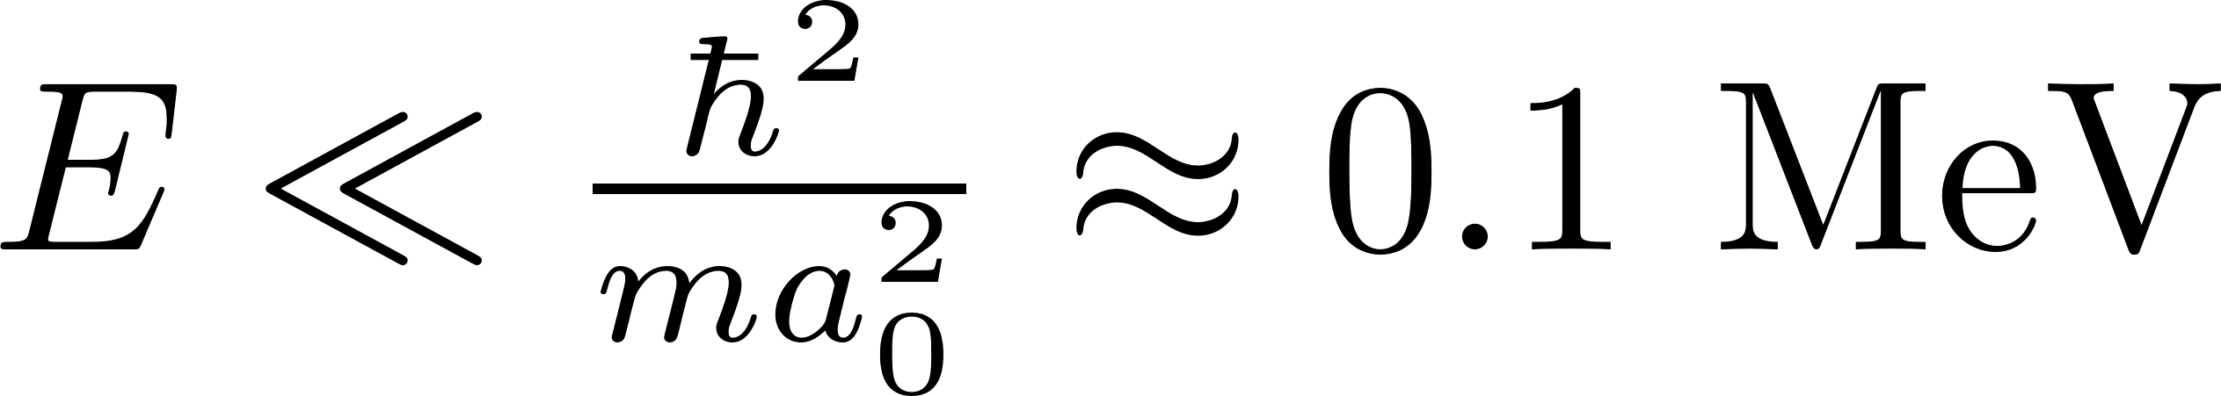
2. Three-Neutron System
Mesh ~ 2048
Use Conformal Field Theory (CFT) as benchmark
- free CFT
- interacting CFT
→ no indication of resonance (up to d-wave)
Hammer & Son
PNAS 118,35 (2021)
preliminary!
Sebatian Dietz TU Prints (TU Darmstadt) – Dissertation (2023)
Backert et al., in preparation (2025)
Sebastian König, NCSU (USA)
FY-Code (2025)

Slide 9
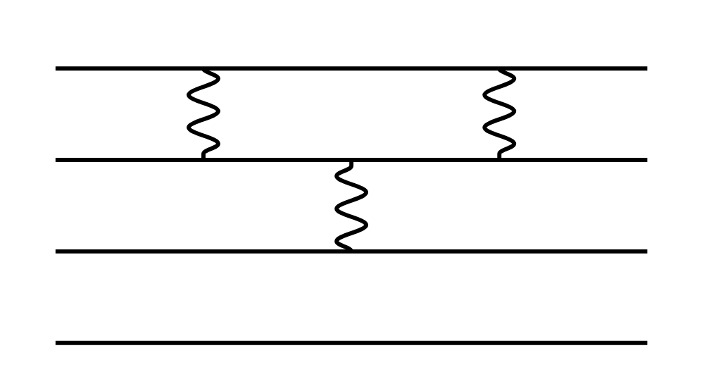
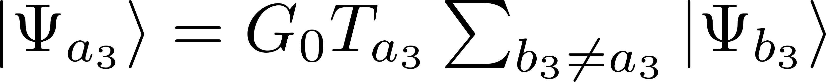
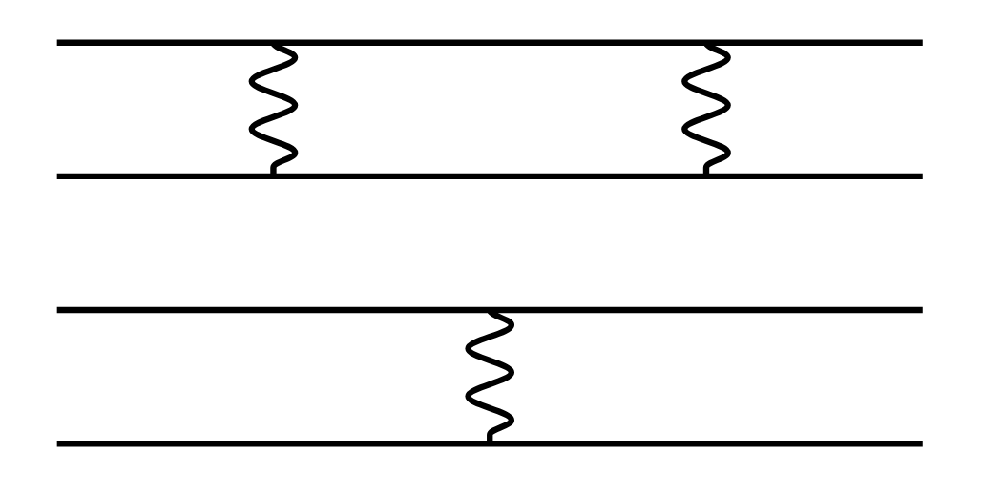
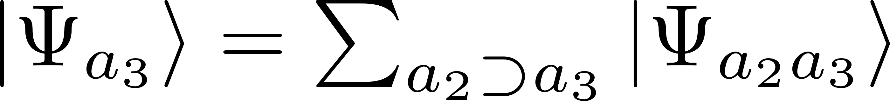
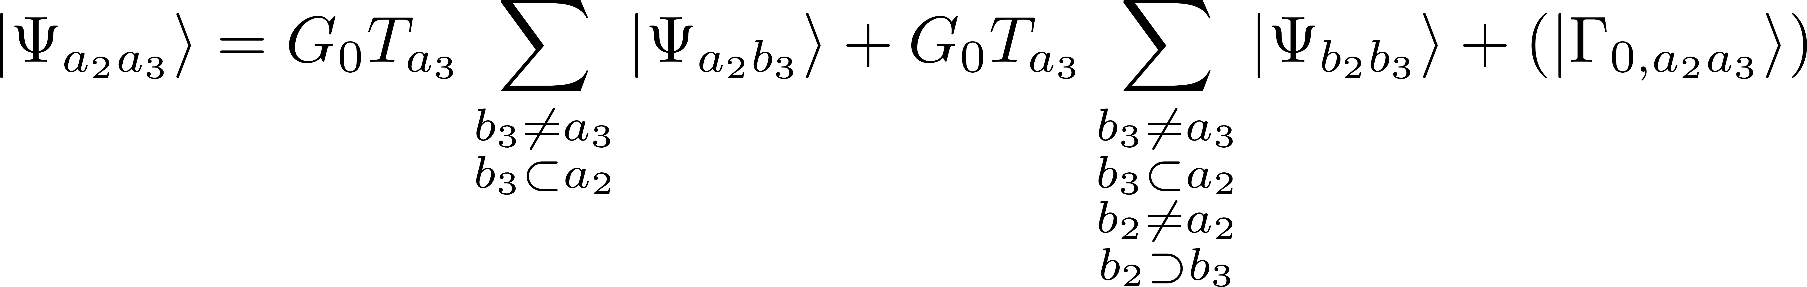
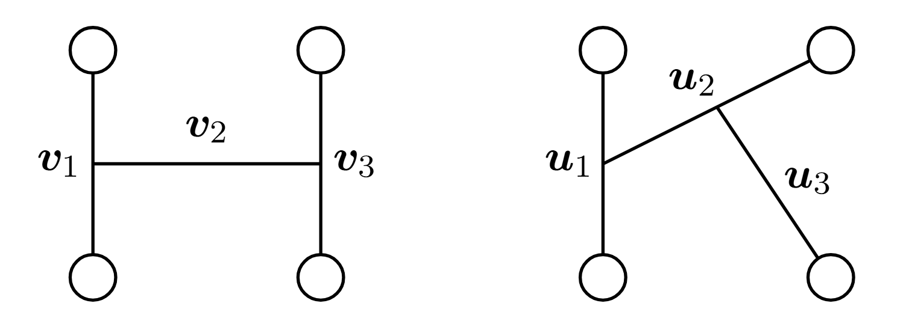
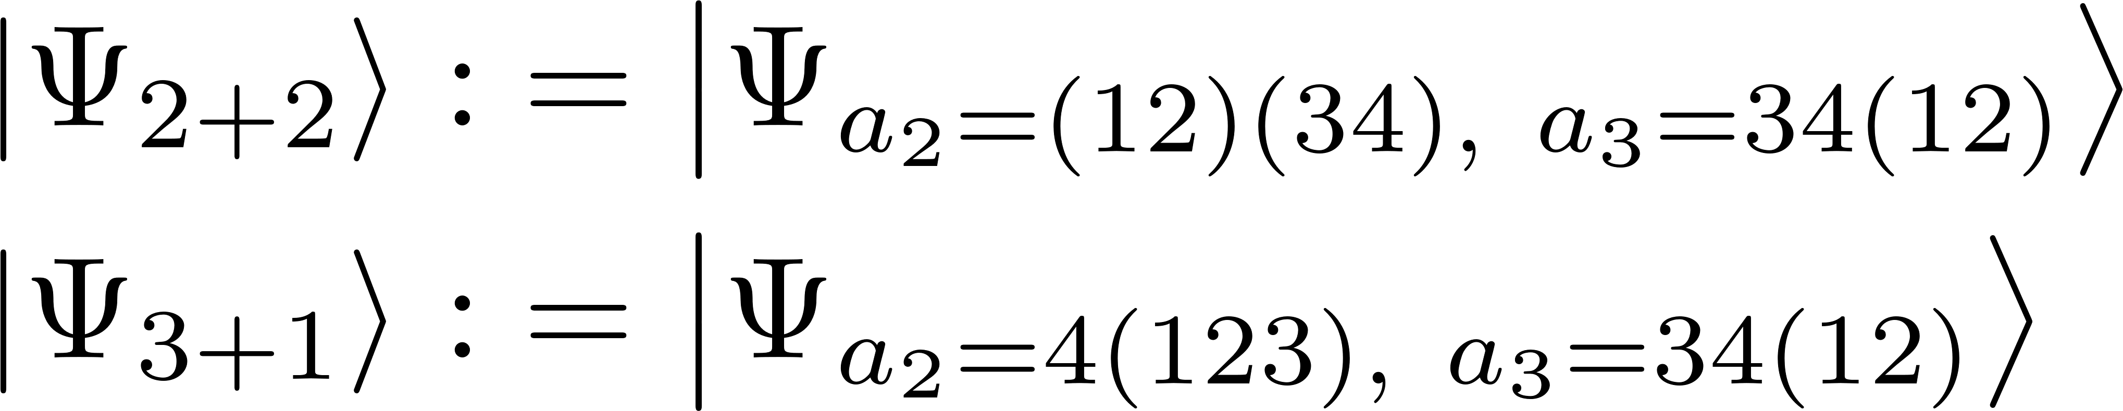
3. Faddeev-Yakubovsky Formalism
4-Body Faddeev eqn.
→ Yakubovsky-decompostion and FY-eqn.
3+1
2+2
Glöckle, The quantum mechanical few body problem
Springer Sc. & Business Media (2012)

Slide 10
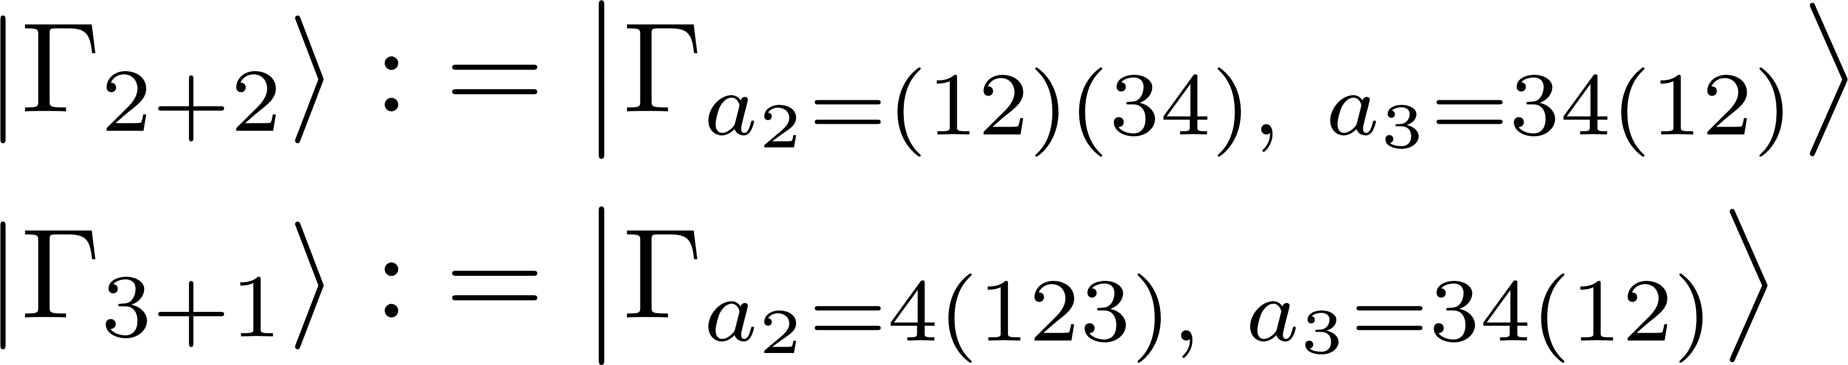
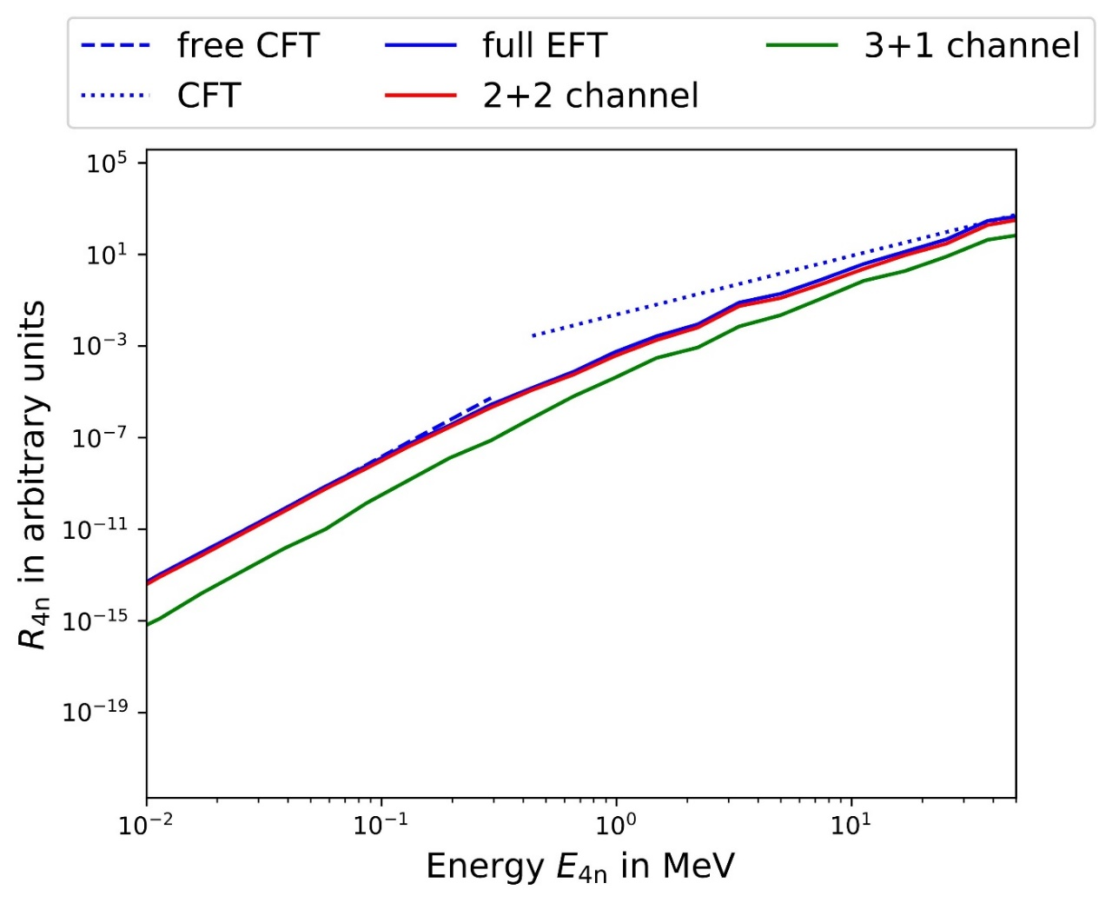
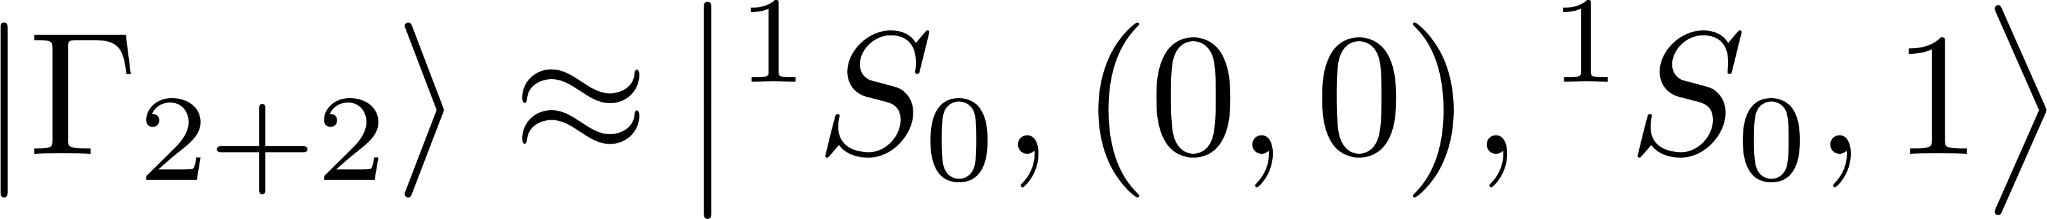
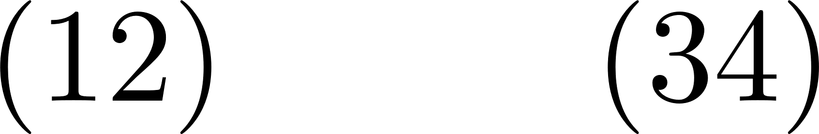
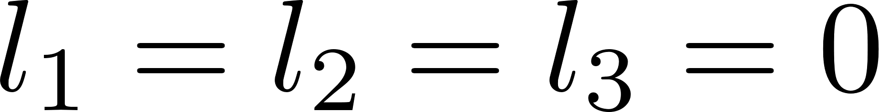
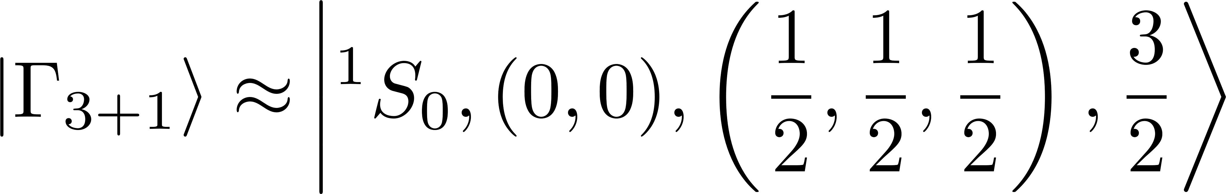
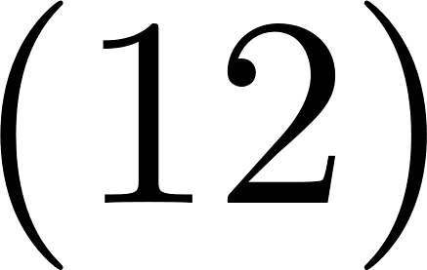
4. Four-Neutron System
Mesh ~ 72
Lowest partial wave contributions:
- 2+2 channel:
- 3+1 channel:
very preliminary!
Sebastian König
FY-Code (2025)
strong 2+2 channel → dineutron-dineutron correlations
Lazauskas et al.
PRL 130 102501 (2023)

Slide 11
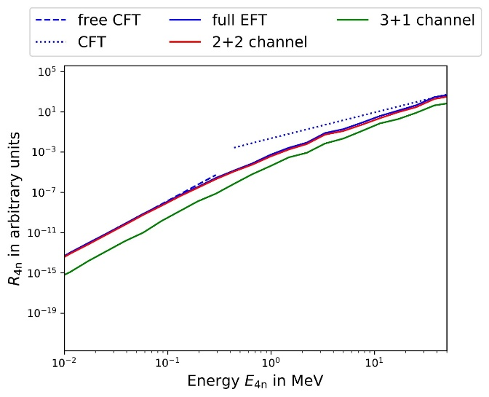
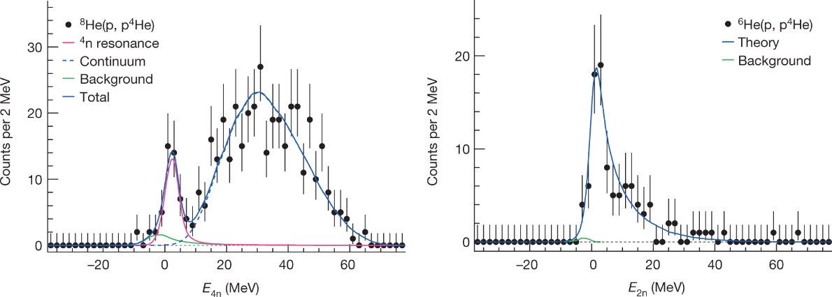
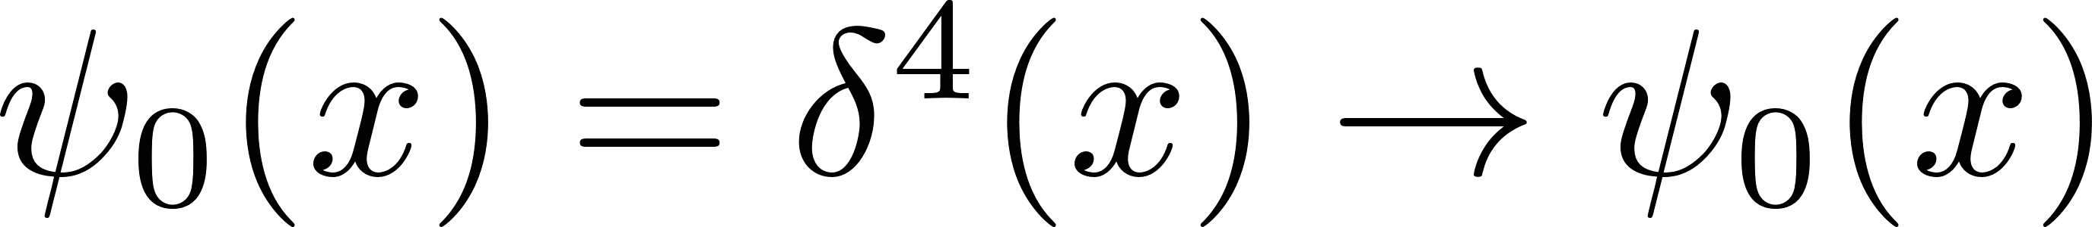
5. Summary & Outlook
Multi-neutron systems → investigate N-N interaction (light & isospin asymmetrical)
Meaning of point-production
Faddeev-Yakubovsky formalism → state decomposition
Investigation of low energy peak origin:
Next possible steps:
- reach convergence of results
- include higher partial-waves
- pp-results with some distribution
very preliminary!
Duer et al.
Nature 606.7915 (2022): 678-682
Sebastian König
FY-Code (2025)

Slide 12
Bonus slides

Slide 13
2. Faddeev Formalism
Lippmann-Schwinger eqn. with
Faddeev fragmentation
Use
Faddeev eqn.
Glöckle, The quantum mechanical few body problem
Springer Sc. & Business Media (2012)
fragmentation, e.g.
disconnected piece
1
3
Fredholm-eqn.
2

Slide 14
2. Faddeev Formalism
Comparison of diagrammatic with Faddeev approach
- diagrammatic:
- Faddeev:

