Slide 1
Study of superheavy nuclei with S³ & Status of S³
J. Piot on behalf of the S³ collaboration
Grand Accélérateur National d’Ions Lourds
European Nuclear Physics Conference 2025
21–26 Sept 2025 – Caen, France
Notes:
Mettre un slide sur la physique de SHE
Pourquoi on les étudie, comment, pourquoi S3 est l’instrument idéal pour ça.

Slide 2
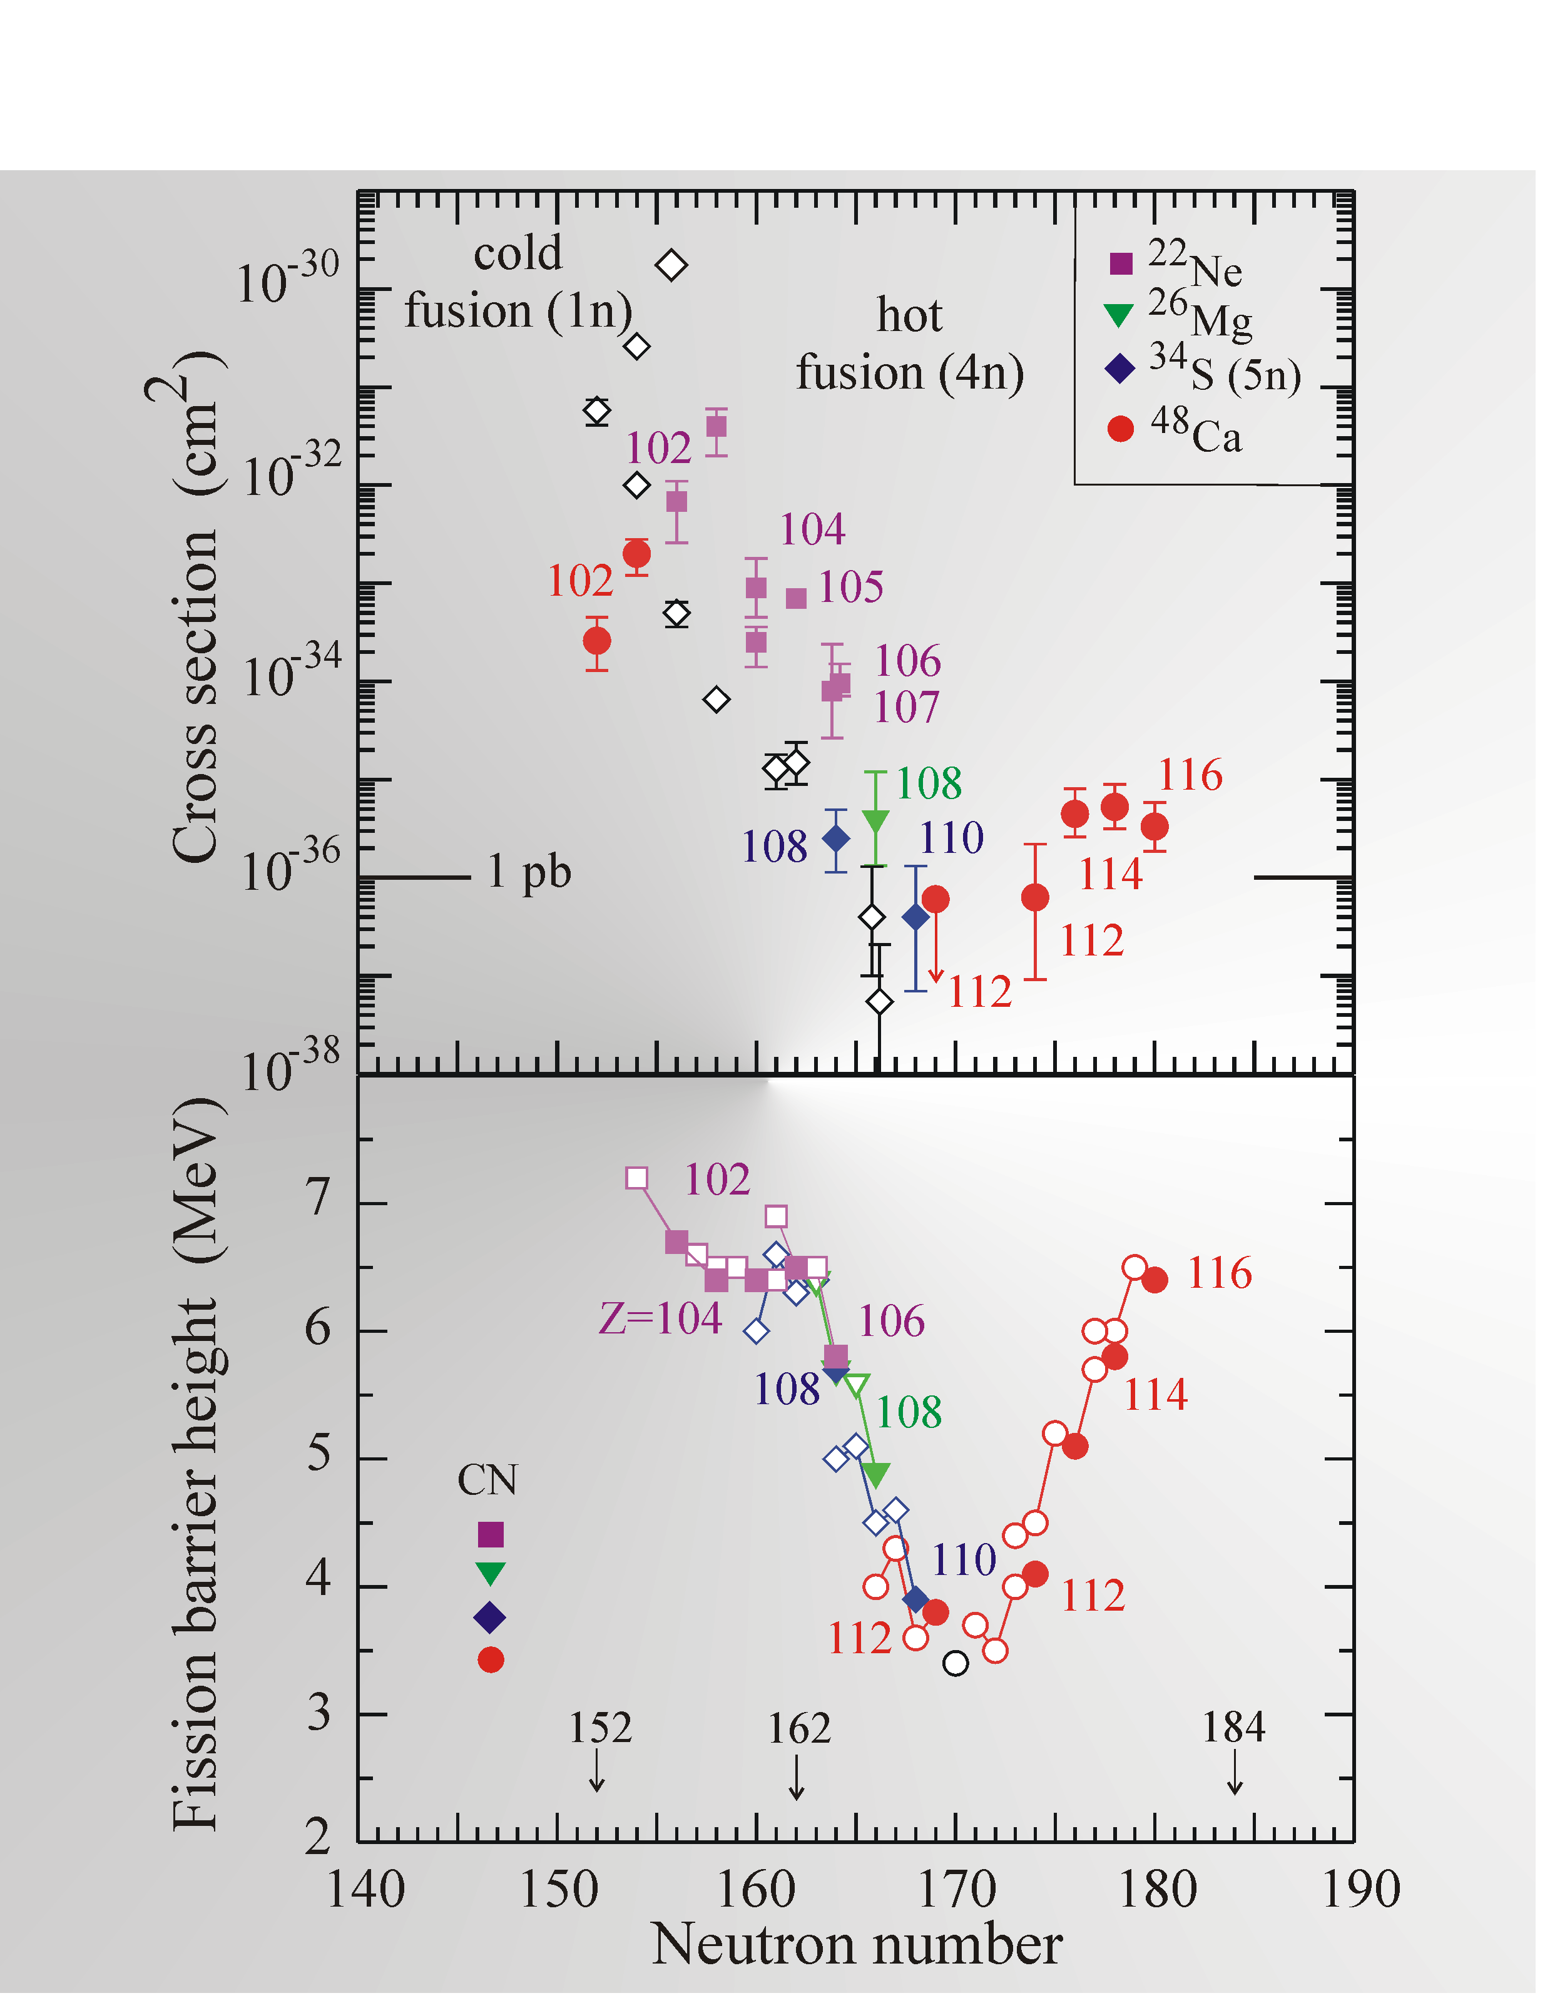
Superheavy nuclei
Nuclei with vanishing Liquid Drop Model Fission barrier
Complete the level schemes of high-cross-sections
Z ⩾ 104
Stabilized by shell effects
Fill the missing isotopes between islander chains and the main-land
Cross-section drops rapidly
Start studying the orbitals involved in the stabilisation of N=162 nuclei
Yu. Ts. Oganessian JPG, 34 (2007) R165
Study Fl and Mc isotopes
Courtesy D. Ackermann

Slide 3
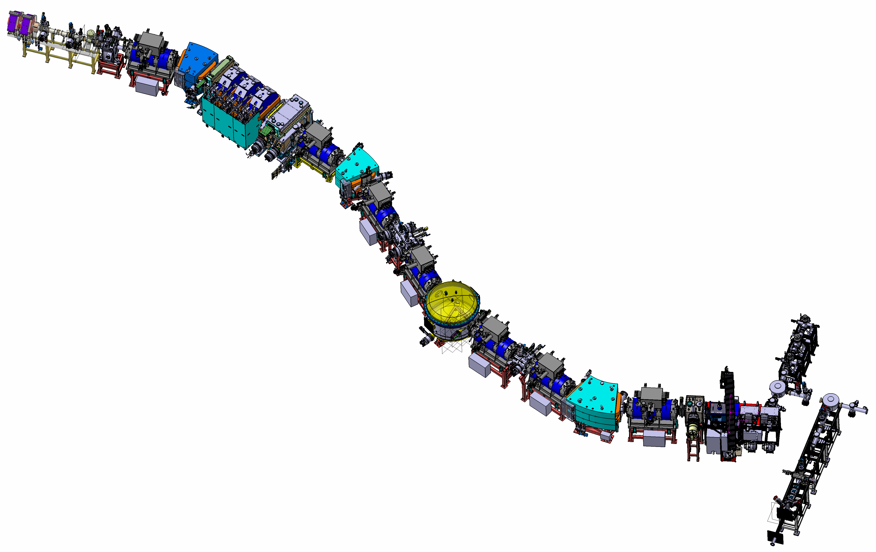



S³ at SPIRAL2
Designed for fusion-evaporation
Use high beam currents from SPIRAL 2 and NEWGAIN
Unique combination of Mass resolution and high transmission
Study rare isotopes down to picobarns

Slide 4
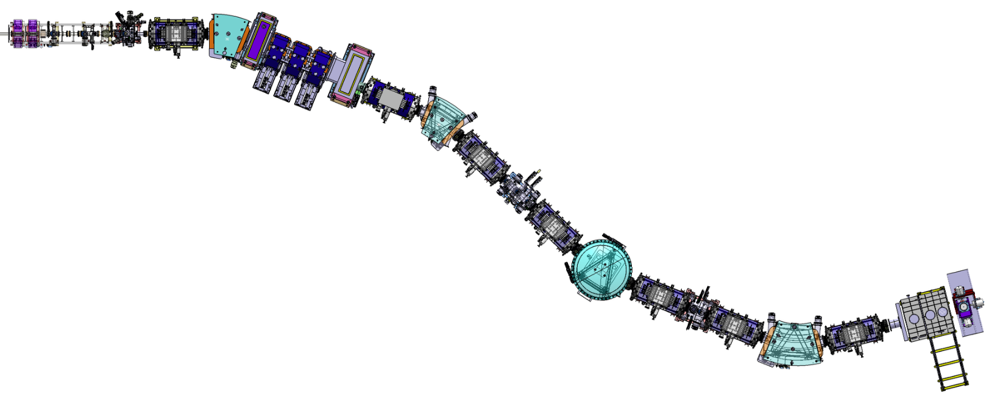
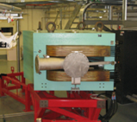
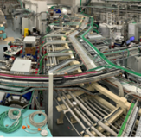
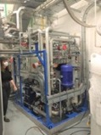

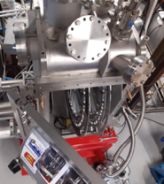
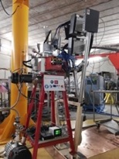
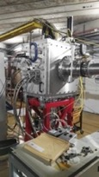

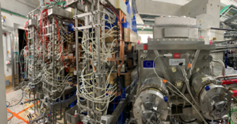


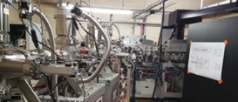

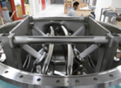


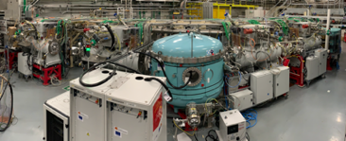



Super Separator Spectrometer
Lot C68, Cooling system, Laser room …
3 × M-dipoles
Infra / Interface
Large H & V gaps
Target system
DSSD, SSD, FEE/BEE, DAQ & Diagbox
High power rotating targets
SIRIUS
Dispersive zone
See Ch. Stodel on Thursday afternoon AI-5
LEB & GISELE Laser Lab
SMT, PSS, Coldbox & LTC
LEB
E-Dipole
20 cm gap & +/- 300 kV
Open slit in the anode
SC Multipoles

Slide 5
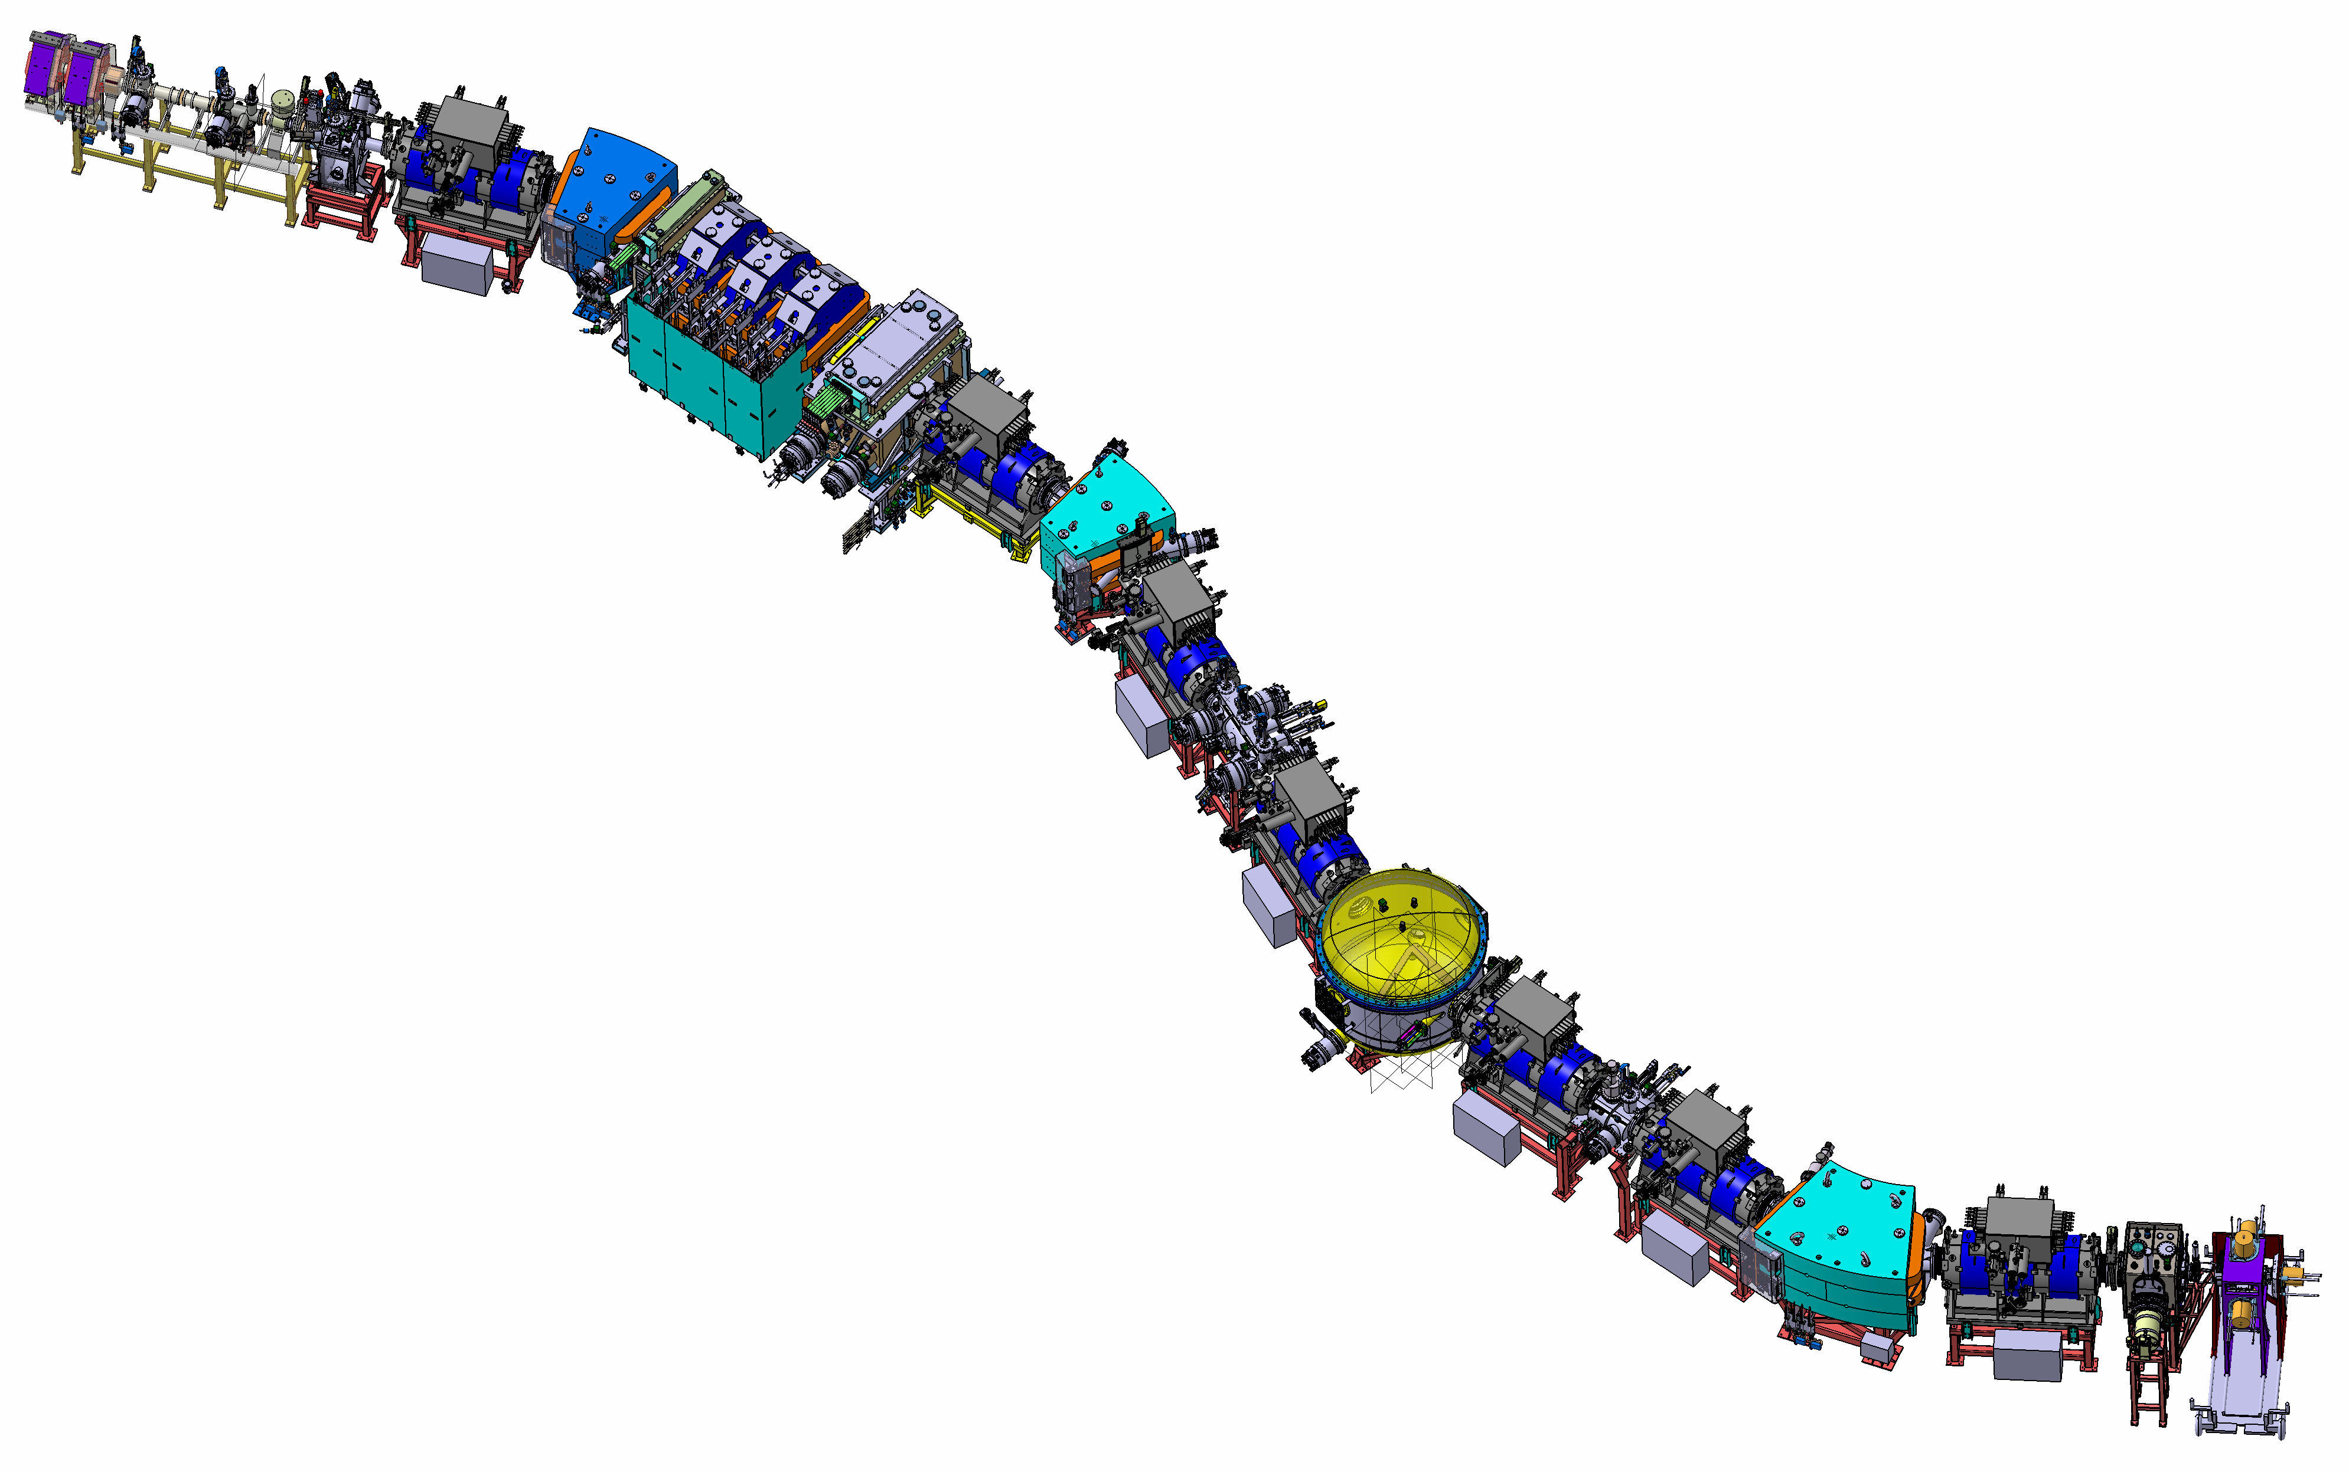
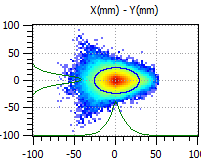
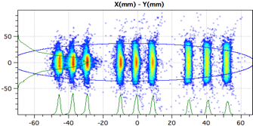
Performances
Achromatic point
Target point
Convergent mode
Primary beam dump
Final focal plane
High Beam intensity
High power target : > 1pµA (= 6.10¹²p/s)
High transmission : 50%
High Selectivity : > 10¹³
Secondary beam dump
Mass Resolution mode
Versatility
➔2 extreme optical modes defined
Convergent : Simplest mode for 1st expt (𝚫_{dp/p}=20%, 𝚫_{𝝦}=90mrad, 𝚫_{𝛗}=140mrad)
High mass res.: M/𝚫M = 505 (𝚫_{dp/p}=16%, 𝚫_{𝝦}=45mrad, 𝚫_{𝛗}=140mrad)

Slide 6
S³ for superheavy nuclei
Designed for fusion-evaporation
Use high beam currents from SPIRAL 2 and NEWGAIN
Unique combination of Mass resolution and high transmission
Study rare isotopes down to picobarns
Complementary setups to study superheavy nuclei :
SIRIUS/SHEXI for Identification, Excitation & Decay Schemes (see A. Bahini earlier)
S3-LEB & SEASON for Mean charge radii, Electric and Magnetic moments (see S. Geldhof on Thursday afternoon AI-5)
PILGRIM for mass measurement & identification
LRC for ion mobility (see M. Laatiaoui – on Thursday afternoon AI-5)

Slide 7

Letters of intent proposed in 2018
S³ detection system | proposed subject | Beamtime A/Q=3 | Beamtime A/Q = 7
LEB | Determination of quadrupole moments along Sb isotopic chain until the proton drip line | 22 | 5
LEB | In-gas laser ionization and spectroscopy of ²¹⁰⁻²¹³Ac and ²¹³⁻²¹⁵Th | 30 | 6
LEB | In-gas laser ionization and spectroscopy of silver isotopes down to (N=Z) ⁹⁴Ag | 27 | 7
LEB | In-gas laser ionization and spectroscopy of nobelium and Lawrencium isotopes | 51 | 9
LEB | Search for octupole deformation in ²²⁵⁻²²⁶U | 18 | 6
LEB | Single-particle states and proton-neutron interaction in the ¹⁰⁰Sn region studied through the neutron deficient In nuclei | 35 | 10
LEB | Mass measurements and laser spectroscopy around ¹⁰⁰Sn | 51 | 10
LEB | Mass measurements and laser spectroscopy on n-deficient isotopes in A~80 region of deformation | 54 | 27
LEB | Fundamental properties of Fermium isotopes around N=152 | 84 | 9
SIRIUS | Detail study of the K-Isomer in ²⁵⁶Rf | 24 | 5
SIRIUS | Search for the end of stability of the No isotopes | 84 | 14
SIRIUS | Search for new isotopes: ²⁵²Rf and ²⁵⁶Rf | 108 | 24
SIRIUS | Alpha-decay specstroscopy of odd-Z isotopes in fermium region | 126 | 23
SIRIUS | Decay spectroscopy of ²⁵³Rf and ²⁵⁷Sg | 60 | 12
SIRIUS | Search for high-K isomeric states in ²⁶⁰Sg | 63 | 13
SIRIUS | Search for cluster radioactivity in the region above ¹⁰⁰Sn | 18 | 4
SIRIUS | N=162 (LoI) | 189 | 38
SIRIUS | Reaction mechanism | 128 | 32
2 focal plane detection systems
LEB - 11 pre-proposals → 3 months „day1“ program
SIRIUS - 11 pre-proposals → 3 months „day1“ program
physics topics:
SHN
basic nuclear properties (masses, ionization potential, quadrupole moments, radii ...)
K-isomers
single partical states
new isotopes
odd-Z nuclei
reaction mechanism
N=152, 162
...
N=Z
basic nuclear properties (masses, ionization potential, quadrupole moments, radii ...)
single particle states
¹⁰⁰Sn region
$α$/cluster radioactivity
...

Slide 8

Letters of intent proposed in 2018
”day1 ” - preproposals
152
beyond
with NEWGAIN
2029
+ SC source
$≥$ 2030
162
184
SIRIUS
120
Isomers
²⁵⁴Rf, ²⁶⁰Sg
S³ LEB
114
Search for new isotopes
²⁵²Rf
relativistic effects and the architecture of the periodic table
rutherfordium/dubnium isotopes
108
Limits of stability/isomers
^{250,249,…}No
E_{shell}
Atomic spectroscopy
(isomers, shapes and moments)
fermium isotopes
Odd Z isotopes – nuclear structure
fermium region
Calc.: A. Sobiszewski
“day 1”
with injector
A/Q=3
Octupole deformation
uranium region

Slide 9
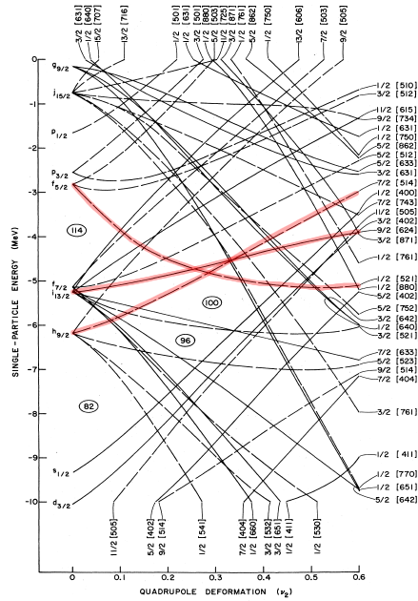
Influence of Z=114 gap
Letter of Intent – S. Antalic et al.
Odd Z isotopes
Z=105
SF
(9/2+)
7/2-
Z=103
SF
1/2-[251]
9/2+
Proton single particle energy (MeV)
1/2-
3/2-
1/2-[251]
7/2+
Z=101
S. Antalic
Woods-Saxon potential R.R. Chasman et al.
Z=99
Two Nilsson orbitals originating from below 7/2-[514] and above ½-[521] the spherical Z=114 gap are accessible in Md, Lr and Db isotopes.
J. Piot
Notes:
Very little information is available on these nuclei.
Odd Z nuclei share the alpha decay strength between many path -> large statstics necessary (ex 247Md level scheme + Alpha spectrum)
Two decay modes are complicating the studies :
Spontaneous fission can happen from ground state or from isomeric states. The preminence of fissioning isomeric states increases with decrasing neutron number. Fission events have been observed in what could be 244Md
However Electron Capture also has a significant branch and can lead to EC delayed Fission.

Slide 10
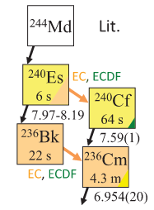
Study of Md isotopes
²⁴⁴⁻²⁴⁵⁻²⁴⁷Md investigated to see the position of isomer
Verify the production of ²⁴⁴Md at LBNL & GSI (See talk by S. Kumar)
Physical Commissioning of S3 with SIRIUS :
Mass identification will help validate ²⁴⁴⁻²⁴⁵ Md production
High statistics to study the structure of these isotopes and follow the ½- isomer in neutron deficient isotopes
Quantify the fission branch in Md and Es and verify the ECDF scheme
J. Khuyagbaatar et al. PRL 125 (2020) 142504

Slide 11
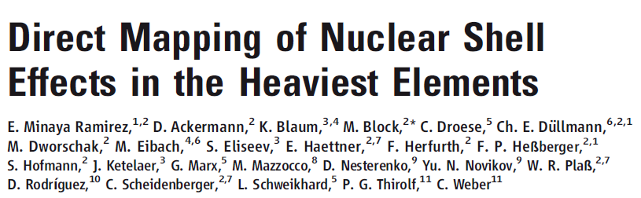
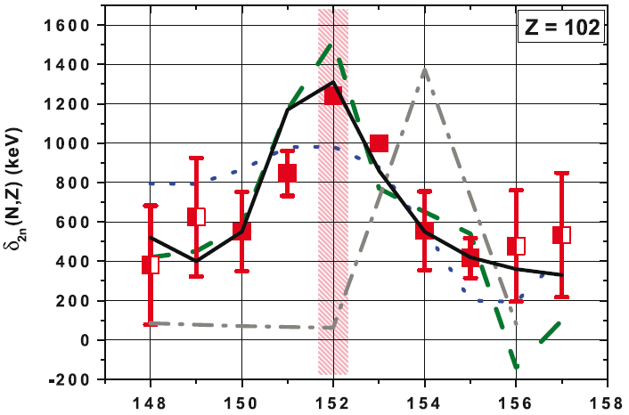
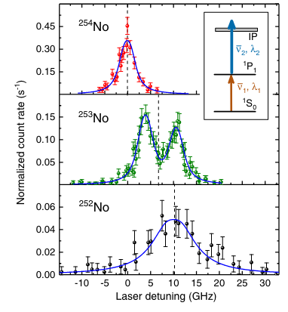

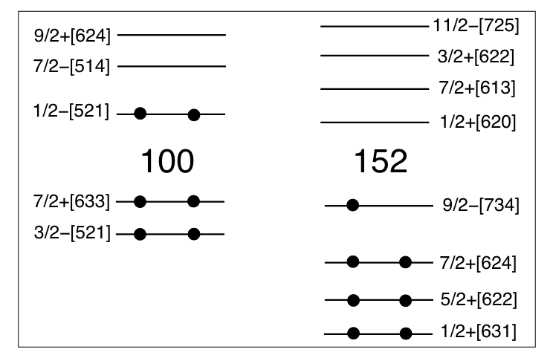
Complete the fermium-nobelium region
Letters of Intent – K. Hauschild, P. Greenlees, R. Ferrer, J. Piot …
²⁵⁴No has been extensively studied : Decay spectroscopy, Mass measurement, Laser spectroscopy
No
Experimental
Muntian (mic-mac)
Z=114 N=184
Möller FRDM
Z=114 N=184
TW-99
Z=120 N=172
SkM*
Z=126 N=184
But question remains on the single particle configuration of the isomers
This region is accessible to laser spectroscopy
Fermium & Nobelium isotopes under investigation at GSI
G.S. of ²⁵³No assigned to 9/2-[734] [1]
Md and Lr will be studied at S³ using both decay spectroscopy and laser spectroscopy
Cross-measurements with SIRIUS & S³-LEB
A. Lopez-Martens et al. EPJA 32 (2007) 245
[1] S. Raeder et al. PRL 120, 232503 (2018)

Slide 12
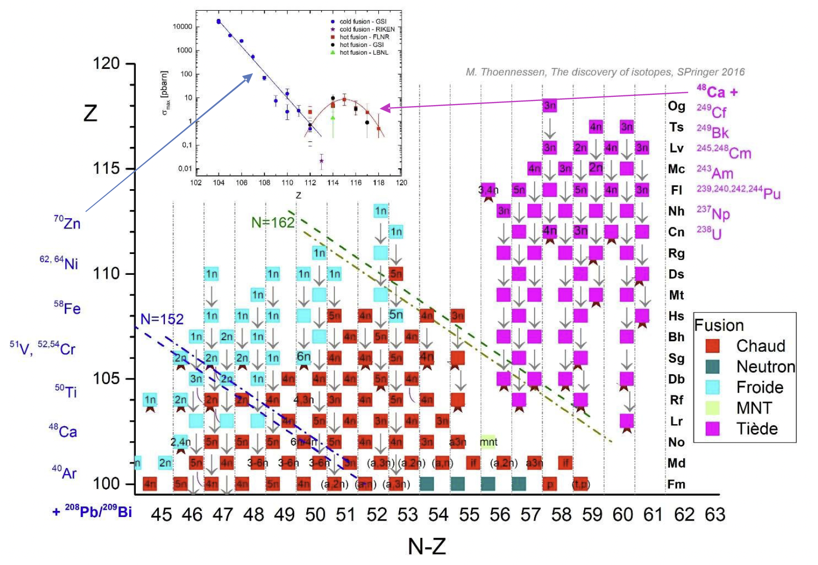

Bridge Cold & Hot fusion chains
Letter of Intent – Ch. Stodel et al.
The production of superheavy nuclei proceed through two types of fusion-evaporation reactions :
48Ca+Actinide based
208Pb/209Bi based
Decay chains produced with 48Ca and actinide targets are not linked to the rest of the Segré chart due to fission.
Produce Sg to Cn in reactions using ²³⁸U targets
Ch. Stodel
J. Piot
GANIL Community Meeting 2018
Notes:
Produce known isotopes using different reaction to confirm the assignment.
Use S3 mass analyzer to validate the A
Compare production cross-section with a fixed target and different projectiles to study the fusion-evaporation reaction mechanism.

Slide 13
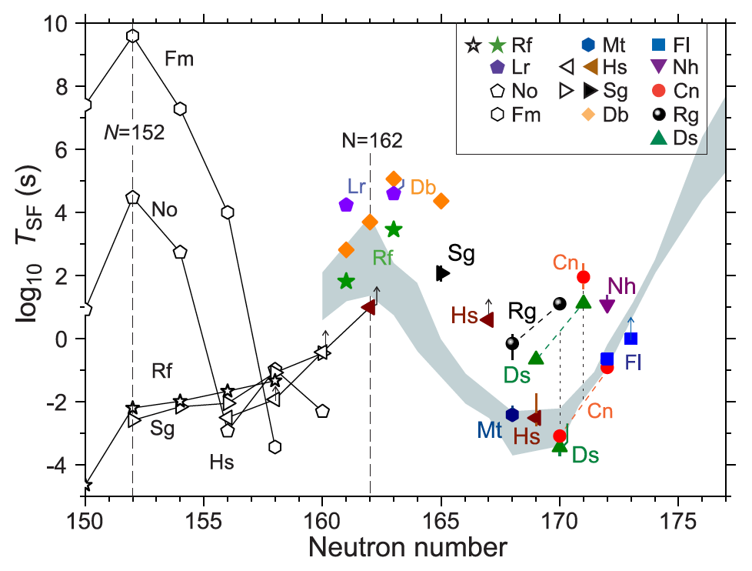
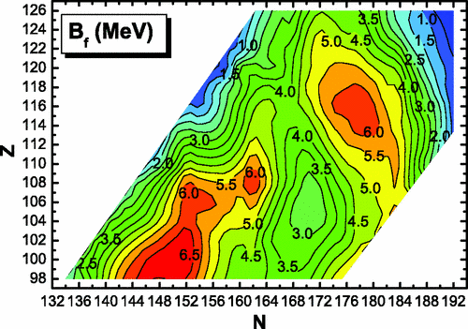
Investigate the N=162 Deformed shell gap
Letter of Intent – A. Drouart et al.
The enhancement of the fission barrier by shell effects at N=162 is expected in the Z=Sg-Ds region.
It is observed experimentally in the few studied isotopes.
However, data is still quite scarce on these isotopes
High-K Isomers are expected and will help investigating the relevant single-particle orbitals.
Low cross-section ~ pbarn requires high beam currents
Some isotopes will require actinide targets
Yu. Ts. Oganessian et al. Phys. Rev. C 112 (2025) 014603
M. Kowal et al. Phys. Rev. C 82, (2010) 014303

Slide 14
Investigate the N=162 Deformed shell gap
Letter of Intent – A. Drouart et al.
First step with stable targets
154
156
158
160
162
164

Slide 15
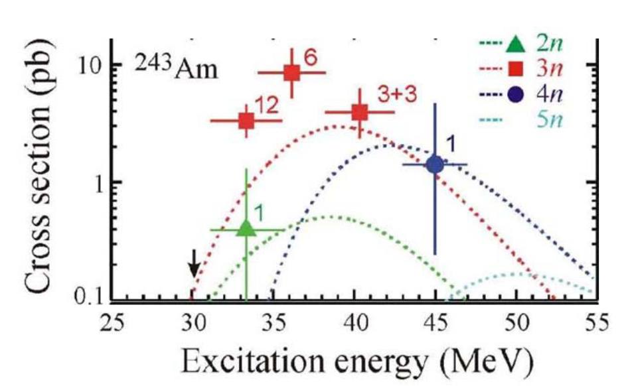
Superheavy nuclei beyond Cn
Study Mc (Z=115) and Fl (Z=114) decay chains
Mass separation from S³ will garantee the evaporation channel
X-ray measurement from SHEXI will provide the Z
Very scarce data on decay patterns.
Electron Capture muddies the decay chains
Measurements of TKE for fissioning nuclei are necessary
No data is available on the excited levels
Require actinide targets :
Development of a dedicated target station : TARDIS (TArget for RaDioactive ISotopes)
Licensing for actinide target : Starting with Pu and Am.
Requires NEWGAIN with high beam intensities of ⁴⁸Ca and ⁵⁰Ti
V.I. ZAGREBAEV, NUCL. PHYS. A734 164 (2004)

Slide 16
Status of S³

Slide 17

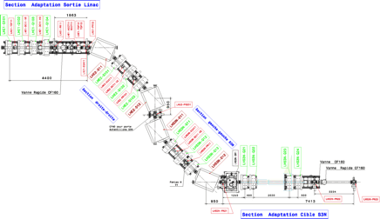
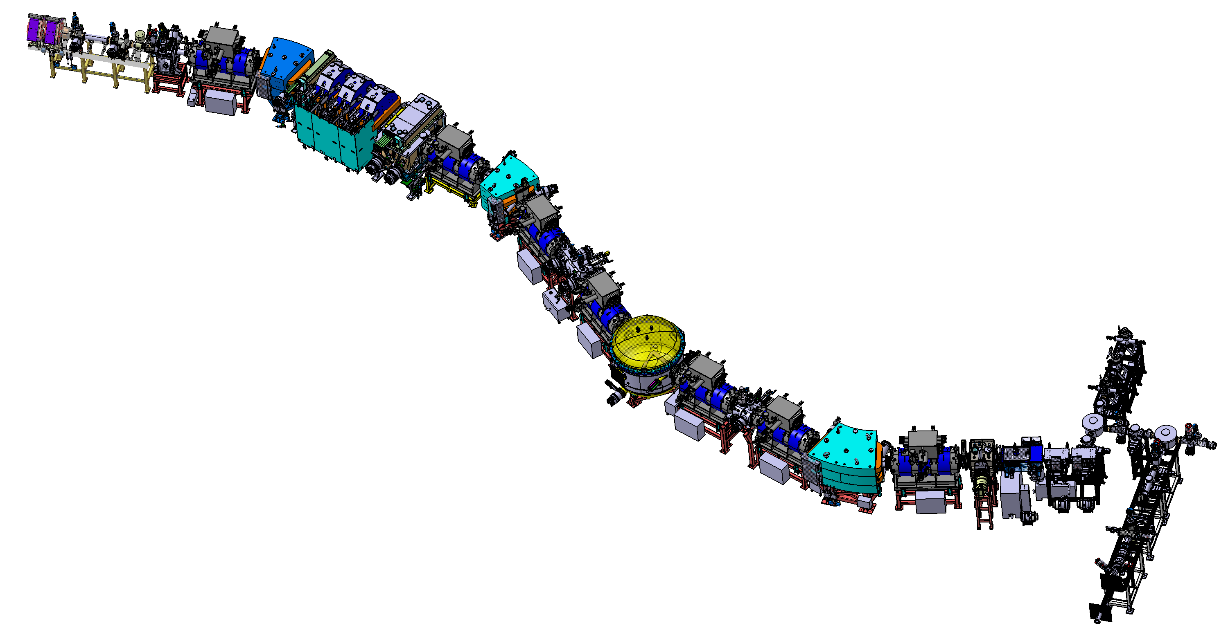
J6x : commissioning milestones
J6A
Accelerator & beam line tuning up to the target
Done in Nov 2024
J6B
Spectrometer optical commissioning with direct beam
Beam
J6C
Scientific commissioning, reactions at the target
Measure and optimise the rejection (case by case)
Estimate transmission
Detection systems : LEB / SIRIUS
LHE-S3N
Achromatic point
Mass separator
Target position
S³LEB
Primary beam dump
Momentum achromat
Final focal plane
Secondary beam dump
LINAC
S³

Slide 18

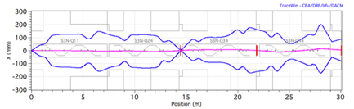
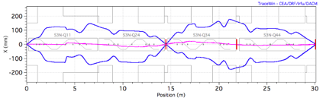
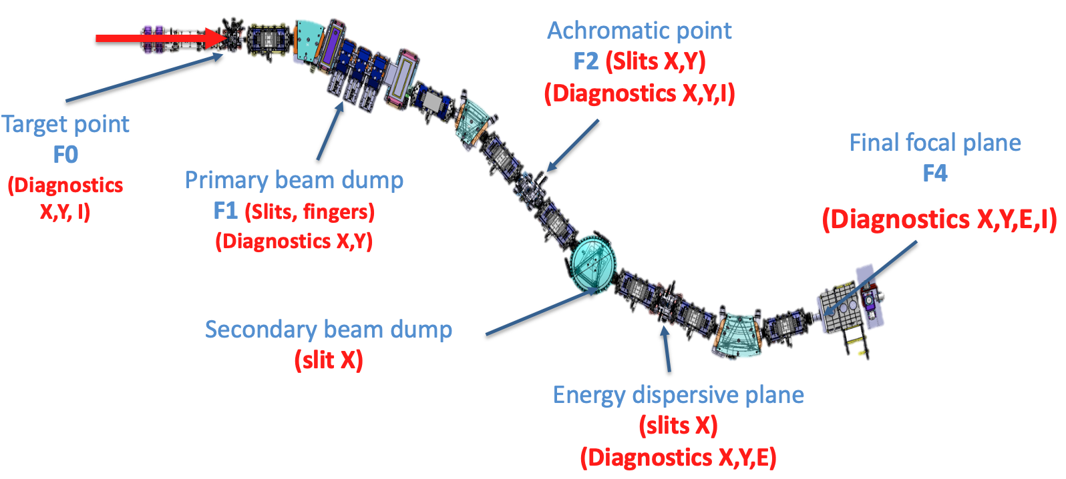
Milestone J6B planned to start end 2025
Spectrometer optical commissioning
Direct and stripped beam up to the focal plane
Progressive tuning of the elements (MA+ MS)
Tools : diagnostics along the spectrometer + additional diagnostics at the focal plane (SIRIUS & LEB can be connected but not used)
➔ Beam ⁴⁰Ar ; E = 0.73 - 5 MeV/u and intensity of 30 W
Prerequisites
Beam on target : commissioning de of LHE-S³ with validation of the beam characteristics at the target point (Done J6A)
Commissioning of individual elements (magnets, power supplies, control-command, diagnostics…)
Alignments of magnets, slits and diagnostics Safety systems must be operational

Slide 19
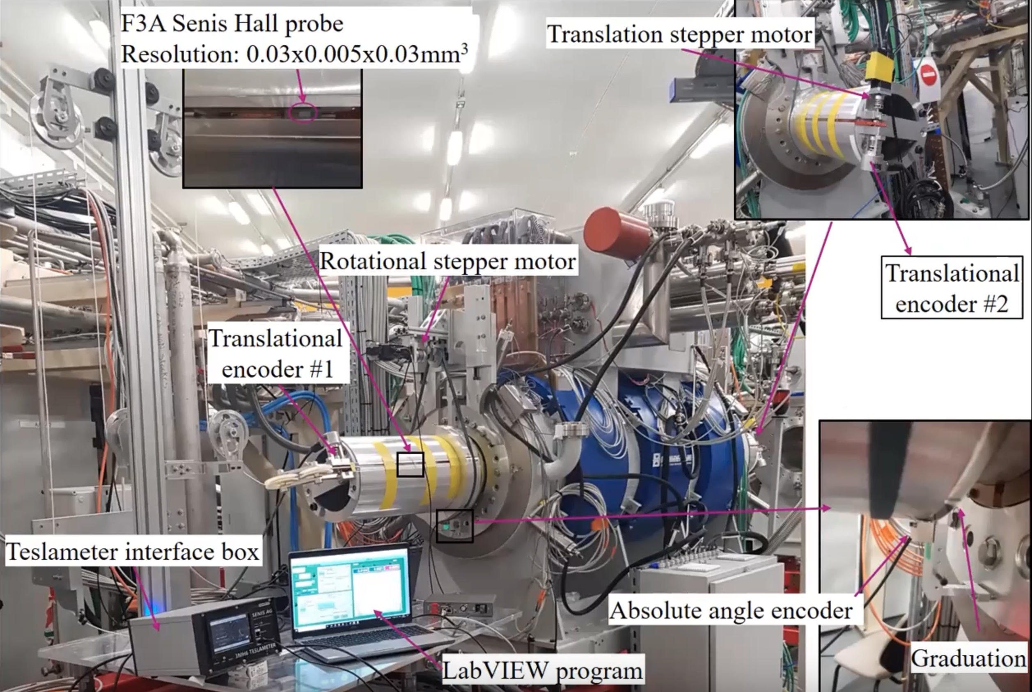
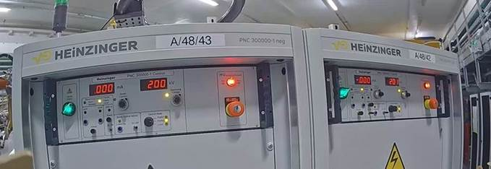
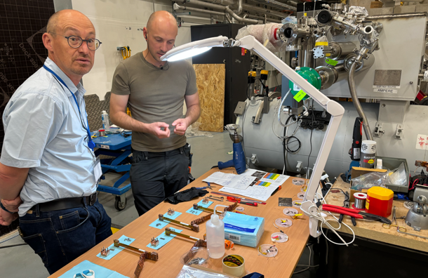
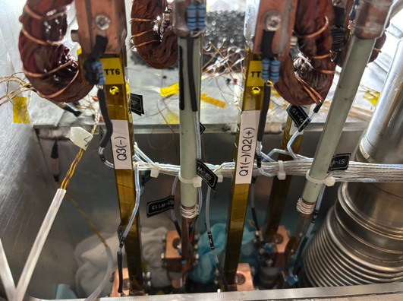
Actions towards Milestone J6B
In May the Electrical Diole was conditionned at +/- 200kV : Voltage sufficient for the Commissioning.
Vaccuum leak repaired on SMT 5
New Helium probe installed on SMT6
HTS Current lead were successfully replaced on SMT 5 and 6
Field mapping done on 2 SMT - Alignement done

Slide 20
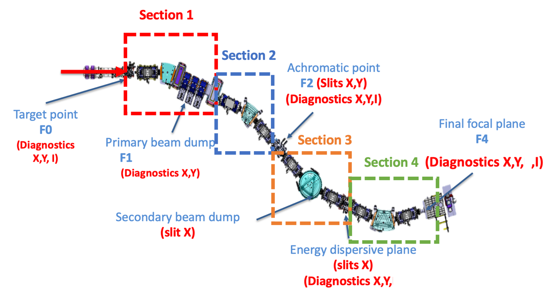
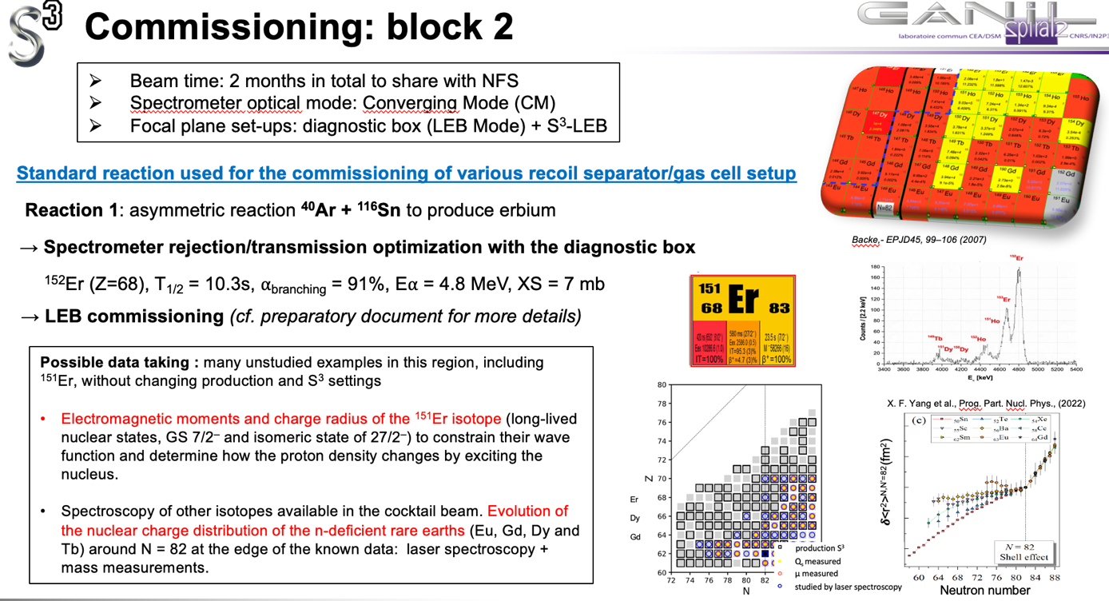
Next expected steps
J6B : Spectrometer beam optics
commissioning with ⁴⁰Ar
at 0.73 MeV/u and 5 MeV/u
J6C : Spectrometer scientific commissioning
⁴⁰Ar + ¹¹⁶Sn
December 2025 : Sections 1 & 2
Mid May 2026 : Sections 3 & 4
From mid of June 2026

Slide 21
J6C : Spectrometer scientific commissioning
⁴⁰Ar + ¹¹⁶Sn
Block 3 (Coverging mode) : SIRIUS
Reaction 2: asymmetric reaction ⁴⁰Ar + ¹⁷⁴Yb to produce known actinides
Reaction 3: asymmetric reaction ⁴⁰Ar + ¹⁸⁰Hf to produce thorium (N=126)

Slide 22
Thank you for your attention
S³ Collaboration - Letters of intent proposed by 18 laboratories:
ANL (U.S.A.), CENBG, IJCLab, JINR-FLNR, (Russia), GANIL, GSI (Germany), INFN Legnaro (Italy), IPHC, IPNL, Irfu CEA Saclay, JYFL (Finland), K.U. Leuven (Belgium), University of Liverpool (U.K.), LNS (Italy), LPSC, MSU (U.S.A.), LMU (Germany), Nanjing University (China), Northern Illinois University (U.S.A.), SAS Bratislava, (Slovaquia), IFJ PAN Cracovie (Poland), Smoluchowski Institute (Poland), CEA-DAM, SUBATECH, TAMU (U.S.A.), University of Mainz (Germany), University of York (U.K.), Vinca Institute (Serbia)
Construction partners :
GANIL, Irfu, IJClab, ANL, KU LEUVEN, IPHC, INSP/UPMC, CIMAP, University of Mainz, University of Jyväskylä, University of JENA, GSI
S3 has been funded by the French Research Ministry, National Research Agency (ANR), through the EQUIPEX (EQUIPment of EXcellence) reference ANR-10EQPX- 46, the FEDER (Fonds Européen de Développement Economique et Régional), the CPER (Contrat Plan Etat Région), and supported by the U.S. Department of Energy, Office of Nuclear Physics, under contract No. DE-AC02-06CH11357 and by the E.C.FP7-INFRASTRUCTURES 2007, SPIRAL2 Preparatory Phase, Grant agreement No.: 212692.
SIRIUS has been funded by the CPIER "Vallée de Seine", and by the Région Normadie & FEDER through the SoSIRIUS RIN tremplin Grant

