Slide 1





Enhanced laser-driven proton acceleration through Formvar film production
Afonso Vicente^{1(*)}, Aarón Alejo², Adrián Bembibre², Daniel Galaviz^{1,3}, Margarida Paulino¹, Pamela Teubig^{1,4}, Raquel Nunes¹, Ricardo Pires¹
^{* Email: ajvicente@lip.pt}
¹ Laboratório de Instrumentação e Física Experimental de Partículas (LIP)
² Instituto Galego de Física de Altas Enerxías (IGFAE), Universidade de Santiago de Compostela (USC)
³ Faculdade de Ciências da Universidade de Lisboa (FCUL)
⁴ Faculdade de Design, Tecnologia e Comunicação da Universidade Europeia (IADE)

Slide 2
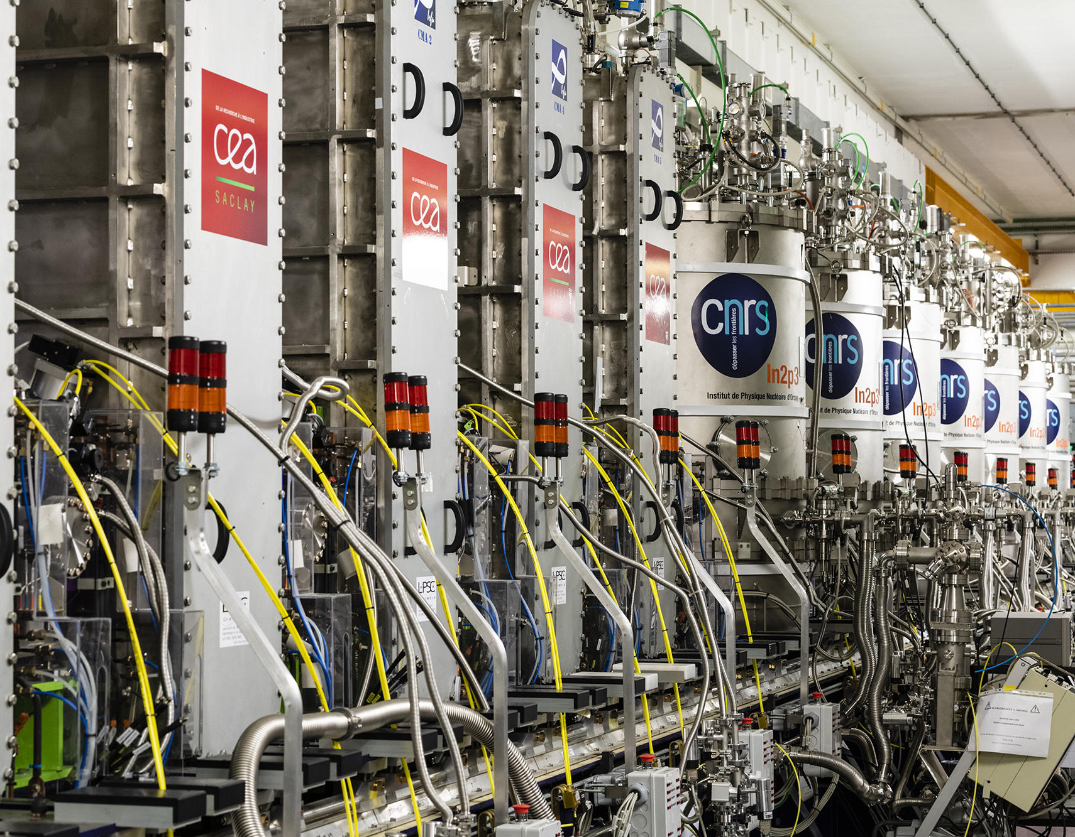
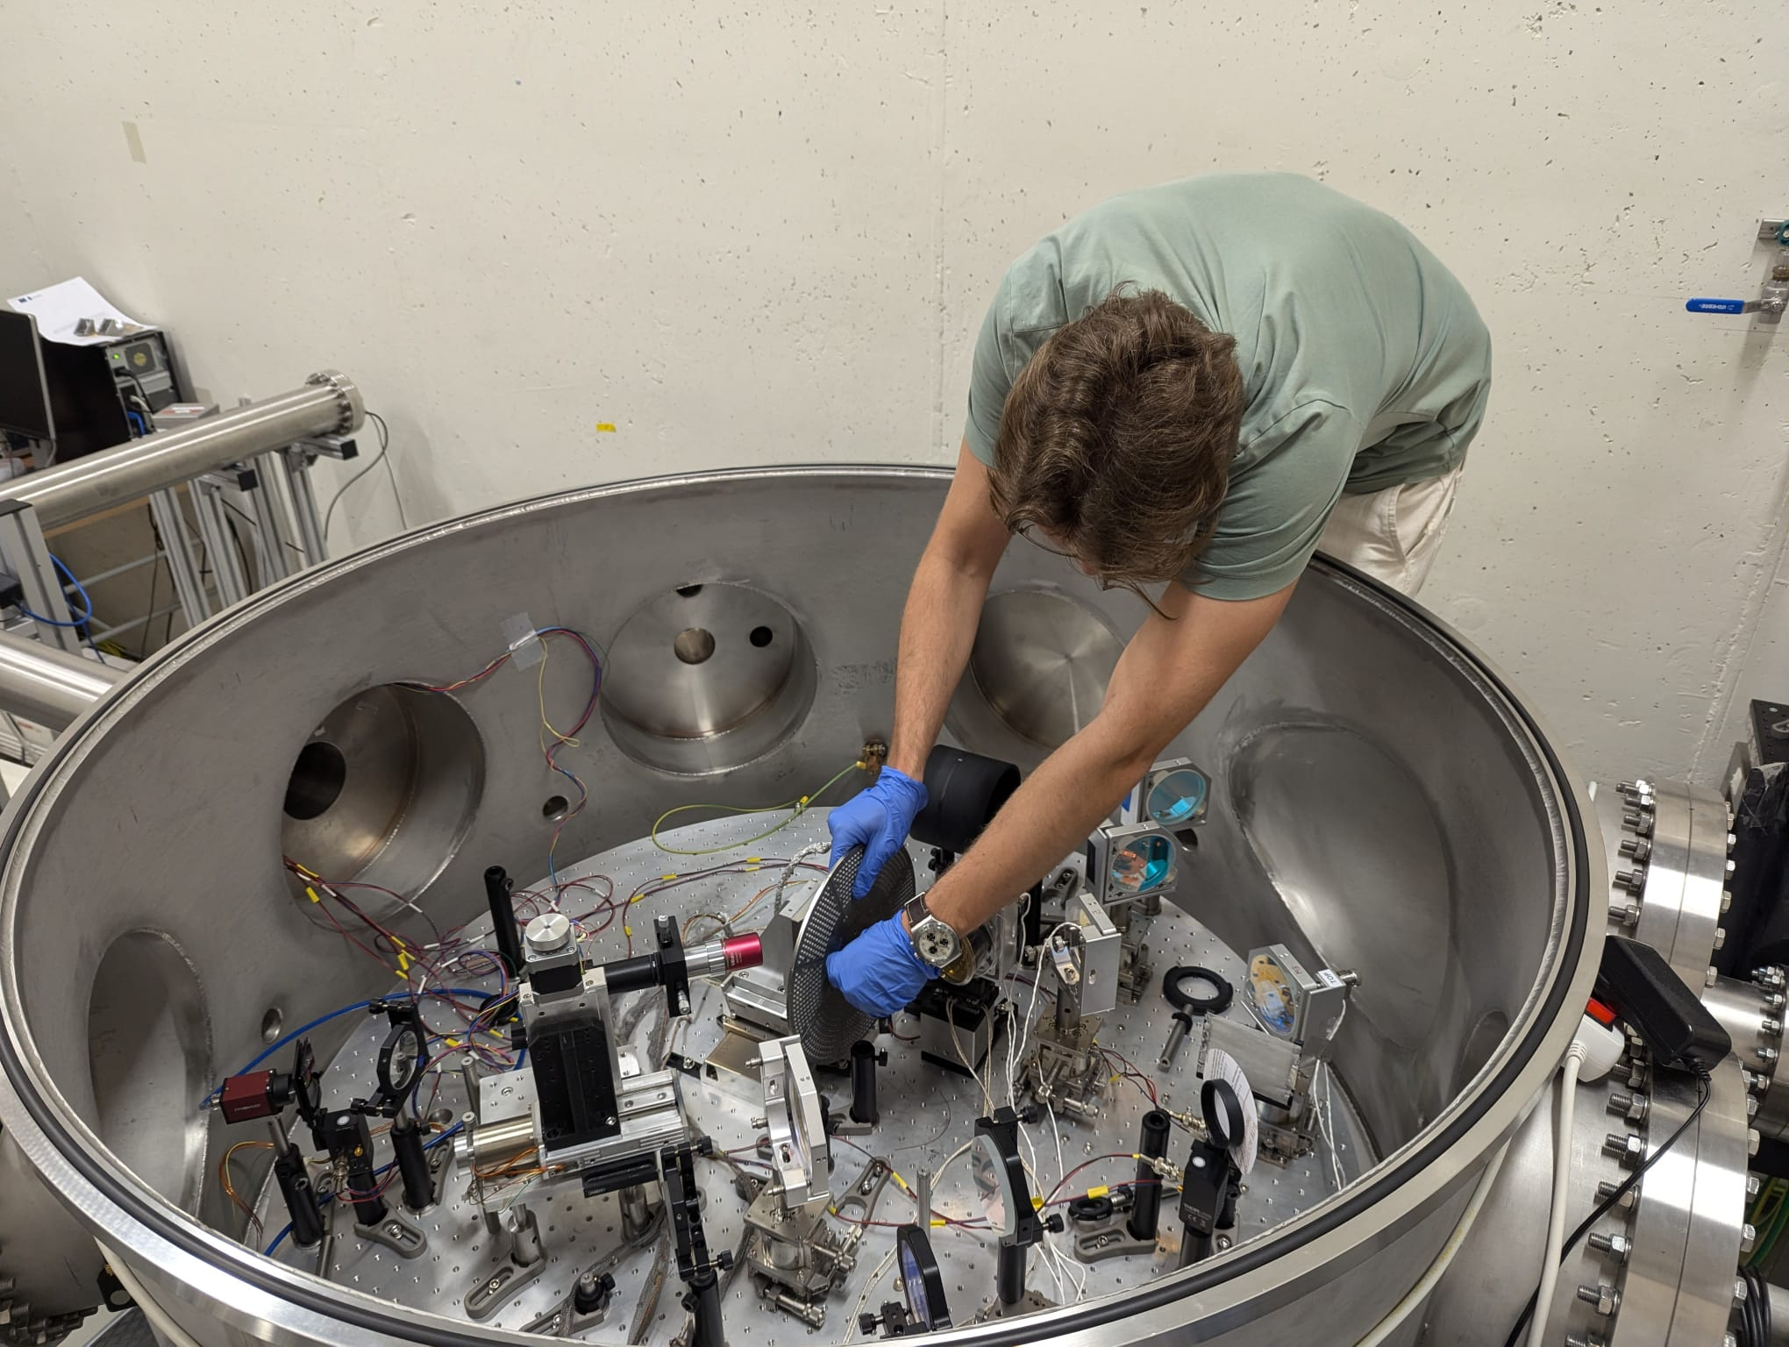
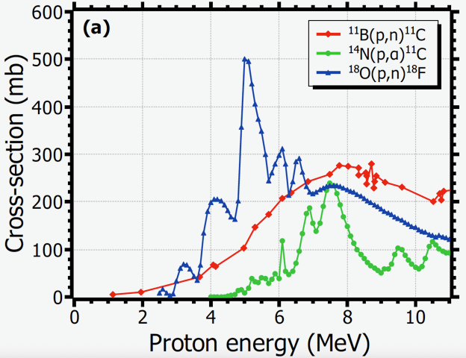
Introduction
Laser-driven ion acceleration is an emerging alternative to conventional acceleration for low-energy:
  Electric field gradients on the order of GV/cm to TV/m;
  Require less space;
  Exceptional accelerator-like spatial quality.
Key requirement: produce a stable beam, capable of operating for prolonged periods of time, with optimum flux and energies.
8 m
> 25 m
The linear accelerator SPIRAL2-LINAC from GANIL.
Picture of the laser-driven accelerator from L2A2-USC.
J. Peñas et al,
Scientific Report 14, 11448 (2024)
Cross-sections of some proton-induced production reactions of radioisotopes of interest in PET.
Notes:
One of the major challenges for conventional accelerators, which use RF technology, is their limit on the maximum acceleration field strength, which is about 100 MV/m. Due to this limitation, the acceleration path has to be extremely long, which requires very large and expensive facilities. Therefore, alternative, more compact acceleration methods are being actively studied.
One of these alternatives is laser-driven acceleration, since this method has acceleration field strengths on the order of GV to TV/cm, which significantly reduces the required acceleration path. This is specially useful for medical applications such as radioisotope production and radiotherapy, since it minimizes their costs. To be a viable option, the generated beam needs to be stable and capable of operating for long periods of time. One way to tackle this requirement is through the optimization of the targets used for irradiating, which was the focus of my work.

Slide 3
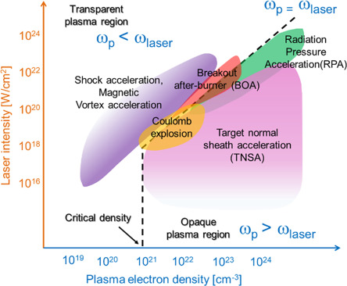


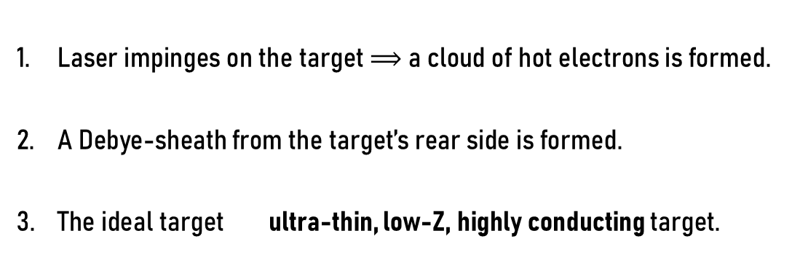
TNSA mechanism
Laser impinges on the target $⟹$ a cloud of hot electrons is formed.
A Debye-sheath from the target’s rear side is formed.
The ideal target ultra-thin, low-Z, highly conducting target.
Target
Debye length
Laser incidence
$$→$$
+
+
+
Hot electron
cloud
+
+
+
+
+
+
This work
+
+
Blow-off
plasma
+
Accelerated
ions
+
+
Different laser-driven acceleration mechanisms.
+
$$\vec{E}$$
Kojima and Hata,
Advances in Accelerators and Medical Physics (Book),
Chapter 31 (2023)
Schematic of the ions being accelerated by the electrons (not to scale).
Notes:
To better contextualise my work, I will now explain the used laser-driven acceleration mechanism, which, as you will see, directly dictates the target requirements. The specific mechanism this work focused on was the Target Normal Sheath Acceleration and, in TNSA, when the main pulse of the laser impinges on the target’s front surface, a cloud of hot electrons is formed, which causes further ionization as it penetrates and propagates throughout the bulk of the target. Although most of the electrons become electrostatically confined to the target, some of them escape the target, and they start to laterally expand on the target’s rear surface. The way the electrons expand creates a kind of sheath, known as the Debye sheath, because it is distanced from the target by a Debye length. This sheath generates a charge-separation field so intense that it rips out light ions from the target’s rear surface and accelerates them, creating an ion beam.
As such, the ideal target would have to be ultra-thin (so that electrons can easily reach the target’s rear side), low-Z (to more easily accelerate ion), and highly conducting (so that the electrons mobility and the plasmas quality are higher).
While previous studies have found that one of the best options, in general, is to use metallic targets with a thin layer of hydrocarbon contaminants on the target’s rear side, in my work I benchmarked a methodology to produce plain plastic and plastics films with a thin silver layer in the target’s front side, instead, to optimise the flux and energy of laser-induced proton beams.

Slide 4
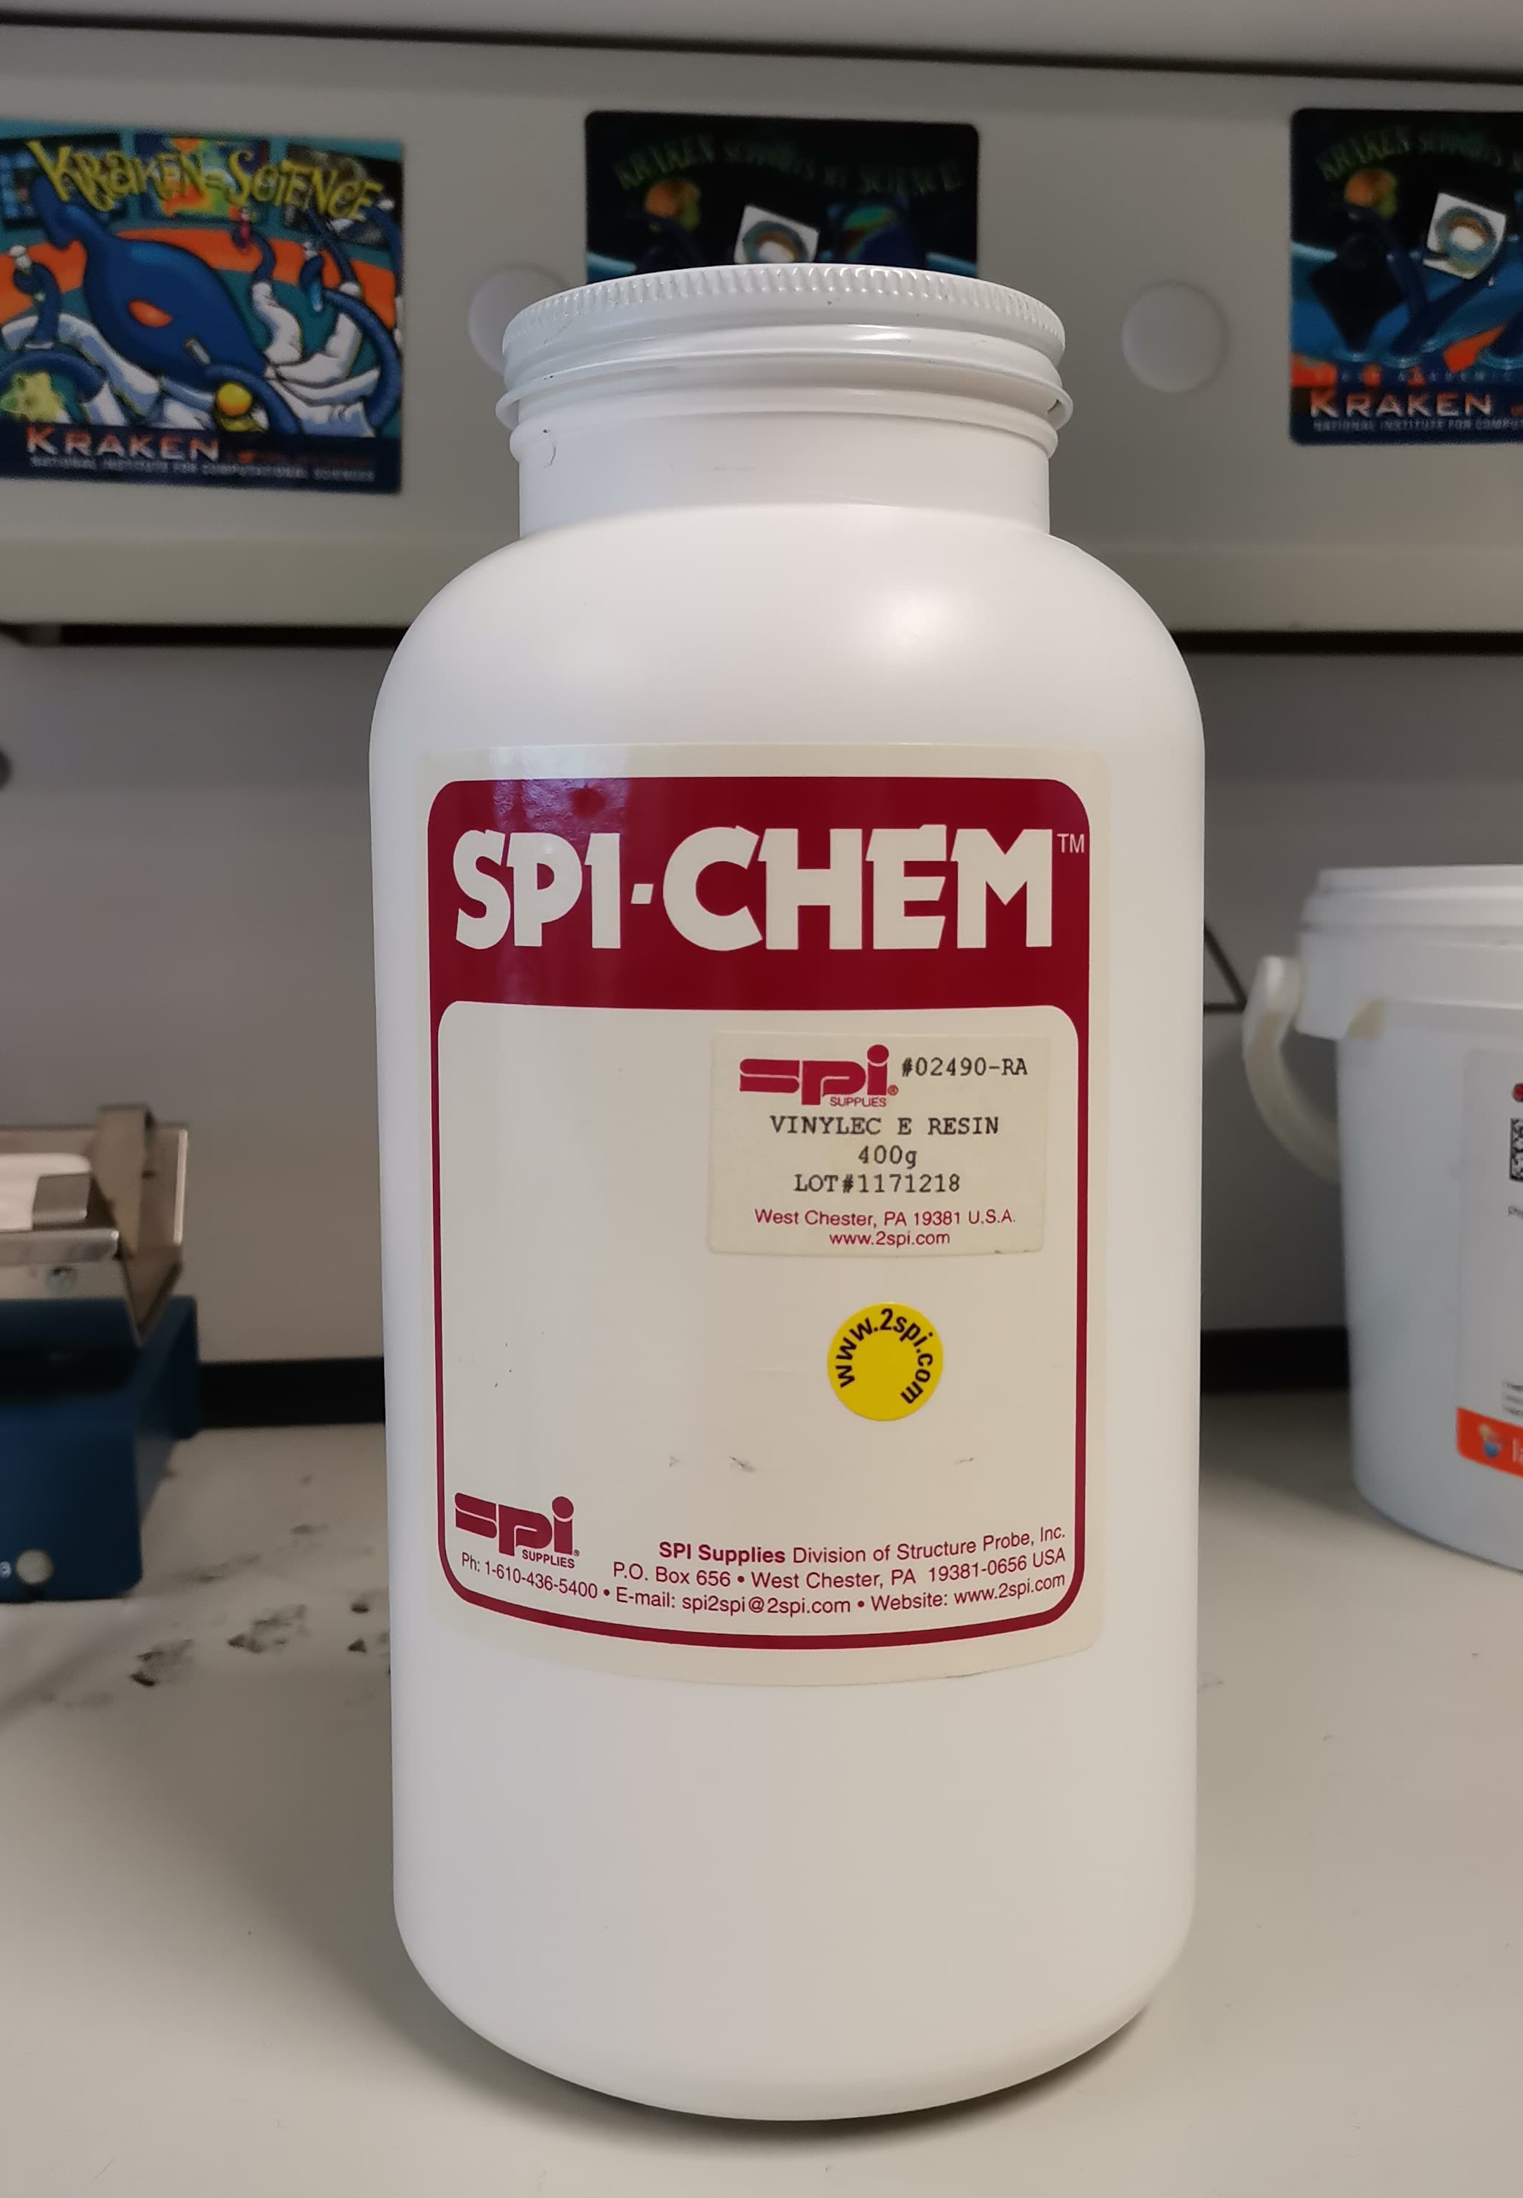
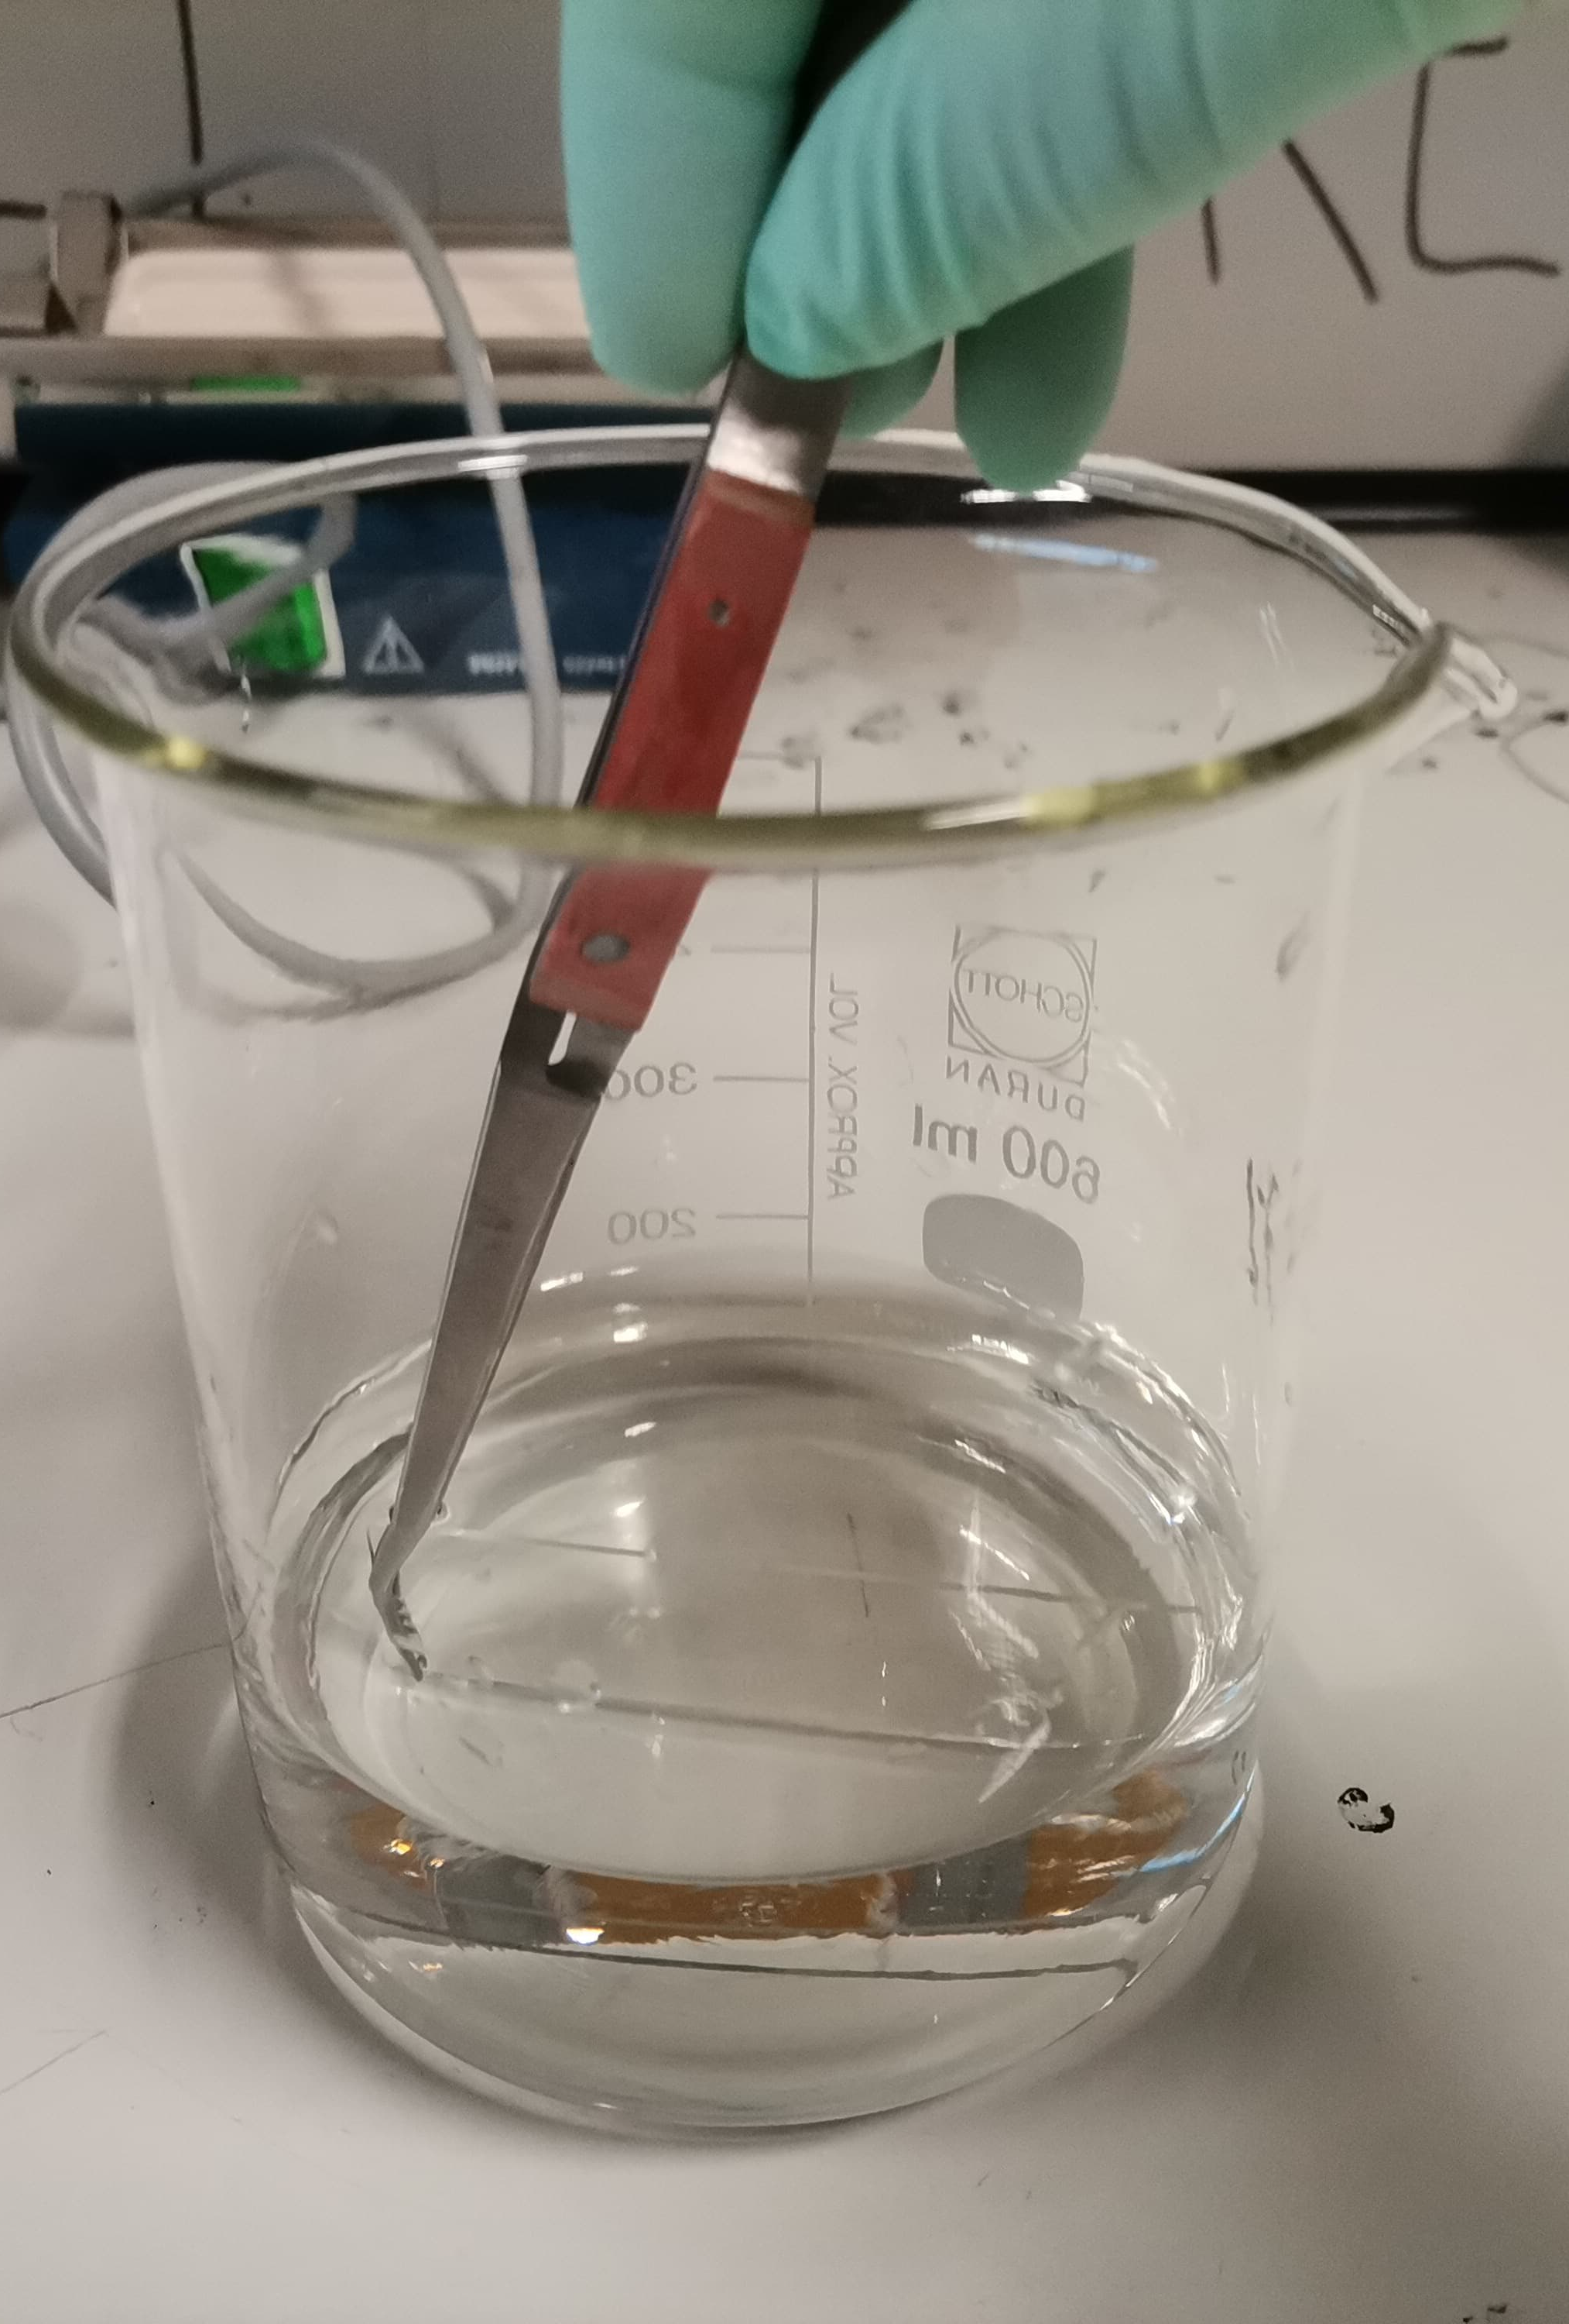
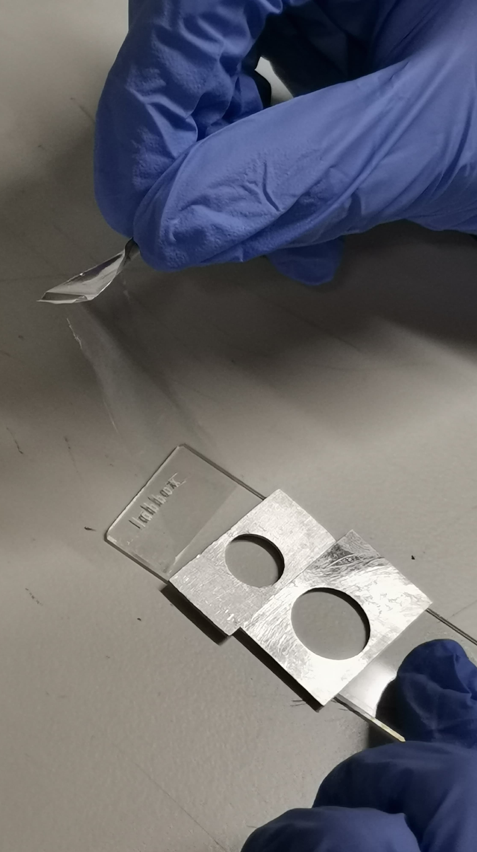
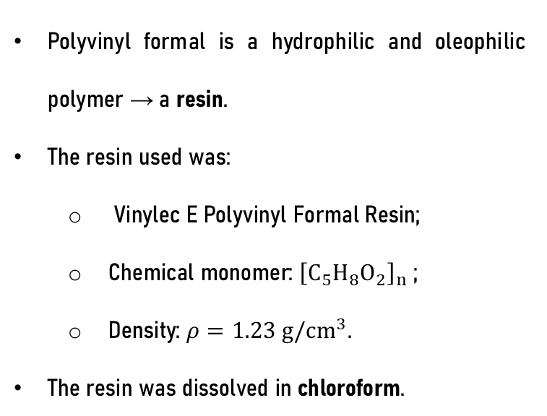
Target production – Formvar foils
Polyvinyl formal is a hydrophilic and oleophilic polymer → a resin.
The resin used was:
  Vinylec E Polyvinyl Formal Resin;
  Chemical monomer: ${\left[C_{5}H_{8}O_{2}\right]}_{n}$ ;
  Density: $ρ=1.23 g/{cm}^{3}$.
The resin was dissolved in chloroform.
Polyvinyl formal resin.
Dipping glass slide in Formvar solution.
Getting a Formvar foil into target frames.
Notes:
To produce the plastics films, I used polyvinyl formal, also known as Formvar, which is a hydrophilic and oleophilic polymer, that is, a resin. In this work, the resin used was acquired from the manufacture Spi-Chem, and it has all of these characteristics, which are important to know for the characterization of the targets, as we will later see. which needs to be mixed with a solvent, in this case chloroform, to create a Formvar solution. That way, since chloroform evaporates at room temperature, a substrate such as a glass slide can be dipped into the solution, which will dry naturally leading to the polymerization of the Formvar on the slide’s surface. To obtain films as uniform as possible for the entire slide, the slides are dipped horizontally.

Slide 5
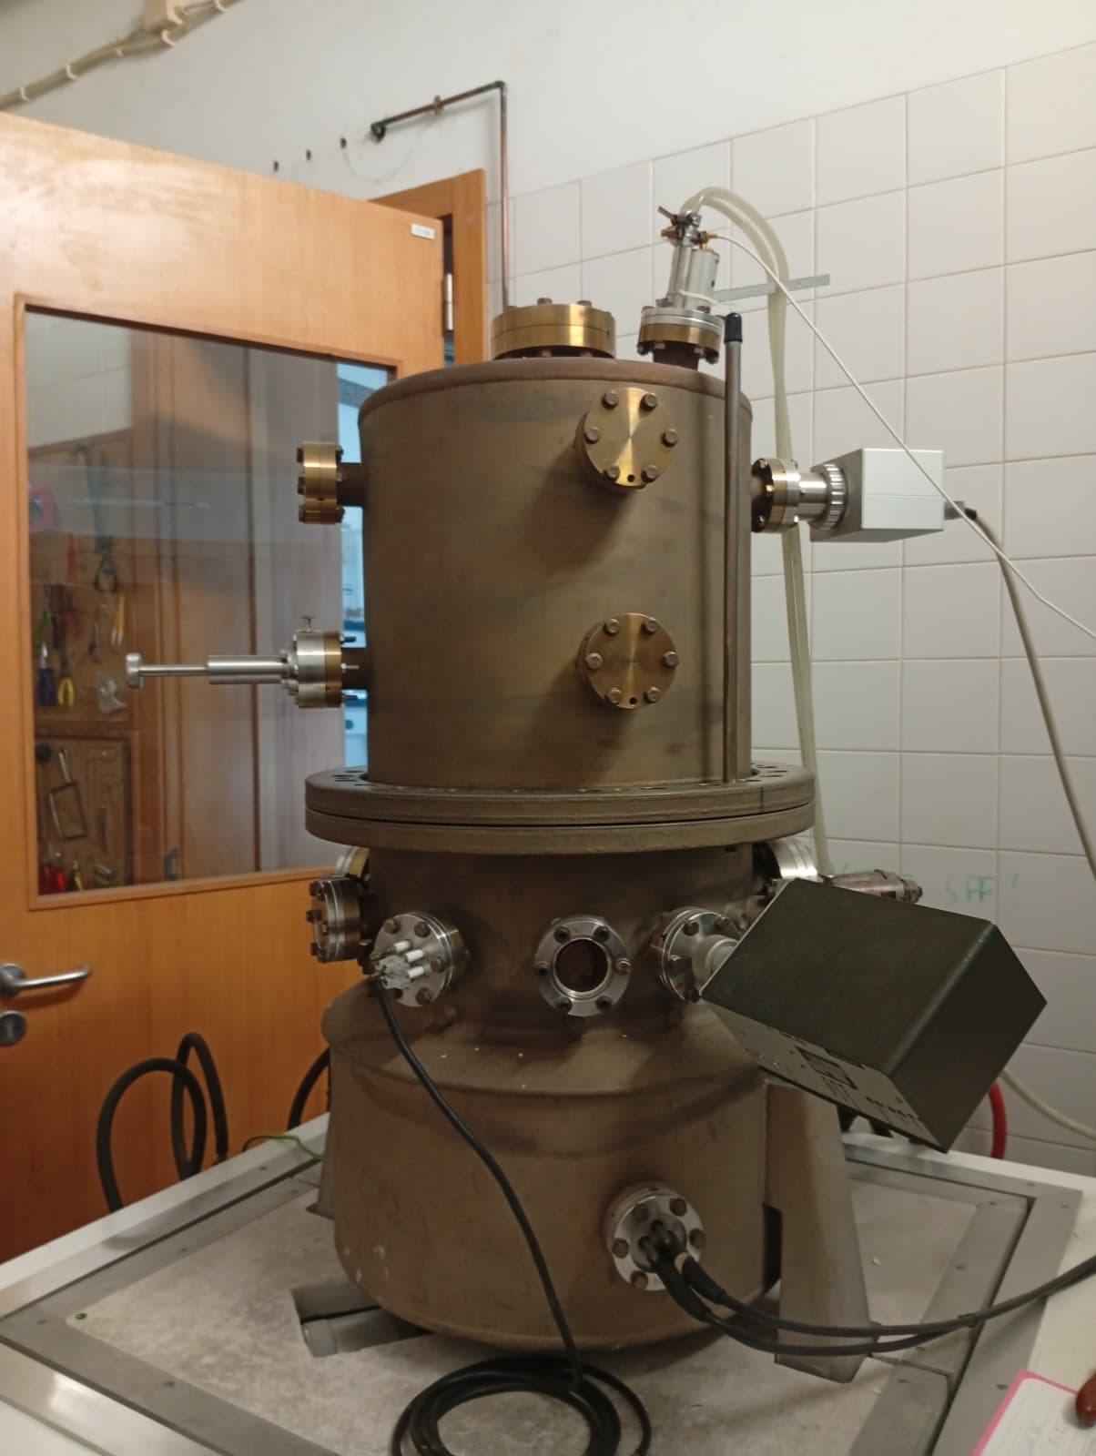
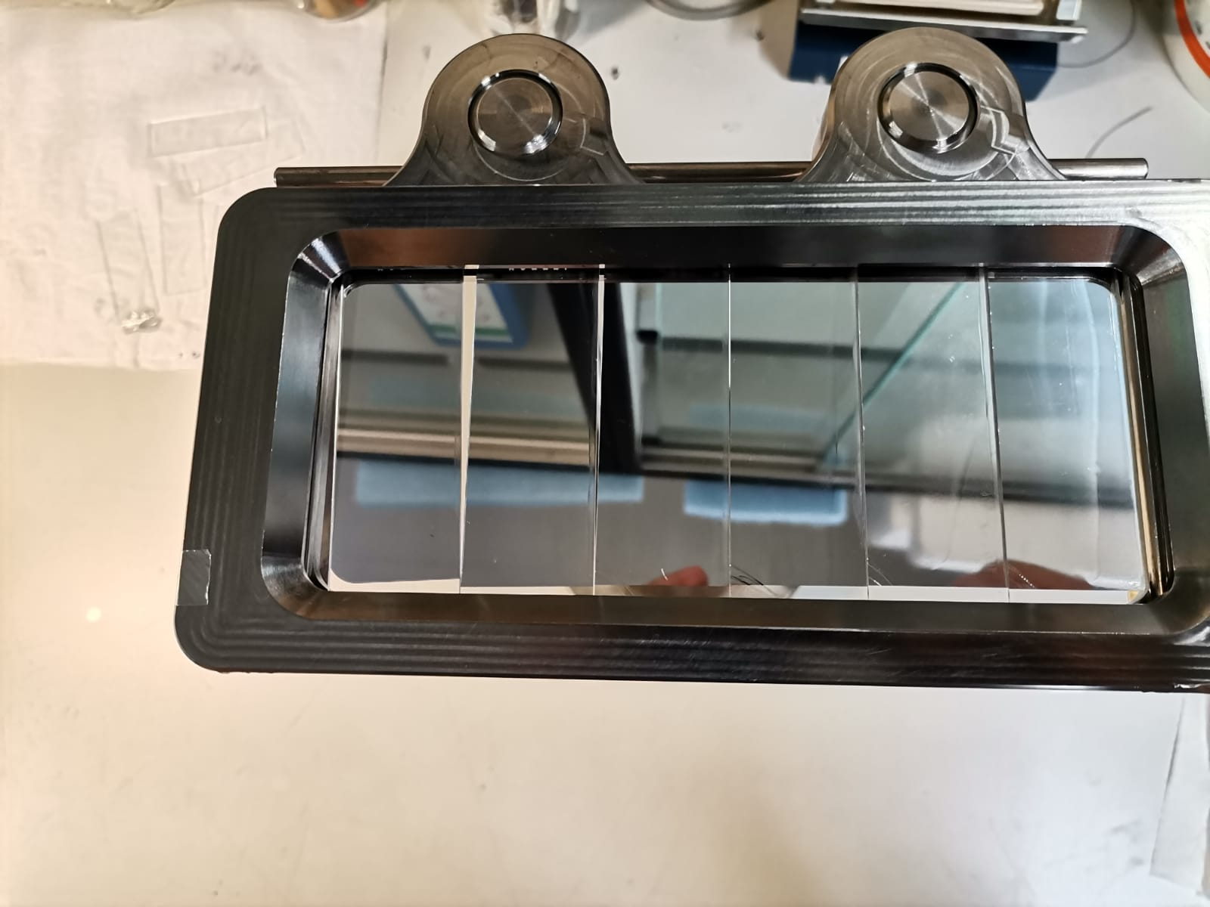
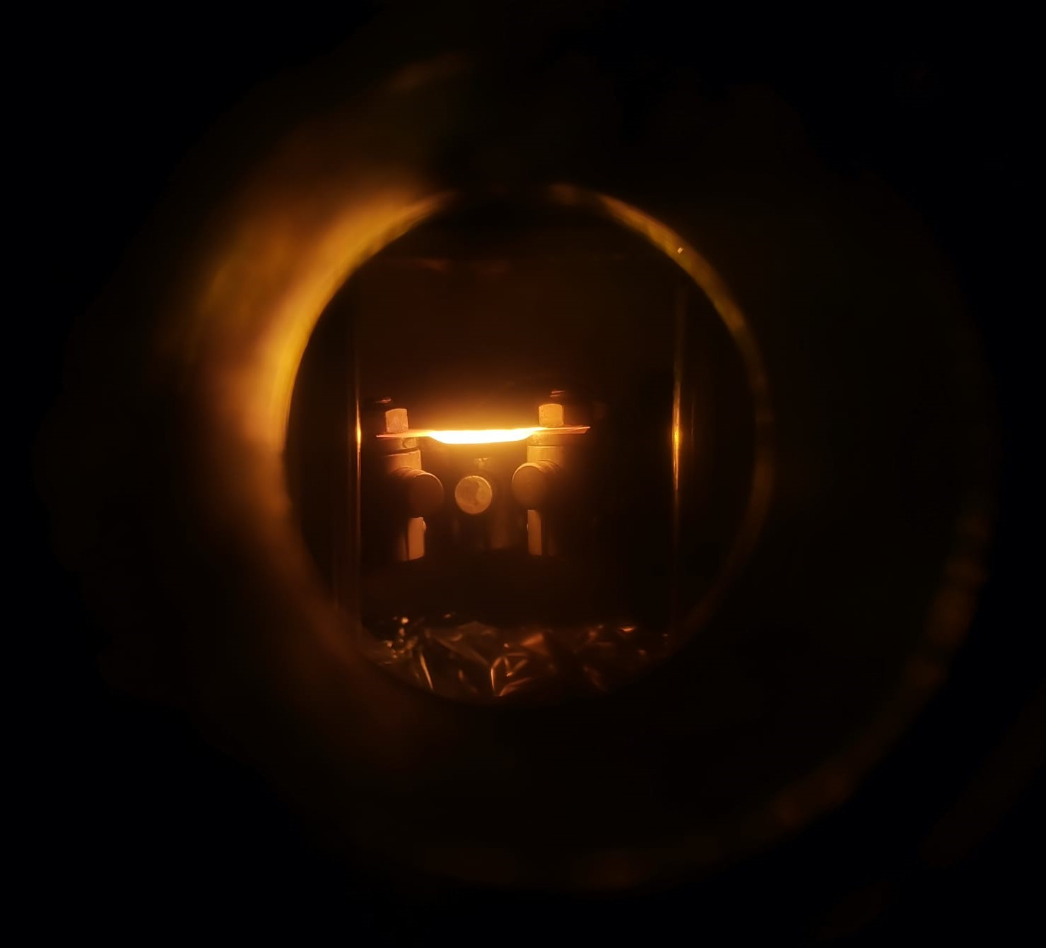
Target production – Metal coatings
Thermal vacuum evaporation is targeted for “materials with a melting point lower than 1850 K”.
Evaporations were performed under similar conditions:
To characterise the coatings;
To test the performance in laser-driven proton acceleration.
A. Stolarz, J Radioanal Nucl Chem 299, (2014)
Boat heating-up during evaporation.
Evaporation facility at the
Target Design Laboratory.
Top-view of the support for the glass slides.
Notes:
The previously mentioned silver-coatings were produced by vacuum thermal evaporation, which is a specific PVD technique targeted for materials with a low melting point. We at the TDL are well-versed in this technique, as we have used it to produce numerous targets for several international collaborations – so, we have different protocols for several materials
But anyway, for this work, multiple evaporations were done under similar conditions, first as a test to characterize the films and a final one was done to use the films in a laser-driven acceleration facility.

Slide 6
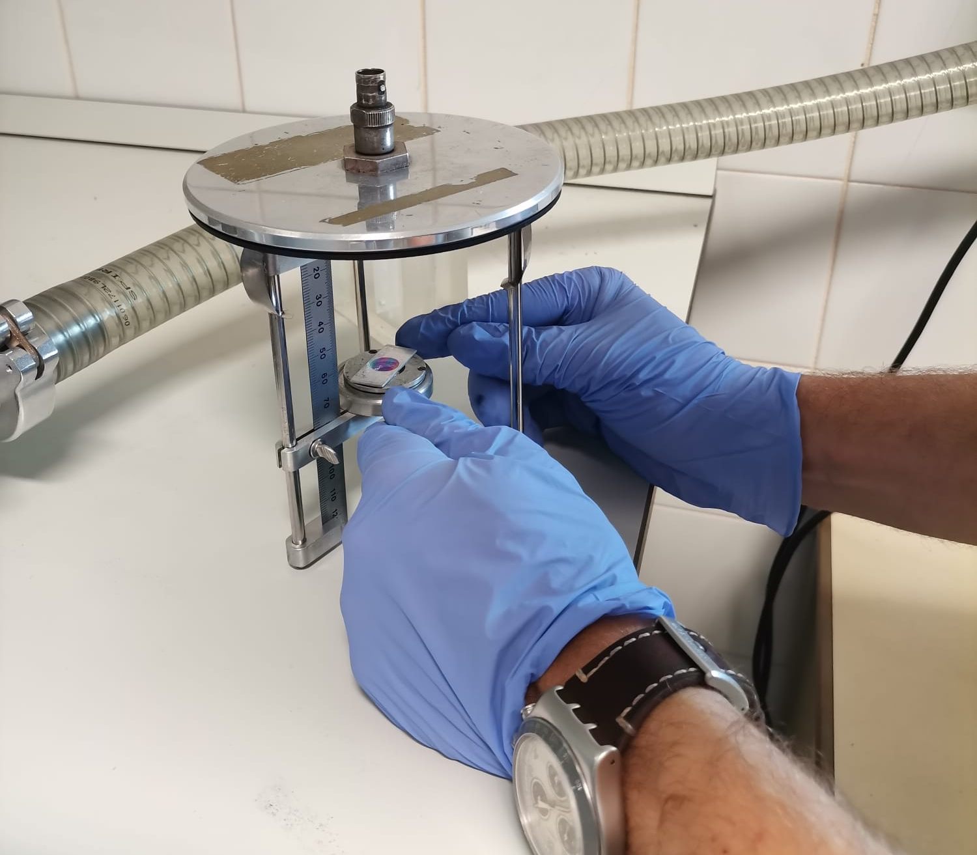
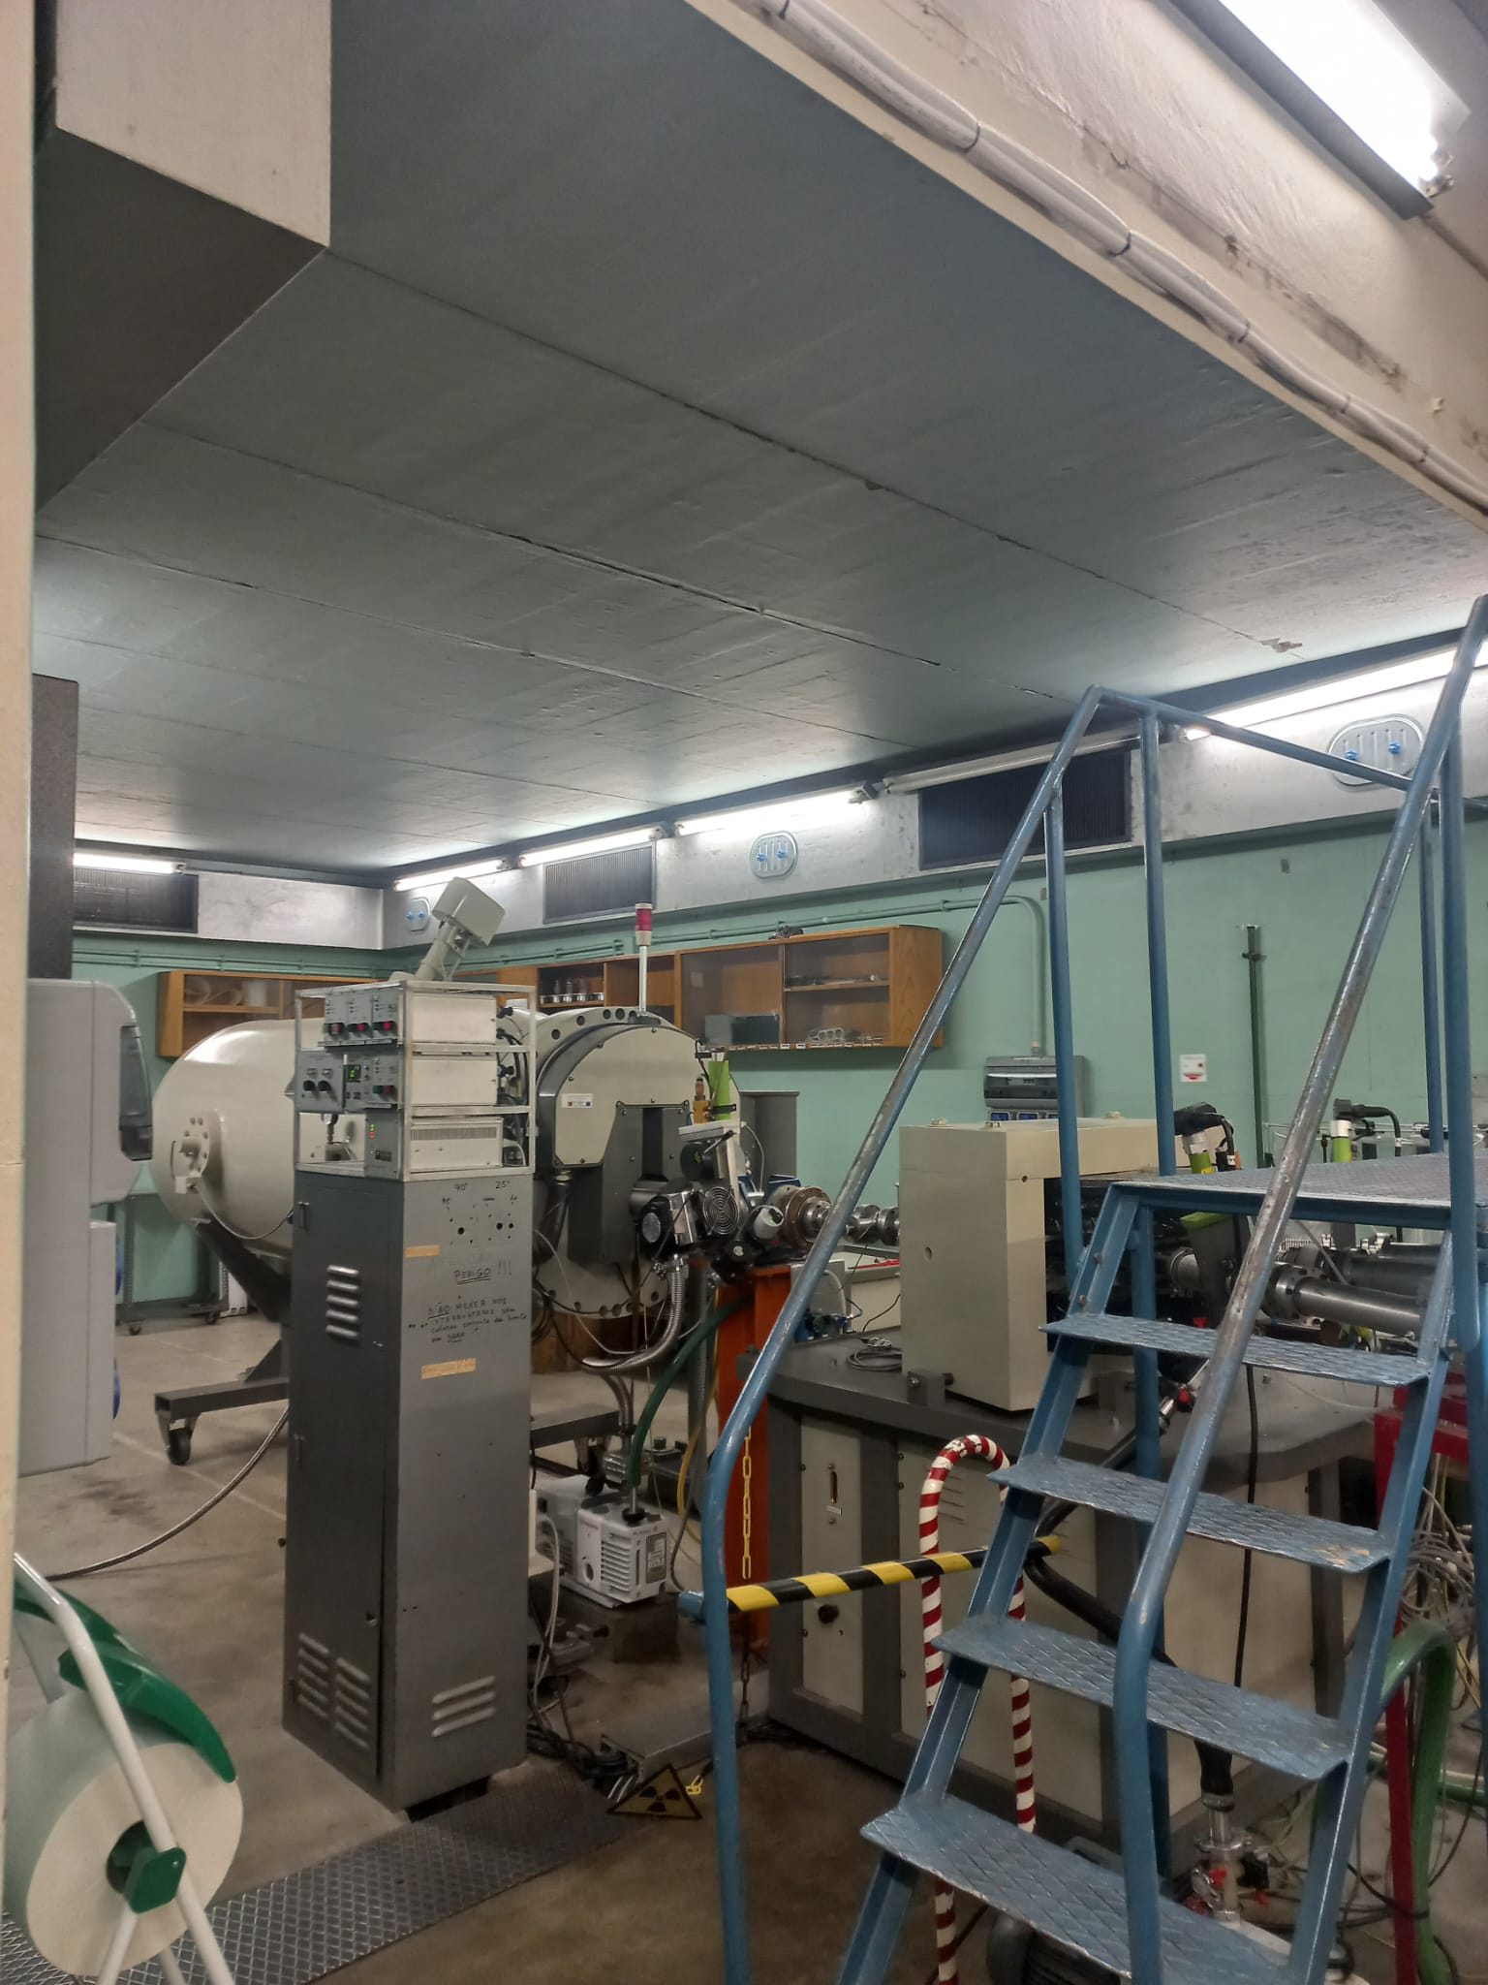
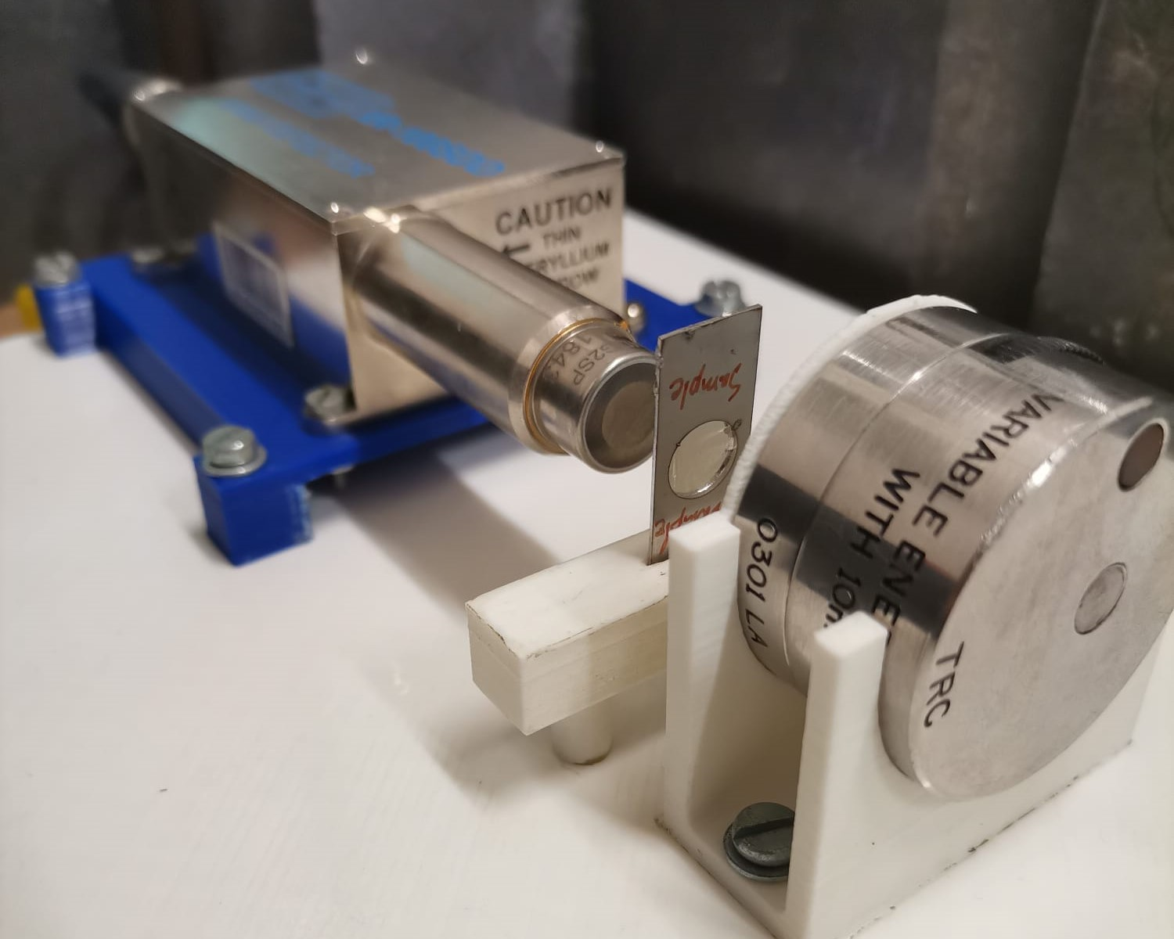
Target characterisation
Rutherford Backscattering Spectrometry technique
Alpha Energy Loss technique
X-Ray Attenuation technique
Formvar foils
Metal-coatings
Notes:
With the targets produced, the next step was to characterize them. For that, 3 techniques were employed, having the metal-coating characterized by 2 different techniques, while the thickness of the Formvar foils was only characterized by one.

Slide 7
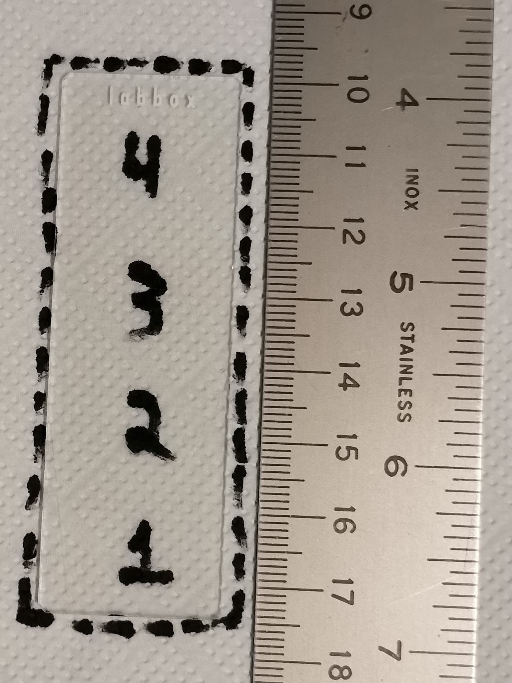
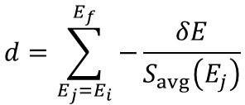


Formvar foil characterisation
$$d=\sum_{E_{j}=E_{i}}^{E_{f}}{−\frac{δE}{S_{avg}\left(E_{j}\right)}}$$
For the AEL technique, the foil thickness is calculated through CSDA:
Thickness of Formvar 1.5 % w/v foils.
Thickness of Formvar 3 % w/v foils.
$$\left\langle d\right\rangle =\left(290±70\right) nm$$
$$\left\langle d\right\rangle =\left(870±140\right) nm$$
Notes:
So, the alpha-energy loss technique, as the name implies, works by measuring the energy lost by α-particles when they transvers through a target. To assess the resulting film thickness gradient, I established this slide mapping to plot the position of the measured targets. Here, it is possible to see how uniform the resulting foils are within a slide for a 1.5% solution. There are some fluctuations between different slides, but these fluctuations are mostly within the results uncertainty regions. For the 3% solution, the fluctuations are higher, but these results still show good consistency.

Slide 8


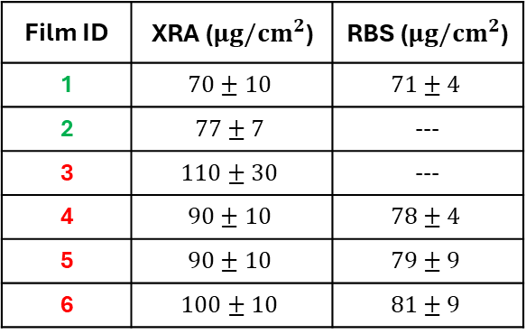
Metal-coating characterisation
2.5 MV Van de Graaff accelerator at LATR.
The closest facility where we could perform RBS measurements:
LATR facility of the CTN-IST.
Soft X-ray attenuation of Formvar foils is very low!
Allows to characterize the metal-coatings’ thickness with accuracy in situ.
1
3
4
56
2
Position of characterised targets from glass slides
(viewed from above).
Characterisation of the Ag-coatings.
Setup to characterize targets with X-rays.
Film ID | XRA ($μg/{cm}^{2}$) | RBS ($μg/{cm}^{2}$)
1 | $$70±10$$ | $$71±4$$
2 | $$77±7$$ | ---
3 | $$110±30$$ | ---
4 | $$90±10$$ | $$78±4$$
5 | $$90±10$$ | $$79±9$$
6 | $$100±10$$ | $$81±9$$
Notes:
As for the metal-coatings, due to the ‘sensitivity’ of the AEL technique, it is not quite suitable for characterizing them. For that, RBS is far more adequate since it is especially useful for accurately evaluating the composition of elemental, multilayer targets. To perform these measurements, we had access to the LATR facility of CTN. In addition, to have a in-situ technique with a different sensitivity to the AEL method, I developed a technique that allowed to characterise the coatings through soft x-ray attenuation. By comparing the results between the 2 techniques, not only can we see that the x-ray technique is a valid method for these specific targets, but we can also see that the evaporation was quite symmetrical and fairly uniform.

Slide 9
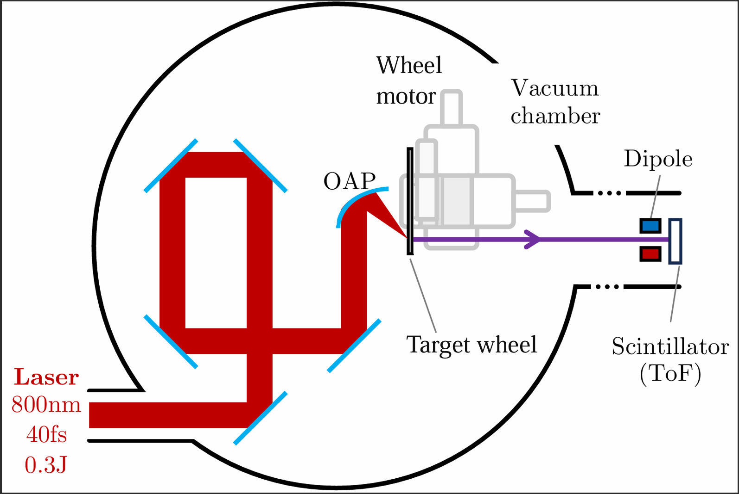
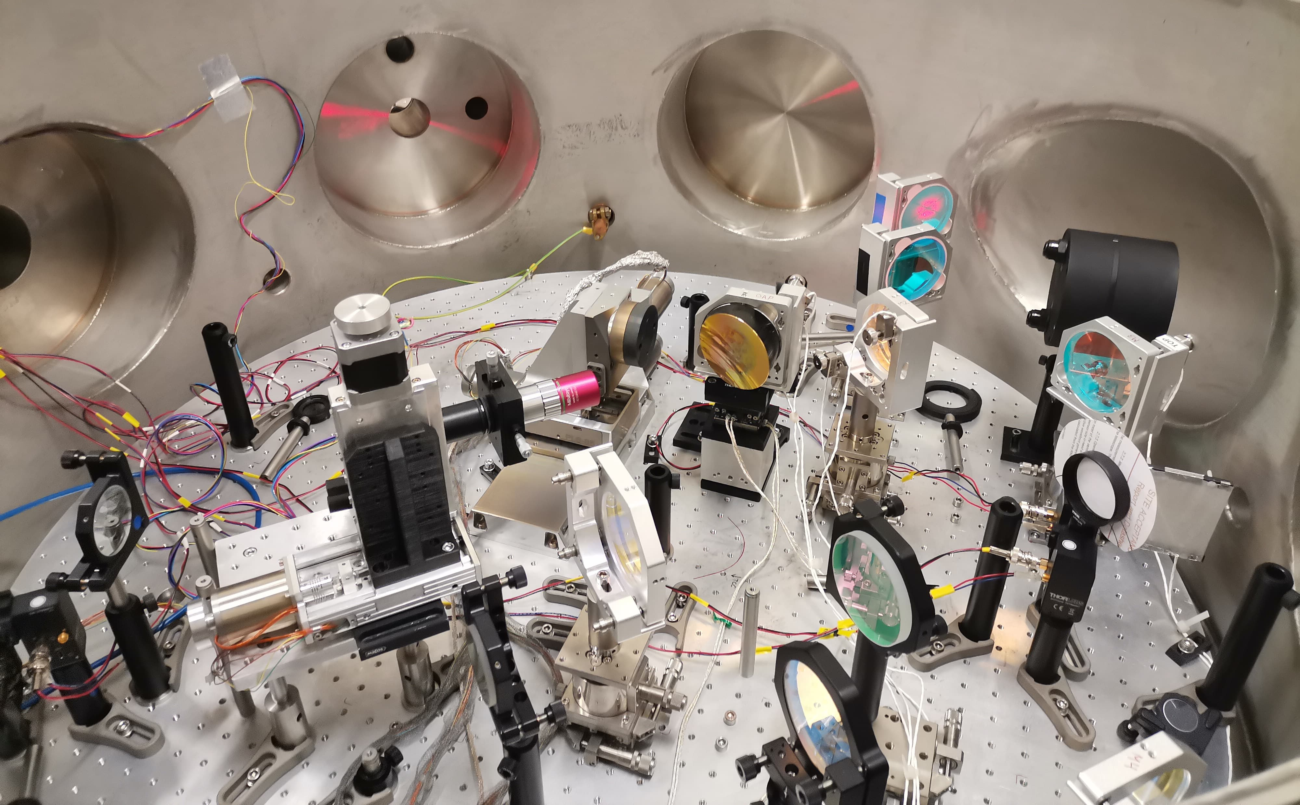
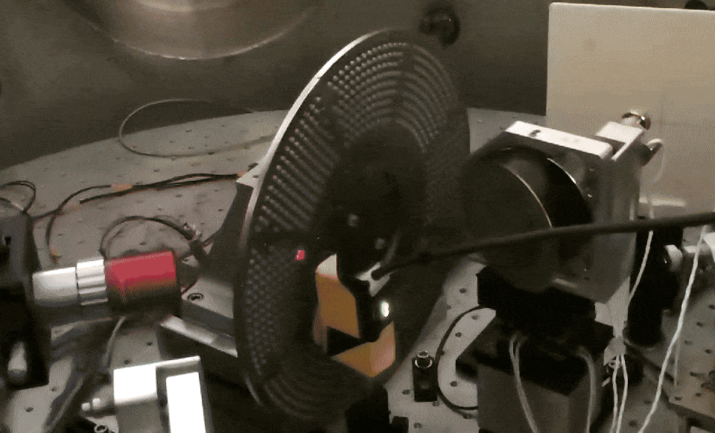
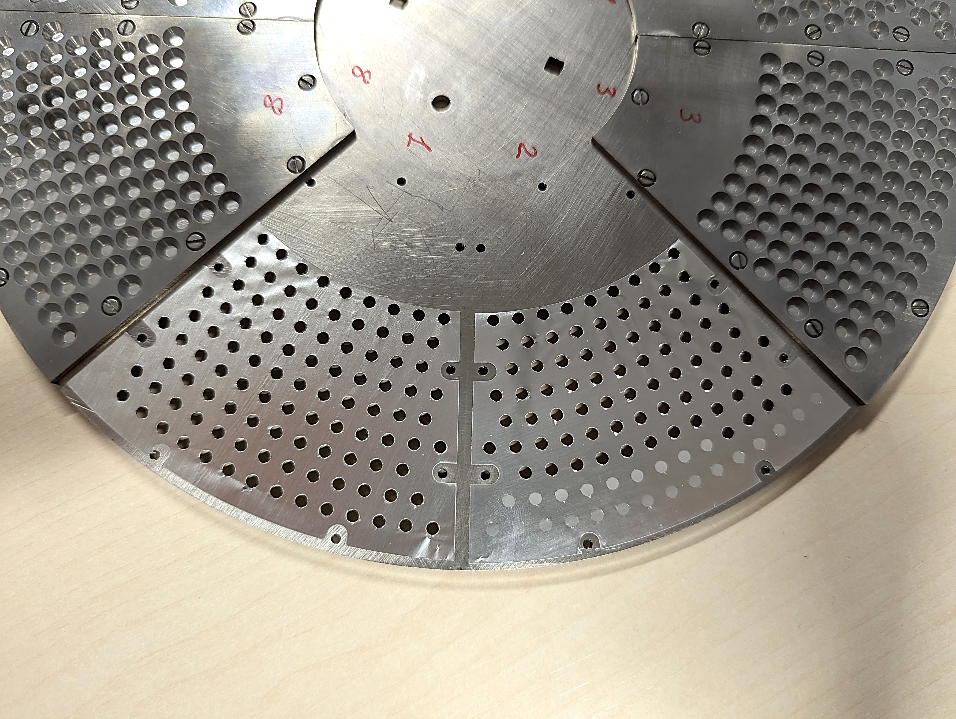
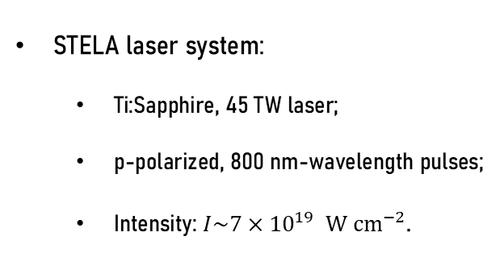
L2A2 setup
STELA laser system:
  Ti:Sapphire, 45 TW laser;
  p-polarized, 800 nm-wavelength pulses;
  Intensity: $I\sim 7×{10}^{19} W {cm}^{−2}$.
Multi-shot target wheel assembly:
  Hosts more than 5000 targets;
  Operates at rates up to 10 Hz.
800 nm
35 fs
0.8 J
J. Penãs et al,
High Power Laser Science and Engineering, Vol. 12 (2024)
Wheel
motor
Gold
parabola
Picture of the vacuum chamber’s interior from the experimental setup used at L2A2-USC.
Notes:
With the films’ thicknesses characterized by 3 techniques, all the steps were completed to test these films in a laser-driven acceleration facility. For that, I had the chance to test the films at the L2A2 facility in Santiago de Compostela. In this picture we have the experimental set up present in the facility and, as we can see, the laser is guided by a set of mirrors and by an Off-Axis Parabola to be focused onto the targets, which are mounted to a motorized wheel.
The generated ion beams are then emitted in this direction and detected by a scintillator.

Slide 10
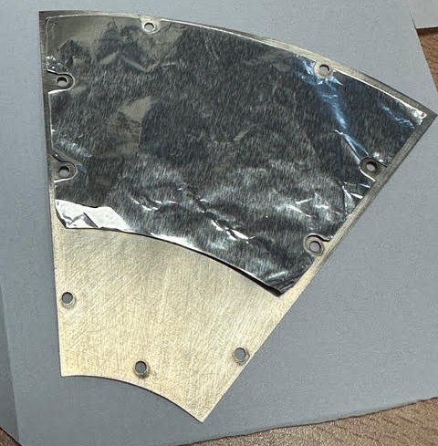
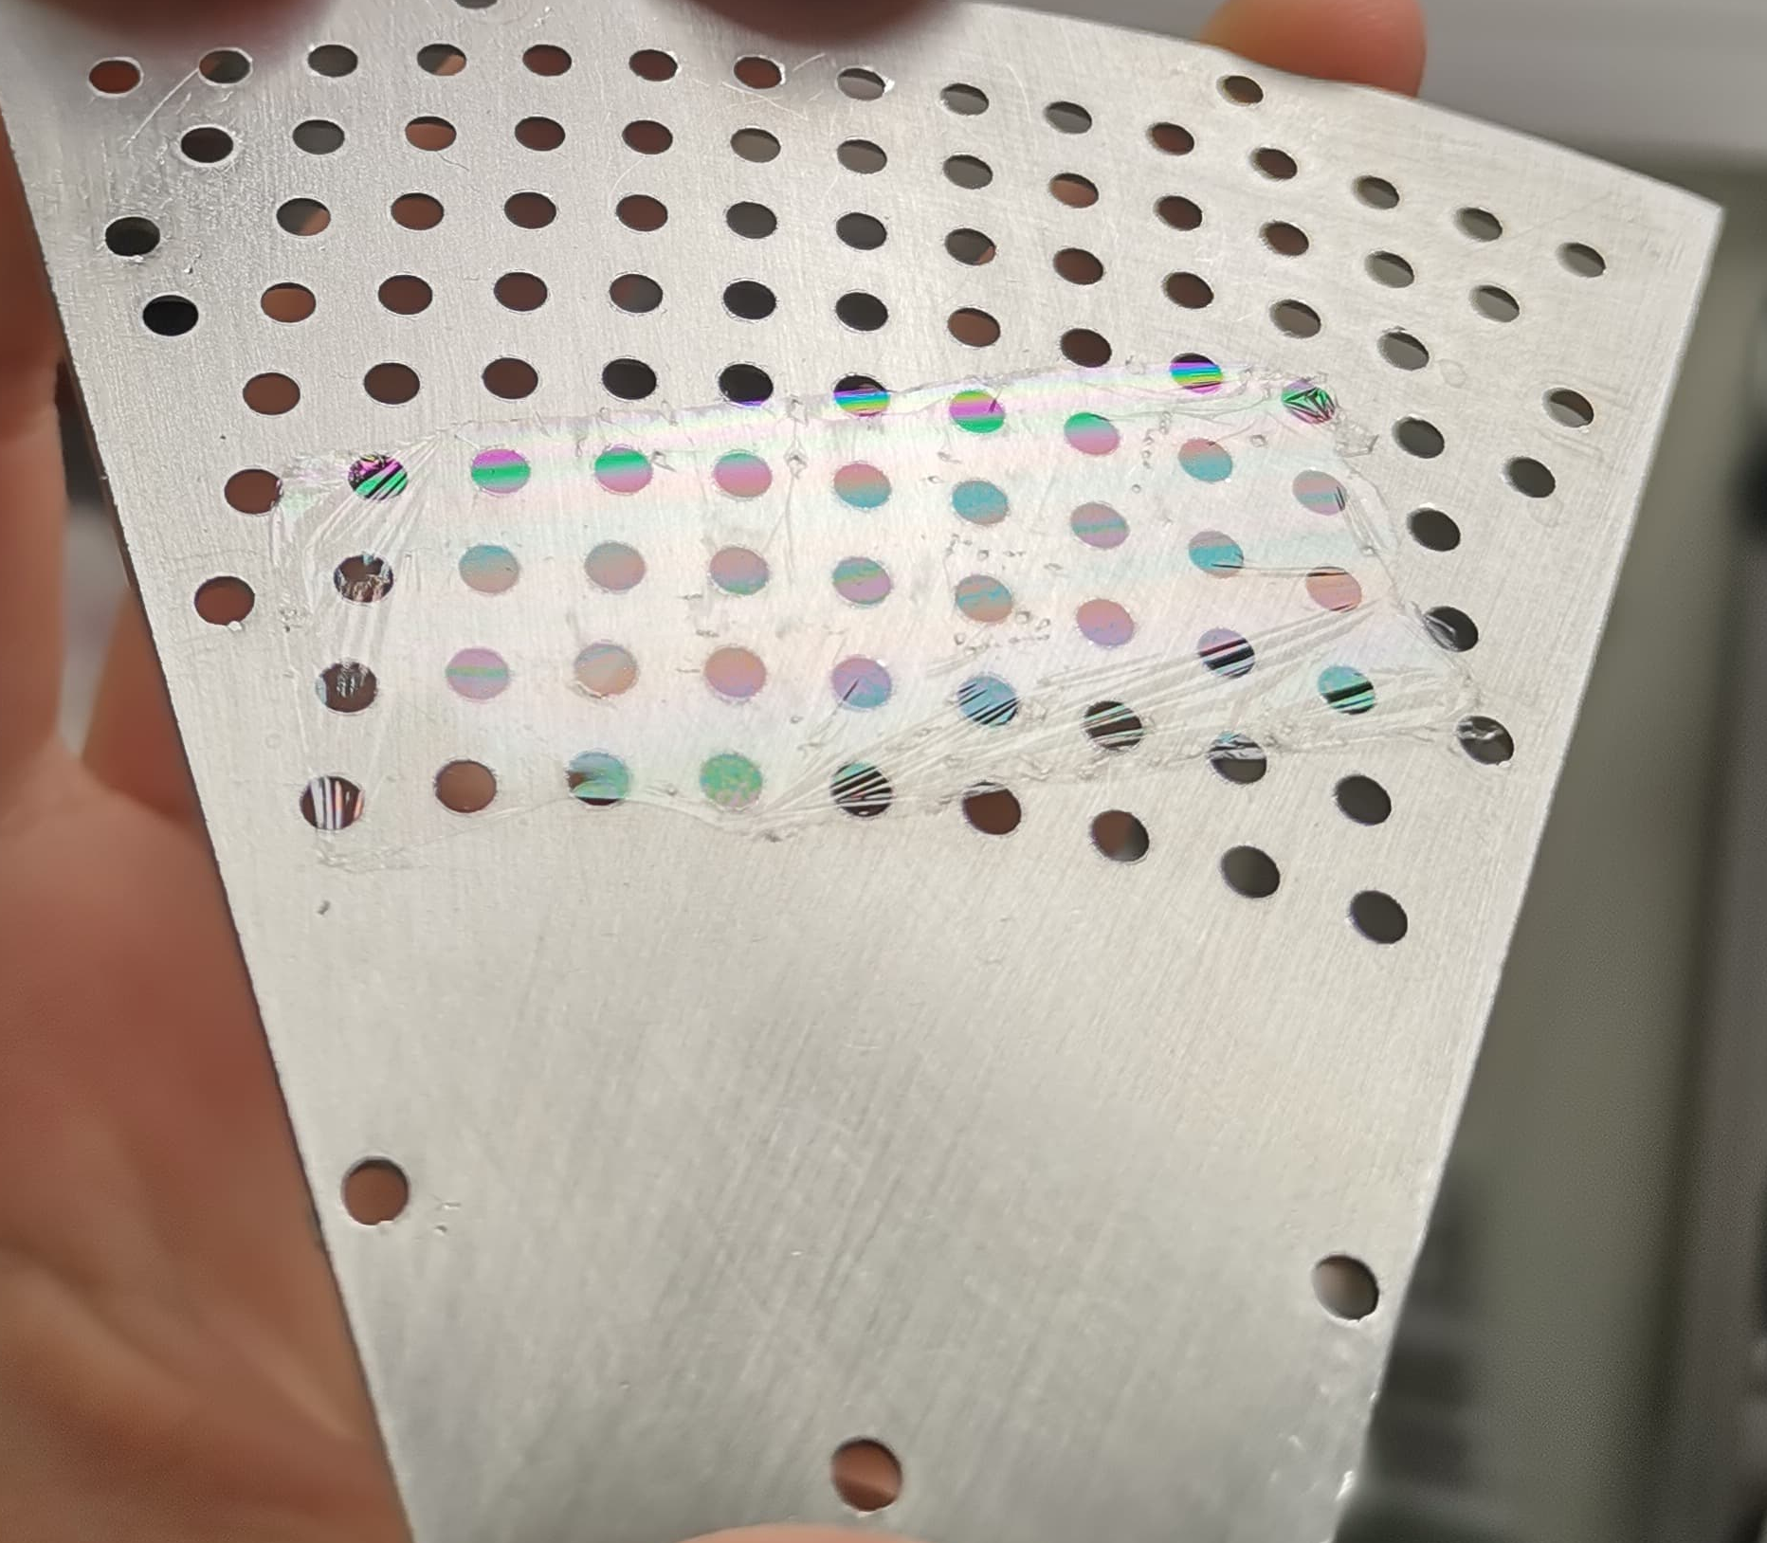
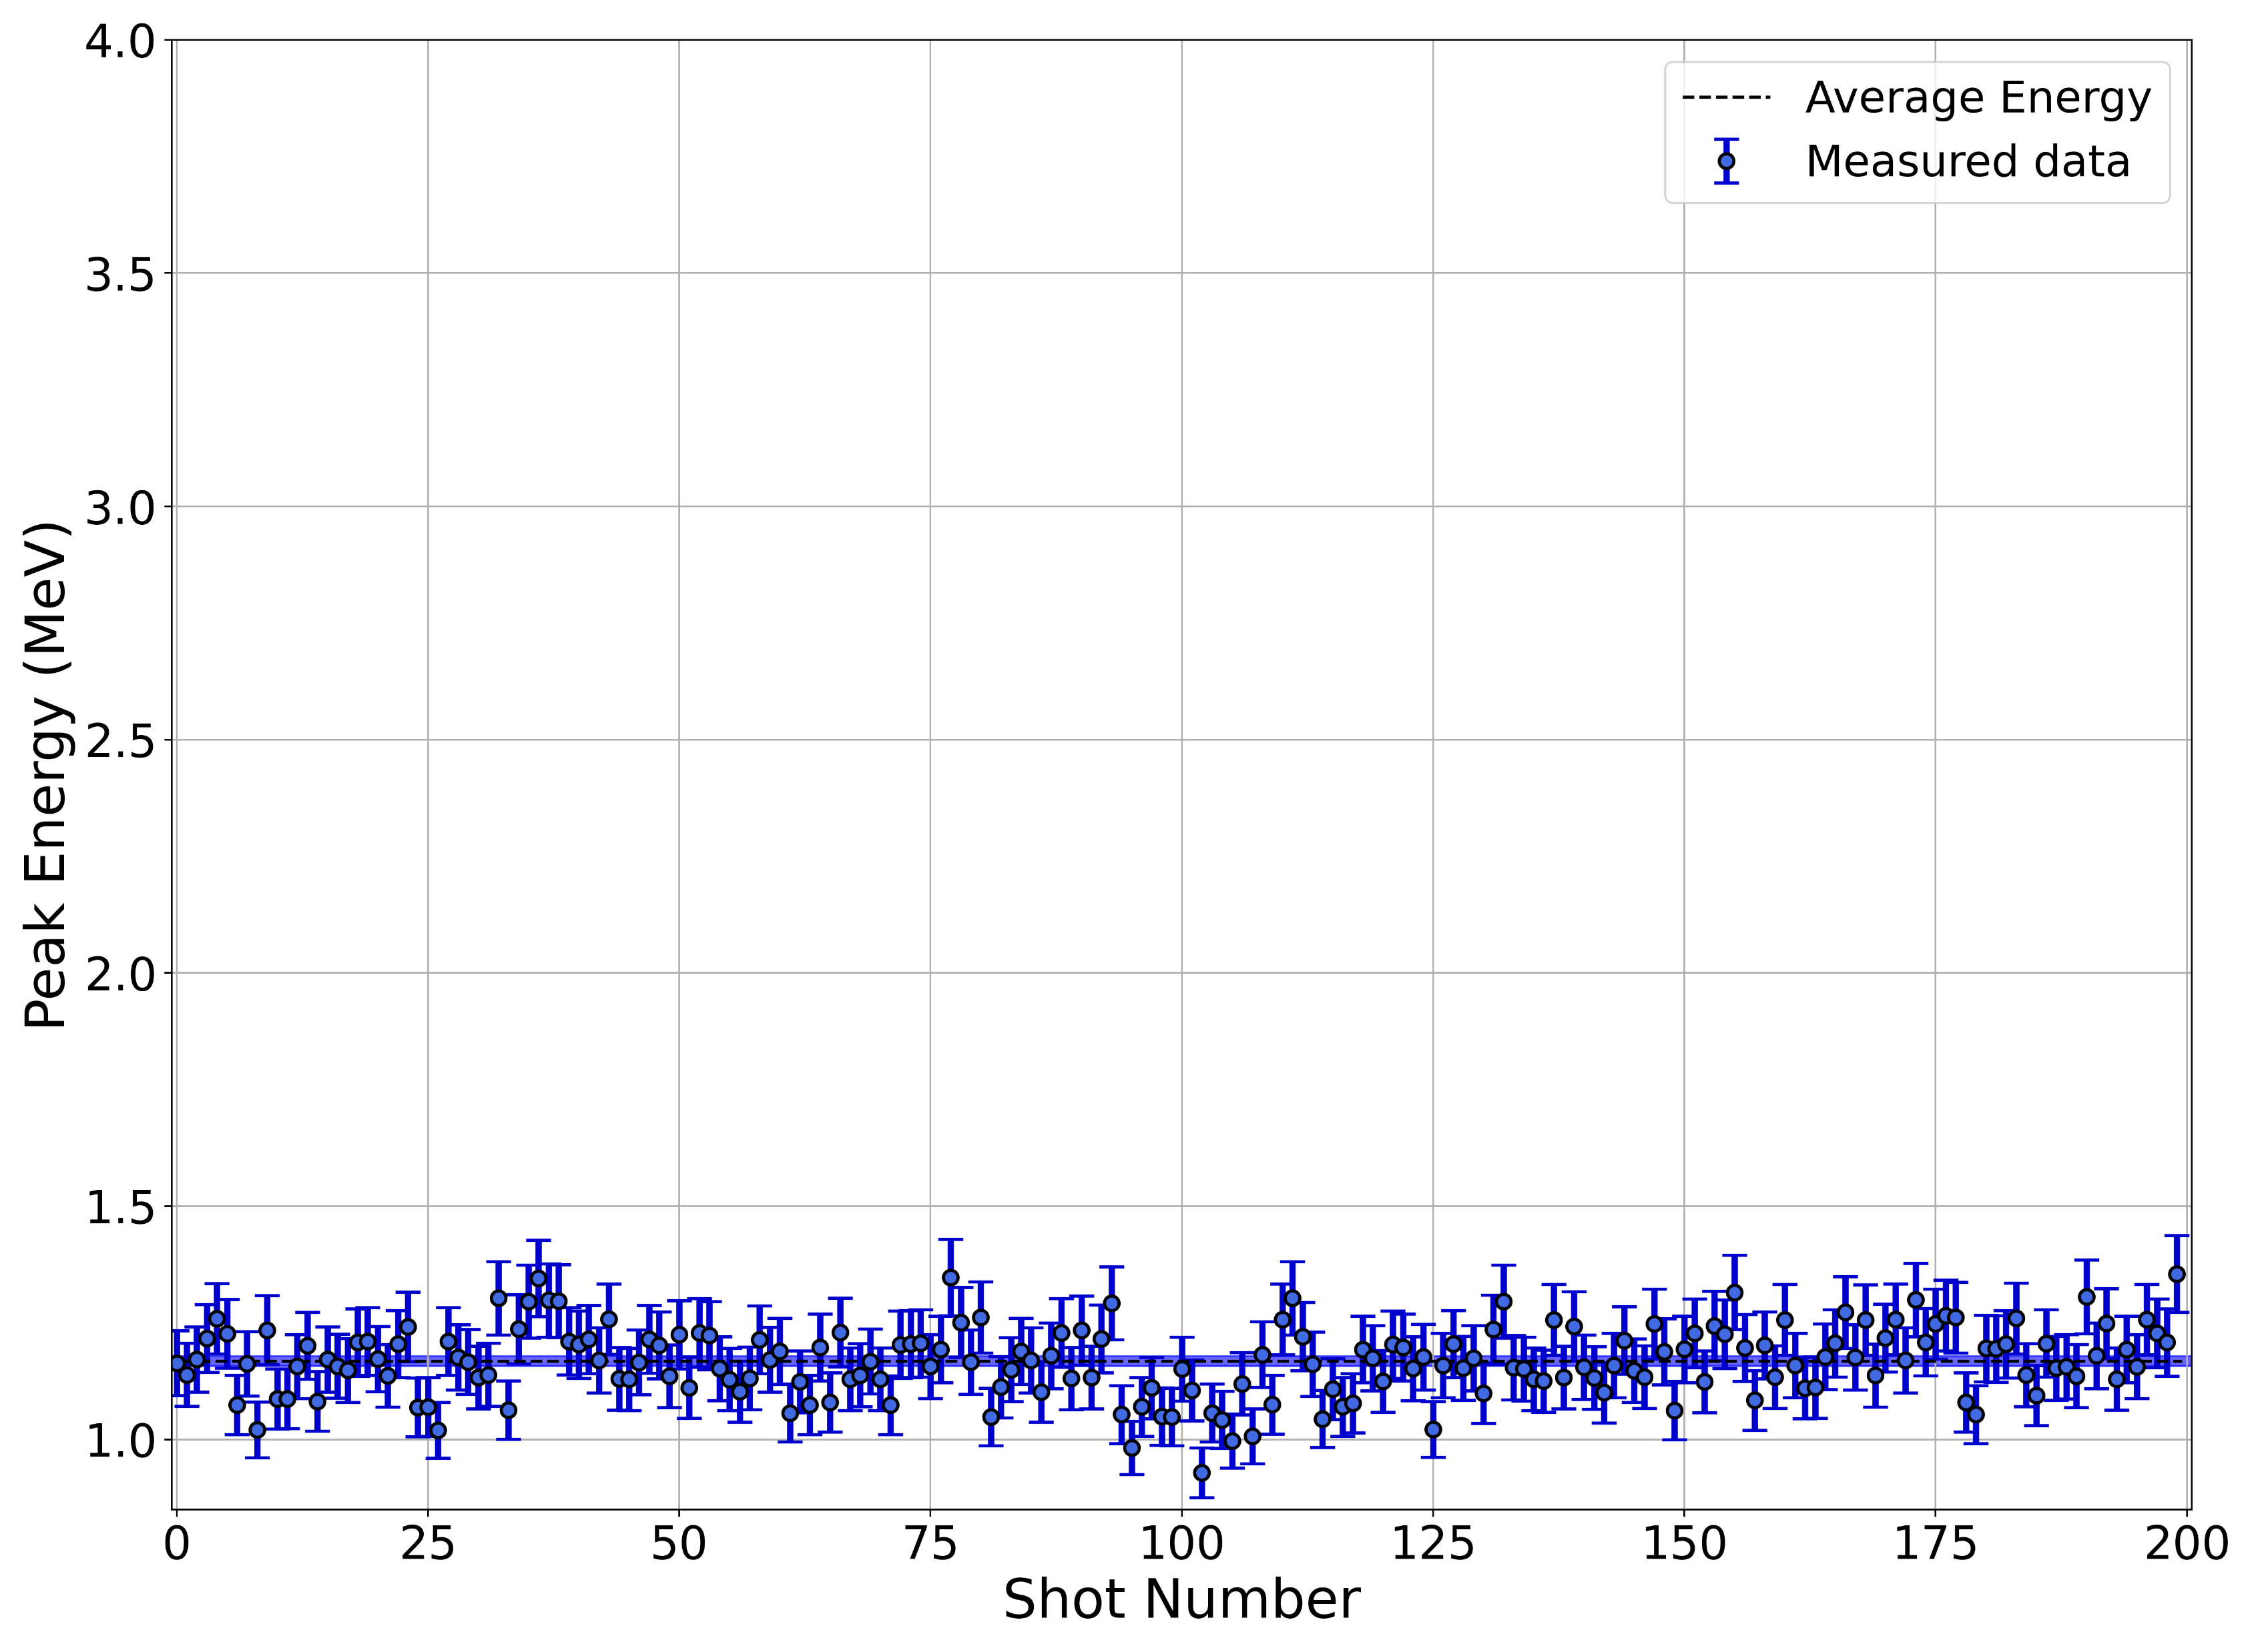
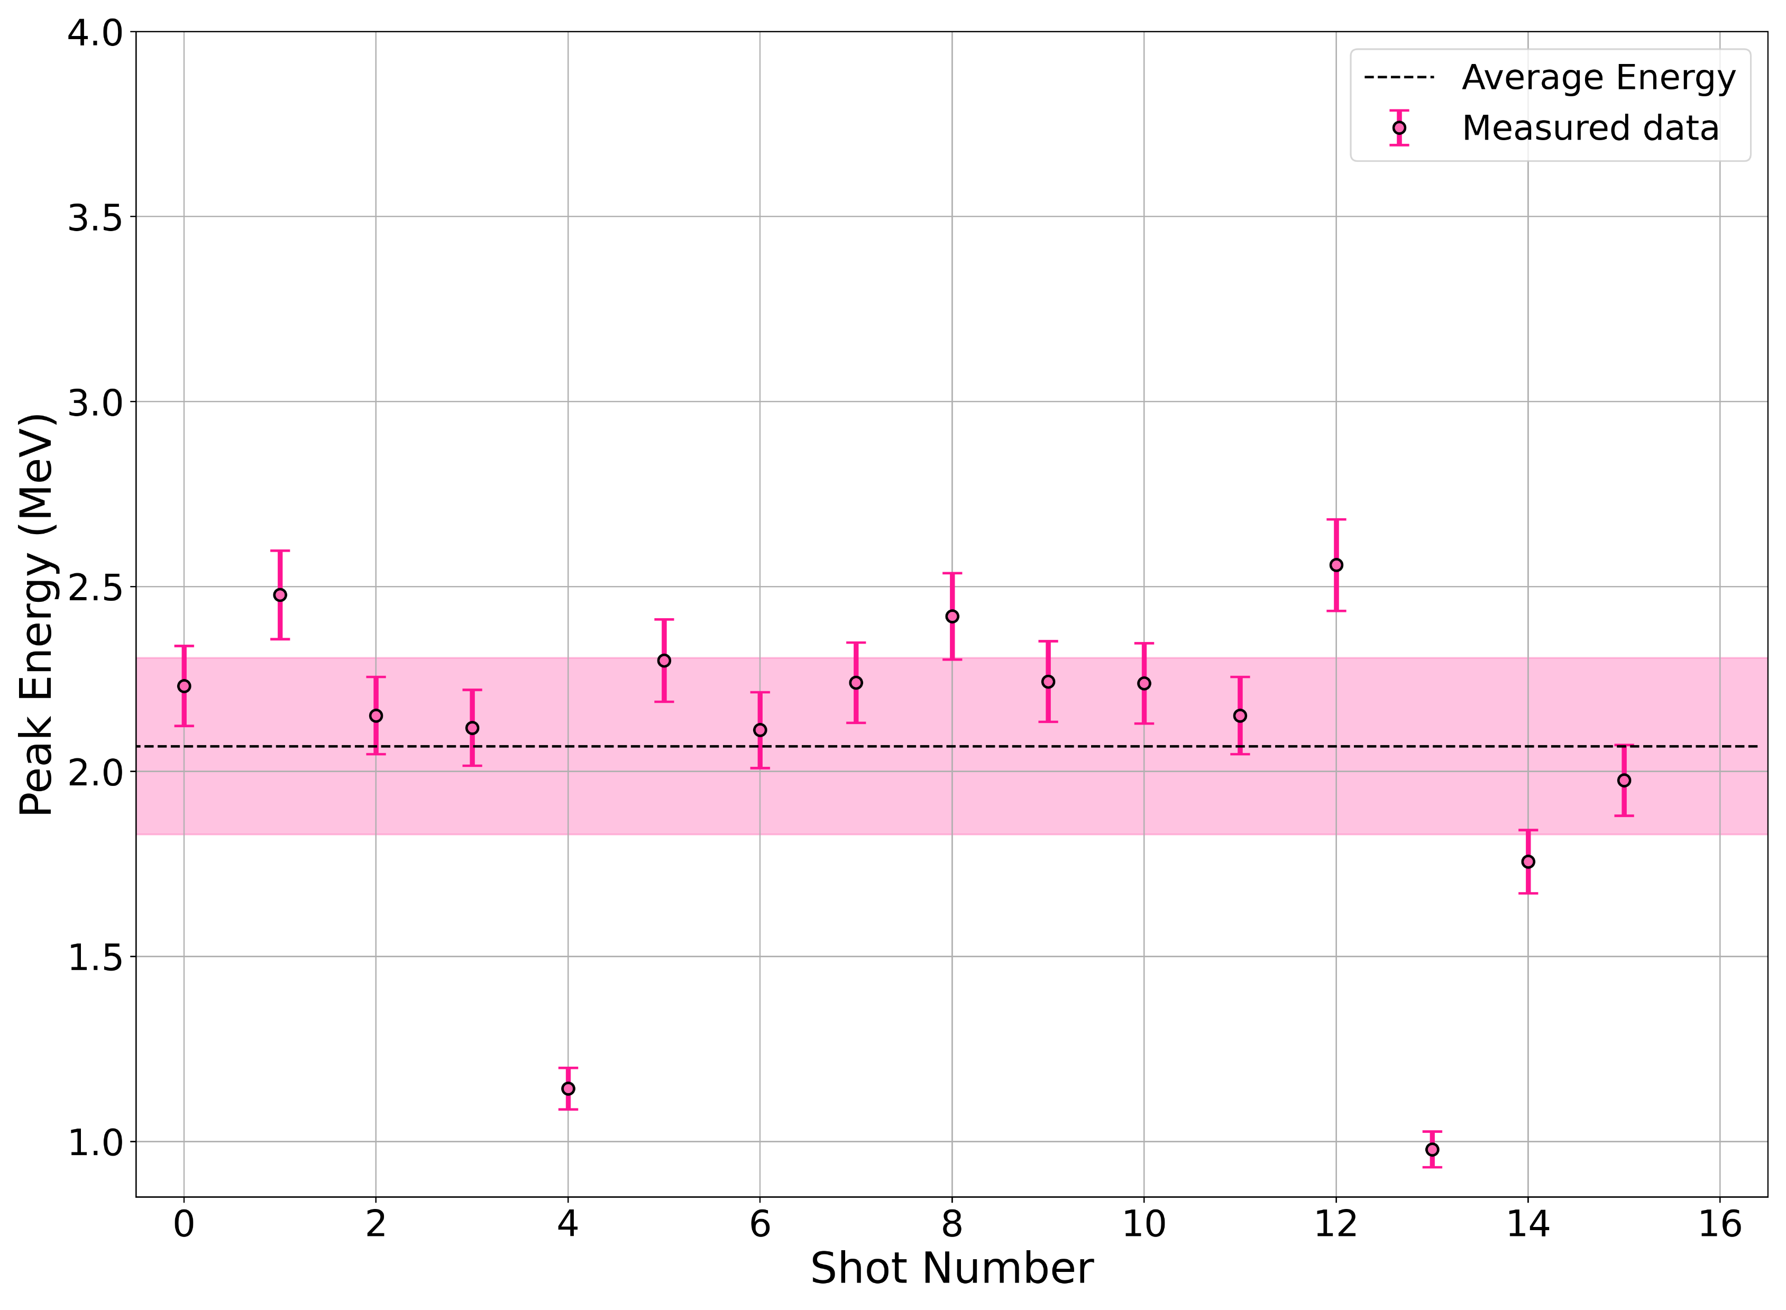
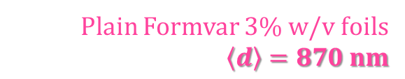

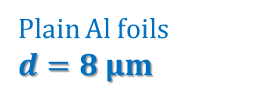

Proton cut-off energy – plain Al and Formvar foils
Plain Al foils
$d=8 μm$
Plain Formvar 3% w/v foils
$\left\langle d\right\rangle =870 nm$
$$\left\langle E_{peak}\right\rangle =\left(\text{1.1}\text{7}\text{±}\text{0.01}\right) MeV$$
$$\left\langle E_{peak}\right\rangle =\left(\text{2}\text{.}\text{1}\text{±}\text{0.2}\right) MeV$$
Notes:
Here is displayed a burst measurement of 200 laser shots using 8 µm Al foils, which are the targets previously used at the L2A2 facility. The obtained σE (0.074 MeV), here represented by the shaded area, shows that the data has significantly high stability, with low fluctuations.
Passing on to plain Formvar foils, here we have the peak energy obtained from the plain 3% Formvar foils. Since these foils offered very low stability, no burst measurements were performed with these type of foils. Nonetheless, comparing to the previous plot, it is clear that there was a significant improvement in terms of peak energy, having reach almost twice the value of the previous case.

Slide 11
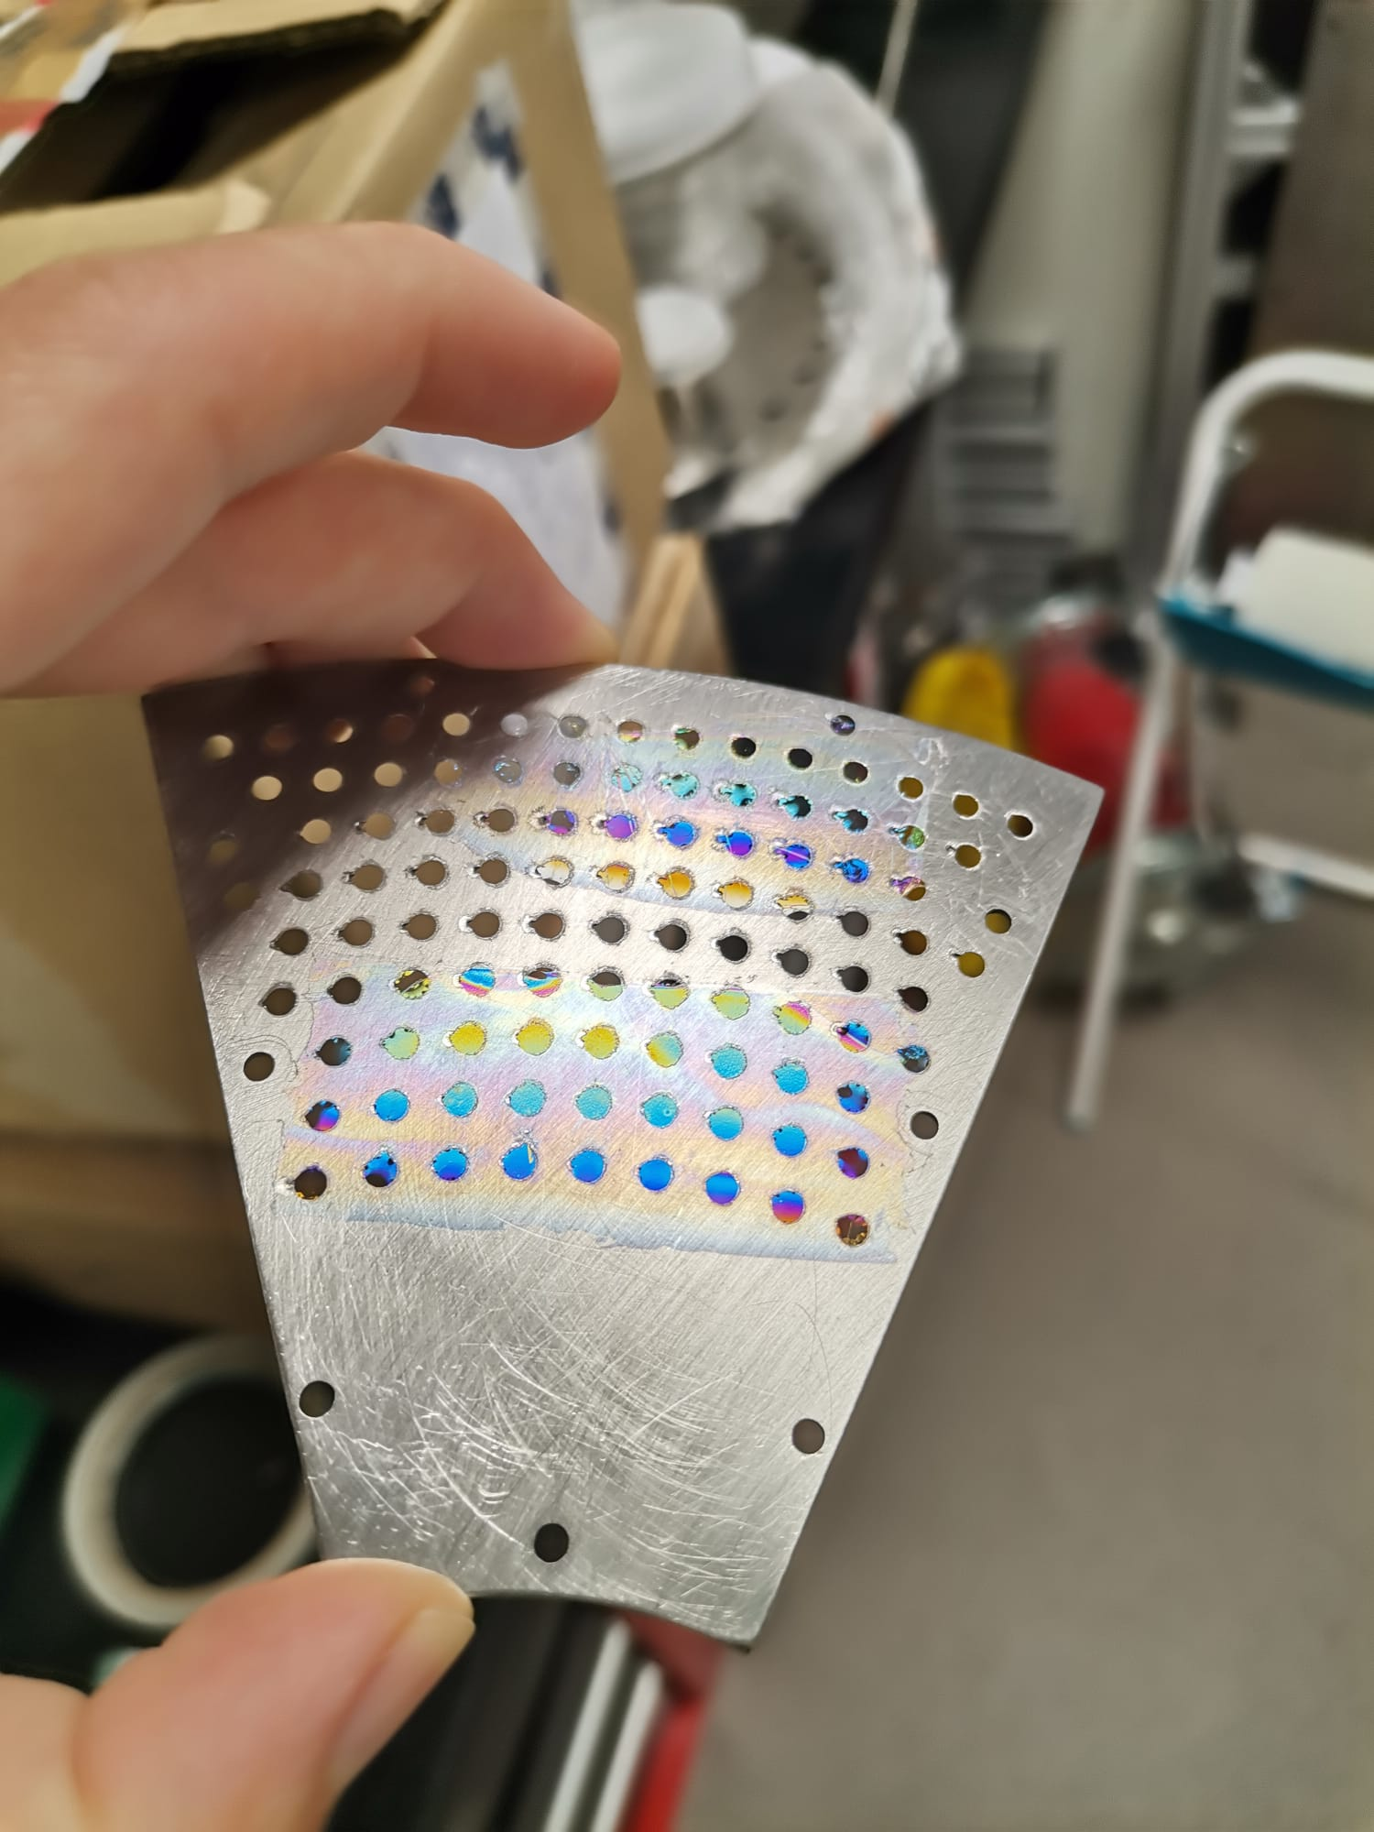
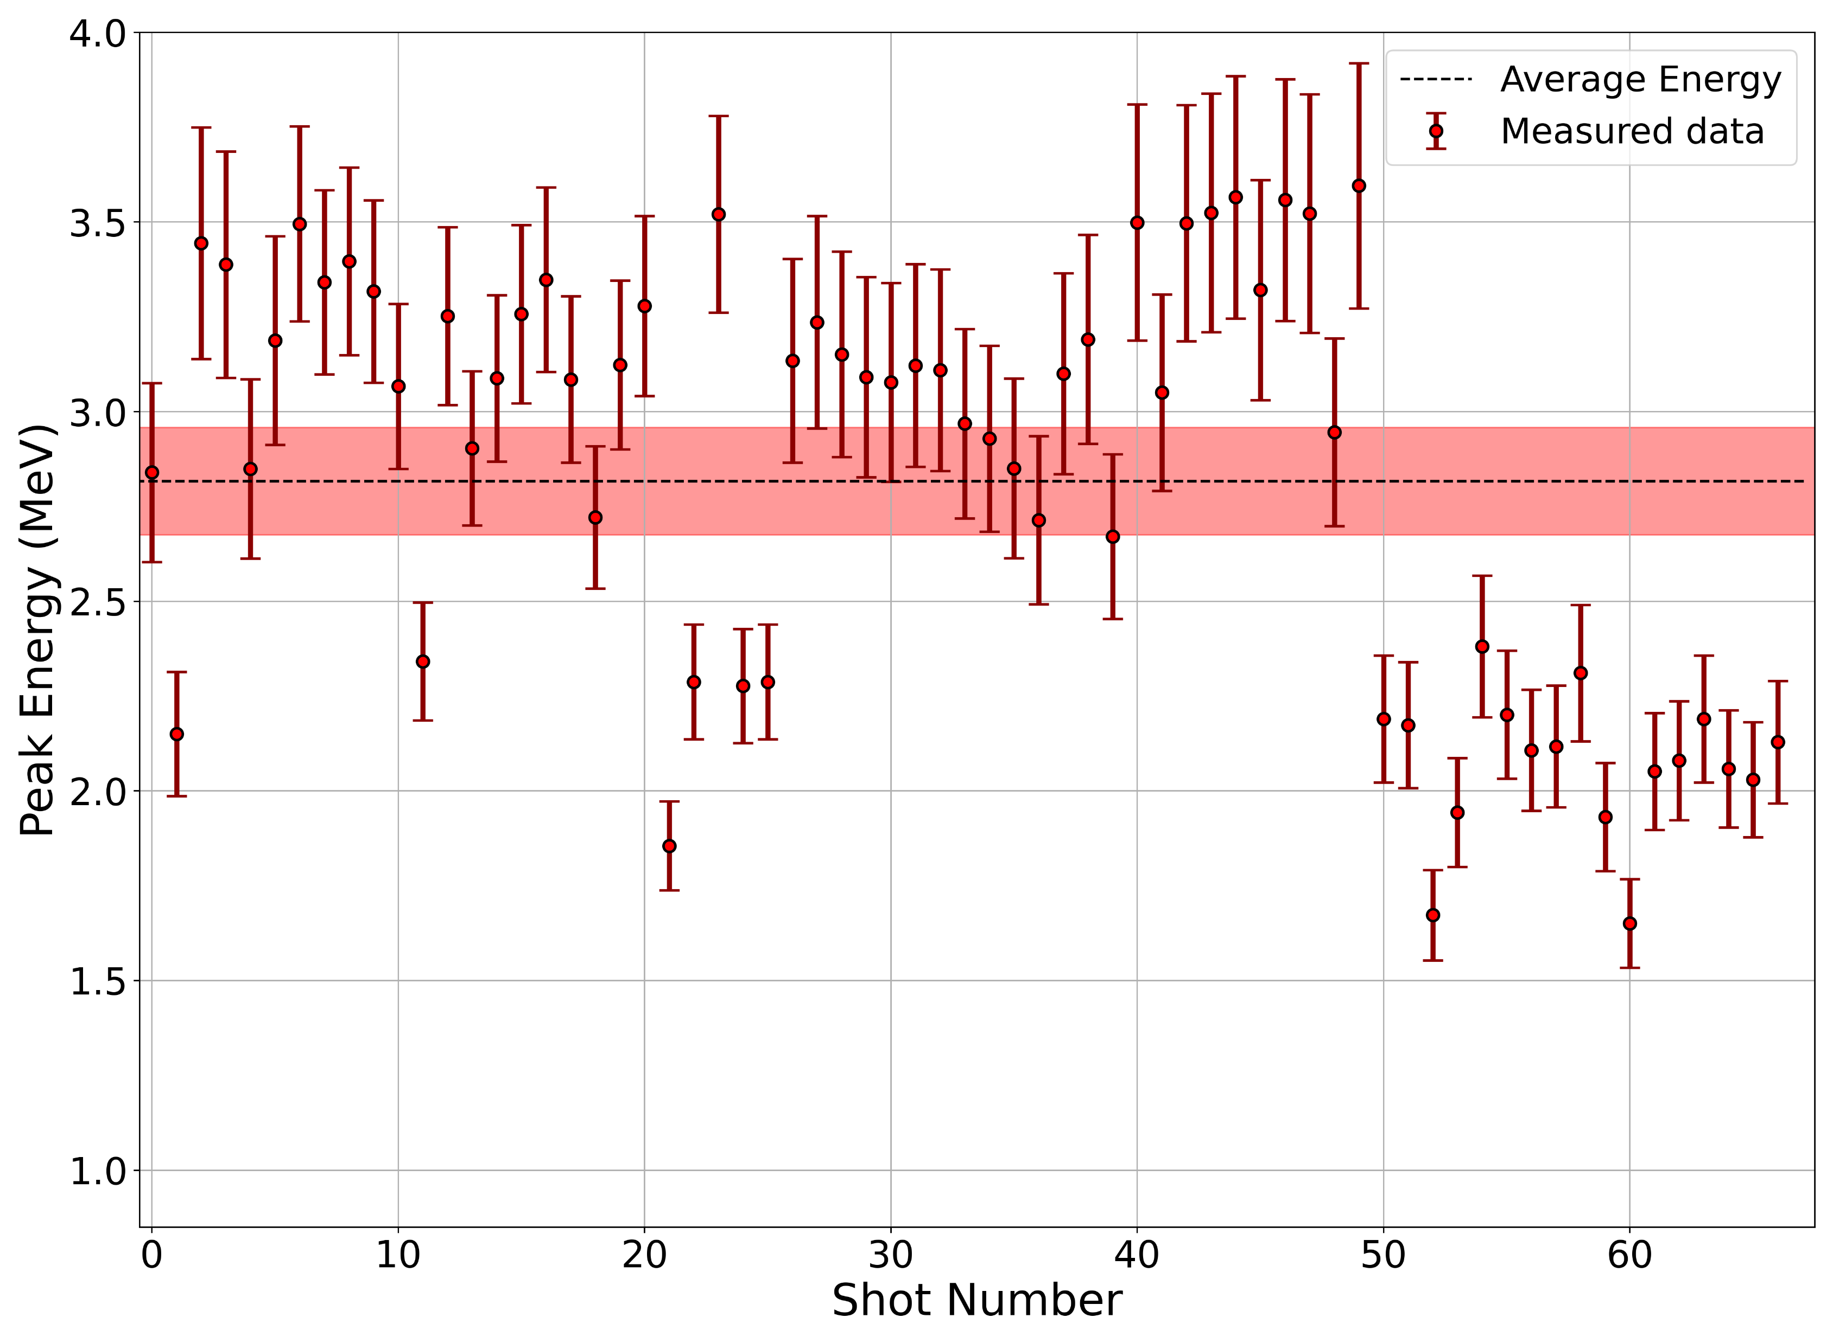

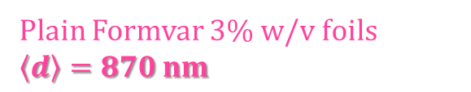

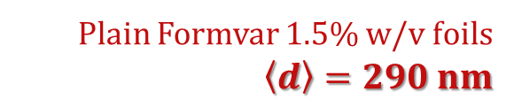
Proton cut-off energy – plain Formvar foils
Plain Formvar 3% w/v foils
$\left\langle d\right\rangle =870 nm$
Plain Formvar 1.5% w/v foils
$$\left\langle d\right\rangle =290 nm$$
$$\left\langle E_{peak}\right\rangle =\left(\text{2}\text{.}\text{1}\text{±}\text{0.2}\right) MeV$$
$$\left\langle E_{peak}\right\rangle =\left(\text{2}\text{.}\text{8}\text{±}\text{0.1}\right) MeV$$
Notes:
If we know compare these results with the ones obtained from the 1.5% w/v foils, there was a clear improvement in terms of fluctuation; hence, here is shown a burst measurement of 67 laser shots from that type of foil (from the horizontal protocol). Using the previous plot as a reference, we can immediately see that not only did the stability improved, but also how the lowest peak energy is higher than the upper limit for the Al-foils, and that the resulting average peak energy is double the value of the previous one.
Observing the plot more carefully, the data shows two distinct groups: one with higher energies, and another with substantially lower energies. The abrupt shift corresponds to a change into a wrinkled region in one of the foils, since two foils (3 dips) were used being that the second one was much more wrinkled than the 1st.

Slide 12

Proton cut-off energy – plain Formvar foils
$$\left\langle E_{peak}\right\rangle =\left(\text{3.0}\text{±}\text{0.1}\right) MeV$$
Notes:
being that the second foil was much more wrinkled than the 1st. This, then, indicates the importance of surface quality for these foils.

Slide 13
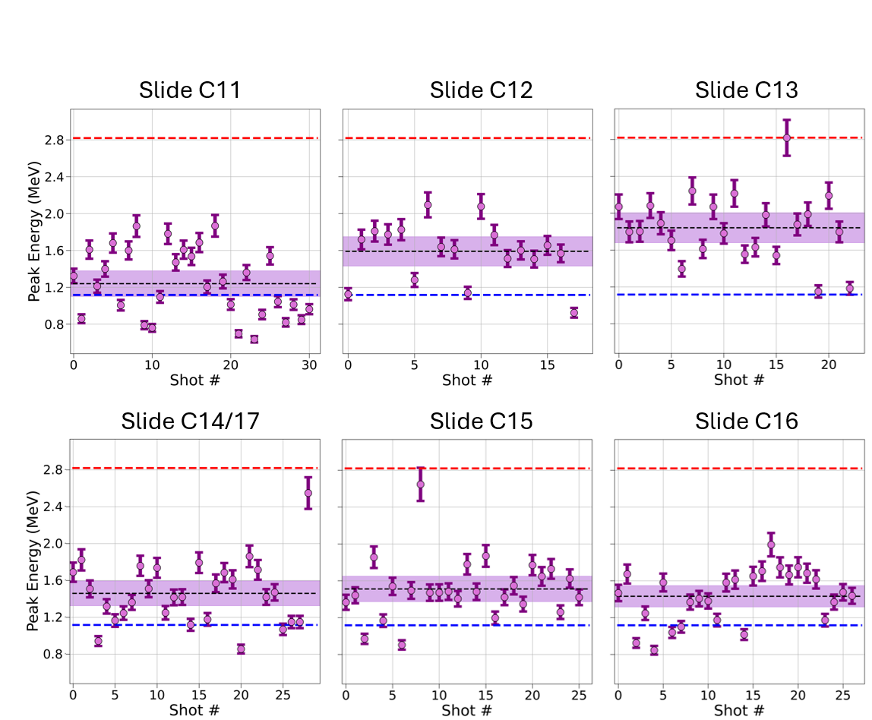
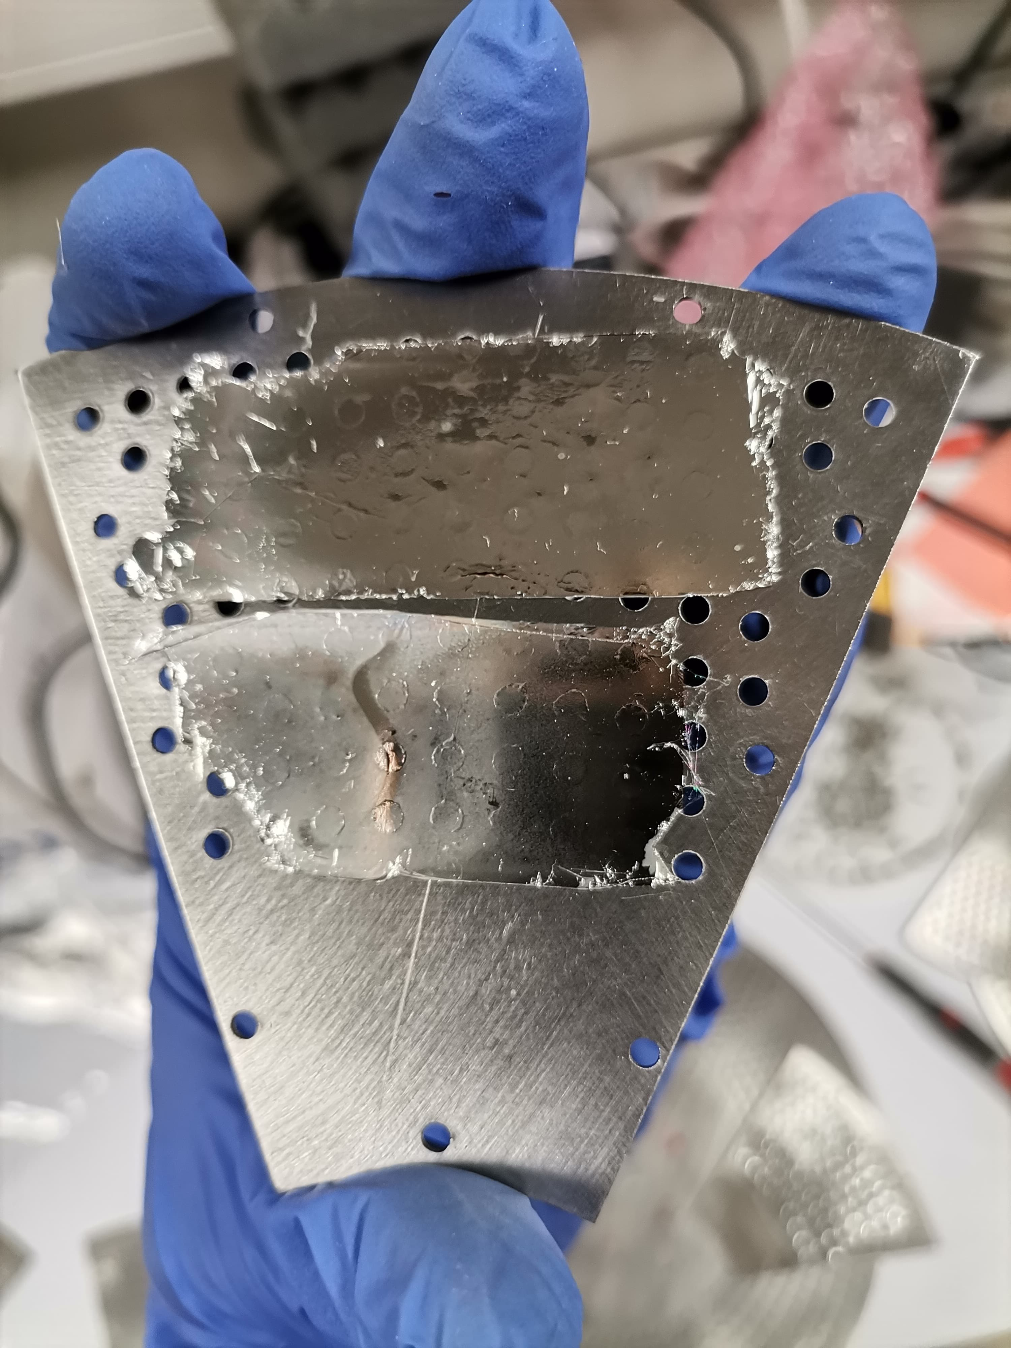
Proton cut-off energy – Ag-coated Formvar films
Ag-coated Formvar films show an improvement over plain Al foils, but they are also less stable.
Peak energy values are lower when compared to plain Formvar foils.
Peak energy evolution from Ag-coated Formvar film burst measurements.
Notes:
As for the Ag-coated Formvar films, when compared to the previously used Al foils (whose avg energy is here in blue), we can see that these films provided higher energies. However, they performed overall worse than the plain Formvar foils (in red) both in average peak energy and in its stability.
Hence, for the proton flux discussion, I will only focus on the plain Formvar foils.

Slide 14
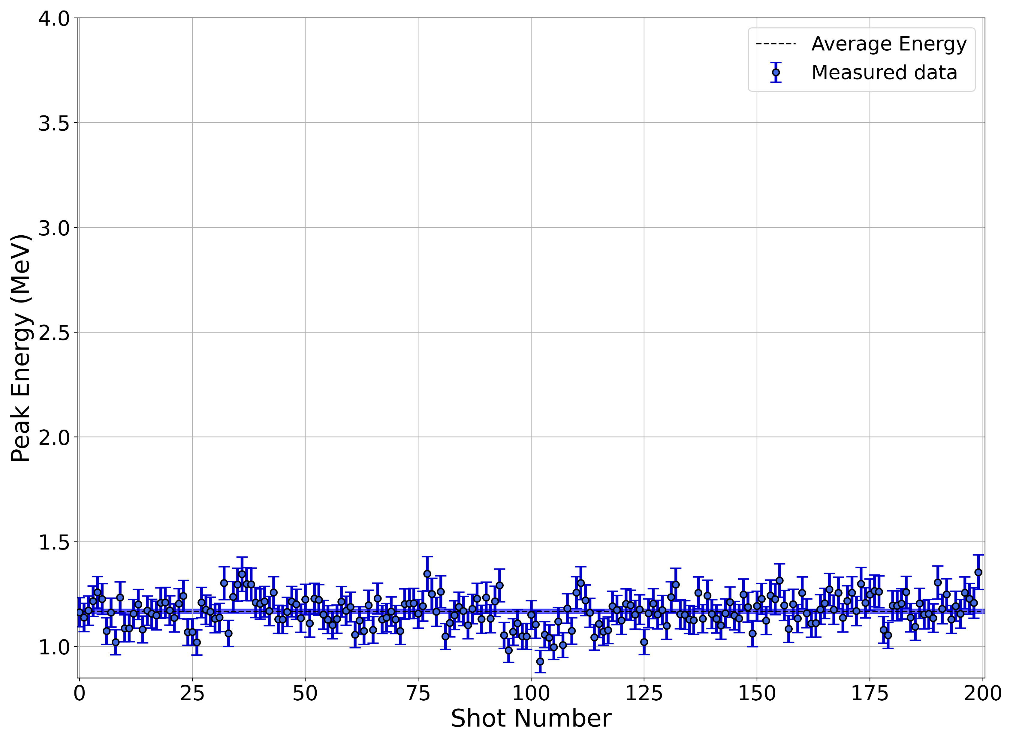
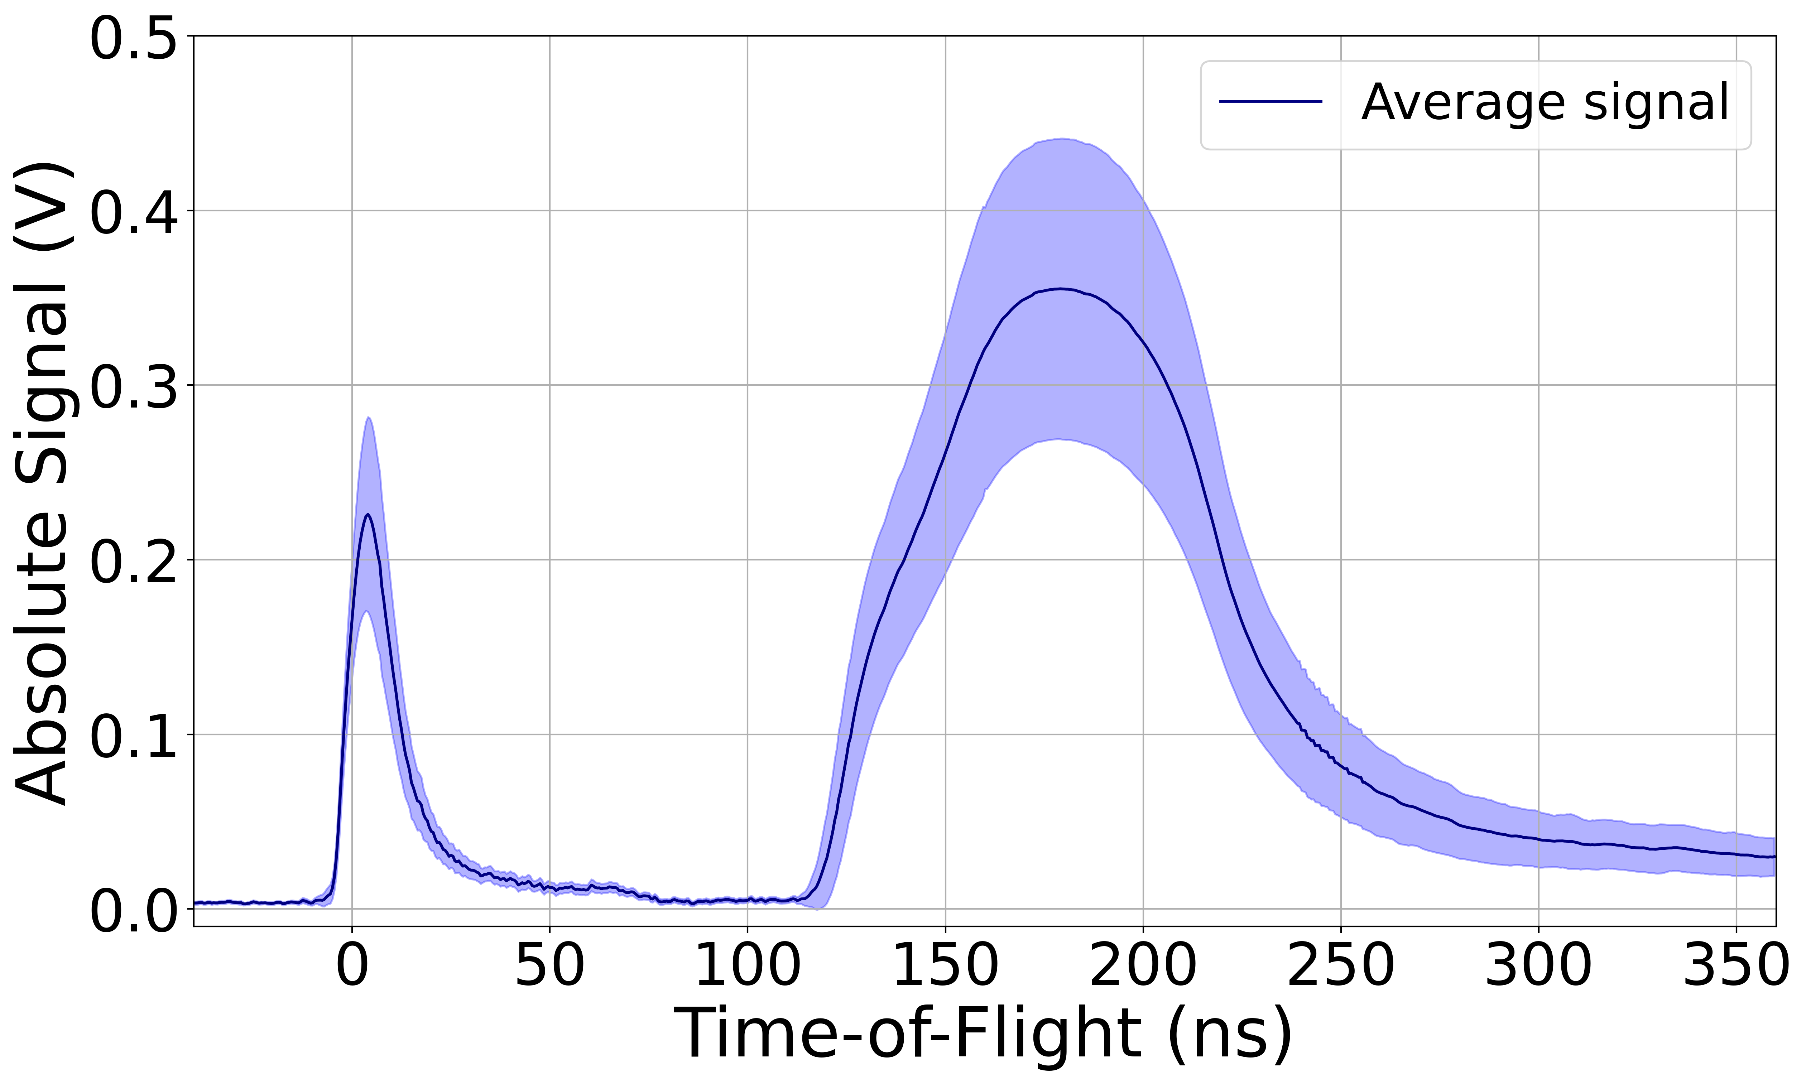
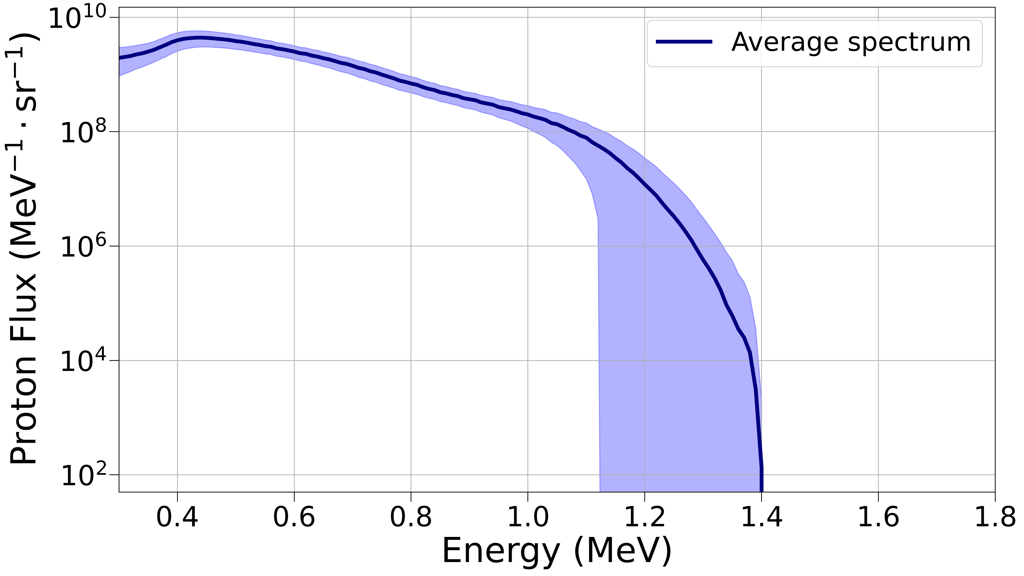
Proton flux – plain Al foils
Peak energy from the plain Al foils.
Average ToF-signal curve from the plain Al foils.
Average flux spectrum from the plain Al foils.
Notes:
So, here is presented the average energy-signal curve resulting from the burst measurement of the plain Al foils, which can be used to obtain the resulting average proton flux. As we can see, the stability of the flux is again very high, just as it was for the peak energy.
Bin = 3.6 MeV / 90 = 40 keV

Slide 15
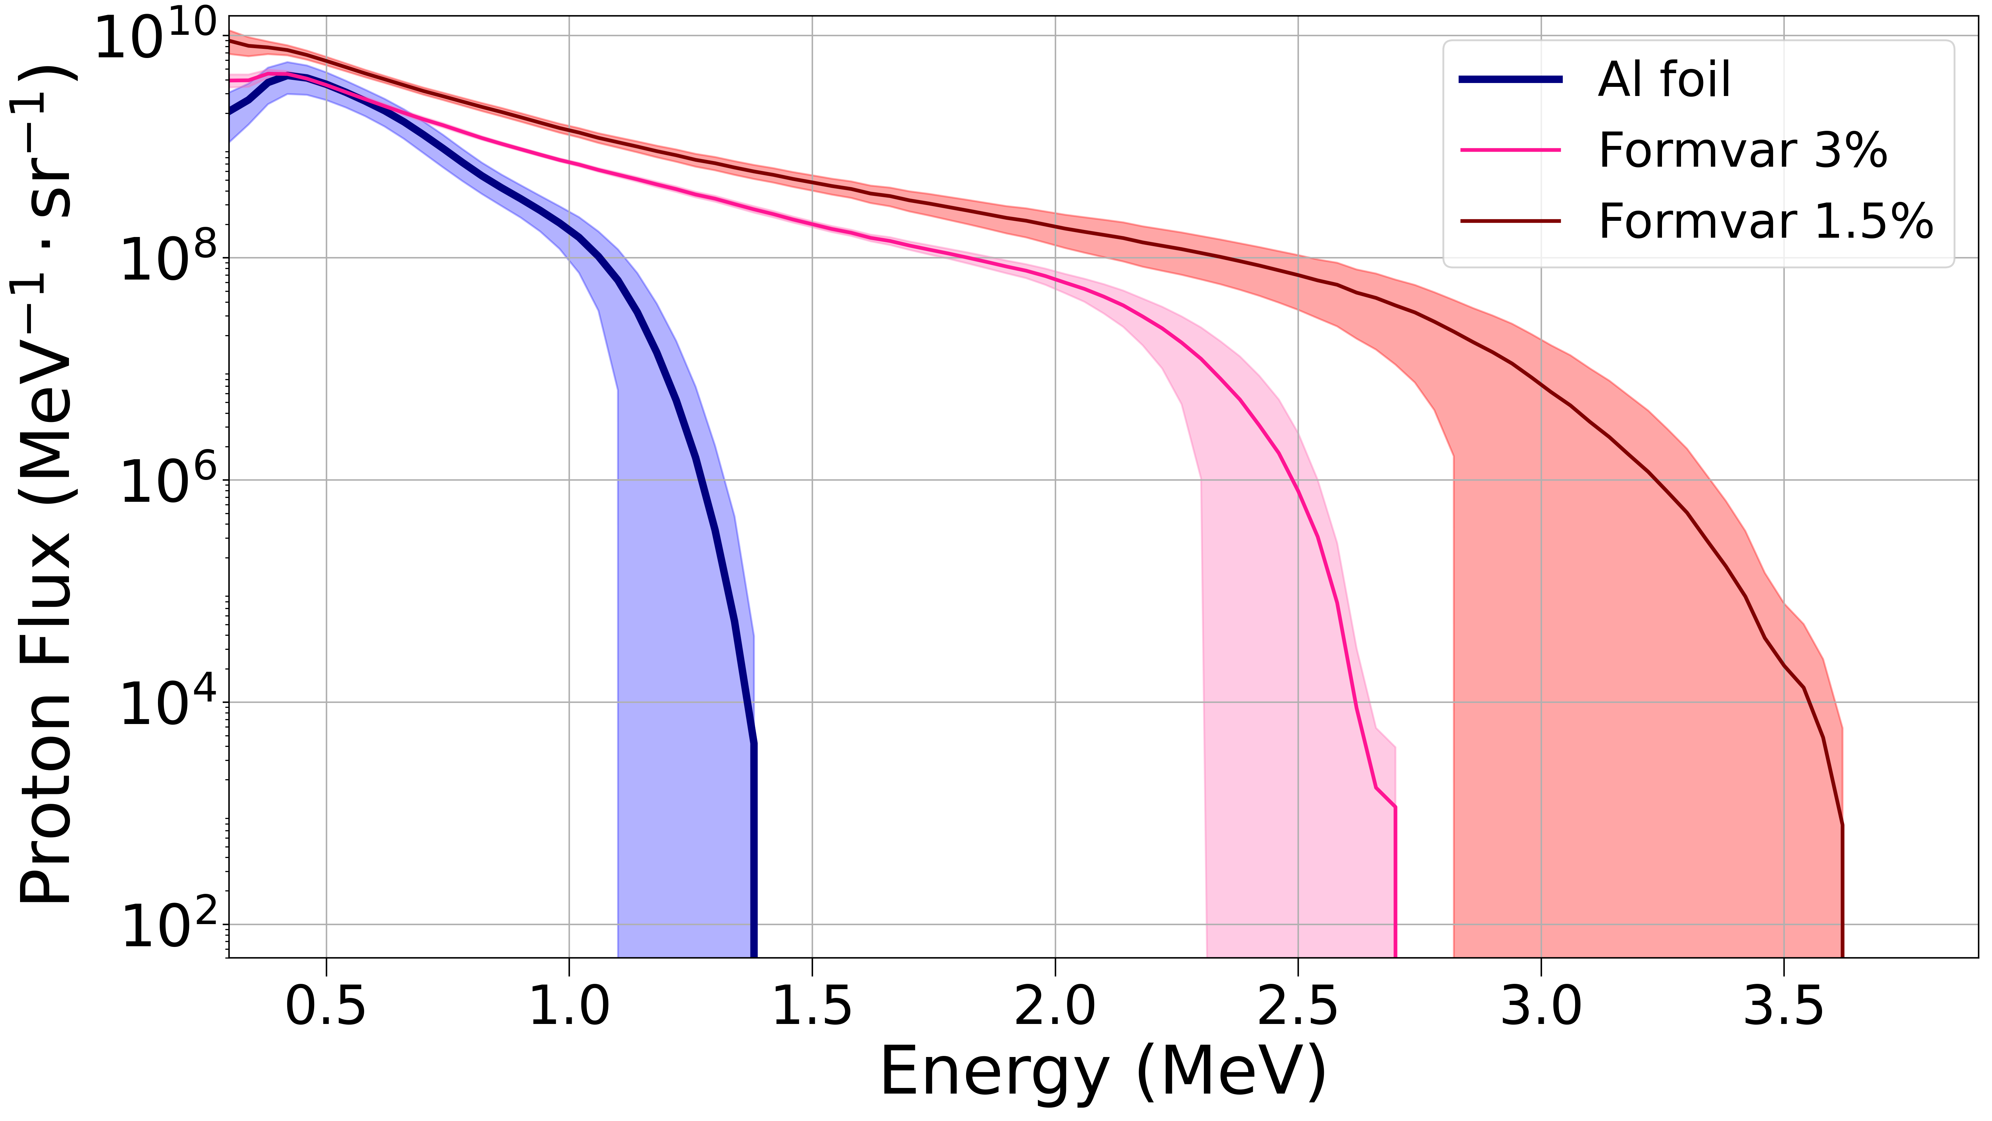
Proton flux – improvements from plain Formvar foils
Comparison of average proton flux curves for the Al, Formvar 1.5 % w/v and 3 % w/v foils.
Notes:
If I now compare it with the flux from the plain Formvar foils, it is clear how the obtained average flux from the Formvar 1.5% foils is substantially greater, even when compared to the flux resulting from the Formvar 3% w/v foils. However, it is also clear how the stability is significantly worse, particularly for higher energies.
Bin = 3.6 MeV / 90 = 40 keV

Slide 16


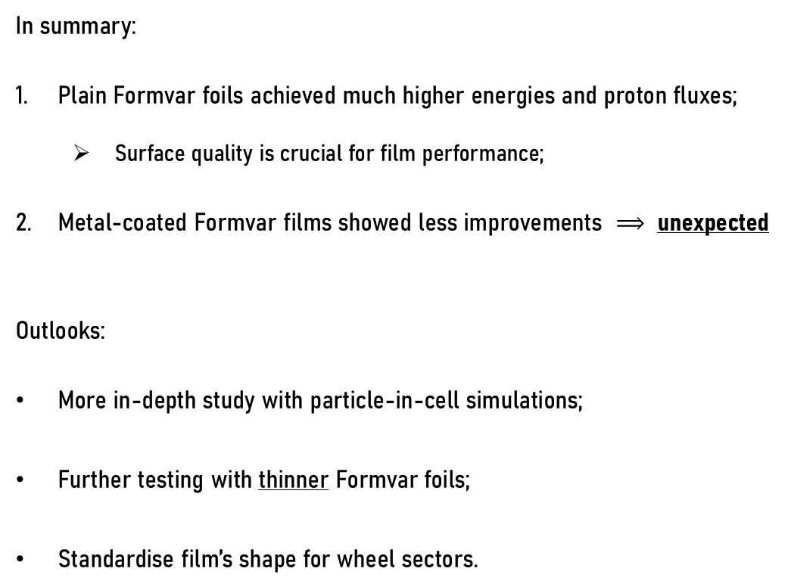
Conclusion
In summary:
Plain Formvar foils achieved much higher energies and proton fluxes;
  Surface quality is crucial for film performance;
Metal-coated Formvar films showed less improvements $⟹$ unexpected
Outlooks:
More in-depth study with particle-in-cell simulations;
Further testing with thinner Formvar foils;
Standardise film’s shape for wheel sectors.
Notes:
To summarise, plain and silver-coated Formvar films were successfully produced, characterized and used for laser-driven proton acceleration. From all of the conducted tests in Santiago de Compostela, results show that plain Formvar foils were the better-performing film type; with these films, we were able to generate substantially higher proton fluxes and reach peak energies never reached before at the L2A2. In contrast, the Ag-coated Formvar films performed worse than the plain Formvar foils – an unexpected result that requires a dedicated study to determine its exact cause. In addition, we still haven’t found the optimum film thickness for the current setup and the films need to be improved to be used for radioisotope production.
By consequence, the next steps would be to further study these films and perform complementary particle-in-cell simulations, which would give better in-sight on what would be the optimum film requirements for the L2A2 setup.
In conclusion, although several questions are left open for a future work, the results show that this work was a clear step in the right direction, laying the ground-foundation for further improvements at the L2A2 facility, in the challenging field that is laser-driven acceleration.

Slide 17



Acknowledgements
NUC-RIA and LIP:
Daniel Galaviz; Pamela Teubig; Ricardo Pires; Margarida Paulino; Raquel Nunes.
IGFAE-USC:
Aarón Alejo; Adrián Bembibre.
CTN-IST
ENEN+ Mobility Program
Notes:
To summarise, from all the tests conducted in Santiago de Compostela, Plain Formvar foils performed better than the Al foils and than the Ag-coated Formvar films. These results were not as expected, and a more dedicated study would be necessary to determine the exact cause of this. The results have also shown that not only does a film’s poor surface quality decrease the reached energies, but it also affects the generated proton flux and the overall stability, hence reducing the film’s appeal as well. This then showcases how the quality of the target is crucial for the performance of Formvar foils in laser-driven proton acceleration.
In conclusion, although several questions are left open for a future work, the results show that this work was a clear step in the right direction, laying the ground-foundation for further improvements at the L2A2 facility, in the challenging field that is laser-driven acceleration.

Slide 18
Questions?

Slide 19
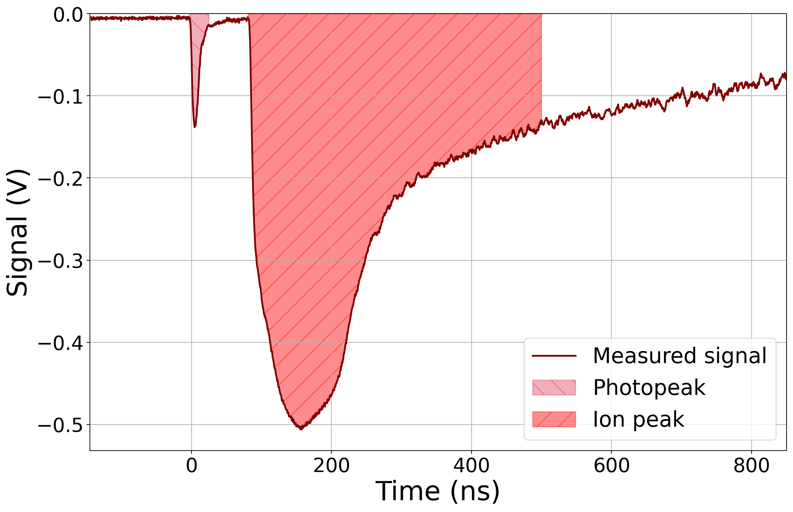
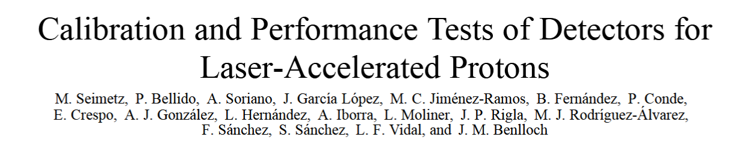
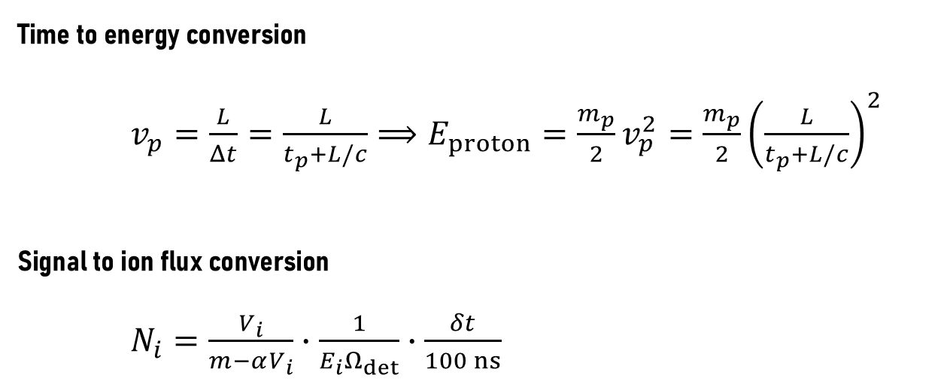

Time of flight techniques
Time to energy conversion
$v_{p}=\frac{L}{Δt}=\frac{L}{t_{p}+L/c}⟹E_{proton}=\frac{m_{p}}{2}v_{p}^{2}=\frac{m_{p}}{2}{\left(\frac{L}{t_{p}+L/c}\right)}^{2}$
Signal to ion flux conversion
$N_{i}=\frac{V_{i}}{m−αV_{i}}∙\frac{1}{E_{i}Ω_{det}}∙\frac{δt}{100 ns}$
M. Seimetz et all, IEEE Transactions on Nuclear Science
$$t_{peak}$$
$$↓$$
$$E_{peak}$$
Example of a measured time-of-flight signal.

Slide 20
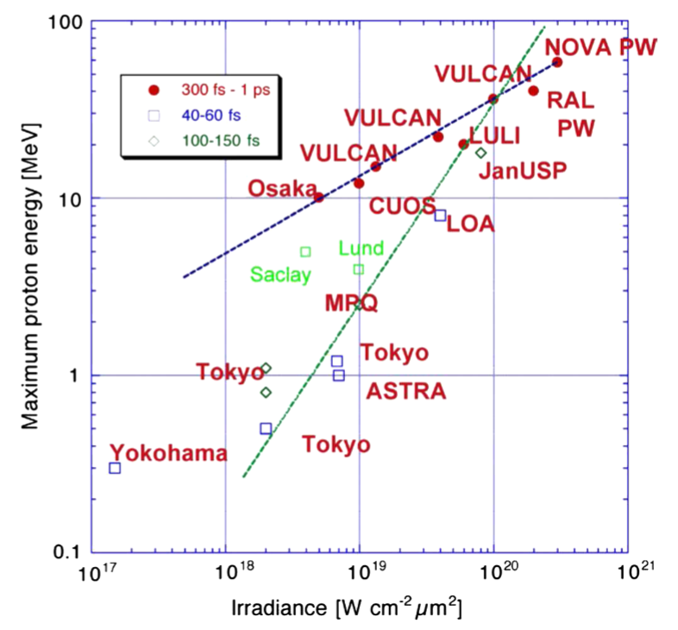
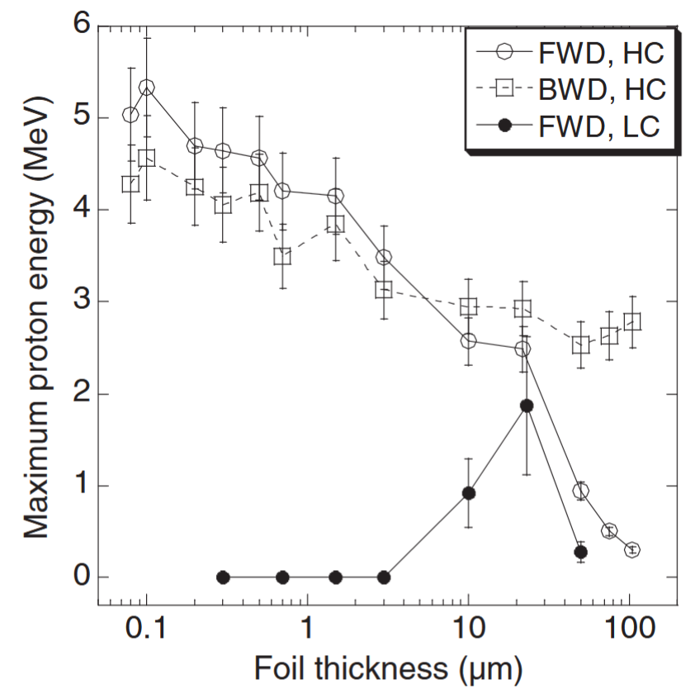

Compared to other studies…
T. Ceccotti et all, Proton Acceleration with High-Intensity Ultrahigh-Contrast Laser Puses, PRL 99, 185002 (2007)
$$Iλ^{2}\sim 7×{10}^{19}×{\left(800 nm\right)}^{2}\sim 5×{10}^{19} W {cm}^{−2}{μm}^{2}$$
M.Borghesi et all, Plasma Phys. Controlled Fusion 50, 124040 (2008)
Maximum proton energy from laser-irradiated solid targets as a function of the laser irradiance and for three ranges of pulse durations
Variation of maximum detectable proton energy as a function of target thickness for ${10}^{19} W/{cm}^{2}$. HC is ${10}^{10}$ and LC is ${10}^{6}$.

Slide 21
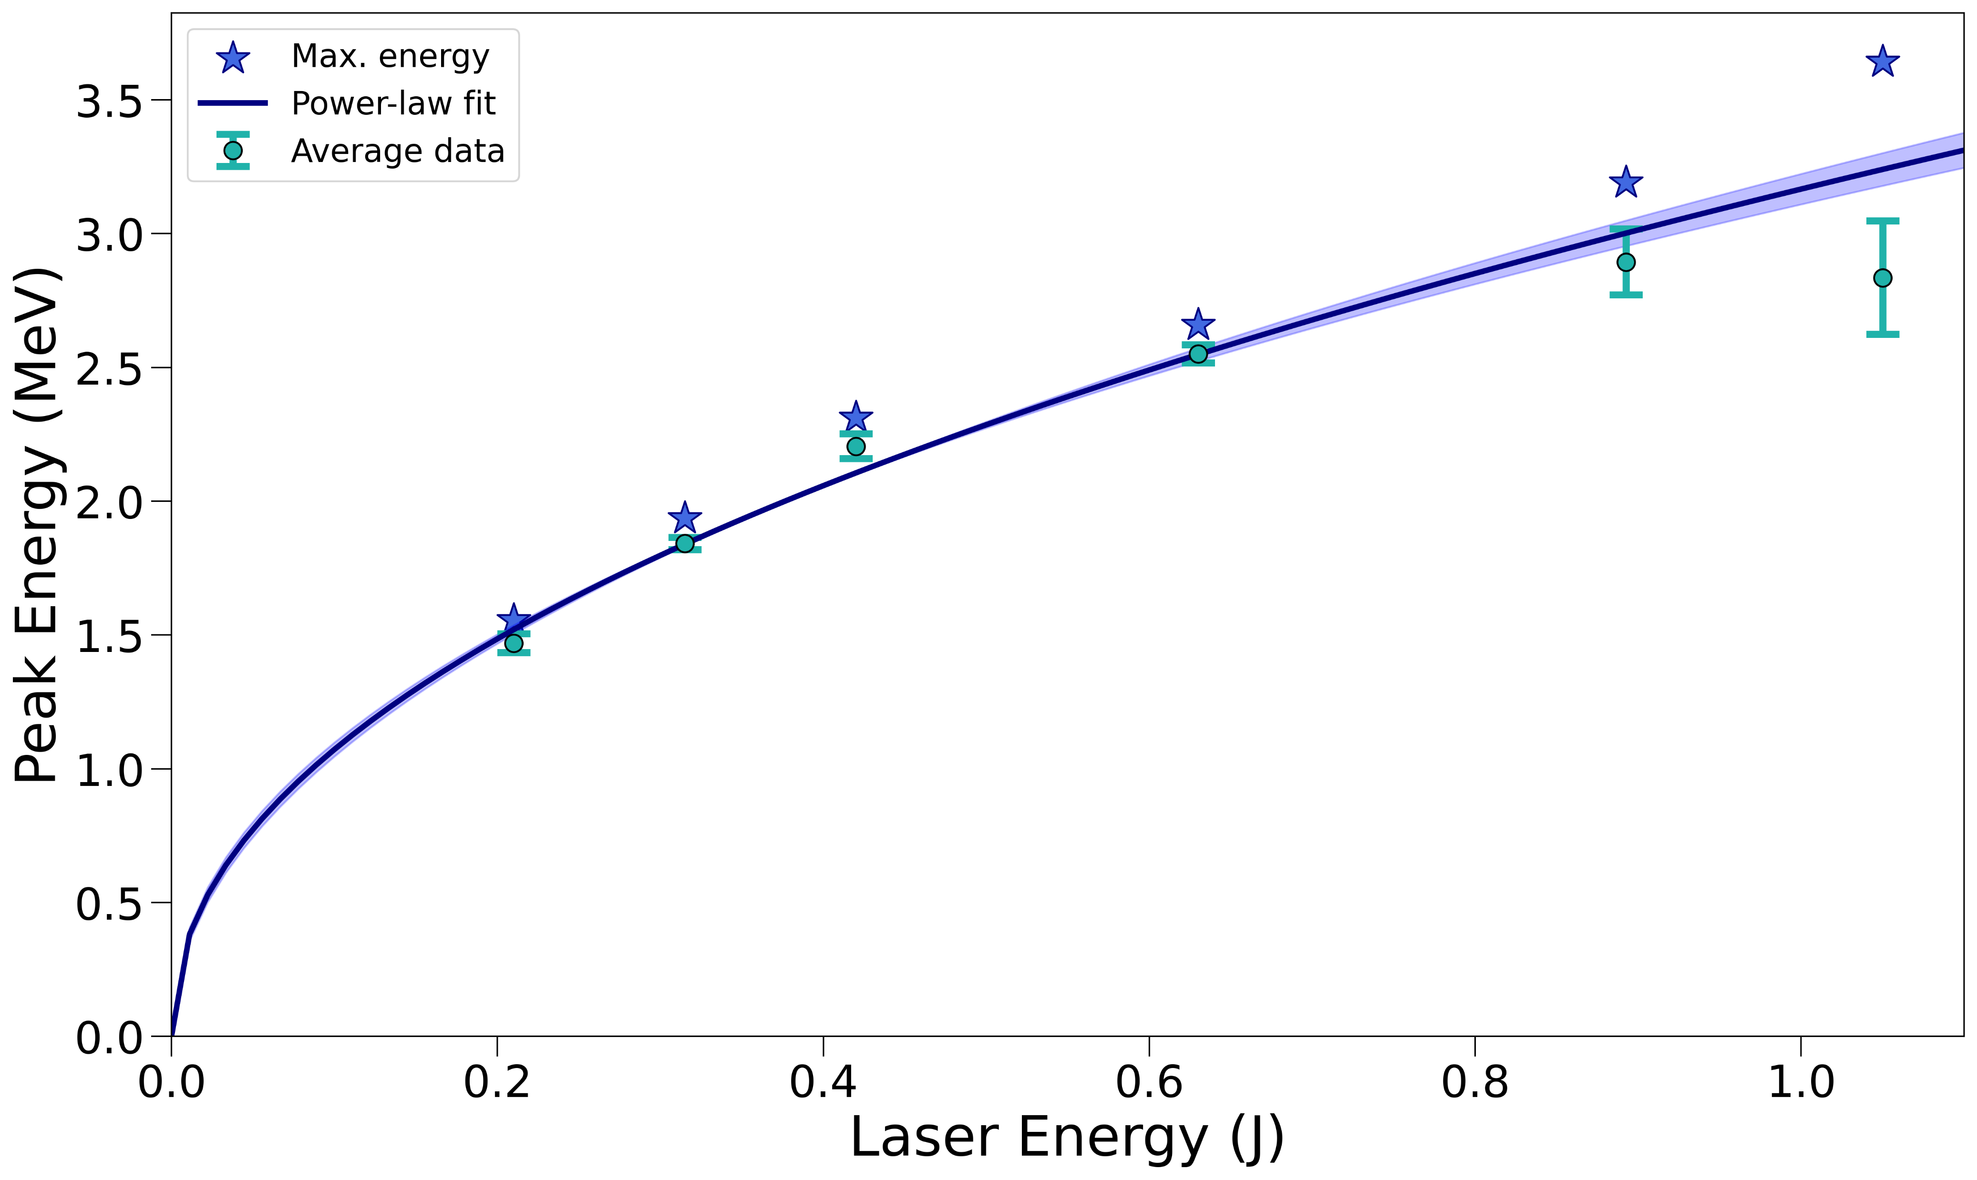
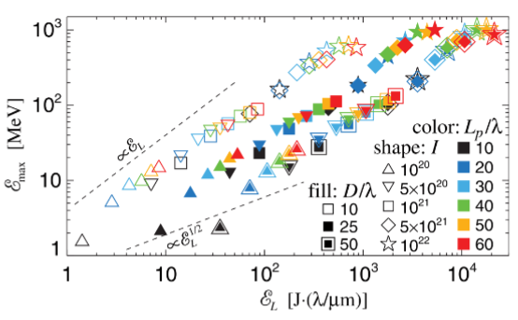

Normalisation to laser energy
Used as reference for
$$∝{\left(E_{laser}\right)}^{0.47±0.02}$$
Measured peak energy — laser-energy relation, with power-law fit.
A. Macchi et all, Ion acceleration by superintense laser-plasma interaction, RMP (2013)
Results from multiparametric 2D simulations for a double layer target fit.

Slide 22



Formvar production – Protocol
General Steps:
dust-particles
1)
2)
chloroform
resin
glass slide
3)
4)
Dipping in Formvar
Take out slide and let it dry

