Slide 1
CRYRING@ESR Facility for Low-Energy Ion Beams
Zoran Andelkovic – Accelerator Operations / Decelerator

Slide 2
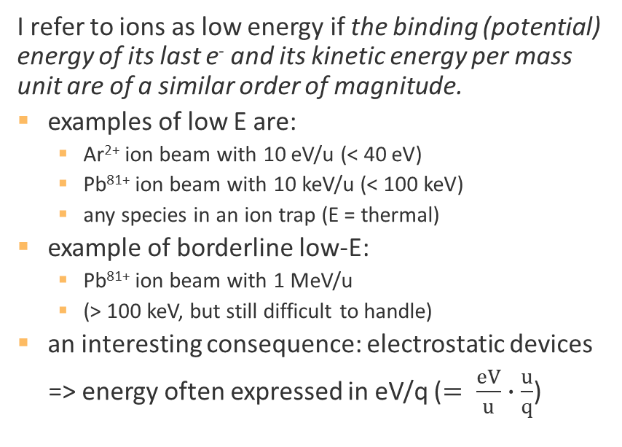
What is an ion at low energy?
I refer to ions as low energy if the binding (potential) energy of its last e⁻ and its kinetic energy per mass unit are of a similar order of magnitude.
examples of low E are:
  Ar²⁺ ion beam with 10 eV/u (< 40 eV)
  Pb⁸¹⁺ ion beam with 10 keV/u (< 100 keV)
  any species in an ion trap (E = thermal)
example of borderline low-E:
  Pb⁸¹⁺ ion beam with 1 MeV/u
  (> 100 keV, but still difficult to handle)
an interesting consequence: electrostatic devices
=> energy often expressed in eV/q ($= \frac{eV}{u}∙\frac{u}{q}$)

Slide 3
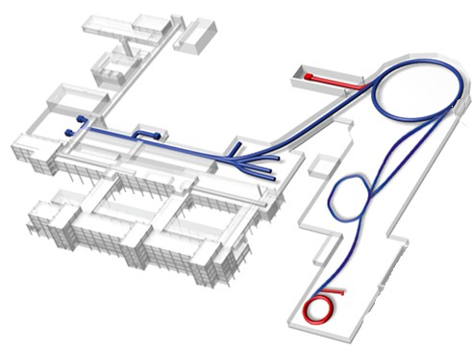
Slow, Heavy, Highly-Charged Ions @ GSI/FAIR
SIS18
FAIR
Ion Sources
UNILAC
production
HITRAP
production
FRS
ESR
200 m
FAIR
CRYRING

Slide 4
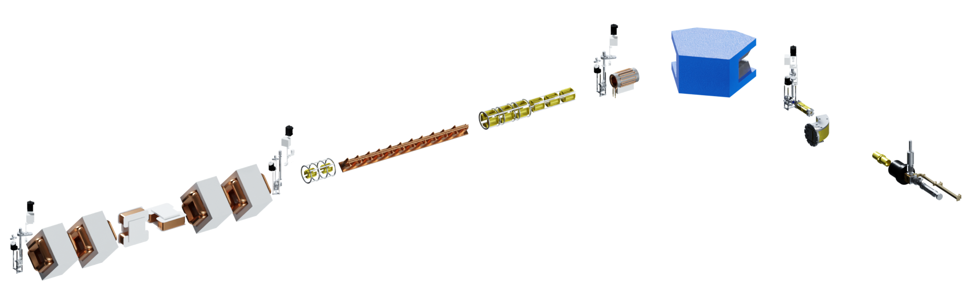
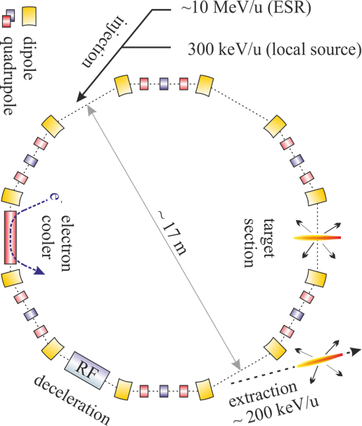
CRYRING@ESR and local injector
RFQ
sector magnet
injection
C=54 meters, 0.04-1.44 Tm rigidity
injection from GSI and local ion source
Max. up to 10⁹ , min. down to 10⁶ charges
10⁻¹¹ mbar, 1 second to 1 hour ion lifetime
three experimental sections + beam extraction
10 GHz
ECRIS
e⁻
electron
cooler
target
section
Low charge | Energy | High charge | Energy
H₂⁺, D⁺, Li⁺, N^{1..5+}, C⁺, O^{2..6+}, F⁶⁺, Ne^{2..7+}, ^{24,25}Mg⁺, S³⁺, Ar⁺ | 1 keV/u (inj.) 150 keV (Mg⁺) 20 MeV (D⁺) | Ar¹⁸⁺, Ag⁴⁶⁺, Au^{75..78+}, Pb^{78..81+}, U⁹¹⁺ | 1 MeV/u … 15 MeV/u
dipole
quadrupole

Slide 5
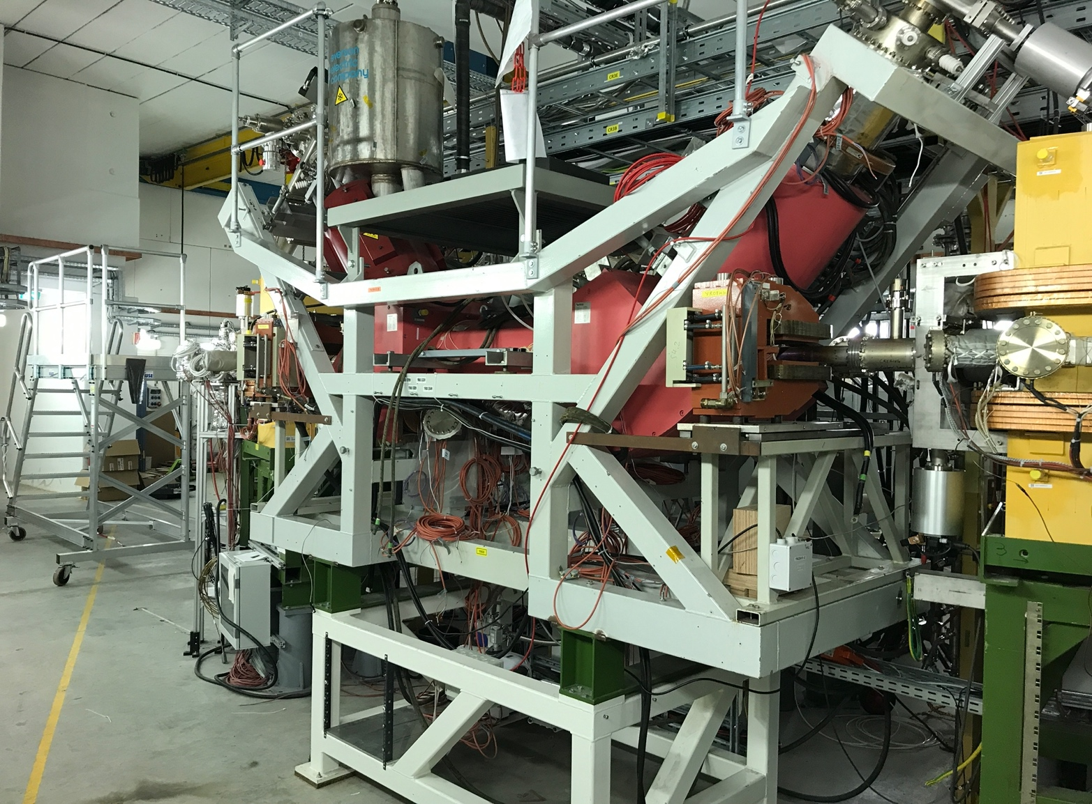
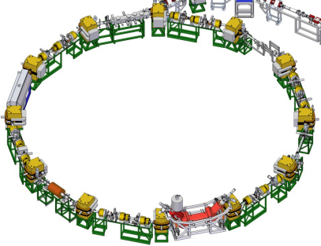
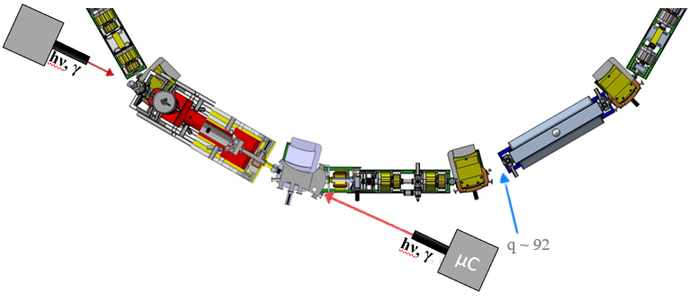
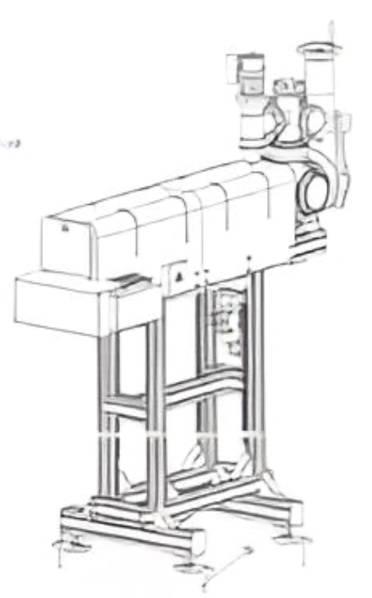
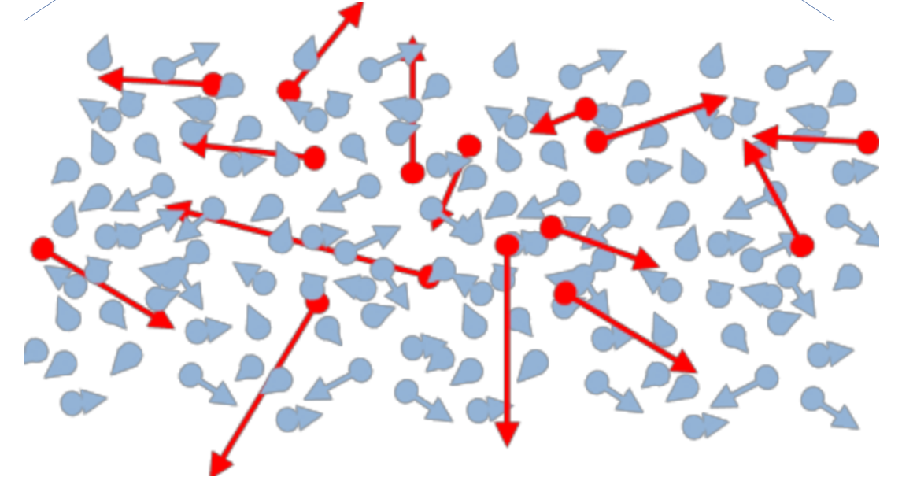
Section YR03: Electron Cooler
Particle
detectors
Electron Cooler
2 m
electron cooling in the center of mass frame: “hot” ions in a bath of “cold” electrons

Slide 6
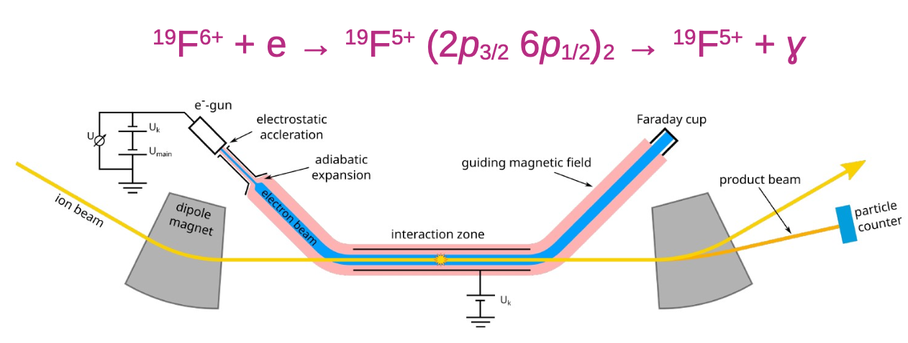
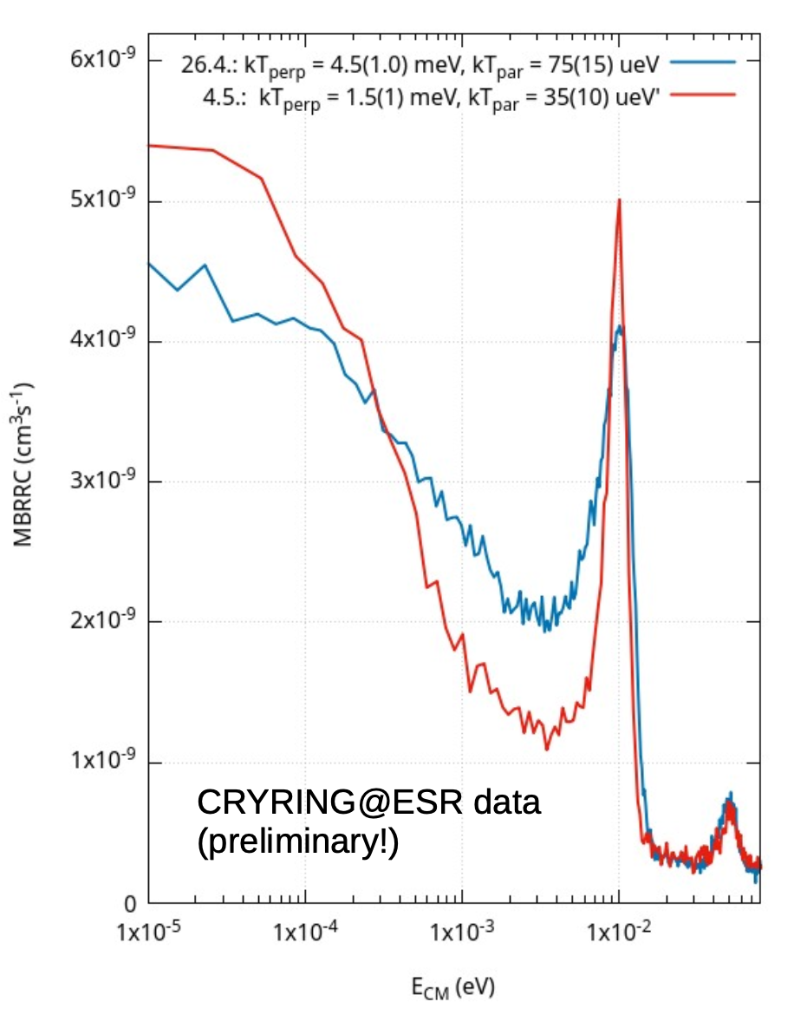
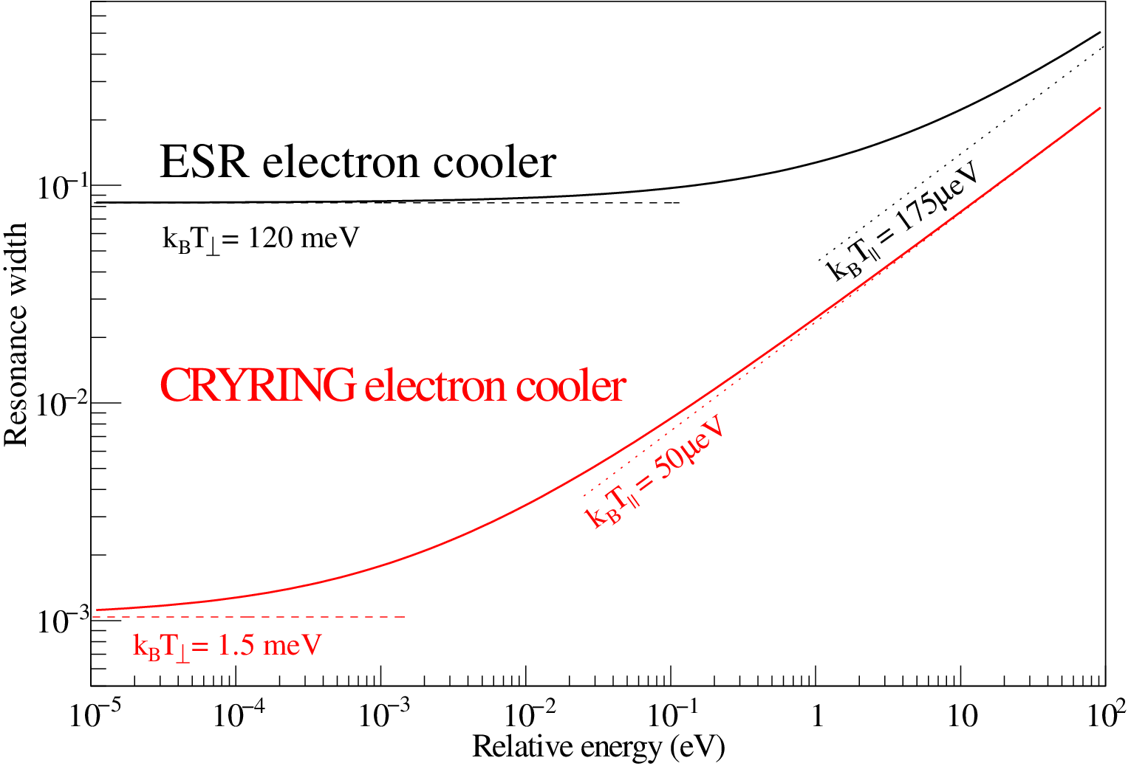
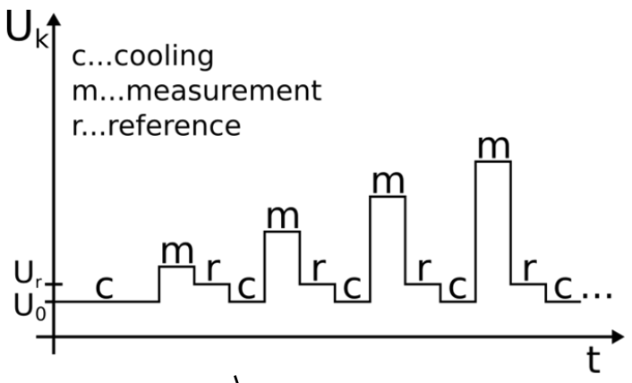
Cooling limit and dielectronic recombination
Cooling: ion velocity = electron velocity
Measurement: variation of cooler voltage
→ relative energy between electrons and ions
Scan of relative energies → spectrum
Goal: DR of F⁶⁺ as a benchmark for the highest spectroscopic resolution in electron-target mode
100x expansion of the e⁻ beam:
kT = 1.5 meV !
Data and graphics courtesy of C. Krantz

Slide 7
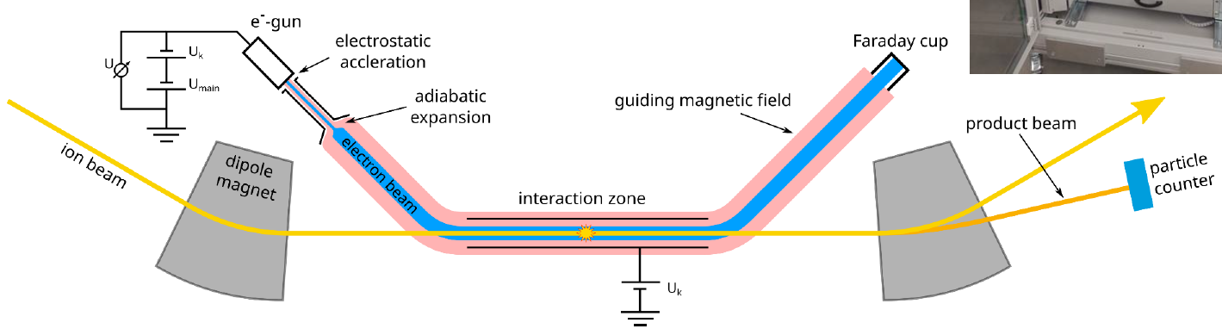
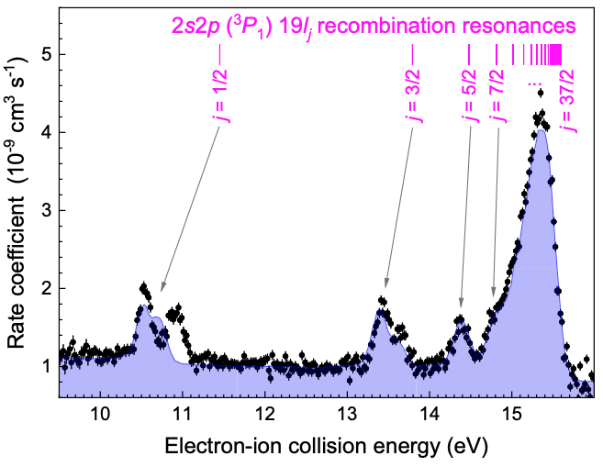
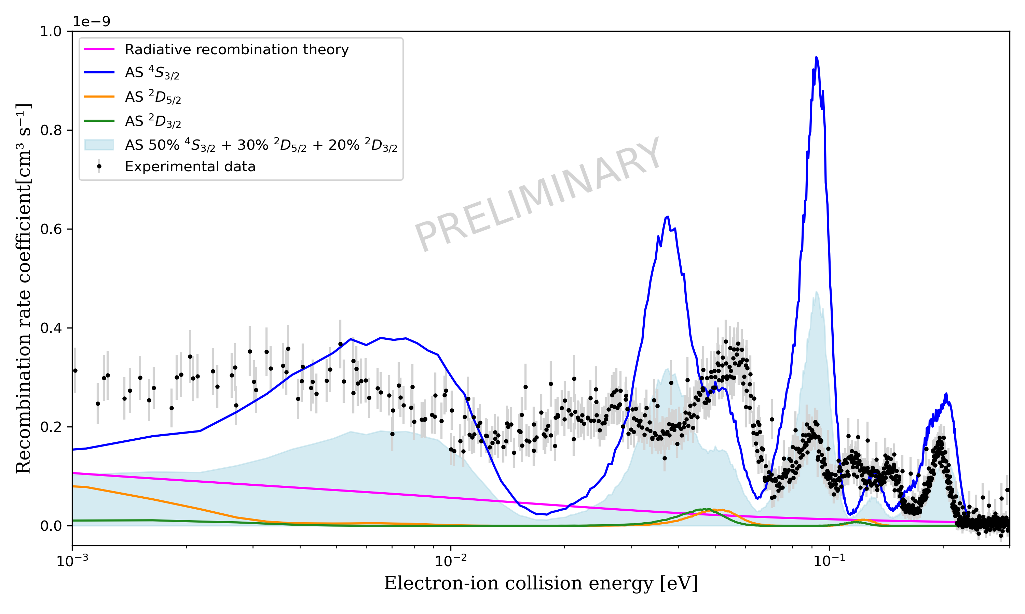
Dielectronic Recombination
U_cooler + U_ramp
· Pb⁷⁸⁺
11 MeV/u
· Ne³⁺ O²⁺
2 MeV/u
· 10⁶-10⁷ ions
Highly charged ions (e.g. Pb⁷⁸⁺):
few-e⁻ ions with a simple structure
ideal test cases for QED theory
Low charged ions (e.g. Ne³⁺, O²⁺):
dominant in astrophysical plasmas for the charge state population
DR rates are applied to estimate plasma densities and temperatures
E. Hanu, M. Lestinsky, et. al.
S. Schippers et al. PRL 135, 113001 (2025)

Slide 8
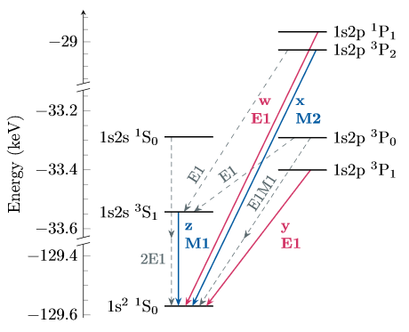
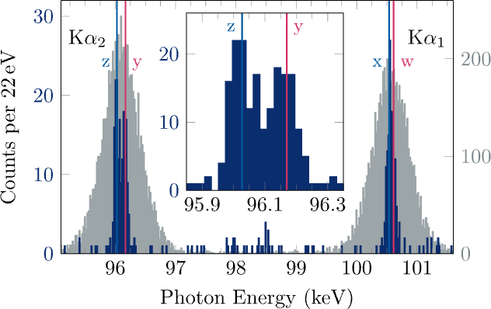

X-Ray Spectroscopy of U⁹⁰⁺
· U⁹¹⁺ beam
13 MeV/u
· Duty cycle
40 sec.
· 5∙10⁶ ions
e⁻ beam
30 mA
U⁹¹⁺ ions
U⁹⁰⁺ ions
stopped by particle detector
maXs
180°
maXs
0°
Radiative recombination followed by photon emission
Coincidence
condition
First (!) identification of Kα components in a high-Z system
Transition energies in agreement with bound-state QED
Uncertainty dominated by counting statistics
G. Weber, T. Stöhlker, et al.

Slide 9
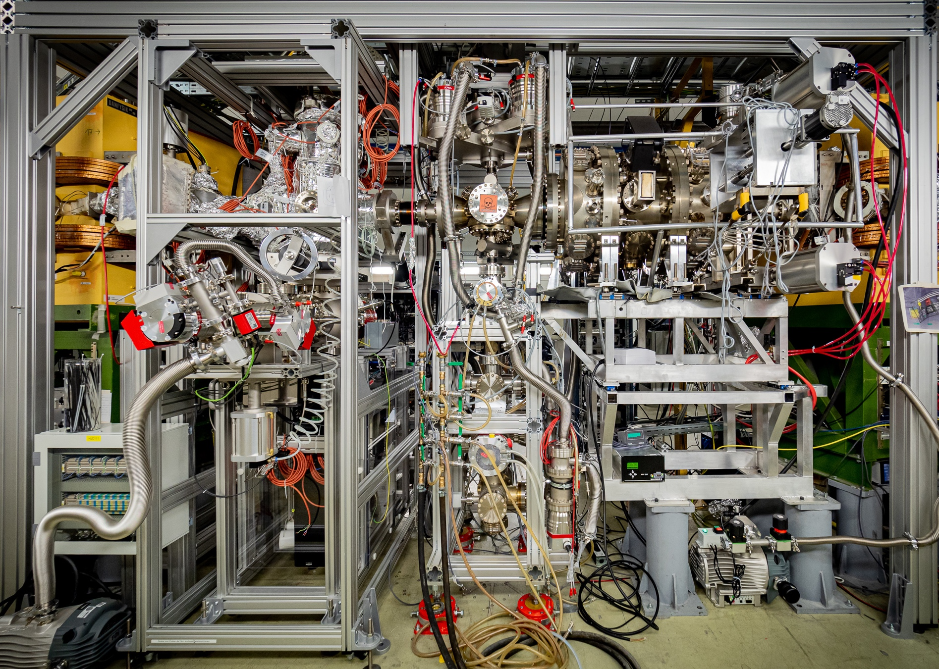
Section YR09: nuclear astrophysics
extensive user acitvity : installation of detectors and targets with support of local expert groups
section is now ready for the upcoming user run(s)
Electron target
Gasjet target
CARME
coordination of user activites: M. Lestinsky
Gasjet target area densities:
Helium: 6 . 10¹¹ cm⁻²
Hydrogen: 2 . 10¹⁴ cm⁻²
Nitrogen: 6 . 10¹¹ cm⁻²
Krypton: 2 . 10¹² cm⁻²
Xenon: 6 . 10¹² cm⁻²
Photo: C. Brandau

Slide 10
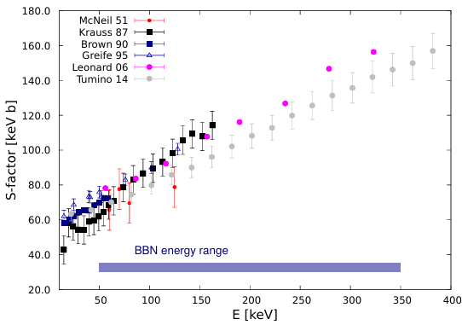
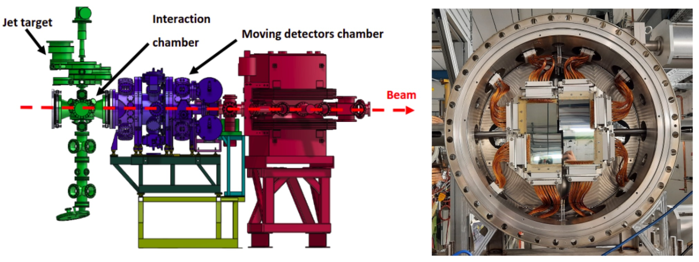
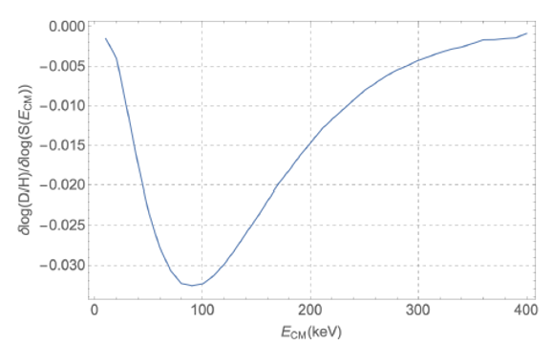
Gas Target & CARME spectrometer
Big Bang Nucleosynthesis: D(D,p)3H
5∙10⁸ locally produced D⁺ ions, E ≥ 90 keV/u, f = 300 kHz
usually not feasible due to D-T contamination
a thick gas target would mask the products
detection with Double-sided Silicon Strip Detectors (CARME)
possible for the first time at CRYRING
Jordan Marsh, Carlo Bruno et al. (CARME)

Slide 11
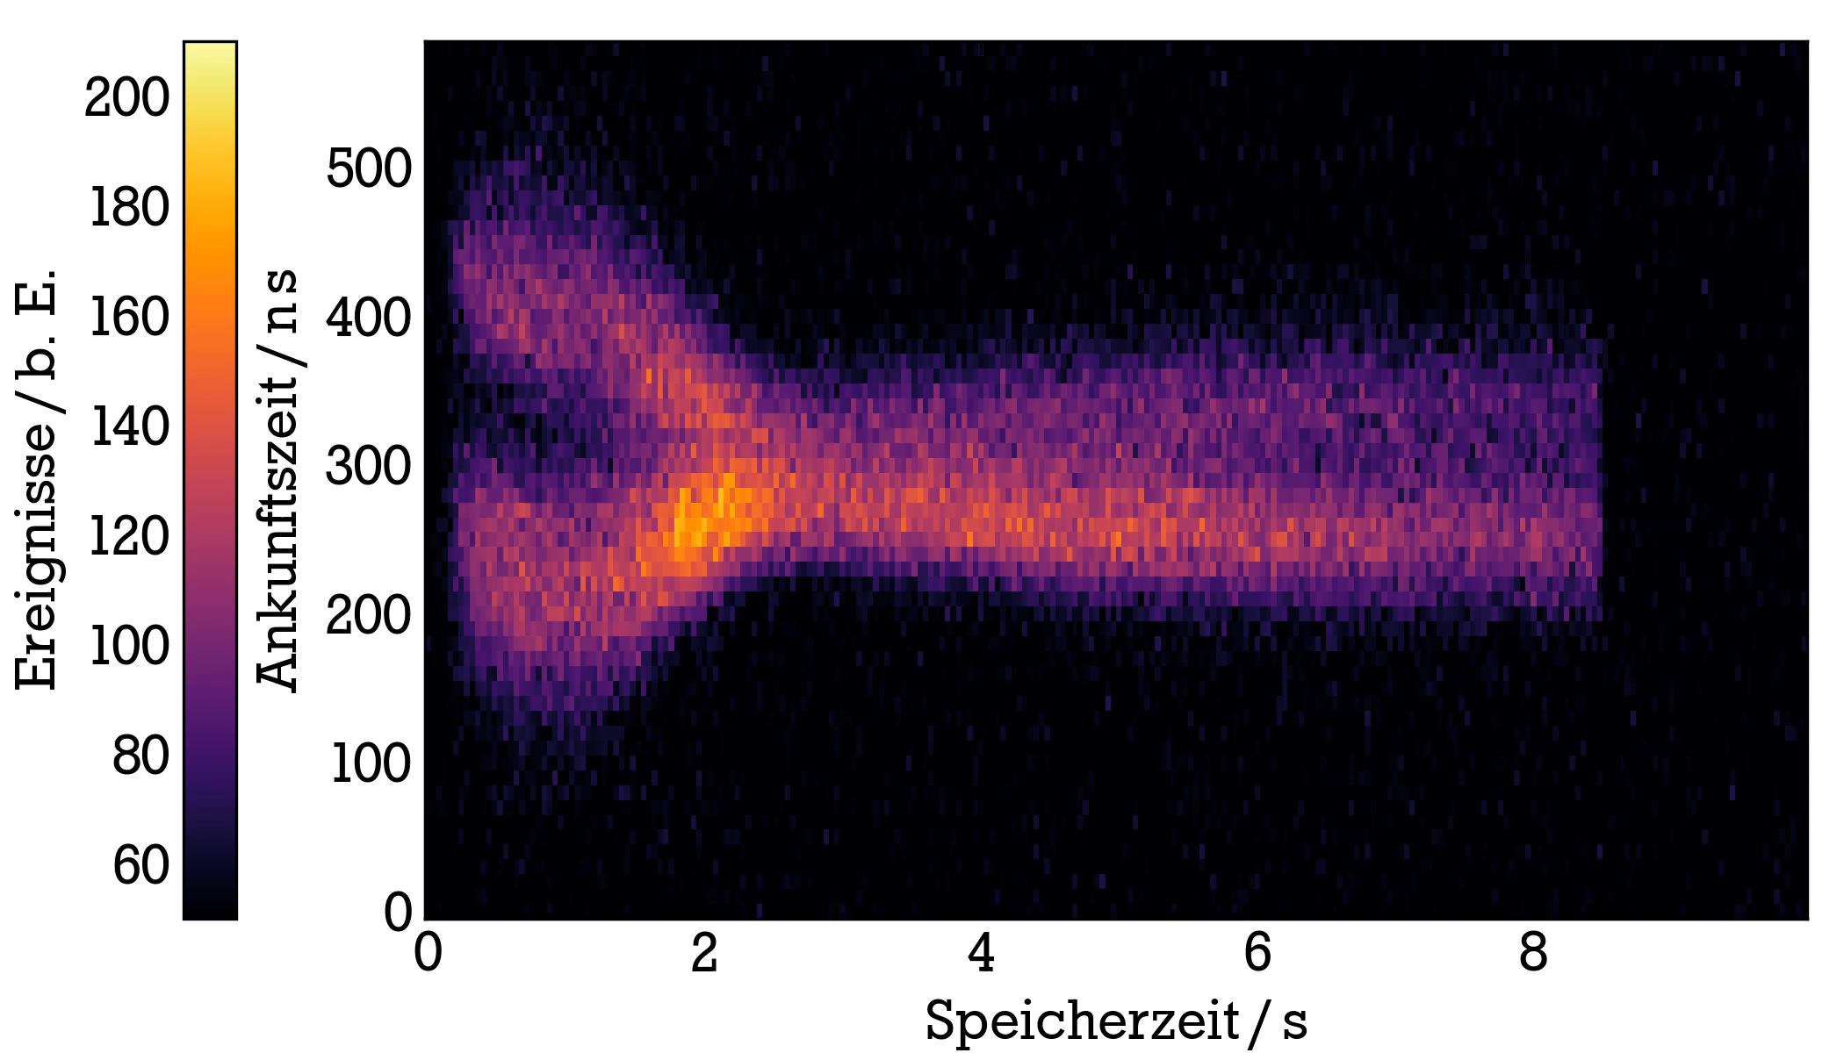
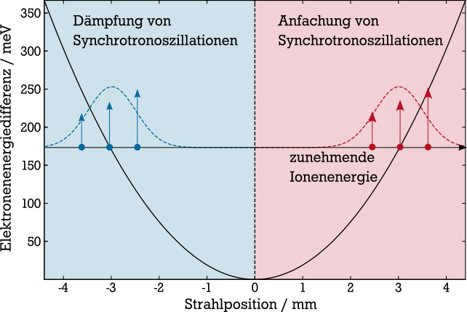
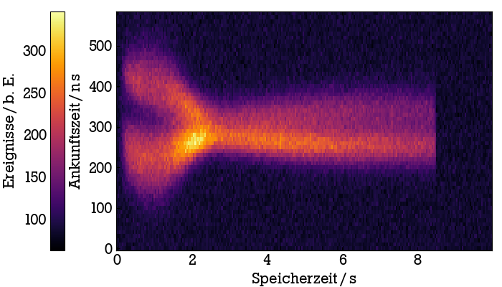
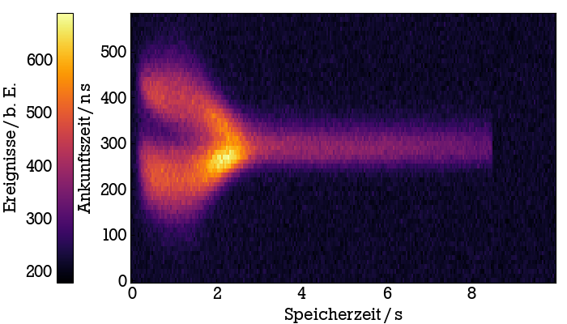
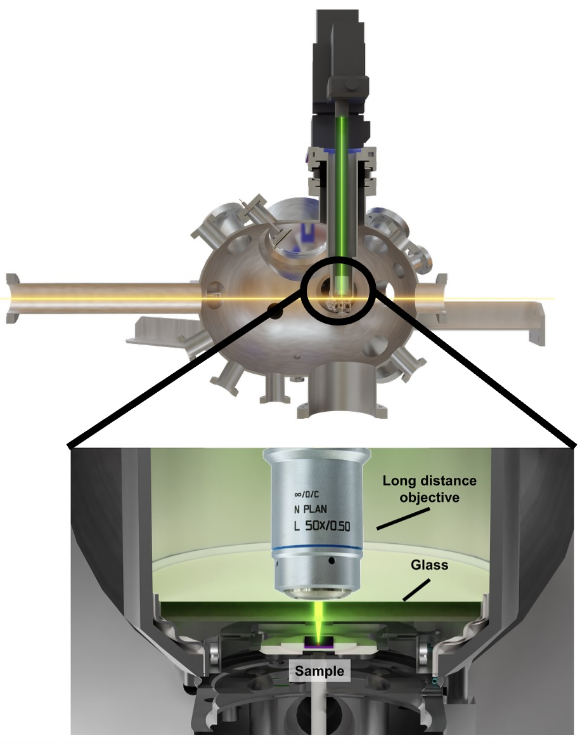
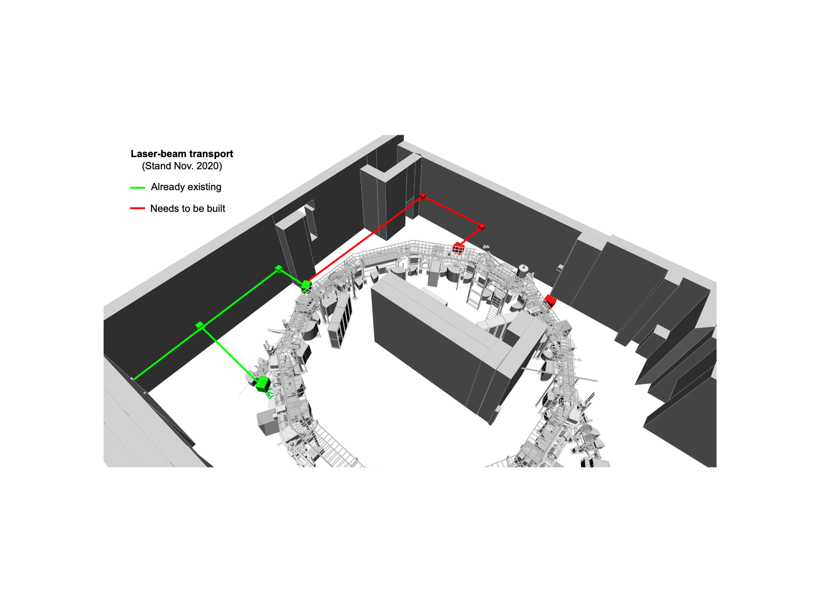
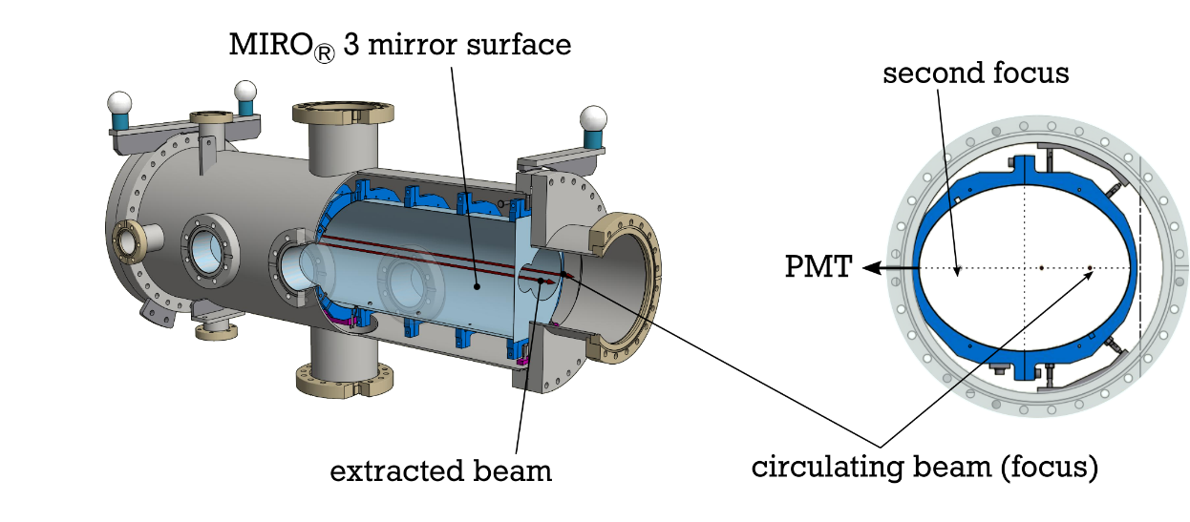
Section YR07: Laser Spectroscopy & Extraction
Laser Spectrscopy of Mg⁺ and Li⁺, 0.2 – 2 MeV/u, 10⁷ ions
Extraction and Raman spectroscopy of Au⁷⁵⁺, 4.8 MeV/u for swift HCI – surface interactions
Lowest possible energy: HCI 0.8 MeV/u, LCI 90 keV/u
e-cooler
K. Mohr, PhD Thesis, TU Darmstadt 2022

Slide 12
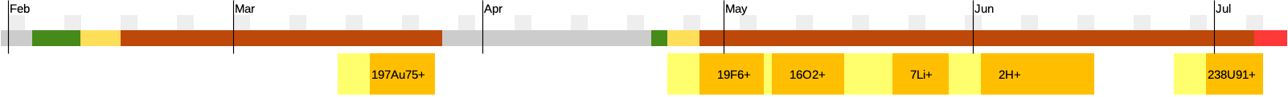
Beamtime Schedule 2025
HITRAP 197Au79+
Easter break
achieved intensity
1⋅10⁷
8⋅10⁶
5 ⋅ 10⁷
5 ⋅ 10⁷
4⋅10⁸
2 ⋅ 10⁶
requested in proposal
5 ⋅ 10⁶
3 ⋅ 10⁶
2⋅10⁷
8⋅10⁶
5 ⋅ 10⁷
1.4⋅10⁶
2021-25 ca. 5 months of GSI beamtime, going towards 8-9 months per year
typical CRYRING beamtime 1-2 weeks, scheduled by GSI PAC
proposals submitted in two-year cycles through collaborations, e.g. SPARC
intensity goals and beam quality always met or closely met
New proposals welcome!

Slide 13

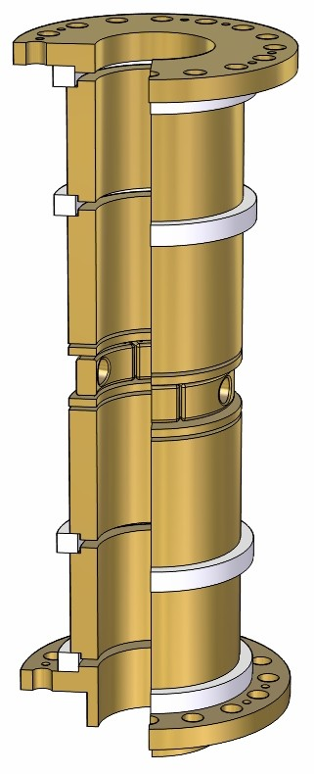
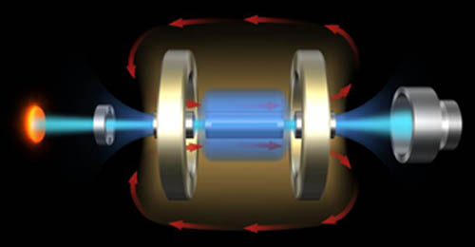
What if we need even lower energies?
1
GSI (a low-charge IS + an accelerator facility)
10⁸
ESR
~ 400 MeV/u
ESR
~ 10 keV/u
SIS18
UNILAC
stripper
target
10⁶
CRYRING
10⁴
2
~ 4 MeV/u
EBIT (a high charge IS + a beamline)
10²
ESR to low-E
~ 4 keV/u
Xe⁴⁴⁺
eV/u
HITRAP
linear decelerator
~ 4 keV/u
U⁹¹⁺
10⁻⁴
buffer gas cell

Slide 14
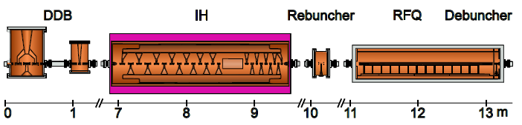
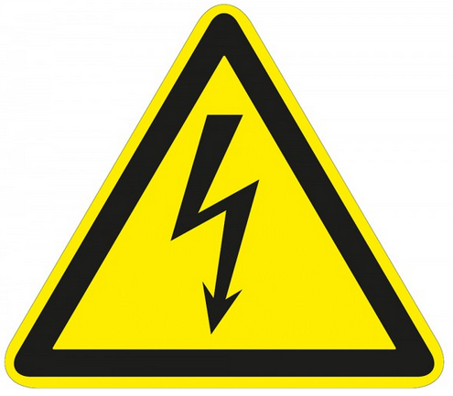

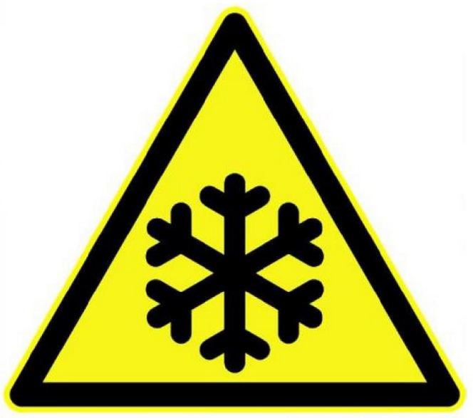
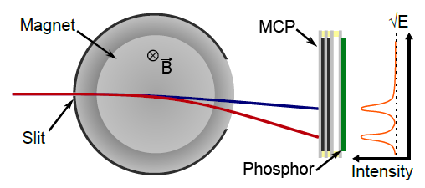
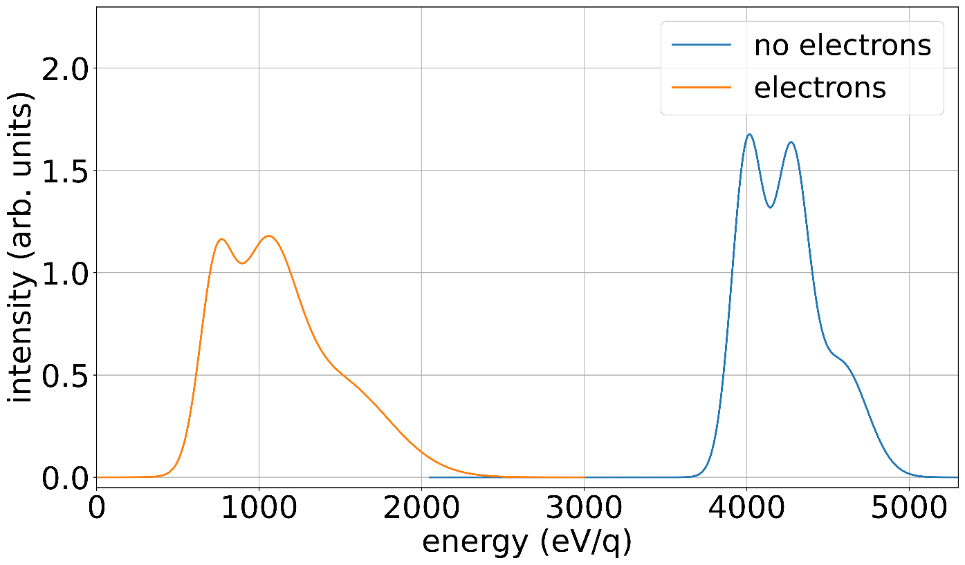
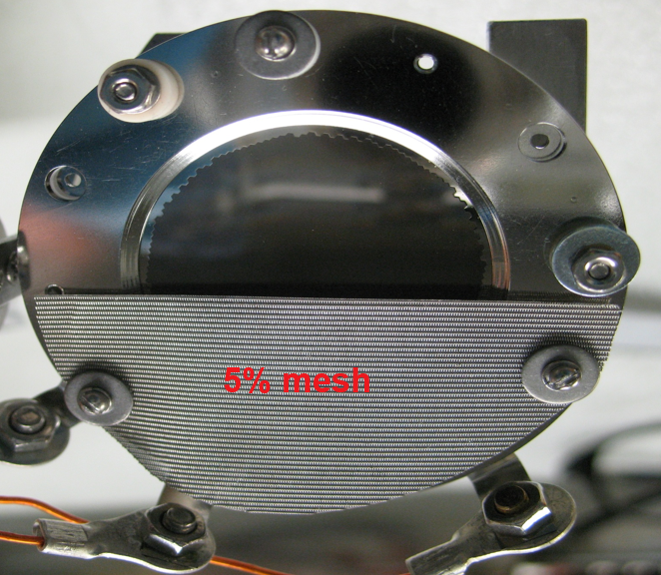
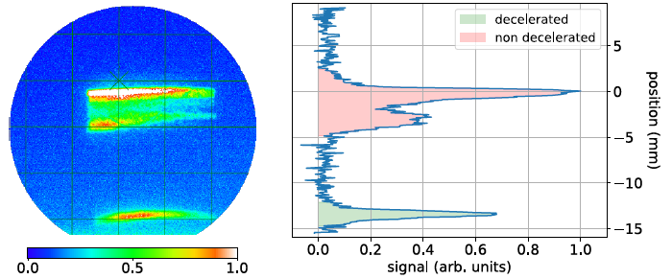
HITRAP: a linear decelerator
4.02
MeV/u
HCI
0.006
MeV/u
e⁻
e⁻
Decelerated beam
Central energy | 6 keV/u
Dispersion | +/- 1keV/u
Intensity | ca. 10⁴ particles
ion trap with 10⁵ Ar¹⁶⁺ / 10¹⁰ e⁻
4 MeV/u
0.5 MeV/u

Slide 15
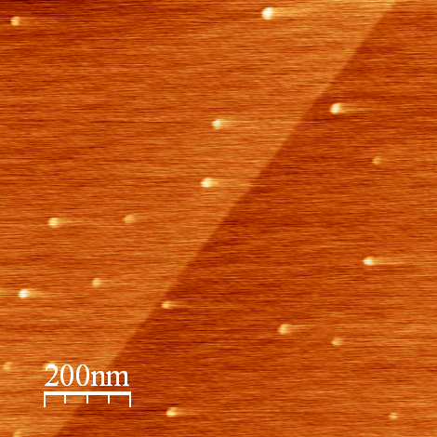
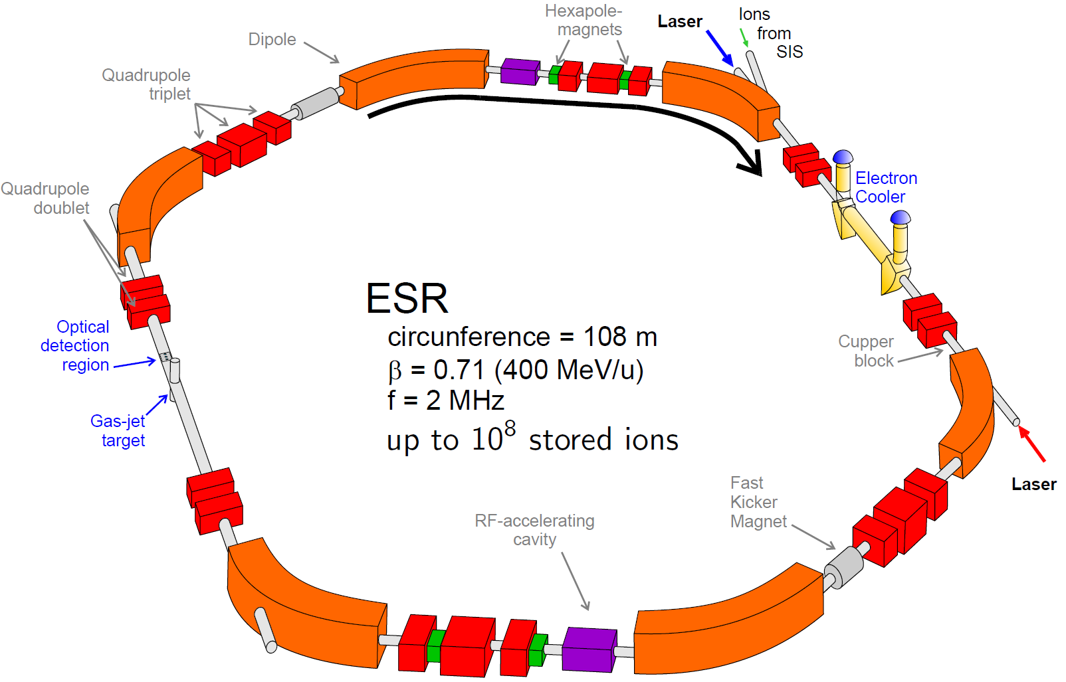
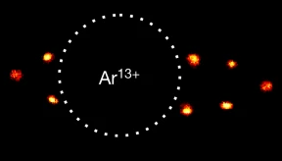
Experiments with ions at rest
First experiment delivered this year
  HCI strikes the surface and penetrates the material
  Formation of Hillocs through energy transfer
Optical Clocks with HCI
Laser Fluorescence Spectroscopy
Thorium nucleus spectroscopy
AFM Topographic Picture of CaF₂ surface after irradiation with 3 keV/u Xe⁴⁰⁺
A. S. El-Said, et al., NIM B 258, 167 (2007).
A. S. El-Said, et al., Phys. Rev. Lett. 100, 237601 (2008).
Thorium in Experimental Storage Ring
Optical Clocks with HCI, e.g. Micke, Leopold, King et al., Nature 578 (2020)
Sympathetic cooling in two-species ion crystals; Schmidt, Murböck, Andelkovic et al.,J. Mod. Opt. 64, 5 (2018)

Slide 16
Summary
Ion beam deceleration works, it is hard work…
… but it offers a unique access to highly charged ions at low-energies
CRYRING@ESR – HCI at low energies
in operation - delivers cooled beam to experiments
many opportunities for experiments at astrophysical energies of 100s of keV/u up to MeV/u energies & beam cooling
HITRAP – HCI at rest
in development - capture and cooling of HCI demonstrated
planned to expand for optical clocks and spectroscopy of Thorium
Thanks to the DEC team and collaborators:
S. Fedotova, W. Geithner, F. Herfurth, J. Ködel, N. Kehl, N. Kotovskiy, I. Kraus, K. Mohr, D. Neidherr, D. Racano, S. Rausch, N. Stallkamp, S. Trotsenko, G. Vorobyev, W. Nörtershäuser, D. Zisis

Slide 17
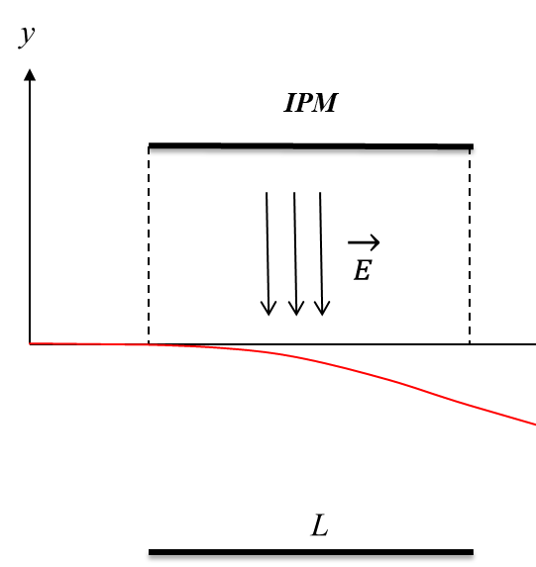
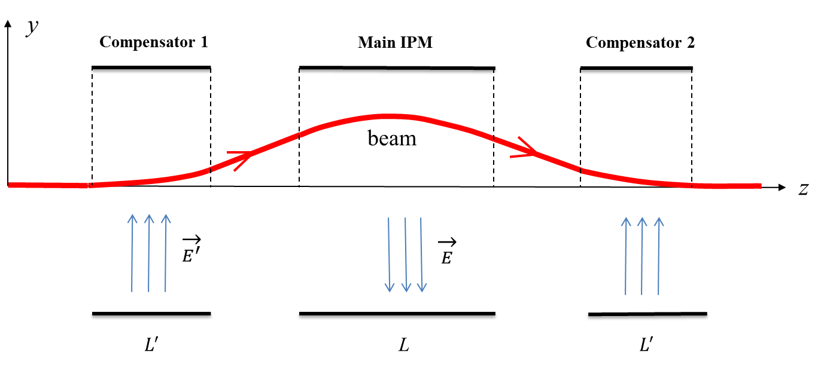
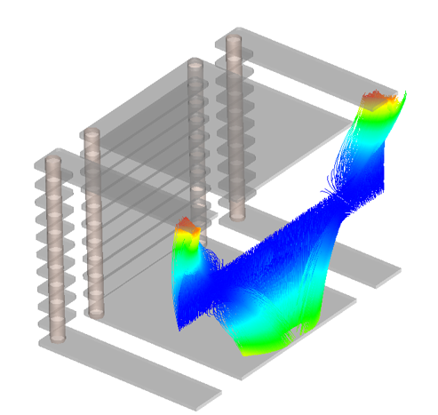
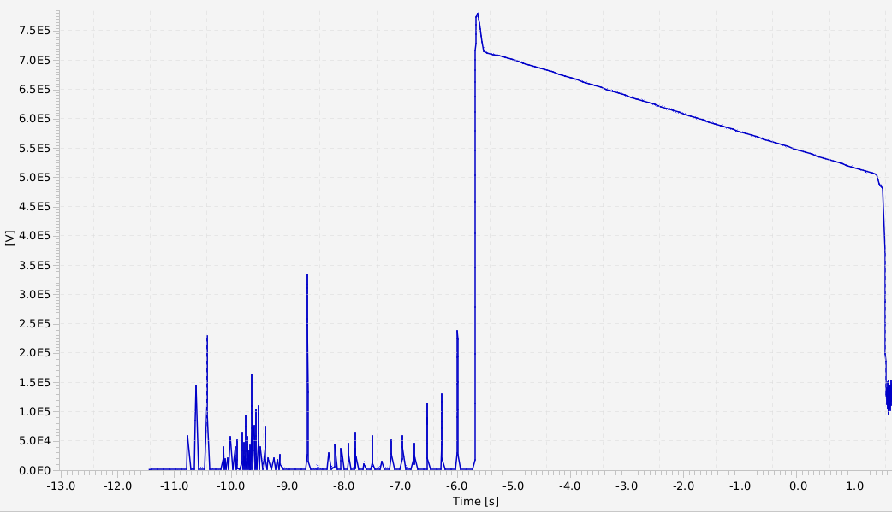
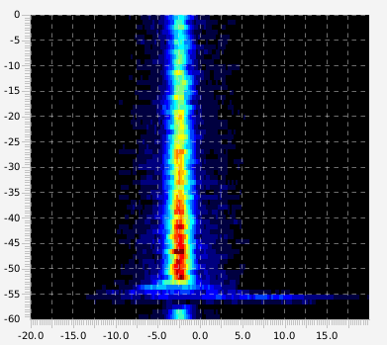
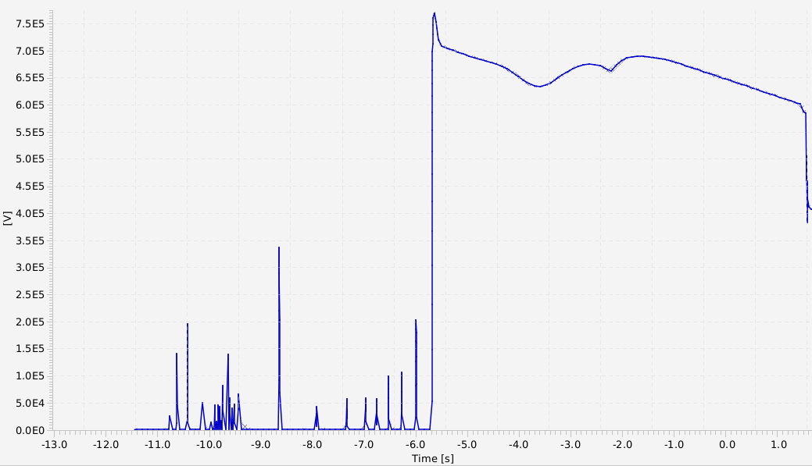
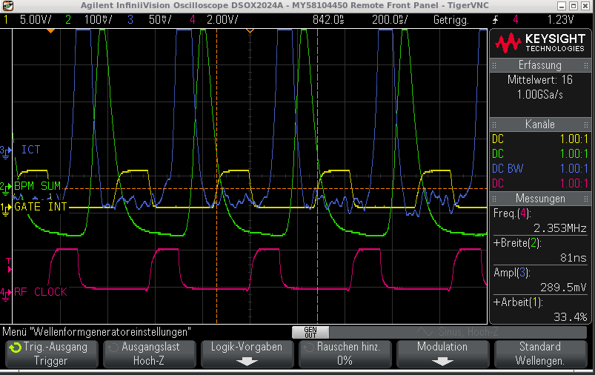
Low-energy beam diagnostics: IPM & Schottky
standard IPM
low Energy IPM
Typical storage ring detectors become:
Destructive (IPM)
Insensitive (current transformer, BPM)
Difficult (Schottky)
=> min. intensity 10⁶ charges for setup
zero-span
ecooler off
zero-span
ecooler on
Bowen Zhou, Zoran Andelkovic, Rudi Hettinger, Nikita Kotovsky, Andreas Reiter et al.

