Slide 1
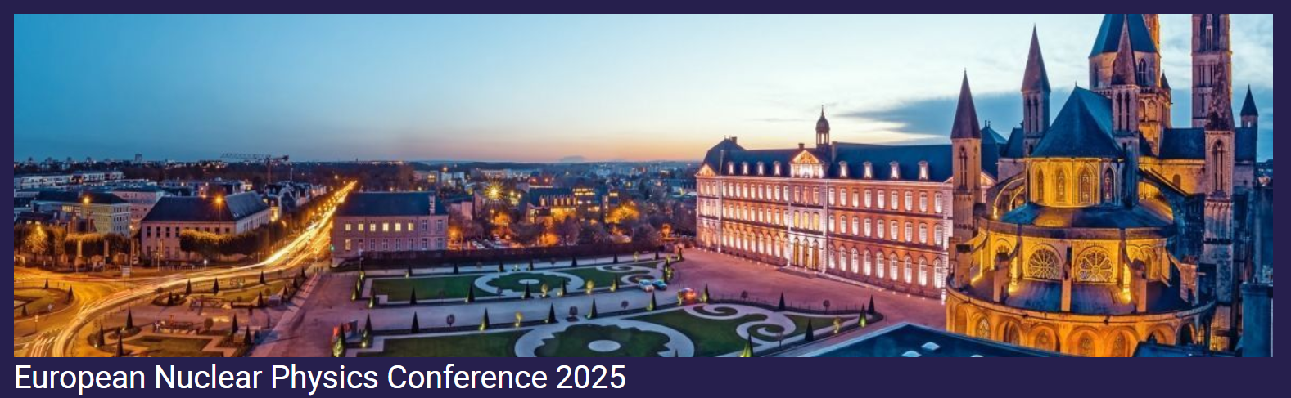



21-26 September 2025
Caen
Results on the CROSSTEST@LNL experiment for NArCoS:
the Cross-talk problem
Brunilde Gnoffo

Slide 2

Outline
Description of NArCoS
Study of the identification capabilities
Study of the cross-talk problem
Conclusions and perspectives
Brunilde Gnoffo

Slide 3
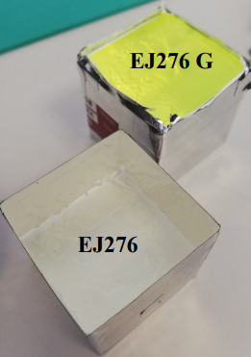
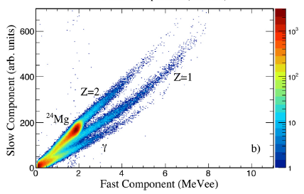
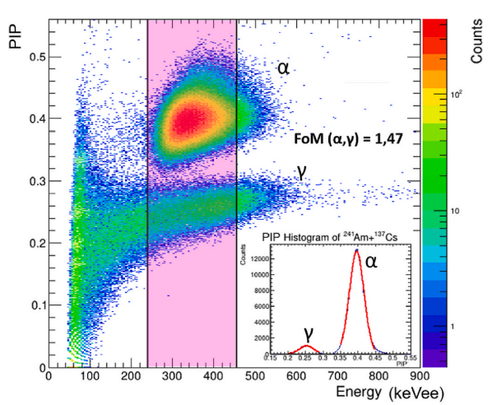
NARCOS: Neutron ARray for COrrelation Studies
NArCoS realized in Catania in the context of the ANCHISE (Array for Neutron and Charged particles with HIgh linear momentum SElection) project, approved and financed by national PRIN2020 funding call and in the context of INFN-CSN3.
A compact and segmented transportable apparatus → consisting of plastic scintillators → EJ276G (ex EJ299-33) (3x3x3cm³)
Pagano E.V. et al., N.S., Nucl. Instrum. Methods A, 905 (2018) 47-52
Pagano E.V. et al., Nucl. Instrum. Methods A 1064 (2024) 169425
Brunilde Gnoffo

Slide 4
NARCOS: Neutron ARray for COrrelation Studies
NArCoS realized in Catania in the context of the ANCHISE (Array for Neutron and Charged particles with HIgh linear momentum SElection) project, approved and financed by national PRIN2020 funding call and in the context of INFN-CSN3.
A compact and segmented transportable apparatus → consisting of plastic scintillators → EJ276G (ex EJ299-33) (3x3x3cm³)
Pagano E.V. et al., N.S., Nucl. Instrum. Methods A, 905 (2018) 47-52
Pagano E.V. et al., Nucl. Instrum. Methods A 1064 (2024) 169425
Reading the light signal: Si-PM
Brunilde Gnoffo

Slide 5
NARCOS: Neutron ARray for COrrelation Studies
NArCoS realized in Catania in the context of the ANCHISE (Array for Neutron and Charged particles with HIgh linear momentum SElection) project, approved and financed by national PRIN2020 funding call and in the context of INFN-CSN3.
A compact and segmented transportable apparatus → consisting of plastic scintillators → EJ276G (ex EJ299-33) (3x3x3cm³)
Pagano E.V. et al., N.S., Nucl. Instrum. Methods A, 905 (2018) 47-52
Pagano E.V. et al., Nucl. Instrum. Methods A 1064 (2024) 169425
Reading the light signal: Si-PM
Modular, reconfigurable (in mechanic and electronic) ->64 detection cells
Brunilde Gnoffo

Slide 6
NARCOS: Neutron ARray for COrrelation Studies
NArCoS realized in Catania in the context of the ANCHISE (Array for Neutron and Charged particles with HIgh linear momentum SElection) project, approved and financed by national PRIN2020 funding call and in the context of INFN-CSN3.
A compact and segmented transportable apparatus → consisting of plastic scintillators → EJ276G (ex EJ299-33) (3x3x3cm³)
Pagano E.V. et al., N.S., Nucl. Instrum. Methods A, 905 (2018) 47-52
Pagano E.V. et al., Nucl. Instrum. Methods A 1064 (2024) 169425
Reading the light signal: Si-PM
Modular, reconfigurable (in mechanic and electronic) ->64 detection cells
Energy measurement from ToF (Δt≤ 500 ps and LToF≈1m) → TOF measured using the RF of the CS or with a MCP (in case of low intensity exotic beams) or kinematic coincidence
Brunilde Gnoffo

Slide 7
NARCOS: Neutron ARray for COrrelation Studies
NArCoS realized in Catania in the context of the ANCHISE (Array for Neutron and Charged particles with HIgh linear momentum SElection) project, approved and financed by national PRIN2020 funding call and in the context of INFN-CSN3.
A compact and segmented transportable apparatus → consisting of plastic scintillators → EJ276G (ex EJ299-33) (3x3x3cm³)
Pagano E.V. et al., N.S., Nucl. Instrum. Methods A, 905 (2018) 47-52
Pagano E.V. et al., Nucl. Instrum. Methods A 1064 (2024) 169425
Reading the light signal: Si-PM
Modular, reconfigurable (in mechanic and electronic) ->64 detection cells
Energy measurement from ToF (Δt≤ 500 ps and LToF≈1m) → TOF measured using the RF of the CS or with a MCP (in case of low intensity exotic beams) or kinematic coincidence
Discrimination of n/γ and light charged particles from PSD
Brunilde Gnoffo

Slide 8
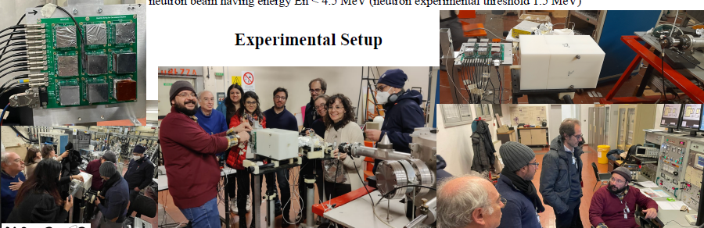
Results of CROSSTEST exp. @LNL (end of 2023)
Spokesperson(s): E.V. Pagano, G. Politi, P. Russotto, T. Marchi
The experiment was performed at CN accelerator of INFN-LNL laboratory using a proton beam of 5 MeV on a LiF target producing a neutron beam having energy En < 4.5 MeV (neutron experimental threshold 1.5 MeV)-> p + ⁷Li —-> ⁷Be + n
Brunilde Gnoffo

Slide 9
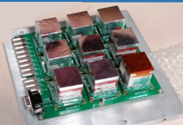
NArcoS: SiPM and mechanics
Brunilde Gnoffo

Slide 10
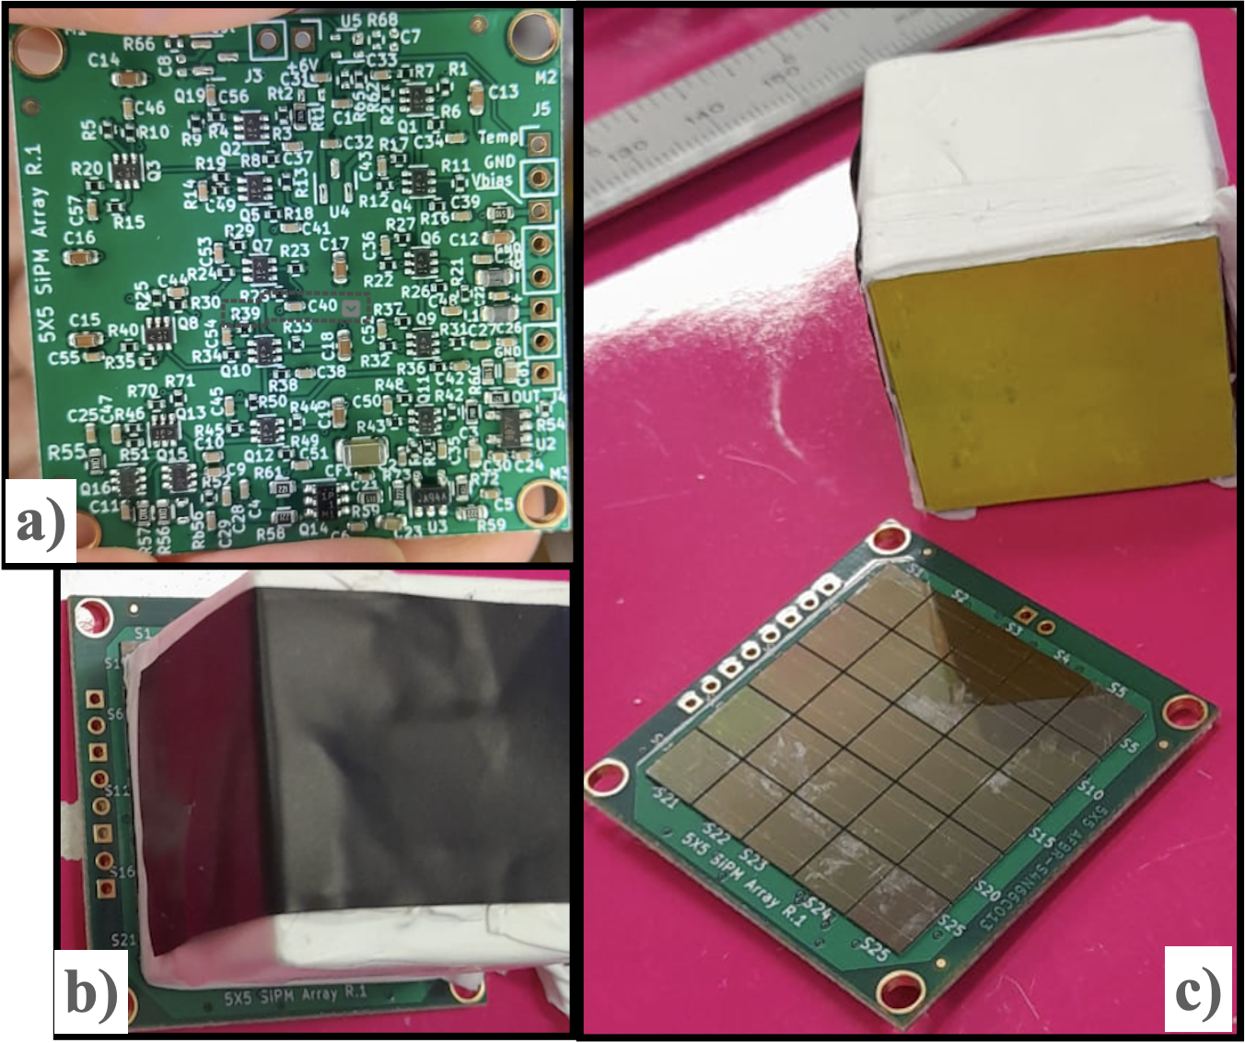
NArcoS: SiPM and mechanics
Each elementary cell of EJ276G or EJ276 (3x3x3 cm3) is read with a matrix of 25 SiPM (6x6 mm2) of 30 𝜇m of thickness (≈ 40k microcells). The SiPM matrix is coupled with the plastic and provided of its PAC and bias/temperature compensation circuit
Brunilde Gnoffo

Slide 11
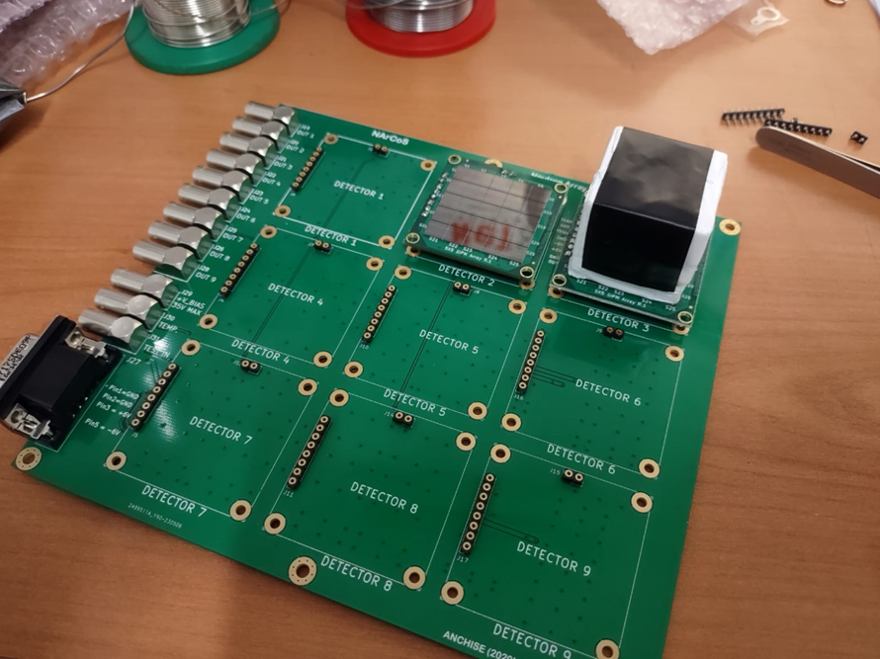
NArcoS: SiPM and mechanics
Prototype Electronic Board for housing the 9 elementary cells with their electronic readout boards, with the out of the signals, test inputs, temperature monitoring and bias input
Each elementary cell of EJ276G or EJ276 (3x3x3 cm3) is read with a matrix of 25 SiPM (6x6 mm2) of 30 𝜇m of thickness (≈ 40k microcells). The SiPM matrix is coupled with the plastic and provided of its PAC and bias/temperature compensation circuit
Brunilde Gnoffo

Slide 12
NArcoS: SiPM and mechanics
Prototype Electronic Board for housing the 9 elementary cells with their electronic readout boards, with the out of the signals, test inputs, temperature monitoring and bias input
Each elementary cell of EJ276G or EJ276 (3x3x3 cm3) is read with a matrix of 25 SiPM (6x6 mm2) of 30 𝜇m of thickness (≈ 40k microcells). The SiPM matrix is coupled with the plastic and provided of its PAC and bias/temperature compensation circuit
Sampling frequency: 1 GHz
Trigger: internal
(only the central plastic detector)
Brunilde Gnoffo

Slide 13
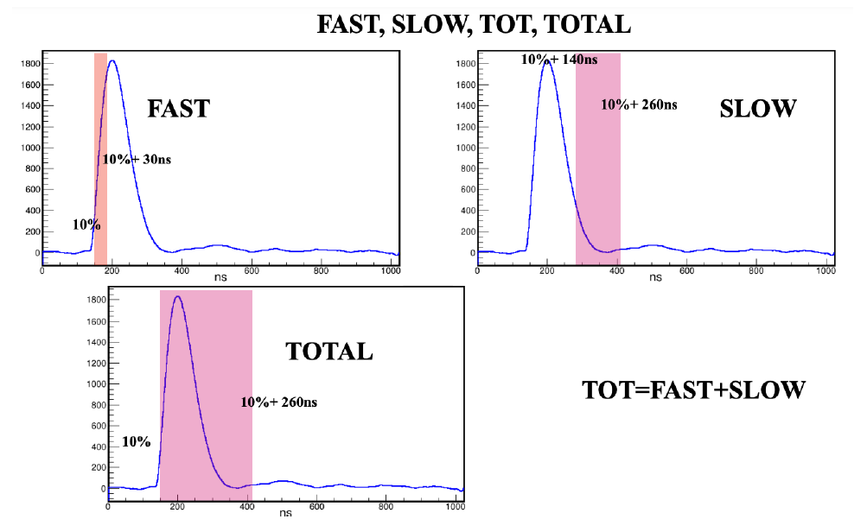
Variables used for the identification
10% of the Rise time ≤ FAST ≤ 10% of the Rise time+30 ns
10% of the Rise time+140 ns ≤ SLOW ≤ 10% of the Rise time+260 ns
10% of the Rise time ≤ TOTAL ≤ 10% of the Rise time+260 ns
Tau= slope of the falltime
TOT=FAST+SLOW
PIDTOT=SLOW/ TOT
PIDTOTAL= SLOW/TOTAL
Brunilde Gnoffo

Slide 14
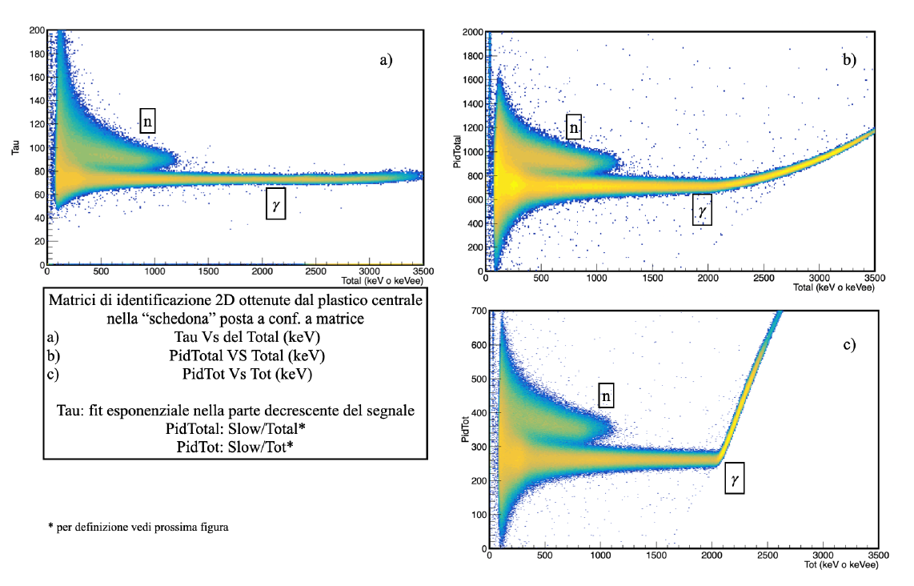
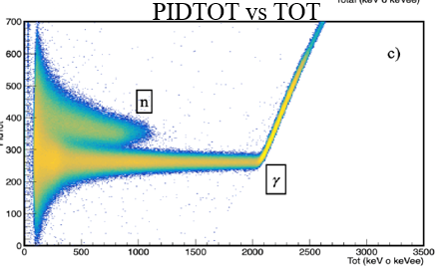
Identification matrices
Pulse shape discrimination by using different variables, for one of the plastic detector.
Tau vs TOTAL
PIDTOTAL vs TOTAL
Brunilde Gnoffo

Slide 15
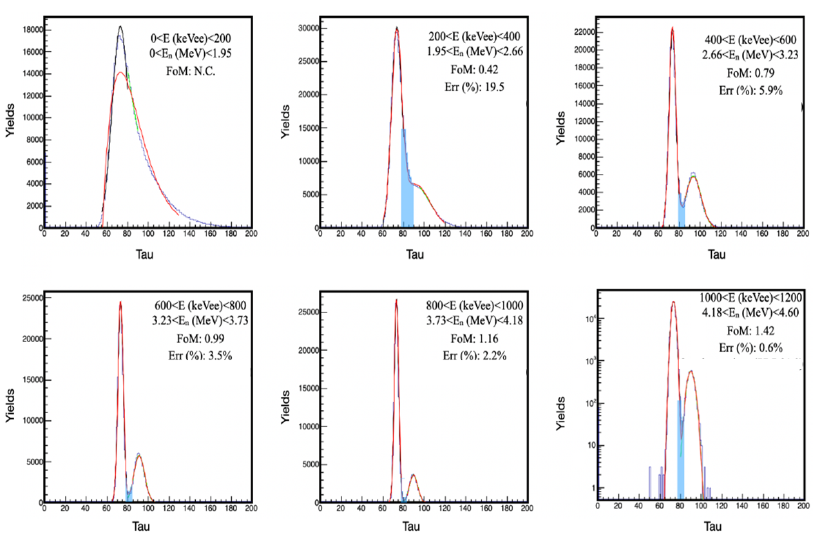
Figures of merit, in different energy ranges, at slice of 200 KeVee
for 0 < E < 1200 KeVee
FoM (distance between the two peaks divided by the sum of the FWHMs of each peak)
6 projections of the 2D Tau Vs Total matrix on the Y axis (Tau) for each of the energy intervals of the Total component in keVee (0,200); (200,400); (400,600); (600,800); (800.1000); (1000,1200).
Gnoffo B., Pagano E.V. et al., IL NUOVO CIMENTO 48 C (2025) 12
Brunilde Gnoffo

Slide 16
Figures of merit, in different energy ranges, at slice of 200 KeVee
for 0 < E < 1200 KeVee
The value of the FoM is shown in each panel.
A good separation is obtained from 600 KeVee where the FoM is ≳1
Brunilde Gnoffo

Slide 17
Results of CROSSTEST exp. @LNL (end of 2023)
Spokesperson(s): E.V. Pagano, G. Politi, P. Russotto, T. Marchi
The experiment was performed at CN accelerator of INFN-LNL laboratory using a proton beam of 5 MeV on a LiF target producing a neutron beam having energy En < 4.5 MeV (neutron experimental threshold 1.5 MeV)-> p + ⁷Li —-> ⁷Be + n
Brunilde Gnoffo

Slide 18
Results of CROSSTEST exp. @LNL (end of 2023)
Spokesperson(s): E.V. Pagano, G. Politi, P. Russotto, T. Marchi
The experiment was performed at CN accelerator of INFN-LNL laboratory using a proton beam of 5 MeV on a LiF target producing a neutron beam having energy En < 4.5 MeV (neutron experimental threshold 1.5 MeV)-> p + ⁷Li —-> ⁷Be + n
Two configurations were tested
Brunilde Gnoffo

Slide 19
Results of CROSSTEST exp. @LNL (end of 2023)
Spokesperson(s): E.V. Pagano, G. Politi, P. Russotto, T. Marchi
The experiment was performed at CN accelerator of INFN-LNL laboratory using a proton beam of 5 MeV on a LiF target producing a neutron beam having energy En < 4.5 MeV (neutron experimental threshold 1.5 MeV)-> p + ⁷Li —-> ⁷Be + n
Two configurations were tested
The 3x3 Matrix (surface crosstalk)
3x3 Matrix
Brunilde Gnoffo

Slide 20
Results of CROSSTEST exp. @LNL (end of 2023)
Spokesperson(s): E.V. Pagano, G. Politi, P. Russotto, T. Marchi
The experiment was performed at CN accelerator of INFN-LNL laboratory using a proton beam of 5 MeV on a LiF target producing a neutron beam having energy En < 4.5 MeV (neutron experimental threshold 1.5 MeV)-> p + ⁷Li —-> ⁷Be + n
Two configurations were tested
The 3x3 Matrix (surface crosstalk)
The 3 clusters (linear crosstalk)
3x3 Matrix
3 clusters
y
z
x
Brunilde Gnoffo

Slide 21
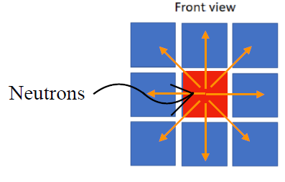
Results of CROSSTEST exp. @LNL (end of 2023)
Neutrons in other plastics in the same event (with multiplicity equal to 2) are crosstalk (or background)
Only the central plastic scintillator was in trigger
Matrix configuration (surface crosstalk)
Brunilde Gnoffo

Slide 22
Results of CROSSTEST exp. @LNL (end of 2023)
Neutrons in other plastics in the same event (with multiplicity equal to 2) are crosstalk (or background)
Only the central plastic scintillator was in trigger
Matrix configuration (surface crosstalk)
Crosstalk probability: $\frac{\text{number} \text{of} \text{neutrons} \text{non} \text{in} \text{trigger}}{\text{number} \text{of} \text{neutron}\text{s} \text{in} \text{trigger}\text{ (}\text{central} \text{cell}\text{)}}$ x 100 %
Brunilde Gnoffo

Slide 23
Results of CROSSTEST exp. @LNL (end of 2023)
Neutrons in other plastics in the same event (with multiplicity equal to 2) are crosstalk (or background)
Only the central plastic scintillator was in trigger
Matrix configuration (surface crosstalk)
Crosstalk probability: $\frac{\text{number} \text{of} \text{neutrons} \text{non} \text{in} \text{trigger}}{\text{number} \text{of} \text{neutron}\text{s} \text{in} \text{trigger}\text{ (}\text{central} \text{cell}\text{)}}$ x 100 %
P (%) = prob (%) ± Erass (%) = (0.117 ± 0.008) %
P (%) ≈ 0.1 %
Brunilde Gnoffo

Slide 24
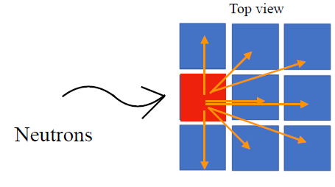
Results of CROSSTEST exp. @LNL (end of 2023)
Neutrons in other plastics in the same event (with multiplicity equal to 2) are crosstalk (or background)
Only the plastic scintillator of the first cell of the central block was in trigger
Cluster configuration (linear crosstalk)
Brunilde Gnoffo

Slide 25
Results of CROSSTEST exp. @LNL (end of 2023)
Neutrons in other plastics in the same event (with multiplicity equal to 2) are crosstalk (or background)
Only the plastic scintillator of the first cell of the central block was in trigger
Cluster configuration (linear crosstalk)
Crosstalk probability: $\frac{\text{number} \text{of} \text{neutrons} \text{non} \text{in} \text{trigger}}{\text{number} \text{of} \text{neutron}\text{s} \text{in} \text{trigger}\text{ (}\text{the} \text{first} \text{cell} \text{of} \text{the} \text{central} \text{block}\text{)}}$ x 100 %
Brunilde Gnoffo

Slide 26
Results of CROSSTEST exp. @LNL (end of 2023)
Neutrons in other plastics in the same event (with multiplicity equal to 2) are crosstalk (or background)
Only the plastic scintillator of the first cell of the central block was in trigger
Cluster configuration (linear crosstalk)
Crosstalk probability: $\frac{\text{number} \text{of} \text{neutrons} \text{non} \text{in} \text{trigger}}{\text{number} \text{of} \text{neutron}\text{s} \text{in} \text{trigger}\text{ (}\text{the} \text{first} \text{cell} \text{of} \text{the} \text{central} \text{block}\text{)}}$ x 100 %
P (%) = prob (%) ± Erass (%) = (0.163 ± 0.005) %
P (%) ≈ 0.2 %
Brunilde Gnoffo

Slide 27
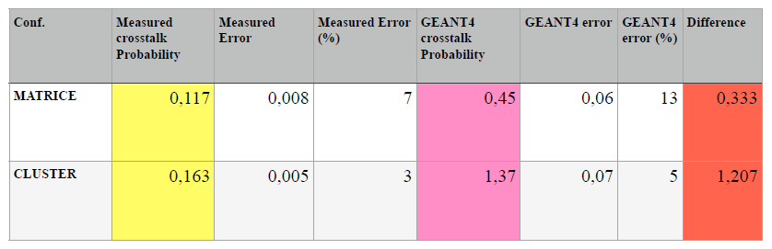
Results of CROSSTEST exp. @LNL (end of 2023)
Crosstalk Measurement and comparison with MC based simulation
The simulated value was obtained form GEANT4 toolkit simulation (G. Santagati and L. Quattrocchi) and from MCNPX toolkit simulation (L. Quattrocchi) The two simulation software were in good agreement
Brunilde Gnoffo

Slide 28
Results of CROSSTEST exp. @LNL (end of 2023)
Crosstalk Measurement and comparison with MC based simulation
The simulated value was obtained form GEANT4 toolkit simulation (G. Santagati and L. Quattrocchi) and from MCNPX toolkit simulation (L. Quattrocchi) The two simulation software were in good agreement
The differences between the measured and the simulated values are not very large in absolute terms, but they become significant in relative terms: a factor of 4 for the matrix configuration, and nearly an order of magnitude for the cluster configuration. Further investigation is therefore required
Brunilde Gnoffo

Slide 29
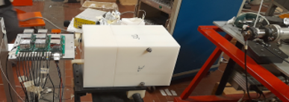
Conclusions and Perspectives
The results of CROSSTEST exp. @LNL (end of 2023) were presented
Brunilde Gnoffo

Slide 30
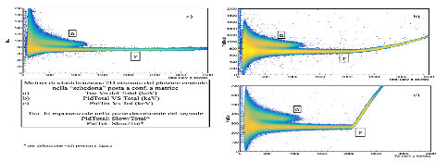

Conclusions and Perspectives
The results of CROSSTEST exp. @LNL (end of 2023) were presented
A good separation between neutron and gamma with a FoM of 1.2 at 4 MeV of neutrons with three different 2D identification matrix,
Brunilde Gnoffo

Slide 31
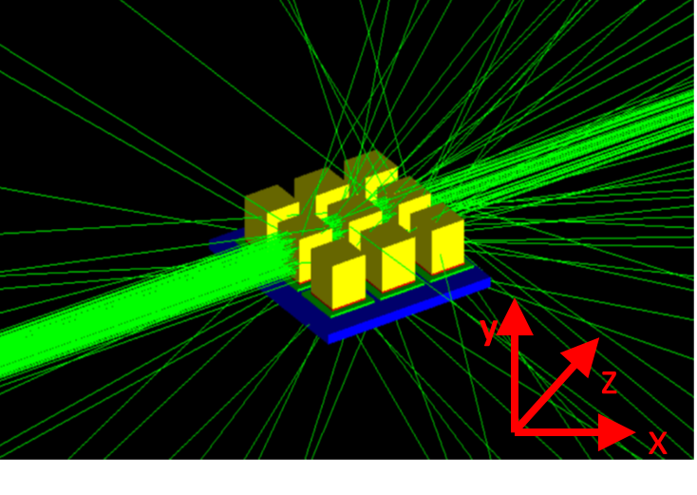
Conclusions and Perspectives
The results of CROSSTEST exp. @LNL (end of 2023) were presented
A good separation between neutron and gamma with a FoM of 1.2 at 4 MeV of neutrons with three different 2D identification matrix,
The crosstalk value at 4.5 MeV of neutrons was measured for the matrix configuration is about P(%) = 0.1% and for the cluster configuration is about P(%) = 0.2%.
Brunilde Gnoffo

Slide 32
Conclusions and Perspectives
New test are on going at LNS-INFN in order to measure the time resolution
Brunilde Gnoffo

Slide 33
Conclusions and Perspectives
New test are on going at LNS-INFN in order to measure the time resolution
New experiments have to be performed in order to test the crosstalk at higher neutron energies in Catania at LNS-INFN and in Legnaro at LNL-INFN.
Brunilde Gnoffo

Slide 34
Conclusions and Perspectives
New test are on going at LNS-INFN in order to measure the time resolution
New experiments have to be performed in order to test the crosstalk at higher neutron energies in Catania at LNS-INFN and in Legnaro at LNL-INFN.
MoReNA experiment. The goal of the experiment is to test the feasibility of using NArCoS for the study of molecular states with low neutron multiplicity, focusing on the decay channel ¹³C → n + ¹²C
Brunilde Gnoffo

Slide 35

Conclusions and Perspectives
New test are on going at LNS-INFN in order to measure the time resolution
New experiments have to be performed in order to test the crosstalk at higher neutron energies in Catania at LNS-INFN and in Legnaro at LNL-INFN.
MoReNA experiment. The goal of the experiment is to test the feasibility of using NArCoS for the study of molecular states with low neutron multiplicity, focusing on the decay channel ¹³C → n + ¹²C
In its final version, the demonstrator will include 16 clusters, each consisting of an array of 4 elementary cells arranged in line along the beam axis and mounted on a 4×1 PCB motherboard.
Brunilde Gnoffo

Slide 36
For more info see :
Pagano E.V. et al., N.S., Nucl. Instrum. Methods A, 889 (2018) 83-
2) Pagano E.V. et al., N.S., Nucl. Instrum. Methods A, 905 (2018) 47-52
3) Pagano E.V. et al., IL NUOVO CIMENTO 41 C (2018) 181
4) Pagano E.V. et al., JPS Conf. Proc. 32, 010096 (2020)
5) Pagano E.V. et al., IL NUOVO CIMENTO 43 C (2020) 12
6) Pagano E.V. et al., J. Phys.: Conf. Ser. 1643 (2020) 012037
7) Pagano E.V. et al., IL NUOVO CIMENTO 45 C (2022) 64
8) Pagano E.V. et al., Front. Phys. 10:1051058
9) Pagano E.V. et al., LNS Report (2022)
10) Pagano E.V., G. Politi, A. Simancas et al., Nucl. Instrum. Methods A 1064 (2024) 169425
11) Santagati G., Pagano E.V. et al., RAD Conference Proceedings, vol. 7, pp. 52-58, 2023
12) Santagati G., Pagano E.V. et al., IL NUOVO CIMENTO C, vol. 48, (2025) 13
13) Pagano E.V. et al., IL NUOVO CIMENTO C, vol. 48, (2025) 12
14 ) Quattrocchi L., Gnoffo B., Pagano E.V. et al., (Proceedings of the International Conference Applied Nuclear Physics 2024 to be published)
Gnoffo B., Pagano E.V. et al., IL NUOVO CIMENTO 48 C (2025) 12
Gnoffo B., Pagano E.V. et al., 2025 JINST 20
16) Gnoffo B., Pagano E.V. et al., on timing performances in preparations
17) Pagano E.V. et al., on croostalk al 4.5 MeV neutron in preparation
Brunilde Gnoffo

Slide 37
B. Gnoffo^{1,2}, E. V. Pagano³, C. Boiano⁴, G. Cardella², A. Castoldi^{4,5}, E. De Filippo², E. Geraci^{1,2}, C. Guazzoni^{4,5},G.Lanzalone^{3,6}, C. Maiolino³, N.S. Martorana²,
S. Pirrone², G. Politi^{1,2}, L. Quattrocchi^{2,7}, F. Risitano^{2,7}, F. Rizzo^{1,3}, P. Russotto³,
G. Saccà², G. Santagati^{3,8}, M.Trimarchi^{2,7}and C. Zagami^{1,3}
1Dipartimento di Fisica ed Astronomia, Università di Catania, Catania, Italy
2INFN, Sezione di Catania, Catania, Italy
3INFN, Laboratori Nazionali del Sud, Catania, Italy
4INFN, Sezione di Milano, Milano, Italy.
5Politecnico di Milano, Dip. Elettronica, Informazione e Bioingegneria, Milano, Italy
6Università di Enna ‘‘Kore’’, Enna, Italy.
7Dipartimento di Scienze MIFT, Università di Messina, Messina, Italy.
8 Istituto di Scienze del Patrimonio Culturale - Consiglio Nazionale delle Ricerche (ISPC-CNR), Catania, Italy

Slide 38
For more info see :
Pagano E.V. et al., N.S., Nucl. Instrum. Methods A, 889 (2018) 83-
2) Pagano E.V. et al., N.S., Nucl. Instrum. Methods A, 905 (2018) 47-52
3) Pagano E.V. et al., IL NUOVO CIMENTO 41 C (2018) 181
4) Pagano E.V. et al., JPS Conf. Proc. 32, 010096 (2020)
5) Pagano E.V. et al., IL NUOVO CIMENTO 43 C (2020) 12
6) Pagano E.V. et al., J. Phys.: Conf. Ser. 1643 (2020) 012037
7) Pagano E.V. et al., IL NUOVO CIMENTO 45 C (2022) 64
8) Pagano E.V. et al., Front. Phys. 10:1051058
9) Pagano E.V. et al., LNS Report (2022)
10) Pagano E.V., G. Politi, A. Simancas et al., Nucl. Instrum. Methods A 1064 (2024) 169425
11) Santagati G., Pagano E.V. et al., RAD Conference Proceedings, vol. 7, pp. 52-58, 2023
12) Santagati G., Pagano E.V. et al., IL NUOVO CIMENTO C, vol. 48, (2025) 13
13) Pagano E.V. et al., IL NUOVO CIMENTO C, vol. 48, (2025) 12
14 ) Quattrocchi L., Gnoffo B., Pagano E.V. et al., (Proceedings of the International Conference Applied Nuclear Physics 2024 to be published)
15) Gnoffo B., Pagano E.V. et al., on timing performances in preparations
16) Pagano E.V. et al., on croostalk at 4.5 MeV neutron in preparation
Brunilde Gnoffo

Slide 39
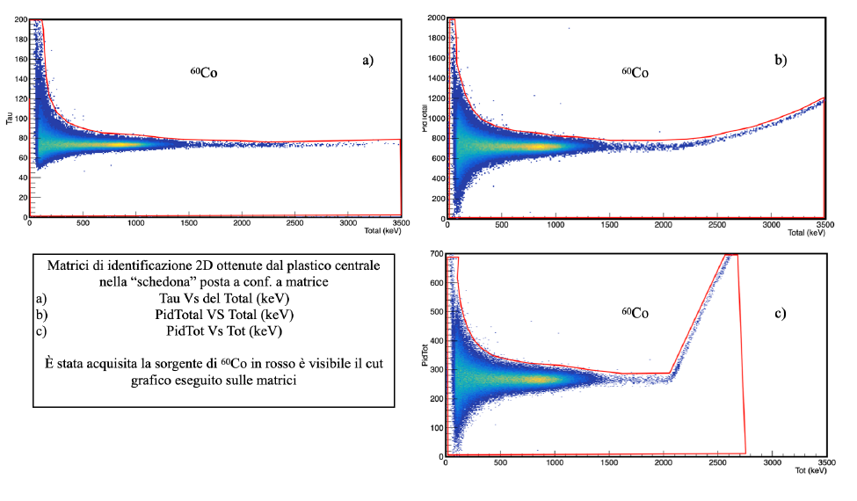
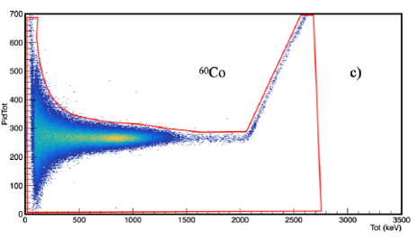
Gamma rays selection
To select gamma rays, a cut around the corresponding line was made in each of the bidimensional matrices obtained during the runs in which ⁶⁰Co source was used for the calibtration.
Tau vs TOTAL
PIDTOTAL vs TOTAL
PIDTOT vs TOT
Brunilde Gnoffo

Slide 40
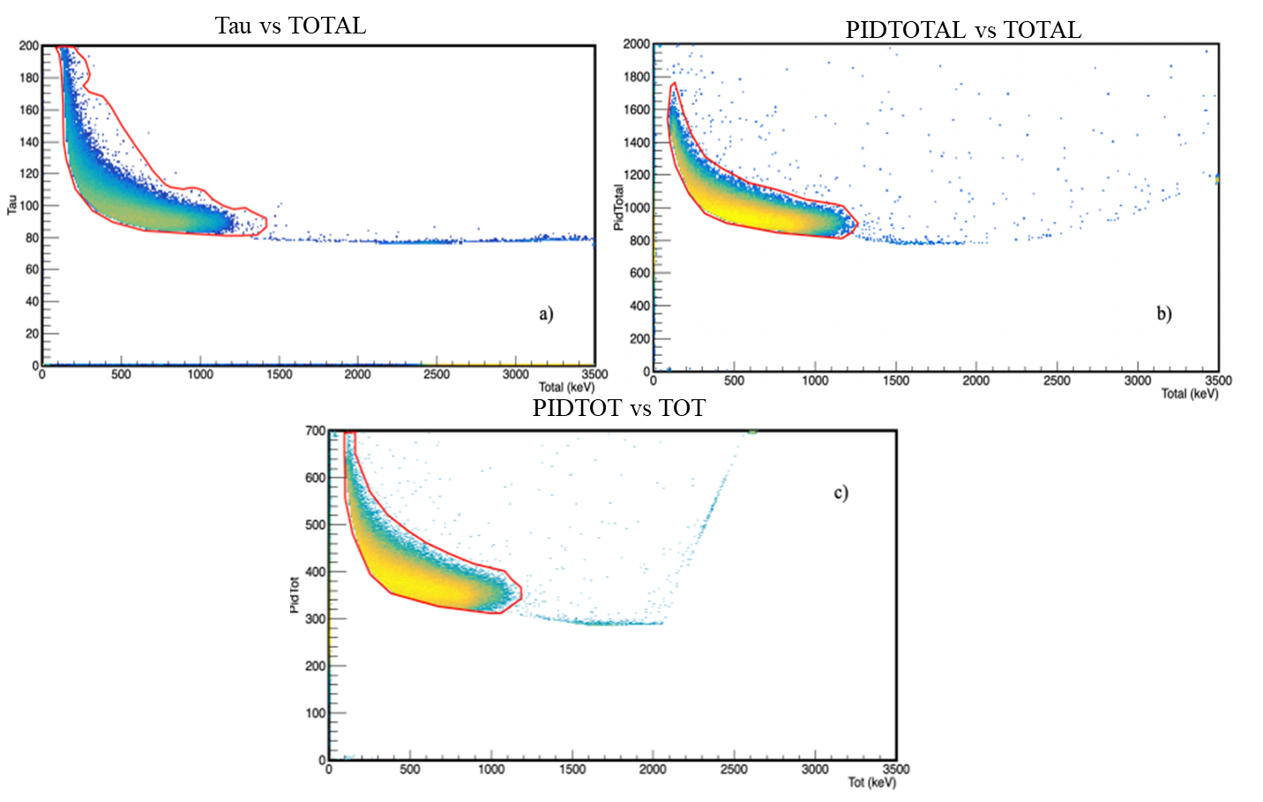
Neutron selection
In the beam runs, to select neutrons, a cut around the corresponding line was made in each of the bidimensional matrices obtained after the subtracted gamma band selected as described above.
Brunilde Gnoffo

Slide 41
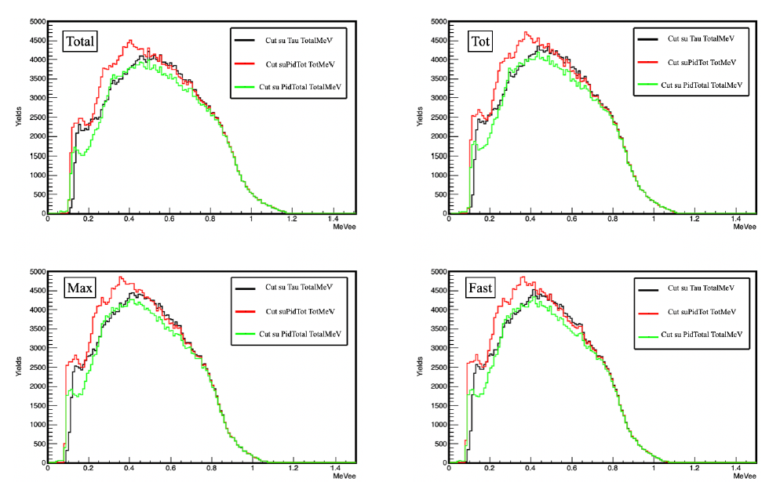
Neutron energy spectra
Energy spectra in MeVee, of neutrons selected as descibed above, shown in black when the selection was made from the 2d plot tau vs TOTAL, in red for the selection made from the Pidtot vs TOT matrix and in green for the selection from Pidtotal vs TOTAL.
Brunilde Gnoffo

Slide 42
Figures of merit
Figures of merit, in different energy ranges, at slice of 200 KeV for 0 < E < 1200 KeV
FoM (distance between the two peaks divided by the sum of the FWHMs of each peak)
Calculation procedure:
two separated gaussian fits for each peak in the corresponding interval
The 6 calculated parameters are used as the entrance parameter in a fit of the entire spectrum, by using as fitting function the sum of two gaussians, relative to the two corresponding intervals (red line in the plot)
Brunilde Gnoffo

Slide 43
Results of CROSSTEST exp. @LNL (end of 2023)
Spokesperson(s): E.V. Pagano, G. Politi, P. Russotto, T. Marchi
Sampling frequency: 1 Gs/s Trigger: internal (only the central plastic detector)
Brunilde Gnoffo

