Slide 1
Measuring electric dipole moment of the muon using the frozen-spin technique
Pranas Juknevicius on behalf of the muEDM collaboration
Caen 2025

Slide 2
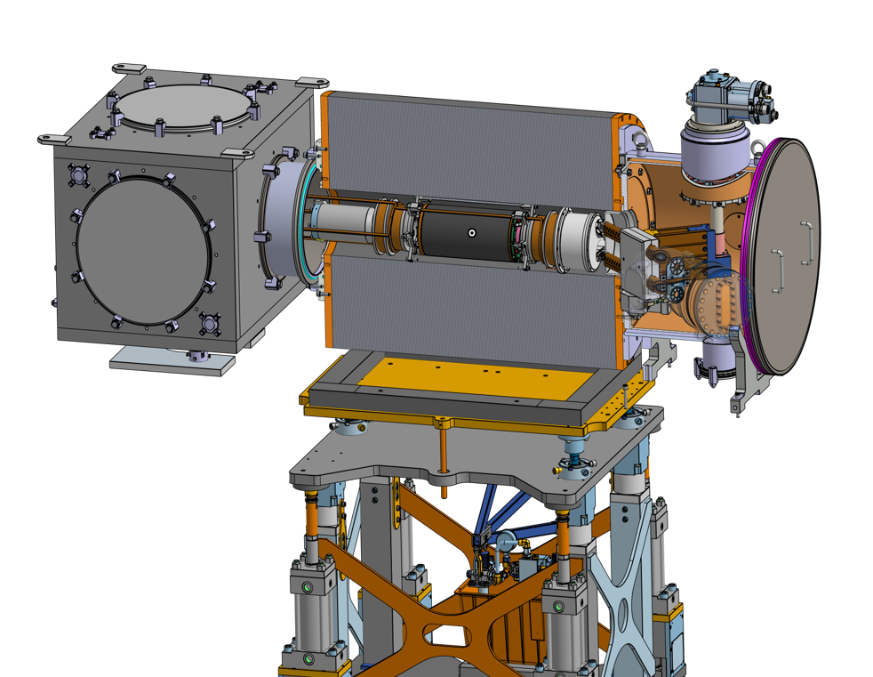
Content
EDM searches
The frozen-spin method
Experiment design
Muon injection
Muon entrance detector
Pulsed magnetic coil
Cylindrical positron detectors
Conclusions

Slide 3




Motivation – EDM and CP-violation
$$H=−\vec{μ}∙\vec{B} −\vec{d}∙\vec{E}$$
$$\vec{μ}=g\frac{q}{2m_{μ}}\vec{s}$$
$$\vec{d}=η\frac{q}{2m_{μ}c}\vec{s}$$

Slide 4

Motivation – EDM and CP-violation
$$H=−\vec{μ}∙\vec{B} −\vec{d}∙\vec{E}$$
$$\vec{μ}=g\frac{q}{2m_{μ}}\vec{s}$$
CP
T
$$\vec{d}=η\frac{q}{2m_{μ}c}\vec{s}$$
$$H=−\vec{μ}∙\vec{B}+\vec{d}∙\vec{E}$$
EDM serves as probes of CP violation in the Standard Model.
Insufficient CP-violation to explain matter-antimatter asymmetry in the universe.

Slide 5
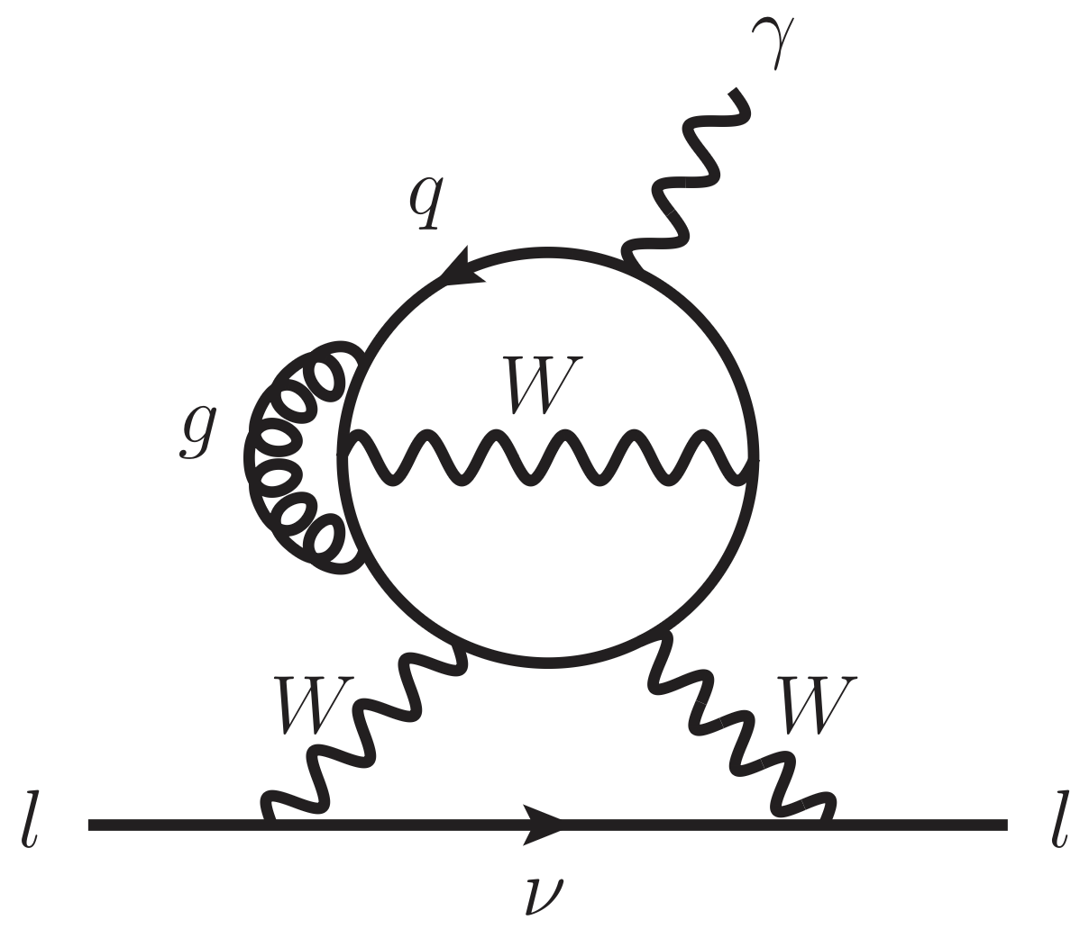
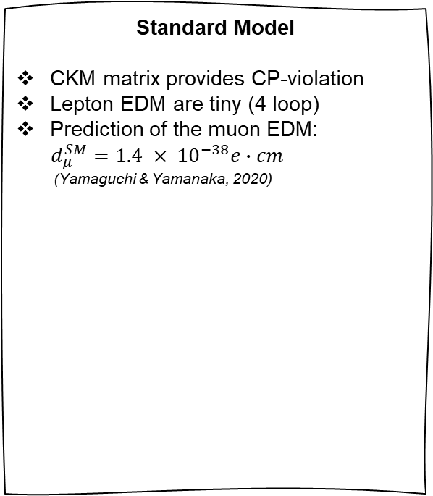

Motivation – EDM and CP-violation
$$H=−\vec{μ}∙\vec{B} −\vec{d}∙\vec{E}$$
$$\vec{μ}=g\frac{q}{2m_{μ}}\vec{s}$$
Standard Model
CKM matrix provides CP-violation
Lepton EDM are tiny (4 loop)
Prediction of the muon EDM:
$d_{μ}^{SM}=1.4 × {10}^{−38}e∙cm$
(Yamaguchi & Yamanaka, 2020)
CP
T
$$\vec{d}=η\frac{q}{2m_{μ}c}\vec{s}$$
$$H=−\vec{μ}∙\vec{B}+\vec{d}∙\vec{E}$$
EDM serves as probes of CP violation in the Standard Model.
Insufficient CP-violation to explain matter-antimatter asymmetry in the universe.

Slide 6
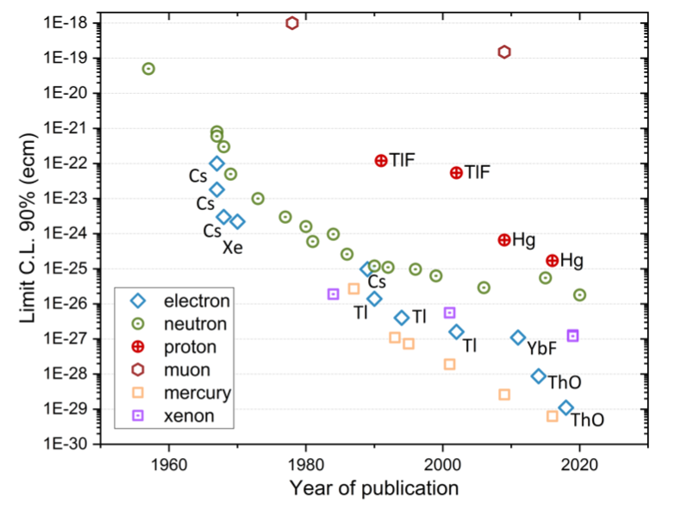
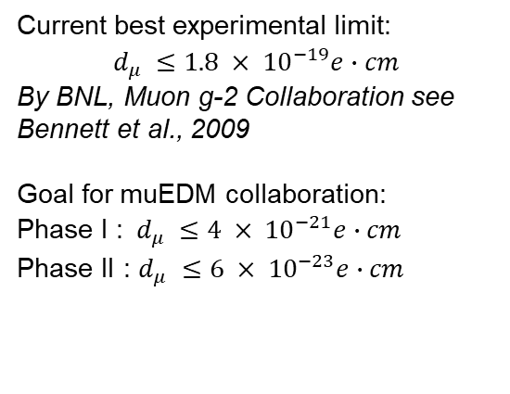
Motivation – EDM and CP-violation
Current best experimental limit:
$$d_{μ}^{}≤1.8 × {10}^{−19}e∙cm$$
By BNL, Muon g-2 Collaboration see Bennett et al., 2009
Goal for muEDM collaboration:
Phase I : ${ d}_{μ}^{} ≤4 × {10}^{−21}e∙cm$
Phase II : $d_{μ}^{}≤6 × {10}^{−23}e∙cm$
BNL
muEDM Phase I
muEDM Phase II

Slide 7
Content
EDM searches
The frozen-spin method
Experiment design
Muon injection
Muon entrance detector
Pulsed magnetic coil
Cylindrical positron detectors
Conclusions

Slide 8
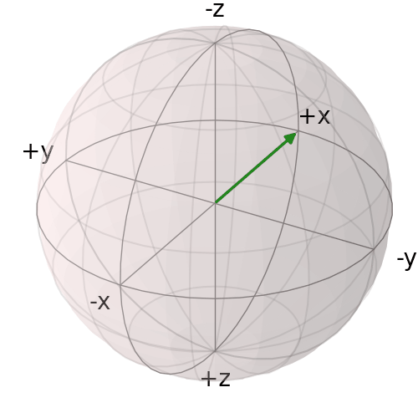



Frozen-spin method
$$H=−\vec{μ}∙\vec{B} −\vec{d}∙\vec{E}$$
$$\vec{d}=η\frac{q}{2m_{μ}c}\vec{s}$$
$$\vec{μ}=g\frac{q}{2m_{μ}}\vec{s}$$
Larmor precession
Spin precession due to muon EDM
4

Slide 9
Frozen-spin technique
Muon orbit

Slide 10
Frozen-spin technique
Muon orbit

Slide 11
Frozen-spin technique
Muon orbit
Thomas BMT Equation
EDM contribution
$$\vec{Ω} =\frac{q}{m}\left(a\vec{B} − \frac{aγ}{γ+1}\left(\vec{β}∙\vec{B}\right)\vec{β}−(a+\frac{1}{1+γ^{2}})\frac{\vec{β}×\vec{E}}{c}\right)+\frac{ηq}{2mc}\left(c\vec{β}×\vec{B}+\frac{γc^{2}}{γ+1}\left(\vec{β}∙\vec{E}\right)\vec{β}+\vec{E}\right)$$

Slide 12
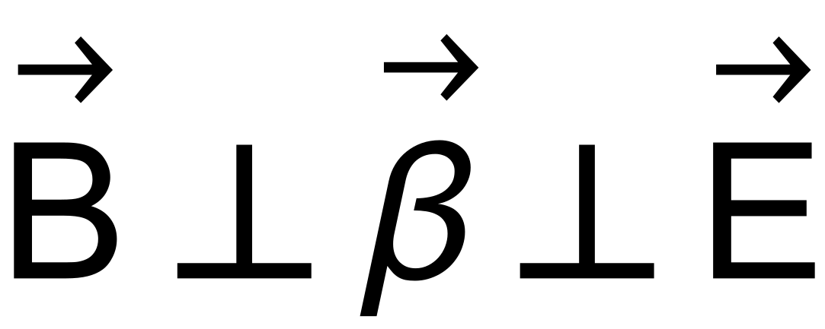
Frozen-spin technique
Muon orbit
Thomas BMT Equation
EDM contribution
$$\vec{Ω} =\frac{q}{m}\left(a\vec{B} − \frac{aγ}{γ+1}\left(\vec{β}∙\vec{B}\right)\vec{β}−(a+\frac{1}{1+γ^{2}})\frac{\vec{β}×\vec{E}}{c}\right)+\frac{ηq}{2mc}\left(c\vec{β}×\vec{B}+\frac{γc^{2}}{γ+1}\left(\vec{β}∙\vec{E}\right)\vec{β}+\vec{E}\right)$$

Slide 13
Frozen-spin technique
Muon orbit
Thomas BMT Equation
EDM contribution
$$\vec{Ω} =\frac{q}{m}\left(a\vec{B} − \frac{aγ}{γ+1}\left(\vec{β}∙\vec{B}\right)\vec{β}−(a+\frac{1}{1+γ^{2}})\frac{\vec{β}×\vec{E}}{c}\right)+\frac{ηq}{2mc}\left(c\vec{β}×\vec{B}+\frac{γc^{2}}{γ+1}\left(\vec{β}∙\vec{E}\right)\vec{β}+\vec{E}\right)$$

Slide 14
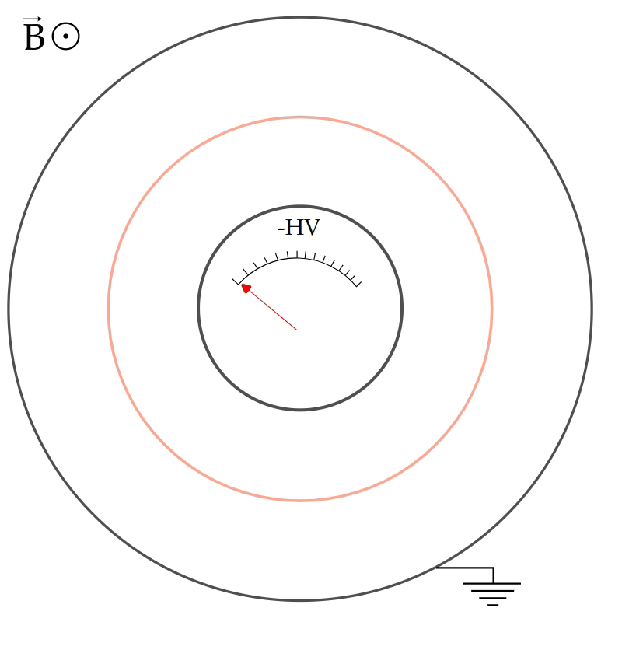

Frozen-spin technique
EDM contribution
$$\vec{Ω} =\frac{ηq}{2mc}\left(c\vec{β}×\vec{B}+\vec{E}\right)$$
In the frozen-spin condition the source for out of orbit plane spin precession proportional to only the muon EDM.

Slide 15
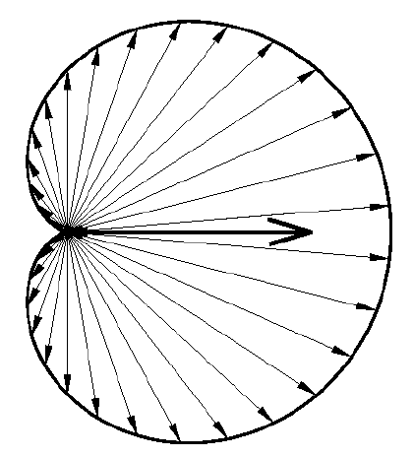
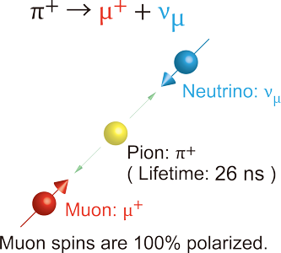
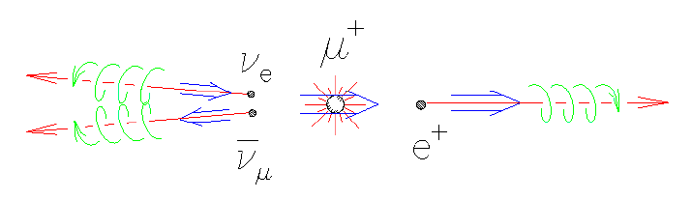
How to measure muon spin direction?
Positrons from muon decay are preferentially ejected along the spin direction
Parity violating pion decay→ muons are polarized
Detecting emitted positron direction from a polarized muon beam → muon spin direction.
Experiment sensitivity to the muon EDM:

Slide 16
Content
Motivation
The frozen-spin method
Experiment design
Muon injection
Muon entrance detector
Pulsed magnetic coil
Cylindrical detectors
Conclusions

Slide 17
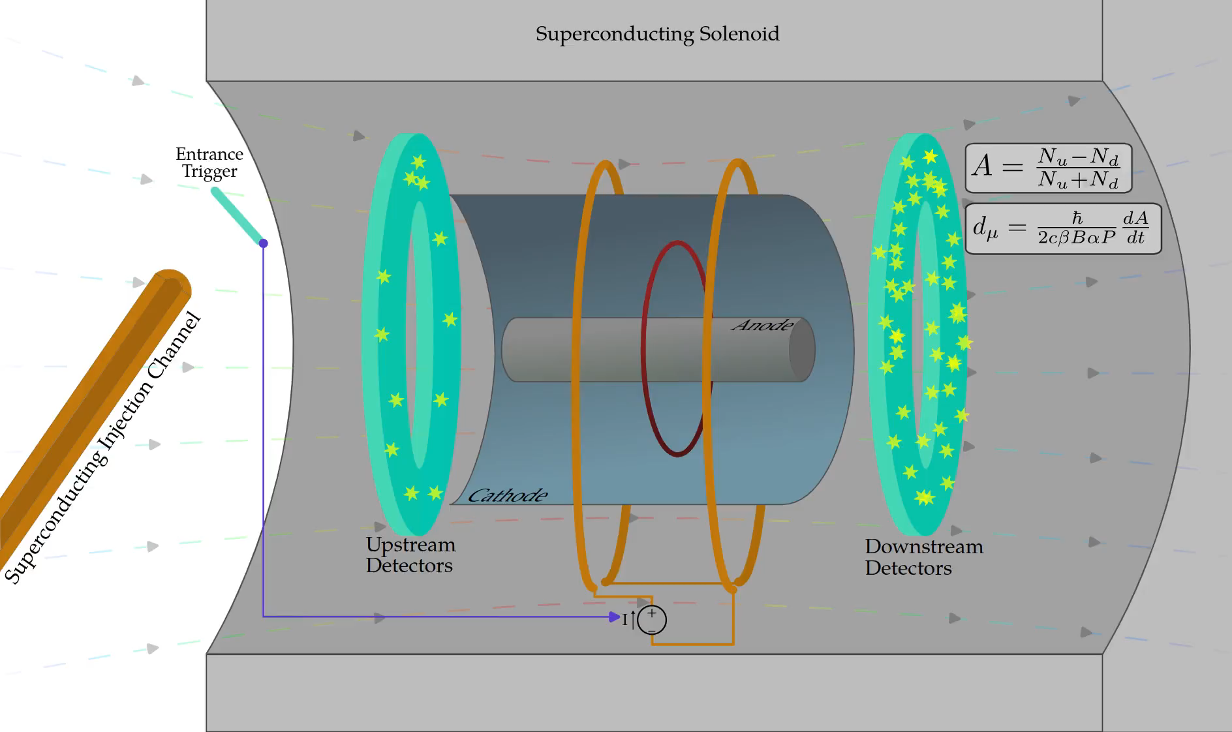
the muEDM experiment

Slide 18
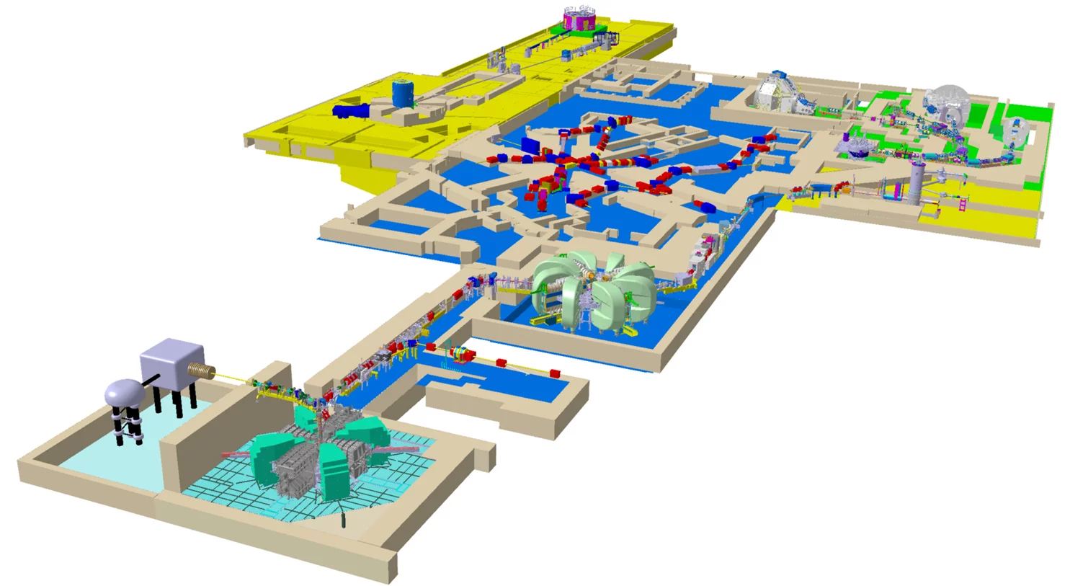
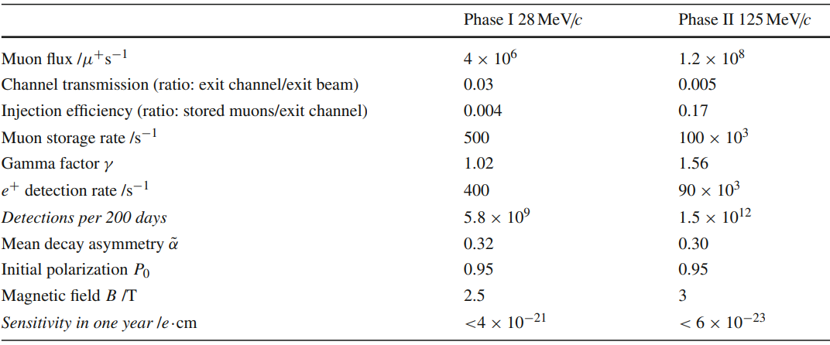
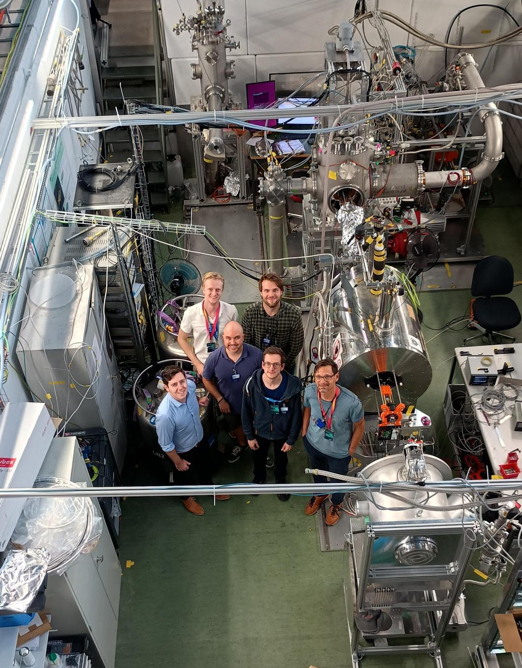
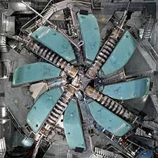
the muEDM experiment
Adelmann, A., Bainbridge, A.R., Bailey, I. et al. A compact frozen-spin trap for the search for the electric dipole moment of the muon. Eur. Phys. J. C 85, 622 (2025).
PSI High Intensity Proton Accelerator (HIPA)
muEDM team at PSI

Slide 19
Content
Motivation
The frozen-spin method
Experiment design
Muon injection
Muon entrance detector
Pulsed magnetic coil
Cylindrical detectors
Conclusions

Slide 20
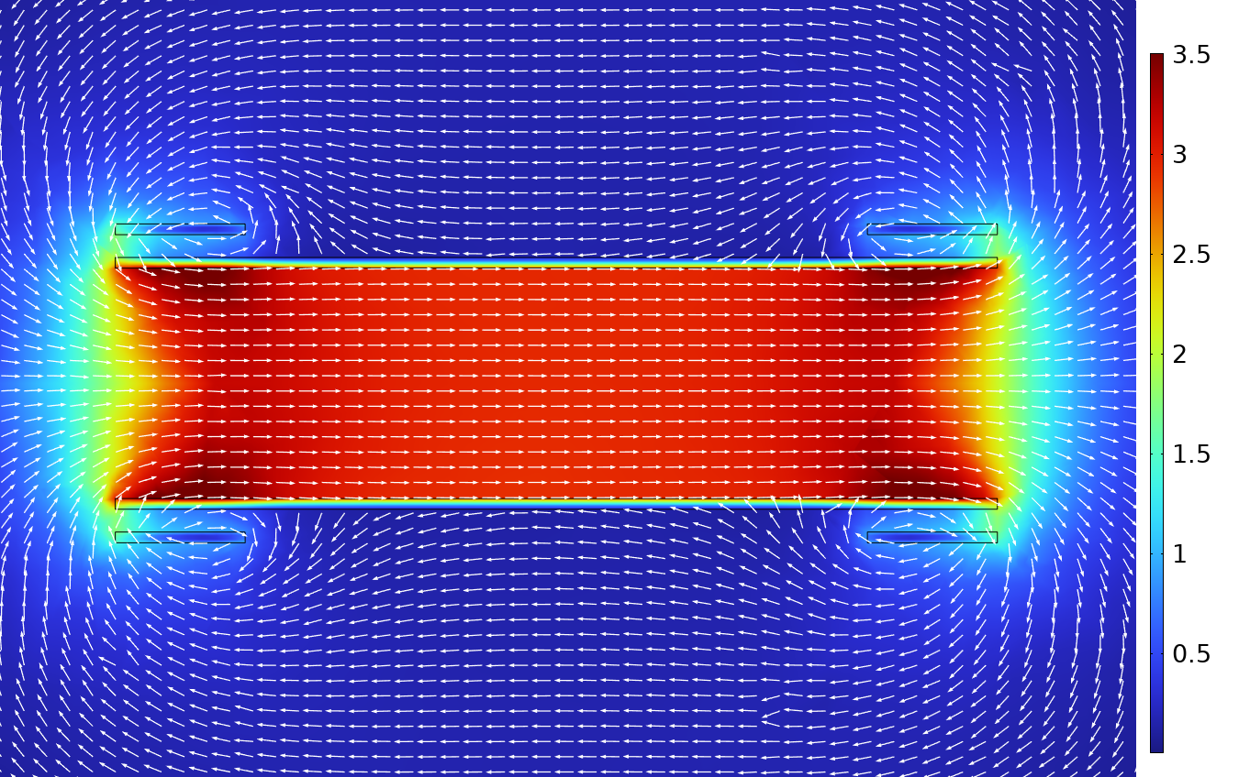
Muon injection channel :: Magnetic mirror effect
Muon beam

Slide 21
Muon injection channel :: Magnetic mirror effect
Muon beam
Challenges:
Non-uniform fringe field
~2T magnetic field
Strong gradient

Slide 22
Muon injection channel :: Magnetic mirror effect
Muon beam
Challenges:
Non-uniform fringe field
~2T magnetic field
Strong gradient
Solution:
Superconducting injection channel

Slide 23
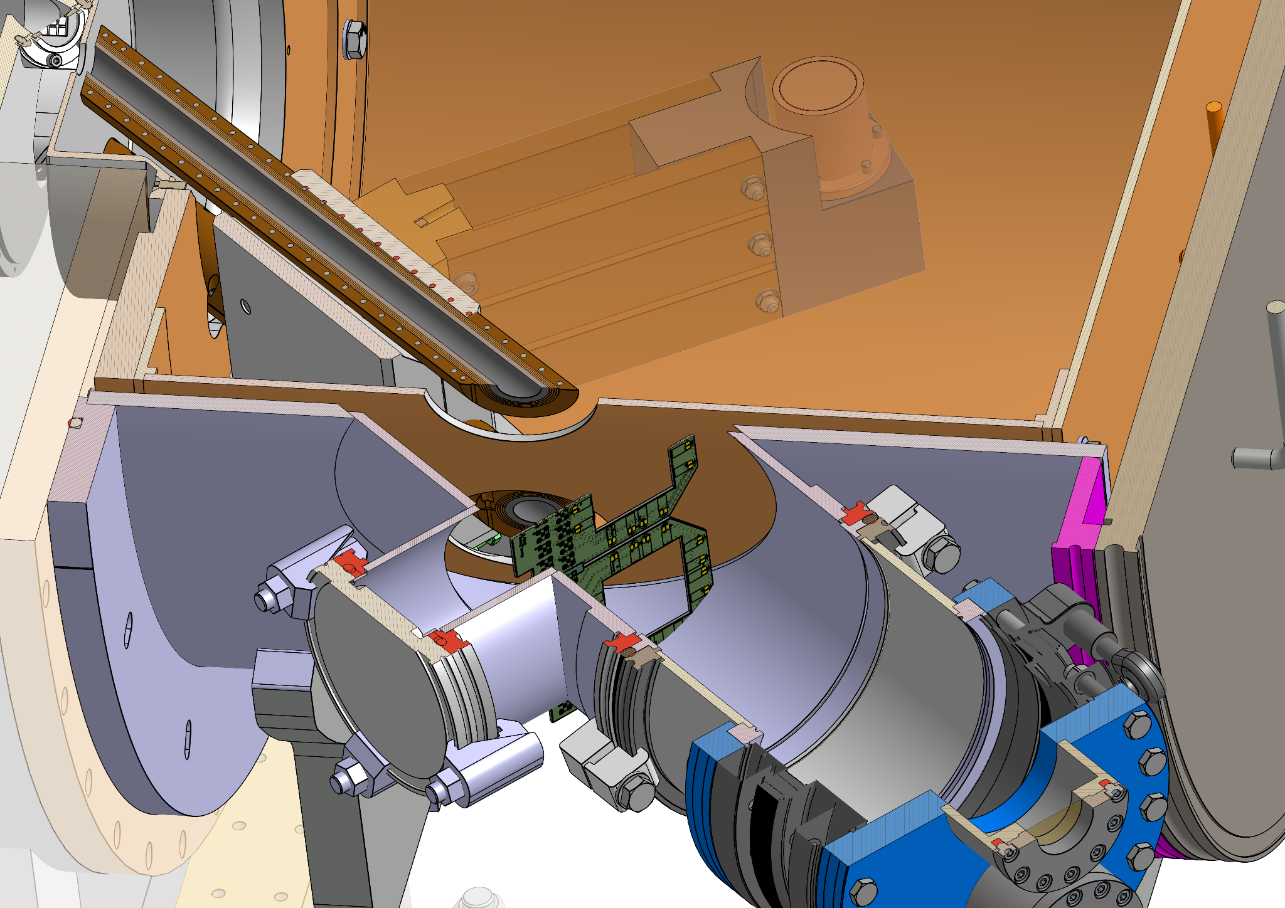
Superconducting injection channel design
Flexible copper thermal connections
Cryo shield
Vacuum chamber

Slide 24
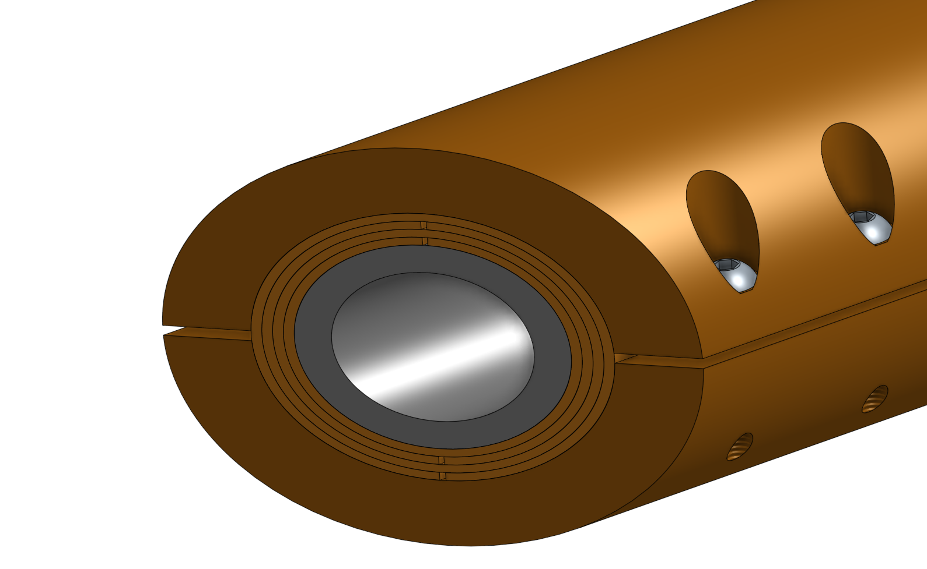
Superconducting injection channel design
Flexible copper thermal connections
4 x Layered NbTi/Cu sheets w=0.7 mm
Cryo shield
Copper half shells OD = 40 mm
Brass supporting tube ID = 16 mm
Vacuum chamber

Slide 25
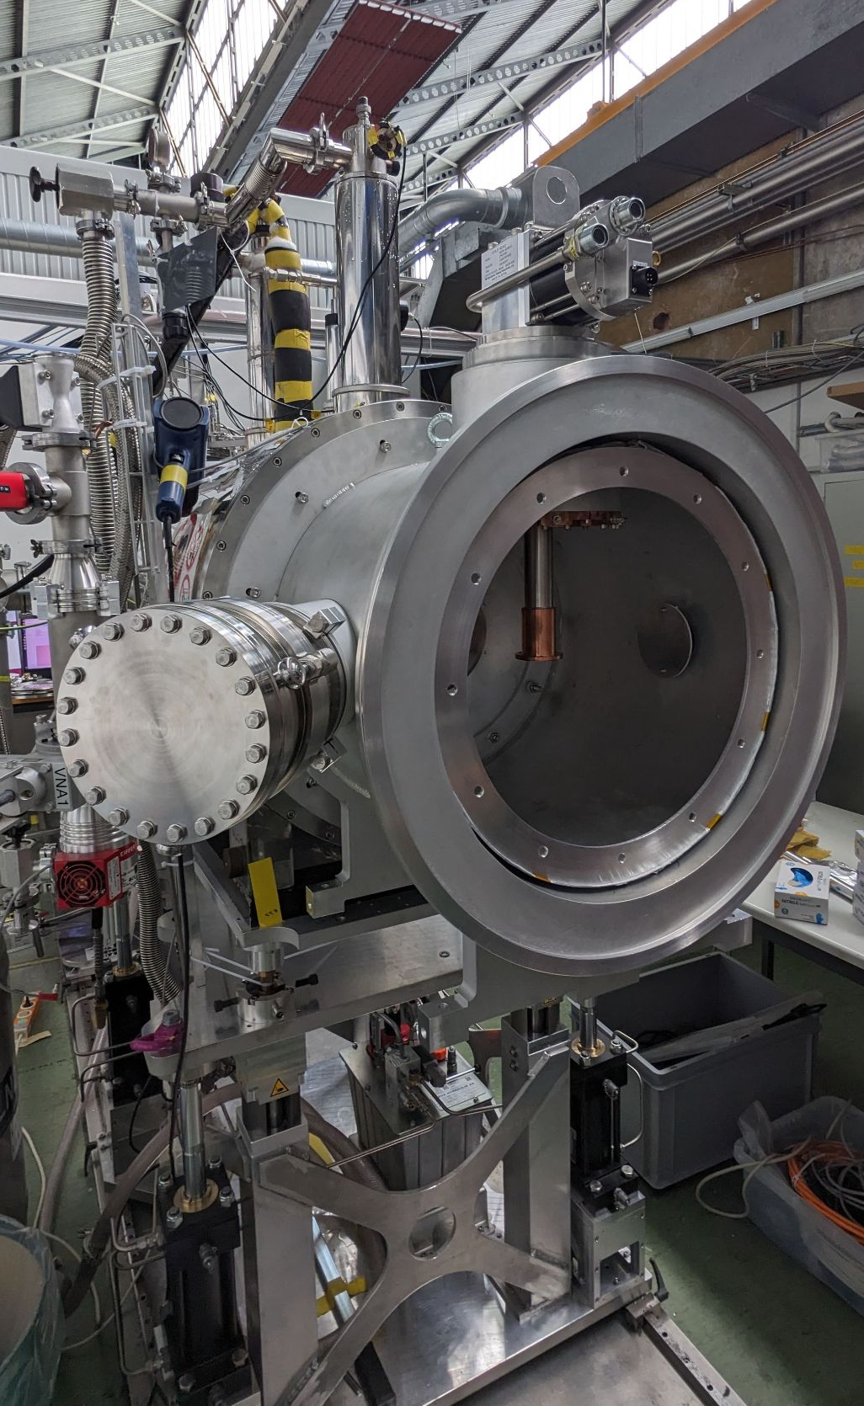
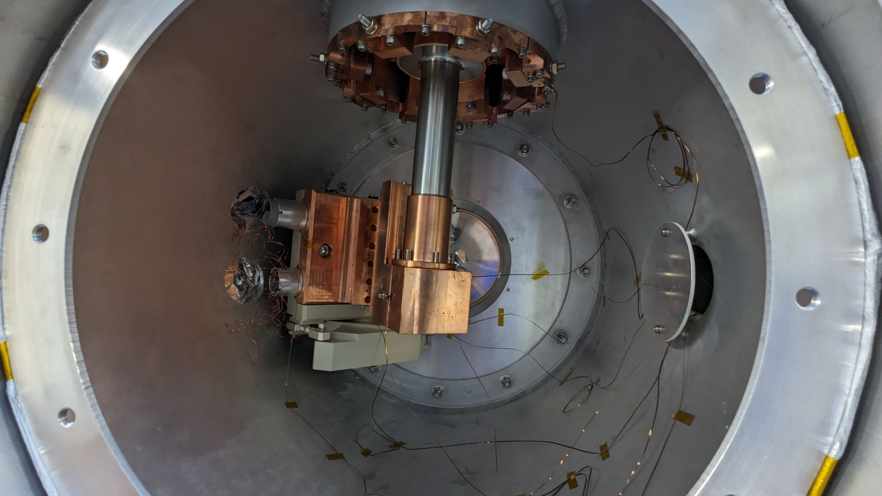
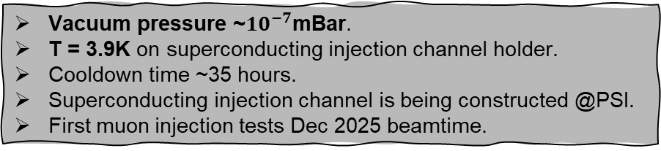
Injection channel status
Vacuum pressure ~${10}^{−7}$mBar.
T = 3.9K on superconducting injection channel holder.
Cooldown time ~35 hours.
Superconducting injection channel is being constructed @PSI.
First muon injection tests Dec 2025 beamtime.

Slide 26
Content
Motivation
The frozen-spin method
Experiment design
Muon injection
Muon entrance detector
Pulsed magnetic coil
Cylindrical detectors
Conclusions

Slide 27

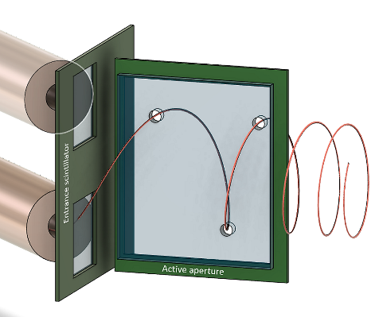
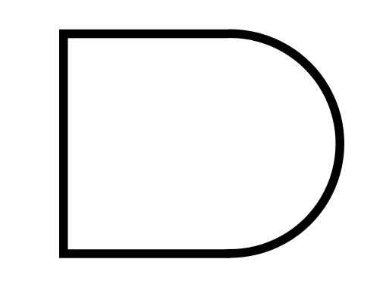
Muon Entrance Trigger
Entrance
Magnetic pulse is triggered only on muons with the correct trajectory
Only 0.4% of muons are in the acceptable phase space (Geant4 simulation)
Entrance Detector: Thin (≤100μm) scintillator
Veto Detector: Thick scintillating slab with holes
Entrance triggered was tested in 2024 beamtime
Veto
⊗
NOT
Magnetic kicker system
AND
12
19.09.2025

Slide 28
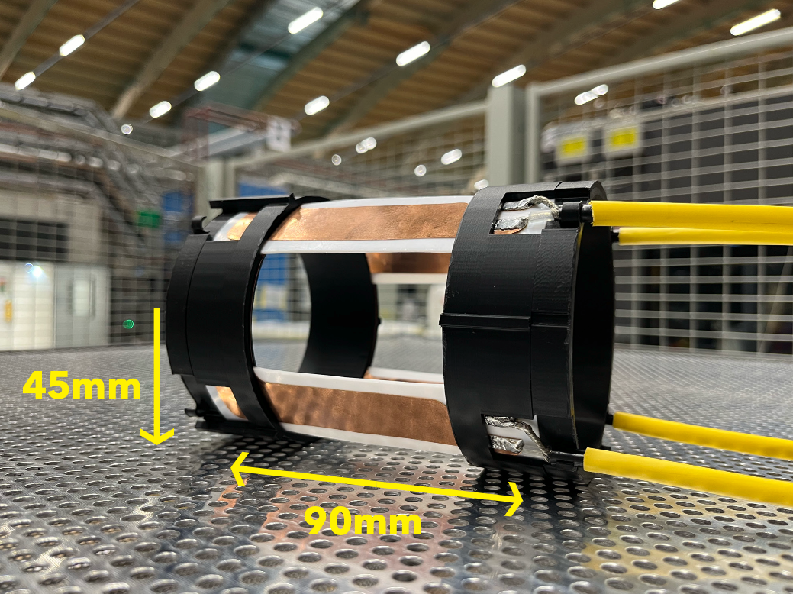
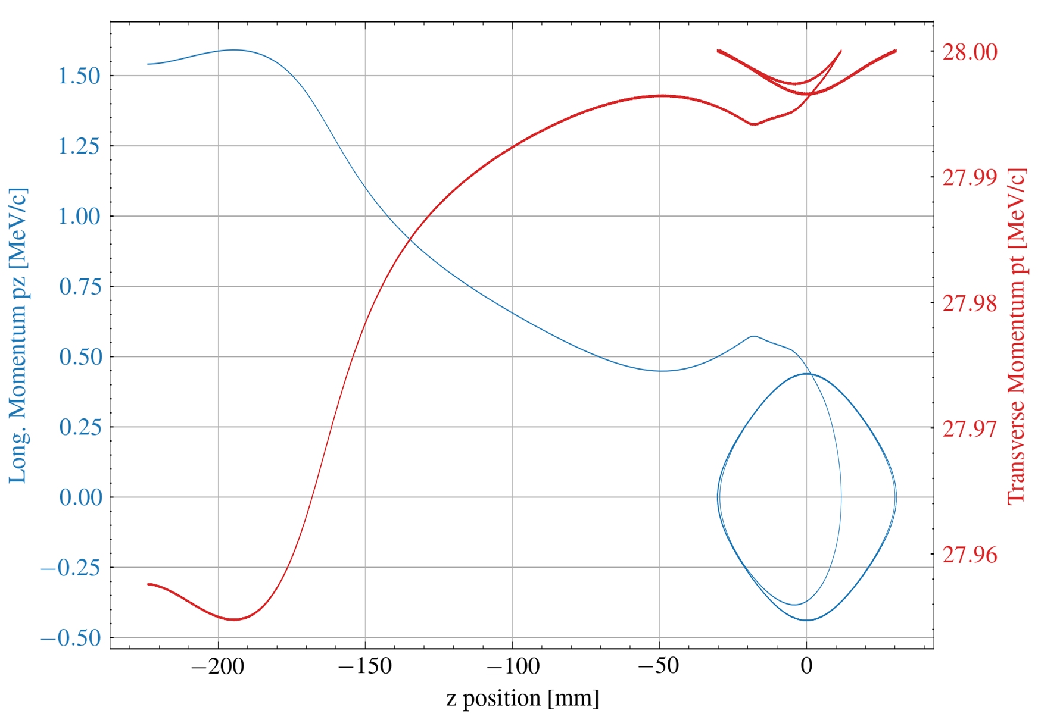
Magnetic kicker coil
Magnetic pulse characteristics:
Peak amplitude ~1mT
Pulse fullwidth ~50ns
Triggered <100ns
Tested in 2024 beamtime

Slide 29
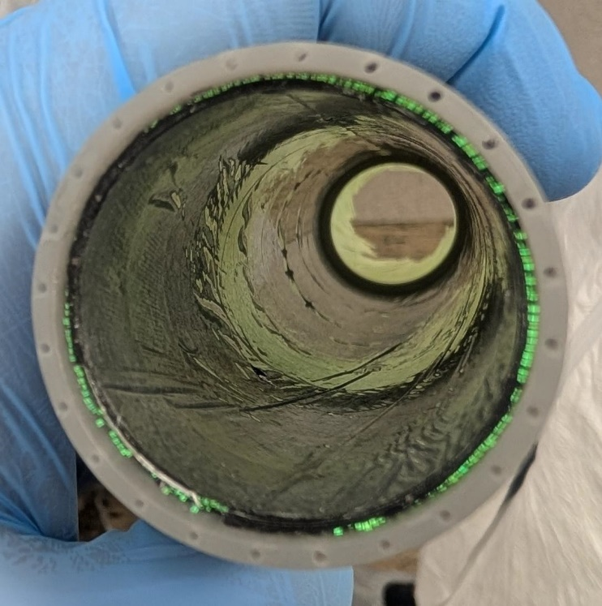
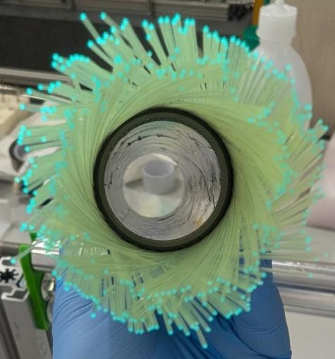
The Positron Tracker
Scintillating fiber detector:
~O(1000) scintillating fibers in hexagonal configuration
Fiber coincidence → positron detection
Able to reconstruct emitted positron trajectory
Coaxial cylinders with 17 mm and 21 mm radius

Slide 30
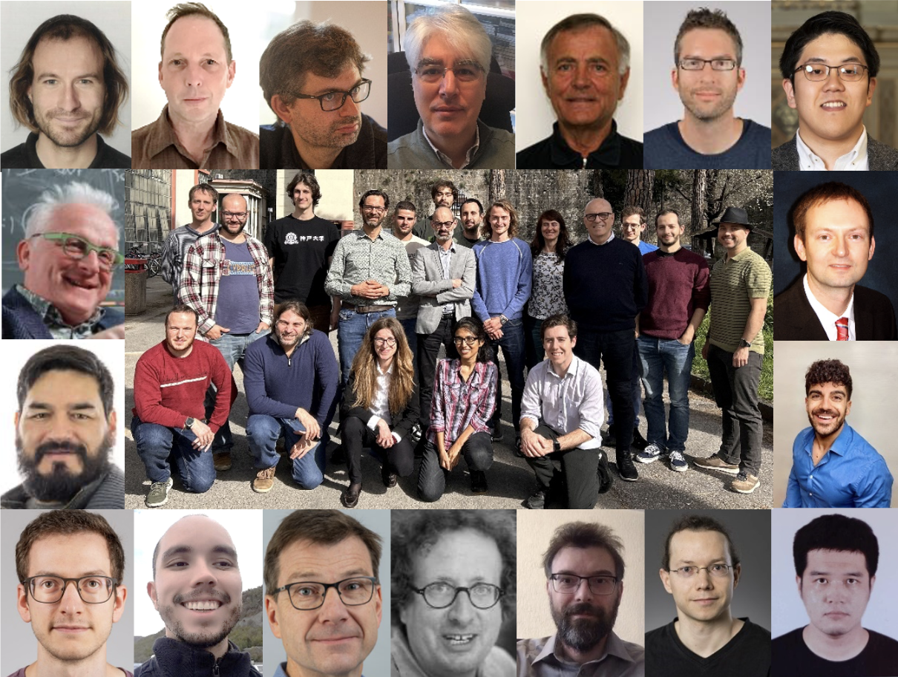

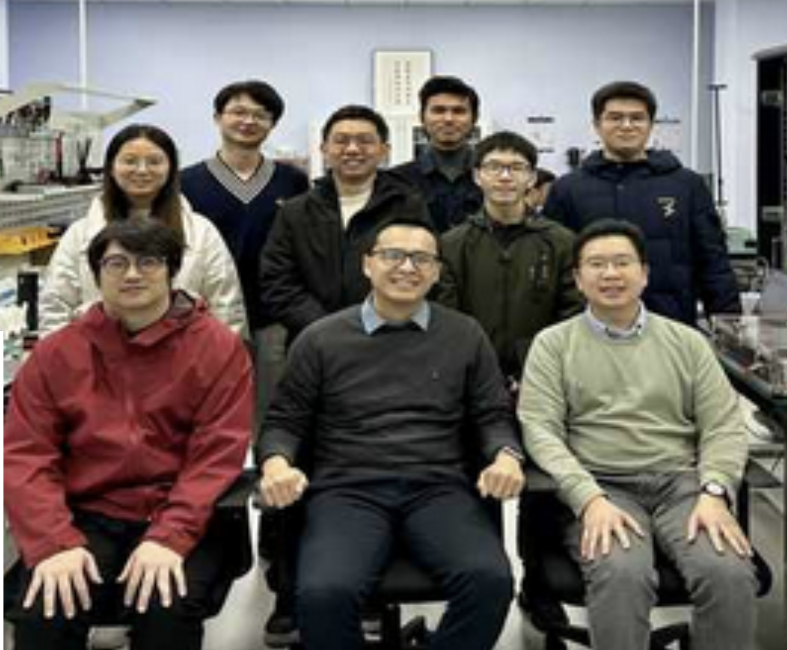
Closing remarks
Open for new collaborators!
muEDM is a dedicated search for the muon EDM in a leptonic system with a novel frozen-spin method approach.
2025 commissioning systems:
Injection with SC channel
Kicker system for pulsed field
Cylindrical positron detectors
Demonstrate muon storage
2026 commissioning systems:
Electrodes for the frozen-spin
Demonstrate the frozen-spin method

Slide 31

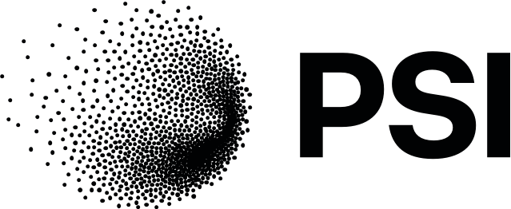

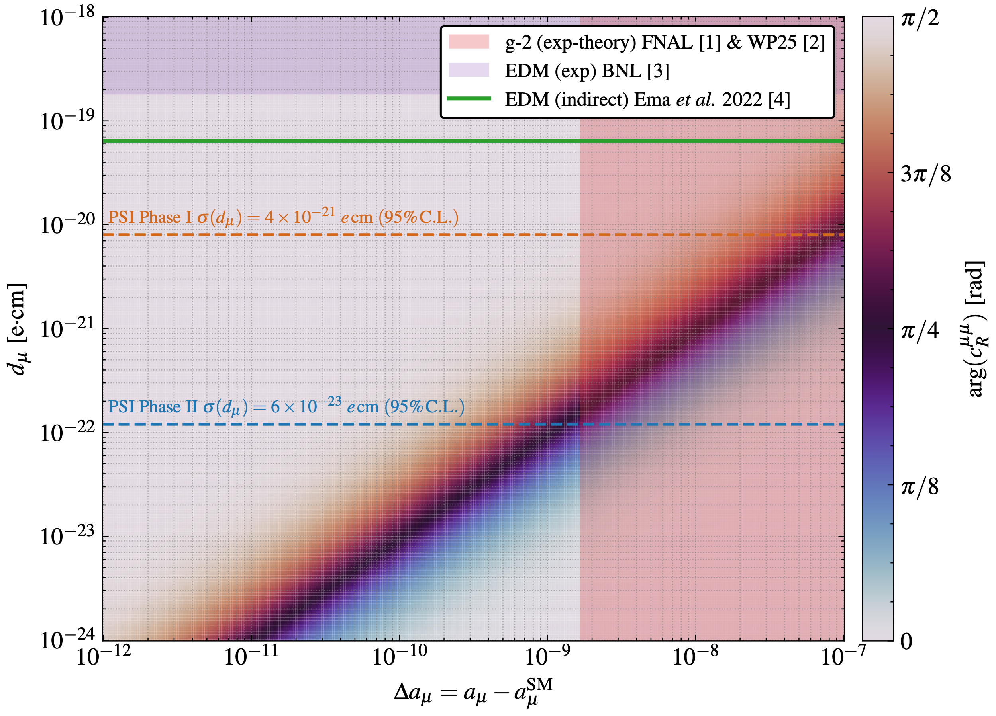
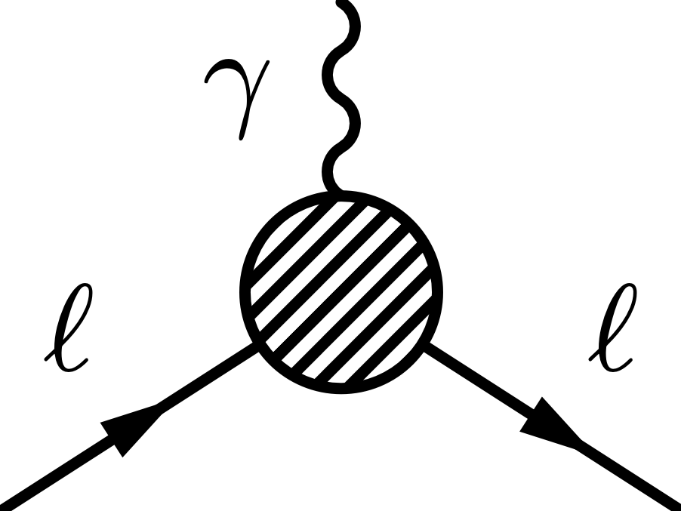

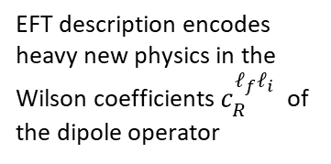





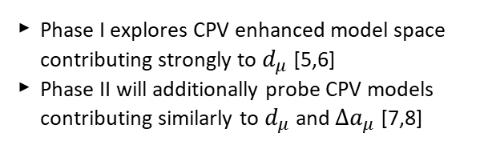

New physics in dipole moments
EFT description encodes heavy new physics in the Wilson coefficients $c_{R}^{ℓ_{f}ℓ_{i}}$ of the dipole operator
$$γ$$
$$μ$$
$$μ$$
$$H_{eff}^{NP}=c_{R}^{ℓ_{f}ℓ_{i}}\overline{ℓ_{f}}σ_{αβ}P_{R}ℓ_{i}F^{αβ}+h.c.$$
The flavour diagonal terms $c_{R}^{ℓℓ}$ are related to the g-2 and EDM
$$Δa_{μ}=\frac{4m_{μ}}{e}Re(c_{R}^{μμ})d_{μ}≈Δd_{μ}=−2Im(c_{R}^{μμ})$$
$$arg(c_{R}^{μμ})=arctan\left(\frac{2m_{μ}}{e}\frac{d_{μ}}{Δa_{μ}}\right)$$
Phase I explores CPV enhanced model space contributing strongly to $d_{μ}$ [5,6]
Phase II will additionally probe CPV models contributing similarly to $d_{μ}$ and $Δa_{μ}$ [7,8]
[1] The Muon g − 2 Collaboration, arxiv:2506.03069 [hep-ex] (2025) [2] Aliberti et al., arxiv:2505.21476 [hep-ph] (2025)
[3] Bennett et al., Phys. Rev. D 80, 052008 (2009)
[4] Ema, Gao & Pospelov, Phys. Rev. Lett. 128, 131803 (2022)
[5] Khaw et al., JHEP 234 (2023)
[6] Dermíšek et al., Phys. Rev. D 107 095043 (2023)
[7] Bigaran & Volkas, Phys. Rev. D 105 015002 (2022)
[8] Hamaguchi et al., JHEP 100 (2023)
Notes:
reduce text - mostly broad, just say
eg. “Express Schiff moment in terms of dmu”
dont forget to introduce the muon in the plot
could hide the additional ones not mentioned
add the sensitivity we are targeting on the plot for context
worthwhile to explore full parameter space, with other flavour structures The leptonic EDMs are described through imaginary parts of Wilson coefficients of EFT dipole operators, such that limits directly constrain new physics without additional input.

Slide 32
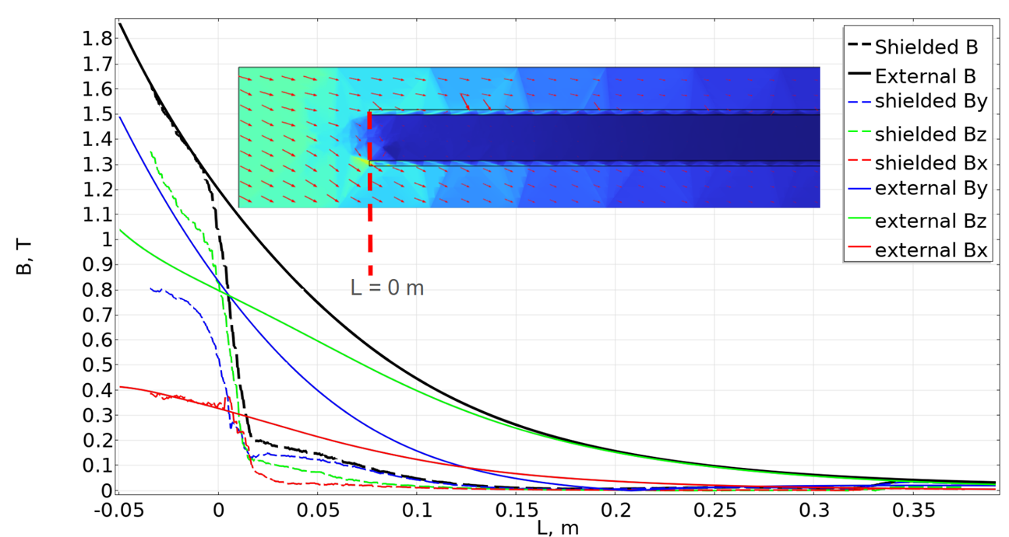
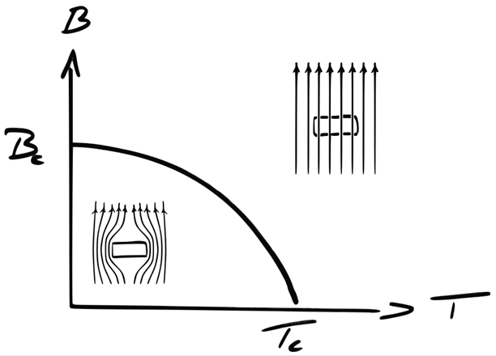
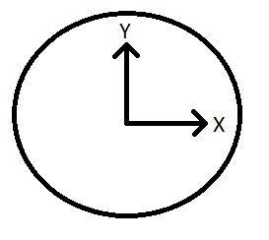
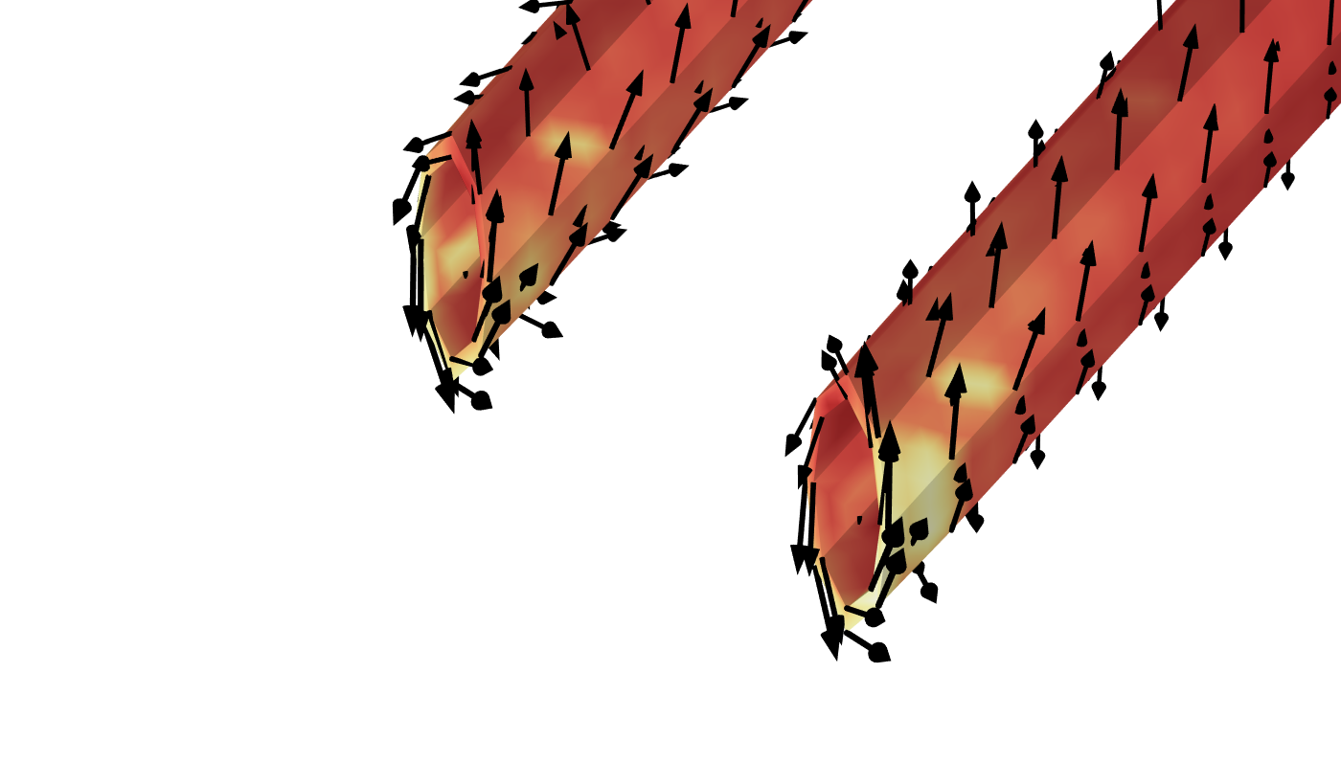
Magnetic field shielding using superconductors
z
Muon storage simulations show that successful storage can be achieved, when B field transversal components < 100 mT.
Superconductor-based passive shielding and screening systems by N. Rotheudt et al
DOI 10.1088/1361-6668/adb7cc

Slide 33
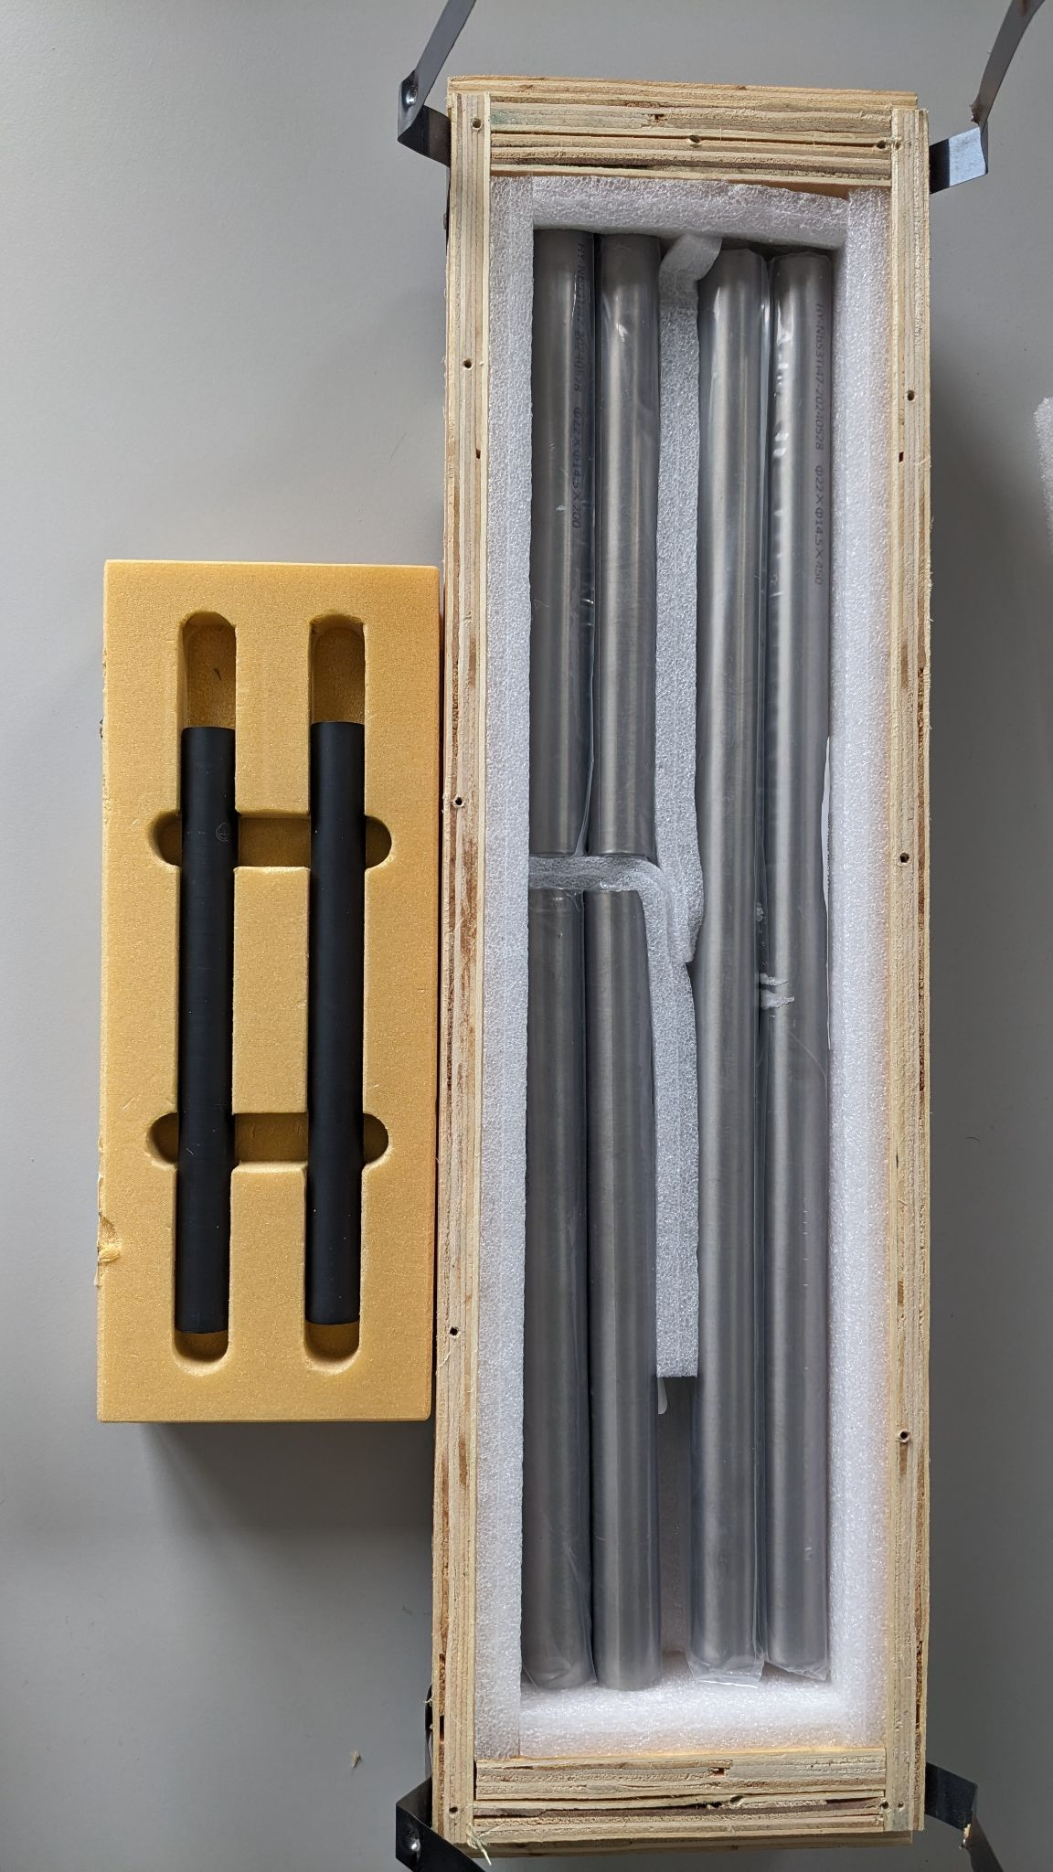
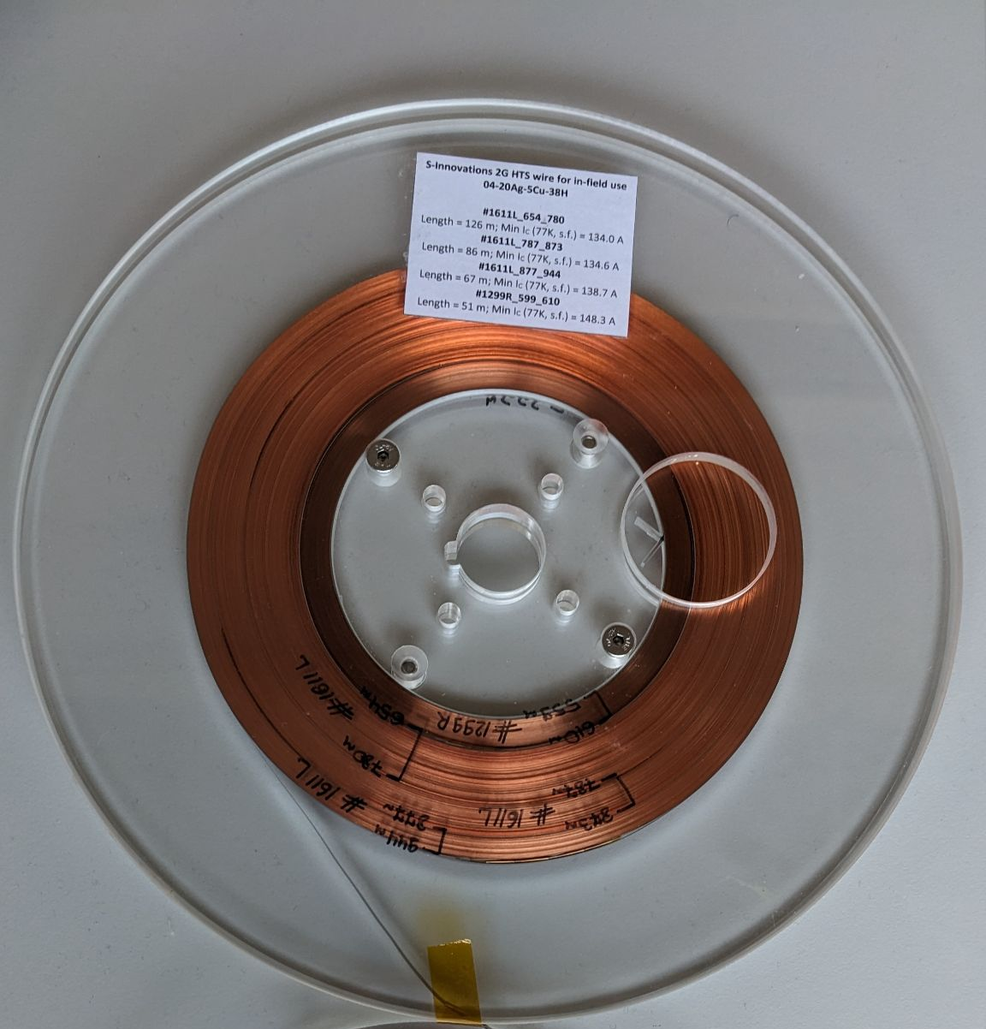
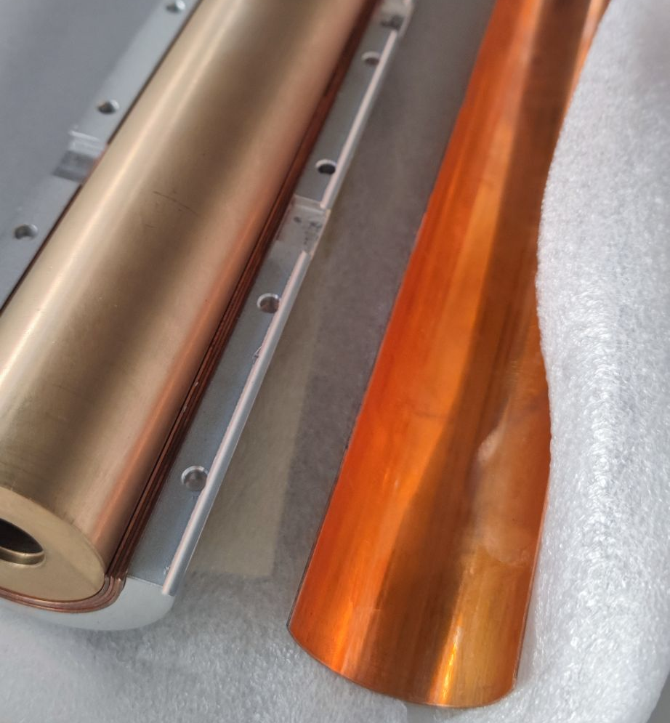
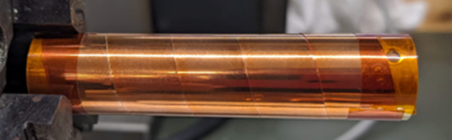
Magnetic field shielding measurements
Bismuth strontium calcium copper oxide (BSCCO2223)
S-Innovations 2G HTS tape 04-20Ag-5Cu-38H
NbTi/Nb/Cu layered sheets
Used at CERN to successfully shield magnetic field up to 3.1T at 4.2K see ref: 10.1109/TASC.2018.2872860
Nb-47Ti

Slide 34
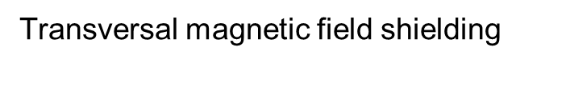
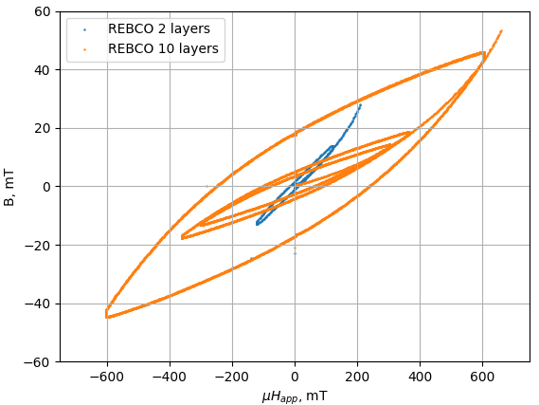
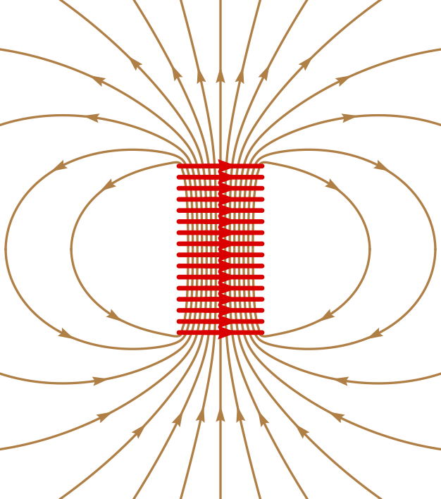

Force sensor
Hall sensor
REBCO shield
SC solenoid
Material | Blim, mT | Force, N
NbTi AXIAL | 66 | 2
BSCCO2223 AXIAL | 50 | 2
REBCO 2 layers TRANS. | 200 | 8
REBCO 10 layers TRANS. | 600 | 12
4 layers of NbTi/Nb/Cu TRANS. | 3100 | ?

Slide 35
Force sensor
Hall sensor
REBCO shield
SC solenoid
Material | Blim, mT | Force, N
NbTi AXIAL | 66 | 2
BSCCO2223 AXIAL | 50 | 2
REBCO 2 layers TRANS. | 200 | 8
REBCO 10 layers TRANS. | 600 | 12
4 layers of NbTi/Nb/Cu TRANS. | 3100 | ?

Slide 36
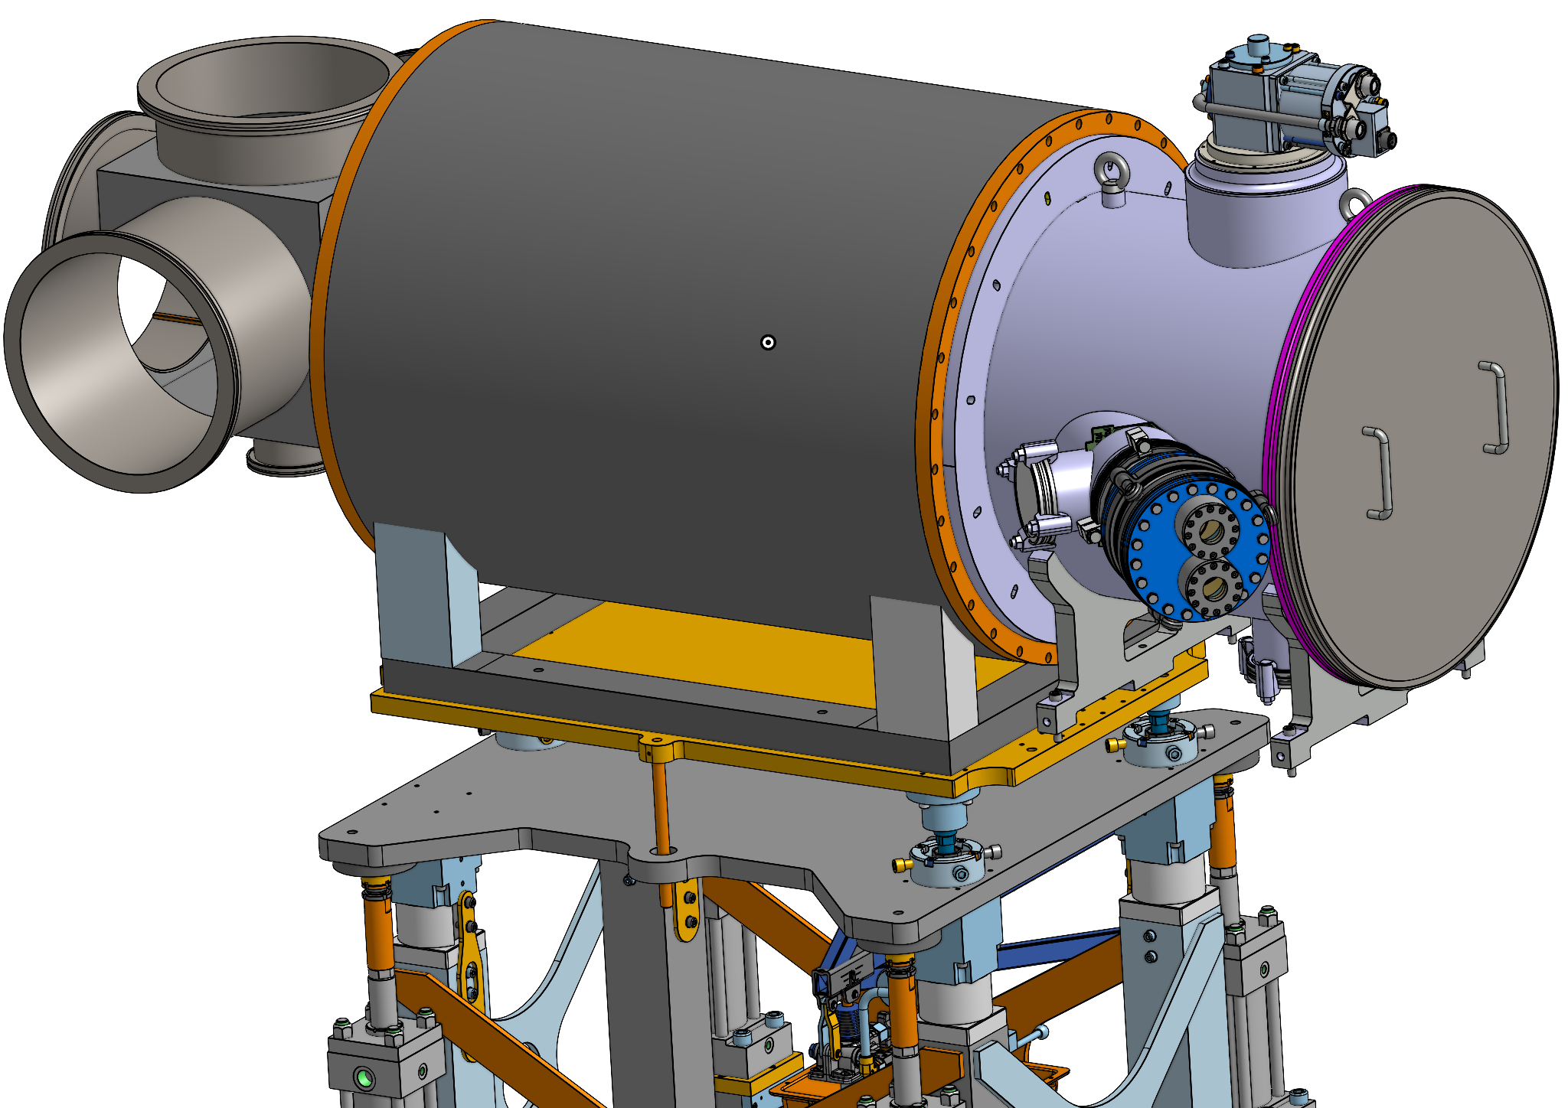
The Experiment - Technical overview
4K cryo head
SC storage magnet
Cryostat in vacuum
Vacuum cross for services
Off-axis Injection tubes
Magnet lifter

Slide 37
The Experiment - Technical overview
Cryo shield
Superconducting Injection tube
Bendable vacuum tube
Vacuum Chamber
μ⁺
Beam entrance
Flange for beam monitors feed-throughs

Slide 38

The Experiment - Storage Parameters
Using G4beamline and surrogate models, we optimized the storage efficiency of muons up to ~0.4 %.

Slide 39



Magnetic field shielding
Active magnetic field shielding:
Coils
Difficulties:
Non-uniform field
~2T magnetic field
Strong gradient
Passive magnetic field shielding
Ferromagnetic (<500mT)
Superconductors (>500mT)
Magnetic field lines in a ferromagnetic material.

Slide 40


Magnetic field shielding
Magnetic field shielding using superconductors
Difficulties:
Cryogenic temperatures
Not easily accessible
Superconductor-based passive shielding and screening systems by N. Rotheudt et al
DOI 10.1088/1361-6668/adb7cc

Slide 41

Magnetic field shielding
Magnetic field shielding using superconductors
Image taken from D.Barna et al see ref: 10.1109/TASC.2018.2872860
Superconductor-based passive shielding and screening systems by N. Rotheudt et al
DOI 10.1088/1361-6668/adb7cc

Slide 42
COMSOL Multiphysics simulation
z
Muon storage simulations show that successful storage can be achieved, when B field transversal components < 100 mT.

Slide 43


Magnetic field shielding measurements
Material | Blim, mT | Force, N
NbTi AXIAL | 66 | 2
BSCCO2223 AXIAL | 50 | 2
REBCO 2 layers TRANS. | 200 | 8
REBCO 10 layers TRANS. | 600 | 12
4 layers of NbTi/Nb/Cu TRANS. | 3100 | ?

Slide 44



