Slide 1

Emerging quantum sensing technology for new physics searches
Image by Sandbox Studios
EuNPC 23 Sept 2025
Leendert Hayen

Slide 2
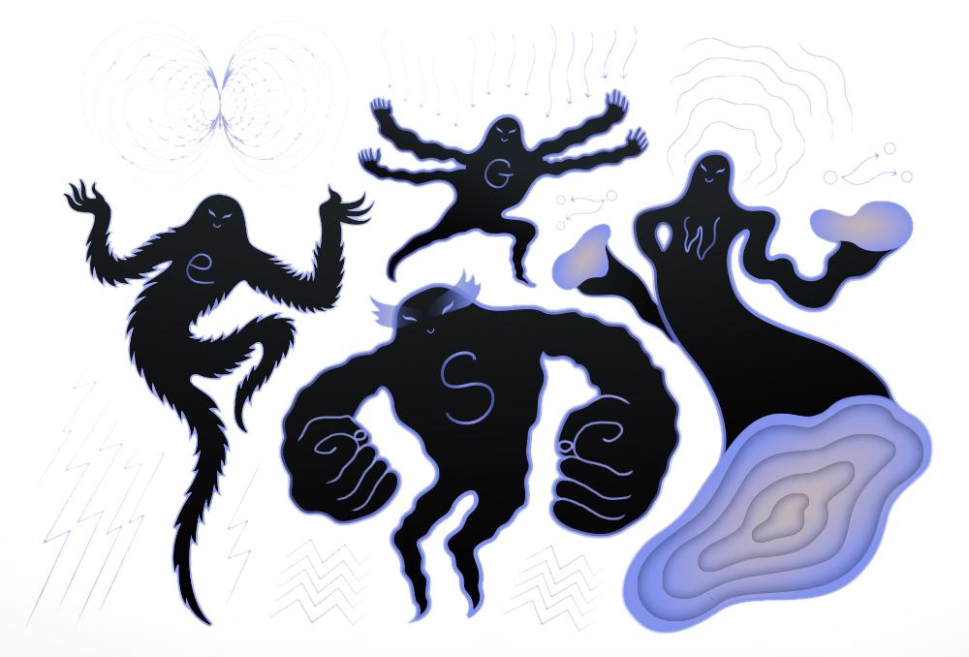
Standard Model tests and Beyond
Symmetry tests in the electroweak sector at low Energy
Parity violation
CP violation
Lorentz structure
CKM & PMNS unitarity
Neutrino mass
Sterile 𝜈
…
all can be probed with (nuclear) 𝛽 decay
Image by Sandbox Studio

Slide 3

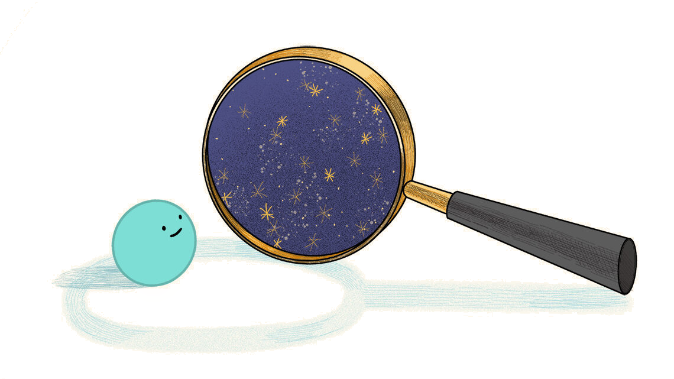
Why cryogenic quantum sensors
Semiconductor era is limited to >keV radiation, but unexplored world below
Dark matter
Foundations of quantum mechanics
Largely unexplored neutrino sector
…
low temperature (mK)

Slide 4
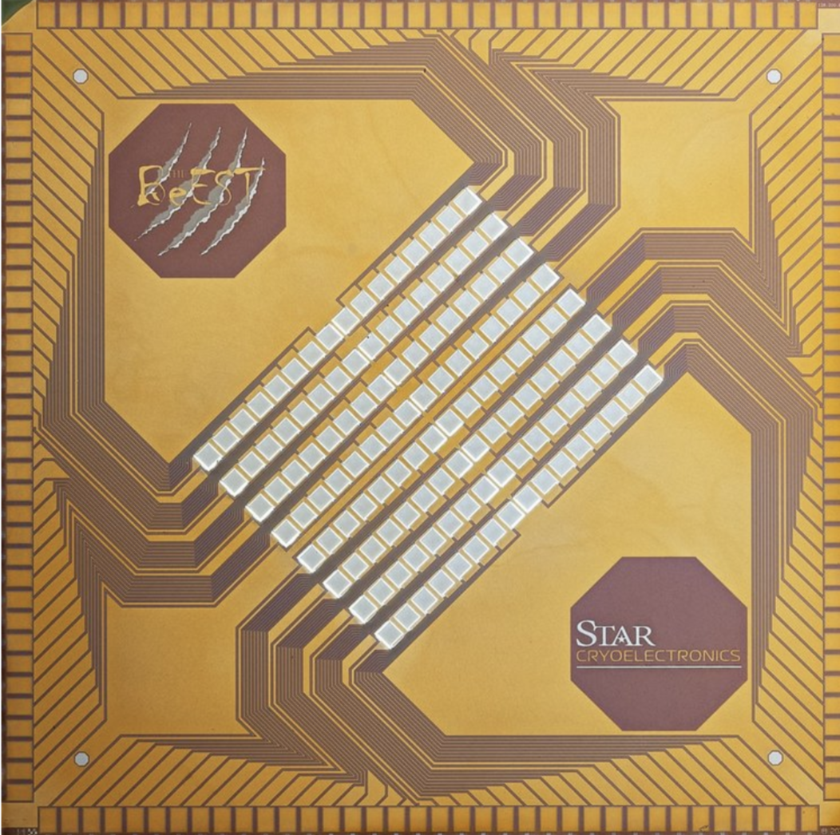
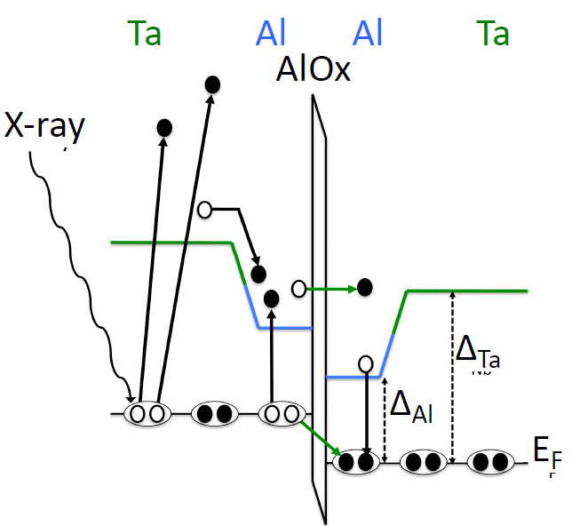

Superconducting Tunnel Junctions: BeEST
Josephson junction, measure tunneling current of broken cooper pairs ( 1 meV)
Unique properties:
High resolution (~ 2 eV)
Low threshold (~ 1 eV)
Fast (up to kHz)
ideal for measurement of short-lived radioactivity

Slide 5
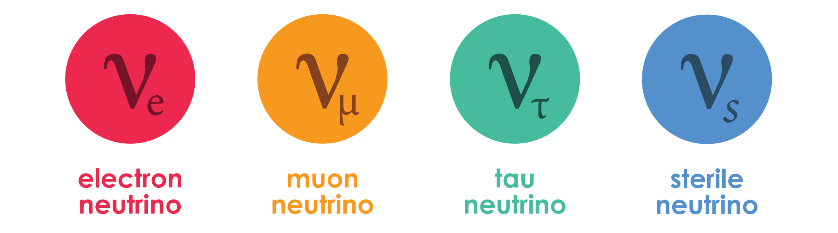
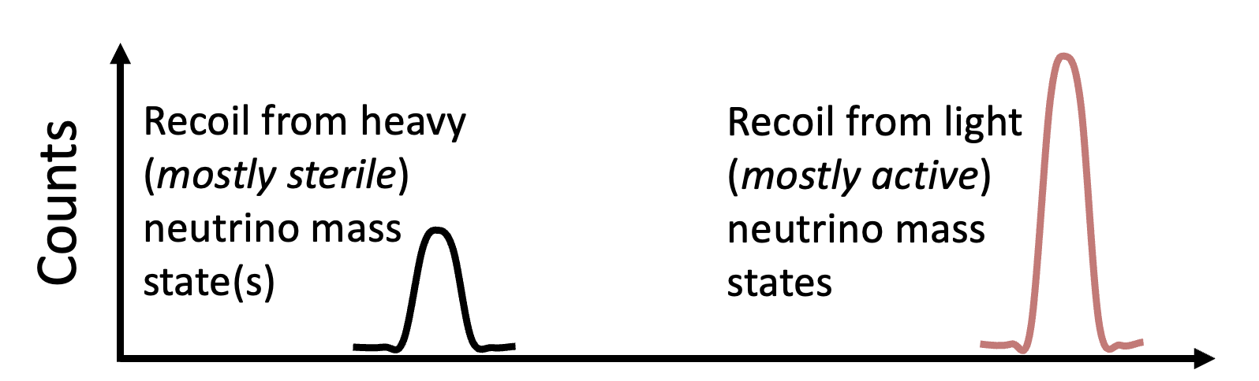
Sterile neutrino signature in electron capture
Sterile neutrinos are well-motivated dark matter candidates
keV-scale is hard to reach, electron capture provides unique decay signature

Slide 6

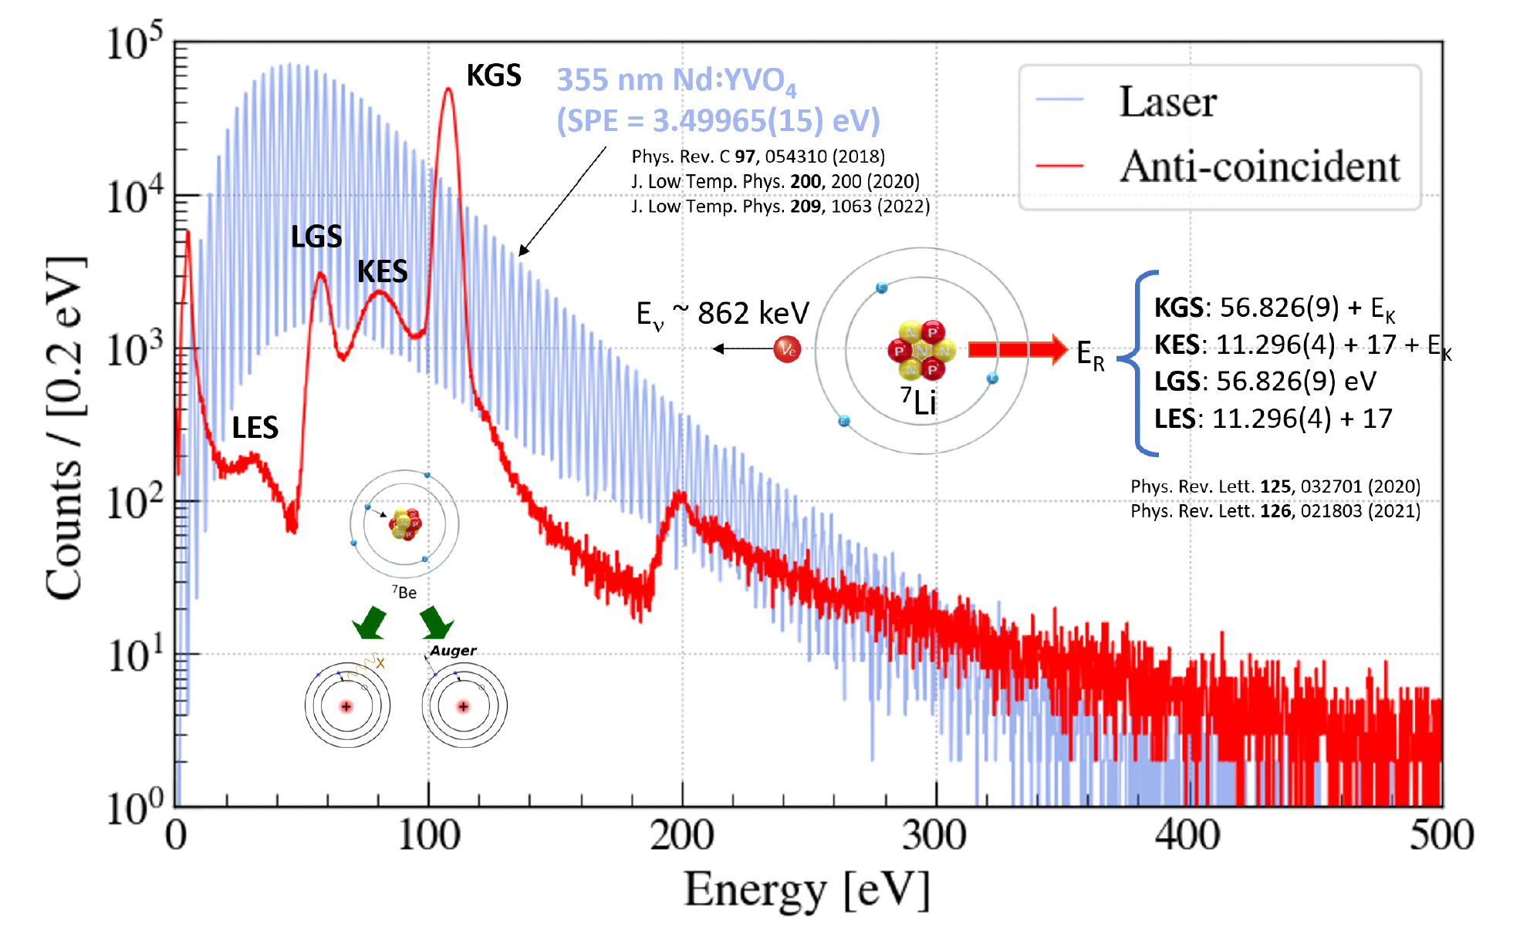
The BeEST experiment
First spectroscopy of ⁷Be recoil + cascade
Competitive sterile neutrino searches
Tests of quantum mechanics!
PRL 126 (2021) 021803; PRL 125 (2020), 032701
Nature 638 (2025) 640

Slide 7
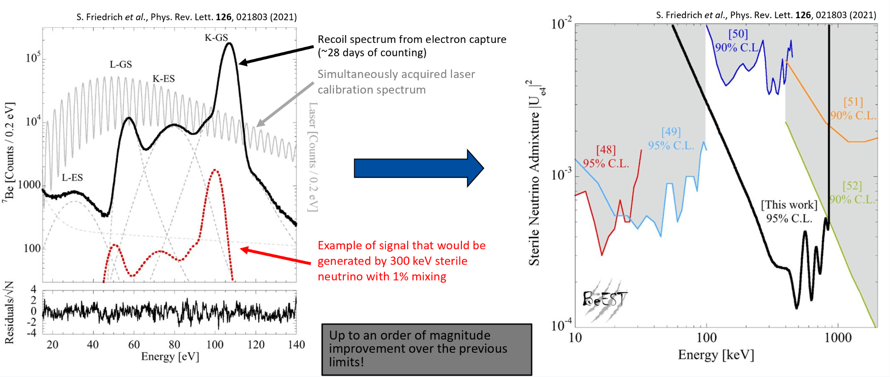
The BeEST experiment - sterile neutrino searches
EC recoil spectrum
Laser calibration
300 keV 1% mixing example
Phase-III results coming soon (analysis PRD 111 (2025) 052010)

Slide 8
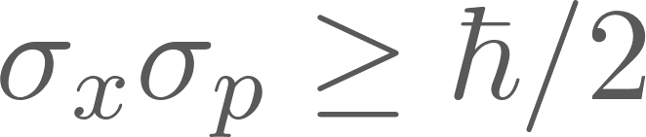
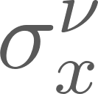
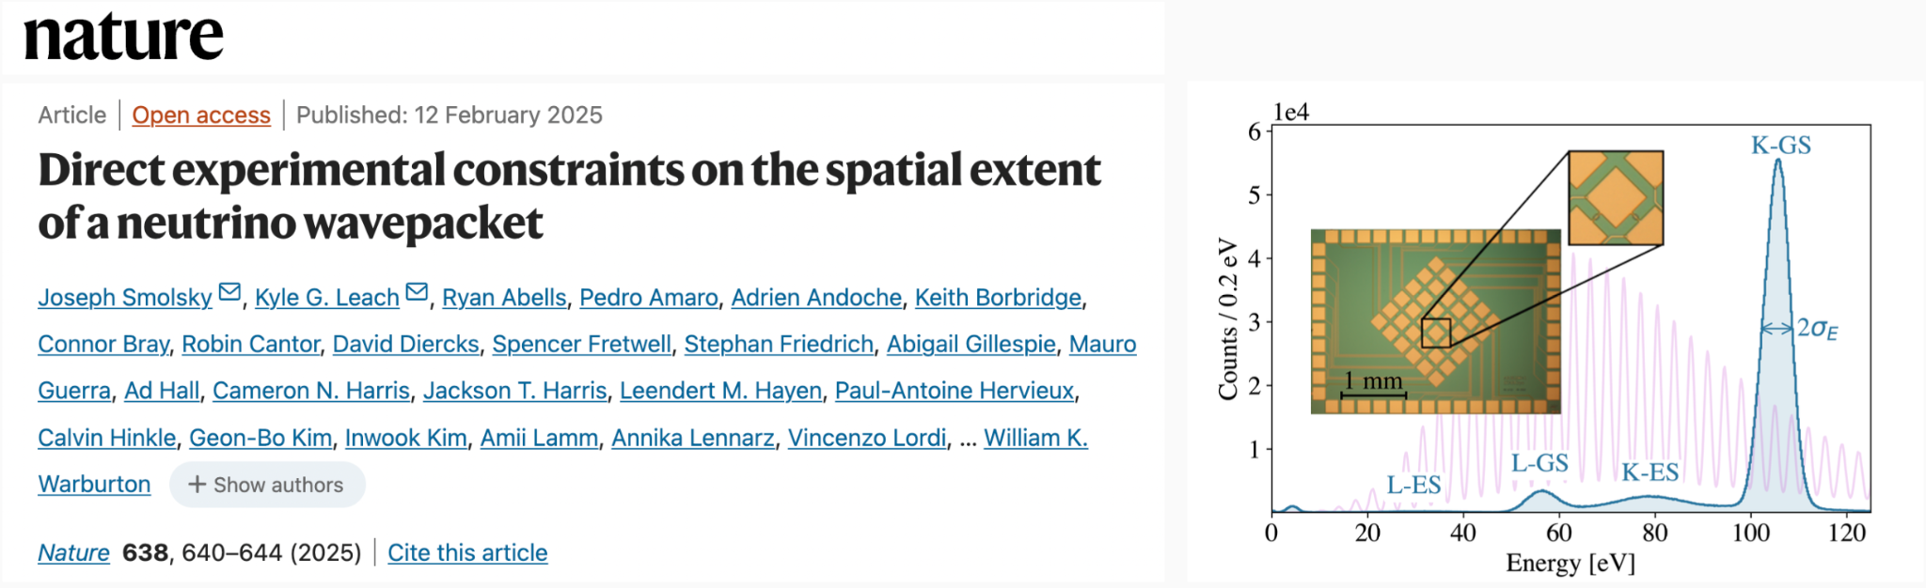
The BeEST experiment - Quantum Mechanics tests
Recoil nucleus is broadened due to get
See also PRD 111 (2025) 052010

Slide 9
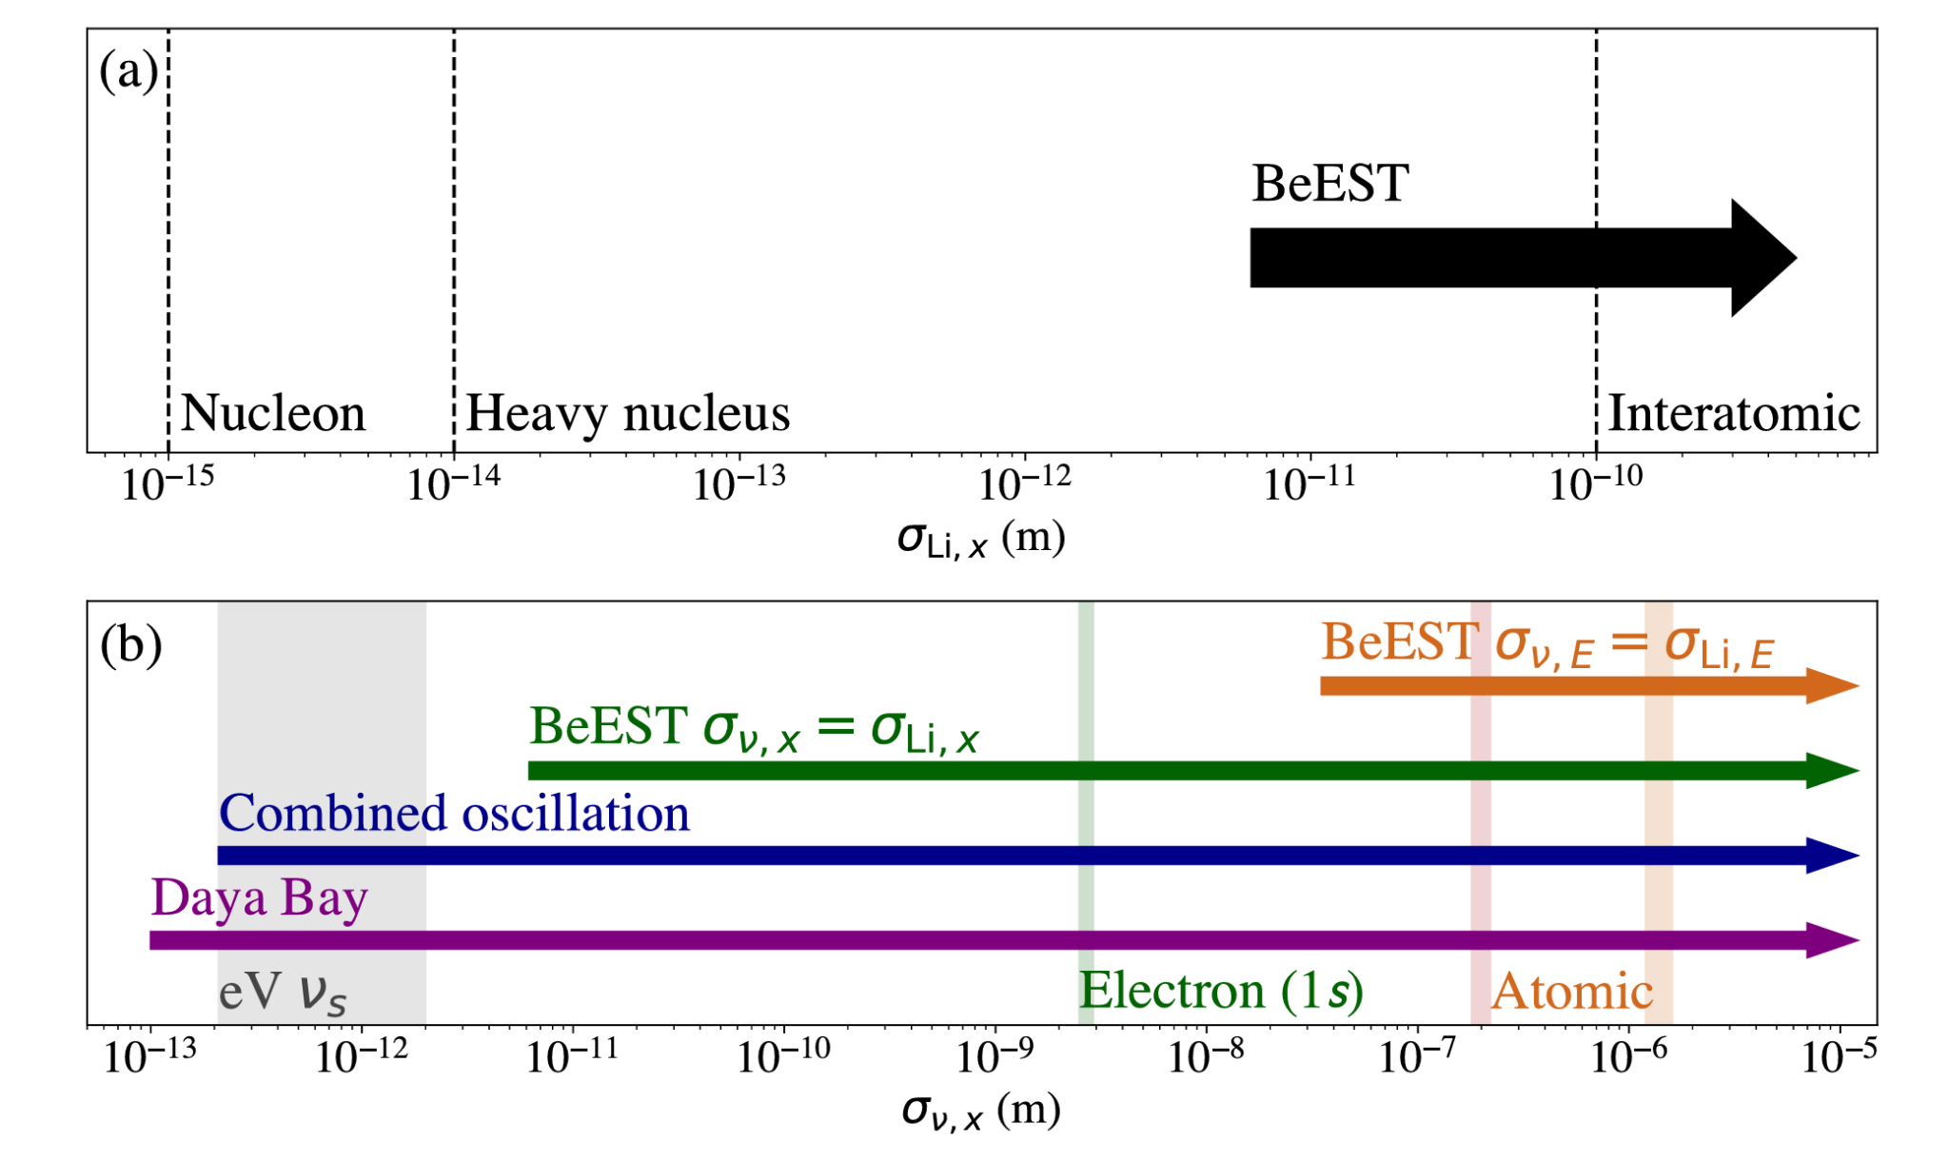
The BeEST experiment - Quantum Mechanics tests
Over 2 orders of magnitude improvement
but unresolved question:
conservation of energy or momentum?
Nature 638 (2025) 640

Slide 10
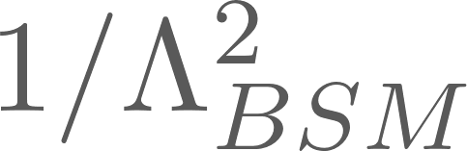
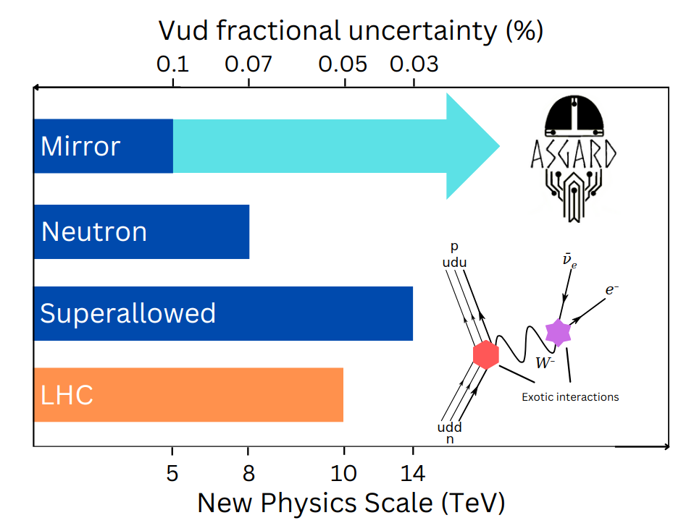
Experimental opportunities with recoil spectroscopy
Competitive with LHC ( )
TeV-scale new currents
Extra flavour components
High precision at low energy probes new physics at high energy
but plateau due to systematics
Recoiling ion has wealth of information, but technologically inaccessible and requires broad theory understanding
LH, ARNPS 74 (2024) 497
LH et al., RMP 90 (2018) 015008

Slide 11
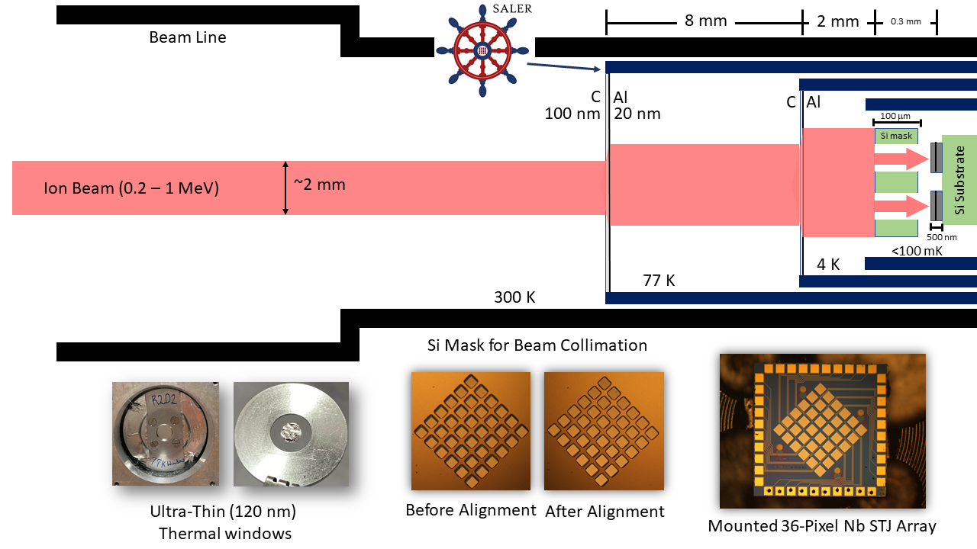
SALER: First short-lived measurements at FRIB
First-of-its-kind
but
closed fridge
significant scattering
no precise implantation
limited isotopes
Commissioning underway!

Slide 12
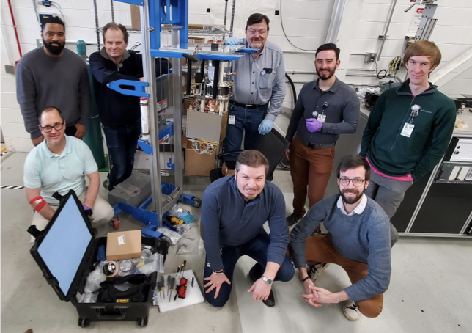
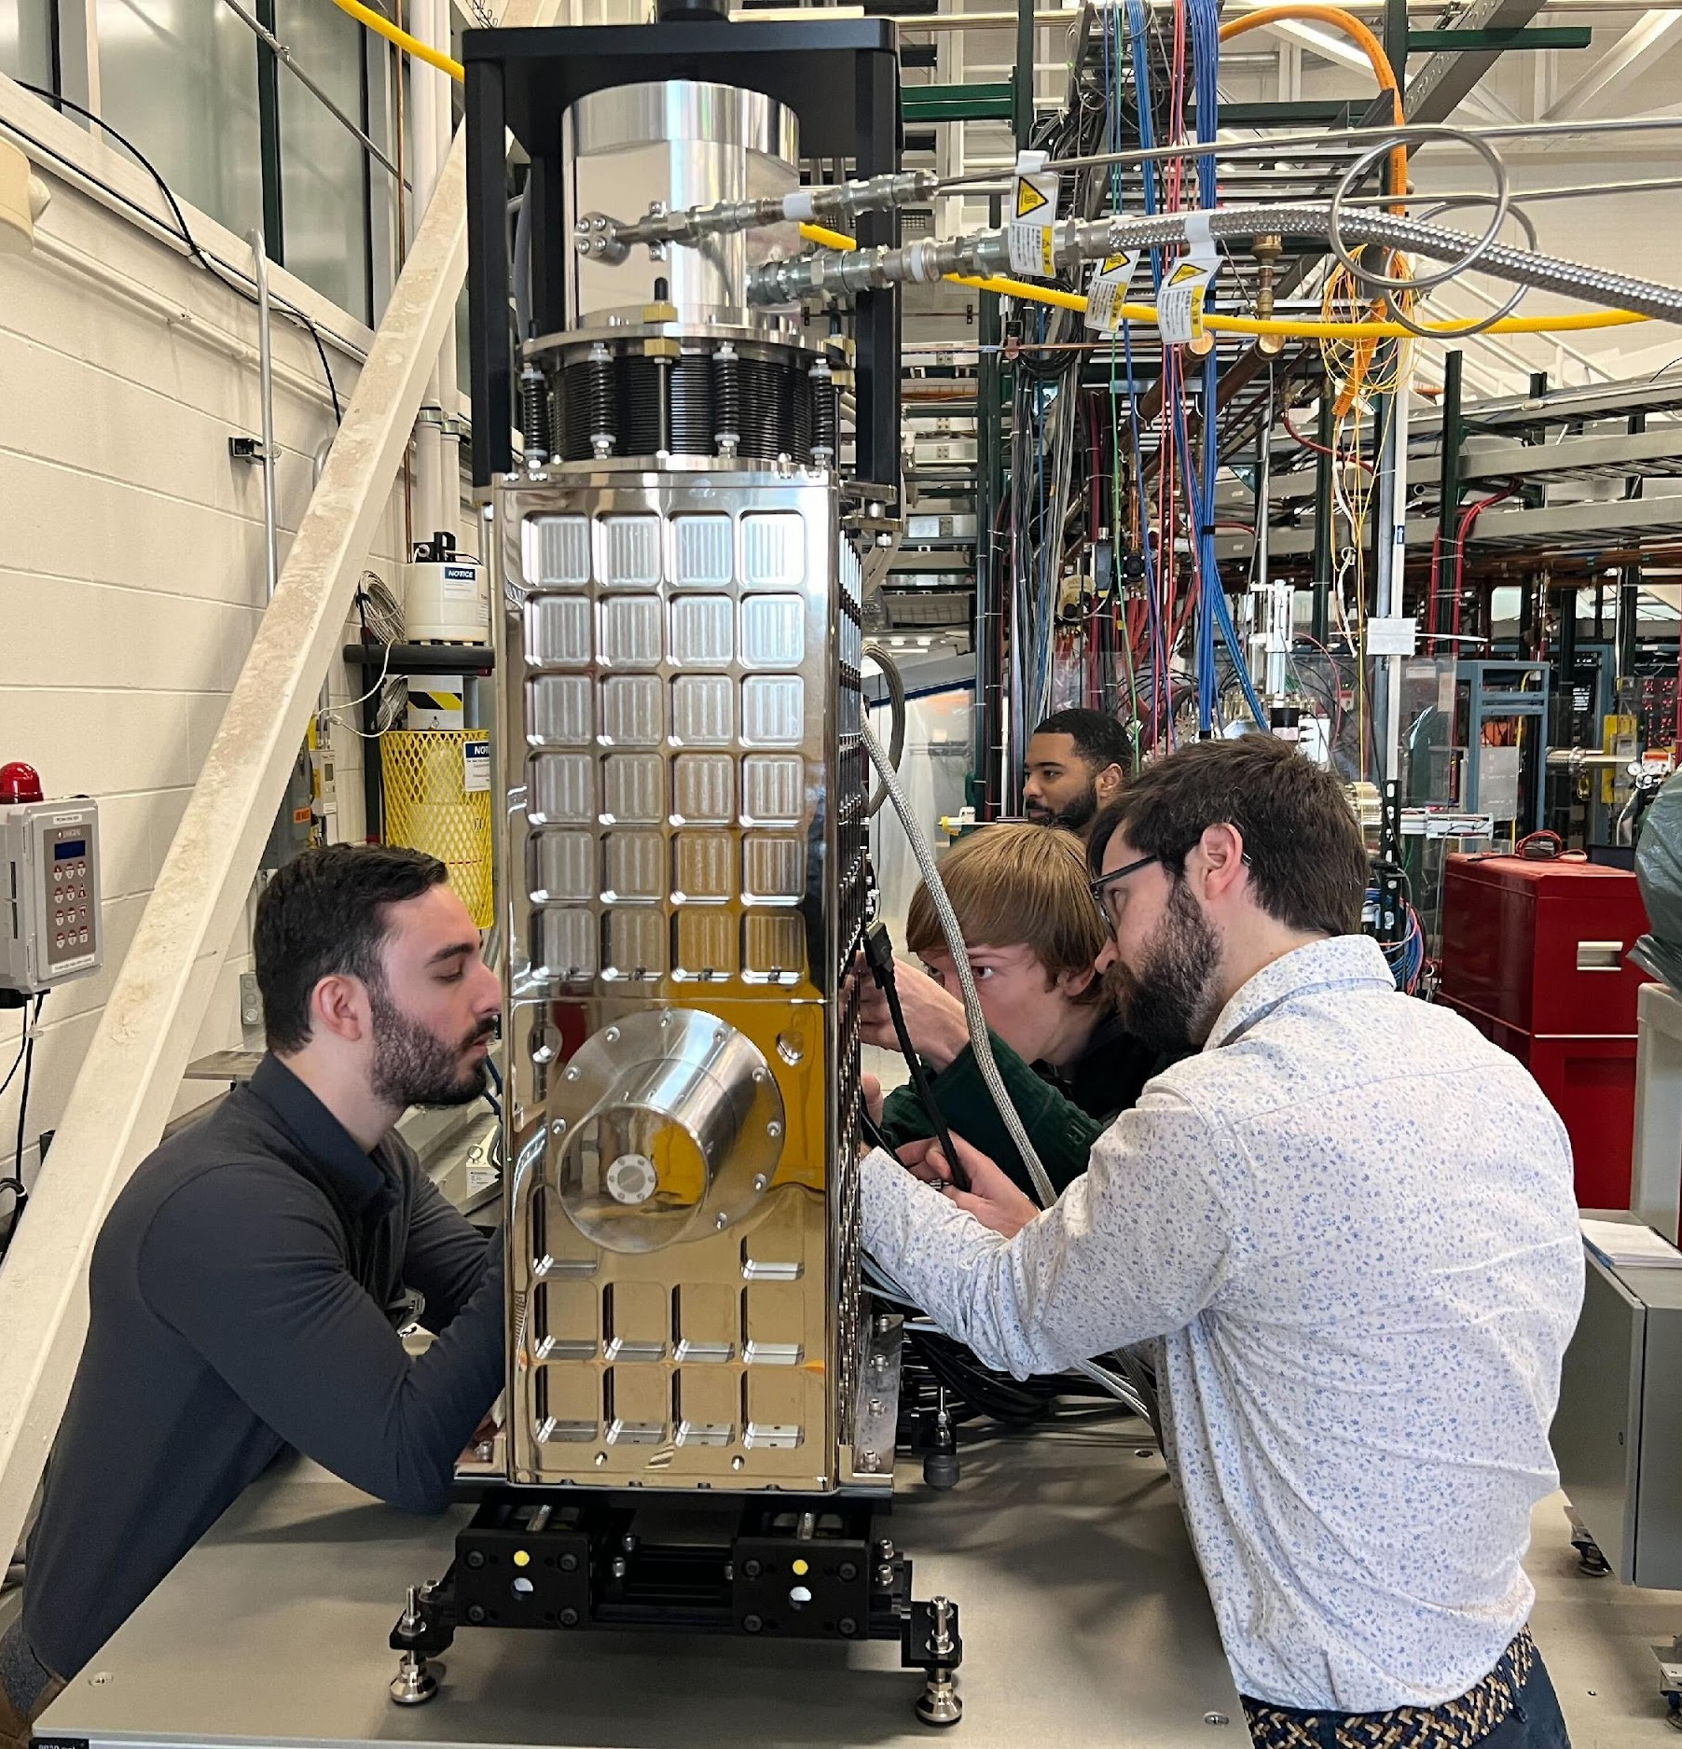
SALER commissioning: First light April 2024
March 2025: Successful calibration, first beam Q1 2026 at FRIB

Slide 13
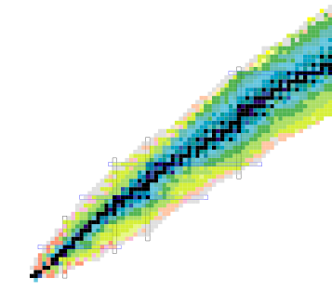
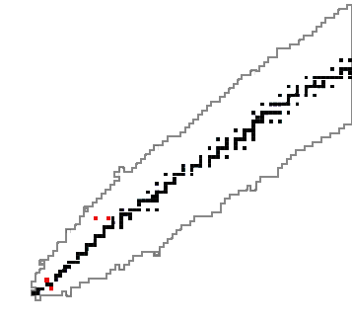
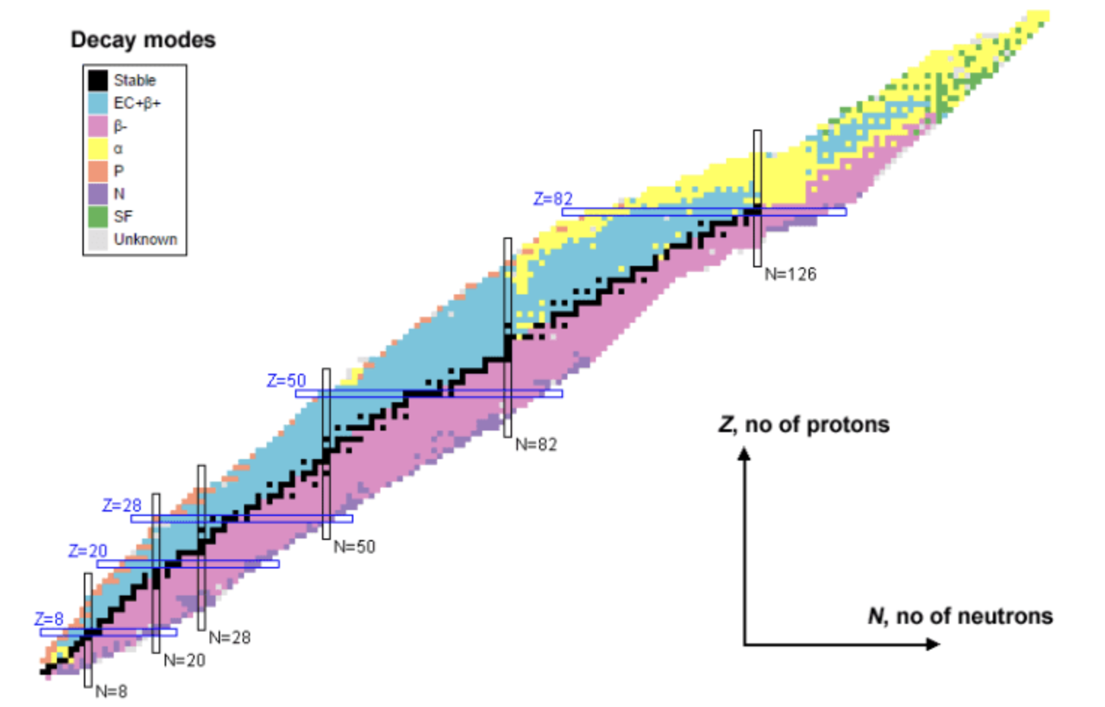
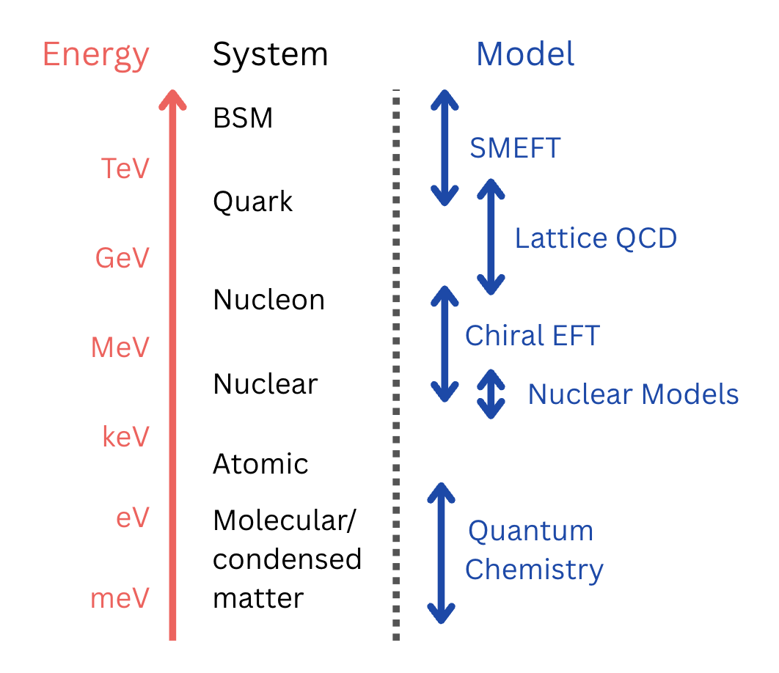
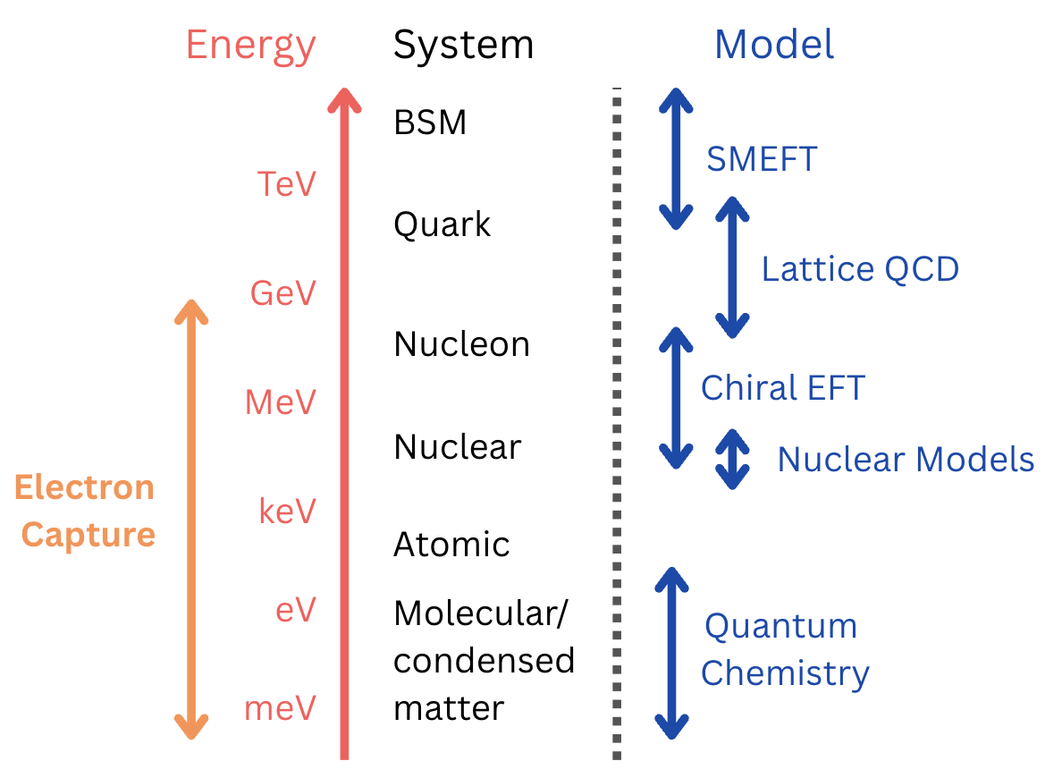
Recoil spectroscopy: broader scope
Out of thousands of known radioactive transitions,
only handful measured recoiling nucleus
Out of thousands of known radioactive transitions,
only handful measured recoiling nucleus
Coherent multi-scale framework
(QCD Chemistry) is crucial, but missing
Recoil: Access to electron capture &
electronic environment

Slide 14

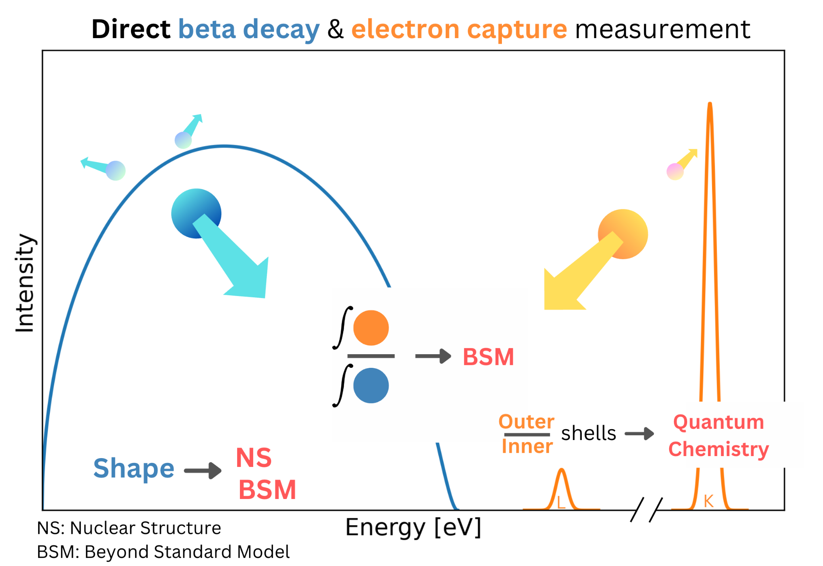
ASGARD: Principle
Perform full spectroscopy of short-lived isotopes with quantum sensors
Two novel measurement schemes:
I: EC/B+ Branching ratio
II: B+ shape
probe new physics at tens of TeV in completely new way
See V. Dumenil poster

Slide 15
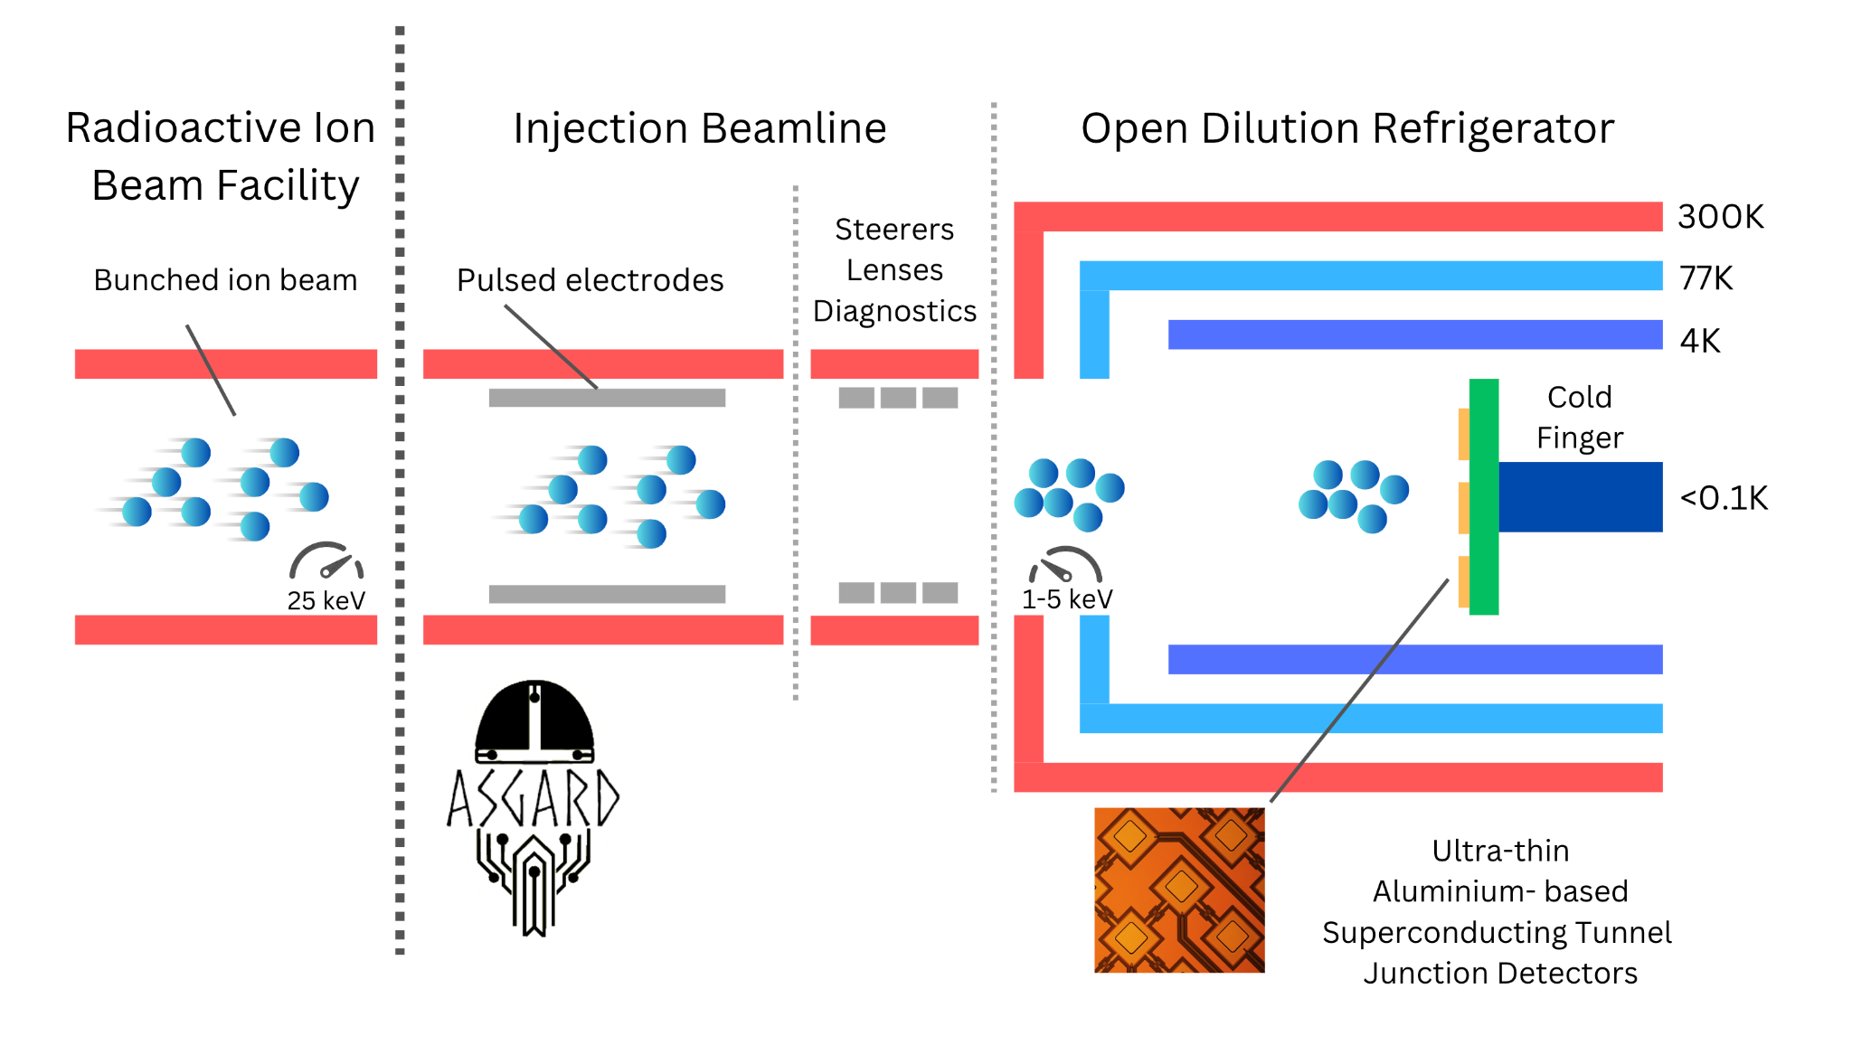

ASGARD: Methodology
Combination of expertise in beta decay and technical innovations
Orders of magnitude improvement in systematic effects and efficiency

Slide 16
ASGARD: Methodology
Key #1: Windowless dilution fridge
Full access to nuclear chart
Key #2: Ultrathin Al-STJs
x100 reduced scattering
Key #3: Injection beam line
Extremely precise implantation
Together world-first precision device

Slide 17
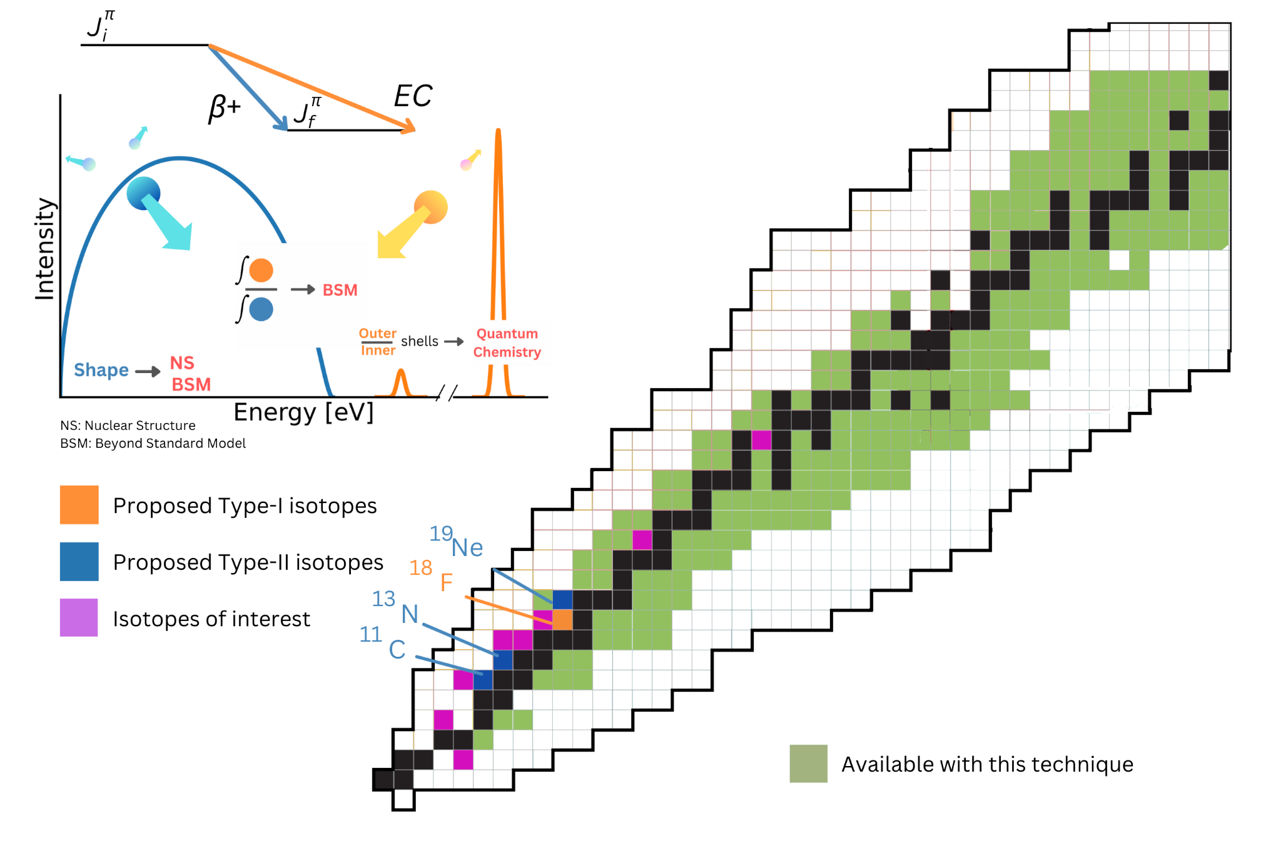
ASGARD: Reach
Complementary high-impact isotopes for BSM
Unlock hundreds of isotopes for study
Nuclear structure
Auger spectroscopy
Completely unexplored variable

Slide 18
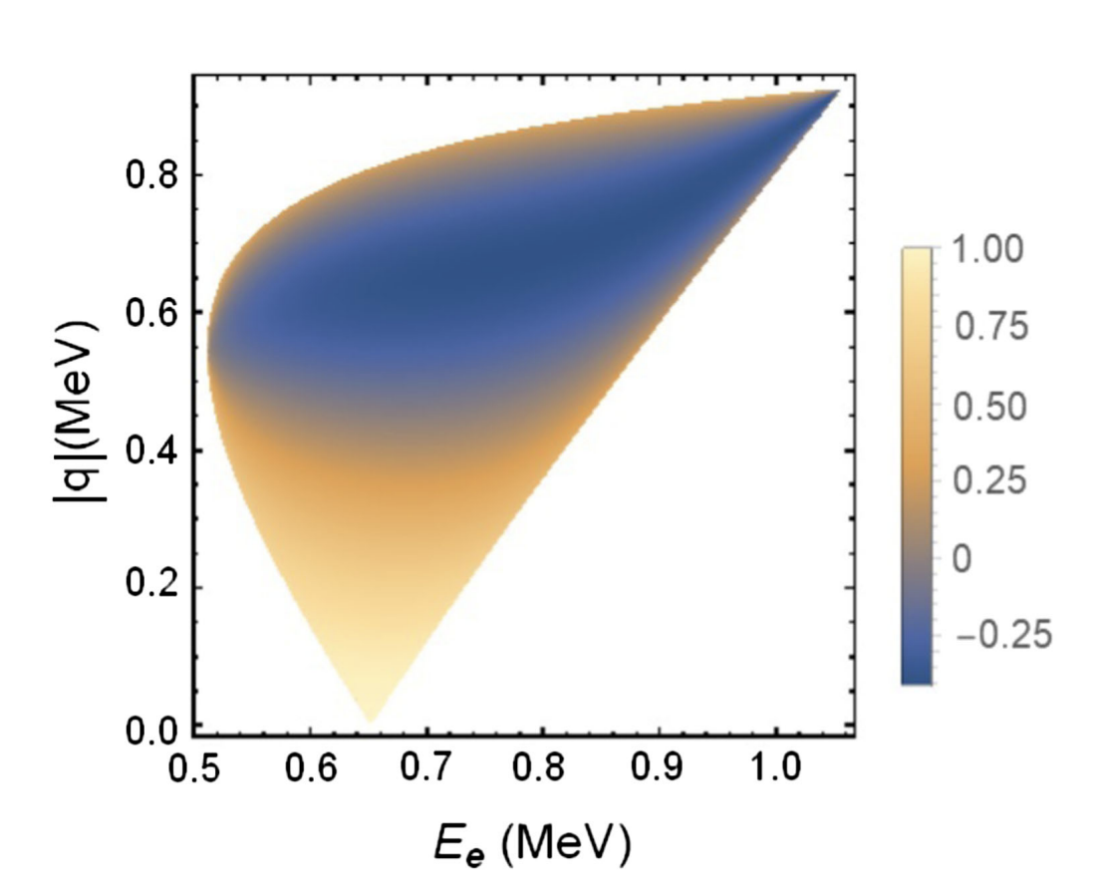
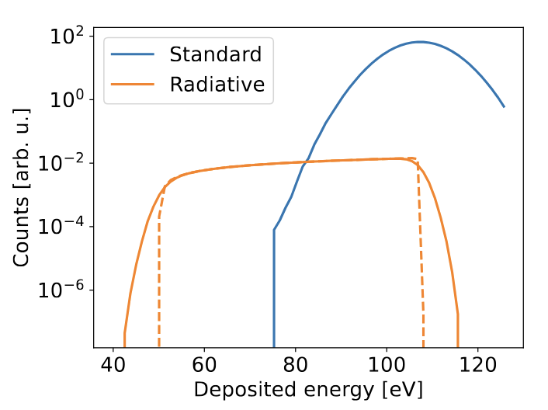
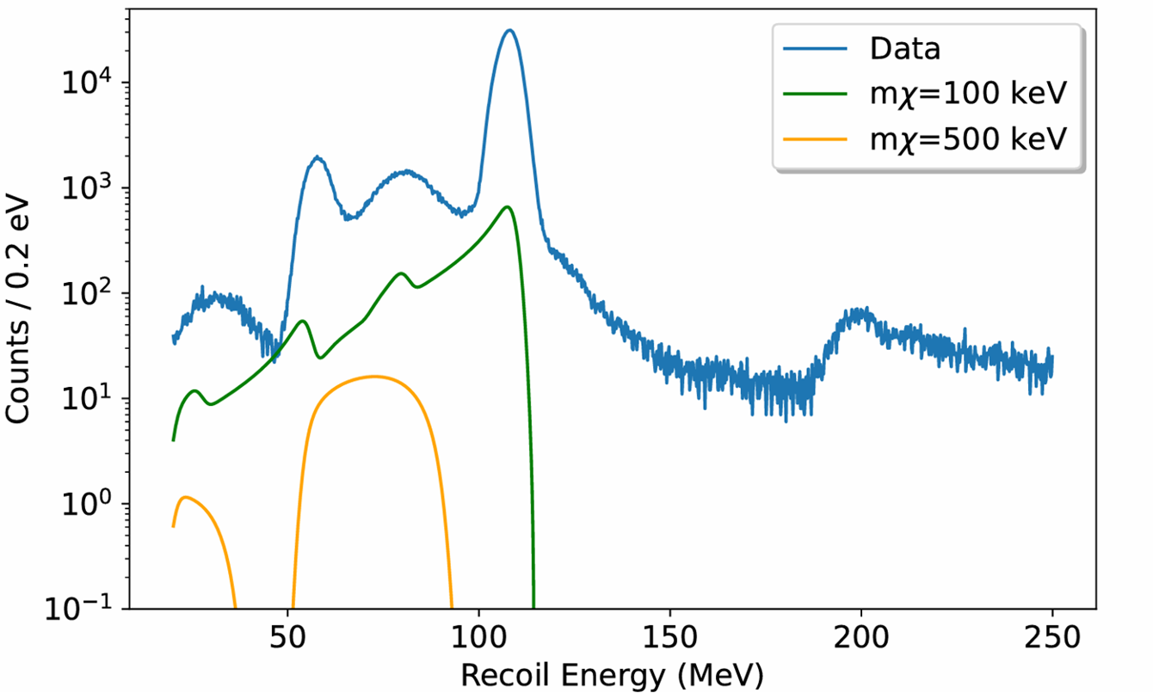
On the horizon
Majoron (and generic 3-body)
searches
First radiative EC recoil spectrum measurements
(B)SM and radiative corrections in forbidden decays?
several more..
Seng, Glick-Magid, Cirigliano PRL 134, 081805 (2025)

Slide 19
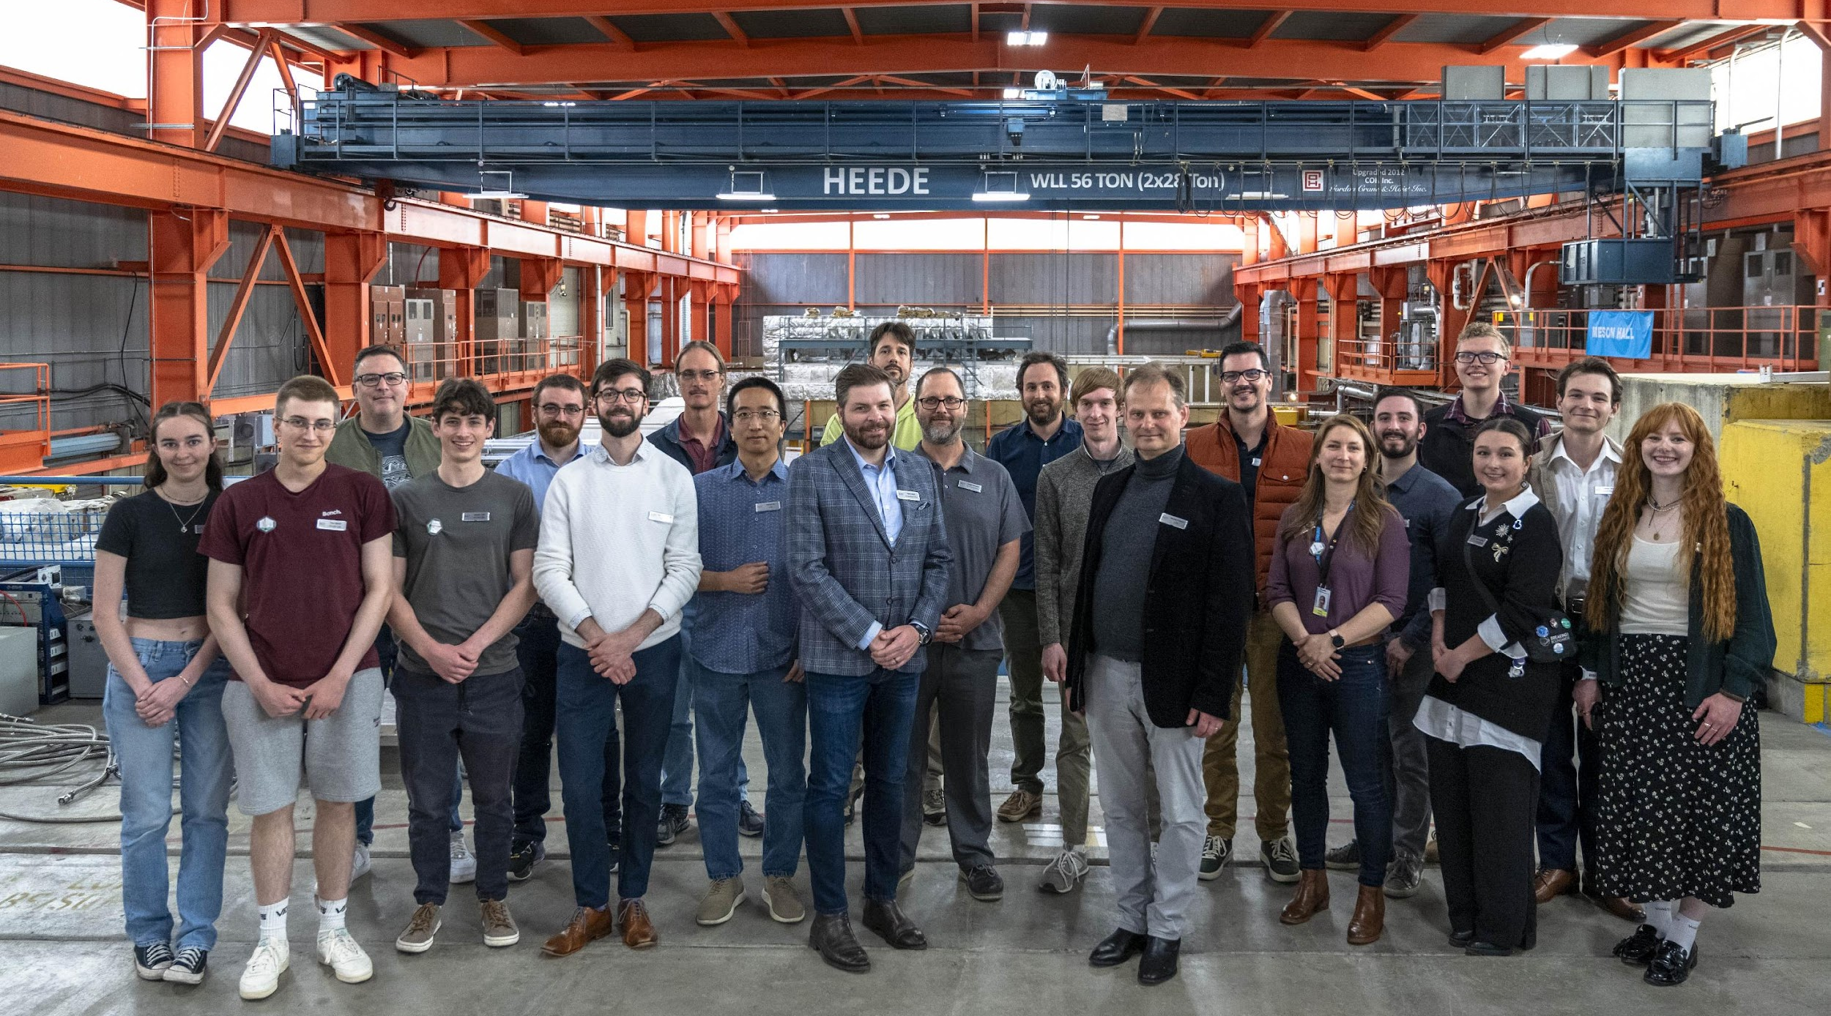









The BeEST Collaboration
2025 Collaboration Meeting
TRIUMF, Canada
CEA Paris-Saclay
Colorado School of Mines
Lawrence Livermore National Laboratory
LPC Caen
McGill University
McMaster University
NOVA School of Science and Technology
Pacific Northwest National Laboratory
SLAC National Accelerator Laboratory
Star Cryoelectronics LLC
TRIUMF
Université Strasbourg
XIA LLC
Yale University

Slide 20

Conclusions
Cryogenic quantum sensors open up a new window into fundamental symmetries, fast sensors like Superconducting Tunnel Junctions allow for precision tests
BeEST Phase-III data unblinding soon, several Dark Matter(-like) searches in parallel
SALER will perform first online measurements of short-lived isotopes
Open up the nuclear chart and enter precision domain with ASGARD

Slide 21
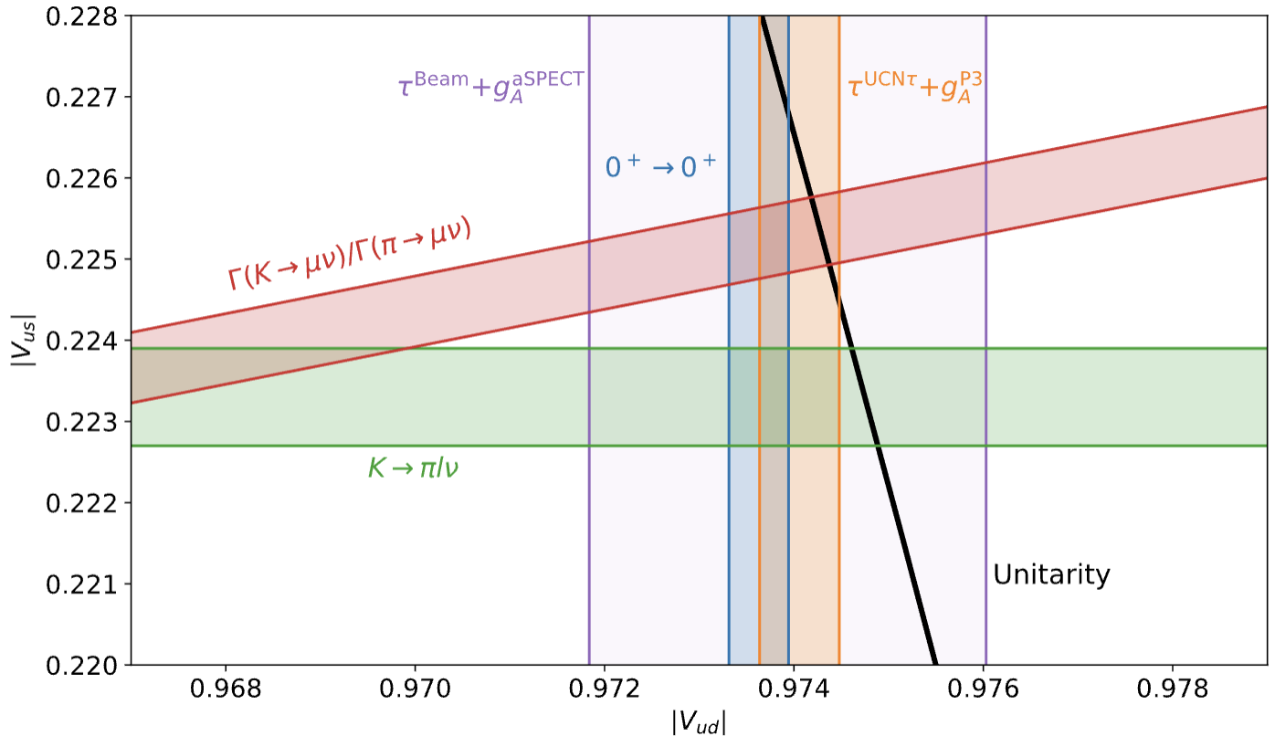
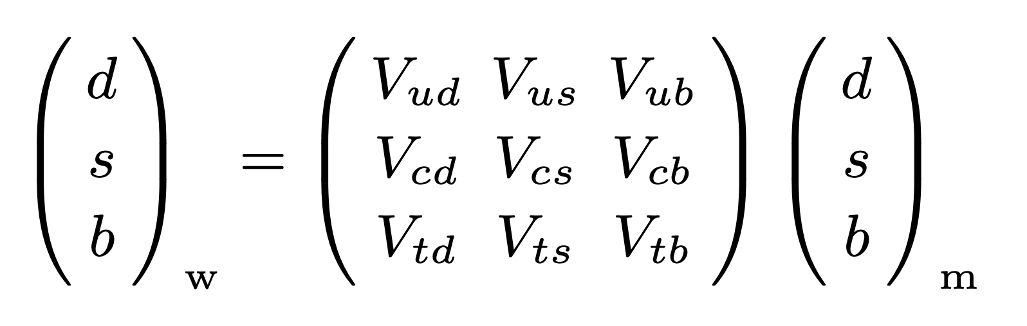
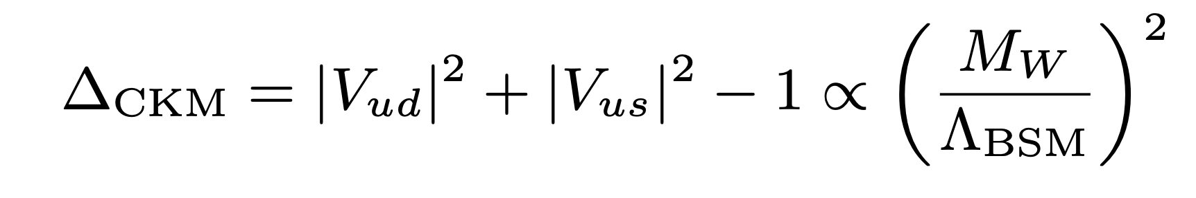
CKM unitarity in the Standard Model
Quark mixing means
and unitarity requirement
is an independent probe for BSM
Situation right now is ‘complicated’:
talks by Alejandro Garcia, John Behr, Leah Broussard, …
LH, ARNPS 74 (2024) 497
LH et al., RMP 90 (2018) 015008

Slide 22
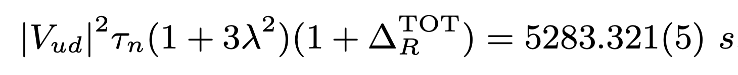
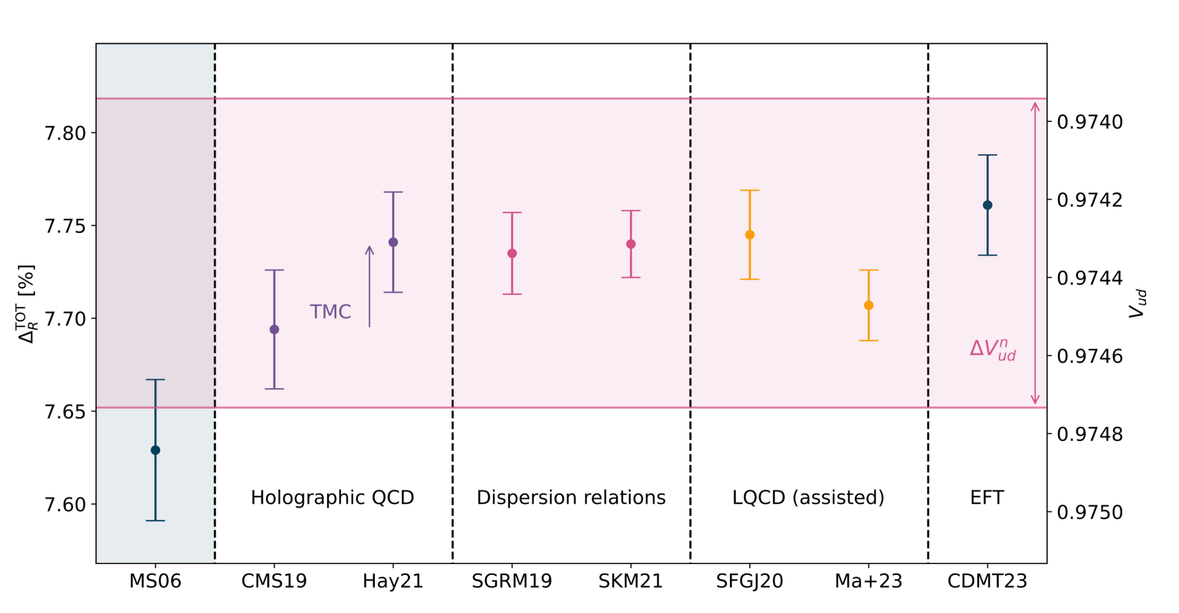
CKM unitarity in the Standard Model: Theory progress
Theory has undergone enormous change in last 10 years
Much work to be done, but path forward on nuclear side
LH, ARNPS 74 (2024) 497

Slide 23
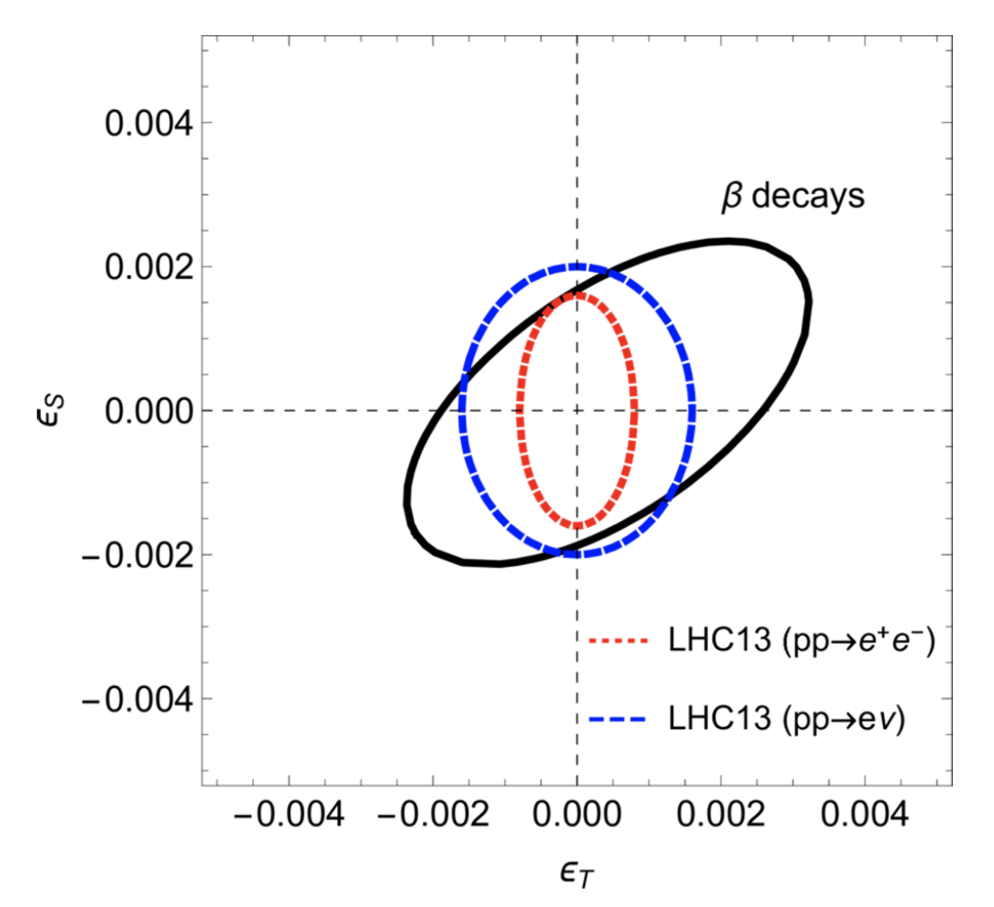
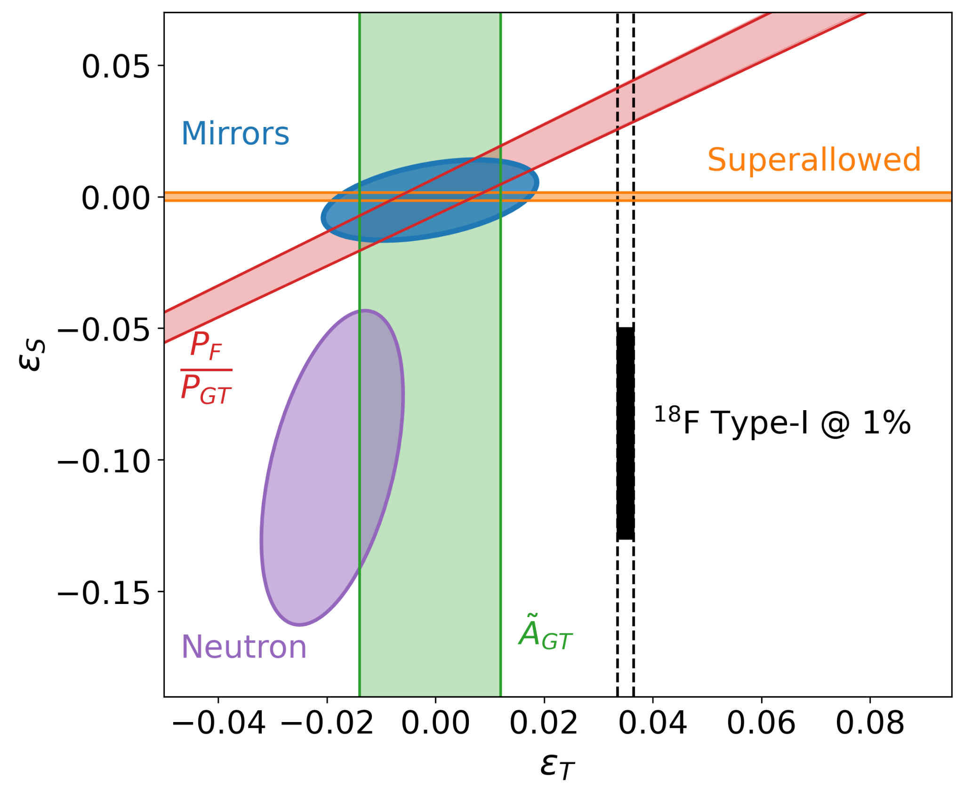
Exotic current constraints

Slide 24
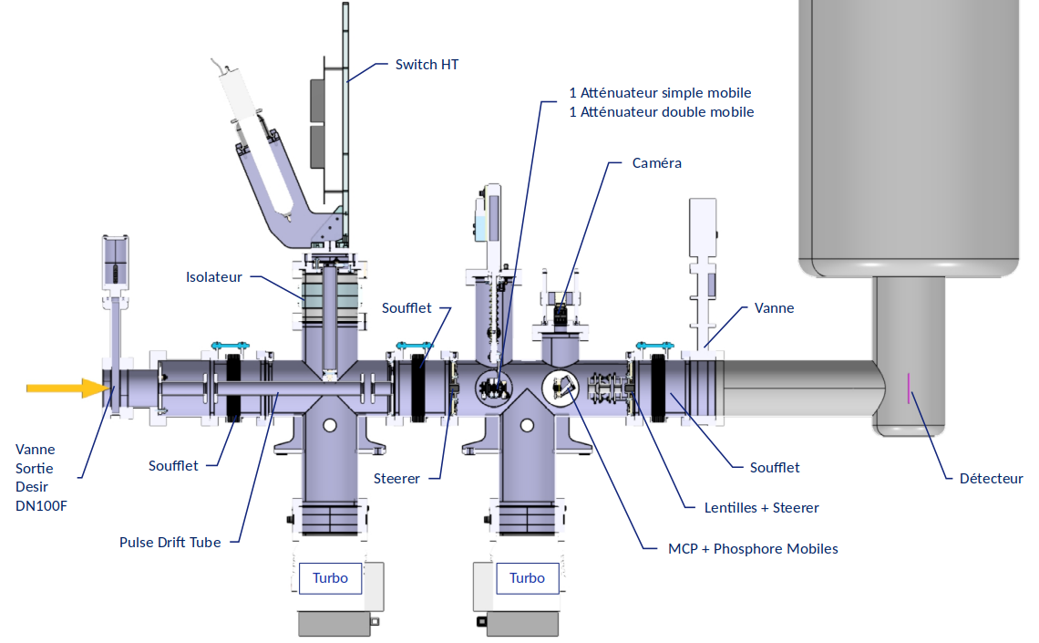
Setup geometry
Relatively compact
(~3m length, 2.5m height)
Closed cooling circuits
Besides PDT, all at ground potential

Slide 25
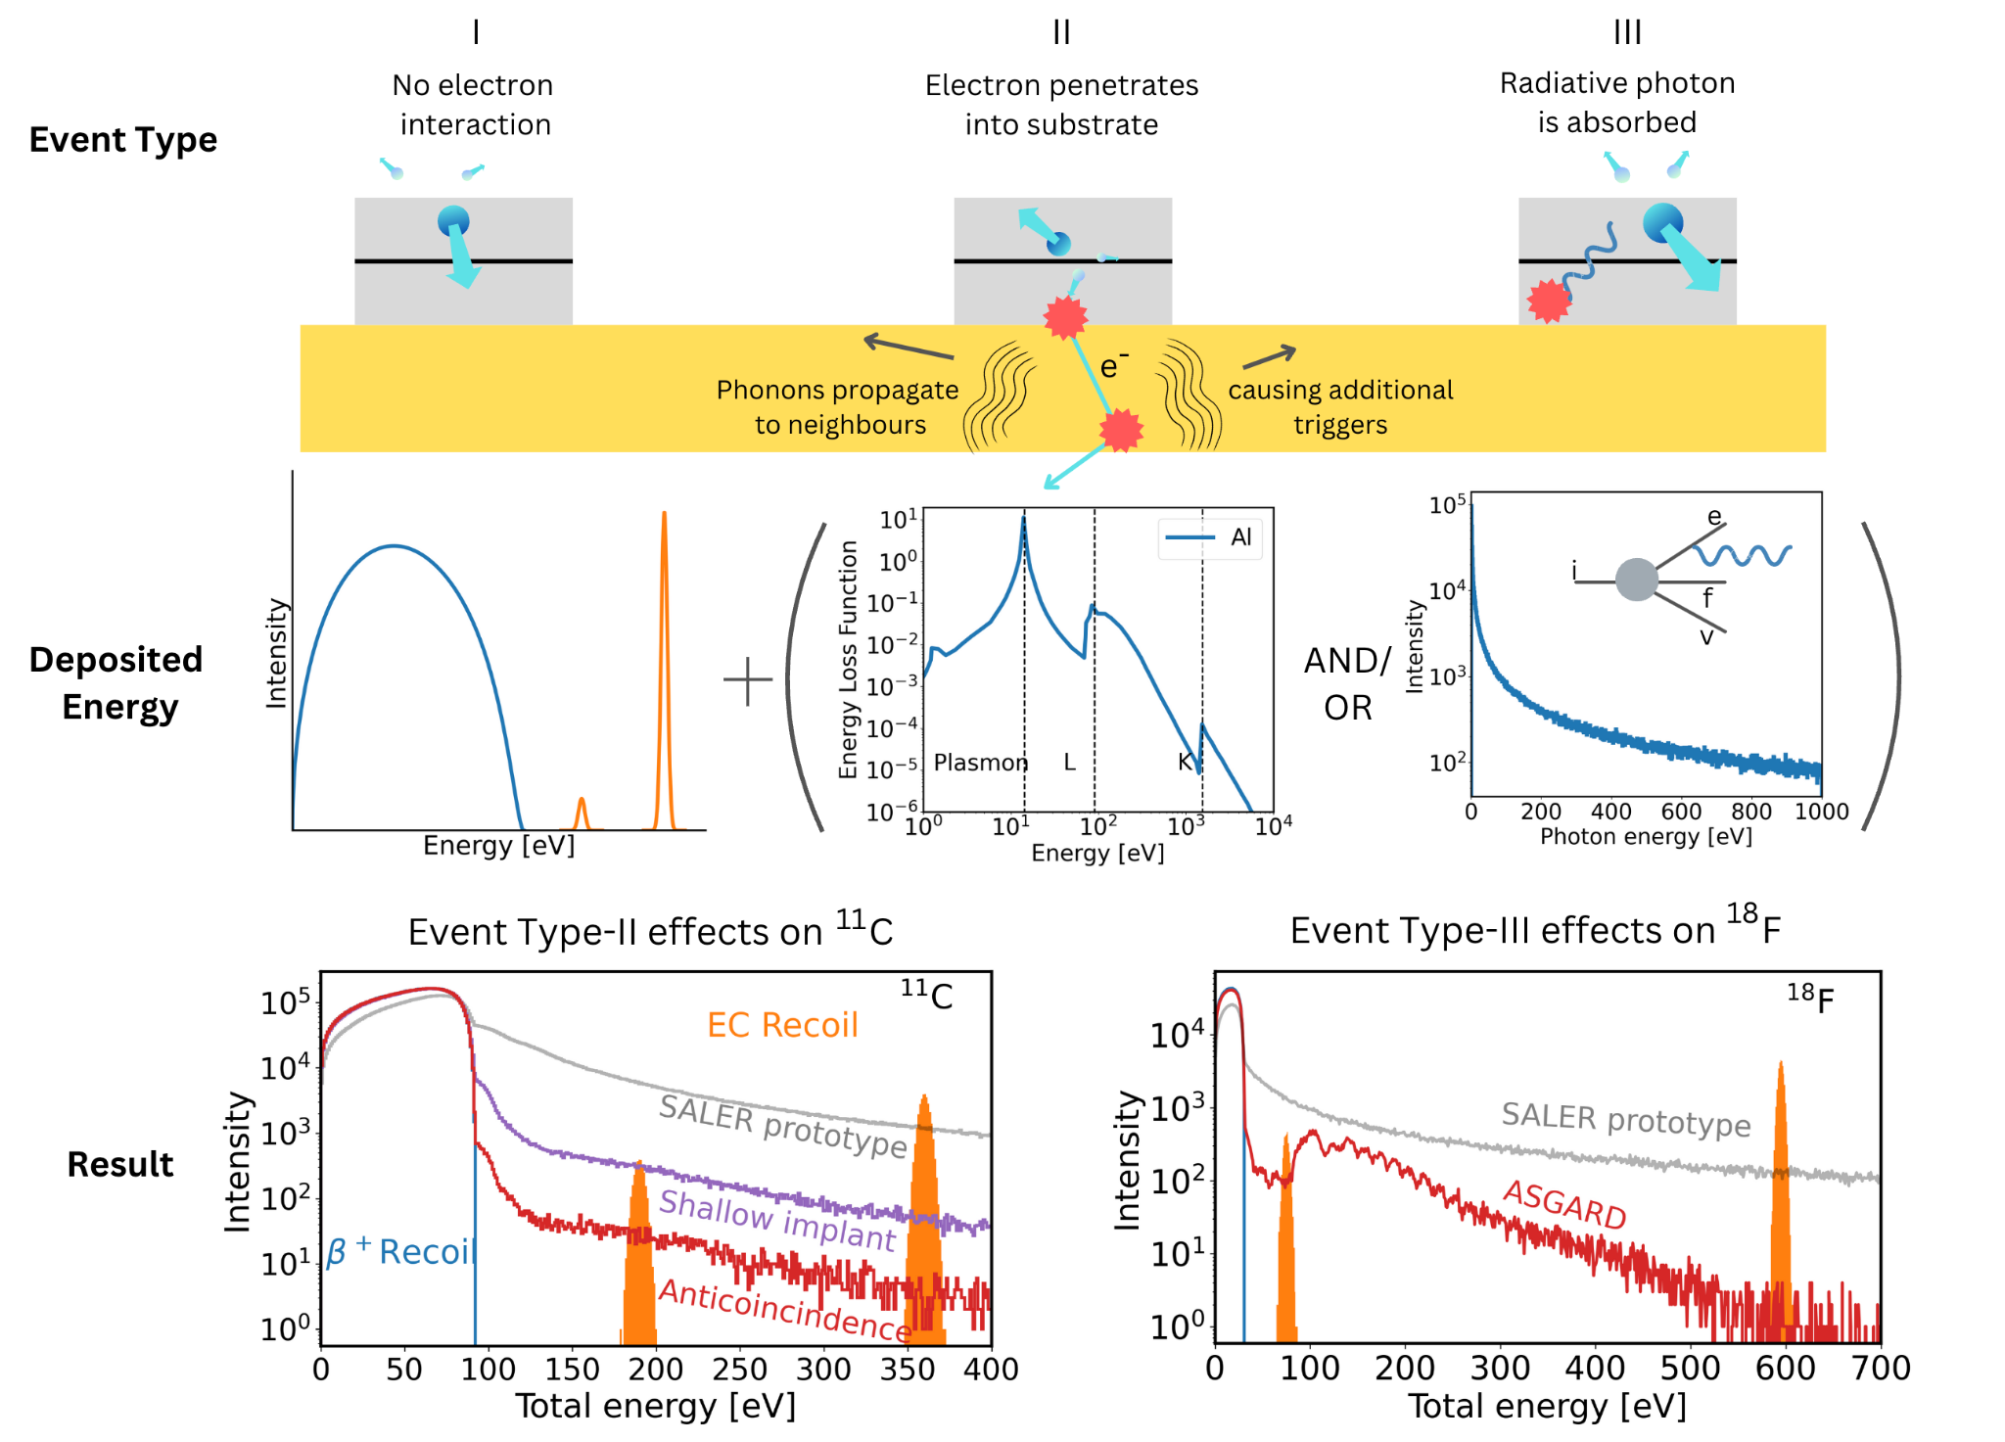

Systematics improvement
Anticipated systematic uncertainties on at or below 0.01% due to scattering

