Slide 1

First measurement of a charge-exchange reaction cross-section for antihydrogen production Sarah GEFFROY – IJCLab on behalf of the GBAR collaboration

Slide 2
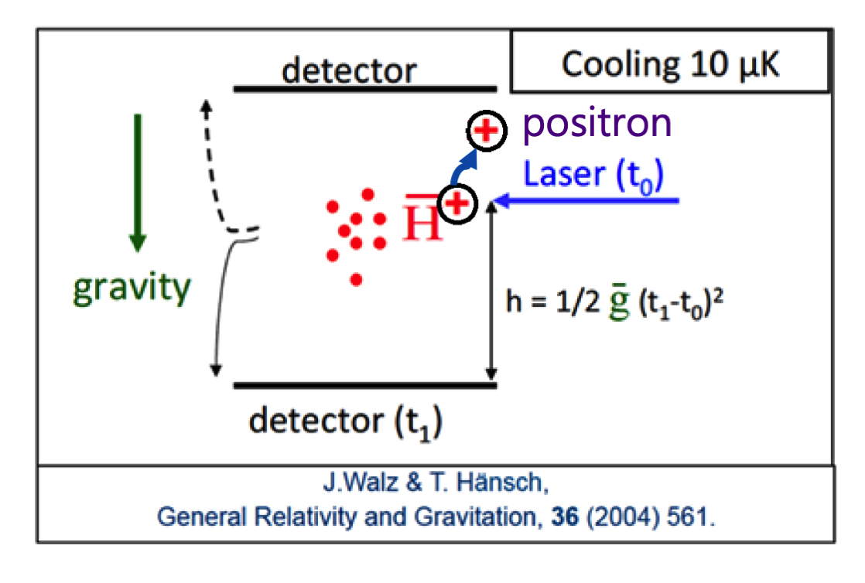
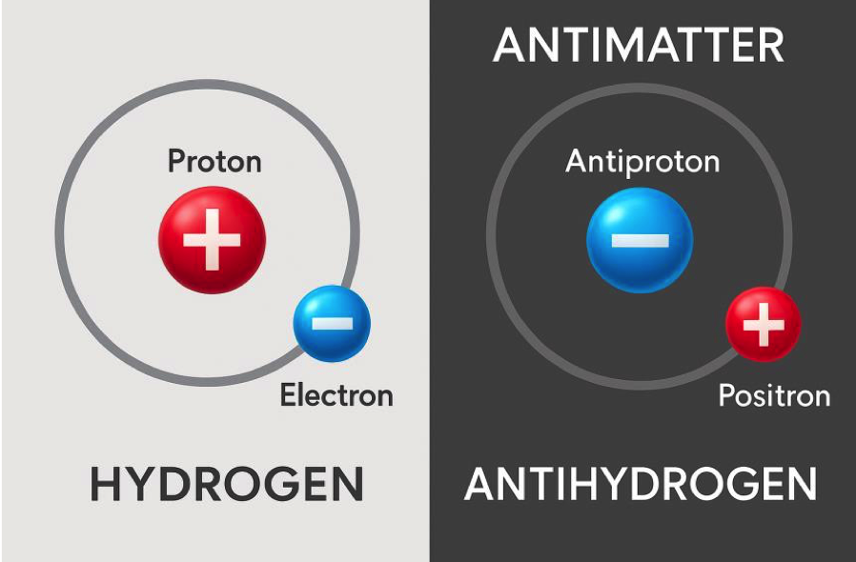
The GBAR experiment
Gravitational Behavior of Antihydrogen at Rest
Antihydrogen is antimatter
Do matter and antimatter fall the same way?
Study of a free-fall of an antihydrogen atom.

Slide 3
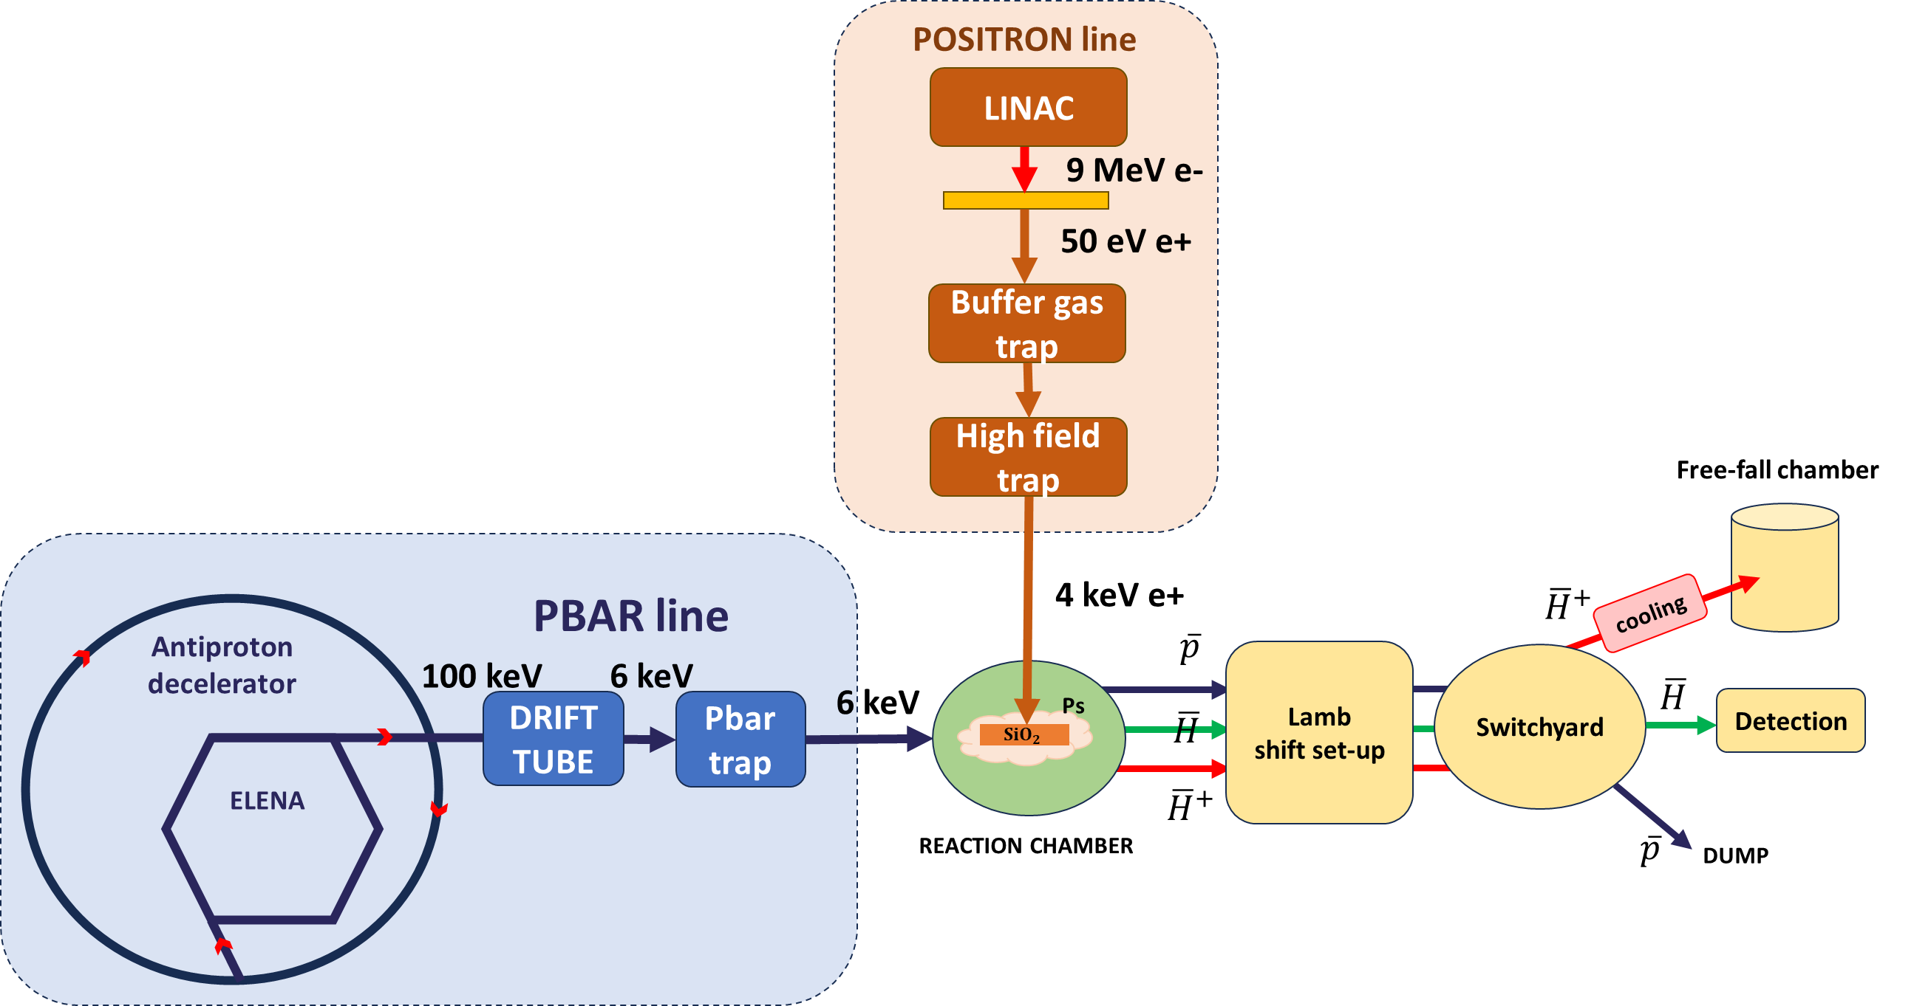
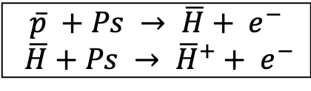
The GBAR experiment
Two successive charge-exchange reactions:
$$\overline{p} +Ps → \overline{H}+ e^{−}$$
$$\overline{H}+Ps → {\overline{H}}^{+}+ e^{−}$$
General scheme of the experiment

Slide 4
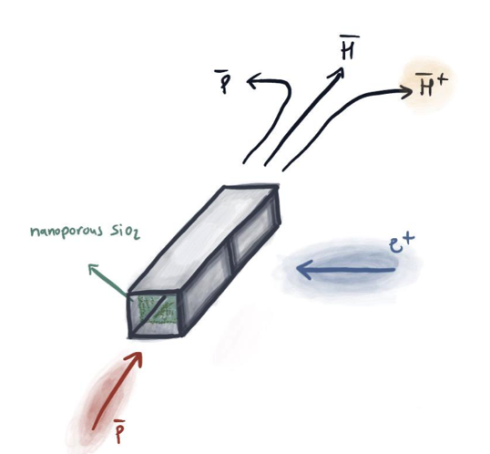
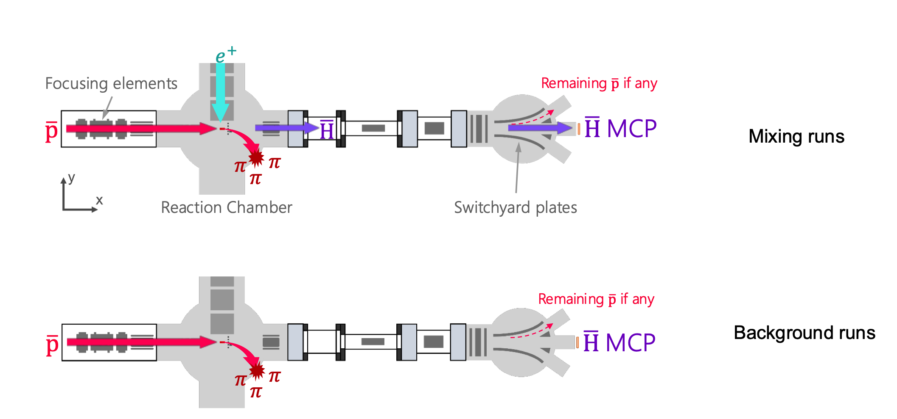
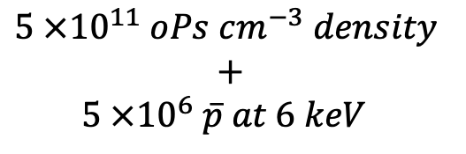

Antihydrogen production
MIXING
BACKGROUND
$$5 ×{10}^{11} oPs cm^{−3} density$$
$$+$$
$5 ×{10}^{6} \overline{p} at 6 keV$
$$0.5 \overline{H}$$
P. Pérez & A. Rosowsky, Nucl. Inst. Meth. A 532, 523 (2004)

Slide 5
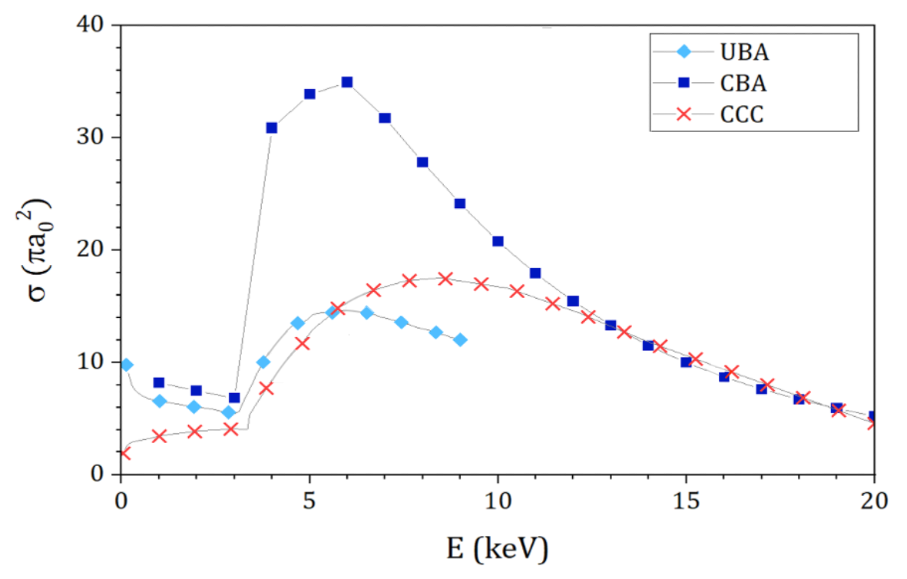
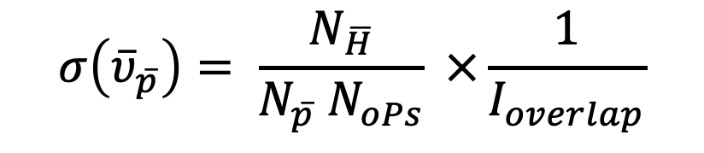
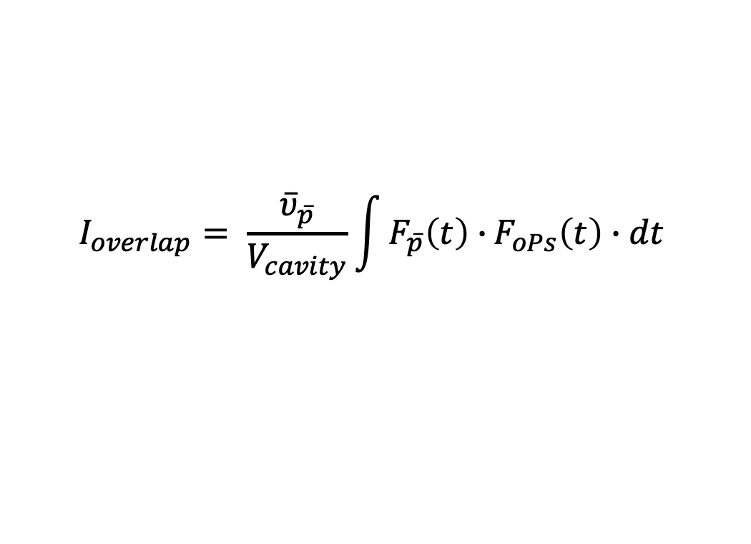

Cross-section measurement
Number of antihydrogen atoms produced
$$σ\left({\overline{υ}}_{\overline{p}}\right)= \frac{N_{\overline{H}}}{N_{\overline{p}} N_{oPs}} ×\frac{1}{I_{overlap}}$$
Number of antiprotons sent
Overlap between $\overline{p } \& oPs$
Number of orthopositronium
$$I_{overlap}= \frac{{\overline{υ}}_{\overline{p}}}{V_{cavity}}\int{F_{\overline{p}}\left(t\right)∙}F_{oPs}\left(t\right)∙dt$$
Theory predictions for the cross-section

Slide 6
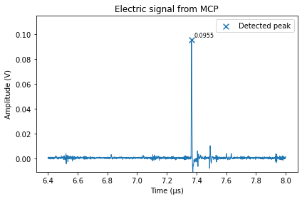
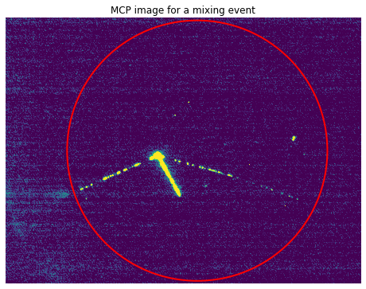

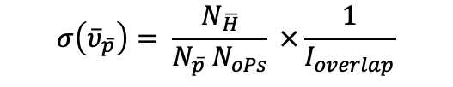
Cross-section measurement
$$σ\left({\overline{υ}}_{\overline{p}}\right)= \frac{N_{\overline{H}}}{N_{\overline{p}} N_{oPs}} ×\frac{1}{I_{overlap}}$$
$N_{\overline{H}} :$Number of antihydrogen atoms produced

Slide 7
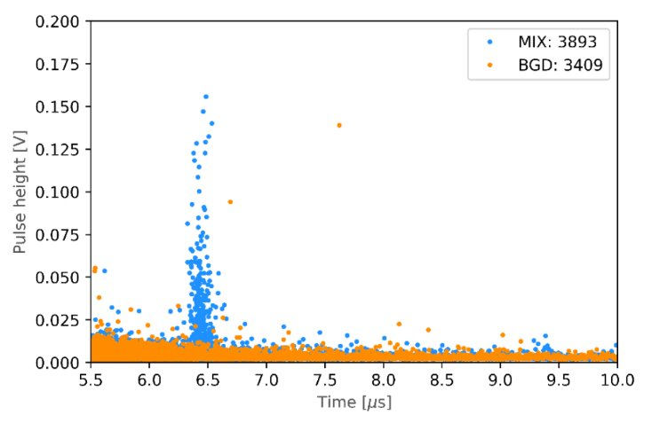
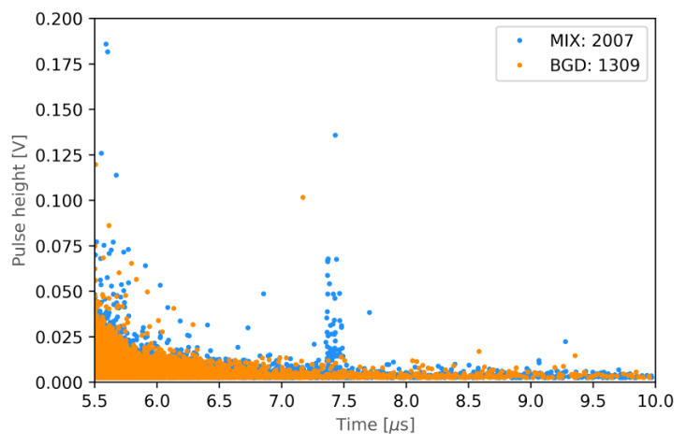
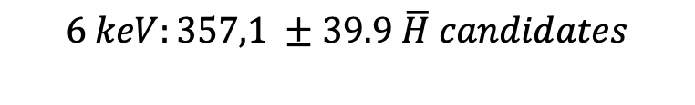
Cross-section measurement
$$σ\left({\overline{υ}}_{\overline{p}}\right)= \frac{N_{\overline{H}}}{N_{\overline{p}} N_{oPs}} ×\frac{1}{I_{overlap}}$$
$N_{\overline{H}} :$Number of antihydrogen atoms produced
$$6 keV:357,1 ±39.9 \overline{H} candidates$$
$$4 keV :76.8 ±18.5 \overline{H} candidates$$
PRELIMINARY
PRELIMINARY

Slide 8
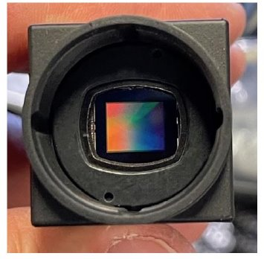

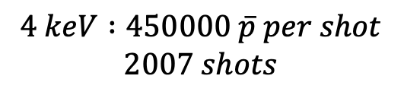
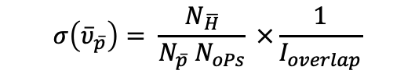
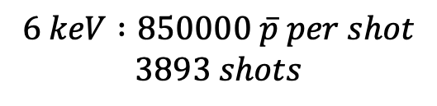
Cross-section measurement
$$σ\left({\overline{υ}}_{\overline{p}}\right)= \frac{N_{\overline{H}}}{N_{\overline{p}} N_{oPs}} ×\frac{1}{I_{overlap}}$$
$N_{\overline{p}} :$Number of antiprotons
$$Number of tracks on CMOS sensor →Number of \overline{p} going through the cavity$$
CMOS sensor
CMOS hit per antiproton annihilation on target estimated by GEANT IV
simulation and cross-checked with ELENA numbers from beam monitor.
Back-scattering of antiprotons on MCP studied and estimated (8%).
$$6 keV :850000 \overline{p} per shot$$
$$3893 shots$$
$$4 keV :450000 \overline{p} per shot$$
$$2007 shots$$

Slide 9
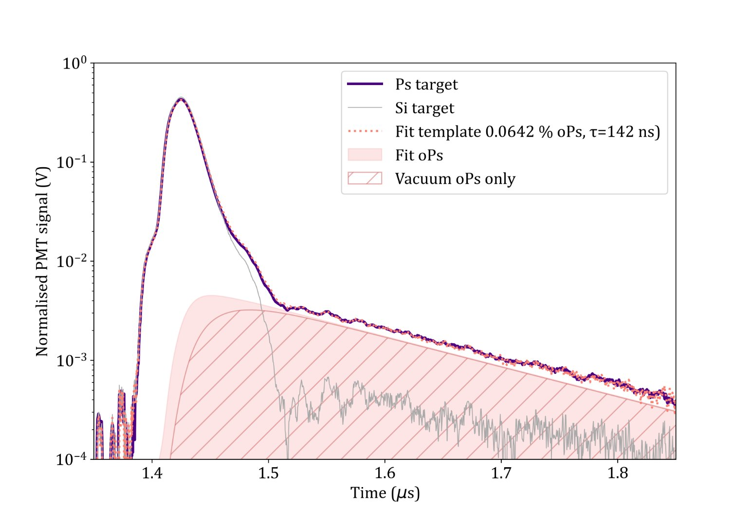



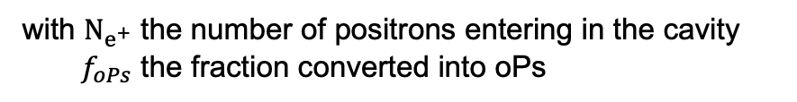
Cross-section measurement
$$σ\left({\overline{υ}}_{\overline{p}}\right)= \frac{N_{\overline{H}}}{N_{\overline{p}} N_{oPs}} ×\frac{1}{I_{overlap}}$$
$N_{oPs} :$ Average number of orthopositronium
$$N_{oPs}={ f}_{oPs}N_{e^{+}}$$
with $N_{e^{+}}$ the number of positrons entering in the cavity
$f_{oPs}$ the fraction converted into oPs
$$6 keV :8,69 ×{10}^{6} oPs$$
$$4 keV :9,26 ×{10}^{6} oPs$$

Slide 10
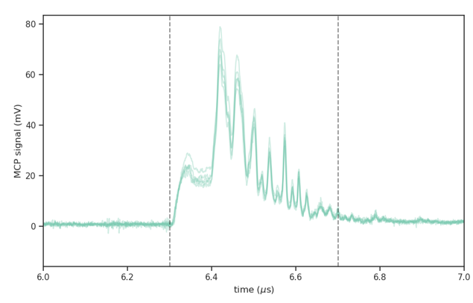
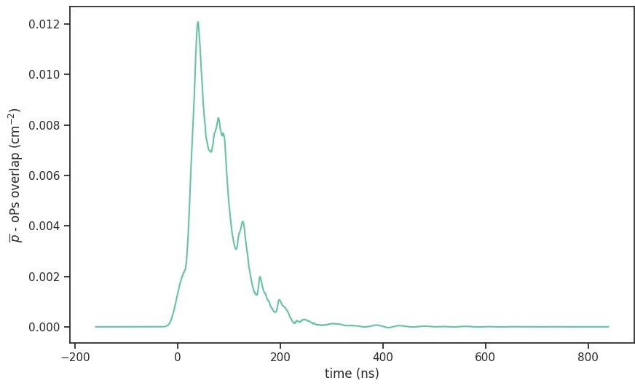

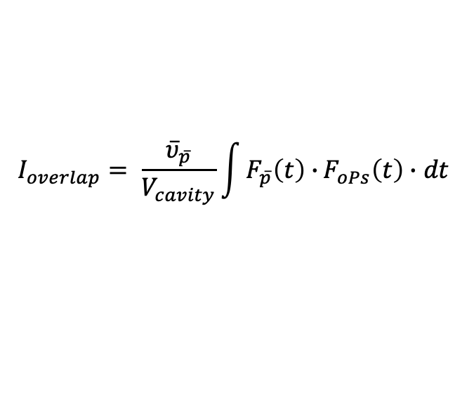

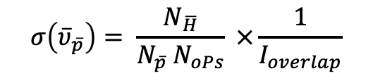
Cross-section measurement
$$σ\left({\overline{υ}}_{\overline{p}}\right)= \frac{N_{\overline{H}}}{N_{\overline{p}} N_{oPs}} ×\frac{1}{I_{overlap}}$$
$$I_{overlap}= \frac{{\overline{υ}}_{\overline{p}}}{V_{cavity}}\int{F_{\overline{p}}\left(t\right)∙}F_{oPs}\left(t\right)∙dt$$
Antiproton pulse
oPs pulse
$$6 keV :9,39 cm^{−2}$$
$$4 keV :9,18 cm^{−2}$$

Slide 11
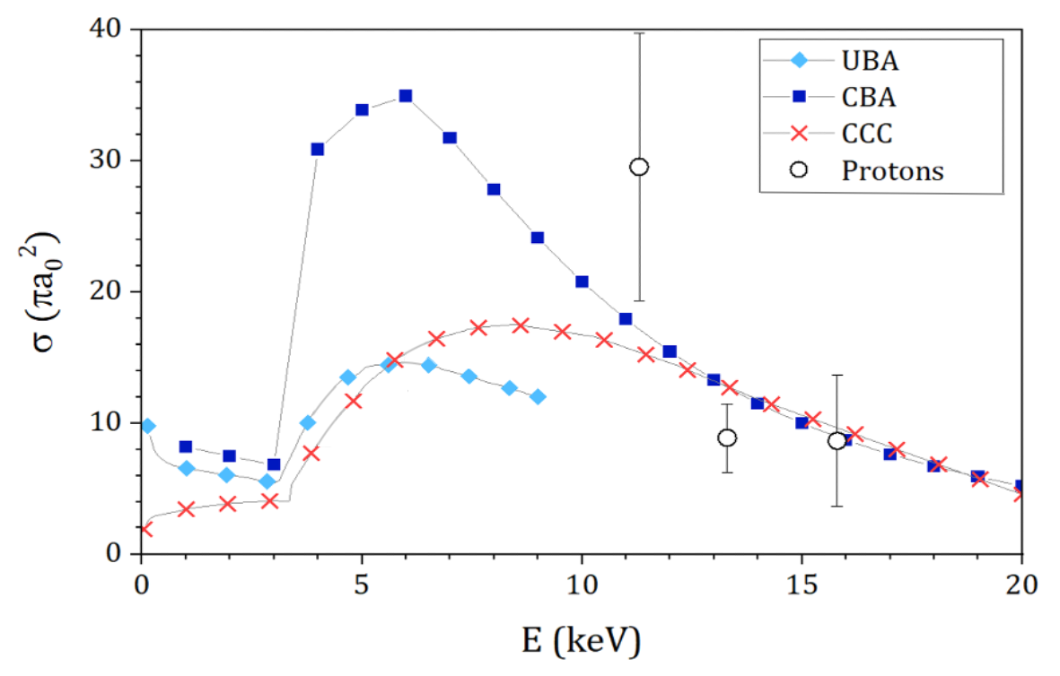
Cross-section measurement
UBA: J. Mitroy, PRA 52, 2859 (1995)
CBA: K. Lévêque-Simon and P.A. Hervieux, PRA 107, 052813 (2023)
CCC: C. M. Rawlins et al., PRA 93, 012709 (2016)
Protons: Merrison, J.P., et al.: Phys.
Rev. Lett. 78, 2728–2731 (1997)

Slide 12
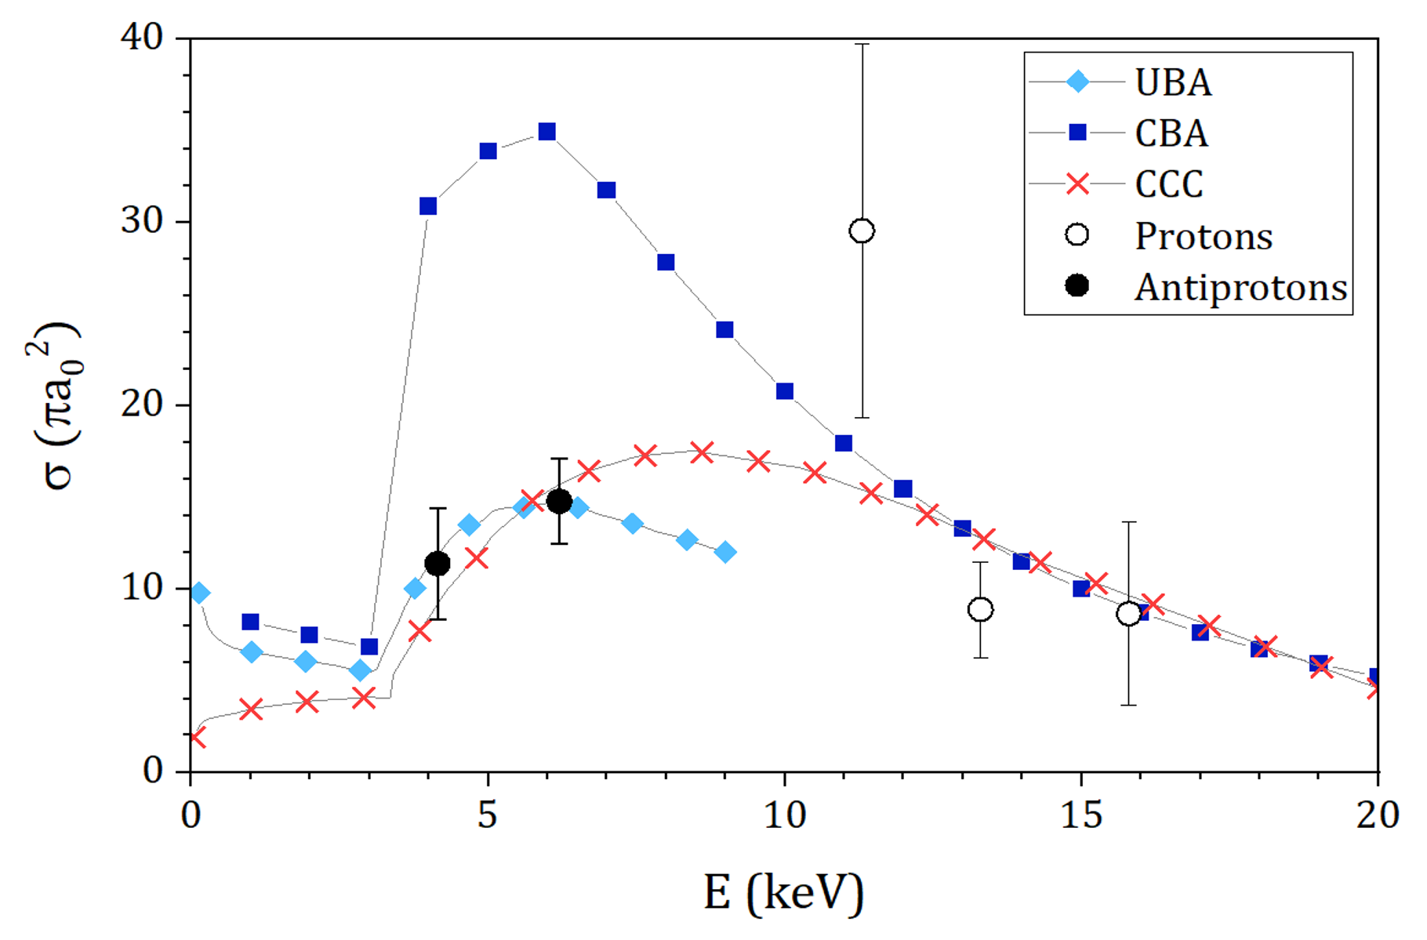
Cross-section measurement
UBA: J. Mitroy, PRA 52, 2859 (1995)
CBA: K. Lévêque-Simon and P.A. Hervieux, PRA 107, 052813 (2023)
CCC: C. M. Rawlins et al., PRA 93, 012709 (2016)
PRELIMINARY
Protons: Merrison, J.P., et al.: Phys.
Rev. Lett. 78, 2728–2731 (1997)

Slide 13
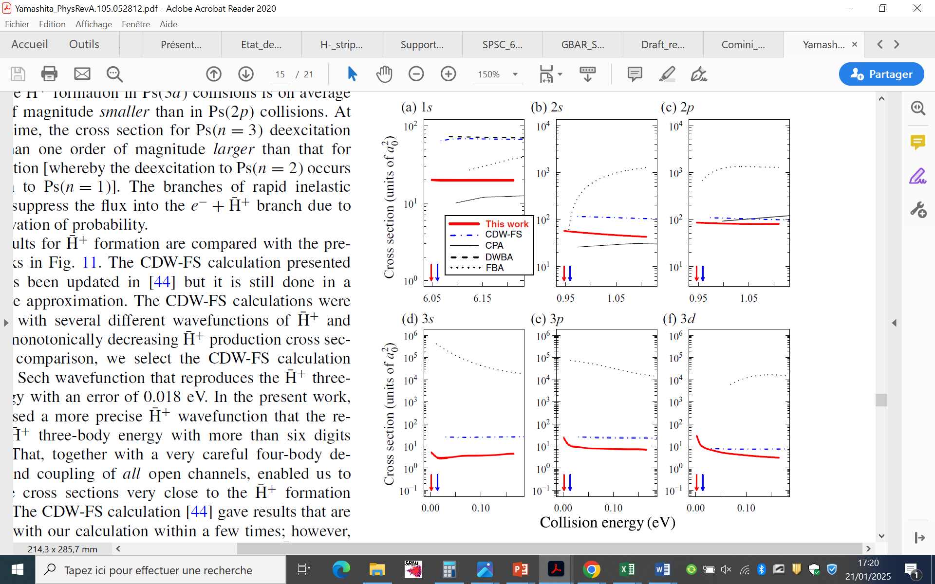







Second charge-exchange reaction: SPHINX project
Antimatter :
$\overline{H}+Ps → {\overline{H}}^{+}+e^{−}$
Matter :
$$H+Ps →H^{−}+e^{+}$$
e⁺
Neutralisation
Charge
separation
$$H^{−}$$
$$H$$
MCP-p5
$$H$$
Target
$$H^{−}$$
Ps Cavity
$$H^{−}$$
Quad-Triplet
Reaction
Chamber
Switchyard plates
MCP-p6
Photodetachment laser
Adapted from: Yamashita et al.,
Phys Rev A 105, 052812 (2022)

Slide 14
















Many thanks to you for your attention
&
to the GBAR collaboration

Slide 15


Cross-section measurement
PRELIMINARY
$$σ\left(6keV\right)=1,303 ×{10}^{−15}cm^{2}$$
$$σ\left(4keV\right)=1,0 ×{10}^{−15}cm^{2}$$

Slide 16
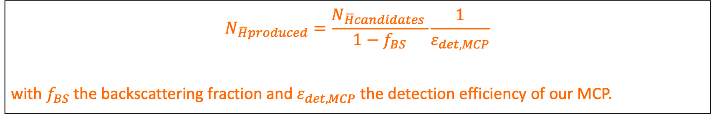
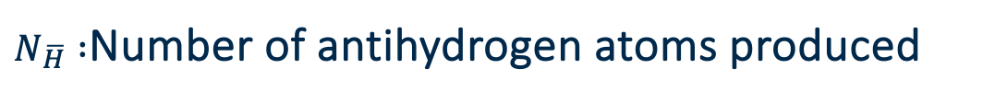
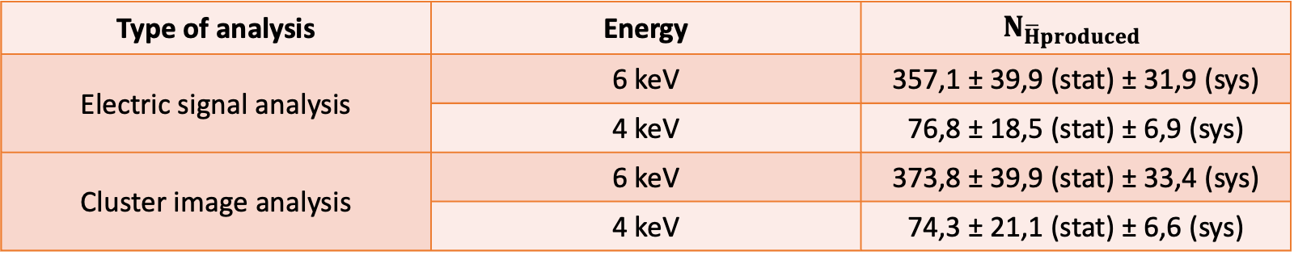
$N_{\overline{H}} :$Number of antihydrogen atoms produced
$$N_{\overline{H}produced}=\frac{N_{\overline{H}candidates }}{1−f_{BS}}\frac{1}{ε_{det,MCP}}$$
with $f_{BS}$ the backscattering fraction and $ε_{det,MCP}$ the detection efficiency of our MCP.
Type of analysis | Energy | $$N_{\overline{H}produced}$$
Electric signal analysis | 6 keV | 357,1 ± 39,9 (stat) ± 31,9 (sys)
 | 4 keV | 76,8 ± 18,5 (stat) ± 6,9 (sys)
Cluster image analysis | 6 keV | 373,8 ± 39,9 (stat) ± 33,4 (sys)
 | 4 keV | 74,3 ± 21,1 (stat) ± 6,6 (sys)

Slide 17
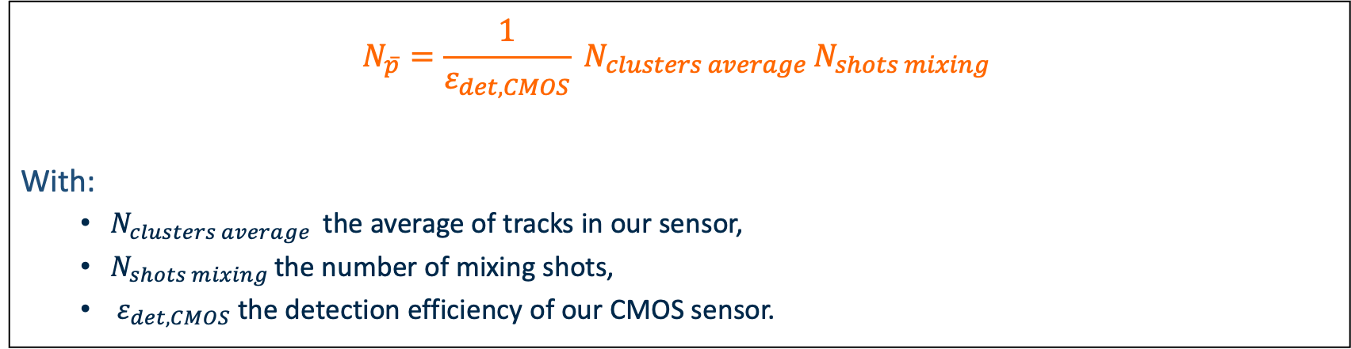
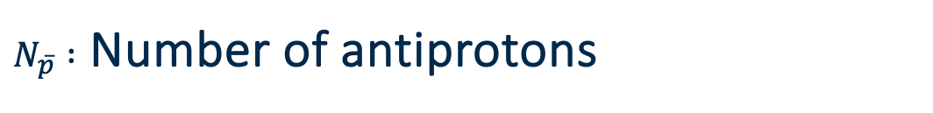
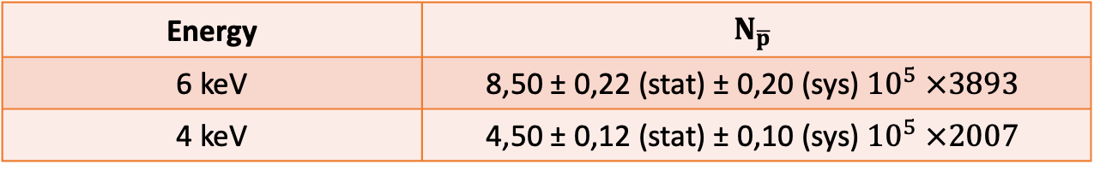
$N_{\overline{p}} :$ Number of antiprotons
$$N_{\overline{p}}=\frac{1}{ε_{det,CMOS}} N_{clusters average }N_{shots mixing }$$
With:
$N_{clusters average }$the average of tracks in our sensor,
$N_{shots mixing }$the number of mixing shots,
$ε_{det, CMOS}$ the detection efficiency of our CMOS sensor.
Energy | $$N_{\overline{p}}$$
6 keV | 8,50 ± 0,22 (stat) ± 0,20 (sys) ${10}^{5} ×3893$
4 keV | 4,50 ± 0,12 (stat) ± 0,10 (sys) ${10}^{5} ×2007$

Slide 18
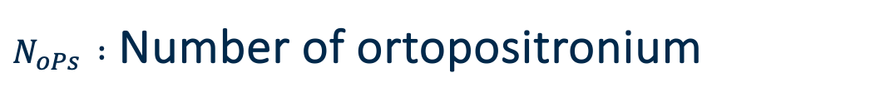
$N_{oPs } :$ Number of ortopositronium
$$N_{\overline{p}}=\frac{1}{ε_{det,CMOS}} N_{clusters average }N_{shots mixing }$$
With:
$N_{clusters average }$the average of tracks in our sensor,
$N_{shots mixing }$the number of mixing shots,
$ε_{det, CMOS}$ the detection efficiency of our CMOS sensor.
Energy | $$N_{\overline{p}}$$
6 keV | 8,50 ± 0,22 (stat) ± 0,20 (sys) ${10}^{5} ×3893$
4 keV | 4,50 ± 0,12 (stat) ± 0,10 (sys) ${10}^{5} ×2007$

Slide 19
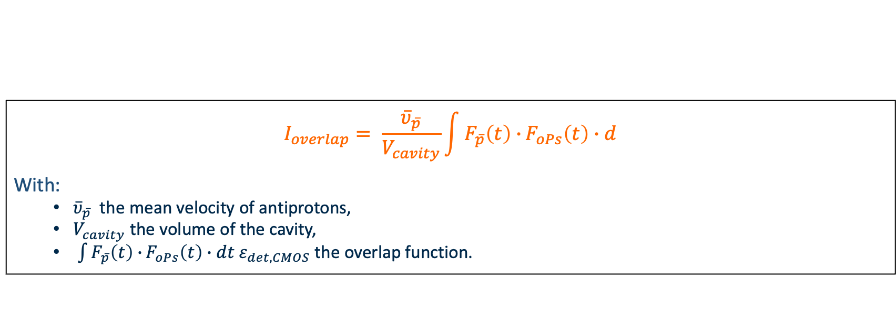
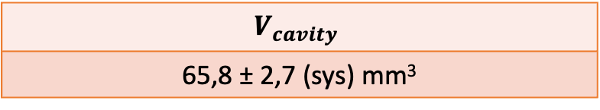
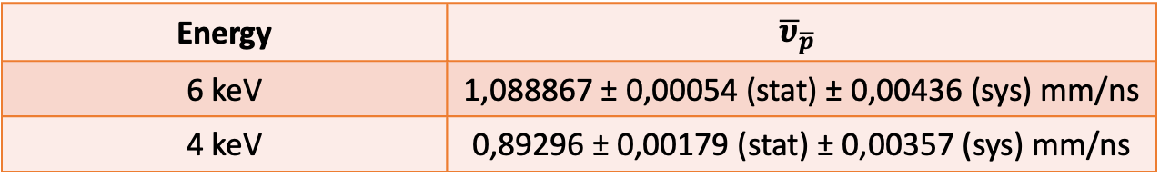
$I_{overlap}:$Overlap between $\overline{p } \& oPs$
$$I_{overlap}= \frac{{\overline{υ}}_{\overline{p}}}{V_{cavity}}\int{F_{\overline{p}}\left(t\right)∙}F_{oPs}\left(t\right)∙d$$
With:
${\overline{υ}}_{\overline{p}}$ the mean velocity of antiprotons,
$V_{cavity}$ the volume of the cavity,
$\int{F_{\overline{p}}\left(t\right)∙}F_{oPs}\left(t\right)∙dt ε_{det, CMOS}$ the overlap function.
Energy | $${\overline{υ}}_{\overline{p}}$$
6 keV | 1,088867 ± 0,00054 (stat) ± 0,00436 (sys) mm/ns
4 keV | 0,89296 ± 0,00179 (stat) ± 0,00357 (sys) mm/ns
$$V_{cavity}$$
65,8 ± 2,7 (sys) mm³

Slide 20


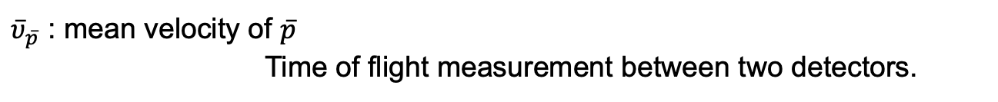

Cross-section measurement
$$σ\left({\overline{υ}}_{\overline{p}}\right)= \frac{N_{\overline{H}}}{N_{\overline{p}} N_{oPs}} ×\frac{1}{I_{overlap}}$$
$$I_{overlap}= \frac{{\overline{υ}}_{\overline{p}}}{V_{cavity}}\int{F_{\overline{p}}\left(t\right)∙}F_{oPs}\left(t\right)∙dt$$
${\overline{υ}}_{\overline{p}}$ : mean velocity of $\overline{p}$
Time of flight measurement between two detectors.
$$6 keV :1,088867 mm/ns$$
$$4 keV :0,89296 mm/ns$$
$V_{cavity}$: volume of the cavity
$$V_{cavity}=65,8 mm^{3}$$
Notes:
not necessary

Slide 21
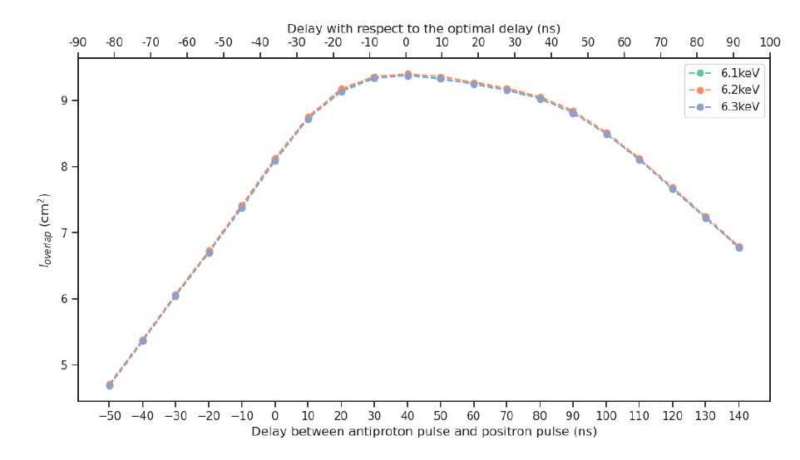
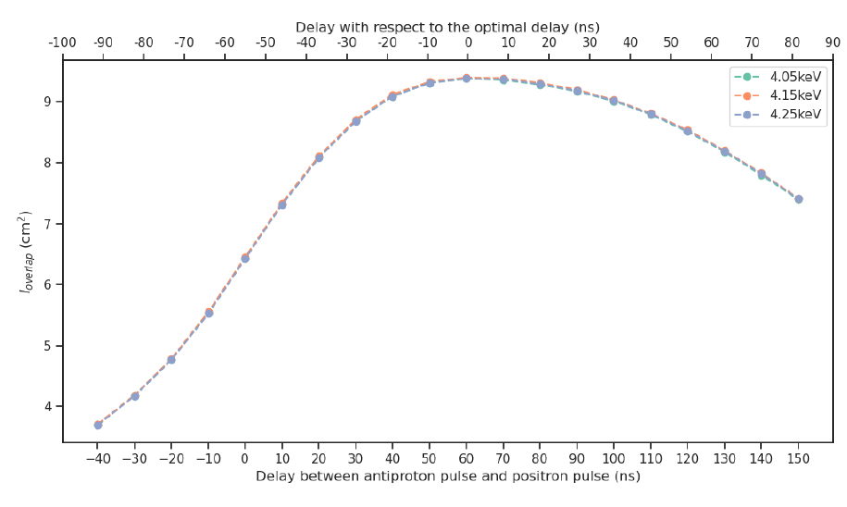
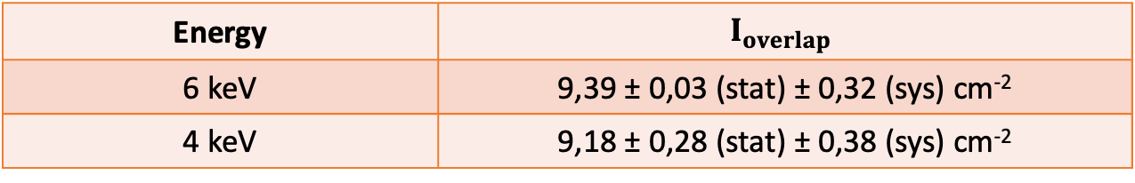
$I_{overlap}:$Overlap between $\overline{p } \& oPs$
Energy | $$I_{overlap}$$
6 keV | 9,39 ± 0,03 (stat) ± 0,32 (sys) cm⁻²
4 keV | 9,18 ± 0,28 (stat) ± 0,38 (sys) cm⁻²

Slide 22
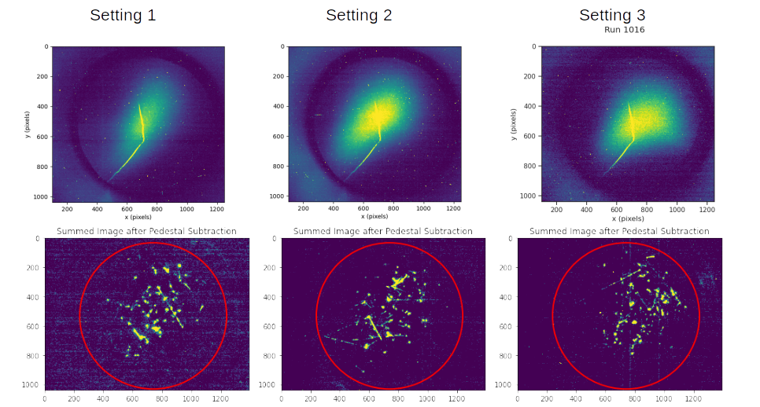
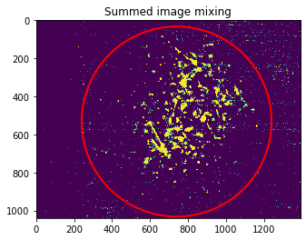
Beam spots contained in MCP
PRELIMINARY

