Slide 1

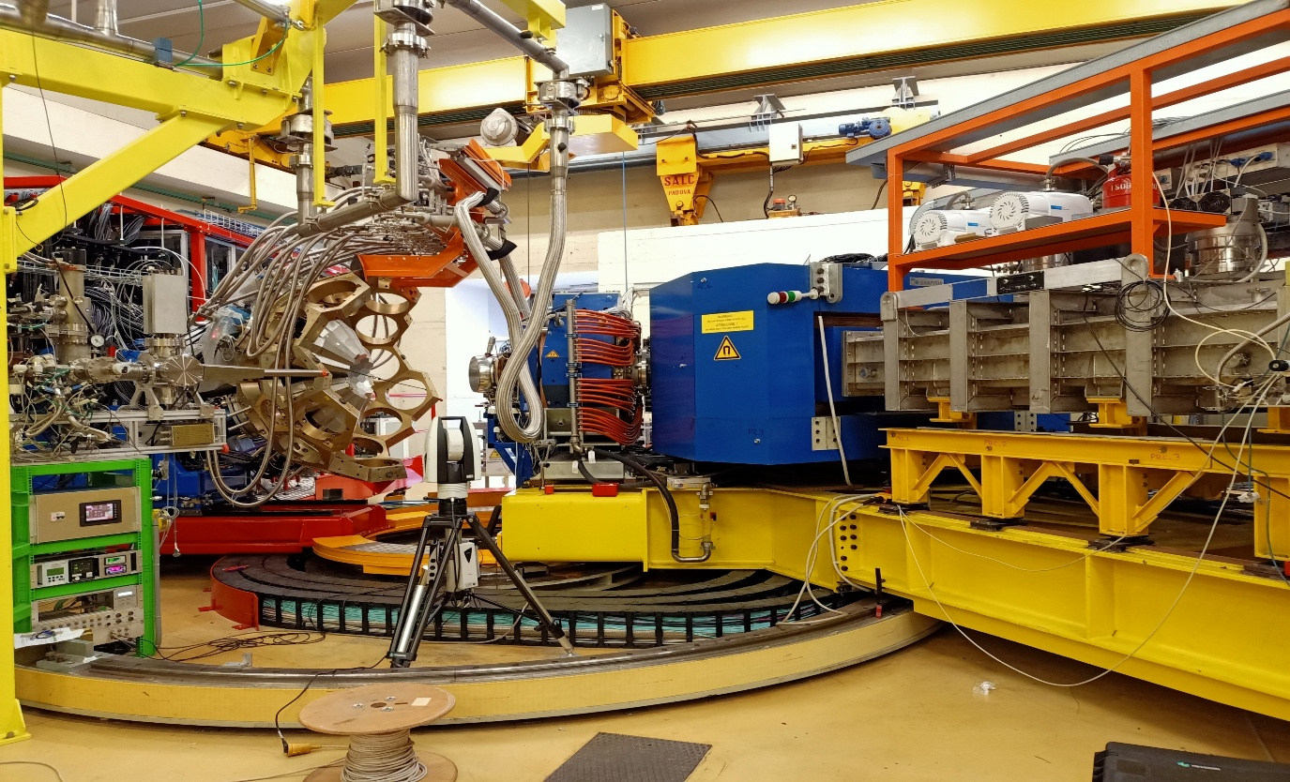
Direct identification of actinides in multinucleon transfer reactions and effect of secondary processes
F. Galtarossa (INFN Sezione di Padova)
EUNPC conference, Caen, September 22nd-26th, 2025

Slide 2
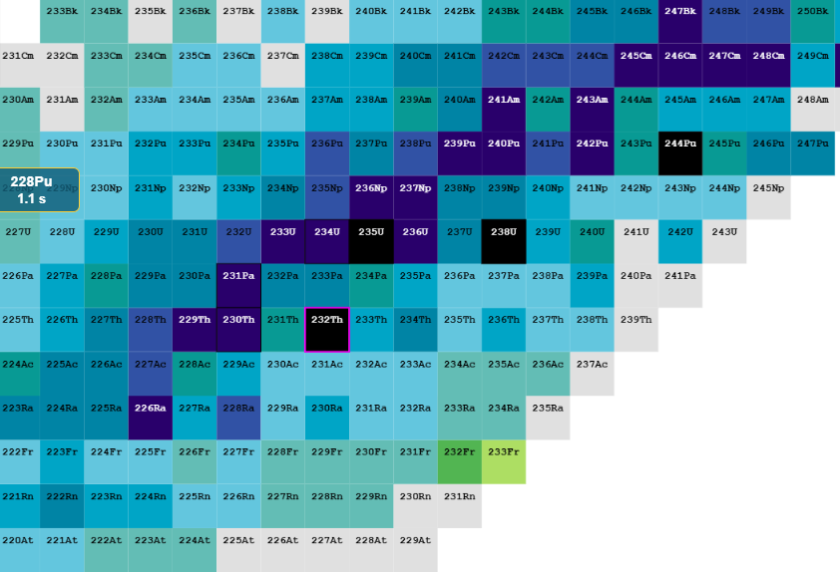
The region around ²³²Th and ²³⁸U
Discovery of new isotopes Niwase PRL 2023
Spectroscopy of neutron-rich actinides Vogt PRC 2015, Sood PRC 2022
Electric Dipole Moments Dobaczewski PRL 2018
Octupole deformations Butler PRL 2020
Parity non-conservation Zhang PRL 2020
Fission barriers Nishio PRC 2025
Fusion
Fragmentation
MNT
Fusion
Fragmentation
MNT
Fusion
Fragmentation
MNT
F. Galtarossa, INFN PD
EUNPC 2025, September 22nd-26th, 2025
2

Slide 3
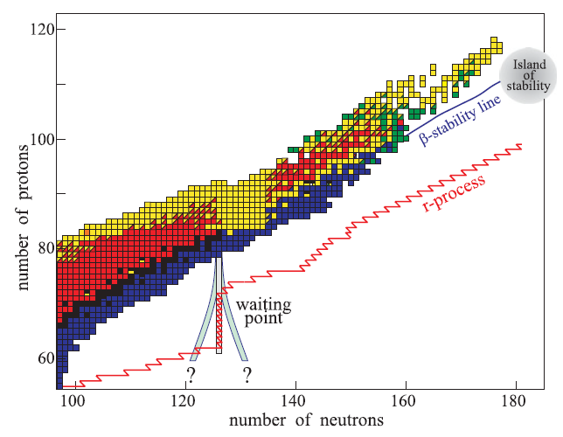
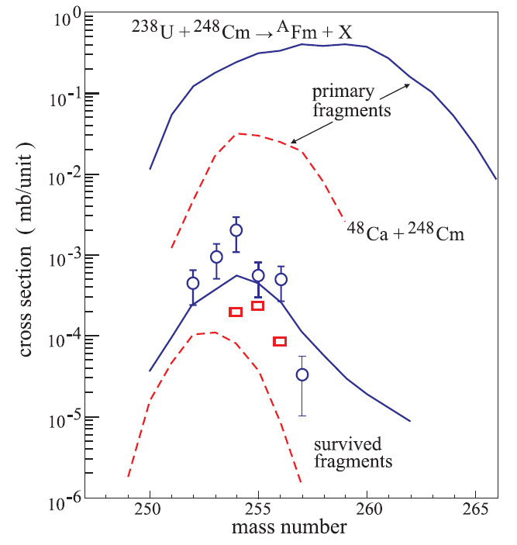
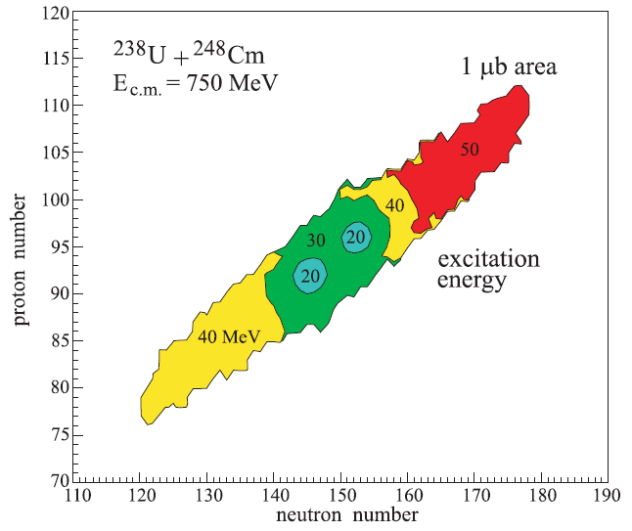
Heavy nuclei produced via MNT reactions
N = 126
State-of-the-art reaction theories (GRAZING, DNS, Langevin-type, ImQMD, TDHF, TD-CDFT, …) predict sizeable cross sections for the production of exotic heavy nuclei via MNT reactions
Large interest in the community for improved calculations and accurate experimental data
Particularly urgent is to collect data on the heavy reaction partner, for which secondary processes (nucleon evaporation, fission) may have a large impact
Important experimental observables to compare with theory:
Total and differential transfer cross sections
Excitation functions
Mass and charge distributions
Q-value distributions
Angular momentum transfer
V. Zagrebaev and W. Greiner, Phys. Rev. C 83 044618 (2011)
F. Galtarossa, INFN PD
EUNPC 2025, September 22nd-26th, 2025
3

Slide 4
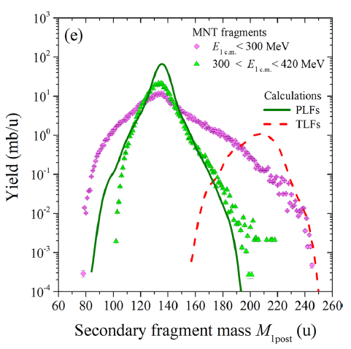
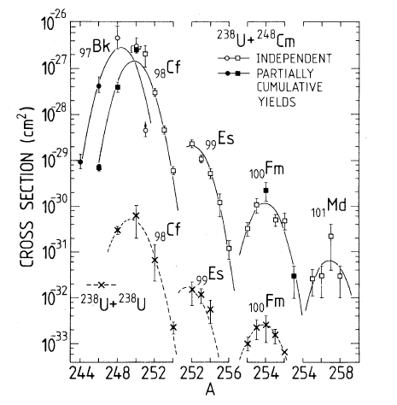
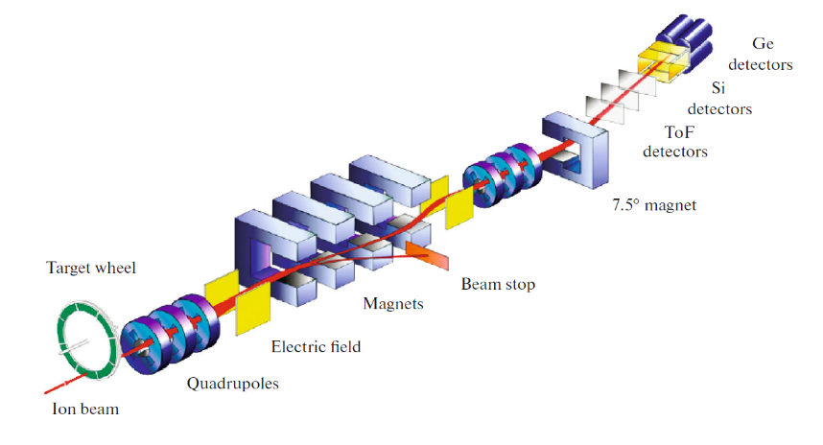
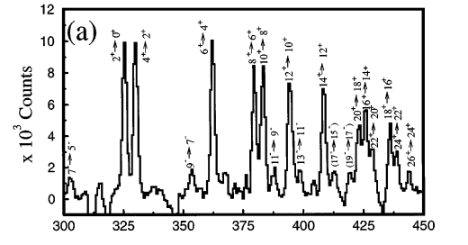
Experimental techniques
Kinematic coincidence measurements
Radiochemical methods
Follow the behaviour of the average mass distributions as a function of bombarding energy, angle, TKEL, etc.
Clear signature of the population of many actinides and transactinides
Very low mass resolution and, in most cases, no Z information
No information on the reaction process
No information on short-lived isotopes
E. M. Kozulin et al., Phys. Rev. C 109, 034616 (2024)
M. Schadel et al., Phys. Rev. Lett. 48, 852 (1982)
γ-γ coincidence technique
Deep-inelastic at 0°
Very intense beams
Sensitivity down to very low cross sections (~nb)
Thick target
No heavy-ion identification issues
Complex γ-decay schemes
Isomers
Fold of γ-ray efficiency
Catch only the tail of the angular distribution
Not equipped for prompt γ-ray spectroscopy
Mainly for proton-rich nuclei
J. F. C. Cocks et al., Phys. Rev. Lett. 78, 2920 (1997)
H. M. Devaraja, Phys. Part. Nucl. Lett. 19, 693 (2022)
F. Galtarossa, INFN PD
EUNPC 2025, September 22nd-26th, 2025
4

Slide 5
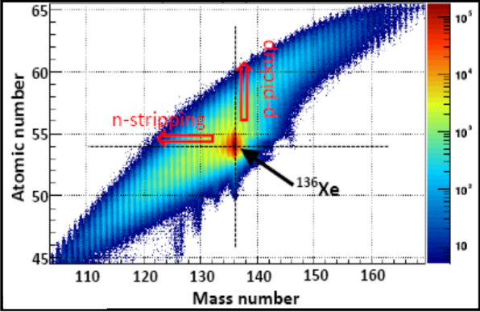
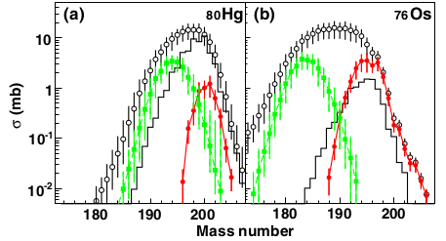
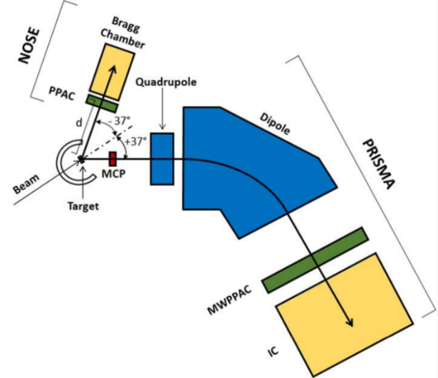
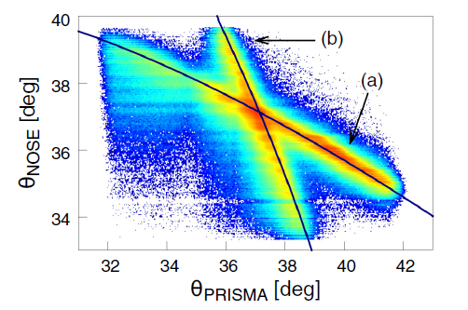
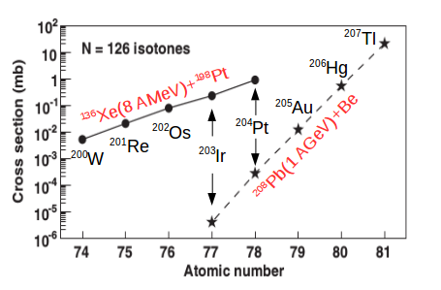
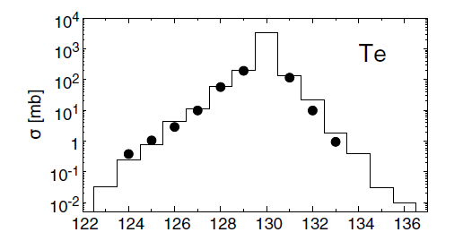
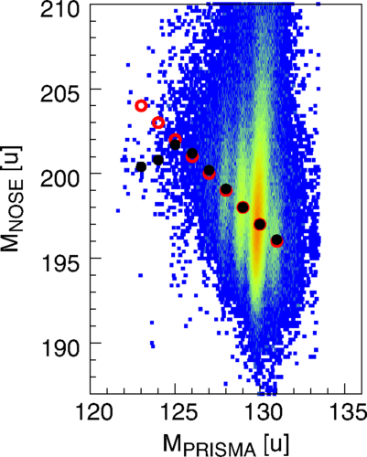
Heavy partner studies with large-acceptance magnetic spectrometers
¹³⁶Xe+¹⁹⁸Pt @ 8 AMeV (~1.5 V_{B}, direct kin.)
VAMOS + EXOGAM
γ-PLF coincidence
¹⁹⁷Au+¹³⁰Te @ 5.4 AMeV (~1.05 V_{B}, inverse kin.)
PRISMA + SECOND ARM
PLF-TLF coincidence
PLF A and Z distr.
TKEL
Theta-theta corr.
Mass-mass corr.
Y. X. Watanabe et al., PRL 115 (2015) 172503
F. Galtarossa et al., PRC 97 (2018) 054606
F. Galtarossa, INFN PD
EUNPC 2025, September 22nd-26th, 2025
6

Slide 6
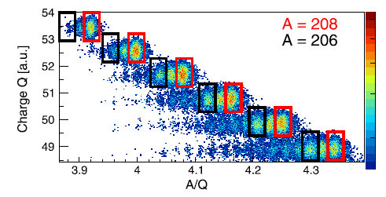
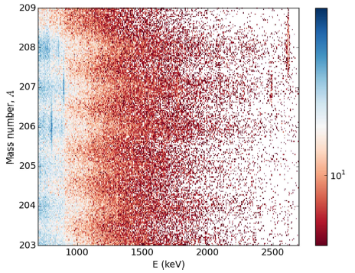
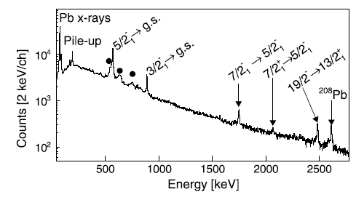
Direct detection of the heavy partner
Heavy partner detected in VAMOS in the reaction ²⁰⁸Pb+¹⁰⁰Mo @ 1.3 GeV using a fraction of the focal plane
High-resolution direct detection of the heavy reaction partner would represent a breakthrough:
Clear assignment of A and Z;
Direct measurement of cross sections after the effect of secondary processes;
Avoid systematic errors and drop of efficiency related to γ-ray detection (complicated level schemes, isomers, no gs population)
Very clean γ-ray spectra for spectroscopy (no fission, no neutron evaporation)
γ-ray spectrum gated on ²⁰⁷Pb
D. Ralet et al., Phys. Lett B 797 (2019) 134797
F. Galtarossa, INFN PD
EUNPC 2025, September 22nd-26th, 2025
6

Slide 7
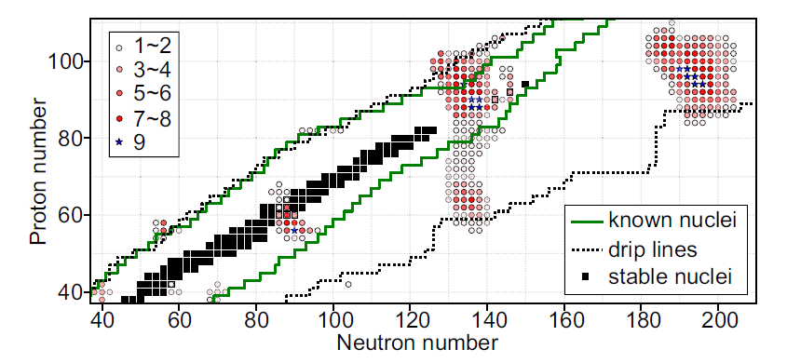
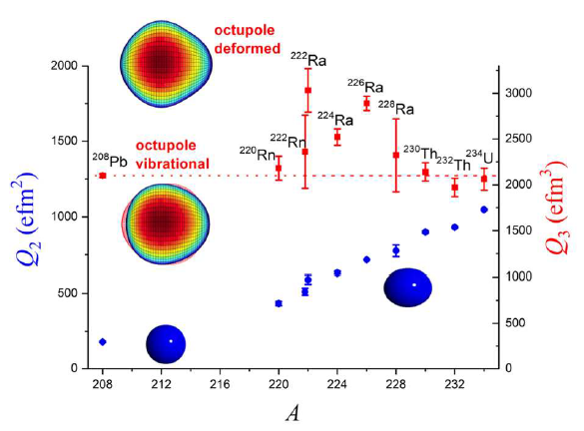
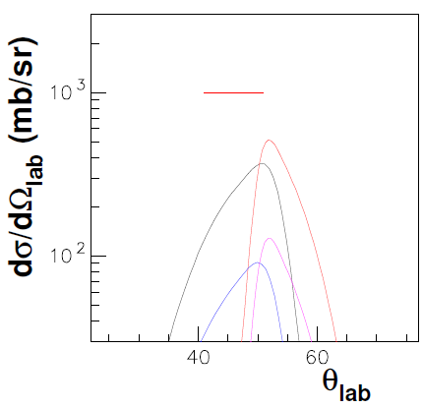
The ¹²⁹Xe+²³²Th reaction studied with PRISMA-AGATA
Search for octupole structures in neutron-deficient U, Th, Pa isotopes via MNT reactions
¹²⁹Xe+²³²Th @ 950 MeV
²³²Th target of 1.5 mg/cm²
θ_{PRISMA} = 46°
«Standard» detection for most of the experiment: PLF in PRISMA
«Reversed» detection for ~20 h: TLF directly in PRISMA with energy of 1.5 MeV/u (no Z identification)
Spokespersons: A. Goasduff, G. de Angelis, P. A. Butler, K. Rezynkina
Y. Cao et al., Phys. Rev. C. 102 (2020) 024311
Th
Xe
PRISMA
AGATA
P. A. Butler, Proc. R. Soc. London A 476 (2020) 20200202
F. Galtarossa, INFN PD
EUNPC 2025, September 22nd-26th, 2025
7

Slide 8
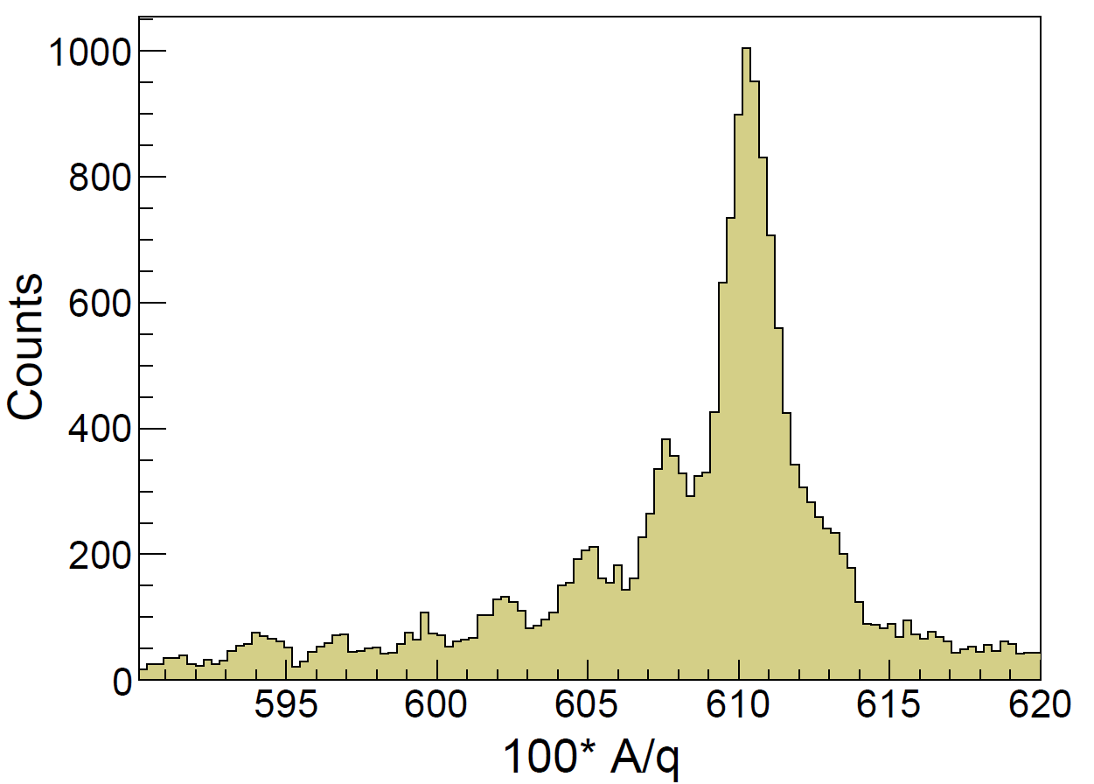
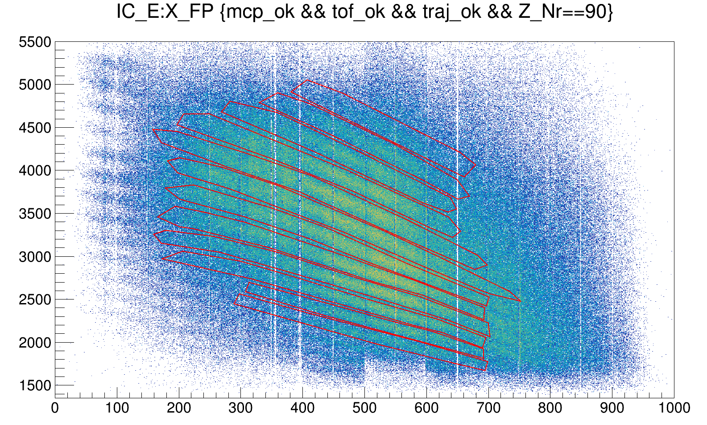
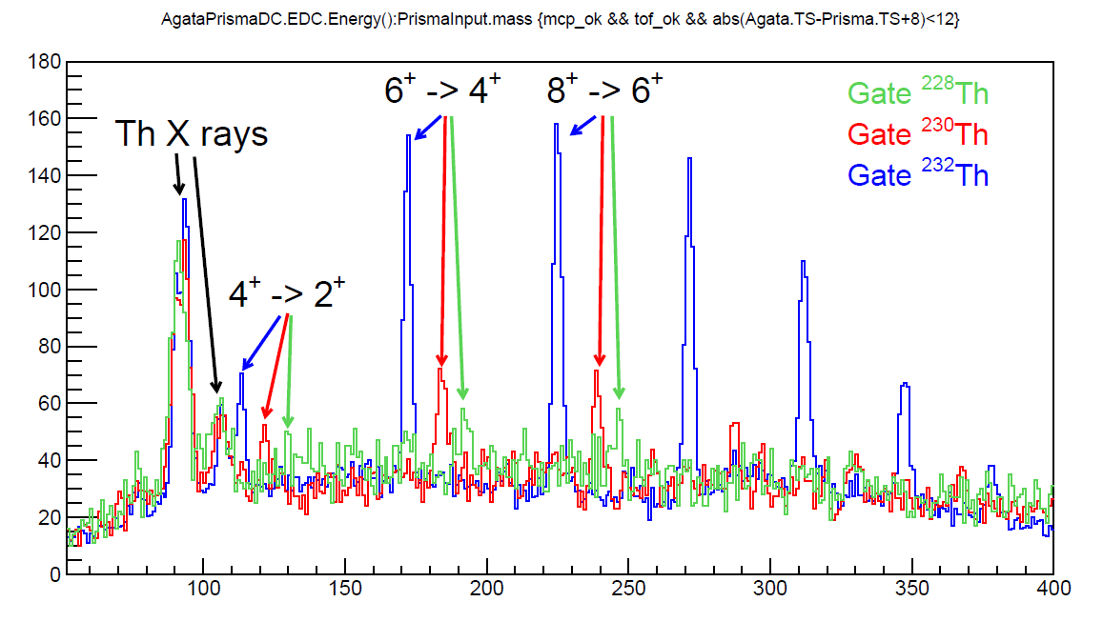
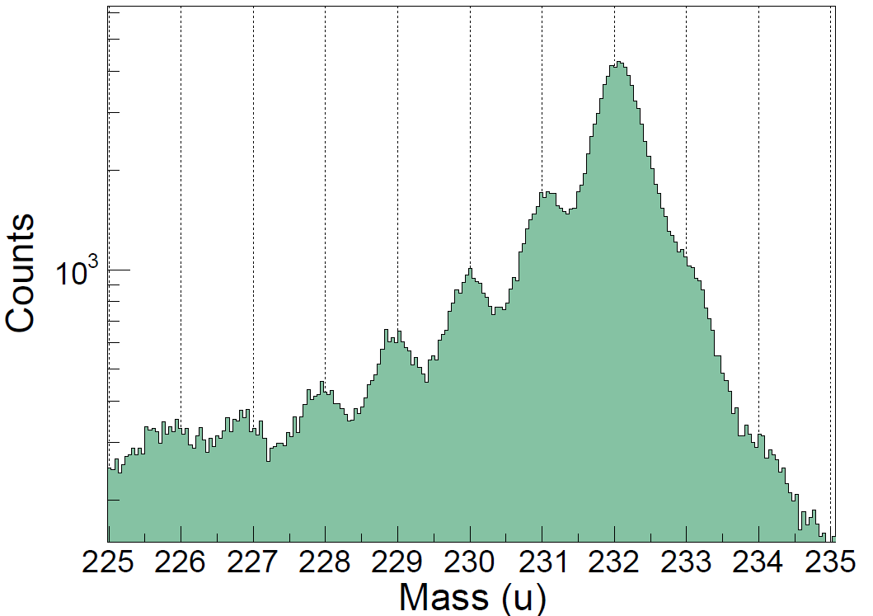

Heavy partner identification in PRISMA
Very promising A/q distribution on half of the focal plane gated on single charge states
Identification of atomic charge states via combination of E-X_{fp} and E-$ρ$β gates
Q = 38⁺
Q = 44⁺
E_{IC} (arb. units)
Q = 33⁺
X_{fp} (mm)
Identification confirmed by prompt Doppler-corrected γ rays in AGATA
Th mass spectrum identified in PRISMA on about 30% of the focal plane
ΔA/A ~ 1/300
0n
-1n
-2n
+1n
-3n
-6n
-5n
-4n
+2n
F. Galtarossa, INFN PD
EUNPC 2025, September 22nd-26th, 2025
9

Slide 9
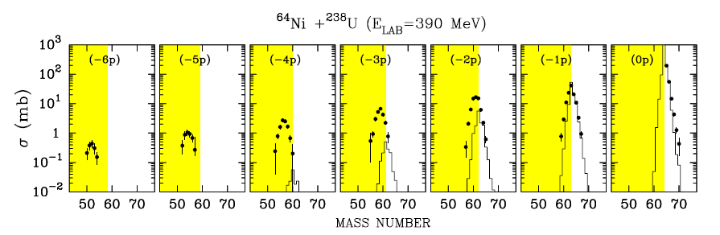
GRAZING, a semiclassical model
The GRAZING code calculates distributions in masses, charges, energies and angular momenta of fragments in collisions between heavy nuclei according to a semiclassical model.
The trajectory is calculated by solving the system of classical equations for the variables of relative motion and the deformation parameters for the surface modes. The two ions interact via a Coulomb + nuclear interaction and may exchange nucleons.
The exchange of many nucleons proceeds via a multi-step mechanism of single nucleons (both, protons and neutrons, via stripping and pick-up processes). The different single-particle states that are participating to the transfer process are described by introducing average single-particle level densities.
The model includes the low-lying 2⁺ and 3⁻ states of both projectile and target.
program GRAZING. http://www.to.infn.it/nanni/grazing
A. Winther, NPA 572 (1994) 191; NPA 594 (1995) 203.
L. Corradi et al., Phys. Rev. C 59 (1999) 261
F. Galtarossa, INFN PD
EUNPC 2025, September 22nd-26th, 2025
9

Slide 10
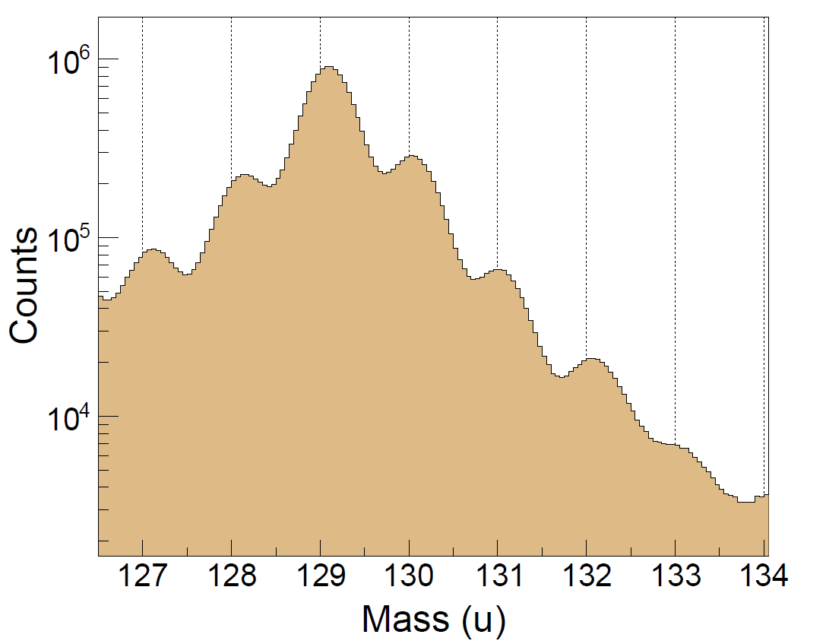
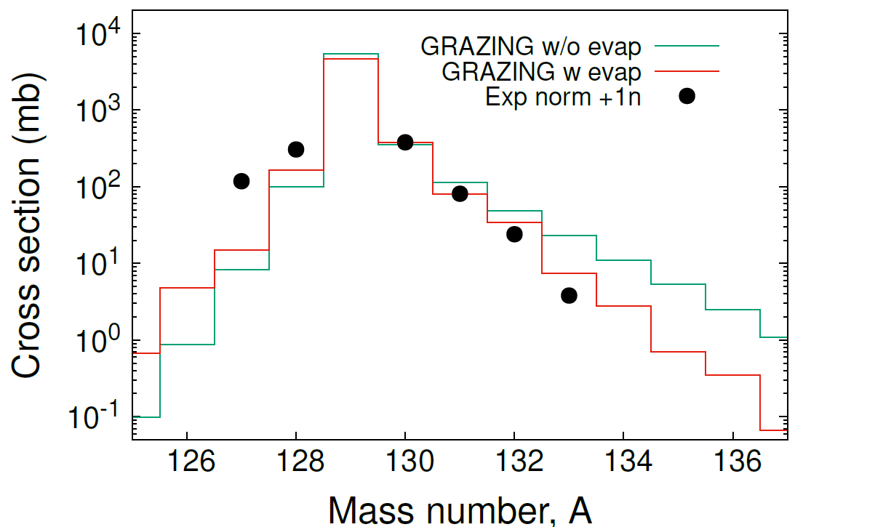
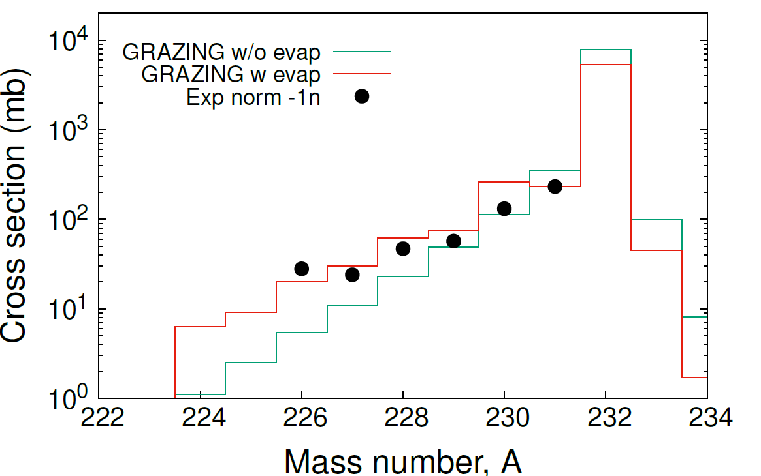
Comparison with GRAZING
Light partner
Heavy partner
Xe
Cortesy C. Sullivan
Th
First direct identification of an actinide isotope by isotope in a magnetic spectrometer
First direct comparison of GRAZING predictions with such heavy nuclei.
Independent normalizations for light and heavy partner
Trend of cross sections including neutron evaporation is nicely reproduced.
No large effect of transfer-induced fission in neutron transfer channels.
PRELIMINARY
PRELIMINARY
F. Galtarossa, INFN PD
EUNPC 2025, September 22nd-26th, 2025
10

Slide 11
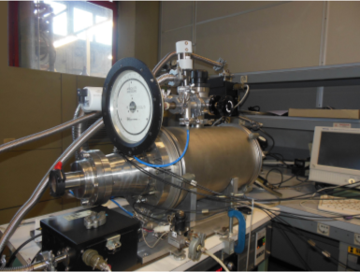
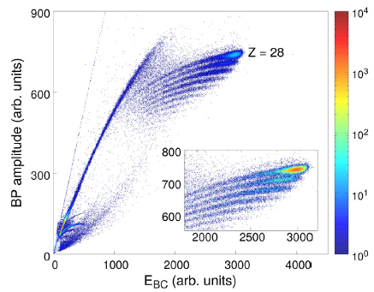
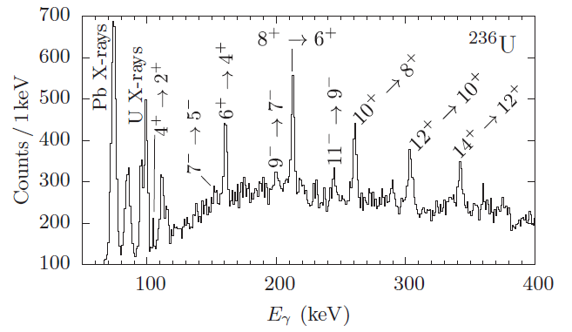
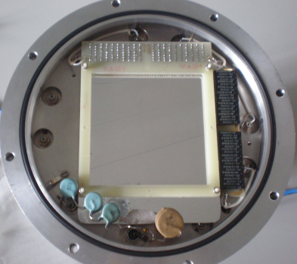
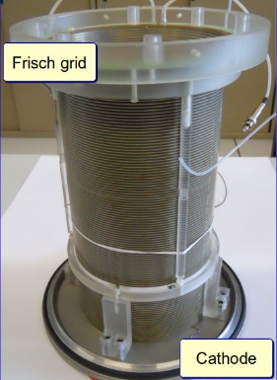
Proton transfer channels
Possible in future experiments? Direct Z identification is extremely challenging at such low energies…
2° option: detect the light partner in a second arm with Z resolution and solid angle comparable to PRISMA
1° option: detect the characteristic X rays in AGATA or in a dedicated detector with larger efficiency
MWPPAC
Axial-field IC
TOF on a 50 cm flight path: < 500 ps resolution;
Position: 1 mm resolution
Energy: 1% resolution
Atomic number: 2% resolution
Solid angle: 30 msr
A. Vogt et al., Phys. Rev. C 92 (2015) 024619
E. Fioretto et al., NIM A 899 (2018) 73-79
F. Galtarossa, INFN PD
EUNPC 2025, September 22nd-26th, 2025
11

Slide 12
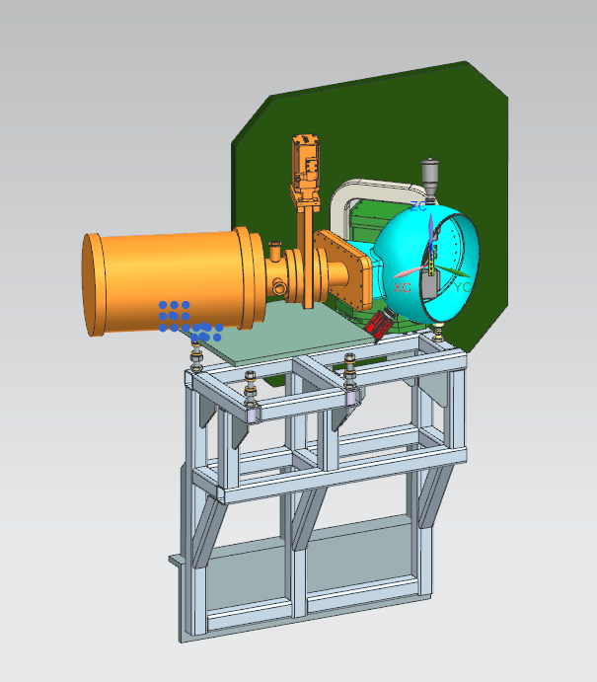
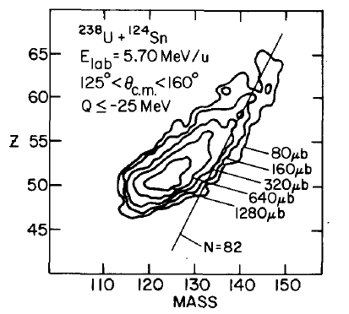
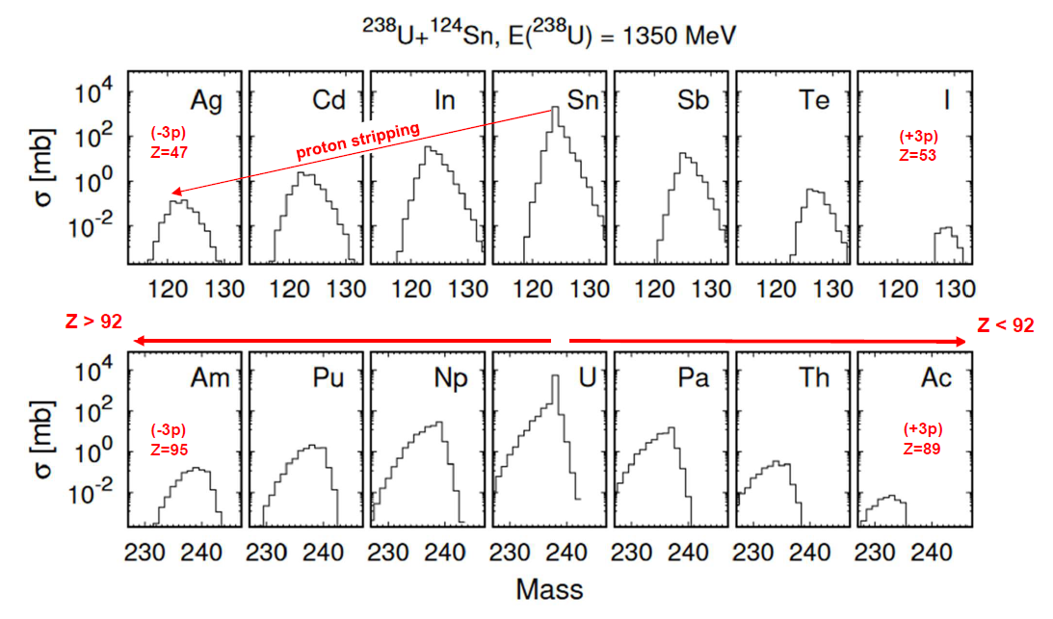
Possibilities with the ²³⁸U beams in 2026
Proposal for next LNL PAC: Production yields of neutron-rich heavy nuclei in the ²³⁸U+¹²⁴Sn multinucleon transfer reaction
Spokespersons: L. Corradi, F. Galtarossa, T Mijatovic
Second arm integration in the PRISMA-AGATA configuration
W. Mayer et al., Phys. Lett. B 152 (1985) 162
Physics goal: study the A, Z, Q-value distributions and associated σ for the population of nuclei around Z=92 -> comparison with state-of-the-art theories
Cross sections for a complete set of n- and p-transfer channels, angular and TKEL distributions, γ-ray spectroscopy, possible direct identification of U-like ions
F. Galtarossa, INFN PD
EUNPC 2025, September 22nd-26th, 2025
12

Slide 13
Conclusions
We studied multi-nucleon transfer reactions in the ¹²⁹Xe+²³²Th system at 950 MeV with the PRISMA-AGATA set-up at INFN LNL
For the first time, we extracted neutron transfer yields for both PLF and TLF and compared them with theoretical predictions with the GRAZING code. Normalizations are done independently to the -1n (Th) and +1n (Xe) channel predicted by GRAZING.
The preliminary results show that GRAZING is able to describe properly the neutron transfer + neutron evaporation for both light and heavy partner. Transfer-induced fission seems not to play a major role, also after the transfer of many neutrons.
Future implementations of a kinematic coincidence PRISMA + Second arm, in conjunction with AGATA, will give us the possibility to exploit the intense ²³⁸U beams delivered by PIAVE-ALPI to extract a full set of proton and neutron transfer channels to study the population of neutron-rich heavy nuclei close to ²³⁸U.
The use of magnetic spectrometers, combined with the availability of new beams/targets and coupled to large γ-ray arrays, can help provide the most complete and high-resolution set of data on MNT reactions at Coulomb barrier energies for the production of heavy neutron-rich(deficient) nuclei and solve some of the open questions that still remain on the effectiveness of these reactions in reaching specific region of the Segrè chart with sizeable cross sections.
F. Galtarossa, INFN PD
EUNPC 2025, September 22nd-26th, 2025
13

Slide 14
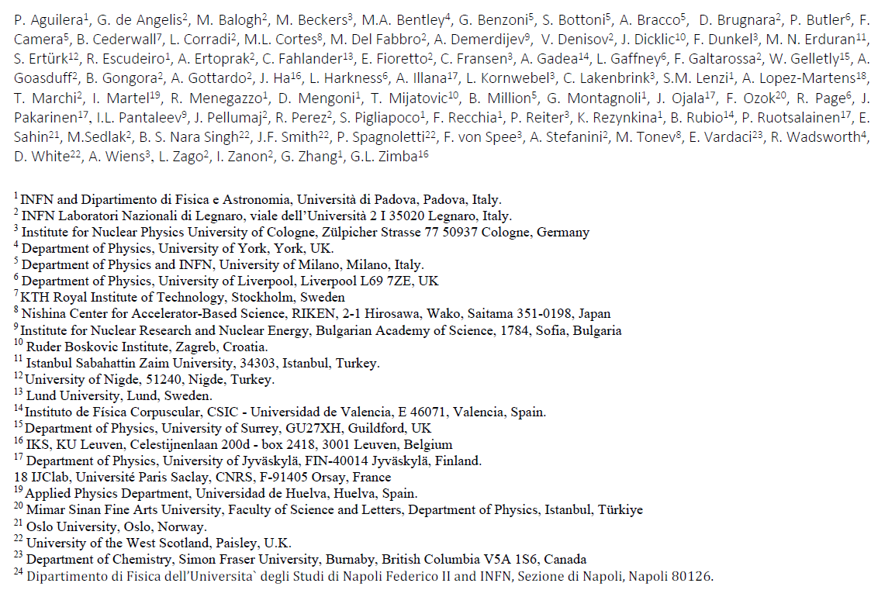



Collaboration
And the whole AGATA collaboration
F. Galtarossa, INFN PD
EUNPC 2025, September 22nd-26th, 2025
14

Slide 15
BACKUP SLIDES

Slide 16
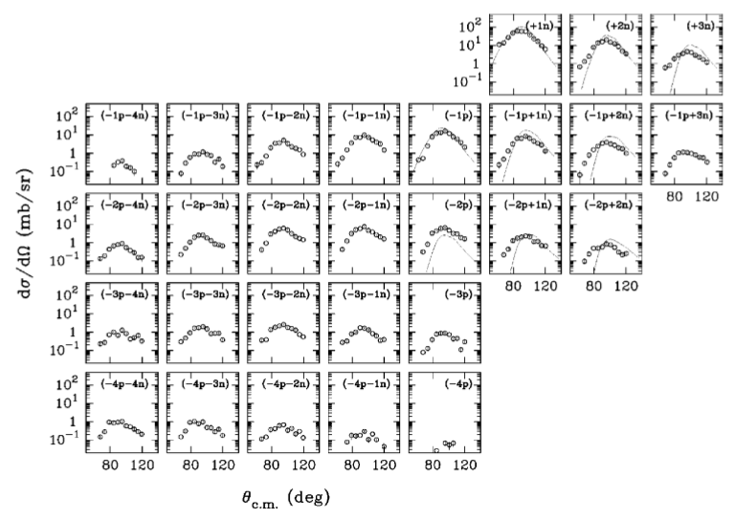
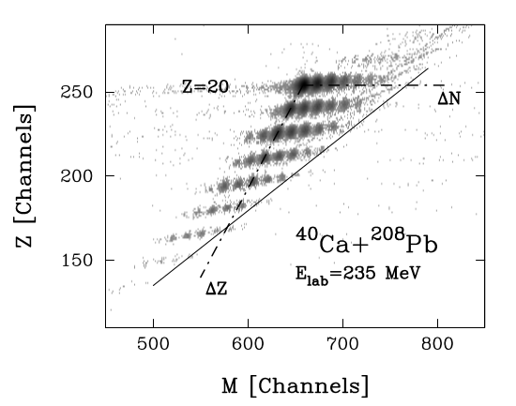
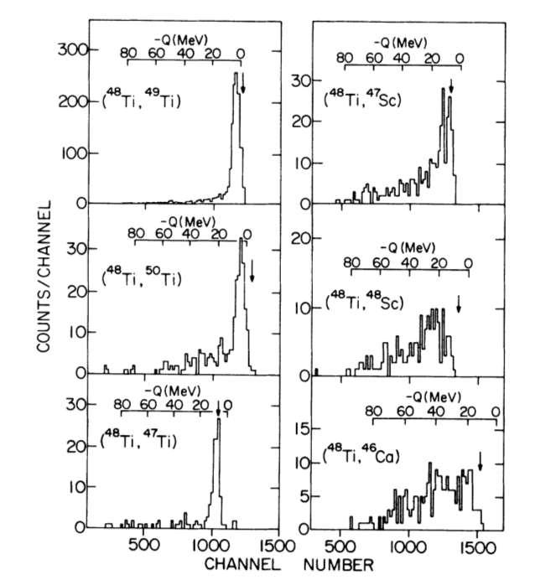
Multinucleon transfer reactions at near-barrier energies
Angular distributions peaked at the grazing angle
Reaction products close to the reactants with A, Z distributions governed by optimum Q-value considerations
Increasing energy loss components as more nucleons are transferred
L. Corradi et al., Phys. Rev. C 59 (1999) 261
S. Szilner et al., Phys. Rev. C 71 (2005) 044610
K. E. Rehm et al., Phys. Rev. C 37 (1988) 2629
F. Galtarossa, INFN PD
EUNPC 2025, September 22nd-26th, 2025
17

Slide 17
Complex WKB
E. Vigezzi, A. Winther, Ann. Phys. 192 (1989) 432.
GRAZING
Program GRAZING. http://www.to.infn.it/nanni/grazing. A. Winther, NPA 572 (1994) 191; NPA 594 (1995) 203
DiNuclear System (DNS) model
Z.-Q. Feng, Phys. Rev. C 95 (2017) 024615
Langevin-type dynamical equations of motion
V. Zagrebaev, W. Greiner, Phys. Rev. Lett. 101 (2008) 122701; A. V. Karpov, V. V. Saiko, Phys. Rev. C 96 (2017) 024618
Time-Dependent Hartree-Fock (TDHF) theory
K.Sekizawa, K. Yabana, Phys. Rev. C 88 (2013) 014614
Improved Quantum Molecular Dynamics (ImQMD)
C. Li et al., Phys. Lett. B 776 (2018) 278
Time-Dependent Covariant Density Functional Theory (TD-CDFT)
D. D. Zhang, D. Vretenar et al., Phys. Rev. C 109 (2024) 024614
SEMICLASSICAL APPROACH
MICROSCOPIC APPROACH
Recently these models have been widely employed and developed to investigate the optimal conditions to produce neutron-rich nuclei in the actinide, trans-actinide and N=126 regions.
F. Galtarossa, INFN PD
EUNPC 2025, September 22nd-26th, 2025
18

Slide 18
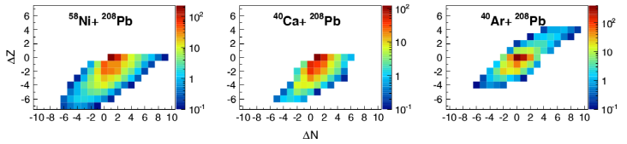
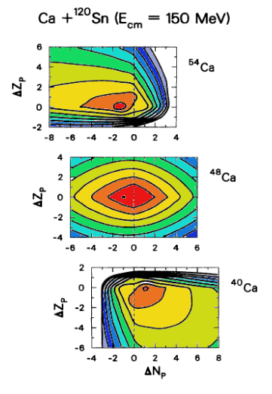
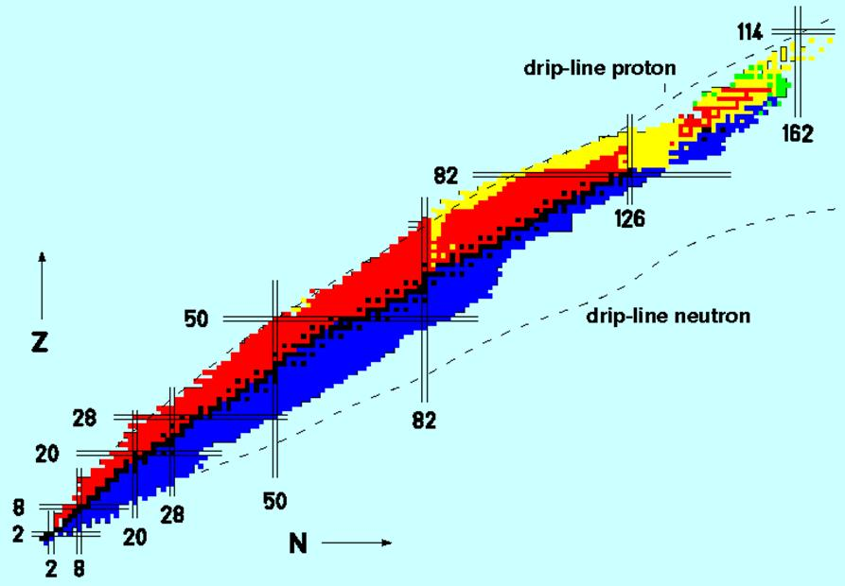
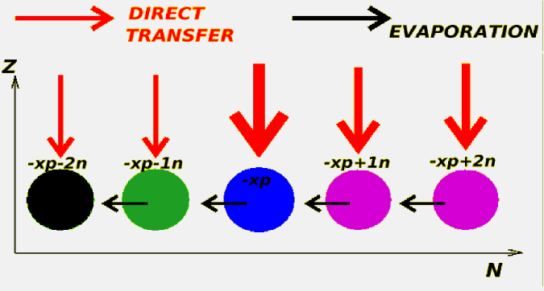
Populating neutron-rich nuclei via MNT reactions
T. Mijatović et al., PRC 94 (2016) 064616
Secondary processes!
C. H. Dasso, G. Pollarolo, A. Winther, PRL 73 (1994) 1907
F. Galtarossa, INFN PD
EUNPC 2025, September 22nd-26th, 2025
19

Slide 19
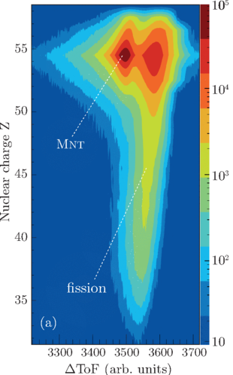
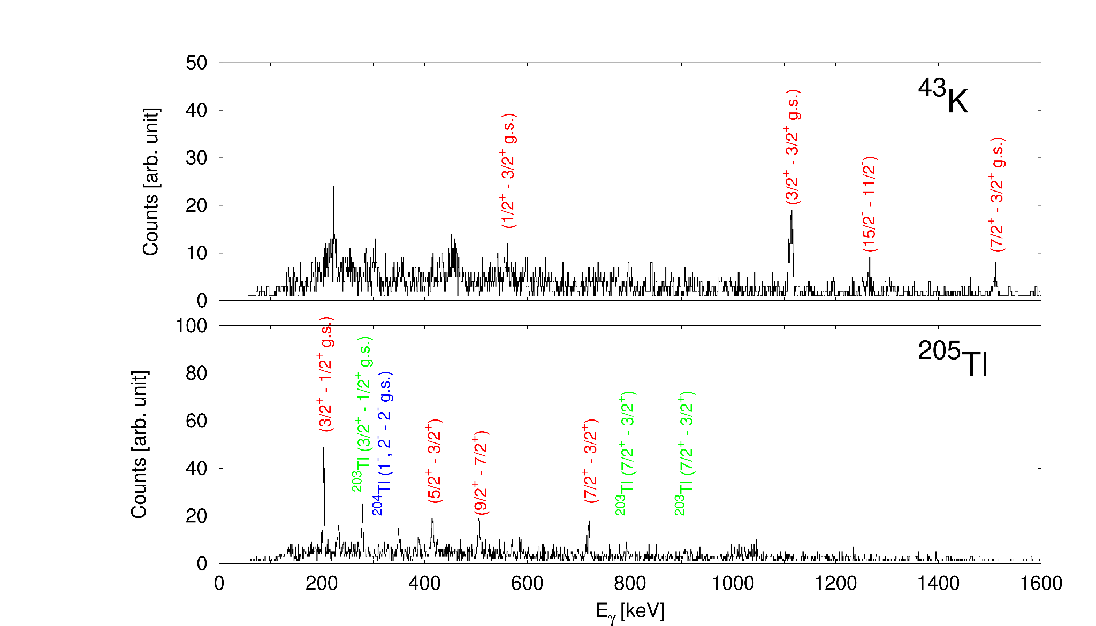
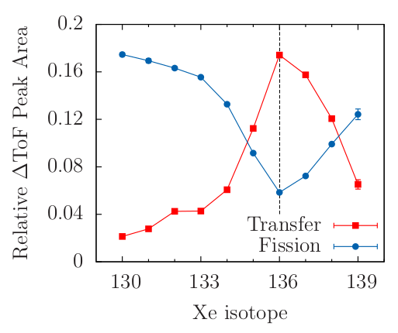
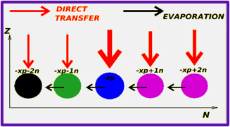
Secondary processes
¹⁹⁷Au+¹³⁰Te
A. Vogt et al., PRC 92 (2015) 024619
Secondary effects (evaporation, transfer induced fission) significantly change the yield and limit the possibility to perform detailed γ-spectroscopy measurements
Studies performed with PRISMA coupled to a second detector (NOSE, DANTE, γ-ray array)
Also important to understand evolution of QE to DIC: what nuclei and which states are populated? What is the cross section?
¹³⁶Xe+²³⁸U
F. Galtarossa et al., PRC 97 (2018) 054606
⁴⁰Ar+²⁰⁸Pb
F. Galtarossa, INFN PD
EUNPC 2025, September 22nd-26th, 2025
20

Slide 20

Bombarding energy dependence in the DNS model
Z. Feng, PRC 108 (2023) L051601
F. Galtarossa, INFN PD
EUNPC 2025, September 22nd-26th, 2025
21

Slide 21


Production of neutron-rich nuclei near N=126 in ¹³⁶Xe+¹⁹⁸Pt
In an experiment performed at GANIL the cross sections to produce neutron-rich N=126 nuclei could be deduced by detecting the light partner in coincidence with γ rays
¹³⁶Xe+¹⁹⁸Pt @ 8 AMeV
VAMOS+EXOGAM
γ-particle coincidences
Gamma spectrum
Y. X. Watanabe et al., PRL 115 (2015) 172503
Multinucleon transfer is a complementary mechanism to the fragmentation of actinides or lead on light targets for the population of heavy neutron-rich nuclei
BUT
direct identification is very difficult
F. Galtarossa, INFN PD
EUNPC 2025, September 22nd-26th, 2025
22

Slide 22





Operation principles of a magnetic spectrometer
A physical event is composed by the parameters:
position at the entrance x, y
position at the focal plane X, Y
time of flight TOF
energy ΔE, E
Z selection
MWPPAC
Courtesy of
T. Mijatović
IC
⁴⁰Ar+²⁰⁸Pb @ 260 MeV
q identification
F. Galtarossa, INFN PD
EUNPC 2025, September 22nd-26th, 2025
5

Slide 23






The use of inverse kinematics with PRISMA
¹⁹⁷Au+¹³⁰Te, E =1070 MeV (~ V_{C}), θ_{lab} = 37°
Au in PRISMA
Te in PRISMA
For neutron transfer channels we could follow nicely the predictions of GRAZING for the light partner, for the heavy through the comparison with simulations
F. Galtarossa et al., PRC 97 (2018) 054606
F. Galtarossa, INFN PD
EUNPC 2025, September 22nd-26th, 2025
23

Slide 24








Important formulas for spectrometers (Schull 1982)
1)
$$ΔE\sim \frac{mZ^{2}}{E}$$
2)
$$ToF\sim \frac{S(x,θ)}{v}$$
S(x, $θ$) ≡ path length
$$q= \frac{2}{S(x,θ)}\frac{E∙ToF}{Bρ(x,θ)}$$
and
$$\frac{m}{q}= \frac{Bρ(x,θ)}{S(x,θ)}∙ToF$$
3)
$$Bρ \sim x \sim \frac{A}{q}v$$
$$v=\sqrt{\frac{2E}{m}}$$
4)
$$E=\frac{1}{2}mv^{2}$$
Non relativistic
q resolution dominated by E resolution
m resolution dominated by ToF resolution
F. Galtarossa, INFN PD
EUNPC 2025, September 22nd-26th, 2025
24

Slide 25




How we distinguish charge states for the heavy partner
$$v=\sqrt{\frac{2E}{A}}$$
In non-relativistic approximation (ok here, β<0.1)
$$x\sim Bρ=\frac{A}{q}v= \frac{\sqrt{2EA}}{q}$$
So when we plot E^{1/2} vs x the curves will depend on both q and A in the following way:
$$E= \frac{q^{2}}{2A}x^{2}$$
This matrix shows the A dependence within a given q
Increasing q
Decreasing A
E
x
F. Galtarossa, INFN PD
EUNPC 2025, September 22nd-26th, 2025
25

Slide 26


226 ≤ A ≤ 234
28 ≤ A ≤ 34
F. Galtarossa, INFN PD
EUNPC 2025, September 22nd-26th, 2025
26

Slide 27


E
$$E∝qρβ$$
ρβ
F. Galtarossa, INFN PD
EUNPC 2025, September 22nd-26th, 2025
26

Slide 28

0n
-1n
-2n
-3n
-4n
-5n
Contamination
F. Galtarossa, INFN PD
EUNPC 2025, September 22nd-26th, 2025
27

Slide 29


²⁰⁸Pb+¹³⁰Te @ 1150 MeV
The contamination is localized on the upper part of the charge state in the E vs Rβ matrix. This is true also for other charge states. Narrower gates excluding this part should result in much cleaner A/q spectra.
F. Galtarossa, INFN PD
EUNPC 2025, September 22nd-26th, 2025
28

Slide 30

²⁰⁸Pb+¹³⁰Te @ 1150 MeV

Slide 31


The KEK Isotope Separator System
KEK Isotope Separator System (KISS) for β-decay spectroscopy of neutron-rich nuclei with A~200 and N~126
Recent discovery of ²⁴¹U isotope!
T. Niwase et al., Phys. Rev. Lett. 130, 132502 (2023)
F. Galtarossa, INFN PD
EUNPC 2025, September 22nd-26th, 2025
30

Slide 32


Q-value selection to suppress neutron evaporation
³²S+¹²⁴Sn(0.5 mg/cm²) @ 160 MeV
³²S+¹²⁴Sn(2.5 mg/cm²) @ 160 MeV
Before selection
After selection
Before selection
After selection
= 0.13(2)
= 0.036(6)
E. Pilotto et al., LNL Annual Report 2022
F. Galtarossa, INFN PD
EUNPC 2025, September 22nd-26th, 2025
31

