Slide 1
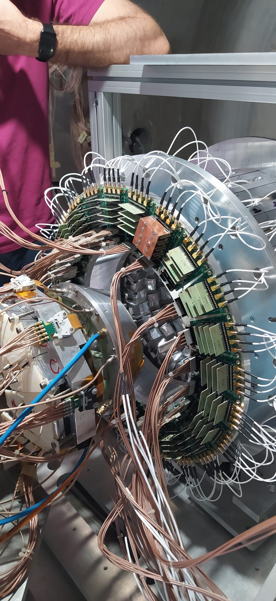
Searching for Alpha-cluster Condensed State in ²⁰Ne
S.Barlini and A.Camaiani for the NUCLEX collaboration

Slide 2

Searching for Alpha-cluster Condensed State in ²⁰Ne
Brief introduction to the physic case
The ALCONE experiment ¹⁶O(⁶Li,d)²⁰Ne* at 13.5MeV/u
Some preliminary results
Summary and perspectives
Caen,21-26 Sept. 2025
S.Barlini and A.Camaiani
Physics Department, University of Florence, Italy
INFN, section of Florence, Italy

Slide 3
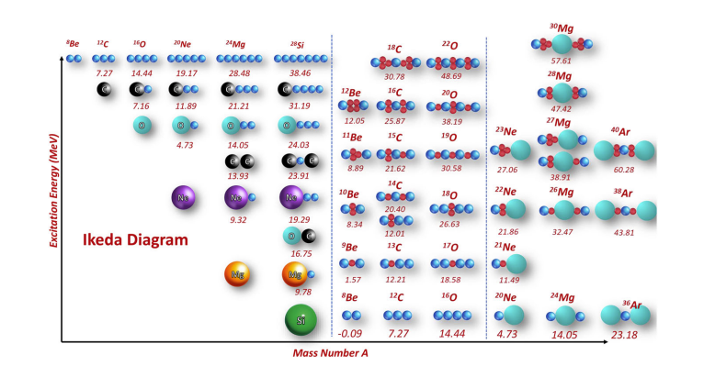
BRIEF INTRODUCTION TO THE PHYSIC CASE
I.Lombardo and D.Dell’Aquila, La Rivista del Nuovo Cimento (2023) 46:521–618

Slide 4
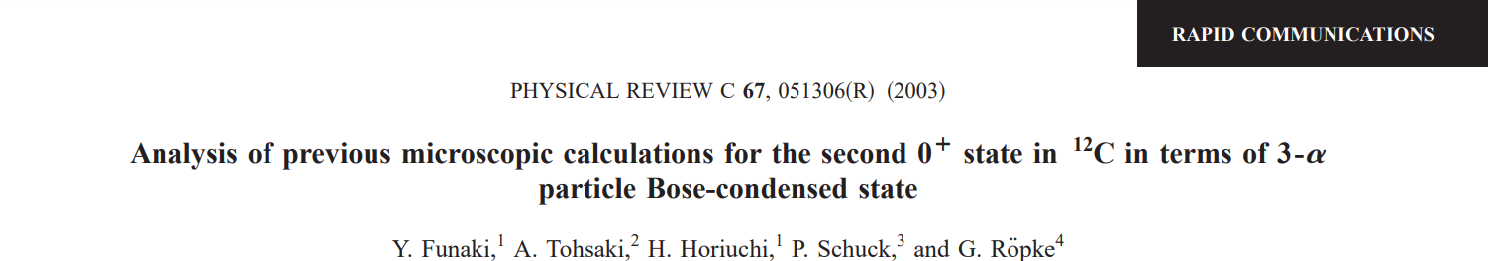
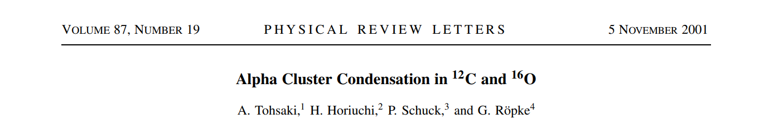
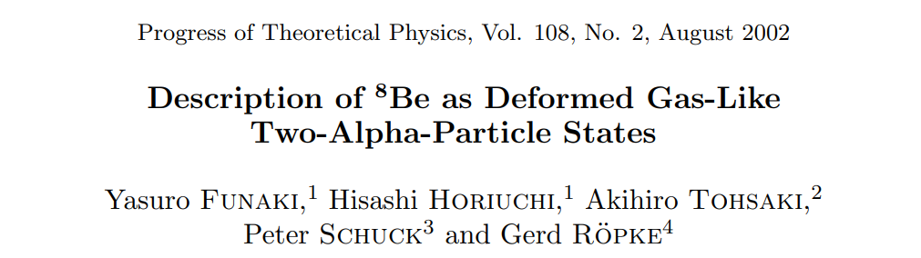
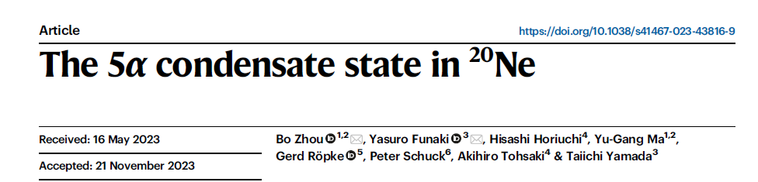
BRIEF INTRODUCTION TO THE PHYSIC CASE
..just few examples from literature
I.Lombardo and D.Dell’Aquila, La Rivista del Nuovo Cimento (2023) 46:521–618
Search for Alpha-cluster Condensed State (ACS) in N=Z systems,
α-particles condensed into the lowest 0⁺_{s}
Large average spatial separation
Reduction of the Coulomb barrier
Theoretically, ACS can survive up to N_{α} ≈ 10

Slide 5
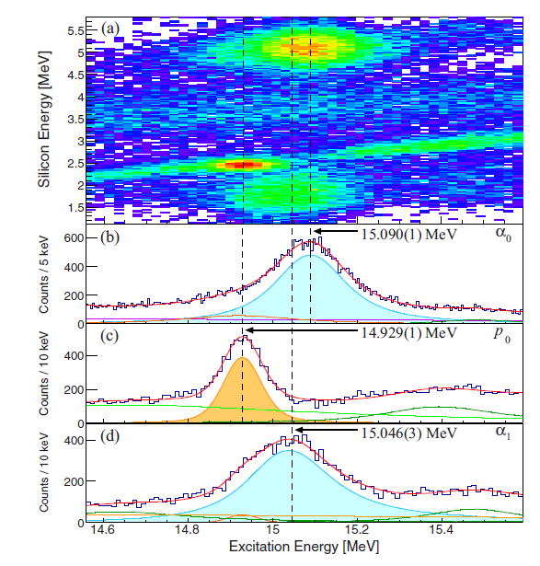
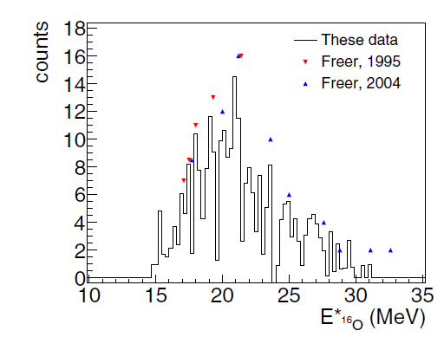
BRIEF INTRODUCTION TO THE PHYSIC CASE
Signatures from experimental point of view
Alpha-Cluster Condensed State decays through ACS
Enhancement of the decay yields with respect to a pure statistical model
Low energy alpha emission
K.CW.Li et al., Phys. Rev.C95(2017), 031302(R)
¹⁶O experimental evidence
M.Barbui et al., Phys. Rev.C98 (2018), 044601
²⁰Ne + α @12 MeV/nucleon: some evidence around the 15.2MeV
¹⁶O(α,α’) @200MeV looking at θlab = 0◦

Slide 6
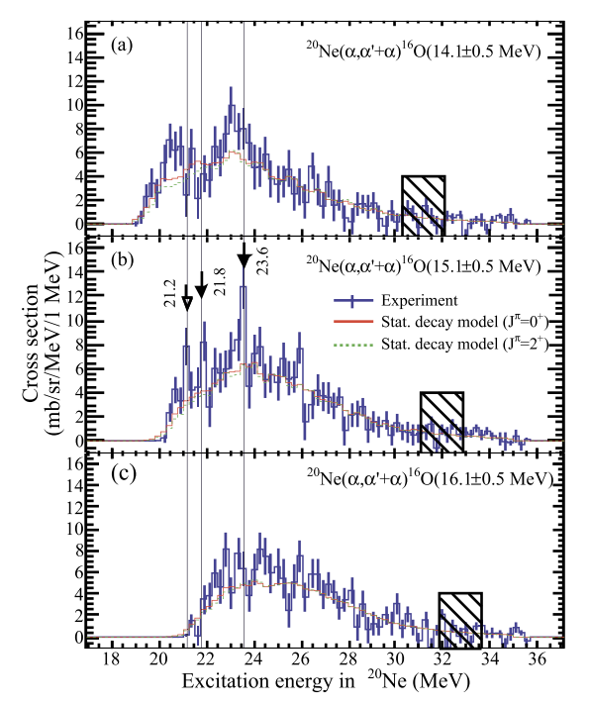
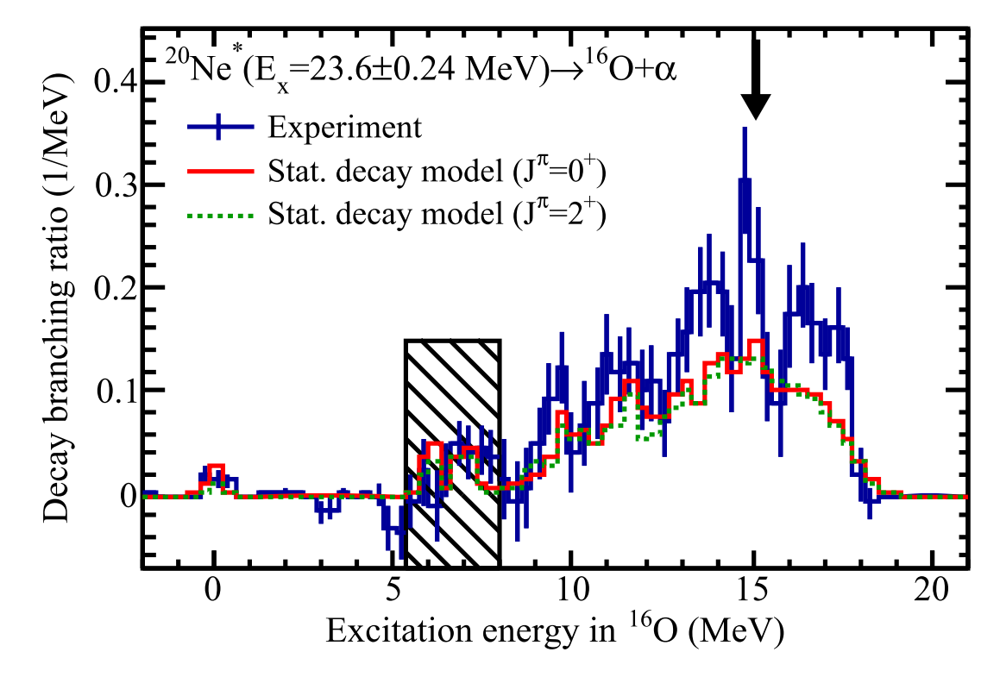
BRIEF INTRODUCTION TO THE PHYSIC CASE
²⁰Ne experimental evidence
Recently, Adachi and collaborators (S. Adachi et al., Physics Letters B 819, 136411 (2021)) performed the ²⁰Ne(α, α’+α)^{*16}O reaction at 385 MeV
Three states 21.2, 21.8, 23.6 MeV of ²⁰Ne* correlated
with 15.1 MeV state in ¹⁶Oxygen
“This result presents the first strong evidence that these states are the candidates for the 5α condensed state in ²⁰Ne because the 0+ 6 state in ¹⁶O is a strong candidate for the 4α condensed state. However, their spins and parities are still ambiguous. An additional measurement to determine their spins and parities is strongly desired.”

Slide 7
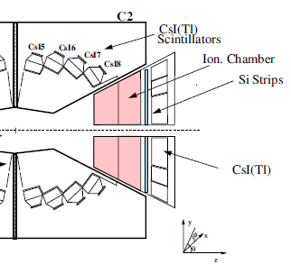
THE ALCONE EXPERIMENT
Main idea: to obtain a ²⁰Ne* nucleus via tranfer reaction ¹⁶O(⁶Li,d)²⁰Ne* at 13.5MeV/u
Ionization Chamber NOT used
OSCAR
beam
RCo
GARFIELD

Slide 8

THE ALCONE EXPERIMENT
Ionization Chamber NOT used
beam
OSCAR
RCo
GARFIELD
SOME GARFIELD APPARATUS FEATURES:
1 stage with 96 CsI(Tl) crystals with Δθ~7.5° and Δφ=7.5°
4 ring to cover from 30°≤θ_{c2}≤85°
Detection of LCP via PSA
M. Bruno et al., Eur. Phys. J. A 49, 128 (2013)

Slide 9
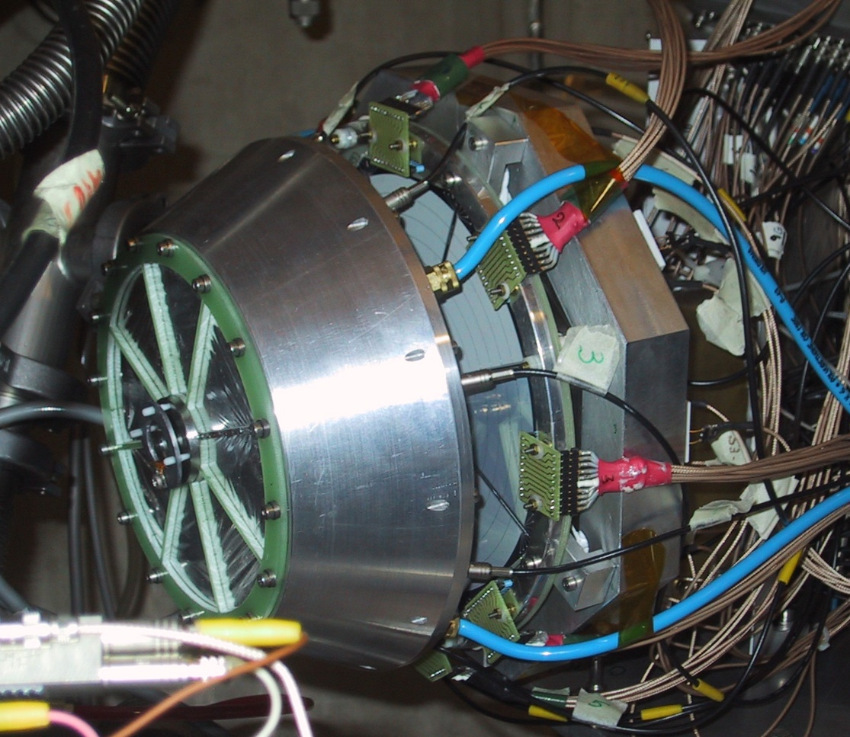
THE ALCONE EXPERIMENT
Ionization Chamber NOT used
Si vs CsI(Tl)
beam
OSCAR
RCo
Si PSA
GARFIELD
SOME RCo FEATURES:
2 stages telescope Si 300µm +Csi(Tl)
128 telescope with Δθ~1.5° and Δφ=22.5°
5≤ θ_{RCo}≤17 with 8 Si strips
Detection of LCP and heavy Fragments via PSA and dE-E
M. Bruno et al., Eur. Phys. J. A 49, 128 (2013)

Slide 10
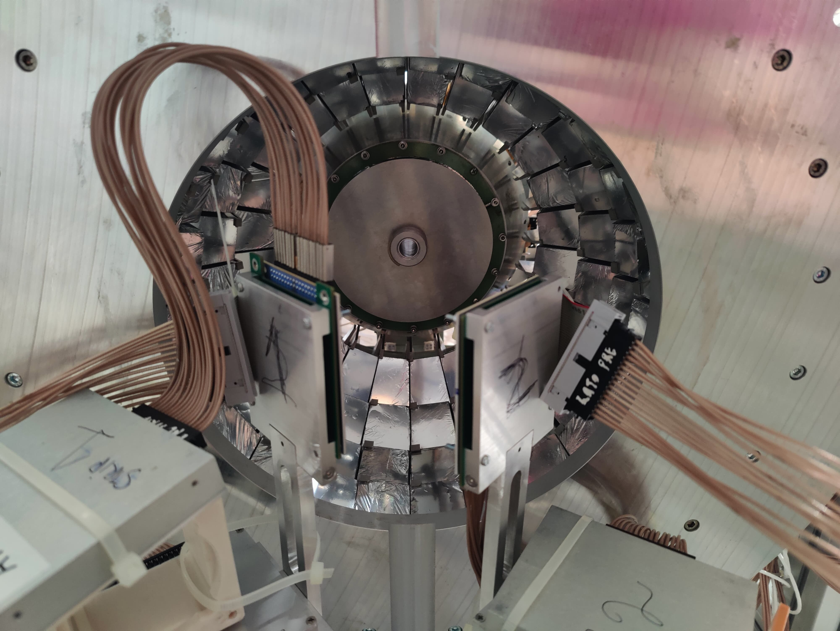
THE ALCONE EXPERIMENT
Ionization Chamber NOT used
beam
OSCAR
RCo
GARFIELD
Strip vs PAD
SOME OSCAR FEATURES:
2 stages telescope Si (20µm)+Si(500µm)
110<θ<150 with r ~ 6 cm
Detection of LCP via dE-E
Angular resolution ~1.5°
16 strip
4x4 matrix Photodiodes
D. Dell’Aquila et al., NIM A 877, 227 (2018).

Slide 11
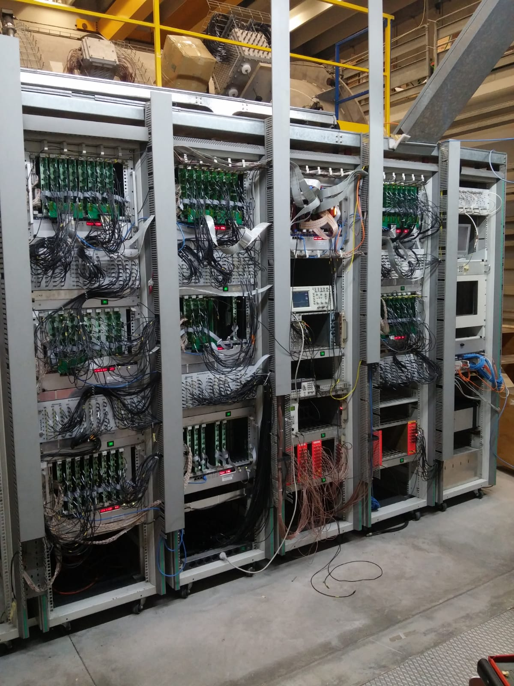
THE ALCONE EXPERIMENT
Main idea: to obtain a ²⁰Ne* nucleus via tranfer reaction ¹⁶O(⁶Li,d)²⁰Ne* at 13.5MeV/u
All channels equipped with digital electronics
New FEE boards (OSCAR and RCo)
Old FEE boards (GARFIELD)
Garfield+Rco Electronic
• Two independent channels
• 14-bit, 125 MHz ADC
• DSP and FPGA on board
Digital trigger
Maximum of Current signal calculated on board from charge signal (used for PSA purpose)
One channel
12-bit, 125 MHz ADC
Only DSP
Analogic trigger with
regulable threshold
P. Ottanelli et al, Nuovo Cimento C 42(2019), 65
Digital Trigger box to creare the experimental trigger (mainly OSCAR+RCo)
P. Ottanelli et al, NIM A 1015, 165745 (2021)

Slide 12
Some preliminary results: event characterization
no PSA identification in RCO considered!!
O+F
O+F
99%
O+Li
O+Li
96%
No PSA in RCo means no ER considered in Z_{tot}

Slide 13
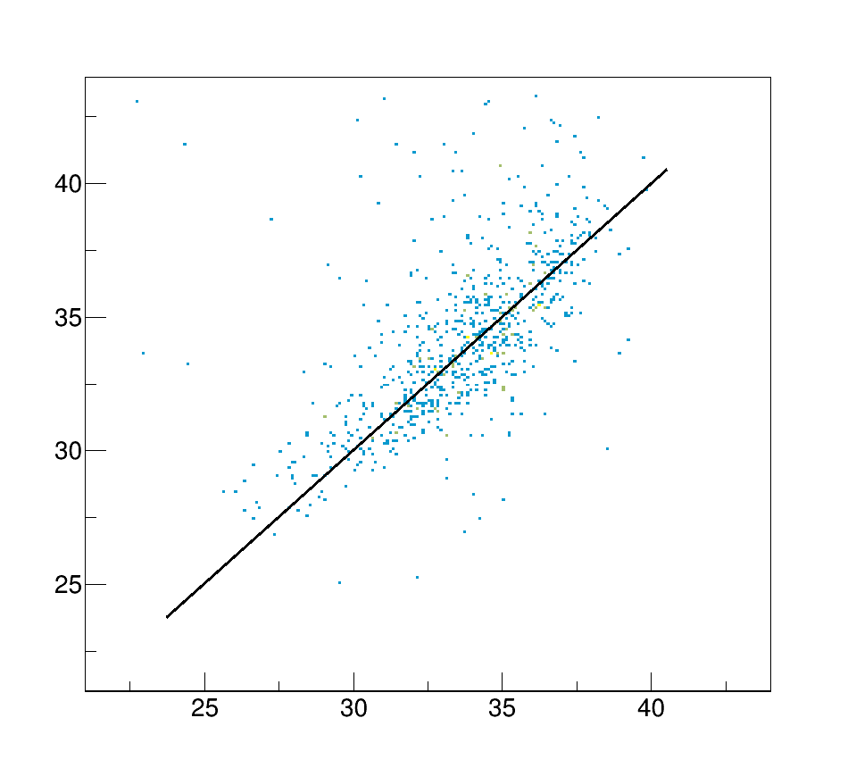
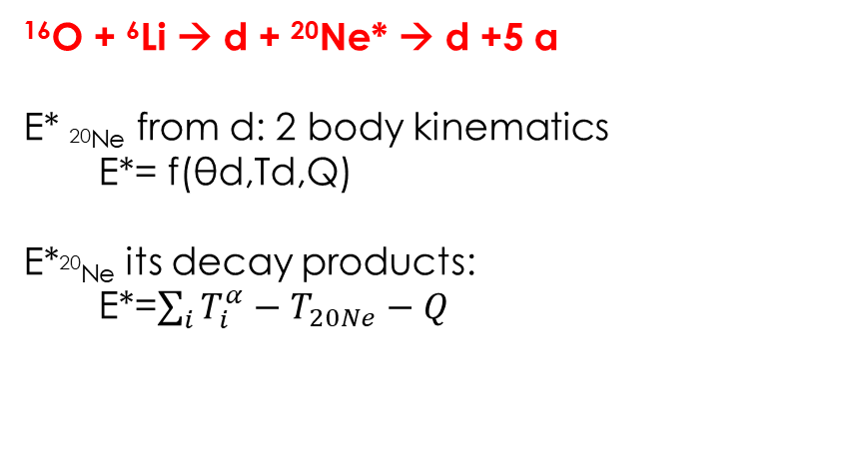
Some preliminary results: events selection
2 body inverse kinematic: from the detection of the deuteron in OSCAR, we can characterize the ²⁰Ne* obtained via nuclear transfer reaction
…of course, not all the deuteron detected are coming from a nuclear transfer reaction!
SPECIFIC CASE:
1 deuteron in OSCAR
5 alphas,
v_{z}(5alphas) > v_{CM}
773 entries
¹⁶O + ⁶Li → d + ²⁰Ne* → d +5 α
E* _{20Ne} from d: 2 body kinematics
E*= f(θd,Td,Q)
E*²⁰_{Ne} its decay products:
E*=$\sum_{i}{T_{i}^{α}−T_{20Ne}−Q}$
²⁰Ne* from deuteron
.. in case of nuclear transfer reaction, the reconstruction of ²⁰Ne* seems to be reliable!
²⁰Ne* from alphas

Slide 14
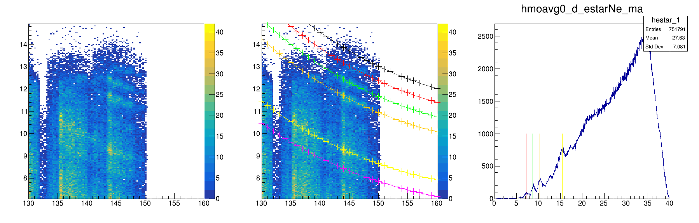
Some preliminary results: events selection
EVENTS SELECTION:
1(and only 1) deuteron in OSCAR
Events with one particles with Z>2 rejected
Only alpha particles in GARFIELD and RCo
V_{z}(nα) > v_{cm}
Kinematic curves from deuteron
Preliminary!
E_{deuteron}
Kinematic curves from deuteron
E_{deuteron}
²⁰Ne*=5.7877 MeV
²⁰Ne*=7.191 MeV
²⁰Ne*=8.7 MeV
²⁰Ne*=10.2732 MeV
²⁰Ne*=15.5 MeV
²⁰Ne*=17.39 MeV
θ_{deuteron}
θ_{deuteron}

Slide 15
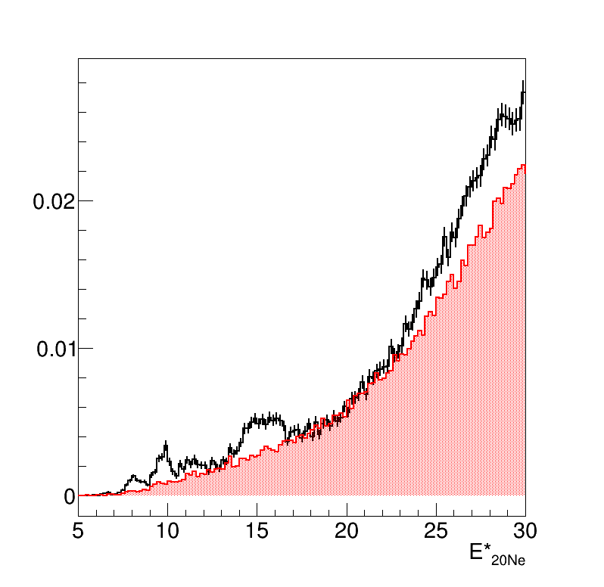
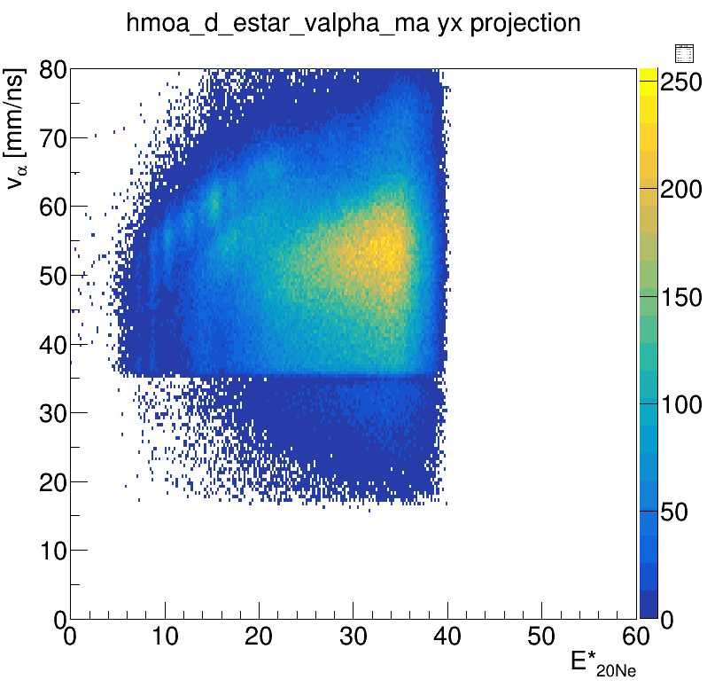
Some preliminary results: the ²⁰Ne* states
EVENTS SELECTION:
40 < v_{a} < 45 mm/ns
Preliminary!
1(and only 1) deuteron in OSCAR
Events with one particles with Z>2 rejected
Only alpha particles in GARFIELD and RCo
V_{z}(nα) > v_{cm}
Normalized yield
Used for bkg estimation

Slide 16
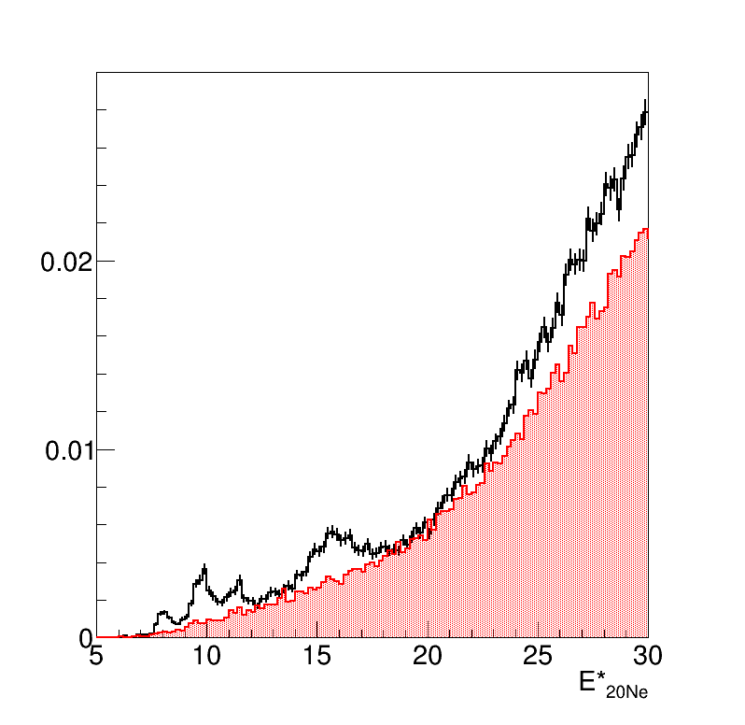
Some preliminary results: the ²⁰Ne* states
EVENTS SELECTION:
45 < v_{a} < 50 mm/ns
Preliminary!
1(and only 1) deuteron in OSCAR
Events with one particles with Z>2 rejected
Only alpha particles in GARFIELD and RCo
V_{z}(nα) > v_{cm}
Normalized yield
Used for bkg estimation

Slide 17
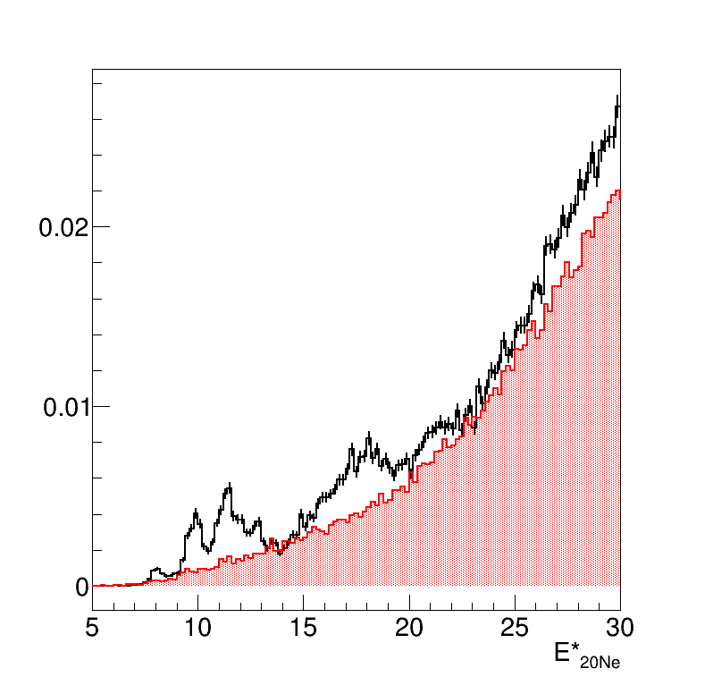
Some preliminary results: the ²⁰Ne* states
EVENTS SELECTION:
1(and only 1) deuteron in OSCAR
Events with one particles with Z>2 rejected
Only alpha particles in GARFIELD and RCo
V_{z}(nα) > v_{cm}
Preliminary!
50 < v_{a} < 55 mm/ns
Normalized yield
Used for bkg estimation

Slide 18
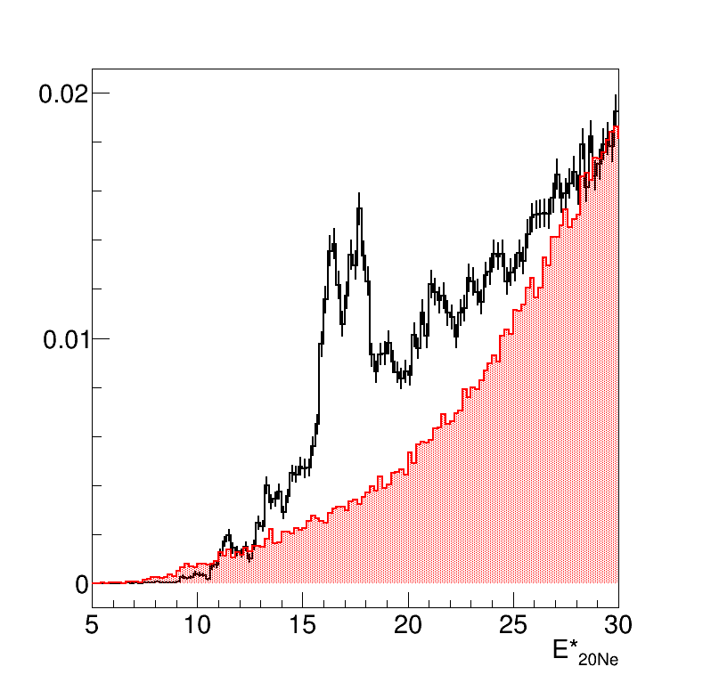
Some preliminary results: the ²⁰Ne* states
EVENTS SELECTION:
1(and only 1) deuteron in OSCAR
Events with one particles with Z>2 rejected
Only alpha particles in GARFIELD and RCo
V_{z}(nα) > v_{cm}
55 < v_{a} < 60 mm/ns
Preliminary!
Normalized yield
Used for bkg estimation

Slide 19
Summary and perspectives
Preliminary results of the ¹⁶O(⁶Li,d)²⁰Ne experiment with the OSCAR+GARFIELD+RCo apparatus have been shown.
Events have been characterized accessing both the target ejectile and ²⁰Ne decay products
A safe region where deuteron is emitted in α-transfer reaction has been pointed out
Three broad peaks in the 20-25 MeV excitation energy region have been identified and deserve further investigation
Thank you for your attention!

