Slide 1
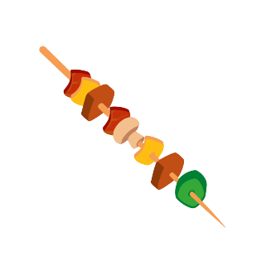
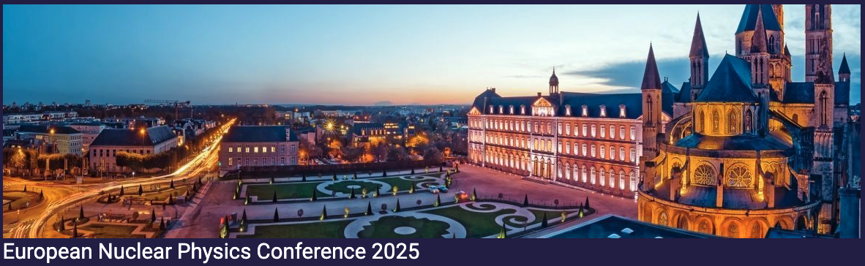


Study of proton and neutron contributions to the excitation
of the 2⁺ states in Si isotopes between N=20 and N=28
1- Motivations
2- Experimental setup - the « brochette » mode
3- Analysis of the Coulomb excitation data
4- Results
5- Theoretical calculations
6- Conclusions
Q. Délignac
PhD work
Stéphane Grévy
LP2i Bordeaux (Laboratoire des 2 infinis Bordeaux)
CNRS/IN2P3
S. Grévy - LP2i Bordeaux CNRS/IN2P3 European Nuclear Physics Conference – Caen – France - 22-26 sept. 2025

Slide 2
1- Motivations
Physics of the N=28 shell closure
Gradual reduction of the N=28 shell gap below ⁴⁸Ca
Proton induced collectivity from the s_{1/2} and d_{3/2} degeneracy
neutron
f_{7/2}
N=20
N=28
empty
j'<
Ca Z=20
⁴⁰Ca
⁴⁸Ca
filled
j'>
f5/2
⁴⁸Ca
p3/2
filling of the νf_{7/2}
j<
j>
28
Ar Z=18
➢ compression of πd_{3/2}d_{5/2}
→ reduction of Z=14 gap
f7/2
proton
neutron
20
j<
removal of the πd_{3/2}
proton
d_{3/2} s_{1/2} d_{5/2}
T. Otsuka et al. PRL95(2005)232502.
d3/2
d3/2
S Z=16
³⁶S
➢ compression of νf_{5/2}f_{7/2}
→ reduction of N=28 gap
j>
s1/2
s1/2
j'<
empty
14
Si Z=14
j'>
d5/2
d5/2
³⁴Si
⁴²Si
filled
π
ν
proton
neutron
S. Grévy - LP2i Bordeaux CNRS/IN2P3 European Nuclear Physics Conference – Caen – France - 22-26 sept. 2025

Slide 3
1- Motivations
Physics of the N=28 shell closure
Gradual reduction of the N=28 shell gap below ⁴⁸Ca
Proton induced collectivity from the s_{1/2} and d_{3/2} degeneracy
neutron
f_{7/2}
N=20
N=28
empty
j'<
Ca Z=20
⁴⁰Ca
⁴⁸Ca
filled
j'>
f5/2
⁴⁸Ca
p3/2
filling of the νf_{7/2}
j<
j>
28
Ar Z=18
➢ compression of πd_{3/2}d_{5/2}
→ reduction of Z=14 gap
f7/2
proton
neutron
20
j<
removal of the πd_{3/2}
proton
d_{3/2} s_{1/2} d_{5/2}
T. Otsuka et al. PRL95(2005)232502.
d3/2
d3/2
S Z=16
³⁶S
➢ compression of νf_{5/2}f_{7/2}
→ reduction of N=28 gap
j>
s1/2
s1/2
j'<
empty
14
Si Z=14
j'>
d5/2
d5/2
³⁴Si
⁴²Si
filled
π
ν
proton
neutron
³⁴Si « magic »
strong Z=14 gap
strong N=20 gap
S. Grévy - LP2i Bordeaux CNRS/IN2P3 European Nuclear Physics Conference – Caen – France - 22-26 sept. 2025

Slide 4
1- Motivations
Physics of the N=28 shell closure
Gradual reduction of the N=28 shell gap below ⁴⁸Ca
Proton induced collectivity from the s_{1/2} and d_{3/2} degeneracy
neutron
f_{7/2}
N=20
N=28
empty
j'<
Ca Z=20
⁴⁰Ca
⁴⁸Ca
filled
j'>
f5/2
⁴⁸Ca
p3/2
filling of the νf_{7/2}
j<
j>
28
Ar Z=18
➢ compression of πd_{3/2}d_{5/2}
→ reduction of Z=14 gap
f7/2
proton
neutron
20
j<
removal of the πd_{3/2}
proton
d_{3/2} s_{1/2} d_{5/2}
T. Otsuka et al. PRL95(2005)232502.
d3/2
d3/2
S Z=16
³⁶S
➢ compression of νf_{5/2}f_{7/2}
→ reduction of N=28 gap
j>
s1/2
s1/2
j'<
empty
14
Si Z=14
j'>
d5/2
d5/2
³⁴Si
⁴²Si
filled
π
ν
proton
neutron
³⁴Si « magic »
strong Z=14 gap
strong N=20 gap
⁴²Si
reduced Z=14 gap
reduced N=28 gap
S. Grévy - LP2i Bordeaux CNRS/IN2P3 European Nuclear Physics Conference – Caen – France - 22-26 sept. 2025

Slide 5
1- Motivations
Physics of the N=28 shell closure
Gradual reduction of the N=28 shell gap below ⁴⁸Ca
Proton induced collectivity from the s_{1/2} and d_{3/2} degeneracy
neutron
f_{7/2}
N=20
N=28
empty
j'<
Ca Z=20
⁴⁰Ca
⁴⁸Ca
filled
j'>
f5/2
⁴⁸Ca
p3/2
filling of the νf_{7/2}
j<
j>
28
Ar Z=18
➢ compression of πd_{3/2}d_{5/2}
→ reduction of Z=14 gap
f7/2
proton
neutron
20
j<
removal of the πd_{3/2}
proton
d_{3/2} s_{1/2} d_{5/2}
T. Otsuka et al. PRL95(2005)232502.
d3/2
d3/2
S Z=16
³⁶S
➢ compression of νf_{5/2}f_{7/2}
→ reduction of N=28 gap
j>
s1/2
s1/2
j'<
empty
14
Si Z=14
j'>
d5/2
d5/2
³⁴Si
⁴²Si
filled
π
ν
proton
neutron
³⁴Si « magic »
strong Z=14 gap
strong N=20 gap
⁴²Si
reduced Z=14 gap
reduced N=28 gap
→ ⁴²Si, with reduced Z=14 & N=28 gaps, is a "golden case" for the study of the tensor force
S. Grévy - LP2i Bordeaux CNRS/IN2P3 European Nuclear Physics Conference – Caen – France - 22-26 sept. 2025

Slide 6
1- Motivations
Physics of the N=28 shell closure
Gradual reduction of the N=28 shell gap below ⁴⁸Ca
Proton induced collectivity from the s_{1/2} and d_{3/2} degeneracy
neutron
f_{7/2}
N=20
N=28
empty
j'<
Ca Z=20
⁴⁰Ca
⁴⁸Ca
filled
j'>
⁴⁸Ca
filling of the νf_{7/2}
j<
Several studies performed in the past
from Ca to Si at N=28 ("below ⁴⁸Ca") :
Variety of shapes :
⁴⁶Ar : nearly spherical * (Z=18)
⁴⁴S : prolate-spherical shape coexistence (Z=16)
⁴²Si : strong oblate deformation (Z=14)
* But SM calculations predict enhanced collectivity
Ar Z=18
➢ compression of πd_{3/2}d_{5/2}
→ reduction of Z=14 gap
j>
⁴⁶Ar
proton
neutron
j<
removal of the πd_{3/2}
proton
d_{3/2} s_{1/2} d_{5/2}
T. Otsuka et al. PRL95(2005)232502.
S Z=16
³⁶S
⁴⁴S
➢ compression of νf_{5/2}f_{7/2}
→ reduction of N=28 gap
j>
j'<
empty
Si Z=14
³⁴Si
⁴²Si
j'>
filled
proton
neutron
³⁴Si « magic »
strong Z=14 gap
strong N=20 gap
⁴²Si
reduced Z=14 gap
reduced N=28 gap
S. Grévy - LP2i Bordeaux CNRS/IN2P3 European Nuclear Physics Conference – Caen – France - 22-26 sept. 2025

Slide 7
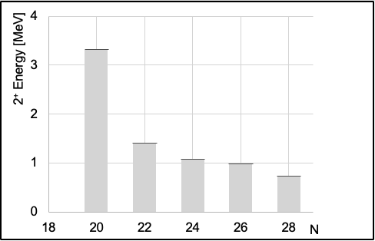
1- Motivations
Physics of the N=28 shell closure
Gradual reduction of the N=28 shell gap below ⁴⁸Ca
Proton induced collectivity from the s_{1/2} and d_{3/2} degeneracy
neutron
f_{7/2}
N=20
N=28
empty
j'<
Ca Z=20
⁴⁰Ca
⁴⁸Ca
filled
j'>
⁴⁸Ca
filling of the νf_{7/2}
j<
Several studies performed in the past
from Ca to Si at N=28 ("below ⁴⁸Ca") :
Variety of shapes :
⁴⁶Ar : nearly spherical * (Z=18)
⁴⁴S : prolate-spherical shape coexistence (Z=16)
⁴²Si : strong oblate deformation (Z=14)
* But SM calculations predict enhanced collectivity
Ar Z=18
➢ compression of πd_{3/2}d_{5/2}
→ reduction of Z=14 gap
j>
⁴⁶Ar
proton
neutron
j<
removal of the πd_{3/2}
proton
d_{3/2} s_{1/2} d_{5/2}
T. Otsuka et al. PRL95(2005)232502.
S Z=16
³⁶S
⁴⁴S
➢ compression of νf_{5/2}f_{7/2}
→ reduction of N=28 gap
j>
j'<
empty
Si Z=14
³⁴Si
⁴²Si
j'>
filled
proton
neutron
³⁴Si « magic »
strong Z=14 gap
strong N=20 gap
⁴²Si → deformed
reduced Z=14 gap
reduced N=28 gap
2⁺
S. Grévy - LP2i Bordeaux CNRS/IN2P3 European Nuclear Physics Conference – Caen – France - 22-26 sept. 2025

Slide 8
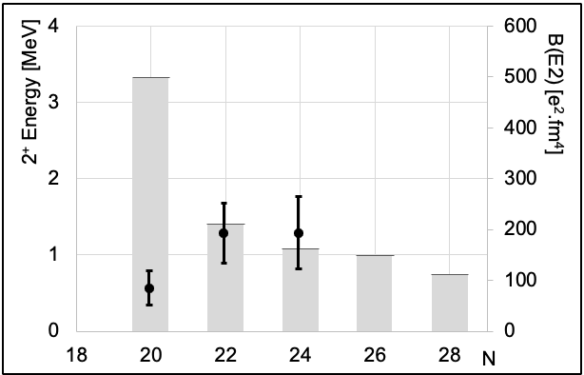
1- Motivations
Physics of the N=28 shell closure
Gradual reduction of the N=28 shell gap below ⁴⁸Ca
Proton induced collectivity from the s_{1/2} and d_{3/2} degeneracy
neutron
f_{7/2}
N=20
N=28
empty
j'<
Ca Z=20
⁴⁰Ca
⁴⁸Ca
filled
j'>
⁴⁸Ca
filling of the νf_{7/2}
j<
Several studies performed in the past
from Ca to Si at N=28 ("below ⁴⁸Ca") :
Variety of shapes :
⁴⁶Ar : nearly spherical * (Z=18)
⁴⁴S : prolate-spherical shape coexistence (Z=16)
⁴²Si : strong oblate deformation (Z=14)
* But SM calculations predict enhanced collectivity
Ar Z=18
➢ compression of πd_{3/2}d_{5/2}
→ reduction of Z=14 gap
j>
⁴⁶Ar
proton
neutron
j<
removal of the πd_{3/2}
proton
d_{3/2} s_{1/2} d_{5/2}
T. Otsuka et al. PRL95(2005)232502.
S Z=16
³⁶S
⁴⁴S
➢ compression of νf_{5/2}f_{7/2}
→ reduction of N=28 gap
j>
j'<
empty
Si Z=14
³⁴Si
⁴²Si
j'>
filled
proton
neutron
³⁴Si « magic »
strong Z=14 gap
strong N=20 gap
⁴²Si → deformed
reduced Z=14 gap
reduced N=28 gap
2⁺
B(E2)
S. Grévy - LP2i Bordeaux CNRS/IN2P3 European Nuclear Physics Conference – Caen – France - 22-26 sept. 2025

Slide 9
1- Motivations
Physics of the N=28 shell closure
Gradual reduction of the N=28 shell gap below ⁴⁸Ca
Proton induced collectivity from the s_{1/2} and d_{3/2} degeneracy
neutron
f_{7/2}
N=20
N=28
empty
j'<
Ca Z=20
⁴⁰Ca
⁴⁸Ca
filled
j'>
⁴⁸Ca
filling of the νf_{7/2}
j<
Several studies performed in the past
from Ca to Si at N=28 ("below ⁴⁸Ca") :
Variety of shapes :
⁴⁶Ar : nearly spherical * (Z=18)
⁴⁴S : prolate-spherical shape coexistence (Z=16)
⁴²Si : strong oblate deformation (Z=14)
* But SM calculations predict enhanced collectivity
Ar Z=18
➢ compression of πd_{3/2}d_{5/2}
→ reduction of Z=14 gap
j>
⁴⁶Ar
proton
neutron
j<
removal of the πd_{3/2}
proton
d_{3/2} s_{1/2} d_{5/2}
T. Otsuka et al. PRL95(2005)232502.
S Z=16
³⁶S
⁴⁴S
➢ compression of νf_{5/2}f_{7/2}
→ reduction of N=28 gap
j>
j'<
empty
Si Z=14
³⁴Si
⁴²Si
j'>
filled
proton
neutron
³⁴Si « magic »
strong Z=14 gap
strong N=20 gap
⁴²Si → deformed
reduced Z=14 gap
reduced N=28 gap
2⁺
B(E2)
Reduced Z=14
Coutesy T. Otsuka
S. Grévy - LP2i Bordeaux CNRS/IN2P3 European Nuclear Physics Conference – Caen – France - 22-26 sept. 2025

Slide 10
1- Motivations
Physics of the N=28 shell closure
Gradual reduction of the N=28 shell gap below ⁴⁸Ca
Proton induced collectivity from the s_{1/2} and d_{3/2} degeneracy
neutron
f_{7/2}
N=20
N=28
empty
j'<
Ca Z=20
⁴⁰Ca
⁴⁸Ca
filled
j'>
⁴⁸Ca
filling of the νf_{7/2}
j<
Several studies performed in the past
from Ca to Si at N=28 ("below ⁴⁸Ca") :
Variety of shapes :
⁴⁶Ar : nearly spherical * (Z=18)
⁴⁴S : prolate-spherical shape coexistence (Z=16)
⁴²Si : strong oblate deformation (Z=14)
* But SM calculations predict enhanced collectivity
Ar Z=18
➢ compression of πd_{3/2}d_{5/2}
→ reduction of Z=14 gap
j>
⁴⁶Ar
proton
neutron
j<
removal of the πd_{3/2}
proton
d_{3/2} s_{1/2} d_{5/2}
T. Otsuka et al. PRL95(2005)232502.
S Z=16
³⁶S
⁴⁴S
➢ compression of νf_{5/2}f_{7/2}
→ reduction of N=28 gap
j>
j'<
empty
Si Z=14
³⁴Si
³⁶Si
³⁸Si
⁴⁰Si
⁴²Si
j'>
filled
proton
neutron
³⁴Si « magic »
strong Z=14 gap
strong N=20 gap
⁴²Si → deformed
reduced Z=14 gap
reduced N=28 gap
Aim of our study :
Follow the evolution of both proton and neutron
excitations in the Si chain from N=20 towards N=28
S. Grévy - LP2i Bordeaux CNRS/IN2P3 European Nuclear Physics Conference – Caen – France - 22-26 sept. 2025

Slide 11
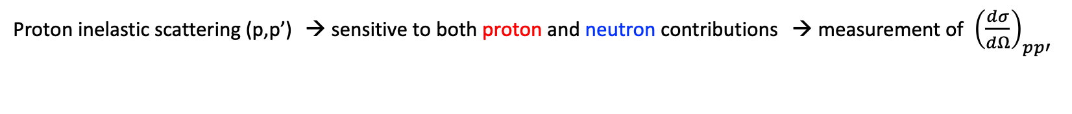
1- Motivations
How to quantify proton and neutrons excitations in Si isotopes from N=20 to N=28 ?
2⁺
→ by exciting the 2⁺ states by different probes
Probes
0⁺
Coulomb excitation → sensitive to proton contributions → measurement of B(E2; 0⁺ → 2⁺)
Proton inelastic scattering (p,p’) → sensitive to both proton and neutron contributions → measurement of ${ \left(\frac{dσ}{dΩ}\right)}_{pp′}$
S. Grévy - LP2i Bordeaux CNRS/IN2P3 European Nuclear Physics Conference – Caen – France - 22-26 sept. 2025

Slide 12


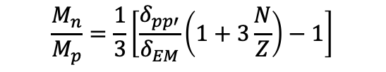
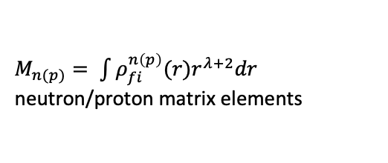
1- Motivations
How to quantify proton and neutrons excitations in Si isotopes from N=20 to N=28 ?
2⁺
→ by exciting the 2⁺ states by different probes
Probes
0⁺
Coulomb excitation → sensitive to proton contributions → measurement of B(E2; 0⁺ → 2⁺)
Proton inelastic scattering (p,p’) → sensitive to both proton and neutron contributions → measurement of ${ \left(\frac{dσ}{dΩ}\right)}_{pp′}$
from ${\left(\frac{dσ}{dΩ}\right)}_{pp′}$
At Fermi energies :
$$\frac{M_{n}}{M_{p}}=\frac{1}{3}\left[\frac{δ_{pp′}}{δ_{EM}}\left(1+3\frac{N}{Z}\right)−1\right]$$
$M_{n(p)}= \int{ρ_{fi}^{n\left(p\right)}(r)r^{λ+2}dr}$
neutron/proton matrix elements
from B(E2; 0⁺ → 2⁺) $∝σ_{CouleX}$
[Ref] A. Berstein et al, P. L. B, 103 (1981)
S. Grévy - LP2i Bordeaux CNRS/IN2P3 European Nuclear Physics Conference – Caen – France - 22-26 sept. 2025

Slide 13





1- Motivations
How to quantify proton and neutrons excitations in Si isotopes from N=20 to N=28 ?
2⁺
→ by exciting the 2⁺ states by different probes
Probes
0⁺
Coulomb excitation → sensitive to proton contributions → measurement of B(E2; 0⁺ → 2⁺)
Proton inelastic scattering (p,p’) → sensitive to both proton and neutron contributions → measurement of ${ \left(\frac{dσ}{dΩ}\right)}_{pp′}$
from ${\left(\frac{dσ}{dΩ}\right)}_{pp′}$
At Fermi energies :
$$\frac{M_{n}}{M_{p}}=\frac{1}{3}\left[\frac{δ_{pp′}}{δ_{EM}}\left(1+3\frac{N}{Z}\right)−1\right]$$
$M_{n(p)}= \int{ρ_{fi}^{n\left(p\right)}(r)r^{λ+2}dr}$
neutron/proton matrix elements
from B(E2; 0⁺ → 2⁺) $∝σ_{CouleX}$
[Ref] A. Berstein et al, P. L. B, 103 (1981)
- If 2⁺ state comes from collective vibration with protons and neutrons having the same amplitude →
$$\frac{M_{n}}{M_{p}}=\frac{N}{Z}$$
- In nuclei dominated by proton closed shell →
$$\frac{M_{n}}{M_{p}}>\frac{N}{Z}$$
- In nuclei dominated by neutron closed shell →
$$\frac{M_{n}}{M_{p}}<\frac{N}{Z}$$
S. Grévy - LP2i Bordeaux CNRS/IN2P3 European Nuclear Physics Conference – Caen – France - 22-26 sept. 2025

Slide 14
2- Experimental setup
Aim : measure the Coulomb excitation and proton inelastic scattering (0⁺ → 2⁺) in Si isotopes between N=20 and N=28
→ Is it possible to make both measurement with a single beam ?
S. Grévy - LP2i Bordeaux CNRS/IN2P3 European Nuclear Physics Conference – Caen – France - 22-26 sept. 2025

Slide 15
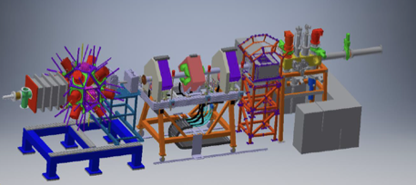
2- Experimental setup
Aim : measure the Coulomb excitation and proton inelastic scattering (0⁺ → 2⁺) in Si isotopes between N=20 and N=28
→ Is it possible to make both measurement with a single beam ?
Yes ! 1- production of the neutron rich Si isotopes with LISE@GANIL. aim: ³⁶Si, ³⁸Si and ⁴⁰Si
2- proton inelastic scattering in the active target ACTAR TPC : almost « transparent » setup
3- Coulex measurement with large efficiency and resolution gamma arrays and heavy ions
detection at zero degree
The brochette mode
Proton Inelastic
Scattering setup
LISE3
n-rich Si
Coulomb Excitation
setup
LISE QD6
S. Grévy - LP2i Bordeaux CNRS/IN2P3 European Nuclear Physics Conference – Caen – France - 22-26 sept. 2025

Slide 16
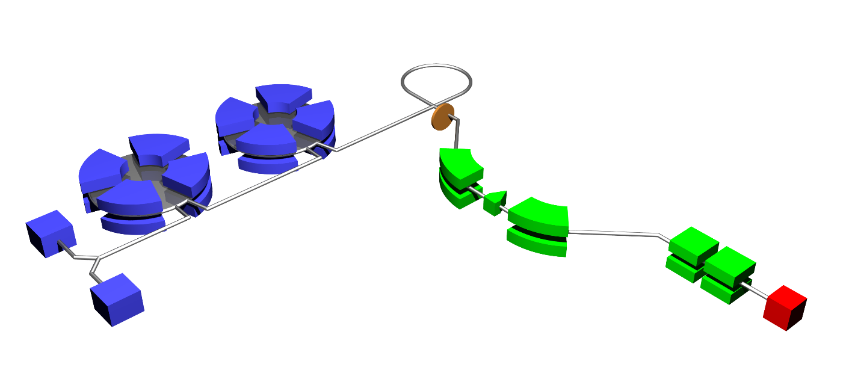


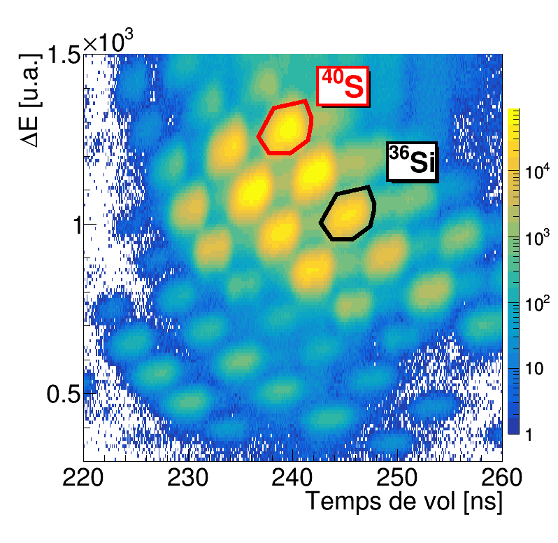



2- Experimental setup
Production of the exotic nuclei
Standard fragmentation production
60 MeV/A ⁴⁸Ca stable beam, 300 µm Be target
LISE3 fragment separator
(A,Z) separation, standard ToF – ΔE (Si) identification
cyclotrons
target
separator
$→$ One setting on ³⁶Si and ⁴⁰S
$→$ One setting on ³⁸Si and ⁴²S
$→$ No setting on ⁴⁰Si…
detector
³⁶Si setting
Z=16
Absolute B(E2) for ⁴⁰S and ⁴²S (as references)
Absolute B(E2) for ³⁶Si and ³⁸Si
Relative B(E2) of ³⁶Si/⁴⁰S and ³⁸Si/⁴²S
Z=14
Time-of-flight [ns]
S. Grévy - LP2i Bordeaux CNRS/IN2P3 European Nuclear Physics Conference – Caen – France - 22-26 sept. 2025

Slide 17

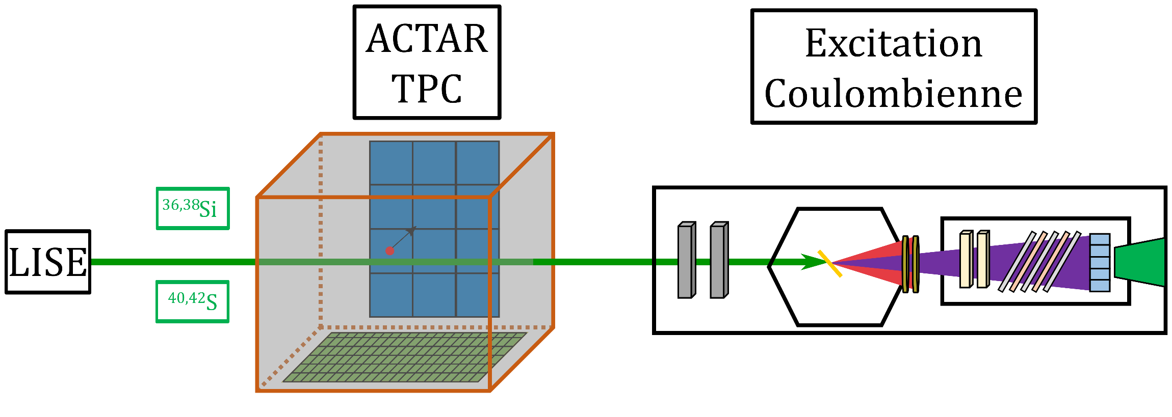
2- Experimental setup
The brochette mode : proton inelastic scattering and Coulomb excitation
(p,p’)
^{40,42}S
ACTAR – TPC
Analysis in progress
S. Grévy - LP2i Bordeaux CNRS/IN2P3 European Nuclear Physics Conference – Caen – France - 22-26 sept. 2025

Slide 18
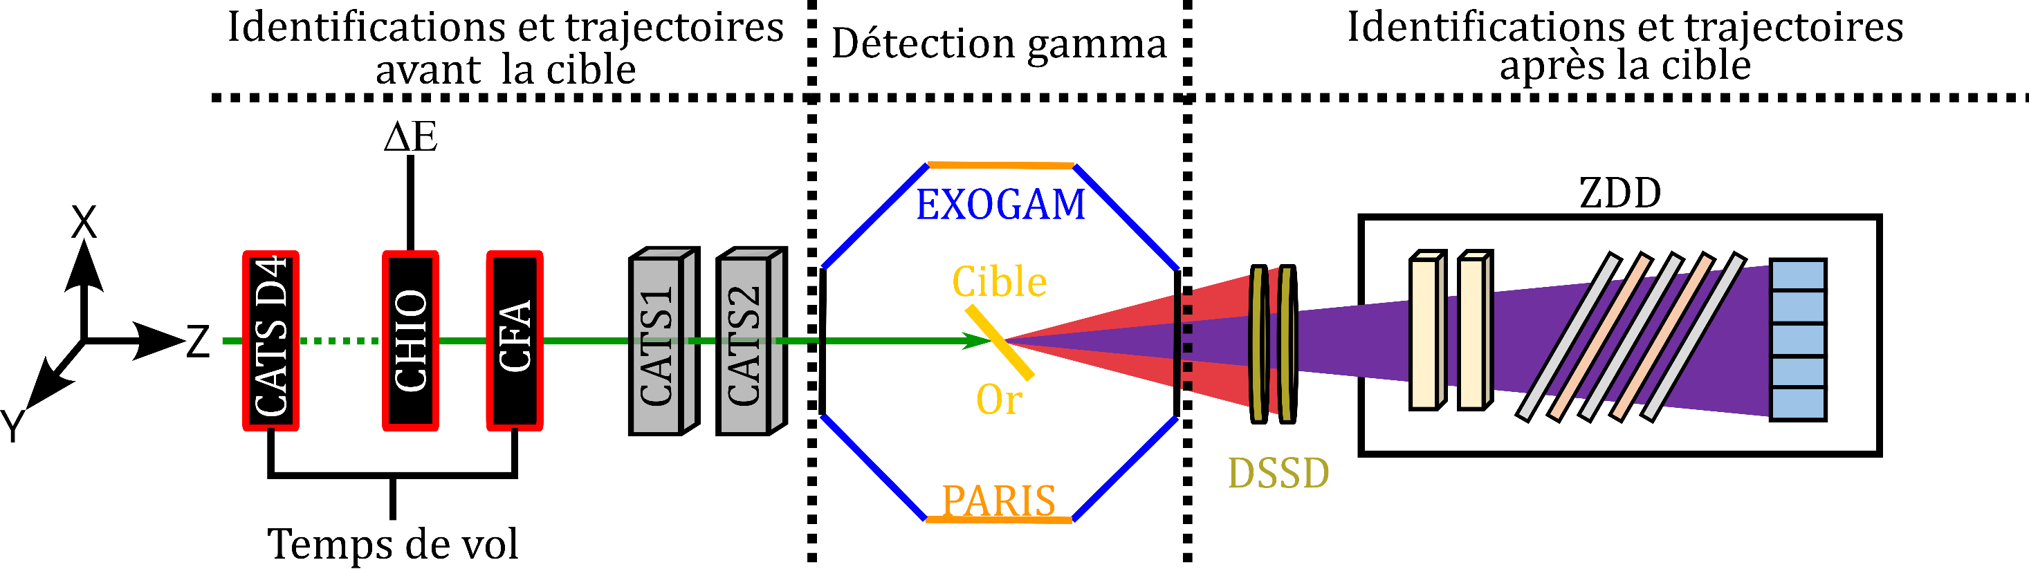
2- Experimental setup
Coulomb excitation setup
Heavy ions detection
5
4
1
2
3
^{36,38}Si
target
^{40,42}S
Au - 400mg/cm²
400 mg/cm²
1 LISE detectors : incident HI identification and selection
2 CATS : determination of the incident angle
3 DSSD : deflected HI identification, selection and angle determination from 3 to 7°
4 ZDD : deflected HI identification, selection and angle determination from 0 to 3°
5 EXOGAM and PARIS : gamma-rays
S. Grévy - LP2i Bordeaux CNRS/IN2P3 European Nuclear Physics Conference – Caen – France - 22-26 sept. 2025

Slide 19
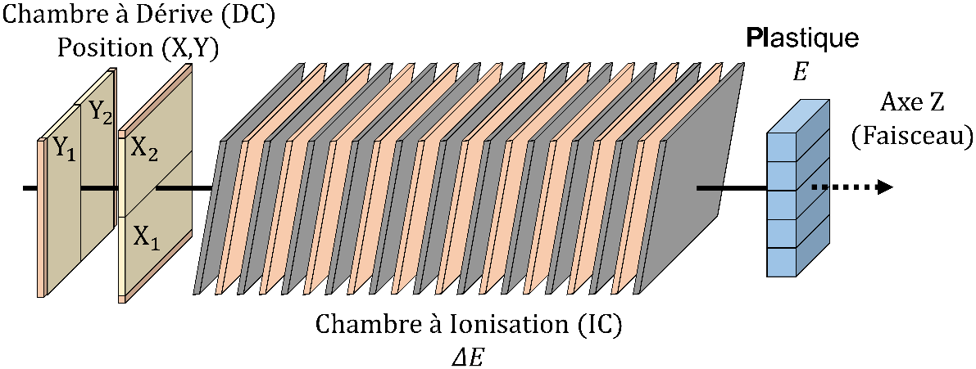
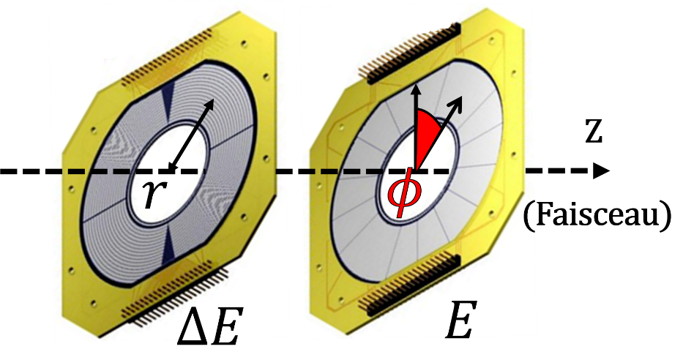
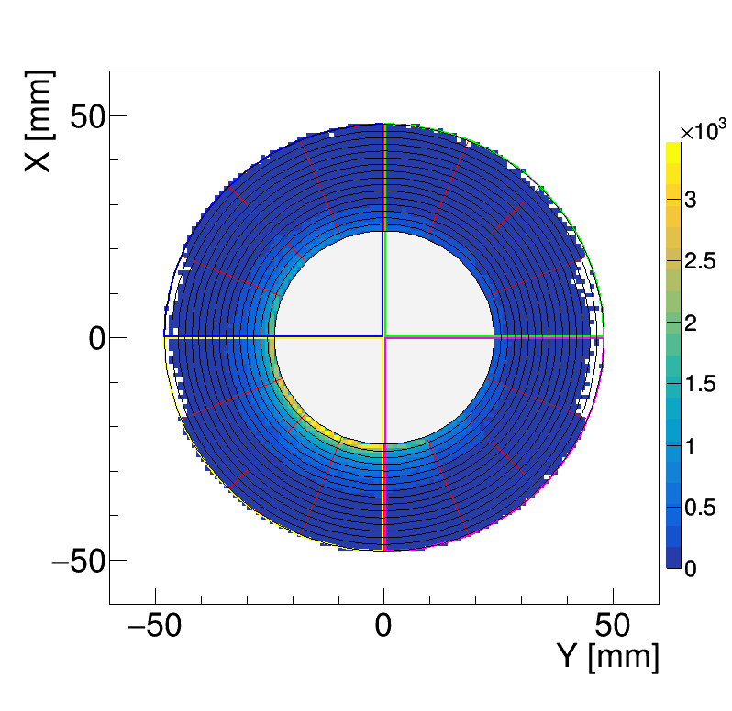
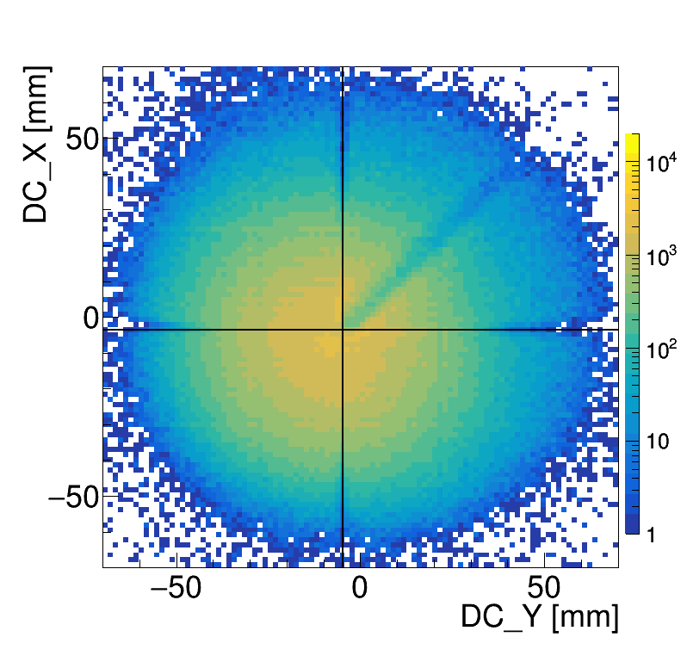
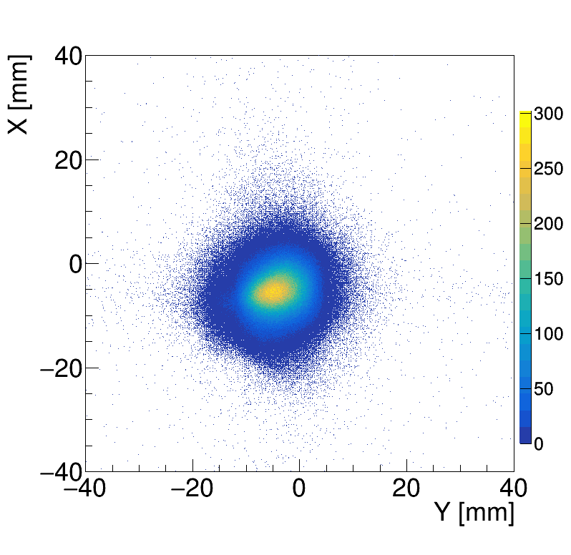
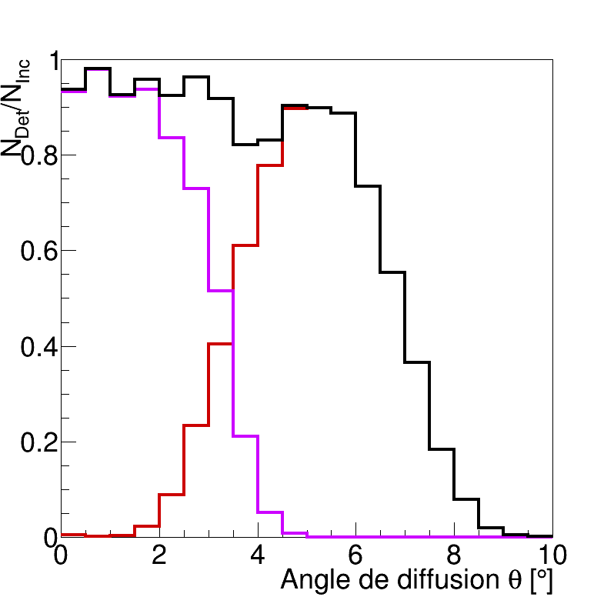
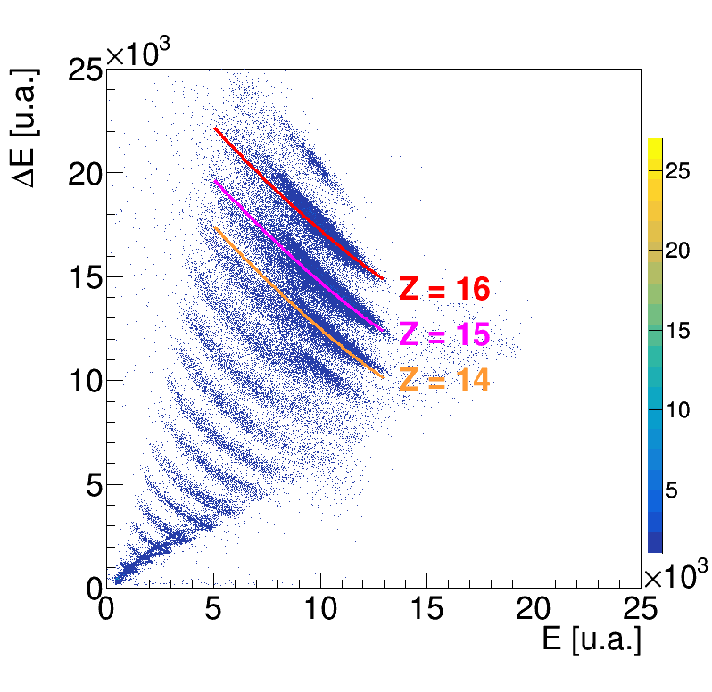
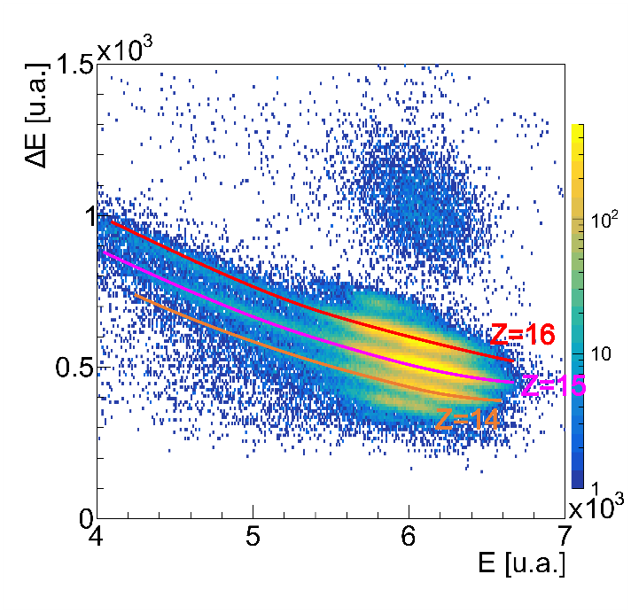
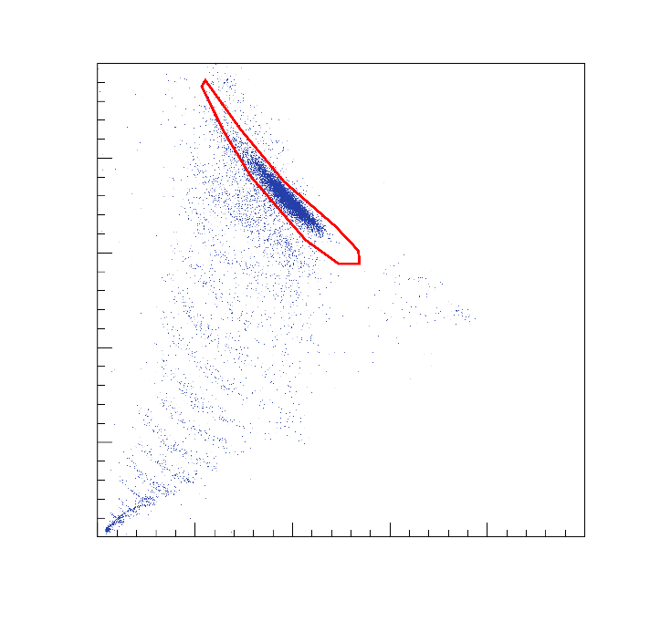
3- Analysis – Coulomb excitation data
Coulomb excitation setup : heavy ions
^{36,38}Si
target
^{40,42}S
Au - 400mg/cm²
400 mg/cm²
ID from LISE
Position @ DSSD
Position @ DC
CATS →Position @ target
Geometrical efficiency
Total
ZDD
DSSD
ID @ DSSD
ID @ IC
S. Grévy - LP2i Bordeaux CNRS/IN2P3 European Nuclear Physics Conference – Caen – France - 22-26 sept. 2025

Slide 20
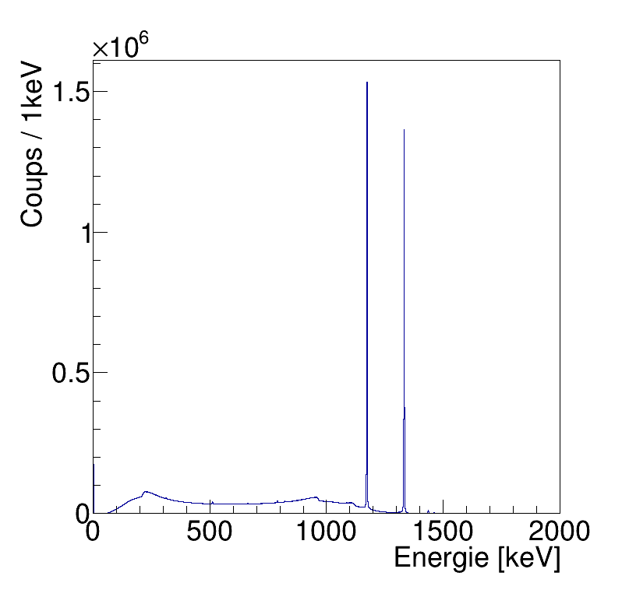
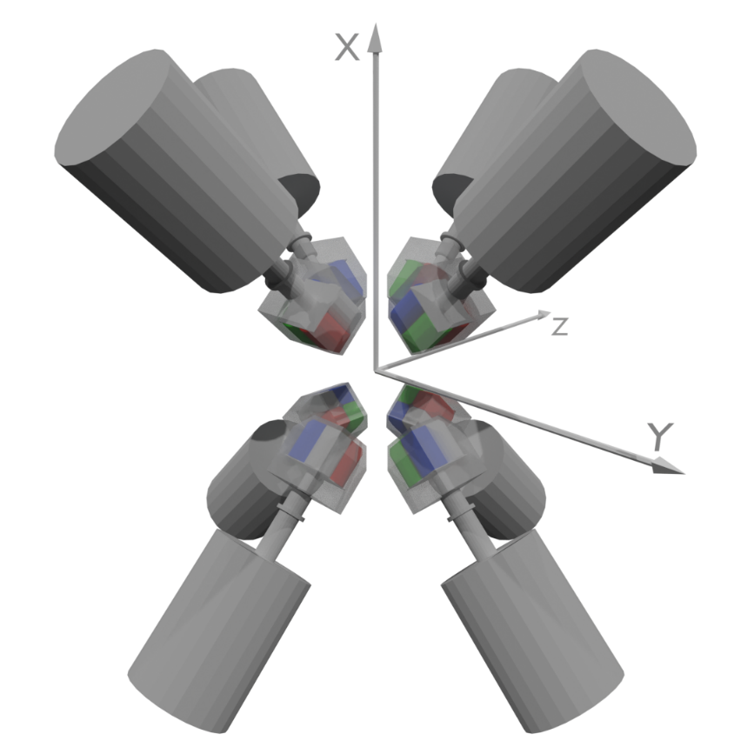
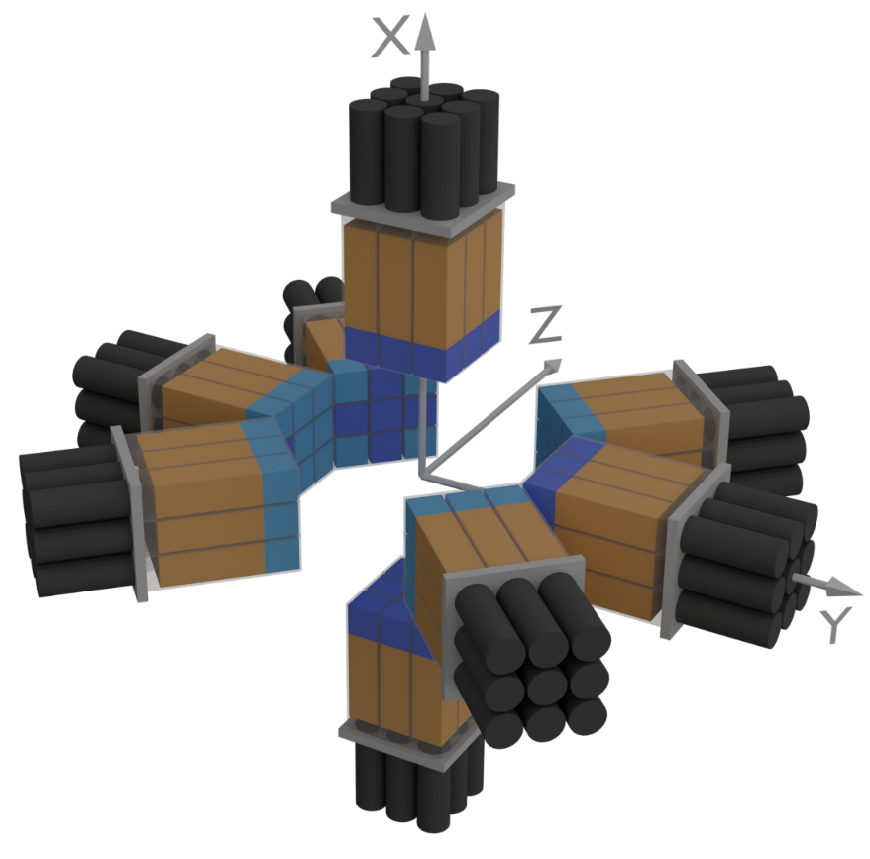
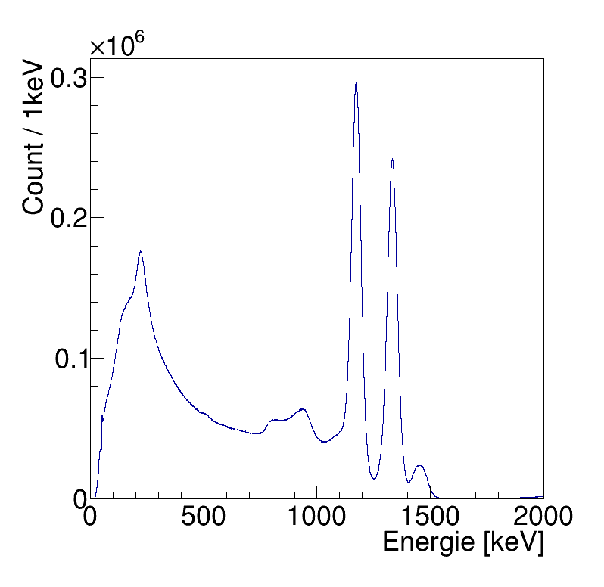
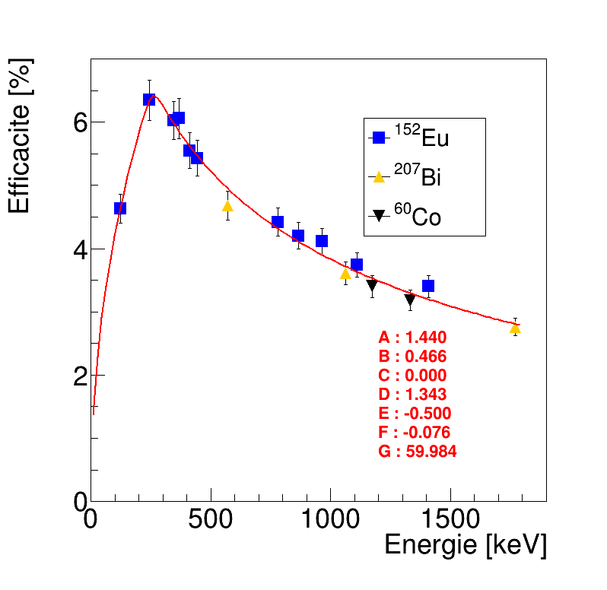
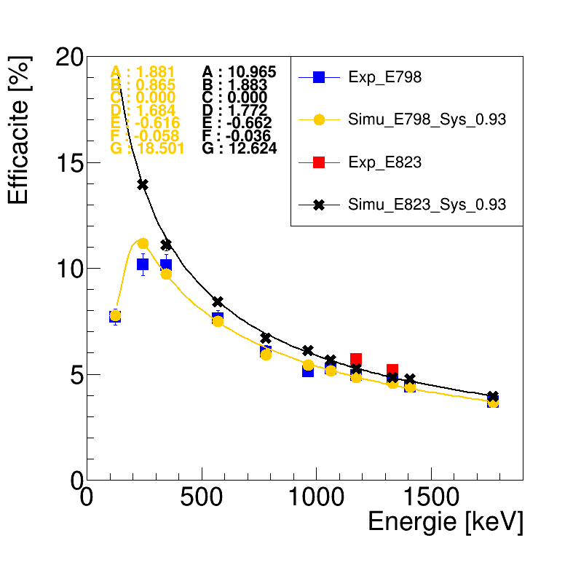




3- Analysis – Coulomb excitation data
Coulomb excitation setup : gamma-rays
EXOGAM
8 clovers
HPGe
PARIS
8 clusters
LaBr₃/CsBr₃+NaI
$$R_{FWHM}$$
$4.4\%$@1MeV
$$R_{FWHM}$$
$0.26\%$@1MeV
^{36,38}Si
target
^{40,42}S
Au - 400mg/cm²
400 mg/cm²
$$ε_{γ}$$
$3.8\%$@1MeV
$$ε_{γ}$$
$6\%$@1MeV
S. Grévy - LP2i Bordeaux CNRS/IN2P3 European Nuclear Physics Conference – Caen – France - 22-26 sept. 2025

Slide 21
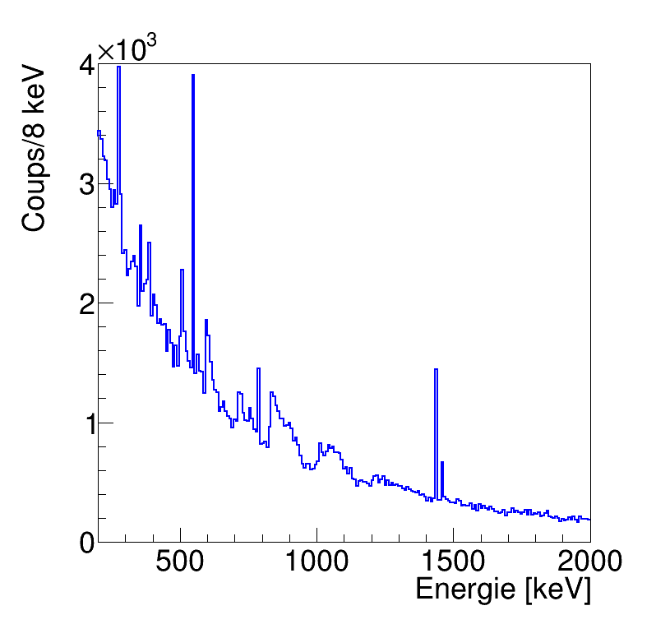
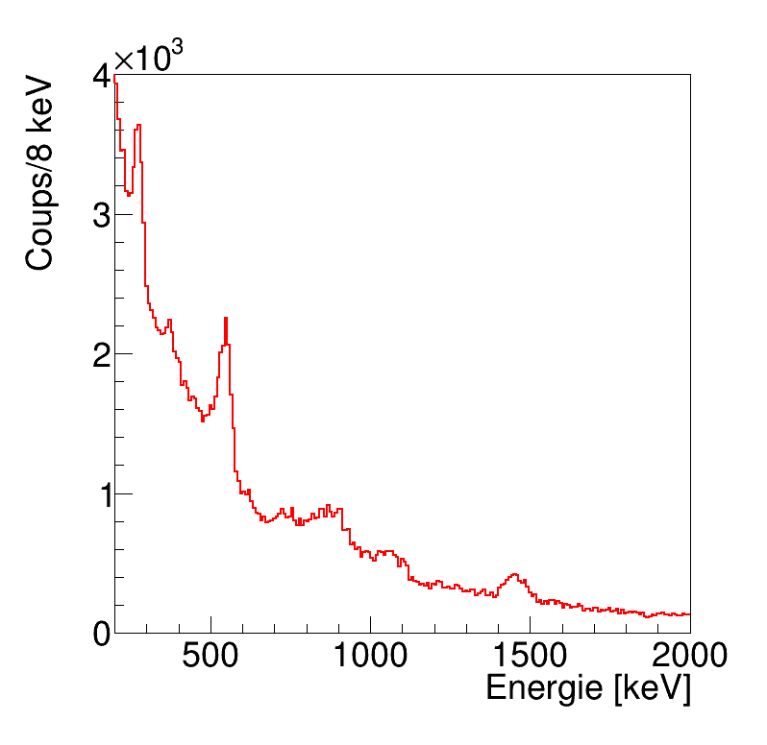
3- Analysis – Coulomb excitation data
Gamma-rays / sulfur-42
EXOGAM
PARIS
target
Au - 400mg/cm²
400 mg/cm²
¹⁹⁷Au
Non Doppler corrected
Non Doppler corrected
Counts/8 keV
Counts/8 keV
¹⁹⁷Au
Coulomb
excitation
of ⁴²S
¹³⁸La
¹³⁸La
⁴⁰K
¹³⁸La
⁴⁰K
Energy (keV)
Energy (keV)
S. Grévy - LP2i Bordeaux CNRS/IN2P3 European Nuclear Physics Conference – Caen – France - 22-26 sept. 2025

Slide 22
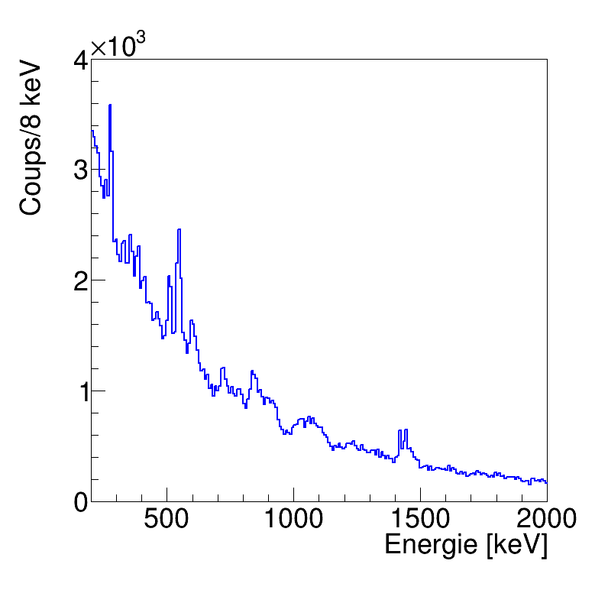
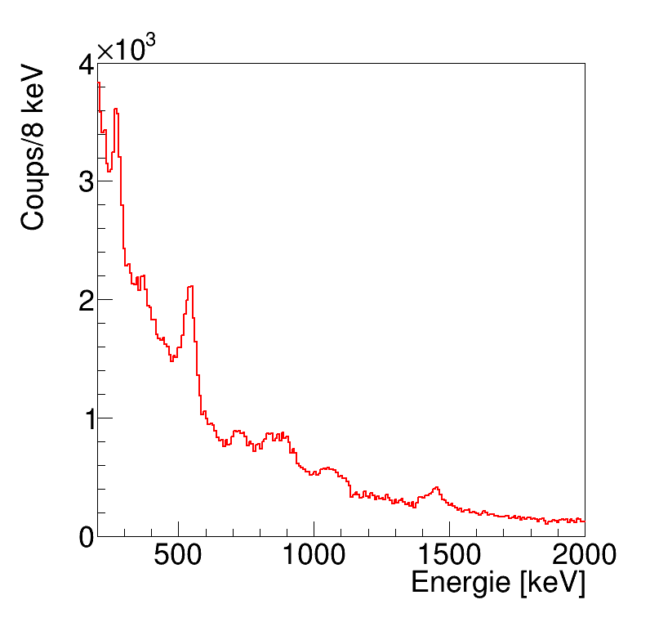
3- Analysis – Coulomb excitation data
Gamma-rays / sulfur-42
EXOGAM
PARIS
target
Au - 400mg/cm²
400 mg/cm²
Doppler correction
Doppler correction
Counts/8 keV
Counts/8 keV
Coulomb
excitation
of ⁴²S
Energy (keV)
Energy (keV)
S. Grévy - LP2i Bordeaux CNRS/IN2P3 European Nuclear Physics Conference – Caen – France - 22-26 sept. 2025

Slide 23
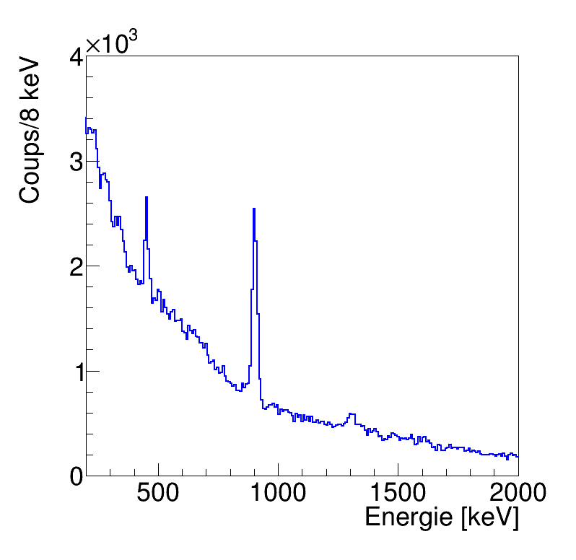
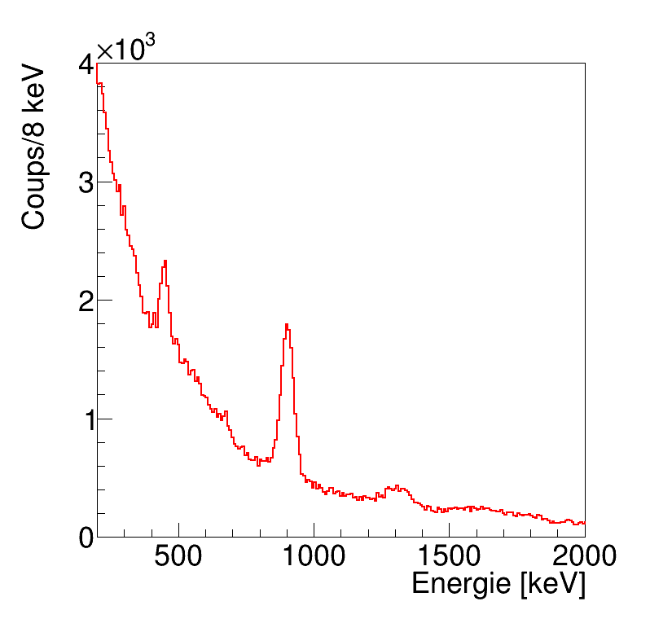
3- Analysis – Coulomb excitation data
Gamma-rays / sulfur-42
EXOGAM
PARIS
target
Au - 400mg/cm²
400 mg/cm²
Doppler corrected
No angular selection
Doppler corrected
No angular selection
Counts/8 keV
Counts/8 keV
⁴¹S : 5/2⁻
⁴²S :2⁺
Coulomb
excitation
of ⁴²S
⁴¹S : 5/2⁻
⁴²S : 2⁺
Energy (keV)
Energy (keV)
S. Grévy - LP2i Bordeaux CNRS/IN2P3 European Nuclear Physics Conference – Caen – France - 22-26 sept. 2025

Slide 24
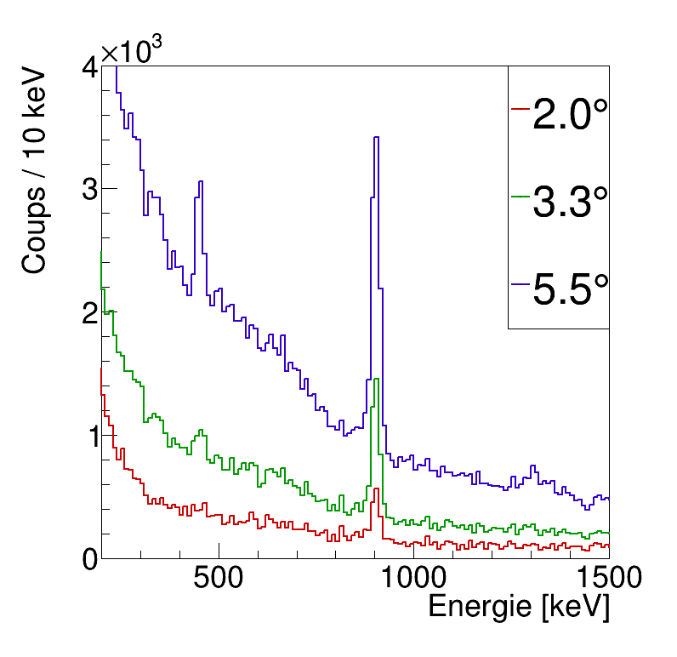
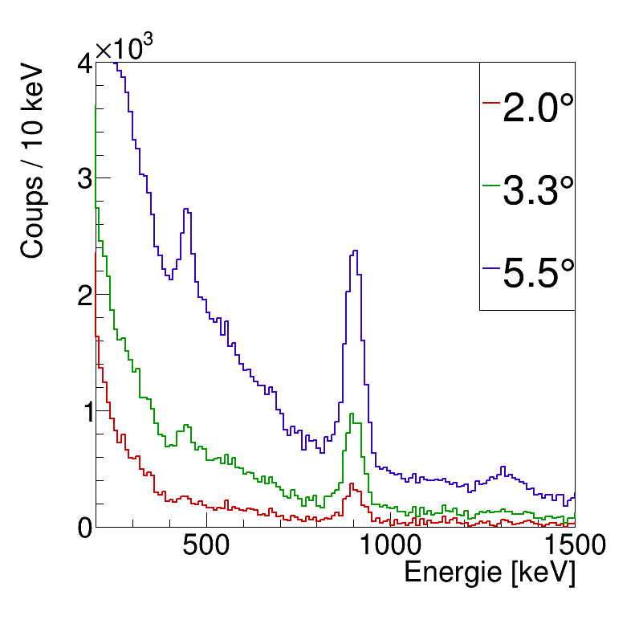
3- Analysis – Coulomb excitation data
Gamma-rays / sulfur-42
EXOGAM
PARIS
target
Au - 400mg/cm²
400 mg/cm²
Doppler corrected
With different angular selections
→ « safe » Coulex i.e. no nuclear excitations
Doppler corrected
With different angular selections
→ « safe » Coulex i.e. no nuclear excitations
Counts/10 keV
Counts/10 keV
⁴¹S : 5/2⁻
⁴¹S : 5/2⁻
⁴²S :2⁺
Coulomb
excitation
of ⁴²S
⁴²S : 2⁺
Angle
Selection :
0-5.5°
0-3.3° safe
0-2.0°
Angle
Selection :
0-5.5°
0-3.3° safe
0-2.0°
Energy (keV)
Energy (keV)
S. Grévy - LP2i Bordeaux CNRS/IN2P3 European Nuclear Physics Conference – Caen – France - 22-26 sept. 2025

Slide 25
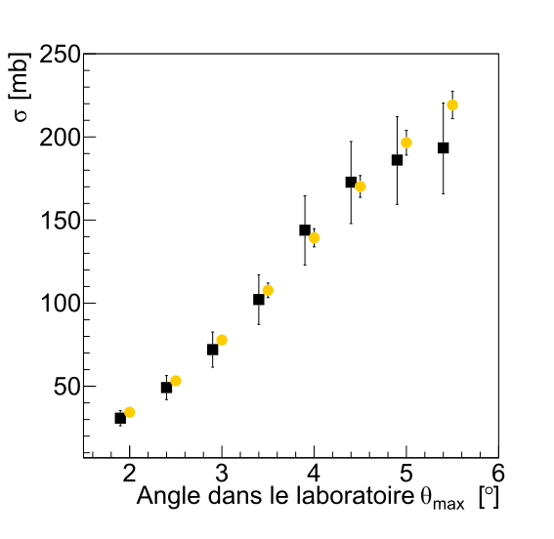
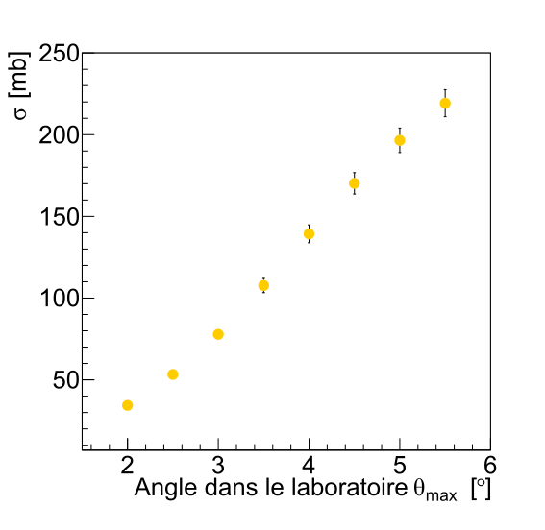
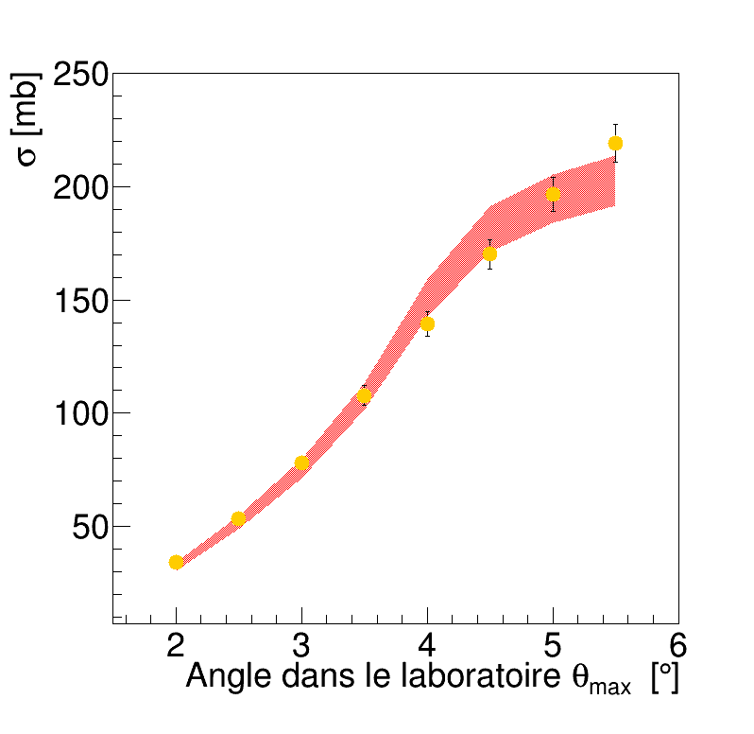
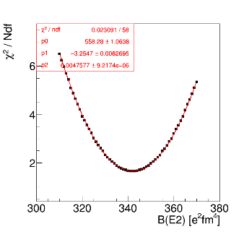
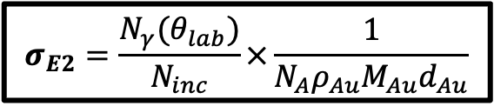
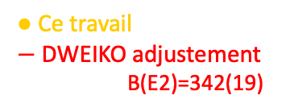
4- Results – Coulomb excitation data
Absolute determination of B(E2) / sulfur-42
$$σ_{E2}=\frac{N_{γ}(θ_{lab})}{N_{inc}}×\frac{1}{{N_{A}ρ}_{Au}M_{Au}d_{Au}}$$
● This work
◼ DWEIKO - BE2 litt : 326(48)
● Ce travail
$−$ DWEIKO adjustement
B(E2)=342(19)
⁴²S
⁴²S
S. Grévy - LP2i Bordeaux CNRS/IN2P3 European Nuclear Physics Conference – Caen – France - 22-26 sept. 2025

Slide 26
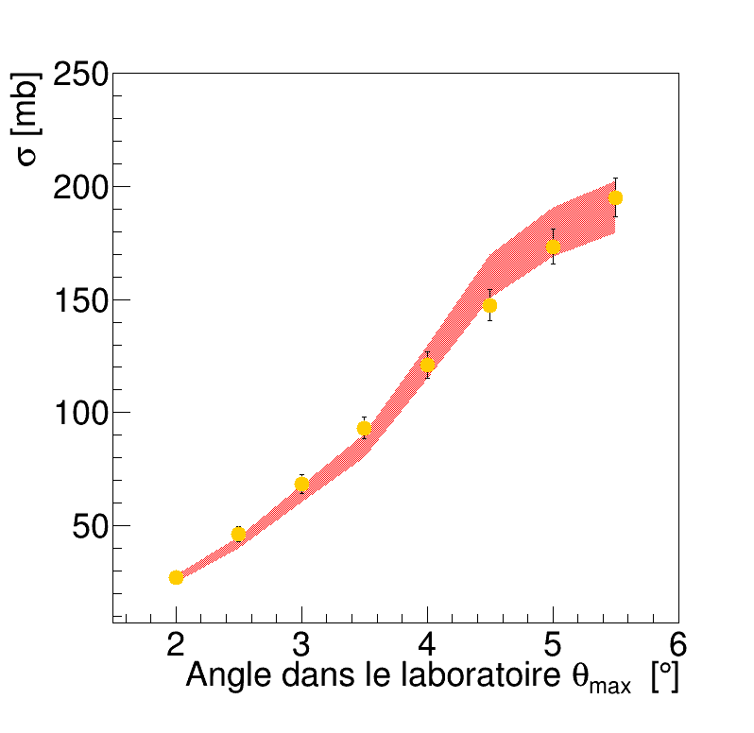
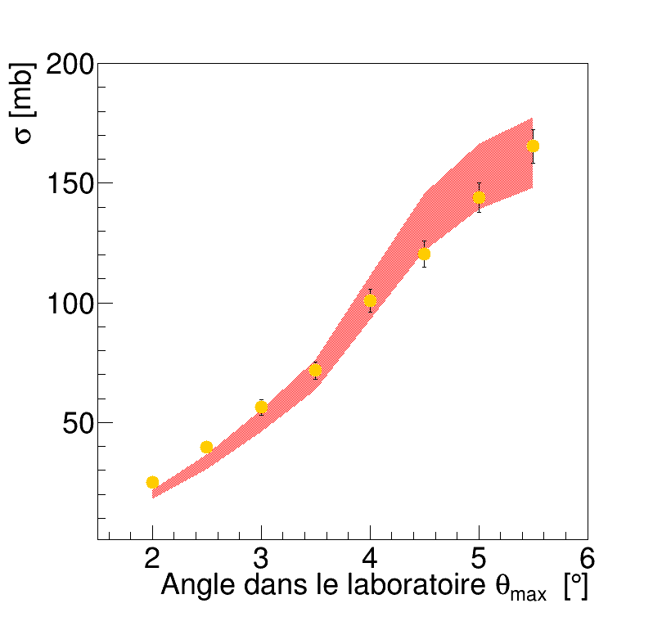
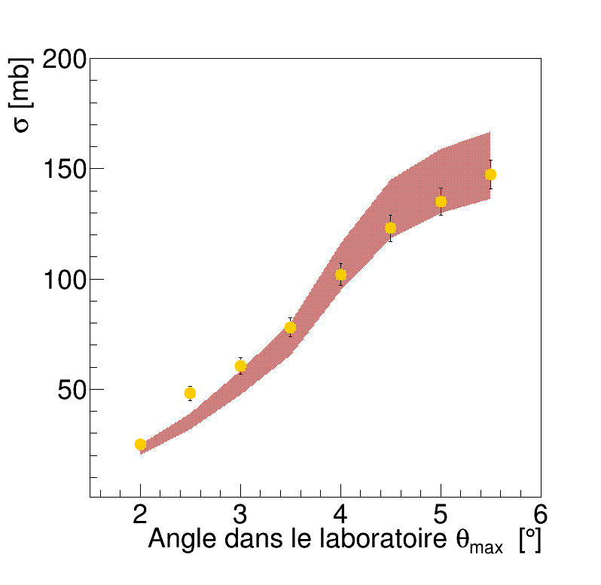
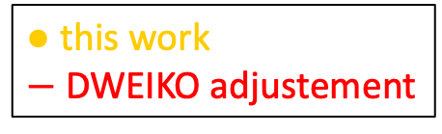
4- Results – Coulomb excitation data
Absolute determination of B(E2) / sulfur-40-42 and silicon-36-38
B(E2)=316(20) e²fm⁴
B(E2)=342(19) e²fm⁴
⁴⁰S
⁴²S
● this work
$−$ DWEIKO adjustement
B(E2)=245(27) e²fm⁴
B(E2)=229(23) e²fm⁴
³⁶Si
³⁸Si
S. Grévy - LP2i Bordeaux CNRS/IN2P3 European Nuclear Physics Conference – Caen – France - 22-26 sept. 2025

Slide 27
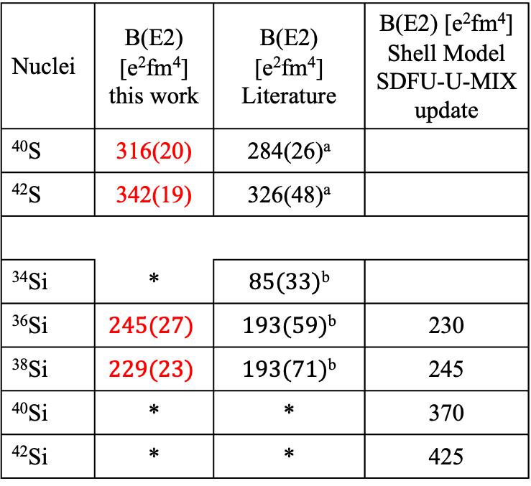
4- Results – Coulomb excitation data
Summary of the results / comparison to litterature
- our new results in agreement with the literature with reduced uncertainties
- no measurement of ⁴⁰Si due to accelerator problems
Nuclei | B(E2) [e²fm⁴] this work | B(E2) [e²fm⁴] Literature | B(E2) [e²fm⁴] Shell Model SDFU-U-MIX update
⁴⁰S | 316(20) | 284(26)ª
⁴²S | 342(19) | 326(48)ª
³⁴Si | * | $85(33)$^{b}
³⁶Si | $$245(27)$$ | $193(59)$^{b} | 230
³⁸Si | $$229(23)$$ | $193(71)$^{b} | 245
⁴⁰Si | * | * | 370
⁴²Si | * | * | 425
Litterature
This work
[a] B. Longfellow et al, P.R.C, 103 (2021)
[b] R. W. Ibboston et al, P.R.L., 80 (1998)
S. Grévy - LP2i Bordeaux CNRS/IN2P3 European Nuclear Physics Conference – Caen – France - 22-26 sept. 2025

Slide 28
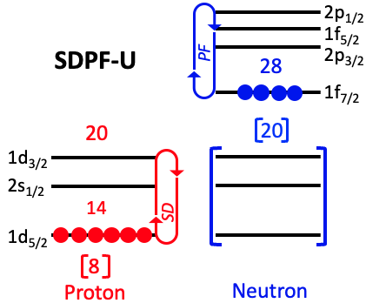
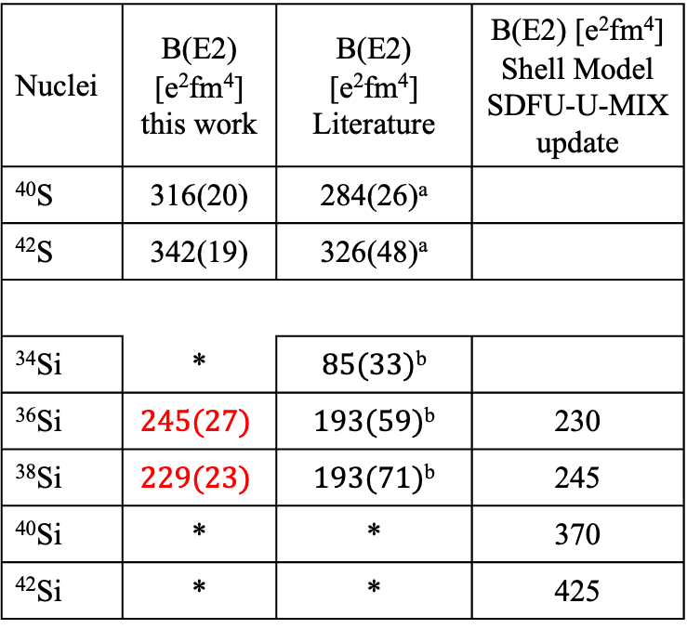
5- Theoretical calculations
Summary of the results / shell model calculations
Nuclei | B(E2) [e²fm⁴] this work | B(E2) [e²fm⁴] Literature | B(E2) [e²fm⁴] Shell Model SDFU-U-MIX update
⁴⁰S | 316(20) | 284(26)ª
⁴²S | 342(19) | 326(48)ª
³⁴Si | * | $85(33)$^{b}
³⁶Si | $$245(27)$$ | $193(59)$^{b} | 230
³⁸Si | $$229(23)$$ | $193(71)$^{b} | 245
⁴⁰Si | * | * | 370
⁴²Si | * | * | 425
Collaboration with the F. Nowacki et al.
- the current SDPF-U effective interaction describing the physics of N=28 does not allow neutron excitation from sd to pf shell which is not satisfactory
[a] B. Longfellow et al, P.R.C, 103 (2021)
[b] R. W. Ibboston et al, P.R.L., 80 (1998)
S. Grévy - LP2i Bordeaux CNRS/IN2P3 European Nuclear Physics Conference – Caen – France - 22-26 sept. 2025

Slide 29
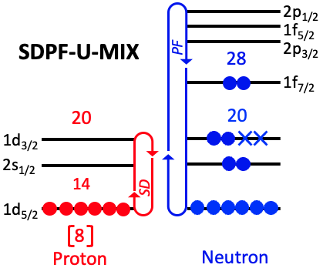
5- Theoretical calculations
Summary of the results / shell model calculations
Nuclei | B(E2) [e²fm⁴] this work | B(E2) [e²fm⁴] Literature | B(E2) [e²fm⁴] Shell Model SDFU-U-MIX update
⁴⁰S | 316(20) | 284(26)ª
⁴²S | 342(19) | 326(48)ª
³⁴Si | * | $85(33)$^{b}
³⁶Si | $$245(27)$$ | $193(59)$^{b} | 230
³⁸Si | $$229(23)$$ | $193(71)$^{b} | 245
⁴⁰Si | * | * | 370
⁴²Si | * | * | 425
Collaboration with the F. Nowacki et al.
- the current SDPF-U effective interaction describing the physics of N=28 does not allow neutron excitation from sd to pf shell which is not satisfactory
- the current SDPF-U-MIX effective interaction describing the physics of N=20 allows neutron excitation from sd to pf shell but is not (yet) tailored to describe at the same time the N=20 and N=28 regions
[a] B. Longfellow et al, P.R.C, 103 (2021)
[b] R. W. Ibboston et al, P.R.L., 80 (1998)
S. Grévy - LP2i Bordeaux CNRS/IN2P3 European Nuclear Physics Conference – Caen – France - 22-26 sept. 2025

Slide 30
5- Theoretical calculations
Summary of the results / shell model calculations
Nuclei | B(E2) [e²fm⁴] this work | B(E2) [e²fm⁴] Literature | B(E2) [e²fm⁴] Shell Model SDFU-U-MIX update
⁴⁰S | 316(20) | 284(26)ª
⁴²S | 342(19) | 326(48)ª
³⁴Si | * | $85(33)$^{b}
³⁶Si | $$245(27)$$ | $193(59)$^{b} | 230
³⁸Si | $$229(23)$$ | $193(71)$^{b} | 245
⁴⁰Si | * | * | 370
⁴²Si | * | * | 425
Collaboration with the F. Nowacki et al.
- the current SDPF-U effective interaction describing the physics of N=28 does not allow neutron excitation from sd to pf shell which is not satisfactory
- the current SDPF-U-MIX effective interaction describing the physics of N=20 allows neutron excitation from sd to pf shell but is not (yet) tailored to describe at the same time the N=20 and N=28 regions
→ Ongoing work to modify the existing SDPF-U-MIX interaction in order to describe correctly both the N=20 and N=28 regions
[a] B. Longfellow et al, P.R.C, 103 (2021)
[b] R. W. Ibboston et al, P.R.L., 80 (1998)
S. Grévy - LP2i Bordeaux CNRS/IN2P3 European Nuclear Physics Conference – Caen – France - 22-26 sept. 2025

Slide 31
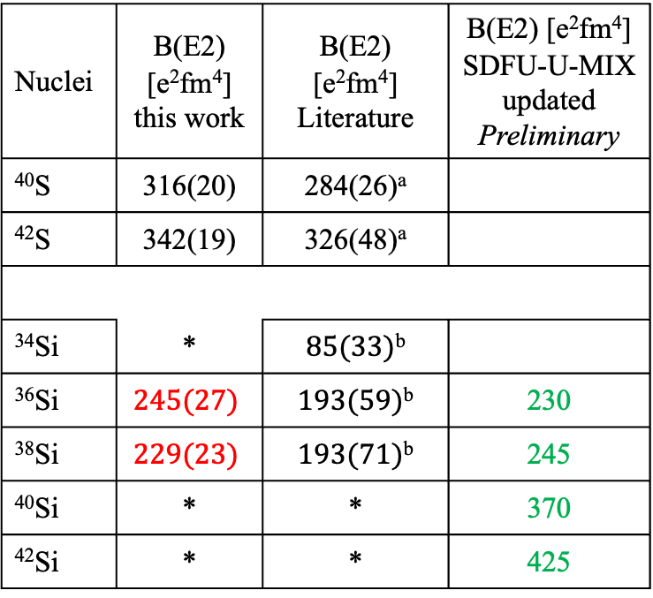
5- Theoretical calculations
Summary of the results / shell model calculations
Nuclei | B(E2) [e²fm⁴] this work | B(E2) [e²fm⁴] Literature | B(E2) [e²fm⁴] SDFU-U-MIX updated Preliminary
⁴⁰S | 316(20) | 284(26)ª
⁴²S | 342(19) | 326(48)ª
³⁴Si | * | $85(33)$^{b}
³⁶Si | $$245(27)$$ | $193(59)$^{b} | 230
³⁸Si | $$229(23)$$ | $193(71)$^{b} | 245
⁴⁰Si | * | * | 370
⁴²Si | * | * | 425
SDPU-U
Literature
This work
[a] B. Longfellow et al, P.R.C, 103 (2021)
[b] R. W. Ibboston et al, P.R.L., 80 (1998)
S. Grévy - LP2i Bordeaux CNRS/IN2P3 European Nuclear Physics Conference – Caen – France - 22-26 sept. 2025

Slide 32
5- Theoretical calculations
Summary of the results / shell model calculations
Nuclei | B(E2) [e²fm⁴] this work | B(E2) [e²fm⁴] Literature | B(E2) [e²fm⁴] SDFU-U-MIX updated Preliminary
⁴⁰S | 316(20) | 284(26)ª
⁴²S | 342(19) | 326(48)ª
³⁴Si | * | $85(33)$^{b}
³⁶Si | $$245(27)$$ | $193(59)$^{b} | 230
³⁸Si | $$229(23)$$ | $193(71)$^{b} | 245
⁴⁰Si | * | * | 370
⁴²Si | * | * | 425
SDPU-U
SDPF-U-MIX
Literature
This work
[a] B. Longfellow et al, P.R.C, 103 (2021)
[b] R. W. Ibboston et al, P.R.L., 80 (1998)
S. Grévy - LP2i Bordeaux CNRS/IN2P3 European Nuclear Physics Conference – Caen – France - 22-26 sept. 2025

Slide 33
5- Theoretical calculations
Summary of the results / shell model calculations
Nuclei | B(E2) [e²fm⁴] this work | B(E2) [e²fm⁴] Literature | B(E2) [e²fm⁴] SDFU-U-MIX updated Preliminary
⁴⁰S | 316(20) | 284(26)ª
⁴²S | 342(19) | 326(48)ª
³⁴Si | * | $85(33)$^{b}
³⁶Si | $$245(27)$$ | $193(59)$^{b} | 230
³⁸Si | $$229(23)$$ | $193(71)$^{b} | 245
⁴⁰Si | * | * | 370
⁴²Si | * | * | 425
SDPU-U
SDPF-U-MIX
SDPU-U-MIX updated
Literature
This work
[a] B. Longfellow et al, P.R.C, 103 (2021)
[b] R. W. Ibboston et al, P.R.L., 80 (1998)
S. Grévy - LP2i Bordeaux CNRS/IN2P3 European Nuclear Physics Conference – Caen – France - 22-26 sept. 2025

Slide 34

5- Theoretical calculations
Summary of the results / shell model calculations
Nuclei | B(E2) [e²fm⁴] this work | B(E2) [e²fm⁴] Literature | B(E2) [e²fm⁴] SDFU-U-MIX updated Preliminary
⁴⁰S | 316(20) | 284(26)ª
⁴²S | 342(19) | 326(48)ª
³⁴Si | * | $85(33)$^{b}
³⁶Si | $$245(27)$$ | $193(59)$^{b} | 230
³⁸Si | $$229(23)$$ | $193(71)$^{b} | 245
⁴⁰Si | * | * | 370
⁴²Si | * | 500(90)^{c} | 425
SDPU-U
SDPF-U-MIX
SDPU-U-MIX updated
Literature
This work
FRIB2025
[a] B. Longfellow et al, P.R.C, 103 (2021)
[b] R. W. Ibboston et al, P.R.L., 80 (1998)
[c] L. A. Riley et al, P.R.C., 112 (2025)
S. Grévy - LP2i Bordeaux CNRS/IN2P3 European Nuclear Physics Conference – Caen – France - 22-26 sept. 2025

Slide 35
6- Conclusions
- Simultaneous measurement of proton inelastic scattering and Coulomb excitation of ³⁶Si and ³⁸Si at GANIL
- Improved B(E2) values
- Inelastic scattering data are under analysis
- Shell model calculations are in progress to better describe both N=20 and N=28 regions with the same interaction.
- Same measurements have been performed at FRIB for ⁴²Si (in two separate experiments)
- All results are consistent with an increase of the B(E2) from N=20 to N=28, signature of a reduction of Z=14 under the action
of the tensor part of the interaction
Q. Délignac, S. Grévy, D.D. Dao, F. Nowacki, T. Roger, D. Ackermann, N. Alahari, A. Barriere, M. Begala, B. Blank, S. Calinescu, A. Cassisa, M. Ciamala, E. Clément, G. de France, F. de Oliviera, J.E. Ducret, M. Flayol, S. Franchoo, J. Giovinazzo, A. Husson, H. Jacob, M. Juhasz, M. Kacy, S. Koyama, N. Kumar, A. Lemasson, M. Lewitowicz, J. Lois Fuentes, I. Matea, J. Michaud, J. Mrazek, A. Ortega-Moral, J. Pancin, J. Piot, F. Rotaru, O. Sorlin, L. Stan, M. Stanoiu, C. Stodel, J.C. Thomas
S. Grévy - LP2i Bordeaux CNRS/IN2P3 European Nuclear Physics Conference – Caen – France - 22-26 sept. 2025

Slide 36

4- Results – Coulomb excitation data
Summary of the results / comparison to literature
- our new results in agreement with the litterature with reduced uncertainties
- no measurement of ⁴⁰Si due to accelerator problems
- recent result from FRIB for ⁴²Si shows a drastic increase towards N=28
Nuclei | B(E2) [e²fm⁴] this work | B(E2) [e²fm⁴] Literature | B(E2) [e²fm⁴] Shell Model SDFU-U-MIX update
⁴⁰S | 316(20) | 284(26)ª
⁴²S | 342(19) | 326(48)ª
³⁴Si | * | $85(33)$^{b}
³⁶Si | $$245(27)$$ | $193(59)$^{b} | 230
³⁸Si | $$229(23)$$ | $193(71)$^{b} | 245
⁴⁰Si | * | * | 370
⁴²Si | * | 500(90)^{c} | 425
Literature
This work
FRIB2025
[a] B. Longfellow et al, P.R.C, 103 (2021)
[b] R. W. Ibboston et al, P.R.L., 80 (1998)
[c] L. A. Riley et al, P.R.C., 112 (2025)
S. Grévy - LP2i Bordeaux CNRS/IN2P3 European Nuclear Physics Conference – Caen – France - 22-26 sept. 2025

Slide 37
2p_{1/2}
2p_{1/2}
1f_{5/2}
1f_{5/2}
SDPF-U-MIX
PF
28
2p_{3/2}
SDPF-U
PF
28
2p_{3/2}
1f_{7/2}
1f_{7/2}
20
20
20
20
1d_{3/2}
1d_{3/2}
2s_{1/2}
2s_{1/2}
14
SD
14
SD
1d_{5/2}
1d_{5/2}
8
8
Proton
Neutron
Proton
Neutron

