Slide 1

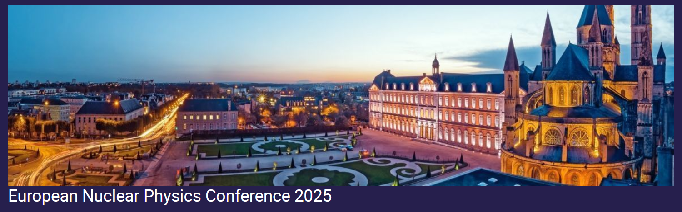
Studying collective excitations at CCB of IFJ PAN Krakow
Maria kmiecik, IFJ PAN

Slide 2
Plan
Introduction and motivation
CCB
GQR
PDR
Experimental method and setup
Results

Slide 3
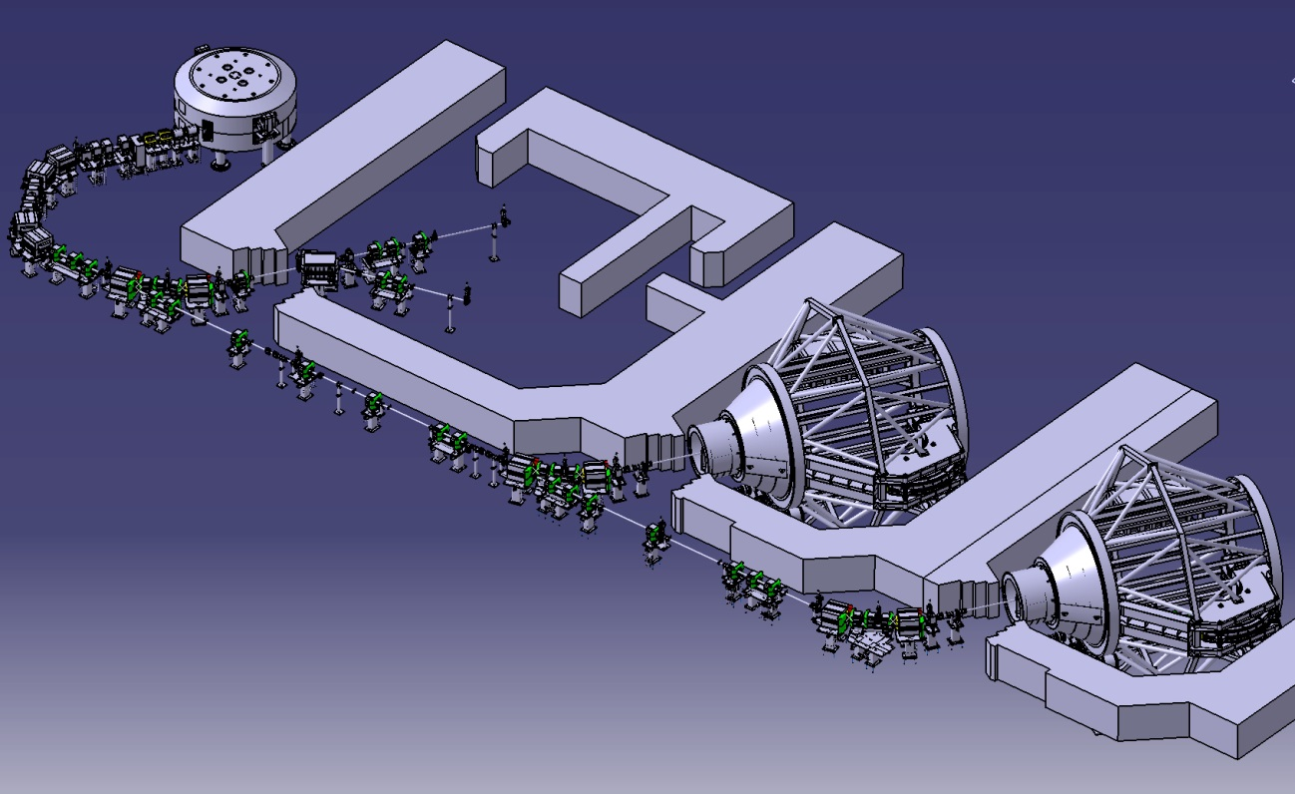
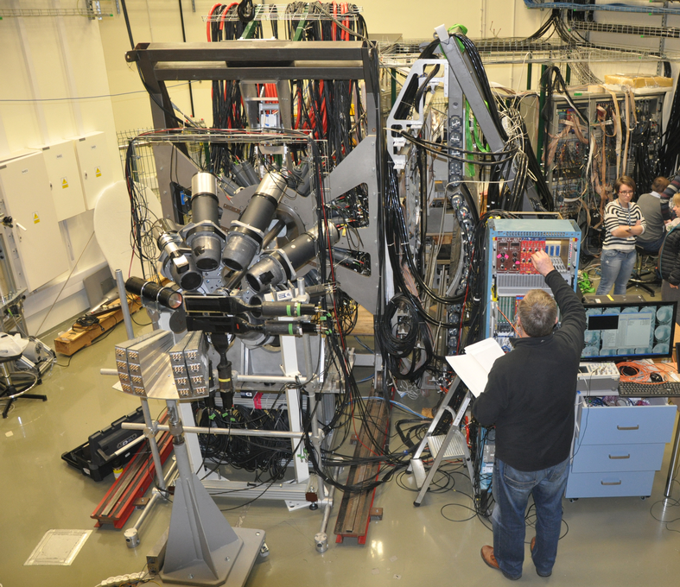
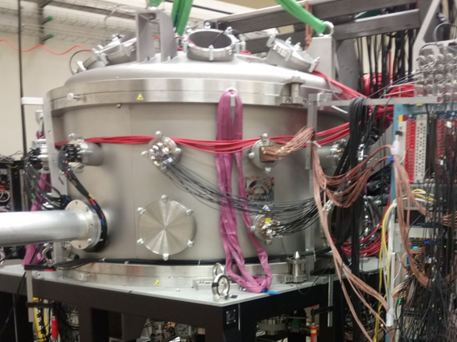
Cyclotron center Bronowice (CCB) at IFJ PAN
proton cancer therapy and additionally research program on:
nuclear physics,
radiobiology
dosimetry
medical physics
230 MeV proton cyclotron (IBA)
energy selector
(70-230 MeV Δp/p<0.7%)
eye therapy room
experimental hall
2 gantries for whole body treatment
experiments during weekends

Slide 4
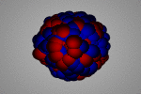
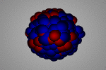
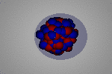
Aim of the investigations
collective excitations induced by proton inelastic scattering
E* (excitation
energy)
GDR (IVGDR – Isovector Giant Dipole Resonance)
GQR (ISGQR – Isoscalar Giant Quadrupole Resonance)
main aim: γ decay
PDR
(Pygmy Dipole Resonance)
S_{n} (neutron separation energy)
soft dipole mode, low-energy part of dipole strength
measurement of γ-rays emitted from the decay (above neutron threshold hindered by neutron emission)
ground state - g. s.

Slide 5
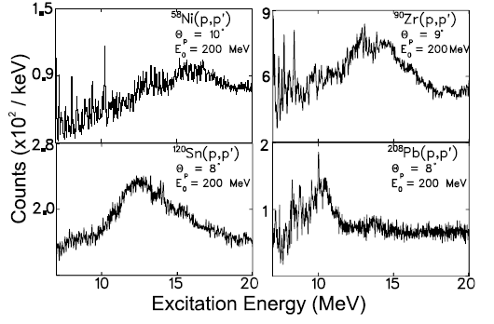
Motivation to study GQR
E*
GQR γ–decay observed previously only once, in 1980s
Inelastic scattering of 381 MeV ¹⁷O on ²⁰⁸Pb
J.Beene et al., PRC39(1989)1307
GQR excitation measured – examples
Shevchenko et al., Phys. Rev. Lett. 93 (2004) 122501-1
difficult to measure – very small probability (~10⁻⁴)

Slide 6
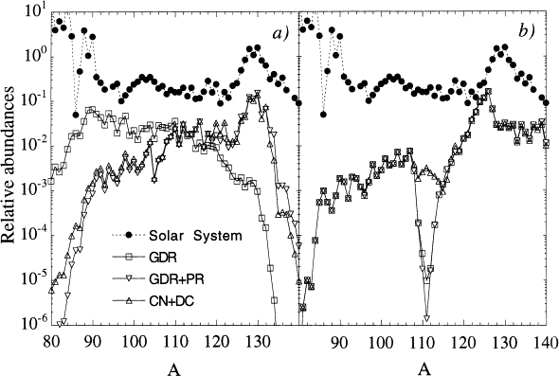
Motivation for studying PDR
E*
PDR – low-energy part of the E1 response below and above Sn
(soft dipole mode)
Studied so far using mainly:
Nuclear resonance fluorescence,
(γ, n) reactions (above Sn),
(p,p’), (α, α’γ) and (¹⁷O,¹⁷O’γ),
S.Goriely, Phys. Lett. B436 10 (1998)
S.Goriely and E. Khan, Nucl. Phys. A706 (2002) 217
Implications of the low-energy E1 strength on the r-process nucleosynthesis
related to determination of nuclear symmetry energy (neutron rich matter)
can be used for neutron skin thickness determination (neutron stars)
Exp.
Theory
Various theoretical approaches – different predictions in terms of collectivity, strength and line-shape of the pygmy resonances
GDR+PDR
GDR
Studies with various probes allow to learn on the structure of PDR states and give an input for theoretical models verification

Slide 7
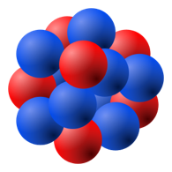

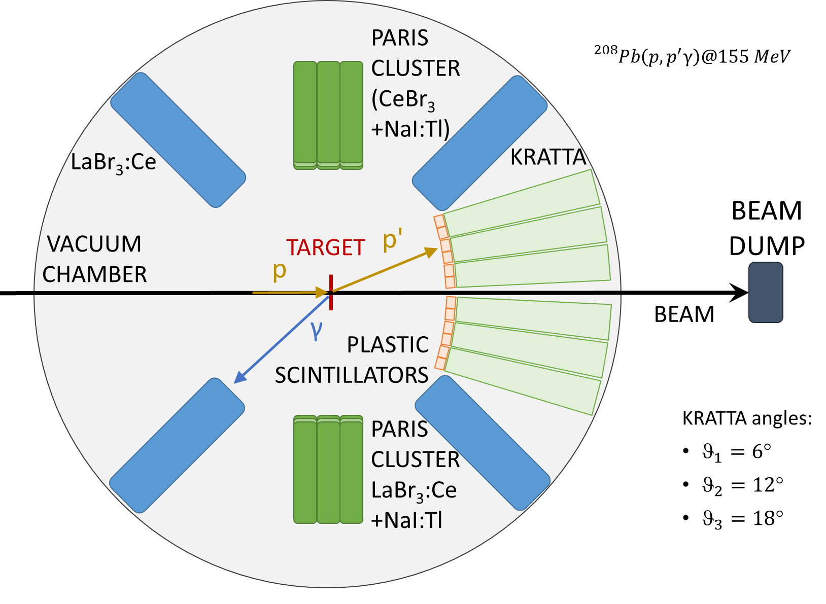
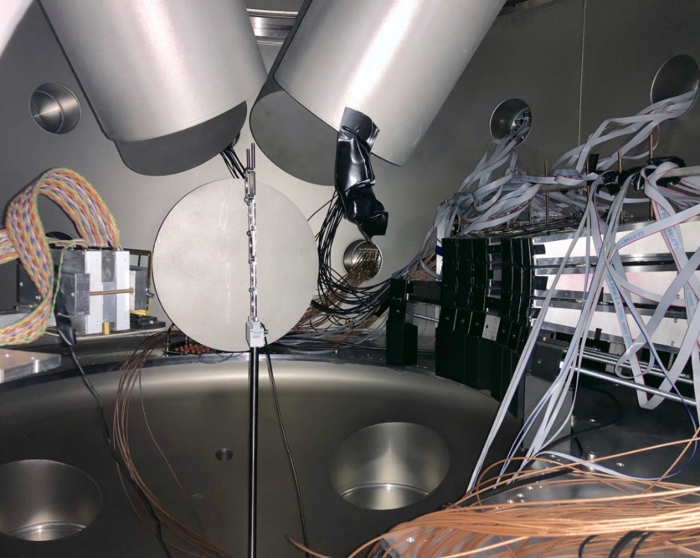

Idea of the measurement
p
inelastic proton scattering (p, p’γ)
p’
p
Target:
²⁰⁸Pb, ¹²⁰Sn
⁵⁸Ni - ⁶⁴Ni
$$γ$$
LaBr₃
KRATTA – p’ (scattered)
HECTOR (BaF₂) LaBr₃ + PARIS - γ
DSSD – p, d, t, α
KRATTA
DSSD
PARIS
p

Slide 8
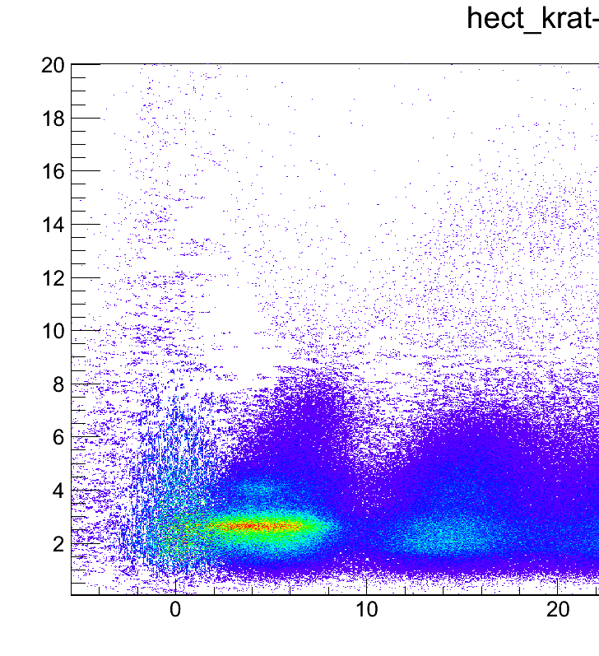
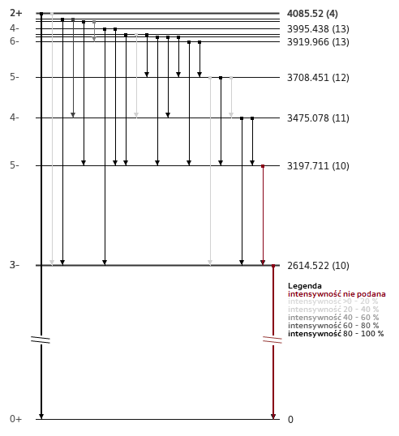
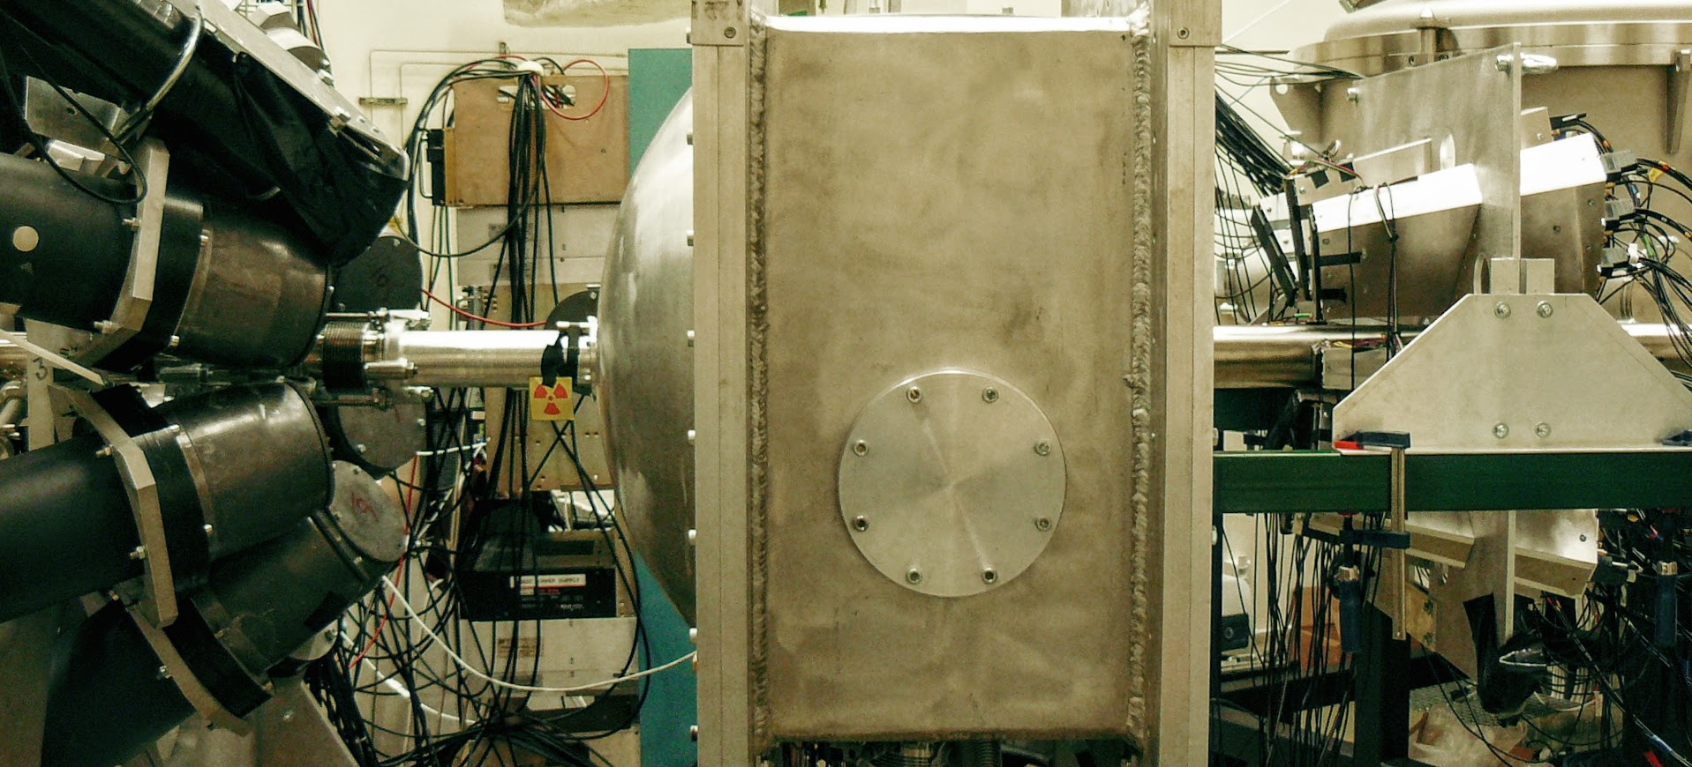
The first experiment
decay to the ground state
p @ 85 MeV on ²⁰⁸Pb target 48 mm (54.5 mg/cm²) thick
g.s. : E* = Eγ
HECTOR
2⁺
4.1 MeV
HECTOR (8 BaF₂)
LaBr₃ (large volume 8”x3.5”)
PARIS (cluster of 9 „phoswiches”
LaBr₃/CeBr₃ + NaI) (γ-rays)
KRATTA (16 CsI telescopes) (protons)
vacuum scattering chamber
Eγ [MeV]
3⁻
2.6 MeV
g.s.
E* [MeV]
²⁰⁸Pb S_{n} = 7.368 MeV
background subtracted
E* = E beam – E scattered proton

Slide 9
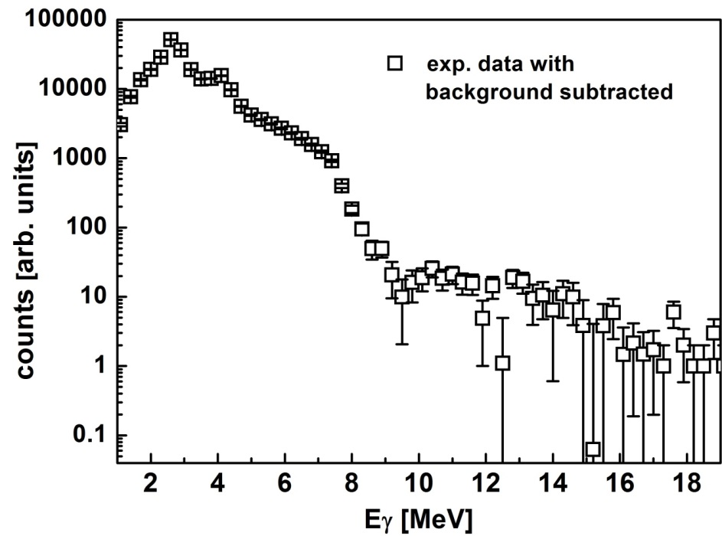
data analysis
decay to the ground state
g.s. : E* = Eγ
HECTOR
2⁺
4.1 MeV
2⁺ (4.1 MeV)
Eγ [MeV]
PDR
3⁻
(2.6 MeV)
GQR
GDR
3⁻
2.6 MeV
g.s.
E* [MeV]
²⁰⁸Pb S_{n} = 7.368 MeV

Slide 10
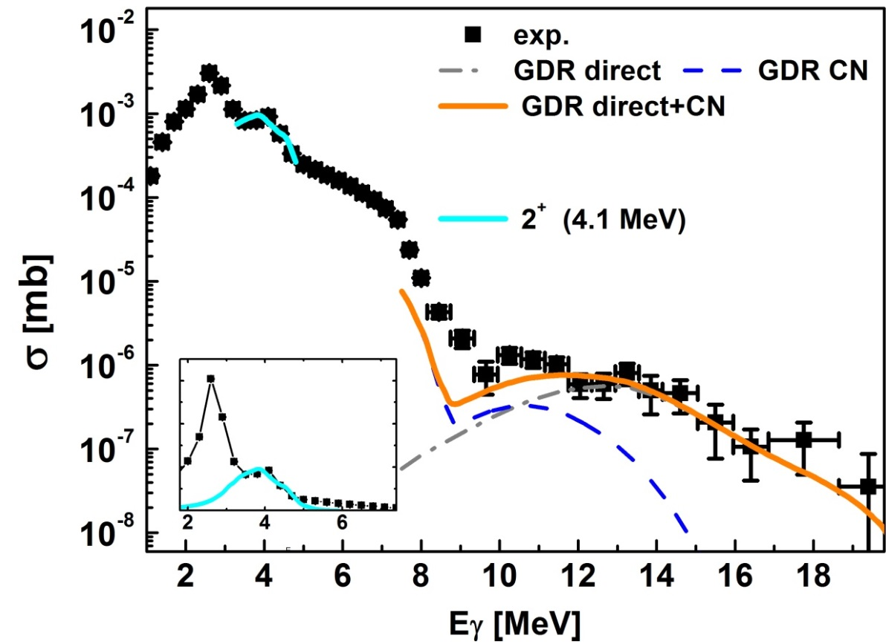
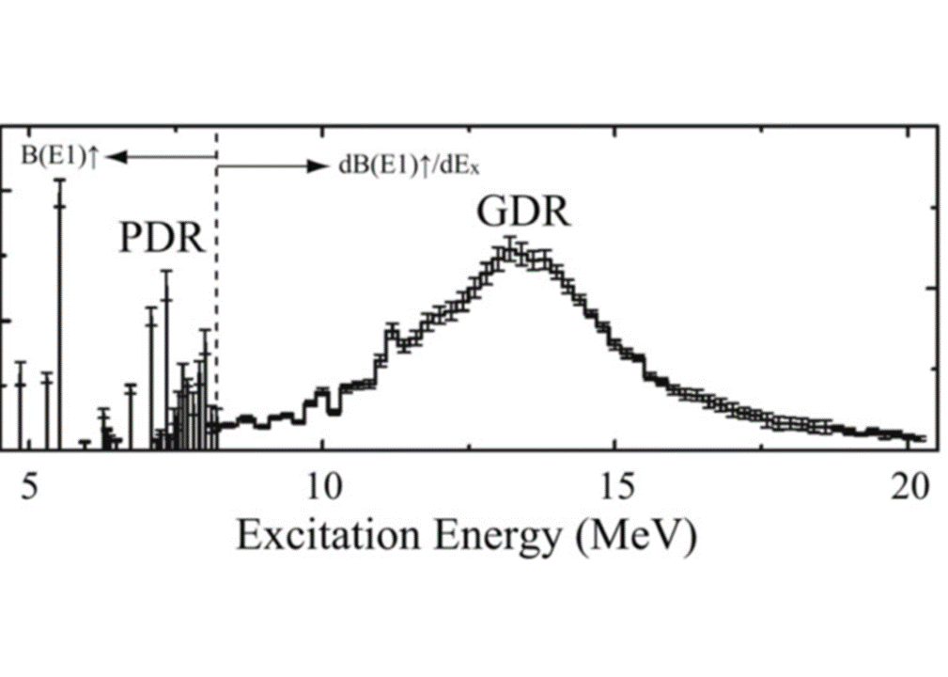
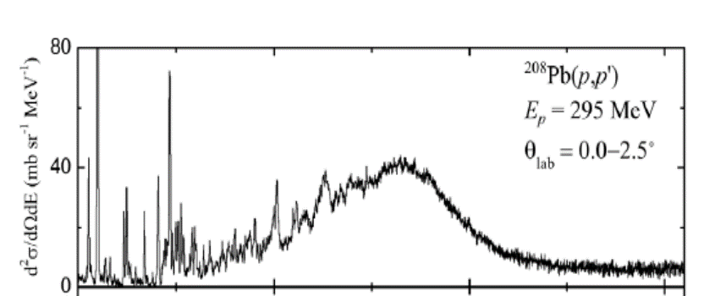
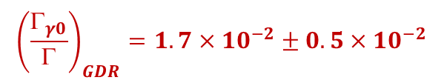
GDR part
$σ_{p,p^{′}γ0}\left(E\right)=σ_{p,p^{′}}\left(E;B\left(E1\right)=1\right)b_{E1}\left(E\right)\left[\frac{Γ_{γ0}}{Γ}+\frac{Γ↓}{Γ}B_{CN}(E)\right]$ $=σ_{direct}+σ_{CN}$
direct decay
statistical (CN) decay
calculated for:
B(E1) for 111% EWSR;
E_{GDR} = 13.4 MeV; Γ_{GDR} = 3.9 MeV
excitation cross section
PDR
GDR
A. Tamii et al., Phys. Rev. Lett. 107, 062502 (2011)
$${\left(\frac{Γ_{γ0}}{Γ}\right)}_{GDR}=1.7×{10}^{−2}±0.5×{10}^{−2}$$
GDR γ-ray decay to the g.s. branching ratio:
In agreement with published value

Slide 11
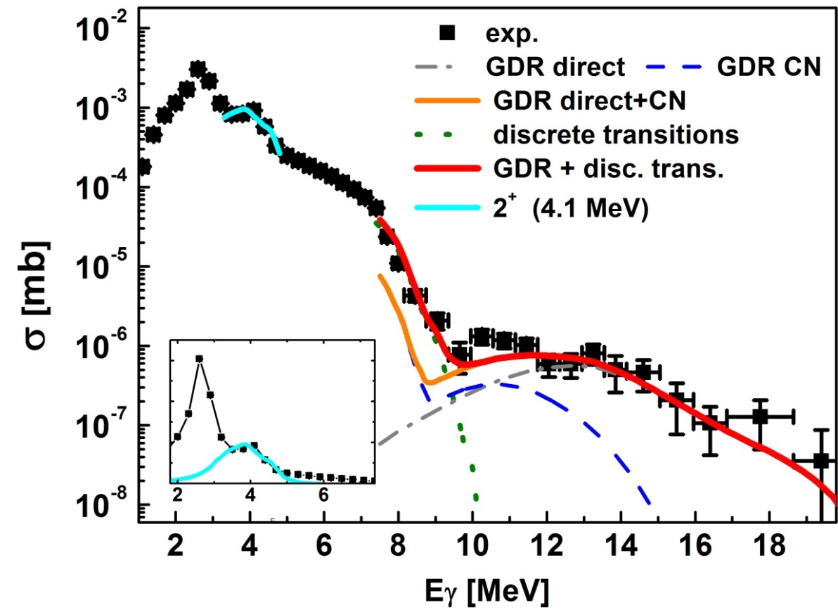
GQR region
excess
in the GQR region
²⁰⁸Pb(p,p’γ) @ 85 MeV
²⁰⁸Pb (¹⁷O,¹⁷O’γ) @ 381 MeV
B. Wasilewska al., PRC105, 014310 (2022)
J.Beene et al., PRC39, 1307 (1989)

Slide 12
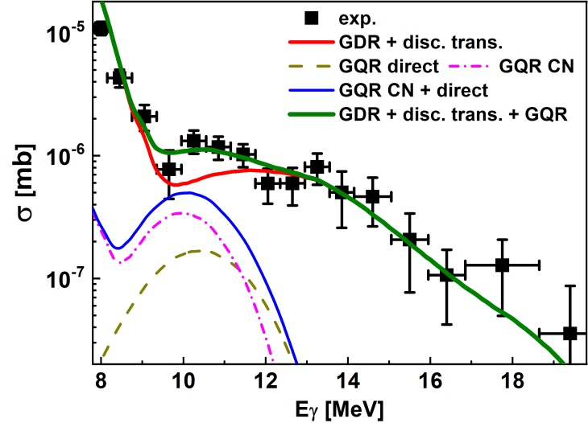
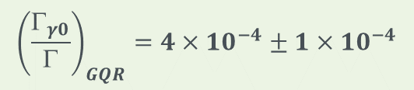
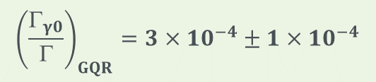
GQR γ-decay in ²⁰⁸Pb
²⁰⁸Pb(p,p’γ) @ 85 MeV
²⁰⁸Pb (¹⁷O,¹⁷O’γ) @ 381 MeV
γ-ray energy
excitation energy measured
in coincidence with γ-rays
Observation, for the 2nd time, of the gamma decay of the ISGQR
B. Wasilewska al., PRC105, 014310 (2022)
branching ratio:
J.Beene et al., PRC39, 1307 (1989)
$${\left(\frac{Γ_{γ0}}{Γ}\right)}_{GQR}=3×{10}^{−4}±1×{10}^{−4}$$
$${\left(\frac{Γ_{γ0}}{Γ}\right)}_{GQR}=4×{10}^{−4}±1×{10}^{−4}$$
branching ratio for the GQR gamma decay to the ground state obtained
with the use of proton beam - in agreement to previous value measured with heavy ions

Slide 13
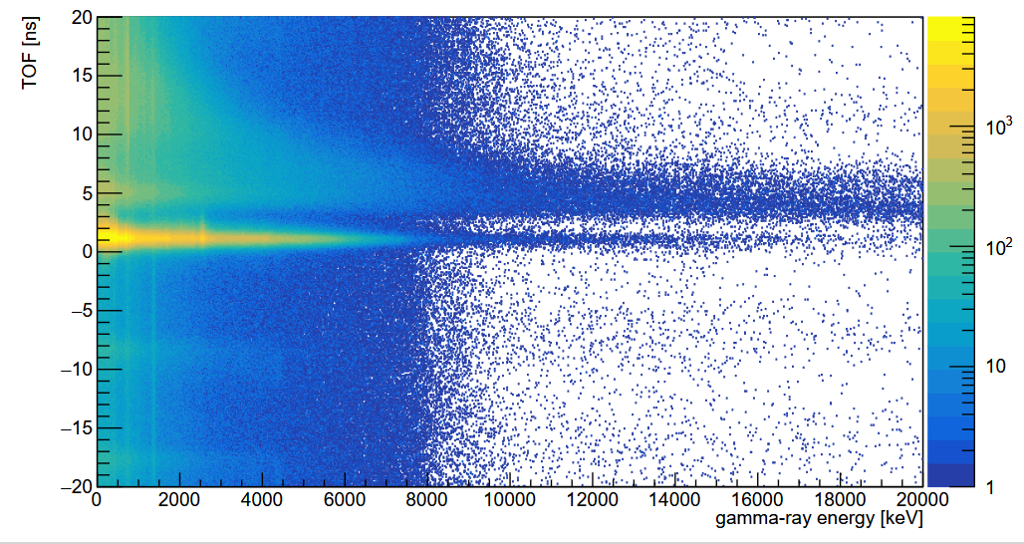
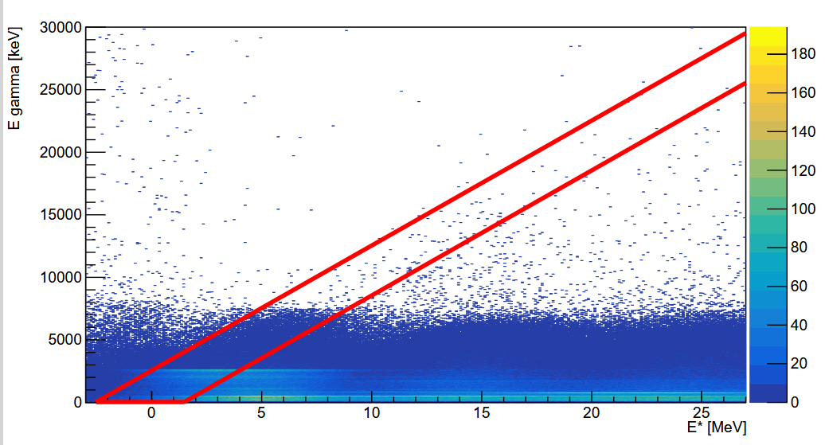
(p, p’γ) on ²⁰⁸Pb @ 155 MeV
TOF
γ-decay to the g.s.
γ prompt
random
background
Eγ [keV]
GQR
GDR
Preliminary
Eγ [keV]
E* [MeV]
larger GQR excitation cross section
than measured for 85 MeV
New setup – better energy resolution
Higher beam energy – enhancement of GQR
analysis ongoing

Slide 14
(p, p’γ) on ¹²⁰Sn @ 200 MeV
¹²⁰Sn
Low Energy Part
¹²⁰Sn
2⁺ → 0⁺
1171 keV
Courtesy: Agnese Giaz
4⁺ → 2⁺
1023 keV
Preliminary
High Energy Part
¹²⁰Sn
Preliminary
GDR
analysis ongoing
GQR
Preliminary

Slide 15
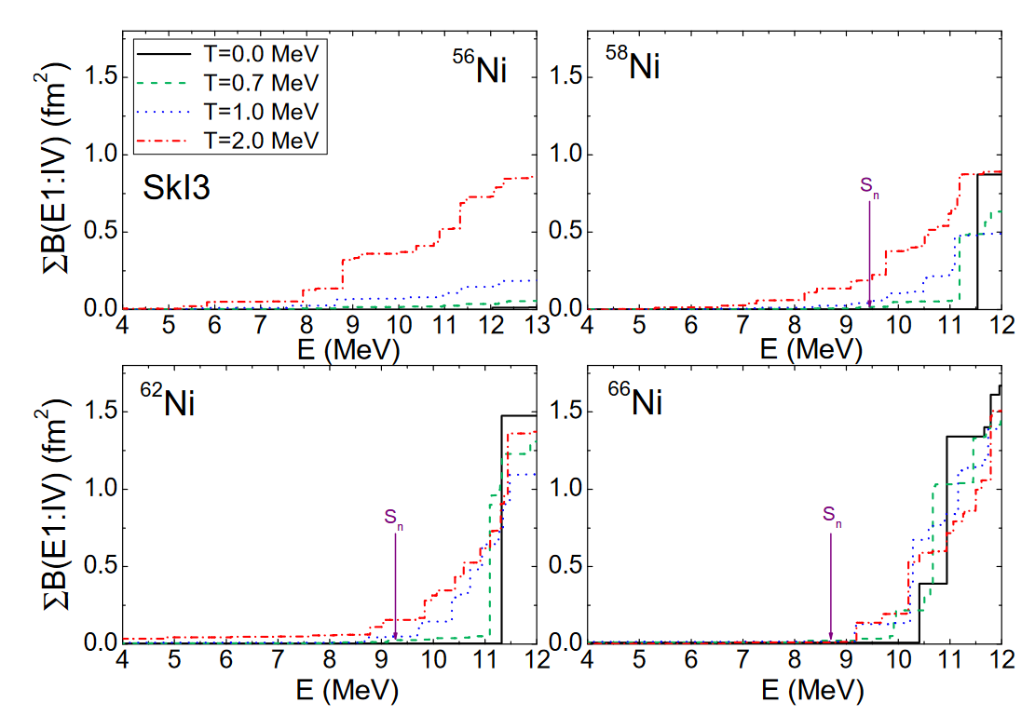
study PDR in Ni isotopes – Motivation
Study PDR strength as a function of neutron number (N/Z) to understand the role of neutrons in states at the onset of the existence of the pygmy strength – „neutron skin”
The PDR strength below 10 MeV observed :
for ⁶⁰Ni 0.5-0.8 % of EWSR (NRF)
for ⁶⁸Ni 3-5% of EWSR (Coulomb excitation)
Theoretical predictions
E. Yüksel et al., Eur. Phys. J. A (2019) 55: 230
⁵⁸Ni N/Z = 1.07
⁶²Ni N/Z = 1.21
58Ni close to N=Z
64Ni N/Z= 1.29
largest N/Z among stable nuclei
Complementary to investigations done at IFIN labs with same isotopes but with fusion evaporation reactions at finite temperature.

Slide 16
γ emission from PDR region for ⁵⁸Ni and ⁶²Ni
⁶²Ni
2⁺ → 0⁺
1173 keV
⁶²Ni Low Energy Part
⁶²Ni High Energy Part
3⁻ → 2⁺
1455 keV
2⁺ → 0⁺
2302 keV
⁵⁸Ni
2⁺ → 0⁺
1455 keV
⁵⁸Ni Low Energy Part
⁵⁸Ni High Energy Part
4⁺ → 2⁺
1005 keV
2⁺ → 0⁺
3038 keV
Maurizio Giunta’s bachelor thesis
Courtesy: Agnese Giaz

Slide 17
PDR results for ⁵⁸Ni and ⁶²Ni
⁶²Ni
N/Z = 1.21
Pygmy expected
⁵⁸Ni
N/Z = 1.07
No Pygmy or negligible Pygmy expected
Maurizio Giunta’s bachelor thesis
Courtesy: Agnese Giaz

Slide 18
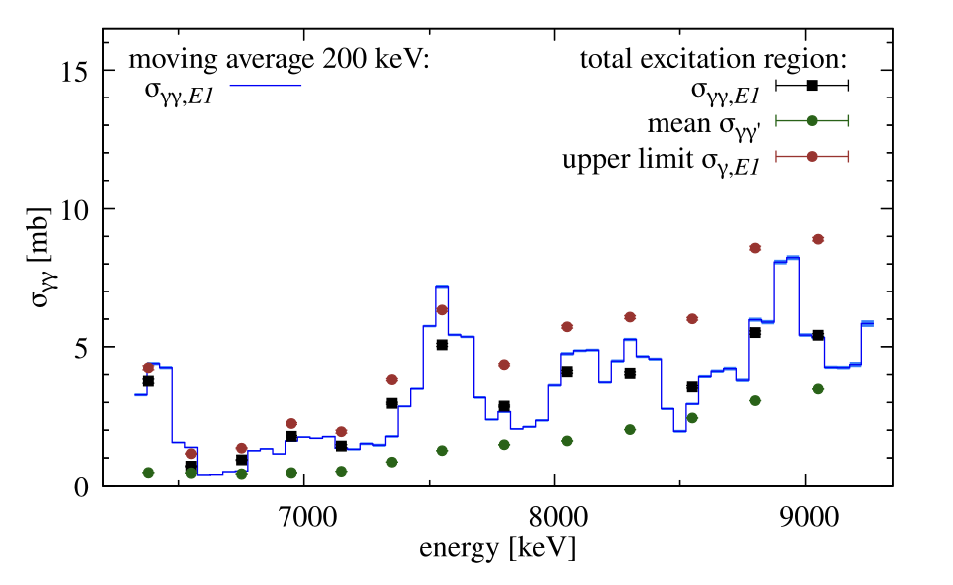
Ongoing experiment for ⁶⁴Ni
⁶⁴Ni
⁶⁴Ni Low Energy Part
⁶⁴Ni High Energy Part
0⁺ → 2⁺
1356 keV
Preliminary
Preliminary
Preliminary
⁶⁴Ni
M. Muescher et al Phys. Rev. C 109, 044318 (2024)
LaBr₃ + PARIS
Courtesy: Agnese Giaz

Slide 19
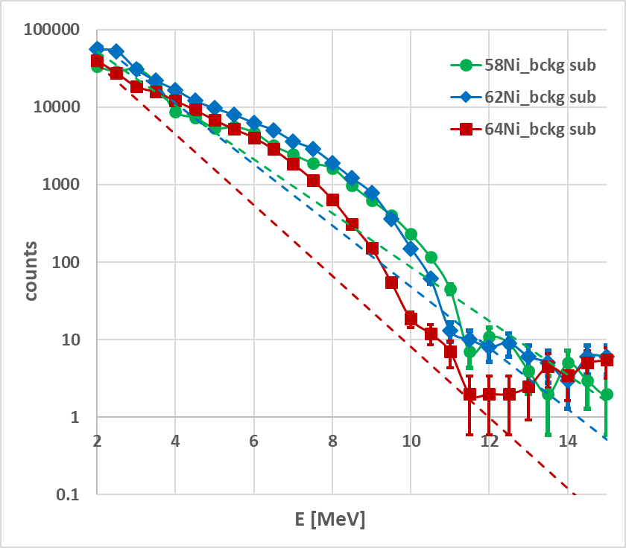
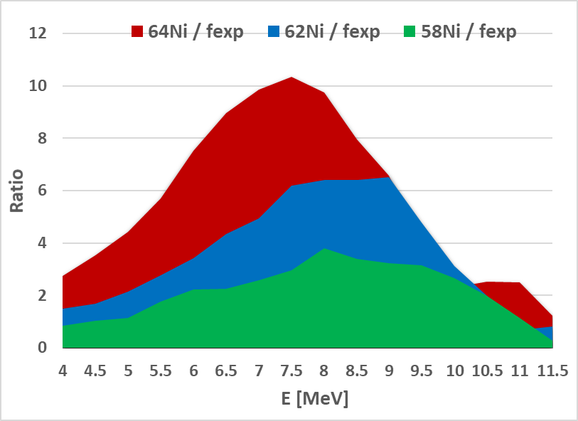
Preliminary comparison for ⁵⁸Ni, ⁶²Ni and ⁶⁴Ni
Preliminary
Preliminary
increase of gamma strength in PDR region with N/Z
experiment on ⁶⁴Ni ongoing

Slide 20
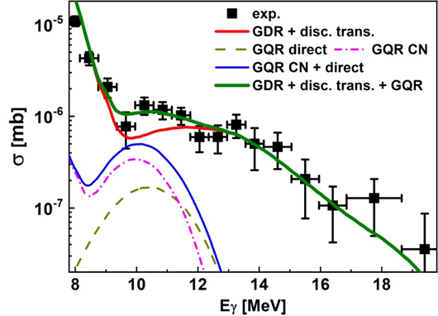
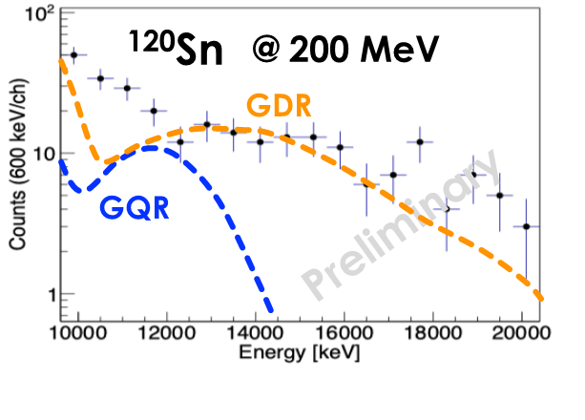
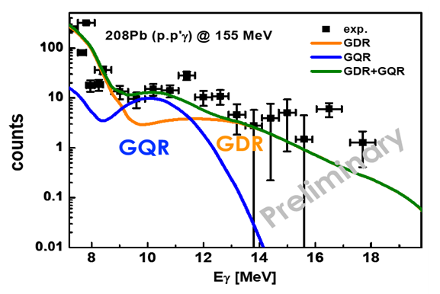
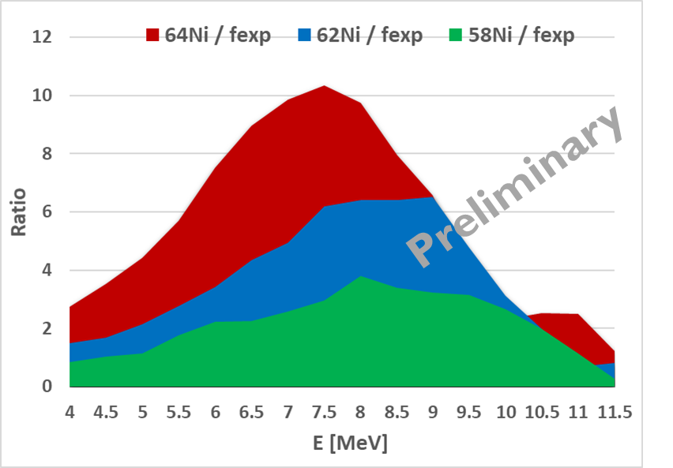
Summary
Using proton beams at CCB IFJ PAN in Kraków and (p,p’γ) reaction we studied ISGQR γ-decay from ²⁰⁸Pb and ¹²⁰Sn
²⁰⁸Pb @ 155 MeV
²⁰⁸Pb @ 85 MeV
and γ-decay from PDR region in ^{58,62}Ni, ⁶⁴Ni results are coming
The analysis of some data is ongoing.
The experiment on PDR study in ⁶⁴Ni is being continued
M. Kmiecik, European Nuclear Physics Conference, 21-26 Sept. 2025

Slide 21
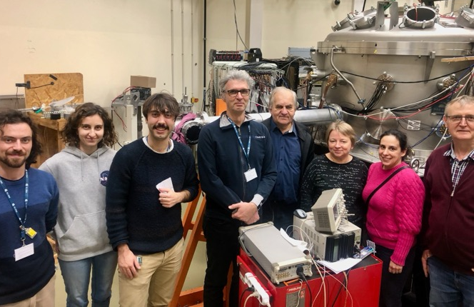
Thanks to
INFN and Uni Milano (Italy): G. Benzoni, S. Bottoni, A. Bracco, S. Brambilla, F. Camera, G. Corbari, F. Crespi, A. Giaz, S. Leoni, M. Luciani, B. Million, O. Wieland
IFJ PAN Krakow (Poland): P. Bednarczyk, N. Cieplicka-Oryńczak, M. Ciemała, I. Dedes, B. Fornal, J. Grębosz, Ł. Iskra, M. Kmiecik, J. Łukasik, A. Maj, M. Matejska-Minda, K. Mazurek, P. Pawłowski, B. Sowicki, M. Ziębliński,
University of Groningen (The Netherlands): M.N. Harakeh,
INFN LNL e Uni Padova (Italy): M. Balogh, D. Stramaccioni, J.J. Valiente-Dobon
GANIL (France): M. Lewitowicz,
IJCLab Orsay (France): C. Hiver, I. Matea, J. Wilson,
CEA Saclay (France): P. Miriot-Jaubert, M. Vandebrouck,
IKP Cologne (Germany): M. Weinert, A. Zilges,
SLCJ UW (Poland): K. Hadyńska-Klęk, P. Napiorkowski,
USTHB Algiers (Algeria): N. Benouaret,
Ithemba (South Africa): R. Neveling, L. Pellegri,
IFJ PAN Krakow (Poland) & IPHC Strasburg (France): C. Schmitt

