Slide 1
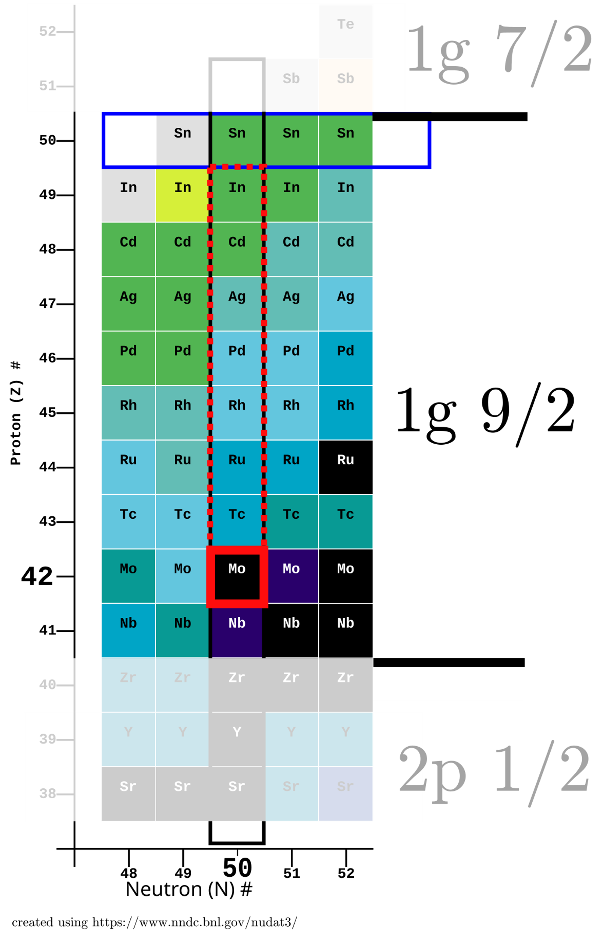
Absolute electromagnetic transition rates in semi-magic N = 50 isotones as a test for (πg_{9/2})^{n} single-particle calculations.
Jan Jolie ¹, Mario Ley ¹, Andrey Blazhev ¹, Arwin Esmaylzadeh ¹, Julia Fischer¹,Lukas Knafla ¹, Aaron Pfeil ¹, Christoph Fransen ¹, Jean-Marc Regis ¹, and Piet Van Isacker ²,
1: IKP, Universität zu Köln, Zülpicher Str. 77, D-50937 Köln, Germany
2: GANIL, CEA/DRF–CNRS/IN2P3, Bvd Henri Becquerel, F-14076 Caen, France
Motivation
Fast timing using centroid difference methods
Experimental set-up
Results for ⁹²Mo, ⁹³Tc, ⁹⁴Ru and ⁹⁵Rh
Conclusions

Slide 2
1. Motivation
Untruncated numerical full shell model calculations with the SR88MHJM
interaction and all proton orbits between Z= 38 and Z=50.
Analytical single-j calculations with a seniority conserving interaction or with
empirical two-body matrix elements. Example: ⁹³Tc as (π1g_{9/2})³
Energy of
state in ⁹³Tc
Sum over
states
in ⁹²Mo
Energy of
state in ⁹²Mo
CFP²
A de Shalit and I. Talmi, The Nuclear Shell Model (1963)

Slide 3
Recently, this approach was extended to electromagnetic quadrupole transition
rates by Piet Van Isacker.
Assumptions:
Seniority is conserved.
The effective charges in one-body E2 operator of the two-j nucleus can be state
dependent.
The effective charges in the quadrupole moment of the state with spin R are the
same as those for B(E2;R→R-2) = B_{R} in the two-particle nucleus.
Then the following relation can be obtained:
(π1g_{7/2})³
First application to ¹³⁵I as P. Spagnoletti et al. Phys. Rev. C 95 (2017) 021302
Very succesful for ²¹¹At using ²¹⁰Po
V. Karayonchev et al., Phys. Rev. C 106, (2022) 044321

Slide 4
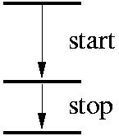
2. Fast timing using Centroid Difference Methods
CFD: constant fraction discriminator
TAC: time to amplitude converter
+
slow energy coincidence circuitry
E₁
τ = ?
E₁,E₂,Δt listmode data
E₂
Mirror Symmetric Centroid Difference (MSCD) method
J.M. Régis, G Pascovici, M. Rudigier, J. Jolie NIM A 622 (2010) 83
ΔC_{decay}(ΔE)=C(D)_{stop}−C(D)_{start}=
C(P)_{stop}+τ−(C(P)_{start}-τ)=PRD(ΔE)+2τ
Prompt Response Difference (PRD):
PRD(ΔE)= C(P)_{stop}-C(P)_{start}
PRD(ΔE) = PRD(E_{feeder}) – PRD(E_{decay}⁾
Δt

Slide 5
Calibration of the PRD curve using the ¹⁵²Eu source
PRD=ΔC-2τ
The PRD curve is shifted in parallel using different reference energies.
68 ps
Remeasurement of PRD relevant lifetime of first
2⁺ state in ¹⁵²Gd (4 weeks measurement):
New τ = 46.9(3) ps Old: τ = 46.2(39)
L. Knafla et al. NIM A 1052 (2023), 168279.
PRD(678-411)
= PRD(678)-PRD(411) = 68 (8) ps

Slide 6
The fast timing method, eliminates the feeding problem of Doppler methods, but the Compton
background has an important time dependence which needs to be corrected for.
Example time response using ⁶⁰Co.
4⁺
ΔC [ps]
1173 keV
2⁺
1.0 ps
0⁺
1333 keV
64 ps
The PRD curve
E_{ref.}=1333 keV
Solution:
Interpolation of background below the used peaks.
E_{γ} [keV]
See also H. Mach et al. Nucl. Phys. A 523 (1991) 197 section 2.3.

Slide 7
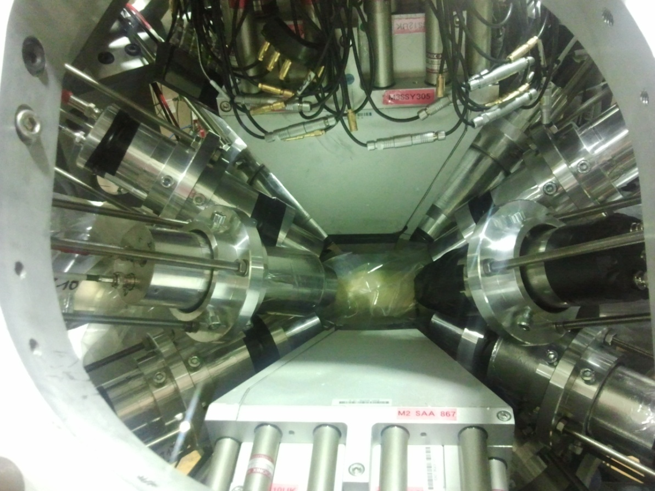
The Generalized Centroid Difference (GCD) method for γ-γ fast timing arrays
[J.M. Régis et al., NIM A 726 (2013) 191]
The generalisation of the MSCD method was done for the FATIMA@EXILL Array in Spring 2013. It holds for arrays holding the same type of scintillators, all at the same distance from the target. Then the averaged spectra still follow the MSCD relations.
The Symmetrized GCD method:
[J.M. Régis, M. Dannhoff, J. Jolie NIM A 897 (2018) 38]
Using the mirror symmetry between delayed and antidelayed time spectra, the latter can be mirrored and added to the first leading when T₀ is put to zero to:
τ = C^{D} − TW (E_{feeder}, E_{decay}).

Slide 8
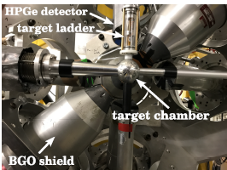
3. Experimental set-up
The HORUS array was equipped with 8 Ge detectors and 9 LaBr3(Ce) scintillators of which 6 with BGO shields.
New:
Completely digital acquisition system (CAEN 500MHz digitisers) with digital CFD algorithm
to reach timestamps with ps resolution. A. Harter et al. NIM A 1053 (2023) 168279.
Symmetrized Analysis. J. M. Régis et al. NIM A 897 (2018) 3.
Remeasurement of PRD relevant lifetime in ¹⁵²Gd. L. Knafla et al. NIM A 1052 (2023), 168279.

Slide 9
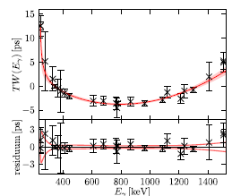
Time Walk (TW) was obtained from a ¹⁵²Eu source (⁹²Mo), extended by a ¹³³Ba and ²²⁶Ra source (⁹³Tc, ⁹⁴Ru, ⁹⁵Rh) and in-beam data from ⁹²Mo (⁹³Tc, ⁹⁴Ru).
Result for ⁹³Tc, ⁹⁴Ru

Slide 10
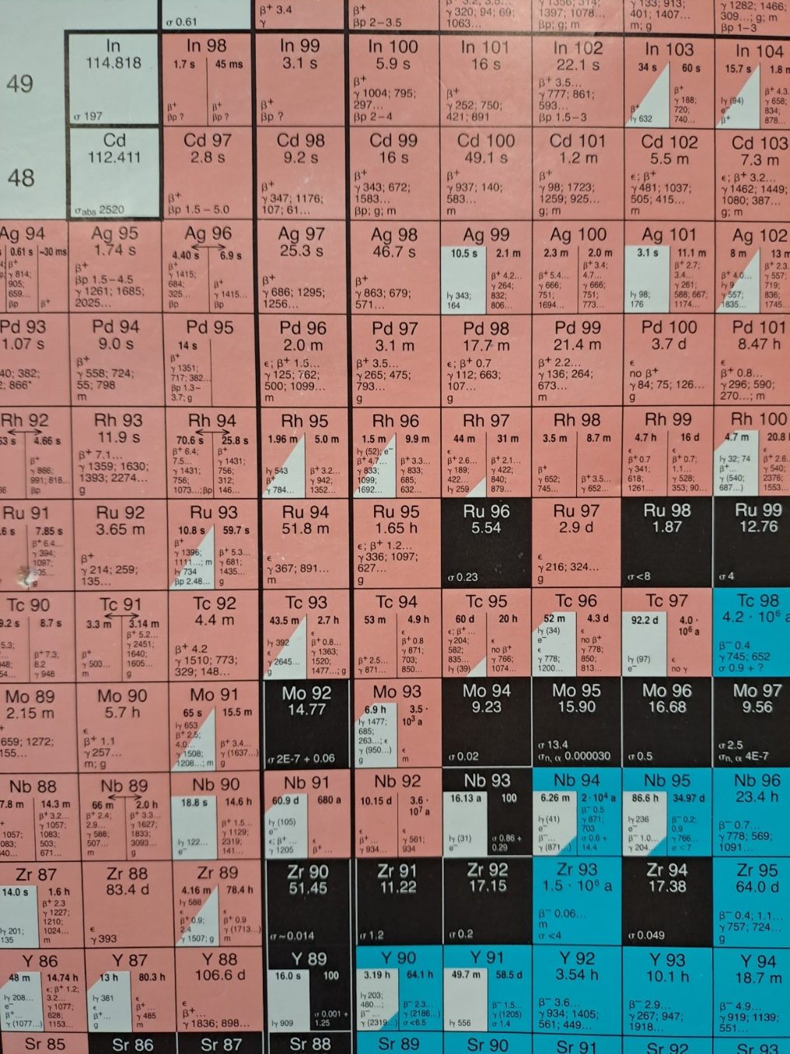
4. Results for 92Mo, 93Tc, 94Ru and 95Rh
.
Z = 50
After the success in the N = 126 isotones,
it would be interesting to study similar isotones.
Candidates could be the N= 50 isotones above Z= 40 where the π(1g_{9/2}) orbit gets filled.
Also here, the knowledge on lifetimes and B(E2) values is limited and often contradictory or
unprecise.
RIB
The problem is to populate the isotones above
⁹⁰Zr using stable or radioactive ion beams.
Z = 40
Here we report on the stable beam experiments
performed recently in Cologne.
N = 50

Slide 11
Reactions used:
⁹²Mo:
⁹⁰Zr(α,2n)⁹²Mo @ 27 MeV on a 5.3mg cm⁻² 97.62% enriched target (EXP1) (Jul 22).
σ = 1050 mb
⁹³Nb(p,2n)⁹²Mo @ 18 MeV on a 5.4mg cm⁻² monoisotopic target (EXP2) (Mar 23).
σ = 800 mb
⁹³Tc:
⁹⁰Zr(⁶Li,3n)⁹³Tc @ 31MeV on a 5.3mg/cm² 98% enriched target (Apr 23).
σ = 410 mb
⁹⁴Ru:
⁹²Mo(α,2n)⁹⁴Ru @ 28MeV on a 5.5mg/cm² 98% enriched target (Apr 23).
σ = 500 mb
⁹⁵Rh:
⁹²Mo(⁶Li,3n)⁹⁵Rh @ 36 MeV on a 5.5mg/cm² 99.93% enriched target (Dec 24).
σ = 60 mb

Slide 12
⁹²Mo:
The main problem is the lifetime of the first 4⁺ state which is needed for the prediction of all
other B(E2) values. Note B(E2) from first 2⁺ known via Coulex.
Recently, the lifetime of the 2⁺ and 4⁺ states were measured for the first time as 0.8(4) ps
and 35.5(6) in a recoil distance experiment at GANIL.
R. M. Pérez-Vidal et al. Phys. Rev. Lett. 129 (2022) 112501.
To verify the lifetime of the first 4⁺ state and reduce the statistical and systematic error two fusion evaporation reactions were used at the 10MV Tandem accelerator in Cologne.

Slide 13
4⁺₁
EXP1
4⁺₁
Exp1: τ = 22.5(11) ps
Exp2: τ = 23(2) ps
GANIL: τ = 35.5(6) ps

Slide 14
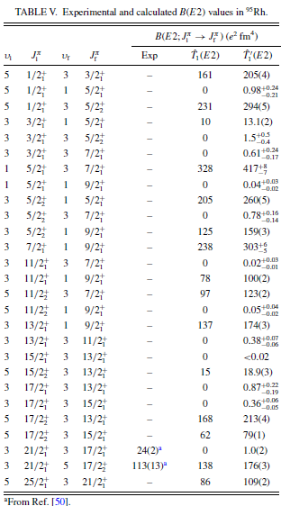
The effective charge in the one-body operator T₁(E2) is obtained from the quadrupole moment of the 9/2⁺ ground state of ⁹¹Nb, with the experimental value and uncertainty Q(9/2 ⁺) =−25(3) e fm2.
The operator T´₁(E2) has effective charges that depend on the two-nucleon states (π1g_{9/2})² and which will be used to predict transition rates in (π1g_{9/2})^{n} states with n>2.
a: R. M. Pérez-Vidal et al. Phys. Rev. Let. 129, 112501 (2022)
τ4⁺ = 87(8) ps from plunger measurement at GANIL
b: B. Das et al. Phys. Rev. C 105, L031304 (2022)
τ4⁺ =32(11) ps from fast timing measurement at GSI

Slide 15
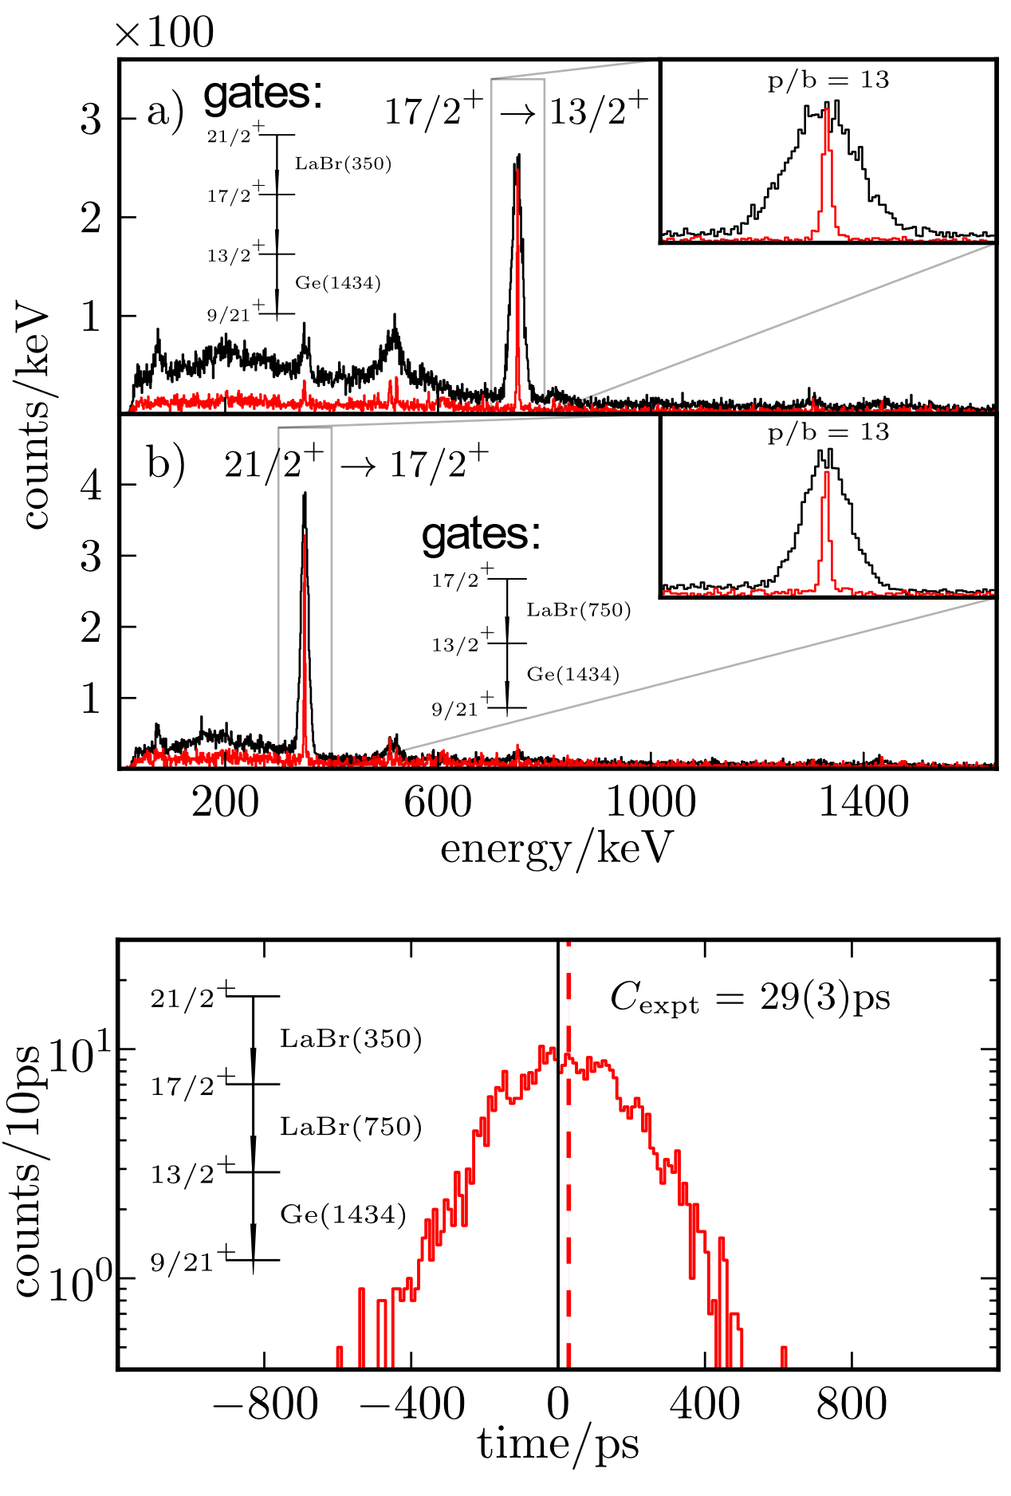
⁹³Tc:
Very few absolute transition rates are known in this three valence proton nucleus:
the B(E2; 17/2₁⁺→ 13/2₁⁺)= 88(18) e²fm⁴ and the B(E2; 21/2₁⁺→ 17/2₁⁺)*= 66(2) e²fm⁴
Results:
13/2₁⁺
17/2₁⁺
* Nuclear Data Sheets Update for A = 93 after correction for (21/2)+
M. Ley et al. PRC 110 (2024) 034320

Slide 16
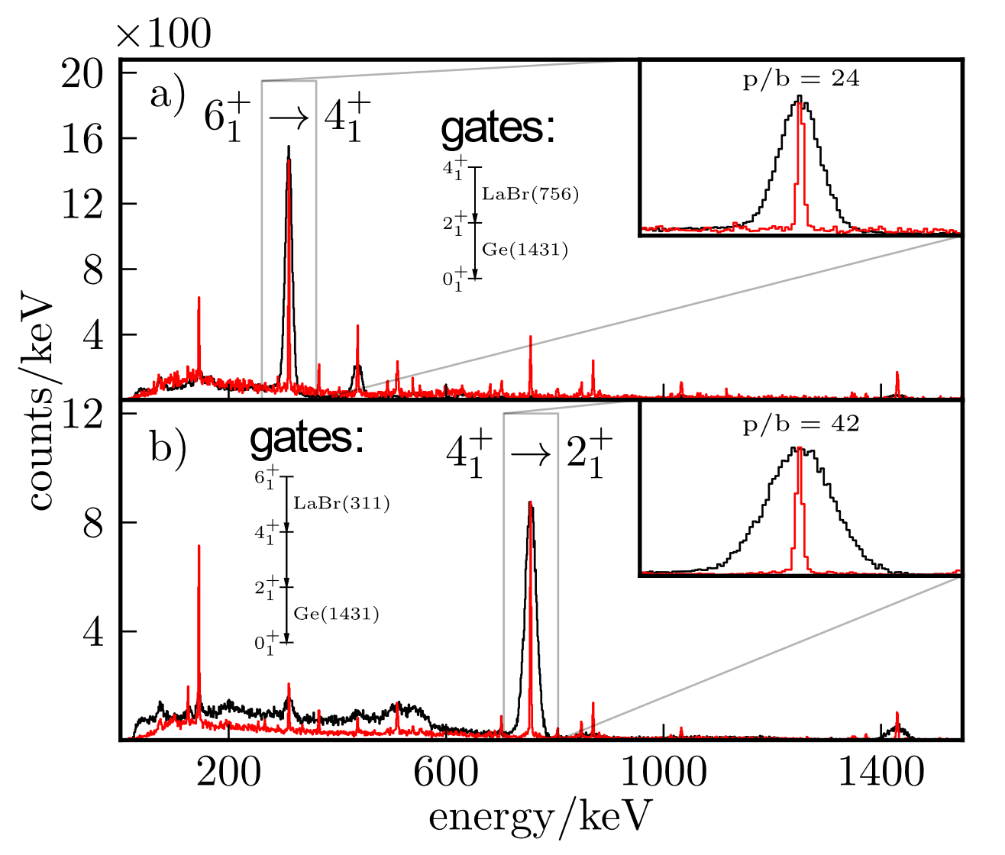
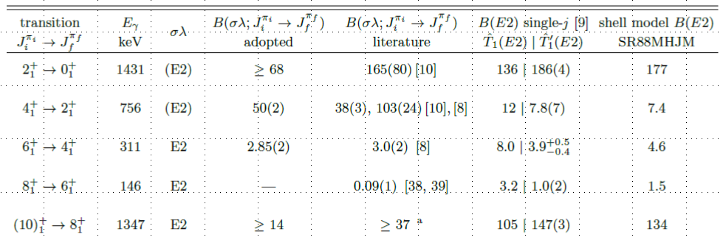
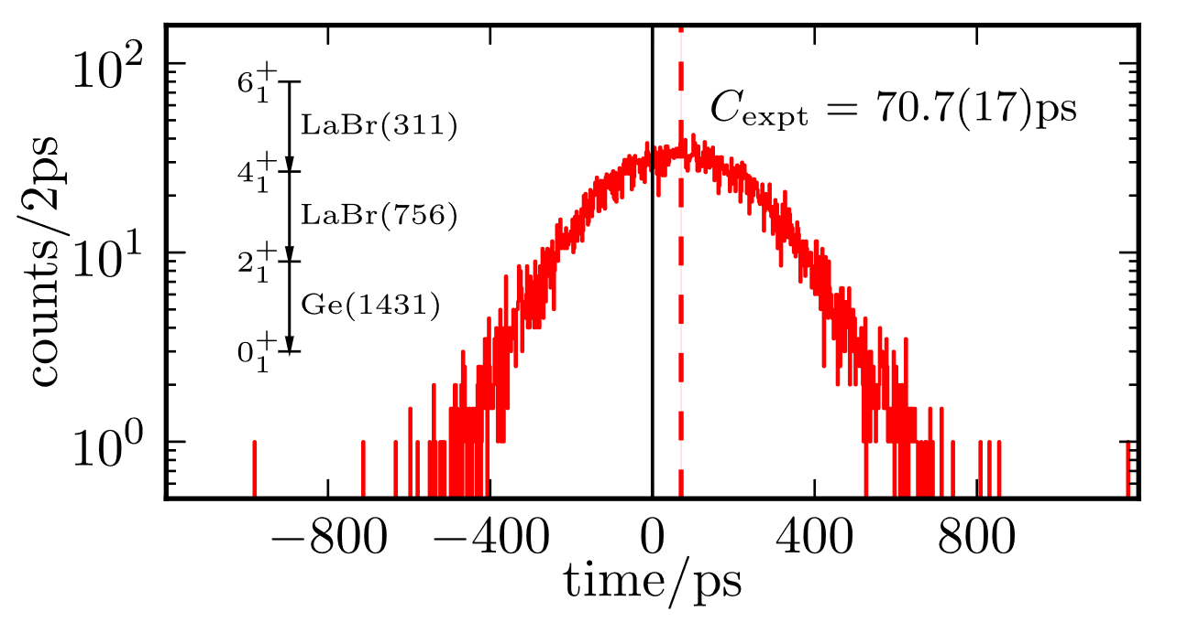
⁹⁴Ru:
Results:
τ4⁺ = 66(2) ps
τ4⁺ =32(11) ps GSI
τ4⁺ = 87(8) ps GANIL
M. Ley, J. Jolie, L. Knafla, A. Blazhev, A. Esmaylzadeh, C. Fransen, A Pfeil, J.-M. Regis, and P. Van Isacker, Phys.Rev C 110 (2024) 034320.

Slide 17
Also here the main problem is the lifetime of the first 4⁺ state. We got τ = 66(2)ps or
B(E2; 4⁺→ 2⁺)= 50(2) e²fm⁴ while the single-j prediction is B(E2; 4⁺→ 2⁺)= 7.8(7) e²fm⁴.
To obtain an understanding of this disagreement, it is essential to consider that for four particles or four holes in a j = 9/2 orbit two 4⁺ levels with v = 2 and v = 4 occur close in energy.
Given that the Δv = 2 transition is ∼14 times faster than the one with Δv = 0, a small admixture of v = 4 in the first 4⁺ state can considerably alter the B(E2; 4⁺ → 2⁺) value.
Assuming an ad hoc mixed structure of the first 4⁺
and 6⁺ state:
Two almost equally good solutions ξ₁ and ξ₂
are obtained.
The values are compared to a large scale shell
model calculation using a 1g,2d,3s configuration
with up to 4p-4h excitations across Z = 50 [5].

Slide 18
⁹⁵Rh:
13/2⁺
17/2⁺
The ⁹⁵Rh Dilemma
Recently a FAIR experiment measured lifetimes in ⁹⁵Rh, the midshell nucleus were Δv =0 transitions are forbidden and Δv =2 maximal.
Very strong deviations were found which no shell model calculations can explain.
T´₁(E2)
1.0(2)
176(3)
0.9(2)
213(4)
174(3)
B. Das et al. Phys. Rev. Research 6, L022038 (2024)

Slide 19
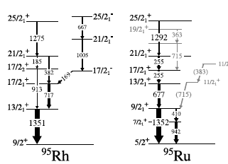
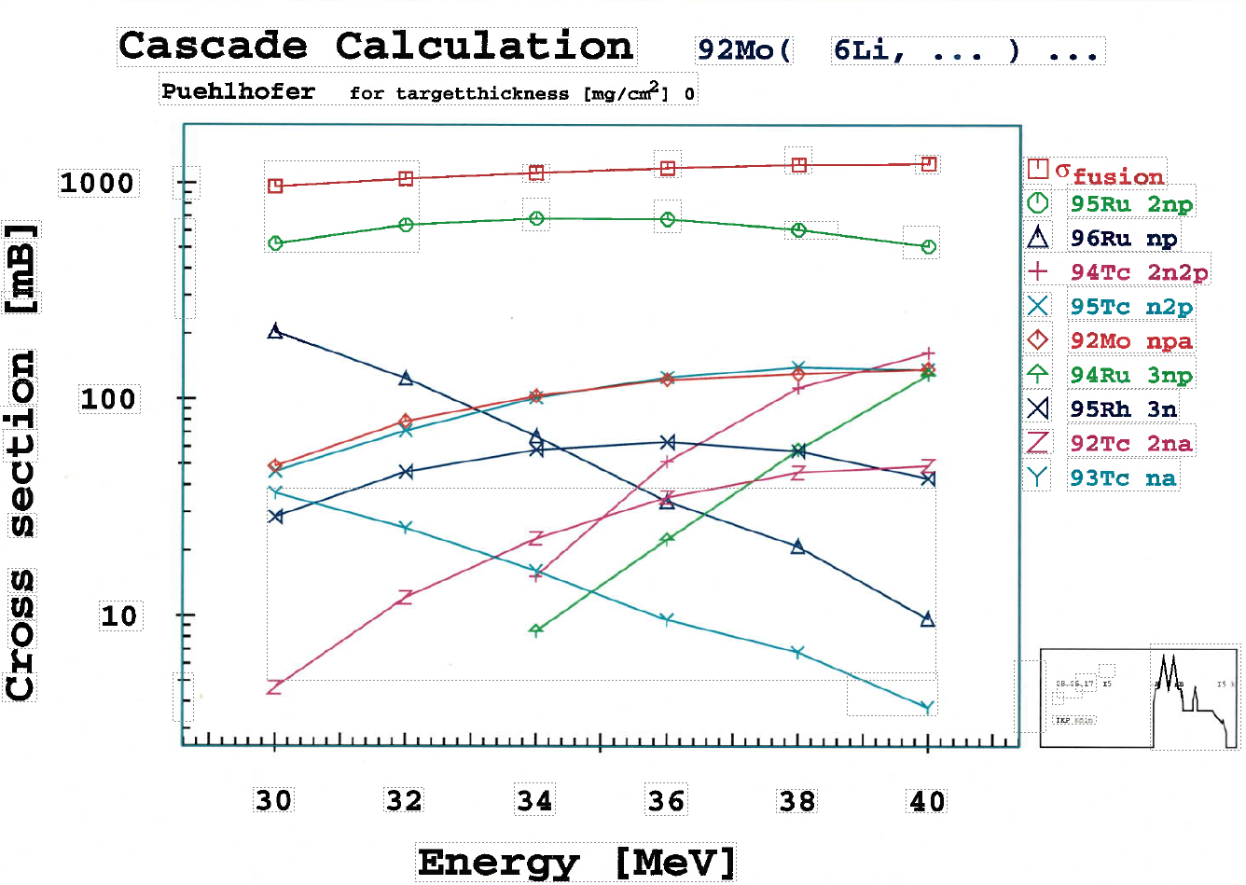
The main problem is the weak population of ⁹⁵Rh in the reaction.
The wanted reaction ⁹²Mo(⁶Li, 3n)⁹⁵Rh has a cross section of 63 mbarns.
The main reaction was ⁹²Mo(⁶Li, 2np)⁹⁵Ru with a cross section of 677 mbarns.
Moreover, the ground state transitions have nearly the same energies.
Also ⁹²Mo, ⁹³Tc and ⁹⁵Ru were populated allowing to verify the previous experiments.
Solution: a 12 day long experiment gave enough statistics to use triple coincidences to study ⁹⁵Rh and eliminate ⁹⁵Ru.

Slide 20
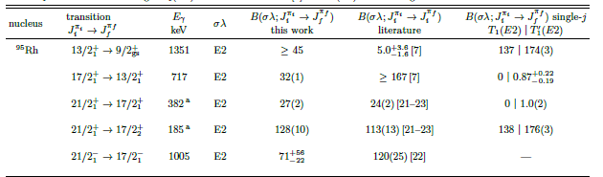

T´₁(E2)
mixed
3.23(24) 10⁺³ 27(2)
3.23(24) 10⁺³ 128(10)
135(4) 32(1)
$≤$4 $≥$45
1.0(2)
176(3)
0.9(2)
213(4)
174(3)
26.2(9)
157(3)
32(1)
182(4)
174(3)
When considering mixing between the v=3 and v=5 17/2⁺ states; |17/2⁺ ₁> = 0.859 |17/2⁺ _{v=3}> + 0.446 |17/2⁺ _{v=5}>
M. Ley, J. Jolie, A. Esmaylzadeh, C. Fransen, A. Blazhev, A Pfeil, J. Fischer, D. Al Daas, R. Burggraf, A. Bohn, S. Dantarayana, M. Droste, F. Dunkel, A. Karaka, C.-D. Lakenbrink, F. von Spee and P. Van Isacker, subm to Phys.Rev C (2025).

Slide 21
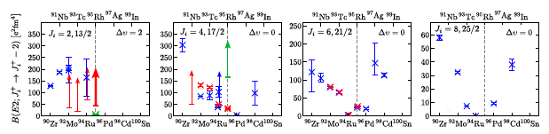
Conclusions and outlook
In order to make single-j predictions for the B(E2) values for the N= 50 isotones, precise lifetimes in ⁹²Mo were first determined to serve as input for the calculations with more than two protons.
More fast timing experiments in ⁹³Tc, ⁹⁴Ru and ⁹⁵Rh yields promising results but more B(E2) values are needed, especially for low spin states.
Red: this work
The B(E2; 4⁺→ 2⁺) in ⁹⁴Ru and B(E2) values in ⁹⁵Rh were measured to solve contradictory results from RIB experiments, but they still disagrees with the single-j predictions and LSSM calculations. Ad hoc isospin mixing can improve the agreement.
Much more stable and RIB experiments are needed.

Slide 22
4
25/2⁺
(25/2⁺)
(π1g_{9/2})⁵
19/2⁺
3
> 4.7 W.u.
13/2⁺
Energy (MeV)
9/2⁺
(21/2⁺)
21/2⁺
15/2⁺
5.0(4)W.u.
15/2⁺
7/2⁺
1.01(8)W.u.
(17/2⁺)
17/2⁺
17/2⁺
2
(17/2⁺)
1/2⁺
9/2⁺
11/2⁺
1.2(1)W.u.
3/2⁺
(11/2⁺)
11/2⁺
3/2⁺
(13/2⁺)
13/2⁺
(5/2⁺)
5/2⁺
5/2⁺
1
> 2.5 W.u.
(7/2⁺)
7/2⁺
0
9/2⁺
9/2⁺
v =1
v=3
v=5

Slide 23
92Mo
5: R. M. Pérez-Vidal et al. Phys. Rev. Let. 129, 112501 (2022)
M. Ley, L. Knafla, J. Jolie, A. Esmaylzadeh, A. Harter, A. Blazhev, C. Fransen, A Pfeil, J.-M. Regis, and P. Van Isacker, PRC108 (2023) 064313.

Slide 24
94Ru

Slide 25
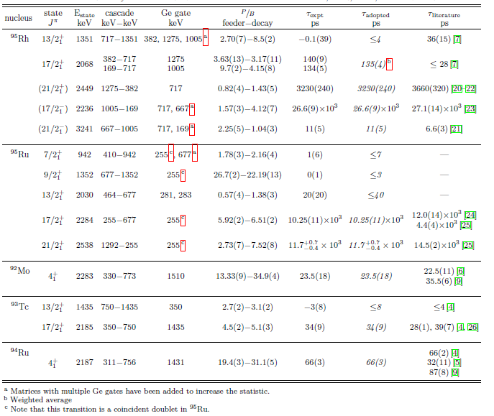
95Rh
M. Ley et al., subm. to PRC(2025)

Slide 26
⁹⁴Ru:
Results:
M. Ley, J. Jolie, L. Knafla, A. Blazhev, A. Esmaylzadeh, C. Fransen, A Pfeil, J.-M. Regis, and P. Van Isacker, Phys.Rev C 110 (2024) 034320.

Slide 27
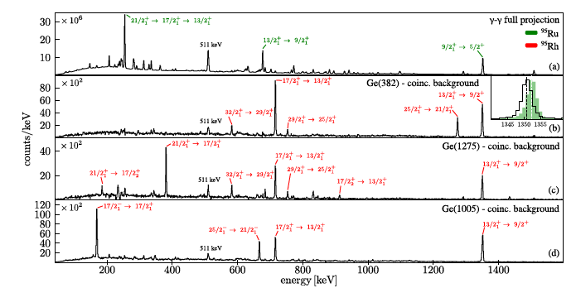
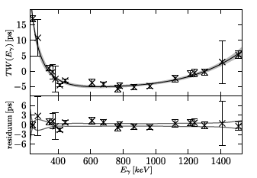
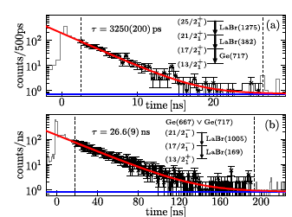
In order to separate the Rh from Ru peaks γ−γ coincidences were used.
The symmetrisized Centroid Difference method was applied using Ge-LaBr-LaBr triple coincidences.
The Timing walk (TW) curve was obtained using ¹⁵²Eu, ¹³³Ba and ²²⁶Ra sources.
The slope method was used for the 21/2⁺ (top) and 17/2⁻(bottom) states

Slide 28


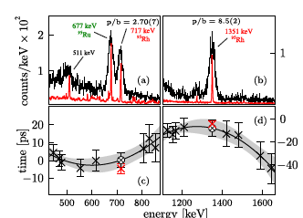
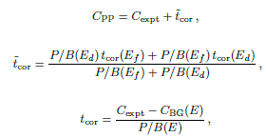
Lifetime of the 13/2⁺ state in ⁹⁵Rh
Background correction:
τ = 0.1(39) ps -> τ < 4ps instead of 36(15) ps by Das et al.

Slide 29
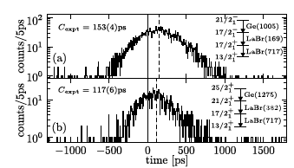

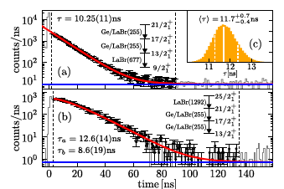




Lifetime of the 17/2⁺ state in ⁹⁵Rh
τ = 135(4) ps instead of τ$≤$ 28 ps by Das et al.
Lifetimes in ⁹⁵Ru
Lifetime of the 9/2⁺ state in ⁹⁵Ru
$$τ≤3 ps$$
Time [ps]
Lifetime of the 17/2⁺ and 21/2⁺ states in ⁹⁵Ru
17/2⁺
$$τ=10.25(11) ns$$
21/2⁺
$$τ={11.7}_{−0.4}^{+0.7} ns$$

Slide 30
Outlook: The ⁹⁵Rh Dilemma
13/2⁺
17/2⁺
Recently a FAIR experiment measured lifetimes in ⁹⁵Rh,
the midshell nucleus were Δv =0 transitions are forbidden
and Δv =2 maximal.
Very strong deviations were found which no shell model
calculations can explain.
T´₁(E2)
1.0(2)
176(3)
0.9(2)
213(4)
174(3)
B. Das et al. Phys. Rev. Research 6, L022038 (2024)
We are already trying to measure ⁹⁵Rh, but it is not easy.

Slide 31
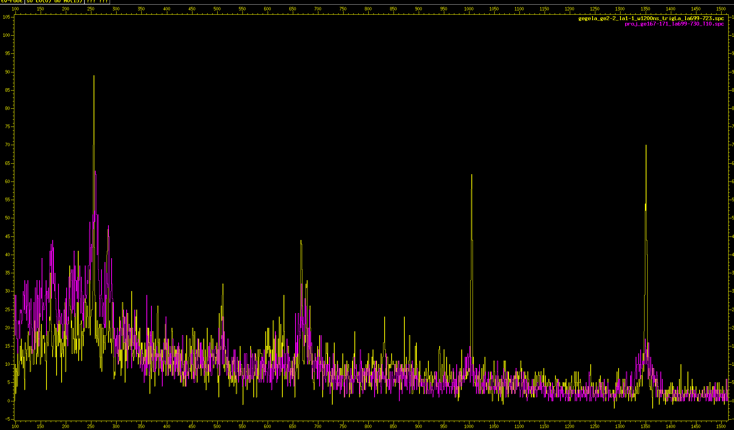
⁹⁵Rh from the ⁹²Mo(⁶Li,3n) ⁹⁵Rh reaction at 34 MeV
performed in september.
Ge gate 168 keV LaBr gate 717 keV
255 ⁹⁵Ru
1351 ⁹⁵Rh, ⁹⁵Ru
1005 ⁹⁵Rh
⁹⁵Rh
667 ⁹⁵Rh
677 ⁹⁵Ru
⁹⁵Ru

Slide 32
References for Cologne Fast Timing Methods:
General methods:
Mirror symmetric Centroid Difference method: J.M. Régis, G Pascovici, M. Rudigier, J. Jolie NIM A 622 (2010) 83
Generalised Centroid Difference Method: J.M. Régis et al., . Nucl. Instr. and Meth. in Phys. Res A 726 (2013) 191
Symmetrized GCD method: : J.M. Régis, M. Dannhoff, J. Jolie . Nucl. Instr. and Meth. in Phys. Res A 897 (2018) 38
Configuration of timing equipment:
Analog elkectronics: J.-M. Régis et al. Nucl. Instr. and Meth. in Phys. Res. A823 (2016) 72–82
Digital electronics: A. Harter et al. . Nucl. Instr. and Meth. in Phys. Res A 1053 (2023) 168279.
Compton background treatment:
Shielding: J.-M. Régis et al. Nucl. Instr. and Meth. in Phys. Res. A811 (2016) 42
Correction: J.-M. Régis et al. Nucl. Instr. and Meth. in Phys. Res. A823 (2016) 72
J.-M. Régis et al. Nucl. Instr. and Meth. in Phys. Res. A955 (2020) 163258
Prompt Response Difference curve:
For (n,γ): J.-M. Régis et al. Nucl. Instr. and Meth. in Phys. Res. A763 (2014) 210
X-rays: J.-M. Régis et al. Nucl. Instr. and Meth. in Phys. Res. A955 (2020) 163258
152Eu: L. Knafla et al. . Nucl. Instr. and Meth. in Phys. Res A 1052 (2023), 168279.
THANKS FOR YOUR ATTENTION

Slide 33
4
⁹³Tc₅₀
(π1g_{9/2})³
43
3
Energy (MeV)
(21/2)⁺
21/2⁺
15/2⁺
(17/2)⁺
17/2⁺
2
9/2⁺
(7/2,9/2,11/2)
3/2⁺
(11/2)⁺
11/2⁺
13/2⁺
(13/2)⁺
5/2⁺
1
(>7/2)
7/2⁺
0
9/2⁺
9/2⁺
v =1
v=3

Slide 34
(10)⁺
10⁺
4
(π1g_{9/2})⁴
8⁺
(8⁺)
6⁺
⁹⁴Ru₅₀
0⁺
4⁺
0⁺
0⁺
44
3⁺
(3,4,5)
7⁺
5⁺
3
0⁺
2⁺
Energy (MeV)
6⁺
8⁺
8⁺
6⁺
(3,4,5)
6⁺
4⁺
4⁺
2
4⁺
2⁺
2⁺
1
0
0⁺
0⁺
v =0
v=2
v=4

Slide 35
4
25/2⁺
25/2⁺
(π1g_{9/2})⁵
19/2⁺
3
>4.7W.u.
(19/2⁺,21/2⁺,23/2⁺)
13/2⁺
Energy (MeV)
9/2⁺
21/2⁺
15/2⁺
21/2⁺
4.4(5)W.u.
15/2⁺
7/2⁺
0.9(1)W.u.
17/2⁺
17/2⁺
17/2⁺
2
17/2⁺
1/2⁺
9/2⁺
11/2⁺
3/2⁺
(11/2⁺)
11/2⁺
13/2⁺
13/2⁺
5/2⁺
5/2⁺
1
(5/2⁺-13/2⁺)
(7/2⁺)
7/2⁺
0
9/2⁺
9/2⁺
v =1
v=3
v=5

Slide 36
with

Slide 38
Study of ²¹¹At based on ²¹⁰Po.
single-j
D. Kocheva et al., Eur. Phys. Journ. A 53 (2017) 175
V. Karayonchev et al., Phys. Rev. C 99, (2019) 024326
V. Karayonchev et al., Phys. Rev. C 106, (2022) 044321
The B(E2) values can be
compared to the
theoretical predictions.
KHP* with
changed from -0.0235
to -0.2 MeV

Slide 39
The PRD is very sensitive to the used set-up and should be made as flat as possible
Analog CFDs
Digital CFDs
t_{d}: CFD delay
TF: Transfer Function
Colors CFD delay
z: Time-walk adjustement
J.-M. Régis et al. NIM A 823 (2016) 72–82
A. Harter et al. NIM A 1053 (2023) 168279.

Slide 41
Some remarks concerning RIB measurements.
Das et al.
For fast timing measurements a optimal fine tuning of the set-up is crucial as well as high statistics for the ¹⁵²Eu source.
Ley et al.

Slide 42
A RIB measurements statistics is very limited, therefor the error determination , including systematic ones, is crucial.
FAIR
doubles
GANIL
singles
Cologne
triples
τ = 32(11) ps ¹ τ = 87(8) ps ² τ = 66(2) ps

Slide 43
⁹⁸Cd
⁹⁷Ag
⁹⁶Pd
⁹⁵Rh
⁹⁴Ru
⁹³Tc
⁹²Mo
⁹¹Nb
Z = 40
⁹⁰Zr
N = 50

Slide 44
The Generalized
Centroid-Shift method
W. Andrejtscheff et al., NIM 204 (1982) 123-128
N calibrations of the zero-time response
of N detectors.
Each γ−γ event is adjusted by 2 corrections.
Each corrected γ−γ event is incremented in
the “start” and the “stop” time spectra
(after corrections, the timing is symmetric).
Symmetric (E,E,t) matrix.
Due to corrections, the zero time t₀ is constant.
|C-t₀|=τ
(ΔC=2τ, as the identical time spectra
are mirrored with respect to t₀)
Major working time: N to 2N days.
Systematic error = ?
The Generalized
Centroid Difference method
J.-M. Régis et al., NIM A 726 (2013) 191-202
No calibrations.
No corrections.
The timing is asymmetric.
Distinction between start and stop events and
incrementation in the according time spectrum.
Asymmetric (E_{start},E_{stop},t) matrix.
The zero time is not constant.
ΔC=PRD+2τ
(calibration of the PRD curve,
the combined γ−γ zero time of FATIMA)
Major working time: 1 to 2 days.
Systematic error = 1/2 of PRD accuracy (~5 ps)

Slide 45
Remeasurement of PRD relevant lifetime of first 2⁺ state in ¹⁵²Gd (4 weeks measurement):
New τ = 46.9(3) ps Old: τ = 46.2(39)
L. Knafla et al. NIM A 1052 (2023), 168279.

Slide 46
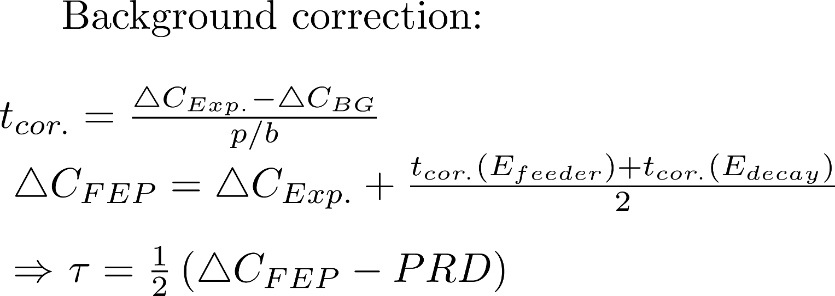

Slide 49
Analytical single-j calculations with empirical two-body matrix elements.
Example: ²¹¹At as (π1h_{9/2})³:
Antisymmetric
eigenstate in ²¹¹At
Three to two Coefficient of
Fractional Parentage (CFP))
Eigenstate
in ²¹⁰Po
Energy of
state in ²¹¹At
Sum over
states
in ²¹⁰Po
Energy of
state in ²¹⁰Po
CFP²
A de Shalit and I. Talmi, The Nuclear Shell Model (1963)

Slide 50
Lifetime measurement in ⁹⁴Ru
experiment
reaction: ⁹²Mo(⁴He, 2n)⁹⁴Ru @ 28MeV
target: 5.5mg/cm² ⁹²Mo (98% enriched)
results
lifetime τ4⁺ = 66(2) ps
B(E2) = 50(2) e²fm⁴
literature
τ4⁺ = 32(11) ps ¹
τ4⁺ = 87(8) ps ²
¹ B. Das et al. Phys. Rev. C 105, L031304 (2022)
² R. M. Pérez-Vidal et al. Phys. Rev. Let. 129, 112501 (2022)

Slide 51
evidence of partial seniority conservation
R. M. Pérez-Vidal et al. Phys. Rev. Let. 129, 112501 (2022)
τ4⁺ = 87(8) ps
seniority symmetry breaking
B. Das et al. Phys. Rev. C 105, L031304 (2022)
τ4⁺ =32(11) ps
Notes:
A further motivation is the circumstance that there are currently two contradicting values for the quadrupole transition strength of the first excited 4⁺ state in ⁹⁴Ru that lead to opposing views on the Seniority conservation here
Going to the (klick) experiment

