Slide 1


Isomeric and β - decays in Neutron-Rich
¹⁸³Hf isotope at the KISS facility
European Nuclear Physics
Conference 2025
Siddharth Doshi
s.doshi1@uni.brighton.ac.uk

Slide 2
Contents
Introduction to Isomers.
Study of Isomers using Experimental Storage Ring (ESR) at GSI.
The region of Interest (A ≈ 180-190).
Study of Isomers using the KEK Isotope Separation System (KISS) Facility at RIKEN.
Aim of the Proposed Experiment and the Experimental Setup.
Yield Calculation and Half-life measurement of ¹⁸³Hf.
Isomeric Spectroscopy in ¹⁸³Hf ground state beta decay to ¹⁸³Ta.
Summary.

Slide 3
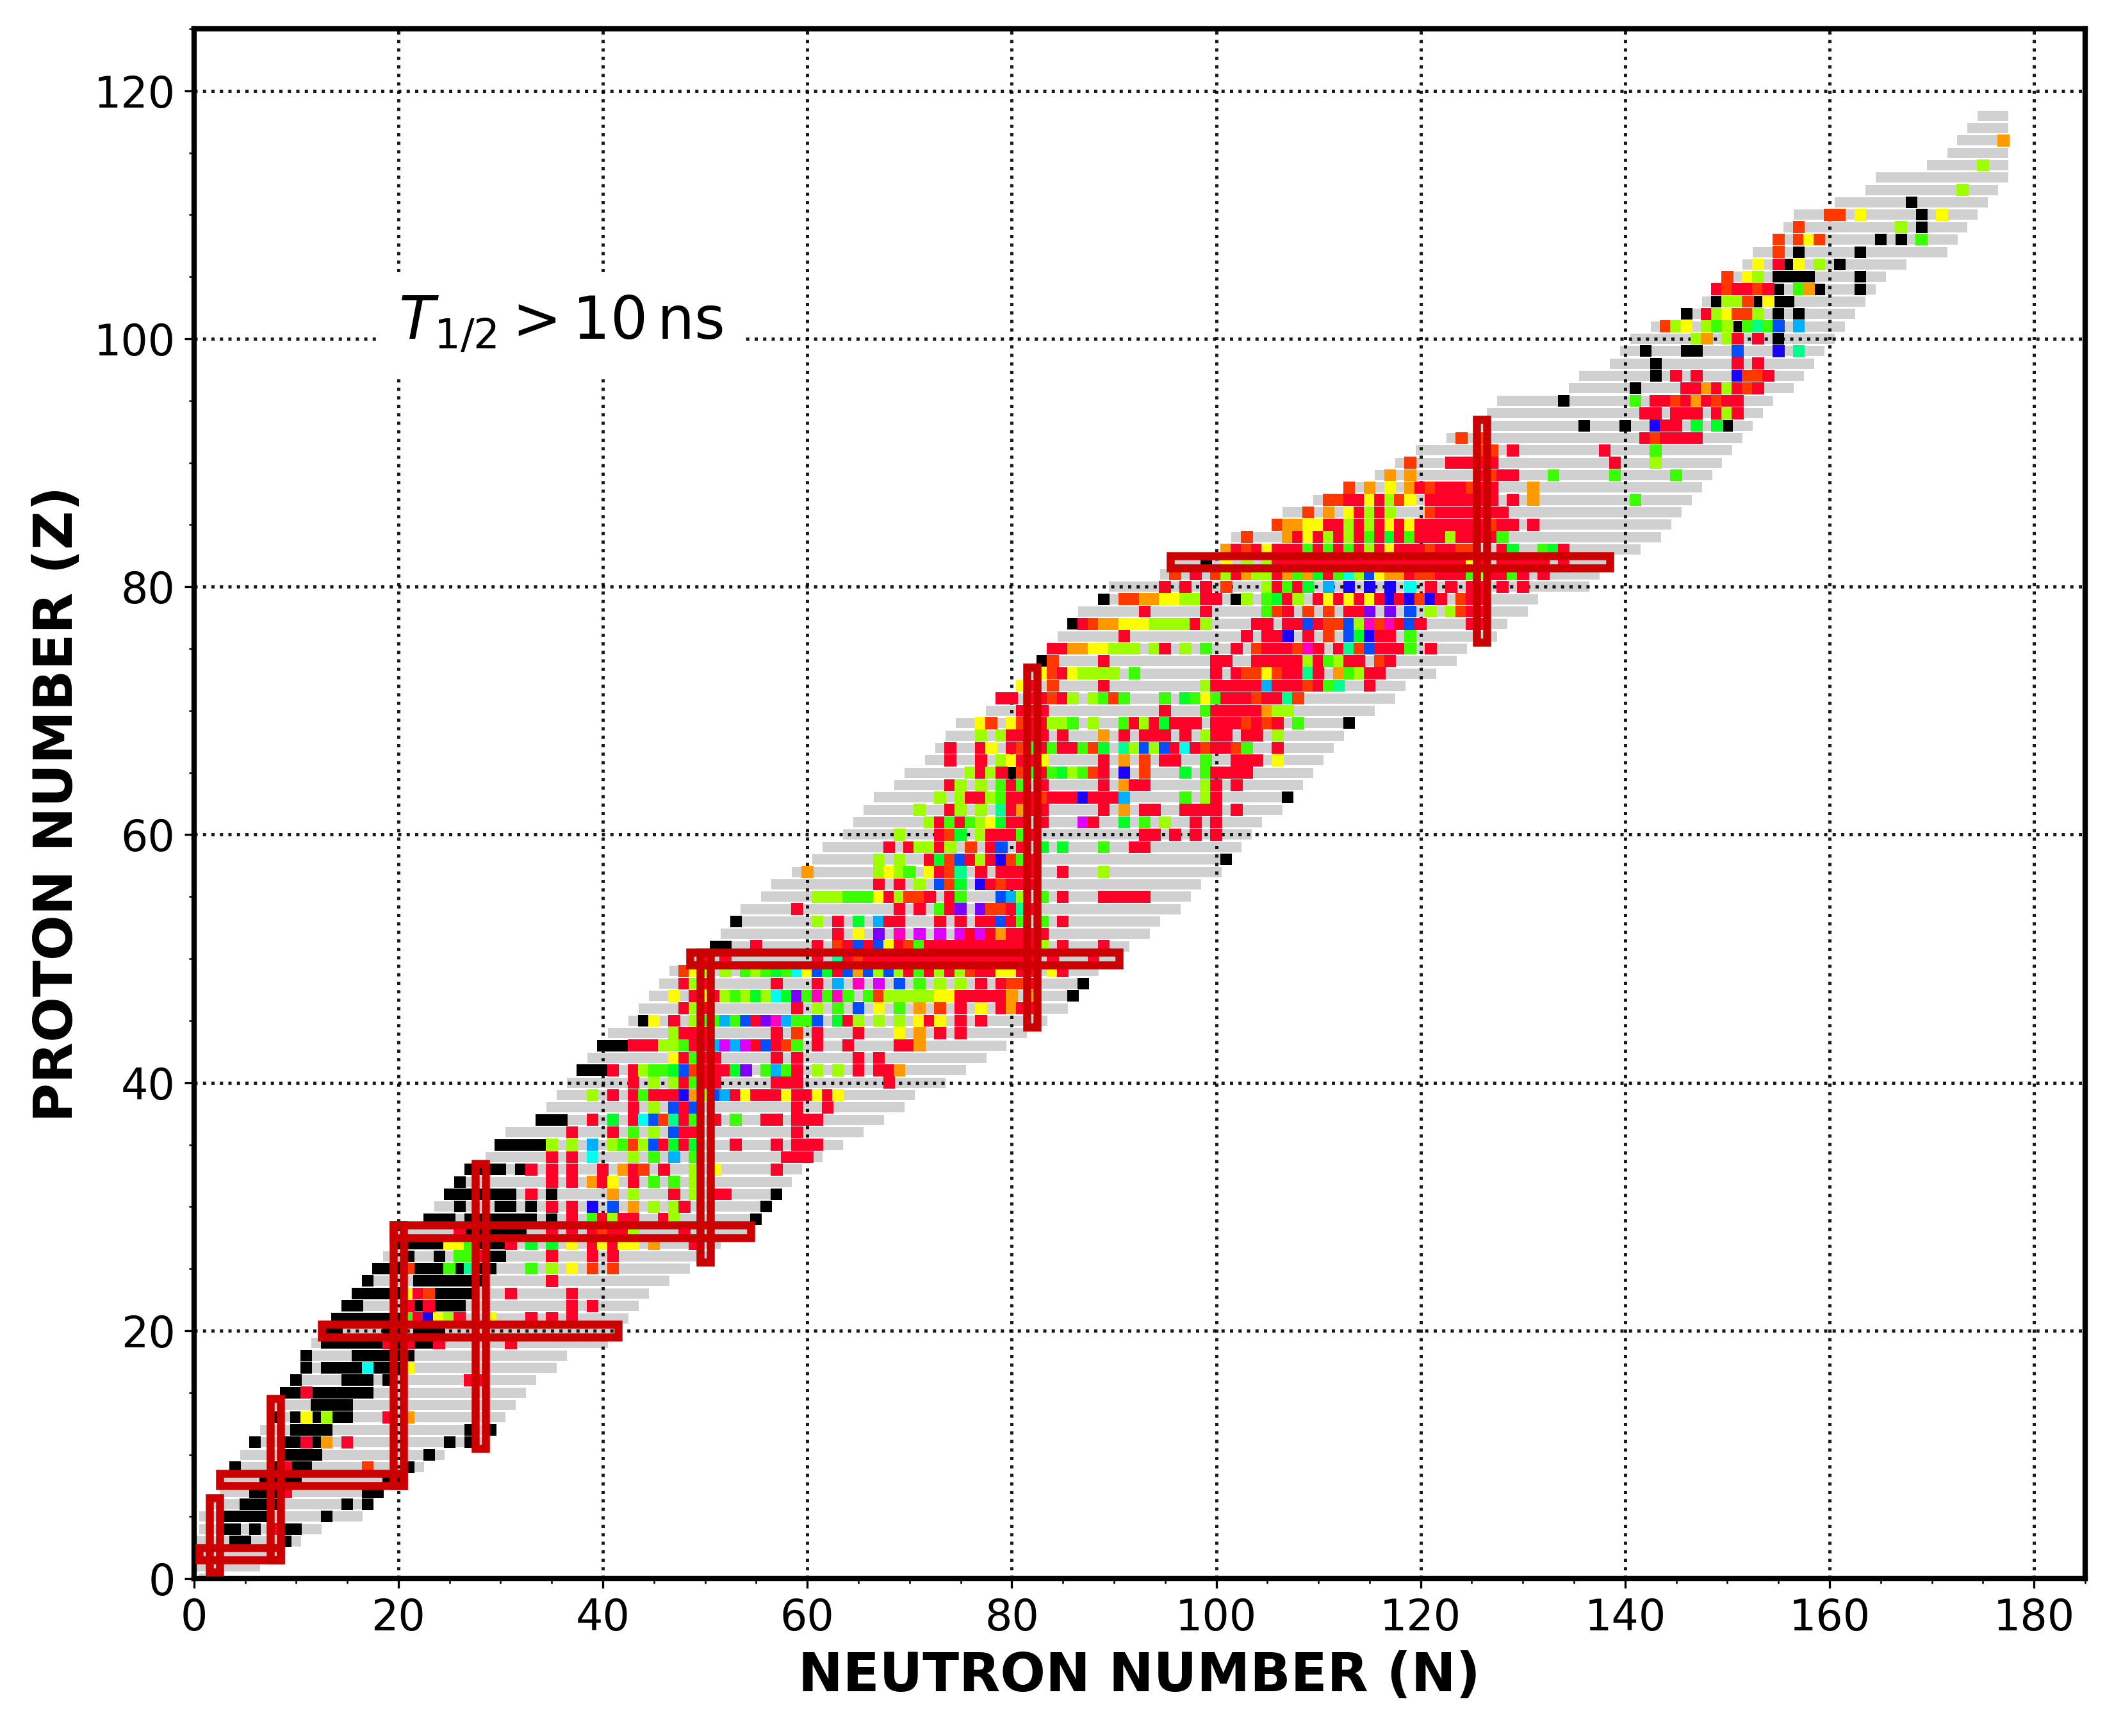
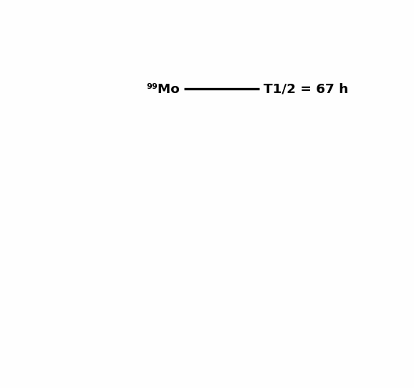
Introduction: Isomers
Isomeric State
τ_{m}
fission
α
β
p
Ground State
τ_{g}
fission
α
β
p
Adapted from P.M.Walker & G. D. Dracoulis, Nature 399 (1999) 35.

Slide 4
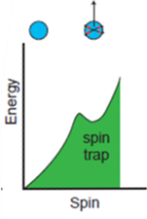
Introduction: Isomers
75 keV
9⁻
t_{1/2} > 10¹⁶ y
γ
^{180m}Ta
0 keV
1⁺
¹⁸⁰Ta
EC/ β decay
Adapted from H.J.Wollersheim., Physics with Exotic Nuclei Talk, 2016 ; P.M.Walker & G. D. Dracoulis, Nature 399 (1999) 35.

Slide 5
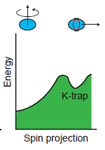
Introduction: Isomers
519.6 keV
10⁻
t_{1/2} = 16 min
E3
K=10
^{182m}Ta
334.6 keV
7⁺
163.1 keV
6⁺
16.3 keV
5⁺
K=5
0.0 keV
3⁻
K=3
^{182g}Ta
Adapted from H.J.Wollersheim, Physics with Exotic Nuclei Talk, 2016 ; P.M.Walker & G. D. Dracoulis, Nature 399 (1999) 35.

Slide 6
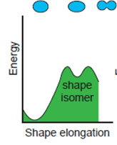
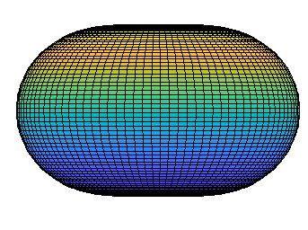
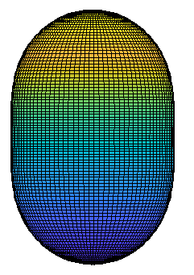
Introduction: Isomers
1013.3 keV
4⁺
519.6 keV
0⁺
455.6 keV
2⁺
t_{1/2} = 13 ns
E0
0⁺
⁷⁴Kr
Adapted from H.J.Wollersheim, Physics with Exotic Nuclei Talk, 2016 ; P.M.Walker & G. D. Dracoulis, Nature 399 (1999) 35.

Slide 7
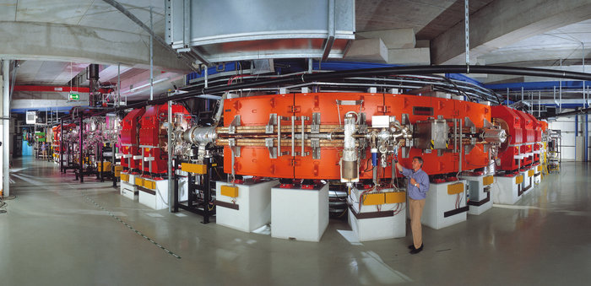
Isomer Studies at ESR (GSI)
ESR at GSI

Slide 8
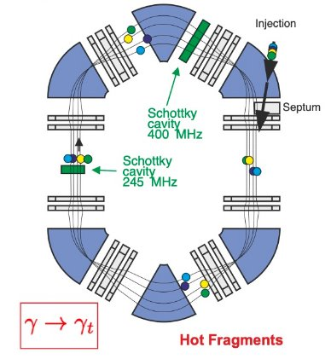
Isomer Studies at ESR (GSI)
ESR at GSI

Slide 9
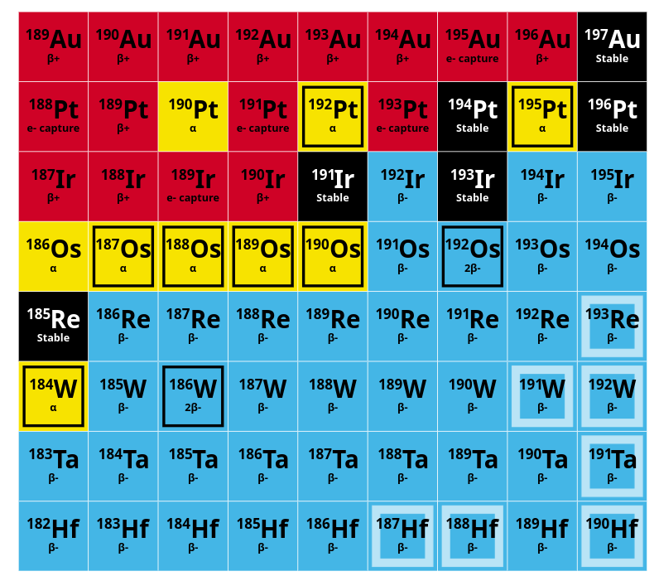
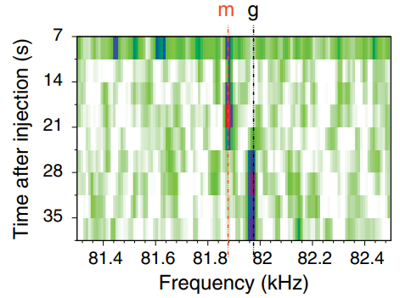
¹⁸³Hf Isomer Study at ESR (GSI)
ESR at GSI
(27/2 ⁻)
1464(64)
m
γ
≈10s
(3/2 ⁻)
0
β
g
¹⁸³Hf
1h
7/2 ⁺
0
β
¹⁸³Ta
5d
New Isomers T_{1/2} > 1s
1/2 ⁻
0
¹⁸³W stable
γ -decay event of an isomer observed in ¹⁸³Hf.
M.W.Reed et al. / Phys. Rev. Lett. 105 (2010) 172501; Phys. Rev. C 86 (2012) 054321.

Slide 10
The Region of Interest
Neutron rich nuclei in the mass 180-190 region:
  Predicted to have longer half-lives^{[1]}.
  Exhibit a prolate to oblate shape transition, resulting in high-K isomers decaying to low-K states^{[2]}.
  K mixing due to triaxiality may limit isomer half-lives, at least for Z > 73^{[3]}.
Challenges:
  Neutron richness.
  Refractory chemical properties of elements from hafnium to platinum.
^{[1]}P.M.Walker et al. / Nature 399(1999)35;Hyp. Int. 135(2001)83
^{[2]} F.R.Xu et al. / Phys. Rev. C 62(2000)014301

Slide 11
The Region of Interest
Neutron rich nuclei in the mass 180-190 region:
  Predicted to have longer half-lives^{[1]}.
  Exhibit a prolate to oblate shape transition, resulting in high-K prolate isomers decaying to low-K oblate states^{[2]}.
  elements from hafnium to platinum.
Prolate
Oblate
^{[1]}P.M.Walker et al. / Nature 399(1999)35;Hyp. Int. 135(2001)83
^{[2]} F.R.Xu et al. / Phys. Rev. C 62(2000)014301

Slide 12
The Region of Interest
Neutron rich nuclei in the mass 180-190 region:
  Predicted to have longer half-lives^{[1]}.
  Exhibit a prolate to oblate shape transition, resulting in high-K prolate isomers decaying to low-K oblate states^{[2]}.
Challenges:
  Neutron richness.
  Refractory chemical properties of elements from hafnium to platinum.
^{[1]}P.M.Walker et al. / Nature 399(1999)35;Hyp. Int. 135(2001)83
^{[2]} F.R.Xu et al. / Phys. Rev. C 62(2000)014301

Slide 13
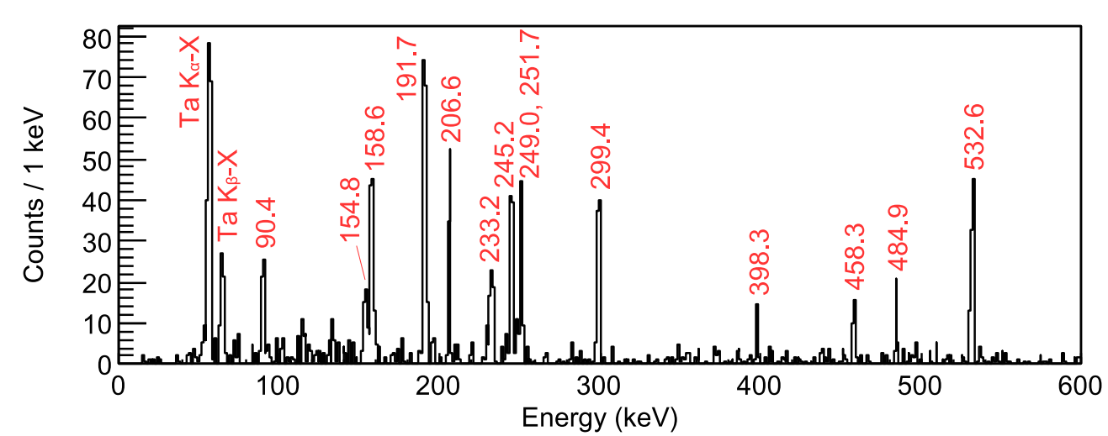
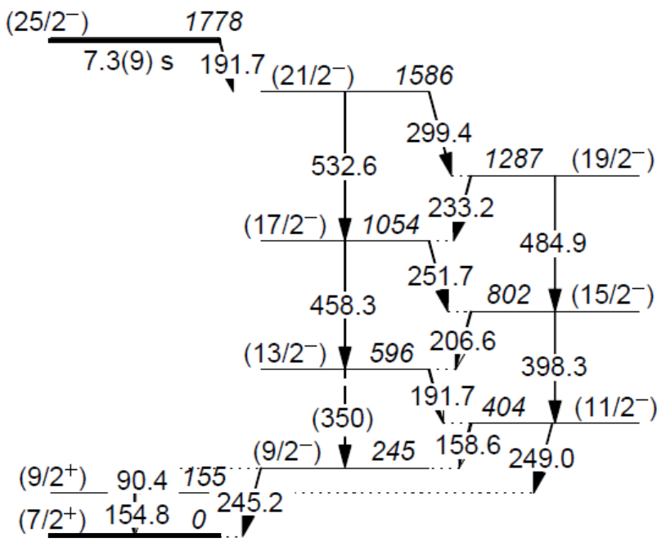
Aim of the Experiment
Using multi-nucleon transfer reactions, the KEK Isotope Separation System (KISS) facility in RIKEN, Japan, has developed a system for studying the spectroscopy of long-lived isomers in neutron rich mass region.
¹⁸⁷Ta
Summed γ-γ coincidence spectrum and the associated level scheme for ¹⁸⁷Ta obtained at KISS.
P.M.Walker et al. / Phys. Rev. Lett. 125 (2020) 192505

Slide 14
Aim of the Experiment
Using multi-nucleon transfer reactions, the KEK Isotope Separation System (KISS) facility in RIKEN, Japan, has developed a system for studying the spectroscopy of long-lived isomers in neutron rich mass region.
¹⁸⁷Ta
Summed γ-γ coincidence spectrum and the associated level scheme for ¹⁸⁷Ta obtained at KISS.
The experiment aimed :
  To make detailed spectroscopic studies of the long-lived isomers in ¹⁸³Hf and ¹⁸⁴Hf,
  To learn about the favouring of high-K states,
  To measure the β and γ-decay properties,
  To investigate the sensitivity to shape changes.
P.M.Walker et al. / Phys. Rev. Lett. 125 (2020) 192505

Slide 15
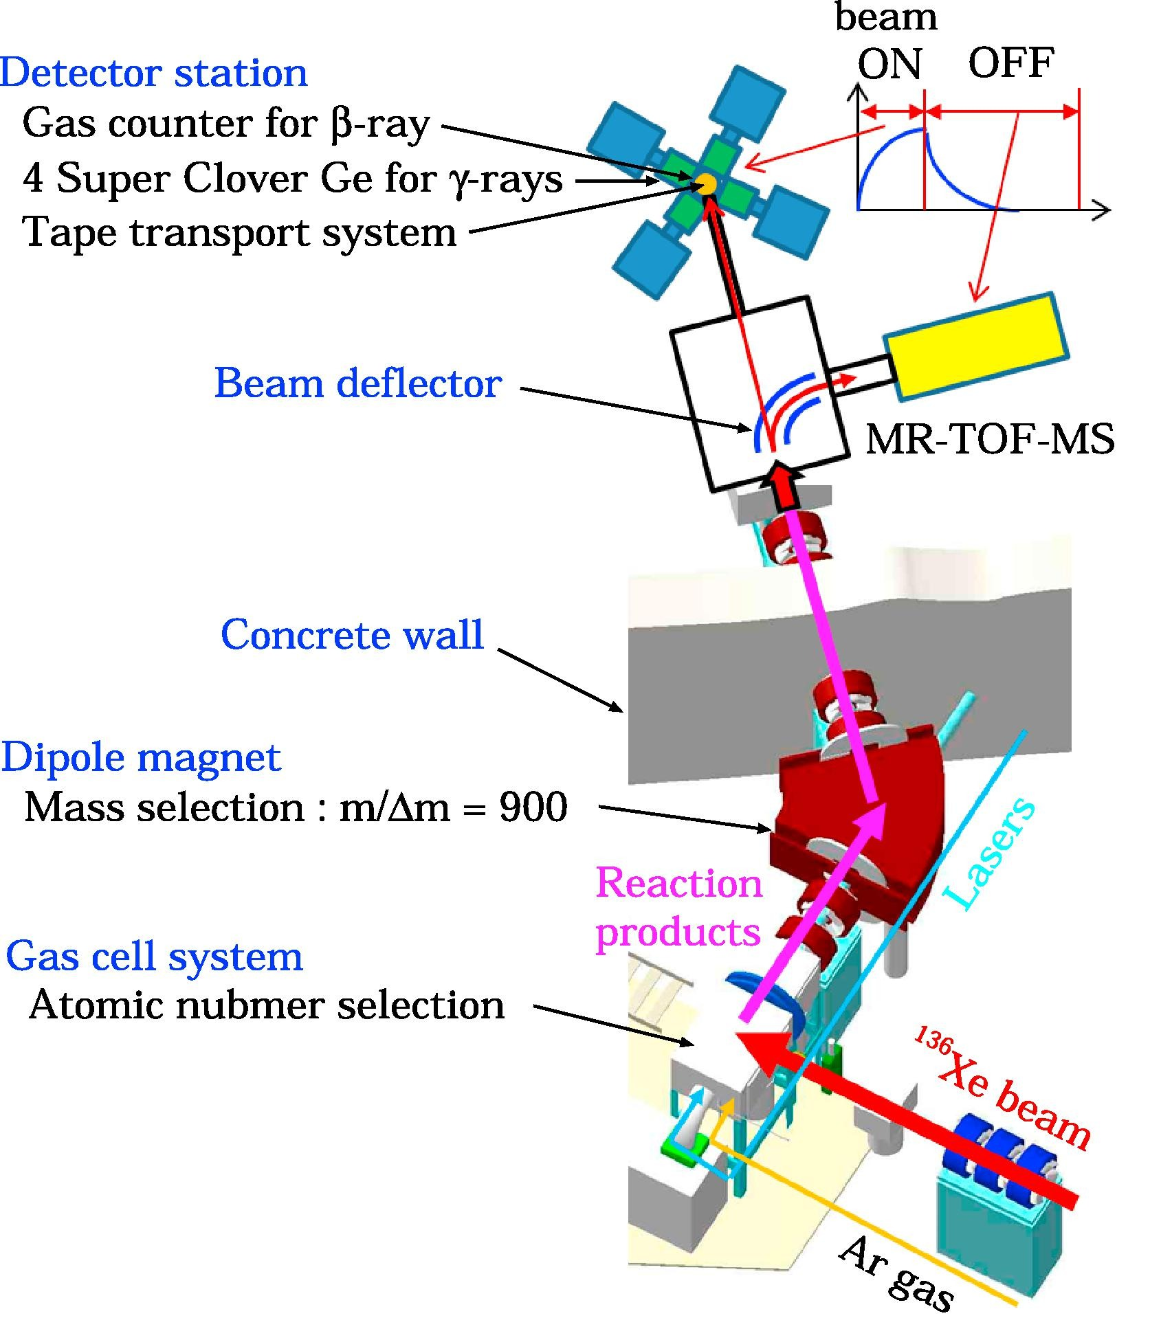
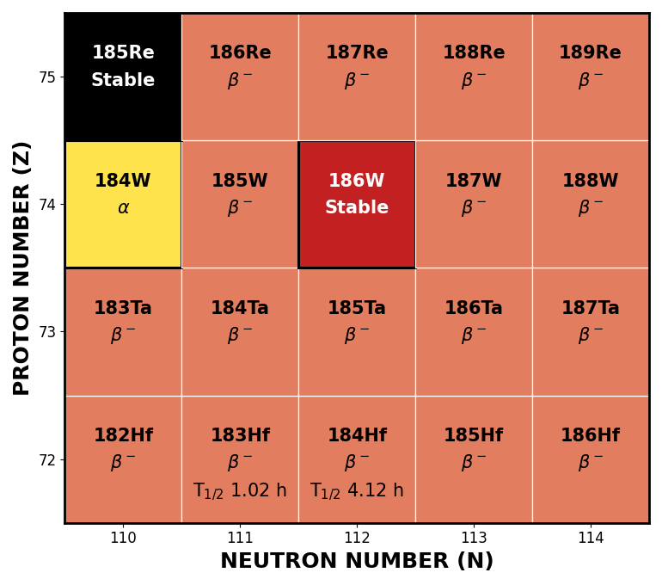
The KISS Setup
Y. Hirayama et al., Nuclear spectroscopy of r-process nuclei using KEK Isotope Separation System; Nucl. Inst. Meth. B 463(2020)425-430
Nat. W Target
Schematics of KISS for ¹³⁶Xe on ^{nat}W → ^{183,184}Hf with subsequent spectroscopy.

Slide 16
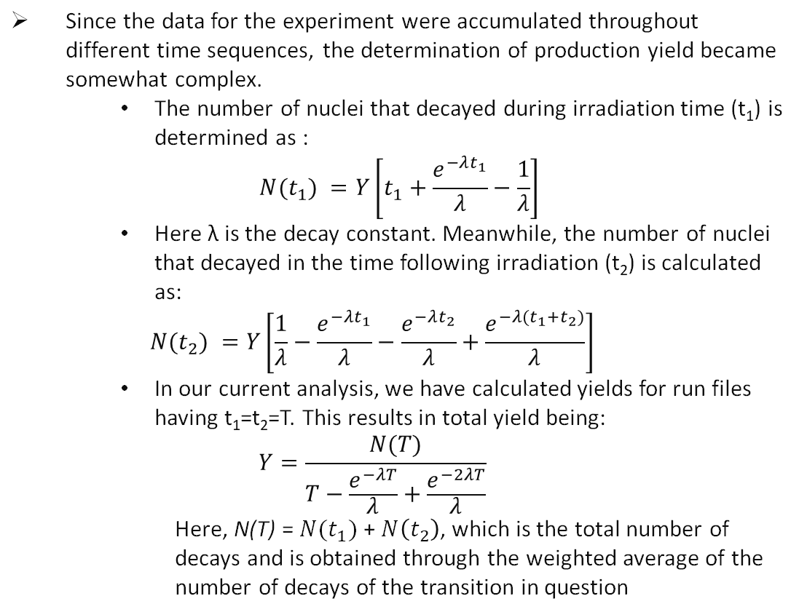
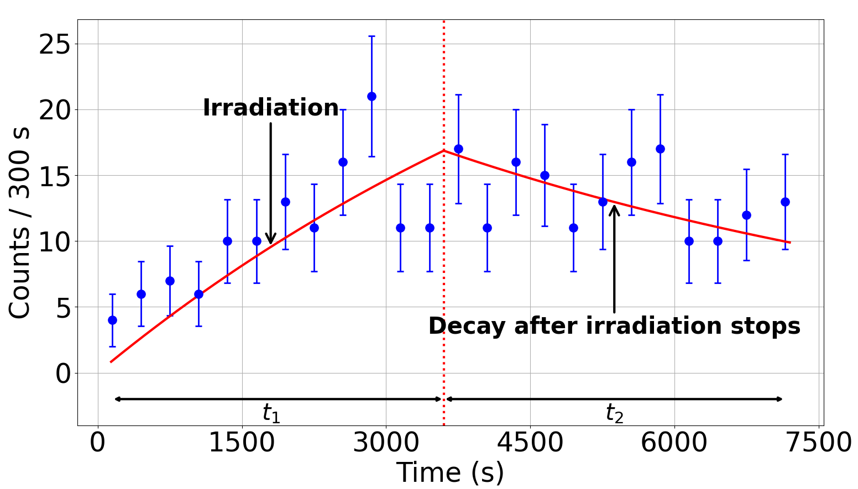
Yield calculation
Growth (1 hour of beam on) and decay (1 hour of beam off) of 73.2 keV transition in ¹⁸³Hf β-decay.

Slide 17
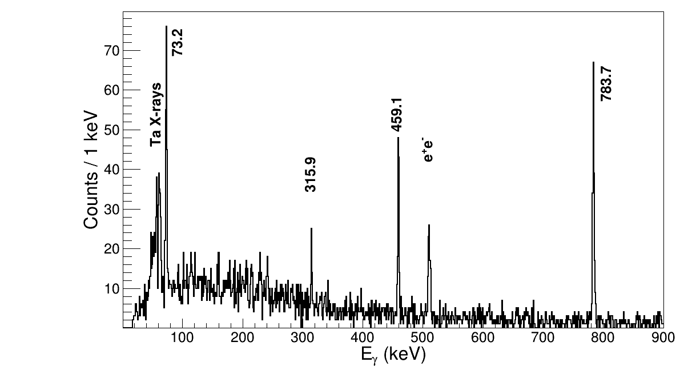


Yield calculation of ¹⁸³Hf
β-γ coincidence spectra.
T_{1/2}=1.018 h
(3/2 ⁻)
0
β- : 100%
(5/2 ⁻)
856.9
783.7
(5/2 ⁺)
459.1
315.9
459.1
9/2 ⁺
143.2
9/2 ⁻
73.2
(107ns)
E_{γ} _{(keV)} | A_{γ} | ε_{γ} | I_{γ} _{From [1]} | N(T) | Wt. N(T) (per run) | Yield (ions/sec)
73.2(2) | 126(14) | 0.137(4) | 38.0(40) | 6030(924) | 1941(179) | 0.85(8)
783.7(3) | 135(15) | 0.090(3) | 65.5(19) | 5713(658)
7/2 ⁺
73.2
0
^{[1]}https://www.nndc.bnl.gov/

Slide 18
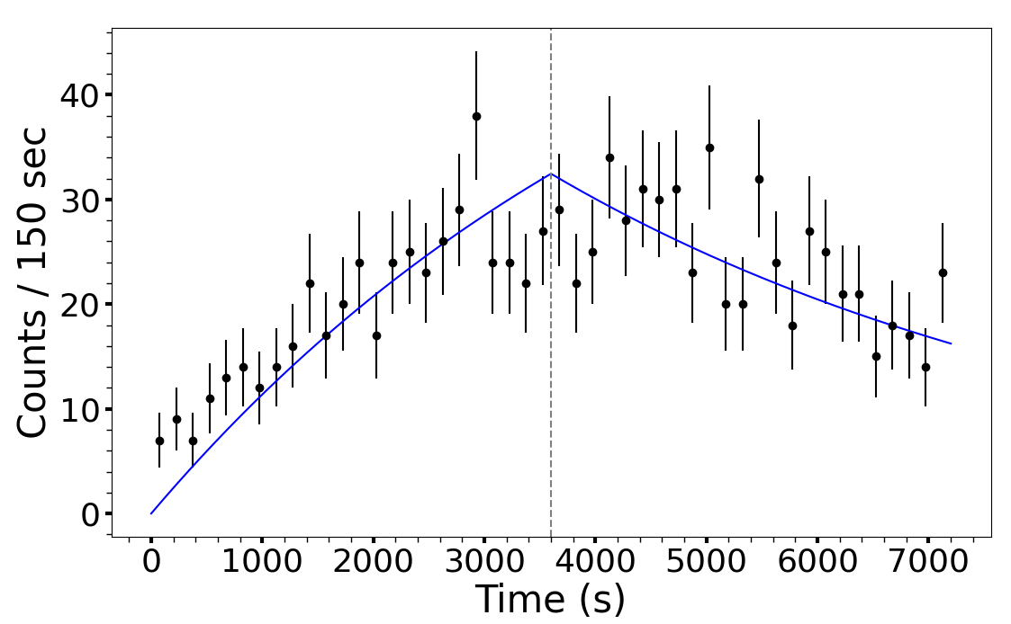


Half-Life measurement of ¹⁸³Hf g.s.
The growth and decay of the 73.2, 459.1 and 783.7 keV transitions as a function of time.
T_{1/2}=1.018 h
(3/2 ⁻)
0
β- : 100%
(5/2 ⁻)
856.9
783.7
(5/2 ⁺)
459.1
459.1
E_{γ} (keV) | T_{1/2} h | Wt. T_{1/2} h | T_{1/2} h [1]
73.2(2) | 1.03(19) | 1.03(14) | 1.018(2)
459.1(5) | 1.01(28)
783.7(3) | 1.03(27)
9/2 ⁻
73.2
(107 ns)
7/2 ⁺
73.2
0
^{[1]}https://www.nndc.bnl.gov/

Slide 19
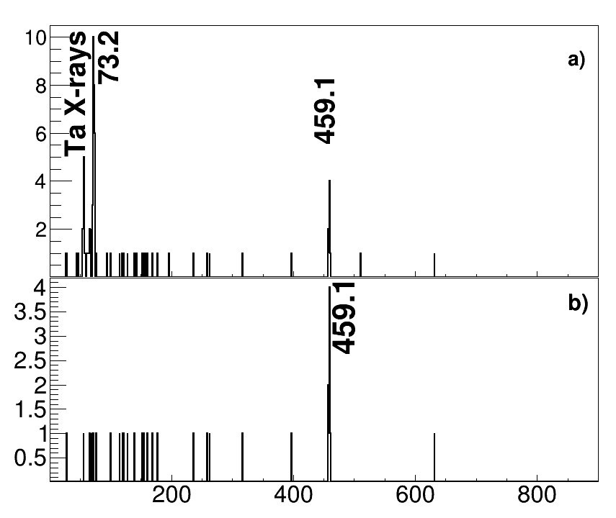
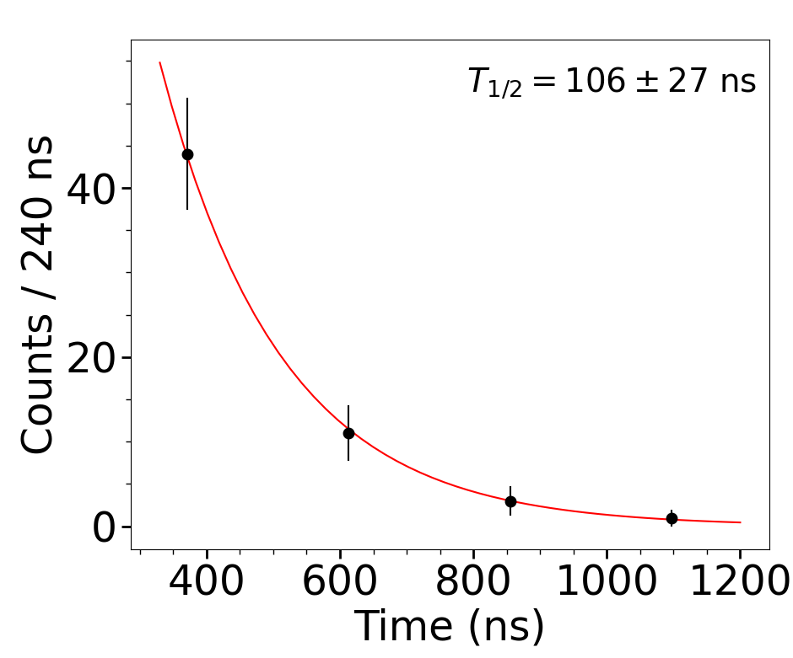


Isomeric spectroscopy of ¹⁸³Hf g.s. β-decay to ¹⁸³Ta
Beam gated β-γ coincidence delayed spectra.
0.3 μs to 8.0 μs
T_{1/2} = 106(27) ns
^{[1]}T_{1/2} = 107(11) ns
1.0 μs to 8.0 μs
^{[1]}https://www.nndc.bnl.gov/

Slide 20
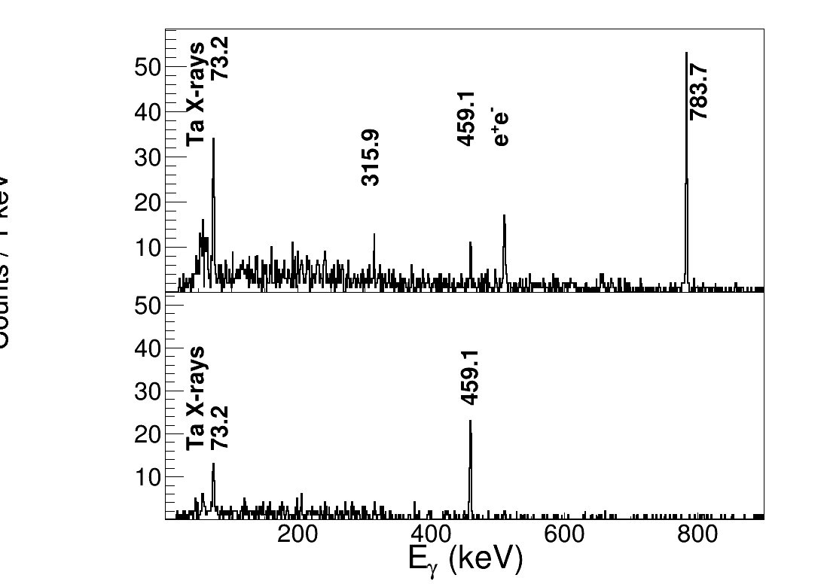
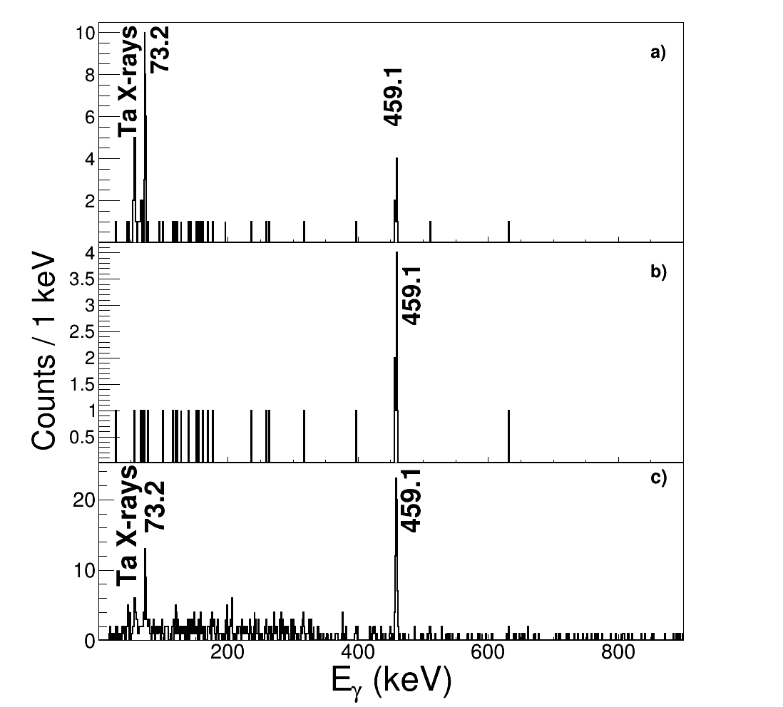
Isomeric spectroscopy of ¹⁸³Hf g.s. β-decay to ¹⁸³Ta
Beam gated β-γ coincidence delayed spectra.
±0.25 μs
Peak areas at 459.1 keV in ¹⁸³Hf run files added together​
 | I_{γ}(%) _{From [1]} | Measured I_{γ}(%)
Total Intensity | 29.8 (10) | 33.1(61)
±0.25 μs |  | 8.2(21)
0.3 μs to 50 μs |  | 24.9(64)
0.3 μs to 500.0 μs
^{[1]}https://www.nndc.bnl.gov/

Slide 21
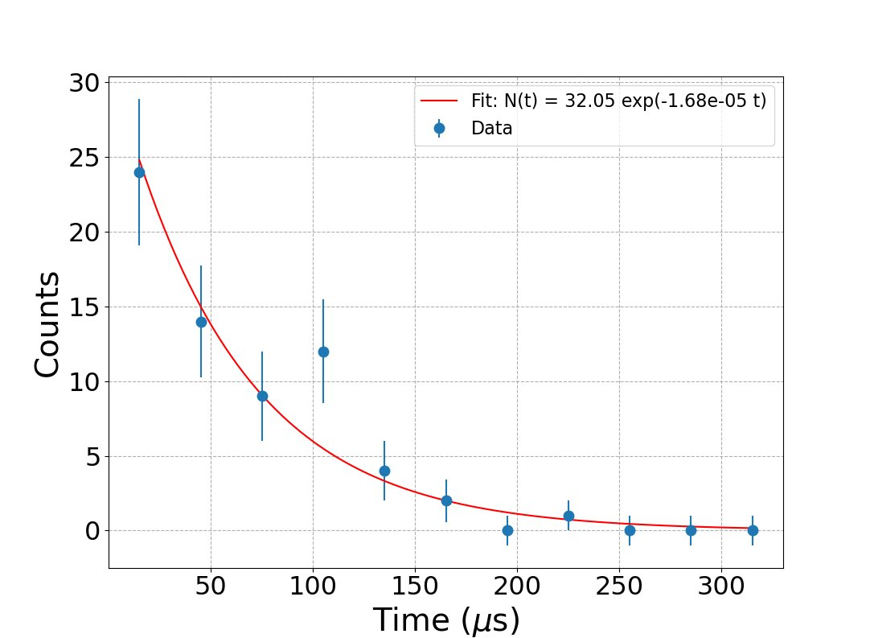

T_{1/2} of Isomeric state
T_{1/2} = 41⁺⁶ μs
₋₄
(3/2 ⁻)
0
T_{1/2}=1.018 h
β- : 100%
(7/2 ⁺)
572.8
113.7
41 μs
459.1 + x
(5/2 ⁺)
x
459.1
315.9
459.1
9/2 ⁺
143.2
9/2 ⁻
143.2
73.2 (107 ns)
7/2 ⁺
73.2
0

Slide 22
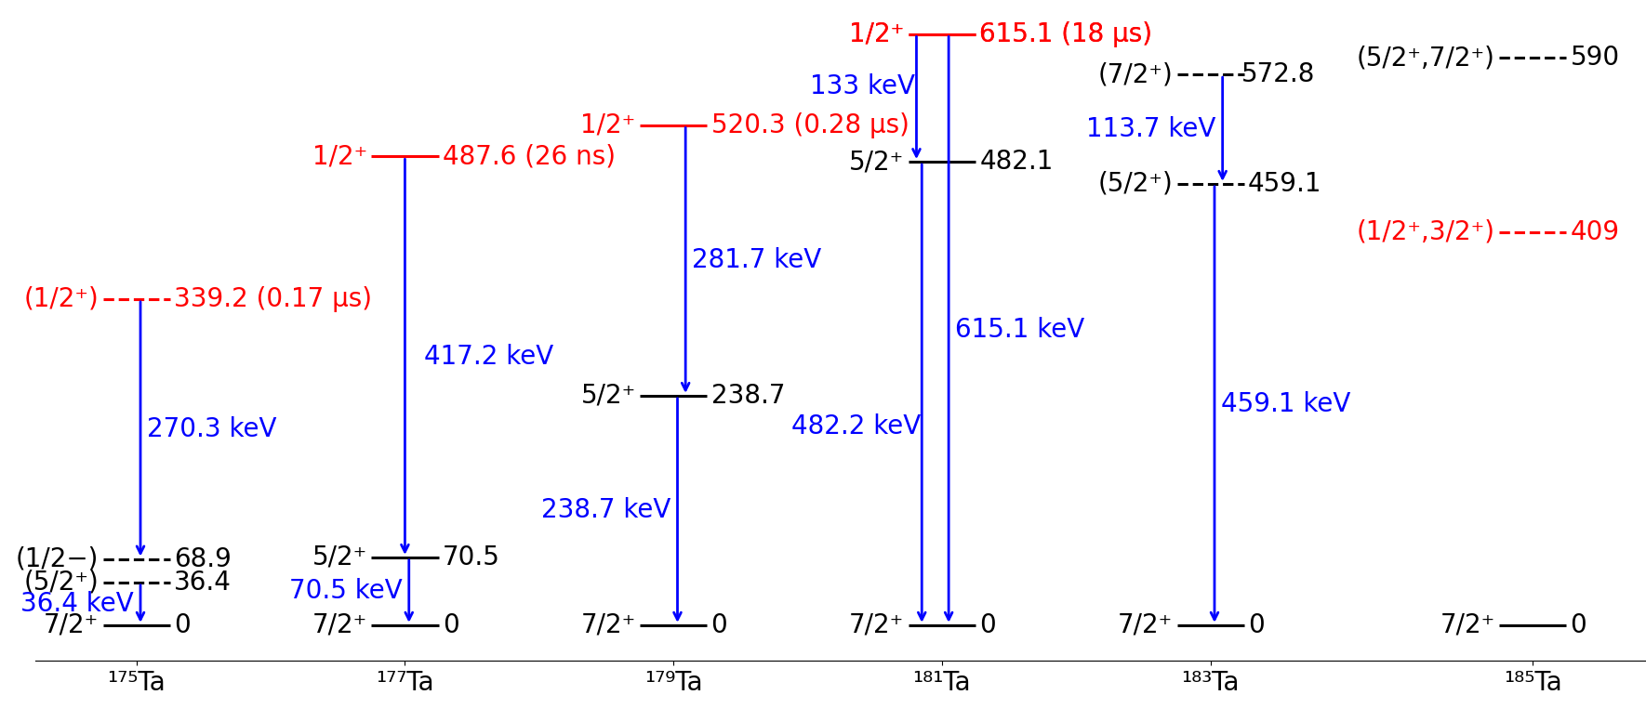
Systematics of 1/2⁺ isomers
^{[1]} M. Shamsuzzoha Basunia, Nuclear data sheets for A=175, Nuclear Data Sheets 102, 719 (2004).
^{[2]} F.G. Kondev, Nuclear data sheets for A=177, Nuclear Data Sheets 159, 1 (2019).
^{[3]} C.M.Baglin, Nuclear data sheets for A=179, Nuclear Data Sheets 110, 265 (2009).
^{[4]} S.-C.Wu, Nuclear data sheets for A=181, Nuclear Data Sheets 106, 367 (2005).

Slide 23
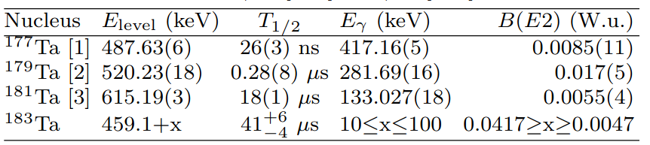
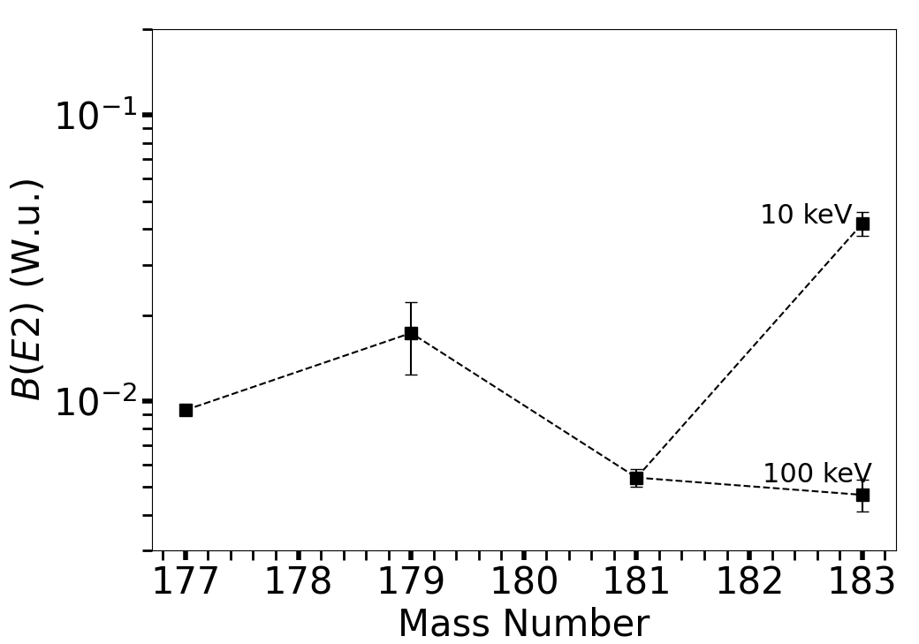

B(E2) estimates
(3/2 ⁻)
0
T_{1/2}=1.018 h
A.K.Jain et al. / Rev. Mod. Phys. 62, 393
β- : 100%
(7/2 ⁺)
572.8
(1/2 ⁺)
113.7
41 μs
459.1 + x
Experimental reduced transition probability B(E2)(W.u.) as a function of mass, for the 1/2⁺[411] → 5/2⁺[402] E2 transitions in odd-A tantalum isotopes.
(5/2 ⁺)
10≤x≤100
459.1
315.9
459.1
Transition | Selection rule
1/2⁺[411] → 5/2⁺[402] | ΔK = 2, Δn_{z} = −1 → hindered E2.
9/2 ⁺
143.2
9/2 ⁻
143.2
73.2 (107 ns)
7/2 ⁺
73.2
0
^{[1]}F.G. Kondev, Nuclear data sheets for A=177, Nuclear Data Sheets 159, 1 (2019).
^{[2]}C.M.Baglin, Nuclear data sheets for A=179, Nuclear Data Sheets 110, 265 (2009).
^{[3]}S.-C.Wu, Nuclear data sheets for A=181, Nuclear Data Sheets 106, 367 (2005).

Slide 24
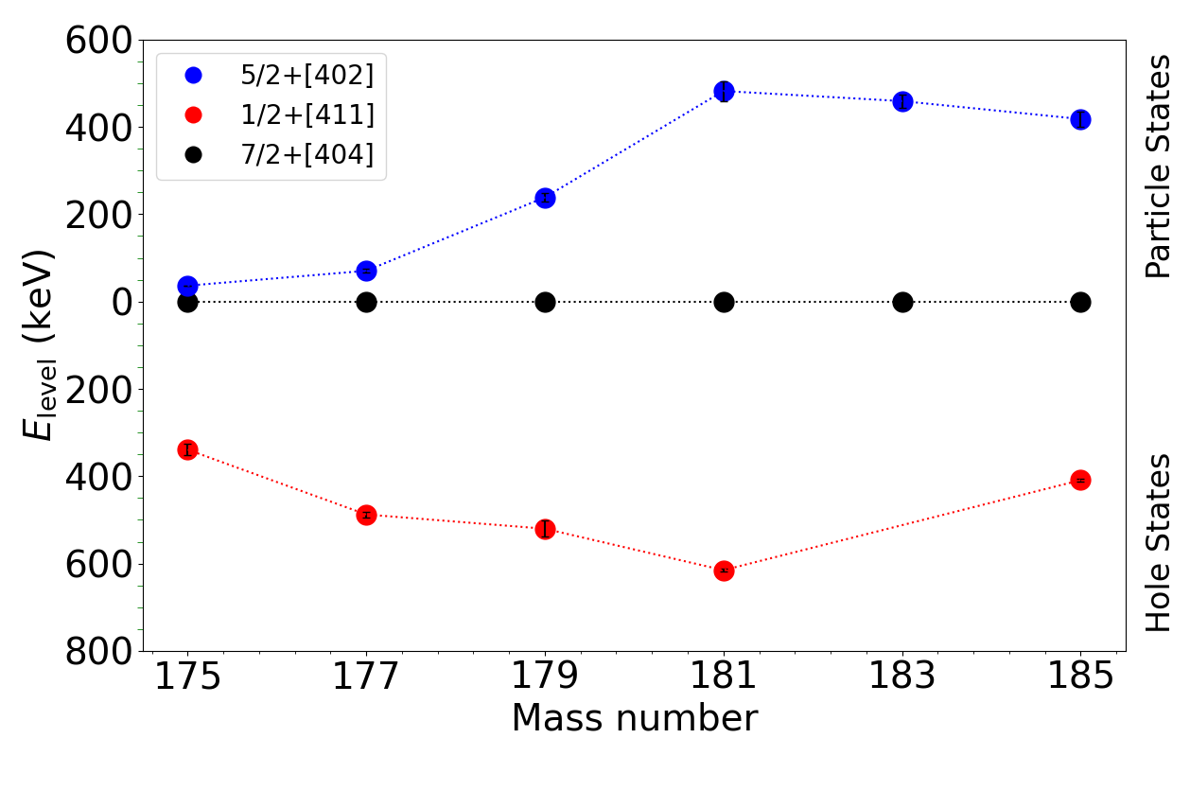
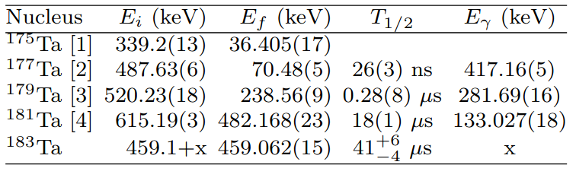
Systematics of Nilsson Orbitals
Adopted levels and γ-ray transitions for nuclides with 1/2⁺[411] isomers.
A.K.Jain et al. / Rev. Mod. Phys. 62, 393
^{[1]} M. Shamsuzzoha Basunia, Nuclear data sheets for A=175, Nuclear Data Sheets 102, 719 (2004).
^{[2]} F.G. Kondev, Nuclear data sheets for A=177, Nuclear Data Sheets 159, 1 (2019).
^{[3]} C.M.Baglin, Nuclear data sheets for A=179, Nuclear Data Sheets 110, 265 (2009).
^{[4]} S.-C.Wu, Nuclear data sheets for A=181, Nuclear Data Sheets 106, 367 (2005).

Slide 25
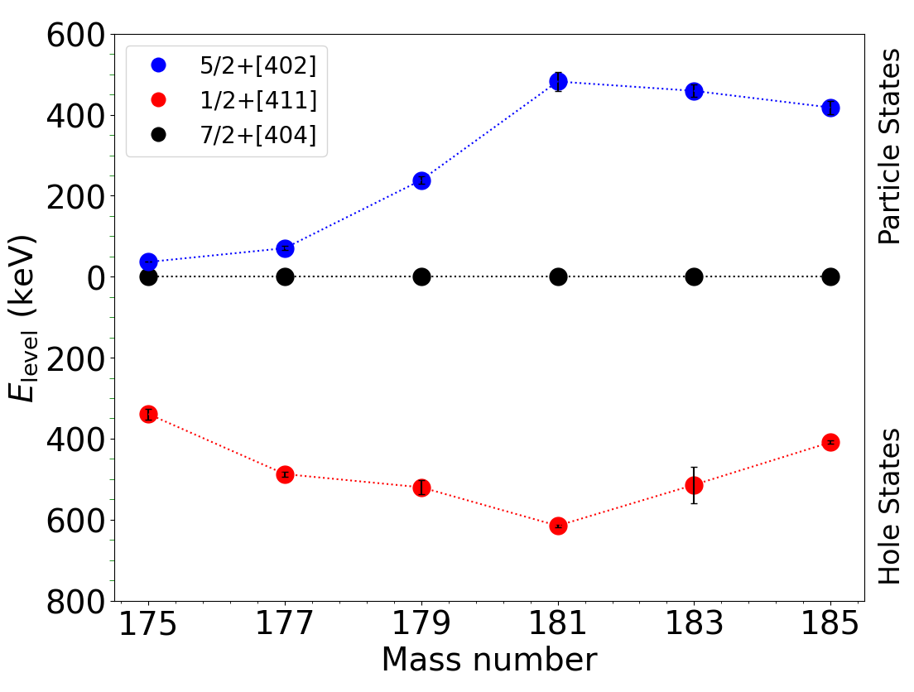

Spin and Parity Assignment of Isomeric State
(3/2 ⁻)
0
T_{1/2}=1.018 h
β- : 100%
(7/2 ⁺)
572.8
(1/2 ⁺)
113.7
41 μs
459.1 + x
(5/2 ⁺)
10≤x≤100
459.1
315.9
459.1
9/2 ⁺
143.2
9/2 ⁻
143.2
73.2 (107 ns)
7/2 ⁺
73.2
0
A.K.Jain et al. / Rev. Mod. Phys. 62, 393

Slide 26
Log(ft) Values
E_{Level} (keV) | J^{π} | I_{β}(%) | log(ft) | log(ft) [1]
856.91(2) | (5/2⁻) | 66.0(2) | 5.87(4) | 5.89(6)
469.1-559.1 | (1/2⁺) | 26.1(64) | 6.74(13)~6.65(13)
459.1(2) | (5/2⁺) | 8.5(22) | 7.24(14) | 6.74(5)
3/2⁻[512]
(3/2 ⁻)
0
T_{1/2}=1.018 h
β- : 100%
(5/2 ⁻)
856.9
783.7
1/2⁺[411]
(1/2 ⁺)
459.1 + x
41 μs
Transition | Selection rule
3/2⁻[512] → 5/2⁻ | Allowed; K=2 γ-vibration band build on 9/2⁻[514] state.
3/2⁻[512] → 1/2⁺[411] | ΔK = 1, Δn_{z} = 0 → first-forbidden, less hindered more intense β branch.
3/2⁻[512] → 5/2⁺[402] | ΔK = 1, Δn_{z} = −1 → first-forbidden, structurally hindered and weak β branch.
5/2⁺[402]
(5/2 ⁺)
10≤x≤100
459.1
459.1
9/2⁻[514]
9/2 ⁻
73.2 (107 ns)
7/2⁺[404]
7/2 ⁺
73.2
0
^{[1]}C.M.Baglin, Nuclear data sheets for A=183, Nuclear Data Sheets 134, 149 (2016).

Slide 27
Summary
The experiment demonstrates the first successful application of resonance ionisation spectroscopy of ¹⁸³Hf at the KISS facility.
The expected production rate was 1.5 pps. But current calculation indicate significant lower yields for ¹⁸³Hf [0.85(8) pps] and ¹⁸⁴Hf [0.18(4) pps]. It is worth noting that despite lower yields, it was for the first time that such isotopes have been produced using the KISS facility.
the “new” isomer populated in ¹⁸³Hf ground-state beta decay (involving 459 keV gamma decay). This is a 1/2⁺[411] state just above the 5/2⁺ 459 keV level in ¹⁸³Ta, which would decay by an E2 transition to the 5/2⁺ state.

Slide 28








Collaborators
S. Pascu, Zs. Podolyák, P. M. Walker, G. Bartram, G. Hudson-Chang, V.Chandrakumar
Y. Hirayama, Y.X. Watanabe, P. Schury, S.Kimura, M. Wada
G. Lane
F.G. Kondev
A.Takamine, J.Yap
J.Cubiss
Y. Litvinov
S. Dutt, S. Guo, G. Li, J.Gada, Z. Liu, P. Ma
H. Watanabe, J. Chen
S. Doshi, A.M.Bruce

Slide 29
Thank You For Listening !

Slide 30
Additional Slides

Slide 31
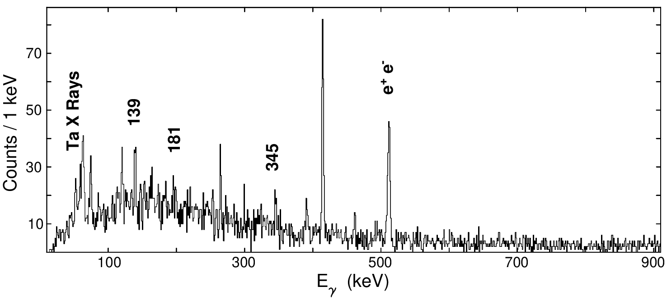


Yield calculation of ¹⁸⁴Hf
β-γ coincidence spectra.
(0 ⁺)
T_{1/2}=4.12 H
0
β- : 100%
1 (⁺)
617.2
344.9
1(⁺)
453.3
181.0
0 ⁻
272.3
1(⁻)
43.9
228.4
E_{γ} _{(keV)} | A_{γ} | ε_{γ} | I_{γ} _{From [1]} | N(T) | Wt. N(T) (per run) | Yield (ions/sec)
139.1(2) | 47(15) | 0.1690(17) | 46.0(70) | 1511(534) | 1614(377) | 0.18(4)
344.9(2) | 31(8) | 0.1290(13) | 35.0(60) | 1716(532)
139.1
(2 ⁻)
89.3
(3 ⁻)
41.4
47.9
(5 ⁻)
47.9
0
^{[1]}https://www.nndc.bnl.gov/

Slide 32
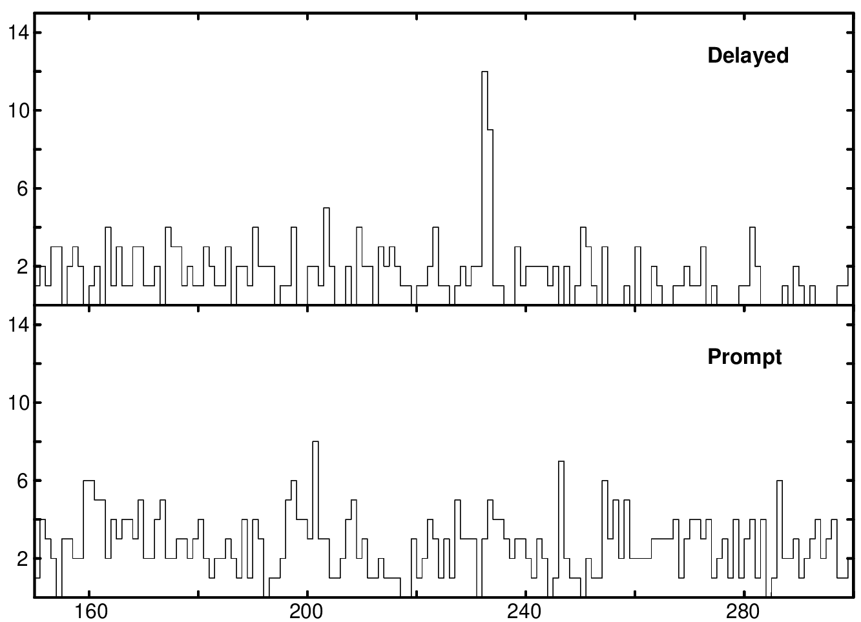
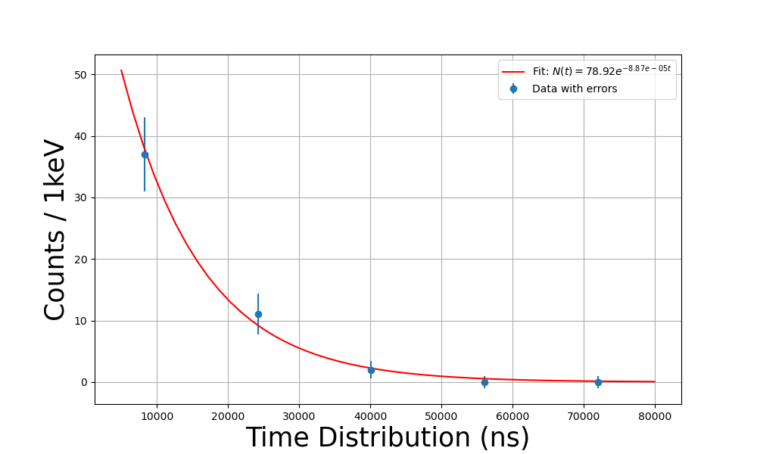
Preliminary Isomeric spectroscopy of ¹⁸⁴Hf g.s β-decay to ¹⁸⁴Ta
Beam gated β-γ coincidence delayed spectra.
233
±0.3 μs to ±50 μs
T_{1/2} = 8±2 μs
±0.25 μs
Comparing peak areas at 233 keV after dividing the beam on period of beam gated β-γ coincidence delayed spectra into smaller time intervals.

Slide 33
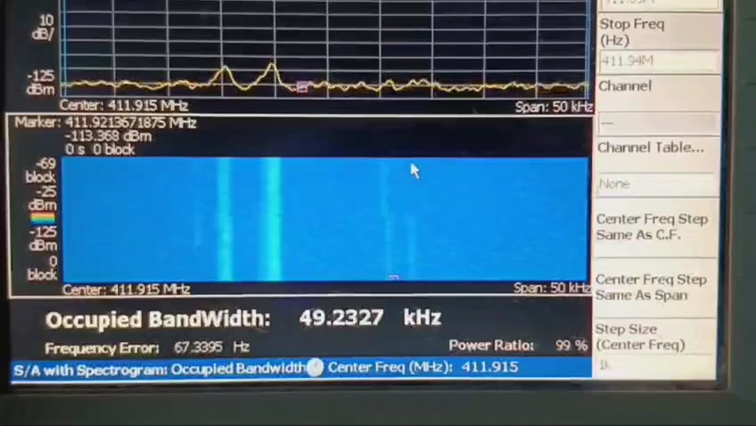
Introduction: Isomers
ESR at GSI

Slide 34
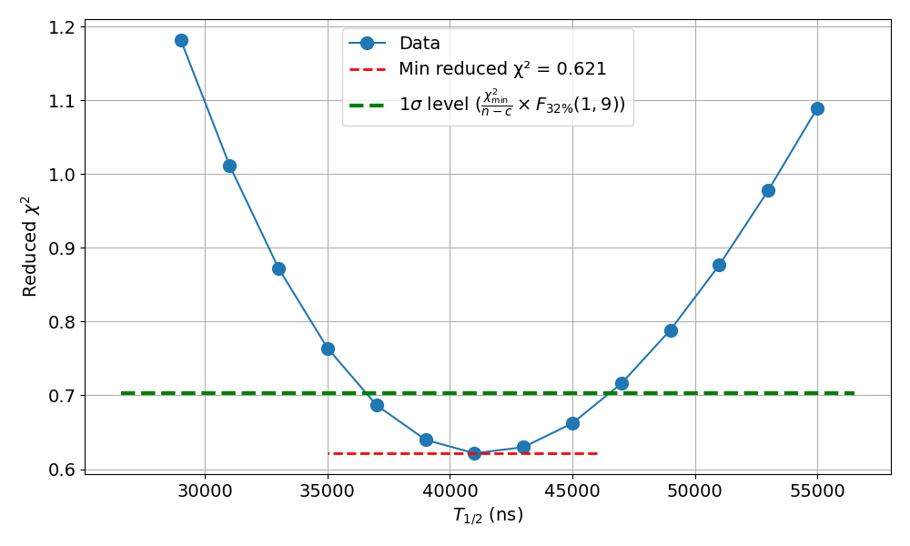
Plotting Reduced χ² vs T_{1/2}
To get errors: 32% confidence level is considered with F‐distribution factor
T_{1/2} = 41⁺⁶₋₄ μs
T_{1/2} = 41⁺⁶₋₄ μs

Slide 35
Missing intensity of 459
Old intensities by normalizing using Iγ of 783.7 keV
Energy | Intensity (%) | Error | Area | Error | Normalized Intensity | Error
73.2 | 38 | 4 | 110 | 15 | 35 | 6
459.1 | 29.8 | 0.9 | 22 | 9 | 9 | 4
783.7 | 65.5 | 1.9 | 134 | 14 | 65 | 10
New intensities obtained by normalizing using Iγ of 783.7 keV
Energy | Intensity (%) | Error | Area | Error | Normalized Intensity | Error
73.2 | 38 | 4 | 127 | 13 | 40 | 7
459.1 | 29.8 | 0.9 | 85 | 11 | 33 | 6
783.7 | 65.5 | 1.9 | 134 | 15 | 65 | 10

Slide 36
Introduction: K isomers
x
J
j₂
j₁
|K_{f} – K_{i}| =|ΔK| ≤ λ
K can only change by units up to multipolarity of the transition
Symmetry axis
Ω₁
Ω₂
z
ΣΩ_{n}=K
|ΔK| - λ = v
Larger changes in K result in hindered transition
Individual nucleons have angular momentum, j, with projection Ω on the symmetry axis, and K is the sum of these Ω values.

Slide 37
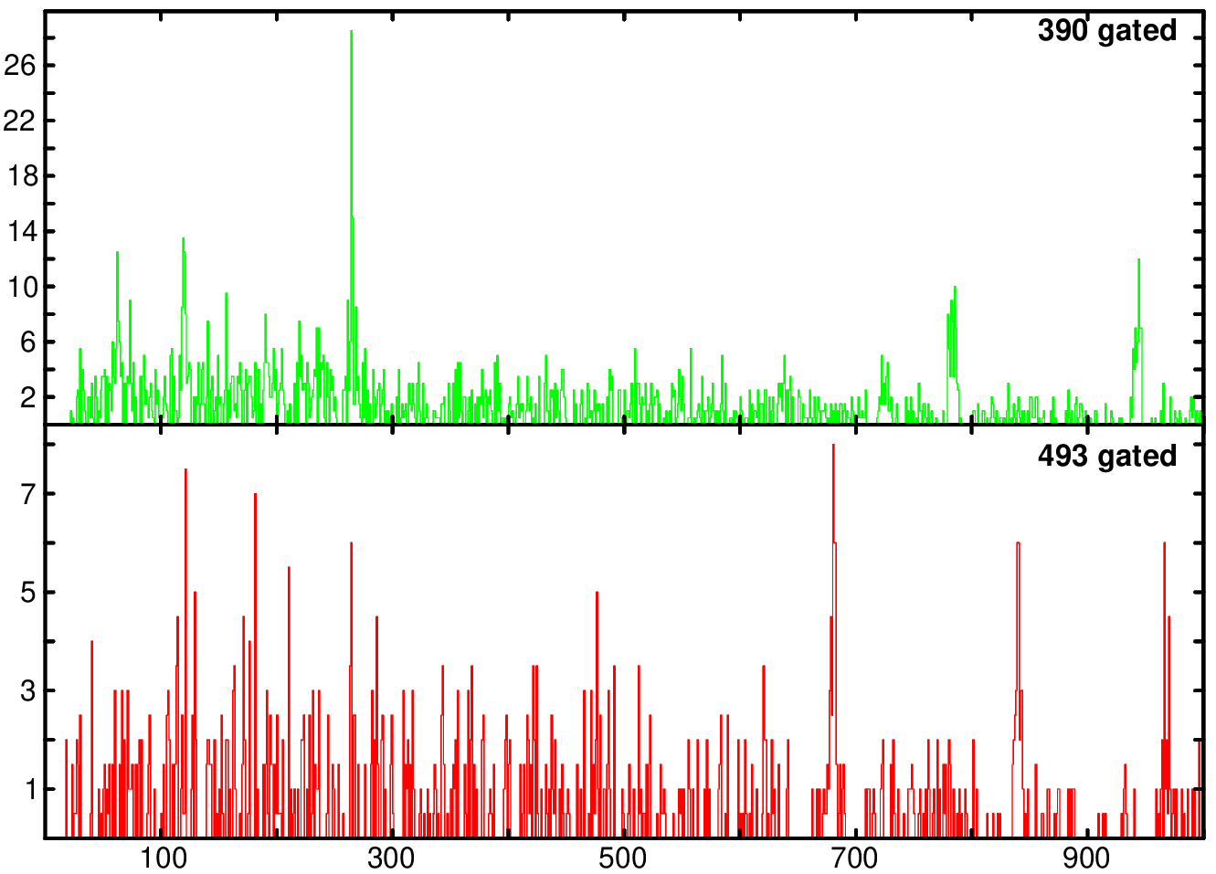


Intensity calculation of ¹⁸⁴Os
264
119
944
5 ⁻
0
3.09 H
ε : 100%
Counts / 1keV
5 ⁺ ,6 ⁺
2400.3
119
264
682
841
682.1
5 ⁻
1718.2
5 ⁻
1718.2
944.1
4 ⁺
493.0
1225.0
Eγ
6 ⁺
774.1
Gating on 494
Gating on 390
841.3
390.4
4 ⁺
383.7
E_{γ} _{(keV)} | I_{γ}% _{From [1]} | Norm. I_{γ}%
119.8 | 100 | 55(22)
263.9 | 100 | 64(31)
841.3 | 100 | 117(45)
682.1 | 146 | 146(55)
E_{γ} _{(keV)} | I_{γ}% _{From [1]} | Norm. I_{γ}%
119.8 | 46 | 38(11)
263.9 | 46 | 43(12)
944.1 | 46 | 46(15)
263.9
2 ⁺
119.8
0 ⁺
119.8
0

Slide 38
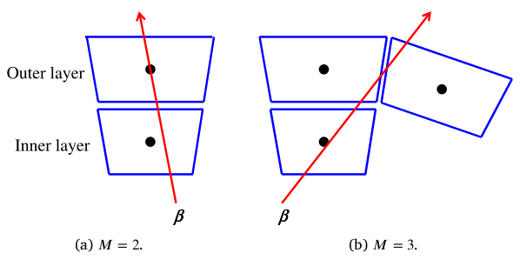
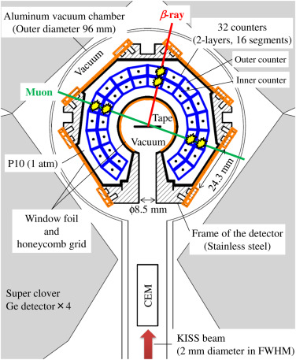
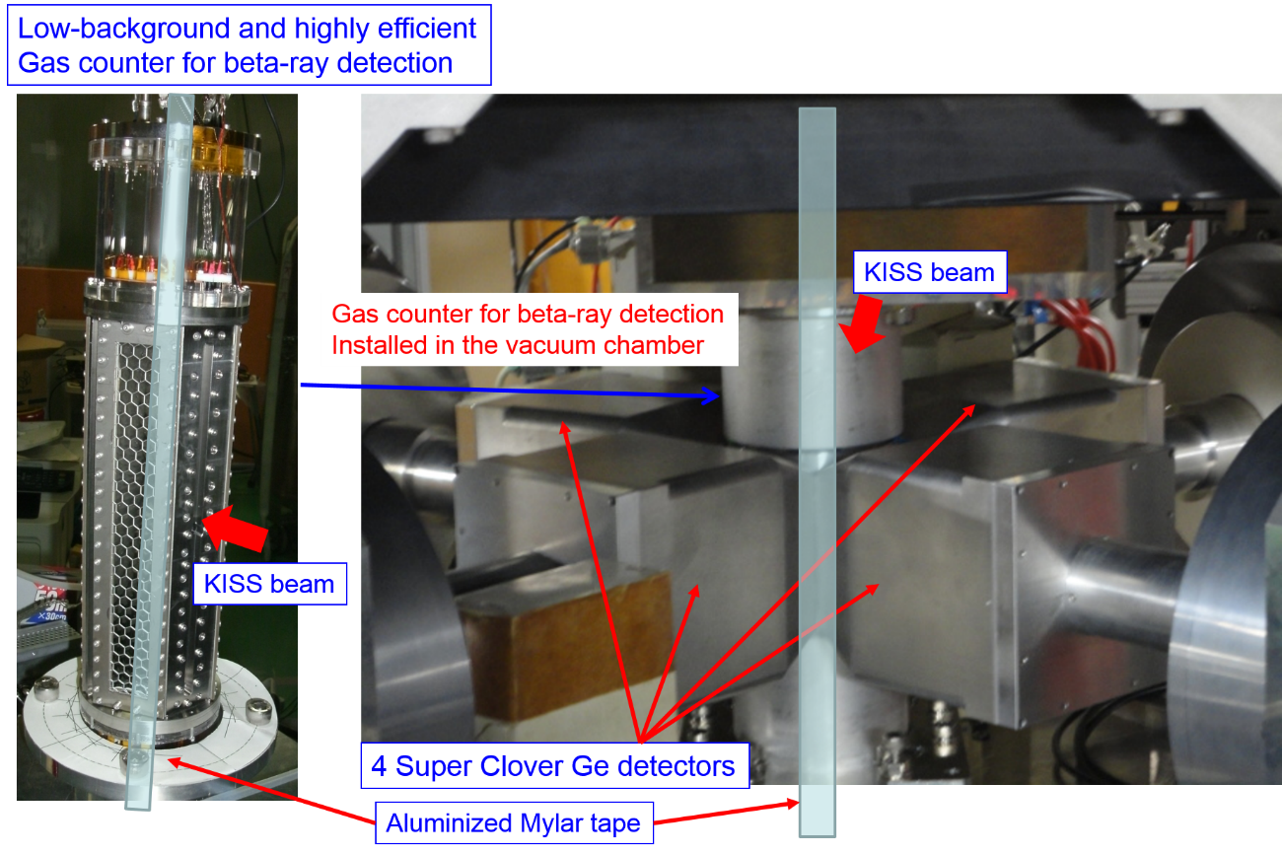
MSPGC
Outer Counter
Inner Counter
M.Mukai et al. / NIM . A. 884 (2018) 01689002

Slide 39
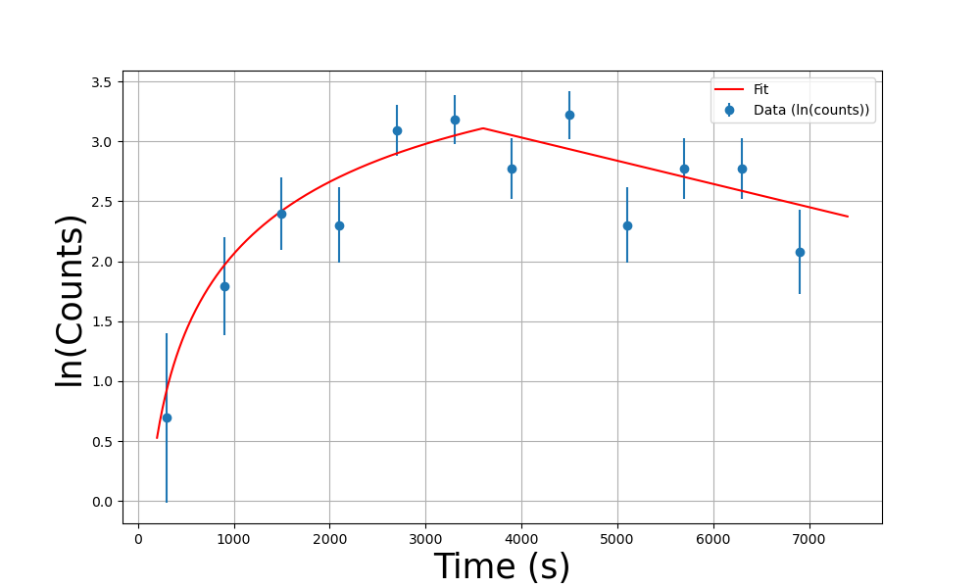
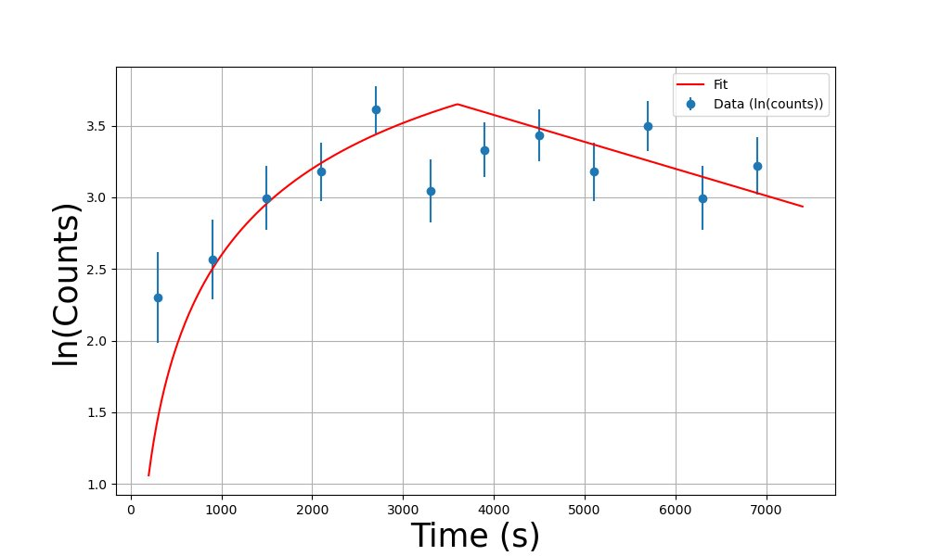
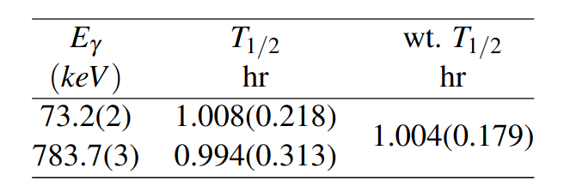
Getting Half-life of ¹⁸³Hf g.s. using build up equation
Fitting peaks, where implantation period is fitted using: N(t) = Y/λ * (1 - exp(-λ * t))
And decay period is fitted using: N(t) = [A/λ * (1 - exp(-λ * t1))] * exp(-λ * (t2))
Buildup of 73 keV
Buildup of 783 keV

Slide 40
¹⁸³Hf: X-Ray analysis

Slide 41
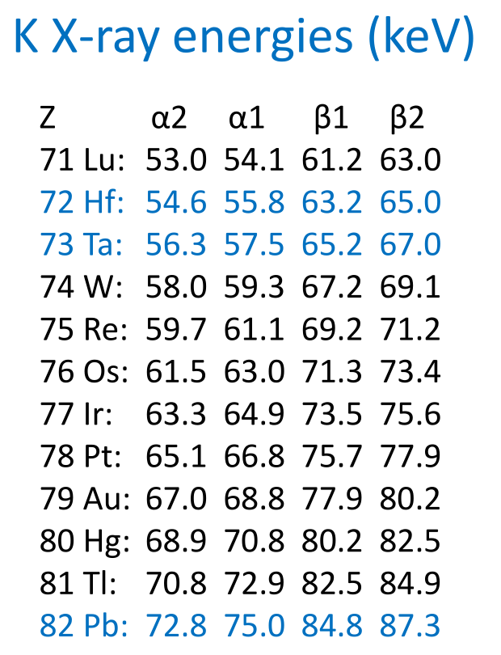
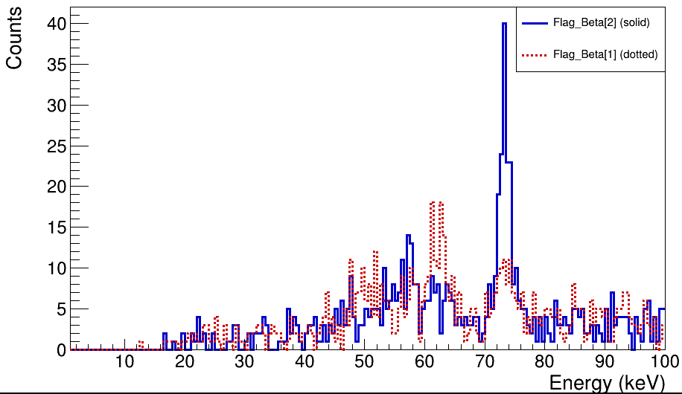
X-ray analysis for ¹⁸³Hf 1hr run files
73.2
73.2
61.3
63.8
62.2
56.0
60.8
57.5
57.4
55.9
47.4
50.4
84.7
93.1
43.3

Slide 42
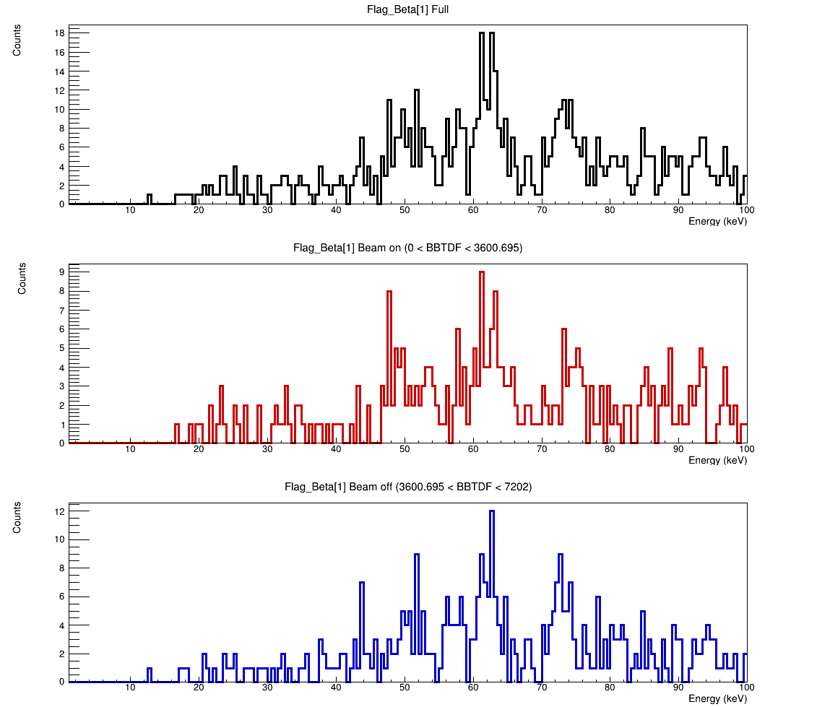
Comparing Beam on Vs Beam off X-ray region for 183Hf 1hr/1hr for M=1
62.2
60.8
50.4, Tm
57.4
73.2
55.9,Hf
43.3
68.1, 183Hf
84.7
93.1

Slide 43
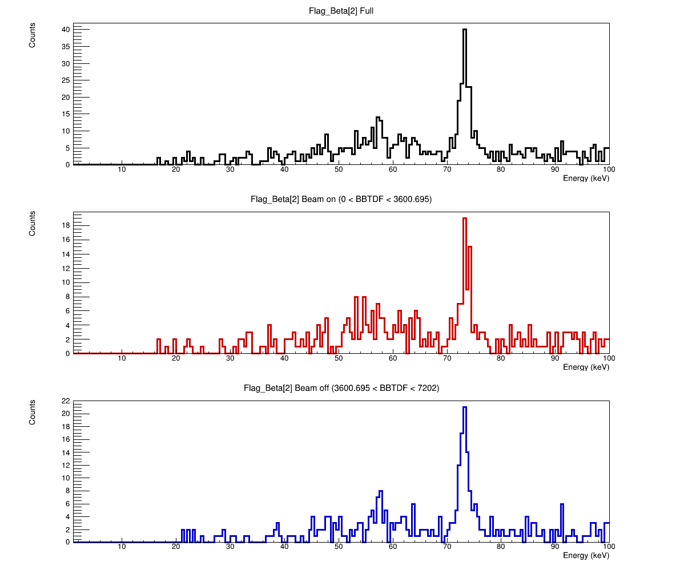
Comparing Beam on Vs Beam off X-ray region for 183Hf 1hr/1hr for M=2
73.2, Ta
57.5,Ta
56.0, Ta
61.3
47.4
63.8

Slide 44
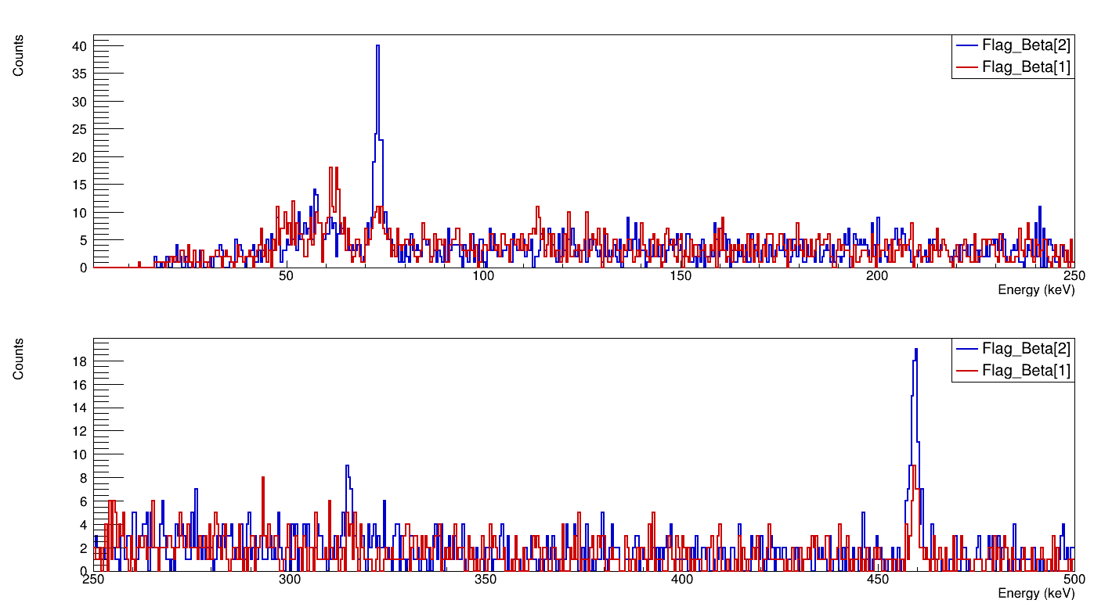
Comparing M=1 Vs M=2 for 183Hf 1hr/1hr
73.2, Ta
113.3, Tm
126.1?
459.7, Ta
459.7, Ta
315.4, Ta
293.3?
310.7?
379.6?
392.7?

Slide 45
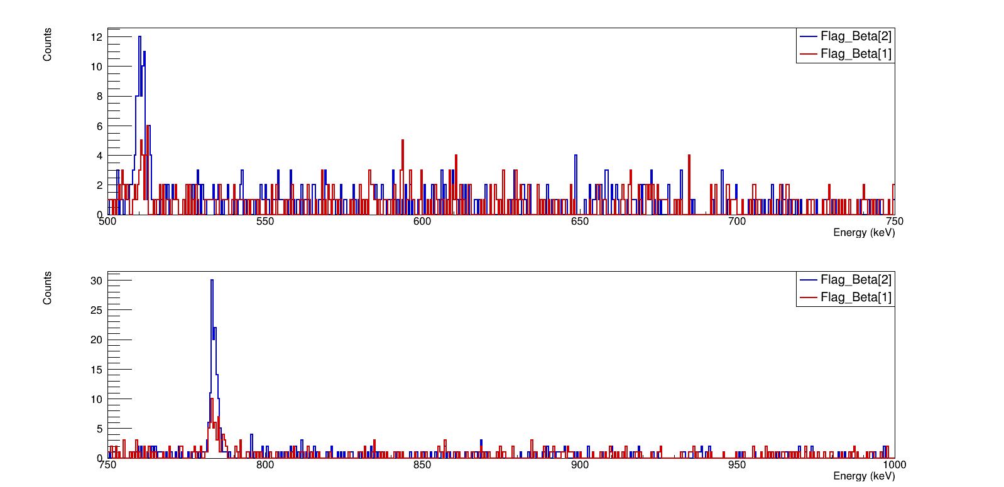
Comparing M=1 Vs M=2 for 183Hf 1hr/1hr
511.1,511.1
510.1
512.8
593.7
584.0
783.5,783.7, Ta
787.1

Slide 46
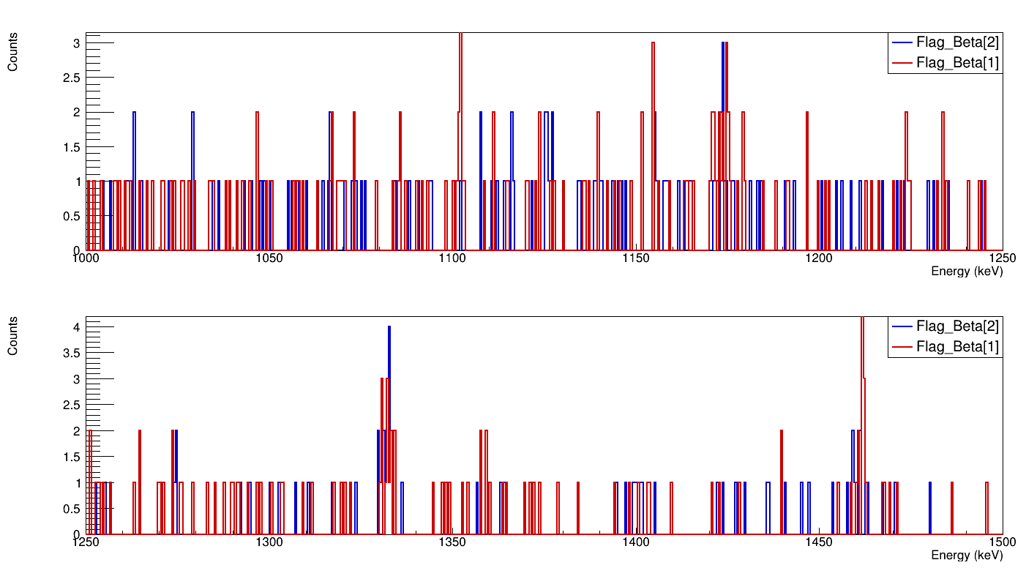
Comparing M=1 Vs M=2 for 183Hf 1hr/1hr
1102.4?
1173.2 , Co
1332.4 , Co
1462.5 , K

Slide 47
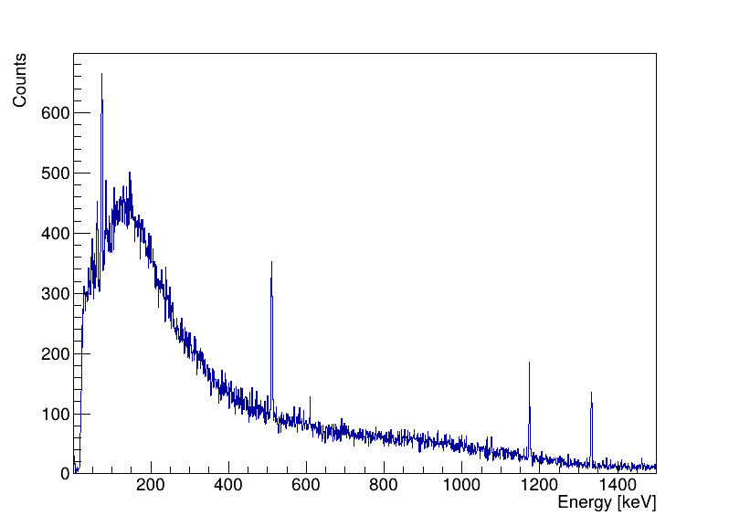


Gamma-Gamma coincidence spectra for 183Hf
783.7
Gating on 73.2keV For Beam On period

Slide 48

Defining Prompt and Delay through β-γTime Difference
-8000
+8000
-250
+250
Delayed
Prompt
Delayed

Slide 49

Looking for activity curve from BBTDF in 184Hf 20min/5sec run file
BBTDF>>(100,1,1300)
1191.2
1196.2
1204.6
1209.6

Slide 50

Delayed Spectra of ¹⁸³Hf
73
56
460
Beam On + Off
Beam On
Beam Off

Slide 51

Delayed Spectra of ¹⁸⁴Hf
252
58
113
233
318
Beam On + Off
215
384
Beam On
Beam Off

Slide 52

Efficiency

Slide 53


Nuclear Deformation
L. P. Gaffney et al. Nature, 497, 2013.

Slide 54

Nuclear Deformation

