Slide 1
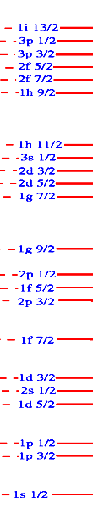

Seniority scheme for j=9/2 orbitals
Which is the best case?
Zsolt Podolyák
University of Surrey

Slide 2
The seniority scheme assumes that the low lying states in a nucleus can be described considering one single orbital, and there is no seniority mixing. The aim of the present paper is to test the validity of this, by focusing on the reduced B(E2) transition strengths, considered to provide more stringent test of the wave function than the excitation energies.
The largest amount of experimental data on seniority is related to j=9/2 orbitals. The proton g9/2 orbital between the Z=40 sub-shell and the Z=50 shell closures is isolated from other orbitals, therefore the N=50 nuclei with Z=42--48 provide a stringent test of seniority. Similarly, the proton h9/2 orbital is the first one above the Z=82 magic number, while the neutron g9/2 is first above N=126, making the N=126 isotones and the neutron-rich Z=82 Pb isotopes good test cases.
All available data, both on even- and odd-mass nuclei, were considered. The seniority scheme provides a good approximation for all these three regions, with the best fit given by the lead isotopes. In addition, shell model calculations using well established interactions were performed. In the N=50 and Z=82 considering all orbitals within a shell provide only a limited improvement in reproducing the data when compared to the seniority scheme. In contrast, the shell model provides much better agreement for N=126 nuclei, where the proton f7/2 orbital has increasing effect on the transition strengths as the j=9/2 orbital is filled. In order to further test whether the lead isotopes provide the best example of the seniority scheme, and investigate the possible effect of the neutron i11/2 orbital, more experimental information is required, especially for 214,215,216Pb.

Slide 3
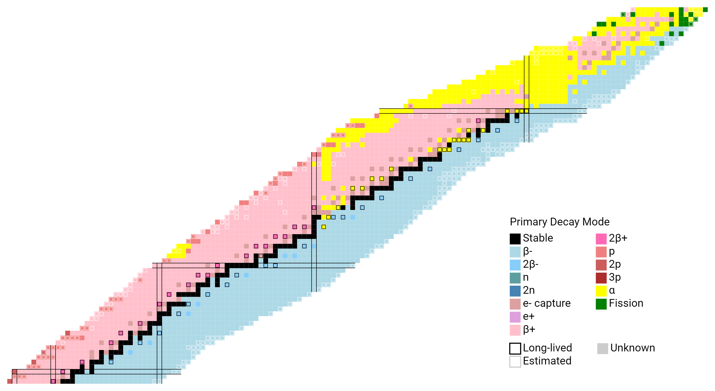
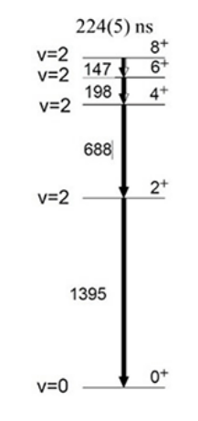
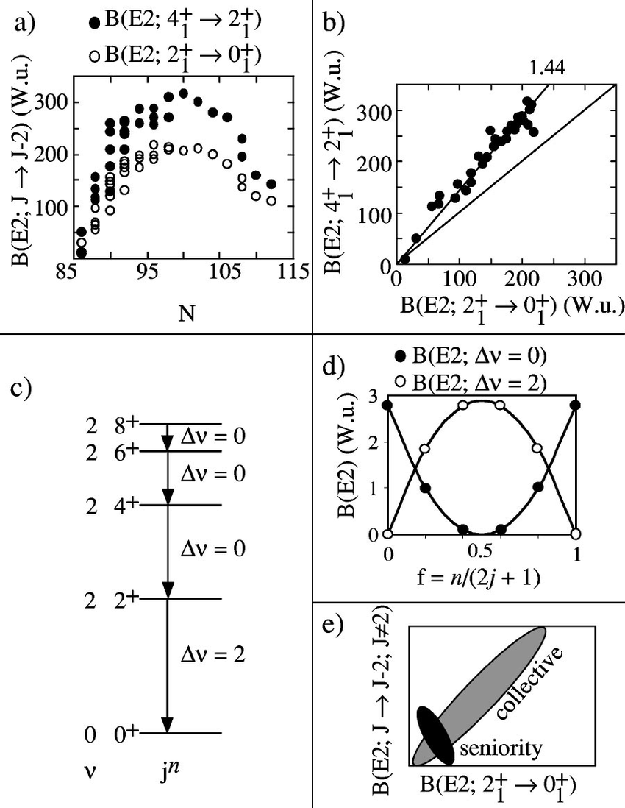
Seniority scheme (and isomers)
N=126
Which region is the “best”?
(through B(E2) values)
Z=28?
N=50?
N=82?
Z=82?
N=126?
h_{9/2}
i_{13/2}
Z=82
N=82
g_{9/2}
h_{11/2}
h_{11/2}
N=50
f_{7/2}
Z=50
⁹⁸Cd
g_{9/2}
h_{11/2}
g_{9/2}
g_{9/2}
Z=28

Slide 4
The “best”
Seniority scheme:
-only one orbital matters (high-j)
-no seniority mixing (valid for all interactions for j<=7/2;
approx. valid for j>=9/2)
Test:
-level energies
-transition strengths

Slide 5
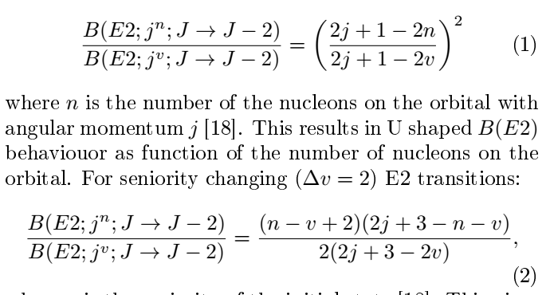
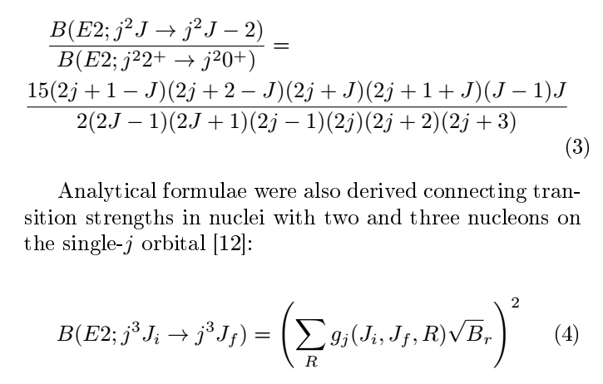
Relations between B(E2) values
For dv=0
dv=2
Within a nucleus with n=2 or n=8
Connecting n=3 to n=2
, B_{r} = B(E2; j²R → j²R − 2)
M. Ley et al., PRC108, 064313(2023); 110, 059901 (2024)
V. Karayonchev et al., PRC 106, 044321 (2022) P. van Isacker
J.J. Ressler et al., Phys. Rev. C 69, 034317 (2004)

Slide 6
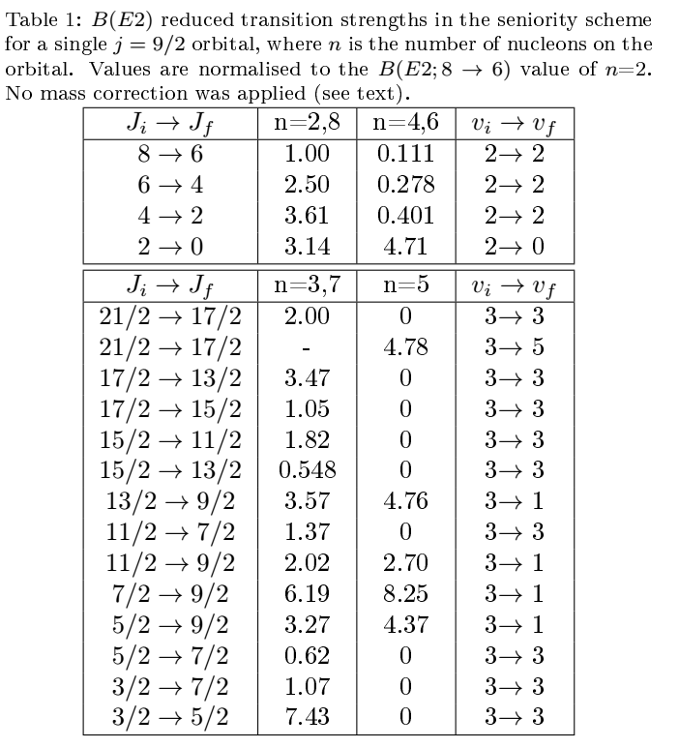

Slide 7
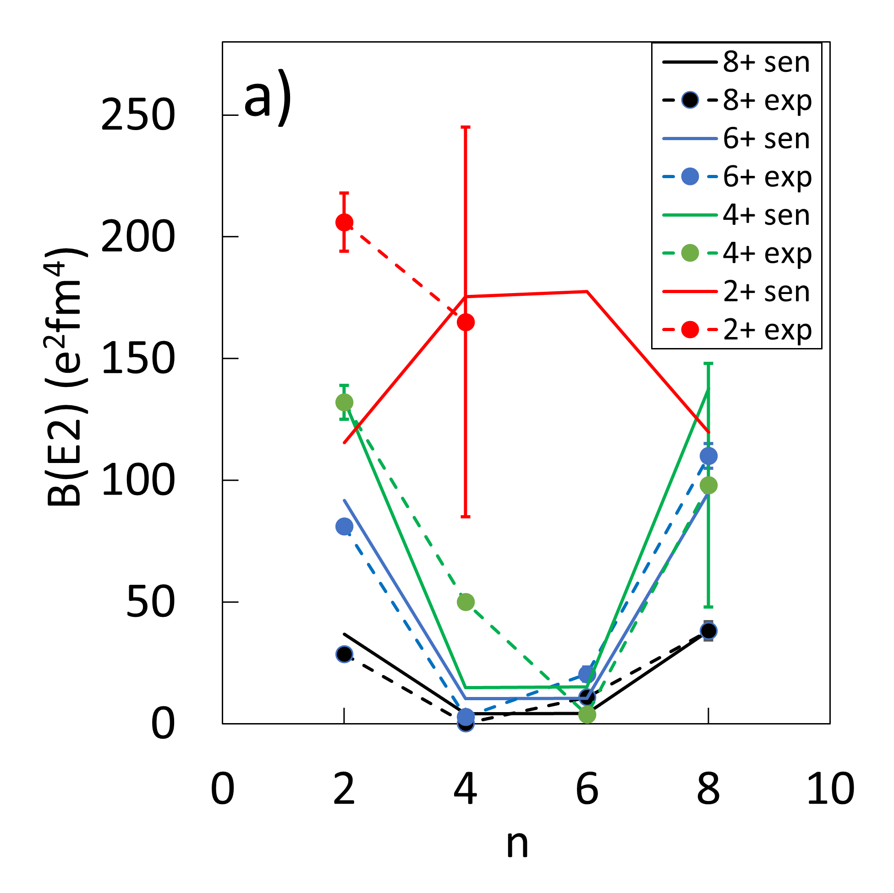
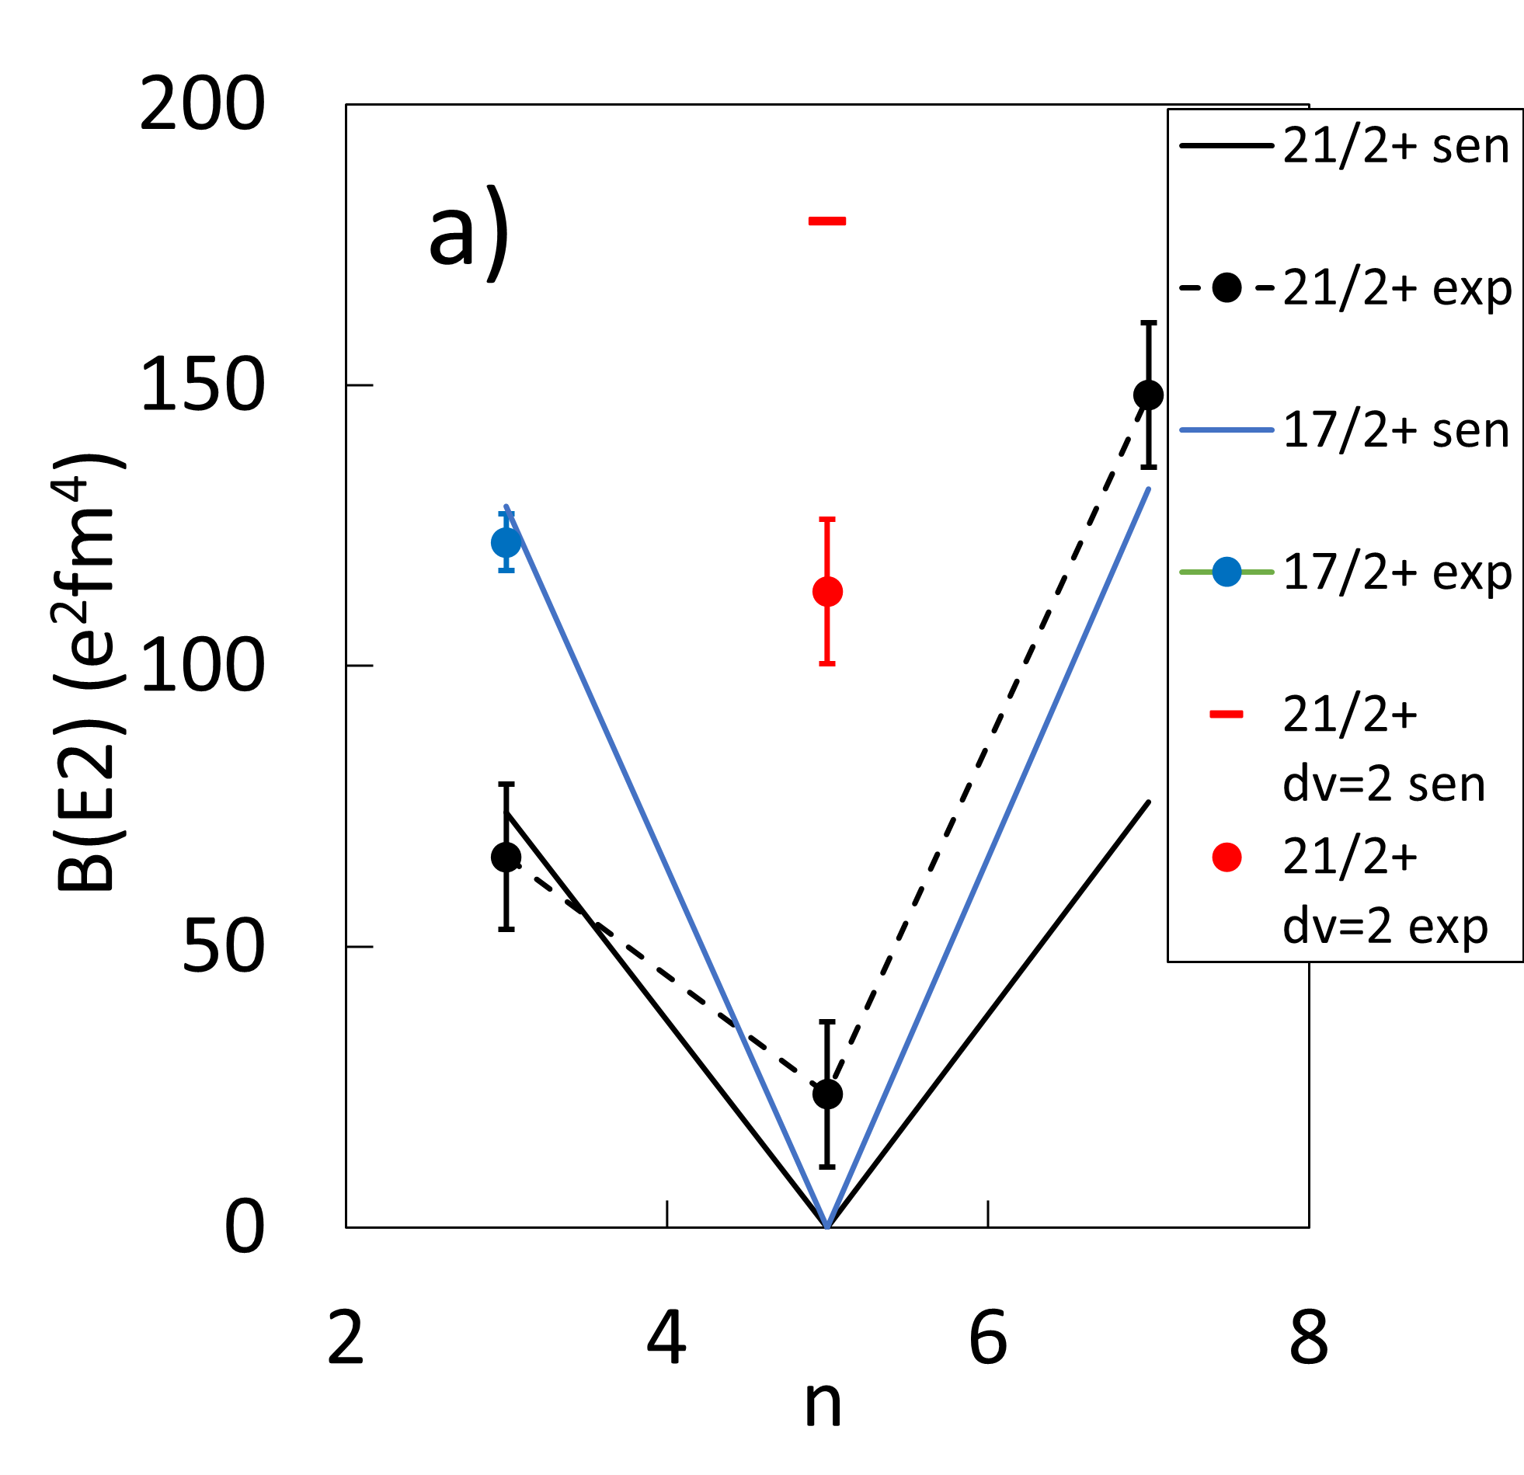
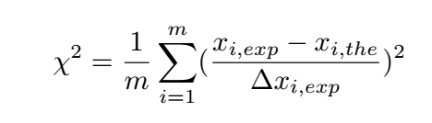
N=50: exp. vs seniority scheme
Normalised to B(E2; 8⁺ → 6⁺) in ⁹⁸Cd

Slide 8
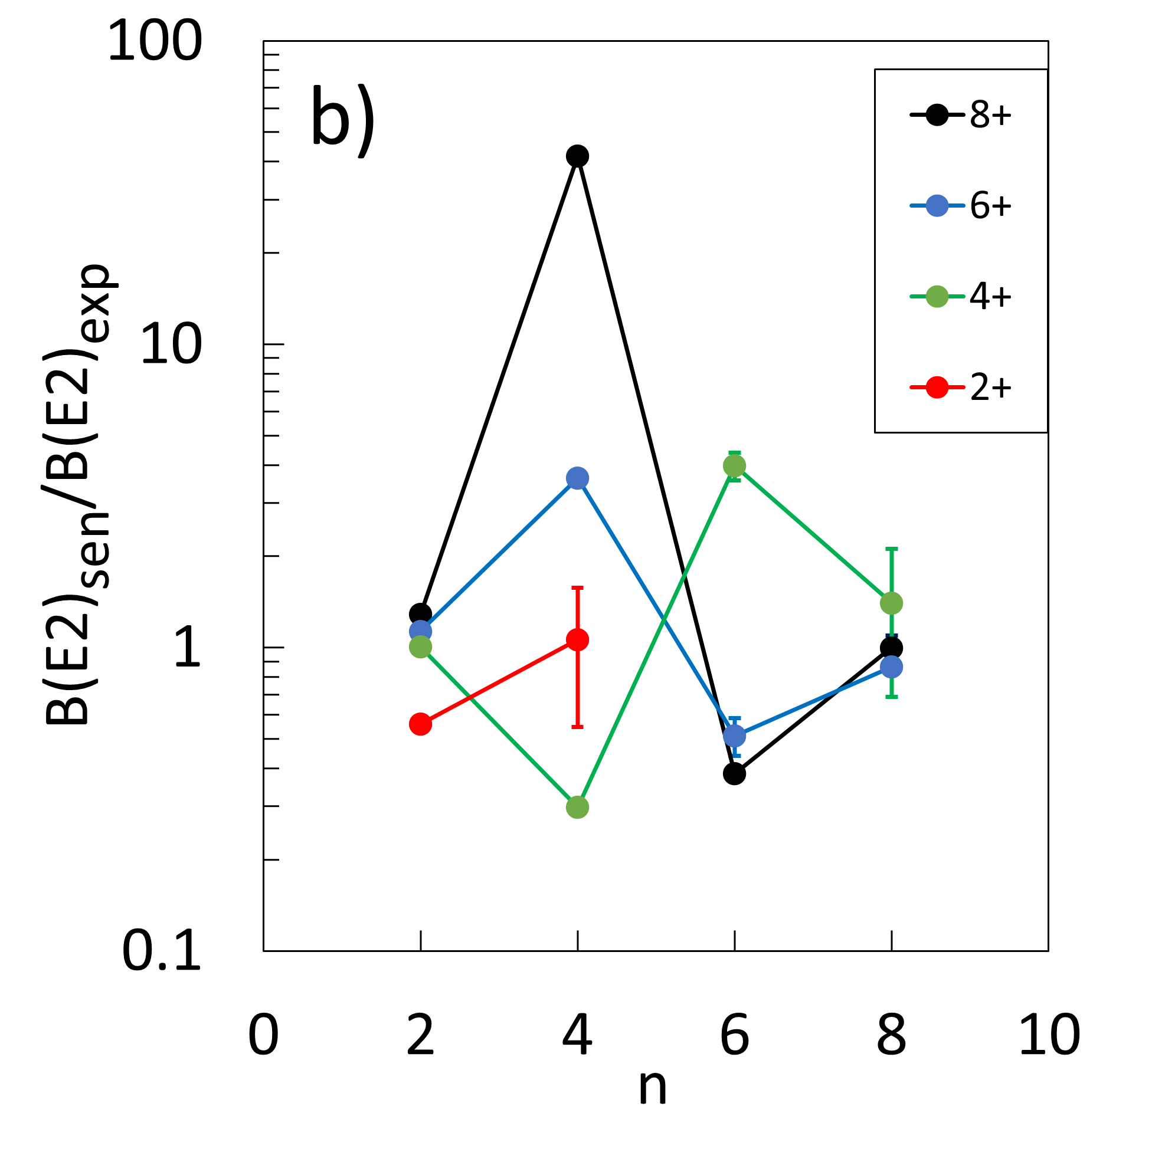
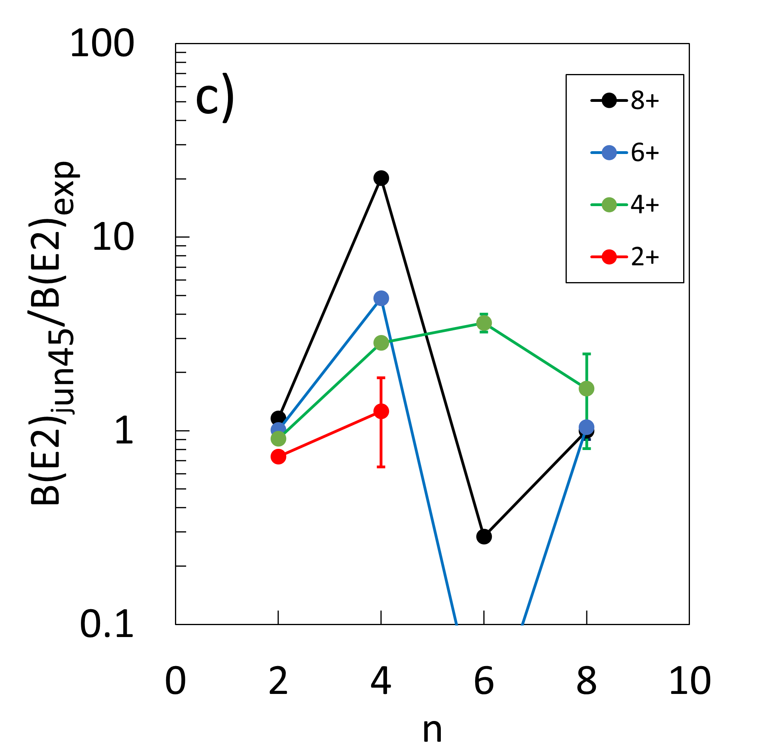
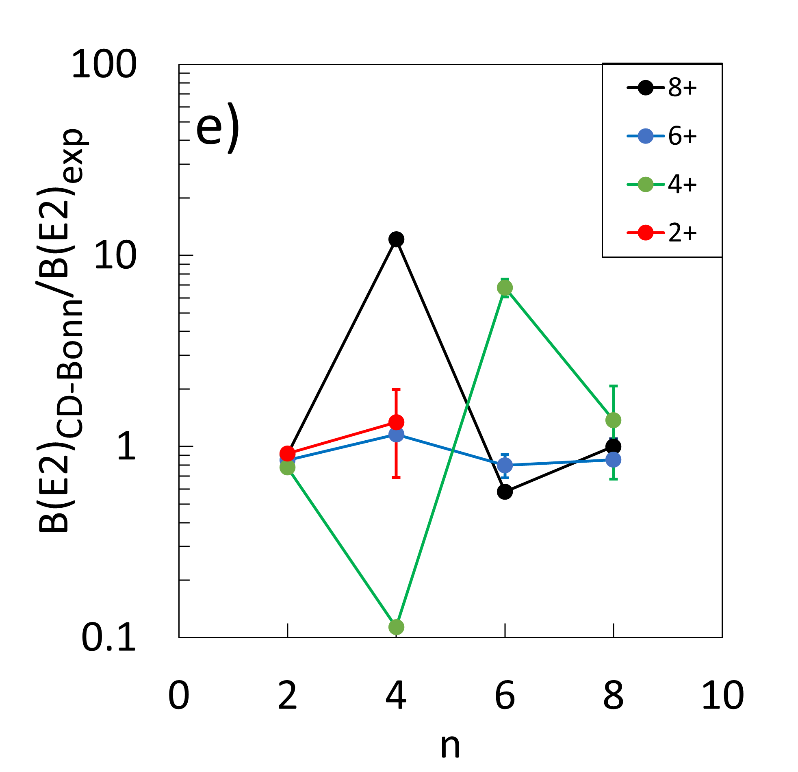
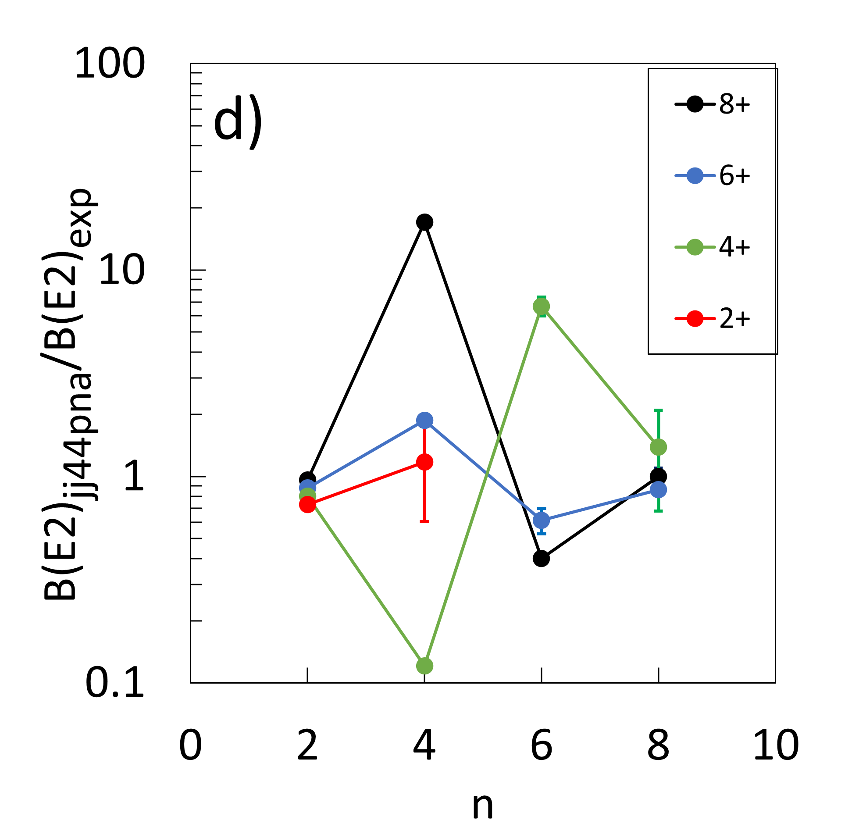
N=50: exp. vs theory
CD-Bonn:
R.M. Perez-Vidal et al.,
PRL 129, 112591 (2022)

Slide 9
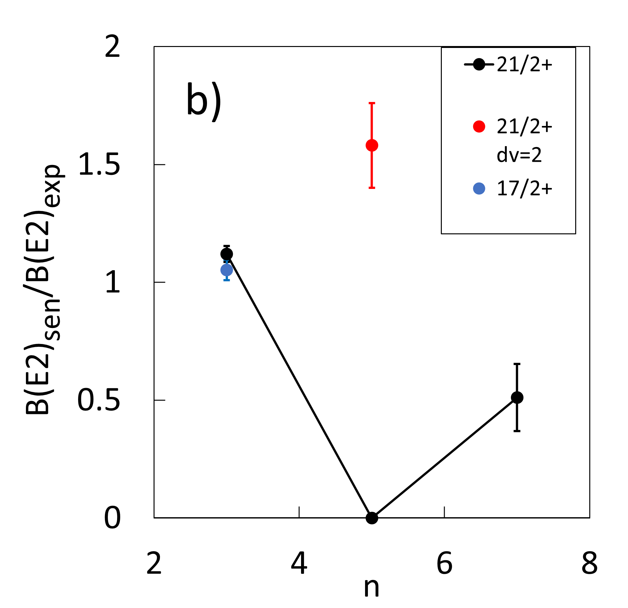
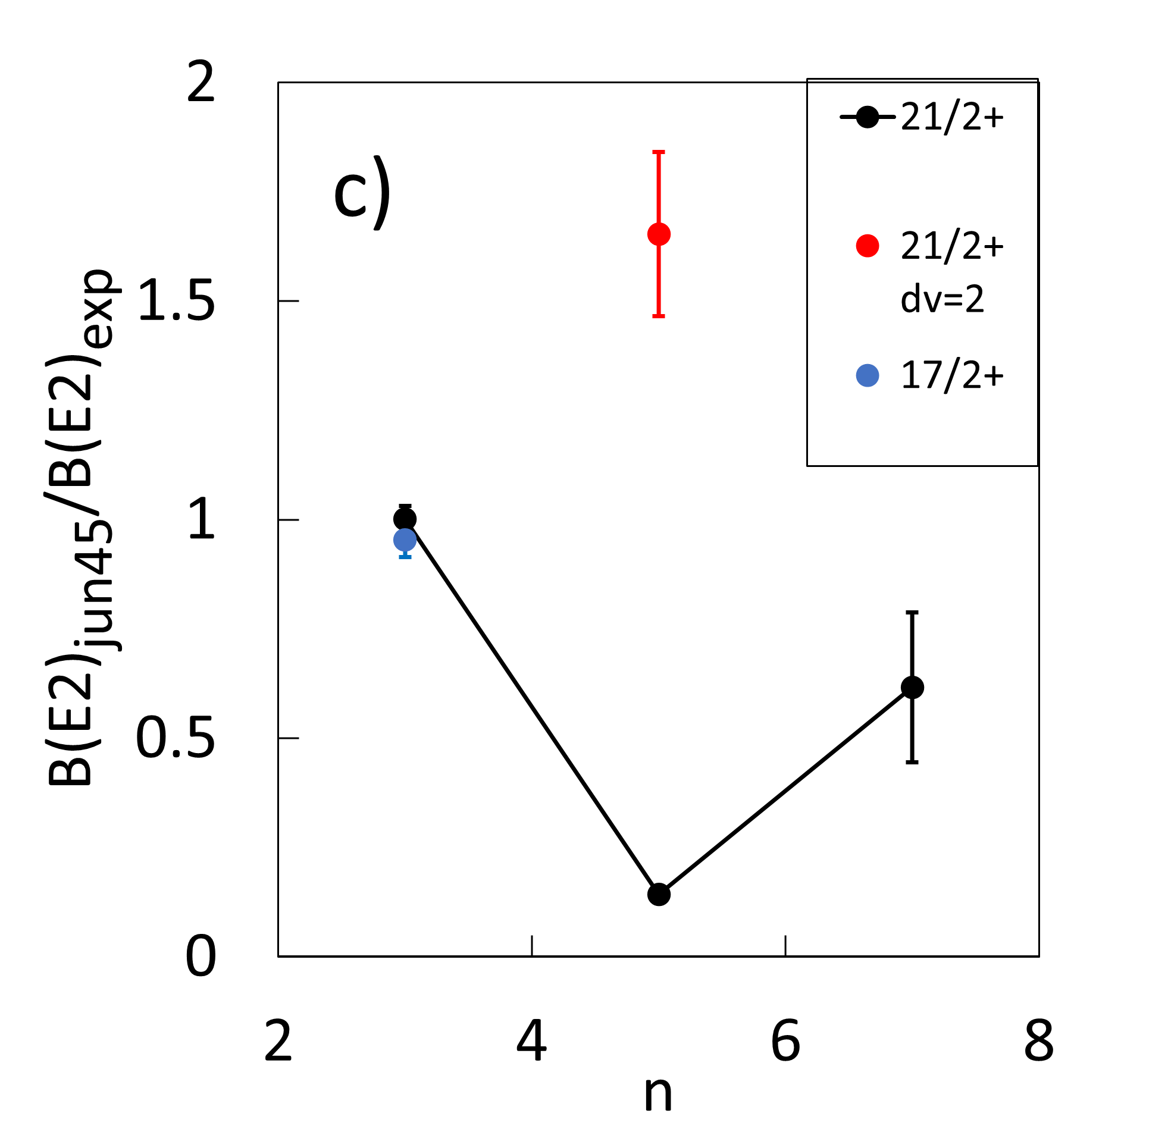
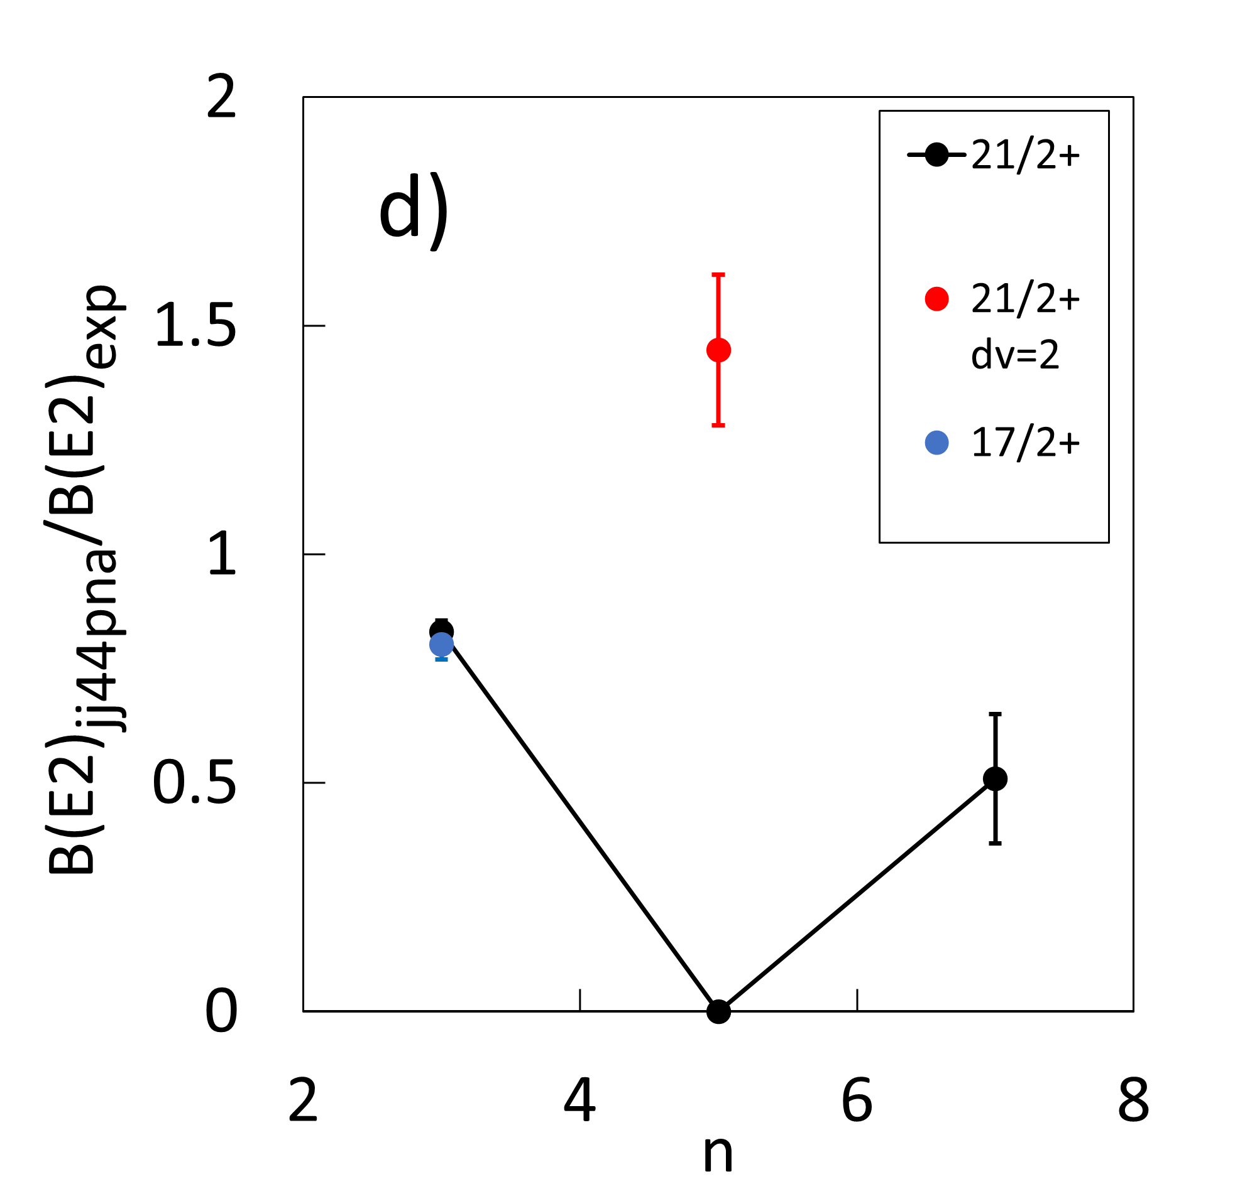
N=50: exp. vs theory

Slide 10
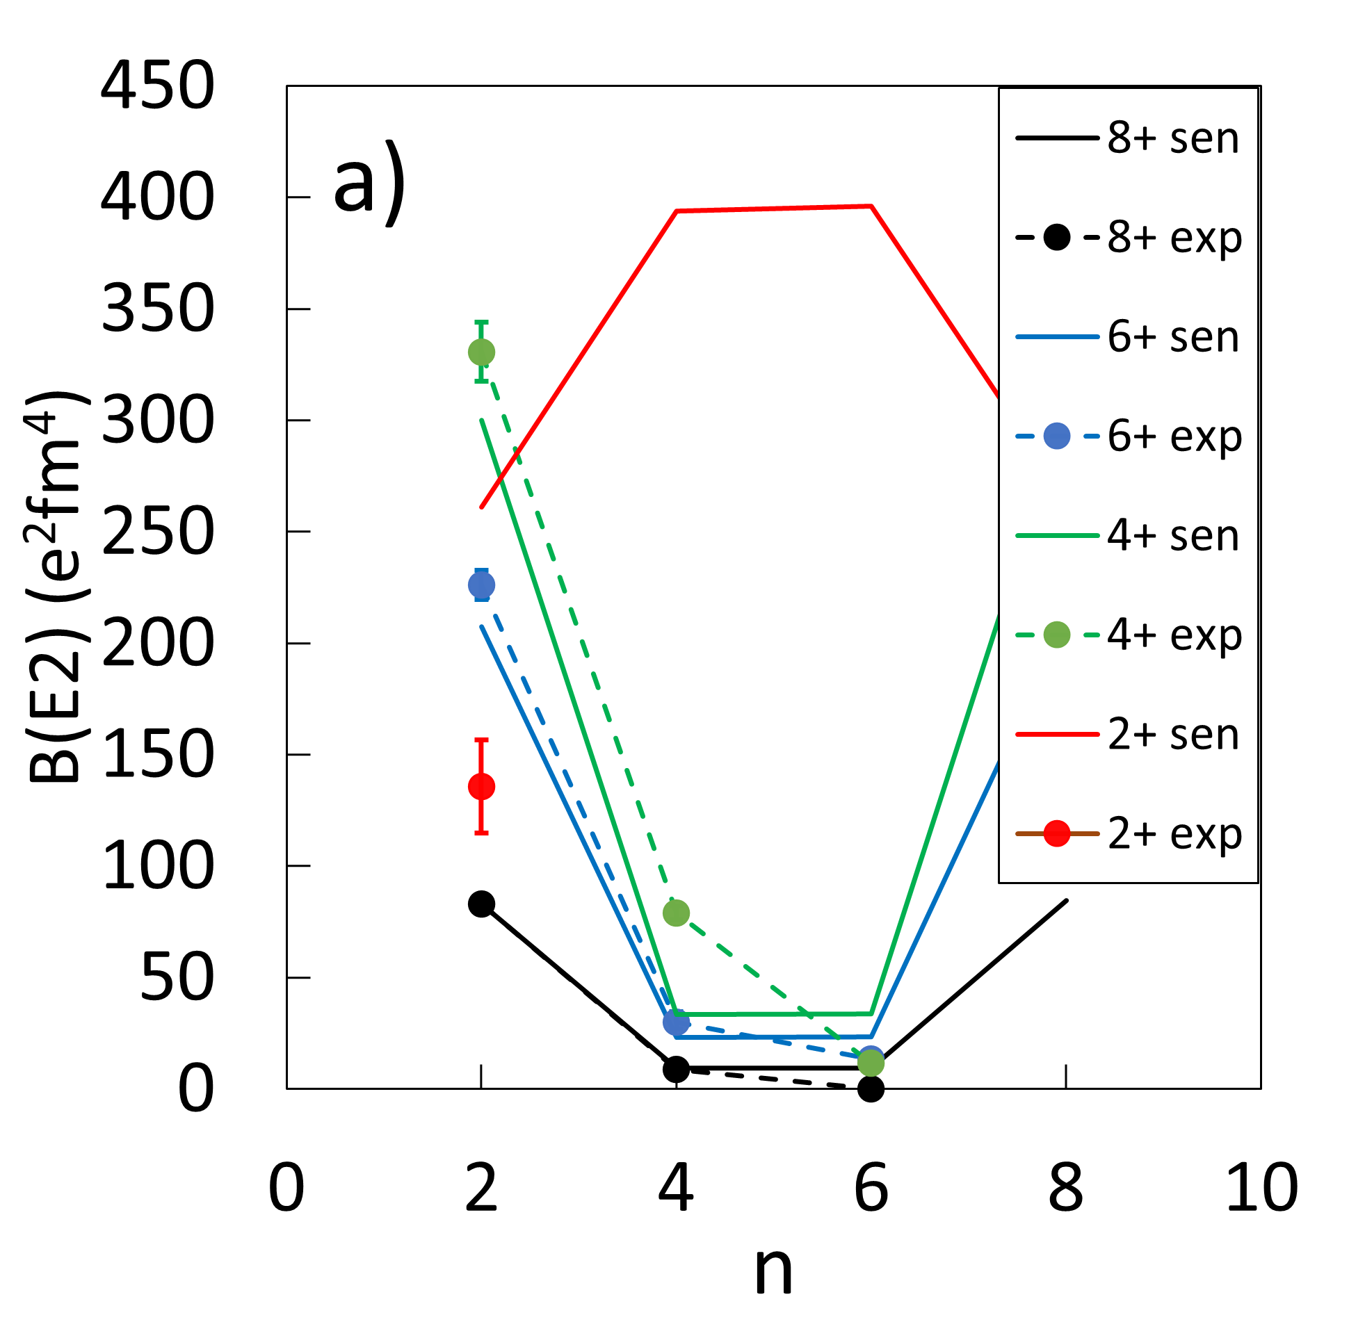
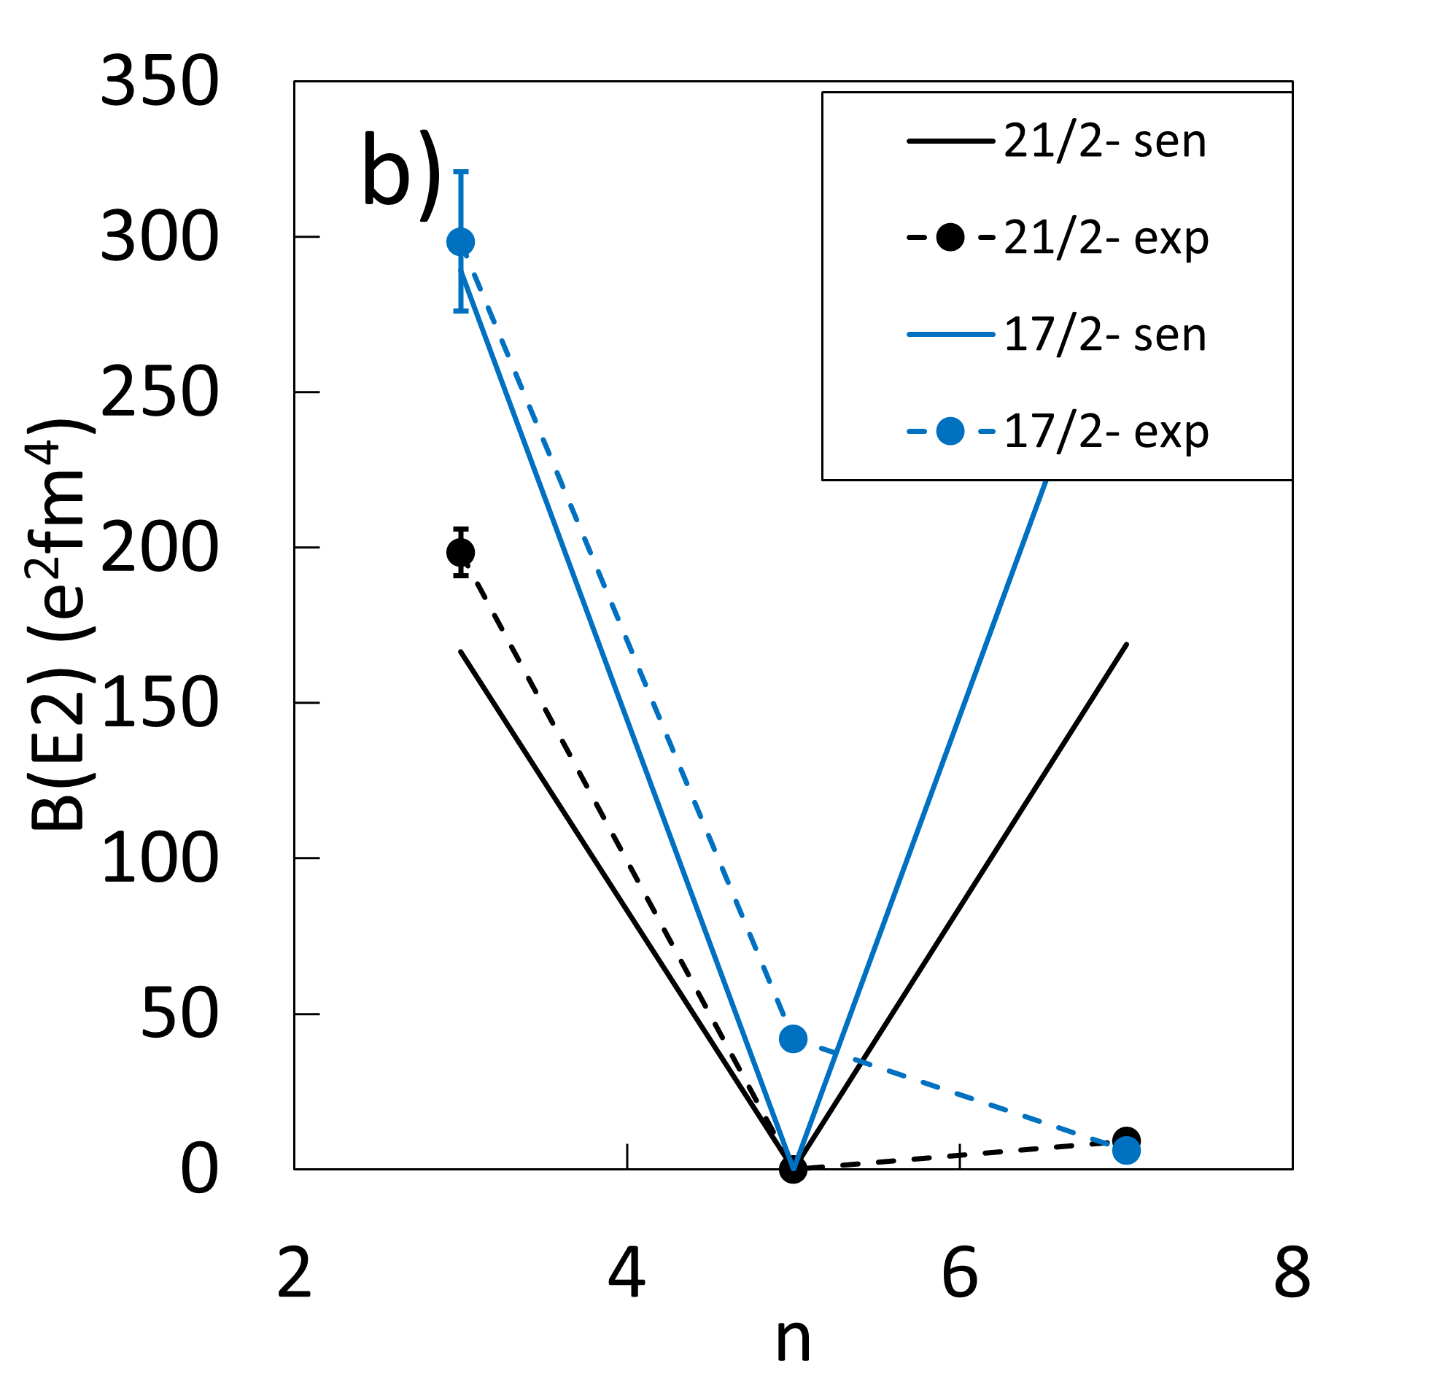
N=126: exp. vs seniority scheme
896 keV
πf7/2
0
πh9/2
Normalised to B(E2; 8⁺ → 6⁺) in ²¹⁰Po
²⁰⁹Bi

Slide 11
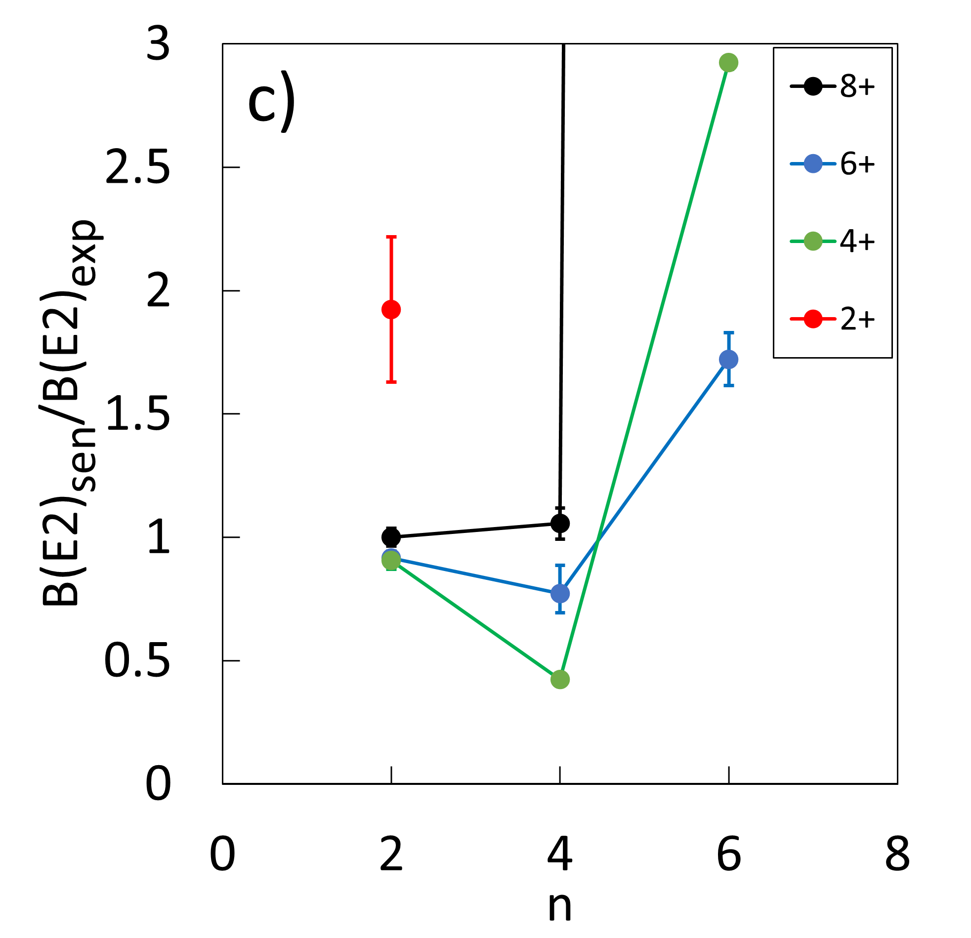
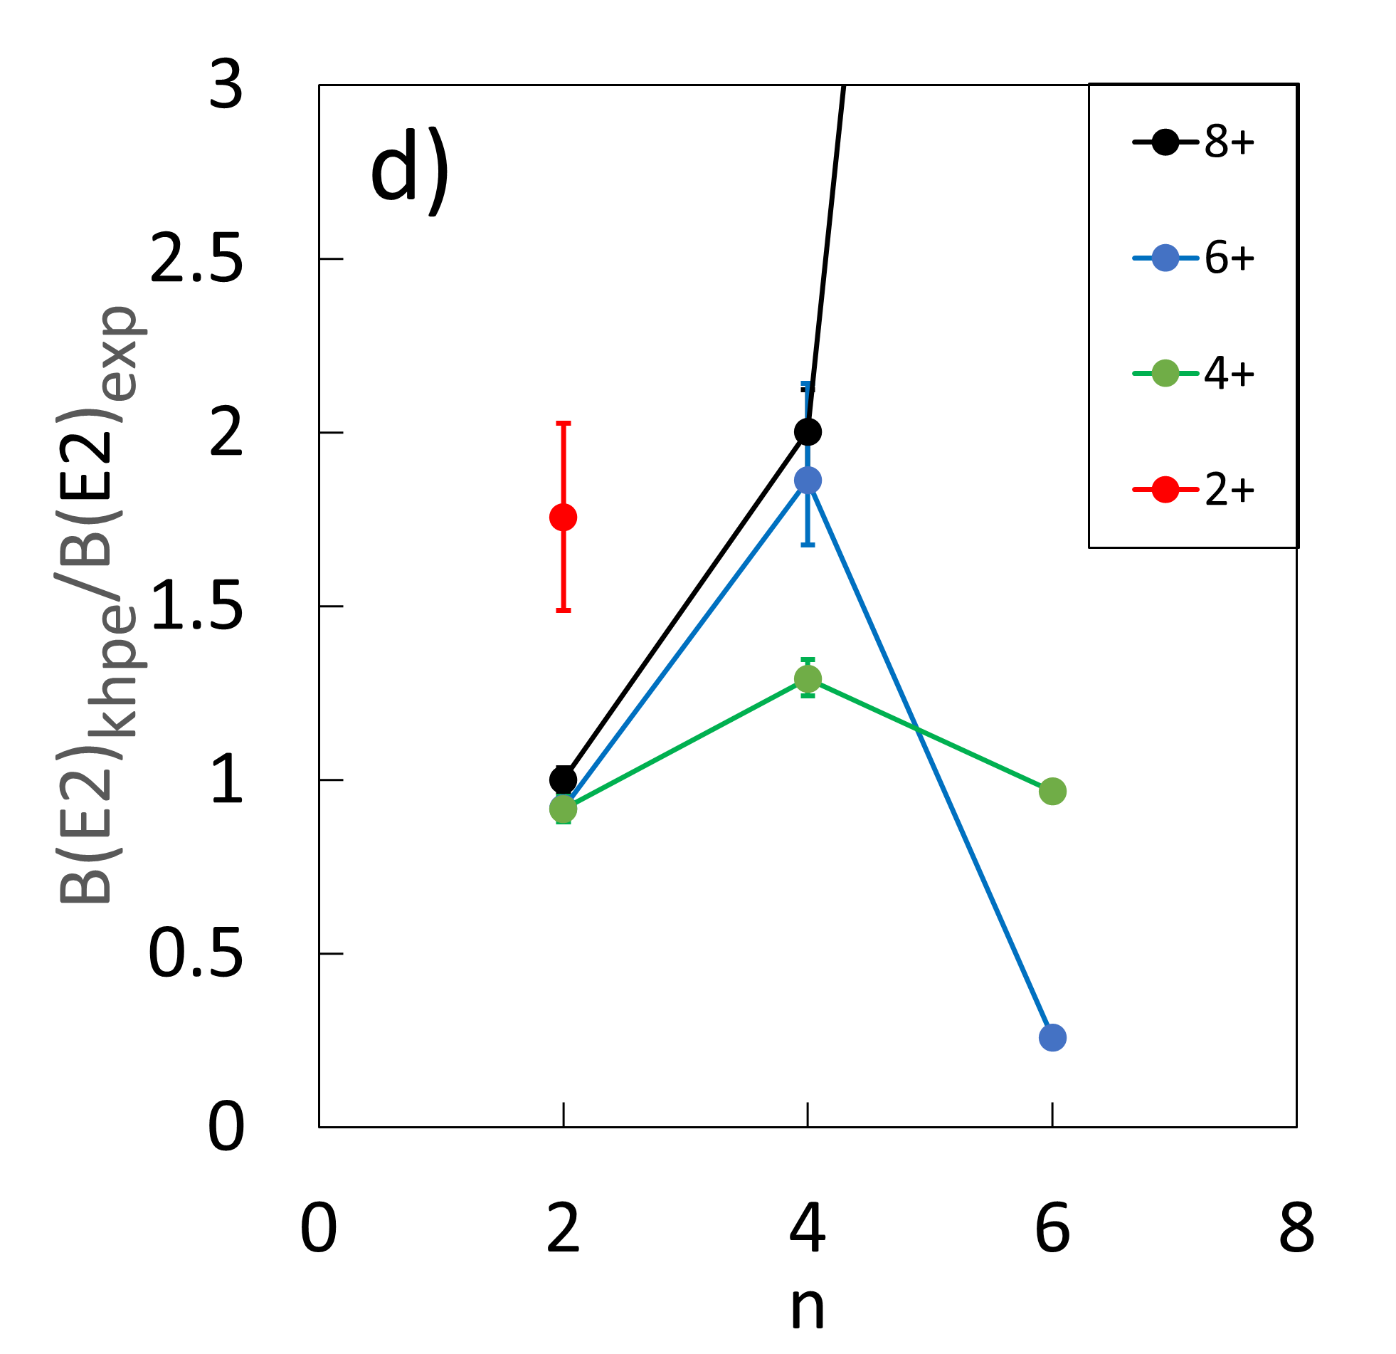
N=126: exp. vs theory
896 keV
πf7/2
0
πh9/2
²⁰⁹Bi

Slide 12
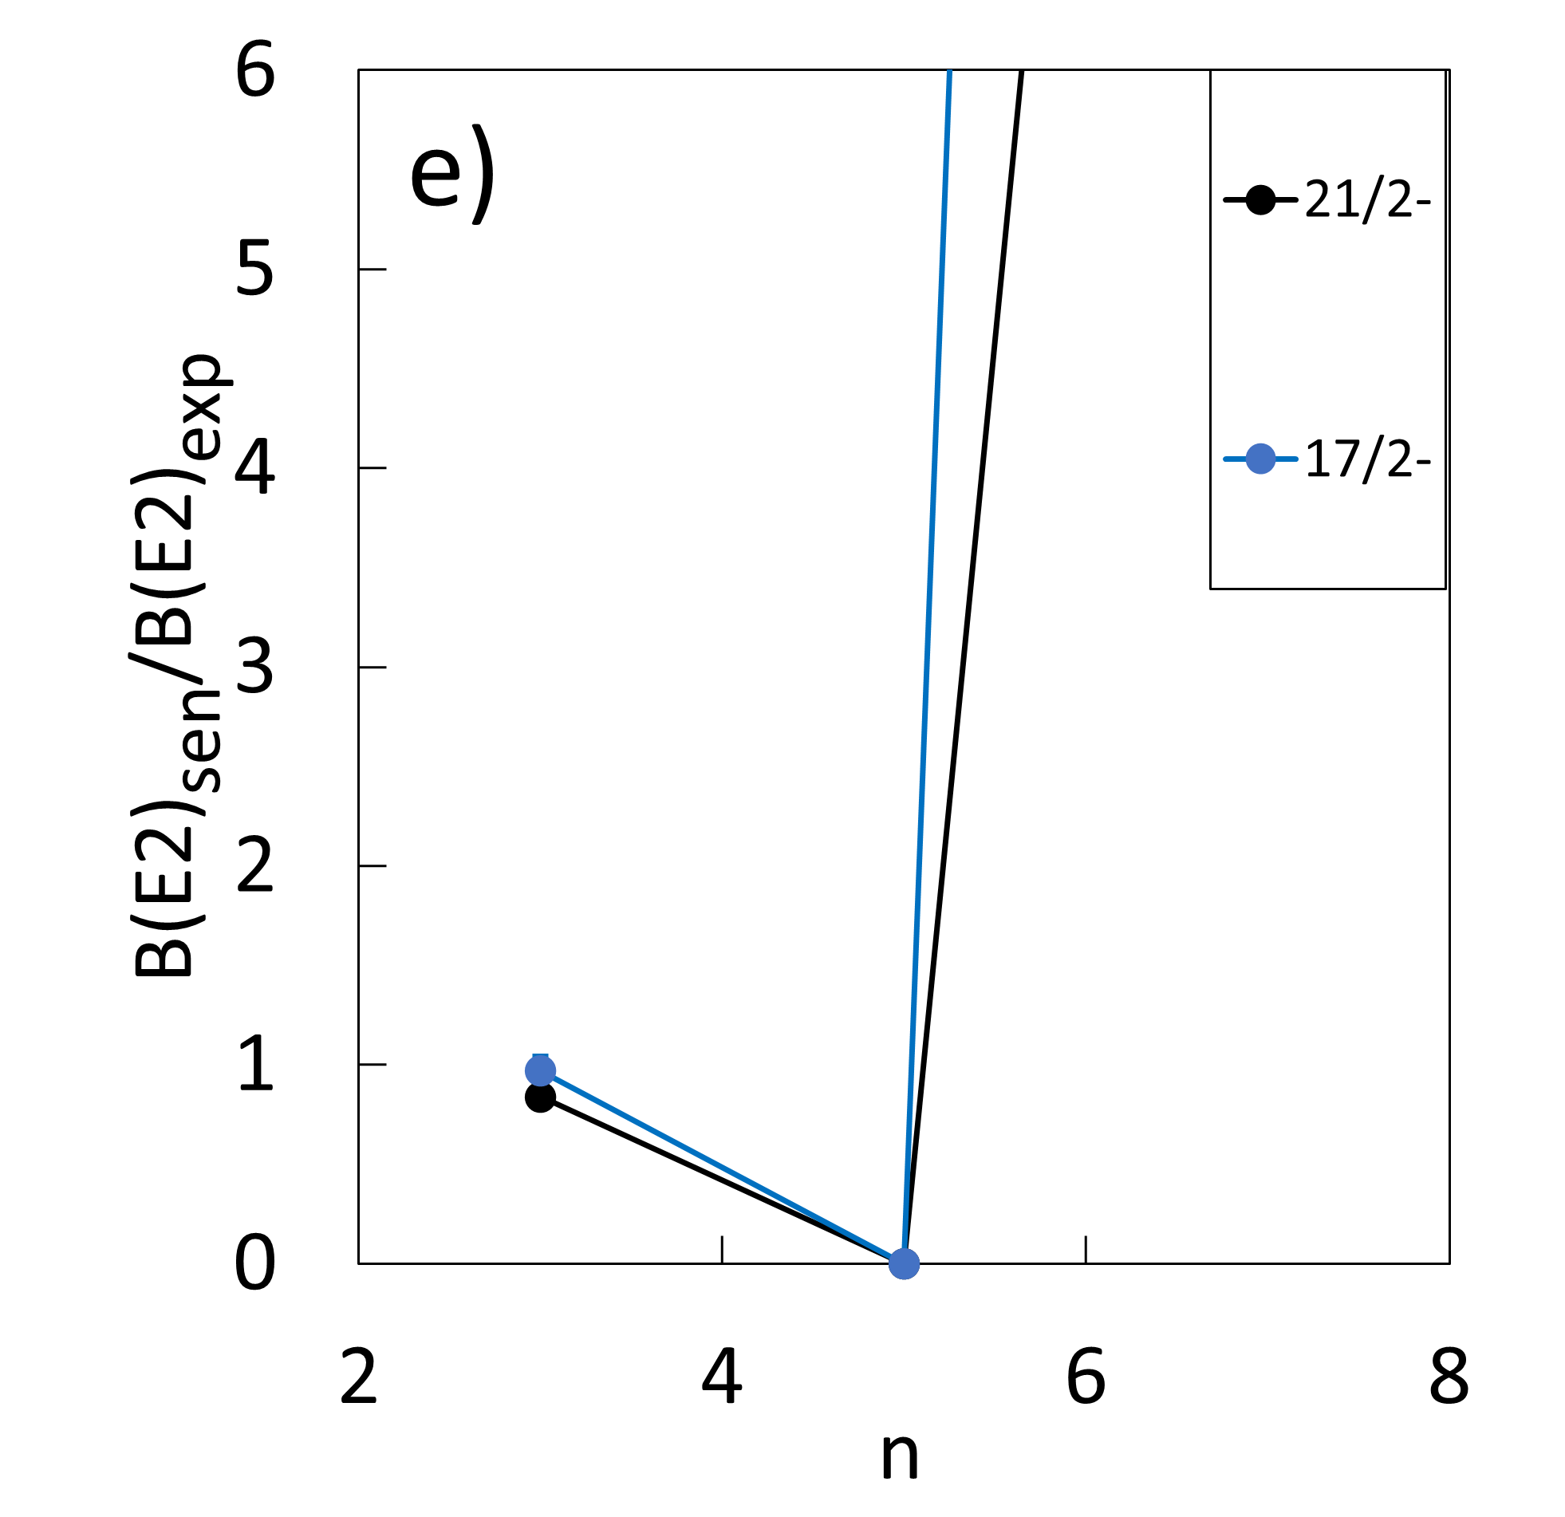
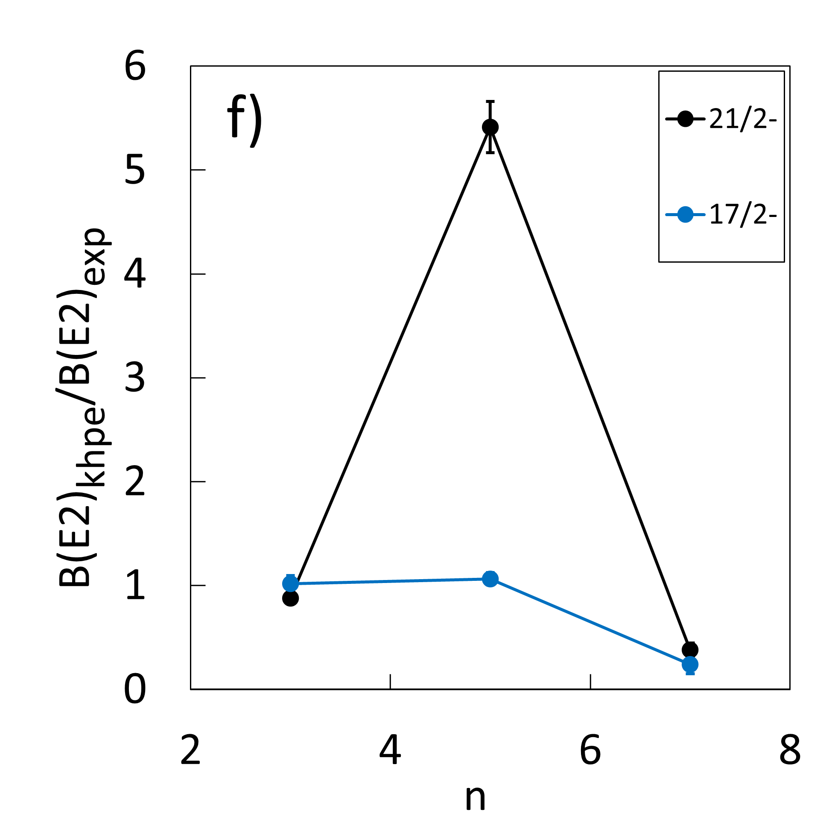
N=126: exp. vs theory

Slide 13
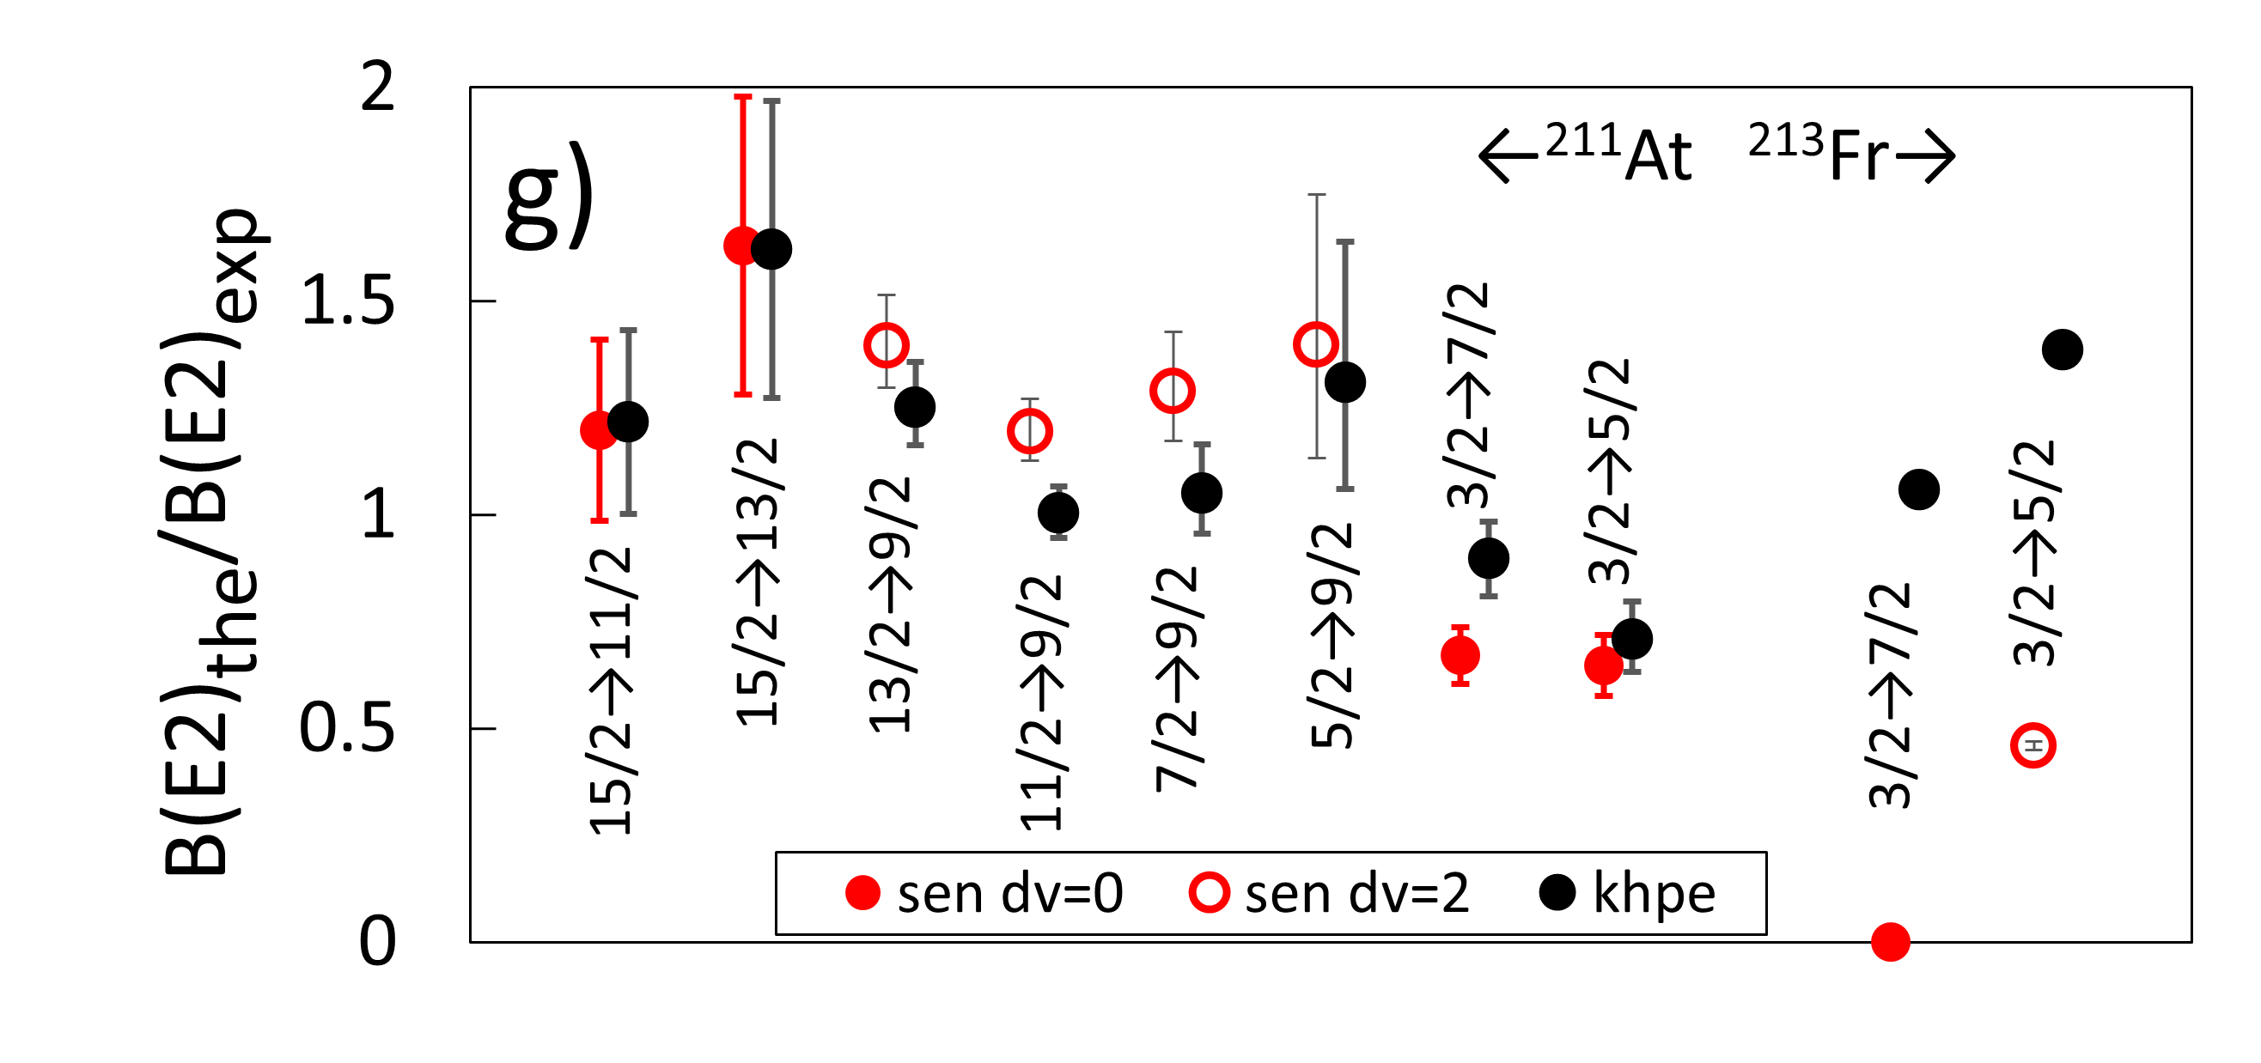
N=126: exp. vs theory, non-yrast states
Excellent agreement!

Slide 14
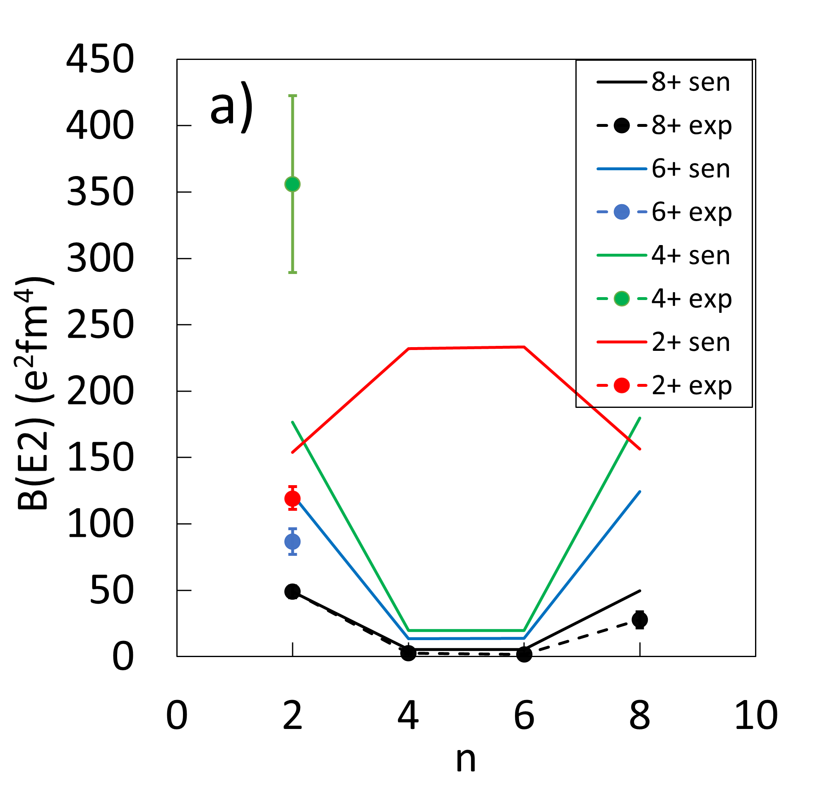
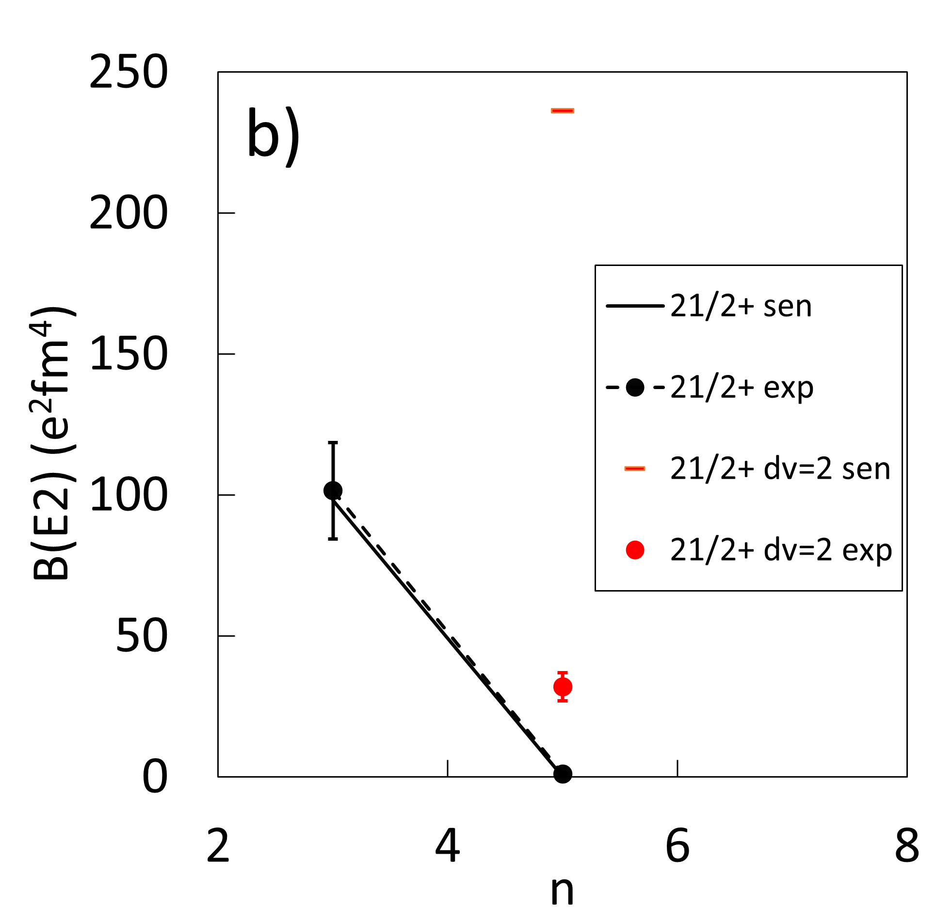
Z=82: exp. vs seniority scheme
Normalised to B(E2; 8⁺ → 6⁺) in ²¹⁰Pb

Slide 15
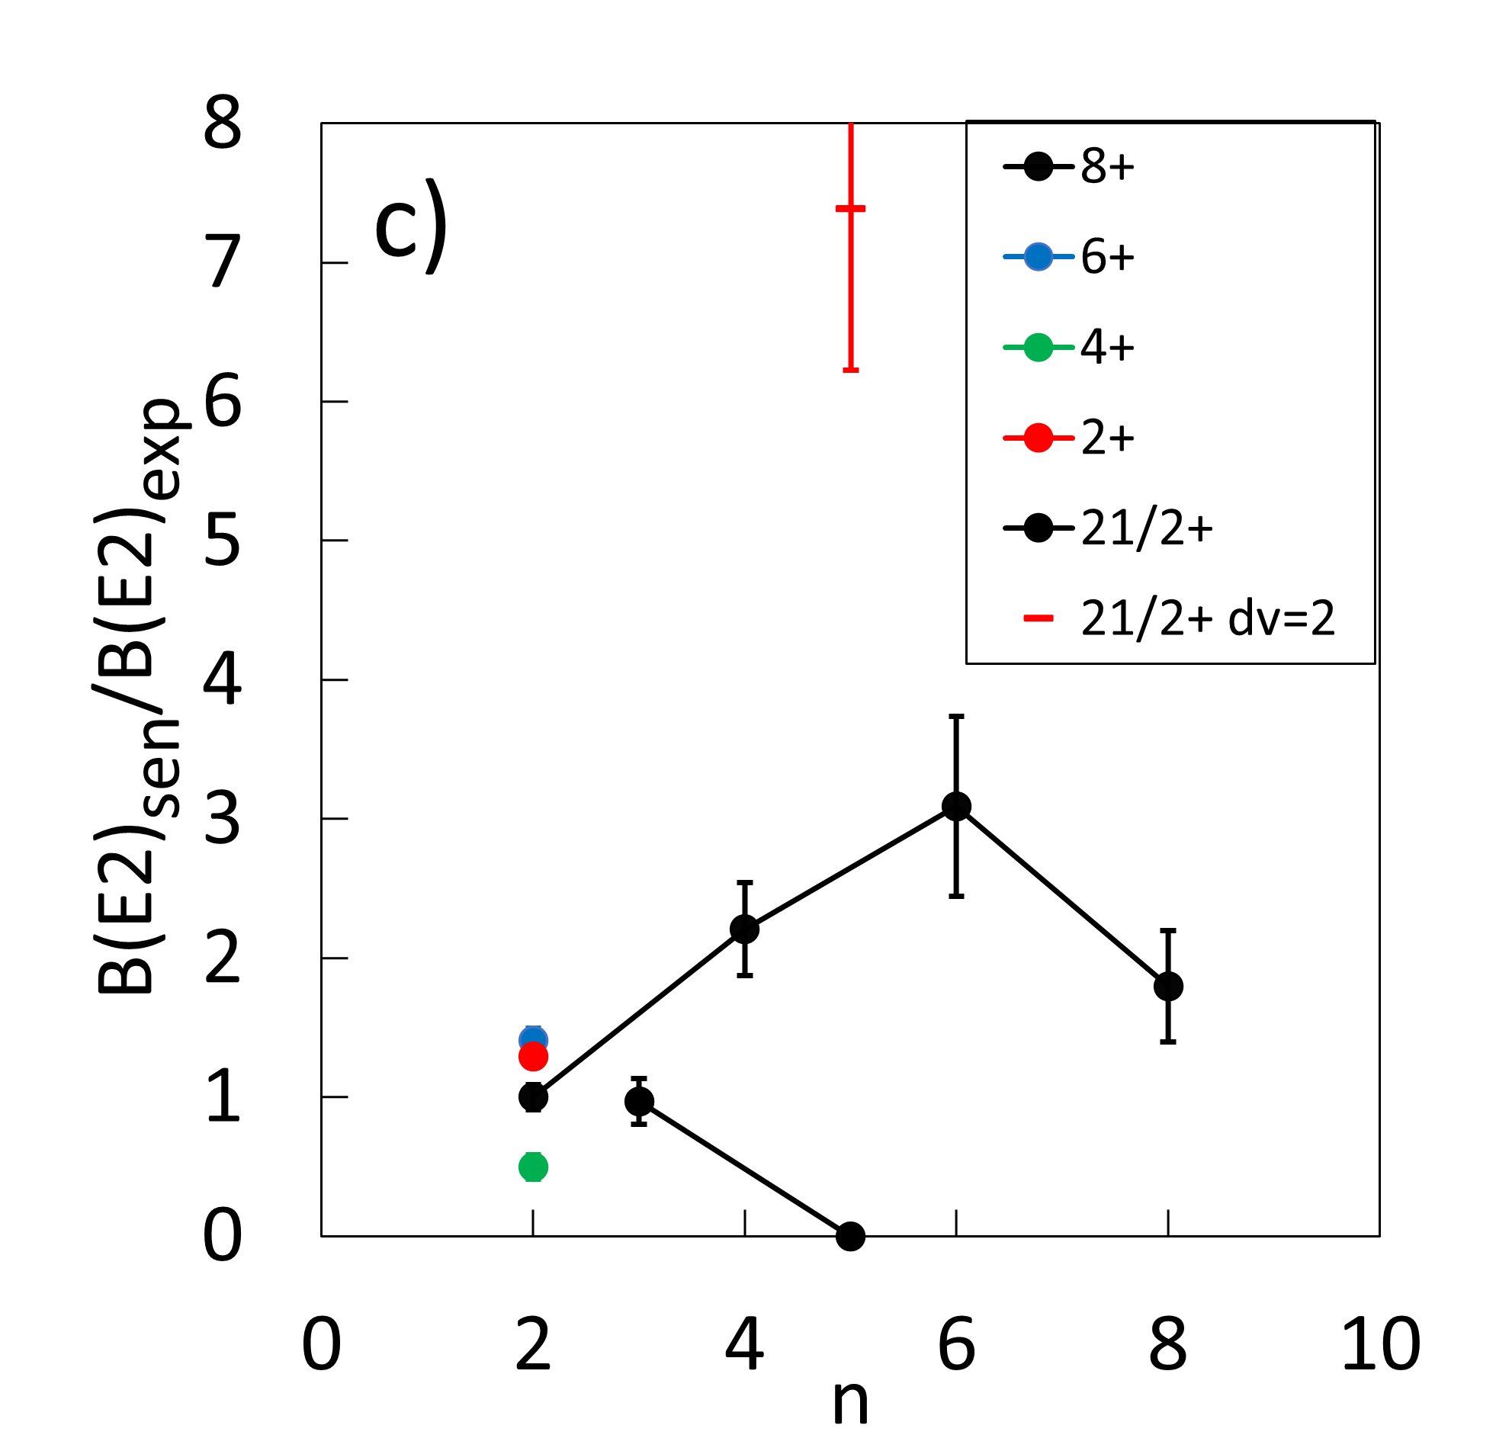
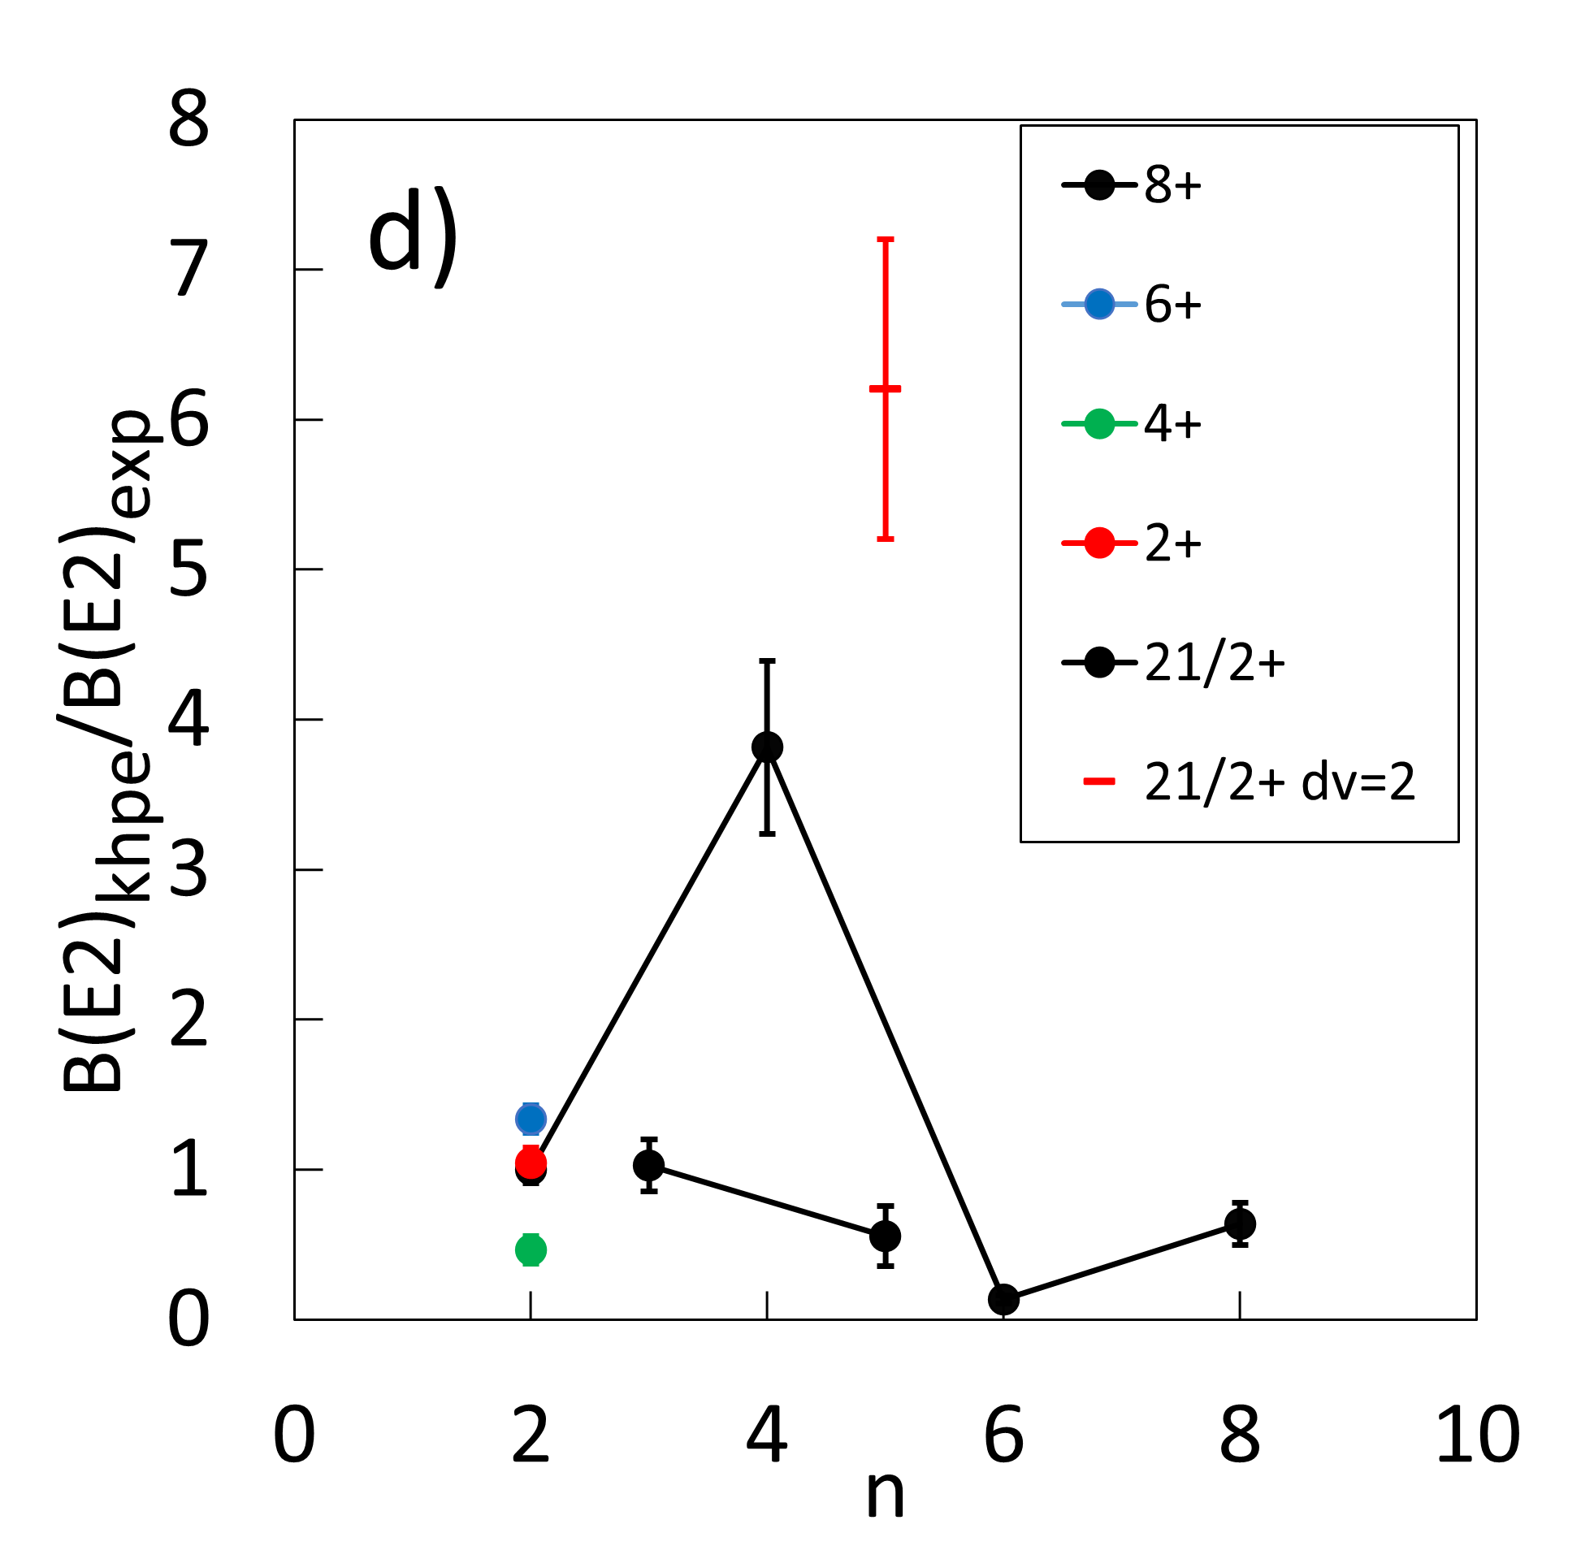
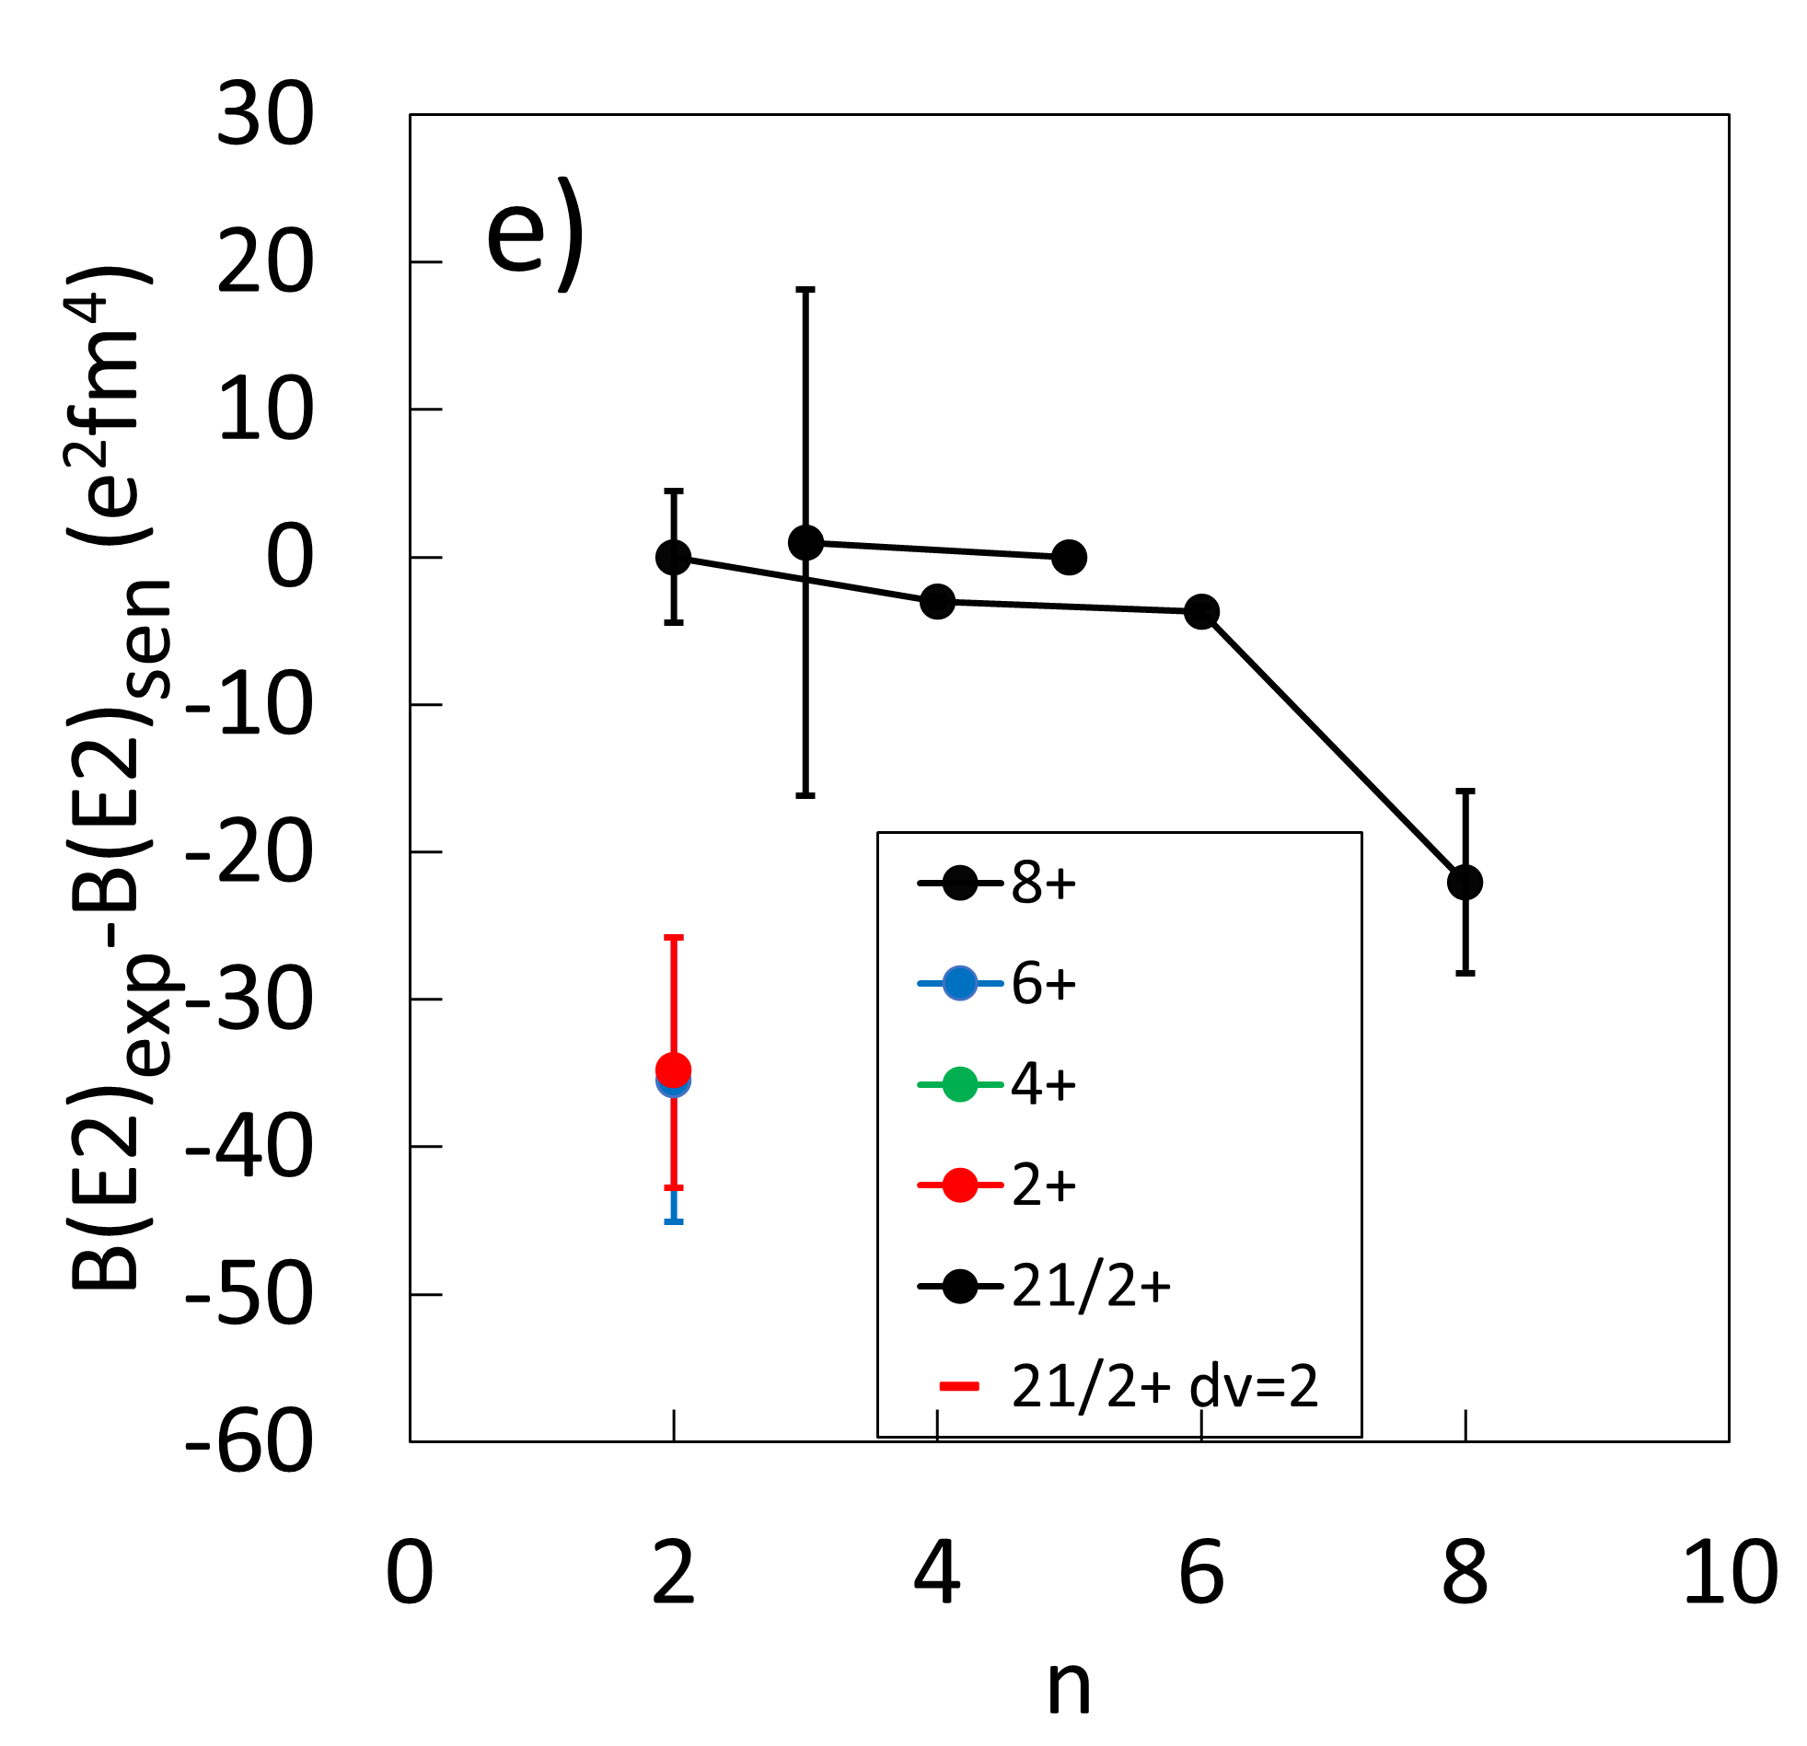
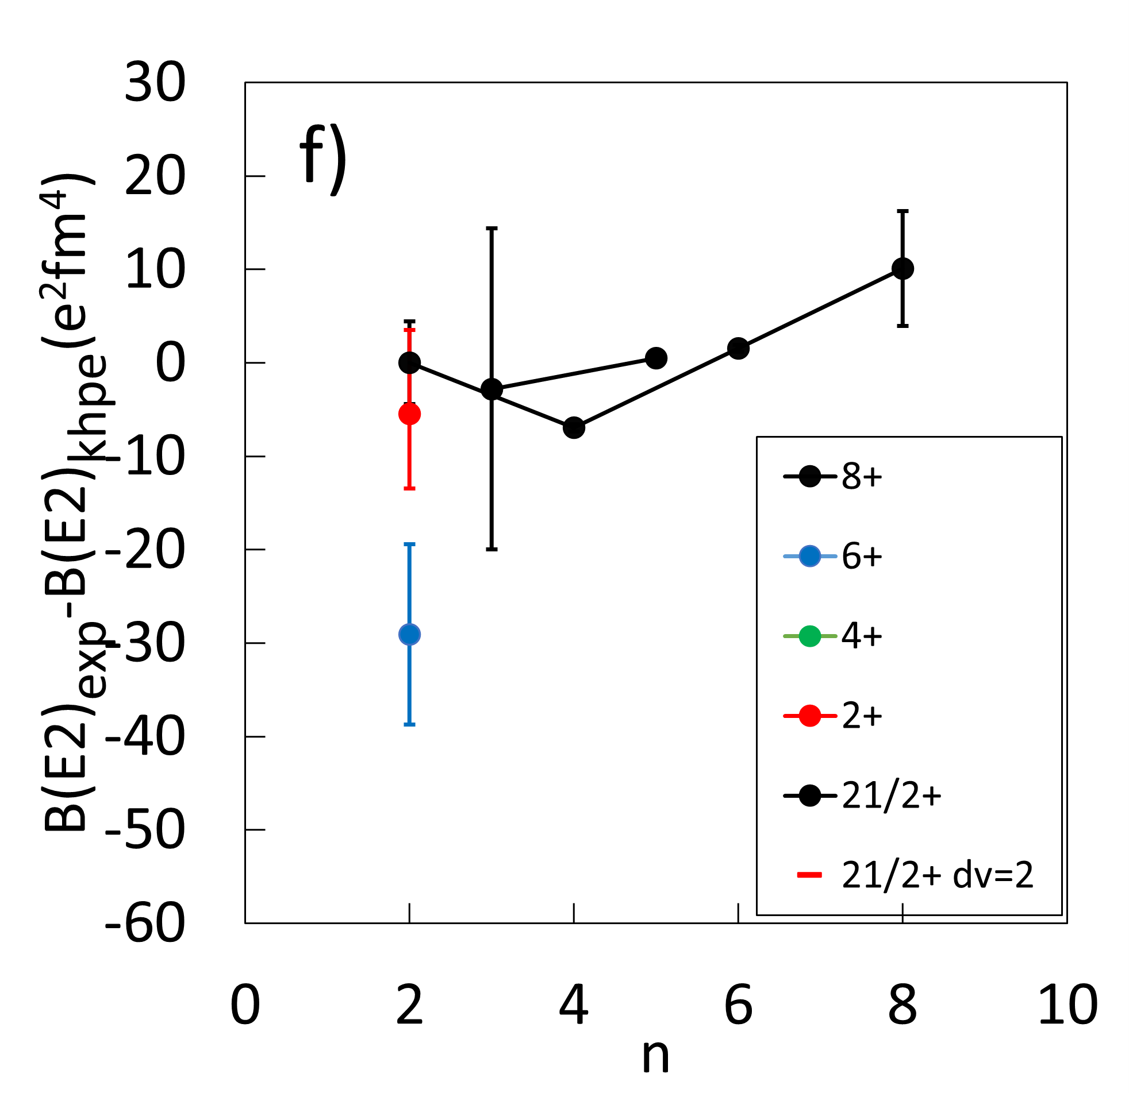
Z=82: exp. vs theory
779 keV
νi11/2
0
νg9/2
²⁰⁹Pb

Slide 16
Conclusions
N=50 N=126 Z=82
(χ2_{sen}=43196 26359 210)
χ2_{sen} /χ2_{jun45} χ2_{sen}/χ2_{khpe} χ2_{sen} /χ2_{khpe}
1.7 44.5 1.3
(0.55 for even-even!)
χ2_{sen} /χ2_{jj44pna}=6.4
χ2_{sen} /χ2_{CD-Bonn}=14.6
(even only)
Problems at n=4,6 πf7/2 influence νi11/2 influence?
“best” is Z=82, but data is scarce

Slide 17
Effect of delta function interaction on two particle states
h9/2 f7/2 g9/2 i11/2
N=126 Z=82
Affected states: even J even J
Lowest state J_{max}=8 J_{max}=10
1+,3+,5+,7+
1+,3+,5+,7+,9+
2+
2+
4+
4+
6+
6+
8+
8+
10+

Slide 18

T.T. Yeung et al., PRL 133, 072501 (2024)

