Slide 1

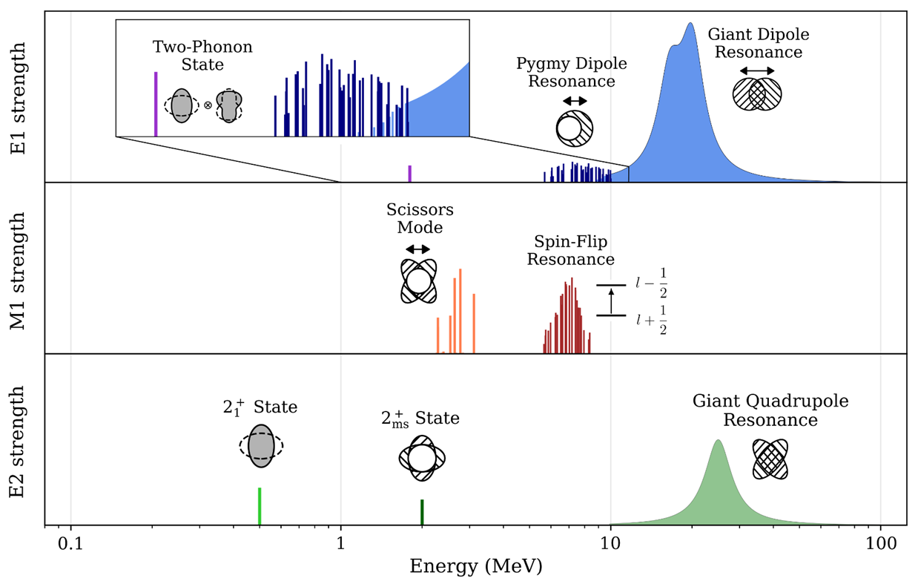
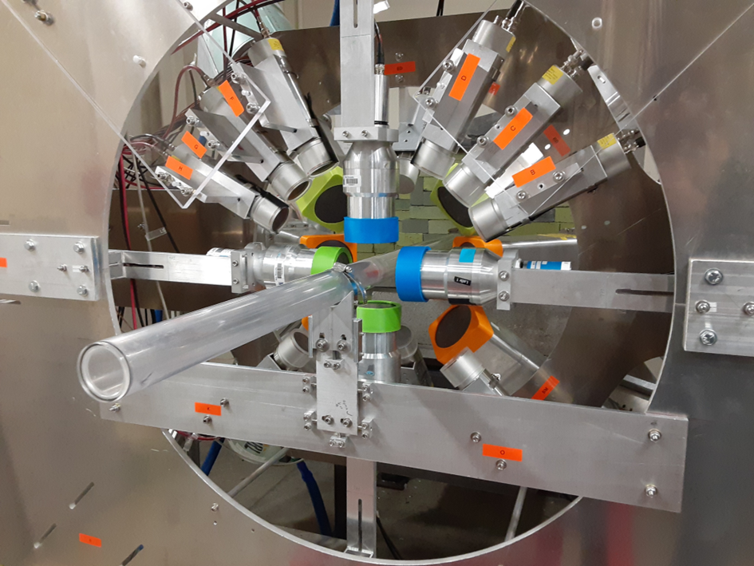
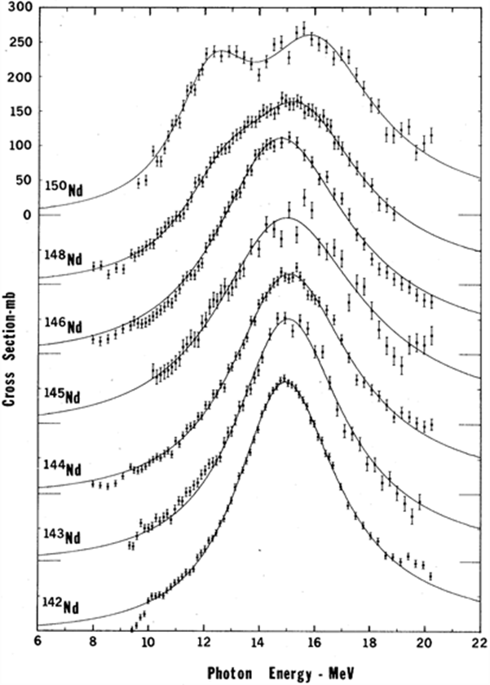
Photographing the Nucleus
Photon-Scattering on its Giant Dipole Resonance
Professor Dr. Norbert Pietralla (TU Darmstadt)

Slide 2
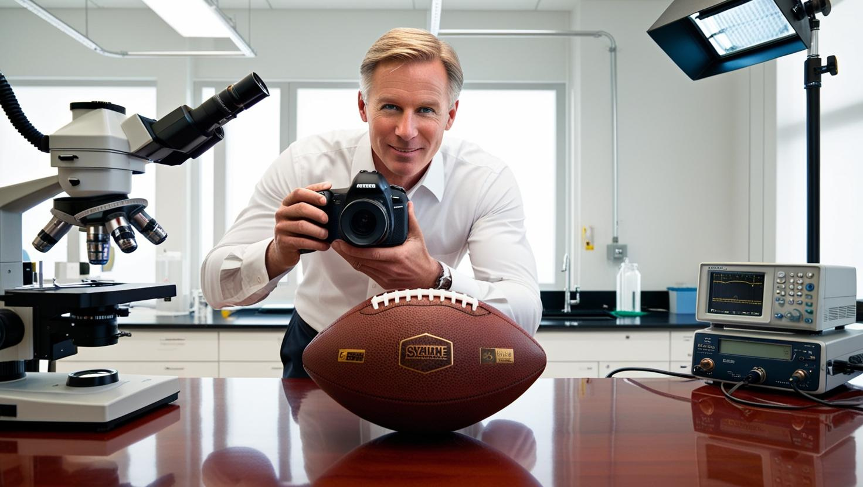
Principle of Photography
Recipe:
Shine photons on object
Detect intensity of scattered photons
For color photos:
Detect wavelength (energy) of scattered photons
For information on object’s shape:
Rotate object and take photos from various directions
AI-generated picture of a photographer in a lab
Do exactly this with a nucleus!

Slide 3

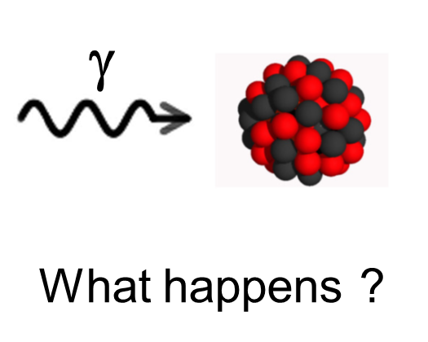
photonuclear phenomena
Figure to the right from:
Figure: N.Pietralla
atomic
nuclear
hadronic

Slide 4
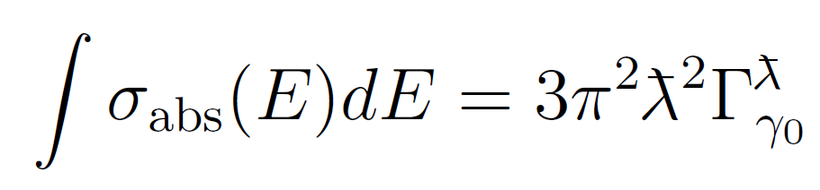
Representative photoabsorption data
¹⁴⁰Ce GDR Lepretre et al, 1976
^{EM excitation} ^{width:}
photoabsorption
cross section
¹⁴⁰Ce

Slide 5
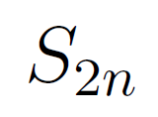
Formulation and interpretation of the GDR
SLO and typical parameter values
¹⁴⁰Ce GDR Lepretre et al, 1976
^{EM excitation} ^{width:}
photoabsorption
cross section
¹⁴⁰Ce
Standard Lorentzian (SLO) parametrization
Γ
E₀
E₀ = 15.0 MeV
Γ = 4.7 MeV
σ₀ = 0.38 b

Slide 6
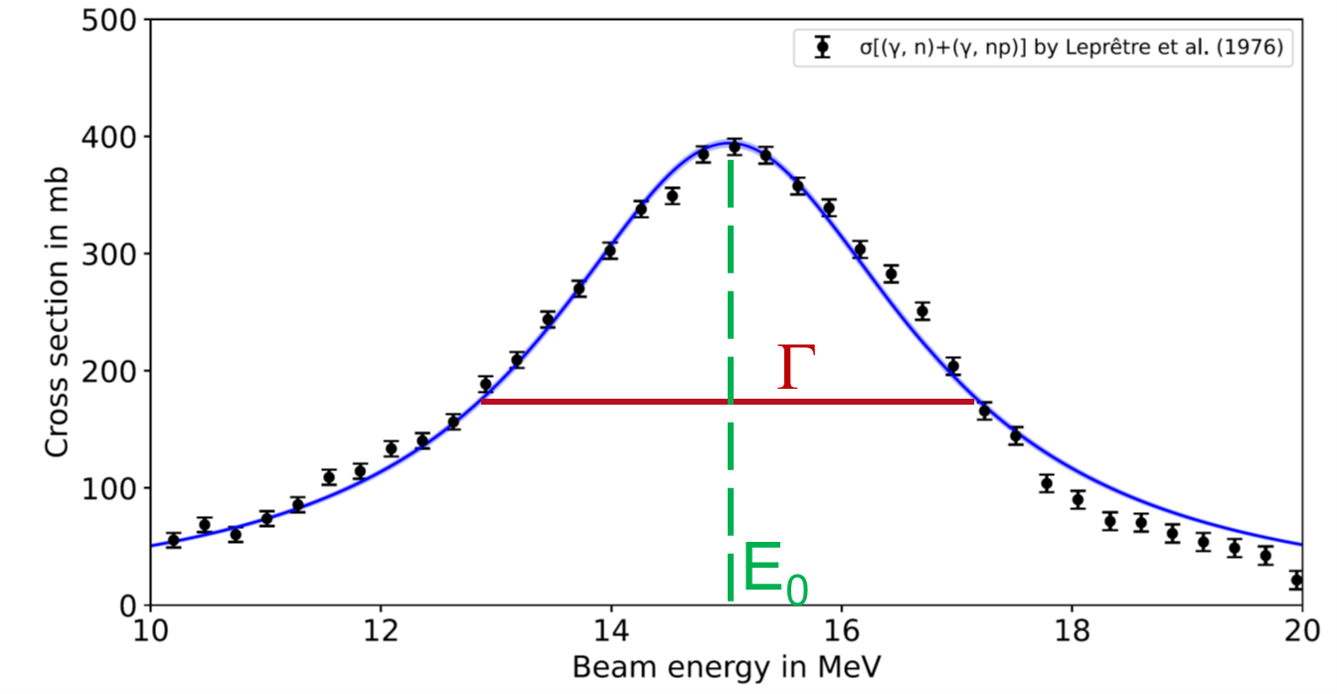
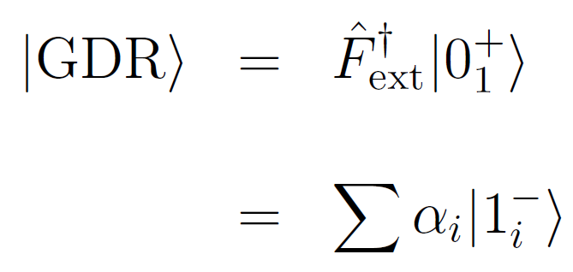
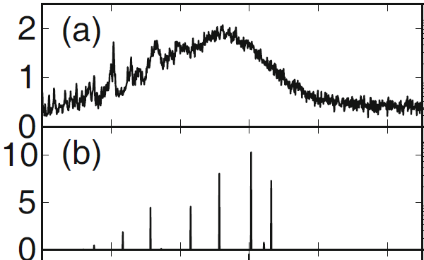
Formulation and interpretation of the GDR
What is the meaning of the GDR width?
^{Coherent superposition} ^{of eigenstates}
τ = 0.14 zs ?

Slide 7
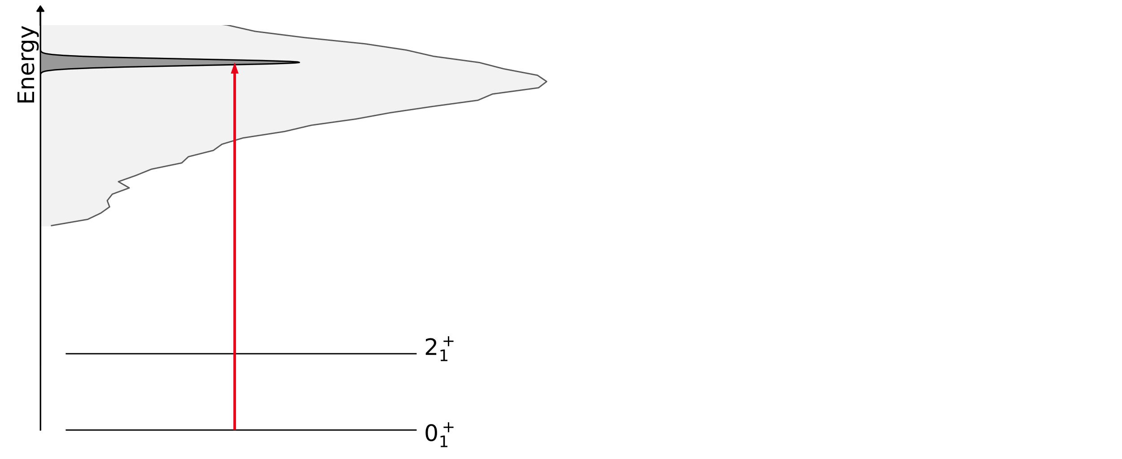
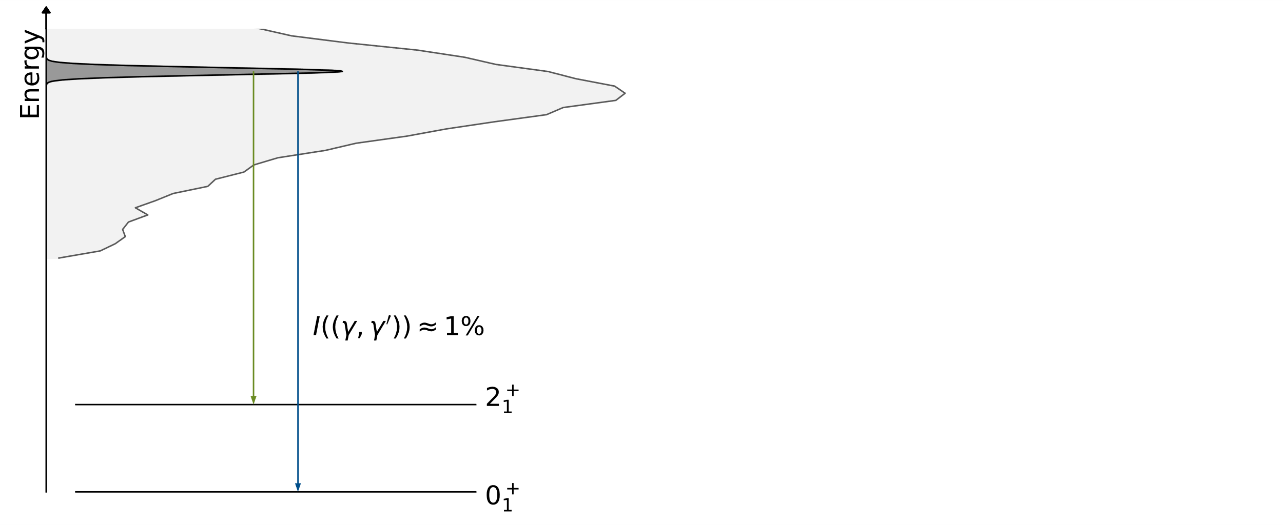
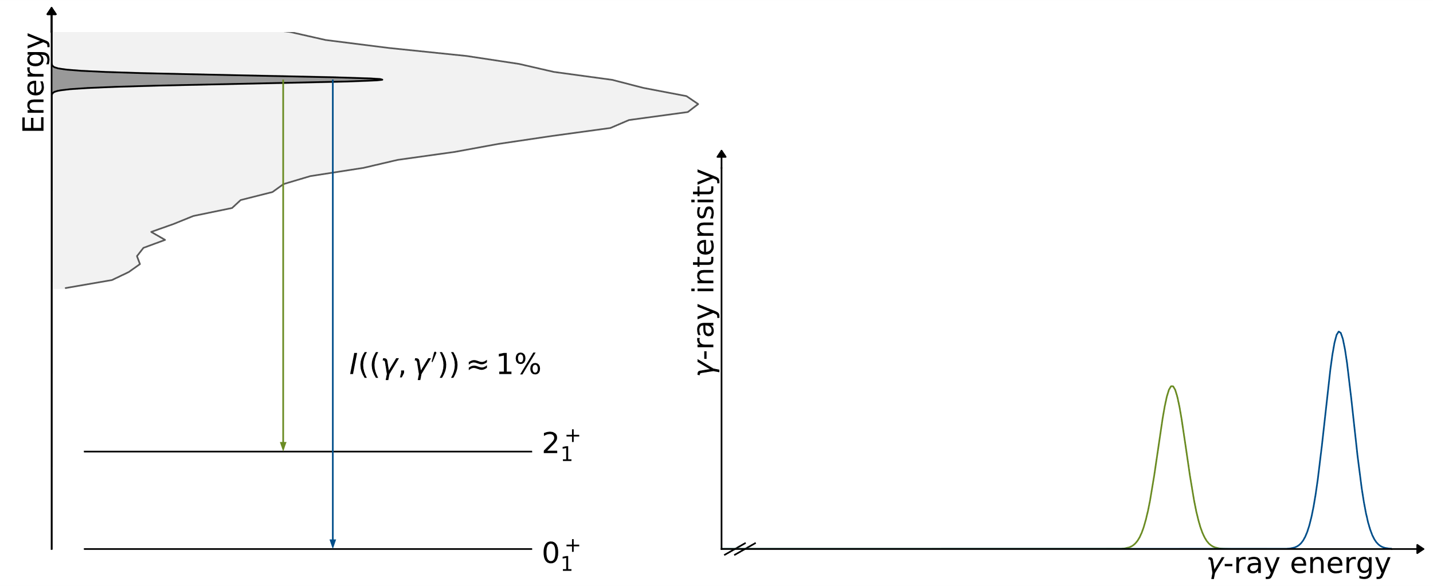
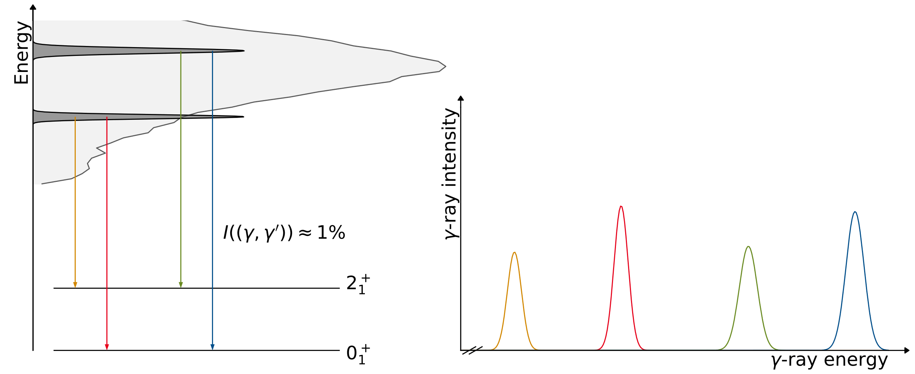
photonuclear experiment
Measurement principle:
Photoexcite energy-slices of the GDR and detect the decay γ-rays

Slide 8
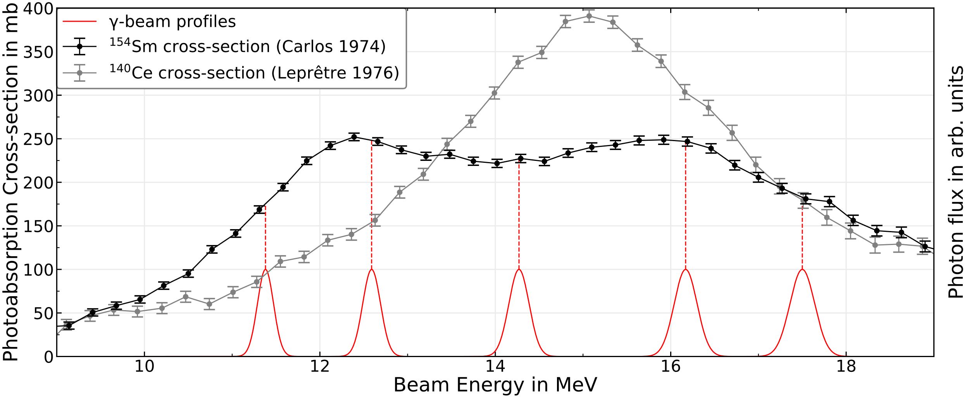
photonuclear experiment
Measurement @ HIγS on ¹⁴⁰Ce and ¹⁵⁴Sm

Slide 9


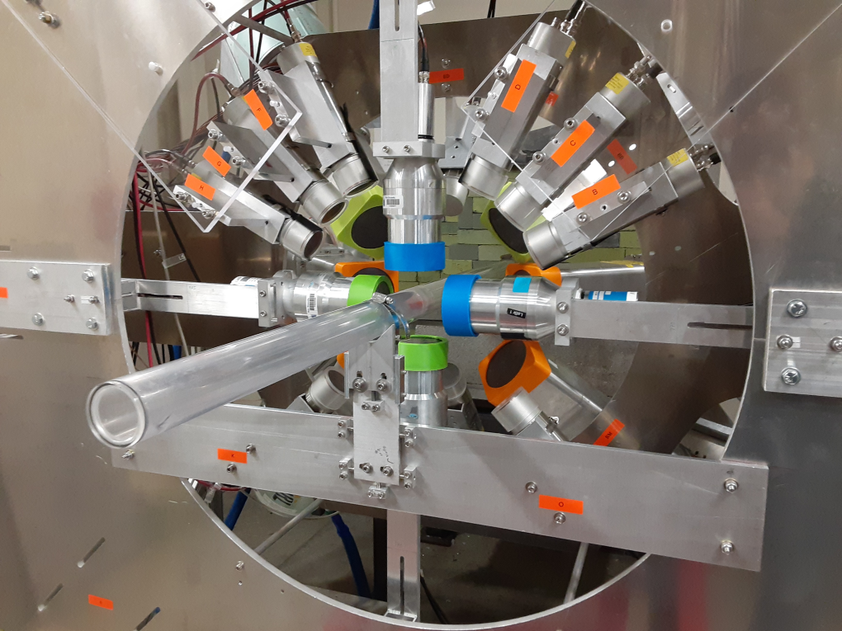
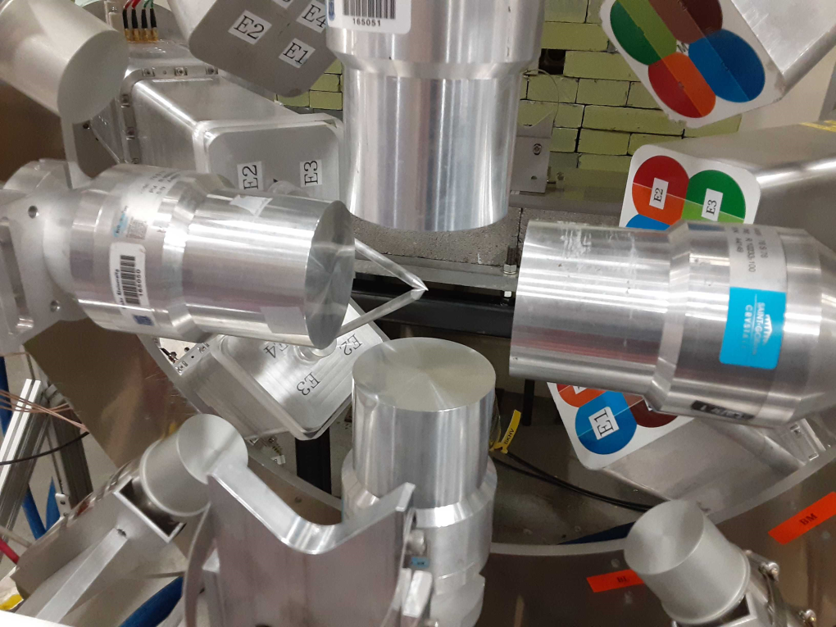
photonuclear experiment
Our “photo camera”: γ³ setup at HIγS
Johann
Isaak
Volker
Werner

Slide 10
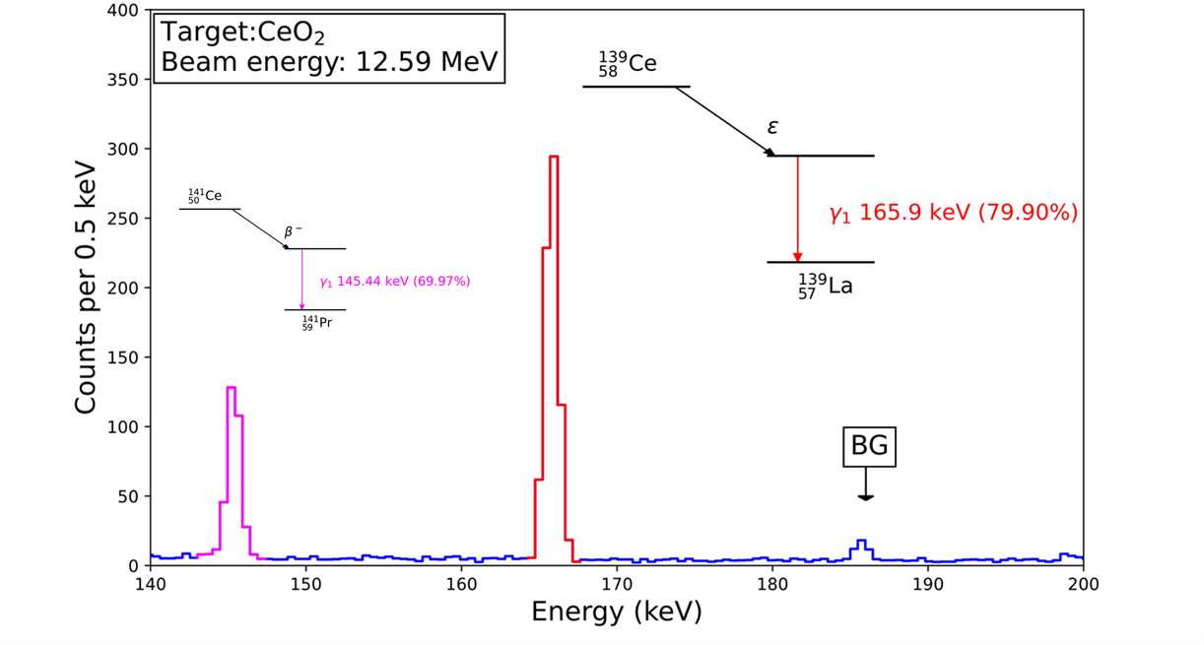
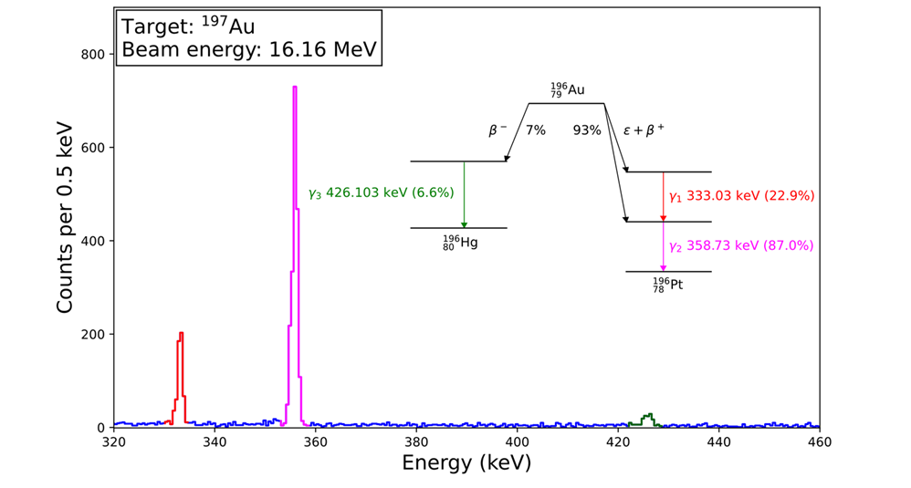
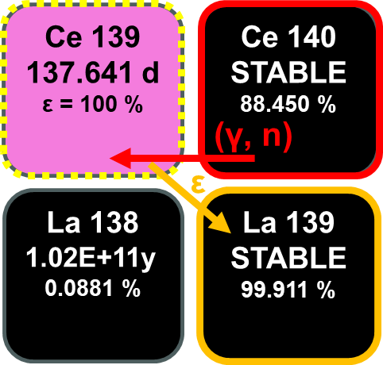

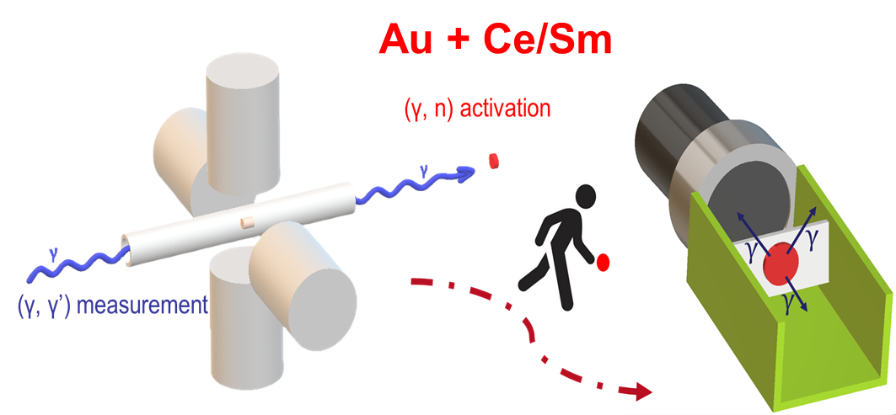
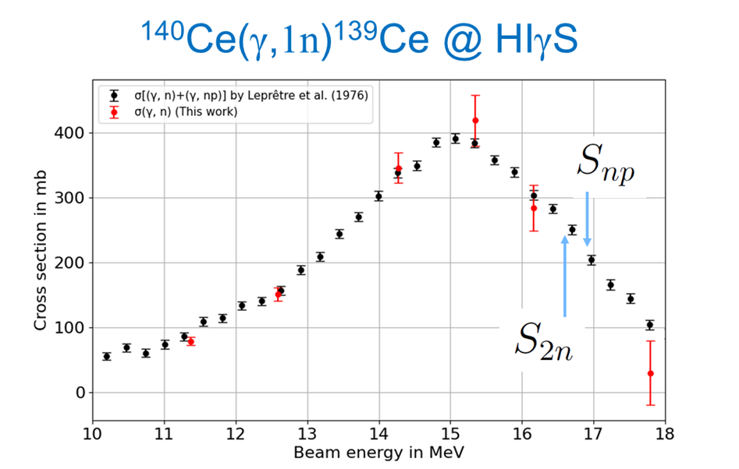
photonuclear experiment: photon-flux calibration
Photon flux calibration and verification of cross sections for ¹⁴⁰Ce and ¹⁵⁴Sm

Slide 11
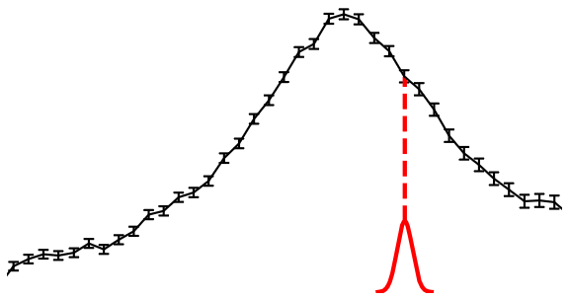
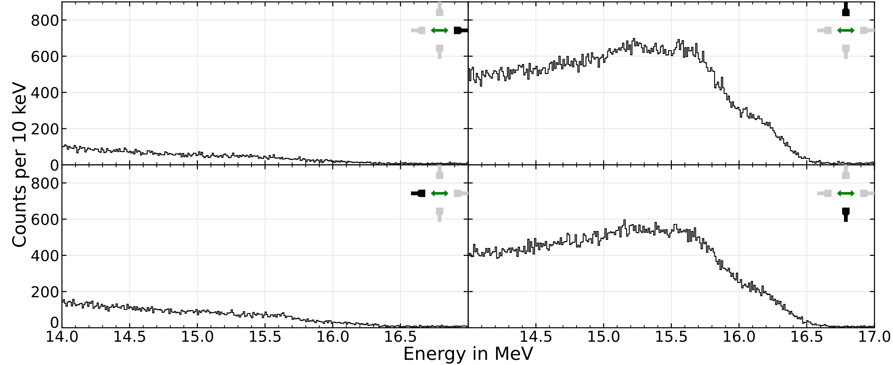
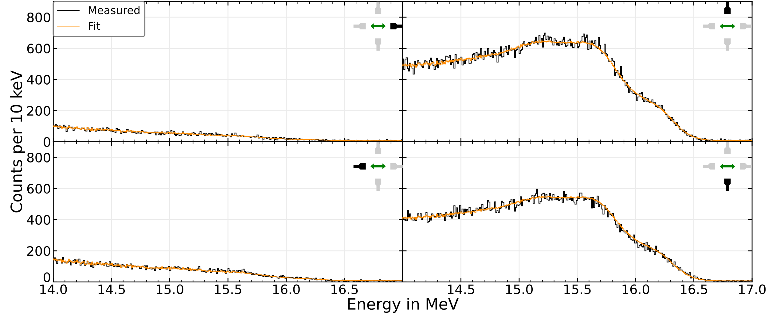
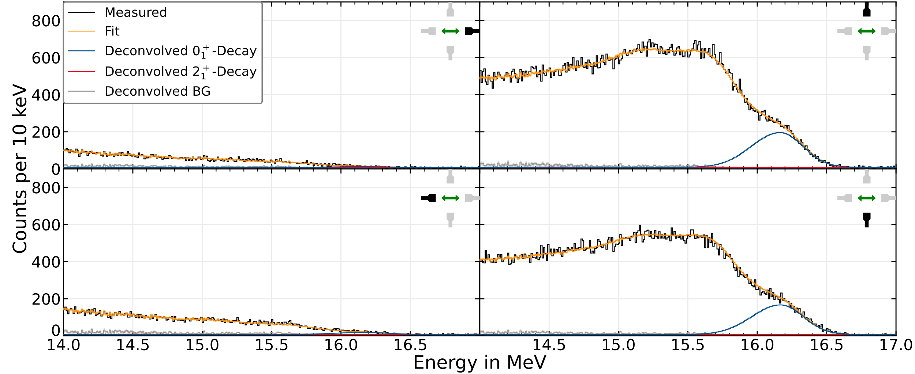
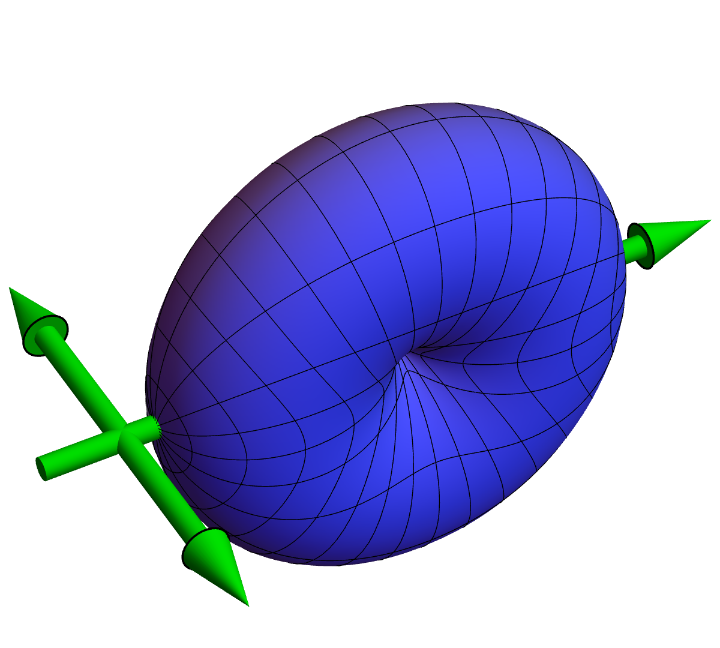



photonuclear experiment
¹⁴⁰Ce(γ,γ’)@16.2 MeV at HIγS
E_{γ}=16.2 MeV
$$0_{1}^{+}→1_{GDR}^{−}→0_{1}^{+}$$
$$\frac{Γ_{2_{1}^{+}}}{Γ_{0_{1}^{+}}}≤0.0015$$
Dr. Jörn
Kleemann

Slide 12
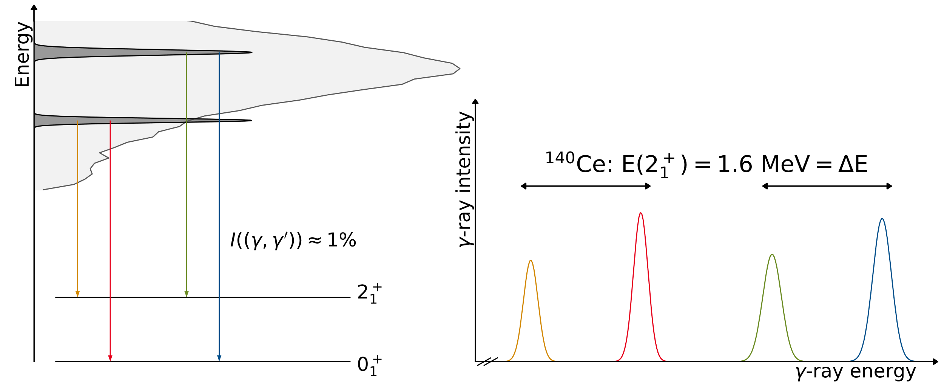
observation: gamma-decay pattern of the GDR
¹⁴⁰Ce
relative cross sections
Dr. Jörn
Kleemann

Slide 13
observation: gamma-decay pattern of the GDR
¹⁴⁰Ce
relative (γ,γ’) cross sections for GDR decay into 2₁⁺ state or ground state
GDR γ-decay into ground state is NOT statistical !

Slide 14
observation: gamma-decay pattern of the GDR
¹⁴⁰Ce
relative cross sections
Observation:
γ-decay branches to 2⁺₁ (or other excited states) are VERY small for ¹⁴⁰Ce. ~10⁻³. At all energies.
GDR decays to gs by γ due to collective operator.
The γ–decay width of the GDR must be the EM width of the collective mode, i.e., Γ_{γ0}= 55 keV.

Slide 15
Elastic gamma-scattering cross section on the GDR
Do the absolute cross sections for
elastic photon scattering
confirm notion of single coherent mode?

Slide 16
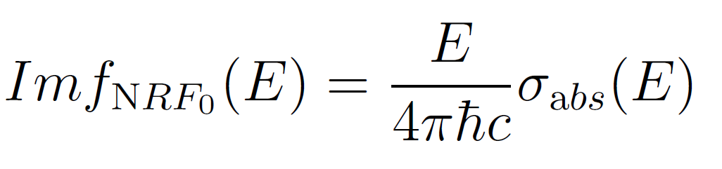
Elastic gamma-scattering cross section on the GDR
Elastic scattering cross section
Thomson: f_{T} known, constant, and real
from optical theorem
and
dispersion relation
providing
for SLO parametrization and constant damping

Slide 17
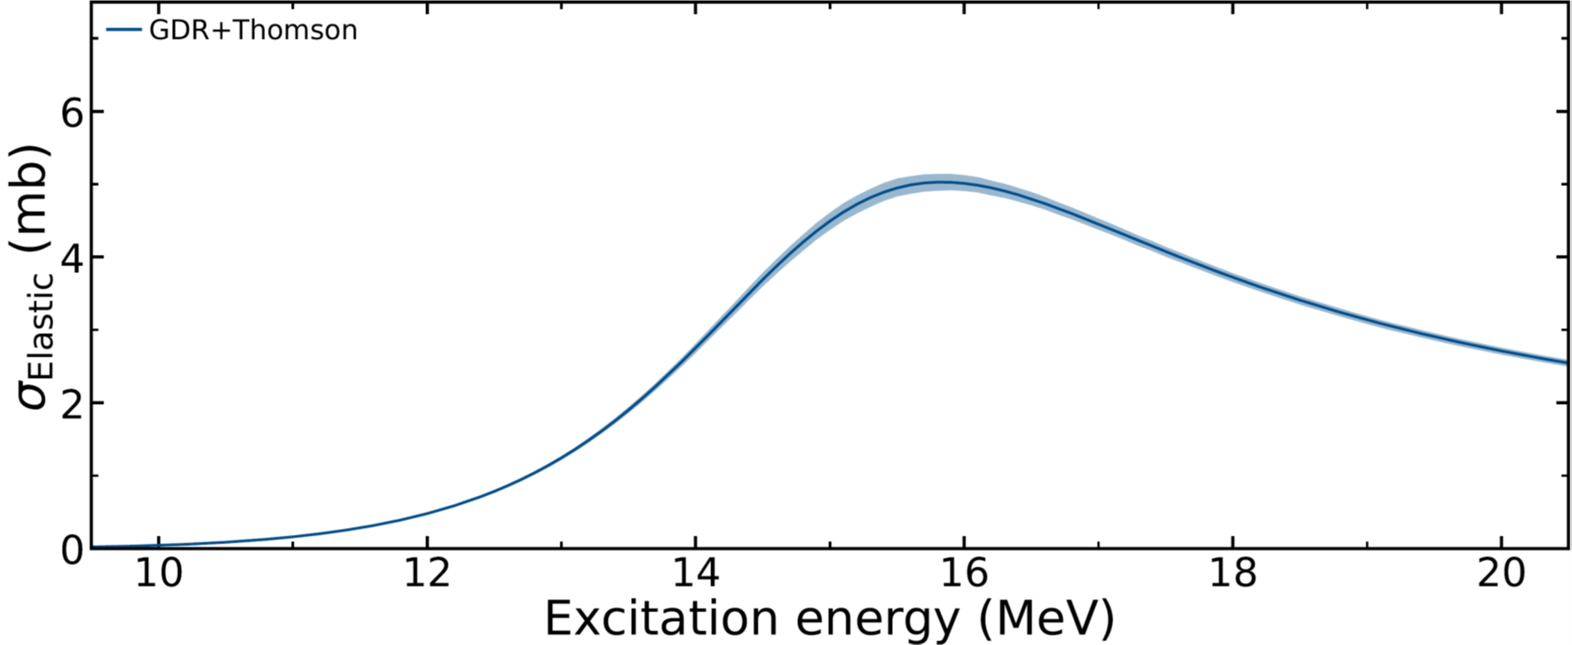
Elastic gamma-scattering cross section on the GDR
GDR’s elastic photon scattering cross section: consequence from SLO
On the order of a few mbarn
≈ 1% of the total absorption cross section

Slide 18
Elastic gamma-scattering cross section on the GDR
GDR’s elastic photon scattering cross section: first compared to data
¹⁴⁰Ce
Dr. Jörn
Kleemann

Slide 19
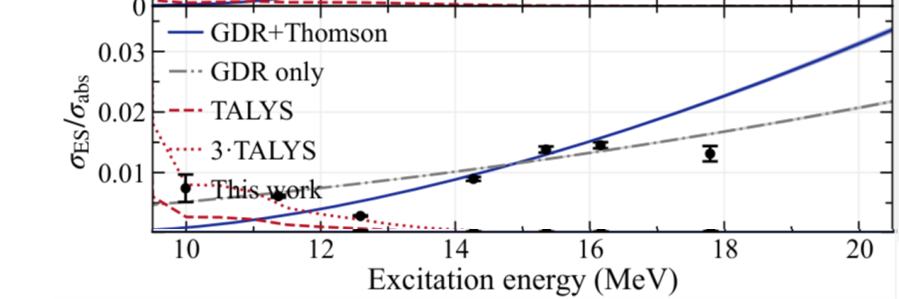
Elastic gamma-scattering cross section on the GDR
What is the energy dependence of the (γ,γ₀’)/(γ,n) branching ratio?
Neglecting the (small) Thomson term in SLO parametrization yields
~ E² σ_{abs}(E)
¹⁴⁰Ce
Dr. Jörn
Kleemann

Slide 20
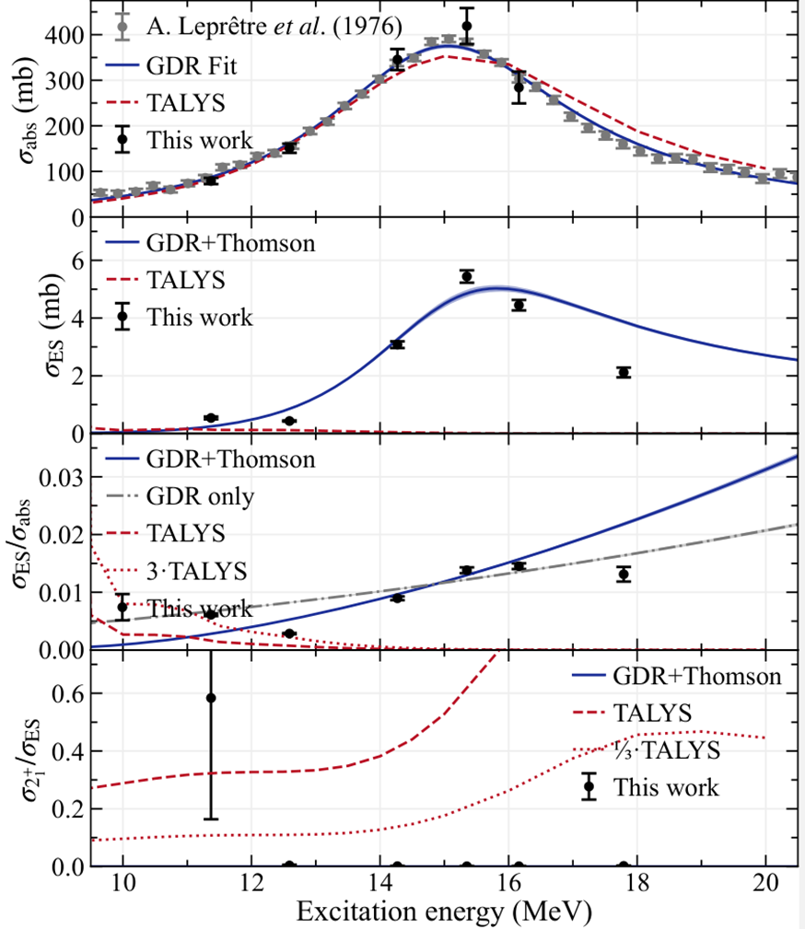
Conclusions
¹⁴⁰Ce
Observations:
GDR decays by γ collectively. (coherent 1p1h)
Width for γ–decay of GDR is EM-width of this collective state. Γ_{γ} = 55 keV.
Decay leading to particle emission is ~90 times faster. ⇒ Γ = 4.7 MeV.
Implying Γ IS the decay probability of this collective GDR state. q.m.-dephasing into chaotic compound
The GDR “dephases” within 0.14 zs. ~ half of oscillation period T=1/ν = h/E
Statistical γ-decay from final compound state is much smaller.

Slide 21
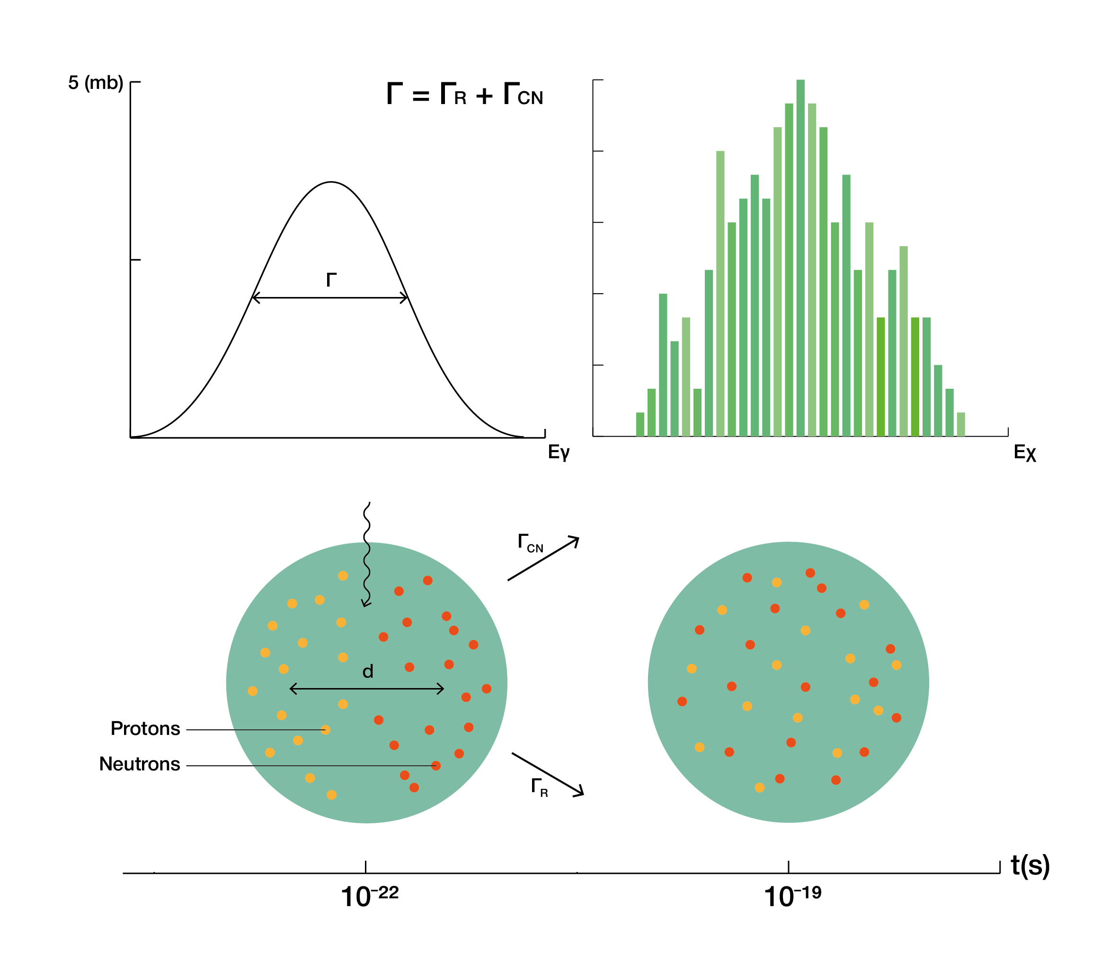
Conclusions
σ (mb)
Γ = Γ_{R} + Γ_{CN}
Γ
99% formation
of compound
nucleus (chaotic)
with subsequent
statistical decay
ordered coherent
motion
~1% collective γ-decay to gs

Slide 22
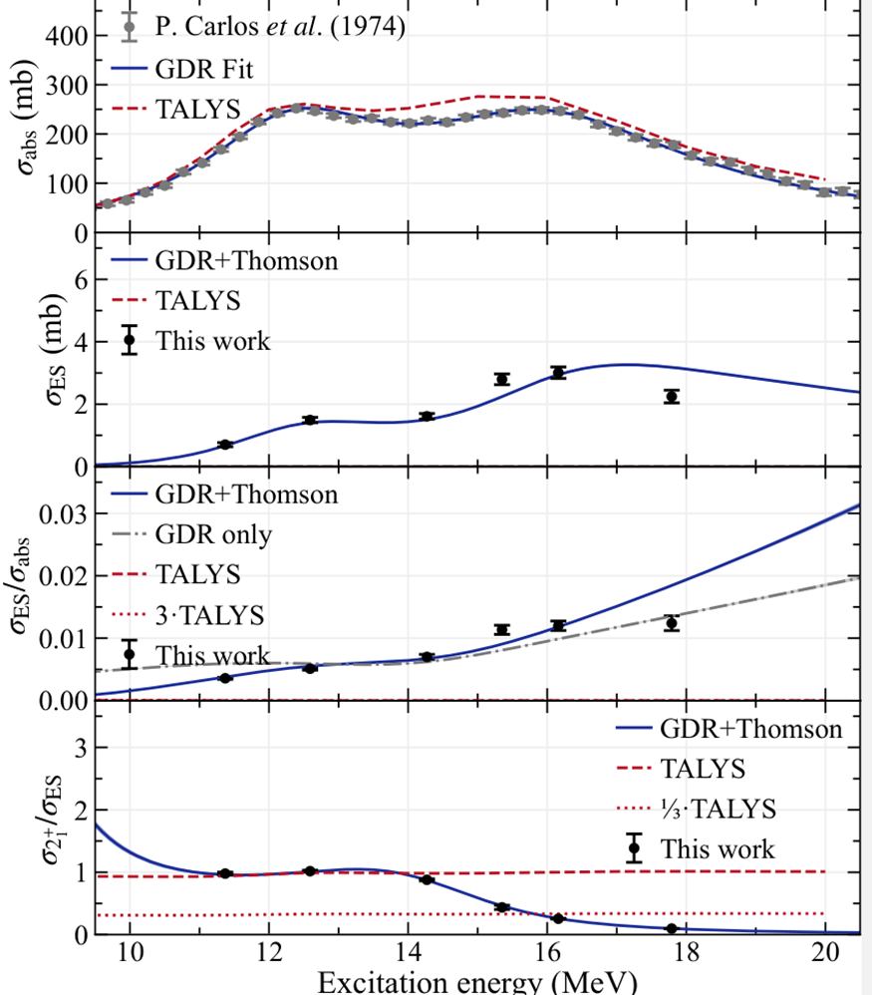
Conclusions
Similar observations on the deformed nucleus ¹⁵⁴Sm:
GDR decays by γ collectively to gs, and to the 2⁺₁, too.
Evolution of γ-branching ratio with energy is due to interferences of decays about 3 axes
Identical conclusions as for ¹⁴⁰Ce
γ-decay from compound is small.
Width of σ_{abs}(E) is the sum of the decay probabilities of the collective modes (“dephasing”) about the three different axes.
J.Kleemann, NP et al., PRL 134, 022503 (2025).
¹⁵⁴Sm

Slide 23
conclusion
Can the data be consistent with zillions of isolated states?
No! It only works when the individual 1⁻ states overlap and mix.
GDR modeled by few thousand equidistant equally-wide 1- states with widths Γ.
The elastic scattering data is recovered, only, if the spacing between the states is of the order of their widths or less.
The GDR is a single mode or a “coherent mixture of 1⁻ states”.
Many resonances
Expt.
E.g., 113 equidistant SLOs

Slide 24
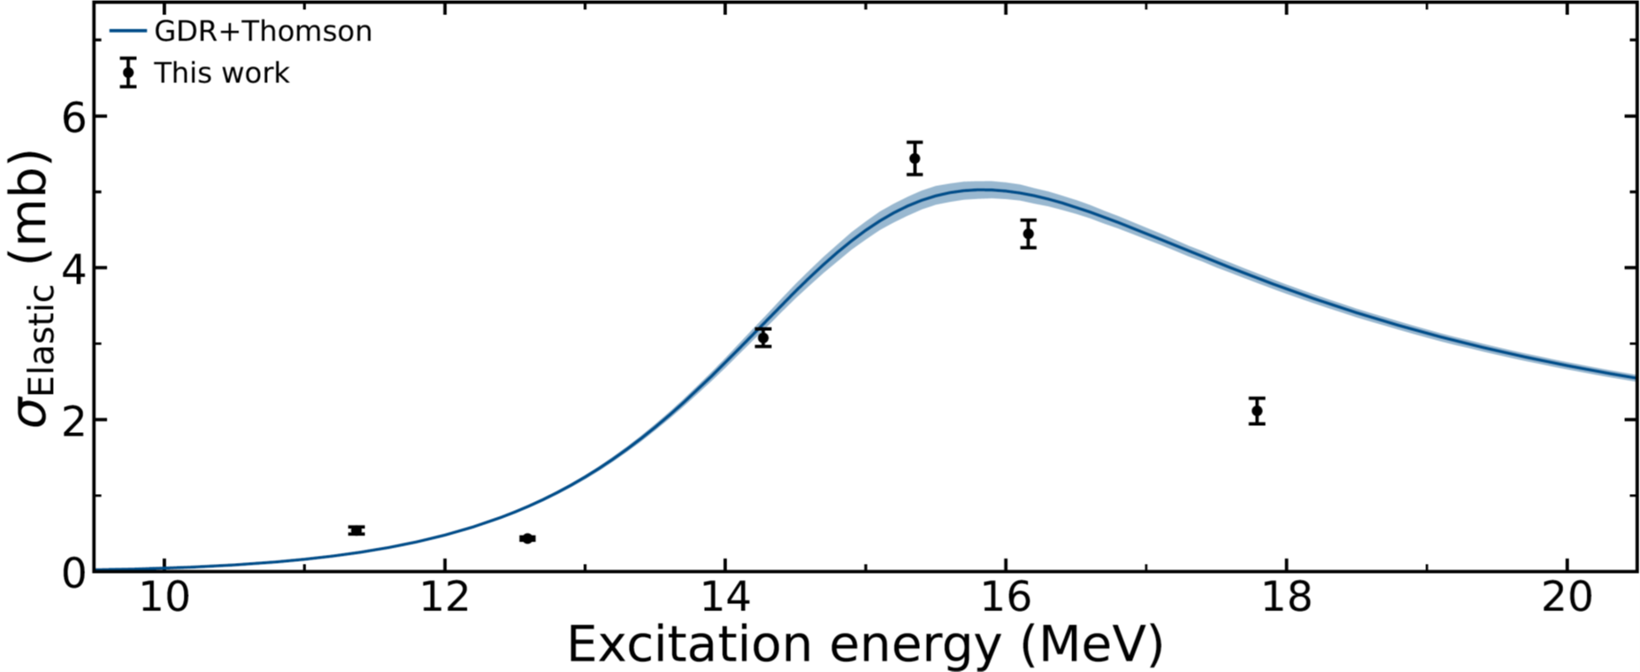

Summary
Observations:
The γ-to-neutron–decay branching ratio of the GDR amounts to about 1%.
It INCREASES with energy over the GDR.
The γ–decay of the GDR is not statistical. It reflects the collective mode.
The NRF cross section evolves over the GDR according to the collective mode.

Slide 25
Summary
Observations:
The γ-to-neutron–decay branching ratio of the GDR amounts to about 1%.
It INCREASES with energy over the GDR.
The γ–decay of the GDR is not statistical. It reflects the collective mode.
The NRF cross section evolves over the GDR according to the collective mode.
Conclusions:
The GDR decays by γ with its collective EM-widths. Γ_{γ0} = 55 keV.
Still, the GDR decays 90 times faster into chaotic compound states that decay statistically.
With internal decay width Γ = 4.7 MeV, corresponding to internal decay time of τ = 0.14 zs.
The GDR width IS its (internal!) decay width “decoherenization”, timescale τ ≈ 0.14 zs.
Conjecture:
The GDR (of heavy nuclei) cannot show any finestructure ! Because it decays too fast.
Nice color photos from the GDR!

Slide 26
photonuclear Education
Stipend 1,000 €/month
for 2 years for excellent female foreign master students.
Spread the word!
Thank you very much!

Slide 27
photonuclear experiment
More information

Slide 28
photonuclear experiment
More information

Slide 29
Representative photoabsorption data
Photofission on U, Baldwin, Klaiber (1947)
Photoneutron from Cu, Bothe, Gentner (1937)
“...cross section for photo-neutron production is about 5x10⁻²⁶ cm²...”
W.Bothe, W.Gentner, Z.Phys.106, 236 (1937).
“...and ν_{i}... corresponding to maximum resonance...”
N.Bohr, Nature 141, 326 (1938).

Slide 30
Representative photoabsorption data
All GDRs of heavy nuclei have a Lorentzian shape about 1, 2, or 3 axes.
Plujko, Gorbachenko et al., At. Data Nucl. Data Tab. (2018)
¹²⁰Sn
¹⁴⁰Ce
¹⁴⁴Sm
¹⁵²Sm
¹⁶⁸Er
²³⁸U

Slide 31
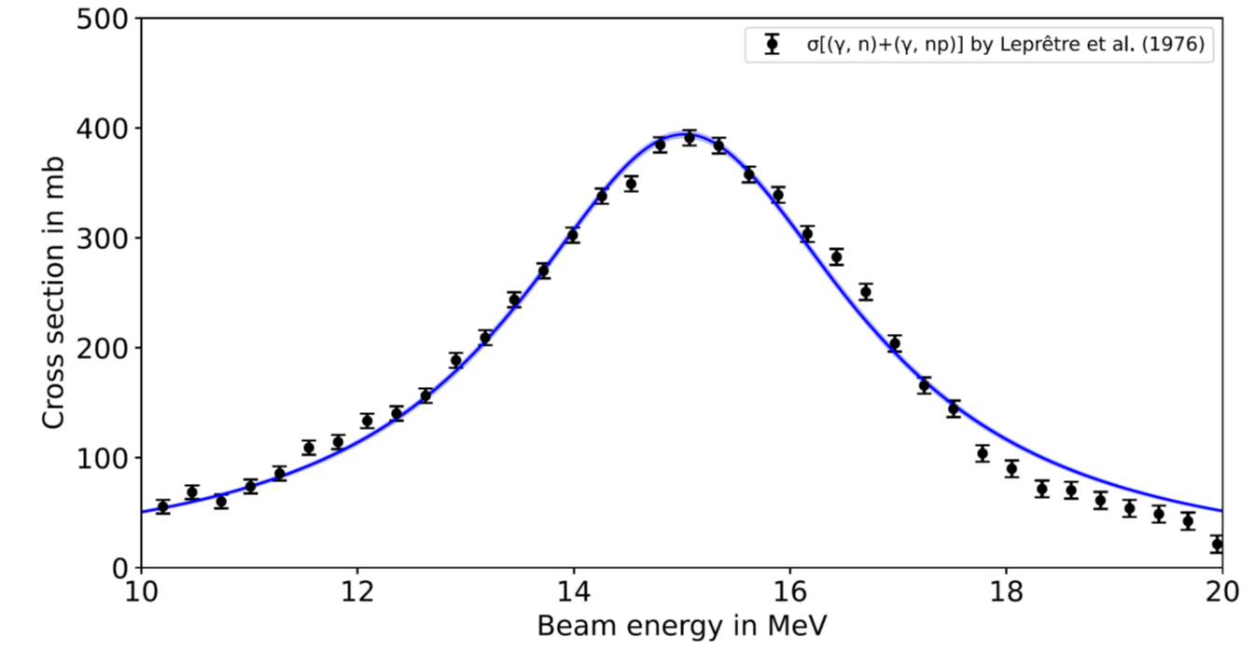
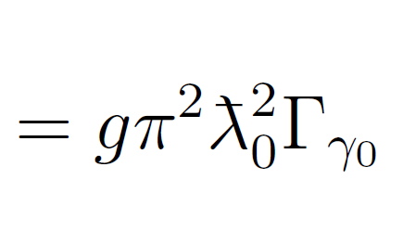
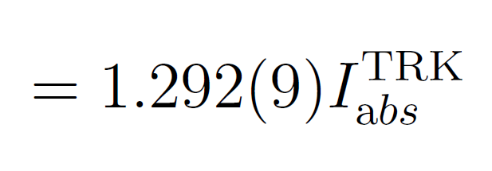
Formulation and interpretation of the GDR
E1 strength and E1 decay width
total width
E1 decay width to the gs
≈ 52 keV for ¹⁴⁰Ce
Thomas-Reiche-Kuhn sum rule

Slide 32
Formulation and interpretation of the GDR
Significance of widths for decay probabilities
Naive(?) expectations from the collective model
GDR lifetime:
γ-decay branching ratio:

Slide 33
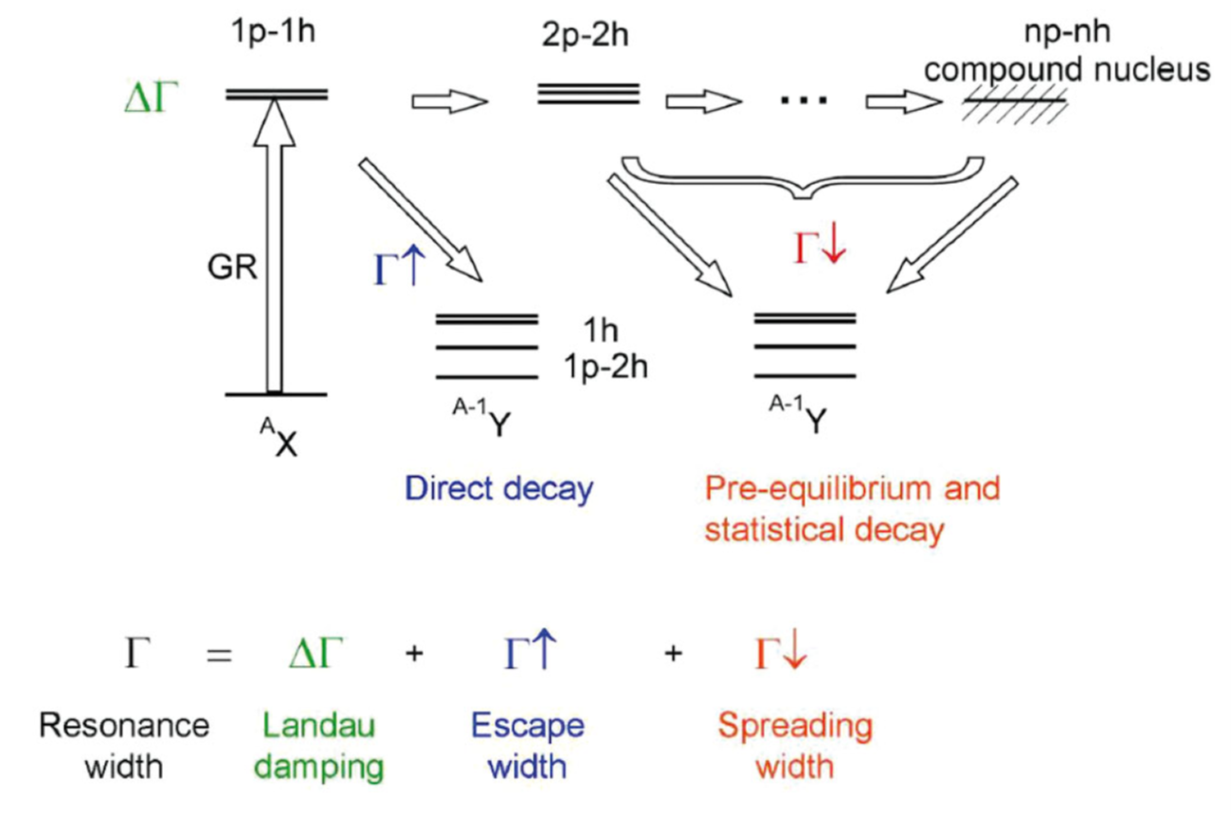
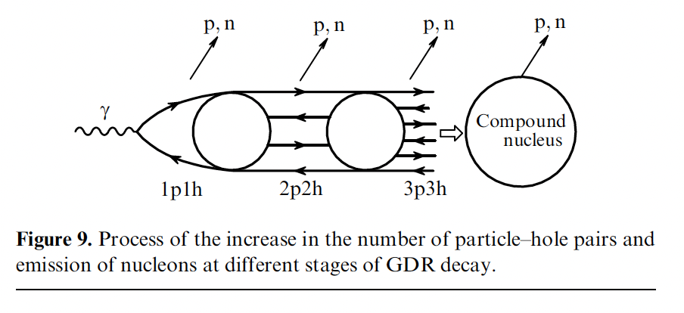
Formulation and interpretation of the GDR
Significance of widths for decay probabilities
“Brown-Bolsterli – process”
γ
γ
B.S. Ishkanov, I.M. Kapitonov, Physics – Uspekhi 64, (2) 141 (2021)
M.N. Harakeh & A. van der Woude, “Giant Resonances” (Oxford, 2001)
P. von Neumann-Cosel, A. Tamii, Eur. Phys. J. A 55, 110 (2019).

Slide 34
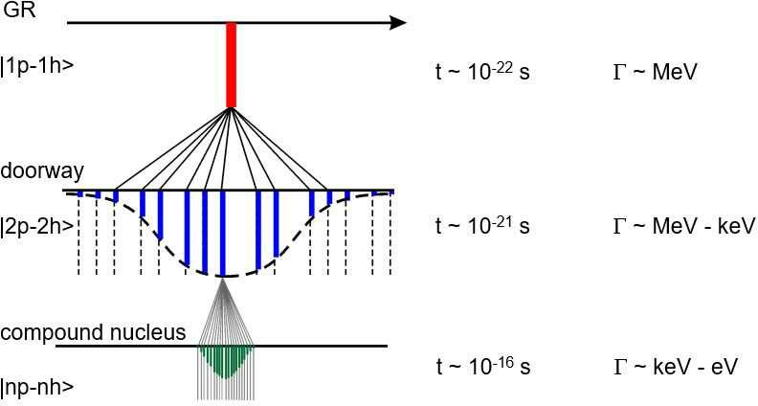
Formulation and interpretation of the GDR
Doorway concept and related time-scales
Γ
γ-decay probes this era
P. von Neumann-Cosel et al., Eur. Phys. J. A 55, 224 (2019)

Slide 35
Formulation and interpretation of the GDR
Naive(?) expectations from the microscopic model:
The GDR decay time is much longer than its inverse width.
The (γ,γ’)/(γ,n) – branching ratio of the GDR is miniscule.
It will decrease with energy over the GDR.

Slide 36
photonuclear experiment
Elastic scattering on GDR: Imginary and real parts of squared amplitude for ¹⁴⁰Ce

Slide 37
photonuclear experiment
Elastic scattering on GDR is sensitive to “high-energy photon absorption”: ¹⁴⁰Ce

Slide 38
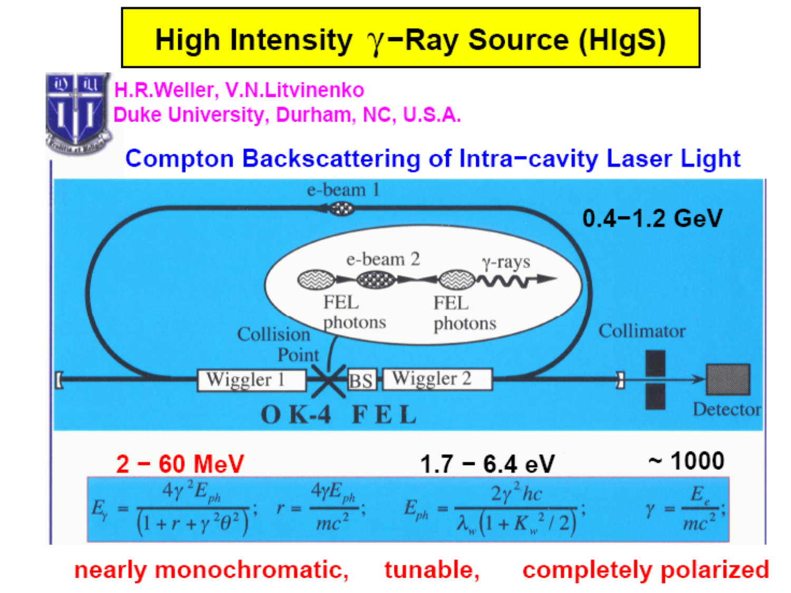
Overview on MeV-rangeD Gamma-ray sources – Laser-Compton Backscattering (LCB)
historic transparency
V.Litvinenko, ~ 2000
at the time with
OK-4
from Novosibirsk

Slide 39
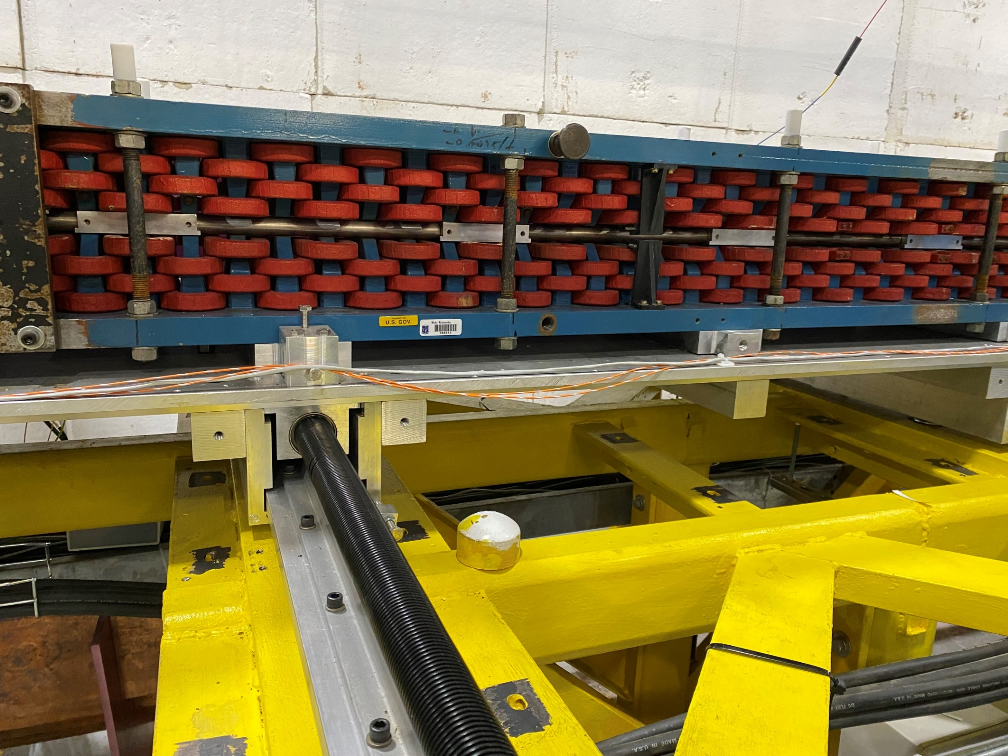
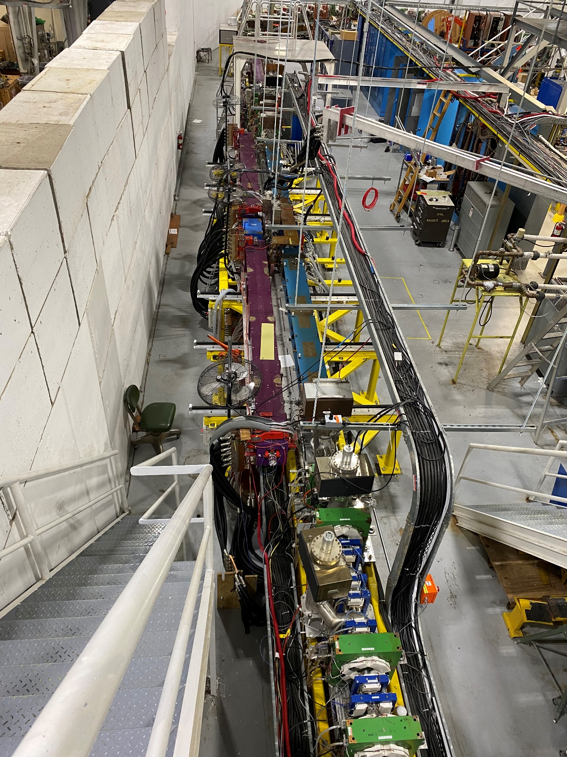
High intensity Gamma-ray source @ TUNL
photos from Sept. 2023
OK-5: this is a lamp!

Slide 40
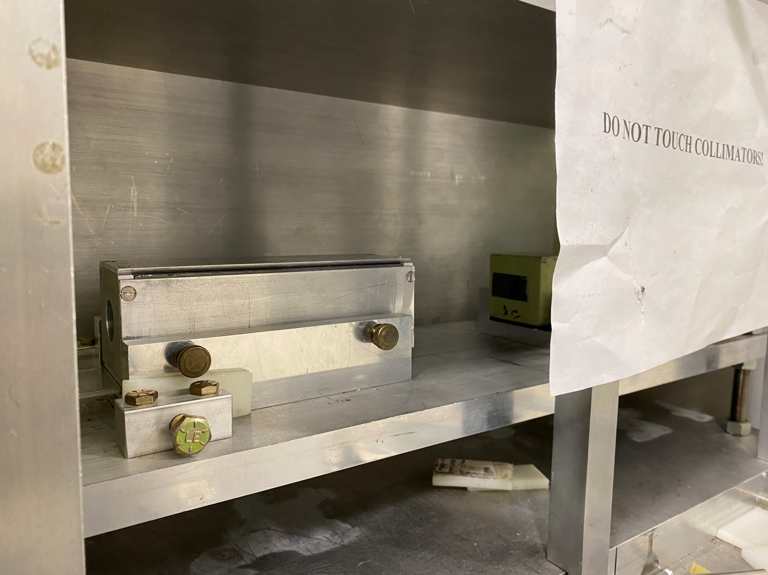
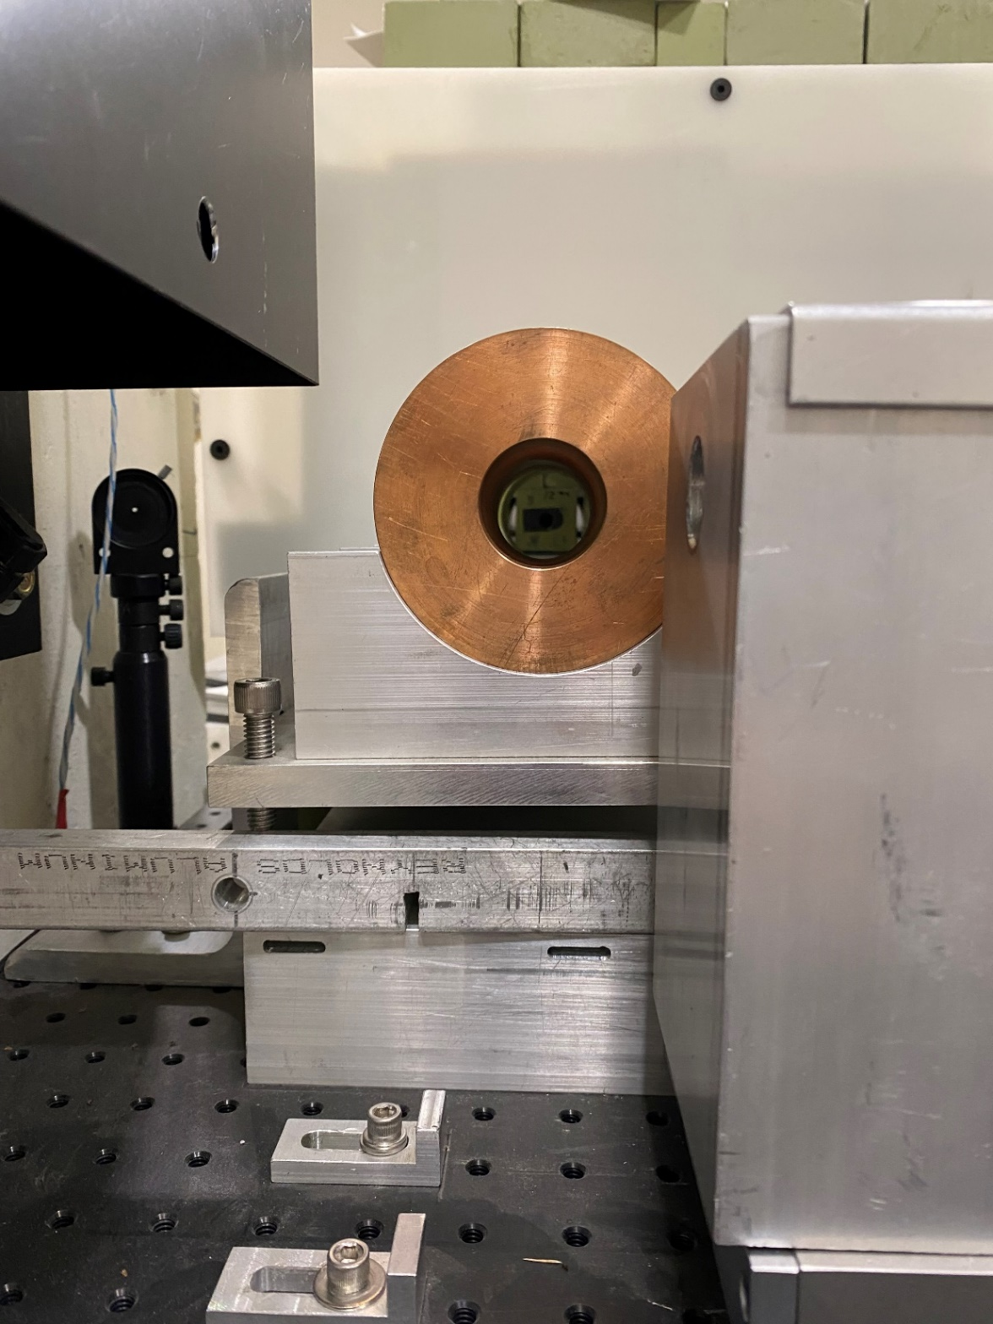
High intensity Gamma-ray source @ TUNL
collimators

Slide 41
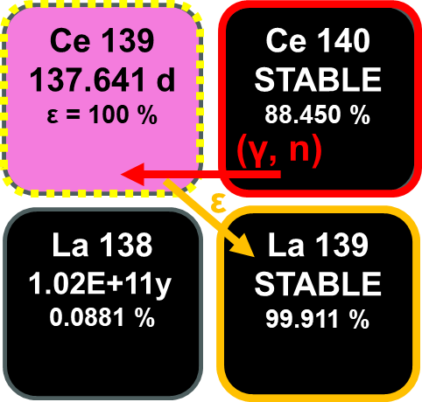

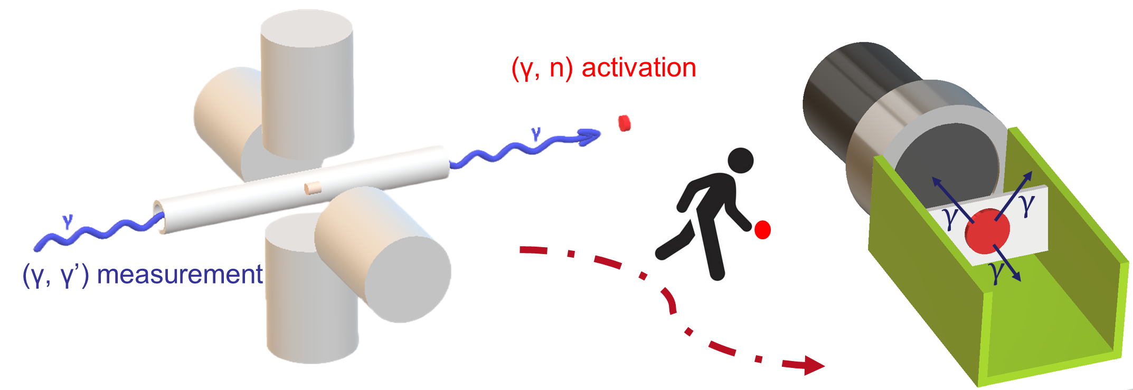
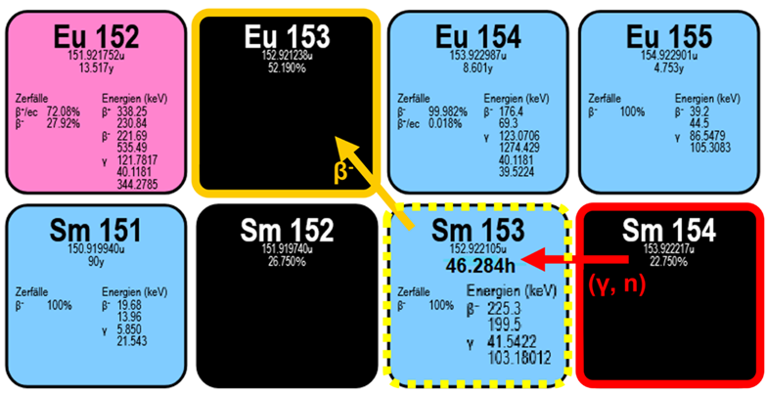
photonuclear experiment: photon-flux calibration
Photon fliux calibration and verification of cross sections
for ¹⁴⁰Ce and ¹⁵⁴Sm
Au + Ce/Sm
Kiriaki Prifti

Slide 42

photonuclear experiment: photon-flux calibration
Photon flux calibration and verification of cross sections for ¹⁴⁰Ce and ¹⁵⁴Sm
Activation targets used:
Samarium oxide (Sm₂O₃) + Gold (Au)
Cerium oxide (CeO₂) + Gold (Au)

Slide 43


photonuclear experiment: photon-flux calibration
Photon fliux calibration and verification of cross sections for ¹⁴⁰Ce and ¹⁵⁴Sm
Consistency check: our photon flux calibration is accurate
Kiriaki
Prifti

Slide 44








Exciting the GDR using a linearly polarized beam
$$0_{1}^{+}→1_{GDR}^{−}→0_{1}^{+}$$
$$0_{1}^{+}→1_{GDR}^{−}→2_{1}^{+}$$
$$+\frac{Γ_{2_{1}^{+}}}{Γ_{0_{1}^{+}}}×$$
$$\left(\frac{Γ_{2_{1}^{+}}}{Γ_{0_{1}^{+}}}\right)$$
$$=$$
N. Pietralla et al.,
Phys. Rev. Lett. 88, 012502 (2001)

Slide 45




¹⁵⁴Sm in 16.2 MeV linearly polarized gamma-beam
¹⁵⁴Sm(γ,γ’)@HIγS
E_{γ}=16.2 MeV
$$\frac{Γ_{2_{1}^{+}}}{Γ_{0_{1}^{+}}}=0.252(4)$$

Slide 46




¹⁵⁴Sm in 12.6 MeV linearly polarized gamma-beam
¹⁵⁴Sm(γ,γ’)@HIγS
E_{γ}=12.6 MeV
$$\frac{Γ_{2_{1}^{+}}}{Γ_{0_{1}^{+}}}=1.011(15)$$

Slide 47




precision measurement of GDR properties
¹⁵⁴Sm
Integrated Absorption cross section
K=0: I_{a} = 0.99 MeV b
K=1: I_{a} = 1.72 MeV b
J. Kleemann, HK 52.3

Slide 48









Measurement points in the GDR of ¹⁵⁴Sm
J. Kleemann et al., to be subm. for publication
$$\frac{Γ_{2_{1}^{+}}}{Γ_{0_{1}^{+}}}=1.011(15)$$
$$\frac{Γ_{2_{1}^{+}}}{Γ_{0_{1}^{+}}}=0.252(4)$$
$$\frac{Γ_{2_{1}^{+}}}{Γ_{0_{1}^{+}}}=0.954(22)$$
$$\frac{Γ_{2_{1}^{+}}}{Γ_{0_{1}^{+}}}=0.091(3)$$
$$\frac{Γ_{2_{1}^{+}}}{Γ_{0_{1}^{+}}}=0.866(17)$$
$$\frac{Γ_{2_{1}^{+}}}{Γ_{0_{1}^{+}}}=0.44(3)$$

Slide 49

Results on gamma-decay behavior of GDR of ¹⁵⁴Sm
data by
J. Kleemann, HK 52.3

Slide 50



Results on gamma-decay behavior of GDR of ¹⁵⁴Sm

Slide 51




activation measurements for absolute gamma-ray scattering cross sections
activity from
¹⁴⁰Ce(γ,1n)¹³⁹Ce @ HIγS
activity from
¹⁵⁴Sm(γ,1n)¹⁵³Sm @ HIγS
initial photon flux from ¹⁹⁷Au(γ,1n)¹⁹⁶Au data from Fultz et al.

Slide 52

Experimental principle

Slide 53
Experimental principle

Slide 54

Photonuclear phenomena
¹⁵⁴Sm(γ,γ₀’)
[b]
Absolute NRF
cross section of
GDR obtained
from dispersion
relation
Excitation Energy (MeV)

Slide 55

Energy-dependence of NRF cross section of GDR
¹⁵⁴Sm(γ,γ₀’)
[b]
Absolute NRF
cross section of
GDR obtained
from dispersion
relation
data by
J. Kleemann, HK 52.3
J. Kleemann et al., to be subm. for publication
Excitation Energy (MeV)

Slide 56


Energy-dependence of cross section for raman scattering off GDR
J. Kleemann et al., to be subm. for publication
¹⁵⁴Sm(γ,γ₁’)
data by
J. Kleemann, HK 52.3

