Slide 1
Direct measurement of the ⁷Li(p,α)⁴He reaction at astrophysical energies using the ELISSA array
Haridas Pai
On behalf of ELISSA collaboration
haridas.pai@eli-np.ro
Extreme Light Infrastructure – Nuclear Physics,
IFIN-HH, 30 Reactorului Street, 077125,
Măgurele Romania
Notes:
I wish to thank the organizers for giving me the opportunity. I am going to talk about .

Slide 2


One of the proposed research topics at ELI-NP is nuclear astrophysics through the detection of charged particles from the photodissociation reactions using the gamma beam.
2
European Nuclear Physics Conference 2025, 21-26 September, Moho, France

Slide 3
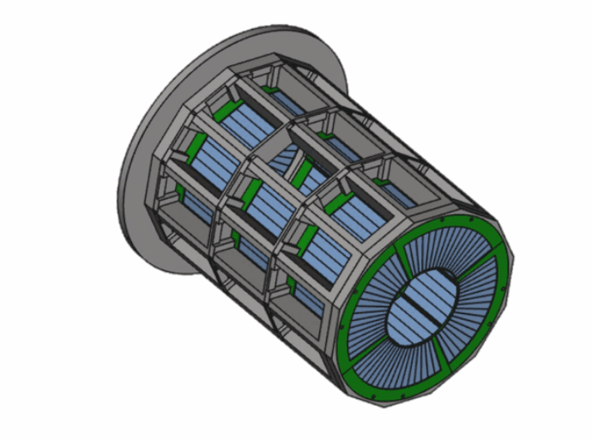
ELI-NP Silicon Strip Detectors Array (ELISSA)
ELISSA is a 4π silicon-strip detector array.
The array is expected to consist of three rings of 35 single-sided X3 detectors and two end-caps made up of eight double-sided QQQ3 detectors manufactured by Micron Semiconductor Ltd.
It has been designed in collaboration with INFN-LNS, Catania.
EPJ Web of Conferences 165, 01026 (2017)
Multiple configurations are possible with the YY1, MMM, and QQQ3 detectors as end-caps detectors.
3
European Nuclear Physics Conference 2025, 21-26 September, Moho, France

Slide 4
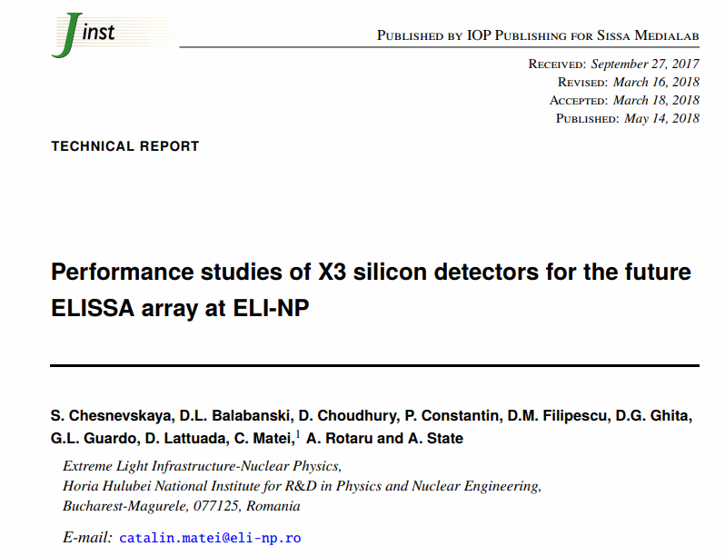
X3 detector
S. Chesnevskaya et al 2018 JINST 13 T05006
The X3 position-sensitive detectors (1000 μm thick) have four resistive strips, 1 cm wide and 7.5-cm long, on the front side. The rear side is non-resistive.
4
European Nuclear Physics Conference 2025, 21-26 September, Moho, France

Slide 5
Several reactions important for the astrophysical p-process, Big Bang Nucleosynthesis, and supernova explosion have been selected for measurement with ELISSA with gamma beams and also with locally available beams.
5
European Nuclear Physics Conference 2025, 21-26 September, Moho, France

Slide 6
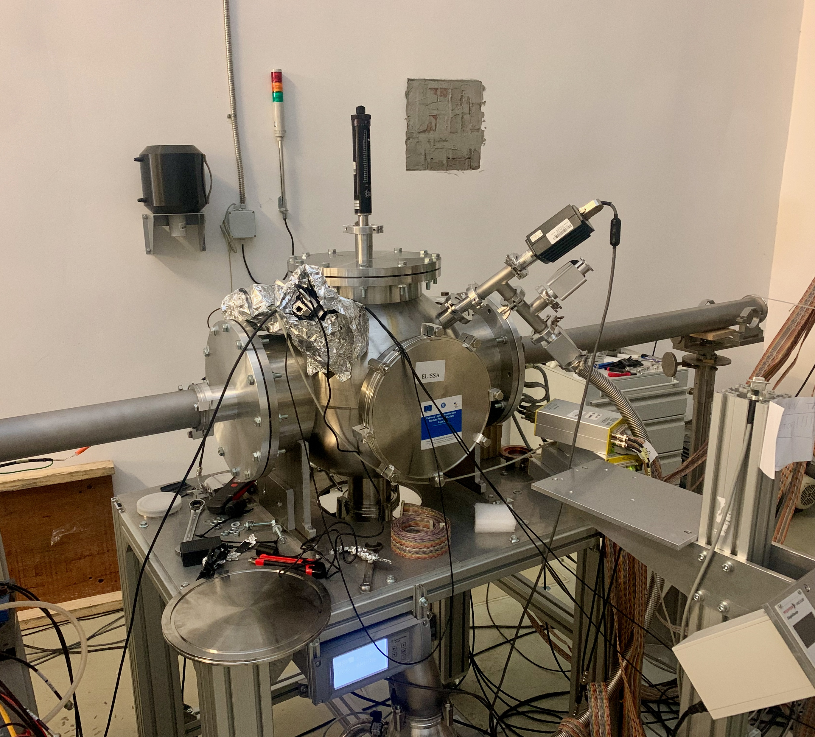
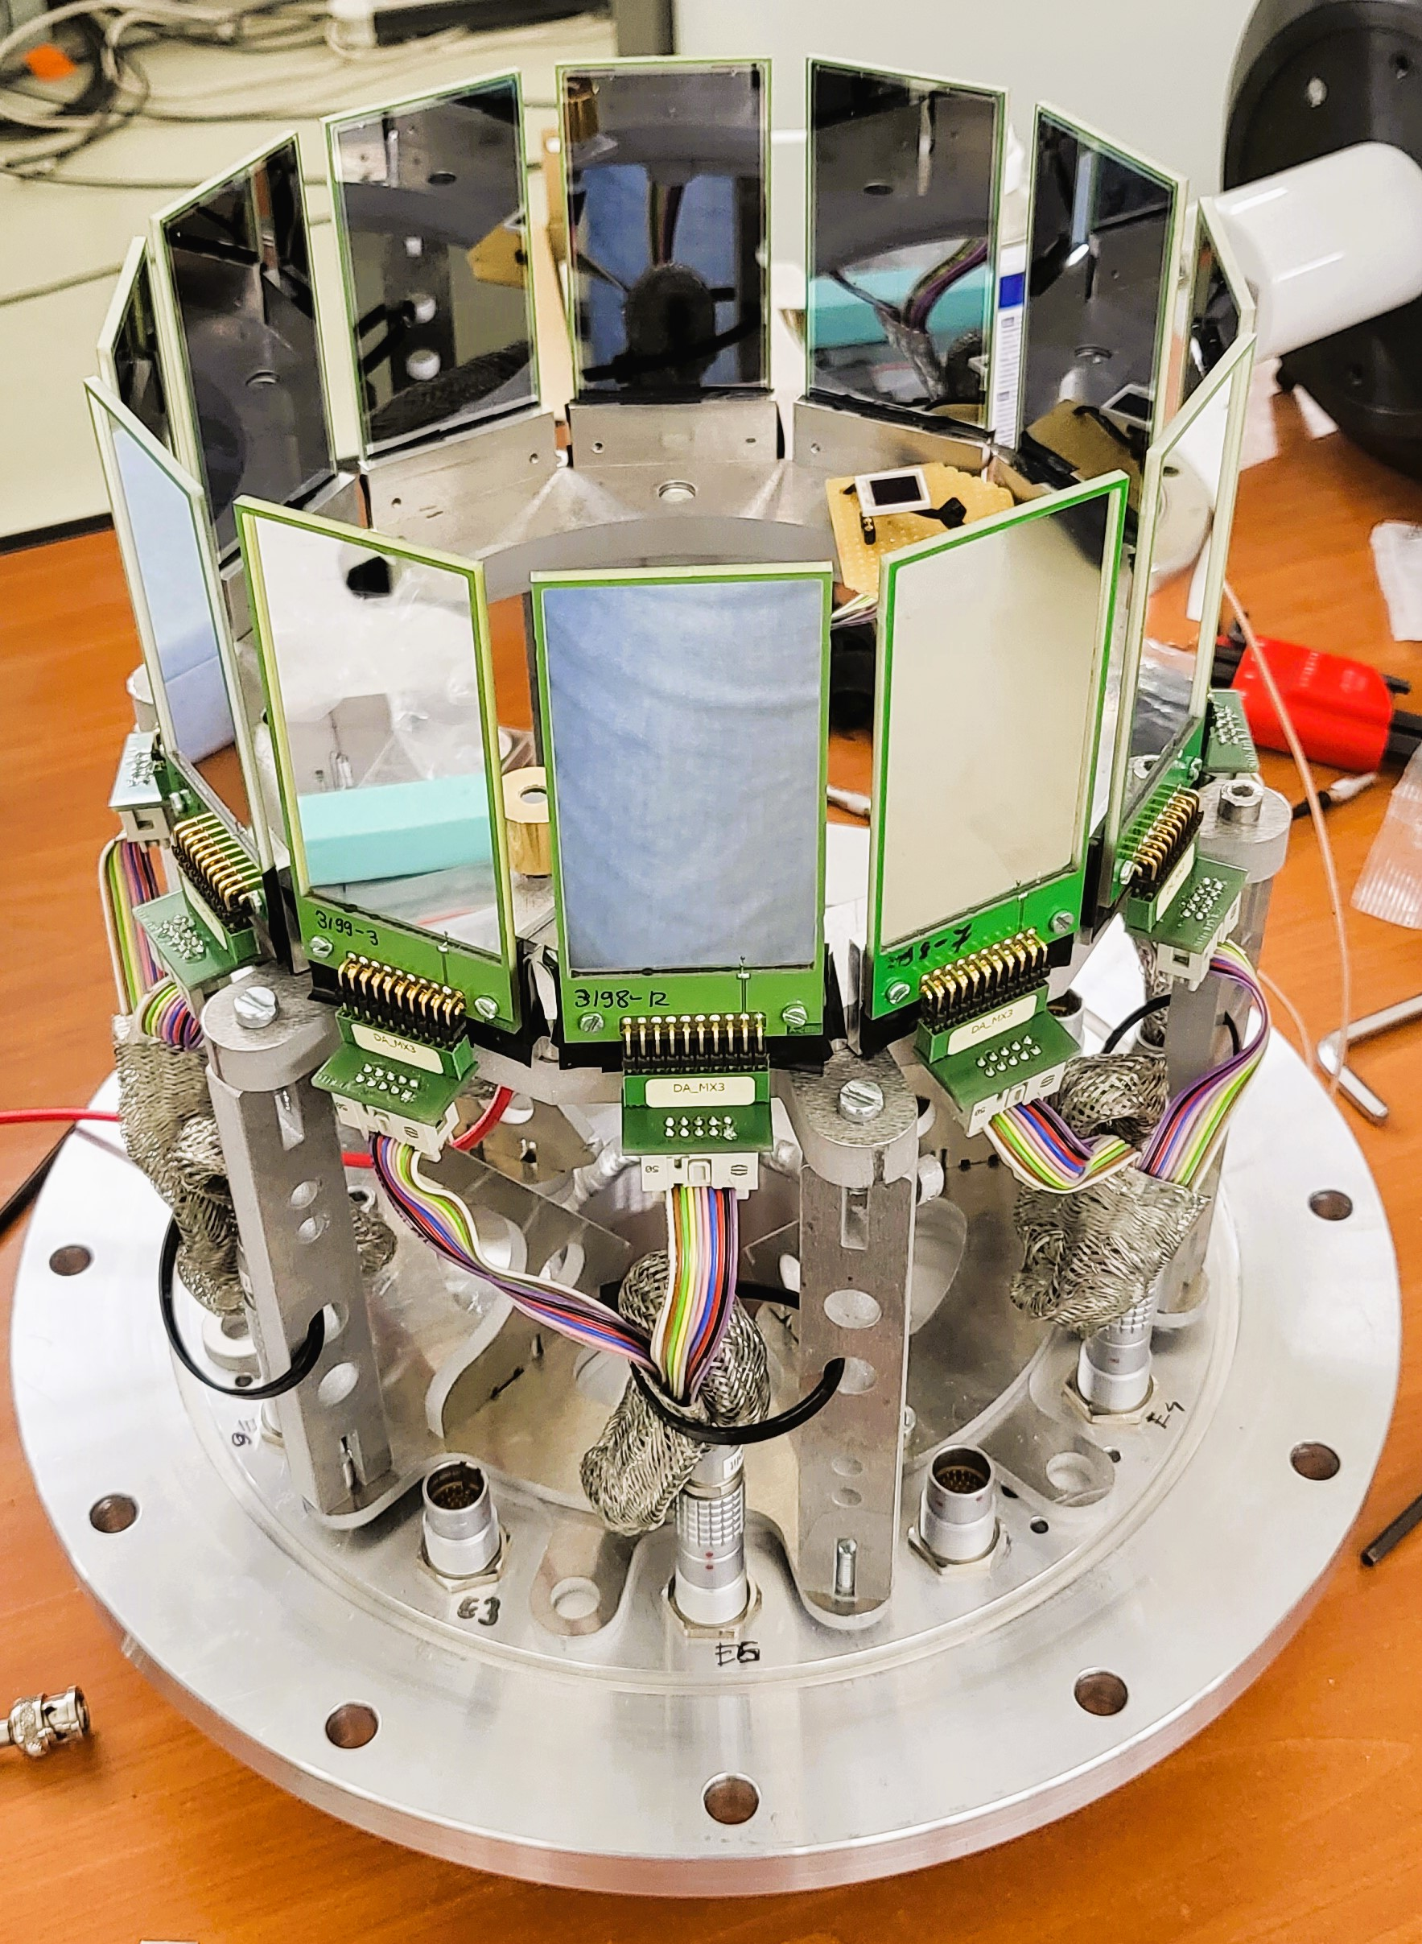
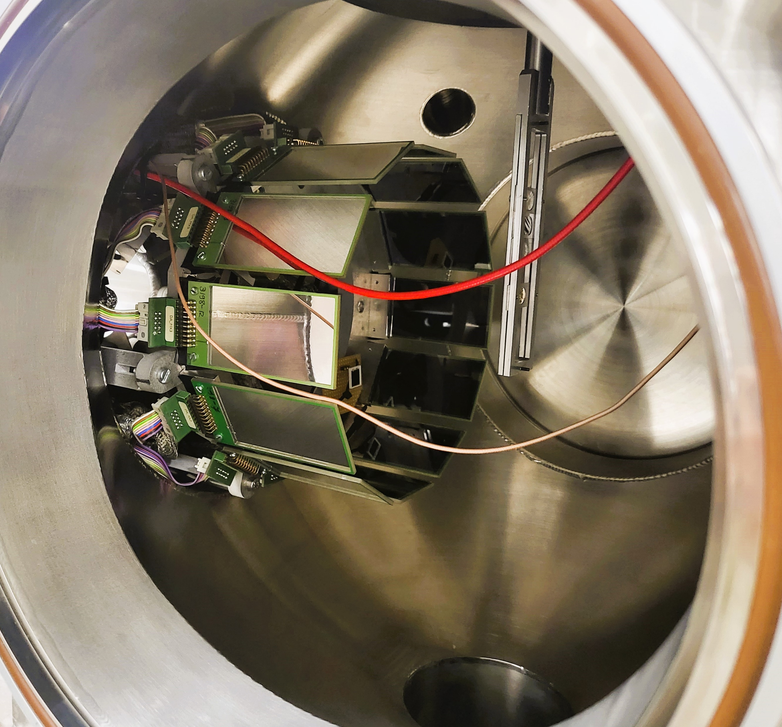
⁷Li(p, α)⁴He experiment at the IFIN-HH 3 MV Tandem
A scaled-down version of the ELISSA detector array in the mini-ELISSA chamber
A scaled-down version of the full ELISSA array (one ring).
mini-ELISSA chamber
6
European Nuclear Physics Conference 2025, 21-26 September, Moho, France

Slide 7
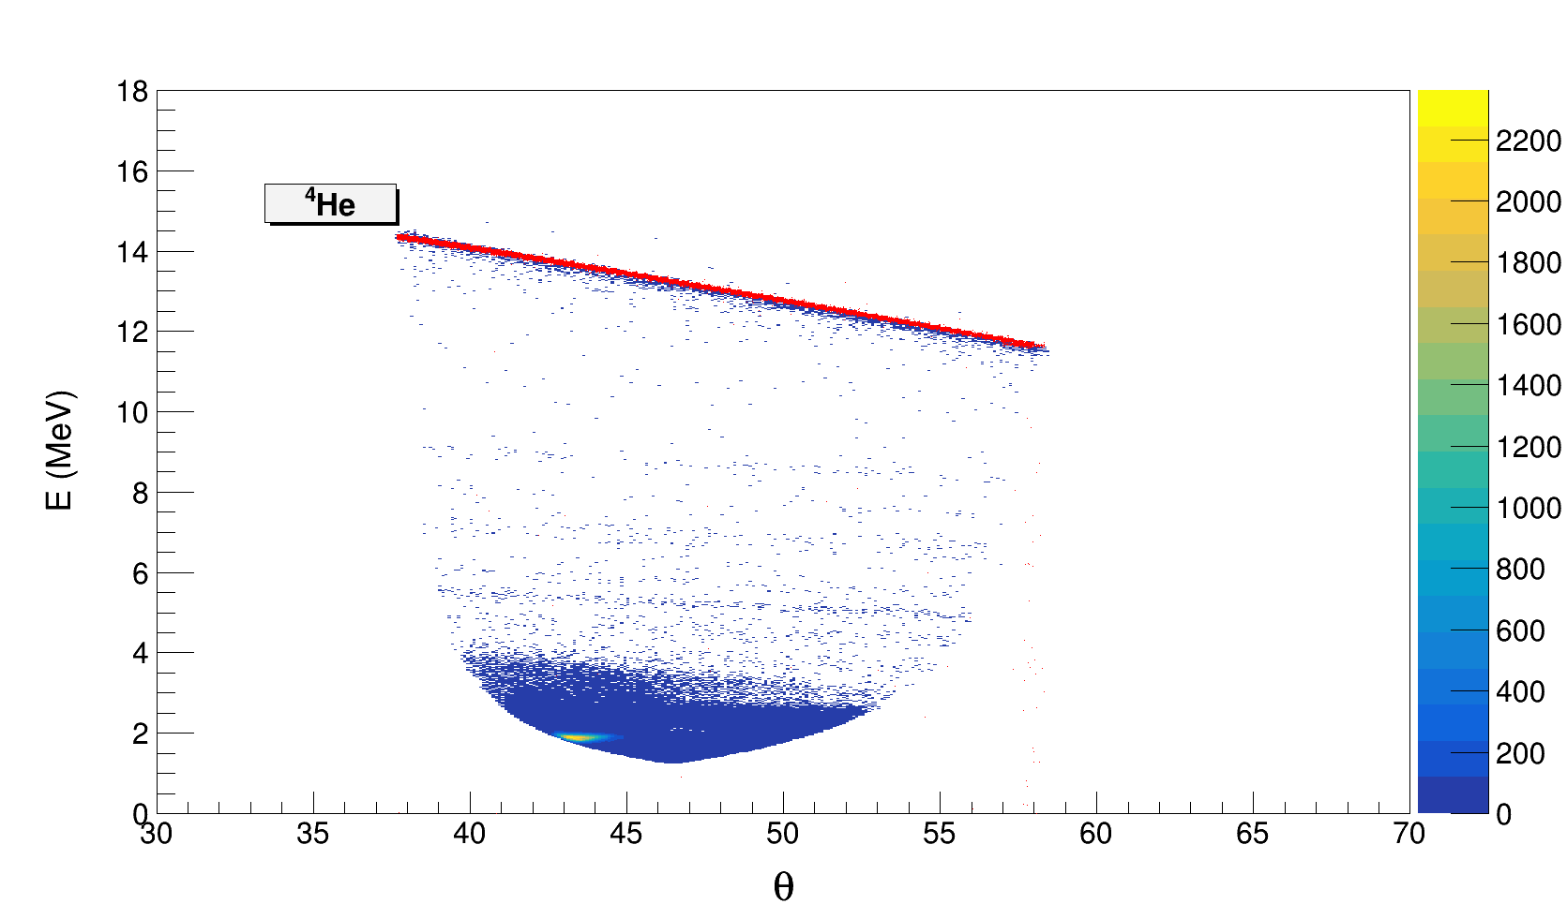
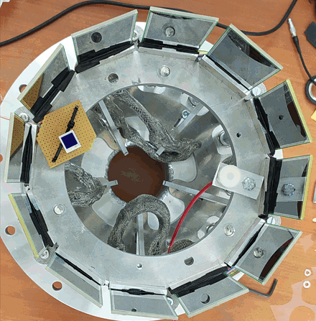
⁷Li(p, α)⁴He experiment at the IFIN-HH 3 MV Tandem
We have successfully measured the ⁷Li(p, α)⁴He reactions at 8, 7, 6, 5, 4, 3, 2, 0.9, 0.75, and 0.6 MeV (E_{lab}) energies.
12 X3 detectors from ELISSA
The X3 detectors are placed at a distance of ~ 6.0 cm from the target center. The diameter of the barrel is ∼ 19.54 cm.
Target: CH₂
Beam: ⁷Li
Beam Energy: 0.6 to 8 MeV
Comparison of E vs θ plot (Kinematic plot) of ⁷Li(p, α)⁴He reaction from Monte Carlo simulation code NPTool (red ) and experimental data (blue) for 3 MeV beam energy.
7
European Nuclear Physics Conference 2025, 21-26 September, Moho, France

Slide 8
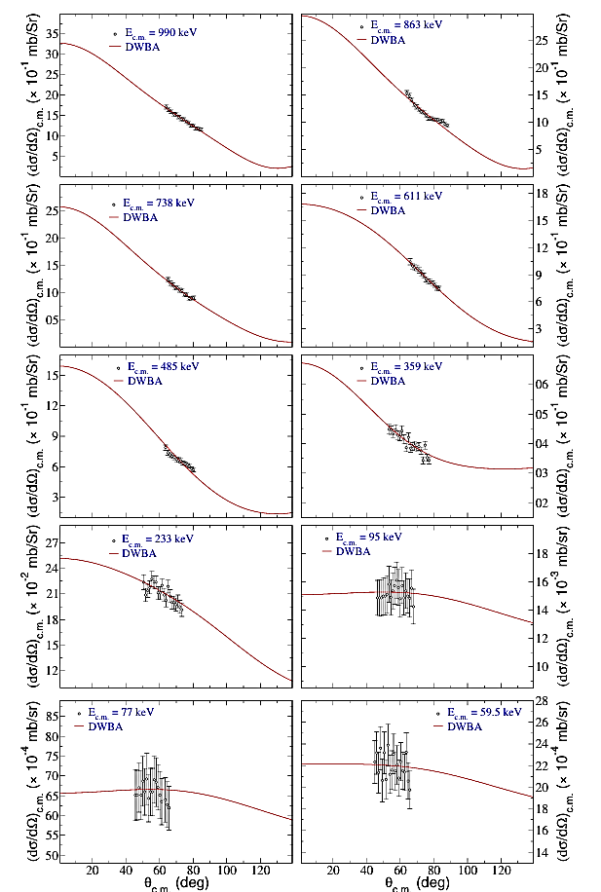
Differential cross sections for ⁷Li(p, α)⁴He and DWBA Calculations
Angular distributions for ⁷Li(p, α)⁴He at 990, 863, 738, 611, 485, 359, 233, 95, 77, and 59.5-keV energies (E_{c.m.}).
The solid curves are the DWBA results, and the black circles are the experimental data points from the present work.
8
European Nuclear Physics Conference 2025, 21-26 September, Moho, France

Slide 9
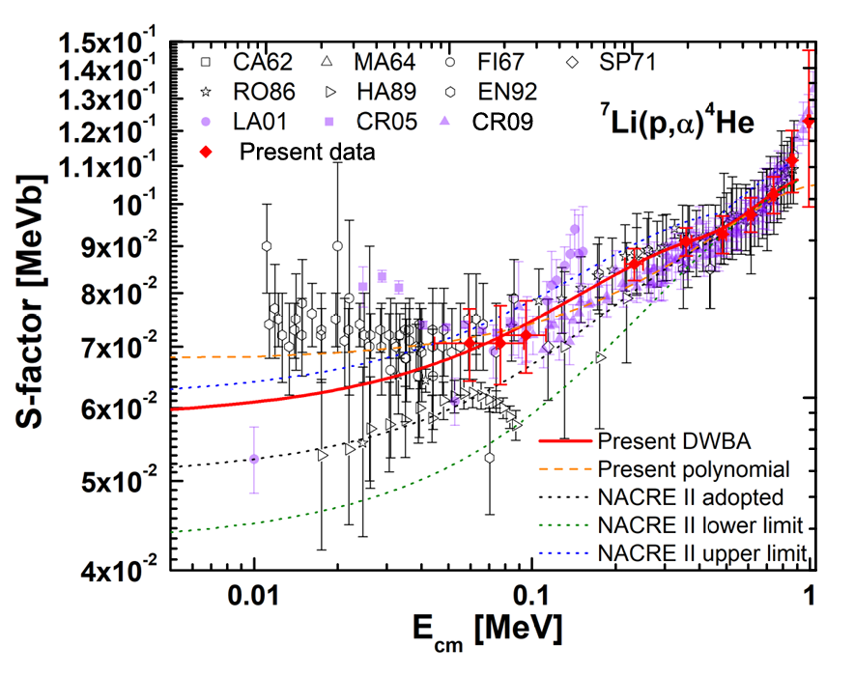
S-factor
In DWBA calculations, the zero-range approximation has been adopted (the interaction between the transferred particle and the core of the ejectile).
From the present DWBA and polynomial fits, S(0)= 59.8 keVb and 68.4 ± 4.9 keVb are obtained, respectively. The present DWBA value lies within the uncertainty bounds of the NACRE-II compilation.
PRELIMINARY RESULTS
A red diamond symbol shows the present data points. Other data points are taken from Y. Xu et al., Nuclear Physics A 918 (2013) 61–169. Horizontal errors originate from the uncertainty in energy loss at the target.
9
XVII. International Conference on Nuclear Structure Properties, 25-27 June 2025
Notes:
In DWBA calculations, a further DWBA fit on the total cross-sections (σtotal)
at nine energy points (59.5-keV t o863-keV) is performed.

Slide 10
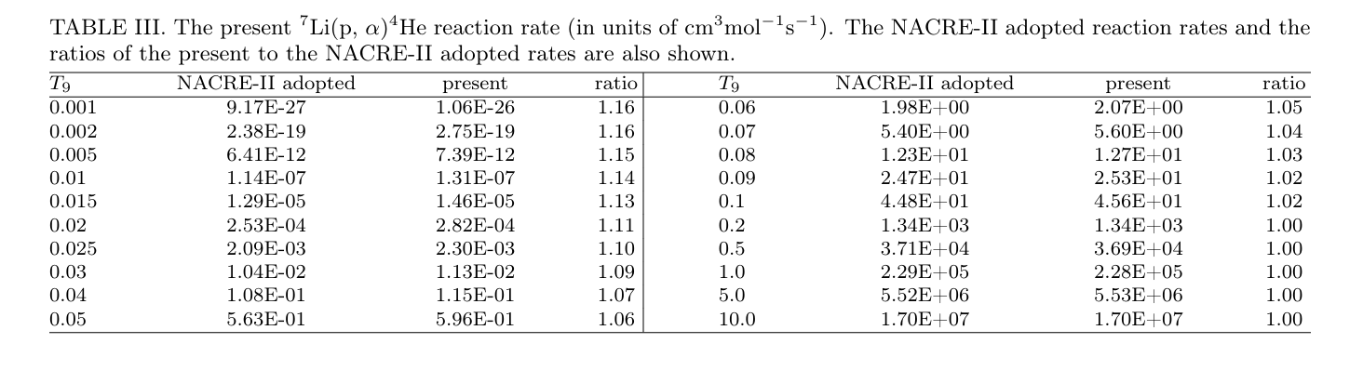
Reaction rates
The ⁷Li(p,α)⁴He reaction rates at 0.001≤T9≤10 are calculated using the present DWBA-predicted cross-sections and available experimental data [literature] below and above Ecm ≃0.9 MeV, respectively.
Below T9 = 0.1, the present reaction rates are found to be higher than the NACRE-II adopted results by a maximum factor of 1.16.
10
European Nuclear Physics Conference 2025, 21-26 September, Moho, France

Slide 11
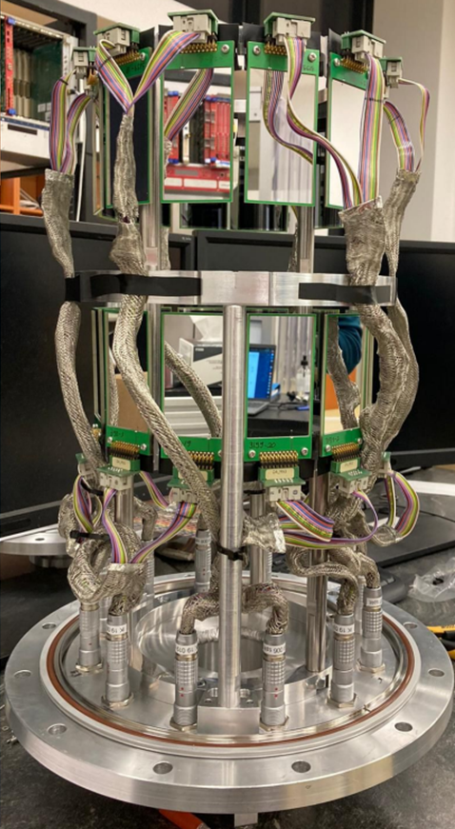
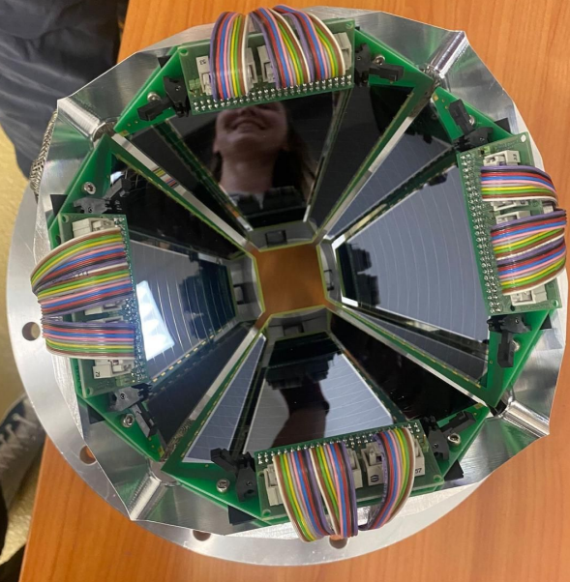
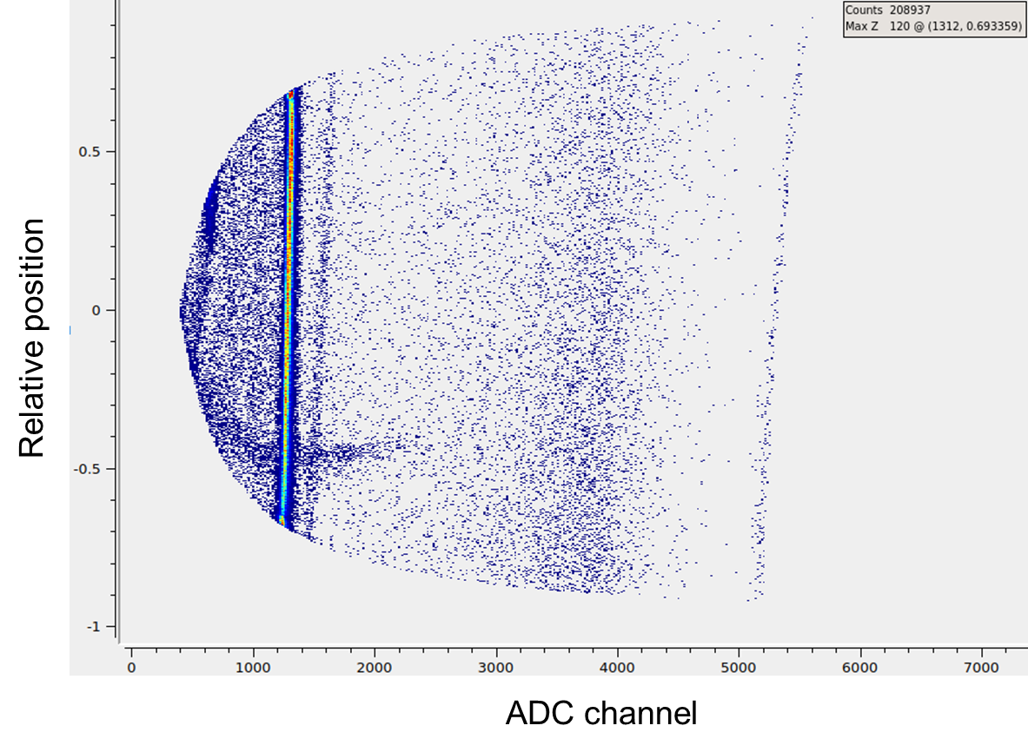

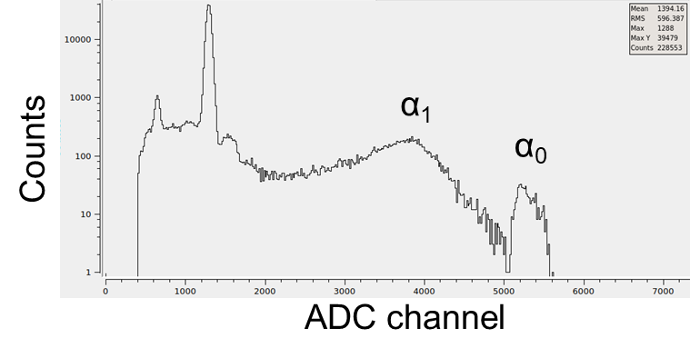
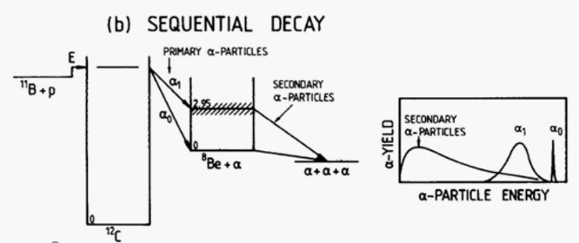
Recent measurements with ELISSA: ¹¹B(p,α)αα
α₀
Spokespersons: T. Petruse and L. Lamia
11
European Nuclear Physics Conference 2025, 21-26 September, Moho, France

Slide 12
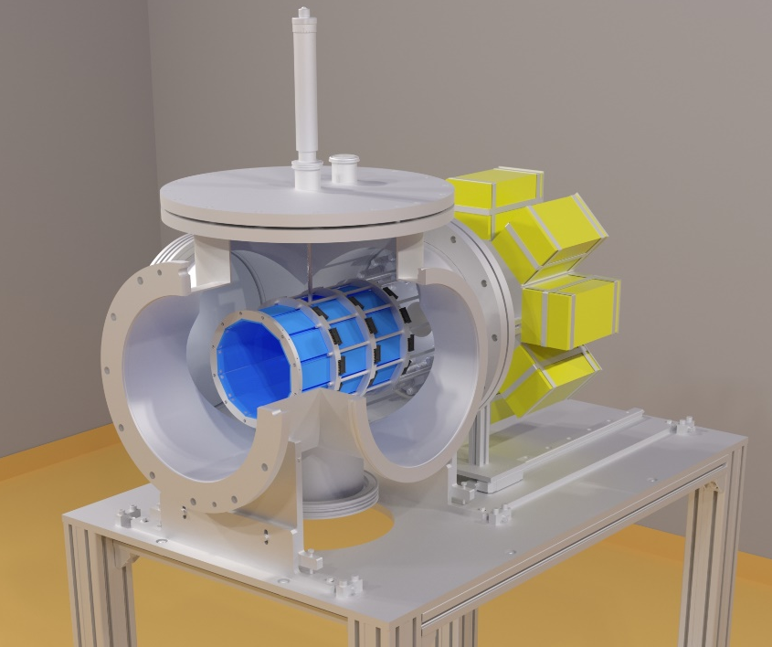
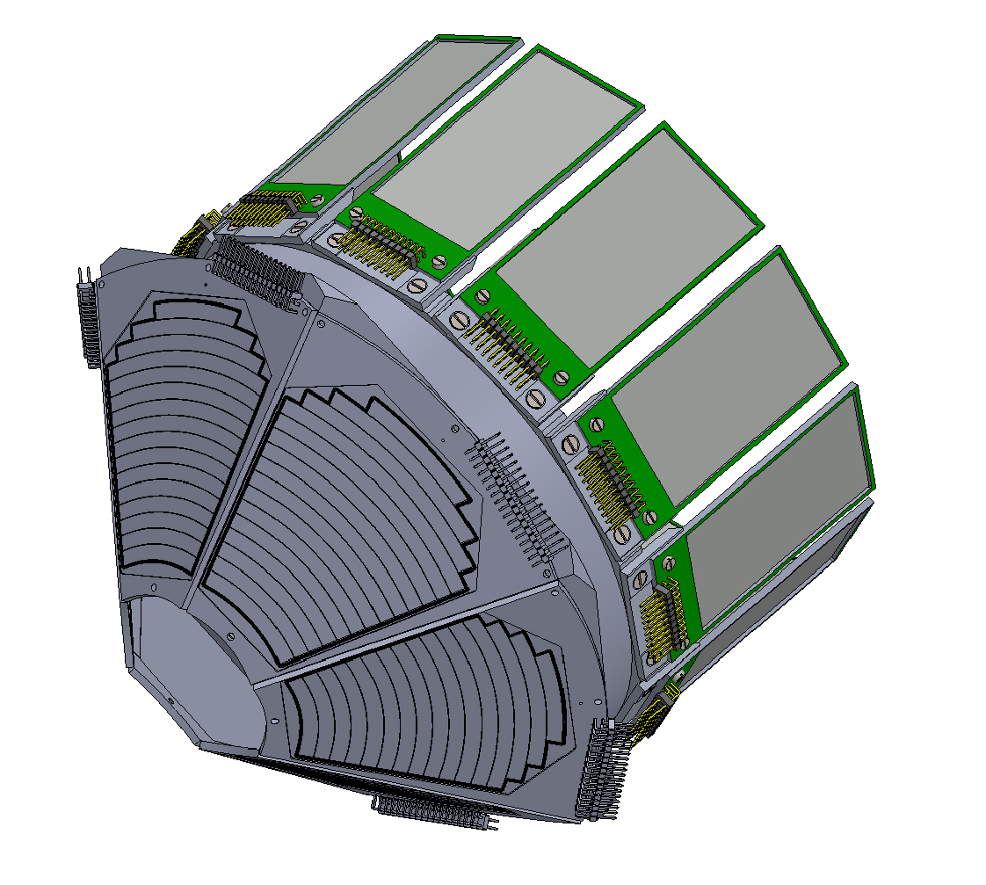
ELISSA – upgrade
ELISSA needs to upgrade to DN320 chamber as mini-ELISSA has limitations in detector configurations
Multiple configurations possible with the X3, YY1, MMM, and QQQ3 detectors
In this regard, the Monte Carlo simulation has been carried out with multiple configurations using the YY1, MMM, QQQ3, and X3 detectors both for gamma beam and ion beams.
YY1 and X3 configuration
12
European Nuclear Physics Conference 2025, 21-26 September, Moho, France

Slide 13
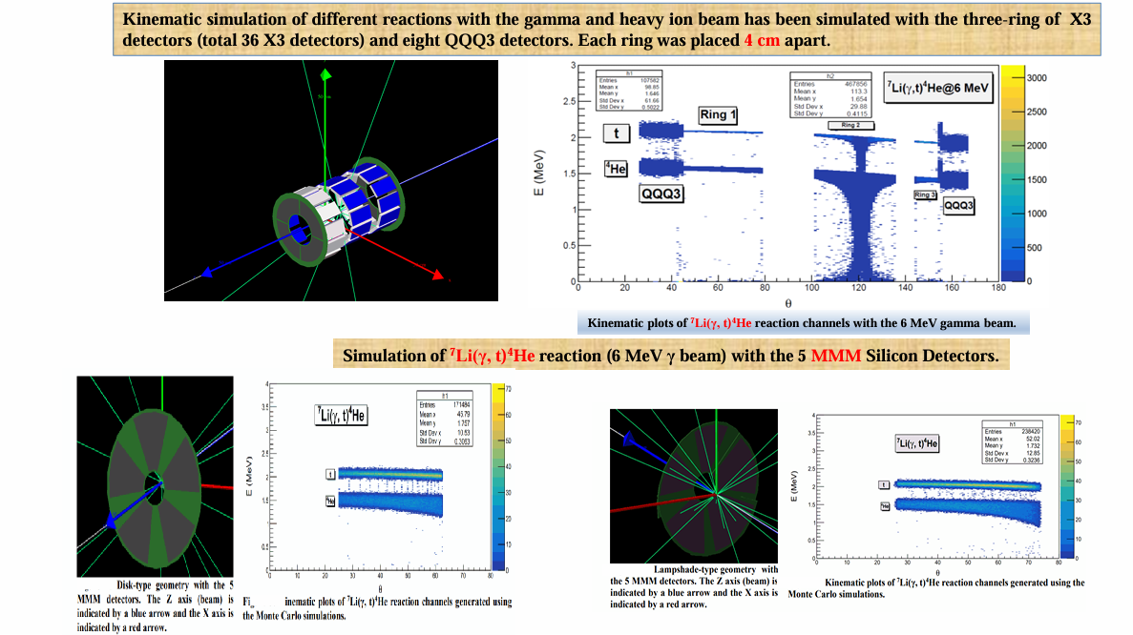
Simulation of ELISSA using the Monte Carlo simulation code NPTool
13
European Nuclear Physics Conference 2025, 21-26 September, Moho, France

Slide 14
Experiment at HIγS, Duke University, USA
14
European Nuclear Physics Conference 2025, 21-26 September, Moho, France

Slide 15
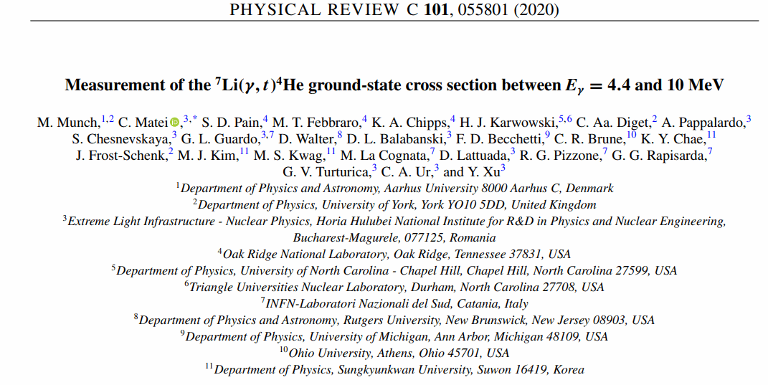
⁷Li(γ, t)⁴He reaction is important for the “Cosmological Li problem”.
The new experiment was carried out from 6th April 2023 to 12th April 2023 using a monoenergetic γ - beam with energies between 3.7 - 6 MeV.
15
European Nuclear Physics Conference 2025, 21-26 September, Moho, France

Slide 16

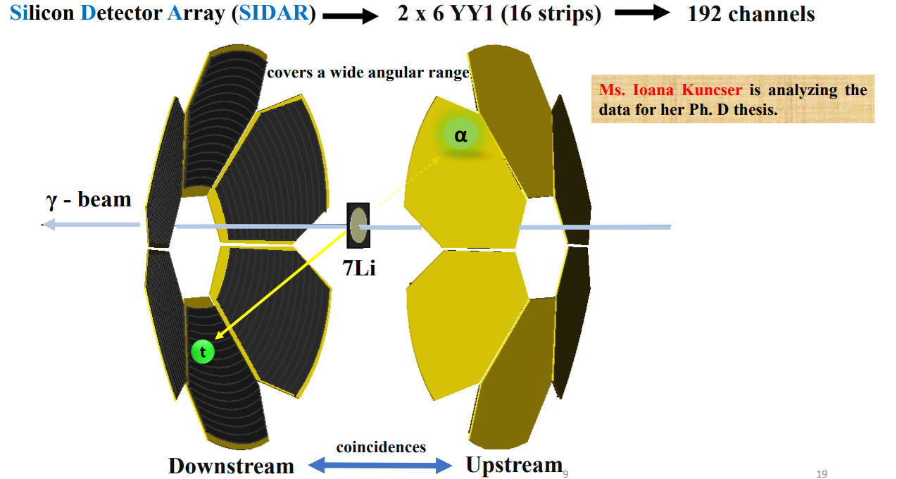
192 channels
16
European Nuclear Physics Conference 2025, 21-26 September, Moho, France

Slide 17
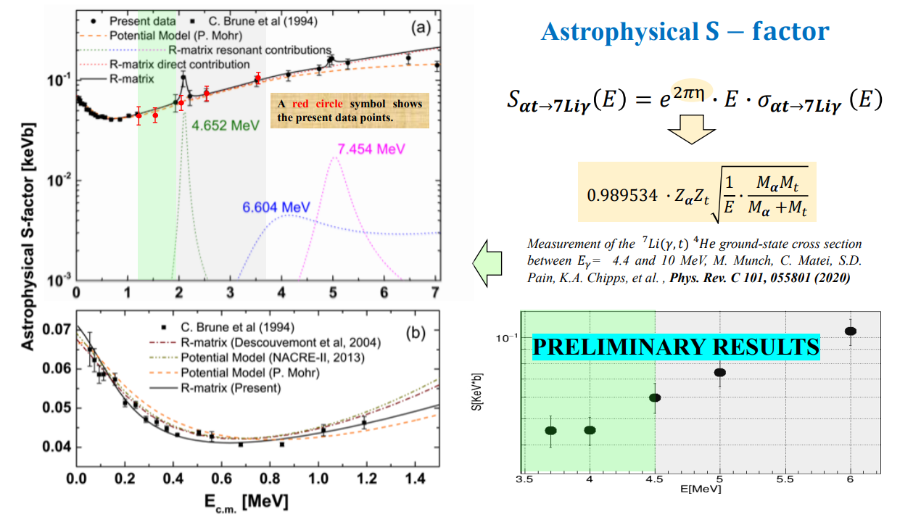
17
European Nuclear Physics Conference 2025, 21-26 September, Moho, France

Slide 18
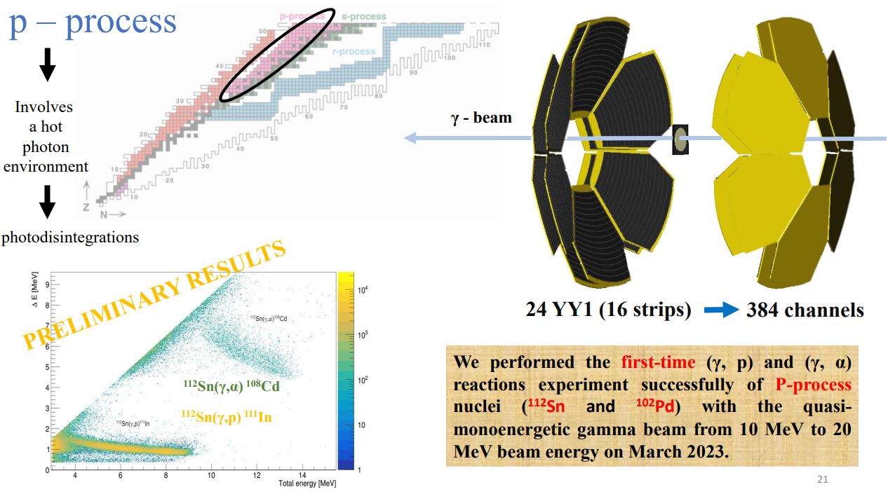
18
European Nuclear Physics Conference 2025, 21-26 September, Moho, France

Slide 19
CONCLUSIONS…..
The ⁷Li(p, α)⁴He experiment was successfully carried out at the IFIN-HH 3 MV Tandem using the mini-ELISSA.
From the present DWBA and polynomial fits, S(0)= 59.8 keVb and 68.4 ± 4.9 keVb are obtained, respectively. The present DWBA value lies within the uncertainty bounds of the NACRE-II compilation.
The ⁷Li(p,α)⁴He reaction rates at 0.001≤T9≤10 are calculated using the present DWBA-predicted cross-sections and available experimental data [literature] below and above Ecm ≃0.9 MeV, respectively.
Below T9 = 0.1, the present reaction rates are found to be higher than the NACRE-II adopted results by a maximum factor of 1.16
The new experiment of ⁷Li(γ, t)⁴He reaction has been carried out recently using quasi-monoenergetic γ - beam with energies between 3.7 - 6 MeV at HIγS, Duke University, USA.
We performed the first-time (γ, p) and (γ, α) reactions experiment successfully of P-process nuclei (¹¹²Sn and ¹⁰²Pd) with the quasi-monoenergetic gamma beam at HIγS, Duke University, USA on March 2023.
19
European Nuclear Physics Conference 2025, 21-26 September, Moho, France

Slide 20
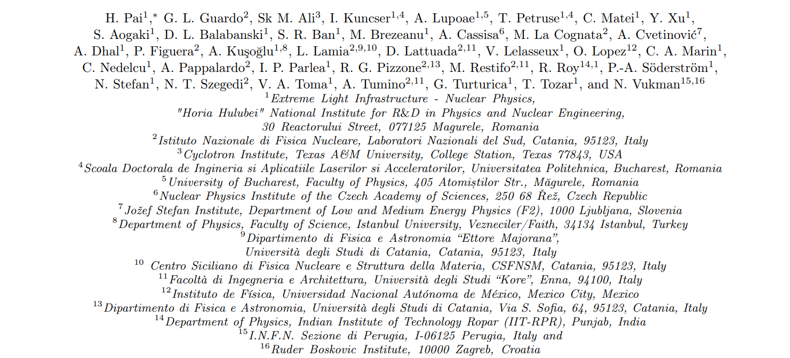
Collaborator for ⁷Li(p, α)⁴He experiment
20
European Nuclear Physics Conference 2025, 21-26 September, Moho, France

Slide 21
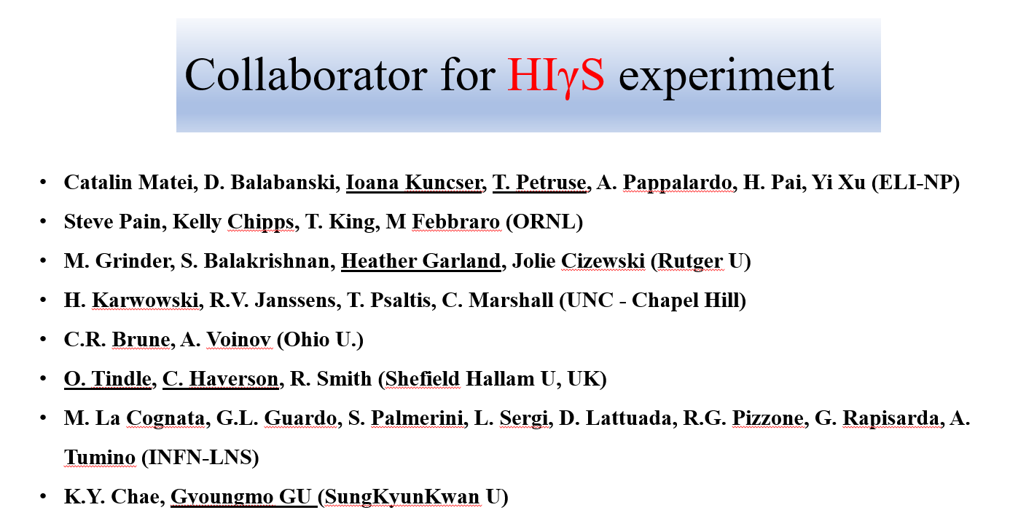
21
European Nuclear Physics Conference 2025, 21-26 September, Moho, France

Slide 22

ELISSA TEAM
I. Kuncser, A. Lupoae, T. Petruse, C. Matei, H. Pai, Yi Xu, D. L. Balabanski.
Acknowledgement : This work was supported by a grant of the Ministry of Research, Innovation and Digitization, CNCS - UEFISCDI, project number PN-IV-P2-2.1-TE-2023-0144, within PNCDI IV. Partial support was received under contract PN 23 21 01 06, also sponsored by the Romanian Ministry of Research, Innovation and Digitalization, as well as from the European Union's Horizon Europe Research and Innovation Programme under Grant Agreement No. 101057511 (EURO-LABS).
22
European Nuclear Physics Conference 2025, 21-26 September, Moho, France

Slide 23
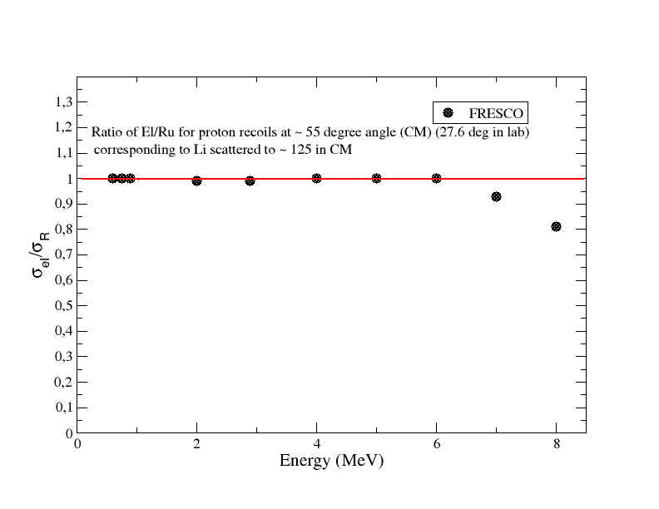
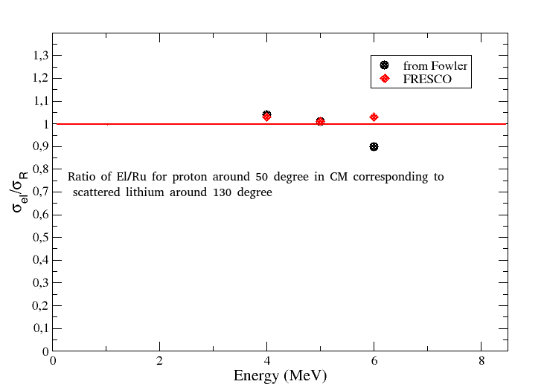
23
European Nuclear Physics Conference 2025, 21-26 September, Moho, France

