Slide 1


Elastic α-scattering with exotic nuclei: pushing forward on p-process understanding
European Nuclear Physics Conference
Monday, 22nd September 2025
Francisco G. Barba

Slide 2
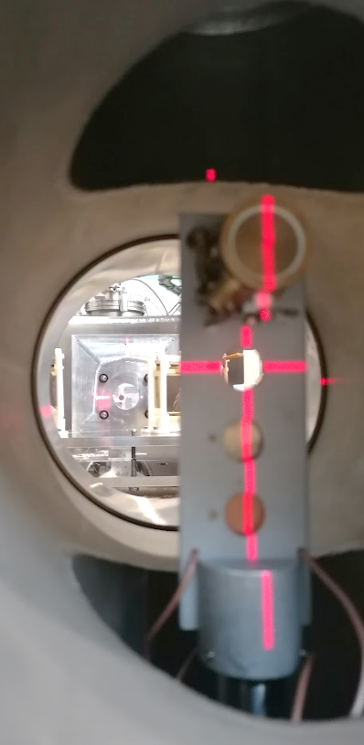
Outline
What is the p-process?
Why perform elastic scattering?
Setup and benchmark of technique
Status of ⁴He(^{A}Sn,⁴He)^{A}Sn analysis with exotic Sn

Slide 3
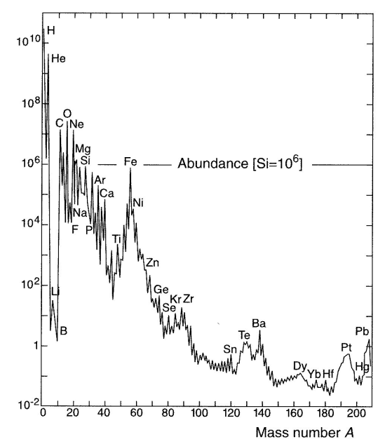

Motivation
Solar Abundance Distribution (SAD)
Bulk of elements:
BBN
Fusion phase
Heavy elements:
Neutron capture processes

Slide 4
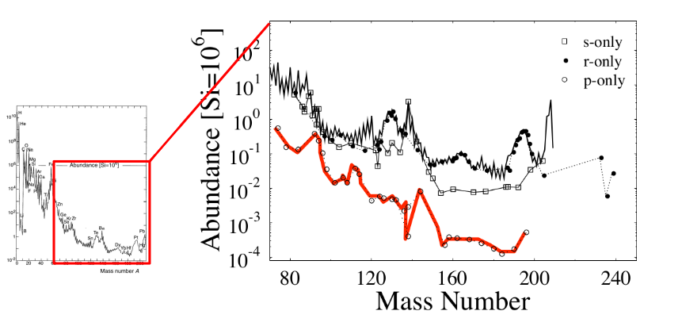
Motivation
p-nuclei

Slide 5
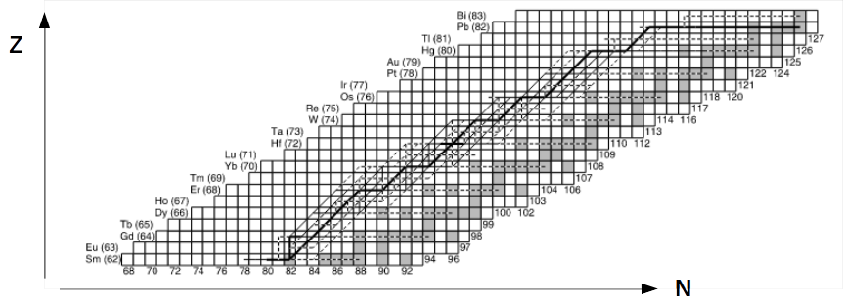

Motivation
Sensitivity studies of gamma Process
W. J. Rapp et al., Astrophys. J 653, 474 (2006)
(ɣ,α) reactions involved
in the path
<σ𝝼>_{(ɣ,α)} depend on the
α-nuclear potential

Slide 6
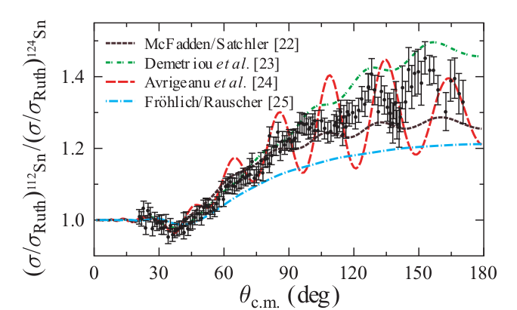
Motivation
α-nuclear potentials: elastic scattering
Mass dependence in stable Sn isotopes
D. Galaviz et al,
PRC71, 0650802 (2005)

Slide 7
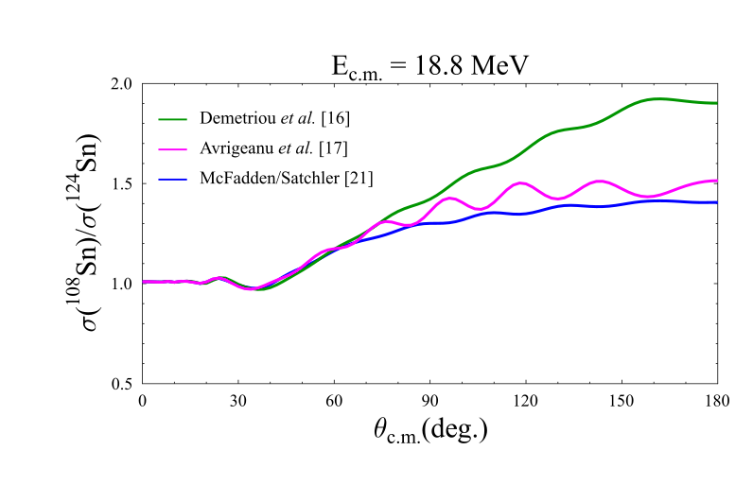
Motivation
α-nuclear potentials: elastic scattering

Slide 8
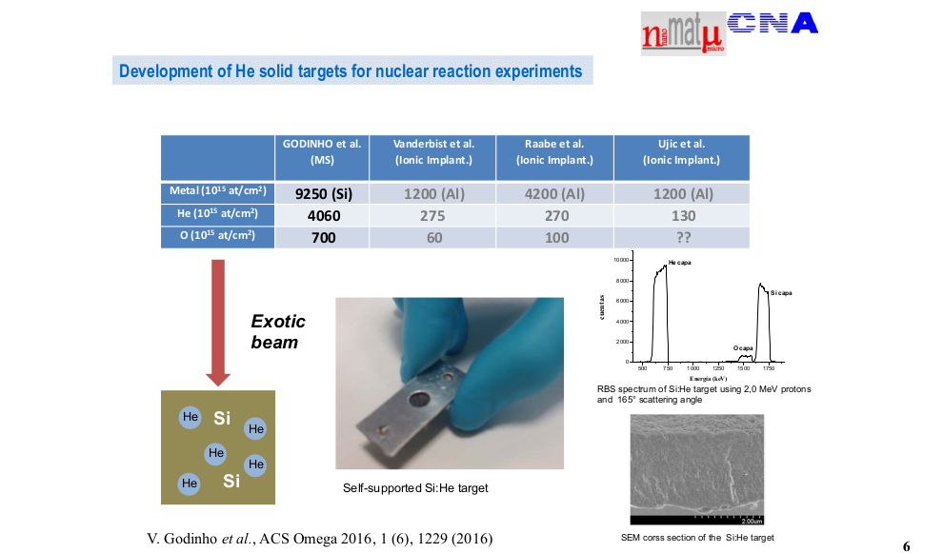
Si/He Targets
Element | Si | He | C | N | O | H
atoms/cm² (x10¹⁵) | 2820 | 1280 | 100 | 390 | 380 | 475
Magnetron Sputtering
Si/He thin films

Slide 9
Si/He Targets
Element | Si | He | C | N | O | H
atoms/cm² (x10¹⁵) | 2820 | 1280 | 100 | 390 | 380 | 475
Magnetron Sputtering
Si/He thin films

Slide 10
Si/He Targets
Element | Si | He | C | N | O | H
atoms/cm² (x10¹⁵) | 2820 | 1280 | 100 | 390 | 380 | 475
Magnetron Sputtering
Si/He thin films
Elastic Scattering in inverse kinematics

Slide 11
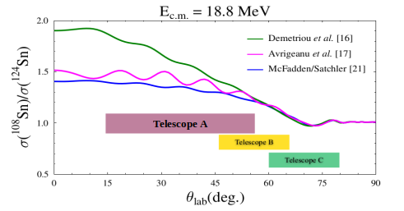
IS698 Proposal
Measurement of the ⁴He(^{A}Sn, ⁴He)^{A}Sn in inverse kinematics at the same E_{c.m}
mass dependance of α-nuclear potentials along the Sn isotopic chain
Telescope A
Detector B
Detector C

Slide 12
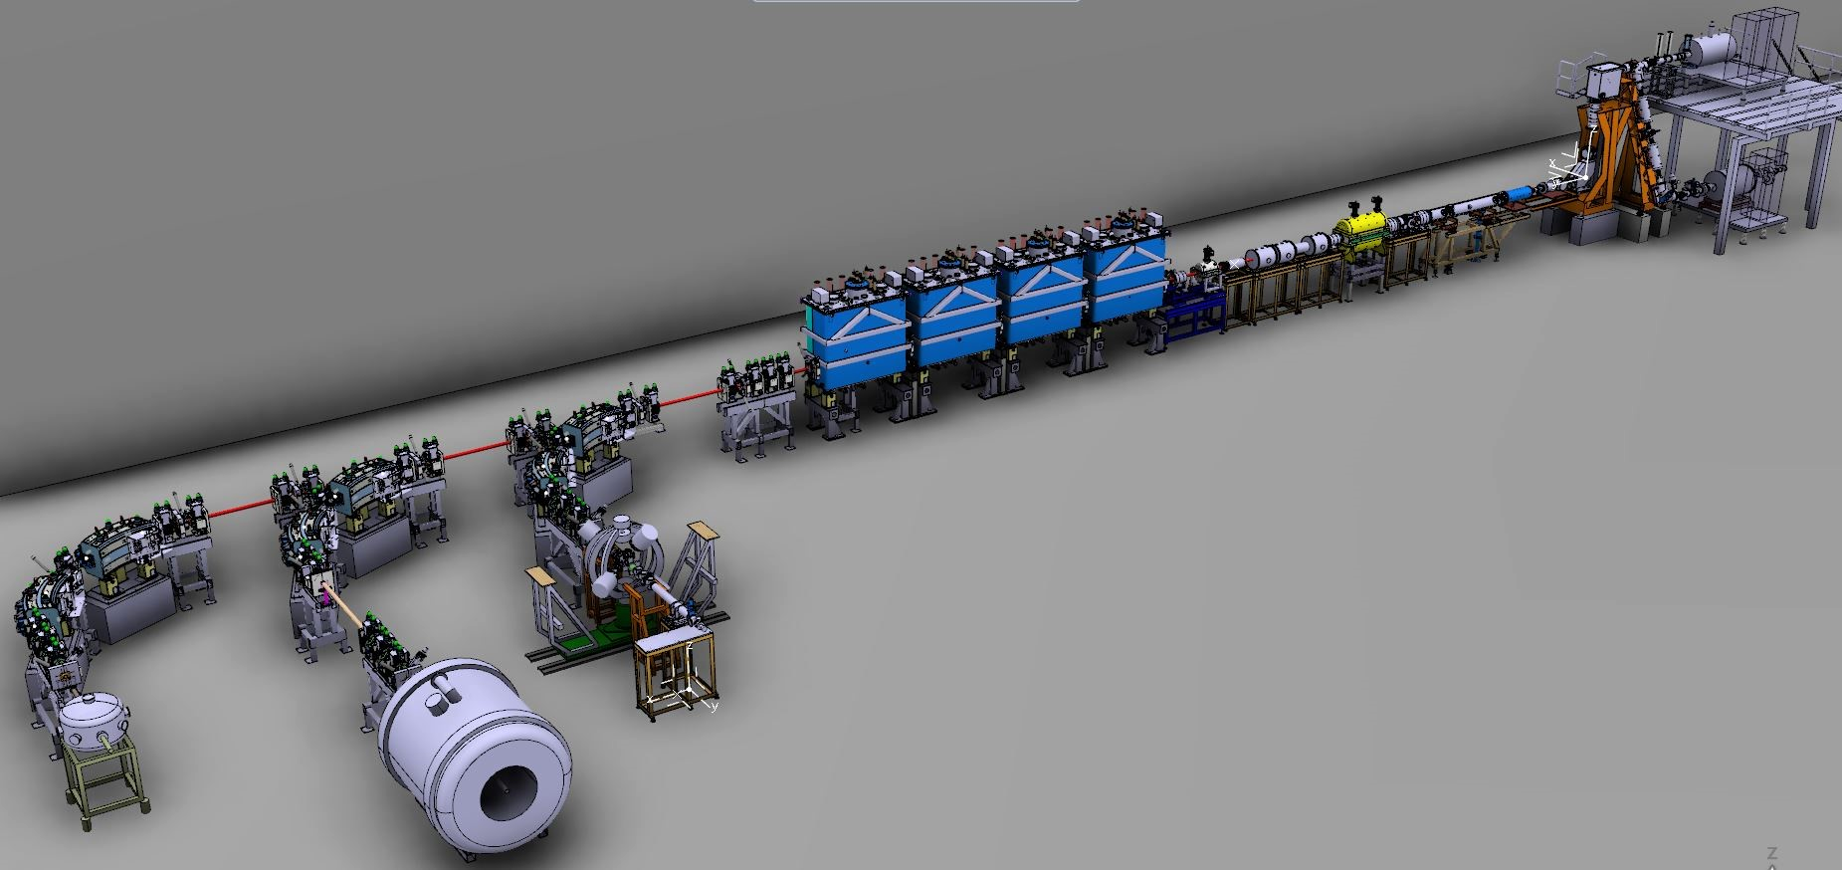
Setup

Slide 13
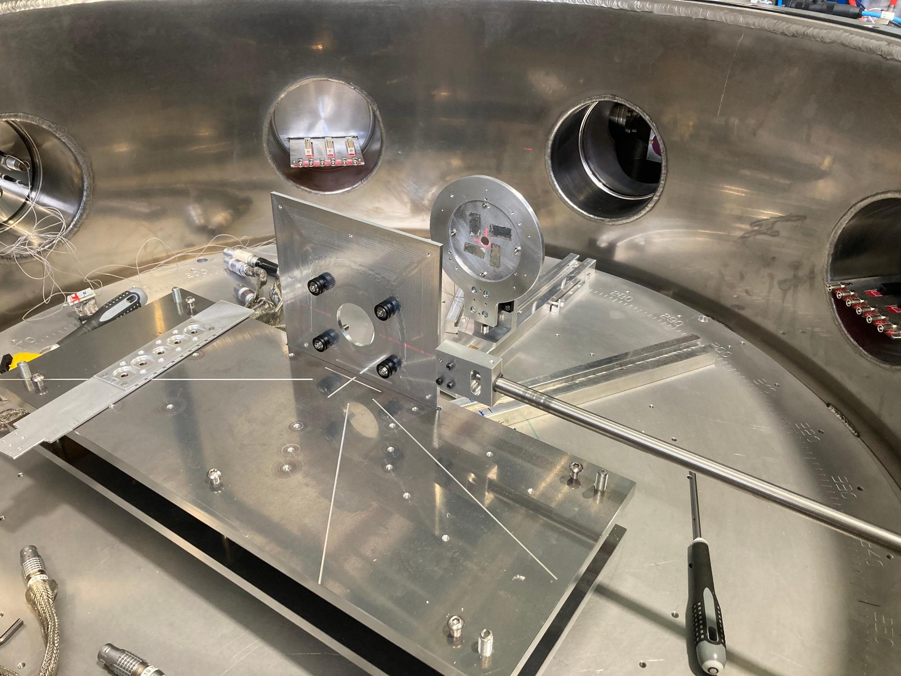
Setup

Slide 14
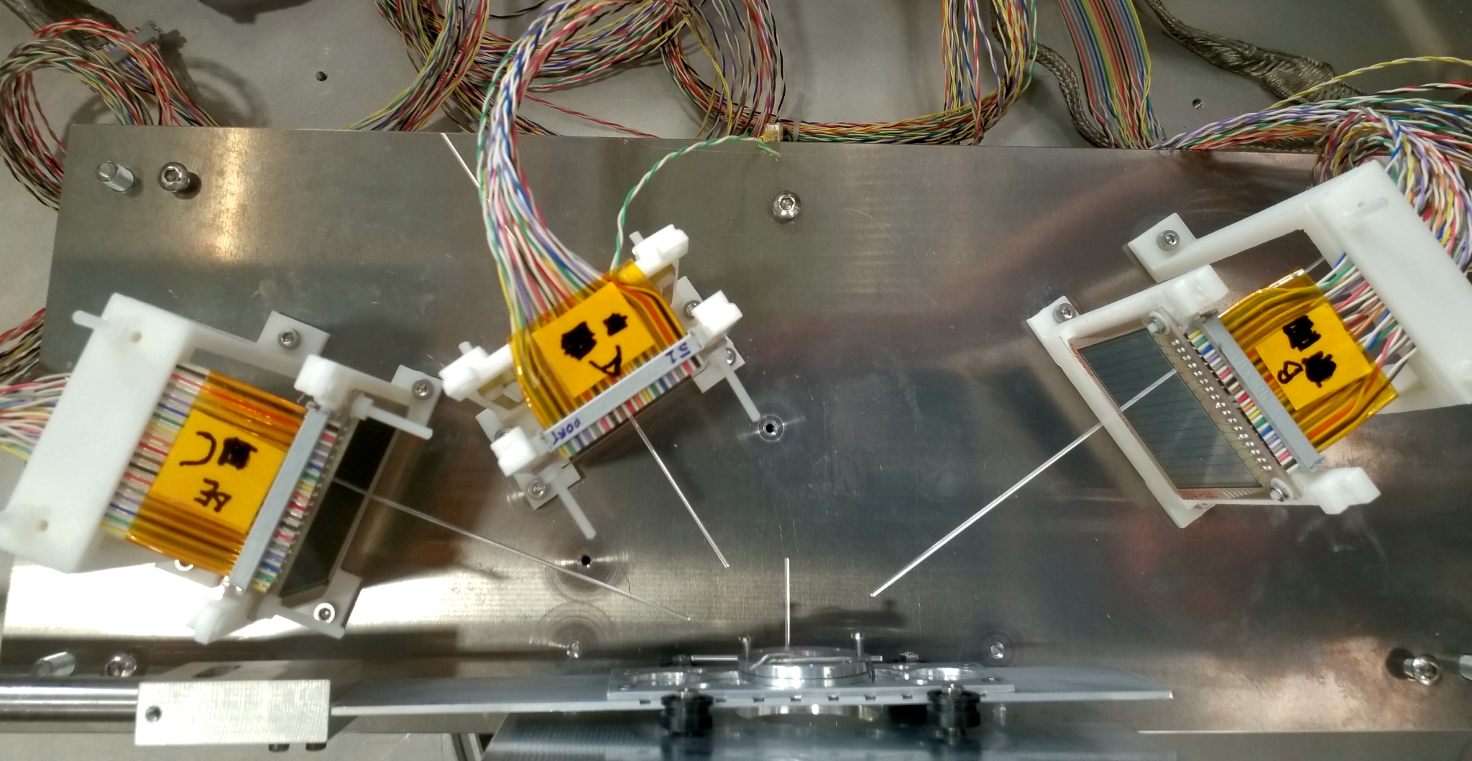
Setup
Beam

Slide 15
Setup
Telescope A
19º to 51º
DSSD 300 µm + PAD 1500 µm
A
Beam

Slide 16
Setup
Telescope A
19º to 51º
DSSD 300 µm + PAD 1500 µm
DSSD 1000 µm
A
B
Detector B
44º to 66º
Beam

Slide 17
Setup
Telescope A
19º to 51º
DSSD 300 µm + PAD 1500 µm
DSSD 1000 µm
DSSD 300 µm
A
B
Detector B
44º to 66º
C
Detector C
60º to 80º
Beam

Slide 18
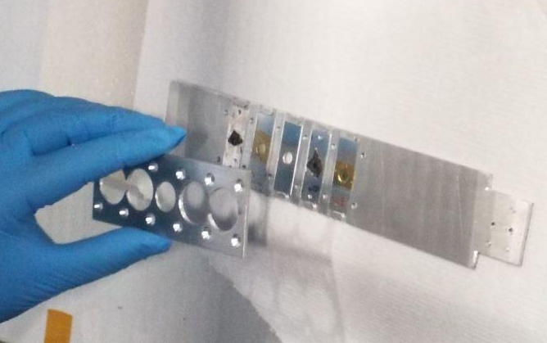
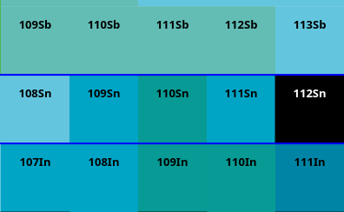
Setup
Pilot Beam E_{Beam}= 4.9 MeV/u
Cocktail of ¹²C, ¹⁶O, ²⁰Ne and ³²S
Sn Beam E_{Beam}= 4.9 MeV/u ¹¹²Sn with i ≈ 30 pA
Targets
¹⁹⁷Au with ≈ 300 μg/cm²
⁴He with ≈ 2 x 10¹⁸atoms/cm²
¹⁰⁸Sn with i ≈ 50 pA
¹¹⁰Sn with i ≈ 80 pA
¹⁰⁹Sn with i ≈ 90 pA
Z
N

Slide 19
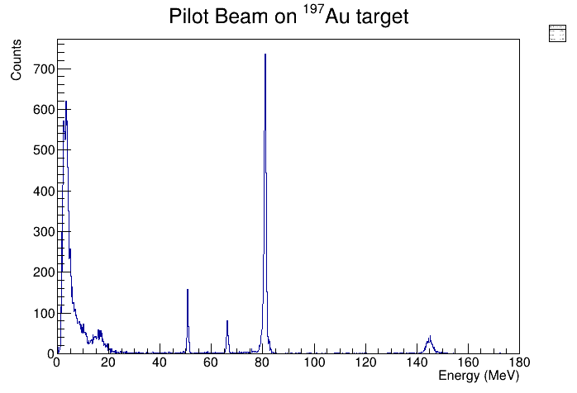
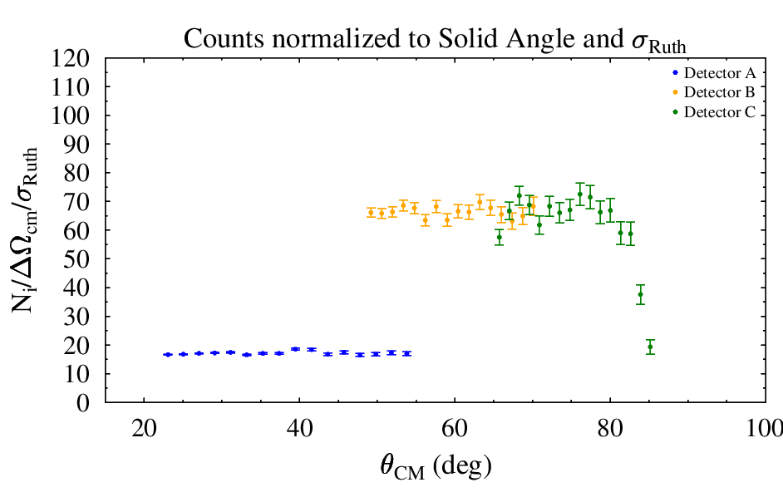
Angular Calibration
¹⁹⁷Au(²⁰Ne,²⁰Ne)¹⁹⁷Au @ 4.9 MeV/u
Pilot Beam Spectra
²⁰Ne
θ_{lab}= 60º
¹²C
¹⁶O
³²S

Slide 20
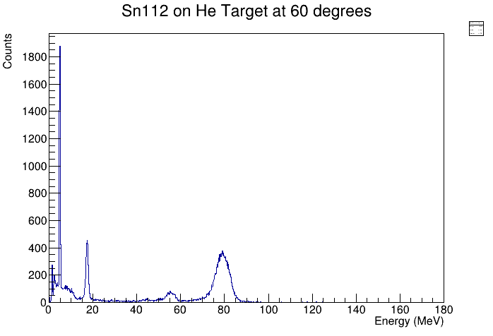
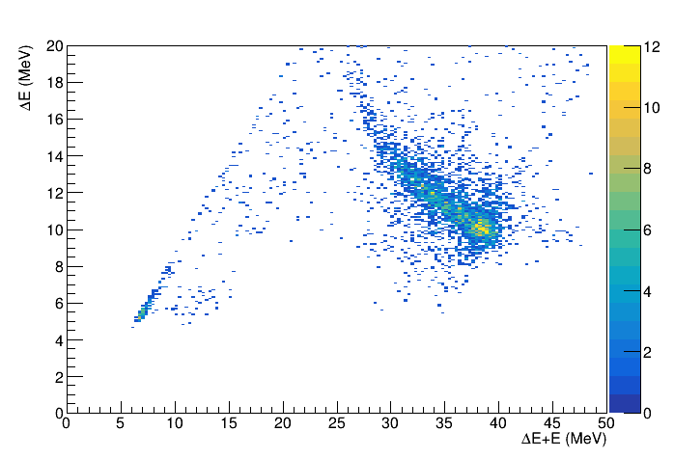
Experimental Data
⁴He(^{A}Sn,⁴He)^{A}Sn @ 4.9 MeV/u
¹¹²Sn beam scattering on Si/He-target
¹¹⁰⁸Sn beam scattering on Si/He-target
²H
θ_{lab}= 60º
θ_{lab}= 36º
?
⁴He
¹H
⁴He
²⁸Si
¹⁶O

Slide 21
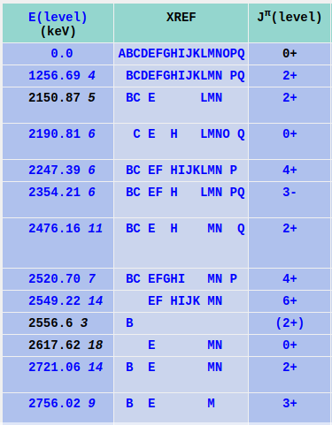
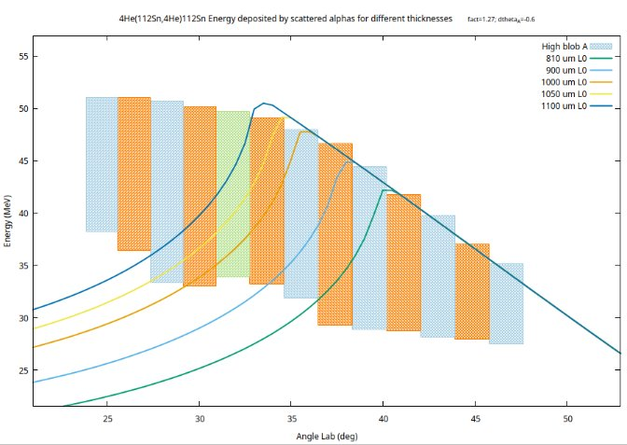
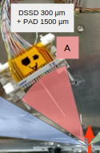


Detector A – inelastic channels
Energy deposited by elastic scattered ⁴He in different Si thicknesses

Slide 22
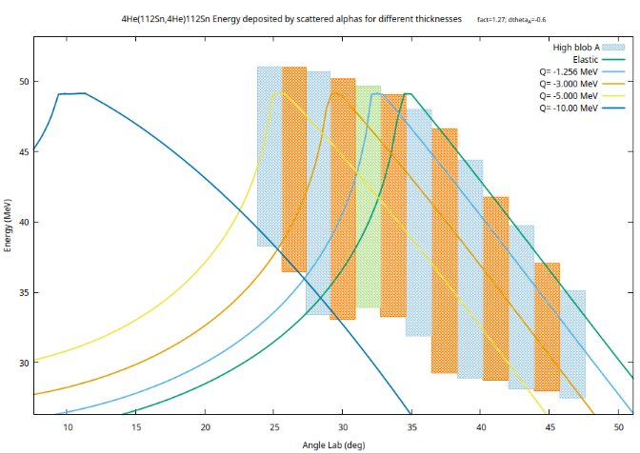
Detector A
Energy deposited by scattered ⁴He in 1050 um Si for different Sn excited states

Slide 23
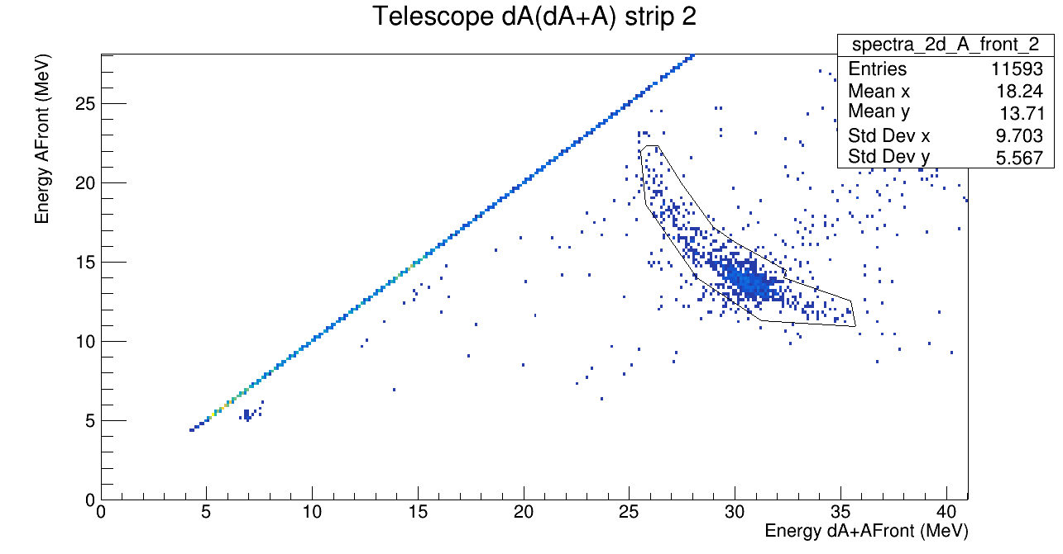
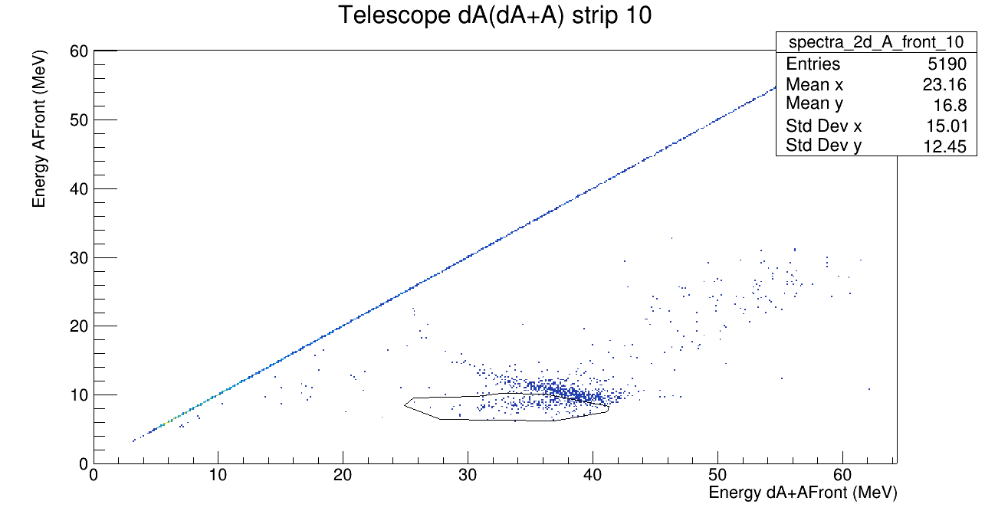
Detector A
Separate what is punchthough (consider Elastic Peak higher energy)
Projection on Total Energy Axis

Slide 24
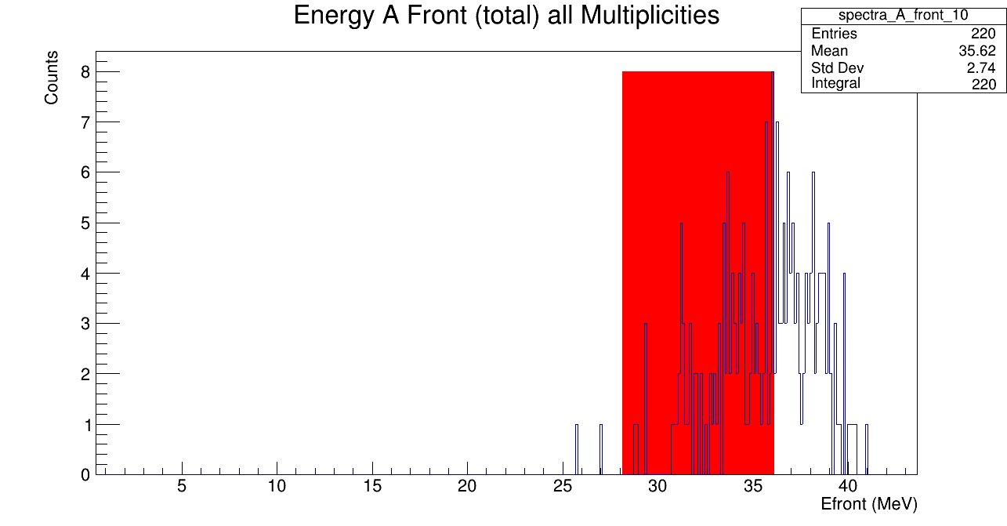
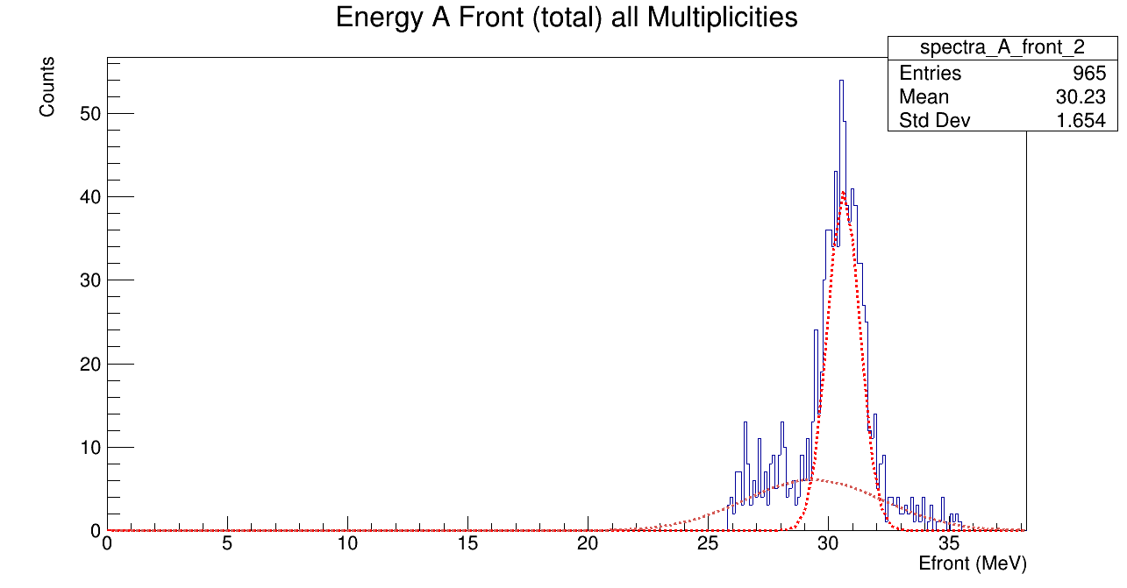
Detector A
Select regions for elastically scattered alpha-particles
Strip 10
Kinematics!

Slide 25
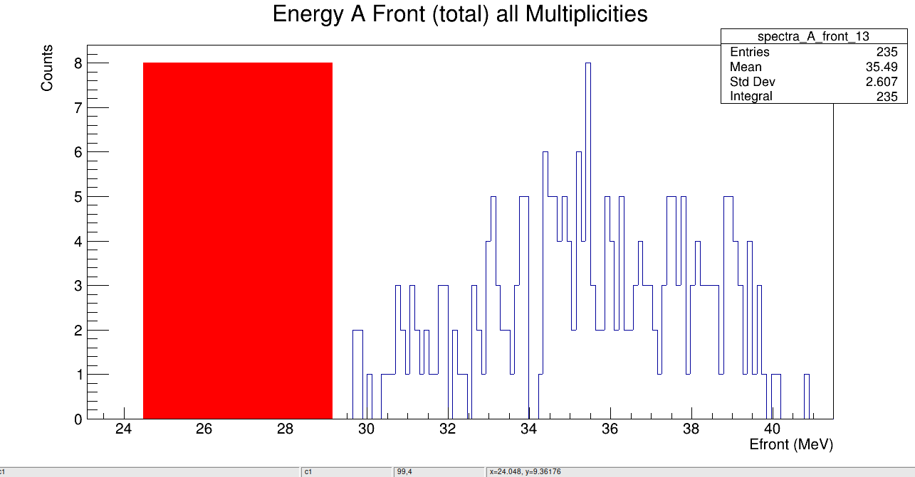
Detector A
Select regions for elastically scattered alpha-particles
Strip 13
Kinematics!

Slide 26
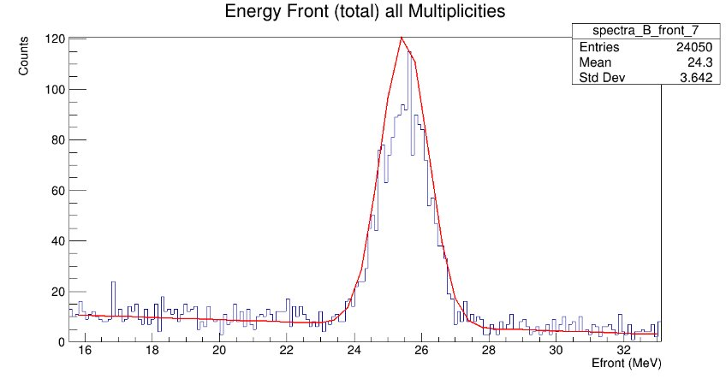
Detector B
I wish they all could be detectors B....!​
Fit Gaus + pol1​
Integrate in centroid +/- sigma​
Apply counter-bg/counter factor to integral in each pixel​

Slide 27
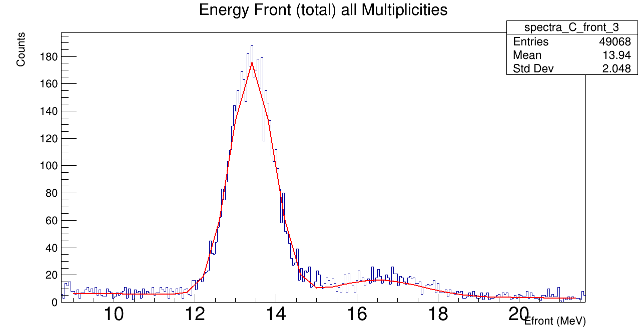
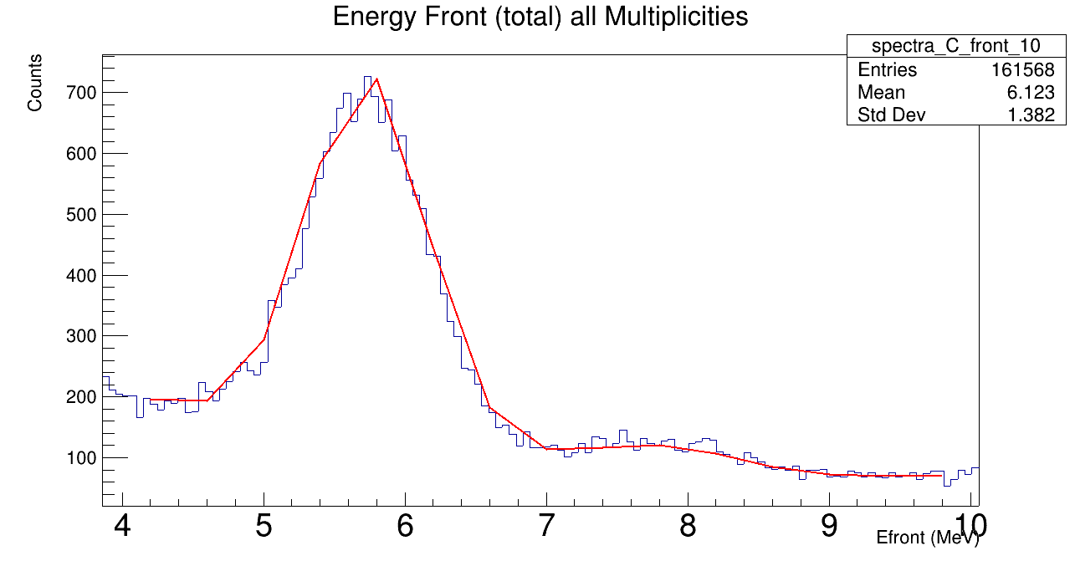
Detector C
Separete Linear bg from quadratic bg
Fit gaus+gaus+pol
Integrate in centroid1-sigma1 and centroid2+sigma2
Apply counter-bg/counter to the amounts in each pixel
Pol 2
Pol 1

Slide 28
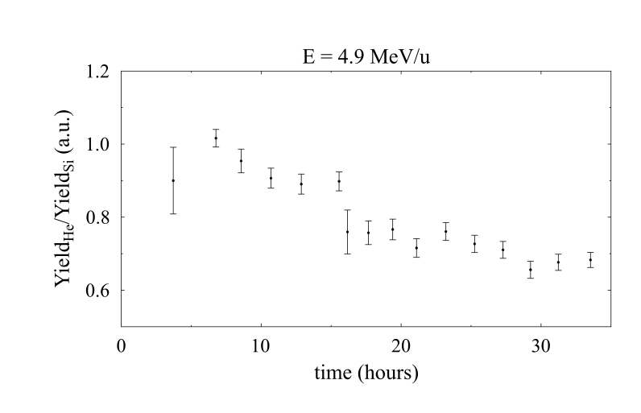
Before counting...!
Amount of ⁴He over time
⁴He amount decreases
Need to account the different amount of ⁴He on each run
Normalize the integral of ⁴He to the ratio He/Si at 60º

Slide 29
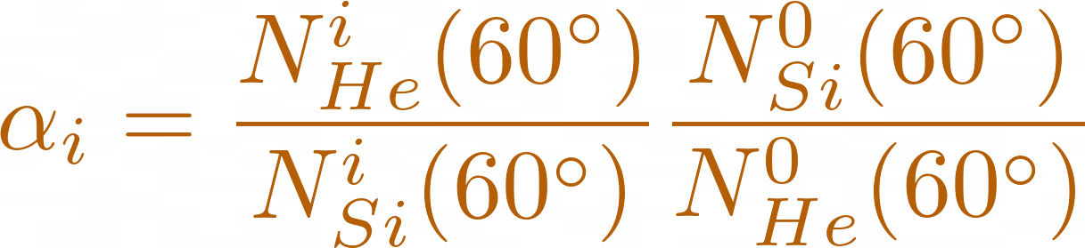
Before counting...!
Amount of ⁴He over time
⁴He amount decreases
Need to account the different amount of ⁴He on each run
Normalize the integral of ⁴He to the ratio He/Si at 60º

Slide 30

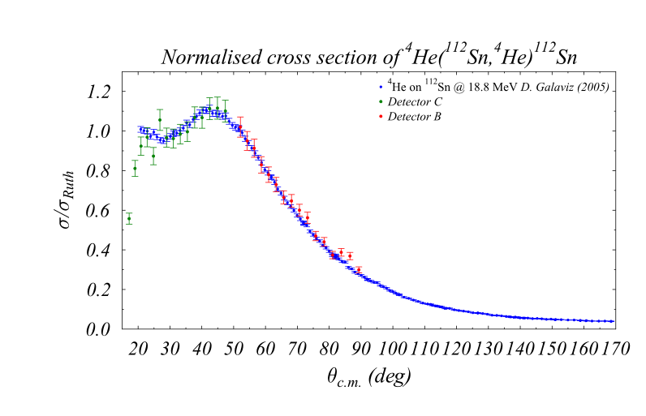
Preliminary results
⁴He(¹¹²Sn,¹¹²⁸Sn)⁴He @ 18.9 MeV (CM)

Slide 31
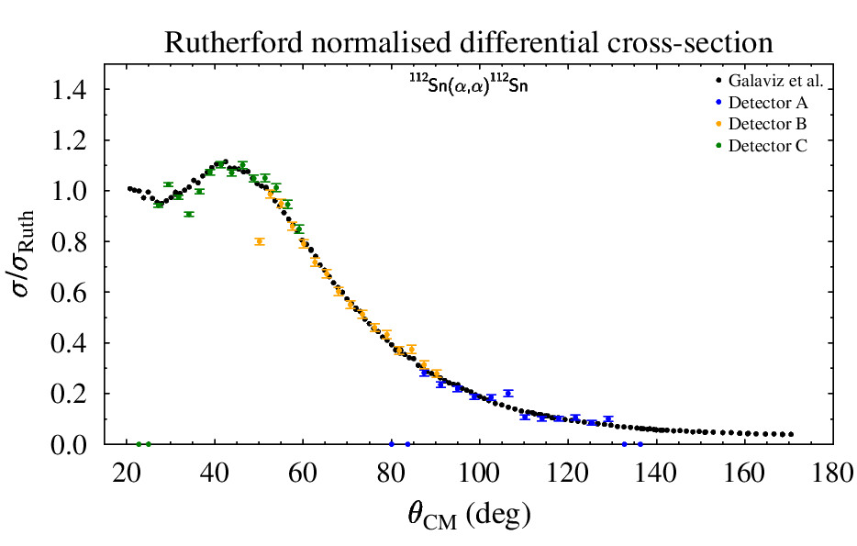
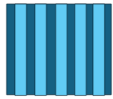
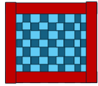
Preliminary results
⁴He(¹¹²Sn,¹¹²Sn)⁴He @ 18.9 MeV (CM)
PRELIMINARY

Slide 32
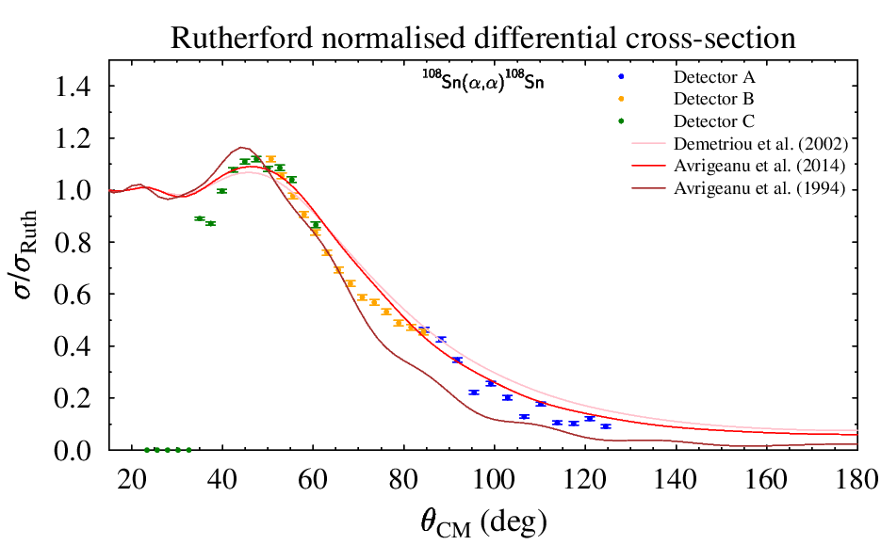
Preliminary results
⁴He(¹⁰⁸Sn,¹⁰⁸Sn)⁴He @ 18.9 MeV (CM)
PRELIMINARY

Slide 33
Conclusions
Four angular distributions measured covering a large angular range.
Analysis defined for all the angular regions.
Technique benchamarked with previously measured data in direct kinematics
Preliminary data on radioactive nuclei showing consistency of the method

Slide 34

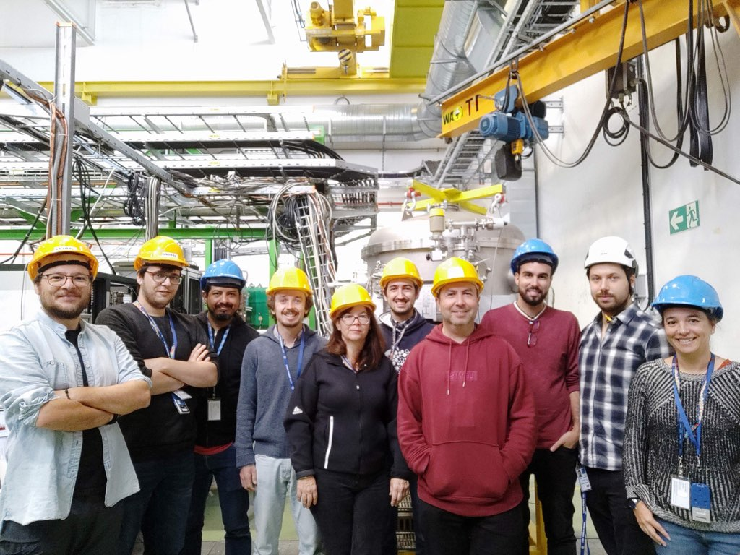









Acknowledgments
RENASCER Project: CERN/FIS-PAR/0009/2021 SCORE Project: EXPL/FIS-NUC/0364/2021 FCT PhD Fellowship: UI/BD/154300/2022

Slide 35


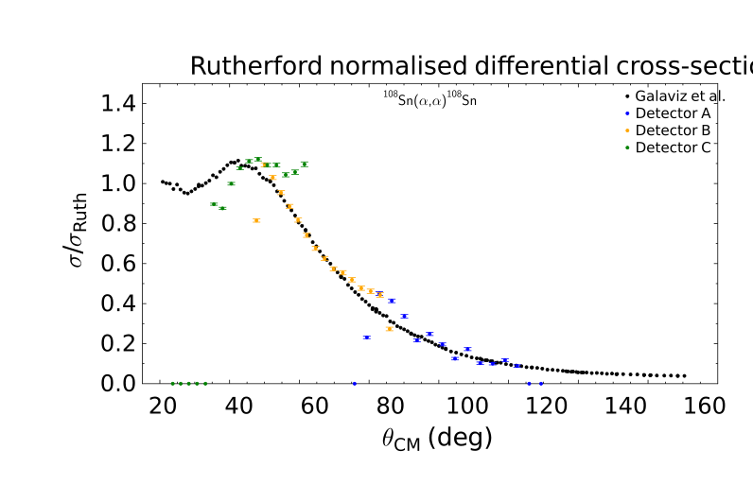
Preliminary results
⁴He(¹⁰⁸Sn,¹⁰⁸Sn)⁴He

Slide 36
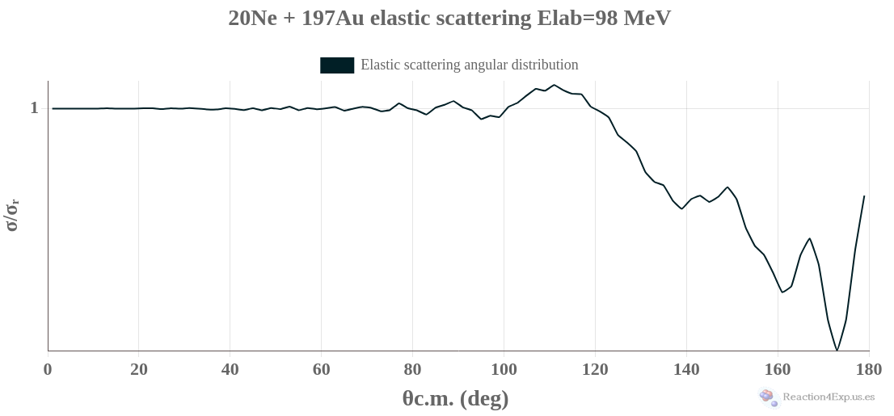
Backup: Pilot Beam calculated xs
⚠

Slide 37
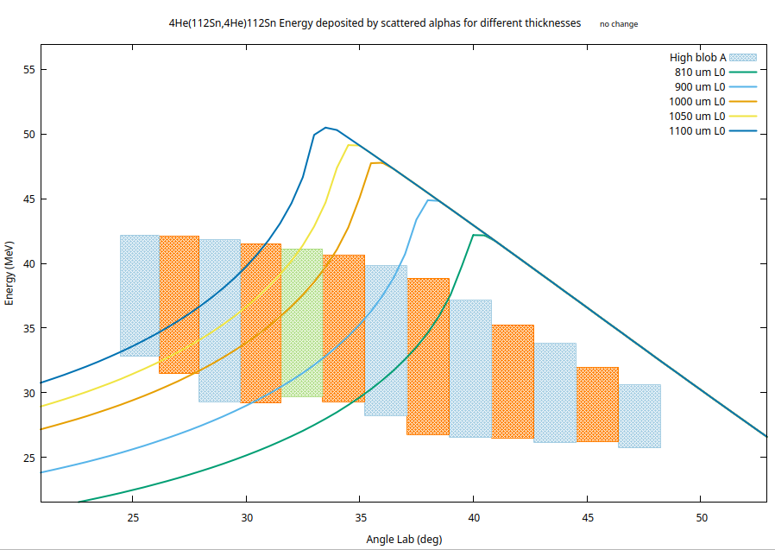
Different Thicknesses
Energy deposited by alphas from elastic scattering at different thicknesses

Slide 38
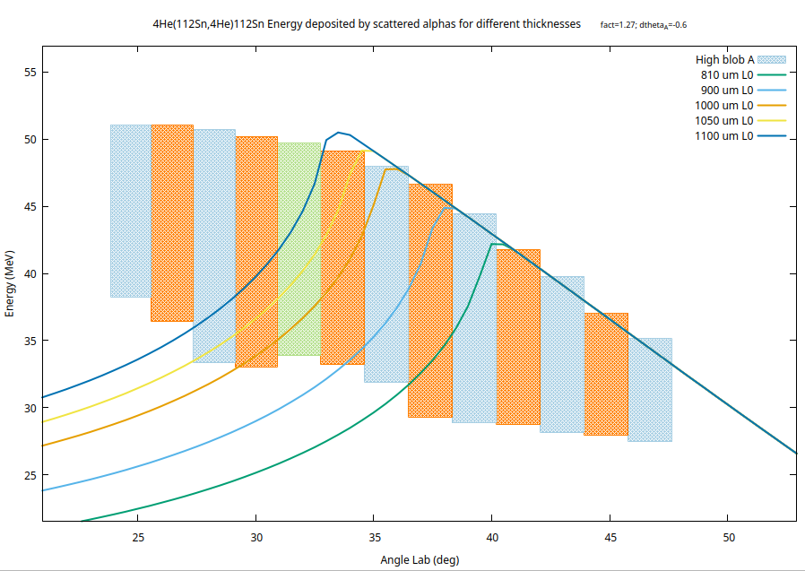
Different Thicknesses
Adjusted gain in pad and angular shifted to meet the kinematic curves

Slide 39
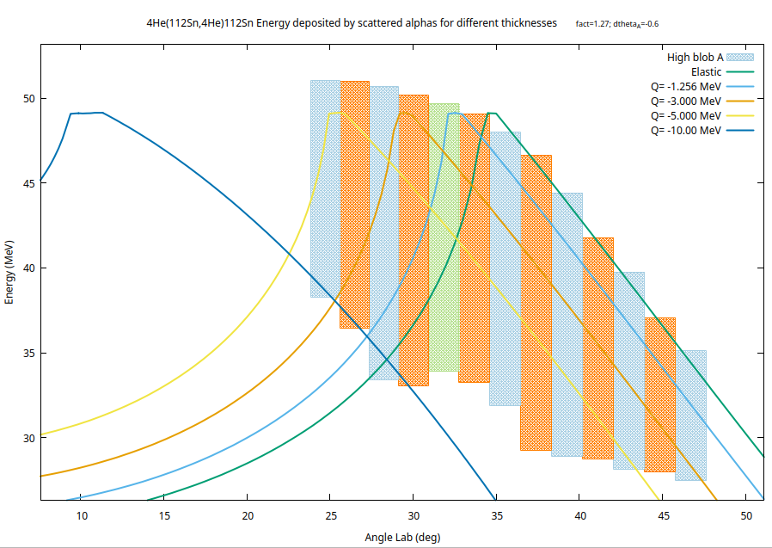
Different Scattering channels
Assuming thickness of 1050 um in the telescope

Slide 40
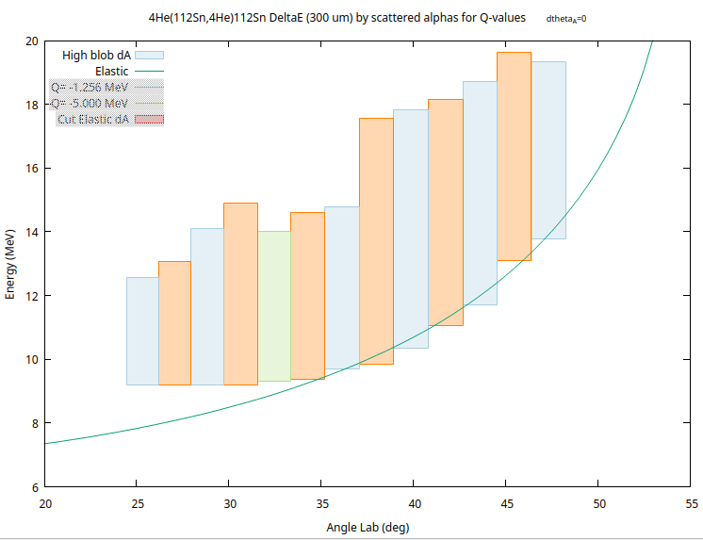

Delta E (DSSSD) check
Energy deposited by elastic alphas in deltaE detector (300 um)

Slide 41
Delta E (DSSSD) check
Adjusted deltaE thickness to 315 um and removed angular shift
(315 um)

Slide 42
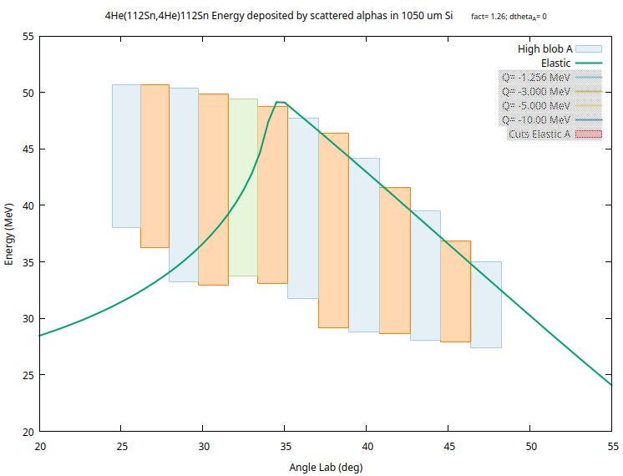
Telescope Characterized
315 um
735 um
(315 um)

