Slide 1




Measurement of the ¹¹⁸Sn(p,γ)¹¹⁹Sb cross-sections with low energy protons using the activation technique
M. Paulino^{1,2}, L. Alves³, V. Corregidor³, J. Cruz², D. Galaviz^{1,4}, R. Nunes^{1,4}, R. Pires^{1,4}, R. Silva³, P. Teubig^{1,5}, A. Vicente^{1,4}
¹ LIP, ² NOVA-FCT, ³CTN-IST, ⁴FCUL,⁵IADE
European Nuclear Physics Conference 2025 (EuNPC2025)

Slide 2
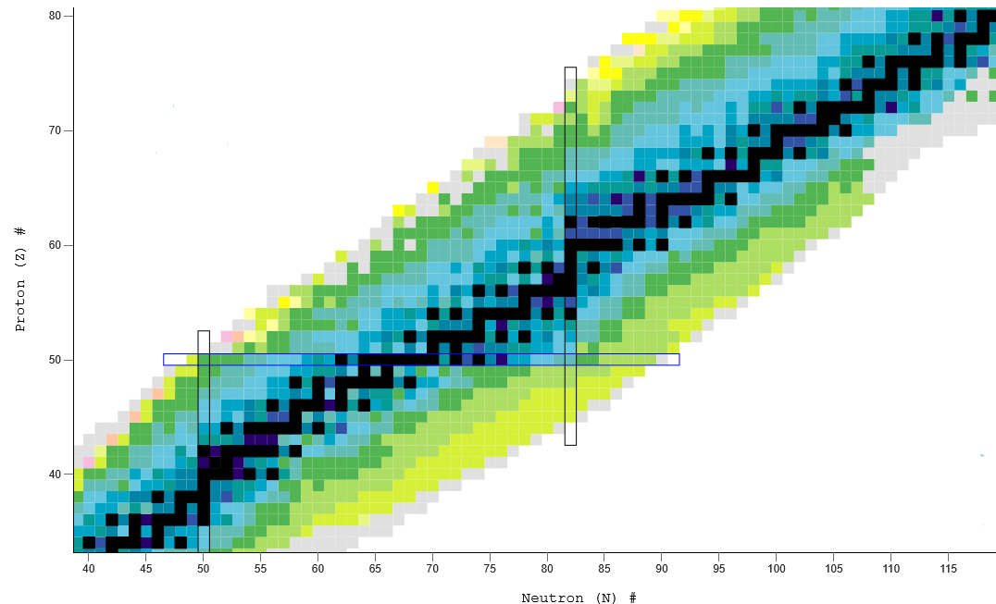
Introduction
Stellar nucleosynthesis
s-process
p-nuclei
r-process
NuDat 3.0, National Nuclear Data Center

Slide 3
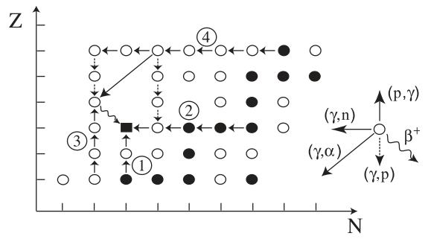
Introduction
Stellar nucleosynthesis
[1] T. Rauscher, Physical Review C - Nuclear Physics 73, 2006
The photo-disintegration reactions make up the γ-process
¹¹⁹Sb is a branching point in the γ-process ^{[1]}
High reaction-rate uncertainties
Goal: Study the inverse reaction
¹¹⁸Sn(p,γ)¹¹⁹Sb
M. Arnould and S. Goriely, Physics Reports, 384, 2003

Slide 4
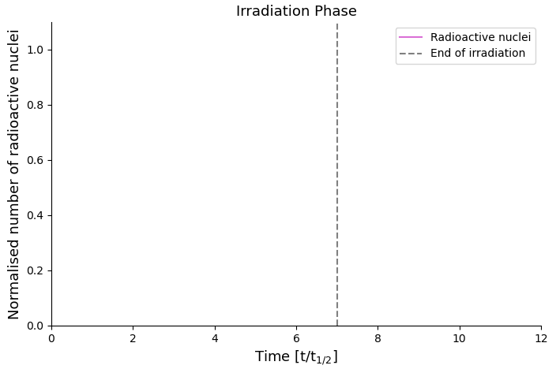
Introduction
The activation technique
Can be used to study the production of radioactive nuclei
A two-phase technique
  The irradiation phase
¹¹⁸Sn + p → ¹¹⁹Sb + γ

Slide 5
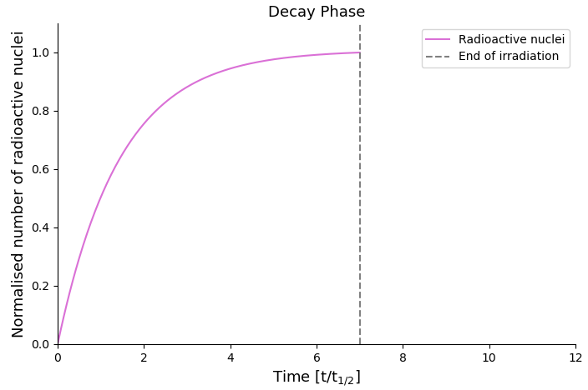
Introduction
The activation technique
Can be used to study the production of radioactive nuclei
A two-phase technique
  The irradiation phase
  The decay phase
¹¹⁹Sb → ¹¹⁹Sn

Slide 6
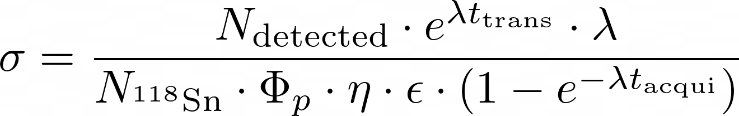
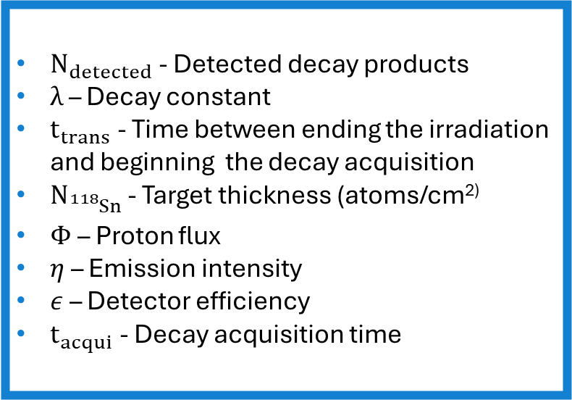
Introduction
The activation technique
Can be used to study the production of radioactive nuclei
A two-phase technique
  The irradiation phase
  The decay phase
$N_{detected}$ - Detected decay products
$λ$ – Decay constant
$t_{trans}$ - Time between ending the irradiation and beginning the decay acquisition
$N_{{}_{}^{118}Sn }$- Target thickness (atoms/cm²⁾
$Φ$– Proton flux
$η$ – Emission intensity
$ε$ – Detector efficiency
$t_{acqui}$- Decay acquisition time

Slide 7
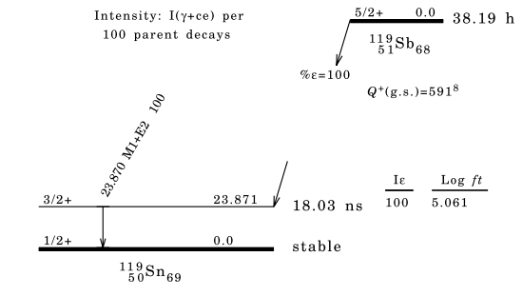

Introduction
The decay of ¹¹⁹Sb
Decay via Electron Capture to the ¹¹⁹Sn first excited state $\left({\frac{3}{2}}^{+}\right)$
¹¹⁹Sn* decays via Internal Conversion or γ emission
K-line X-rays
Auger electrons
L-line X-rays
23.87 keV
D. Symochko et al., Nuclear Data Sheets (2009)

Slide 8

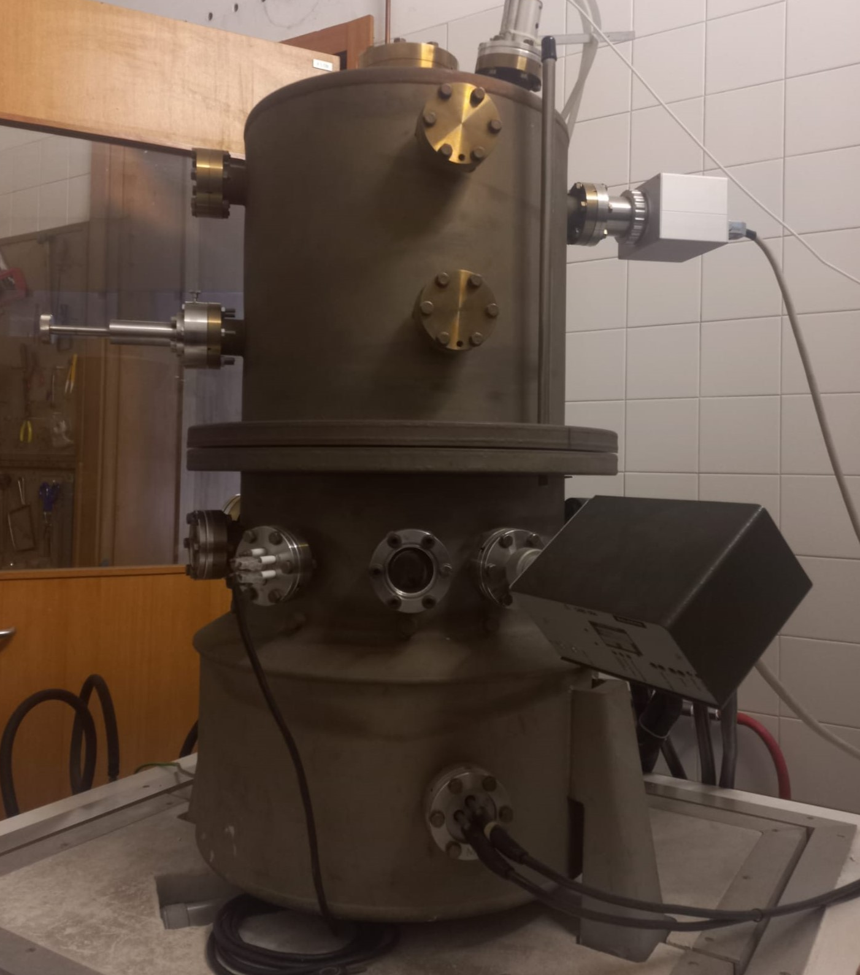
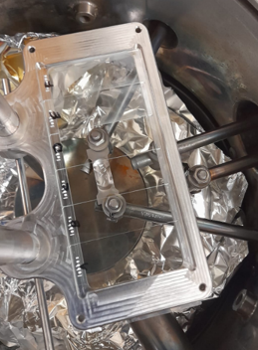
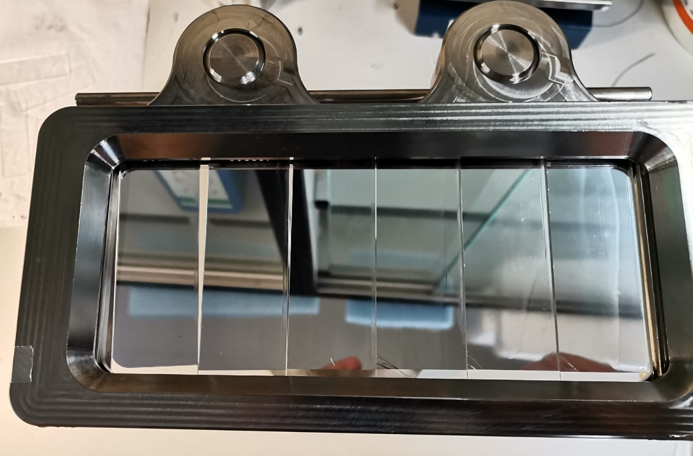
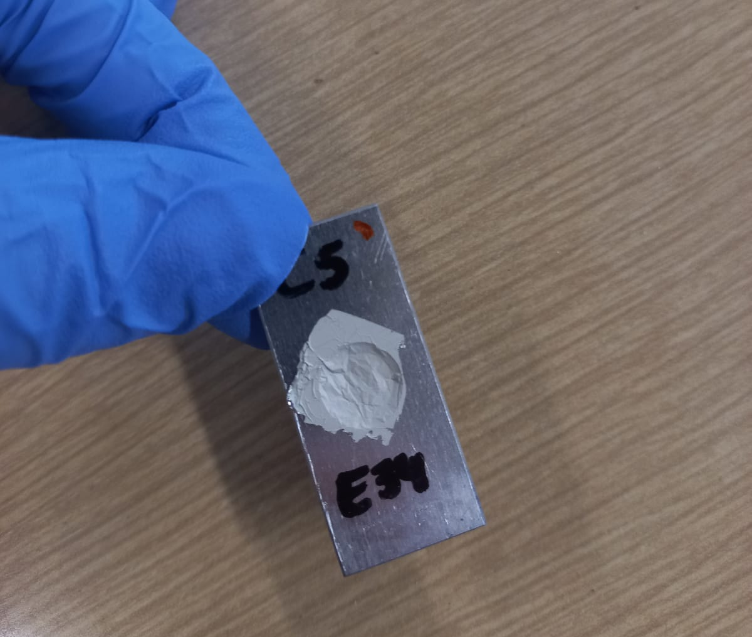
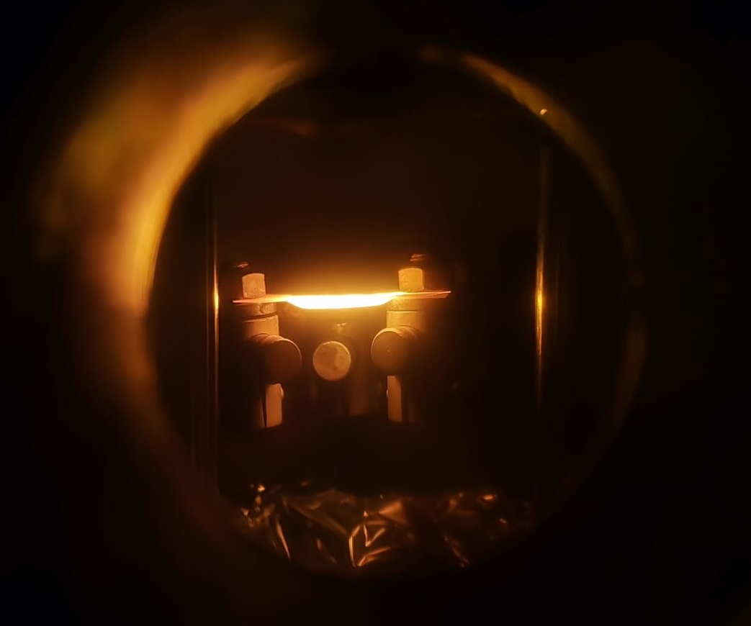
Target production
Thermal evaporation
Production of targets enriched with ¹¹⁸Sn, with an Al backing
Boat
Glass substrate

Slide 9

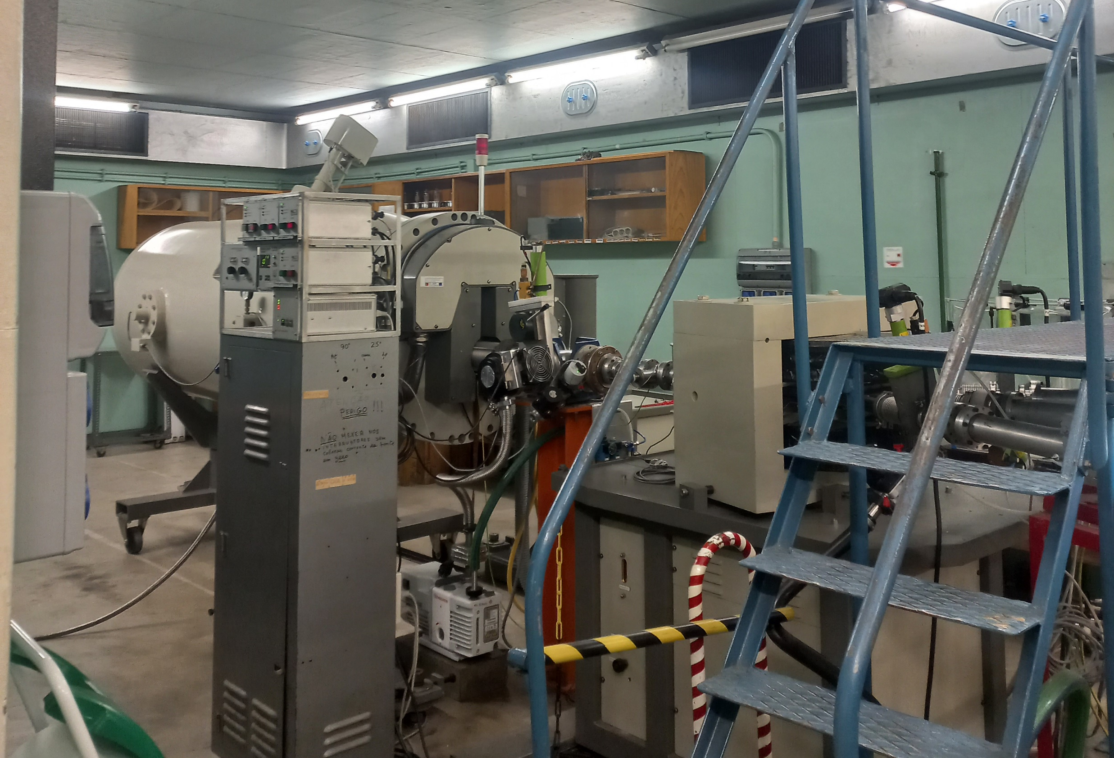
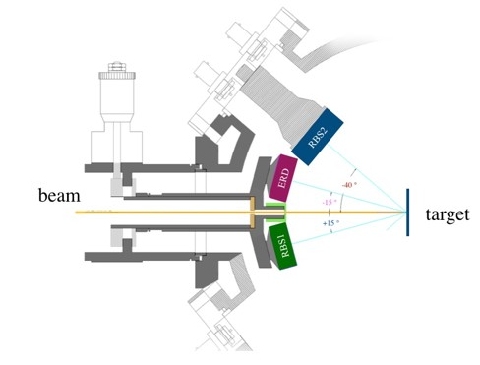
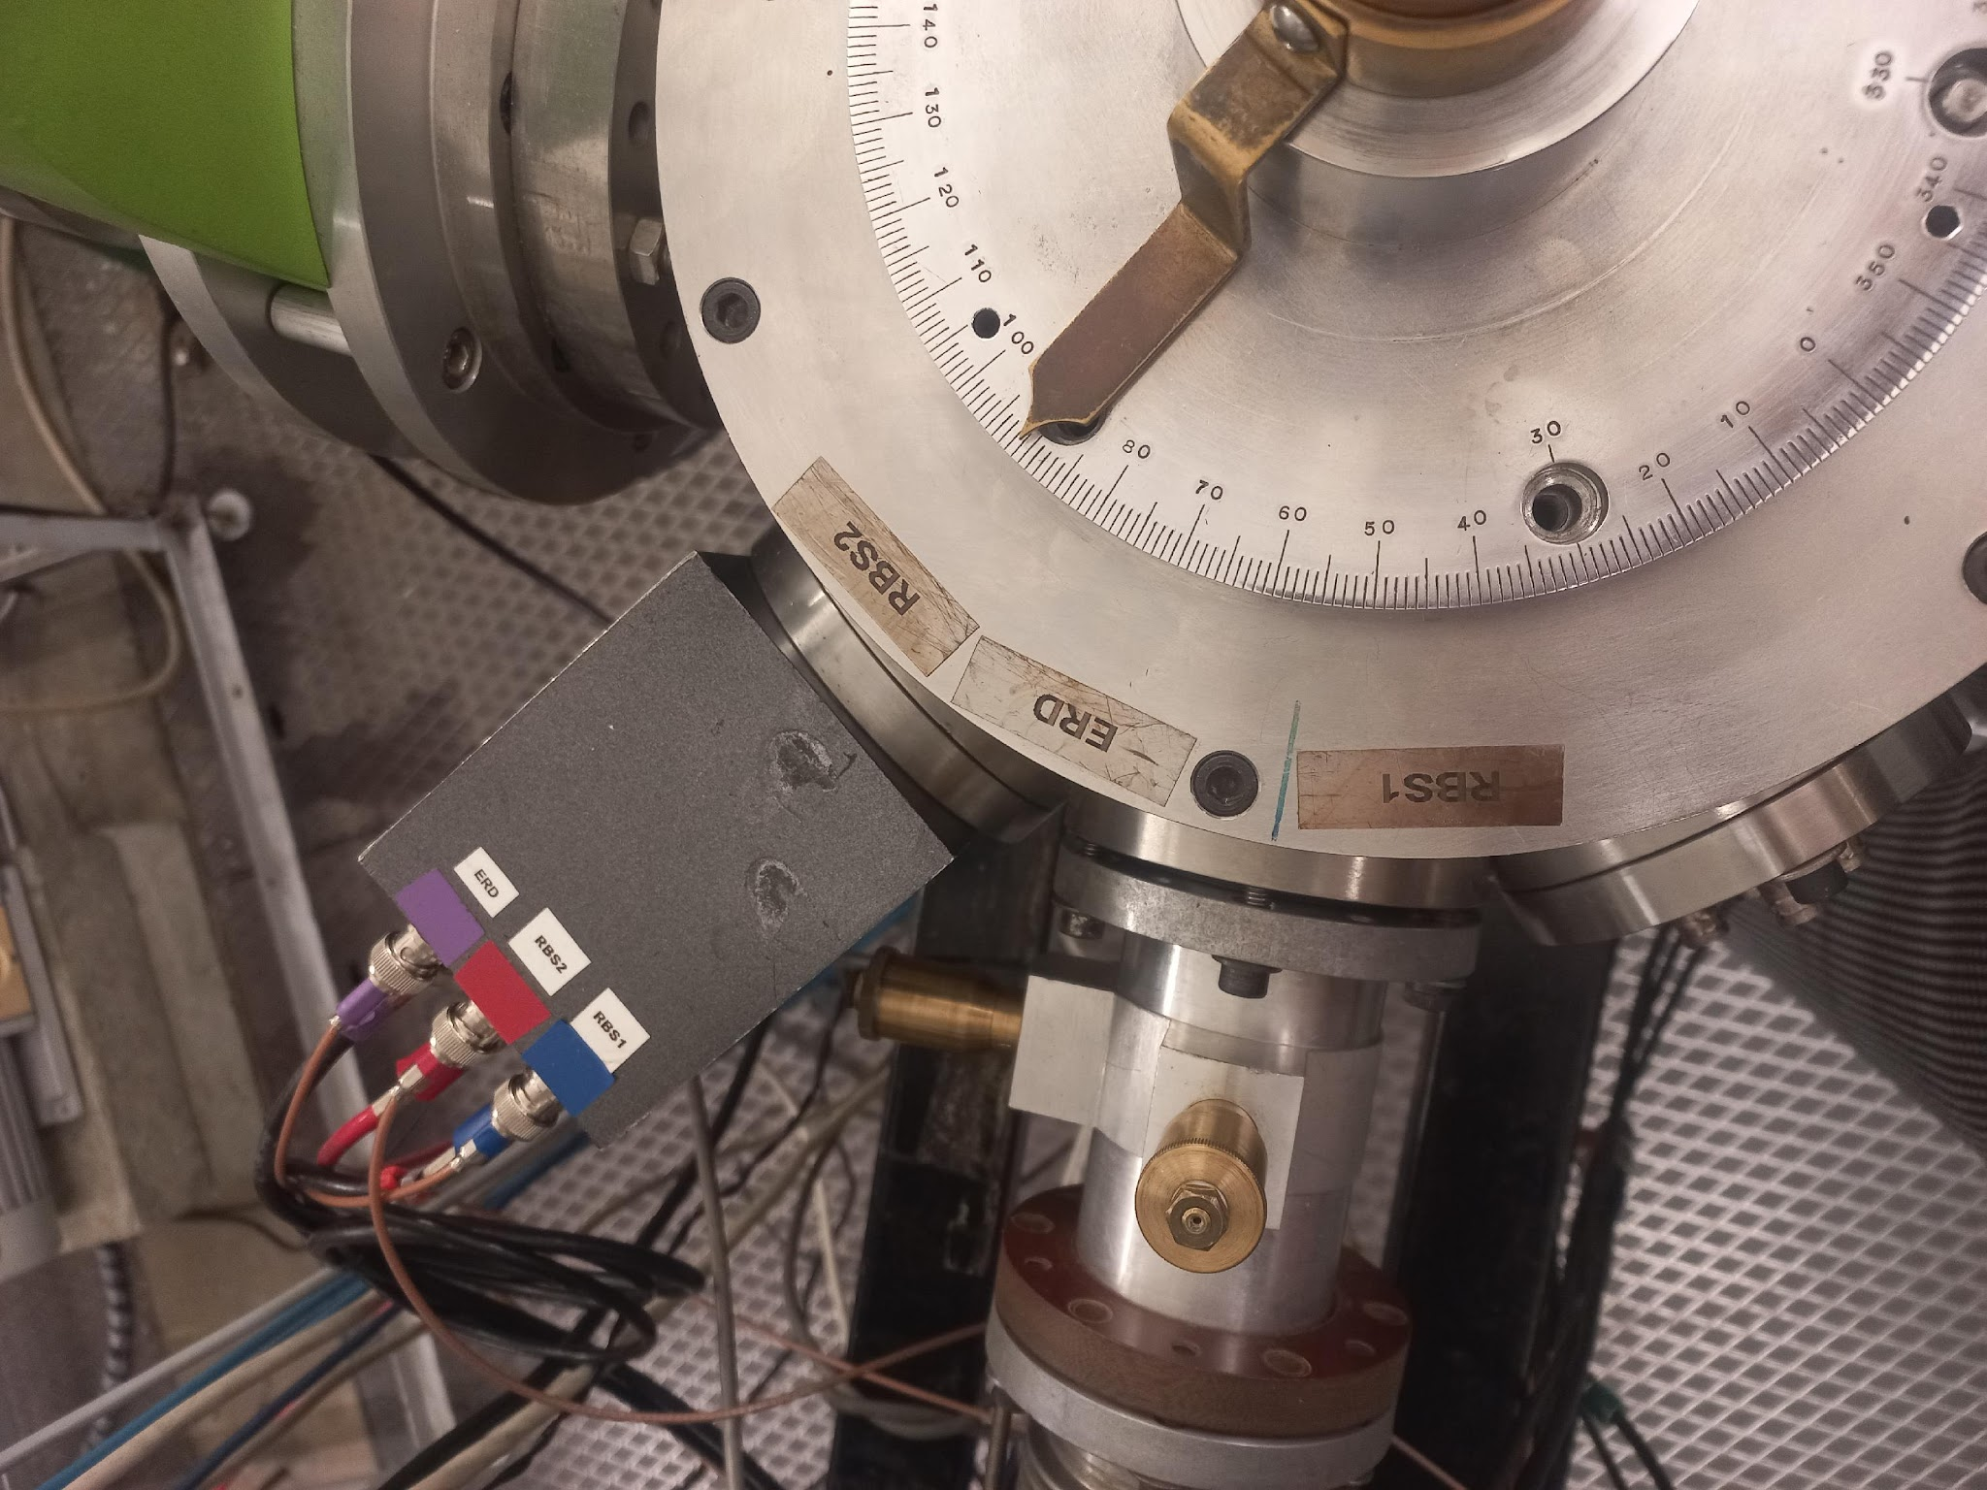
Target production
Rutherford Backscattering Spectrometry
Procedure done at the CTN-IST facility, using the Van de Graaff accelerator
LATR, Van de Graaff Manual

Slide 10

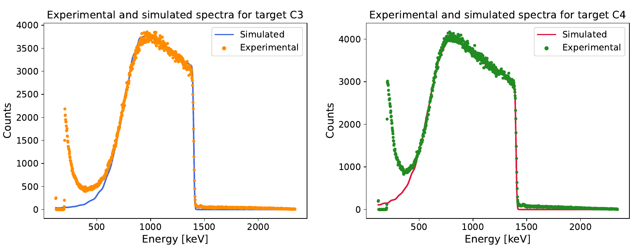
Target production
Target characteristics
SIMNRA
Targets characterised with α particles with 1.6 MeV
(538 ± 17) μg/cm²
(644 ± 39) μg/cm²

Slide 11
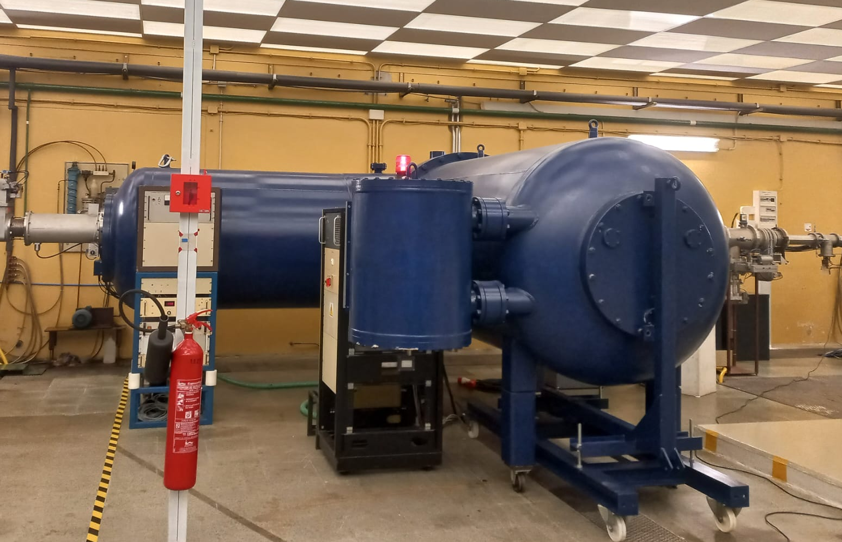
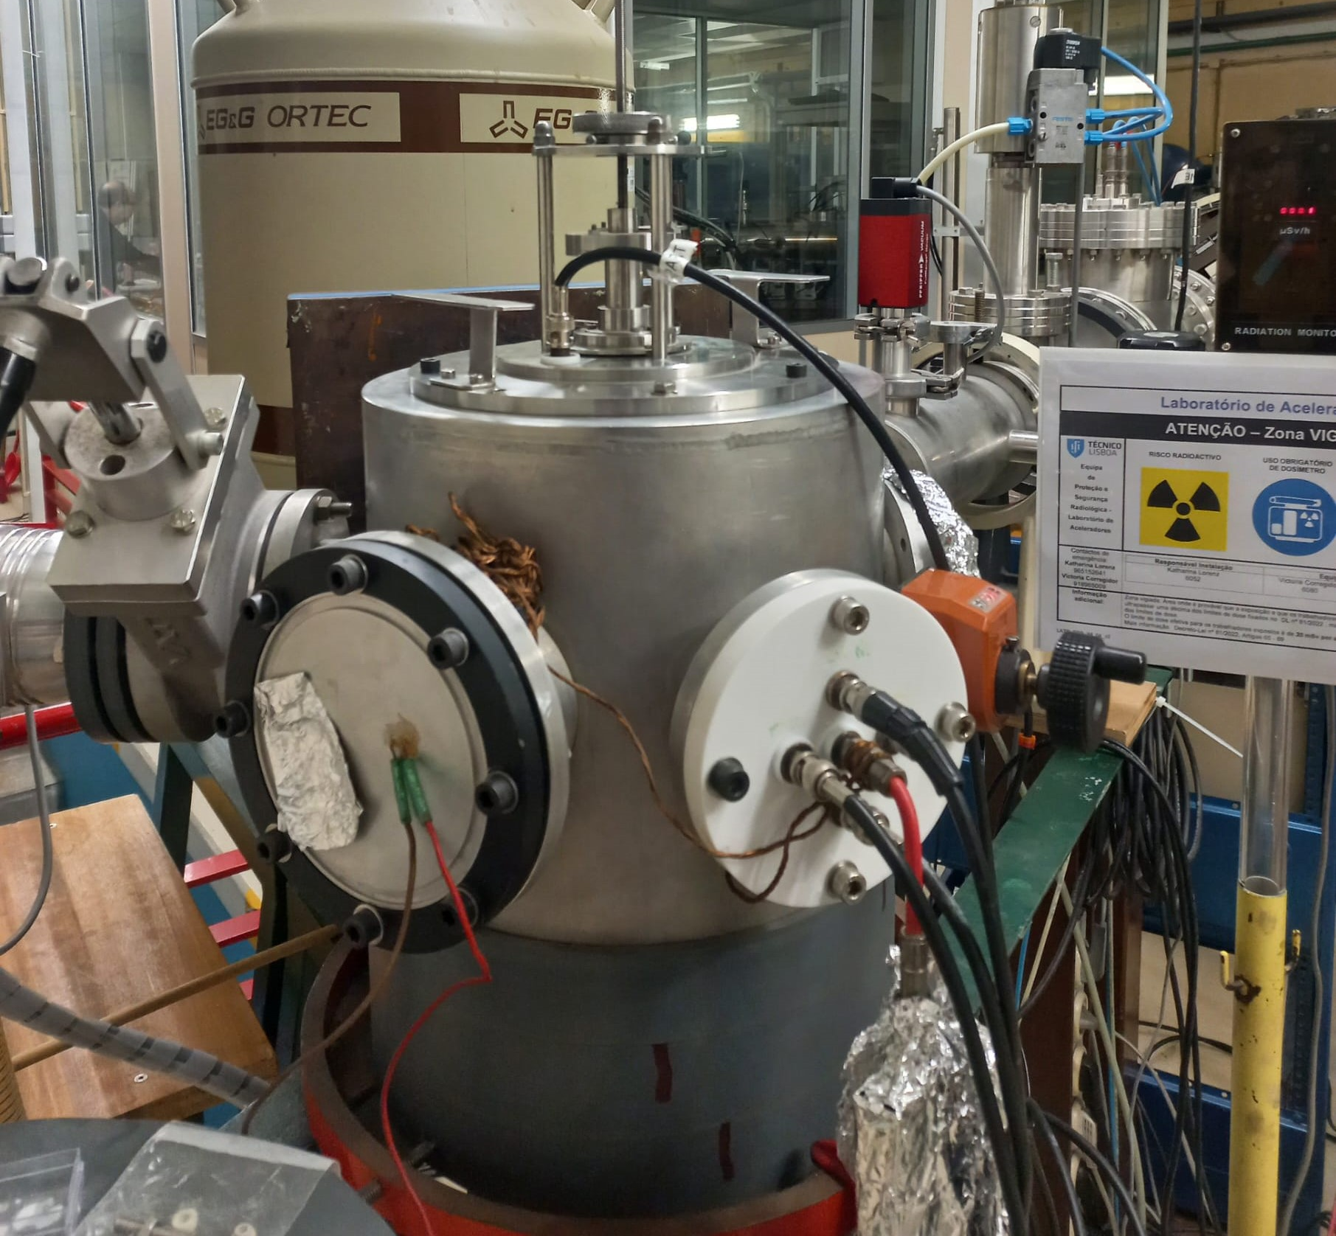
Experimental procedure
Irradiation phase
Measurements done at three energies: 2.6 MeV, 2.8 MeV and 3 MeV

Slide 12
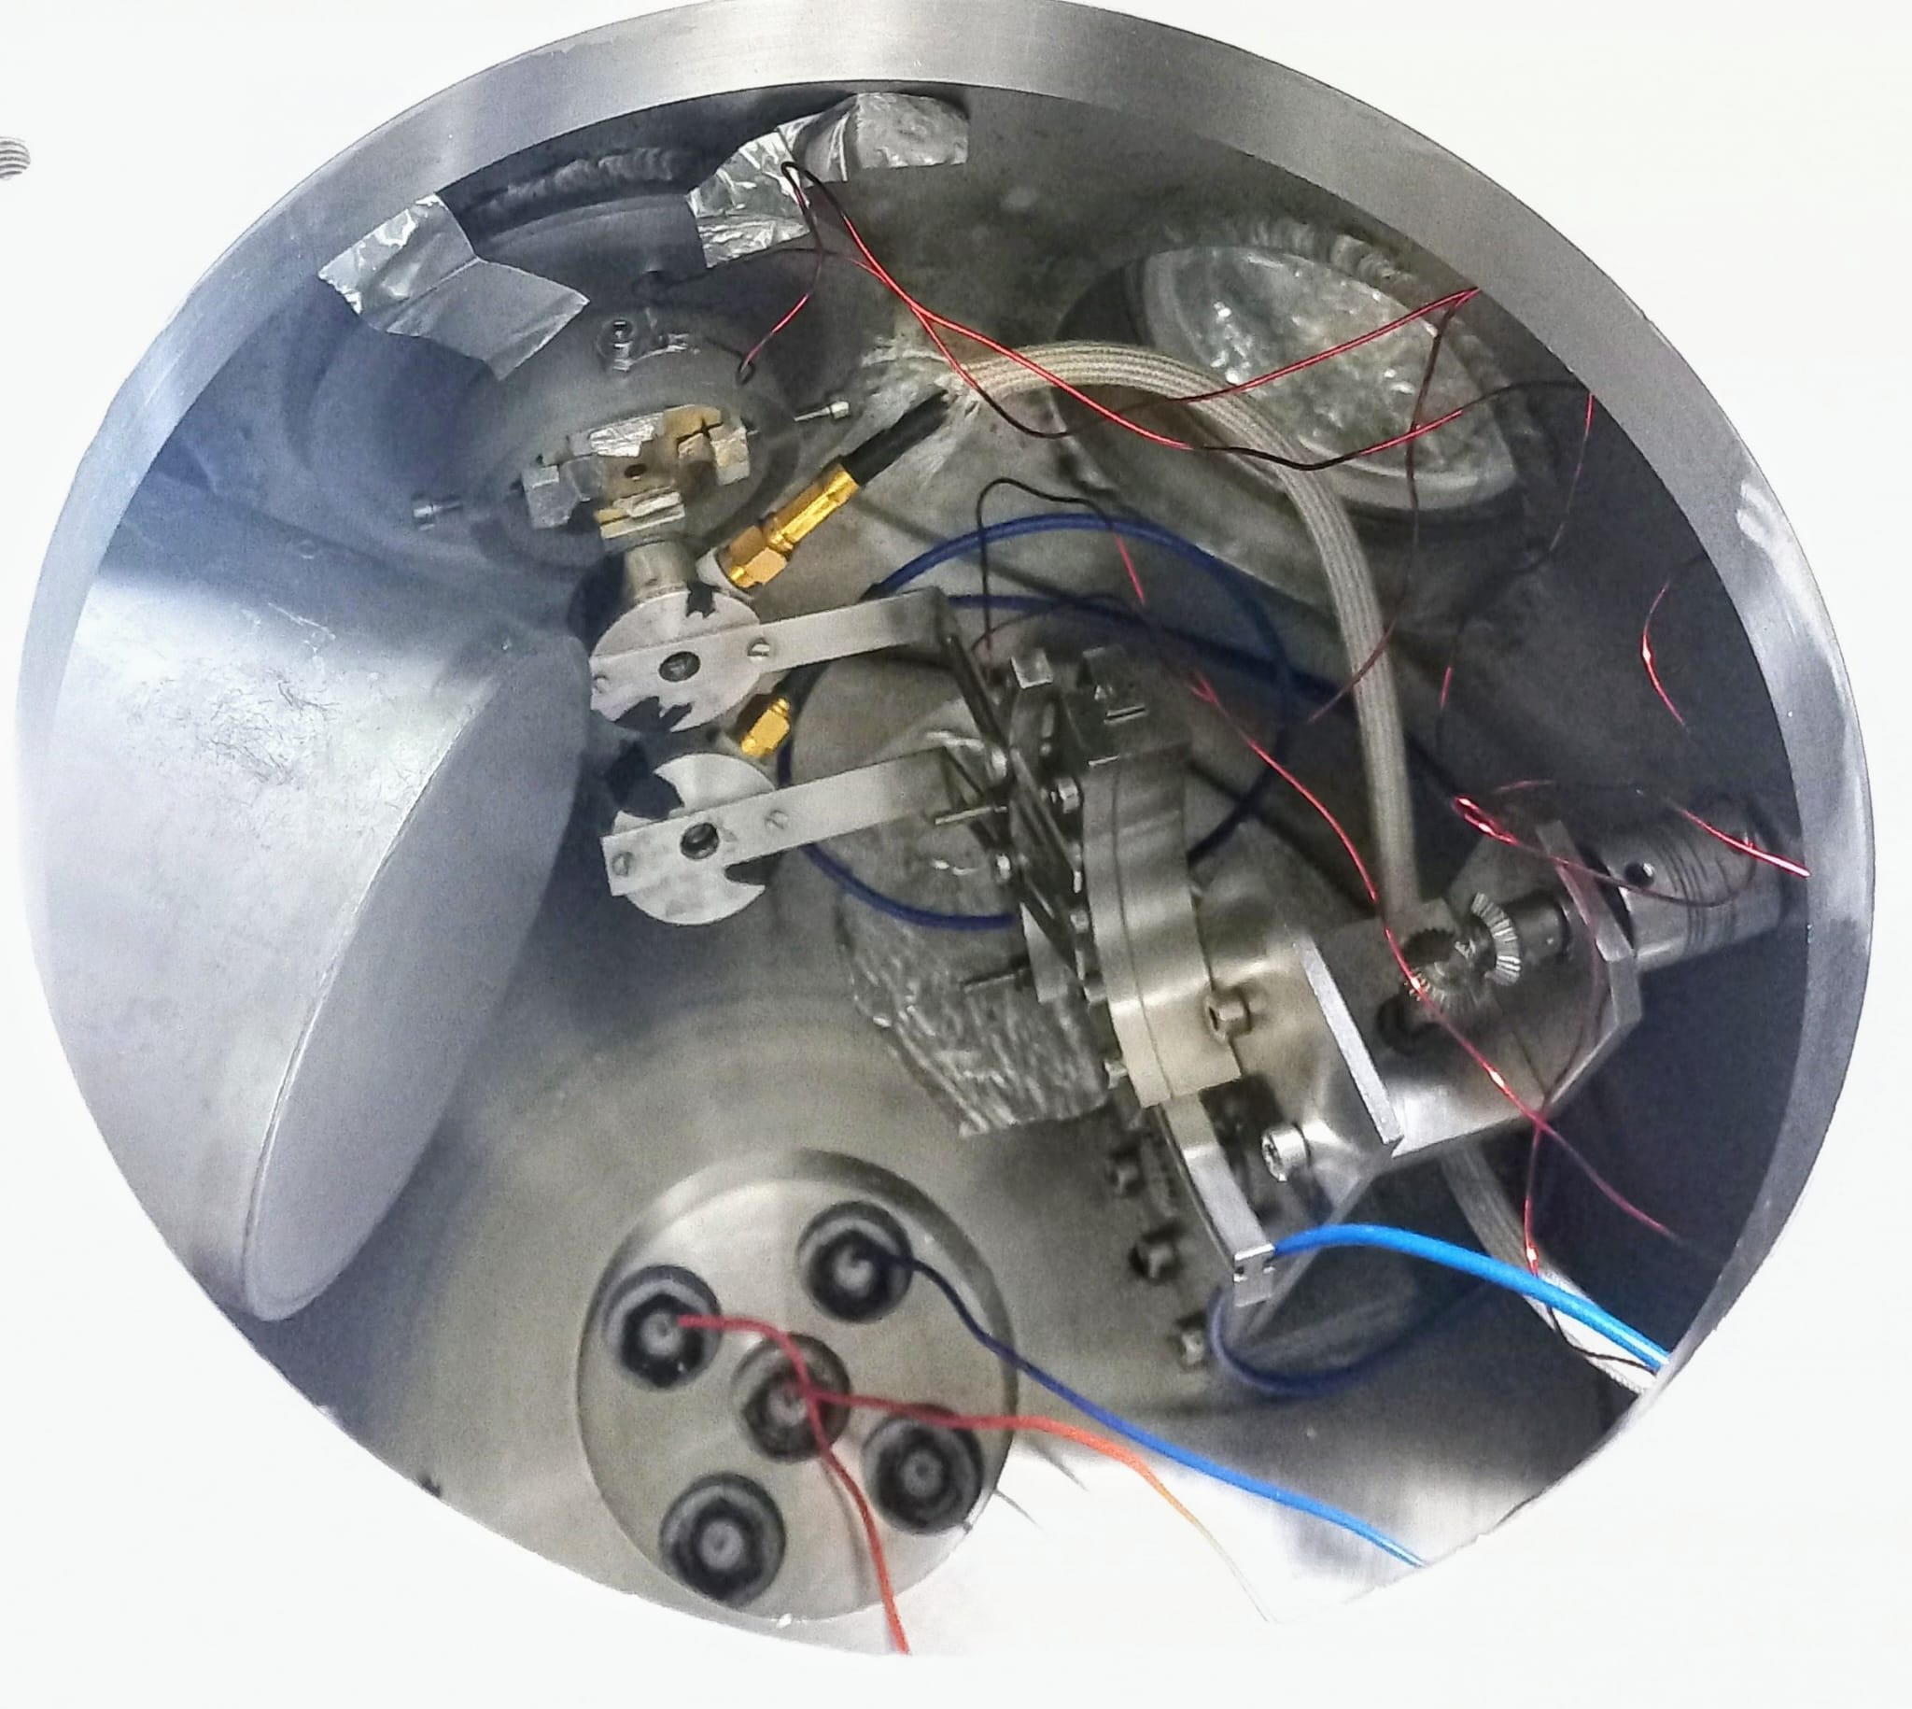
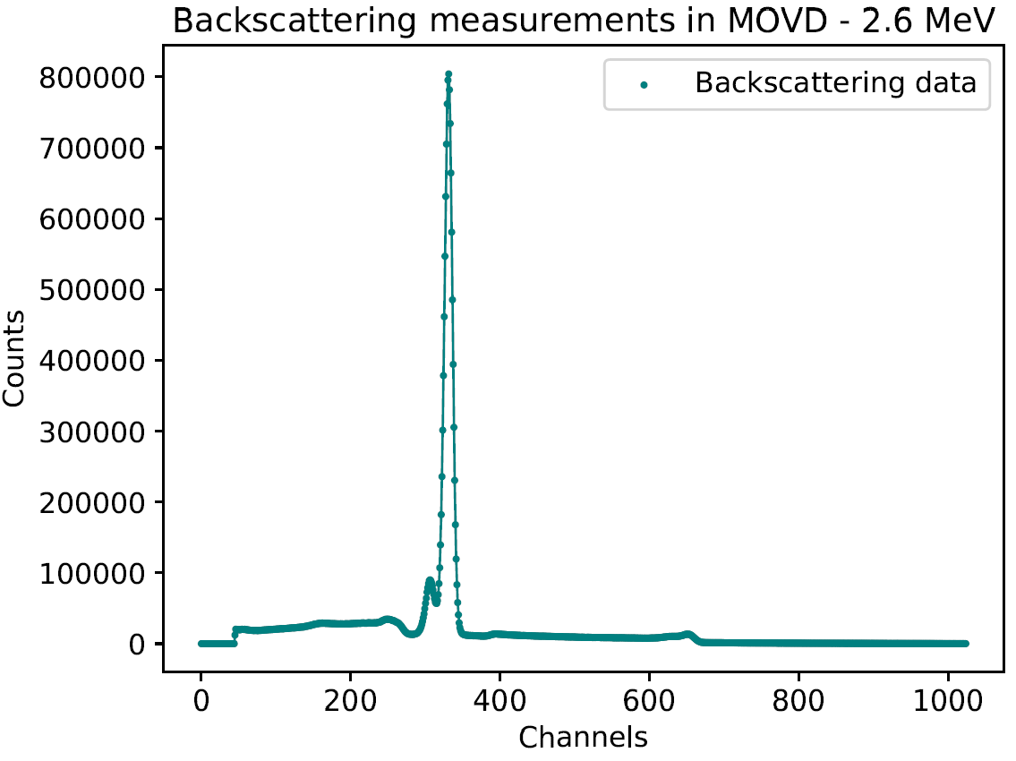
Experimental procedure
Irradiation phase
Measurements done at three energies: 2.6 MeV, 2.8 MeV and 3 MeV
^{PIPS detectors}
^{Sn}
^{Al}
^{HPGe}

Slide 13
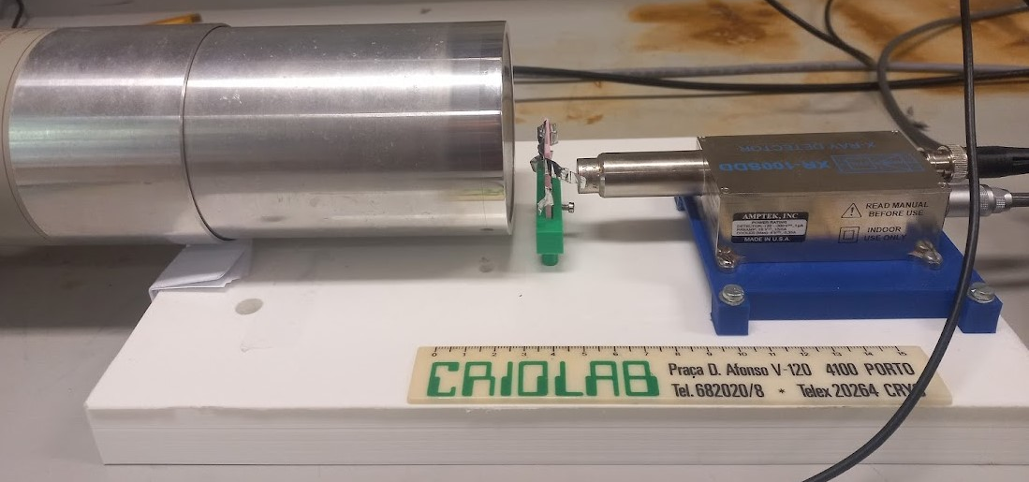

Experimental procedure
Decay acquisition phase
Two detectors used
  BEGe
  XR-100SDD
Calibrated with ²⁴¹Am sources
Efficiencies simulated with
BEGe
XR-100SDD
Target

Slide 14
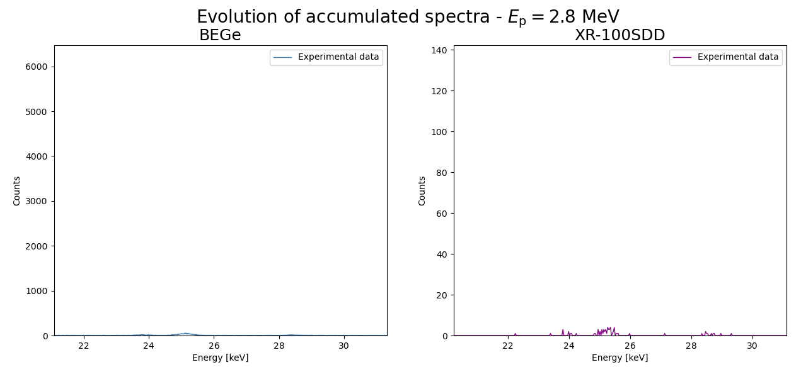
Experimental procedure
Decay acquisition phase

Slide 15
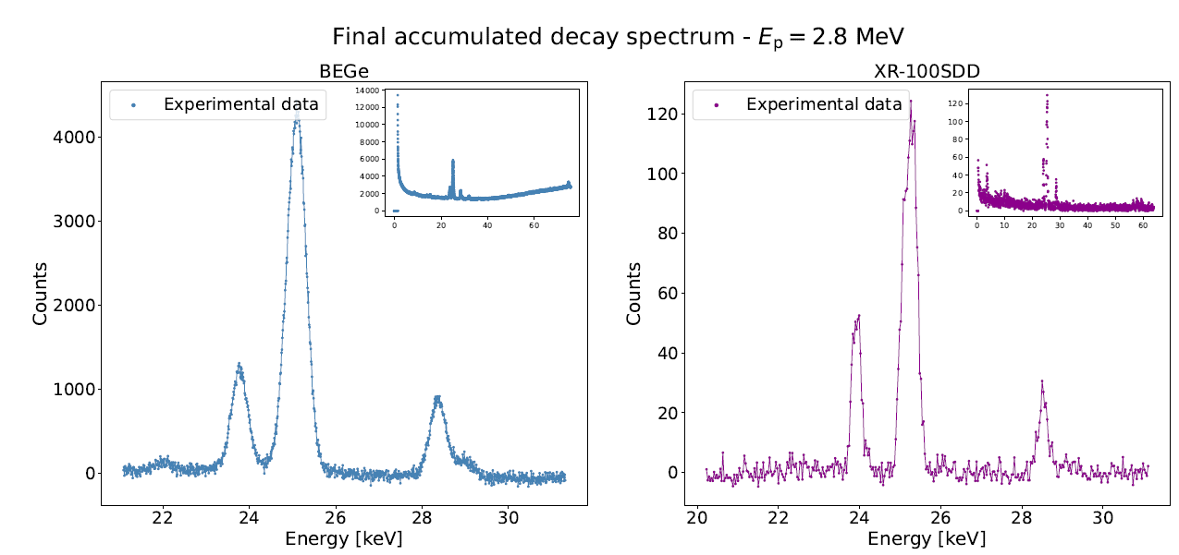
Data analysis
Accumulation study
Kα₁ + Kα₂
Kα₁ + Kα₂
γ
γ
Kβ₁ + Kβ₃
Kβ₁ + Kβ₃
Kβ₂

Slide 16
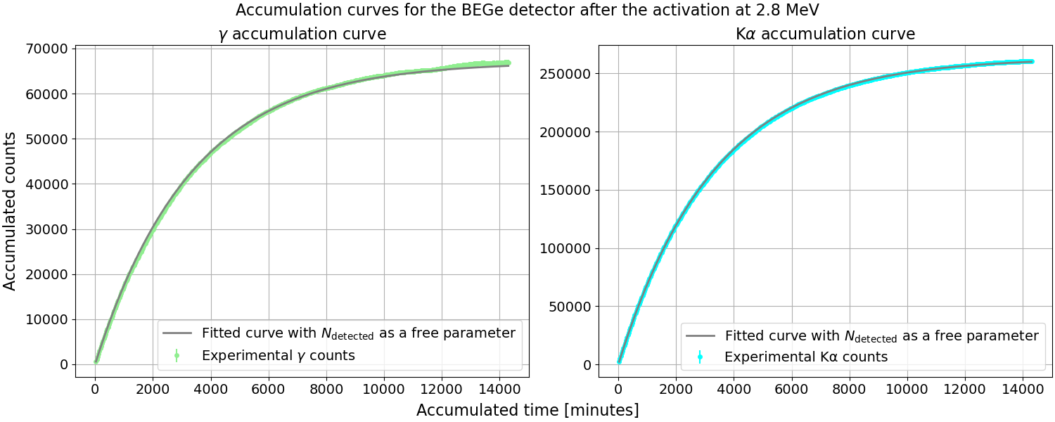
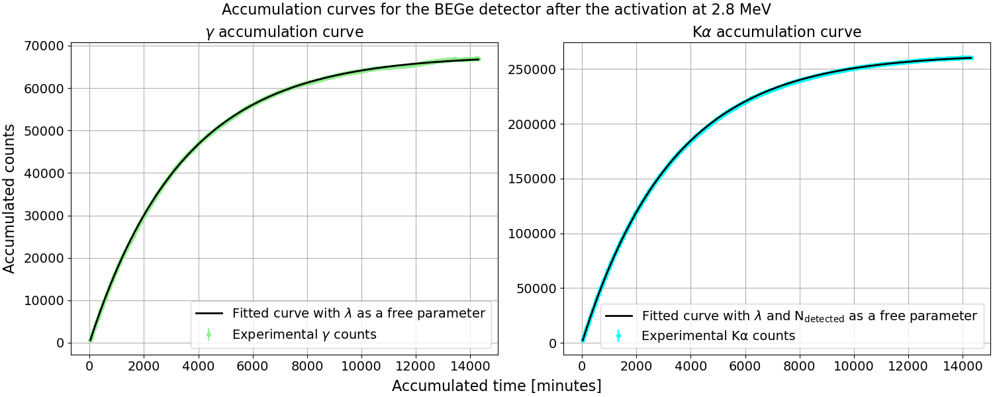
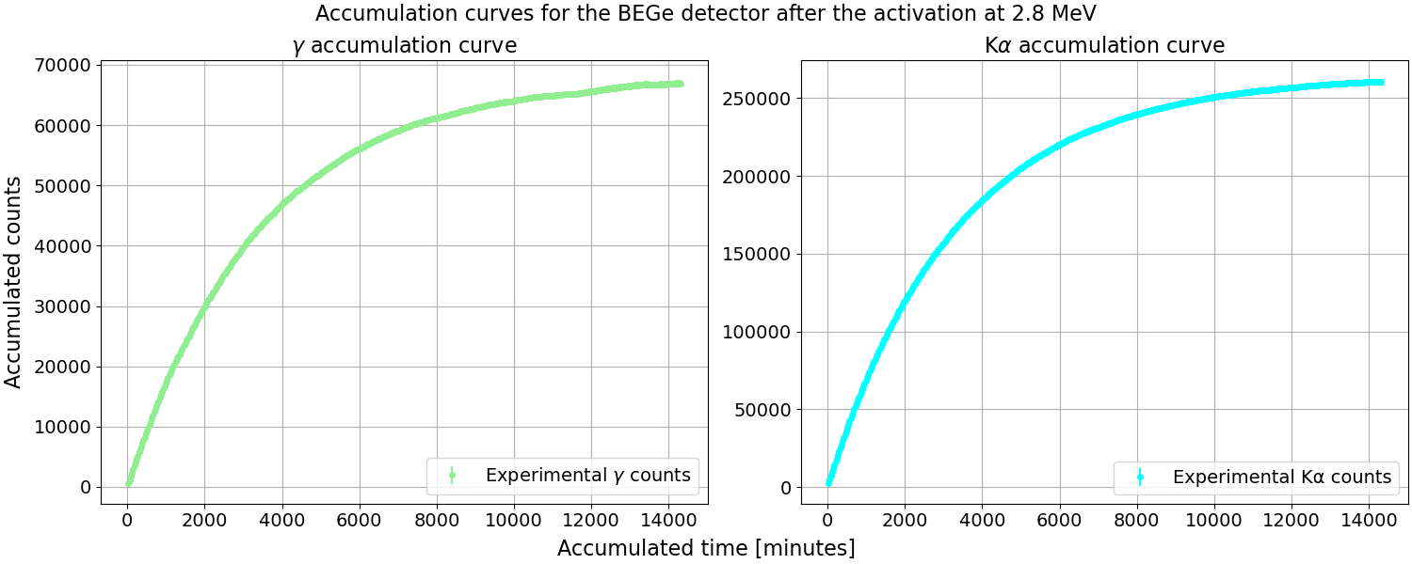
Data analysis
Accumulation study

Slide 17
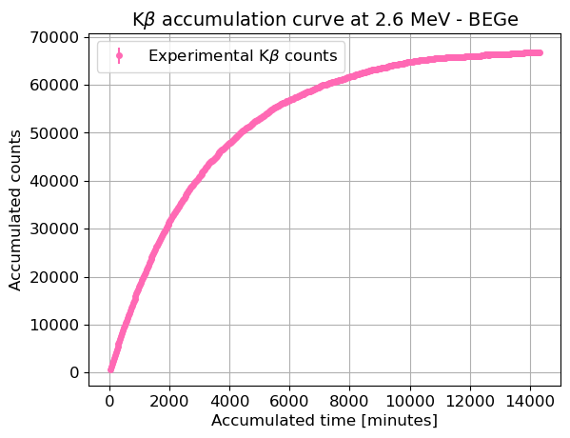
Data analysis
Calculation method

Slide 18
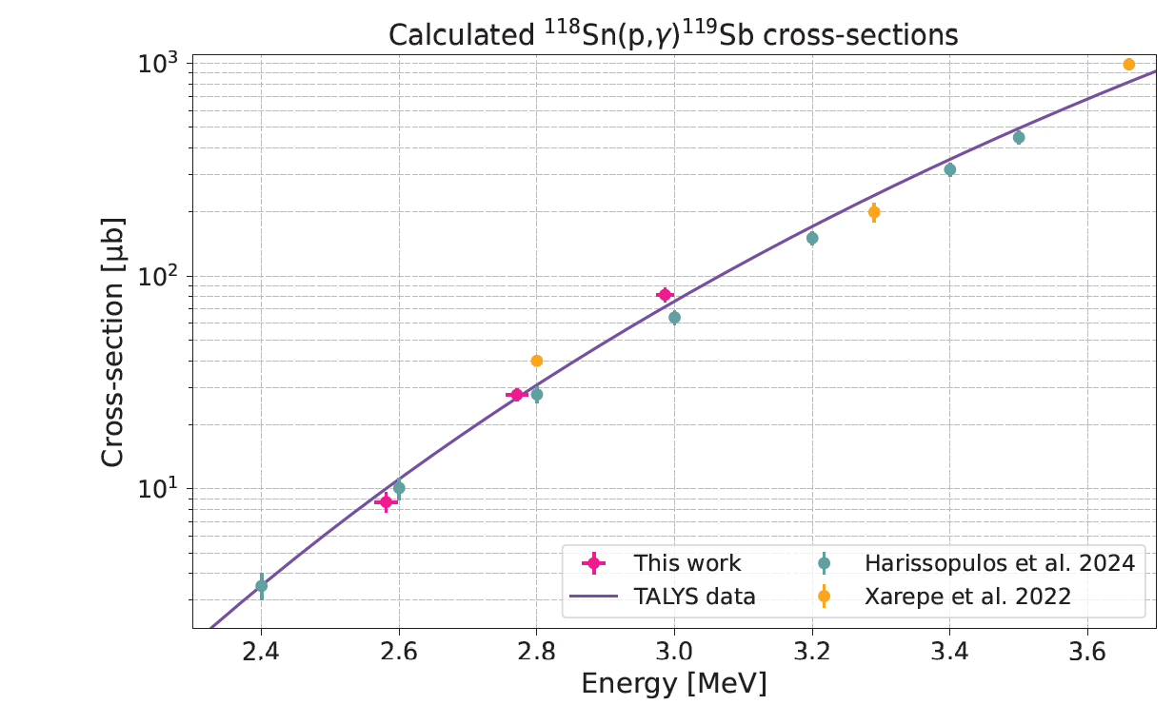
Data analysis
Results
Energy [MeV] | Average cross-section [μb]
2.99 ± 0.01 | 82 ± 6
2.77 ± 0.02 | 28 ± 2
2.58 ± 0.02 | 9 ± 1

Slide 19
Conclusions
Enriched targets allowed for higher reaction yields and guaranteed that no additional reaction channels were opened
Cross-sections in accordance with TALYS calculations and literature values
High detection efficiency may enable the first measurements of cross-sections below 2 MeV for this reaction
Future work

Slide 20

Thank you!
Questions?

