Slide 1



Investigating Δ-Resonances in Neutron Stars:
Insights from Nuclear and Astrophysical
Observations
Conference ID: 17
Vivek Baruah Thapa
Assistant Professor – I
Department of Physics, B. A. College, Assam, India
Visiting Associate,
Inter-University Centre for Astronomy & Astrophysics, Pune, India
In collaboration with
V. Parmar, I. Bombaci (INFN-Pisa), M. Sinha (IIT Jodhpur)
23 September 2025
EuNPC 2025 @ MoHo, Caen

Slide 2

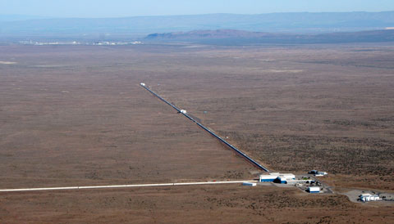
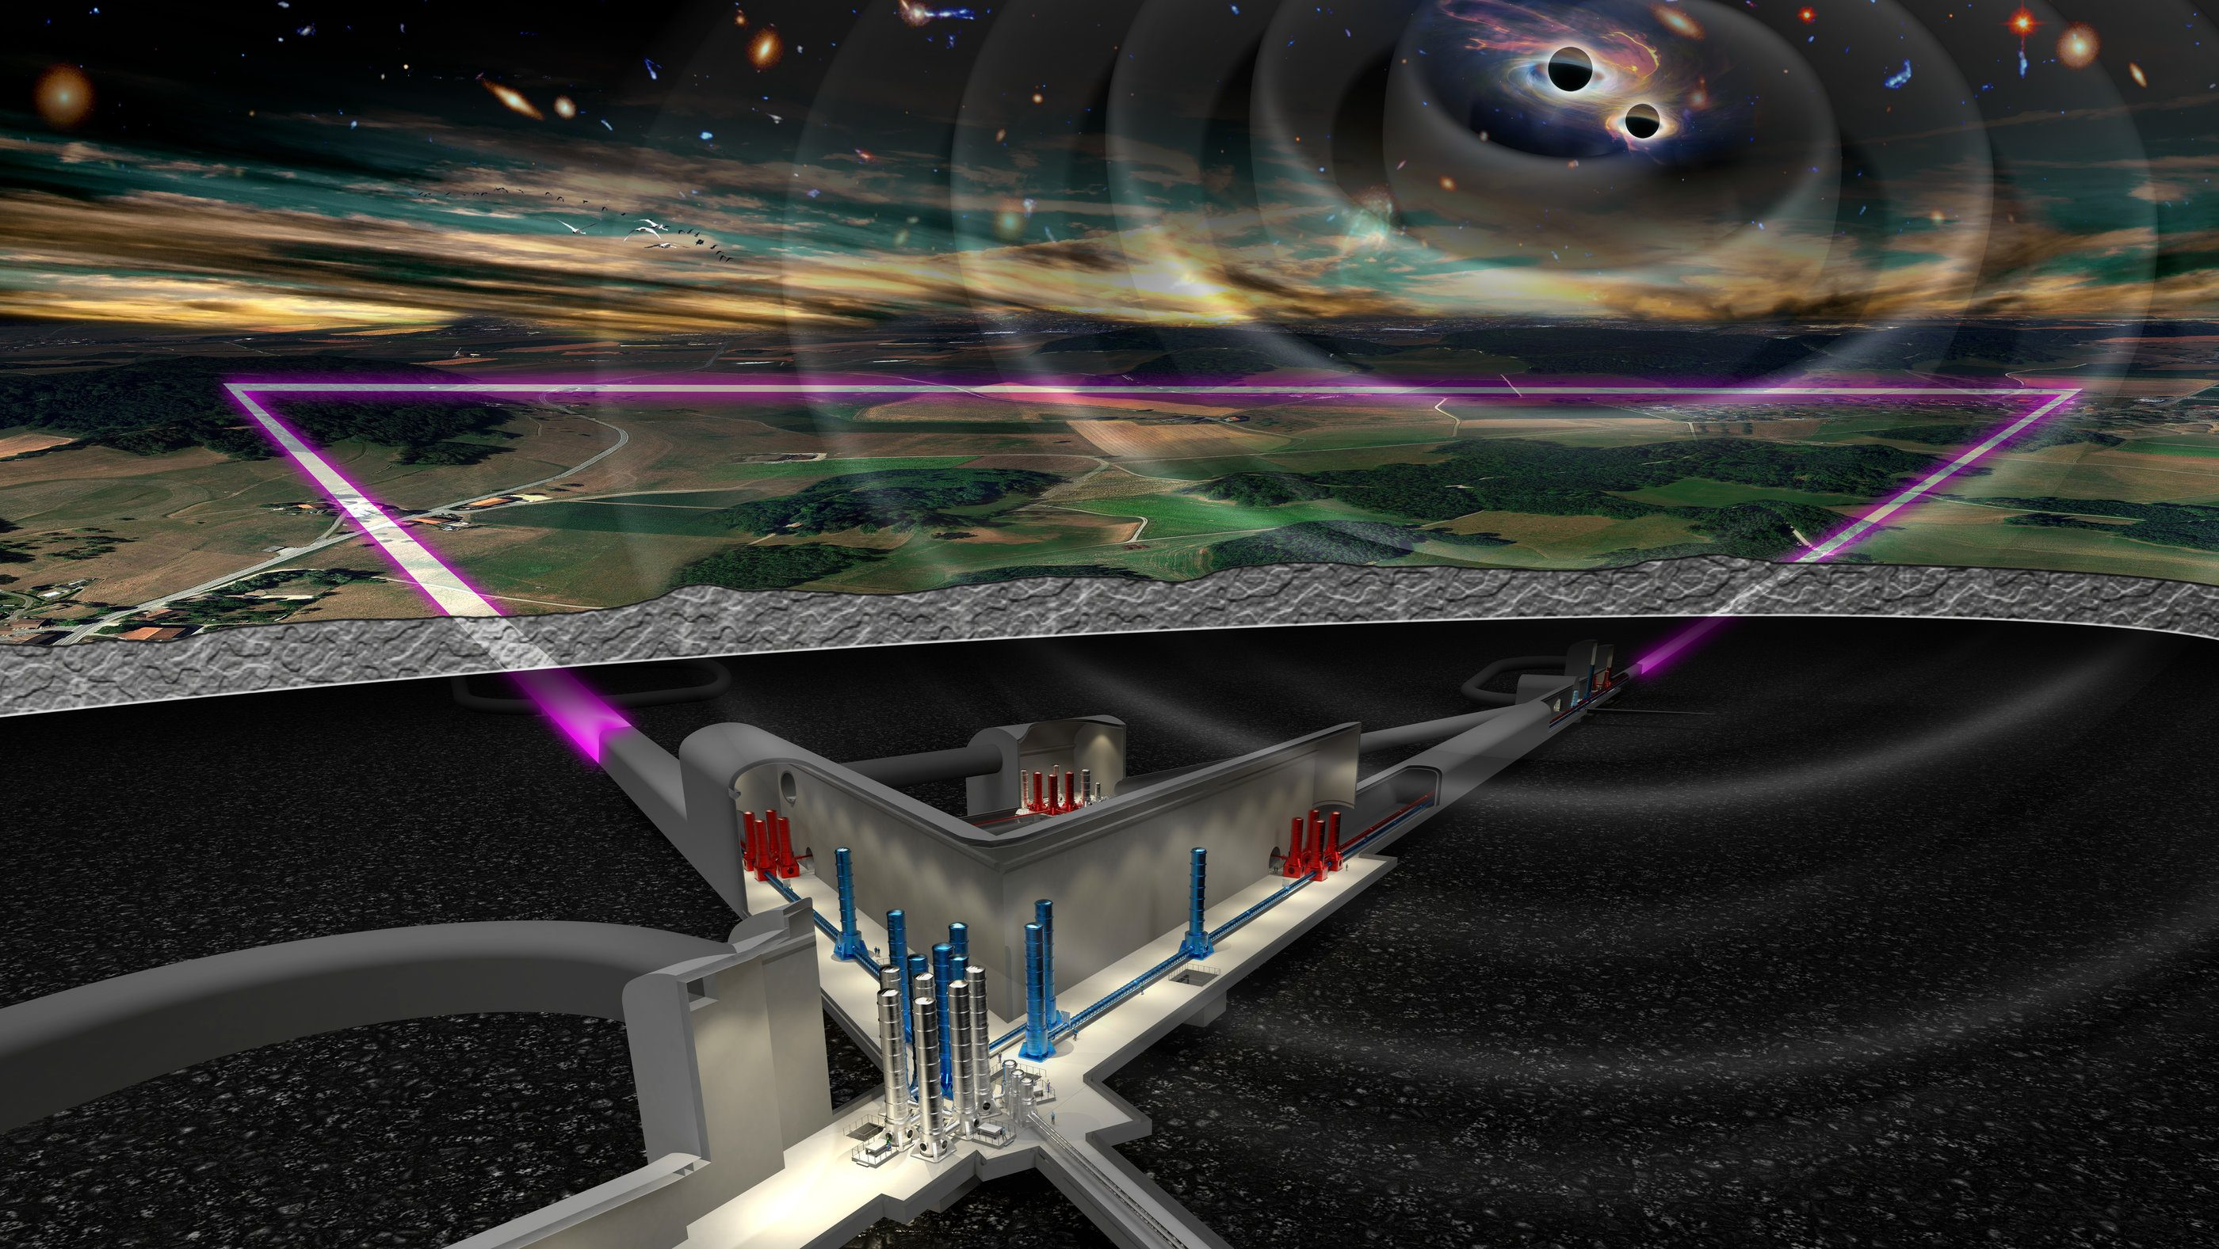
Brief Outline…
Fate of massive stars
Neutron stars
NSs: Multiwavelength observations
Equation of State Models
Methodology
Results
Summary

Slide 3
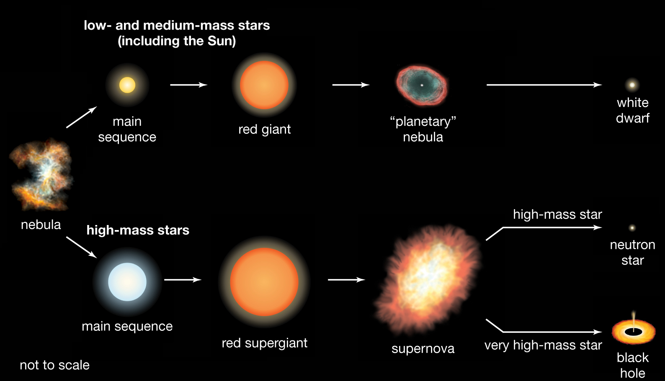


Fate of massive stars
M_{i}<8M ⊙
$$e^{−}$$
degeneracy
M_{i}<25M ⊙
$$n$$
degeneracy
M_{i}>25M ⊙
M_{i}>8M ⊙
Singularity
Figure: Life history of massive stars
Image courtesy: The European Space Agency: Science & Exploration

Slide 4
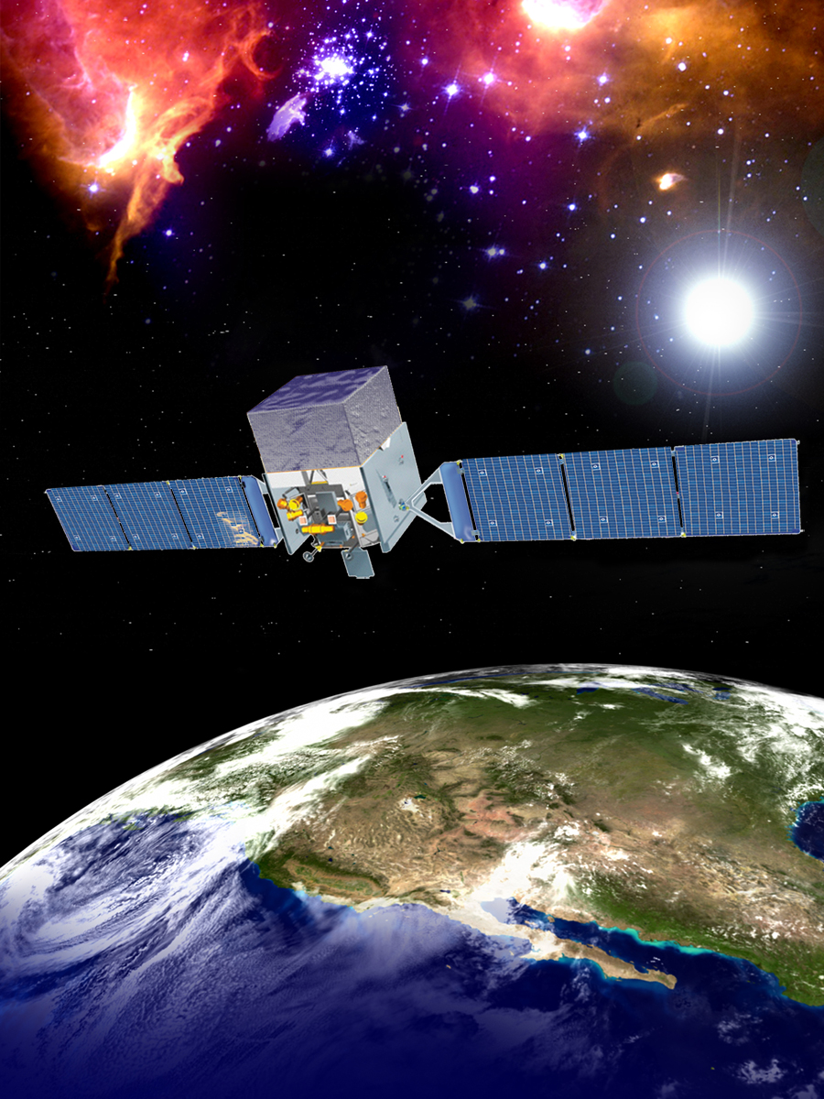
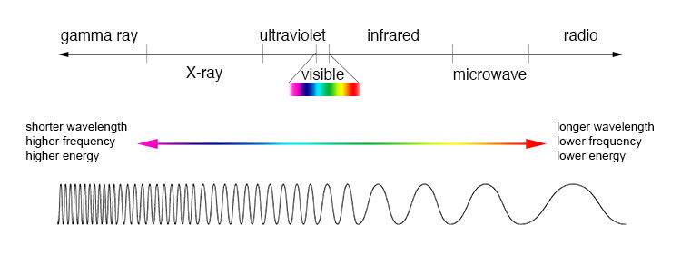
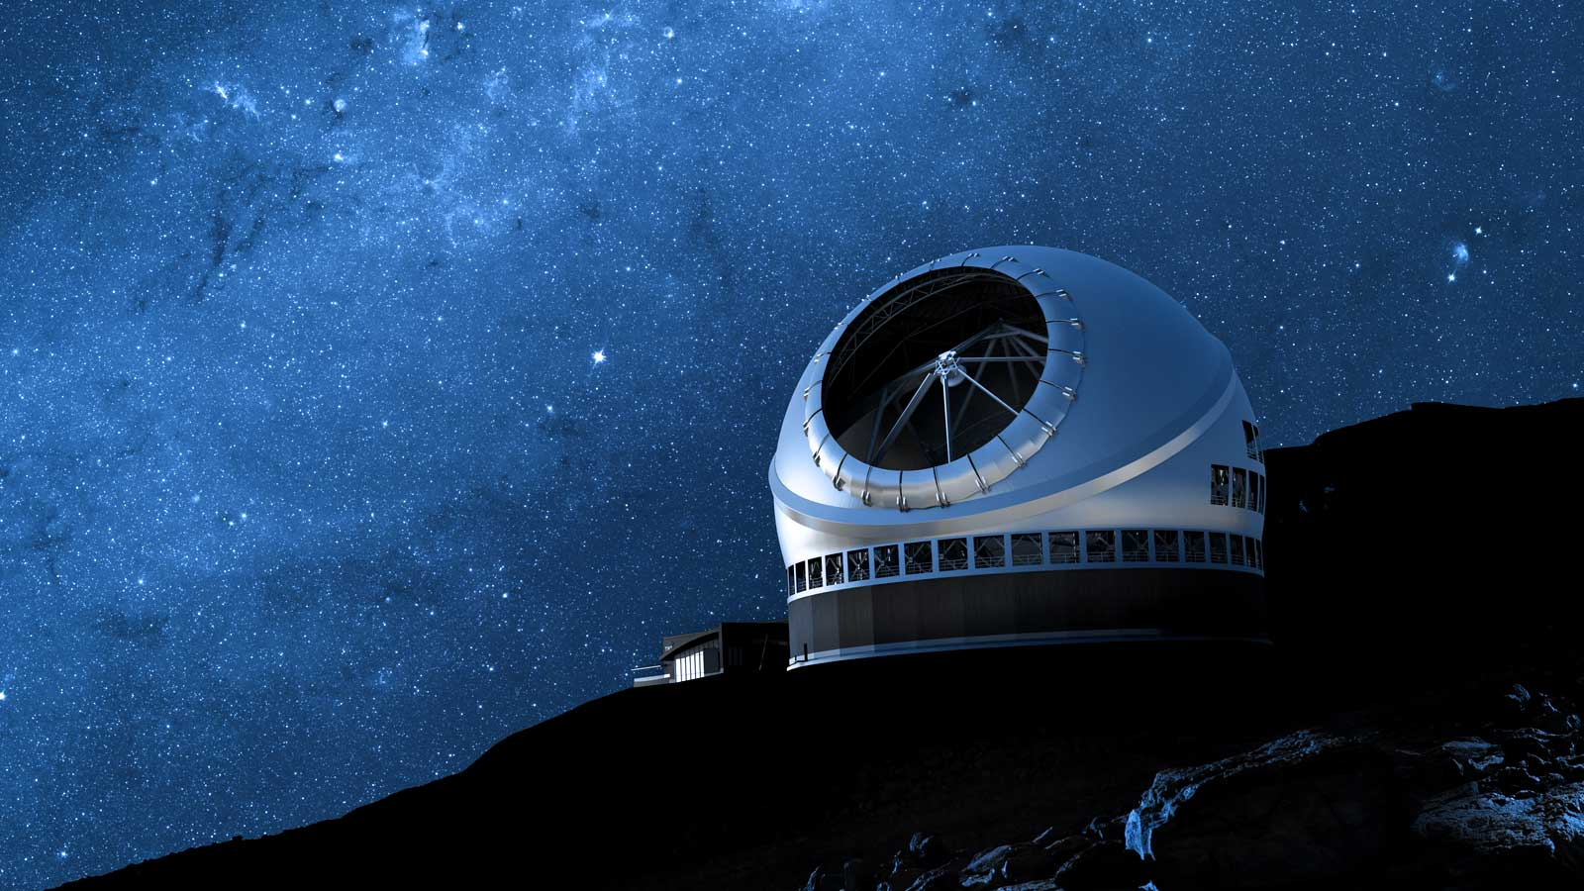
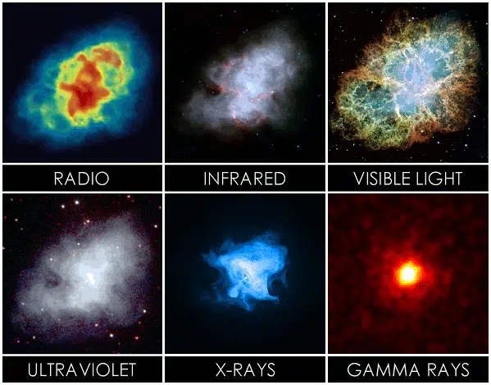
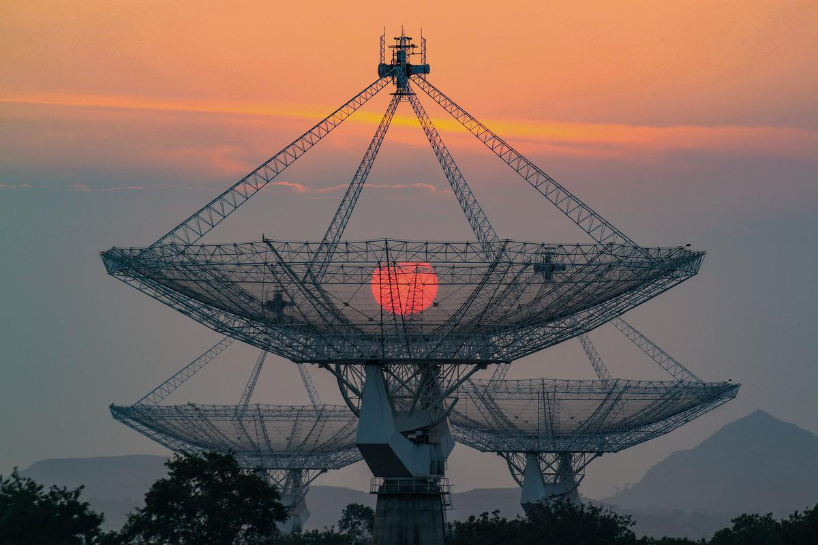
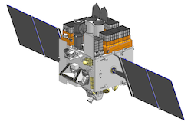
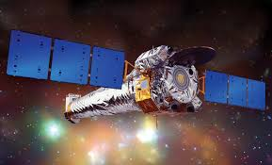
Neutron stars:
Multiwavelength Observations
Gamma (INTEGRAL, Fermi, CTA, THESEUS)
IR/ Optical (LSST, TMT)
Radio (uGMRT, SKA)
Multiwavelength (AstroSat)
X-ray (Chandra, NICER)

Slide 5
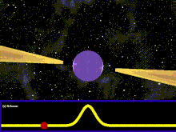
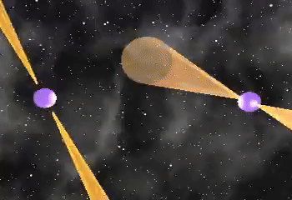
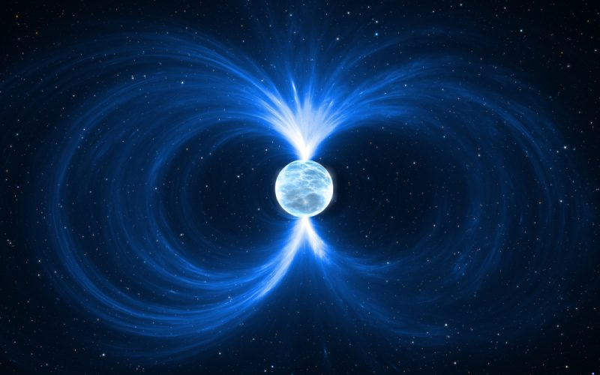
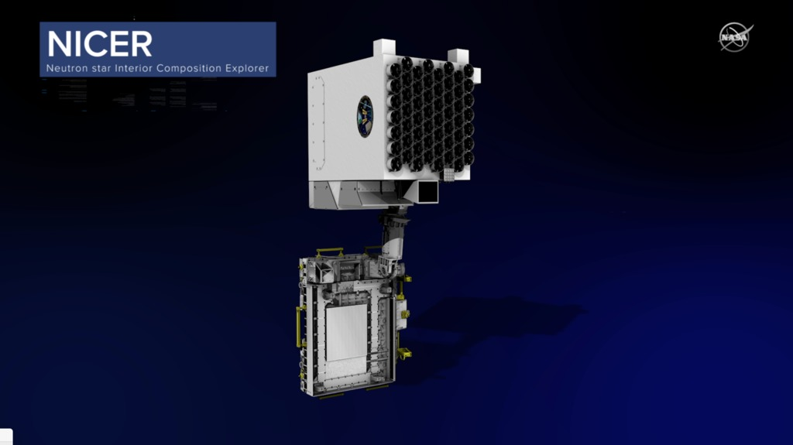
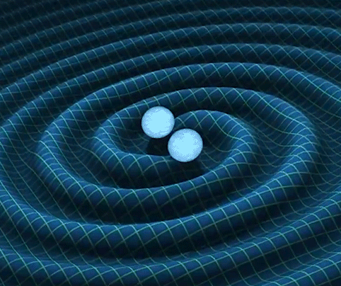
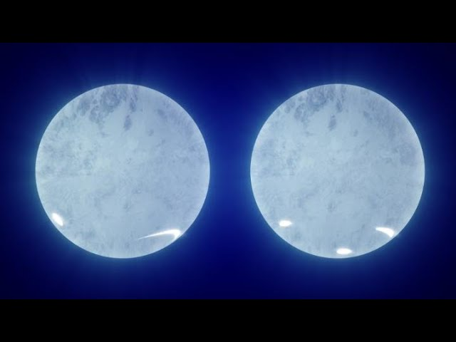
Neutron star Astrophysical Observables
Mass
Spin-Period
Magnetic Field
Radius
Temperature
Tidal Deformability

Slide 6
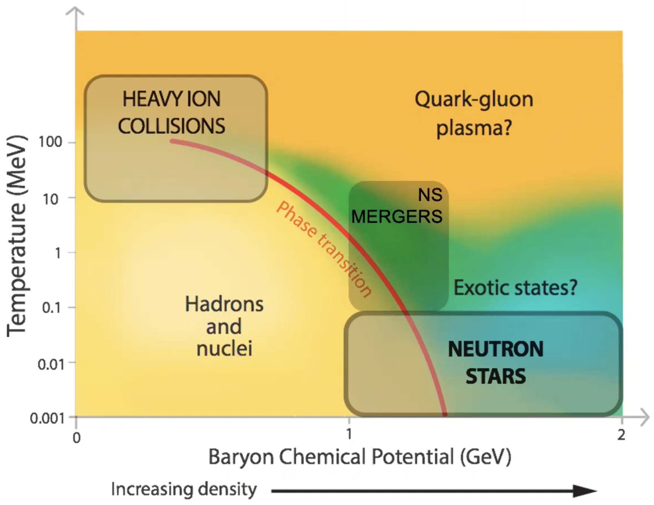
Why Neutron Stars?
Astrophysics: What is the minimum mass of a black hole?
Nuclear Physics: What are the limits of nuclear existence and the EOS of nuclear matter?
Particle Physics: Dense quark matter and quark gluon plasma exist inside the star?
General Relativity: Rapidly rotating neutrons stars as a source of gravitational waves?
Condensed Matter Physics: Signatures for the liquid to crystalline state transition?
Figure: QCD phase diagram
The primary focus is to investigate the possibility of exotic particles in dense matter equation of state and its implications on NS observables

Slide 7
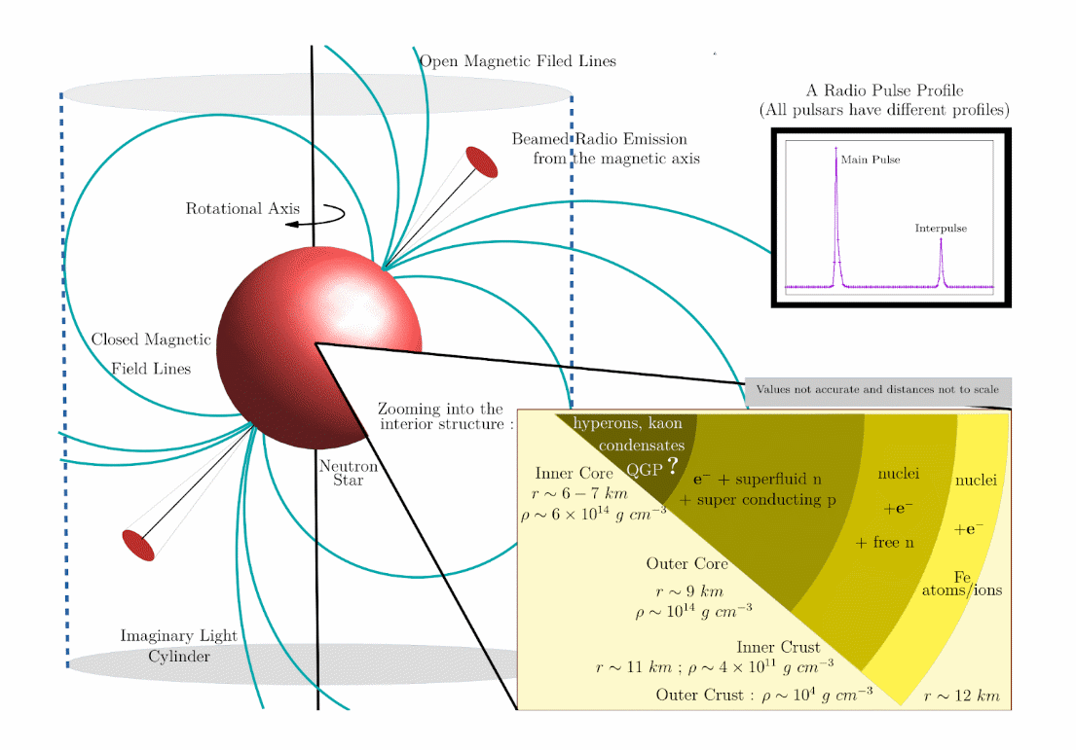
Anatomy of a neutron star

Slide 8
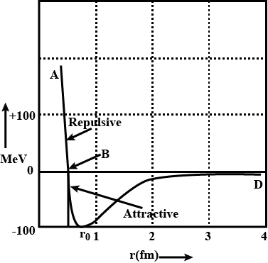
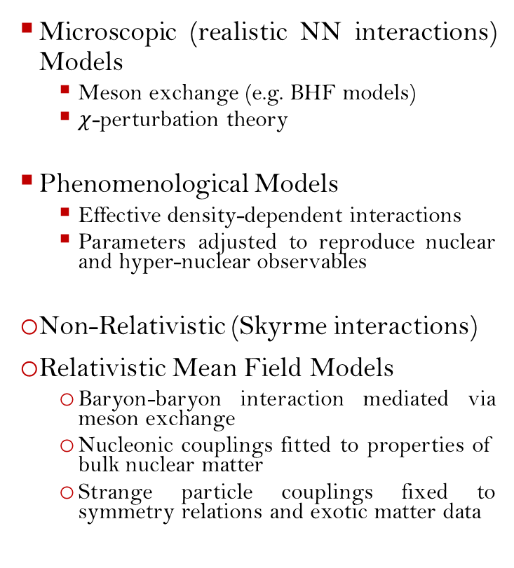
NS Equation of State:
Theoretical Models
Microscopic (realistic NN interactions) Models
  Meson exchange (e.g. BHF models)
  $χ$-perturbation theory
Phenomenological Models
  Effective density-dependent interactions
  Parameters adjusted to reproduce nuclear and hyper-nuclear observables
Non-Relativistic (Skyrme interactions)
Relativistic Mean Field Models
  Baryon-baryon interaction mediated via meson exchange
  Nucleonic couplings fitted to properties of bulk nuclear matter
  Strange particle couplings fixed to symmetry relations and exotic matter data
Figure: Radial profile of NN potential

Slide 9
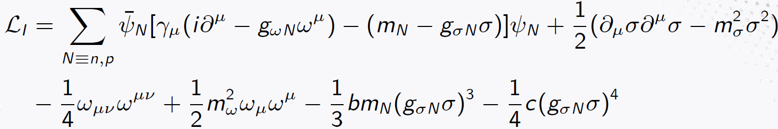
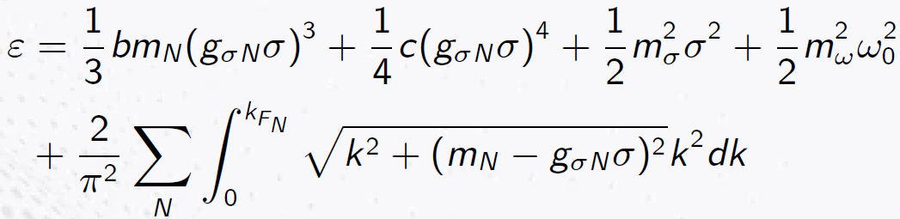
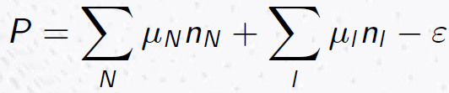

$σ−ω$model (QHD-I)
In this model, the long and intermediate range attractive interactions between the nucleons are mediated via the exchange of neutral isoscalar-scalar σ-meson and that of the short-range repulsive interactions are via exchange of neutral isoscalar-vector ω-meson
After implementing the Euler-Lagrange equation as well as the energy – momentum tensor, we get the energy density as
The matter pressure is then evaluated via the Gibbs-Duhem relation as
Coupling Constants

Slide 10
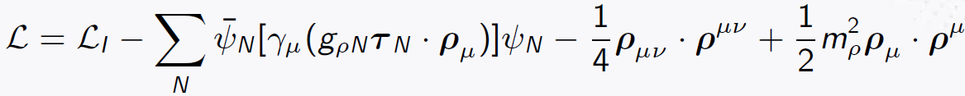
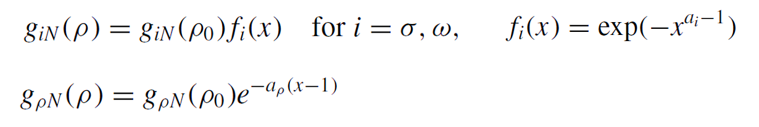
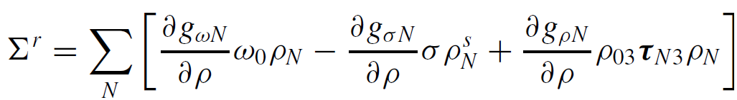
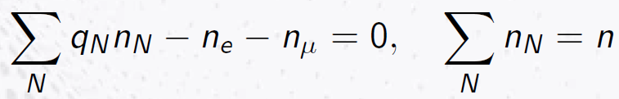


$σ−ω−ρ$model (QHD-II)
In order to provide an account of another nuclear saturation parameter namely, symmetry energy (E_{sym}) the incorporation of the charged isovector-vector ρ-meson is necessary
The chemical equilibrium conditions between species in the particle spectrum is given by $μ_{j}=μ_{n}−q_{j}μ_{e}$where, $q_{j}$ is the charge of j-th baryon, $μ_{e}$, $μ_{n}$ denote the chemical potentials of electron and neutron respectively
The dense matter EoS is calculated self-consistently taking into account two additional constraints, viz. charge neutrality and baryon number conservation
In case of Density-Dependent RMF Model, the couplings are considered as:
And a self-energy re-arrangement term is introduced in the chemical potential expression to maintain thermodynamic consistency,
x=ρ/ρ₀

Slide 11
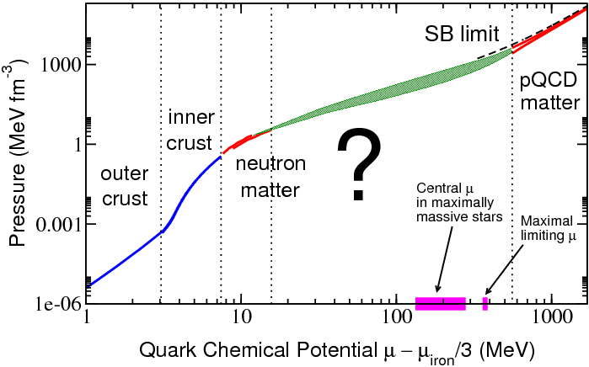
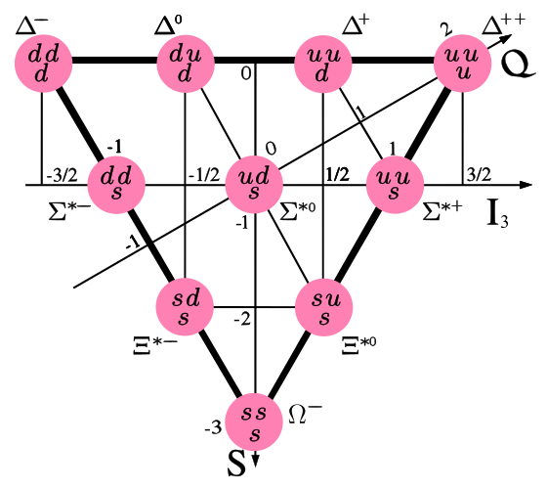
Inclusion of exotic particle spectrum:
(Inner core composition)
Can ∆-resonances exist inside neutron stars?
What can be their implications?
∆-puzzle?
Figure adapted from Fraga, Eduardo S. et al., 2015
Traditionally dismissed due to their high energy thresholds, ∆s may appear at surprisingly low densities (~1.5 - 2ρ₀) in modern relativistic models (Li et al., 2018; Ribes et al., 2019, Thapa et al., 2021)
Few suggest they might not appear inside the neutron star at all (T.F. Motta et al. 2020)

Slide 12
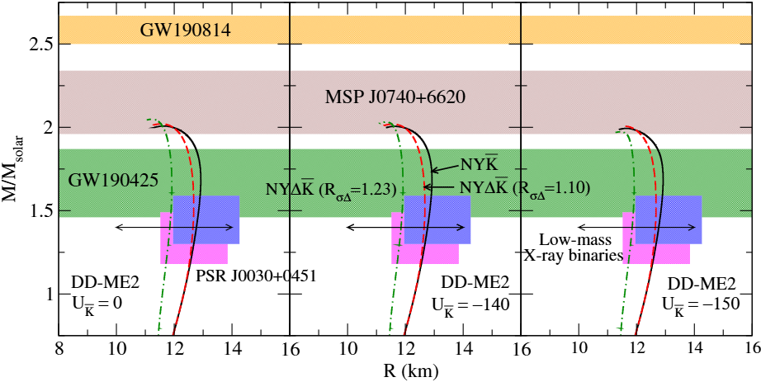
∆-Resonances in NSs:
A case study (Thapa et al., 2021)
Intermediate Soft
Higher Stiff
Early onset
Substantial decrease in NS radius

Slide 13
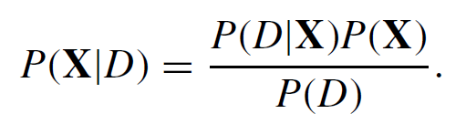
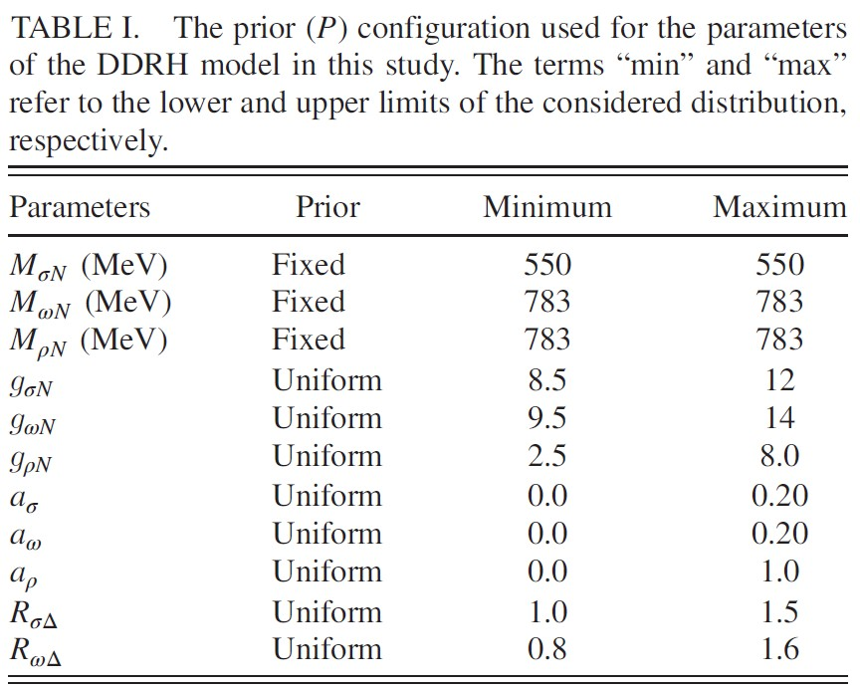
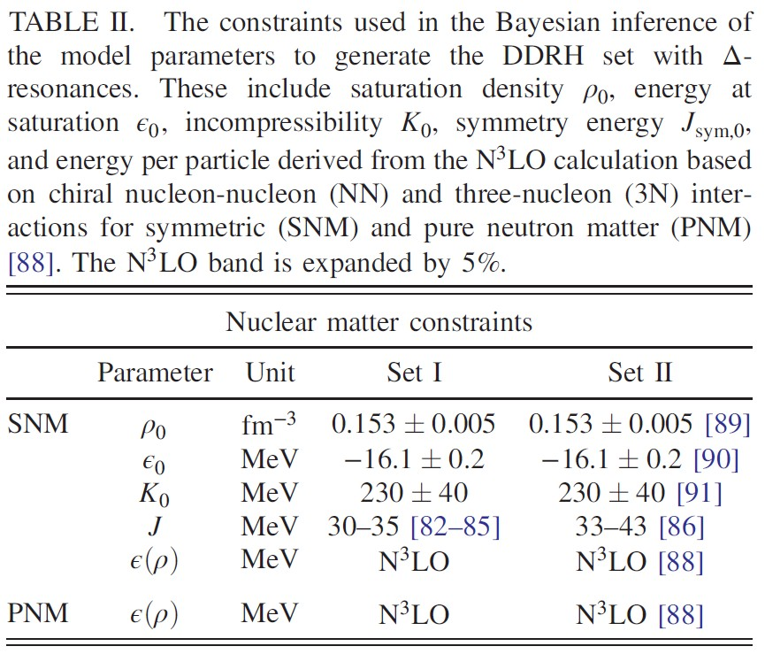
∆-resonances in NS matter:
Bayesian Inference
The probability distribution of a set of model parameters X, with given data (D) based on Bayes’ theorem is given by,
Constraints:
Nuclear matter saturation properties
Symmetric (SNM) and Pure neutron (PNM) matter
GW170817
PSR J0030+0451 & PSR J0740+6620
Incorporating data from NMP, gravitational waves (GW), and NICER mass-radius measurements, we adopted the following total likelihood functional form:
Around 15,000 valid EoS configurations for each of the two sets (Set-I and Set-II) EoS configurations have been obtained after evaluating the likelihood functions

Slide 14
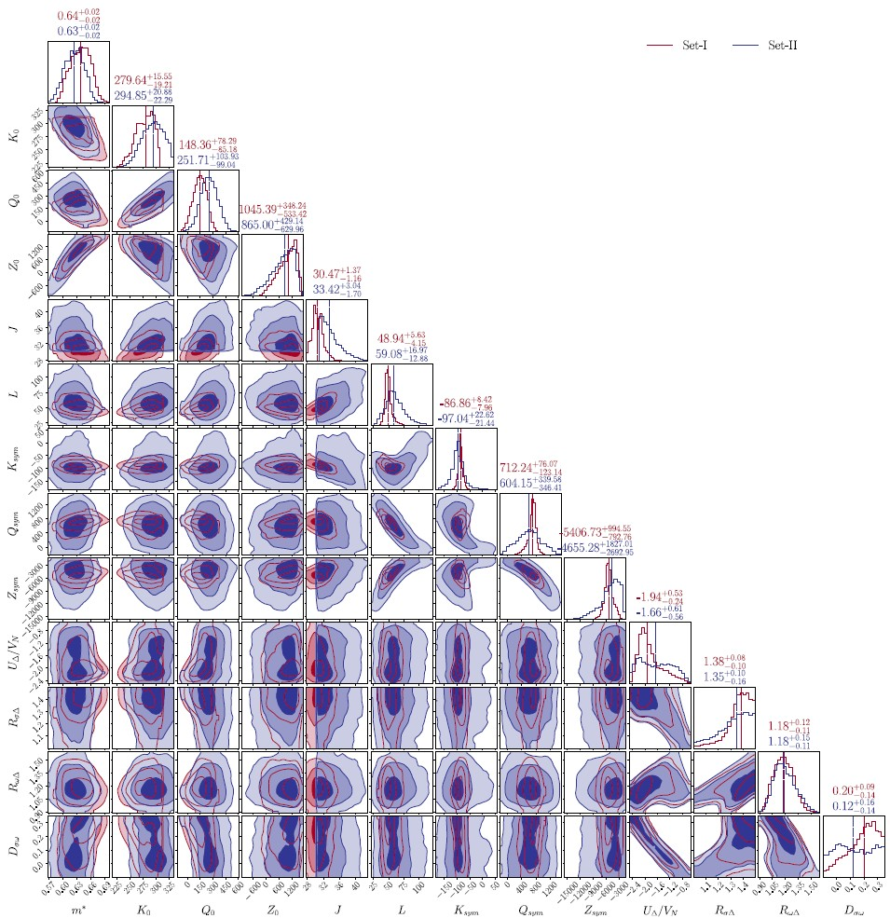
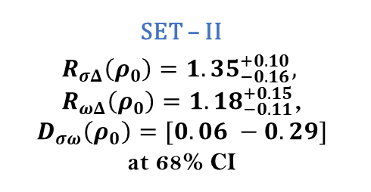
Marginalized posterior distributions
(Matter Parameters)
SET – II
$$R_{σΔ}\left(ρ_{0}\right)=1.35_{−0.16}^{+0.10},$$
$R_{ωΔ}\left(ρ_{0}\right)=1.18_{−0.11}^{+0.15}$,
$$D_{σω}\left(ρ_{0}\right)=[0.06 −0.29]$$
at 68% CI
PREX – II is not favoured:
  Even with Set – II, posterior values lean toward lower symmetry energy and slope disfavoring the high values
Inferred values of ∆-potential lie within the range [1.05 – 2.22], varied through coupling strengths rather than fixed inputs

Slide 15
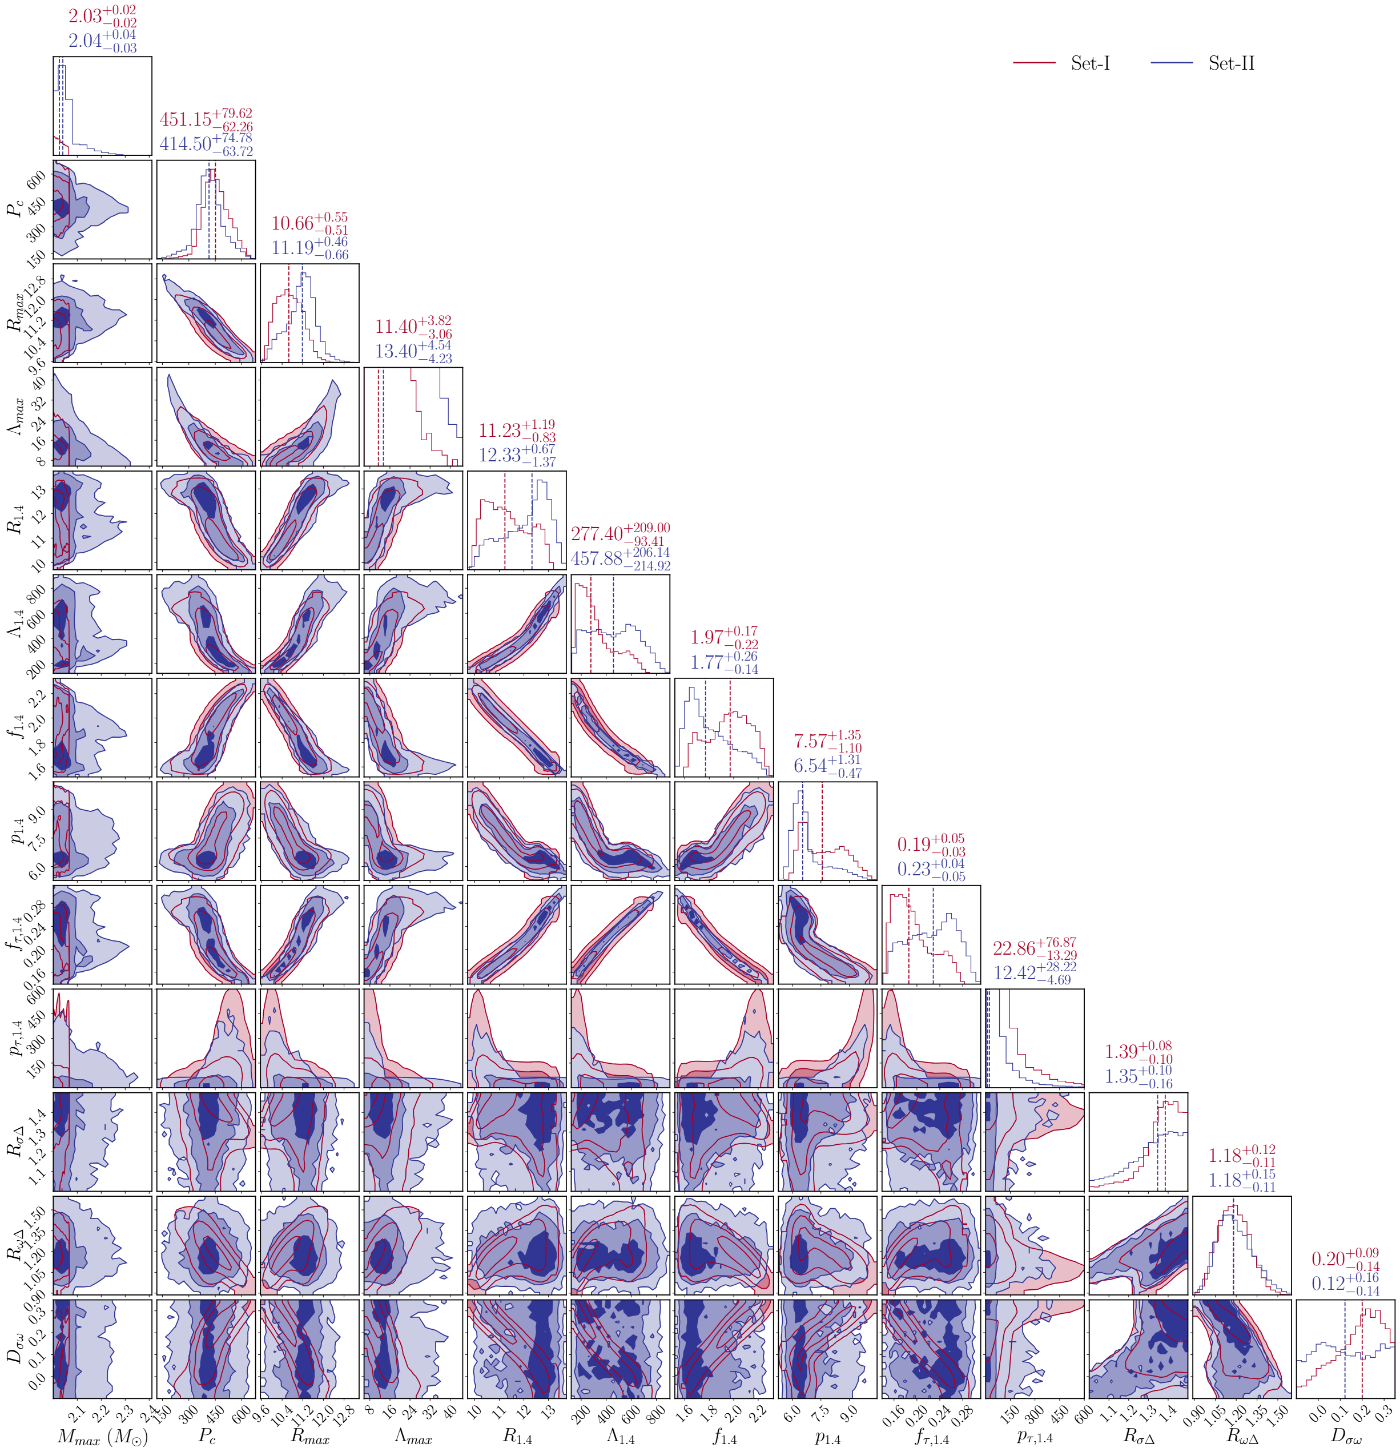


Marginalized posterior distributions
(NS properties)
SET – II
$R_{1.4}=12.33_{−1.37}^{+0.67}$ km,
$Λ_{1.4}=457.{88}_{−214.92}^{+206.14}$,
$f_{1.4}=1.77_{−0.14}^{+0.26}$ kHz,
$p_{1.4}=6.54_{−0.47}^{+1.31}$ kHz,
at 68% CI
$D_{σω}=$ $R_{σΔ}−R_{ωΔ}$shows a strong correlation with neutron star properties such as radius and tidal deformability. This implies that the relative strength of scalar and vector ∆-couplings is more critical than individual magnitudes

Slide 16
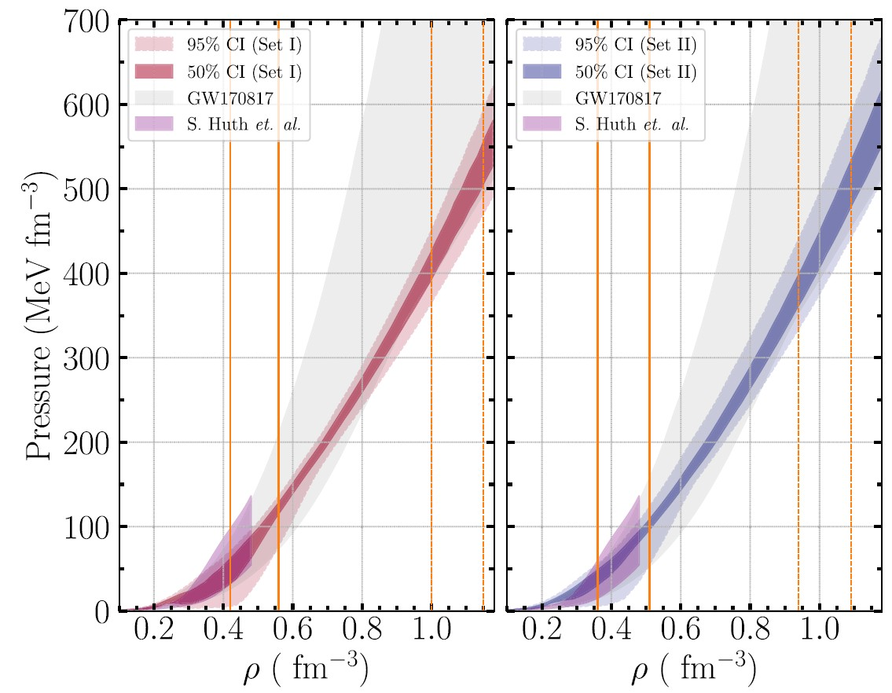
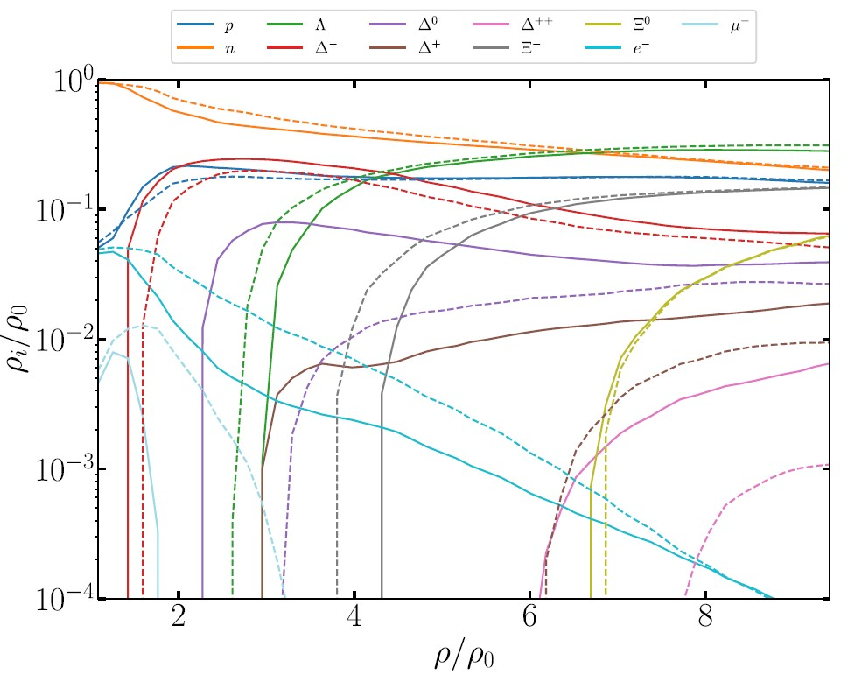



Equation of State
Set – II
(Higher symmetry energy)
  Produces stiffer EoS
  Delays onset of ∆-resonances
Spinodal instabilities handled implementing Maxwell’s construction
Impact of ∆-resonances:
  Softens EoSs at lower densities
  Ensures stiffness to support ~ 2 $M_{⊙}$ NSs.
Central densities for maximum mass NSs
Figure: Joint probability
distribution ${P(P}_{m},ρ)$
Central densities for 1.4 $M_{⊙}$

Slide 17
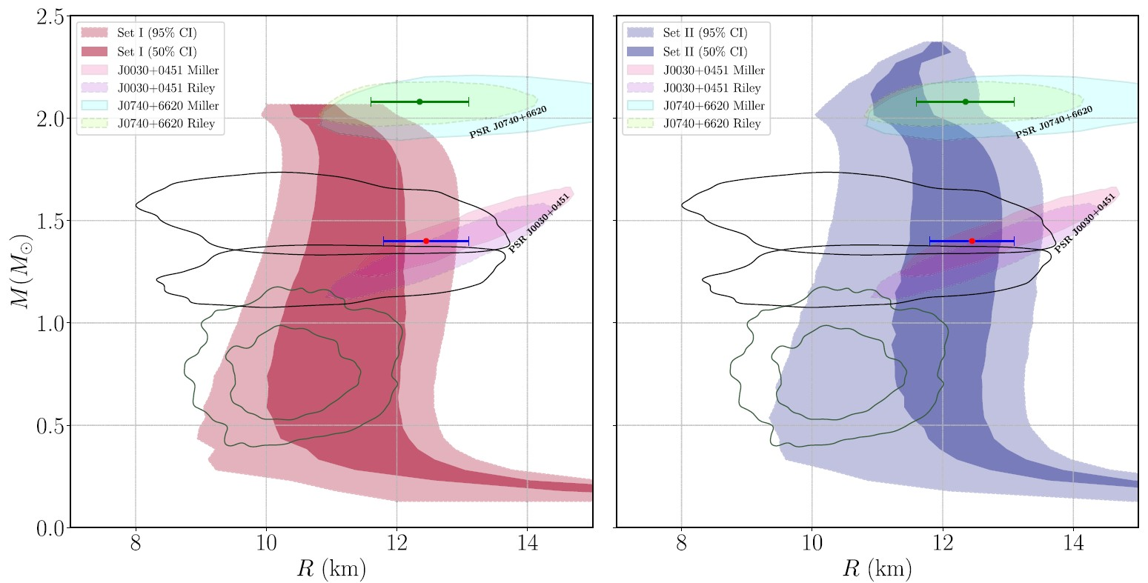
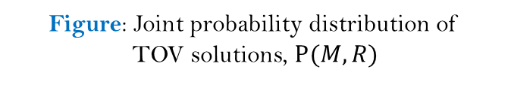
∆-Resonances in view of NS observables
(TOV solutions)
Explains compactness of HESS J1731347.
Figure: Joint probability distribution of
TOV solutions, $P(M,R)$

Slide 18
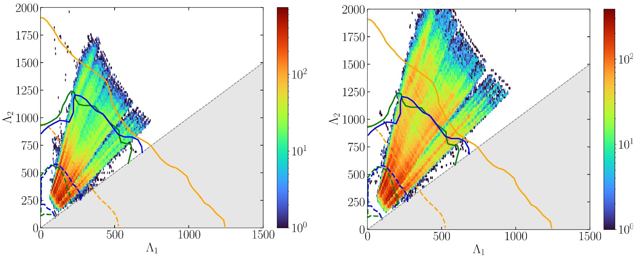
∆-Resonances in view of NS observables
(Tidal Deformability)
Figure: Posterior probability distributions
P(Λ₁, Λ₂)

Slide 19
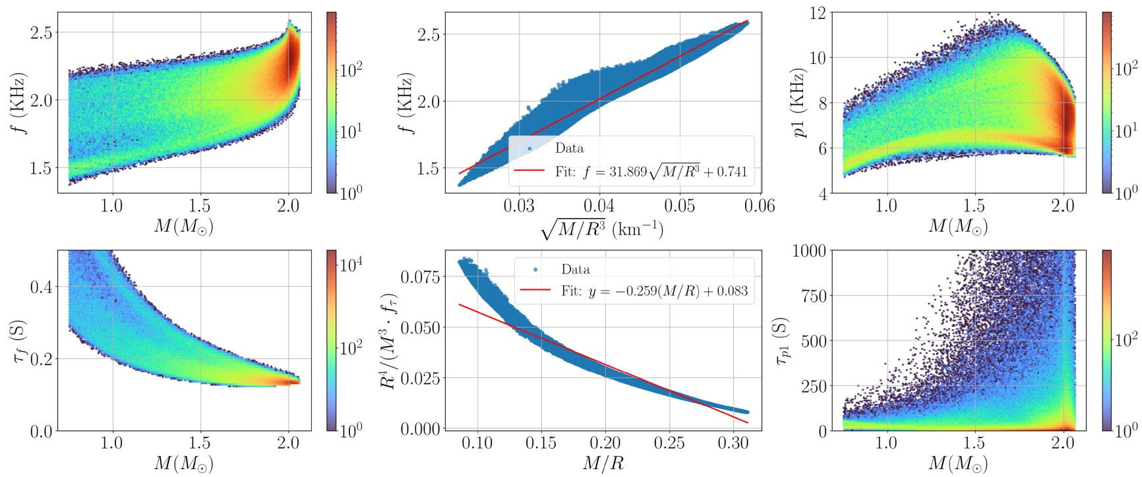
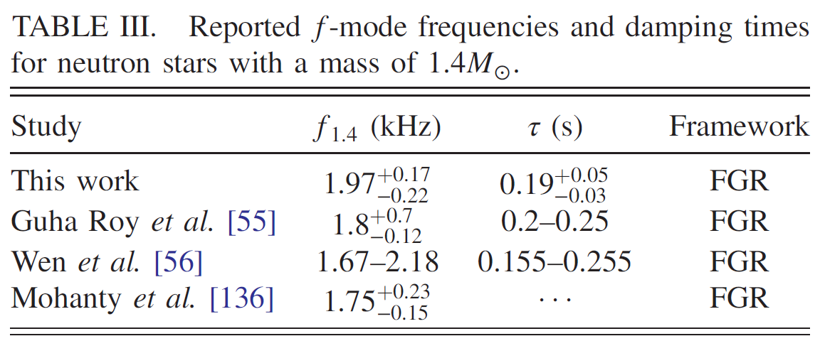


∆-Resonances in view of NS observables
(Quasinormal Modes)
$$f=a\sqrt{\frac{M}{R^{3}}}+b$$
$$\frac{R^{4}}{M^{3}τ_{f}}=a\frac{M}{R}+b$$

Slide 20
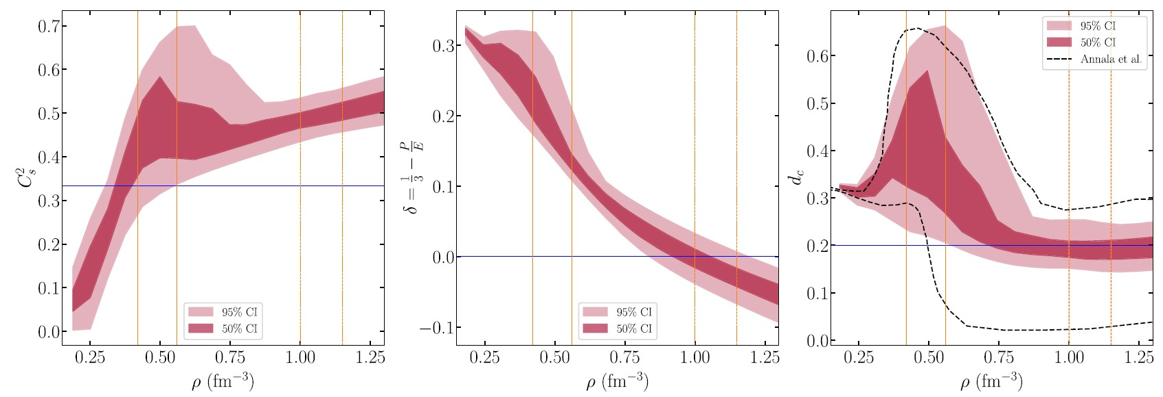

Speed of sound
As matter approaches the conformal limit, the value of δ tends to zero
It has also been suggested that conformal matter can be characterized by the condition d_{c} < 0.2
The findings indicate that the proposed signatures of deconfined matter are model dependent rather than universal, and thus require further study
$d_{c}=\sqrt{δ^{2}+{\left(\frac{dδ}{dlnE}\right)}^{2}}$

Slide 21

Takeaways…
Conclusion:
Δ-resonances may appear at low densities (1.5 – 2 ρ₀) and can significantly soften the EoS, reducing neutron star radii → can explains compact objects like HESS J1731
The inferred Δ-resonance potential (${U_{Δ}}/{U_{N}}$) lies in the range 1.05 – 2.22, varied through coupling strengths rather than fixed values
Bayesian inference with nuclear & astrophysical constraints yields ~15,000 valid EoSs per set, disfavouring high symmetry energy
Δ-resonances strongly influence NS observables – radius, tidal deformability, oscillation modes – and proposed deconfined/conformal matter signatures appear model dependent, requiring further tests
Future Outlook:
Merger & Cooling Signatures: Explore Δ effects on binary neutron star mergers, post-merger gravitational waves, and neutrino cooling pathways

Slide 22


Acknowledgement
Thank you for your time and attention
I am grateful to the SOC, EuNPC2025 for providing me the “Early Career Researchers Grant” and the opportunity to present this work
I acknowledge the travel support from Council of Scientific & Industrial Research (CSIR) and University Grants Commission (UGC), Govt. of India
Email: vivek.thapa@bacollege.ac.in
Readers may go through the works:
  Physical Review D 103, 063004 (2021) (arXiv: 2102.08787)
  Physical Review D 112, 023016 (2025) (arXiv: 2503.07256)

