Slide 1

Electron screening: answer to an old problem from a new perspective
EuNPC2025
Caen,
September 2025
Aleksandra Cvetinović
Jožef Stefan Institute, Ljubljana

Slide 2
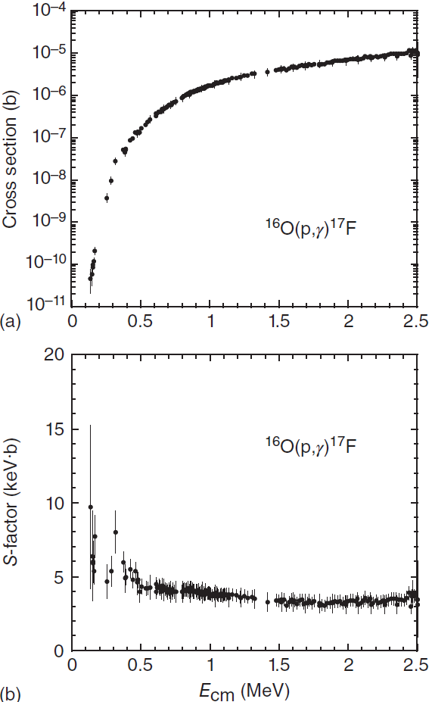
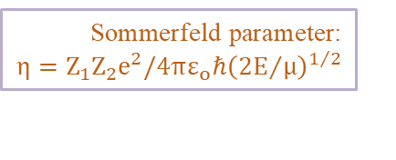

Introduction: Nuclear Reactions at the Gamow window
In nuclear reactions induced between charged particles at low energies, when the energy of the incident beam in the center-of-mass system is far below the Coulomb barrier, tunneling is the only way the fusion process can happen.
$$\text{Som}\text{m}\text{erfeld} \text{parameter}\text{:}$$
$$η=Z_{1}Z_{2}e^{2}/4πε_{o}ℏ{\left({2E}/μ\right)}^{1/2}$$
Gamow factor:
$G=exp\left(−2πη\left(E\right)\right)$ - describes the s-wave penetration through the Coulomb barrier of point like charges
Cross section:
$$σ\left(E\right)=S\left(E\right)E^{−1}\exp\left(−2πη\left(E\right)\right)$$
$E$ – geometrical factor
Astrophysical 𝑆-factor:
$S\left(E\right)$ - contains all nuclear effects and in the case of non-resonant reactions varies smoothly with energy
Simplified model, not to scale!
C. Iliadis, Nuclear Physics of Stars - Second, Revised and Enlarged Edition, Wiley-VCH, Weinheim, 2015.

Slide 3
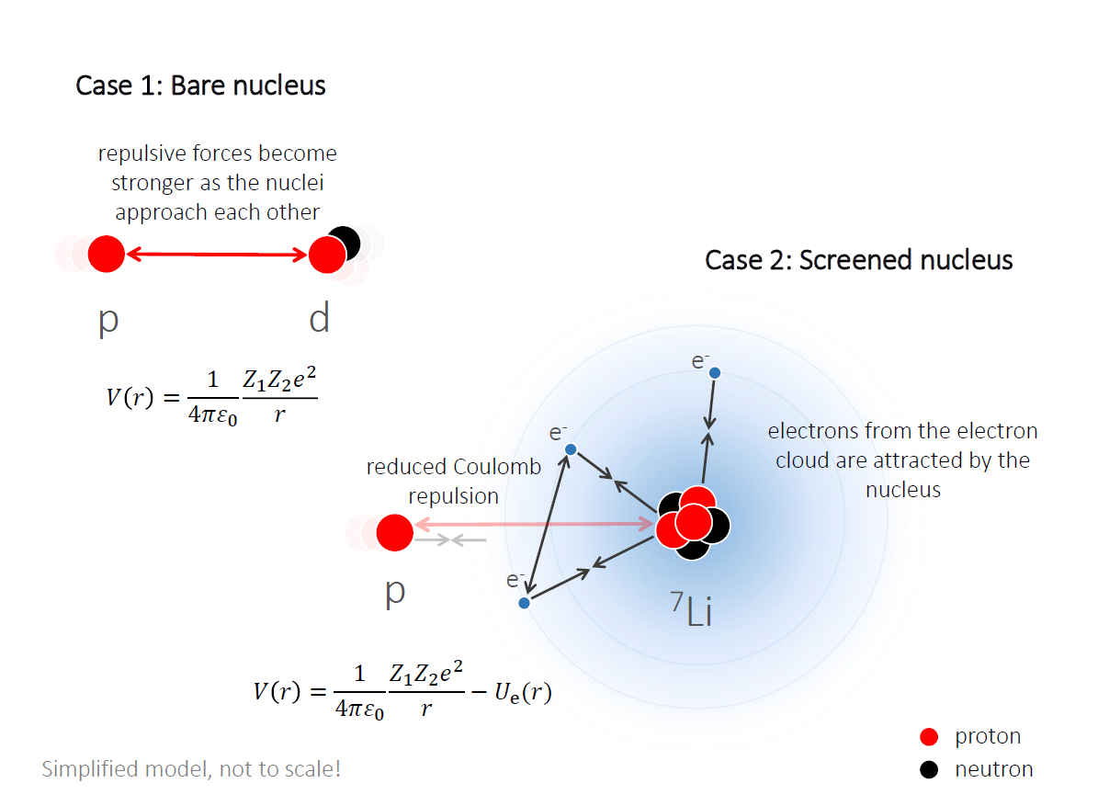
Electron Screening Effect
[1] A. B. Balantekin et al. Nucl. Phys. A, 627 (1997) 324.
Accurate measurements of nuclear reactions induced by low-energy charged particles, show a large enhancement of the cross section in Gamow energy region, that is attributed to the presence of atomic electrons.
Adiabatic Model:
Employs a static approximation
Assumes unchanged electron density
between interacting nuclei
V_{nucleus} << V_{e_orb}
Upper theoretical limit for Ue :
Adiabatic limit in a static approximation
Atomic and nuclear polarizabilities, vacuum polarization, electron excitations or relativistic effects lead to a lower value of the screening potential^{[1]}.

Slide 4
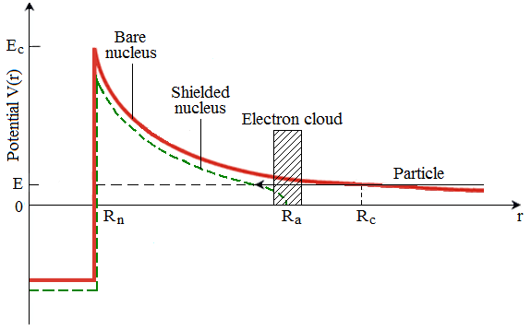
Electron Screening Effect
[1] A. B. Balantekin et al. Nucl. Phys. A, 627 (1997) 324.
Accurate measurements of nuclear reactions induced by low-energy charged particles, show a large enhancement of the cross section in Gamow energy region, that is attributed to the presence of atomic electrons.
Adiabatic Model:
Employs a static approximation
Assumes unchanged electron density
between interacting nuclei
V_{nucleus} << V_{e_orb}
Upper theoretical limit for Ue :
Adiabatic limit in a static approximation
Atomic and nuclear polarizabilities, vacuum polarization, electron excitations or relativistic effects lead to a lower value of the screening potential^{[1]}.
Simplified model, not to scale!
Due to the electron cloud, the screened Coulomb potential is reduced, both in height and radial extension and vanishes beyond the atomic radius (Ra)

Slide 5

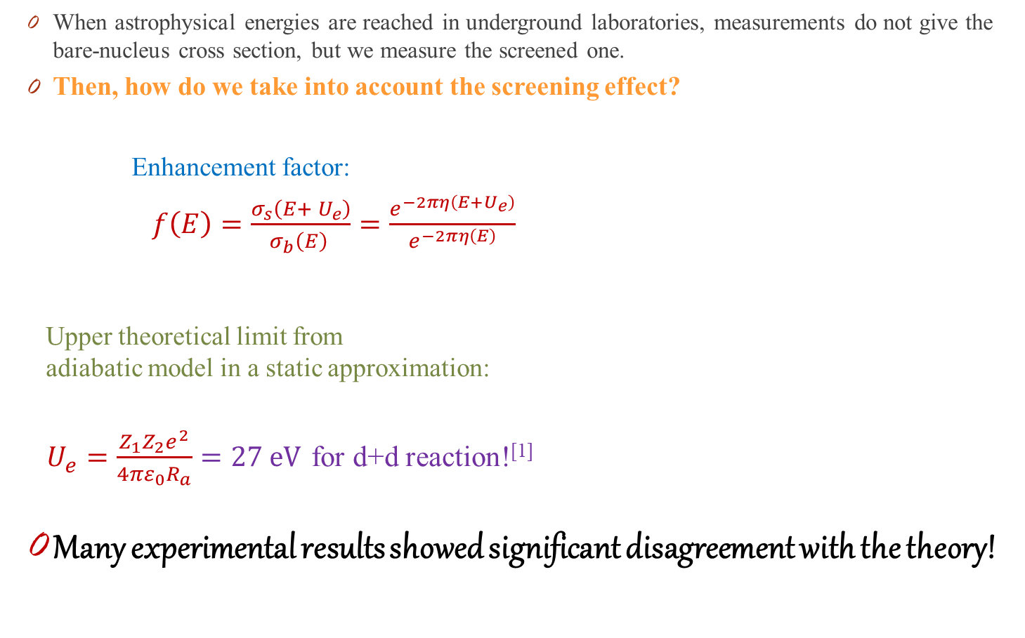
Electron Screening Effect
[1] H. J. Assenbaum, K. Langanke and C. Rolfs, Z. Phys. A 327 (1987) 461.
[2] C. A. Bertulani et al, J. Phys.: Conf. Ser. 703 (2016) 012007.
When astrophysical energies are reached in underground laboratories, measurements do not give the bare-nucleus cross section, but we measure the screened one.
Then, how do we take into account the screening effect?
Enhancement factor:
$f\left(E\right)=\frac{σ_{s}\left(E+ U_{e}\right)}{σ_{b}\left(E\right) }=\frac{e^{−2πη\left(E+U_{e}\right)}}{e^{−2πη\left(E\right)}}$
Upper theoretical limit from
adiabatic model in a static approximation:
$U_{e}=\frac{Z_{1}Z_{2}e^{2}}{4πε_{0}R_{a}}=27 eV$ for d+d reaction!^{[1]}
Many experimental results showed significant disagreement with the theory!
Trojan Horse Method (THM)
Asymptotic Normalization Coefficient (ANC)
Coulomb dissociation method (CD)
Surrogate and charge-exchange reactions
[2]

Slide 6
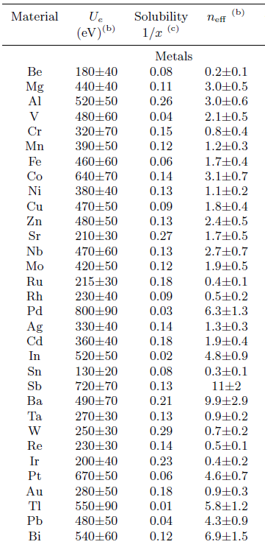

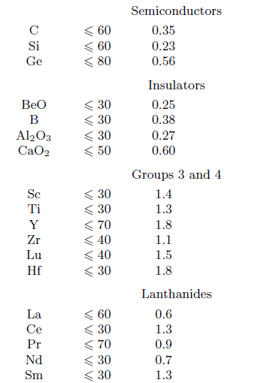
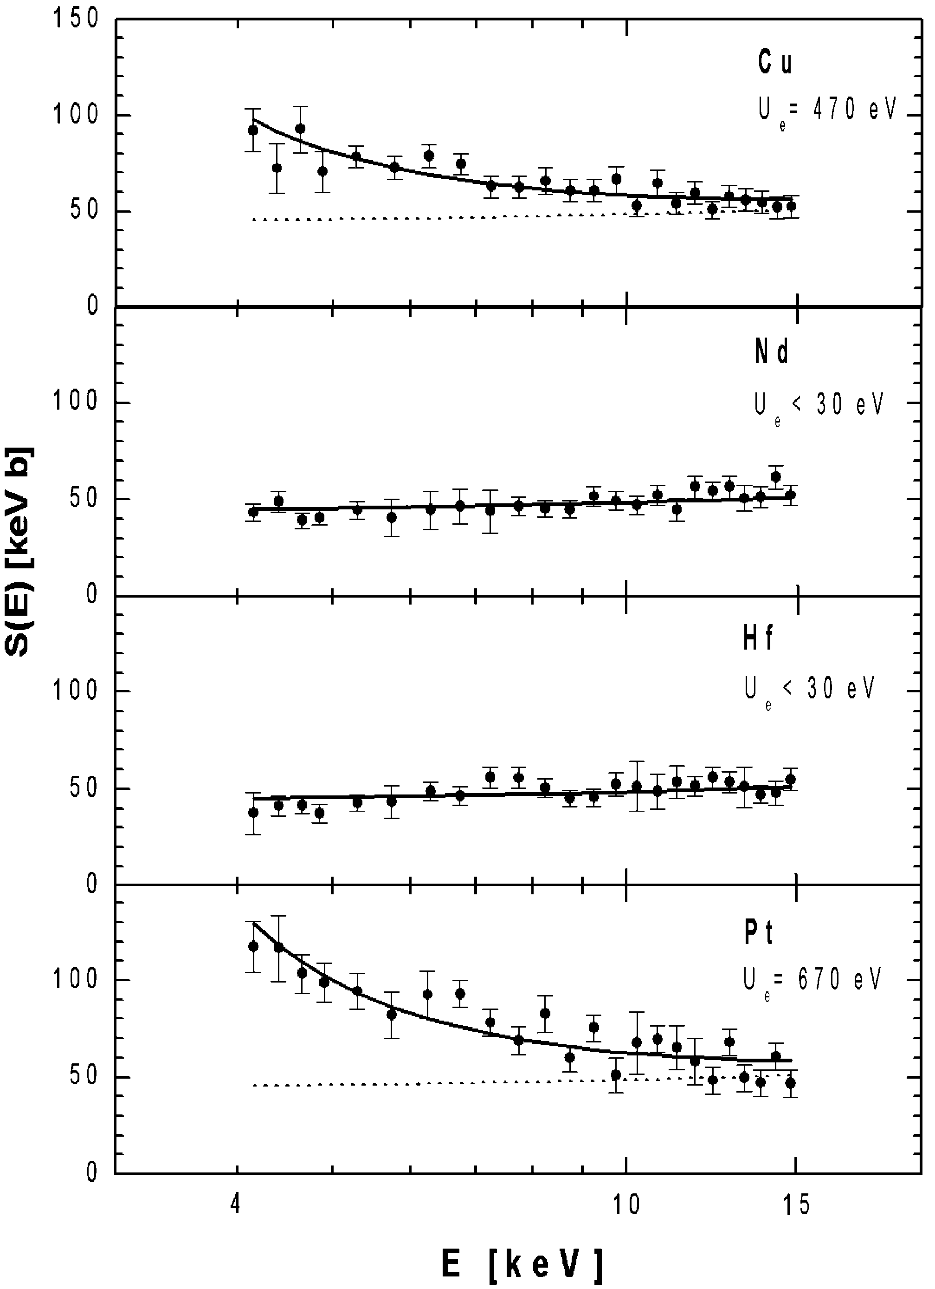
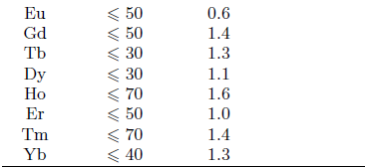

Previous Results
With gaseous targets, obtained screening potentials are in agreement with the adiabatic limit.
With the target nucleus implanted in a solid lattice, obtained screening potentials are much above the adiabatic limit
$$U_{e}^{ad}=27 eV for \text{2}\text{H}\text{(}\text{d}\text{,}\text{p}\text{)3}\text{H}$$
F. Raiola et al., Eur. Phys. J. A19 (2004) 283.

Slide 7
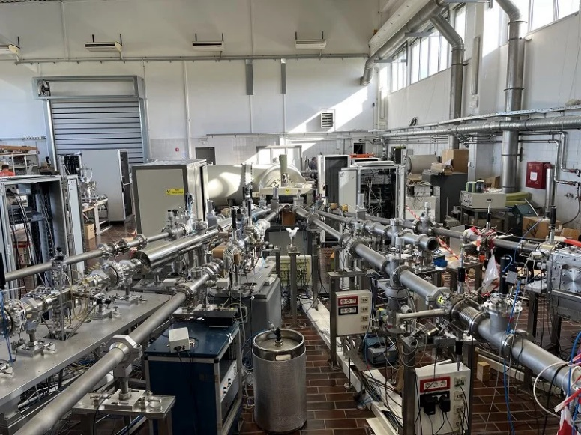
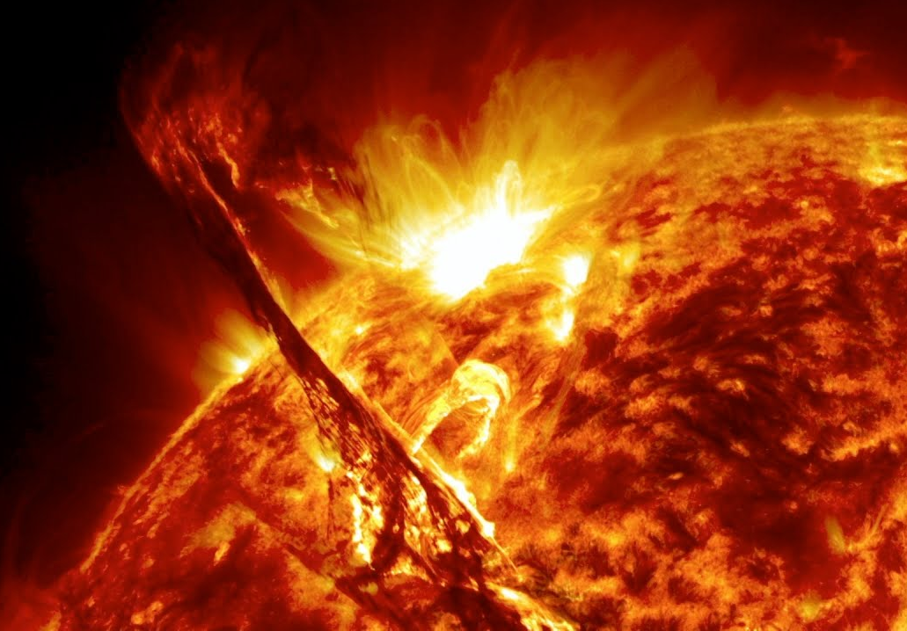
≠
Another difficulty…
Electron screening cannot be neglected in Nucleosynthesis calculations since all reactions occur at low energies.
Electron screening in the lab Electron screening in stars
We cannot predict the consequences of electron screening on the thermonuclear processes in stars until we first fully understand electron screening in the laboratory.

Slide 8

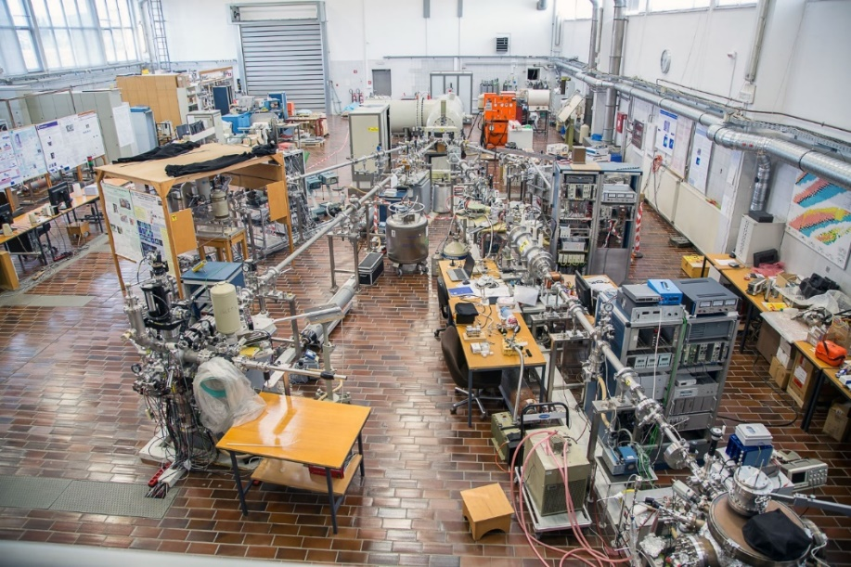
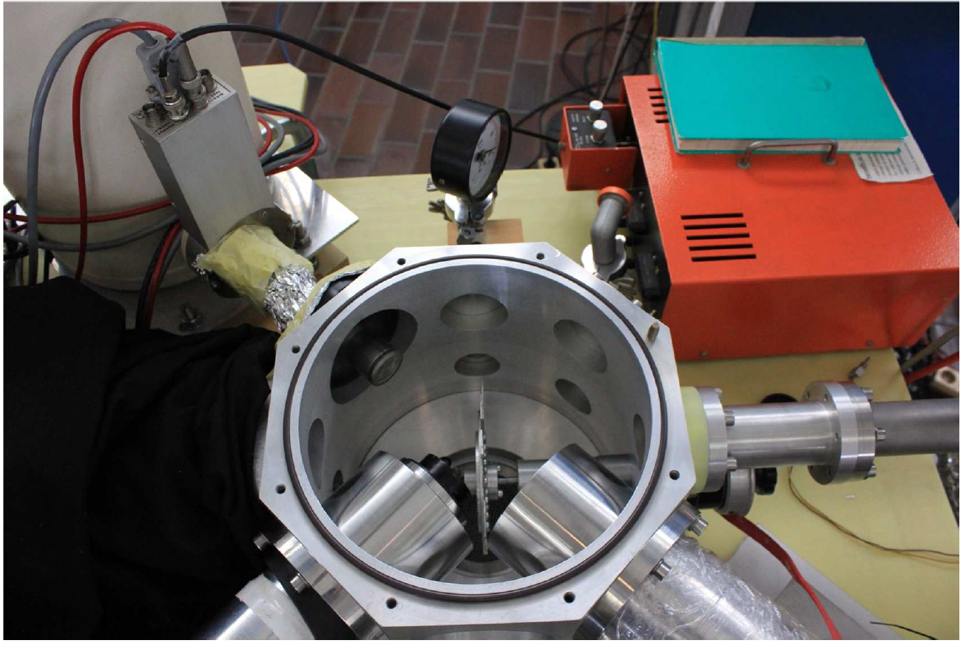
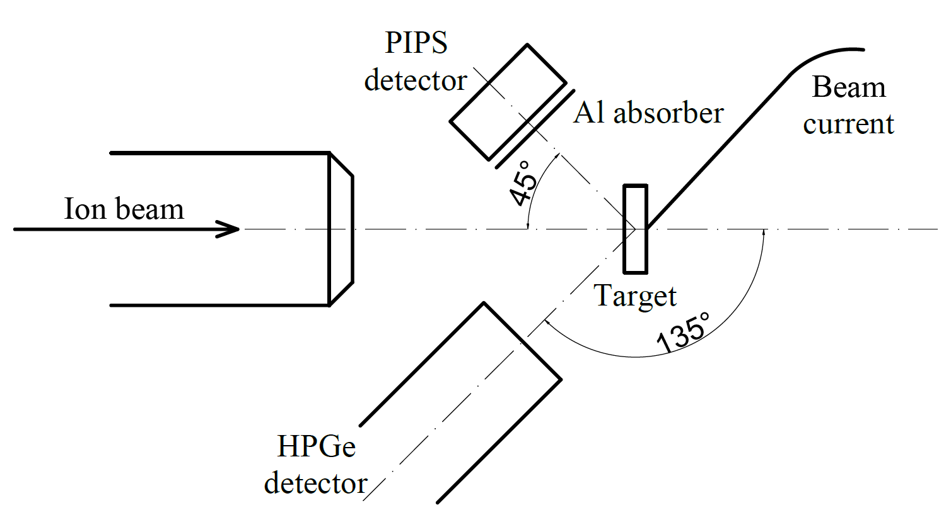
Electron Screening @ JSI
2-MV Tandetron accelerator at Jožef Stefan Institute
Nuclear reactions are studied in inverse kinematics!

Slide 9
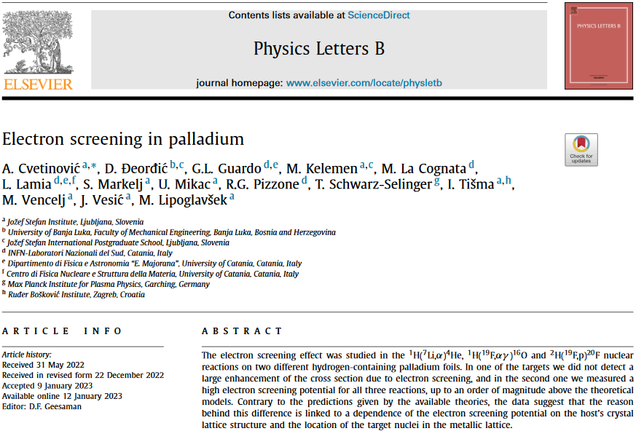


Our Previous Results
Reaction | U_{ad} [keV] | U_{e} [keV]
⁶Li+d | 0.24 | To be discussed
⁷Li+p | 0.24 | 2.9±0.2
¹⁹F+p | 2.19 | 18.7±1.5
¹⁹F+d | 2.19 | 18.2±3.3
$$U_{ad}=2.19 keV$$
Dependence on projectile Z number is ~ Z² instead of expected linear dependence.
Largest electron screening in inverse kinematics, while in forward kinematics no large electron screening, except for the p+d reaction.
Target preparation influence electron screening, pointing to a dependence of the enhancement factor on the position of the target nuclei in the metallic lattice and electron densities around the target nucleus.
These findings cannot be explained by the available model and theory based on static electron densities.
See also: A. Cvetinović et al. Phys. Rev. C, 92 (2015) 065801.

Slide 10
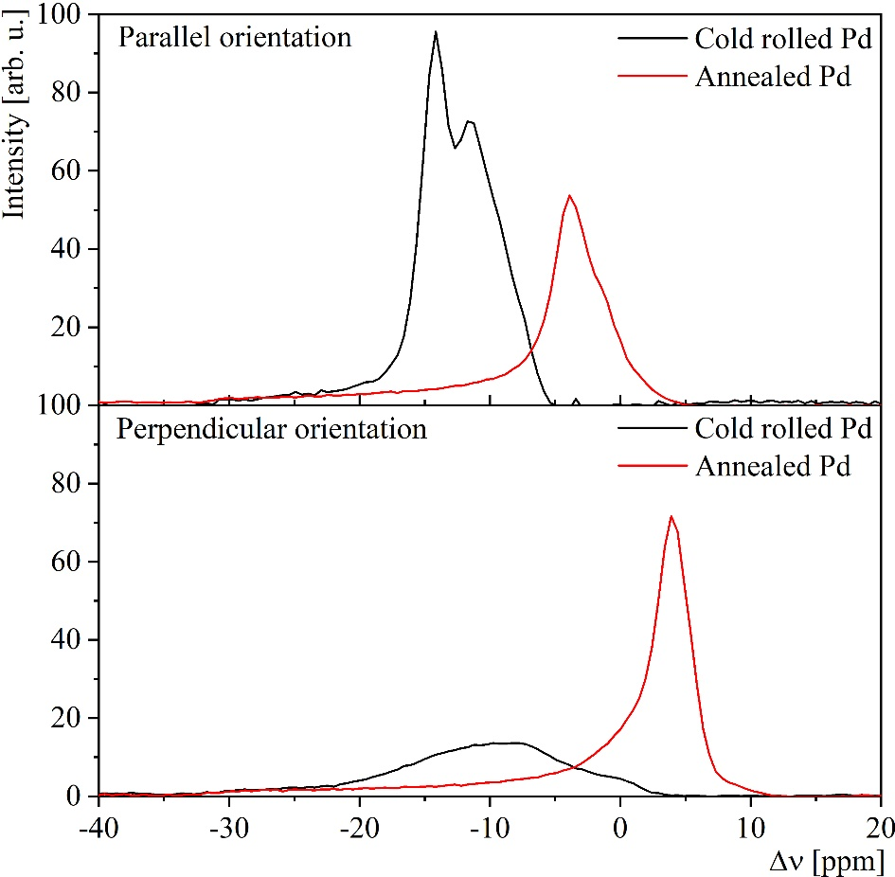
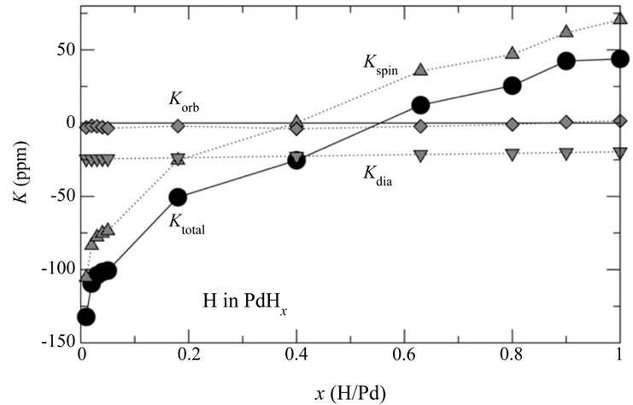
Target analysis: Nuclear Magnetic Resonance and Knight shift
The Knight shift originates from the interaction of conducting electrons in metals with nuclear spins and is proportional to the density of electronic states at the Fermi level at the nucleus site
Foil | n_{D} | K_{H1} [ppm] | K_{H2} [ppm] | K_{Ht} [ppm]
Annealed Pd | 0.70 | 26.7 | / | 18
Cold rolled Pd | 0.47 | 20.2 | 15.6 | -14
The theoretical Knight shift of H in PdHx over the entire range of x [M. Deng et al. Solid State Communications, 150:1262, 2016.].
A. Cvetinović et all., Phys. Lett. B, 838 (2023), 137684

Slide 11
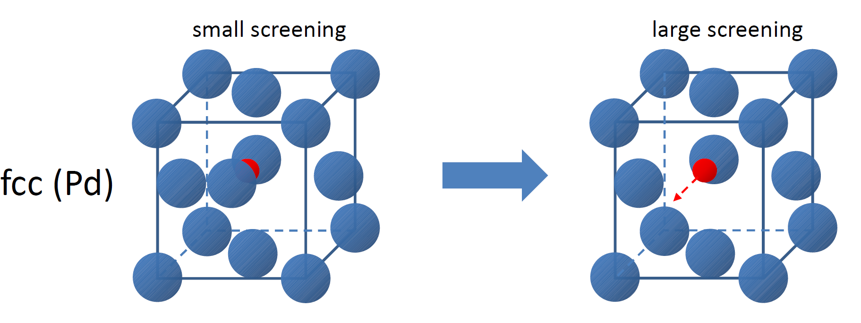
Latest Results: Crystal symmetry
H located at regular octahedral interstitial sites
H trapped at grain boundaries, dislocations and voids

Slide 12
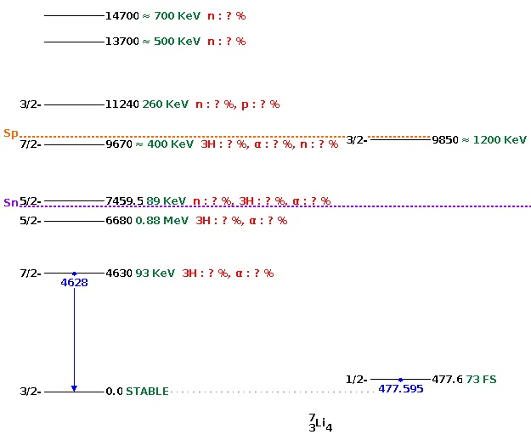
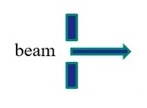




Latest Results: Electron screening with Lithium ion beam
A. Cvetinović et al., Phys. Lett. B, 868, (2025), 139816
⁷Li level sheme
https://www.nndc.bnl.gov
⁶Li + ²H → ⁸Be* → ⁴He + ⁴He
→ ⁷Li + p₀
→ ⁷Li + p₁ + γ
Inverse kinematics on
²H containing targets!

Slide 13
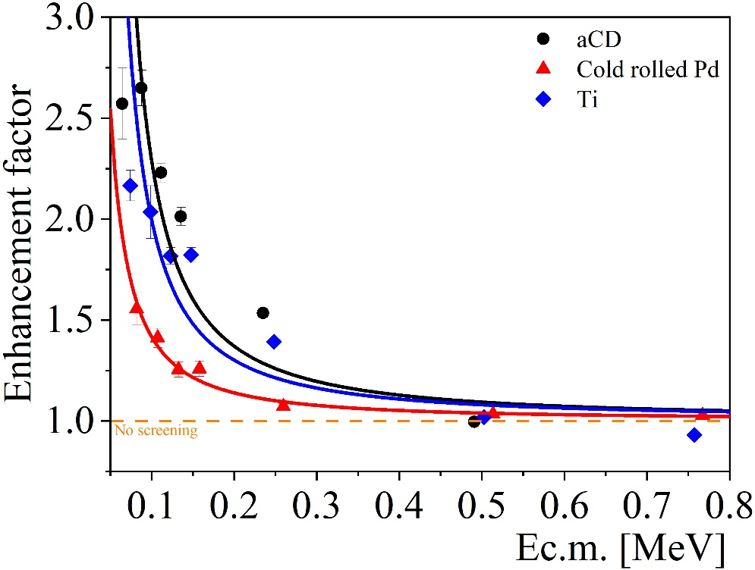
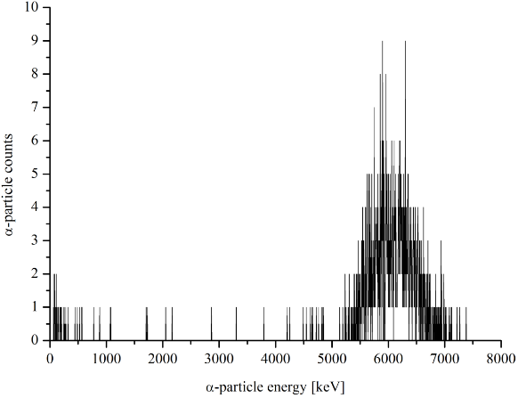

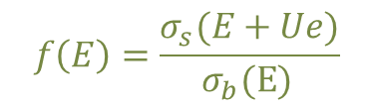

Latest Results: ²H(⁶Li,α)⁴He
$$U_{ad}=0.24 keV$$
$$f\left(E\right)=\frac{σ_{s}(E+Ue)}{σ_{b}\text{(}\text{E}\text{)} }$$
A. Cvetinović et al., Phys. Lett. B, 868, (2025), 139816
C. Spitaleri et al., Phzys. Rev. C 63, 055801 (2001).
Target | U_{e} [keV]
aCD | 13.1 ± 1.9
Cold rolled Pd | 8.4 ± 1.2
Annealed Pd | 5.2 ± 1.4
Ti | 11.0 ± 2.1

Slide 14
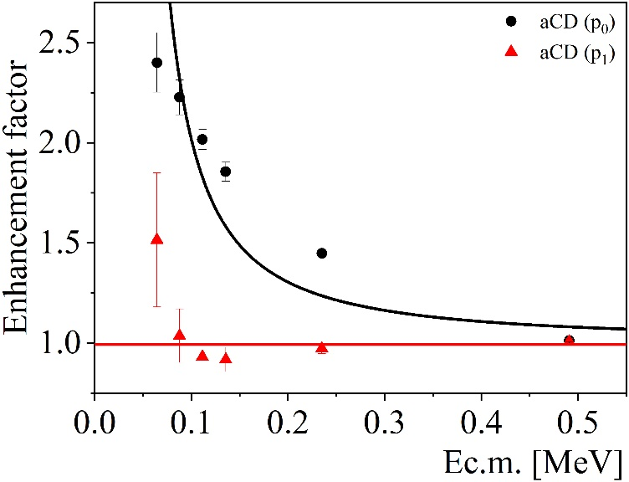
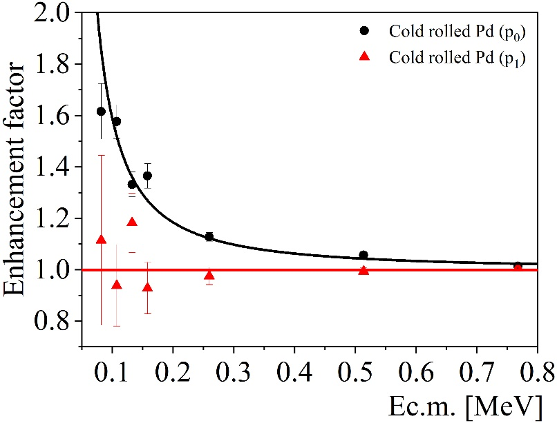
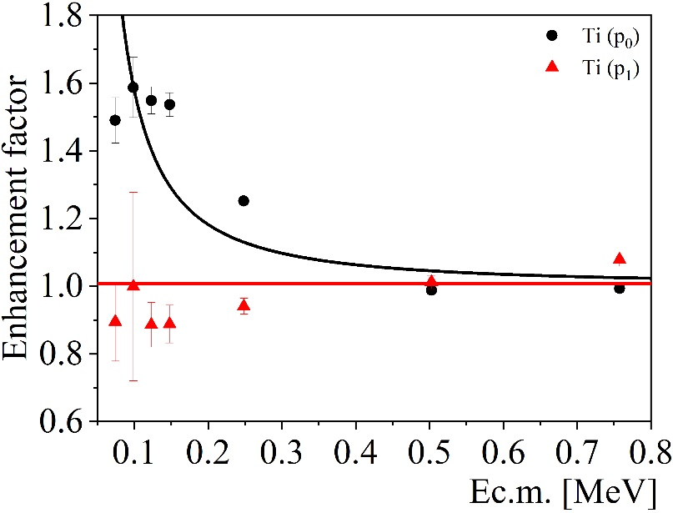

Enhancement factor: ²H(⁶Li,p₀)⁷Li and ²H(⁶Li,p₁)⁷Li
A. Cvetinović et al., Phys. Lett. B, 868, (2025), 139816
$$U_{ad}=0.24 keV$$
Target | U_{e} (p₀) [keV]
aCD | 17.2 ± 4.0
Cold rolled Pd | 12.2 ± 1.5
Ti | 11.0 ± 3.4

Slide 15
Latest Results: ⁶Li+D → ⁷Li+p₀/p₁
J^{π} of particles in the entrance channel (both ⁶Li and D) = 1⁺
J^{π} of the ground state of ⁷Li = 3/2⁻
J^{π} of the 1st exited state of ⁷Li = 1/2⁻
p₀ - no orbital angular momentum
p₁ - orbital angular momentum =1
V_{Coulomb} = 1.9 MeV
Q-value = 5 MeV
V_{Centrifugal} = 10 MeV
⁷Li level sheme
https://www.nndc.bnl.gov

Slide 16
Conclusions
Contrary to the predictions given by the Adiabatic model, the large electron screening is not linked to the static electron densities around interacting nuclei.
Static picture can explain only small electron screening.
Crystalline effects have to be considered in order to explain huge measured U_{e} values.
Large screening is induced by placing the target nuclei at specific positions in crystal lattice where the density of electronic states is higher.
Connection between metals and plasma is still not understood!
Thank you for your atention!

Slide 17
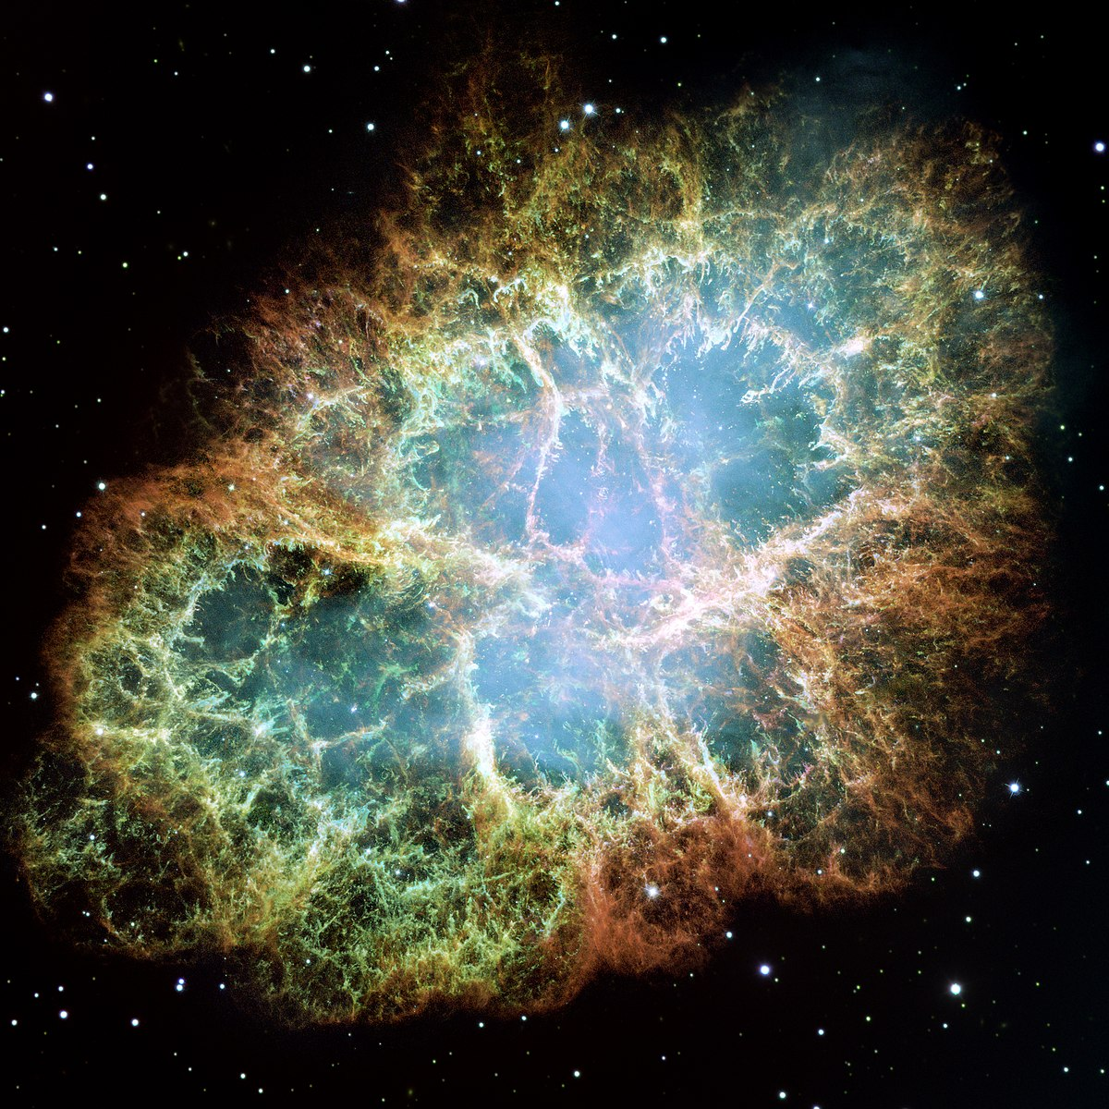
Introduction: How were the chemical elements created?
The only way to answer this question is to study nuclear reactions at energies within the Gamow window.
Knowing reaction probabilities at these energies accurately will allow us to learn more about the nucleosynthesis and internal processes happening in stars.

Slide 18
Introduction: Nuclear Reactions at the Gamow window
3-30 keV for stellar hydrogen-burning reactions in the cores of main sequence stars
~300 keV for stellar helium-burning reactions in the cores of red giant stars
1-2 MeV for stellar carbon burning

Slide 19
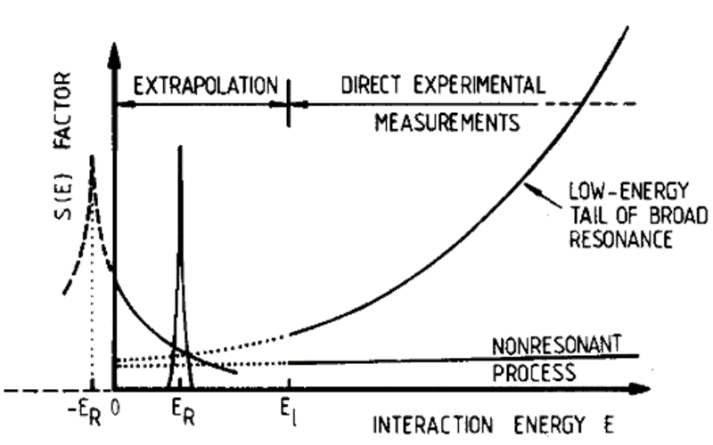

Introduction: Nuclear Reactions at the Gamow window
When the tunneling effect is the only way for the reaction to happen, the probability for fusion drops steeply with decreasing beam energy because of the huge repulsive Coulomb barrier through which the projectile has to penetrate.
The cross sections at energies in the astrophysical region are extremely difficult to measure.
⁷Li(p,α)⁴He Cross Section
10⁻¹² barn!!
C. Rolfs and R.W.Kavanagh, Nucl. Phys. A455 (1986) 179.

Slide 20
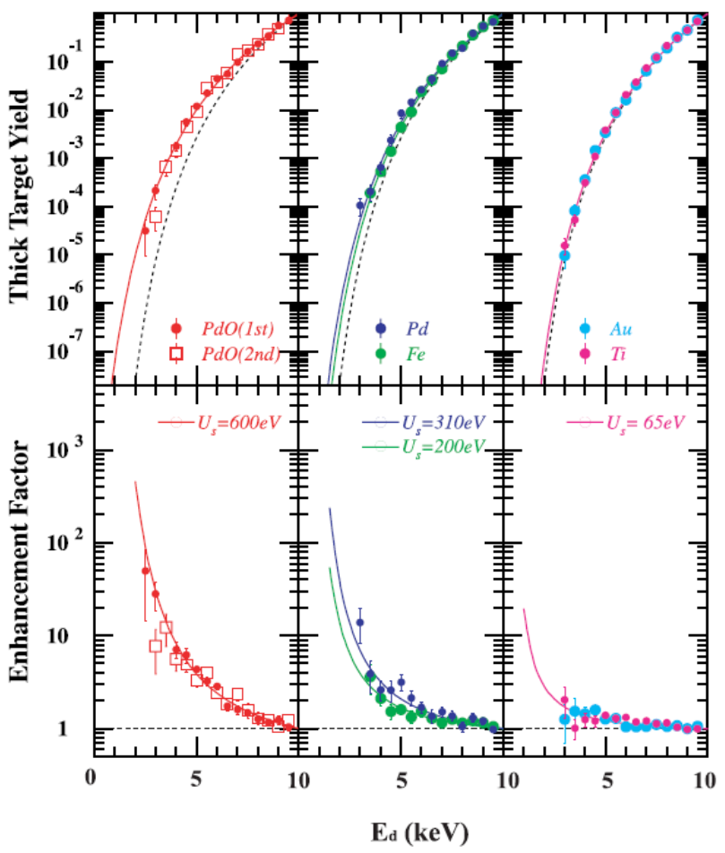
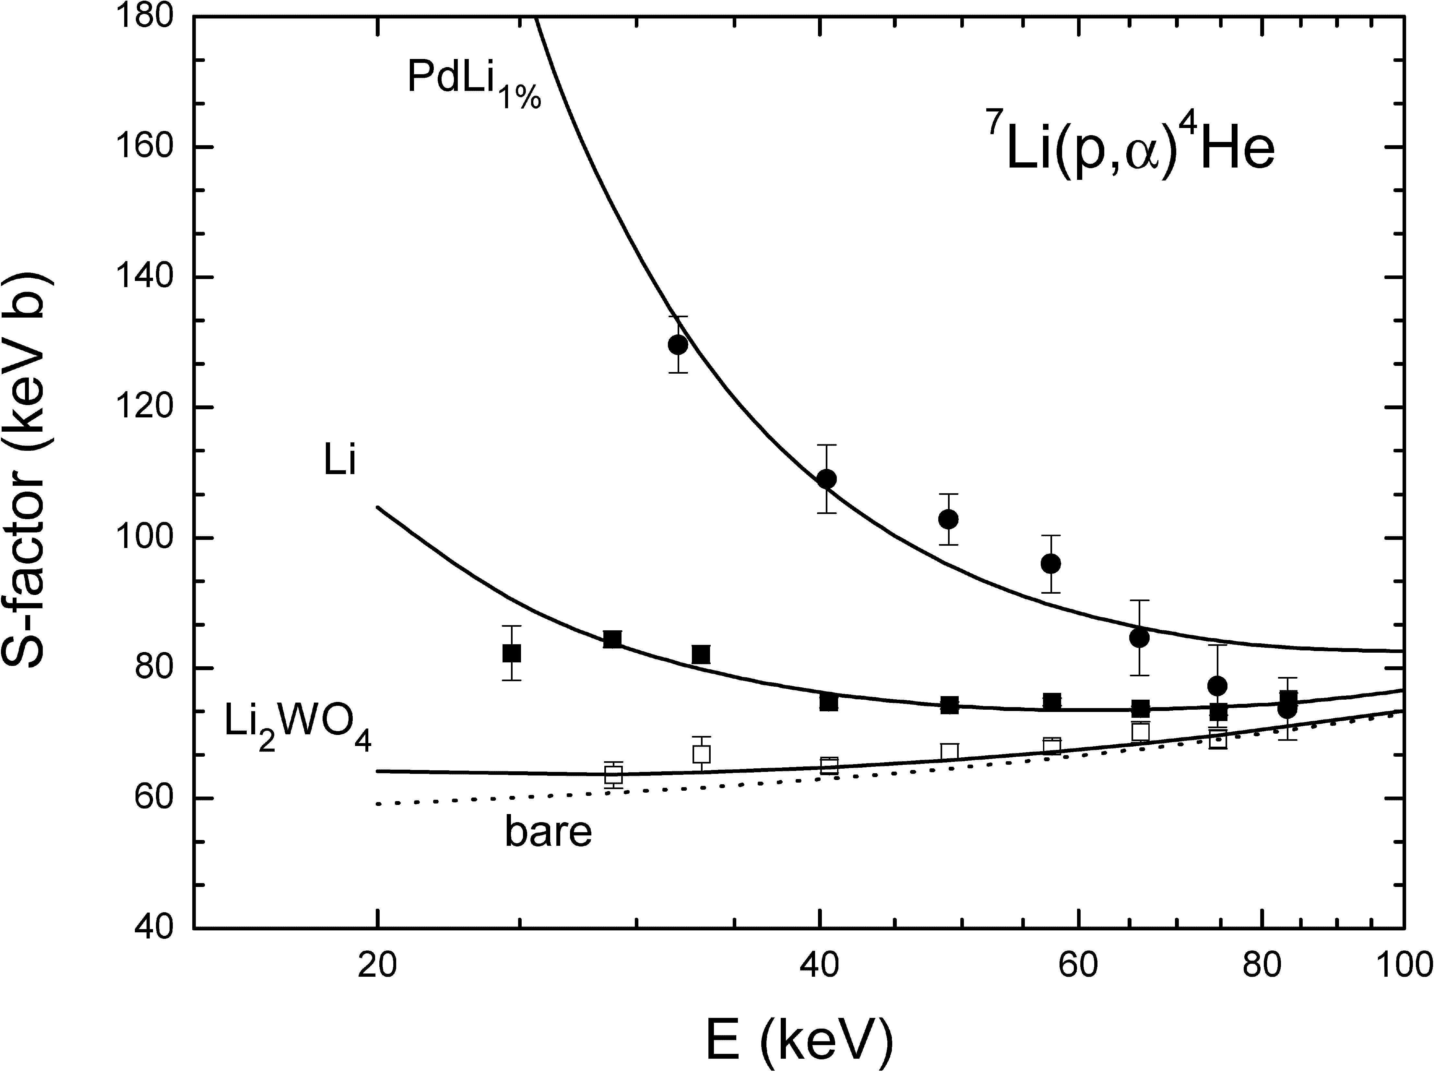
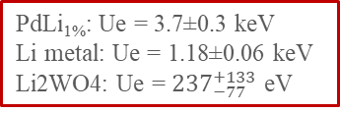

Previous Results
$$\text{2}\text{H}\text{(}\text{d}\text{,}\text{p}\text{)3}\text{H}$$
J. Kasagi, Prog. Theo. Phys. Suppl. 154 (2004) 365.
J. Cruz et al., Phys. Lett. B 624 (2005) 181
PdLi_{1%}: Ue = 3.7±0.3 keV
Li metal: Ue = 1.18±0.06 keV
Li2WO4: Ue = ${237}_{−77}^{+133}$ eV

Slide 21
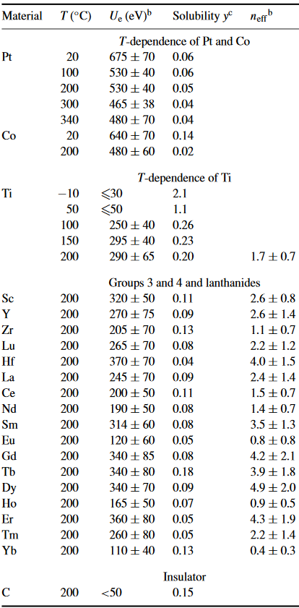
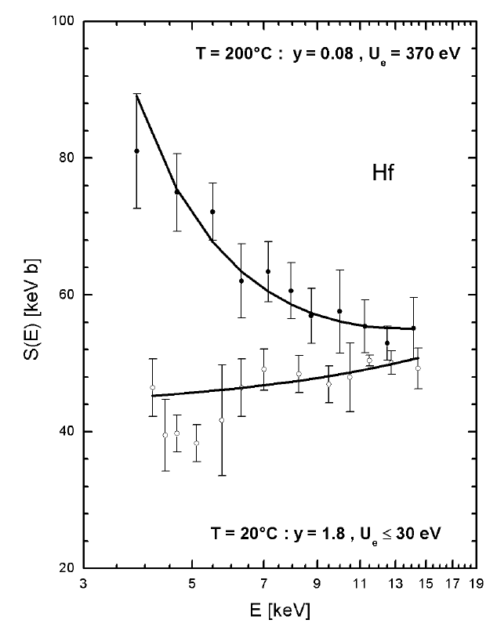

Previous Results
$$U_{e}^{ad}=27 eV for \text{2}\text{H}\text{(}\text{d}\text{,}\text{p}\text{)3}\text{H}$$
F. Raiola et al., J. Phys. G 31, (2005) 1141.
Hydrogen solubility y(T) and the screening potential Ue(T) in Ti as a function of sample temperature T.

Slide 22
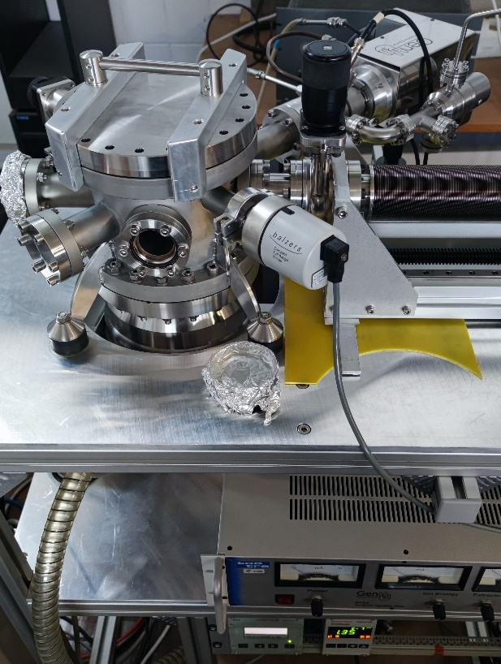
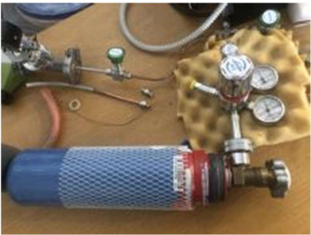
Electron Screening @ JSI: Preparations for experiments
Goal: to find two targets with different U_{e}
H or D containing targets:
Pd, Ti, Zr, aCH, aCD
PdHx system does not behave like a stoichiometric compound but like a homogeneous alloy.
Targets implanted with ion gun:
Extraction voltage: 3.5 kV for 24 h
Passive cooling with copper holder
Gas loaded Pd targets:
At room temperature and 1atm for 24 h
Gas mixture: 85% D and 15% H
Soft Pd: 70% of H(D) per metallic atom (Chempur, ANNEALED)
Hard Pd: 47% of H(D) per metallic atom (Zlatarna Celje, COLD ROLLED)

Slide 23
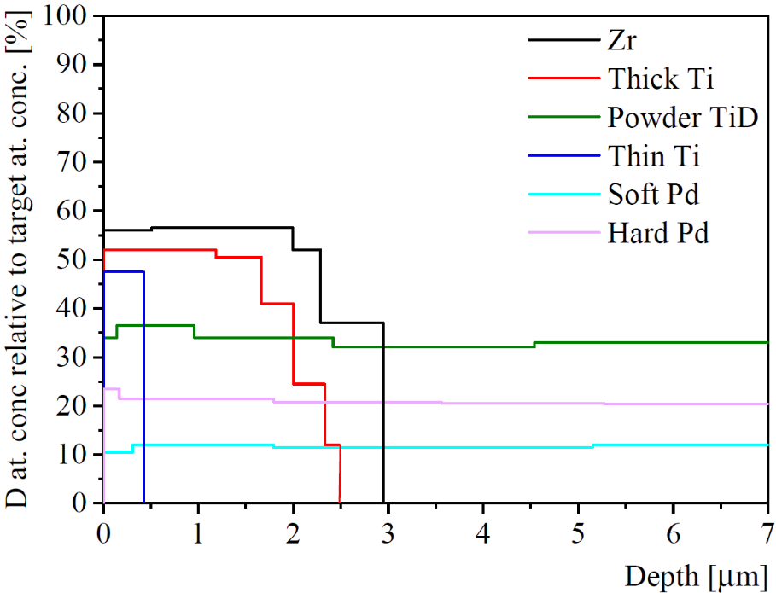
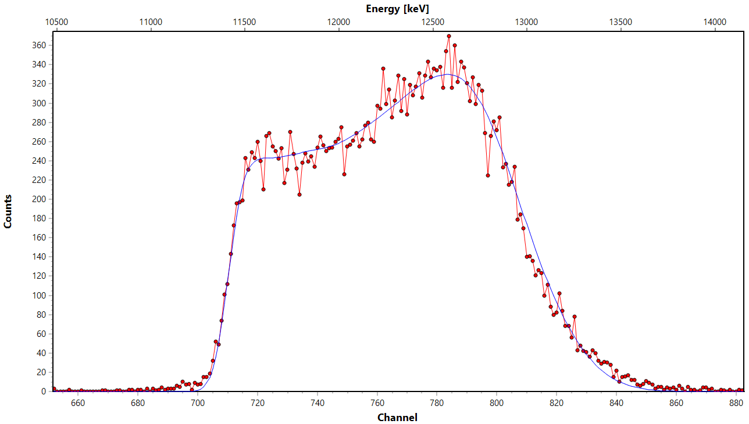
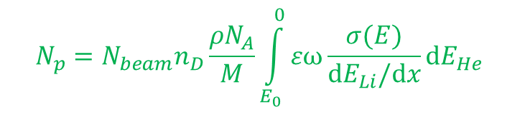
Electron Screening @ JSI: Deuterium depth distribution
Quantitative depth profiling of deuterium with the Nuclear Reaction Analysis (NRA)
High-energy protons from the ²H(³He,p)⁴He reaction were measured
at seven beam energies from 0.629 to 4.297 MeV.
$$N_{p}=N_{beam}n_{D}\frac{ρN_{A}}{M}\int_{E_{0}}^{0}{εω}\frac{σ(E)}{dE_{Li}/dx}dE_{He}$$
?

Slide 24
Electron Screening @ JSI: Hydrogen in Palladium – gravimetric measurements
Hydrogen cycling

Slide 25
Electron Screening @ JSI: Experimental setup
2-MV Tandetron accelerator at Jožef Stefan Institute
Employed method: inverse kinematics
„Z“ dependence of e.s.
Isotopic dependence of e.s.
nonresonant r. resonant r.
¹H(⁷Li,α)⁴He ¹H(¹¹B,αα)⁴He
²H(⁶Li,α)⁴He ¹H(¹⁹F,αγ)¹⁶O
²H(⁶Li, p₀/p₁)⁷Li
²H(¹⁹F,p)²⁰F ^{β-} ²⁰Ne+γ

Slide 26
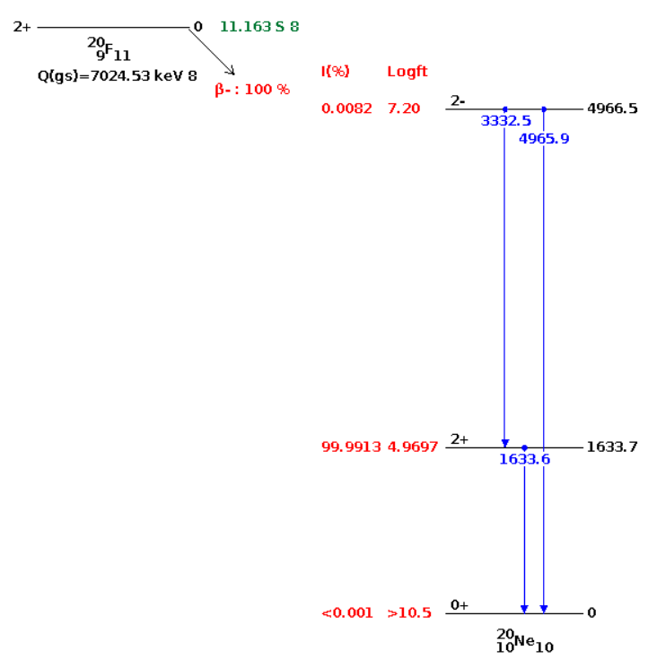
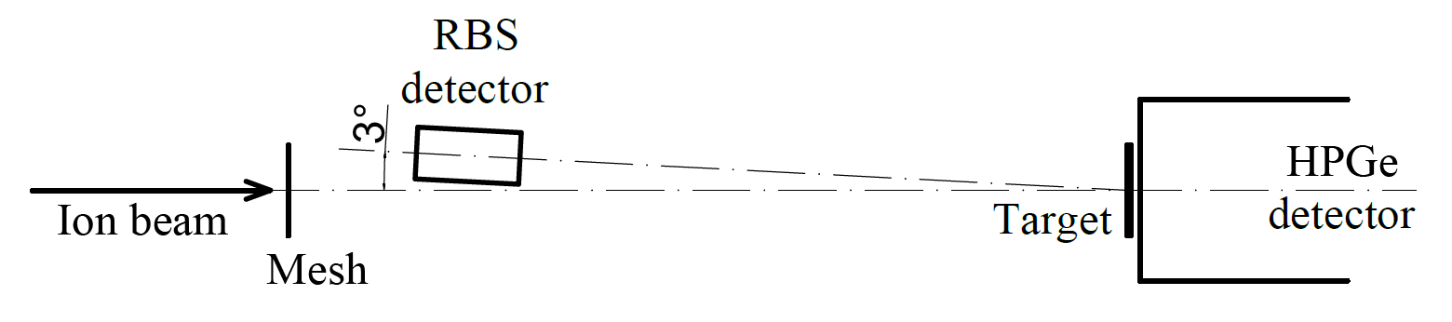

Bare-nucleus cross-section: The ¹⁹F+D reaction
Enhancement factor:
$f(E) =\frac{σ_{s}(E+U_{e})}{σ_{b}(E) }$
Screened-nucleus cross-section @ JSI, Ljubljana
Inverse kinematics
Bare-nucleus cross-section @ IPP, Garching
Forward kinematics
The ¹⁹F(d,p)²⁰F reaction
~100 nm thick CaF₂ target
Deuterium beam

Slide 27

Bare-nucleus cross-section: The ¹⁹F+D reaction
$$U_{ad}=2.19 keV$$
Target | U_{e} (¹⁹F+d) [keV]
Hard Pd | 18.0 ± 3.0
Soft Pd | 6.0 ± 1.1
Ti | 11.5 ± 0.6

Slide 28
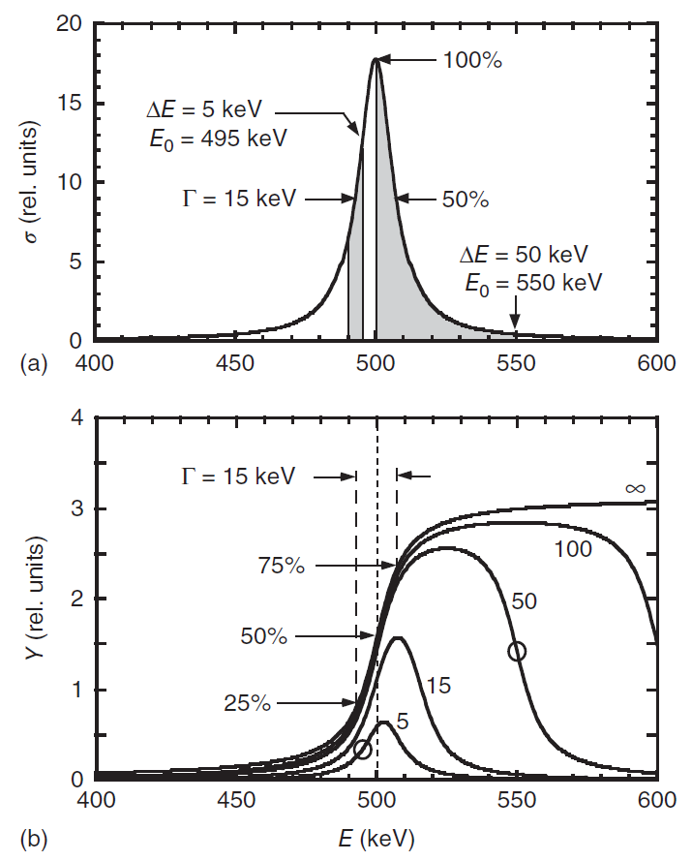
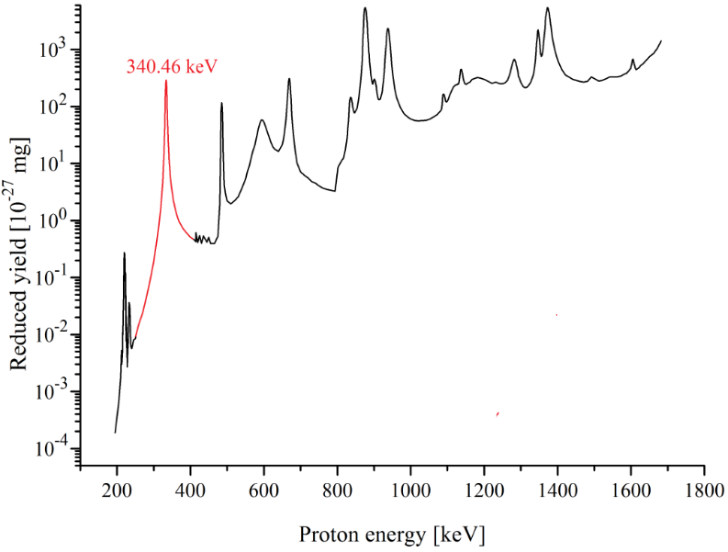
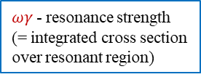
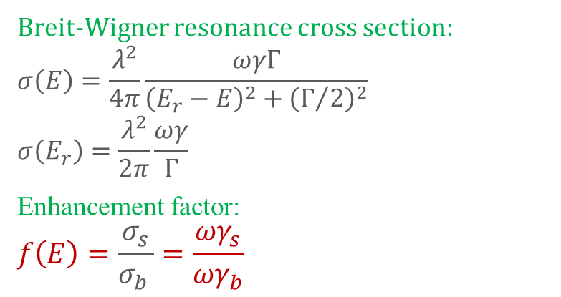
Latest Results: Resonant reactions
Breit-Wigner resonance cross section:
$$σ\left(E\right)=\frac{λ^{2}}{4π}\frac{ωγΓ}{{\left(E_{r}−E\right)}^{2}+{\left(Γ/2\right)}^{2}}$$
$$σ\left(E_{r}\right)=\frac{λ^{2}}{2π}\frac{ωγ}{Γ}$$
Enhancement factor:
$$f\left(E\right)=\frac{σ_{s}}{σ_{b} }=\frac{{ωγ}_{s}}{{ωγ}_{b}}$$
[3]
$ωγ$- resonance strength
(= integrated cross section
over resonant region)
[1, 2]
[3] C. Iliadis. Nuclear Physics of Stars - Second, Revised and Enlarged Edition, Wiley-VCH, Weinheim, 2015.
[1] K. Spyrou et al., Z. Phys., A 357, 283 (1997).
[2] K. Spyrou et al., Eur. Phys. J., A 7, 79 (2000).

Slide 29
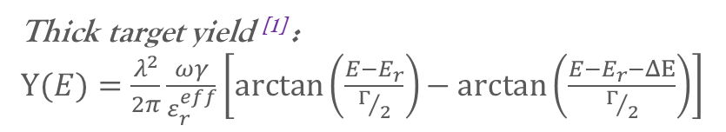
Latest Results: The ¹H(¹⁹F,αγ)¹⁶O reaction
Target | ωγ [eV]
aCH | 13.3 ± 0.8
Hard Pd | 16.6 ± 0.5
Soft Pd | 10.9 ± 0.3
Ti | 13.2 ± 0.3
Thick target yield ^{[1]} :
Y$(E)=\frac{λ^{2}}{2π}\frac{ωγ}{ε_{r}^{eff}}\left[\arctan\left(\frac{E−E_{r}}{Γ/2}\right)− arctan\left(\frac{E−E_{r}−ΔΕ}{Γ/2}\right)\right]$
[1] C. Iliadis. Nuclear Physics of Stars, 2015.
[2] K. Spyrou et al. Eur. Phys. J., A 7:79, 2000.

Slide 30
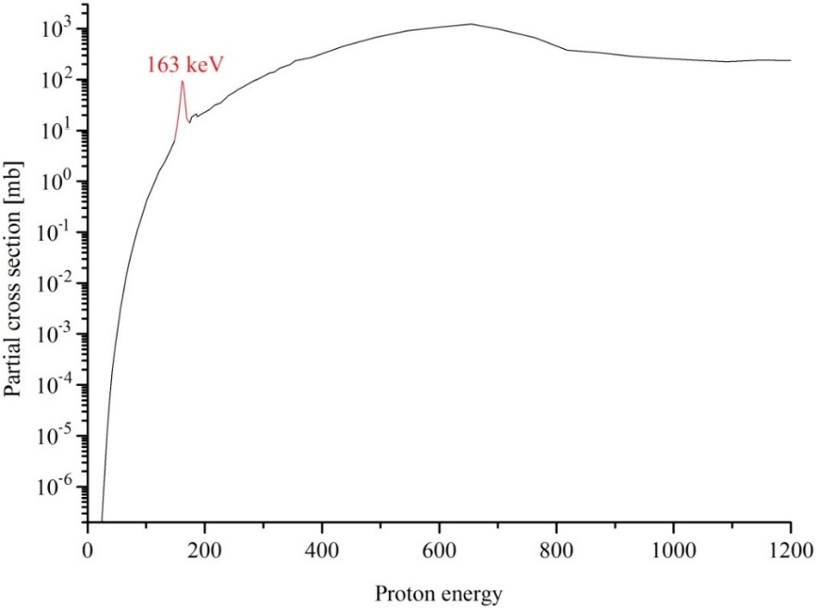
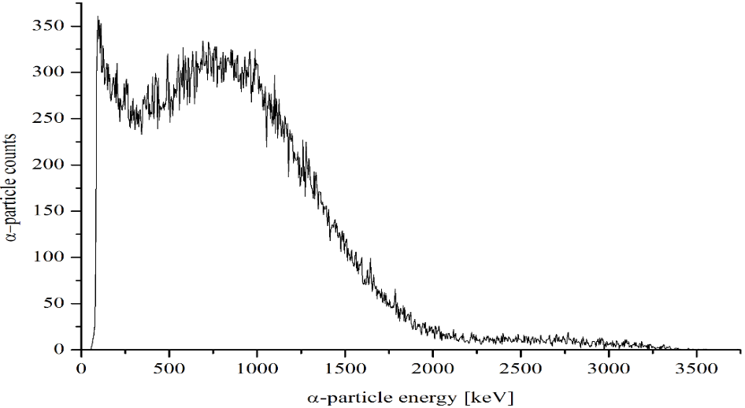
Latest Results: The ¹H(¹¹B,αα)⁴He reaction
α-spectrum
Η. W. Becker et al., Z. Phys., A 327, 341 (1987).
Target | ωγ [eV]
aCH | 0.13 ± 0.01
Hard Pd | 0.12 ± 0.02
Soft Pd | 0.11 ± 0.01
Ti | 0.11 ± 0.01

