Slide 1




European Nuclear Physics Conference 2025
New challenges for experimental data
dedicated to
nuclear reactor physics
Maëlle Kerveno

Slide 2

OUTLINE
nuclear data for fission technologies
What are we talking about?
Definition of needs
Experimental challenges (a few)
Building bridges!

Slide 3
OUTLINE
nuclear data for fission technologies
What are we talking about?
Definition of needs
Experimental challenges (a few)
Building bridges!

Slide 4
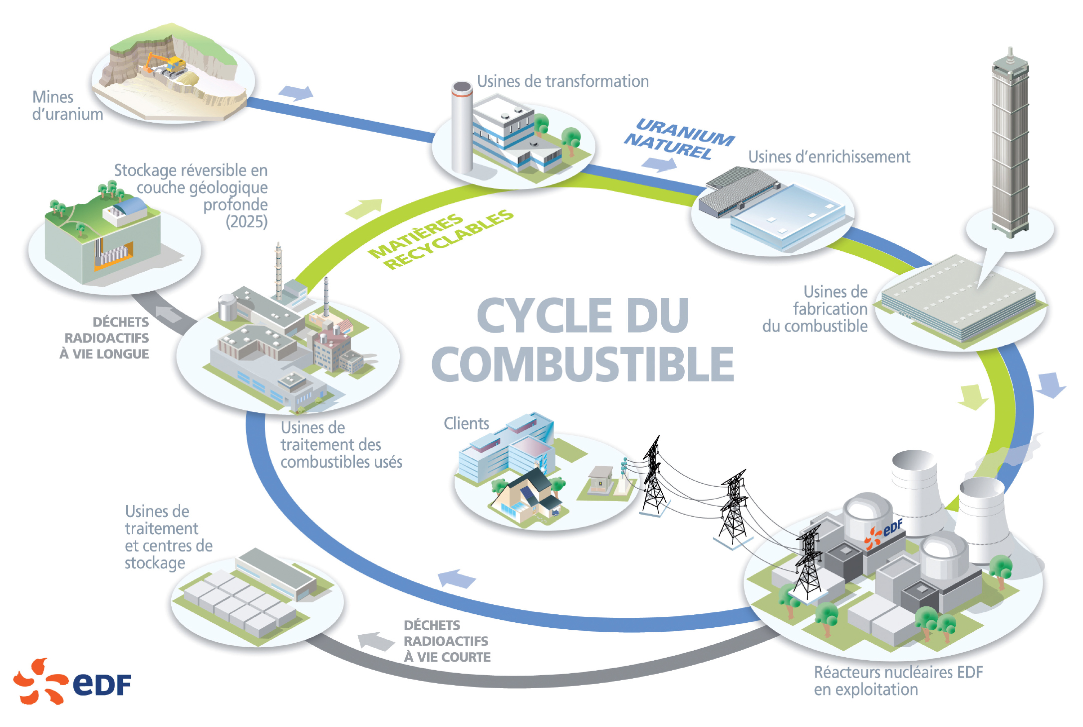
nuclear data for fission technologies
« fission technologies » cover
Uranium mines
Processing plants
Natural uranium
Enrichment plants
reversible deep
geological storage
recyclable materials
fuel
plants
long-lived radioactive waste
FUEL CYCLE
customers
Spent fuel processing plant
processing plant
and
repository
facilities
short-lived
Radioactive
waste
EDF nuclear reactor
in operation

Slide 5
nuclear data for fission technologies
« fission technologies » cover
Uranium mines
Processing plants
Natural uranium
All reactor types :
  GEN III – LWR, BWR, HWR
  GEN IV – based on lead and sodium coolants, molten salts, ADS and SMR, AMR
  Research
  Propulsion systems
Enrichment plants
reversible deep
geological storage
recyclable materials
fuel
plants
long-lived radioactive waste
FUEL CYCLE
customers
Spent fuel processing plant
processing plant
and
repository
facilities
short-lived
Radioactive
waste
EDF nuclear reactor
in operation

Slide 6
nuclear data for fission technologies
« fission technologies » cover
Uranium mines
Processing plants
All reactor types :
  GEN III – LWR
  GEN IV – based on lead and sodium coolants, molten salts, ADS and SMR, AMR
  Research
  Propulsion systems
Natural uranium
Enrichment plants
reversible deep
geological storage
recyclable materials
fuel
plants
long-lived radioactive waste
FUEL CYCLE
customers
What ever reactor types :
Fuel management
[production, transport, storage, burnup, etc]
Spent fuel management
[transport, reprocessing, storage, disposal, etc]
Radioprotection, safety, decommissioning etc
Spent fuel processing plant
processing plant
and
repository
facilities
short-lived
Radioactive
waste
EDF nuclear reactor
in operation

Slide 7
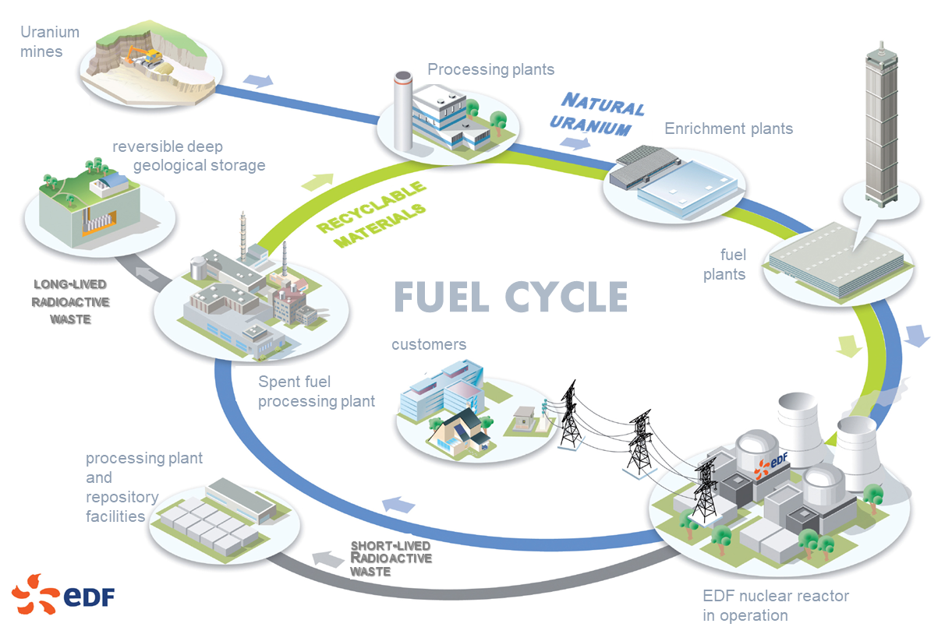
nuclear data for fission technologies
All the fuel cycle steps can/must be simulated
to answer to the safety authority requests & for economical issues
to study/design new reactor concepts & fuel cycles
Ex – reactors currently in operation :
for safety authorities, several quantities have to be calculated with uncertainty,
for various conditions (starting, stopping, during cycle and in accidental conditions)
K_{eff} (neutron multiplication factor)
Power distribution in the reactor core
Counter-reaction effects (doppler, temperature, void, moderator)
Control rode efficiency
Power/Activity factor
Consumable poison
Isotopic inventory
Cycle length
γ heating
Reflector effect
Radiotoxicity
Residual power
Radiation damages
Ex – future reactors :
for the studies, design & licensing, these quantities have to be calculated too

Slide 8
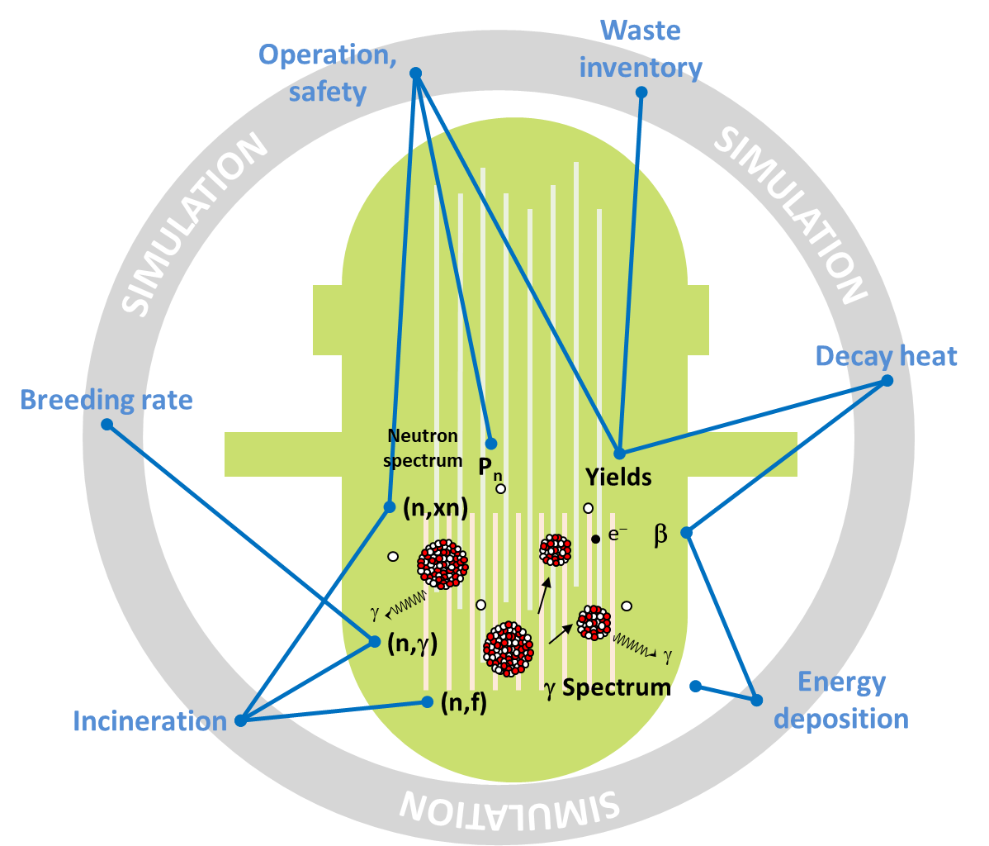
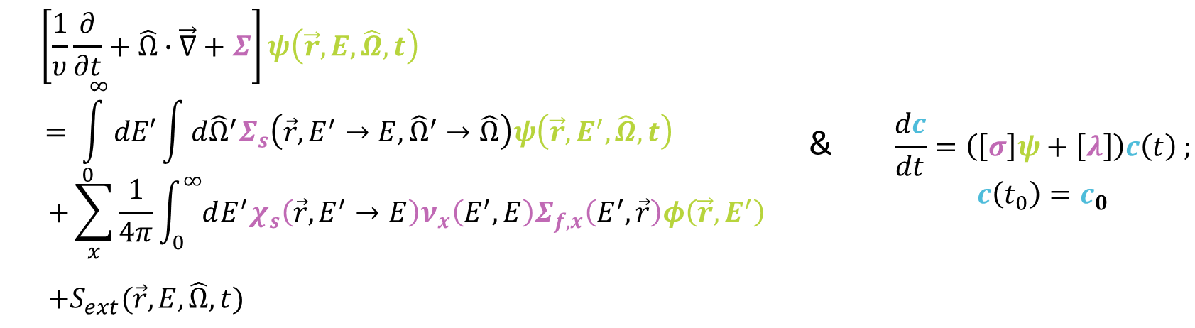
nuclear data for fission technologies
The calculation/assessment of these quantities depends on 2 main parameters :
the neutron flux and the evolution of nuclides which are described by 2 equations
The story of a balance sheet : what is created, what disappears?
) In a conventional reactor (REP operating in normal conditions):
10⁹ neutrons/cm³ evolving in a material with 10²² atoms/cm³
=> Can be consider as a neutron gas
statistical gas theory which gives the evolution of the neutron population via the Boltzmann equation
Neutron population
is described by
the Boltzmann equation
Nuclide evolution
is described by
the Bateman equations
&
Reaction cross section,
fission yields,
neutron and γ multiplicity & spectra,
decay data,
total radioactive decay constants
The coefficient are numbers called « nuclear data »
related to nuclear physics process and constants.
k_{eff}, power distribution, isotopic inventory, cycle length, γ heating, etc.

Slide 9
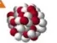
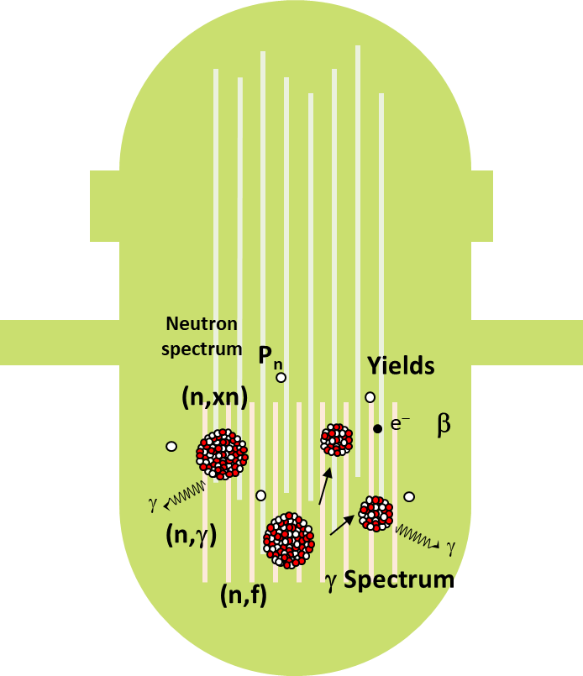
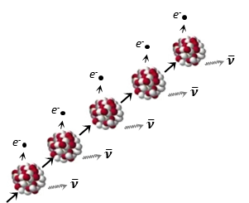





nuclear data for fission technologies
e⁻
e⁻
$$\overline{ν}$$
e⁻
$$\overline{ν}$$
Reactions of interest
e⁻
$$\overline{ν}$$
CHAIN
REACTION
e⁻
$$\overline{ν}$$
FP
$$\overline{ν}$$
γ
n
γ
HEAT
Fission
FP
γ
DECAY
HEAT
Neutron emission
(elastic
-inelastic scattering)
Capture
TOXICITY,
WASTE
γ
Lcp production
p,
α, …
GAZ
Production,
Damages

Slide 10
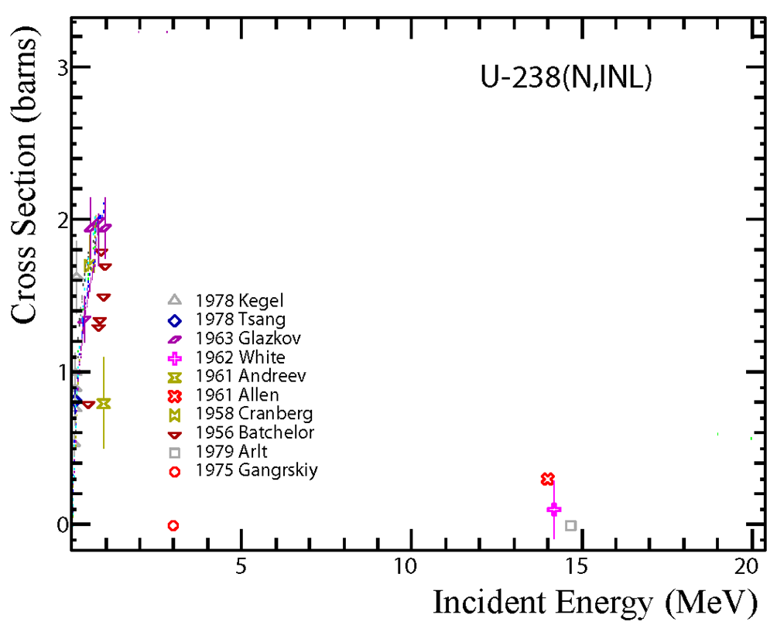
nuclear data for fission technologies
A short reminder :
evaluated nuclear data (“numbers”)
Experimental Data
Differential

Slide 11
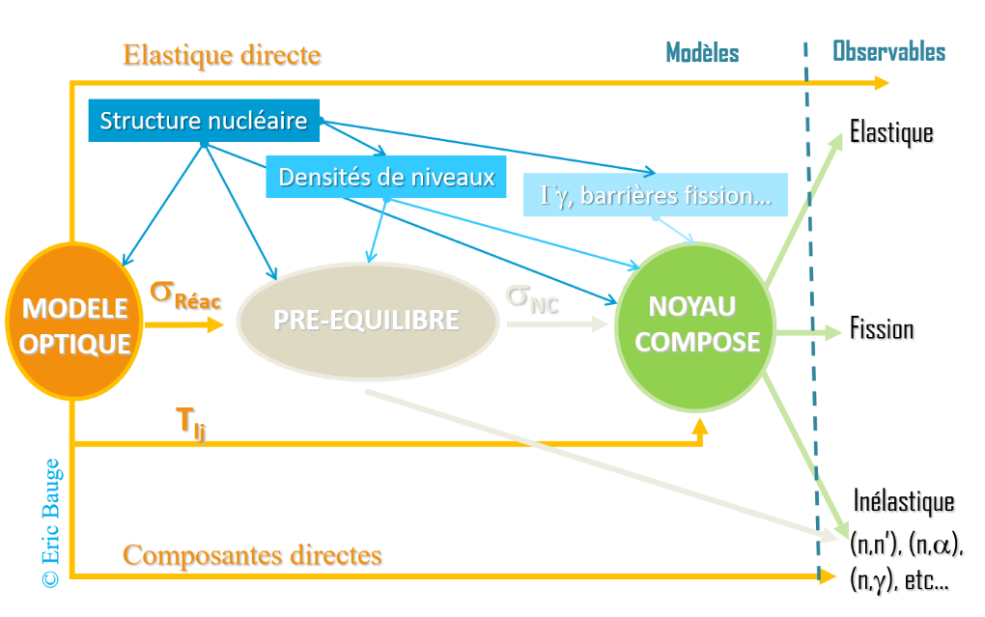
nuclear data for fission technologies
A short reminder :
evaluated nuclear data (“numbers”)
Experimental Data
Differential
Theoretical Models

Slide 12
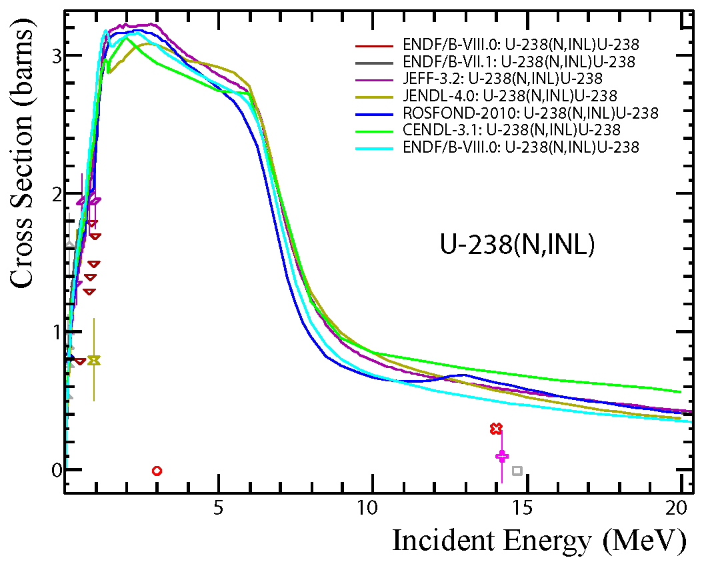
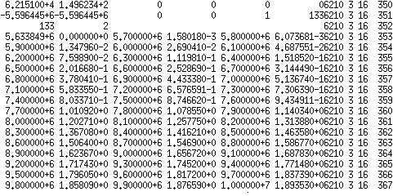
nuclear data for fission technologies
A short reminder :
evaluated nuclear data (“numbers”)
Experimental Data
Differential & semi/integral
Theoretical Models
Evaluated Data
Evaluated data must be :
Robust – defined with uncertainties & covariance matrices, repeatable, traceability

Slide 13

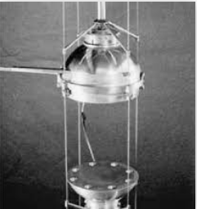
nuclear data for fission technologies
A short reminder :
evaluated nuclear data (“numbers”)
Experimental Data
Differential & semi/integral
BENCHMARKING
Theoretical Models
Jezebel
²³⁹Pu critical sphere
Evaluated Data
Evaluated data must be :
Robust – defined with uncertainties & covariance matrices, repeatable, traceability
Validated – experimentally, useable for applications
Applications

Slide 14
OUTLINE
nuclear data for fission technologies
What are we talking about?
Definition of needs
Experimental challenges (a few)
Building bridges!

Slide 15
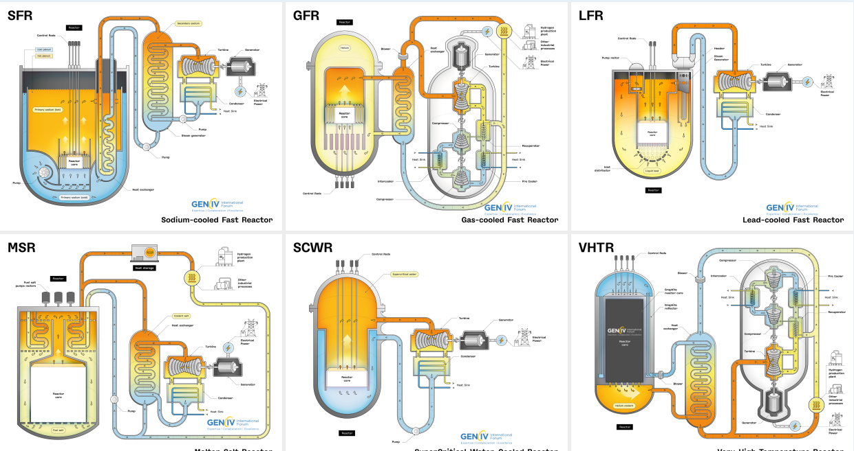
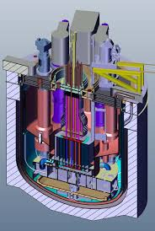

Definition of needs
Sensitivity studies
System modeling f
Target accuracy requirements
For an operation domain,
Design & safety quantity Q,
With target uncertainty C_{Q}
(margins)
First reference work made by SG 26 (2008)
For 8 nuclear systems
ABTR, EFR, SFR (Na)
LFR, ADMAB (Pb) Fast reactors
GFR (gas)
• PWR
• VHTR
Input parameters P
Parameter uncertainty Δp/p
(=Cp)
Thermal reactors
Sensitivity coefficient :
S = p /Q × (∂Q/∂p)
M. Salvatores and R. Jacqmin.
Nuclear Science-
NEA/WPEC-26, Vol. 26, NEA No 6410., 2008.
Q = f(p)
Sensitivity analysis (perturbation) :
Output requirement C_{Q} -> quality requirement on nuclear data input P
ND uncertainty + uncertainty propagation
-> assessment of ND improvement needs
Updated in 2023 by SG 46 – TAR exercise
with other reactor types
MACRE, Moltex, Alfred, Astrid, ESFR, JSFR, Nuscale, MYRRHA
Oscar Cabellos and Mathieu Hursin.
NEA/WPEC-26, Vol. 46, NEA No xxx., 2023.

Slide 16
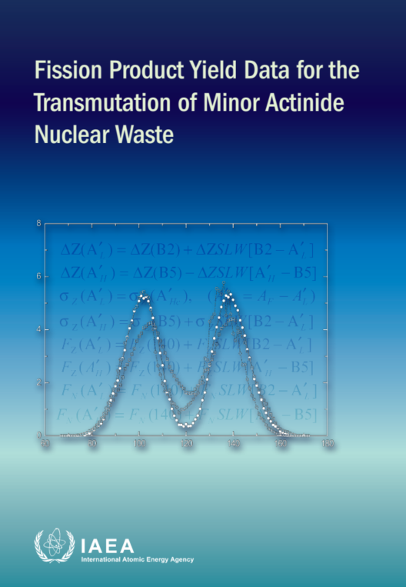
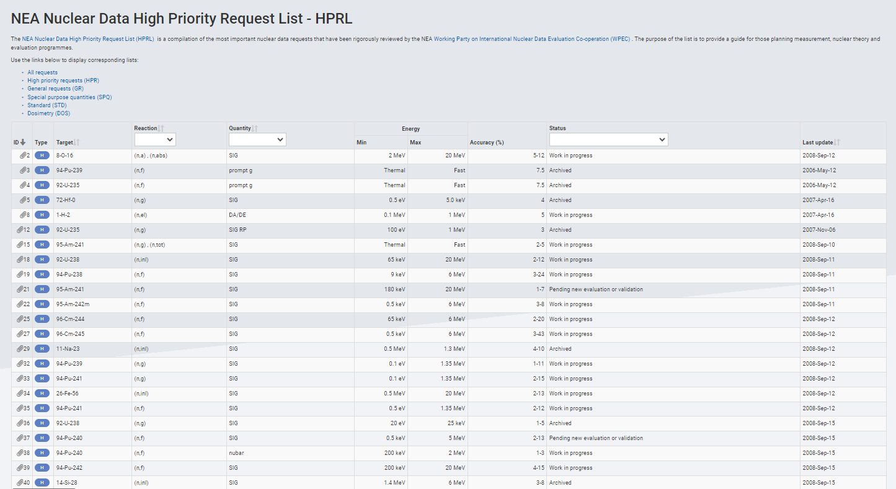

Definition of needs
List of requirements
Decay heat, k_{eff} and reactivity vs burnup purposes
Cross section, nubar
SG26 & 46 : very tight target accuracy (a few %) requirements for several reactions & nuclides
HPRL : fed partially by the above mentioned work
Fission yields
Work done in successive IAEA CRP’s
“Fission product yield data for the transmutation
of minor actinide nuclear waste” (2008)
https://www-nds.iaea.org/fycrp/
“Updating Fission Yield Data for Applications 2020-2025” INDC(NDS)-0817; https://doi.org/10.61092/iaea.qwbr-a6z9
decay data
Many IAEA CRP’s works and documents
Essential tools & documentation to drive new measurements
Ex: 7 over the 11 (n,f) XS in HPRL have been measured at CERN n_TOF
https://www.oecd-nea.org/dbdata/hprl/search.pl?vhp=on

Slide 17

Definition of needs
Why do we still need new measurements? (summary)
New experimental data
where no or only rare data exists (e.g. GEN IV systems, SMR, AMR)
More accurate experimental data (e.g. evaluation puzzle, HPRL, SG26 & 46)
Experimental data for nuclear model improvement
Need to provide a systematic to calibrate the model especially for nuclei for which measurement is difficult (short lifetime, radioactive FP, Actinides)
Directly driven
by technological needs

Slide 18
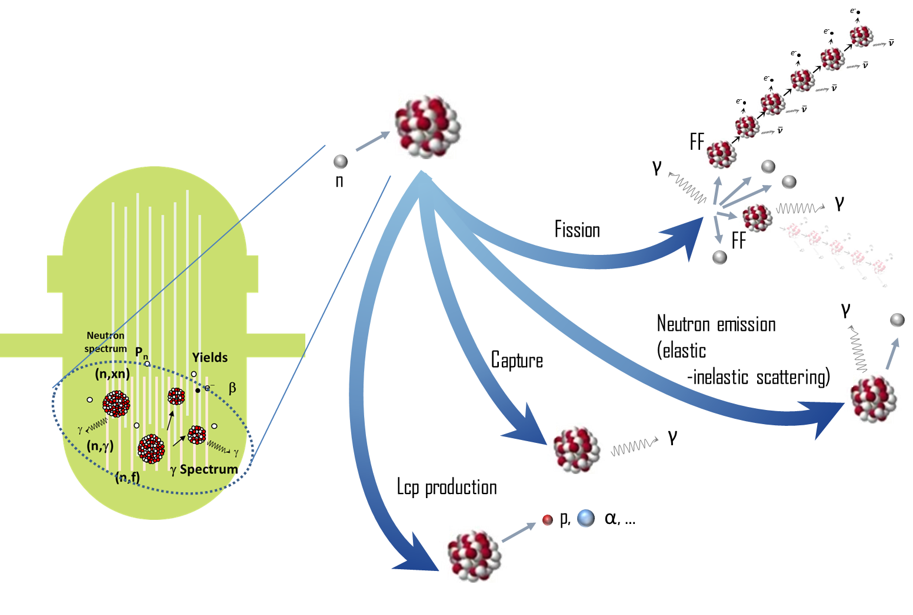



OUTLINE
nuclear data for fission technologies
What are we talking about?
Definition of needs
Experimental challenges (a few)
Building bridges!
Addressing PRiorities
of Evaluated Nuclear Data
in Europe
https://aprende-project.eu/

Slide 19
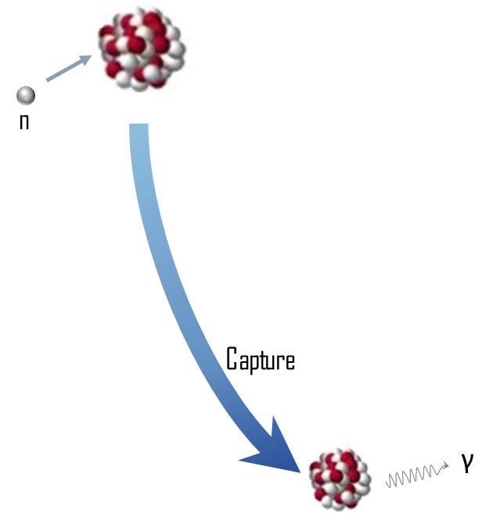
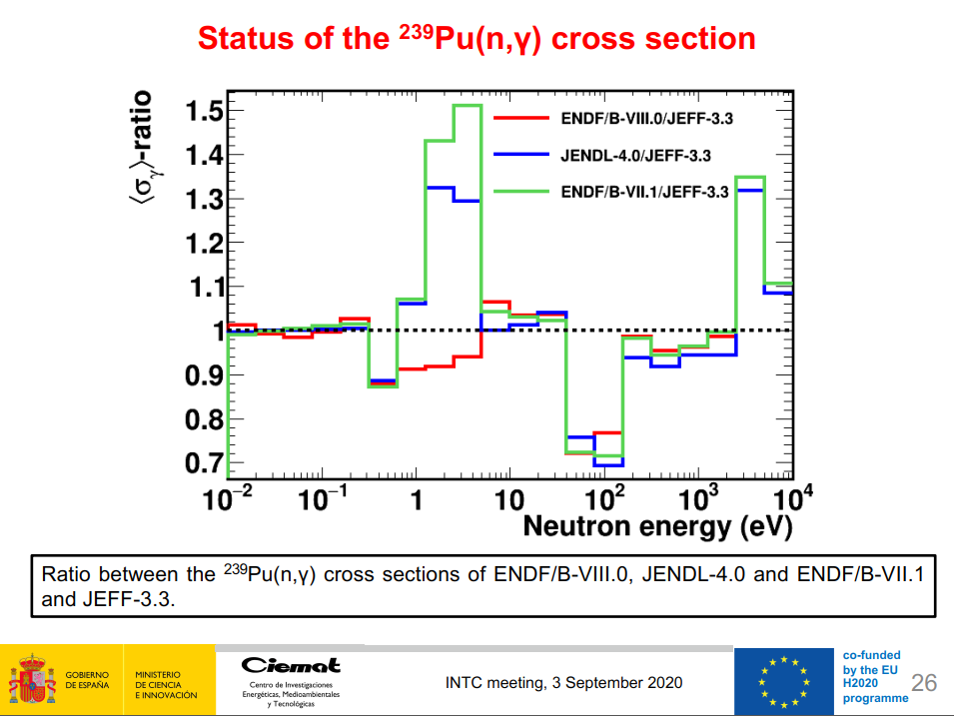

Experimental challenges (a few)
NEUTRON CAPTURE
Impact on k_{eff}, production of long-lived actinides
See in ND2025
Rather long list of requirements :
HPRL : ^{239,241}Pu (2008); ^{53,50}Cr (2008); ^{155,157}Gd (2018); ²⁰⁹Bi (2018); ¹⁶⁷Er (2021); ²³³U (2007); ²⁴²Pu (2007)
SG26 & 46 : ^{235,238}U; ^{239,240,242}Pu; ^{241,242m,243}Am; ²⁴⁴Cm
²³⁹Pu
Important for next generation fast reactors (U/Pu cycle)
or current reactors loaded with MOX fuel
a few measurements (only 2 allowing resonances analysis, 1971, 2014)
Discrepancies between evaluations
Challenging measurement
  Discrimination of γ’s from fission
  Quality of the sample (reduce impurities)
  Robustness of detector (α from ²³⁹Pu)
  Measurement on a broad energy range (th – 1 MeV)
V. Alcayne et al., « Proposal: measurement of 239Pu(n,γ) and
α–ratio at EAR1 with TAC + fission detectorsINTC 2020

Slide 20

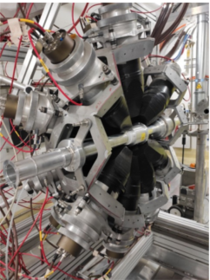
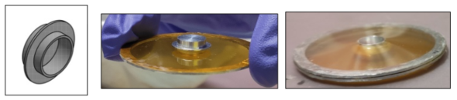
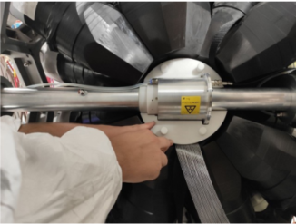

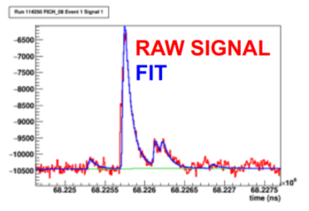

Experimental challenges (a few)
NEUTRON CAPTURE
²³⁹Pu(n,γ) & α-ratio @ n_TOF
CIEMAT, University of Lodz, JRC-Geel, and the n_TOF collab
To meet the challenge :
Fission tagging configuration up to 1 keV & Thick sample configuration
NEW thick ²³⁹Pu (100 mg) encapsulated sample (Prepared by JRC-Geel).
NEW fission chamber (University of Lodz) with 10 x ~1mg ²³⁹Pu targets
(Mounted and tested with neutrons at JRC-Geel/GELINA).
NEW Li-doped neutron absorber
(designed by CIEMAT and fabricated by CERN).
NEW pipes and structure material for the FC inside the TAC
NEW pulse shape analysis routine for both FC and TAC
Expected uncertainties
FTC : 3% < 100 eV < 4-6% < 1 keV ;
TSC : 100 eV < 3-4% < 10 keV.
TAC@n_TOF
New
& more accurate measurements
A. Sanchez Caballero et al. EPJ Web of Conferences 294, 01003 (2024)
D. Cano Ott, JEFFDOC 2217

Slide 21
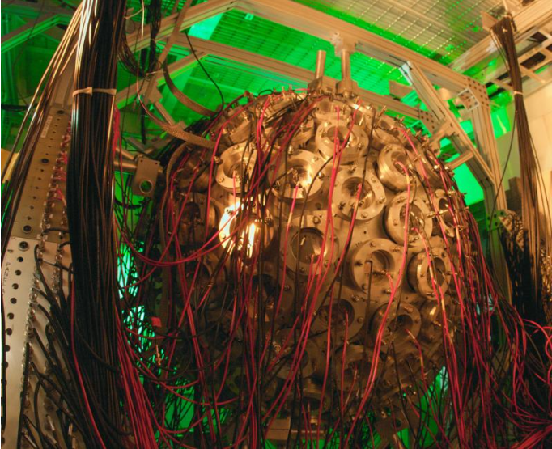
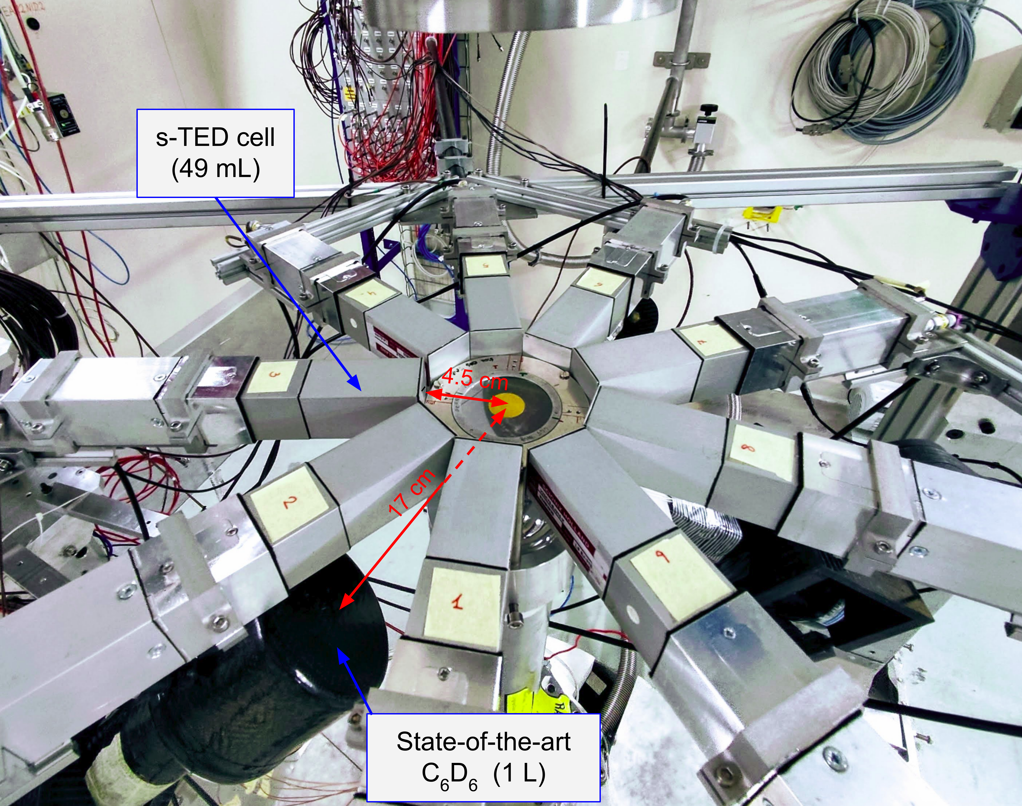
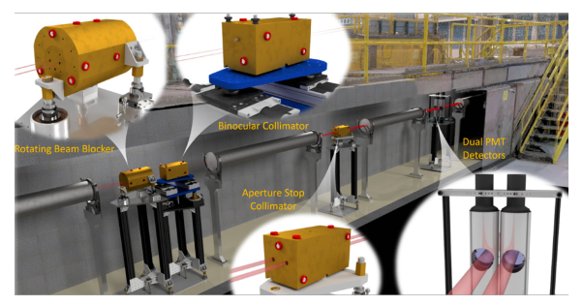
Experimental challenges (a few)
NEUTRON CAPTURE
Many experimental programs dedicated to (n, γ) measurement
with important detectors development
See the long list of ND2025 presentations on (n,γ) experimental measurements
Challenging measurement on short-lived nuclei
Importance of encouraging exchanges with evaluators
to better understand the needs then better constrain/design the exp. Project ; ex ²³⁸U(n, γ)
DANCE@LANSCE
S-TED@n-TOF
DICER@LANSCE
Transmission experiment

Slide 22
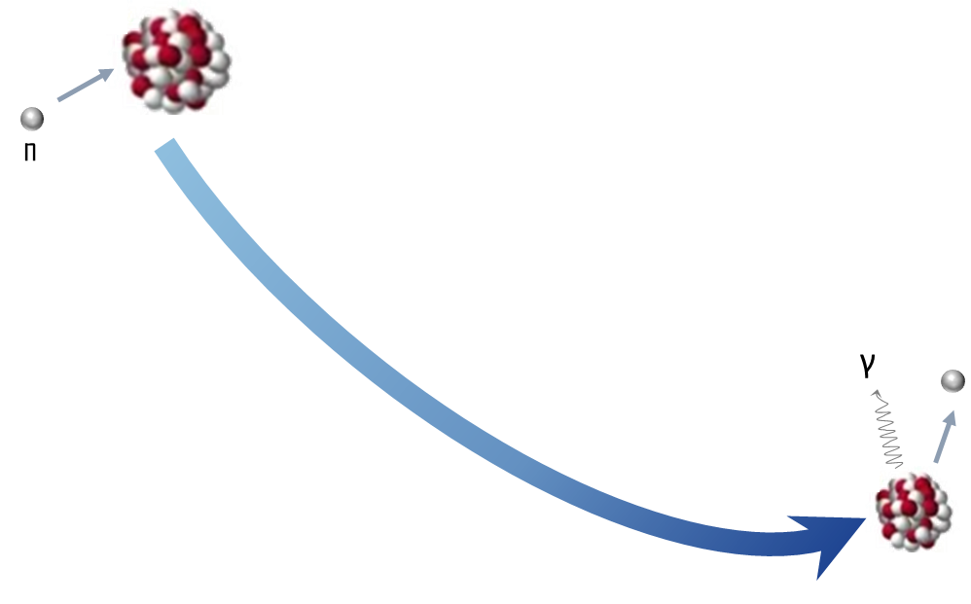
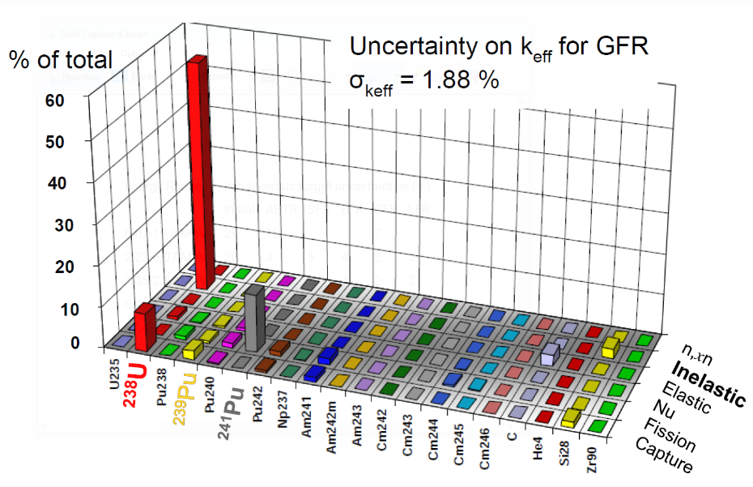
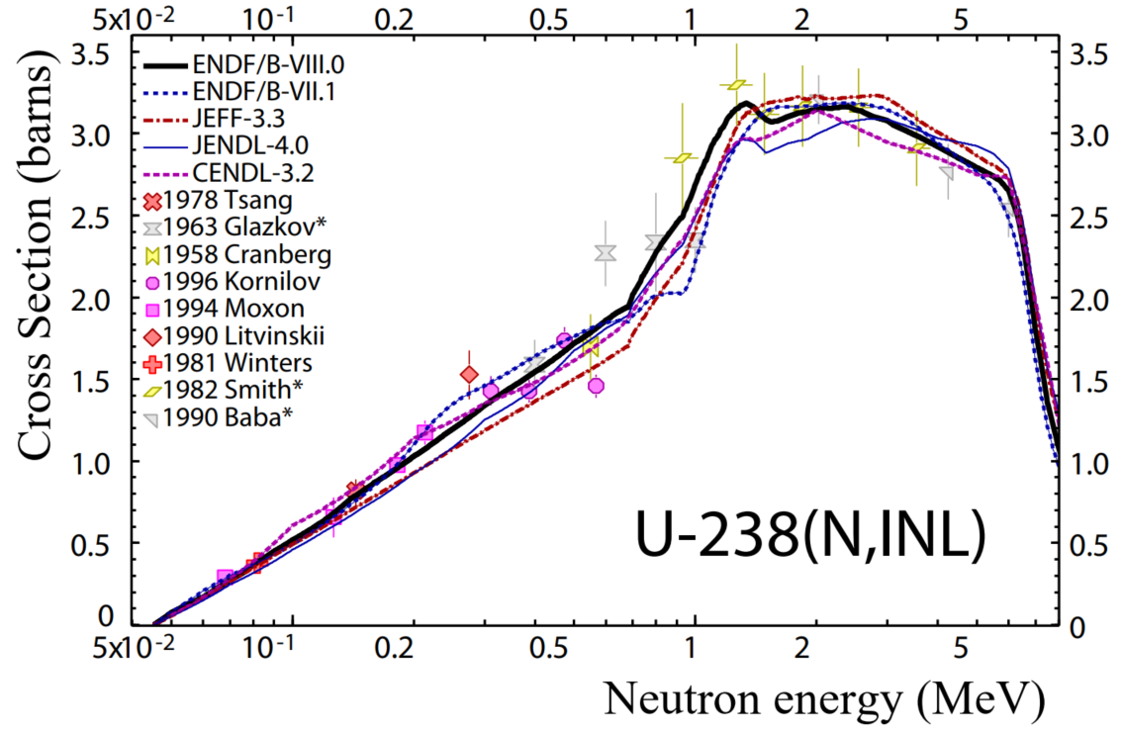
Experimental challenges (a few)
NEUTRON SCATTERING
Impact on k_{eff}, peak power and doppler & void coefficient
SG26
See in ND2025
Requirements :
HPRL : ²³⁸U (2008); ⁵⁶Fe (2008); ^{206,208}Pb (2008)
SG26 & 46 : ²⁰⁷Pb, ²³Na
²³⁸U
Only few experimental data
Challenging measurement
  Complex neutron detection
  In actinides, γ measurement penalized by the high IC coefficient (first level de-excitation)
  Tight target accuracy
New & more accurate measurements
& Nuclear model improvements

Slide 23
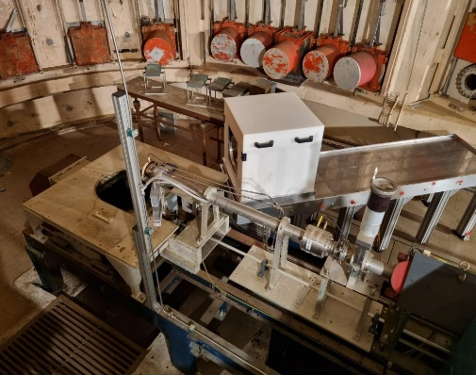
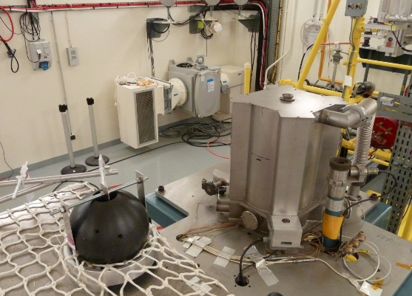
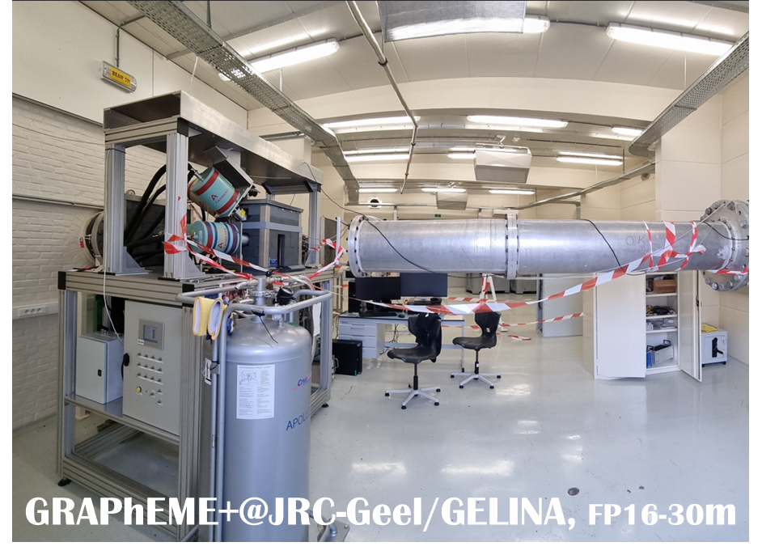
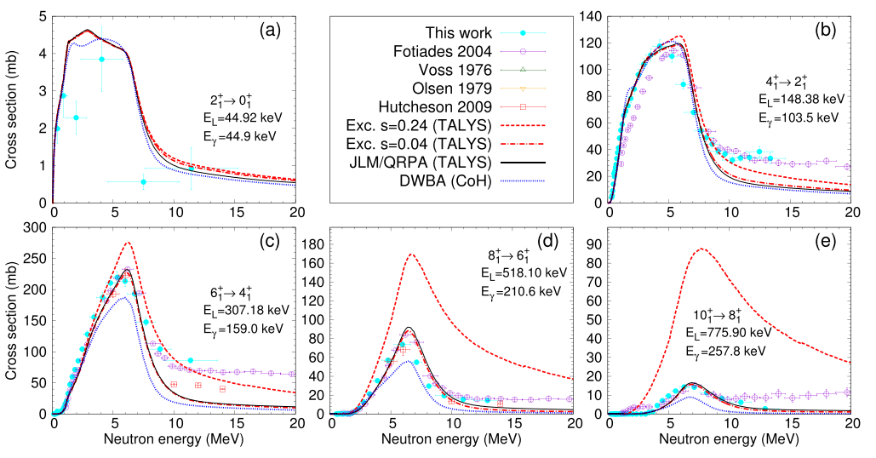
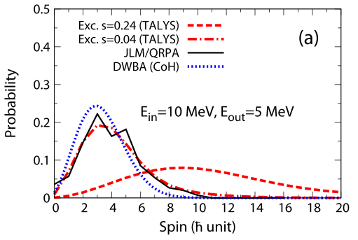
Experimental challenges (a few)
NEUTRON SCATTERING
²³⁸U(n, n’γ) & ²³⁸U integral meas. & theory
CNRS/IPHC, CEA/DES & DAM, IAEA, LANL
A whole efficient package (10 years collaboration) :
2 new integral experiments for ²³⁸U(n, n’) XS validation:
overestimation of the XS (~10%)
Differential ²³⁸U(n, n’γ) XS measurement
INTEGRAAL I &II
EXCALIBUR
New spin cutoff
used in the
JEFF upgrades
M. Kerveno, M. Dupuis et al., Phys. Rev. C 104, 044605 (2021)
Constraint on modeling :
Calibration of the
pre-equilibrium spin cutoff

Slide 24

Experimental challenges (a few)
MAELS@
SPIRAL2-NFS
GAINS@
JRC-Geel
COGNAC@
LANL
ELISA@
JRC-Geel
GENESIS@
BNL
RPI
NEUTRON SCATTERING
Inelastic scattering & (n, xn)
Importance to use all the experimental techniques
and facilities available
Prompt γ-ray spectroscopy,
neutron detection,
n-γ coincidences,
quasi-differential measurements…
Still important measurements to come on actinides
(ex ²³⁹Pu with GRAPhEME@JRC-Geel)
High resolution measurements on structural materials are mandatory
to describe the region of high energy resonances (new initiative @ CERN/n_TOF)
Measurement campaigns for (n, xn) reactions have started at the new GANIL-NFS facility

Slide 25
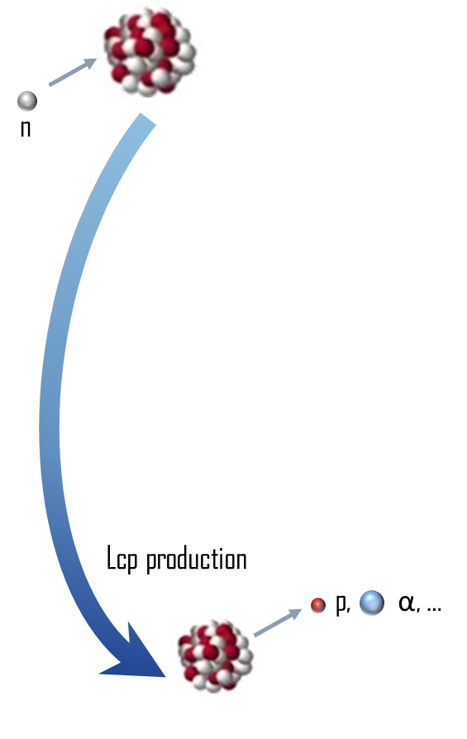
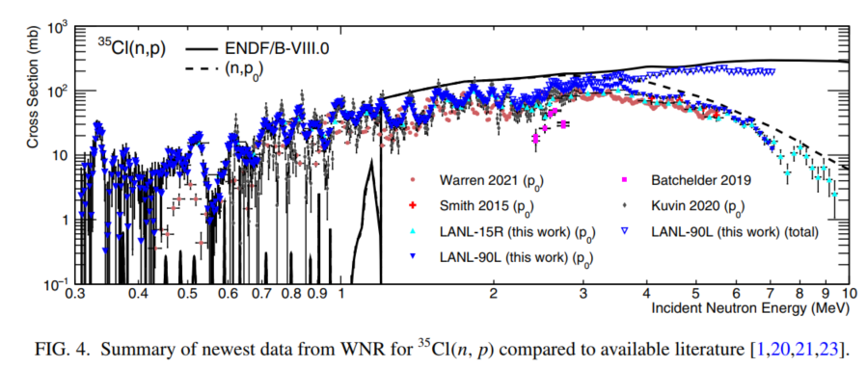

Peut être juste un slide, 2 max pour ça?
Lcp production -> MSFR 35Cl exemple HPRL
1 pres ND #619 Daniel Smith
Manip au xUS et manip APRENDE Avec différentes techniques
Experimental challenges (a few)
LCP PRODUCTION
Impact on production of gas and material damages
And reactivity in fast chloride molten salt reactor design
There is currently large uncertainty in reactivity for chloride fast reactors, due mainly to the uncertainty in the Cl-35 (n,p) cross section at high energies. This is a difficulty for chloride fast reactor design because the required fissile loading has large uncertainty, and this uncertainty also propagates to other parameters important to safety, such as reactivity coefficients. Production of S-35 via this reaction is also important for corrosion.
See in ND2025
A few entries but new interest for MSFR reactor type:
HPRL : ¹⁶O(n,α) (2008), ³⁹K(n,p) (2017), ³⁵Cl(n, p) 0.1-5 MeV (2022)
SG 46 : ³⁵Cl(n, p) 0.5 -10 MeV (2023)
K. Hanselman et al., Phys. Rev. C 110, 024609 (2024)
³⁵Cl A request from stakeholders
Needs of new and more accurate measurements above 100 keV
Experimental and theoretical efforts
  Several new measurements (LANL, CERN, NPL, …)
  with different techniques at different facilities
  Solve the discontinuous jump between R-matrix and HF approaches
New
& more accurate measurements
& Nuclear model improvements

Slide 26
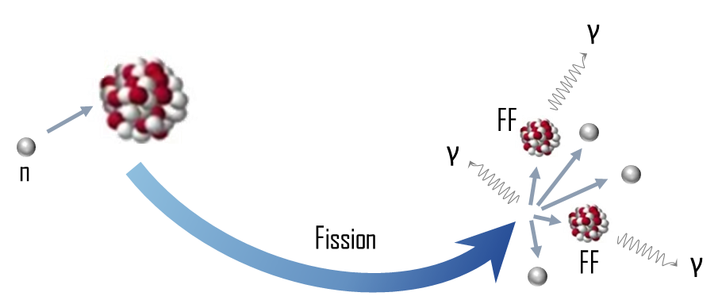
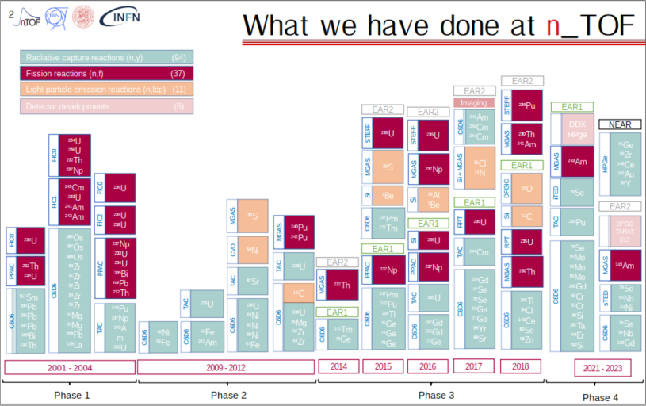
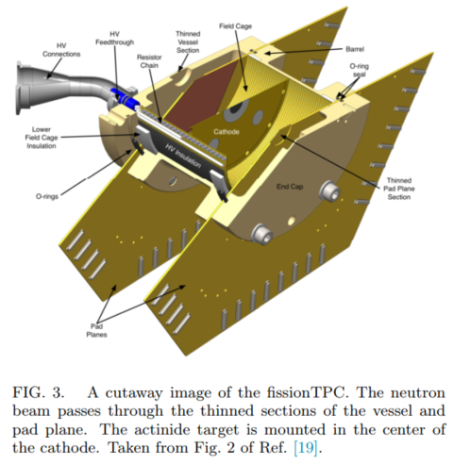
Experimental challenges (a few)
NEUTRON INDUCED FISSION
A. Manna et al., CNR*24
Still many entries in HPRL:
HPRL : ²³⁵U, ²³⁷Np, ^{238,239,240,241,242}Pu, ^{241,242m}Am, ^{244,245}Cm (2008)
SG 46 : ^{239,240}Pu, ²³⁸U (2023)
A lot of (n,f) fission XS measurements exist but :
“old“ measurements lack the level of detail regarding uncertainty quantification (ex. ²³⁹Pu)
To avoid “renormalization” issues,
new measurement on wide neutron energy ranges are required
“non-fissile” actinides (n,f) XS are still experimentally poorly known (ex. ^{240,242}Pu, ²⁴³Am)
Investigations of (n,f) XS standard over a wide range of energy (extension to high energy > 100 MeV) HPRL SPQ-Standards
New
& more accurate measurements
NIFFTE Fission TPC@WNR
L. Snyder,et al., Nucll. Data Sheet 178 (2021) 1–40

Slide 27
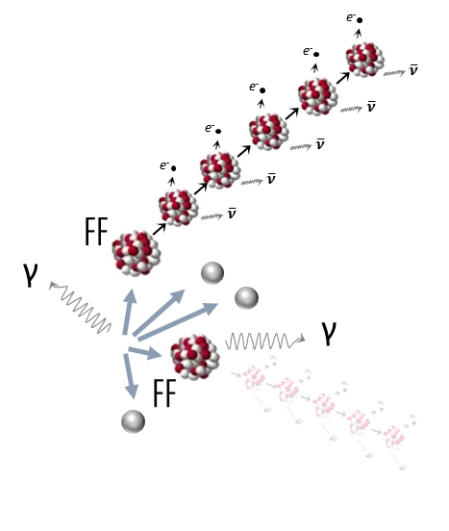
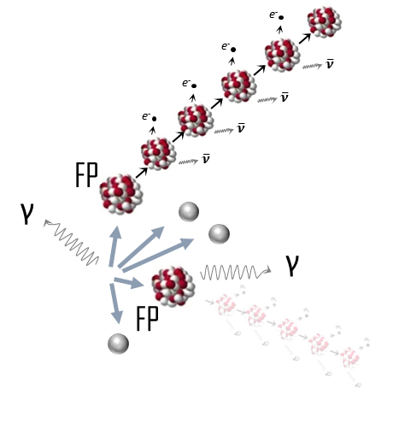
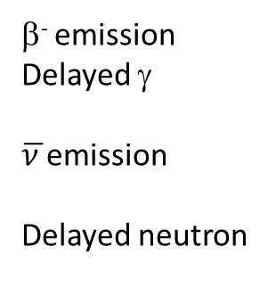
Experimental challenges (a few)
POST-FISSION OBSERVABLES
Fission : a complex process
β⁻ emission
Delayed γ
$\overline{ν }$emission
Delayed neutron
Decay heat (reactor safety),
Reactor monitoring,
non-proliferation tool
Chain reaction control
Decay data
Fission Products
Heat, toxicity
Prompt neutrons
Chain reaction
Prompt γ
Heat

Slide 28
Experimental challenges (a few)
POST-FISSION OBSERVABLES
Fission Product Yields
Impact :
𝒀(𝑨, 𝒁) fission yields
- Inventory and radiotoxicity of spent fuel
- Isotopic composition → Residual power
(Z, I) Kinetic energy dependence : excitation energy and spin distributions
- modeling prompt particle emission (n/𝛾) for material damage/heating in the reactor
A double challenge : accurate measurements & modeling
Novel interest in FY with emerging of fast reactor concepts and waste transmutation.
In the 2000s, data exist only for E_{th}, 500 keV and 14 MeV.
Challenges :
Need to extend the systematic to new FPY in the fast energy range and for minor actinides
Multi-observables measurements -FF(A,Z, E*,J^{π})- before and after neutron evaporation, emitted neutrons & γ’s
Needs to produce accurate data with covariance information (E_{th} and above) for evaluation and codes validation
For neutron induced fission experiments, keep the accessibility of spectroscopic targets

Slide 29
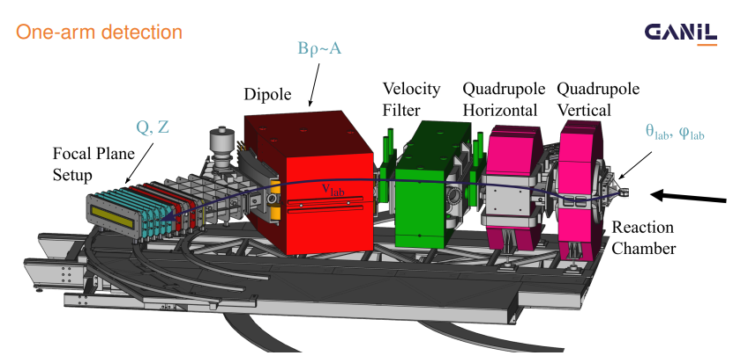
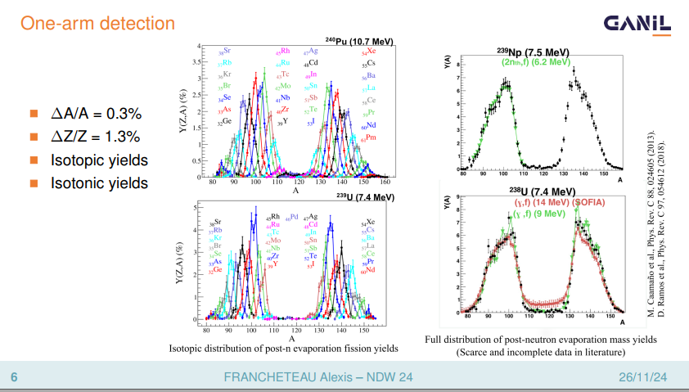
Experimental challenges (a few)
POST-FISSION OBSERVABLES
Fission Product Yields
Manip SOFIA?
Besoin de nouvelle mesure précises at ETh Lohengrin*
Et de Nouvelles mesures à haute énergie, bonne dynamique avec plusieurs projest d’envergure pour les rapides
plusieurs detceteur
SPIDER, FALSTAFF, VERDINeeds of Energy-dependent IFPYs (A,Z,E*) and correlation
Several initiatives to measure FPY
with more and more complete experimental setups
that give access to several quantities
Ex : The VAMOS (magnetic spectrometer) experiment @GANIL
using transfer/fusion induced reaction
Access to a Large range of actinides
Identification of the fissioning system:
Access to excitation energy ΔE* ~700 keV (FWHM)
Measurement of isotopic yield Y(A,Z)
ΔA/A = 0.3% ΔZ/Z = 1.3%
Two arms setup : meas. of the 2nd fragment
2v method -> pre-neutron isotopic yield and TKE
Neutron detector
Neutron multiplicity & energy
A. Francheteau, JEFFDOC 2368
A. Francheteau, JEFFDOC 2368

Slide 30
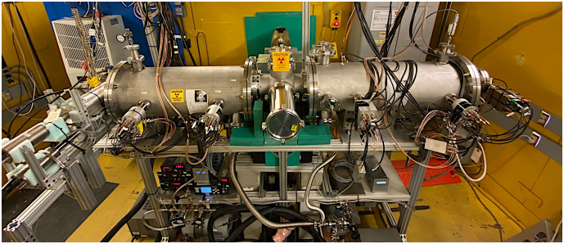
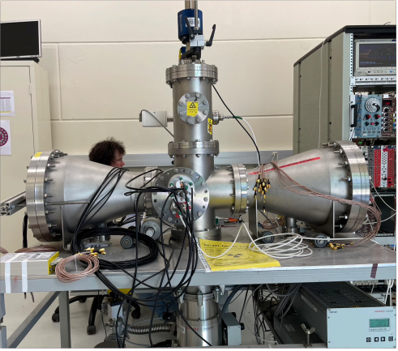
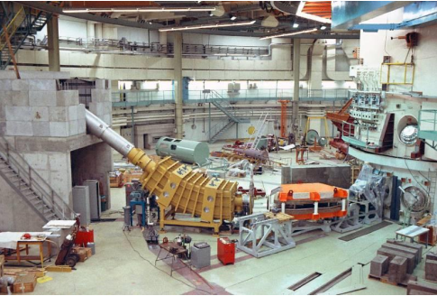
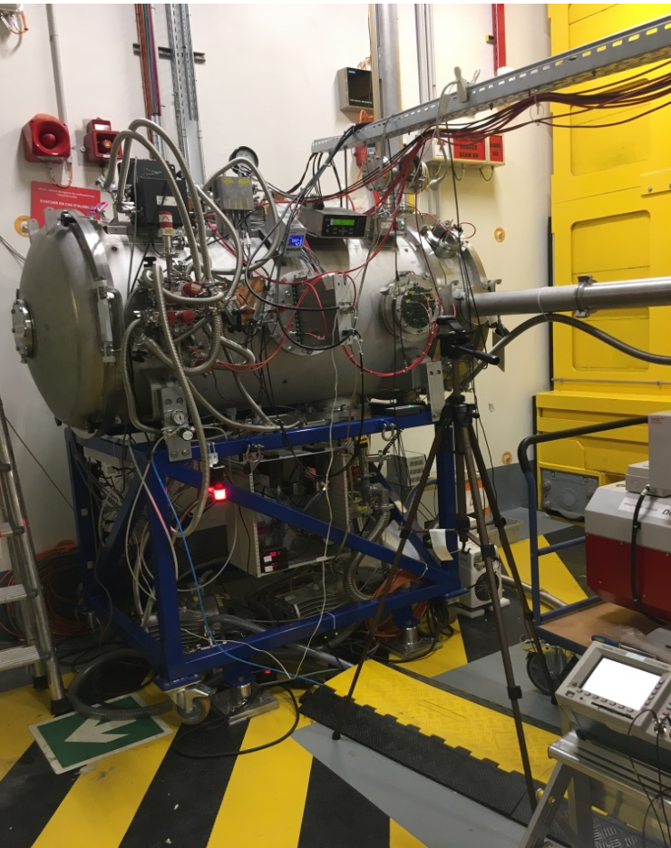
Experimental challenges (a few)
POST-FISSION OBSERVABLES
Fission Product Yields :
Measurements of isomeric ratio
to better understand the angular momentum
in fission fragment, constrain models and
enhance the predictive power of simulation tools
(γ-heating in reactors)
LOHENGRIN@ILL, JYFLTRAP@IGISOL, ν-ball@ALTO
2E-2v measurements at neutron beams
Challenge of the mass resolution
and isotopic identification!
SPIDER@LANL
VERDI
LOHENGRIN@ILL
New
& more accurate measurements
& Nuclear model improvements
FALSTAFF@NFS

Slide 31
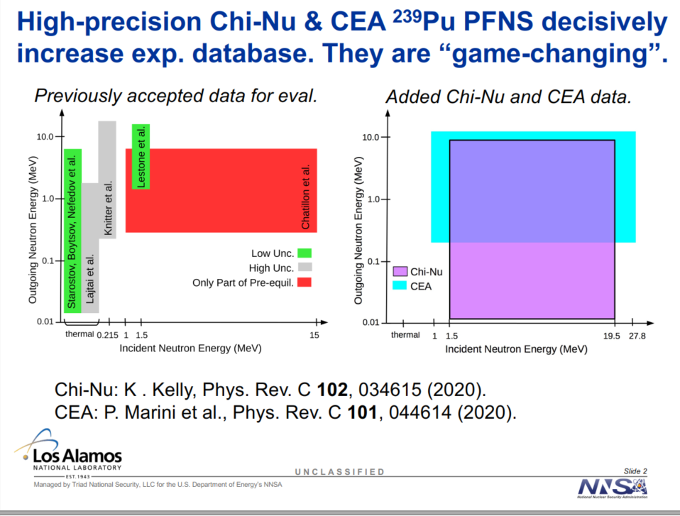
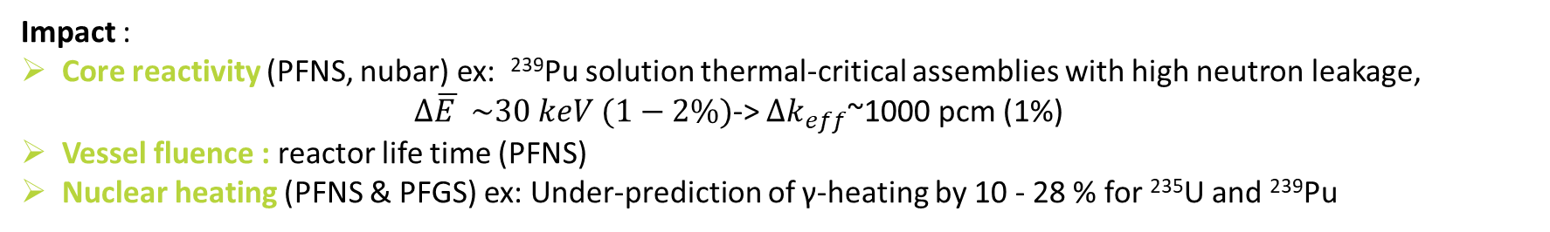
Experimental challenges (a few)
POST-FISSION OBSERVABLES
Prompt Fission Neutron / Gamma Spectra & multiplicity
Impact :
Core reactivity (PFNS, nubar) ex: ²³⁹Pu solution thermal-critical assemblies with high neutron leakage,
$Δ\overline{E }$ $\sim 30 keV (1−2\%)$-> $Δk_{eff}$~1000 pcm (1%)
Vessel fluence : reactor life time (PFNS)
Nuclear heating (PFNS & PFGS) ex: Under-prediction of γ-heating by 10 - 28 % for ²³⁵U and ²³⁹Pu
R. Capote et al., NucL; Data Sheets 131 (2016) 1–106
Requirements :
IAEA CRP in 2009 on PFNS to produce new PFNS evaluations with uncertainties for actinides.
HPRL request in 2006 for ²³⁵U and ²³⁹Pu PFGS ;
      request for ²⁴⁴Cm and ²⁴³Am PFNS
Challenges :
PFNS : solve discrepancies in measurements
& improve measurements at low & high energies
( En <100 keV , En> 10 MeV)
PFGS : γ-discrimination between prompt-fission γ and neutron induced γ,
wide-spread time distribution (from ps to μs)
Neutrons and γ spectra are difficult to model
© D. Deneucker INDEN workshop 2020

Slide 32



Experimental challenges (a few)
POST-FISSION OBSERVABLES
Prompt Fission Neutron Spectra & multiplicity
Huge measurement program @WNR (CEA-NNSA collaboration) :
20 years of instrumental developments to increase the quality of PFNS measurements!
Better neutron angular coverage, increase of the measured outgoing neutron energy range, more « transparent » FC, better statistics, …
Important experimental data for evaluation but also for discrimination between the different theoretical approaches.
FIGARO
K.J. Kellyet al., NucL; Data Sheets 173 (2021) 42–53
New
& more accurate measurements
& Nuclear model improvements
Chi-Nu

Slide 33

OUTLINE
nuclear data for fission technologies
What are we talking about?
Definition of needs
Experimental challenges (a few)
Building bridges!

Slide 34
BUILDING BRIDGES !
A take away message for experimentalists
Substantial experimental effort to provide new and high-quality nuclear data, over the last 30 years !
The “easy” measurements have been already done, some challenges still remain.

Slide 35


BUILDING BRIDGES !
A take away message for experimentalists
Substantial experimental effort to provide new and high-quality nuclear data, over the last 30 years !
The “easy” measurements have been already done, some challenges still remain.
Understand the needs
take advantage of the IAEA’s and NEA extraordinary documentary database (CRP, WPEC,…)
Exchanges with evaluators before and after the experiment to enhance the chance to meet the experimental needs and improve the evaluation process (action in progress in EU-APRENDE project https://indico.psi.ch/event/16894/)

Slide 36
BUILDING BRIDGES !
A take away message for experimentalists
Substantial experimental effort to provide new and high-quality nuclear data, over the last 30 years !
The “easy” measurements have been already done, some challenges still remain.
Understand the needs
Provide consolidated data
Apply the FAIR principle
Detailed document on the uncertainty quantification, potential bias to improve the evaluation process
(some templates exist ! Ex: D. Neudecker, A.M. Lewis,
J.R. Vanhoy, et al., EPJ N 9 (2023) 31-32,33,35)
Provide experimental correlations and covariances

Slide 37
BUILDING BRIDGES !
A take away message for experimentalists
Substantial experimental effort to provide new and high-quality nuclear data, over the last 30 years !
The “easy” measurements have been already done, some challenges still remain.
Understand the needs
Provide consolidated data
Evaluators Community
& Users/Stakeholders

Slide 38
BUILDING BRIDGES !
A take away message for experimentalists
Substantial experimental effort to provide new and high-quality nuclear data, over the last 30 years !
The “easy” measurements have been already done, some challenges still remain.
Nuclear structure data
Understand the needs
Provide consolidated data
Many experimental techniques are based on nuclear structure information.
Lack of precise information.
Need for precise nuclear structure data for reactor studies, G.Henning et al. EPJ N 10, 6 (2024)
Evaluators Community
& Users/Stakeholders

Slide 39
BUILDING BRIDGES !
A take away message for experimentalists
Substantial experimental effort to provide new and high-quality nuclear data, over the last 30 years !
The “easy” measurements have been already done, some challenges still remain.
Nuclear structure data
Understand the needs
Provide consolidated data
Innovative experiments
Still challenge for nuclei
with short half life
(Xe-135, U-237, Np-239)
IAEA Technical Meeting on Neutron-induced Reactions on Short-lived Nuclei- 2025/08/25-29
Take advantage of new development in fundamental nuclear physics research.
Ex : storage Rings
Evaluators Community
& Users/Stakeholders

Slide 40
BUILDING BRIDGES !
A take away message for experimentalists
Substantial experimental effort to provide new and high-quality nuclear data, over the last 30 years !
The “easy” measurements have been already done, some challenges still remain.
nuclear structure data
Understand the needs
Provide consolidated data
Innovative experiments
Use of ia/deep learning
A real potential for complex data analysis or signal treatment
Evaluators Community
& Users/Stakeholders

Slide 41
BUILDING BRIDGES !
A take away message for experimentalists
Substantial experimental effort to provide new and high-quality nuclear data, over the last 30 years !
The “easy” measurements have been already done, some challenges still remain.
Nuclear structure data
Innovative experiments
Use of ia/deep learning
Understand the needs
Provide consolidated data
Fondamental
Nuclear Physics Community
Evaluators Community
& Users/Stakeholders

Slide 42
BUILDING BRIDGES !
A take away message for experimentalists
Substantial experimental effort to provide new and high-quality nuclear data, over the last 30 years !
The “easy” measurements have been already done, some challenges still remain.
Nuclear structure data
Innovative experiments
Use of ia/deep learning
Understand the needs
Provide consolidated data
Fondamental
Nuclear Physics Community
Evaluators Community
& Users/Stakeholders
Maintain :
the capability to provide high quality samples
state of the art facilities
attractivity to the next physicist generation

Slide 43
BUILDING BRIDGES !
A take away message for experimentalists
Substantial experimental effort to provide new and high-quality nuclear data, over the last 30 years !
The “easy” measurements have been already done, some challenges still remain.
Nuclear structure data
Innovative experiments
Use of ia/deep learning
Understand the needs
Provide consolidated data
Fondamental
Nuclear Physics Community
Evaluators Community
& Users/Stakeholders
National and International Bodies
Maintain :
the capability to provide high quality samples
state of the art facilities
attractivity to the next physicist generation

Slide 44


THANK YOU
David Bernard,
Emmeric Dupont,
Olivier Sérot,
Arjan Plompen,
Dimitri Rochman,
Gilles Noguere,
Stephan Oberstedt
et al.
In memory of Sylvain David

