Slide 1
Gamma-Neutron discrimination
Franco Camera, A. Giaz, O. Wieland, G. Benzoni, S. Bottoni, A. Bracco, S. Brambilla, F. Crespi, L. D’Amato, M. Giunta, S. Leoni, B. Million
University of Milano and INFN section of Milano, via Celoria 16, 20133 Milano, Italia
Outline:
Gamma-Neutron discrimination techniques (most used)
LaCl₃:Ce undoped
LaCl₃:Ce doped
  Measurement using R6231, H6531, R9420 PMTs
FFT
Conclusion

Slide 2
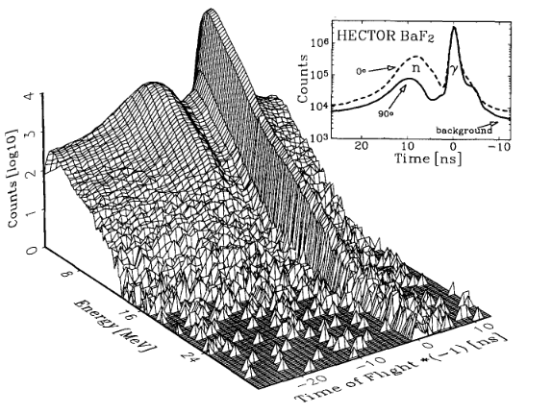

FAST Neutron Discrimination
Time of Flight (TOF)
Pulse Shape Analysis (PSA)
It is only possible with high performing digitizers, but It could select neutrons (independently they are prompt or delayed). Therefore, It could be useful the additional measurement of TOF.
$$∆t=d \sqrt[2]{\frac{m}{2E_{k}}}$$
Neutron has mass and therefore is slower than γ (Δt_{n} > Δt_{γ})
The values of ‘Δt’ and ‘d’ has some uncertainness (σ_{Δt} and σ_{d,}
σ_{Δt} ⇒ Time resolution and σ_{d} ⇒ detector thickness).
In general, it is not possible to have a precise measurement of neutron kinetic energy.
TOF doesn’t select only neutrons, but all the ‘delayed’ events (whether they are neutrons, gamma, protons, …).
In this case both events will be selected, independently on the kinetic energy of the neutron.
Neutron
neutron
Neutron
Neutron
As the neutron doesn’t have any charge, the use of PSA technique requires:
The transfer of the neutron kinetic energy to a charged particle
  Elastic scattering on very light nuclei
  Nuclear reactions which emit charged particles
Sensitivity of the signal to the ionization density
In general, the elastic scattering of a neutron on a very light nucleus (e.g. Hydrogen) cannot provide a precise estimate of the neutron Kinetic energy. It can only provide an electric signal which can be used for PSA.
In general, the cross section for a nuclear reaction with a fast neutron is very small if compared to the electromagnetic one. In the best cases, the cross section could be of the order of hundreds of millibarn.
In general, almost all scintillators have some kind of sensitivity (large or small) to the ionization density.
In this case both events (the neutrons and the γs) produce delayed events.
gamma
Neutron
wall
Time
A.Maj et al. NPA571(1994)185

Slide 3
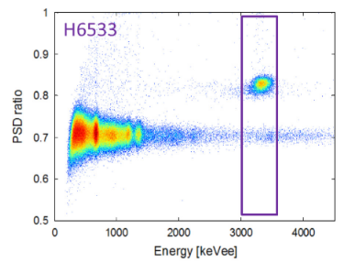
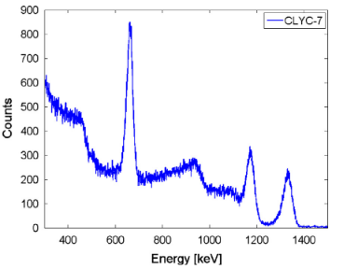
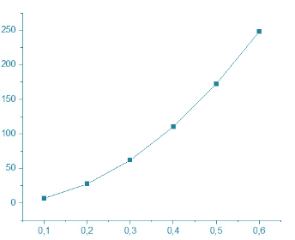
FAST Neutron Discrimination
Time of Flight (TOF)
Pulse Shape Analysis (PSA)
Using a time resolution of 1 ns and a distance of 30 cm one would need approximately one hundred of 3’x3’ detectors to cover the full solid angle.
A good scintillator is CLYC or TLYC:
neutrons
Detectors number
⁶⁰Co + ¹³⁷Cs
A.Giaz et al. NIM A810(2016)132
But:
CLYC hasn’ t a very high density (3.3 g/cm³)
CLYC scintillation light has a long time constant (τ > 1μs).
CLYC seems to exhibit severe degradation due to the dose (Richards and Sycora NIM A902(2018)45)
We have also noticed than our CLYC scintillators deteriorated,
An alternative to CLYC could be very useful.
PSA doesn’t need ‘long’ flight path. In principle a scintillator could be placed some cm from the target. Therefore, many detectors are not needed to cover the full solid angle.
Detector distance [m]
In addition, it will be not possible to have a precise estimation of the neutron energy.

Slide 4
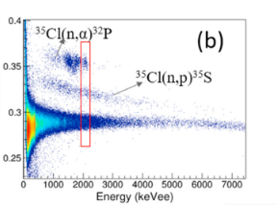
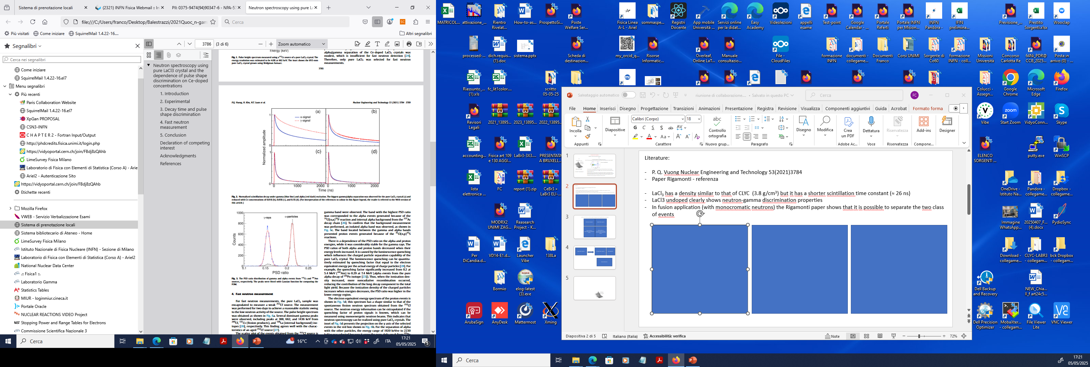
Pulse Shape Analysis (PSA)
In the case it is needed only the identification of a neutron-induced event (a precise estimate of the neutron’s energy is not needed) there are some arrays already available (e.g. NEDA, which uses the liquid scintillator BC501A)
In the case are needed both some information on the type of incident particles and on its kinetic energy, some kind of nuclear reaction is needed.
  La, Ce, Br, … do not have large cross sections for (n,p) or (n,α) reactions.
  ³⁵Cl has a good cross section (some order of magnitude higher as compared to La, Ce, Br) for (n,p) and (n,α) reactions.
  Scintillators with Clorine could be a good starting point (e.g. CLYC, CLLBC, LaCl₃(Ce), CHC, …).
  LaCl₃ could be an alternative to CLYC.
    Density = 3.84 g/cm³.
    Time constant of scintillation light (5% doped with Ce) ∼ 25 ns
  LaCl₃ has some additional very interesting features
    Undoped LaCl₃
P. Q. Vuong et al. Nuclear Eng. and Tech. 53(2021)3784 and S.W.Ahn et al. Rad. Phys. and Chem 222(2024)111855
Doping 0.01%
noDoped
Doping 0.05%
Doping 0.1%
The scintillation light time constant of an undoped LaCl₃ is longer than that of CLYC
An undoped LaCl₃ could be better than CLYC as it can separate neutron-induced alpha from neutron-induced protons events

Slide 5
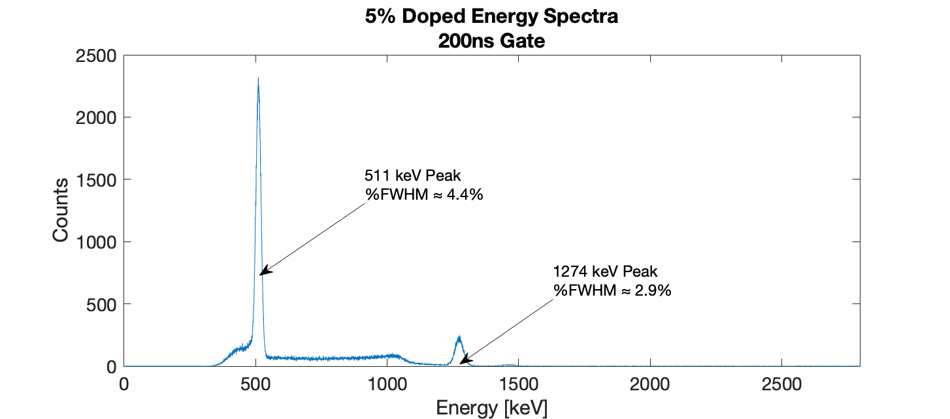
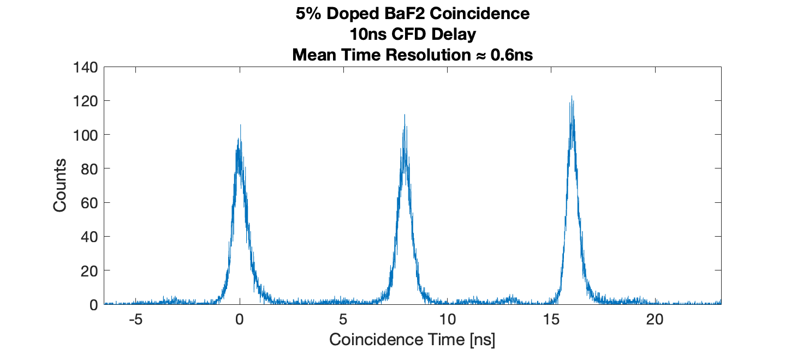
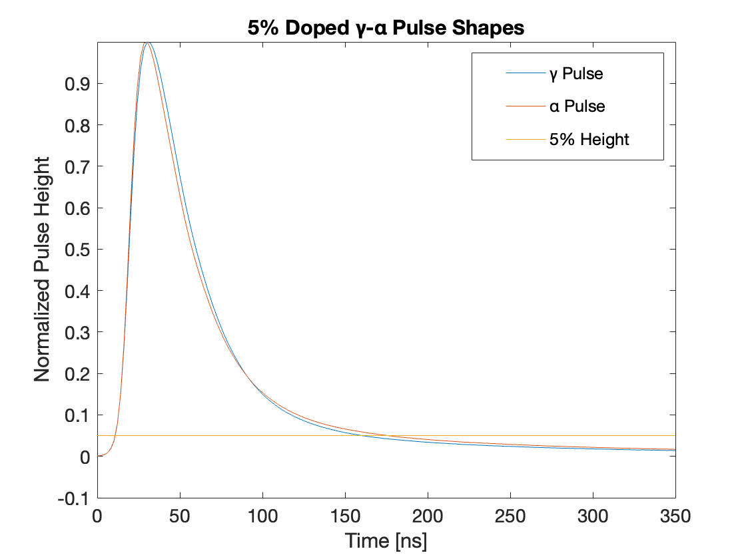
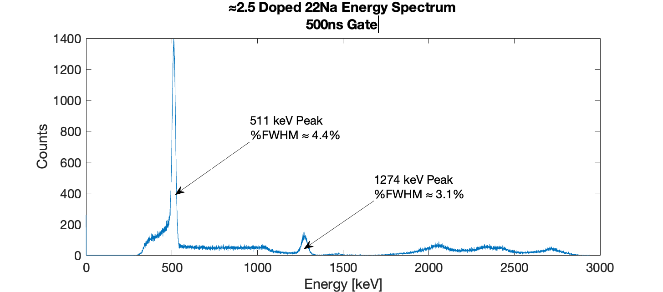
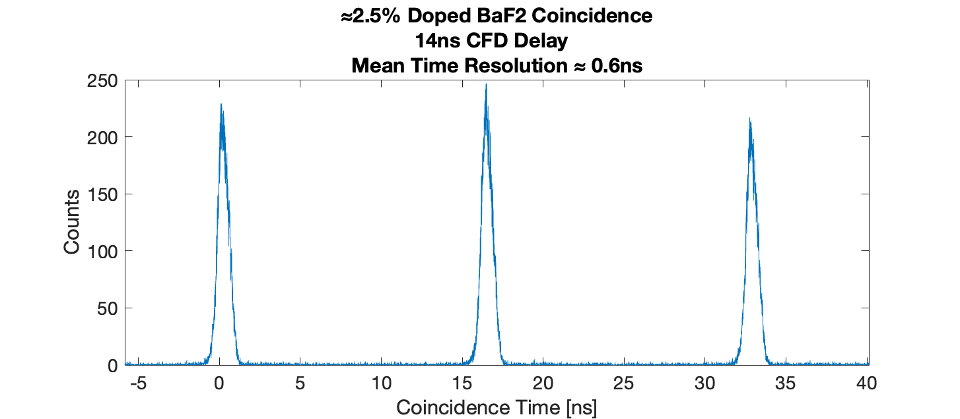
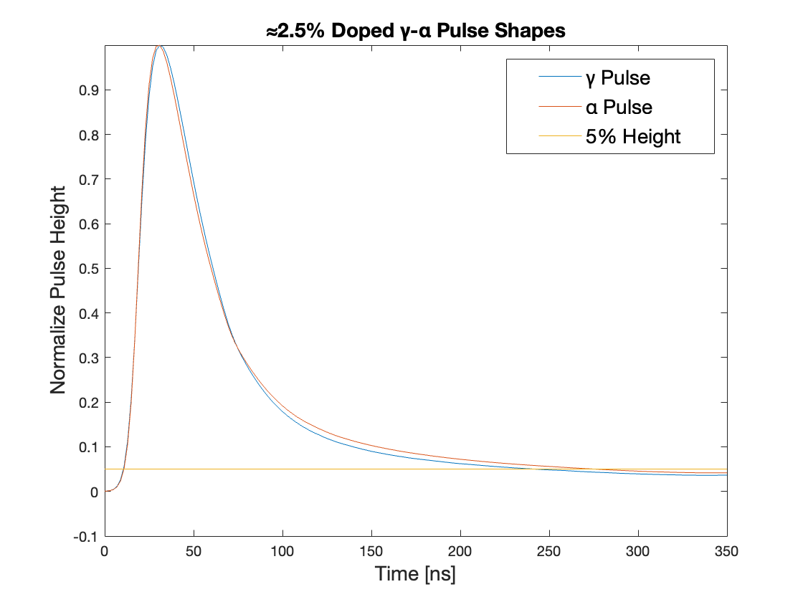
LaCl₃(Ce) Cerium concentration 5%
LaCl₃(Ce) Cerium concentration ∼ 2.5%
As expected, there are no differences in performances between the two crystals.
It would be very interesting to measure with a completely undoped LaCl₃
Courtesy of Lorenzo D’Amato

Slide 6
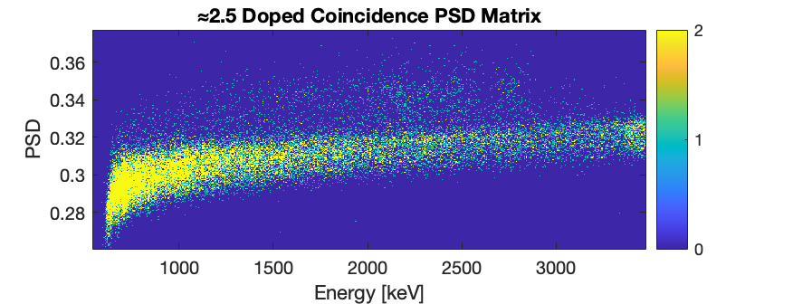
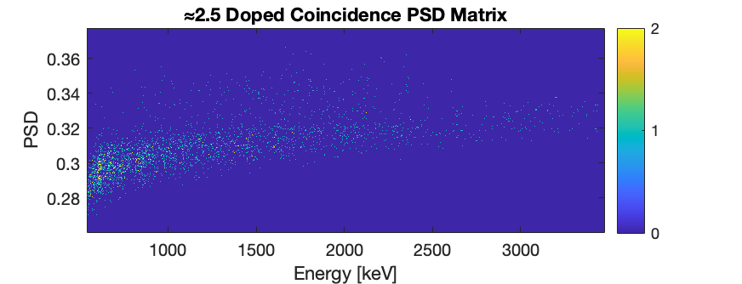
To eliminate alpha contaminations, we used coincidence events.
LaBr₃(Ce)
LaCl₃(Ce)
4.4 MeV gamma ray
Neutron
AmBe source
(⁹Be+α) ⇒ ¹³C* ⇒ ¹²C+n+kγ
Not asking the coincidence with a 4.4 MeV γ ray in LaBr₃
Requiring the coincidence with a 4.4 MeV γ ray in LaBr₃
Courtesy of Lorenzo D’Amato

Slide 7
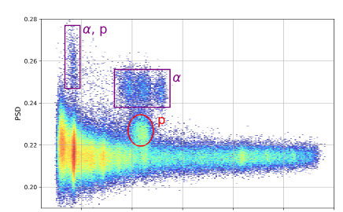
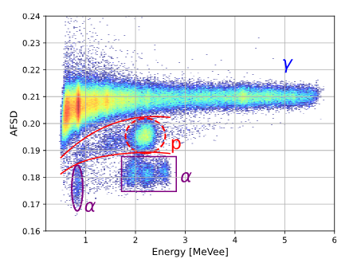
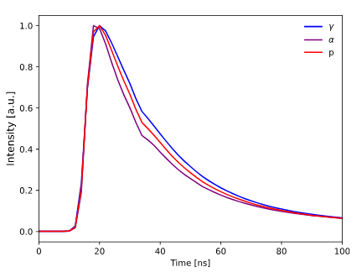
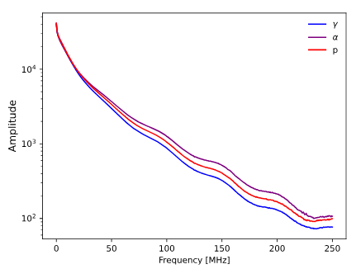
Doped LaCl₃:Ce
D. Rigamonti et al. Meas. Sci. and Tech. 36(2025)015907
FFT
Neutrons have 2.5 MeV of kinetic energy and
they are monochromatic
(they are produced in the D-D fusion)
PMT
Hamamatsu
R9420-100
was used

Slide 8
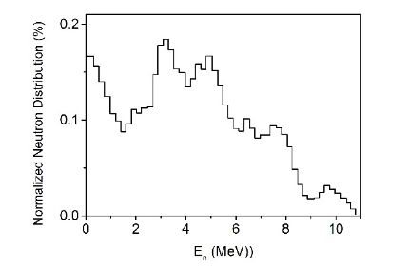

Source AmBe
Non monocromatic neutrons
FFT algorithm ⇒ $y_{p+1}=\sum_{j=0}^{n−1}{x_{j+1}e^{−2πi f(p+1)/n}} where x_{j+1} are the digitized samples$
          y_{p+1} is a complex number representing the amplitude and the frequency of the sinusuidal component.
          f is the samplig frequency
⇒ $A=abs (y)$
L. Lebreton et al. Radiat. Prot. Dosimetry 126(2007)3

Slide 9
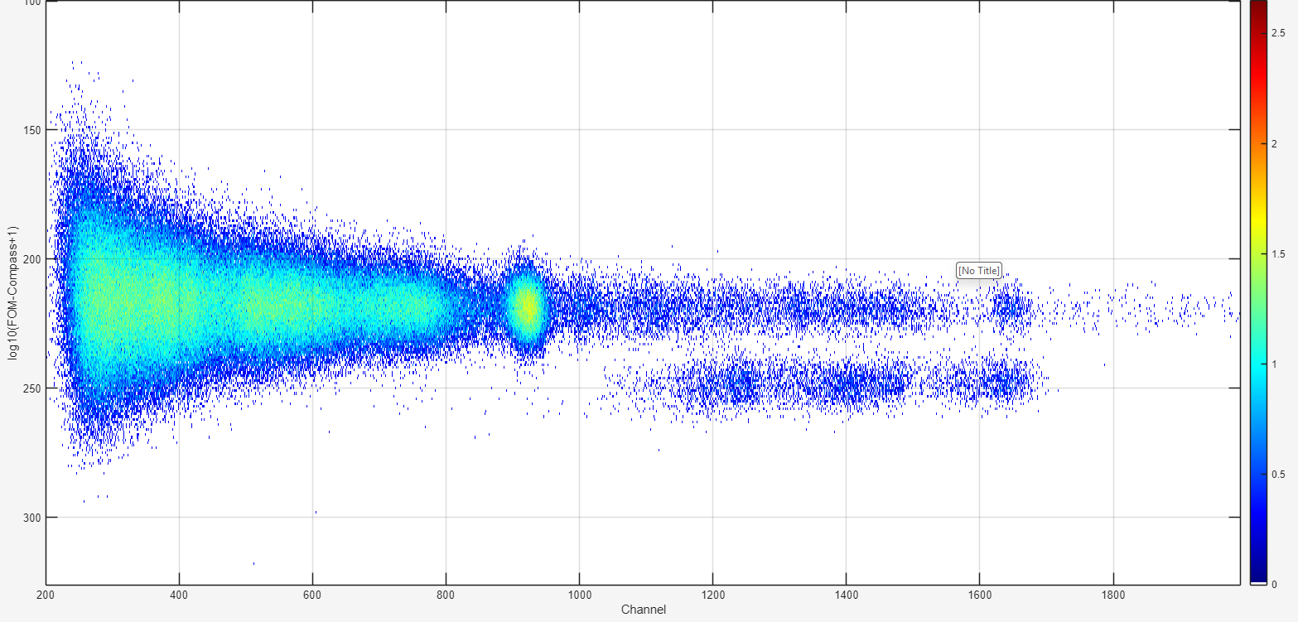
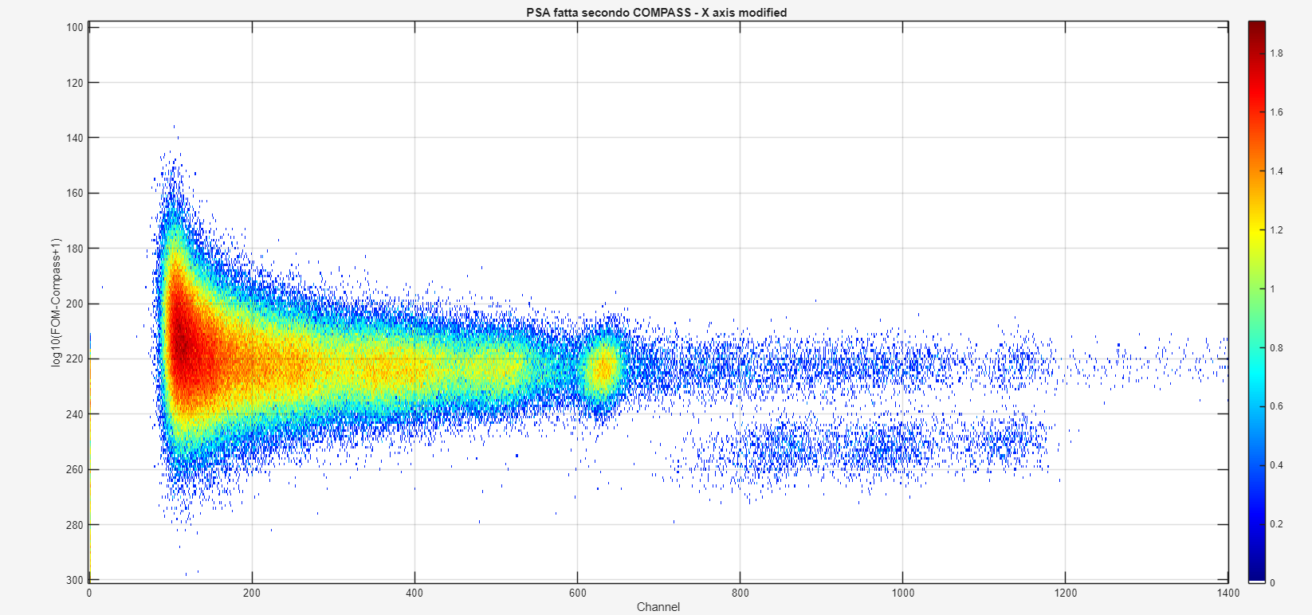
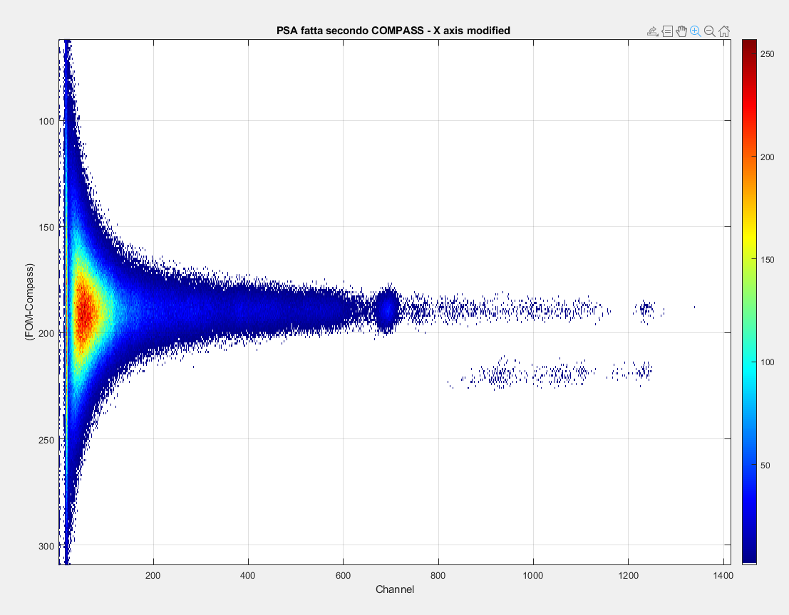
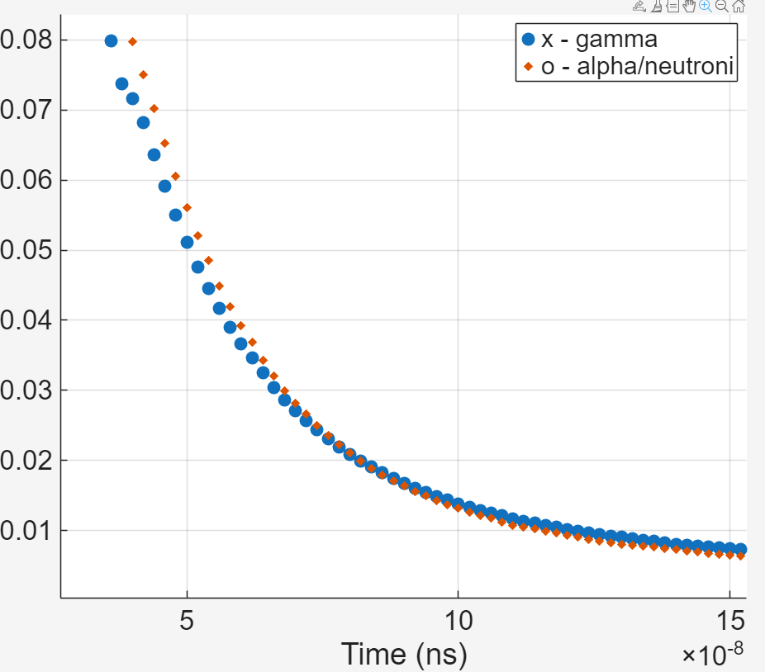
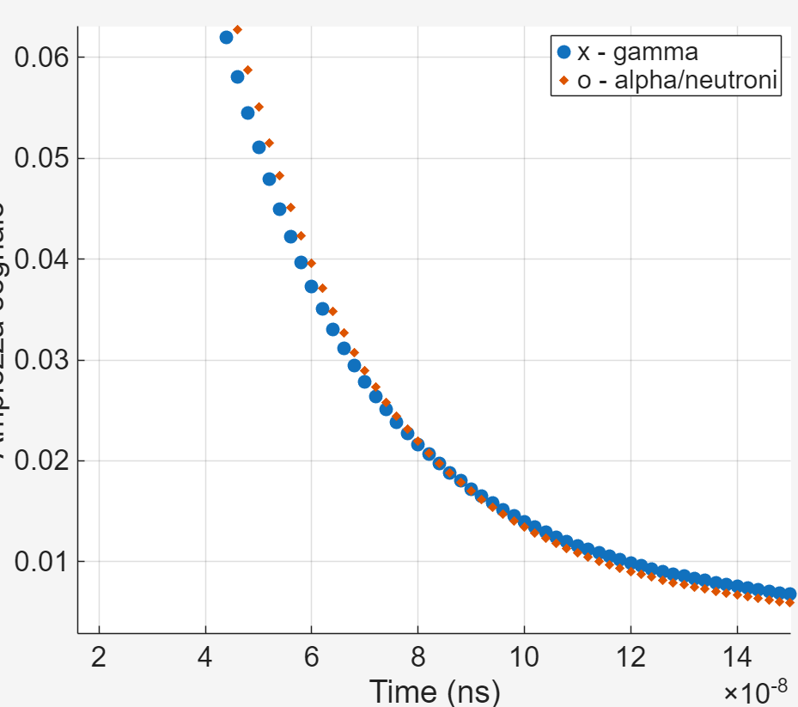
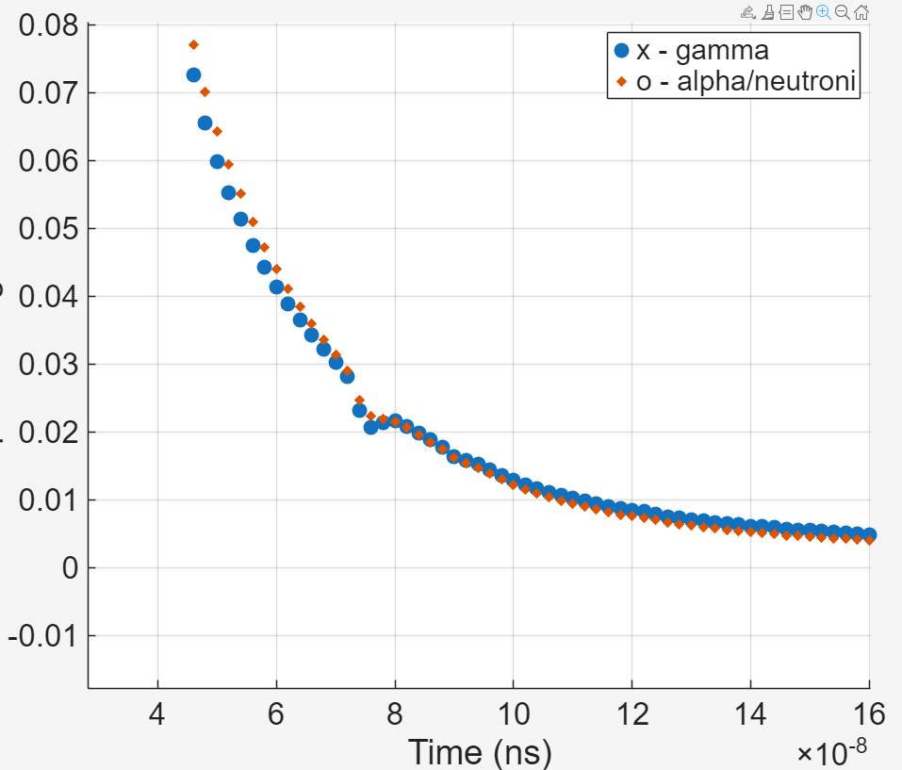
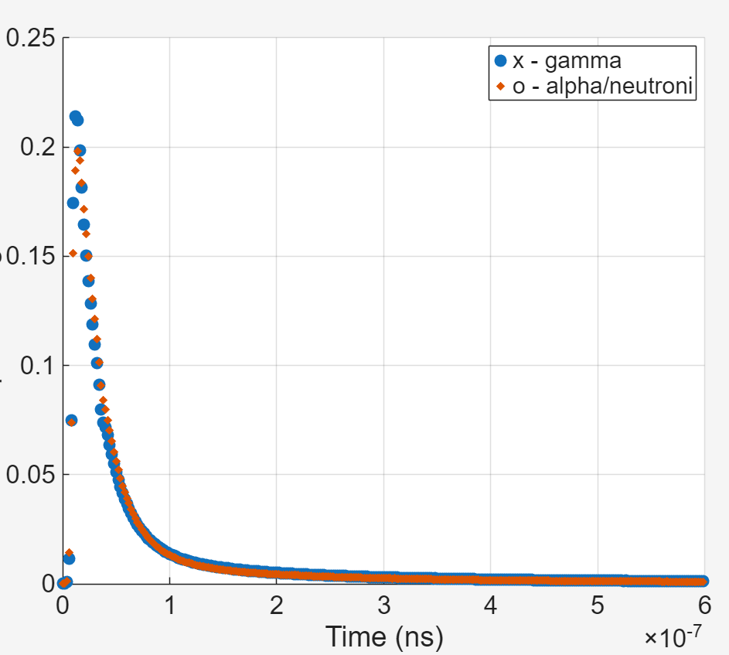
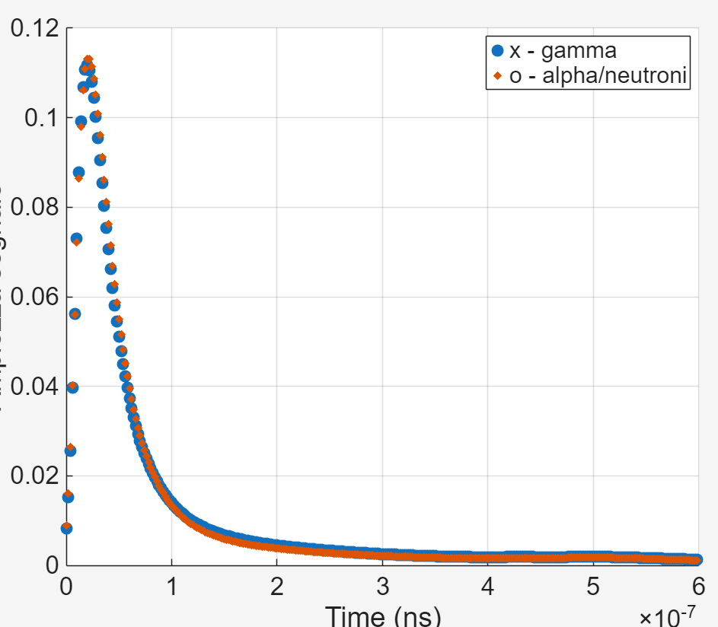
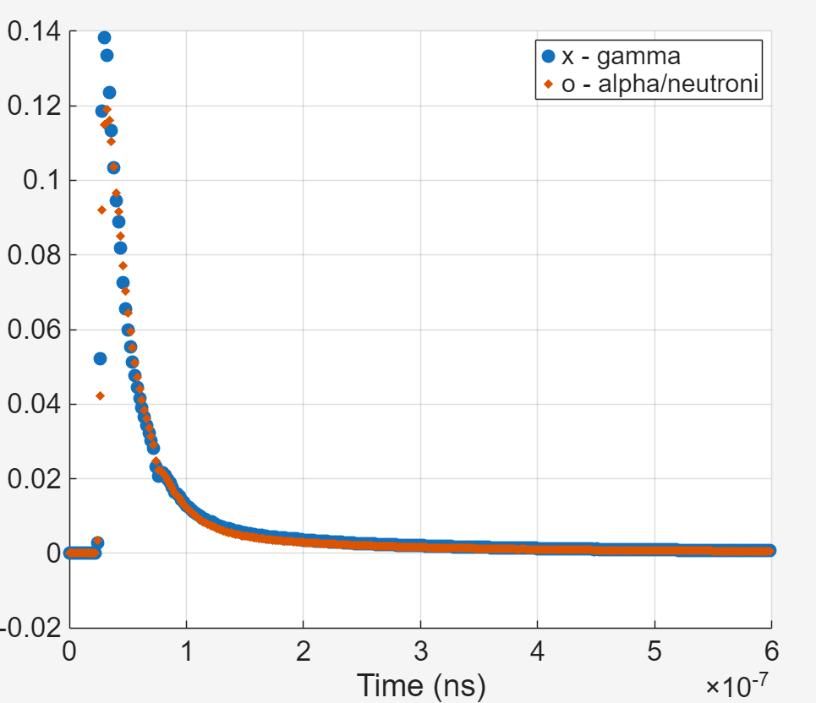
Doped LaCl₃:Ce - nosource
Hamamatsu R6231
Spectroscopic 2’ PMT
Hamamatsu H6533
Very fast 1’ PMT
Hamamatsu R9420
Fast 1’ PMT
Energy resolution at 1274 keV 2.8%
Energy resolution at 1274 keV 4.5%
Energy resolution at 1274 keV 3.0%
Signal amplitude [a.u.]
Signal amplitude [a.u.]
Signal amplitude [a.u.]
Signal amplitude a.u.
Signal amplitude [a.u.]
Signal amplitude [a.u.]
Signal amplitude a.u.
20
60
80
100
Time [ns]
20
60
80
100
Time [ns]
FOM = [int(0-600 ns)-int(0-100 ns)]/int(0-600 ns)
FOM = [int(0-600 ns)-int(0-100 ns)]/int(0-600 ns)
FOM = [int(0-600 ns)-int(0-100 ns)]/int(0-600 ns)
It is possible to reject/select alpha particles using the charge difference method with all the tested PMTs

Slide 10
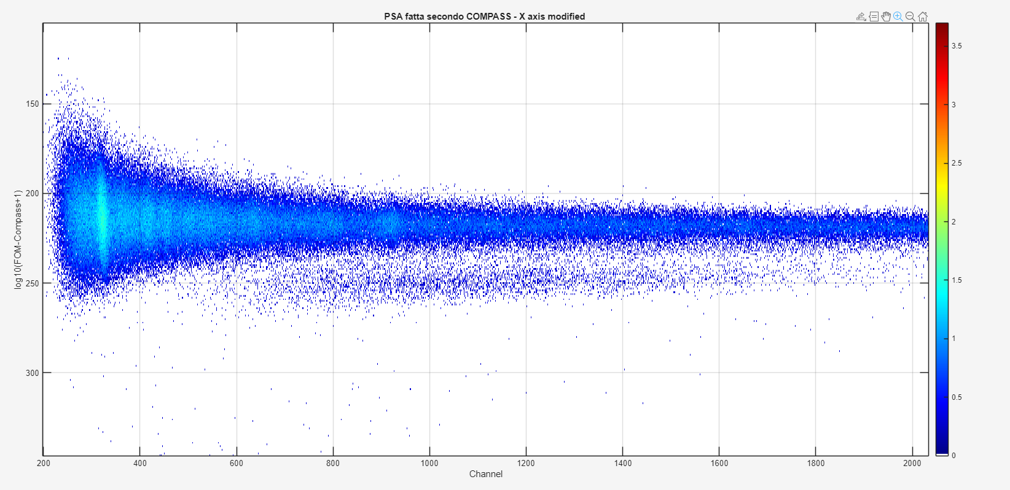
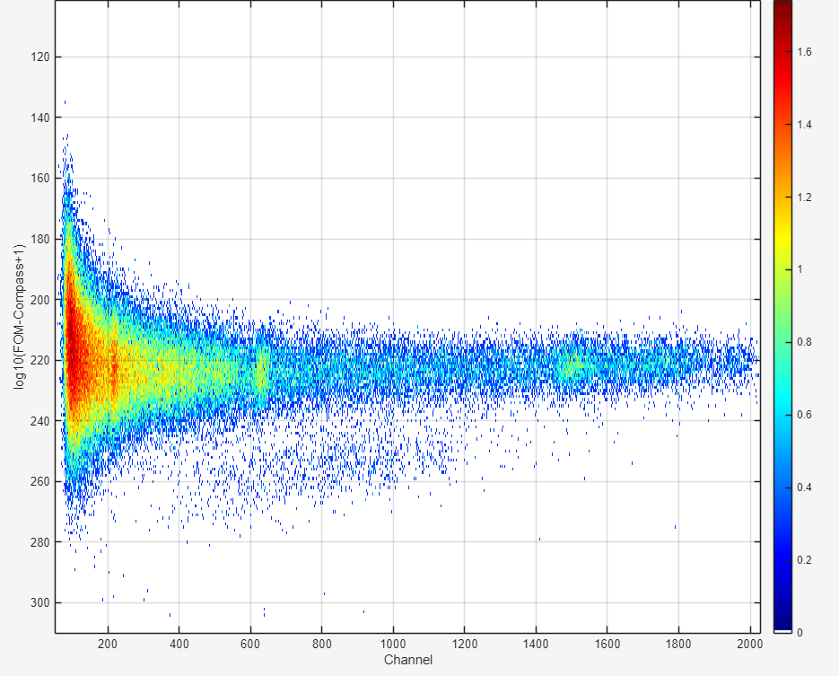
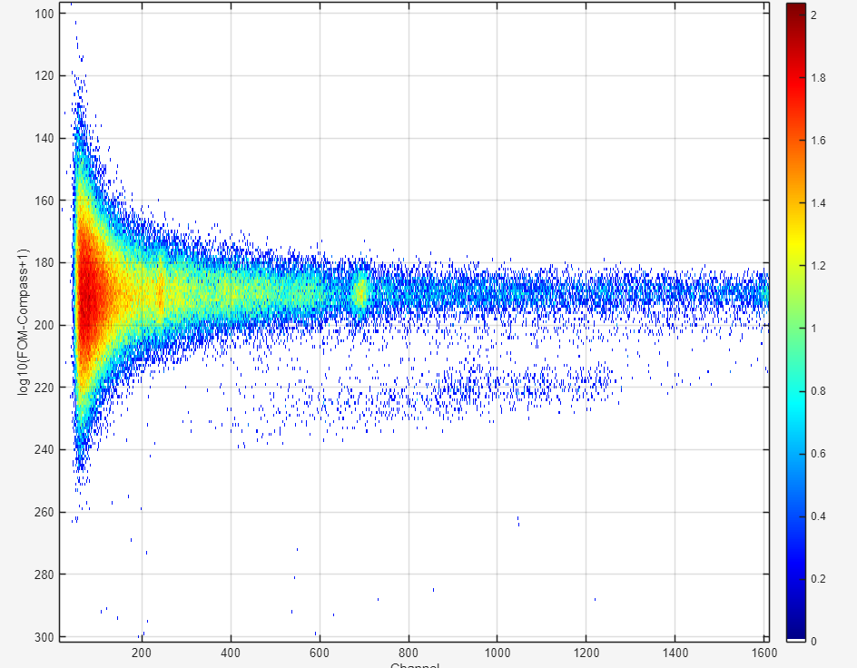
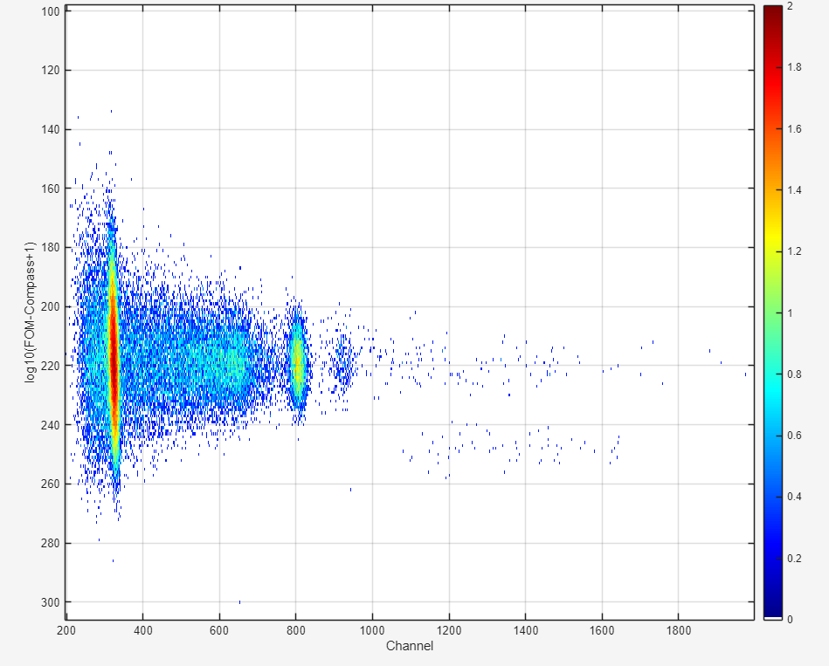
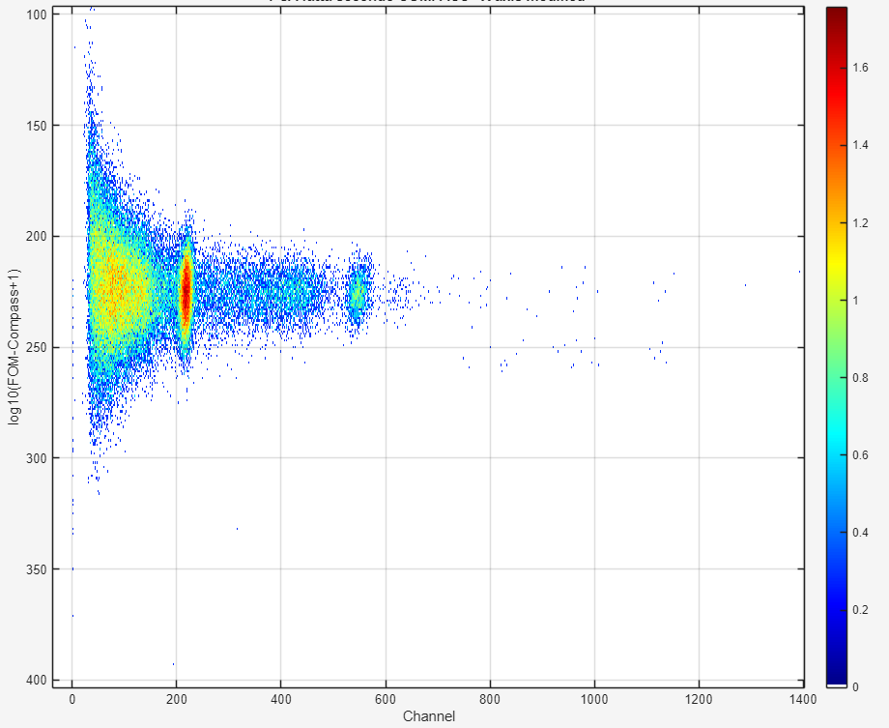
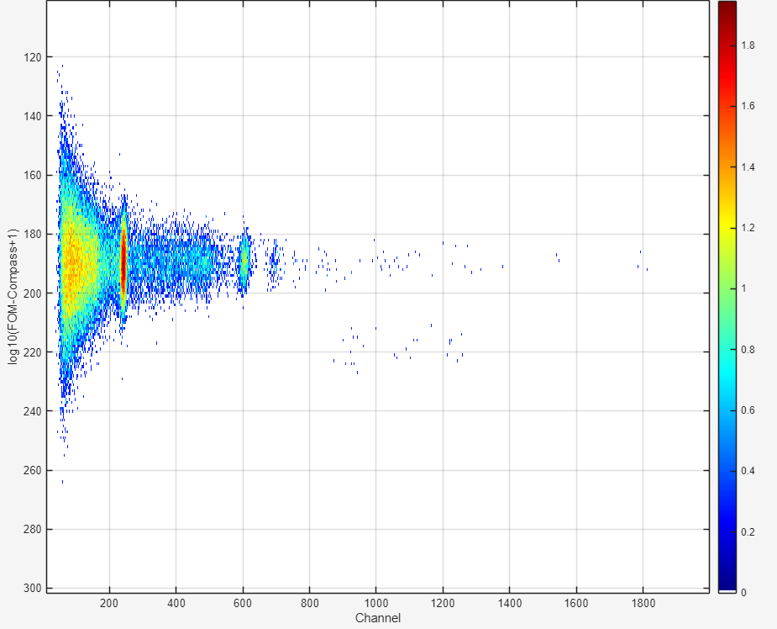
Doped LaCl₃:Ce – AmBe source
Hamamatsu H6533
Very fast 1’ PMT
Hamamatsu R9420
Fast 1’ PMT
Hamamatsu R6231
Spectroscopic 2’ PMT
neutrons
Alpha (int.rad.) and neutrons
neutrons
Alpha (int.rad.) and neutrons
neutrons
Alpha (int.rad.) and neutrons
Doped LaCl₃:Ce – ²²Na source
FOM = [int(0-600 ns)-int(0-100 ns)]/int(0-600 ns)
FOM = [int(0-600 ns)-int(0-100 ns)]/int(0-600 ns)
FOM = [int(0-600 ns)-int(0-100 ns)]/int(0-600 ns)

Slide 11
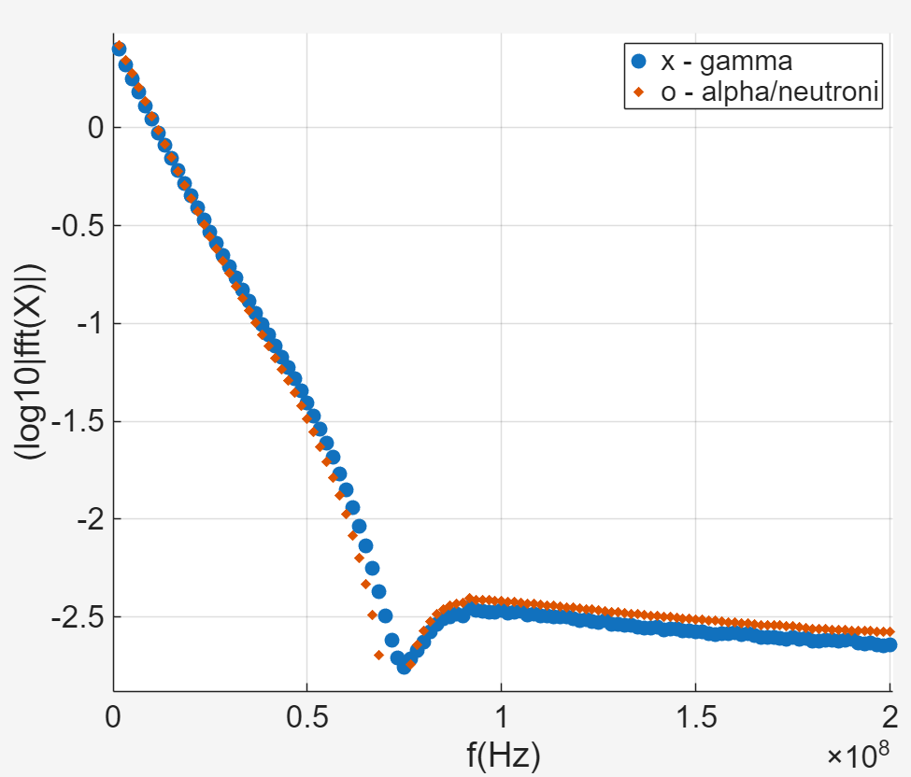
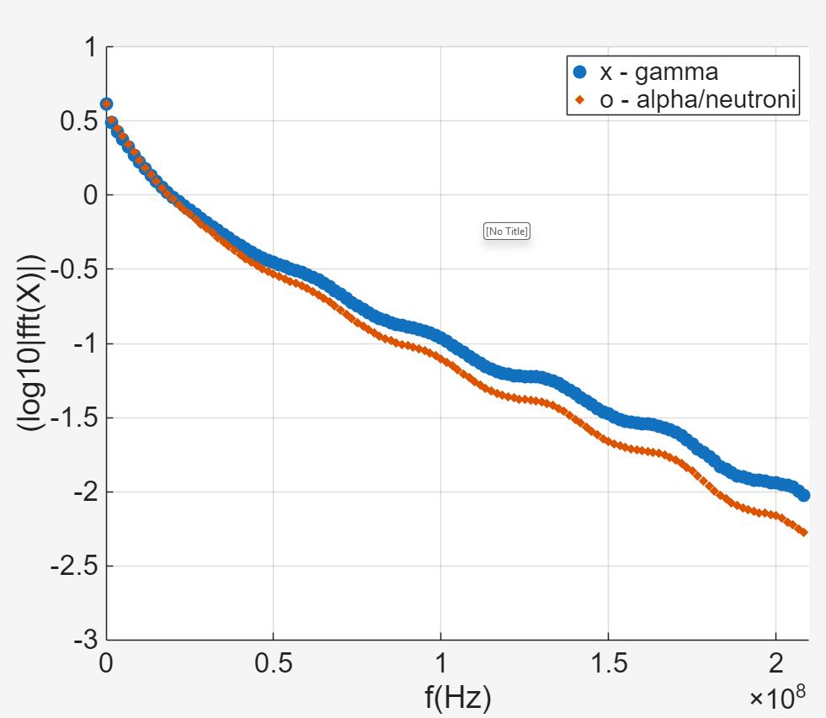
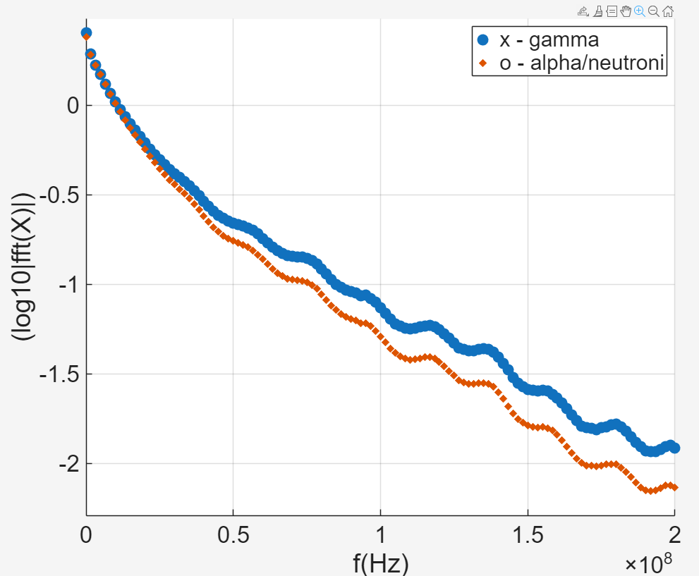
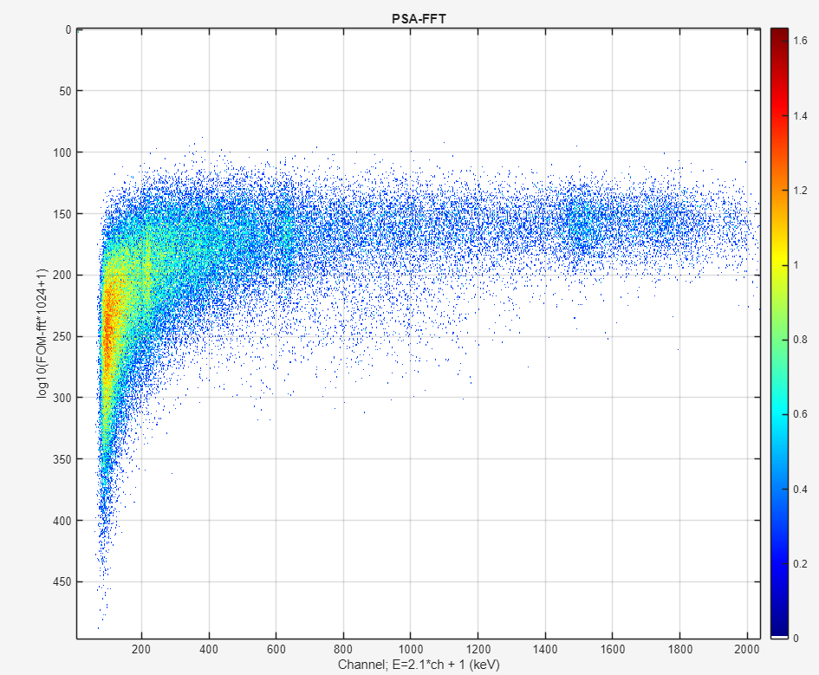
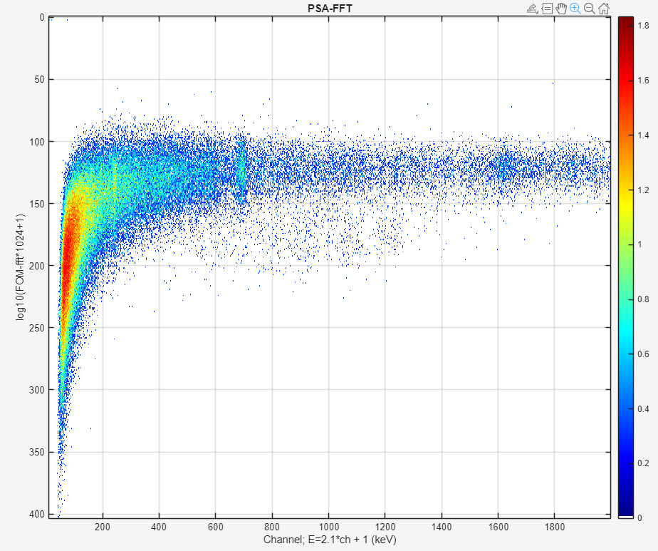
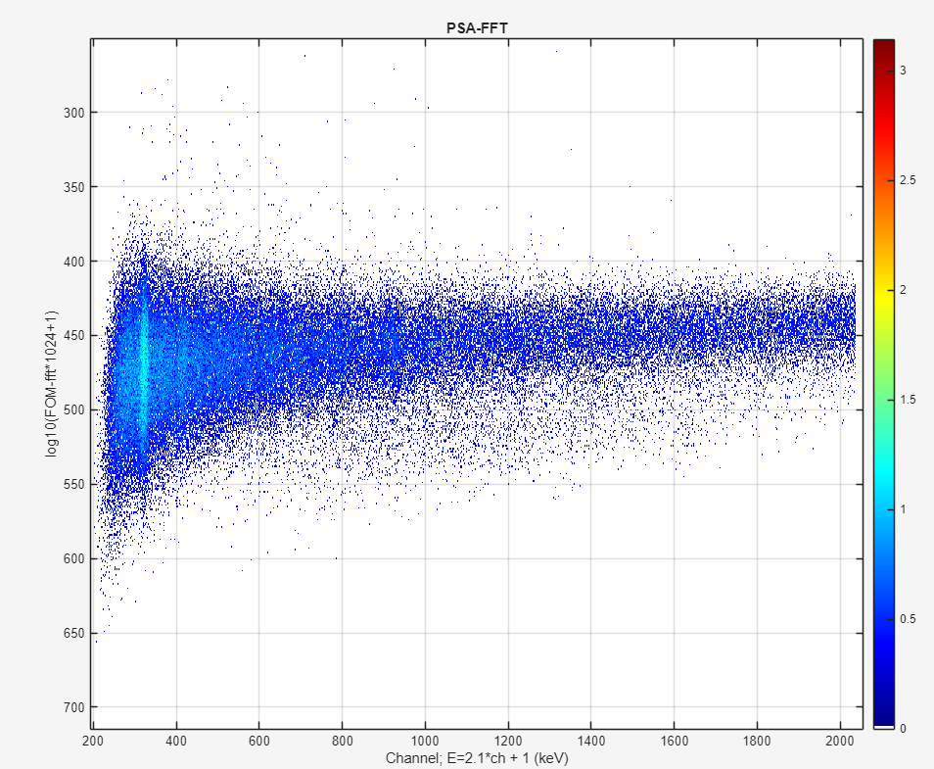
AmBe source
FFT
FFT
FFT
Hamamatsu R6231
Spectroscopic 2’ PMT
Hamamatsu H6533
Very fast 1’ PMT
Hamamatsu R9420
Fast 1’ PMT
Nothing higher than 70 MHz
FOM = 0.25 * int(30-65 MHz)/FFT(1)
FOM = 0.25 * int(100-180 MHz)/FFT(1)
FOM = 0.25 * int(100-180 MHz)/FFT(1)

Slide 12
Conclusions
- Neutron discrimination can be performed using TOF or PSA (see for example CLYC)
- Clorine has a large cross section for (n,p) and (n,α) nuclear reactions
  Internal Radiation - Charge Difference
  AmBe – charge difference
In an undoped LaCl₃, neutron-induced proton and neutron-induced alpha events are clearly observable. Therefore, It could be very interesting to have measurements with an undoped LaCl₃
I show measurements using two different LaCl₃ with a doping of 5% and ∼ 2.5%
As expected, the FFT algorithm permits to identify neutrons but …
  one need a high bandwidth PMTs, in general they PMTs with a 1’ window
      a high bandwidth PMT in general has a worse energy resolution
      a high bandwidth PMT in general requires a small crystal
      a small crystal has a reduced efficiency on high energy gamma rays
I think that the use of matrix of SIPMs will not help as a matrix of SIPM (to cover a large area) will probably have a smaller bandwidth
A.I. algorithms could help ?
  I think so. Perhaps, a ‘democratic’ criteria could be the algorithm which will work best .

