Slide 1
Isoscalar electric giant resonances: Compression modes and nuclear incompressibility
Muhsin N. Harakeh
European Nuclear Physics Conference (EuNPC)2025
Caen, France

Slide 2
Operators and Microscopic Structure

Slide 3
Microscopic picture: GRs are coherent (1p-1h) excitations induced by single-particle operators.
Excitation energy depends on
i) multipole L (Lħω, since radial operator ∝ r^{L}; except for ISGMR and ISGDR, 2ħω & 3ħω, respectively),
ii) strength of effective interaction and
iii) collectivity.
Exhaust appreciable % of EWSR
Acquire a width due to coupling to continuum and to underlying 2p-2h configurations.

Slide 4


Microscopic structure of ISGMR & ISGDR
Transition operators:
Constant Overtone
2ћω excitation
Spurious c.o.m. motion
Overtone
3ћω excitation (overtone of c.o.m. motion)

Slide 6
Compression Modes
ISGMR & ISGDR
Hydrodynamic Models

Slide 7
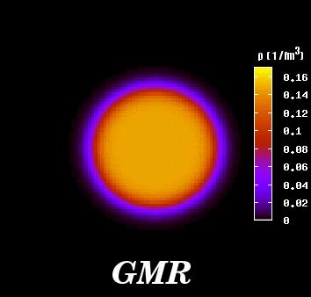
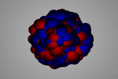
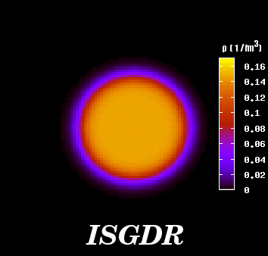
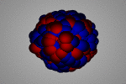
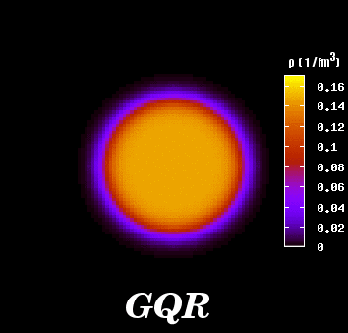
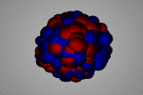
The Collective Response of the Nucleus: Giant Resonances
Compression
modes
Isoscalar (In phase)
ΔT = 0
Isovector (Out of phase)
ΔT = 1
Monopole
ΔL = 0
(GMR)
Dipole
ΔL = 1
(GDR)
Quadrupole
ΔL = 2
(GQR)
M. Itoh

Slide 8
Compression Modes of Nuclei
Compression modes: ISGMR, ISGDR
In Constrained and Scaling Models:
=
K
E
ћ
A
ISGMR
m
r
2
+
27
ε
7
K
E
=
ћ
A
25
F
ISGDR
3
2
m r
ε_{F} is the Fermi energy and K_{A} is the nucleus incompressibility
K_{A} =[r²(d²(E/A)/dr²)]_{r =R0} J.P. Blaizot, Phys. Rep. 64 (1980) 171
ISGMR, ISGDR ⇒ Incompressibility, symmetry energy
K_{A} = K_{vol} + K_{surf} A^{−1/3} + K_{sym}((N−Z)/A)²+K_{Coul}Z²A^{−4/3}

Slide 9
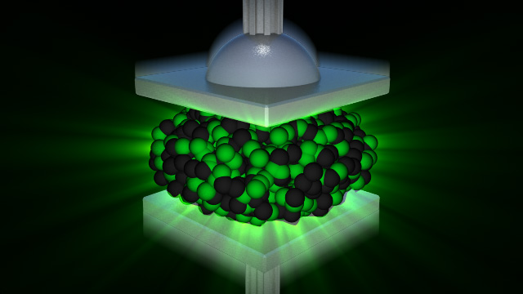
Thomas Flechel
Köln

Slide 10


α′ particle
α particle
Nucleus, e.g., ²⁰⁸Pb
Inelastic α scattering

Slide 11
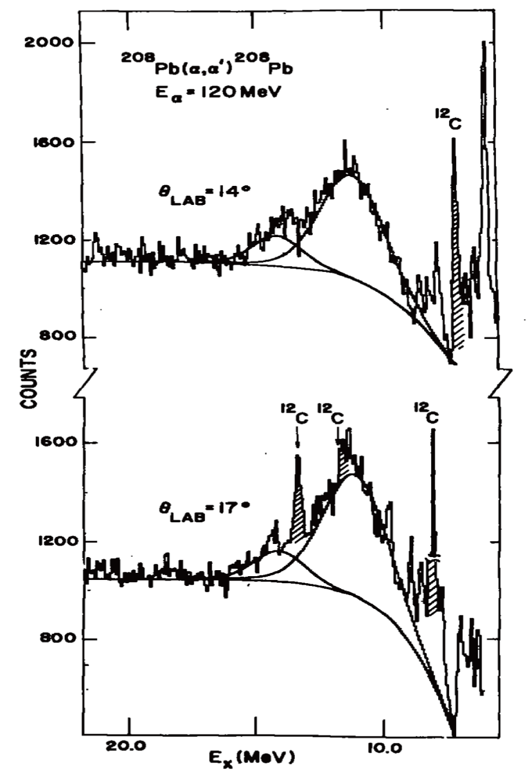
ISGQR, ISGMR
10.9 MeV
KVI (1977)
²⁰⁸Pb(α,α′) at E_{α}=120 MeV
Spectra obtained with solid-state detectors
13.9 MeV
Large instrumental background
and nuclear continuum!
M. N. Harakeh et al., Phys. Rev. Lett. 38 (1977) 676

Slide 12
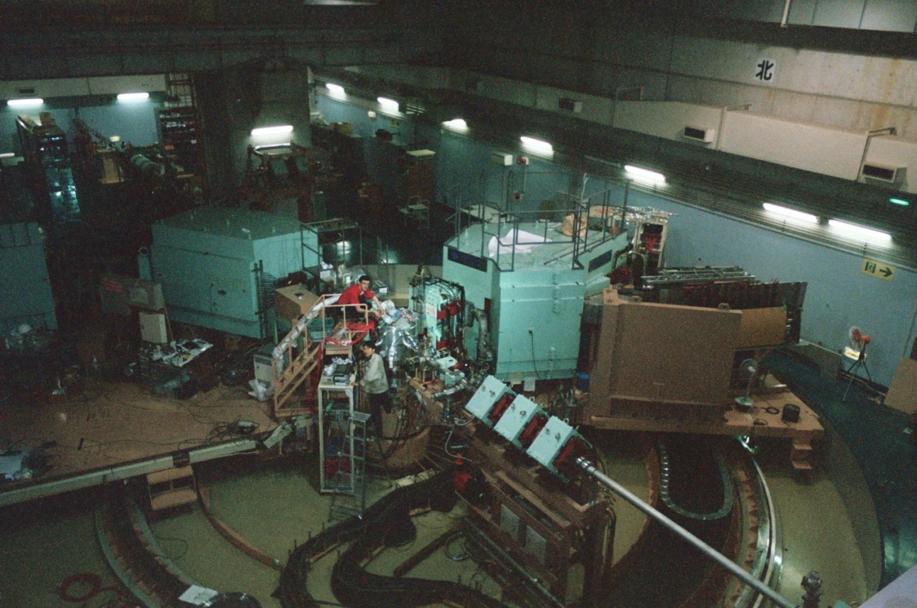
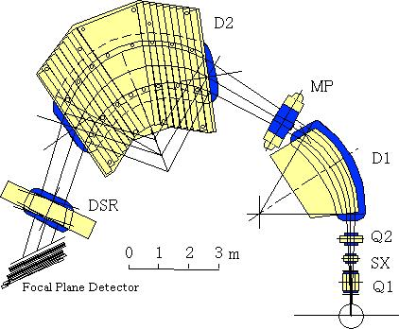
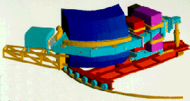
Grand Raiden@
RCNP
(p,p′) at E_{p}~ 300
(α,α′) at E_{α}~ 400 & 200 MeV at RCNP & KVI,
respectively
BBS@KVI

Slide 13
ISGQR at 10.9 MeV
ISGMR at 13.9 MeV
↑
↑

Slide 14
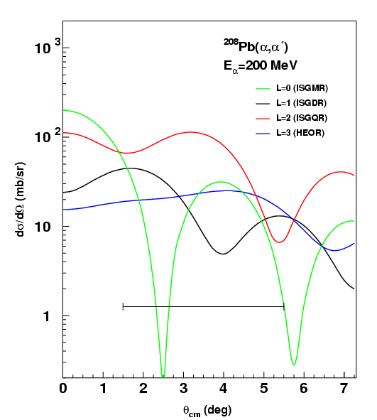
ISGMR L = 0
ISGDR L = 1

Slide 15
Difference of spectra
0° < θ_{α′} < 3°
0° < θ_{α′} < 1.5°
1.5° < θ_{α′} < 3°
Difference

Slide 16
ISGMR, ISGDR
ISGQR, HEOR
100 % EWSR
At E_{x}= 14.5 MeV

Slide 17
′

Slide 18
Multipole decomposition analysis (MDA)
ISGR (L<15)+ IVGDR (through Coulomb excitation)
DWBA formalism; single folding ⇒ transition potential

Slide 19
Transition density
ISGMR Satchler, Nucl. Phys. A472 (1987) 215
ISGDR Harakeh & Dieperink, Phys. Rev. C23 (1981) 2329
Other modes Bohr-Mottelson (BM) model

Slide 20
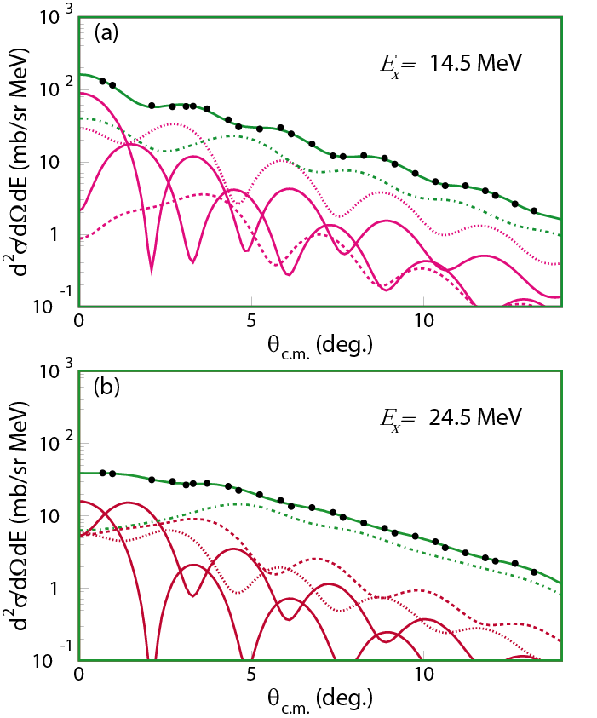
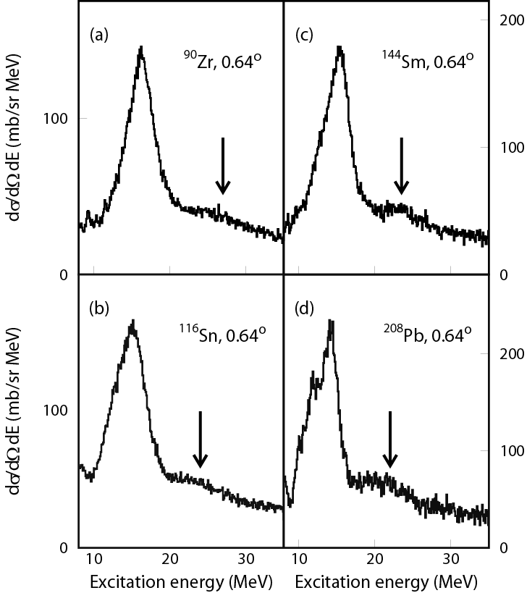
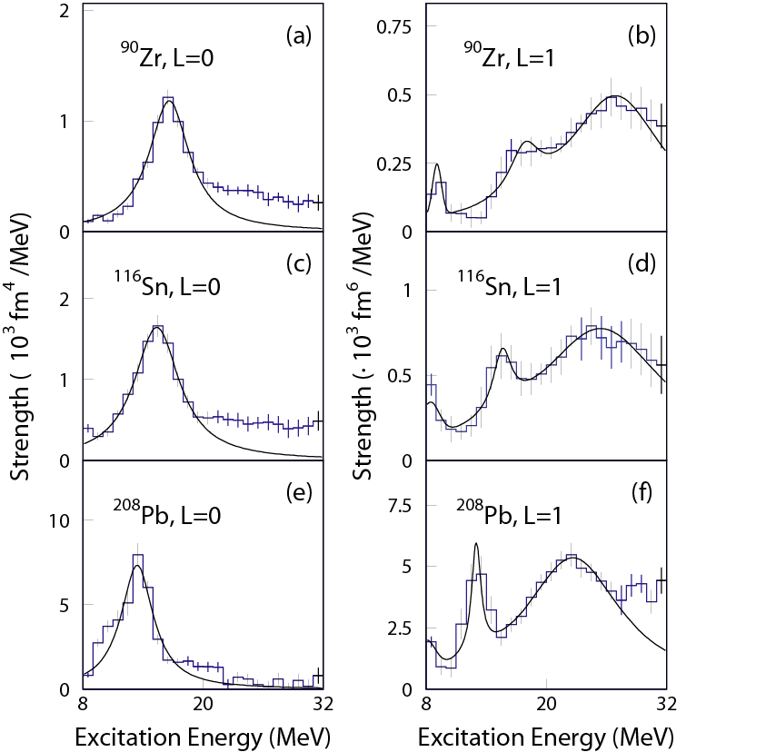
Multipole Decomposition Analysis
Uchida et al.,
Phys. Lett. B557 (2003) 12
Phys. Rev. C69 (2004) 051301
¹¹⁶Sn
(α,α′) spectra at 386 MeV
ISGDR
ISGDR
MDA results for L=0 and L=1
ISGMR
ISGMR
ISGDR
ISGDR
ISGMR
ISGMR

Slide 21
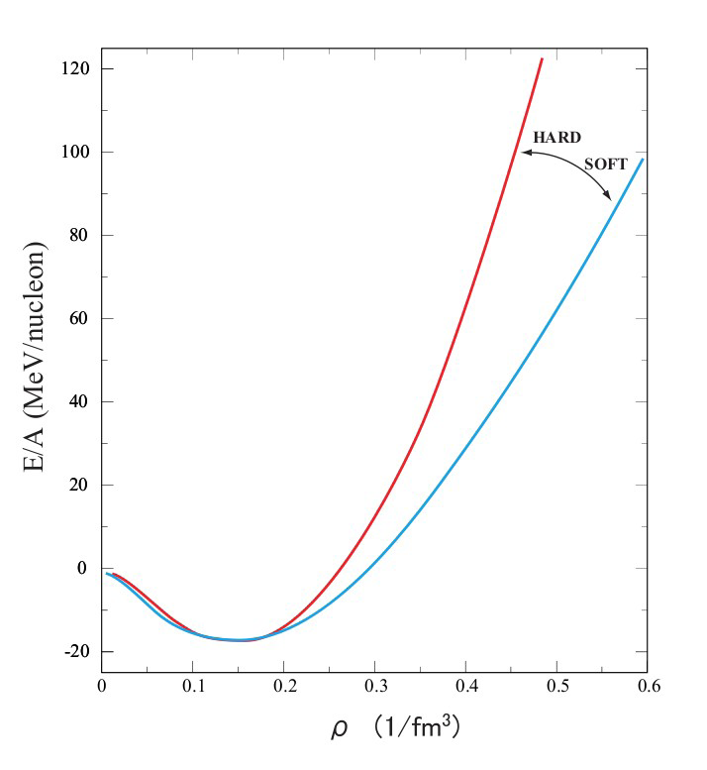
For the equation of state of symmetric nuclear matter at saturation nuclear density:
and one can derive the incompressibility of nuclear matter:
E/A: binding energy per nucleon
ρ : nuclear density
ρ₀ : nuclear density at saturation
J.P. Blaizot, Phys. Rep. 64 (1980) 171

Slide 22
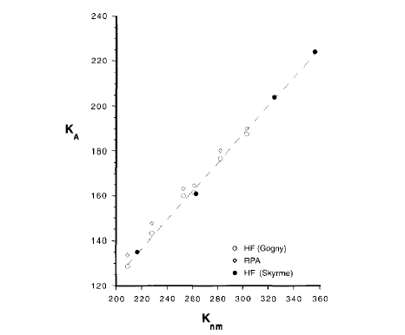
In HF+RPA calculations,
Nuclear matter
E/A: binding energy per nucleon K_{A}: incompressibility
ρ : nuclear density
ρ₀ : nuclear density at saturation
²⁰⁸Pb
K_{A} is obtained from excitation energy of ISGMR & ISGDR
K_{A} =0.64K_{nm}- 3.5
J.P. Blaizot, Nucl. Phys. A591 (1995) 435

Slide 23
From GMR data on ²⁰⁸Pb and ⁹⁰Zr,
K∞ = 240 ± 10 (± 20) MeV
[See, e.g., G. Colò et al., Phys. Rev. C 70 (2004) 024307]
This number is consistent
with both ISGMR and ISGDR Data
and
with non-relativistic and relativistic calculations
Notes:
23

Slide 24
Isoscalar GMR strength distribution in Sn-isotopes obtained by Multipole Decomposition Analysis of singles spectra obtained in ^{A}Sn(α,α′) measurements at incident energy 400 MeV and angles from 0º to 9º
D. Patel et al., Phys. Lett. B718 (2012) 447

Slide 25
K_{A} ~ K_{vol} (1 + cA^{-1/3}) + K_{τ} ((N - Z)/A)² + K_{Coul} Z²A^{-4/3}
K_{A} - K_{Coul} Z²A^{-4/3} ~ K_{vol} (1 + cA^{-1/3}) + K_{τ} ((N - Z)/A)²
~ Constant + K_{τ} ((N - Z)/A)²
We use K_{Coul} = - 5.2 MeV (from Sagawa)
(N - Z)/A
¹¹²Sn – ¹²⁴Sn: 0.107 – 0.194

Slide 26
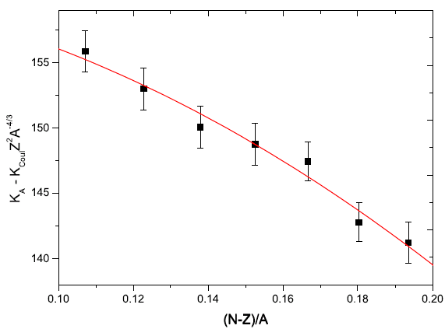
Sn isotopes ⇒ K_{τ} = − 550 ± 100 MeV
T. Li et al., Phys. Rev. C81 (2010) 034309
Notes:
26

Slide 27
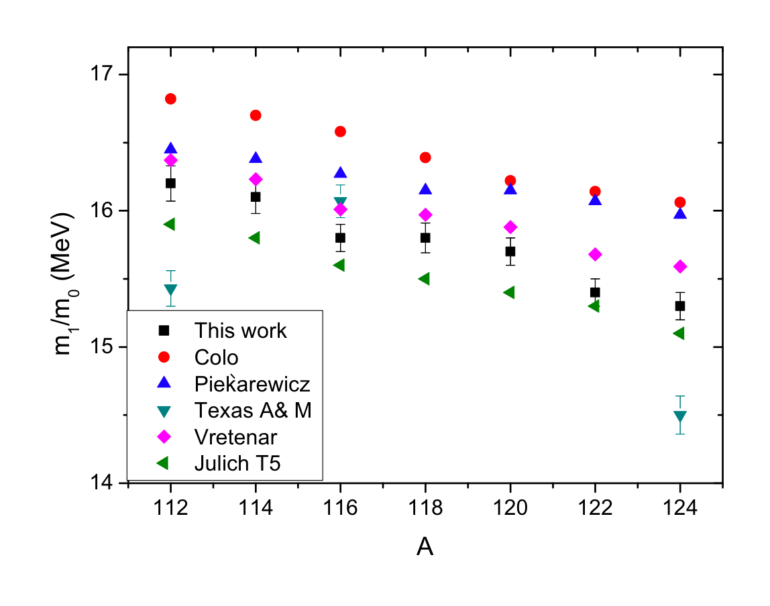
Sn isotopes
Notes:
27

Slide 28
Colò et al.: Non-relativistic RPA (without pairing) reproduces ISGMR in ²⁰⁸Pb and ⁹⁰Zr.
Piekarewicz: Relativistic RPA (FSUGold model) reproduces g.s. observables and ISGMR in ²⁰⁸Pb, ¹⁴⁴Sm and ⁹⁰Zr [K∞ = 230 MeV]
Vretenar: Relativistic mean field (DD-ME2: density-dependent mean-field effective interaction).
[K∞ = 240 MeV]. Possibly agreement is fortuitous since strength distributions are not much different from those by Colò et al. and Piekarewicz.
Tselyaev et al.: Quasi-particle time-blocking approximation (QTBA) (T5 Skyrme interaction)
[K∞ = 202 MeV?!]
=> Softness of Sn-nuclei is still unresolved ?!

Slide 29
Z.Z. Li, Y.F. Niu, and G. Colò, PRL 131 (2023) 082501
Fully self-consistent Quasiparticle Random-Phase Approximation plus Quasiparticle-Vibration Coupling model (QPVC) have been developed, based on the Skyrme-Hartree-Fock-Bogoliubov (SHFB) framework. Both QPVC effects and pairing effects are considered self-consistently.
Results suggest that QPVC effects are crucial in order to reach a unified description of the ISGMR in Ca, Sn, and Pb isotopes at the same time.
This conclusion has been corroborated by Elena Litvinova [PRC 107 (2023) L041302] in which the inclusion of beyond-mean-field correlations of QPVC type allowed for a simultaneous description of the ISGMR in nuclei of Pb, Sn, Zr, and Ni mass regions.

Slide 30
ISGMR strength functions in even-even ¹¹²⁻¹²⁴Sn, ⁴⁸Ca, and ²⁰⁸Pb isotopes, calculated either by (Q)RPA using a smoothing with Lorentzian having a width of 1 MeV (dash-dotted [black] line), or (Q)RPA+(Q)PVC (solid [blue] line). The SV-K226 Skyrme force is used. The experimental data are given by green crosses
Z.Z. Li, Y.F. Niu, and G. Colò

Slide 31
SkP SkM* SV-K KDE0 SV-bas SV-K SAMi
K∞ 201 217 226 229 233 241 245
(Q)RPA
⁴⁸Ca 0.11 0.89 1.09 1.17 1.40 1.70 1.72
¹²⁰Sn 0.22 0.43 0.78 0.76 1.05 1.31 1.34
²⁰⁸Pb 0.74 0.14 0.14 0.20 0.37 0.60 0.76
(Q)PVC
⁴⁸Ca 0.70 0.25 0.36 0.51 0.67 0.90 1.07
¹²⁰Sn 0.67 0.14 0.02 0.18 0.36 0.68 0.82
²⁰⁸Pb 0.94 0.37 0.25 0.06 0.08 0.31 0.48
The deviation of ISGMR energies from experimental data [|E^{theo.} – E^{exp.}| (MeV)] in ⁴⁸Ca, ¹²⁰Sn, and ²⁰⁸Pb, calculated by (Q)RPA and (Q)PVC using the Skyrme parameter sets SkP, SkM*, SV-K226, KDE0, SV-bas, SV-K241, and SAMi. The experimental data are taken from [1, 2, 3].
1- D. Patel, et al., Phys. Lett. B 726, 178 (2013). -- Pb
2- T. Li, et al., Phys. Rev. Lett. 99, 162503 (2007). -- Sn
3- S. D. Olorunfunmi, et al., Phys. Rev. C 105, 054319 (2022). -- Ca

Slide 32
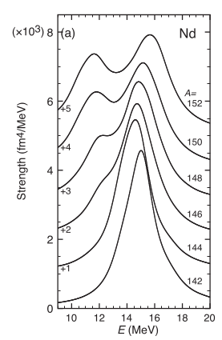
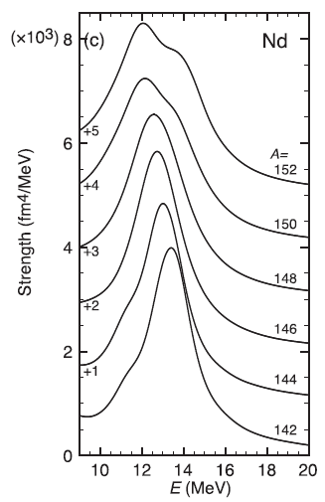
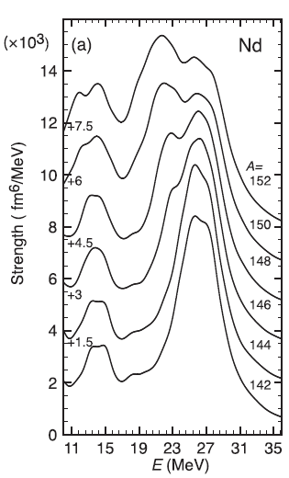
Isoscalar Giant Resonances in Nd isotopes: QRPA calculations
A=152
A=152
150
A=152
150
150
148
148
148
146
146
146
144
144
144
142
142
142
ΔL = 0; ISGMR
ΔL = 2; ISGQR
ΔL = 1; ISGDR
K. Yoshida and T. Nakatsukasa, Phys. Rev. C 88 (2013) 034309
32

Slide 33
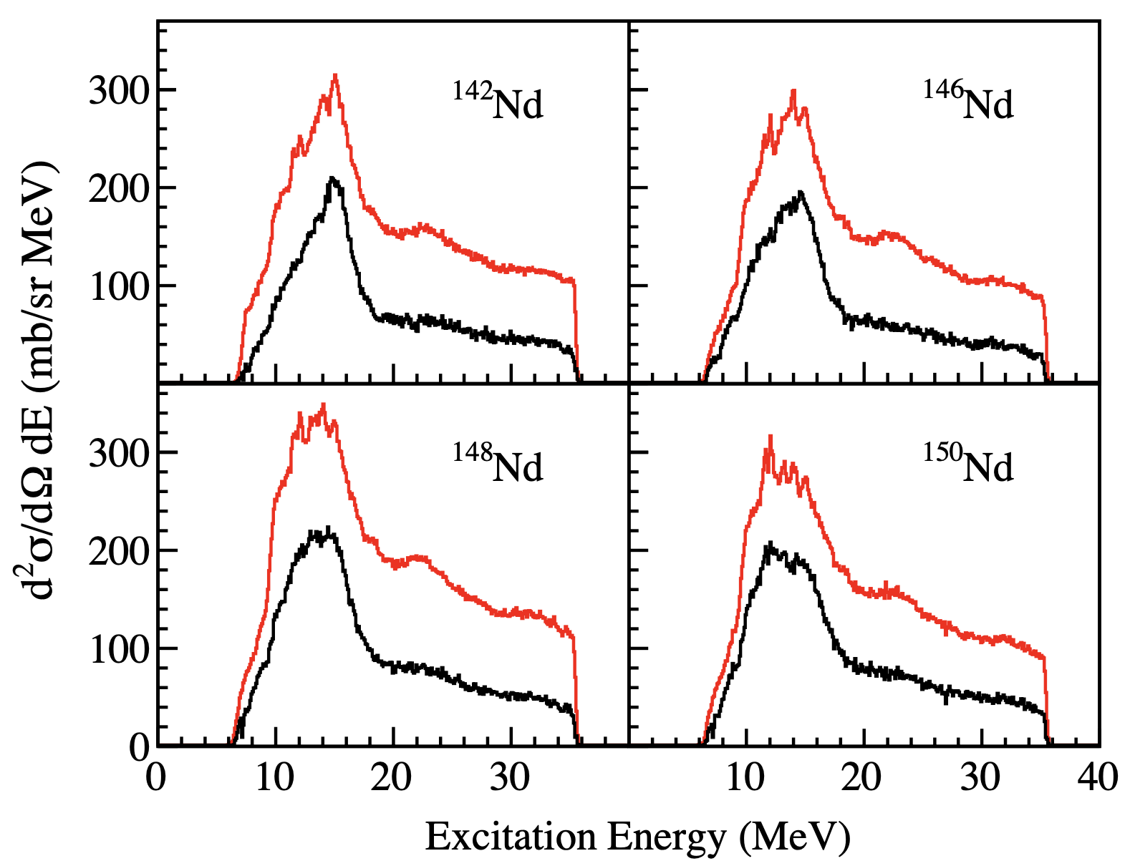
^{142,146,148,150}Nd(𝛼,𝛼′) spectra at 𝜃_{Lab} = 0.75◦ after particle identification, subtraction of the instrumental background, and of contaminants are shown in black histograms. The red histograms show the spectra before instrumental-background and contaminants subtraction.
M. Abdullah et al., Phys. Lett. B855 (2024) 138852

Slide 34
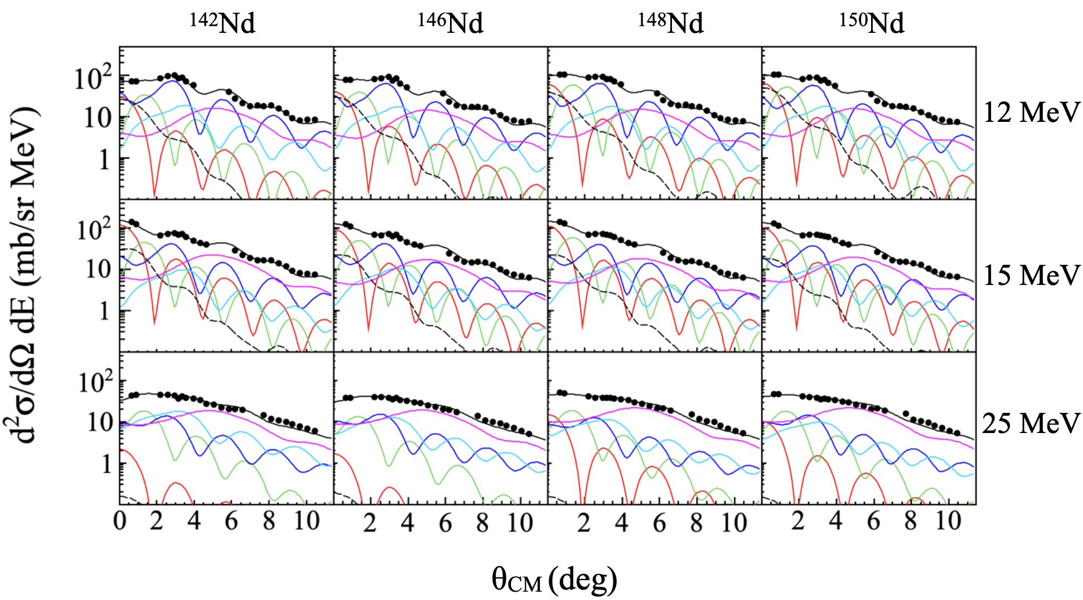
Multipole-decomposition analyses for ^{142,146,148,150}Nd

Slide 35
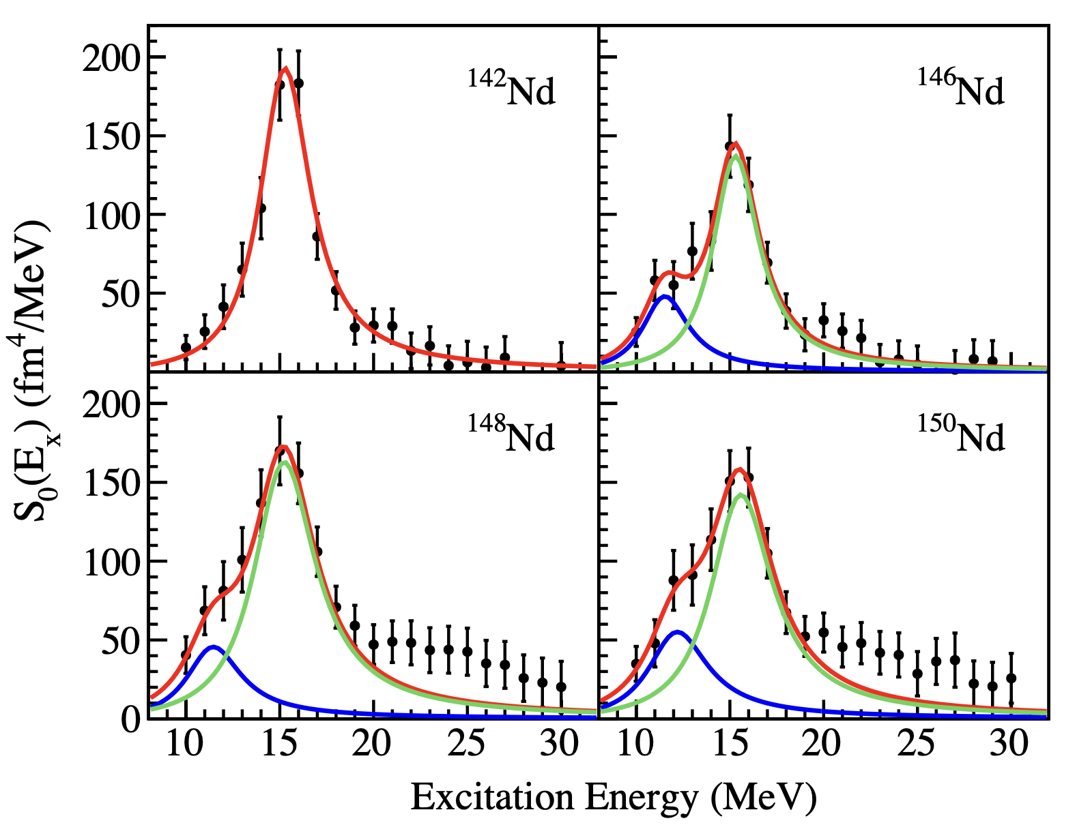
The monopole strength distributions for ¹⁴²⁻¹⁵⁰Nd obtained from MDA. The red lines show the results of single-Lorentzian fitting in ¹⁴²Nd (upper left) and of double-Lorentzian fitting in ¹⁴⁶Nd (upper right), ¹⁴⁸Nd (lower left), and ¹⁵⁰Nd (lower right). In deformed Nd isotopes, the low- and high-energy components of the ISGMR are indicated by blue and green lines, respectively.

Slide 36
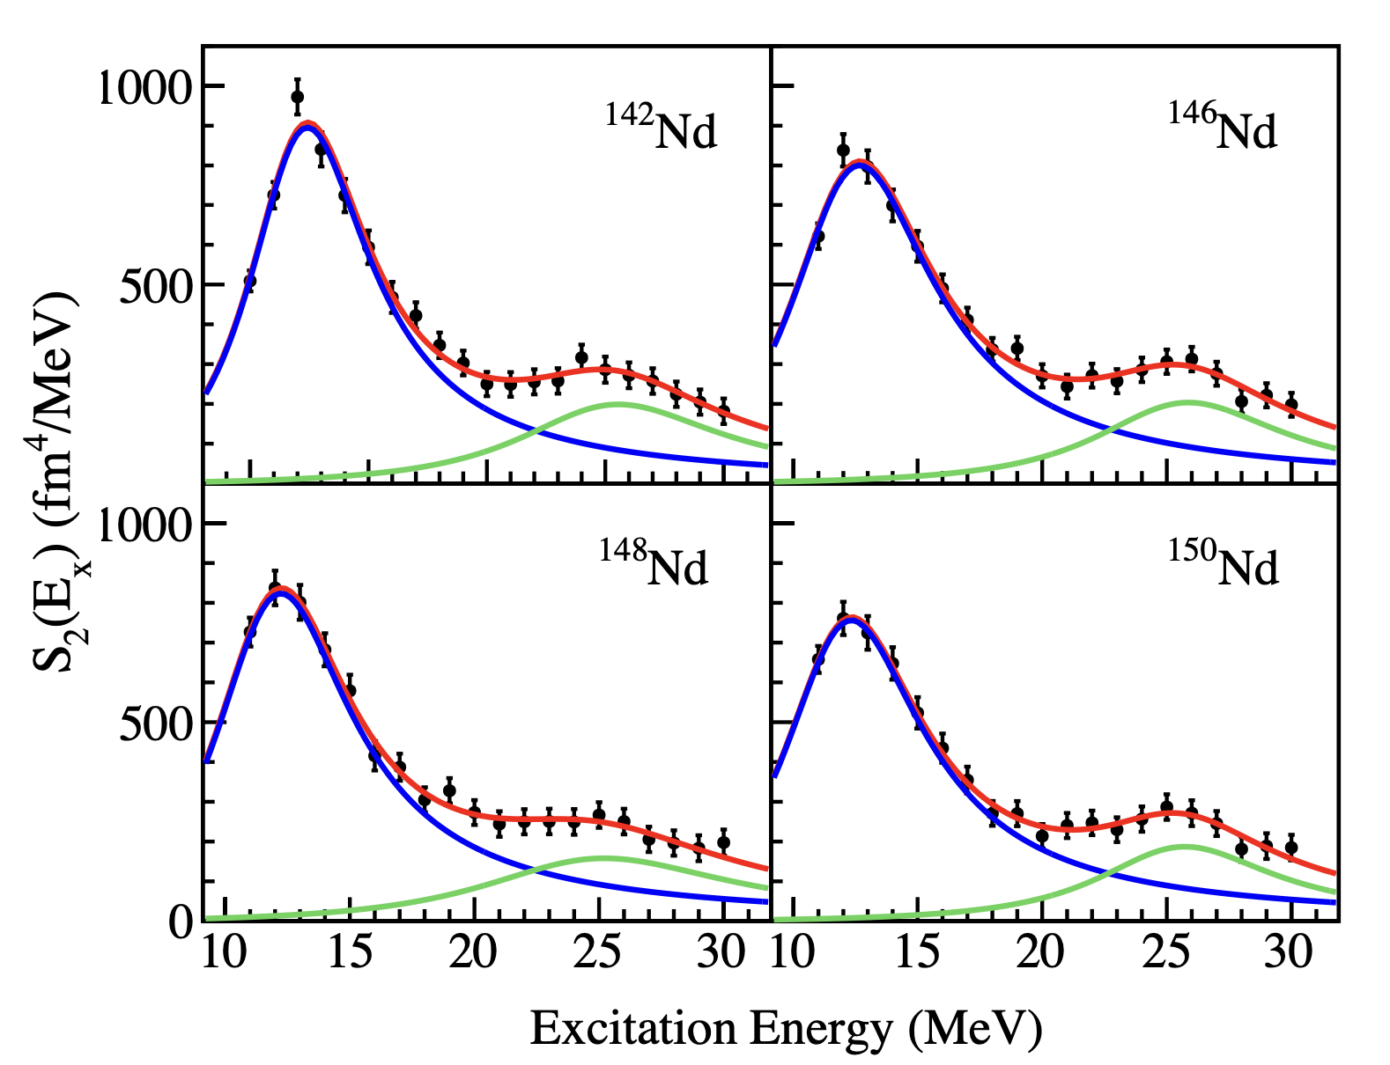
The quadrupole strength distributions for ¹⁴²⁻¹⁵⁰Nd isotopes obtained from MDA. The overall fits, employing a double-Lorentzian function, are represented by red lines. The main-tone modes (∑𝑟_{i}²𝑌₂ , 2ħ𝜔)
of the quadrupole resonances are depicted using blue lines, while the overtone compression modes (∑𝑟_{i}⁴𝑌₂ , 4ħ𝜔)
are illustrated with green lines.

Slide 37
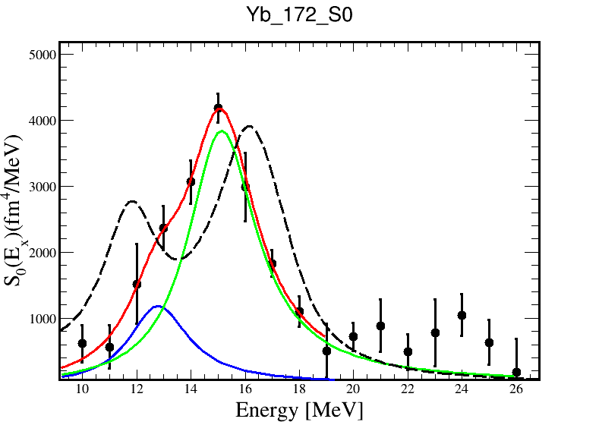


Strength distributions of isoscalar GMR compared with Quasiparticle Finite Amplitude Method (QFAM) calculation in ¹⁷²Yb
Systematic error is added in the expt. data points.
QFAM calculation
Expt. total fit
HE expt.
LE expt.
E_{LE} (MeV) | width_{LE} (MeV) | %EWSR_{LE} (10 to 26 MeV) | E_{HE} (MeV) | width_{HE} (MeV) | %EWSR_{HE} (10 to 26 MeV)
12.78±0.40 | 2.67±0.70 |  | 15.13±0.12 | 3.08±0.22

Slide 38
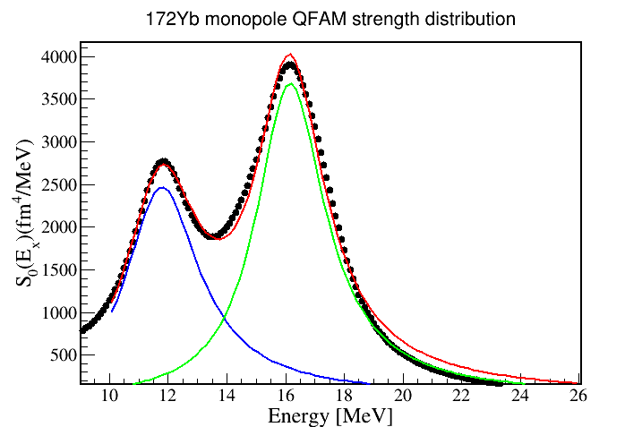
Theoretical (QFAM) strength distribution of isoscalar GMR in ¹⁷²Yb
QFAM theoretical data
E_{LE} (MeV) | width_{LE} (MeV) | E_{HE} (MeV) | width_{HE} (MeV)
11.78±0.02 | 3.05±0.09 | 16.15±0.01 | 2.86±0.04
Fitting parameters
HE QFAM
Total fit to QFAM strength
LE QFAM

Slide 39
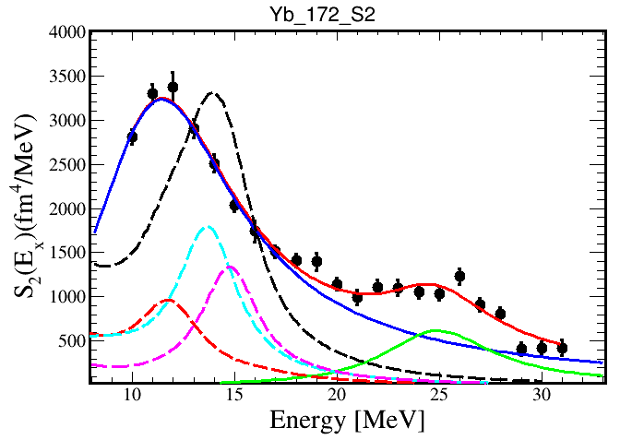


Strength distributions of isoscalar GQR compared with Quasiparticle Finite Amplitude Method (QFAM) calculation in ¹⁷²Yb
expt. maintone fit
K_total theo.
K_1 theo.
expt. overtone fit
expt. total fit
K_0 theo.
K_2 theo.
E (MeV) (maintone) | Width (MeV) (maintone) | %EWSR (Maintone) (10 to 20 MeV) | E (MeV) (Overtone) | width (MeV) (Overtone) | %EWSR (Overtone) (20 to 30 MeV)
11.44±0.10 | 8.54±0.14 |  | 24.90±0.28 | 6.55±0.56

Slide 40
The quadrupole strength distributions for ¹⁰⁴⁻¹¹⁰Nd obtained from MDA. Data obtained at RCNP with inelastic alpha scattering at an energy of 386 MeV
Umesh Garg et al.

Slide 41
Conclusions!
There has been much progress in understanding ISGMR & ISGDR macroscopic properties Systematics: E_{x}, Γ, %EWSR
⇒ K_{nm}≈ 230 MeV
⇒ K_{τ} ≈ − 550 MeV
Softness of Sn and Cd nuclei compared to ²⁰⁸Pb and ⁹⁰Zr is explained By fully self-consistent Quasiparticle Random-Phase Approximation plus Quasiparticle-Vibration Coupling model (QPVC) calculations.
Observation of quadrupole compression mode, i.e. overtone of ISGQR in

Slide 42
Thank you for your attention

Slide 43
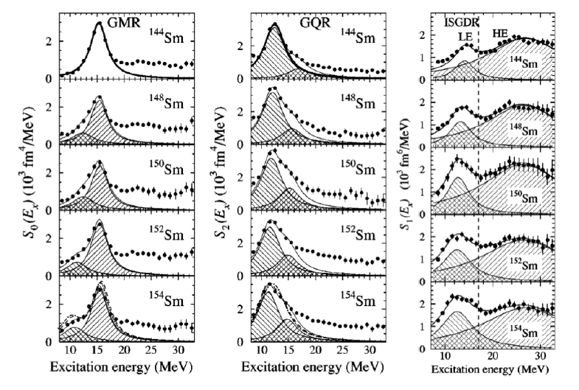
Effect of deformation on Isoscalar Giant Resonances: Sm isotopes
¹⁴⁴Sm
β₂ = 0.0881 (13)
¹⁴⁸Sm
¹⁵⁰Sm
¹⁵²Sm
¹⁵⁴Sm
β₂ = 0.339 (3)
ΔL = 0; ISGMR
ΔL = 2; ISGQR
ΔL = 1; ISGDR
M. Itoh et al., Phys. Rev. C 68 (2003) 064602

Slide 44
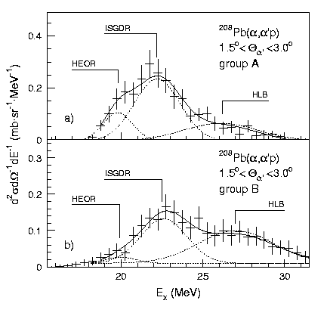
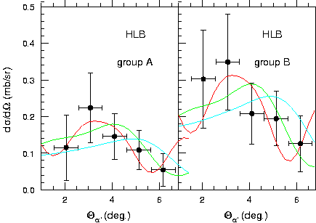
Overtone of the ISGQR? [r⁴Y₂]
E_{x} = 26.9 ± 0.7 MeV
Muraviev and Urin
Bull. Acad. Sci. USSR
Phys. Ser. 52 (1988) 123
E_{x} = 28.3 MeV
------- L=2
------- L=3
------- L=4

