Slide 1
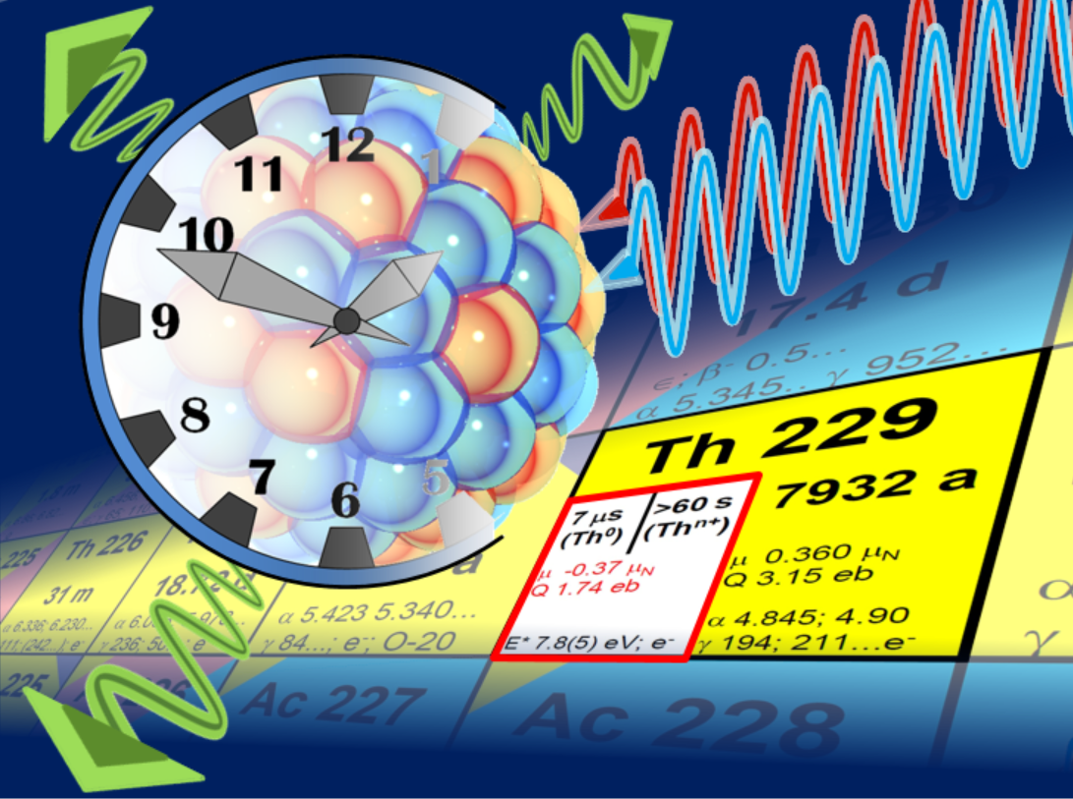
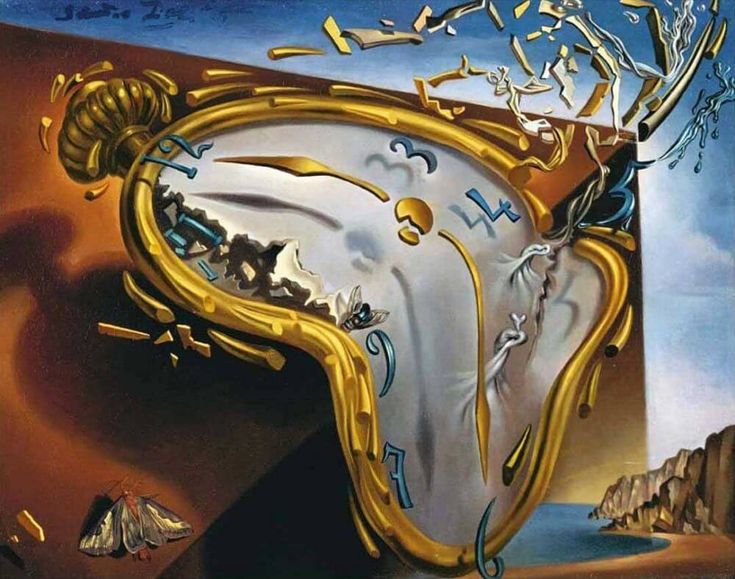
On the Horizon: The 229mTh Nuclear Clock
Peter G. Thirolf, LMU München
image: C. Düllmann
image: S. Dali
1

Slide 2
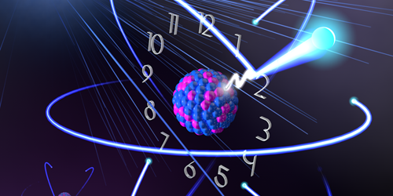
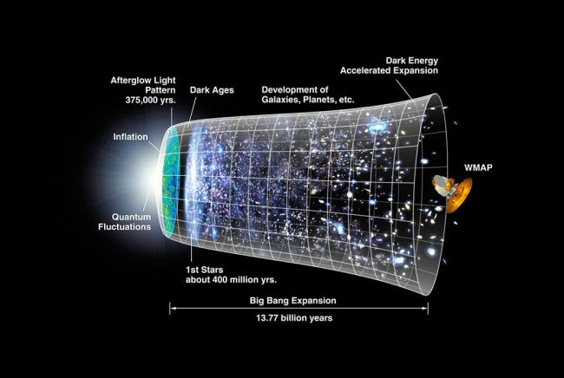
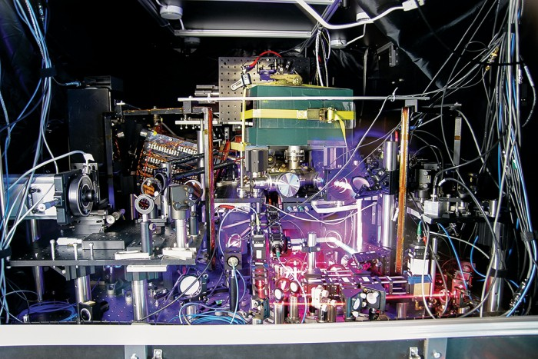
The ‚Big Picture’
Ultra-Precise Clocks:
Timekeeping and Quantum Sensors for Fundamental Physics
Tantalizing fundamental and still unsolved questions:
- how ‚constant‘ are fundamental constants?
- what is the nature of the invisible ‚Dark Matter‘ in the Universe?
(Maybe) surprising: appropriate equipment comprises
- table-top lasers
- ions traps or crystals
- radioactive nuclei
NASA / WMAP Science Team
2
Jun Ye group/JILA, Boulder

Slide 3
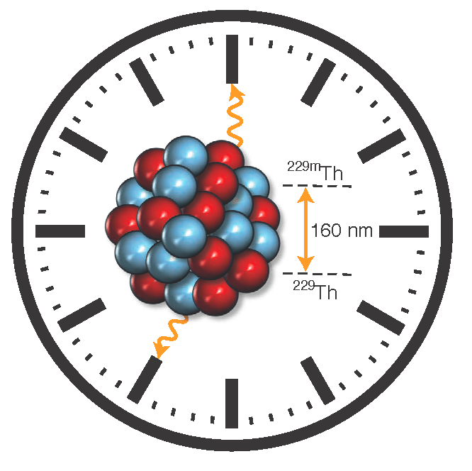
Outline
Atomic Clock & Thorium Nuclear Clock
Applications of a Nuclear Clock
The Thorium Isomer 229mTh:
- insights gained by nuclear spectroscopy
- recent achievements by laser spectroscopy
Ongoing Activities and Perspectives
3

Slide 4
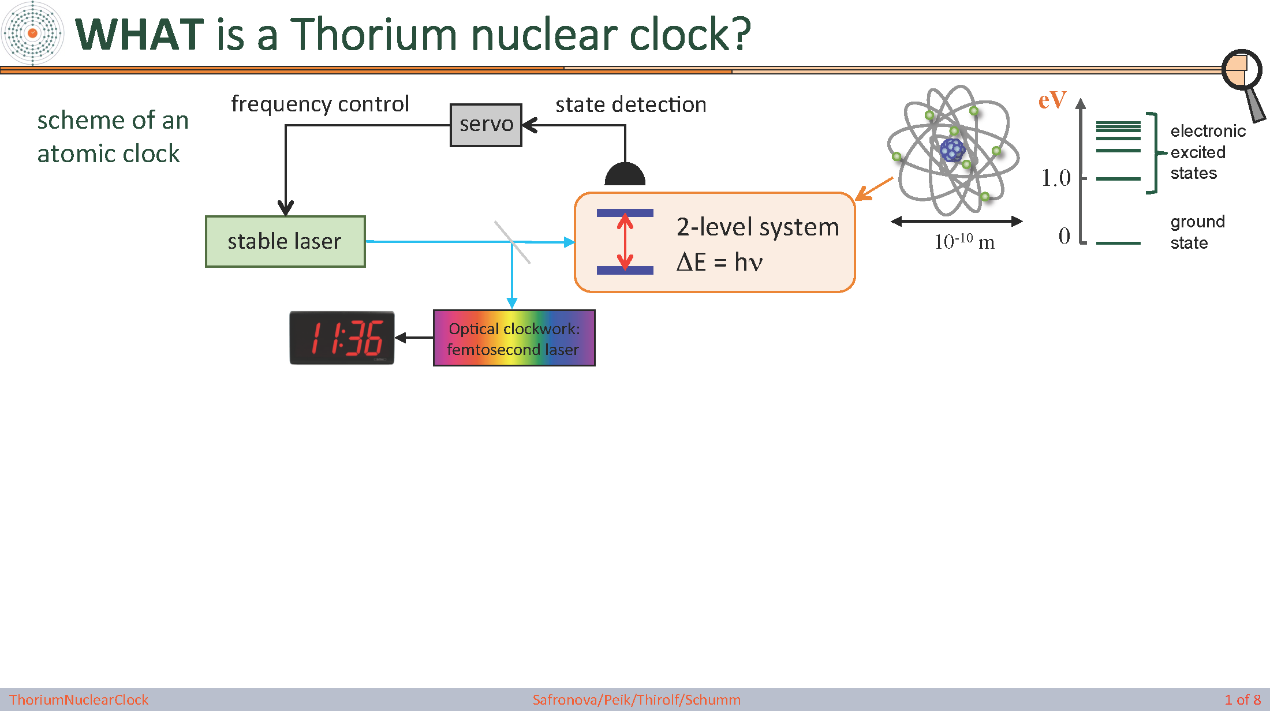
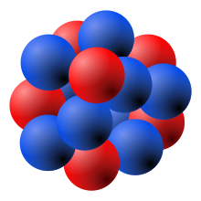
Thorium Nuclear Clock
scheme of an
atomic clock
electronic
excited
states
ground
state
scheme of a
nuclear clock
MeV
nuclear
excited
states
Nuclear clock proposal: E. Peik and Chr. Tamm, Europhys. Lett. 61, 181-186 (2003)
10 -19 performance estimate of 229Th ion clock: C. J. Campbell, et al., PRL 108, 120802 (2012)
ground
state
10-14 m
Is there a suitable nuclear candidate ?
→ low energy (eV)
→ long-lived (isomer)
→ 229mTh: ‘Thorium Isomer’
4

Slide 5
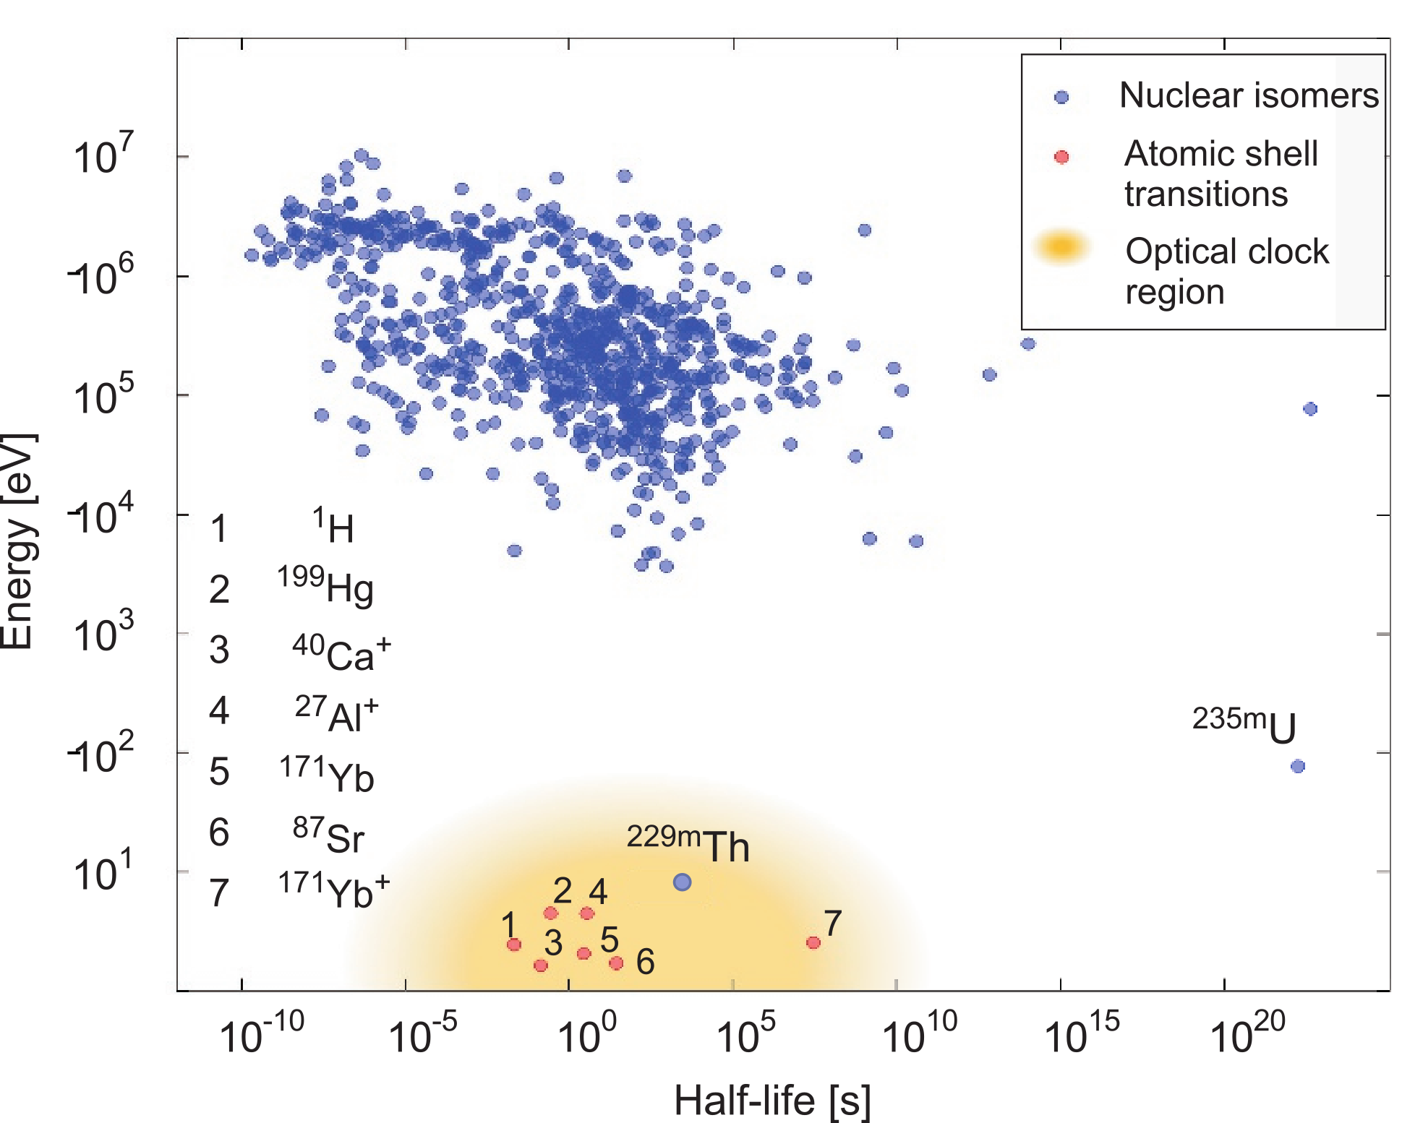
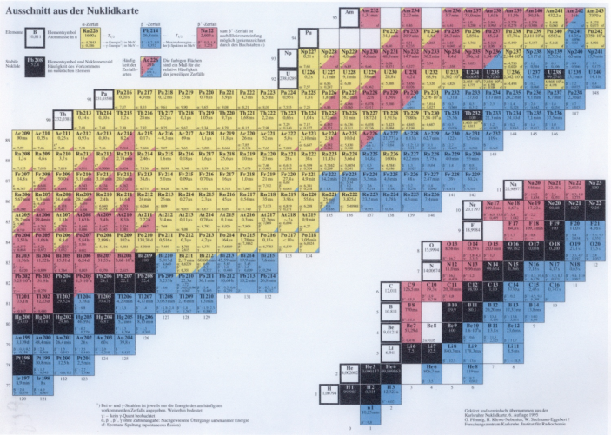
Unique properties of the ^{229m}Th Isomer
7880a
α: 4.845 MeV
3/2+
229Th isomer
E* ≈ 8.35574(3) eV
λ = 148.3821(4) nm
τ ≈ 2000 s
5/2+
229Th ground state
lowest E* of all ~186000 presently known nuclear excited states
ΔE/E ~ 10-20 ~ 0.1 mHz natural linewidth
5

Slide 6
Applications of Nuclear Clocks: Timekeeping and Beyond
229mTh nuclear clock:
ΔE/E ~ 10-20 (~ 0.1 mHz nat. linewidth): extremely stable nuclear frequency standard
performance estimate of 229Th ion clock: ~ 10-19 rel. uncertainty
C.J. Campbell, et al., PRL 108, 120802 (2012)
- small nuclear moments: less sensitivity to perturbations by external fields
Beyond Timekeeping:
Quantum Sensor due to different operation principle compared to atomic clocks:
- Coulomb + weak + strong interaction contribute to clock frequency
- sensitivity to new physics searches: enhanced by 104-106 compared to present clocks
unique opportunity for new physics discoveries
M.S. Safronova et al., Rev. Mod. Phys 90, 025008 (2018)
E. Peik, PT et al., Quant. Sci. Tech. 6, 034002 (2021)
→ measurements involve monitoring the ratio of nuclear/atomic clocks over time
6
PT et al., Annalen d. Physik 531, 1800391 (2019)

Slide 7
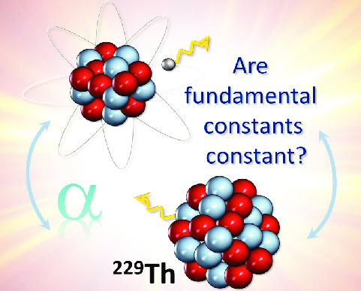


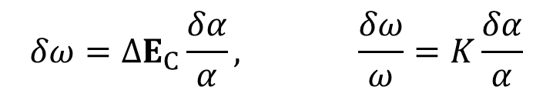
Applications of Nuclear Clocks
Temporal variation of fundamental constants
theoretical expectation: temporal (spatial) variations of fundamental “constants”
J.P. Uzan, Living Rev. Relativ. 14, 2 (2011)
α/α = (1.8 ± 2.5) . 10-19 yr-1
M. Filzinger et al., PRL 130, 253001 (2023)
- enhanced sensitivity by ~ 104 expected for 229mTh
V.V. Flambaum, PRL 97, 092502 (2006)
sensitivity of 229mTh transition frequency ω to temporal variation of α:
$$δω=ΔE_{C}\frac{δα}{α}, \frac{δω}{ω}=K\frac{δα}{α}$$
enhancement factor:
$$K=\frac{ΔE_{C}}{ω}$$
ΔE_{C}: Coulomb energy difference between 229Th, 229mTh
- measurements involve monitoring the ratio of nuclear/atomic clock over time
7
PT et al., Annalen d. Physik 531, 1800391 (2019)

Slide 8
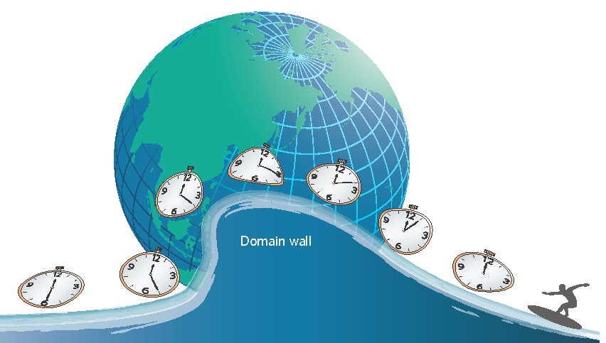
Applications of Nuclear Clocks
Search for Dark Matter
- ultralight scalar fields: searches for oscillatory variation of fundamental constants
Arvanitaki et al., PRD 91, 015015 (2015),
Van Tilburg et al., PRL 115, 011802 (2015), Hees et al., PRL 117, 061301 (2016)
- topological dark matter: monopoles, 1D strings, 2D ‘domain walls’
transient: use networks of ultra-precise synchronized clocks
- more stringent limits: non-transient variations of fundamental constants
(back action of ambient matter on scalar field)
Derevianko & Pospelov, Nat. Phys. 10, 933 (2014)
Y. Stadnik, PRD 102 (2020)
8

Slide 9
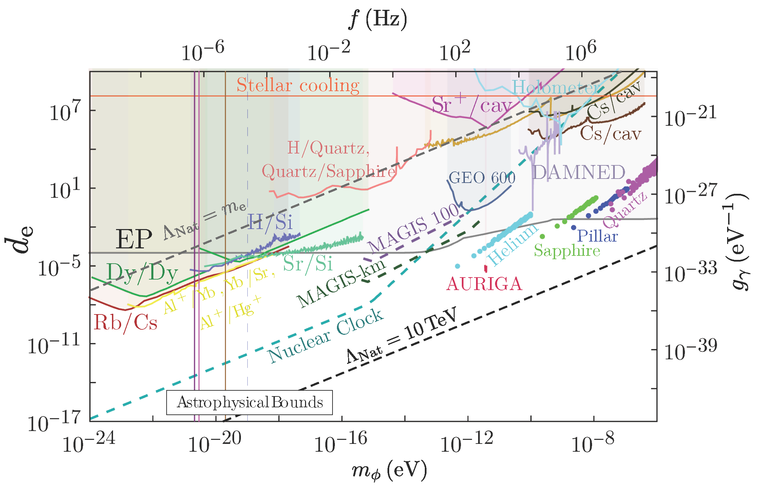
Ultra-light DM: combined exclusion plot
d_{e}: strength of the scalar DM coupling to the electromagnetic field tensor
relative to the strength of gravity
Snowmass 2021 White Paper:
New Horizons:
Scalar and Vector Ultralight
Dark Matter,
arXiv:2203.14915v1 [hep-ex]
9

Slide 10
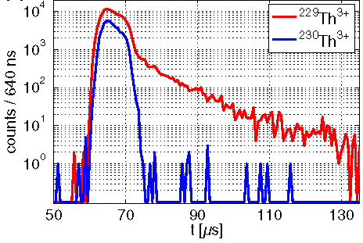
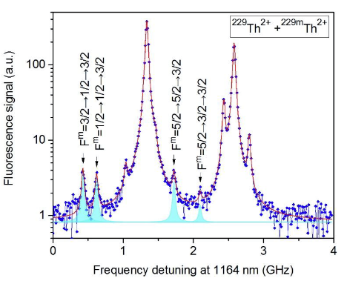
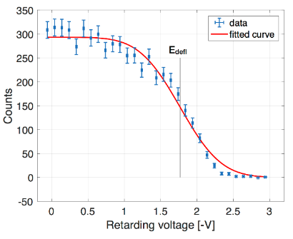
Characterization of ^{229m}Th
Internal Conversion decay:
First direct identification via Internal Conversion decay branch
→ electron detection (following α decay from 233U)
Nature 533, 2016
Isomer’s Halflife:
neutral isomer:
t_{1/2} = 7±1 μs
PRL 118, 2017
conversion coefficient: α_{IC} ~ 109 (in agreement with theory)
Hyperfine Structure:
collinear laser spectroscopy (2018: 229mTh2+, LMU + PTB)
(2024: 229mTh3+, RIKEN/Japan)
→ nuclear moments, charge radii, ionic halflife (1400600₃₀₀ s)
Nature 556, 2018
Nature 629, 2024
Isomeric excitation energy until 2022:
E*(iso) = 8.28 ± 0.17 eV (= 149.7 ± 3.1 nm)
Nature 573, 2019
E*(iso) = 8.10 ± 0.17 eV (= 153.1 ± 3.7 nm)
PRL 125, 2020
→ combined value 8.19 ± 0.12 eV (= 151.4 ± 2.2 nm)
10

Slide 11
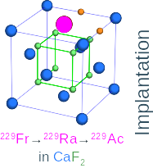
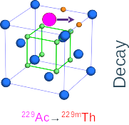
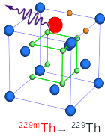
‘Game Changer’: Radiative Decay via VUV Photon
Photon spectroscopy of radioactive decay chains in solids:
- Isomer population in radioactive decay
- Implantation in (VUV transparent) large-bandgap crystals to ensure suitable chemical environment
- Vacuum-ultraviolet spectroscopy of ~150 nm photons from radiative decay
So far: experimental efforts using the alpha-decay of 233U
  → observation of radiative decay unsuccessful for almost 50 years
  new approach: using short-lived 229Ac produced using ISOL technique (Isotope Production On-Line)
11

Slide 12
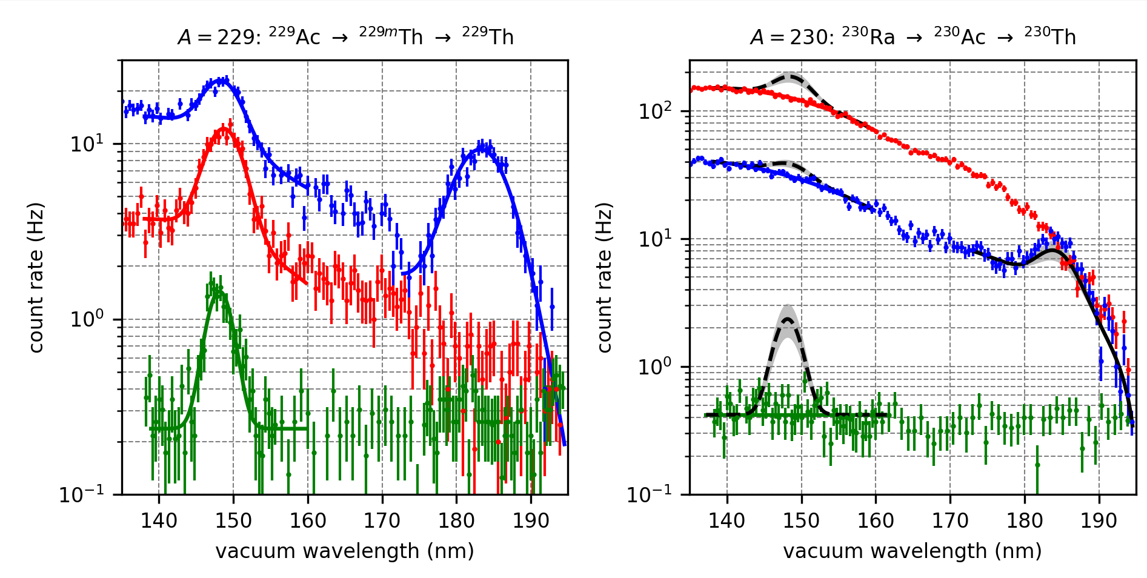
VUV Spectroscopy Results
→first observation of photonic de-excitation of thorium isomer
MgF₂ (5 mm)
CaF₂ (5 mm)
CaF₂ (50 nm)
A=229
A=230
Excitation energy:
E*(229mTh) = 8.338(24) eV
λ = 148.71(42) nm
7-fold precision improvement
Halflife:
t_{1/2} = 670(102) s (in MgF₂ )
scaled for vacuum:
~n3 : t_{1/2}~2500(380) s
S. Kraemer et al., Nature 617, 706 (2023)
12

Slide 13
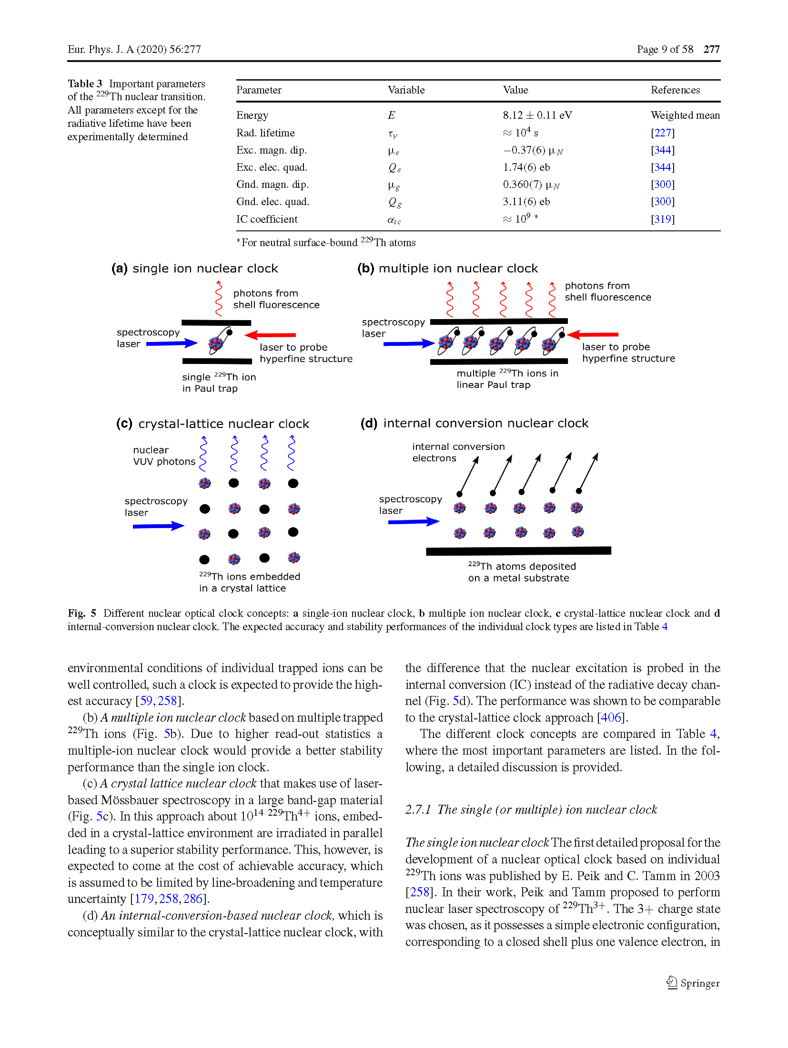
Concepts for
Direct Laser Spectroscopy of 229mTh
Crystal lattice approach
Solid surface approach
Ion trap approach
- implant 229Th nuclei in
large-bandgap crystal
- IC forbidden if band gap > E*_{iso}
- excite isomer with VUV laser light
- observe photons from isom. decay
- deposit layer of 229Th on surface
- IC allowed: band gap < E*_{iso}
- excite isomer via VUV laser light
- observe electrons from isom. decay
- store ion(s) in Paul trap
- IC is forbidden (large IP)
- excite isomer via VUV laser light
- observe hyperfine shift of electron
shell induced by nuclear spin change
PTB (Ekkehard Peik),
TU Vienna (Thorsten Schumm)
UCLA (Eric Hudson), JILA (Jun Ye)
JILA (Jun Ye)
UCLA (Eric Hudson)
PTB (Ekkehard Peik), LMU (Peter Thirolf)
U Mainz (F. Schmidt-Kaler)
13
L. v.d. Wense, B. Seiferle, EPJ-A 56, 277 (2020)

Slide 14
Laser-Excitation of the 229mTh Nuclear Resonance
high power, broad bandwidth
frequency comb
- initial search
- shorter scan times
- compromise on frequency resolution
- precision frequency determination
- longer scan times
laser
nuclear resonance
nuclear resonance
bandwidth ∆f
f_{rep}
1-10 GHz
1 kHz
frequency
groups:
UCLA (Eric Hudson)
PTB (Ekkehard Peik)
JILA Boulder (Jun Ye)
TU Wien (Thorsten Schumm)
LMU (Peter Thirolf)
14

Slide 15
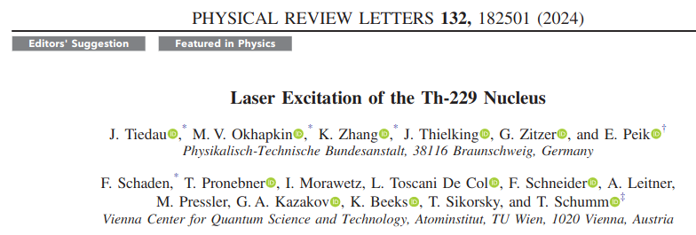

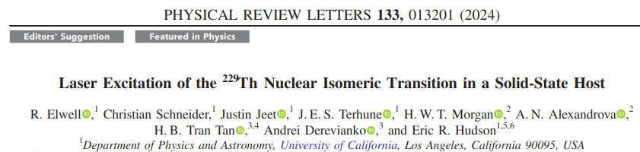
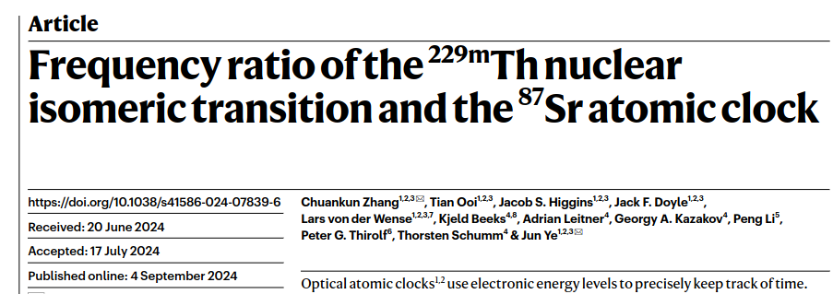
‘hot of the press’:
2024: 229mTh laser excitation breakthroughs
→ solid-state approach: 229Th doped VUV-transparent (CaF₂) crystals (TU Wien, ~1018/cm3)
PTB, UCLA: 4-wave mixing laser, linewidth ~ 10 GHz
VUV frequency comb, ~ 300 kHz
15

Slide 16
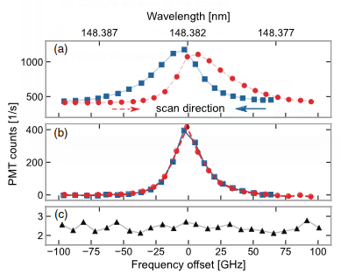
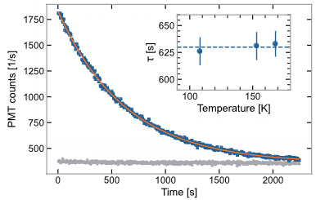
First laser excitation of the Thorium Isomer
Nuclear 229mTh resonance via laser:
229mTh halflife (in CaF₂):
229Th
230Th
Thorium Isomer:
CaF₂:
E* = 8.35574(3) eV
λ = 148.3821(5) nm
ν = 2020.409(7) THz
T_{1/2} = 1740(50) s
LiSrAlF₄:
E* = 8.355733(11) eV
λ = 148.38219(21) nm
ν = 2020.4073(31) THz
T_{1/2} = 1289(79) s
J. Tiedau et al.,
PRL 132 (2024)
R. Elwell et al.,
PRL 133 (2024)
16

Slide 17
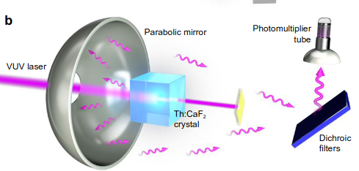
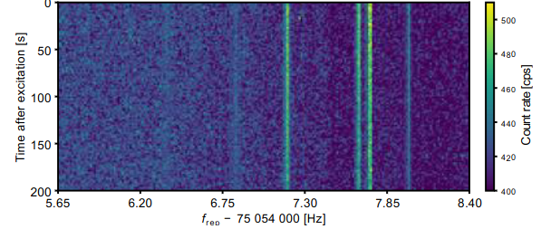
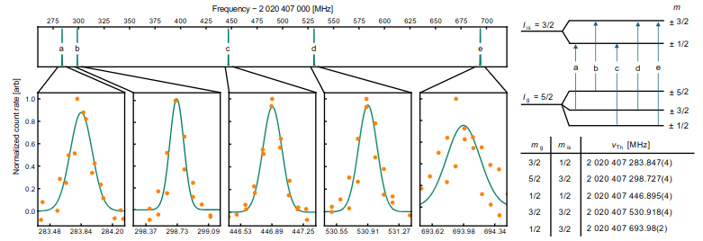
Excitation of the Thorium Isomer 229mTh via
VUV Frequency Comb
C. Zhang et al., Nature 633, 63(2024)
nuclear electric
quadrupole splitting:
sensitivity enhancement
for α:
K = 5900 (2300)
.
K. Beeks et al,
arXiv:2407.17300
17

Slide 18
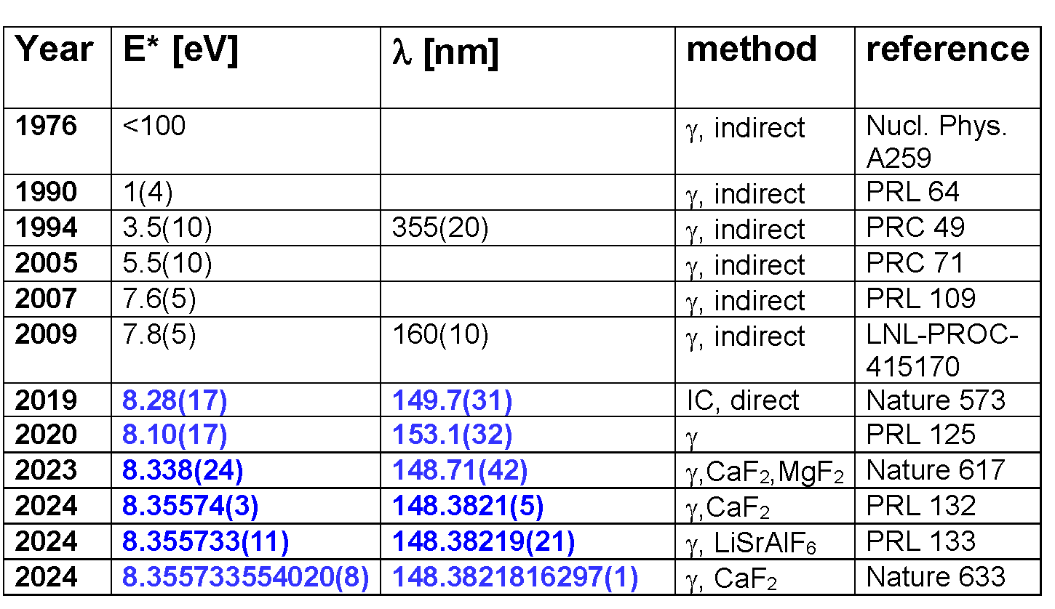
Excitation Energy of the Thorium Isomer 229mTh
2019-2024: improvement by ~ 1011
18

Slide 19
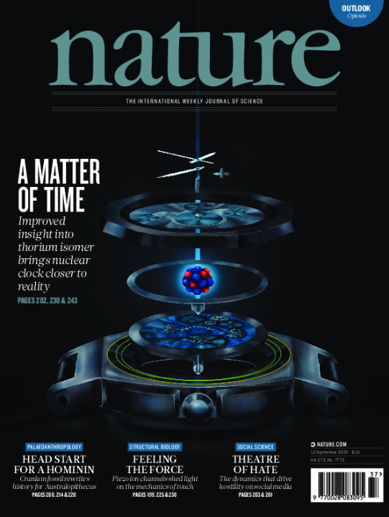
Summary: From the Atomic to the Nuclear Clock
Enormous exp. progress in recent years on 229mTh:
→ identification & characterization of the thorium isomer:
from nuclear spectroscopy to laser spectroscopy:
2019: E* = 7.8(5) eV
2024: E* = 8.355733554020(8) eV
Next major milestones:
→ optimize nuclear resonance excitation with narrowband laser towards
metrological precision
→ realize nuclear clock prototype with ion-trap approach
→ measure ionic lifetime in vacuum
→ development of intense, narrow-band cw VUV laser
→ consolidate sensitivity enhancement for α
◊ exciting program at GSI for highly-charged 229mTh studies (nuclear hyperfine mixing)
.
All building blocks for a nuclear clock have been demonstrated:
one/several nuclear clock prototypes will appear in the coming years
19

Slide 20

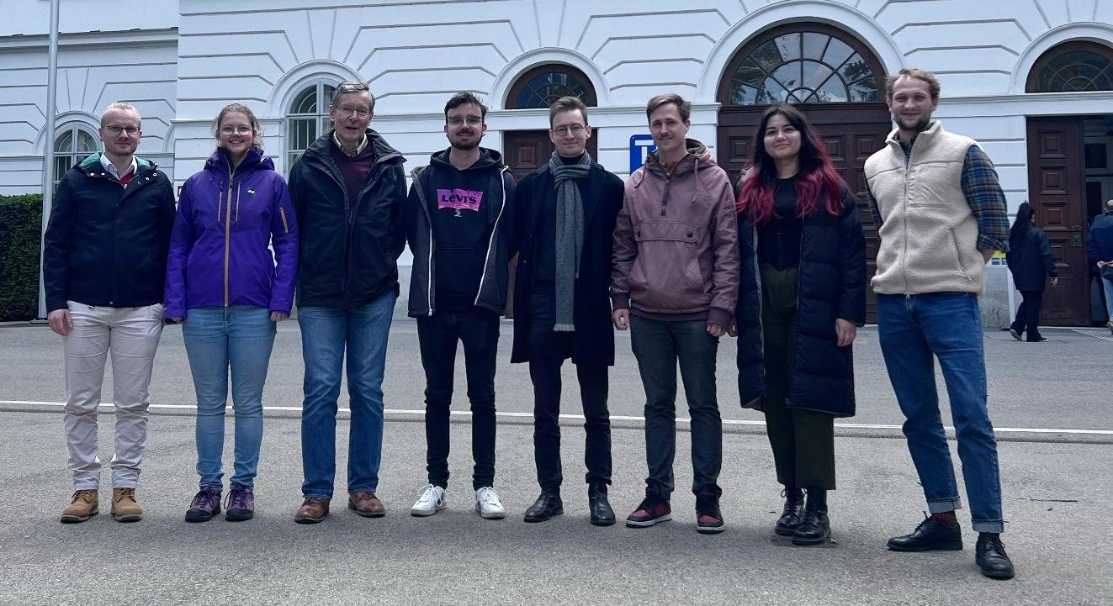


Thanks to ….
LMU: K. Scharl, D. Moritz, S. Ding, S. Kraemer, I. Hussain, T. Teschler, L. Löbell, F. Zacherl, L. v.d. Wense,
B. Seiferle, G. Holthoff, J. Rebhan, T. Teuner, M. Wiesinger, S. Wissenberg
GSI/JLU Giessen: E. Haettner, T. Dickel
PTB Braunschweig: J. Thielking, P. Glowacki, D.M. Meier, M. Okhapkin, J. Tiedau, G. Zitzer, E. Peik
Helmholtz-Institut Mainz & Johannes Gutenberg-Universität Mainz, GSI Darmstadt:
C. Mokry, J. Runke, K. Eberhardt, N.G. Trautmann, C.E. Düllmann
TU Wien: T. Schumm, S. Stellmer, T. Sikorsky, K. Beeks, C. Lemell, F. Libisch
MPQ/ILT Aachen: J. Weitenberg
MPI-HD: P. Bilous, N. Minkov, J. Crespo
U Würzburg: A. Pàlffy
NIST: S. Nam, G. O’Neil
UCLA: E. Hudson, C. Schneider, J. Jeet,
R. Elwell, J. Terhune
U Delaware: M. Safronova
Thank You !
20

