Slide 1




Theory of nuclear matter: ab initio developments and connections to the nuclear energy functional
Francesco Marino
Institut für Kernphysik and PRISMA+ Cluster of Excellence,
Johannes Gutenberg-Universität Mainz
European Nuclear Physics Conference 2025
Caen, France

Slide 2


Outline
Microscopic theory of infinite nuclear matter and non-empirical energy functionals
FM, PhD thesis, University of Milano (2023)
Link: https://hdl.handle.net/2434/1023132
Ab initio Green’s functions for infinite nuclear matter
Ab initio-constrained nuclear energy density functionals

Slide 3
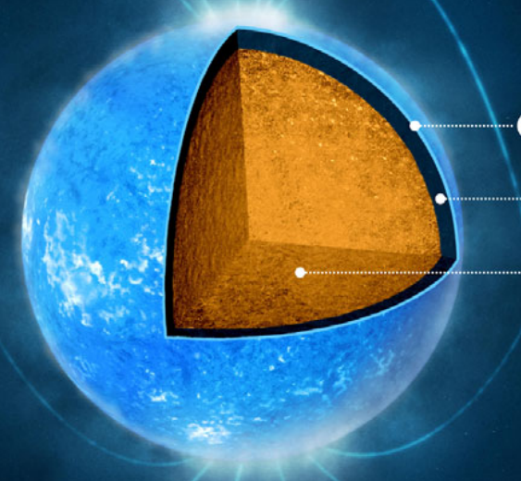
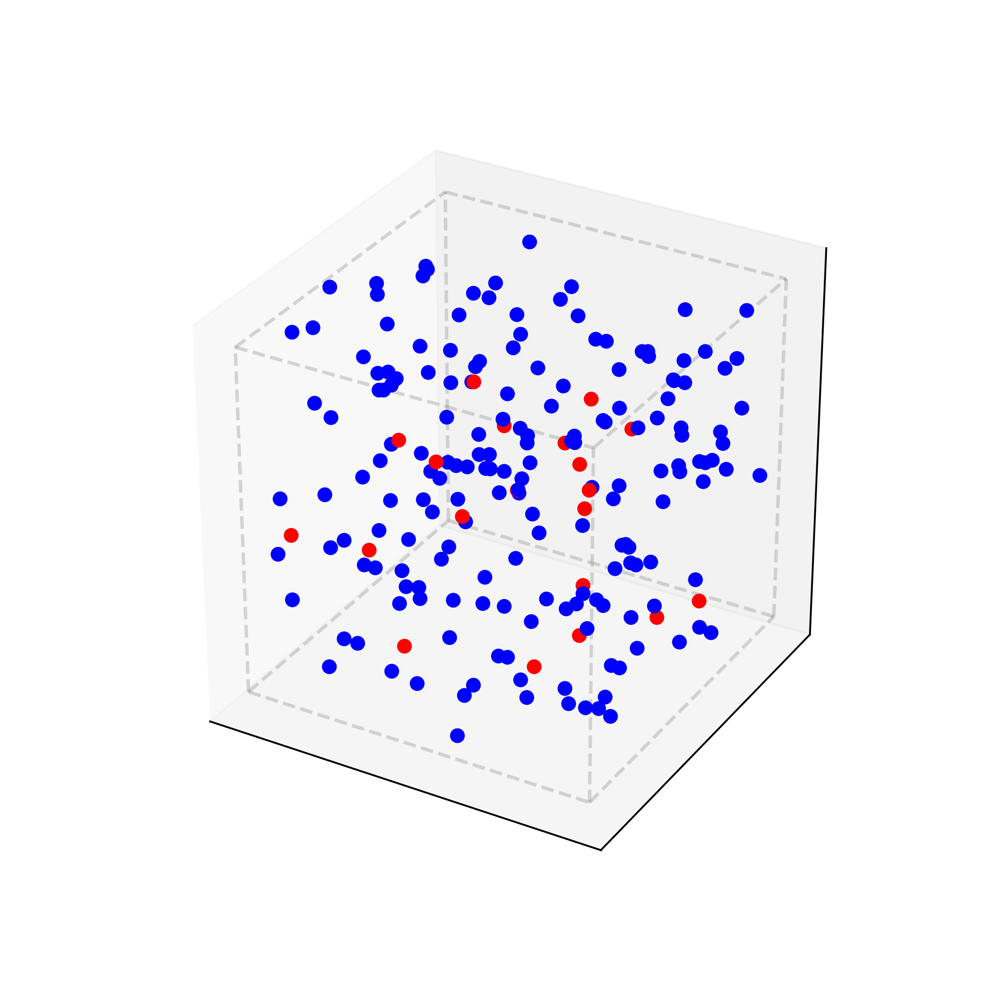
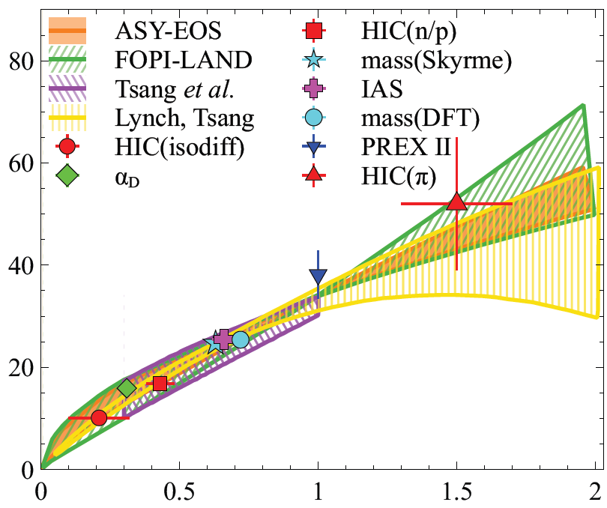
What is nuclear matter?
What is the structure of neutron stars?
Nuclear matter is an extended system of interacting nucleons
Macroscopic scale
Watts et al., Rev. Mod. Phys. 88, 021001 (2016)
Can we constrain nuclear matter properties from laboratory experiments?
Idealized model, but implications on real physical systems!
Microscopic scale
Sorensen et al., Prog. Part. Nucl. Phys. 134, 104080 (2024)

Slide 4
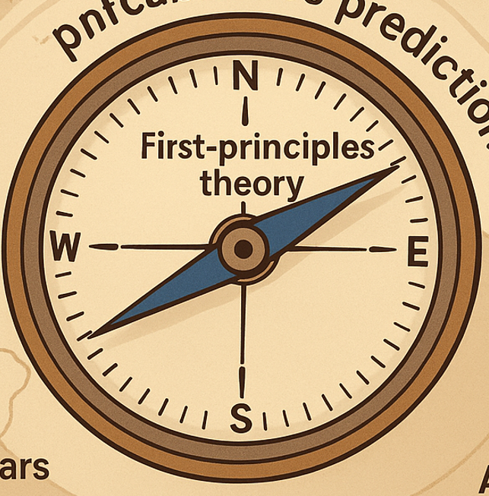
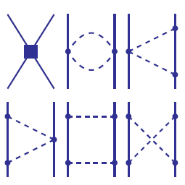

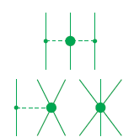
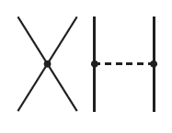

How do we study nuclear matter?
We study nuclear matter with ab initio nuclear theory
QCD
Realistic nuclear interactions
Chiral effective field theory
LO (Q⁰)
NLO (Q²)
NNLO (Q³)
Advanced many-body techniques
$$H\left|Ψ\right\rangle =E\left|Ψ\right\rangle$$
Machleidt et al., Prog. Part. Nucl. Phys. 137, 104117 (2024)
Predictions with controlled theoretical uncertainties

Slide 5
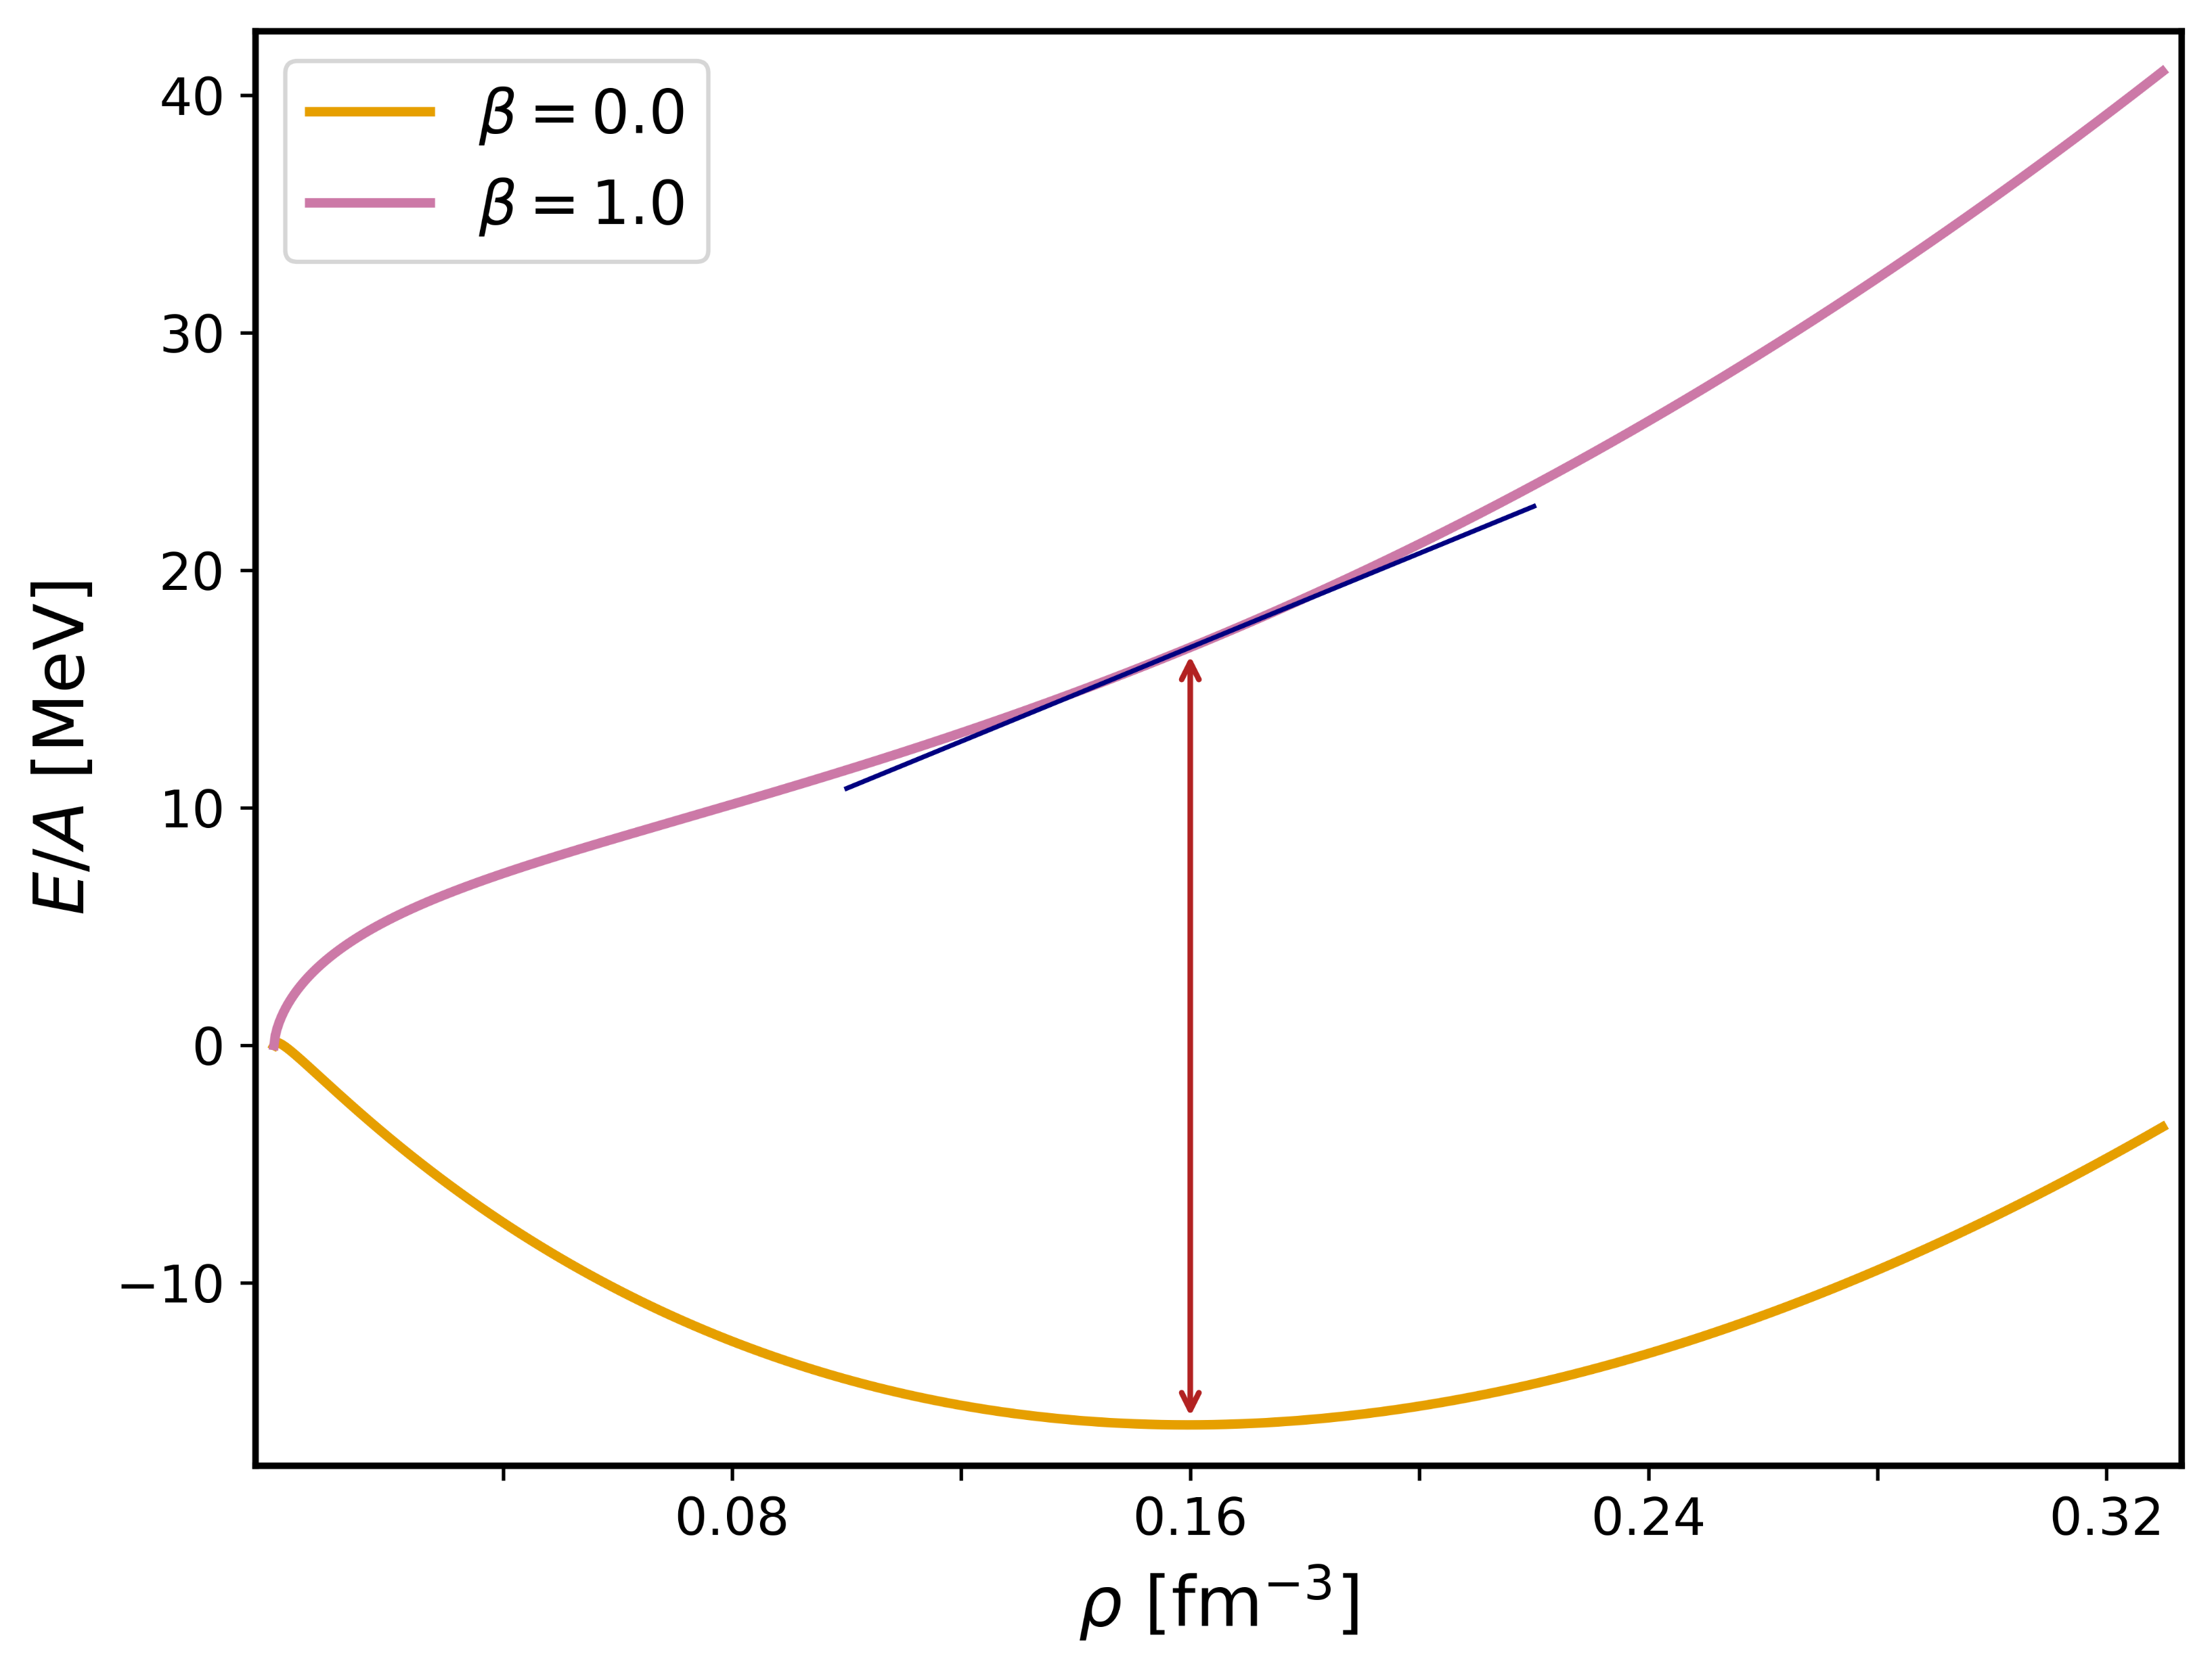
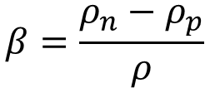

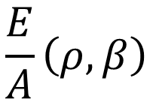
The equation of state
$$\frac{E}{A}\left(ρ,β\right)$$
Neutron matter
$$ρ=ρ_{n}+ρ_{p}$$
$$β=\frac{ρ_{n}−ρ_{p}}{ρ}$$
Symmetric nuclear matter

Slide 6
Ab initio Green’s functions for infinite nuclear matter

Slide 7
Self-consistent Green’s functions
$$g\left(ω\right)=g^{\left(0\right)}\left(ω\right)+g^{\left(0\right)}\left(ω\right)Σ^{⋆}(ω)g(ω)$$
Propagator
Self-energy
Total energy
One-body observables
Somà et al., Phys. Rev. C 84, 064317 (2011)
Barbieri et al., Phys. Rev. C 105, 044330 (2022)

Slide 8
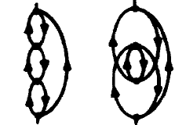
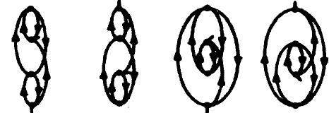
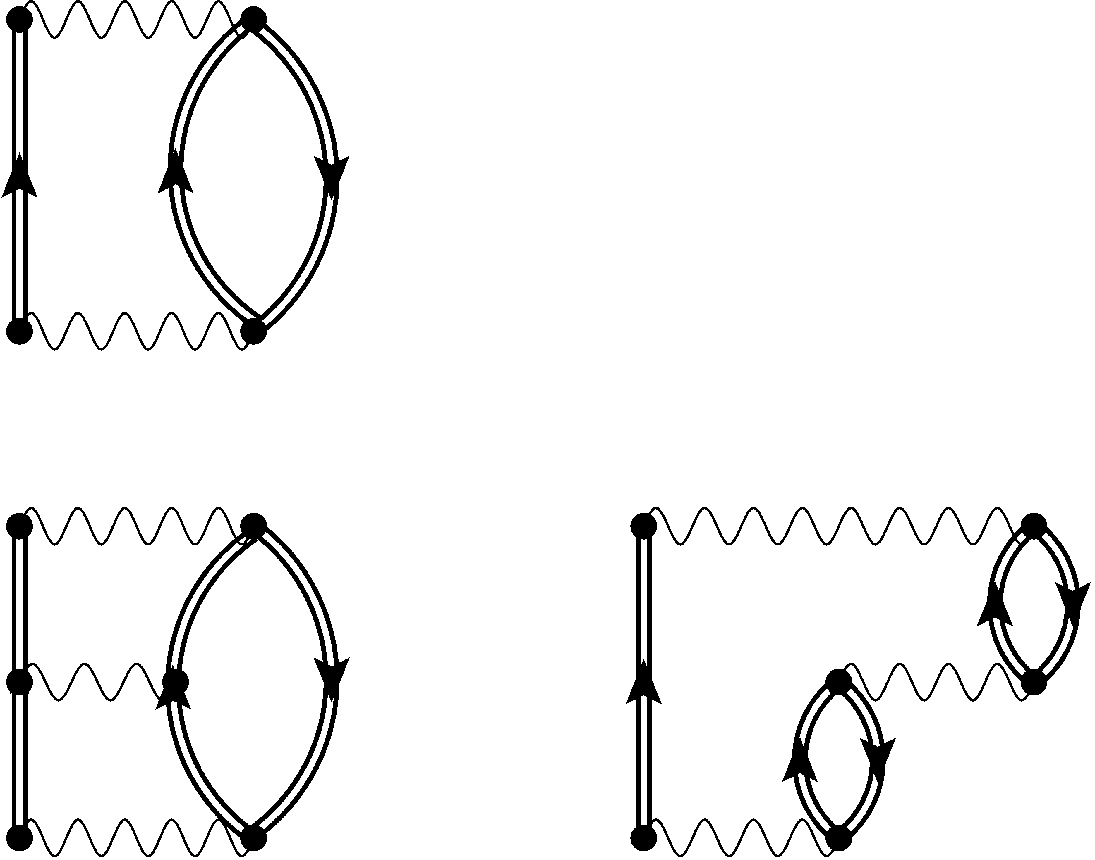
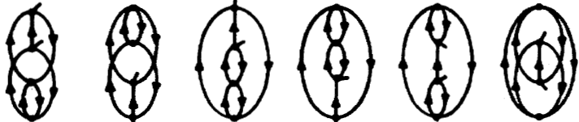

Algebraic diagrammatic construction
ADC(4)
ADC(2)
ADC(3)
`
Schirmer et al., Phys. Rev. A 28, 1237 (1983)
ADC(3)-D
ADC(3) combined with coupled-cluster amplitudes
High accuracy
Moderate cost
Barbieri et al., Lect. Notes Phys. 936, 571 (2017)
FM et al., Phys. Rev. C 110, 054322 (2024)

Slide 9
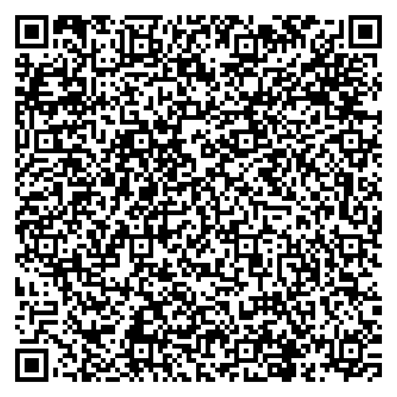
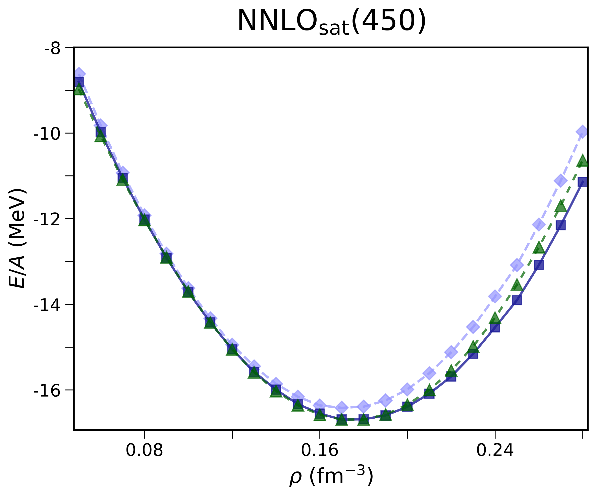
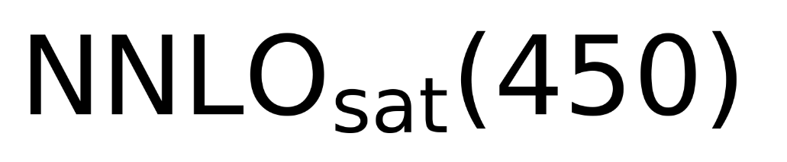
Equation of state: many-body uncertainties
EOS available at:
FM, W. Jiang and S. Novario, Phys. Rev. C 110, 054322 (2024)
Symmetric nuclear matter
ADC(3)
ADC(3)-D
Coupled-cluster - CCD(T)
ADC provides accurate predictions for the EOS, with small many-body uncertainties

Slide 10
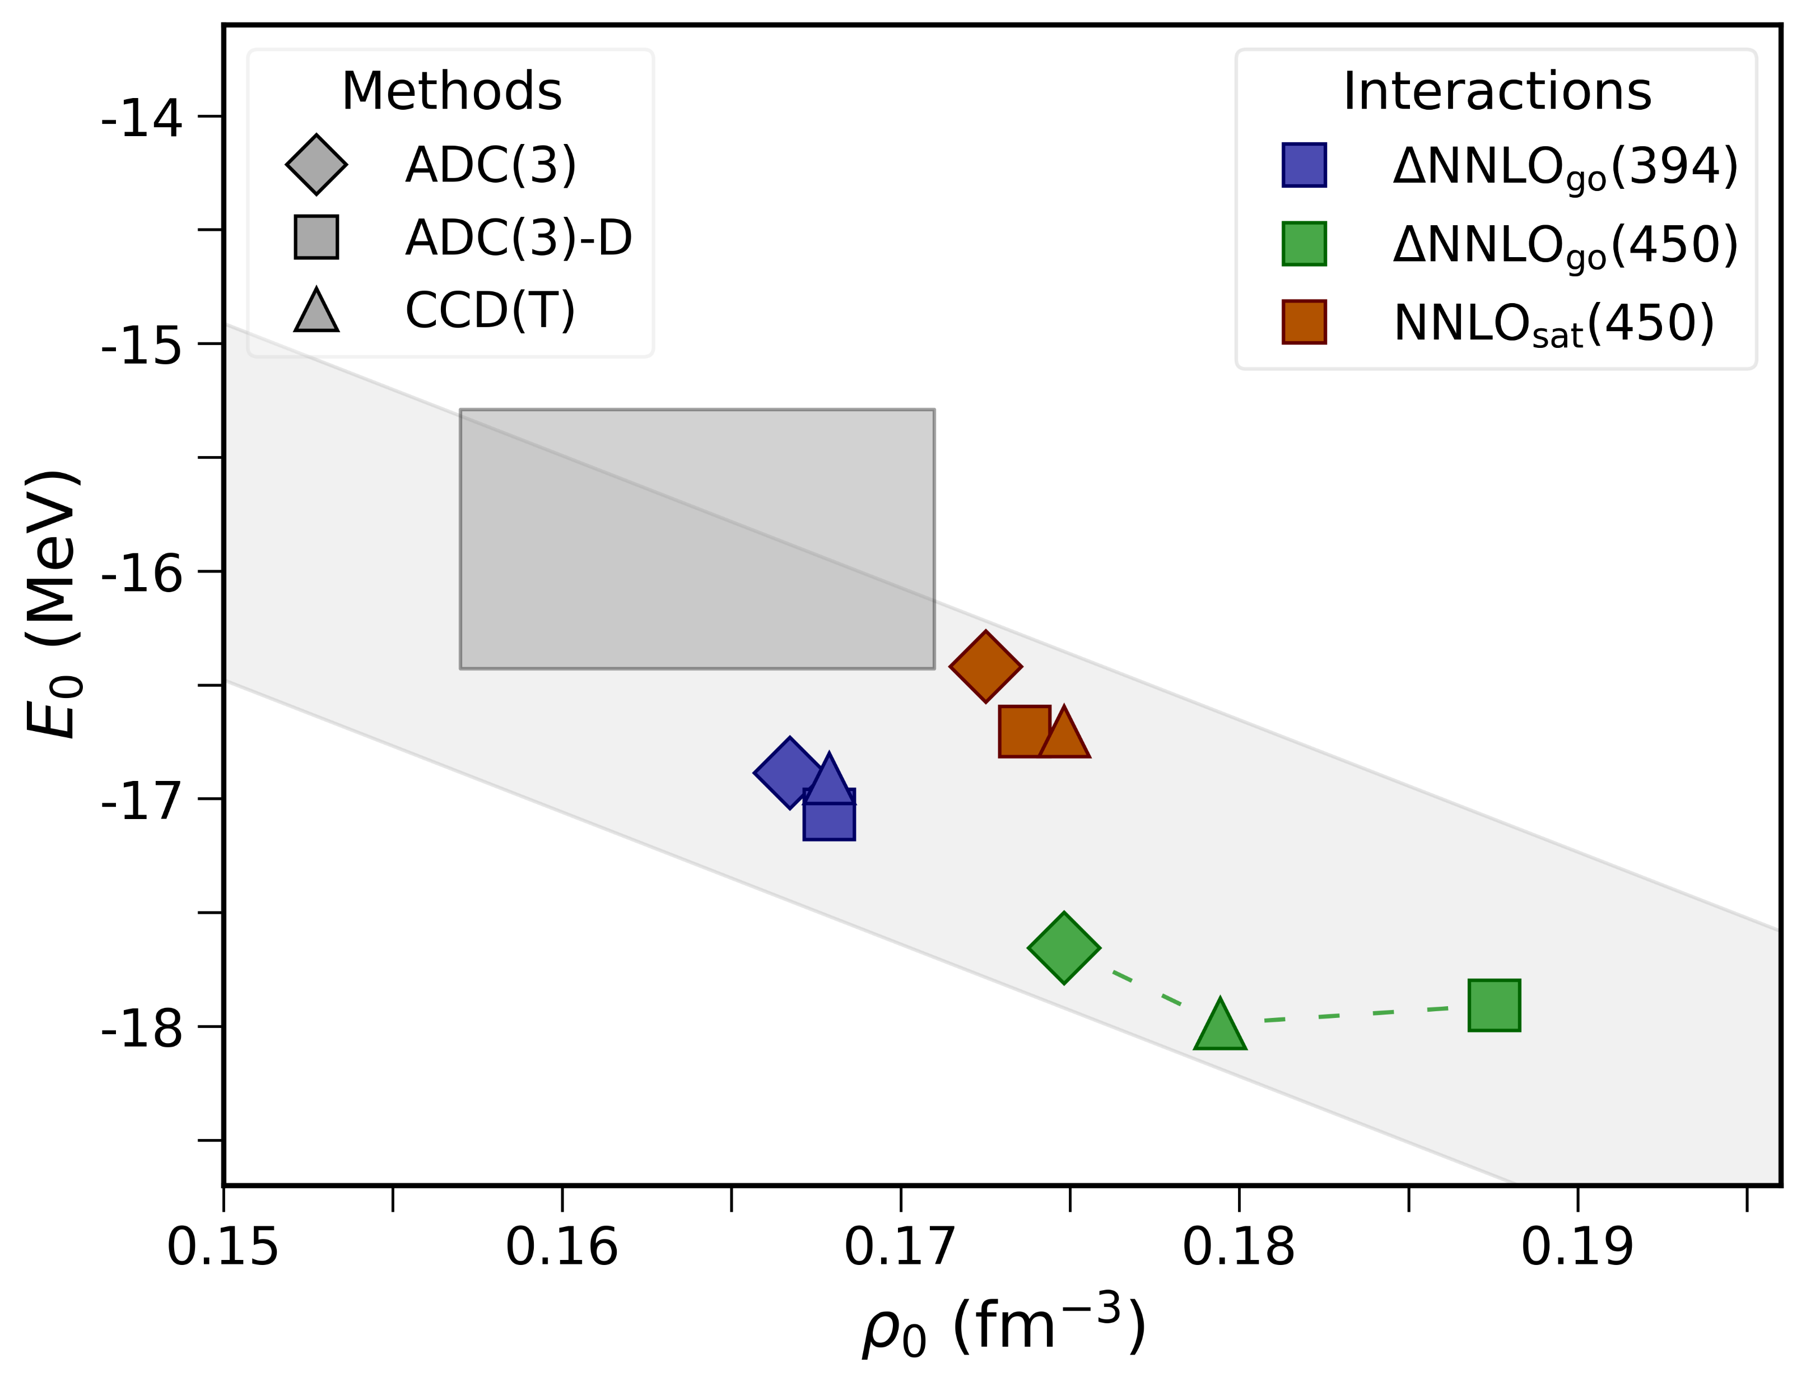
… and interaction dependence
Saturation point of symmetric nuclear matter
The dependence on the interaction is the dominant uncertainty
Empirical saturation box
But a simultaneous description of symmetric matter and finite nuclei with chiral potentials can be achieved
FM et al., Phys. Rev. C 110, 054322 (2024)

Slide 11
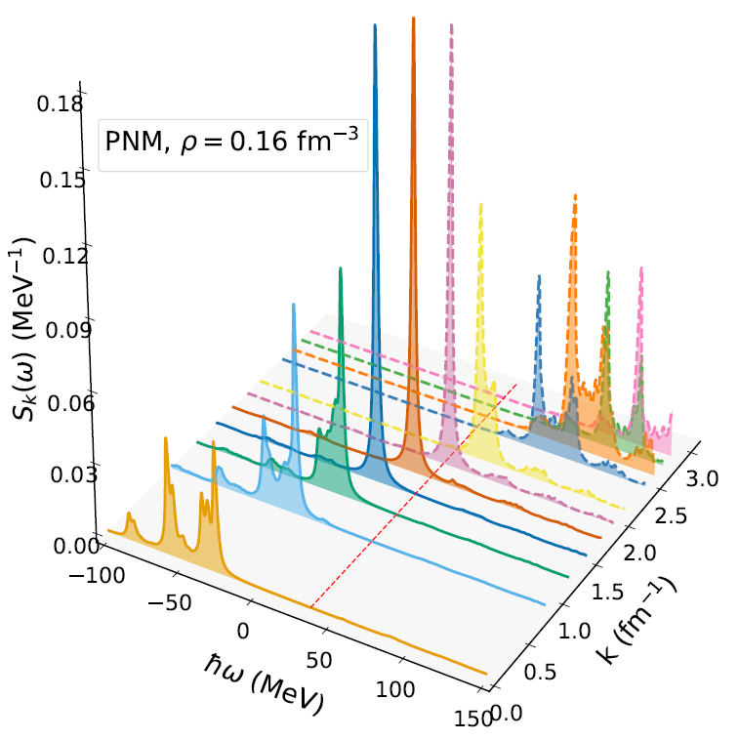
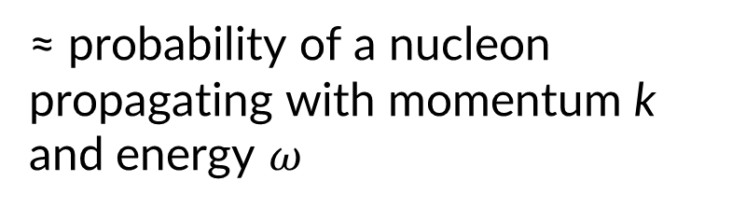

How do nucleons distribute?
Quasiparticles
Spectral functions $S\left(k,ω\right)$
≈ probability of a nucleon propagating with momentum k and energy $ω$
Interactions induce fragmentation
Fermi energy
FM et al., to be submitted

Slide 12
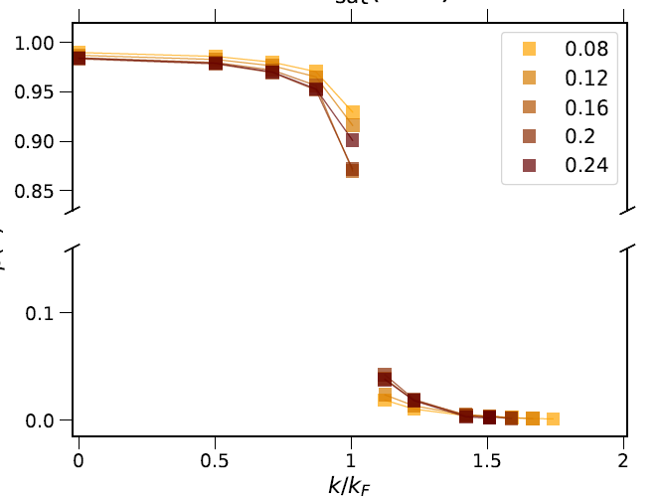
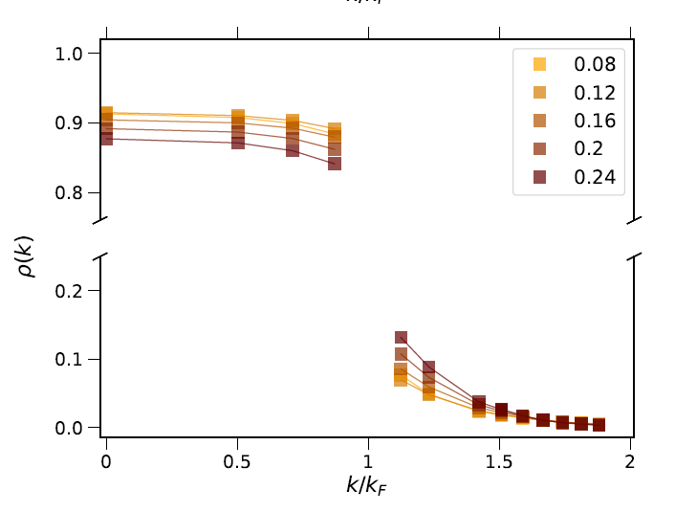
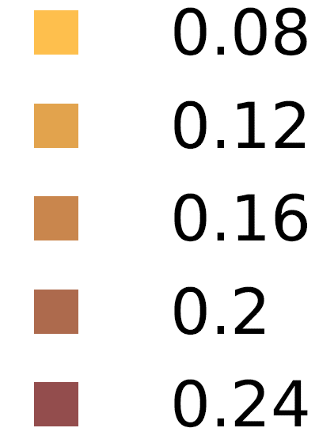


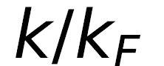
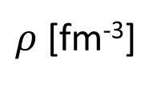
Momentum distributions
Pure neutron matter
Symmetric nuclear matter
FM et al, PoS QNP2024, 180 (2025)
$ρ$ [fm⁻³]
Discontinuity at the Fermi surface
High-momentum tail

Slide 13
Ab initio-constrained nuclear energy density functionals

Slide 14
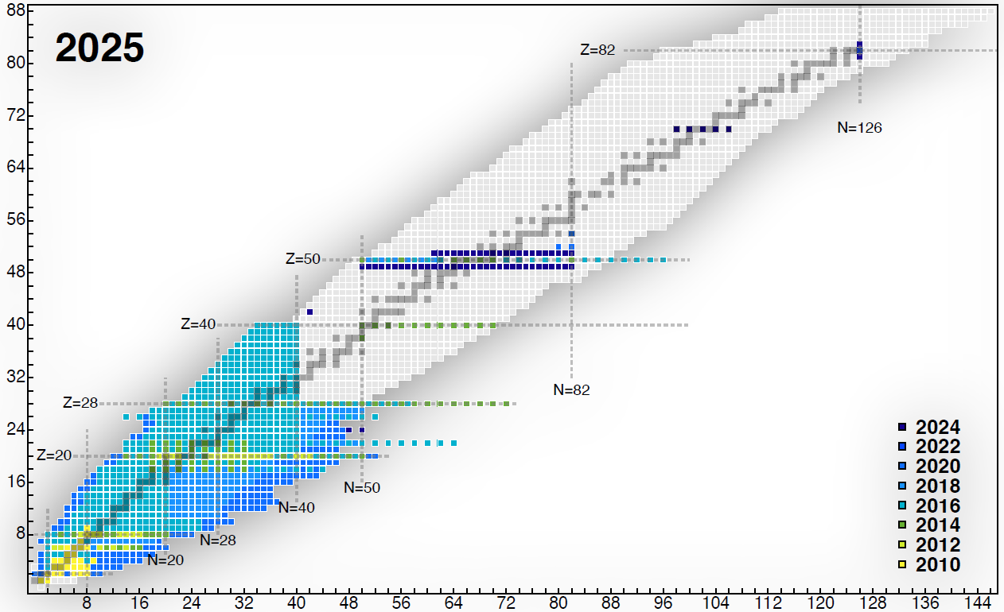
Status of ab initio in 2025
Density functional theory
Protons
Credit: Heiko Hergert
Hergert, Front. Phys. 8, 00379 (2020)
Neutrons

Slide 15
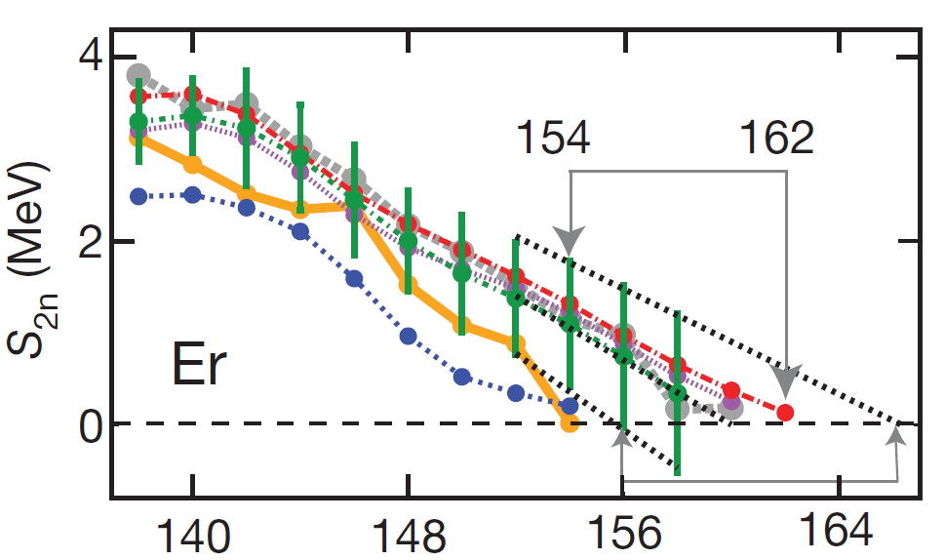
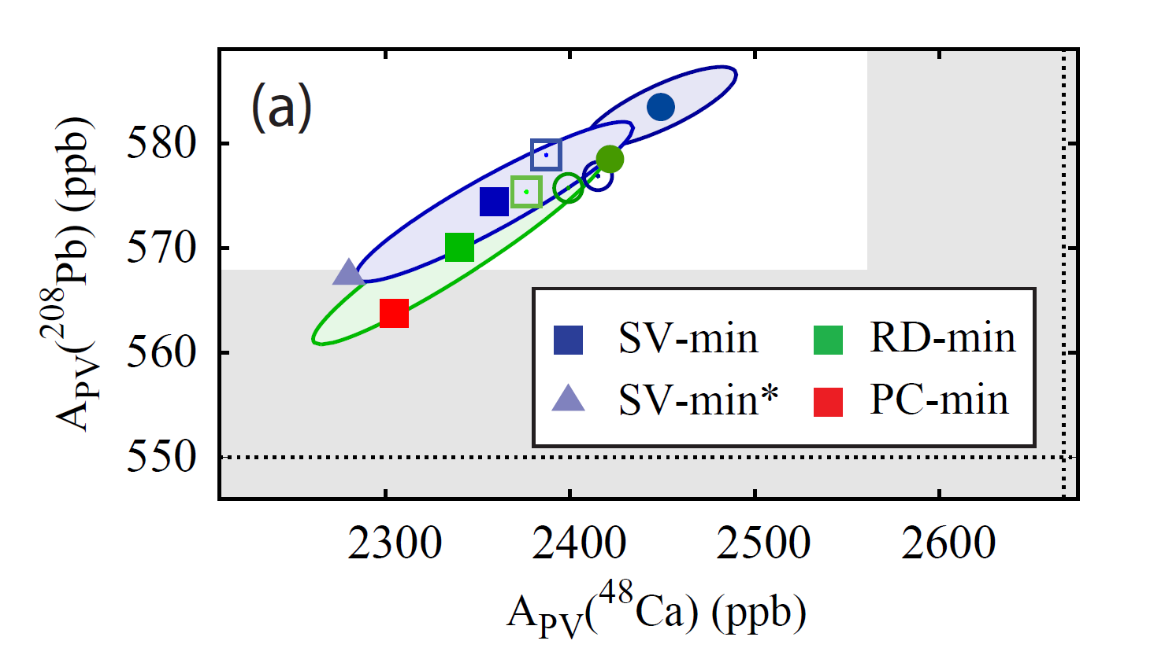
Nuclear density functional theory
DFT is in principle exact, but the energy density functional (EDF) is approximate
Prediction of neutron driplines
CREX/PREX puzzle
Erler, Nature 486, 509–512 (2012)
Open problems of empirical EDFs
Reinhard et al., PRL 129, 232501(2022)
Neutron number
Can we use ab initio to improve the nuclear EDFs?
Colò, Adv. Phys.-X 5, 1740061 (2020)
See e.g.: Drut et al., Prog. Part. Nuc. Phys. 64, 120–168 (2010); Furnstahl, Eur. Phys. J. A 56: 85 (2020); Zurek et al., Phys. Rev. C 109, 014319 (2024)
FM et al, Phys. Rev. C 104, 024315 (2021)

Slide 16

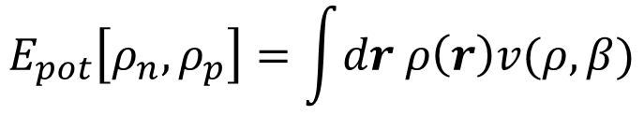

From the EOS to the nuclear EDF
$${E\left[ρ_{n},ρ_{p}\right]=E_{kin}+E}_{pot}+E_{Coul}$$
First step: local density approximation
Fully ab initio, no empirical fits
$$E_{pot}\left[ρ_{n},ρ_{p}\right]=\int{dr ρ\left(r\right)v(ρ,β)}$$
$$E/A\left(ρ,β\right)=t\left(ρ,β\right)+v\left(ρ,β\right)$$
Ab initio EOS
EDF for finite nuclei
Second step: gradient approximation
Tuned on few exp energies
$$E_{GA}=E_{LDA}+{∫dr C}^{∇ρ}{\left|∇ρ\right|}^{2}+{∫dr C}^{∇J}ρ∇⋅J$$
Density-gradients
Spin-orbit

Slide 17
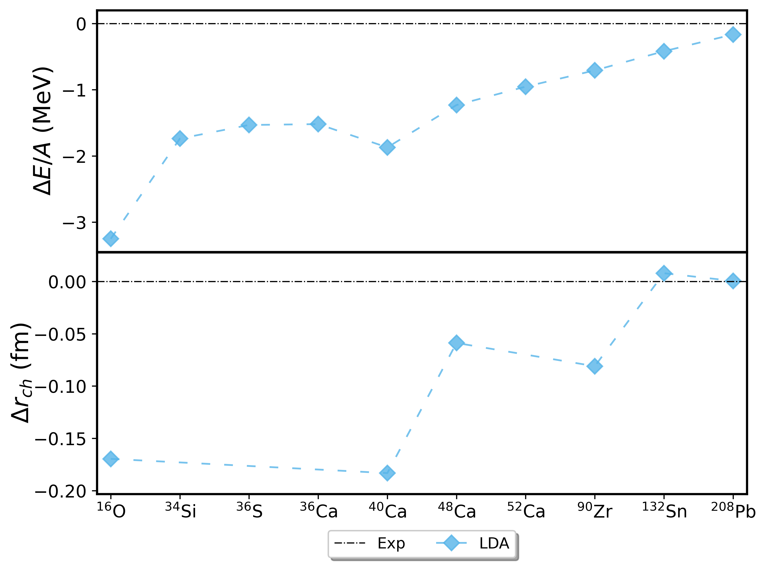
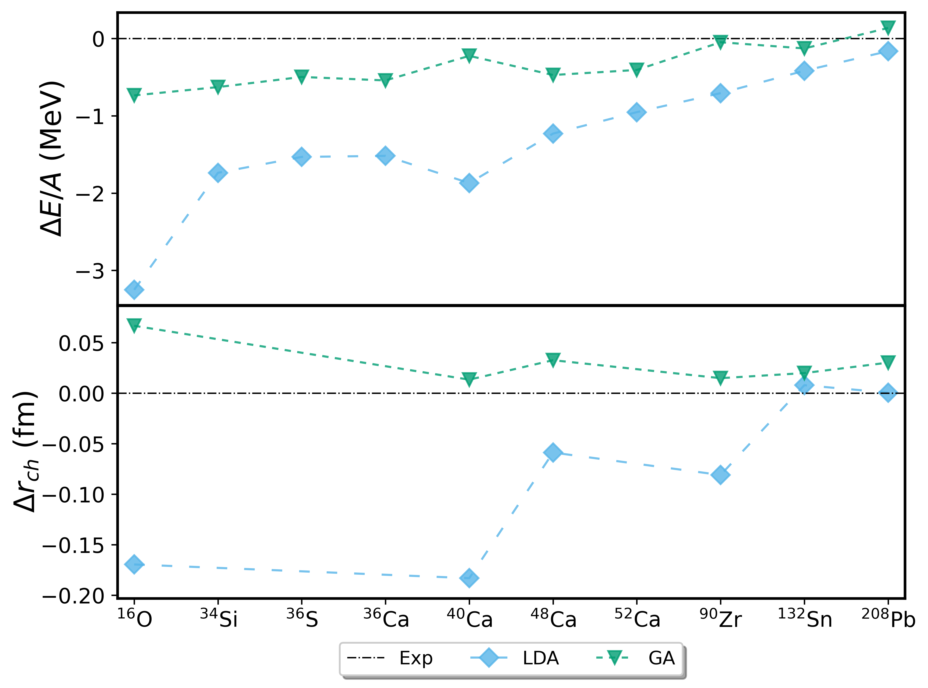
From the EOS to the nuclear EDF
FM et al, Phys. Rev. C 104, 024315 (2021)
Local density approximation
Gradient approximation
Binding energies per nucleon
Experiment
Mixing ab initio and empirical data works
Charge radii

Slide 18
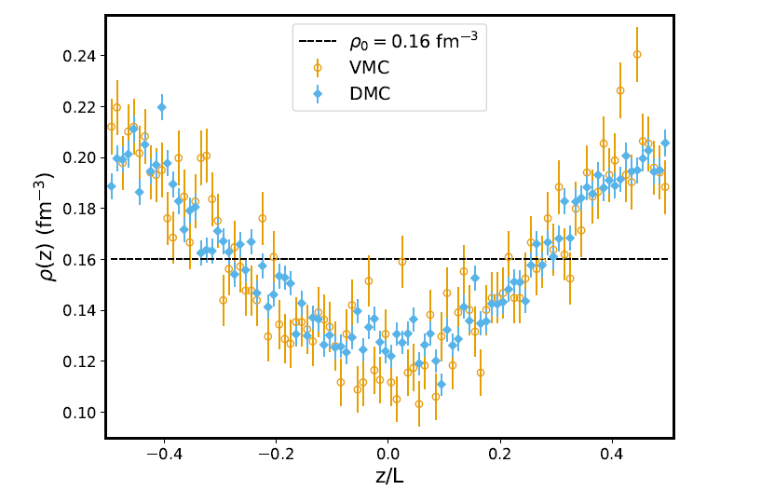
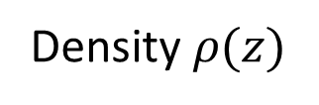
Ab initio-constrained surface terms?
Uniform matter is not enough.
To probe the surface part of the EDF, we need inhomogeneous matter
Try simulating matter subject to a perturbation
Density $ρ(z)$
Perturbed matter
EDF fully ab initio?
Preliminary

Slide 19
Conclusions and perspectives
The ADC Green’s functions method is a state-of-the-art tool for exploring nuclear matter
Outlook: pairing gaps in low-density neutron matter, response functions, EOS with exotic degrees of freedom…
Nuclear EDFs constrained to ab initio EOS work (with limited empirical input)
Constructing a fully “non-empirical” EDF is ongoing (inhomogeneous matter)

Slide 20
Special thanks to
My supervisor Gianluca Colò (Milano)
Carlo Barbieri (Milano)
Many collaborators and mentors:
Weiguang Jiang (Mainz), Alessandro Lovato (Argonne), Francesco Pederiva (Trento), Xavier Roca-Maza (Barcelona), Enrico Vigezzi (Milano)

Slide 21
Thank you for your attention!

