Slide 1
From Nuclear Physics to Isotope Geochemistry: Identifying Anthropogenic Contamination Sources in the Environment
SEPTEMBER 2025
Alkiviadis Gourgiotis
alkiviadis.gourgiotis@asnr.fr

Slide 2
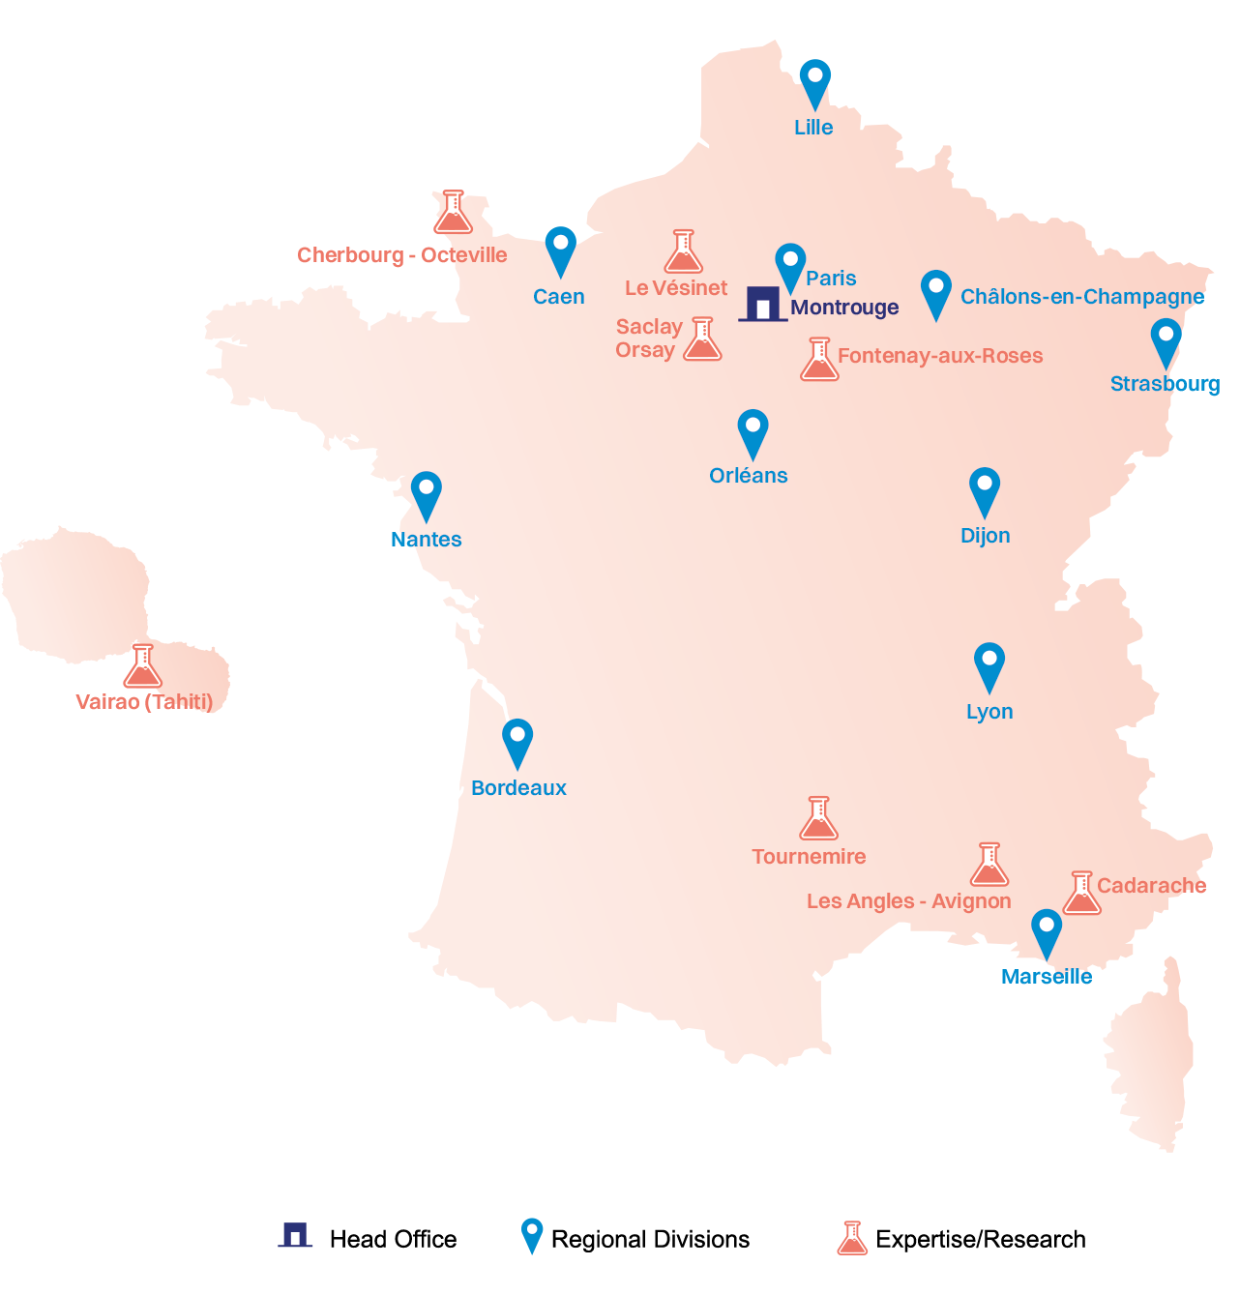
Who are we:
The French Authority for Nuclear Safety and Radiation Protection (ASNR)
ASNR sites: ASNR is spread over 10 sites across France and overseas:
  The ASNR oversees civil nuclear activities in France on behalf of the French State. It also carries out research, expert assessments, training, and public information in the fields of nuclear safety and radiation protection.
  Main missions of the ASNR:
    Oversight
    Regulation
    Expertise
    Research
    Emergency situations
    Information and dialog
    Training and development of a culture of radiation protection
The research conducted by ASNR has two main aims: to maintain and develop the knowledge and skills required for expert assessments in the various fields of nuclear safety and radiation protection, and to advance fundamental knowledge, in particular to understand the effects of ionizing radiation on health and the environment.
Our department: Radioactive Waste and Pollution Department (SPDR)
Our lab: Research Laboratory on Transfers in Contaminated Sites and Soils (LT2S)

Slide 3
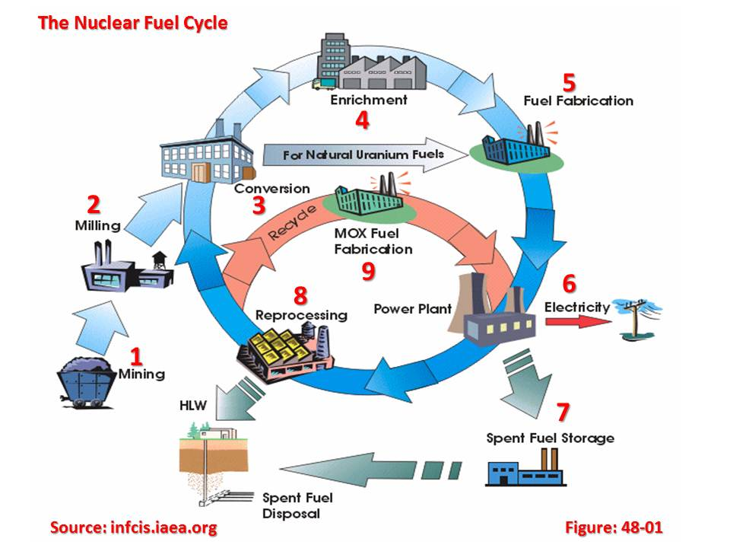
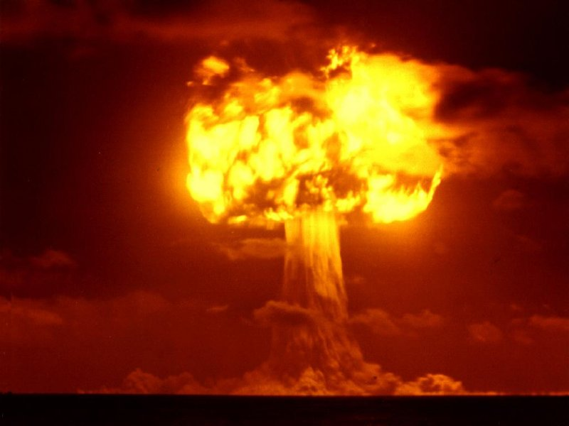
ASNR's Environmental Mission: Identification of contamination sources
As part of its expertise and environmental monitoring missions, ASNR carries out numerous studies related to contaminated sites.
Identifying the origin of radiological contamination --> help us to support decision-making and optimize current management strategies for contaminated sites and soils.

Slide 4
historical overview
01

Slide 5
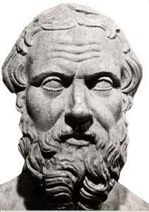
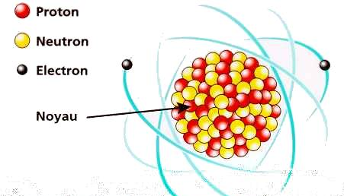
L’atome
From the discovery of isotopes to isotope geochemistry
The atom
An atom → ancient Greek, ἄτομος [atomos] → that which cannot be divided
The atomist theory (Democritus) → supports the idea of matter made up of indivisible 'grains

Slide 6
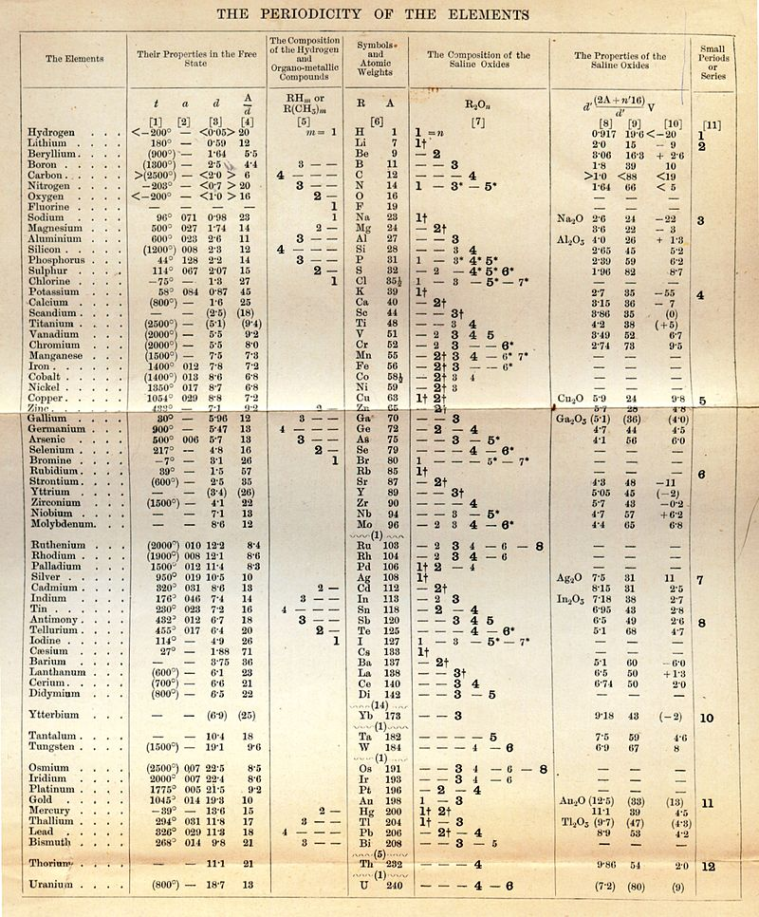
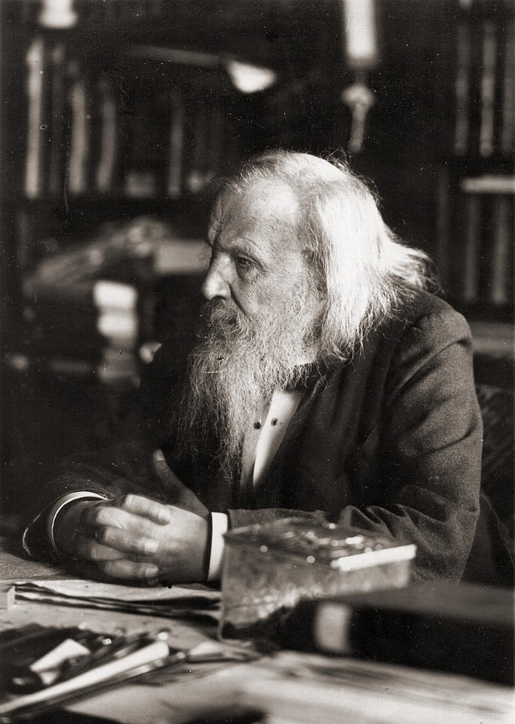
From the discovery of isotopes to isotope geochemistry
The scientific discovery of the atom dates back to Dalton, in 1803
Dmitri Mendeleïev : Periodic classification of the elements 1891

Slide 7
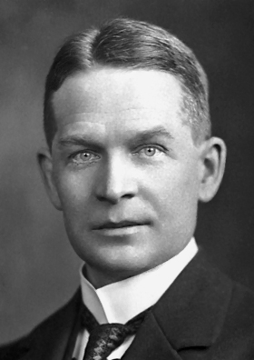
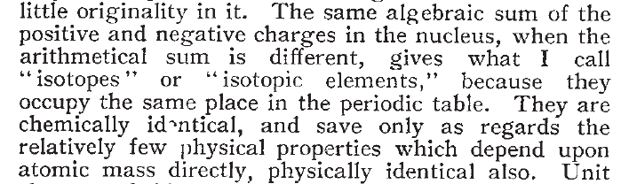
From the discovery of isotopes to isotope geochemistry
Frederick Soddy 1913
Nature 1913

Slide 8
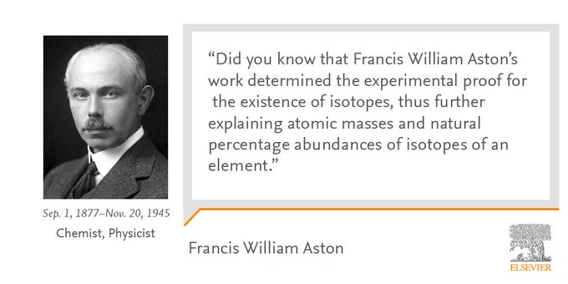
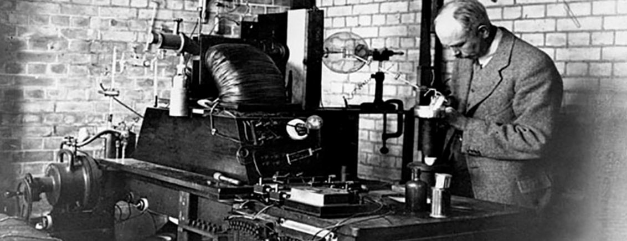
From the discovery of isotopes to isotope geochemistry
Francis William Aston :
Measurement of isotopes starting from 1919

Slide 9
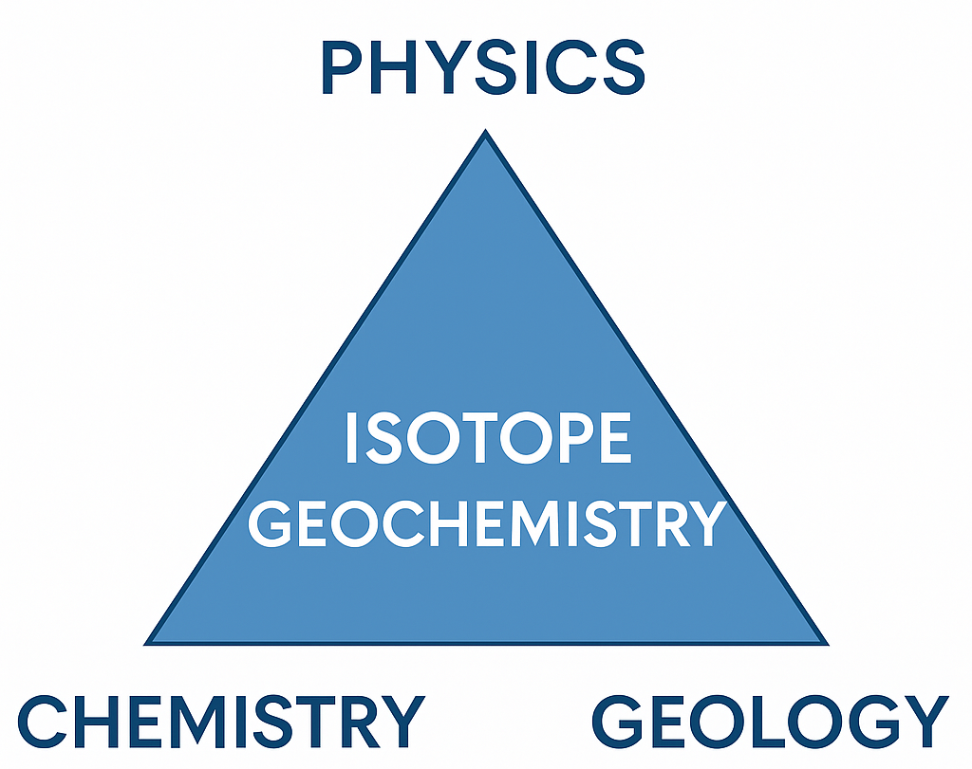
From the discovery of isotopes to isotope geochemistry
IG → radioactive disequilibria as well as isotope variations (fractionations, mixing, etc.) as sources of information of the materials origin and the physicochemical processes in the nature.

Slide 10
use of isotopes for tracing contamination SOURCES in the environment
02

Slide 11
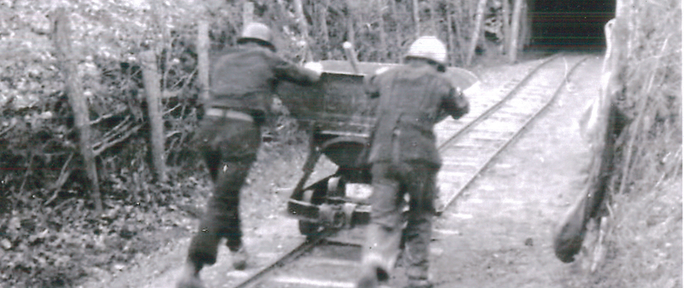
Uranium mines in France
Industrial exploitation from 1948 to 2001
At the end of 2018, 250 mining sites were listed at the national level

Slide 12
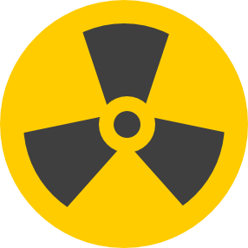
U-mines
The goal of the study
During the operation of the mining sites, and even after their closure (due to the radioactive materials that remain on site), radioactive substances may be transferred to the environment through atmospheric transport or mine drainage water.
Water catchment
crust
(geochemical background)
[U] ~3 µg/g
+ Th, Ra, Pb
The identification of the origin of env. contaminations → Optimizing current management methods for former mining sites
U-mine
U-ore
[U] > 400 µg/g
+ RN (Th, Ra, Pb)
Weathering
and
erosion
(2) U supply:
sedimentntation
U⁶⁺_{(aq)}=> U⁴⁺_{(s)}
Complex U-OM
2
1
U transfer:
Particles
Adsorbed U
Dissolved U
Watercourses
Contamination from mining activities
U transfer
(Th, Ra, Pb)
How can we do this ?
Using only concentration/activity → false positives
Red
wetland
Ox
supply
?
Sediments
[U] >100 µg/g
+ high Th, Ra, Pb
Sediments
U mining activities:
U mine
Chemical-processing plant
Tailling storage
Regenspurg, S. et al, Geochimica et Cosmochimica Acta 2010, 74, (7), 2082-2098
Peña, J. et al, Science of The Total Environment 2020, 727, 138368
Lefebvre, P. et al, Geochimica et Cosmochimica Acta 2022, 338, 322-346
Natural systems,
[U] up to 6000 ppm

Slide 13
U-MINES: particulate transport
Lead isotopes as a relevant tracer to highlight the environmental impact of uranium mining
U-ore → distinct lead isotopic signature
238
235
232
206Pb
U
U
Th
208Pb
204
206
207
208
Pb
Pb
Pb
Pb
206Pb
208Pb
Radiogenic Pb
Stable Pb isotopes

Slide 14
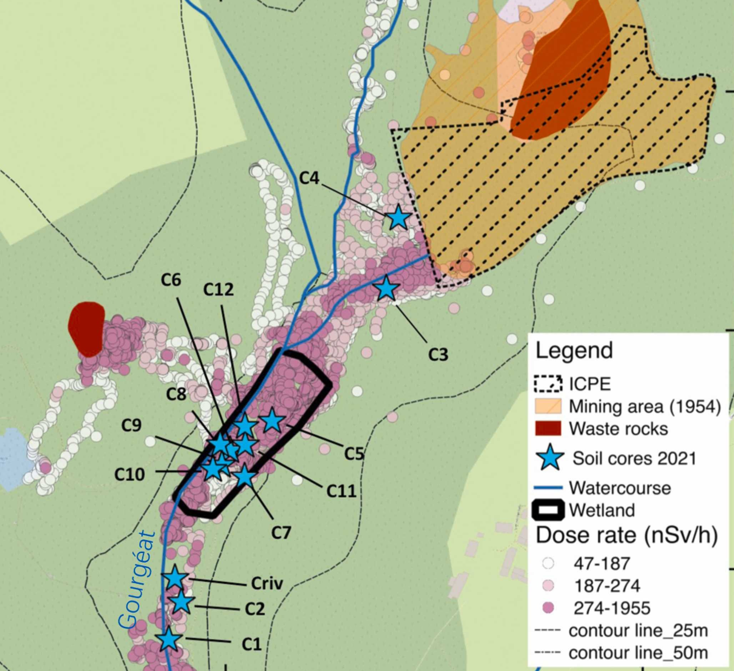
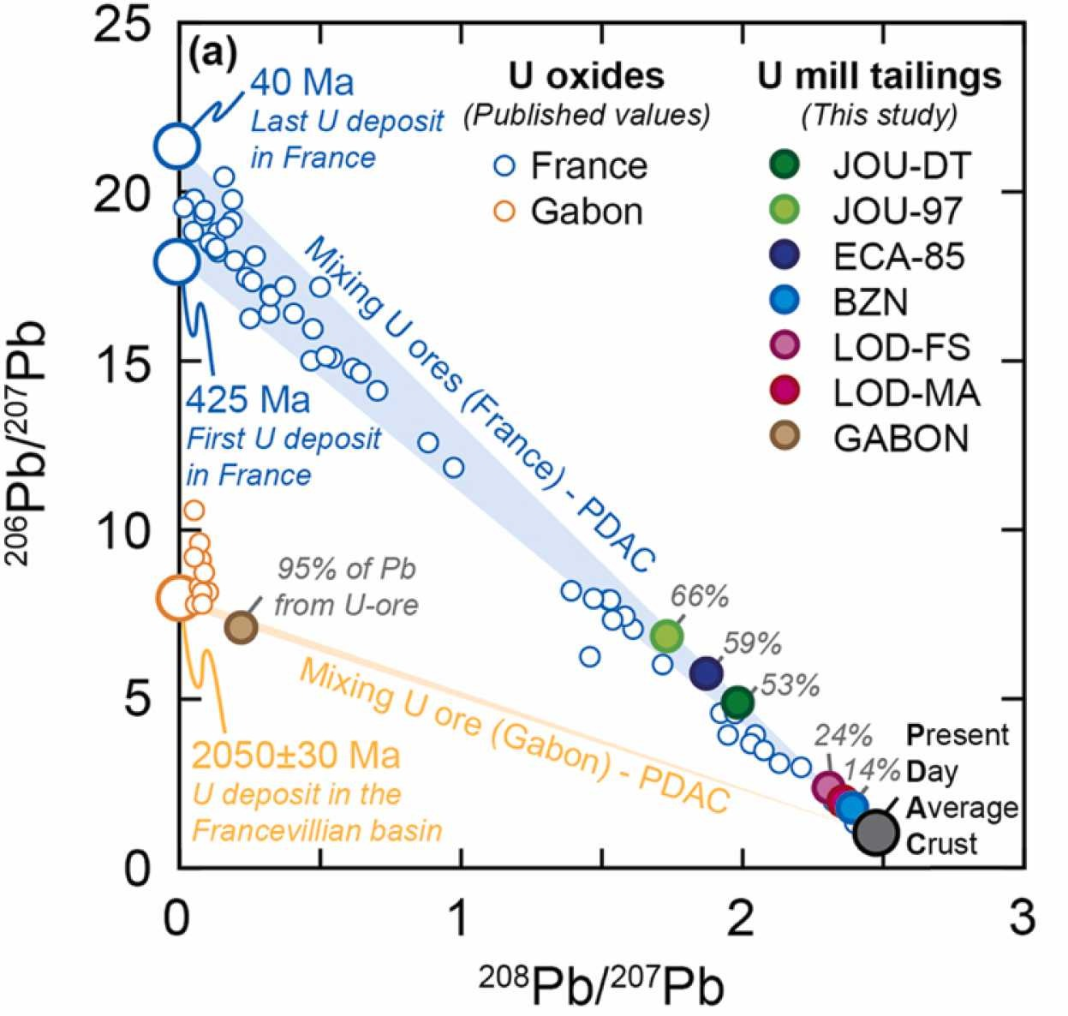
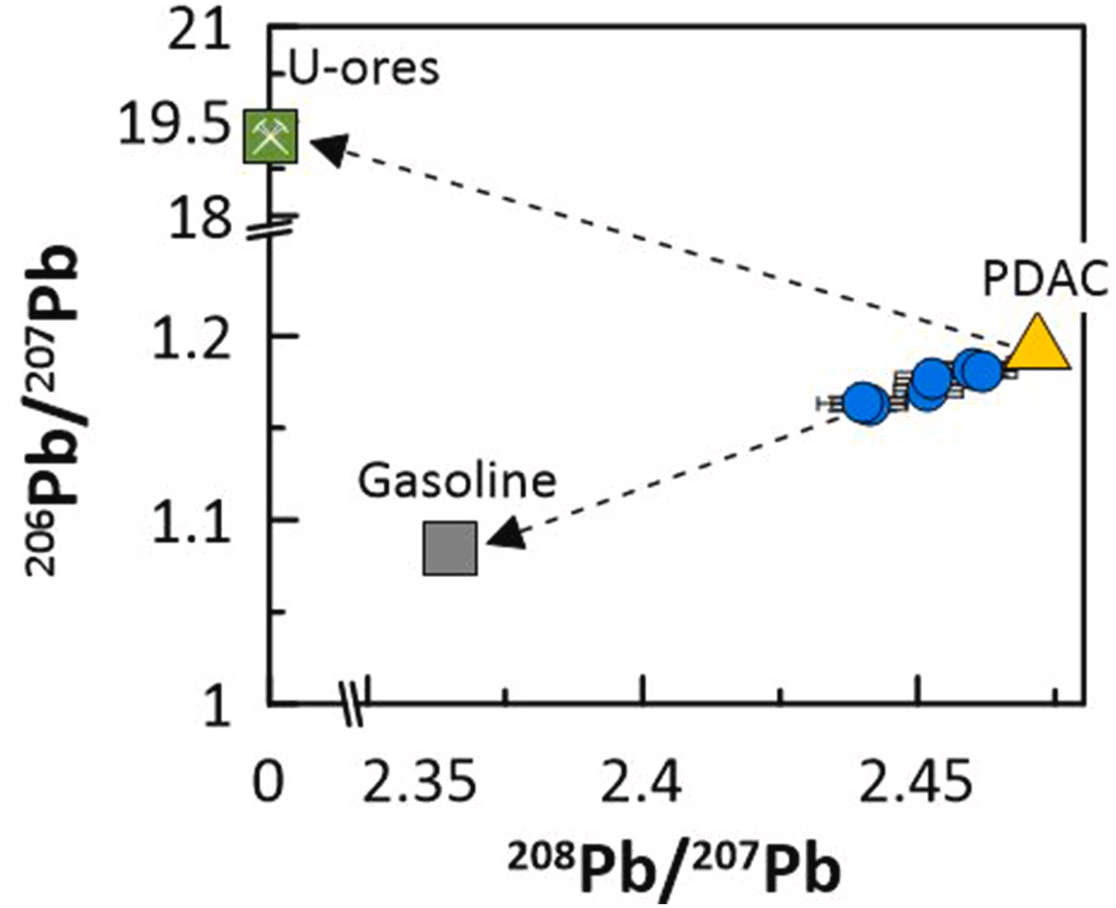
U-MINES: particulate transport
Lead isotopes as a relevant tracer to highlight the environmental impact of uranium mining
Study site: Rophin wetland (Puy-de-Dôme, Auvergne-Rhône-Alpes, France)
Suspected contamination
Specific area in which all the samples affected by mining materials are found
Beaumais et al. JHM 2022
Geng et al. JHM 2024
Morerau et al. Chemosphere 2022

Slide 15
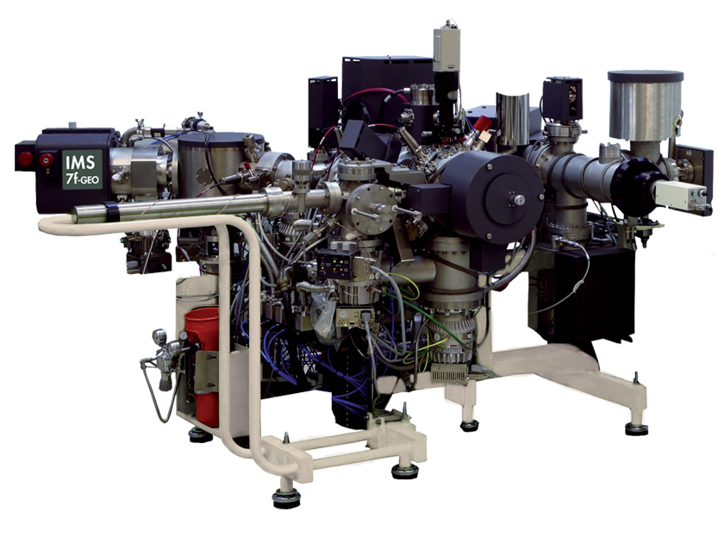
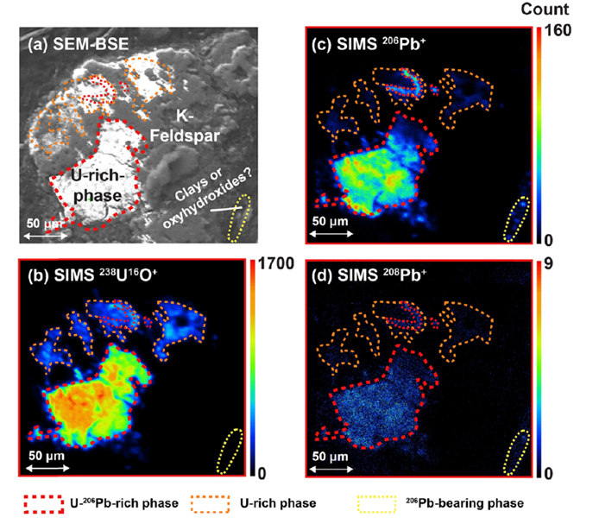
U-MINES: particulate transport
Lead isotopes as a relevant tracer to highlight the environmental impact of uranium mining
The benefit of particulate analysis → contaminations that may be masked by the high presence of natural materials
SIMS 7F
Beaumais et al. JHM 2022

Slide 16
U-MINES: dissolved transport
U and Ra isotopes as a relevant tracer to highlight the environmental impact of uranium mining
 | (²³⁴U/²³⁸U) | (²²⁸Ra/²²⁶Ra)
Water in contact with U-ore subjected to congruent dissolution from mechanical treatment. | ~1 | <<0.1
Waters from natural weathering of rocks. | >>1 | ~1.2

Slide 17
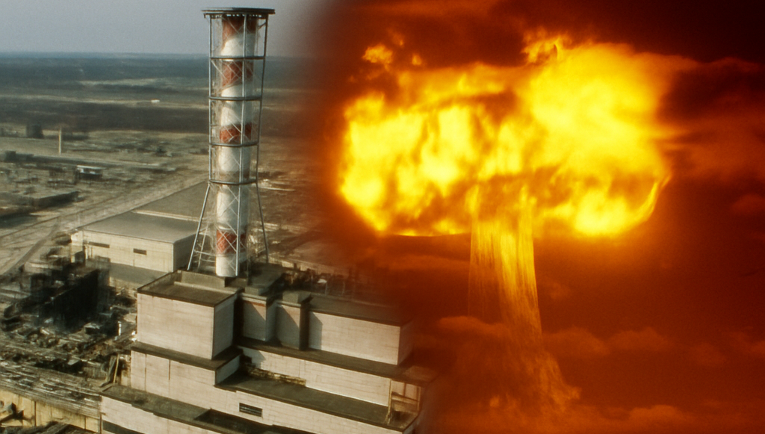
Nuclear ACCIDENTS and Global fallout

Slide 18
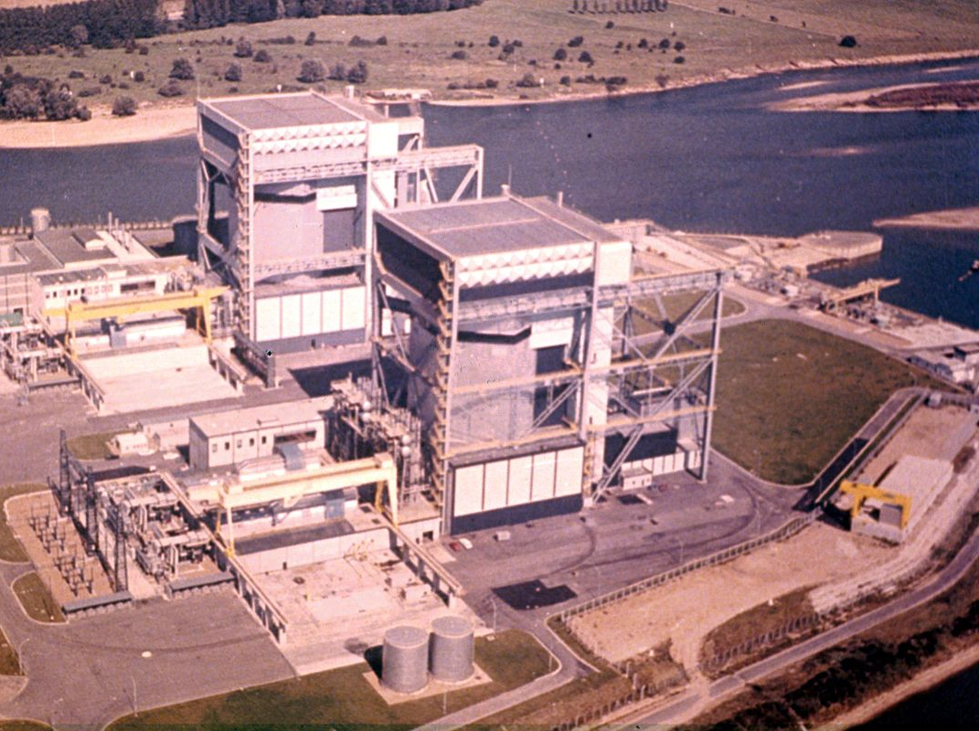
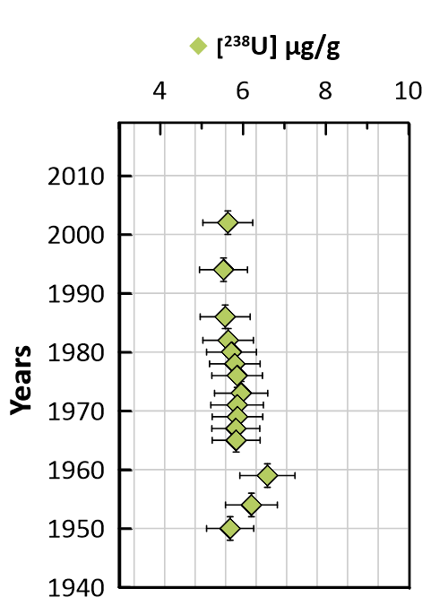
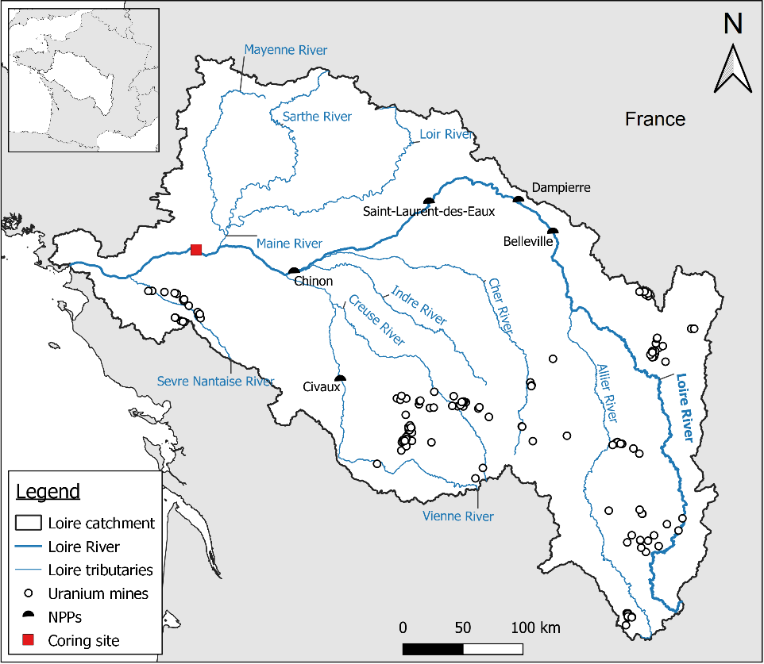
Nuclear accidents and global fallout:
the accidents of the NPP saint laurent des eaux
Two accidents occurred at Saint-Laurent-des-Eaux (EDF) in 1969 and 1980, both involving graphite-gas reactors (UNGG). They involved partial core meltdowns due to issues during fuel loading/unloading operations.

Slide 19
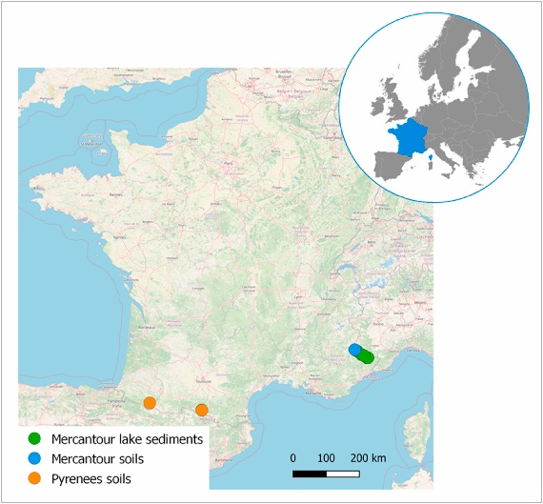
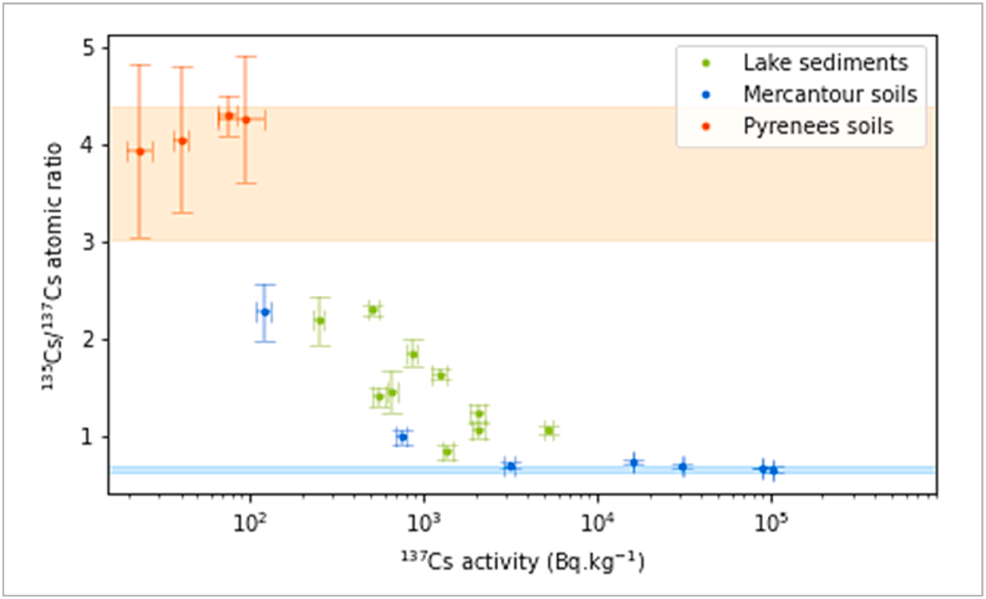
Nuclear accidents and global fallout:
The origin of radiocesium: global fallout versus Chernobyl
GF
135Cs/137Cs
Chernobyl
Magre et al. Env. Pollution 2023
Zok et al. ES&T 2021

Slide 20
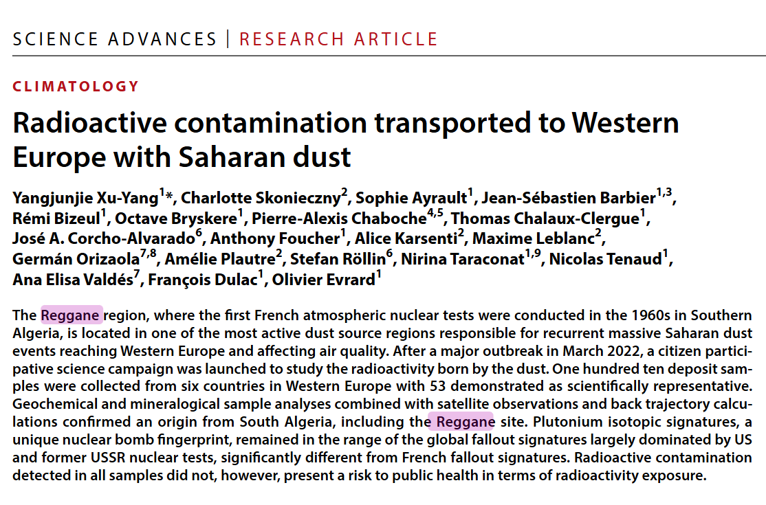
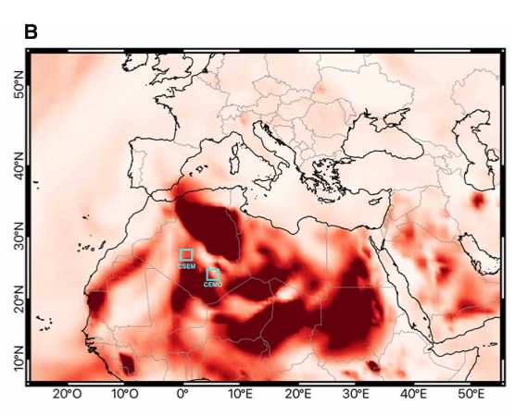
The origin of the radioactivity observed in Saharan dusT

Slide 21
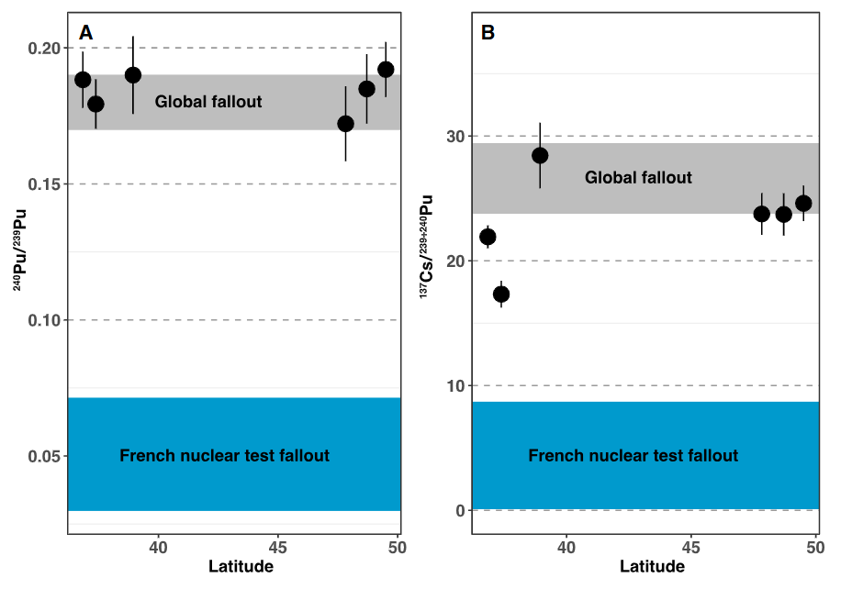
The origin of the radioactivity observed in Saharan dusT

Slide 22
Conclusions
Thanks to the knowledge acquired in nuclear physics on radioactive decay and to the isotopic abundances of man-made and/or natural materials etc, isotope geochemistry is today a field that supports environmental monitoring and regulatory decision-making.
It is important to continue work on new isotopic systems that better distinguish anthropogenic inputs from natural ones.
We must also anticipate the emergence of new potential contamination sources (SMRs, nuclear energy revival…).
Continued efforts are needed at low concentration levels: keeping up with analytical developments is essential.

Slide 23
Thank you for your attention

Slide 24
